Slide 1
Characteristic transport and diffusion in multi-beams-plasma system
Hands on Session 6
Lecturer: Fulvio Zonca
TA: Chen Zhao, Quan Yuan and Po-Yen Lai
Notes:
自我介紹，講明目的 (運用數值方法來解析 O’neil’s problem)

Slide 2

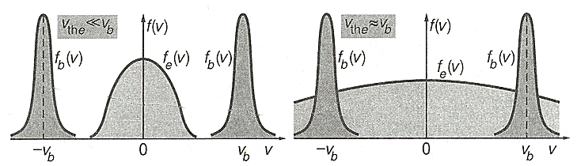
System
Initial beams distribution:
…
Initial conditions
Notes:
回到講義 page 6: 分別講這四條方程式的意義

Slide 3
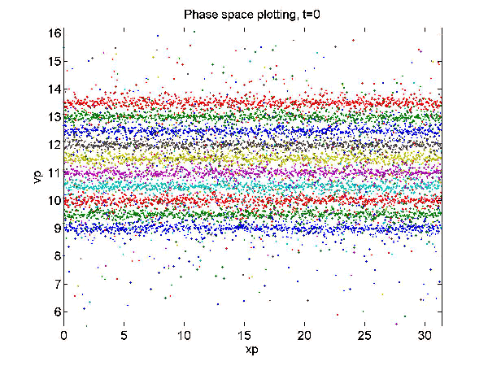
Dynamics of phase space

Slide 4

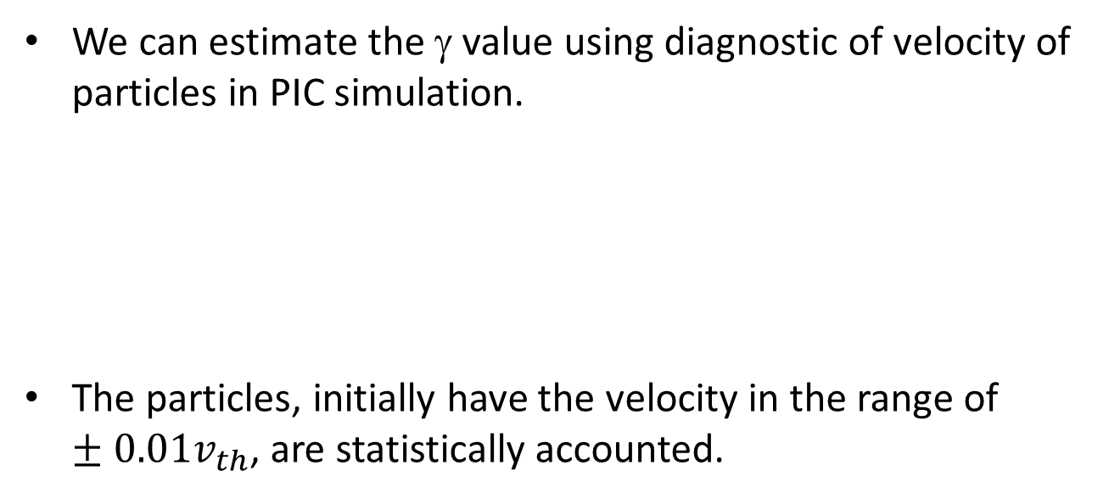
Diffusion
The transport exponent can be describe the characterization of transport:
We can estimate the γ value using diagnostic of velocity of particles in PIC simulation.
The particles, initially have the velocity in the range of $±0.01v_{th}$, are statistically accounted.
$$0.02v_{th}$$
Notes:
從第四式來的

Slide 5
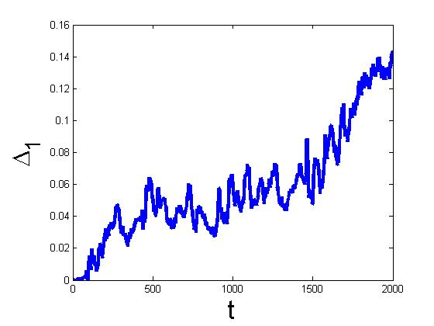
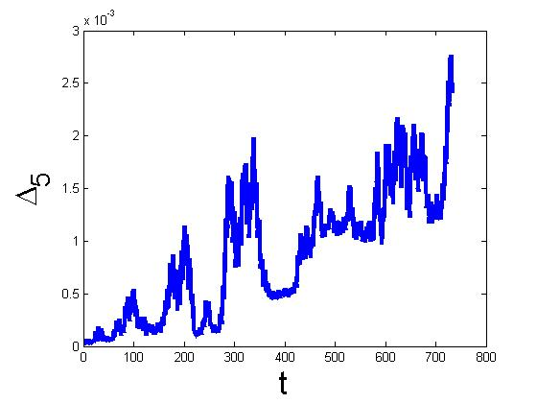
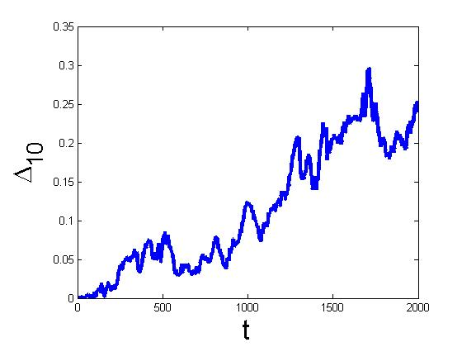
Time evolution of diffusion

Slide 6
Nonlinear time evolution of the electric field intensity (e.g., Lecture 6-18)
If the PIC is adopted, you can diagnostic the spatial distribution of electric fields at dumping time; then, do the Fourier transform to calculate the corresponding electric fields. (E_{k}) (Noted: the grids number and macro particle number should be enough)
If the Oneil’s multi-beam sheet model is adopted, you directly output the information of the corresponding electric potential. (Φ_{k})

Slide 7
FTLE
After obtaining E_{k} or Φ_{k}, you can easily finish the FTEL plot.
(See hand-on session 4)

Slide 8
Thanks for your attention!

