Slide 1
Multi-beams simulation in PIC1D
Hands-on section 4

Slide 2

Initialization in velocity of multi-beams
Lorentz distribution:
The density of probability is equal for any distribution:
We can use this result to initialize v of particles and use some different
vb and vd to get multi-beams. Then we do similar things like hands-on
section 2.

Slide 3
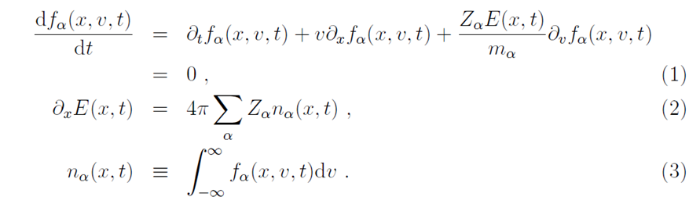
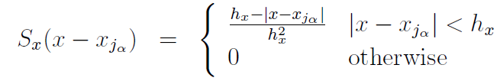
1D Vlasov-Poisson equations
Equation of PIC weight

Slide 4
Flow chart of PIC1D
Set the initial conditions
Mainly (x, v)
Push particles with the equation of motion
PIC method
Gather particles into grid
and calculate the electric field E.
t = t + dt
Locate E into ever particle
t = t (end)
end

Slide 5
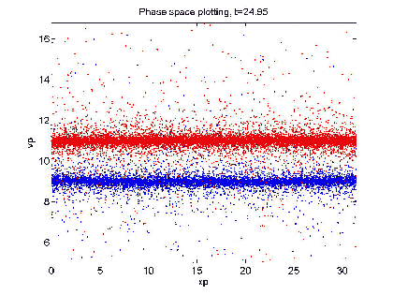
Plot of 2 beams in phase space

Slide 6
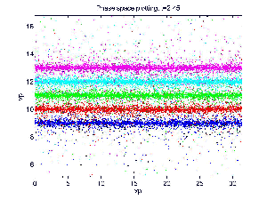
Plot of 5 beams in phase space

