Slide 1
FTLE contour based on
O’Neil formulation and kinetic Poincaré plot of PIC1D
Hands on Session 4
Lecturer: Fulvio Zonca
TA: Chen Zhao, Yuan Quan and Po-Yen Lai

Slide 2
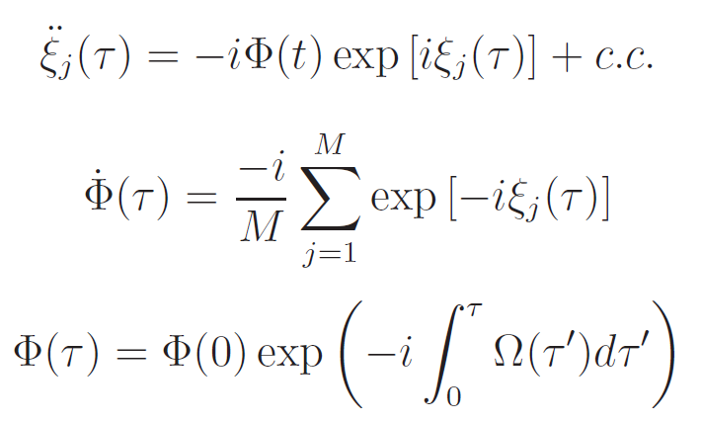
Normalized governing equations
The normalized governing equations describing beam-plasma system in lecture 3-6 can be shown as:

Slide 3

Initial conditions
The initial conditions of positions and velocities for the sheets following the Eqs. (19) in the paper [O’neil et al 1971] can be expressed as follows:
The FTLE in phase space:

Slide 4
Flow chart of numerical approach of potential
Set the initial conditions
Initialize the useful arrays
No t = t + dt
Use the 4th order Runge-Kutta method to iterate the time-dependent governing equations
Programmed stop or not
Main loop
Yes
End
output the potential

Slide 5
Flow chart of numerical approach of FTLE
Set the initial conditions
Initialize the useful arrays
No t = t + dt
Use the 4th order Runge-Kutta method to iterate the time-dependent governing equations
If t=Δt
Main loop
Yes
We should use the potential we have
already got .
Calculate the FTLE

Slide 6
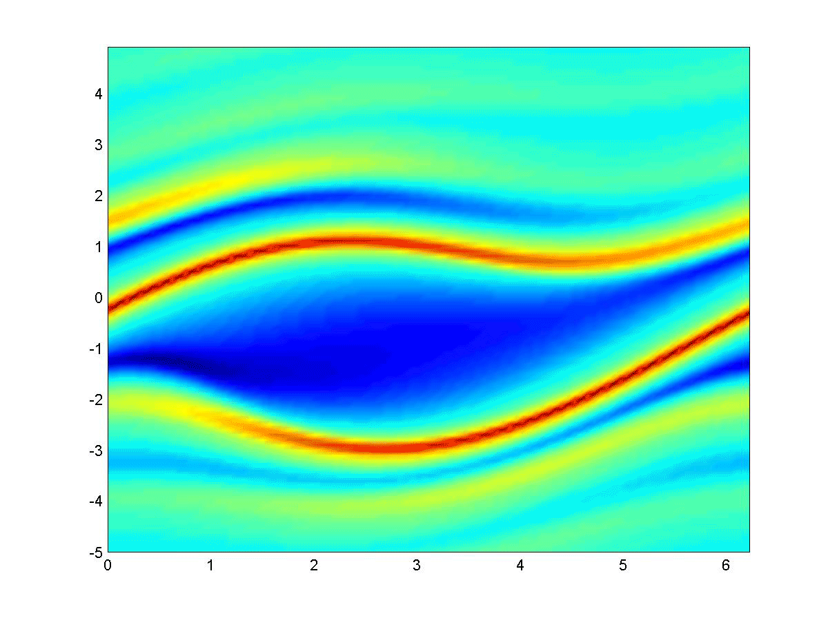
The contour of FTLE

Slide 7
Flow chart of numerical approach of Poincaré
Set the initial conditions
Initialize the useful arrays
No t = t + dt
Use the PIC method to iterate the time-dependent governing equations
Programmed stop or not
Main loop
Yes
End
output the Poincaré plot

Slide 8
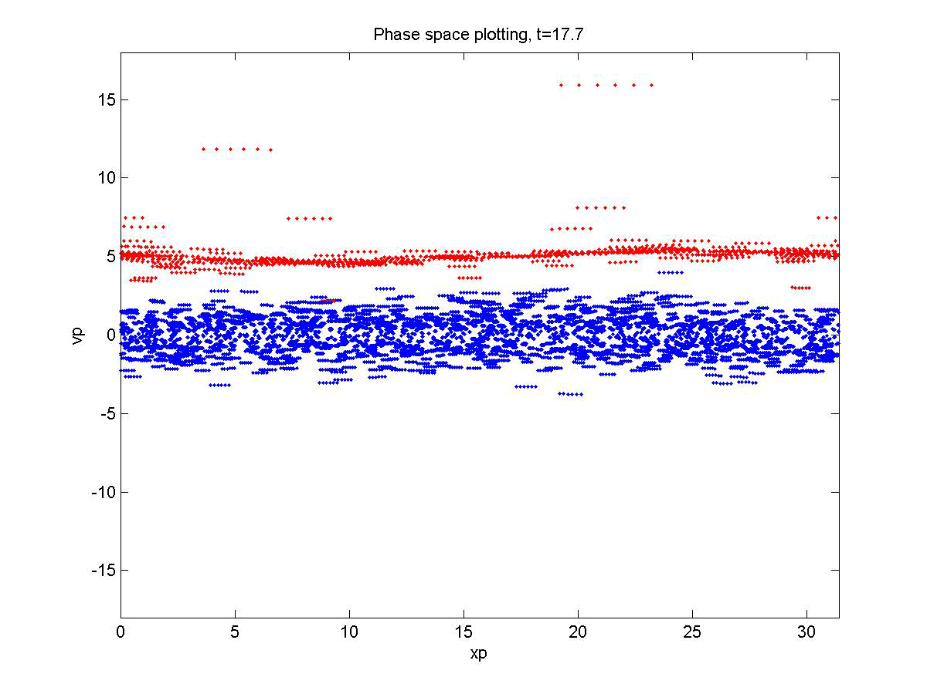
The kinetic Poincaré plot

Slide 9
Thanks for your attention!

