Slide 1
The nonlinear beam-plasma system:
O’Neil formulation
Hands on Session 3
Lecturer: Fulvio Zonca
TA: Chen Zhao, Yuan Quan and Po-Yen Lai

Slide 2
Normalized governing equations
The normalized governing equations describing beam-plasma system in lecture 3-6 can be shown as:

Slide 3
Normalized governing equations
Eq. (4) can be written as:

Slide 4
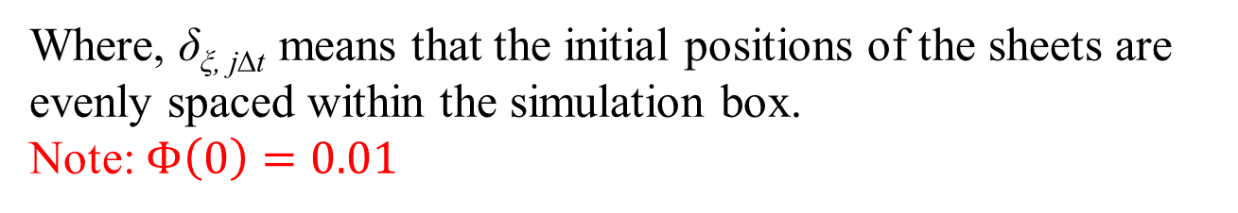
Initial conditions
The initial conditions of positions and velocities for the sheets following the Eqs. (19) in the paper [O’neil et al 1971] can be expressed as follows:
Where, δ_{ξ, j∆t} means that the initial positions of the sheets are evenly spaced within the simulation box.
Note: $Φ\left(0\right)=0.01$

Slide 5

Flow chart of numerical approaches
Set the initial conditions
Initialize the useful arrays
No t = t + dt
Use the 4th order Runge-Kutta method to iterate the time-dependent governing equations
Programmed stop or not
Main loop
Yes
t = t_{dump}
End
Dump data

Slide 6
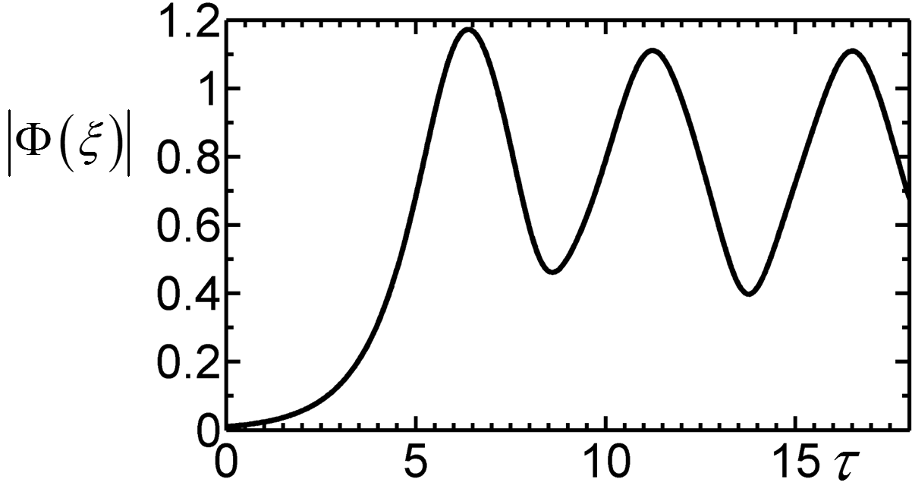
FIG. 1. Wave amplitude is a function of time
Use the Eq. (1) to (3) and Eq. (5) and consider the initial conditions showing in Eq. (6) and Eq. (7) under M = 500; we can numerically obtain the results as follows.

Slide 7
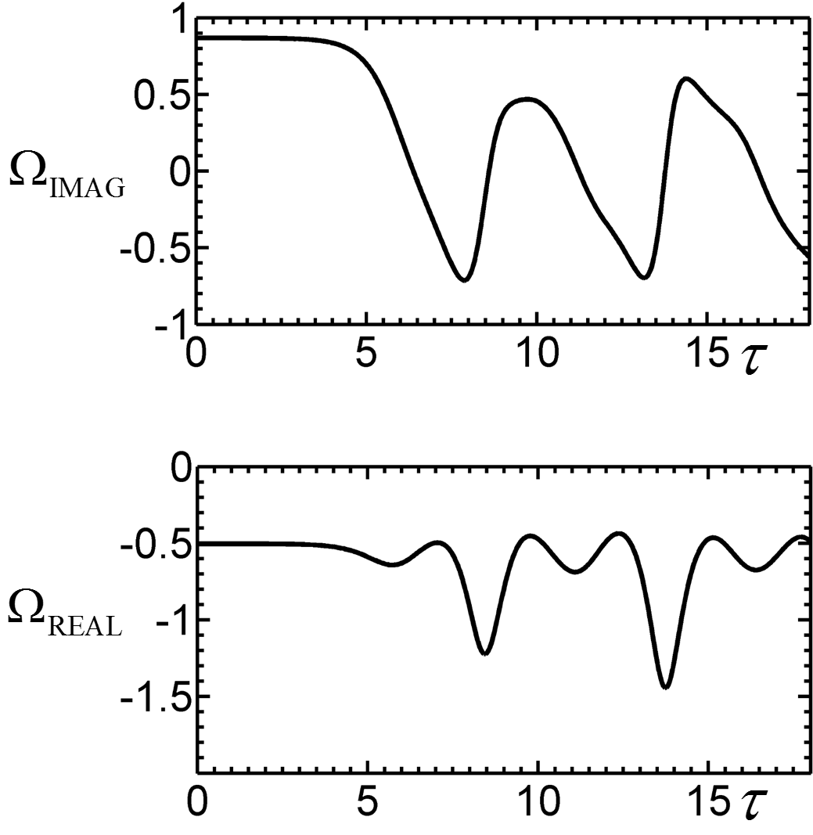
FIG. 2. Real and imaginary part of the instantaneous wave frequency as a function of time.

Slide 8
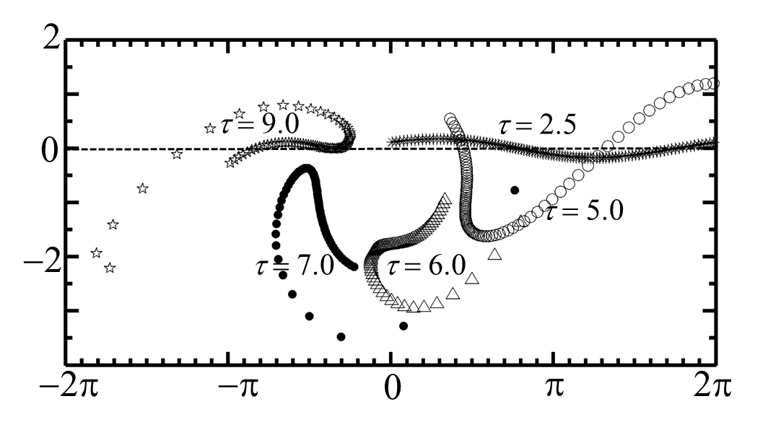
FIG. 3. The information of beam sheets in phase space
dξ/dτ
ξ

Slide 9
Conservation laws
Conservation law of momentum and energy can be written as
and we can represent the momentum and energy of system as the function of time to demonstrate the conservation laws in next two slides.

Slide 10
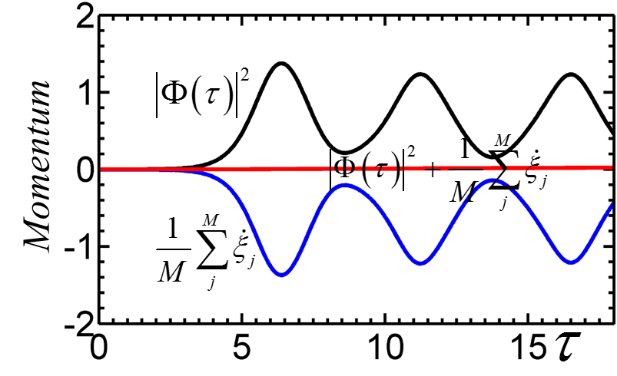
FIG. 4. The momentum of the system as a function of time.

Slide 11
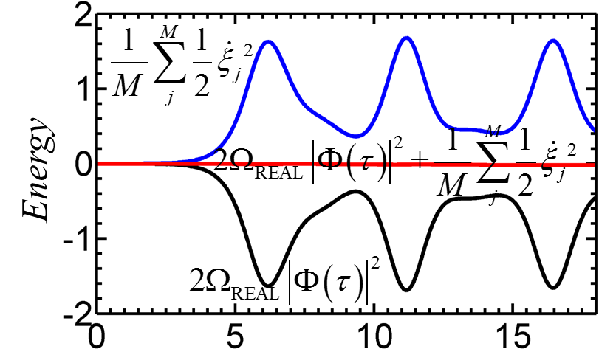
FIG. 5. The energy of the system as a function of time.

Slide 12
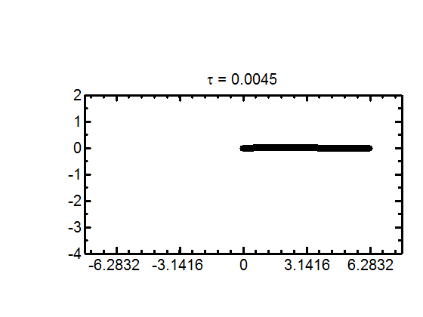
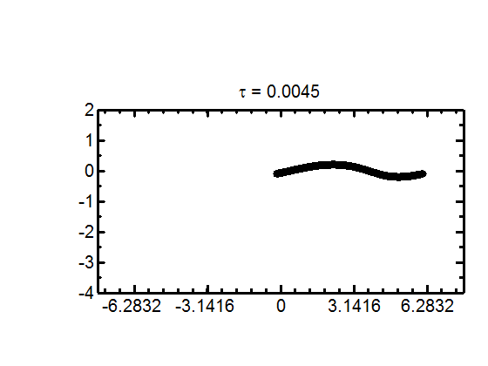


Animations: Time evolution of beam particles in phase space under different initial conditions
dξ/dτ
$$Φ\left(0\right)=0.01$$
ξ
dξ/dτ
$$Φ\left(0\right)=0.1$$
ξ

Slide 13
Thanks for your attention!

Slide 14
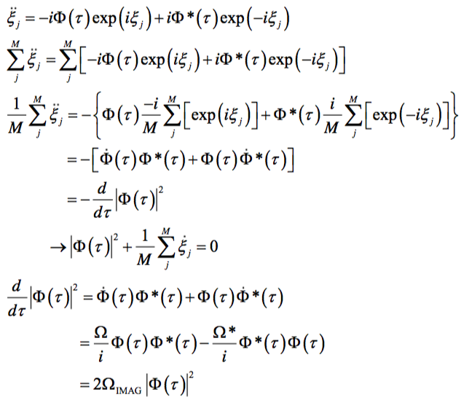
Appendix: Derivation of conservation laws
Momentum conservation Eq. (8):

Slide 15
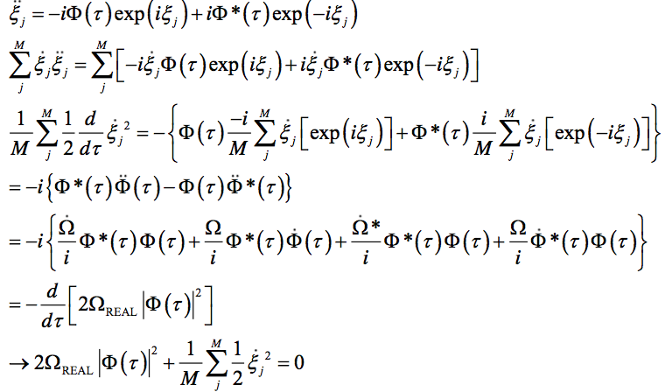
Appendix: Derivation of conservation laws
Energy conservation Eq. (9):

