Slide 1


The concept and use of
Lagrangian Coherent Structures
IFTS Intensive Course on Advaned Plasma Physics-Spring 2015
Theory and simulation of nonlinear physics of the beam-plasma system
M. Falessi^{1,2}, F. Pegoraro³, N. Carlevaro^{2,4}, G. Montani^{2,4}, F. Zonca²
¹Dipartimento di Matematica e Fisica Università di Roma tre, ²ENEA for EUROfusion - C.R. Frascati (Roma), ³Dipartimento di Fisica Università di Pisa, ⁴Dipartimento di Fisica Università Sapienza.
Hands-on Session 1 – May 5th 2015

Slide 2
Transport processes in plasma physics
The study of transport processes is of main importance in plasma physics. Different models are used to analyze the plasma behavior:
Hands-on Session 1 – May 5th 2015
Slides by Matteo Valerio Falessi

Slide 3
Transport processes in plasma physics
The study of transport processes is of main importance in plasma physics. Different models are used to analyze the plasma behavior:
two fluids and MHD;
Vlasov-Poisson Eulerian;
Vlasov-Poisson Lagrangian, i.e. PIC;
N-body.
NLED web seminar
Hands-on Session 1 – May 5th 2015
Slides by Matteo Valerio Falessi
Matteo Valerio Falessi

Slide 4
Transport processes in plasma physics
The transport process in these system is essentially the mixing of:
NLED web seminar
Hands-on Session 1 – May 5th 2015
Slides by Matteo Valerio Falessi
Matteo Valerio Falessi

Slide 5
Transport processes in plasma physics
The transport process in these system is essentially the mixing of:
Fluid elements;
phase space volumes;
charge distribution
NLED web seminar
Hands-on Session 1 – May 5th 2015
Slides by Matteo Valerio Falessi
Matteo Valerio Falessi

Slide 6
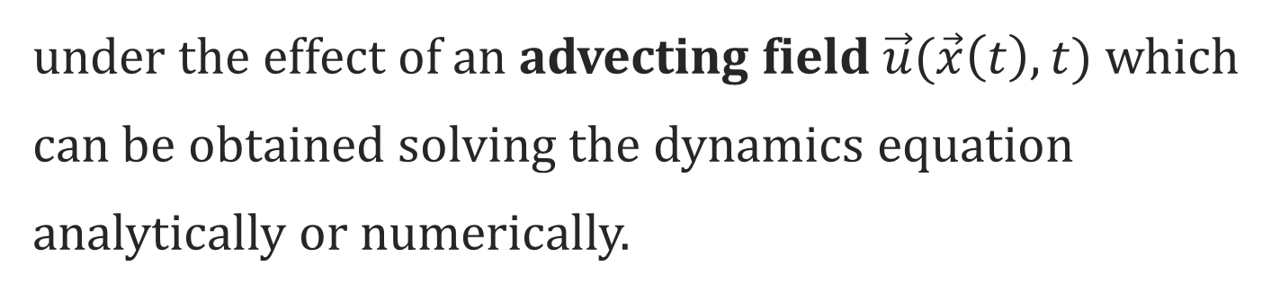
Transport processes in plasma physics
The transport process in these system is essentially the mixing of:
Fluid elements;
phase space volumes;
charge distribution
under the effect of an advecting field $\vec{u}(\vec{x}\left(t\right),t)$ which can be obtained solving the dynamics equation analytically or numerically.
NLED web seminar
Hands-on Session 1 – May 5th 2015
Slides by Matteo Valerio Falessi
Matteo Valerio Falessi

Slide 7
Analogy with transport processes in fluids
Analogy with the Lagrangian advection of passive tracers in a fluid:
Hands-on Session 1 – May 5th 2015
Slides by Matteo Valerio Falessi
NLED web seminar
Matteo Valerio Falessi

Slide 8
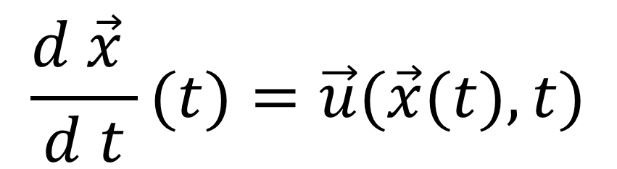
Analogy with transport processes in fluids
Analogy with the Lagrangian advection of passive tracers in a fluid:
$$\frac{d \vec{x} }{d t}(t)=\vec{u}(\vec{x}(t),t)$$
Hands-on Session 1 – May 5th 2015
Slides by Matteo Valerio Falessi
NLED web seminar
Matteo Valerio Falessi

Slide 9
Analogy with transport processes in fluids
Analogy with the Lagrangian advection of passive tracers in a fluid:
$$\frac{d \vec{x} }{d t}(t)=\vec{u}(\vec{x}(t),t)$$
Advecting field obtained solving the P.D.E.
Hands-on Session 1 – May 5th 2015
Slides by Matteo Valerio Falessi
NLED web seminar
Matteo Valerio Falessi

Slide 10
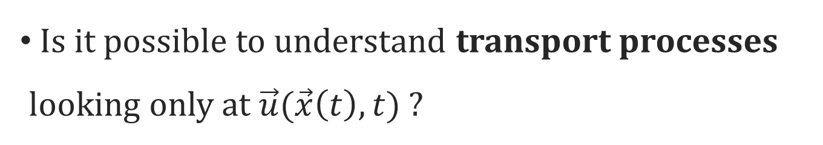
Analogy with transport processes in fluids
Analogy with the Lagrangian advection of passive tracers in a fluid:
$$\frac{d \vec{x} }{d t}(t)=\vec{u}(\vec{x}(t),t)$$
Advecting field obtained solving the P.D.E.
Is it possible to understand transport processes looking only at $\vec{u}(\vec{x}\left(t\right),t)$ ?
Hands-on Session 1 – May 5th 2015
Slides by Matteo Valerio Falessi
NLED web seminar
Matteo Valerio Falessi

Slide 11
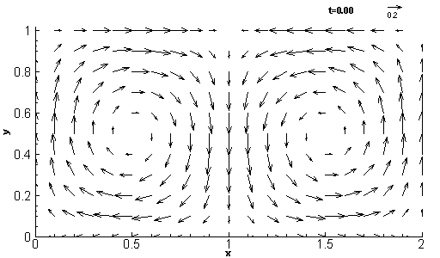
Velocity field: the double gyre
Shadden Physica D 212 (2005)
7th IAEA Technical Meeting on Plasma Instabilities
Hands-on Session 1 – May 5th 2015
Slides by Matteo Valerio Falessi
Matteo Valerio Falessi

Slide 12
Velocity field: the double gyre
Tracers trajectories?
Shadden Physica D 212 (2005)
7th IAEA Technical Meeting on Plasma Instabilities
Hands-on Session 1 – May 5th 2015
Slides by Matteo Valerio Falessi
Matteo Valerio Falessi

Slide 13
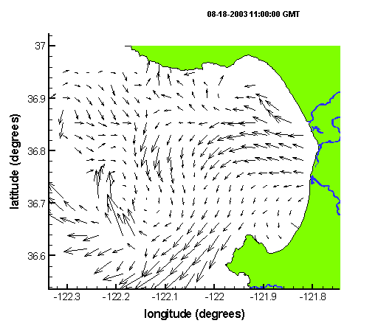
Velocity field: Monterey Bay
Lekien Physica D 210 (2005)
NLED web seminar
Hands-on Session 1 – May 5th 2015
Slides by Matteo Valerio Falessi
Matteo Valerio Falessi

Slide 14
Velocity field: Monterey Bay
Tracers trajectories?
Lekien Physica D 210 (2005)
Hands-on Session 1 – May 5th 2015
Slides by Matteo Valerio Falessi
NLED web seminar
Matteo Valerio Falessi

Slide 15
Lagrangian vs Eulerian
The trajectories of the particles are Lagrangian while the velocity field is Eulerian;
NLED web seminar
Hands-on Session 1 – May 5th 2015
Slides by Matteo Valerio Falessi
Matteo Valerio Falessi

Slide 16
Lagrangian vs Eulerian
The trajectories of the particles are Lagrangian while the velocity field is Eulerian;
an integration is needed to obtain the trajectories;
NLED web seminar
Hands-on Session 1 – May 5th 2015
Slides by Matteo Valerio Falessi
Matteo Valerio Falessi

Slide 17
Lagrangian vs Eulerian
The trajectories of the particles are Lagrangian while the velocity field is Eulerian;
an integration is needed to obtain the trajectories;
sensitivity to initial condition problem;
NLED web seminar
Hands-on Session 1 – May 5th 2015
Slides by Matteo Valerio Falessi
Matteo Valerio Falessi

Slide 18
Lagrangian vs Eulerian
The trajectories of the particles are Lagrangian while the velocity field is Eulerian;
an integration is needed to obtain the trajectories;
sensitivity to initial condition problem;
complicated plots of bundles of trajectories are required to study transport processes.
NLED web seminar
Hands-on Session 1 – May 5th 2015
Slides by Matteo Valerio Falessi
Matteo Valerio Falessi

Slide 19
Lagrangian vs Eulerian
The trajectories of the particles are Lagrangian while the velocity field is Eulerian;
an integration is needed to obtain the trajectories;
sensitivity to initial condition problem;
complicated plots of bundles of trajectories are required to study transport processes.
Let’s start with the steady state …
NLED web seminar
Hands-on Session 1 – May 5th 2015
Slides by Matteo Valerio Falessi
Matteo Valerio Falessi

Slide 20
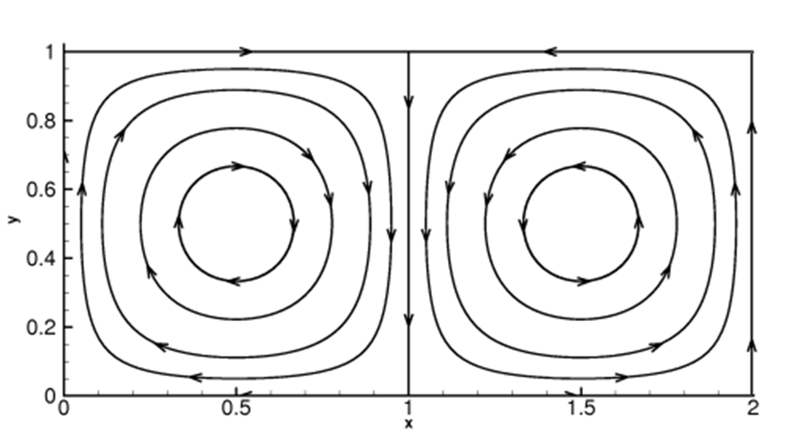
Velocity field: steady double gyre
Adapted from Shadden
NLED web seminar
Hands-on Session 1 – May 5th 2015
Slides by Matteo Valerio Falessi
Matteo Valerio Falessi

Slide 21
Velocity field: steady double gyre
Streamlines are trajectories!
Adapted from Shadden
NLED web seminar
Hands-on Session 1 – May 5th 2015
Slides by Matteo Valerio Falessi
Matteo Valerio Falessi

Slide 22
Velocity field: steady double gyre
Streamlines are trajectories!
Adapted from Shadden
Separatrix
Saddle points
NLED web seminar
Hands-on Session 1 – May 5th 2015
Slides by Matteo Valerio Falessi
Matteo Valerio Falessi

Slide 23
Transport processes in steady systems
Streamlines (Eulerian) and trajectories (Lagrangian) coincide;
NLED web seminar
Hands-on Session 1 – May 5th 2015
Slides by Matteo Valerio Falessi
Matteo Valerio Falessi

Slide 24
Transport processes in steady systems
Streamlines (Eulerian) and trajectories (Lagrangian) coincide;
transport processes , i.e. the mixing of passive tracers, can be described looking only at the velocity field;
NLED web seminar
Hands-on Session 1 – May 5th 2015
Slides by Matteo Valerio Falessi
Matteo Valerio Falessi

Slide 25

Transport processes in steady systems
Streamlines (Eulerian) and trajectories (Lagrangian) coincide;
transport processes , i.e. the mixing of passive tracers, can be described looking only at the velocity field;
stable and unstable manifolds relative to the fixed points of $\vec{u}(\vec{x}\left(t\right),t)$ split the phase space into macro-regions;
NLED web seminar
Hands-on Session 1 – May 5th 2015
Slides by Matteo Valerio Falessi
Matteo Valerio Falessi

Slide 26

Transport processes in steady systems
Streamlines (Eulerian) and trajectories (Lagrangian) coincide;
transport processes , i.e. the mixing of passive tracers, can be described looking only at the velocity field;
stable and unstable manifolds relative to the fixed points of $\vec{u}(\vec{x}\left(t\right),t)$ split the phase space into macro-regions;
tracers starting into different regions will have qualitatively different evolution. The boundaries of these regions are transport barriers;
NLED web seminar
Hands-on Session 1 – May 5th 2015
Slides by Matteo Valerio Falessi
Matteo Valerio Falessi

Slide 27
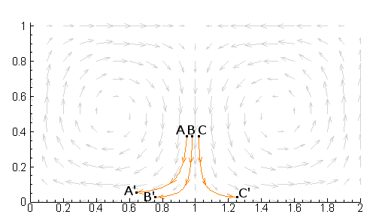
Velocity field: steady double gyre
Adapted from Shadden
NLED web seminar
Hands-on Session 1 – May 5th 2015
Slides by Matteo Valerio Falessi
Matteo Valerio Falessi

Slide 28
Velocity field: steady double gyre
Separatrix
Adapted from Shadden
Fluid elements A and B can mix while B and C diverge.
NLED web seminar
Hands-on Session 1 – May 5th 2015
Slides by Matteo Valerio Falessi
Matteo Valerio Falessi

Slide 29
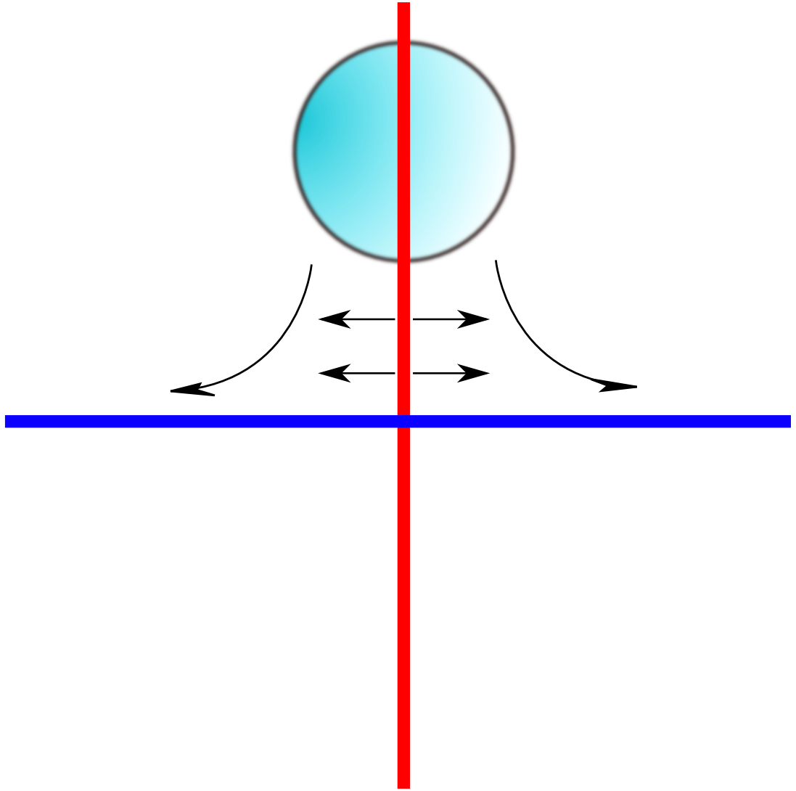
Stable and unstable manifolds
Adapted from Haller
NLED web seminar
Hands-on Session 1 – May 5th 2015
Slides by Matteo Valerio Falessi
Matteo Valerio Falessi

Slide 30
Stable and unstable manifolds
Parcel of fluid
Adapted from Haller
Unstable manifold:
Points advected into the saddle point with a backward-time evolution (asymptotically)
Stable manifold:
Points advected into the saddle point (asymptotically)
NLED web seminar
Hands-on Session 1 – May 5th 2015
Slides by Matteo Valerio Falessi
Matteo Valerio Falessi

Slide 31
Time dependent systems
How to obtain transport barriers in a:
  time dependent system?
NLED web seminar
Hands-on Session 1 – May 5th 2015
Slides by Matteo Valerio Falessi
Matteo Valerio Falessi

Slide 32
Time dependent systems
How to obtain transport barriers in a:
  time dependent system?
  Numerical simulation?
NLED web seminar
Hands-on Session 1 – May 5th 2015
Slides by Matteo Valerio Falessi
Matteo Valerio Falessi

Slide 33
Time dependent systems
How to obtain transport barriers in a:
  time dependent system?
  Numerical simulation?
Several problems:
NLED web seminar
Hands-on Session 1 – May 5th 2015
Slides by Matteo Valerio Falessi
Matteo Valerio Falessi

Slide 34
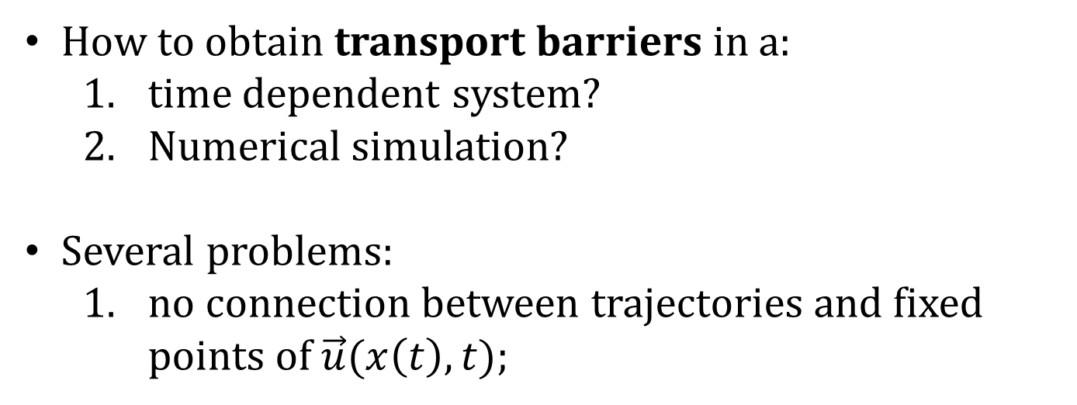
Time dependent systems
How to obtain transport barriers in a:
  time dependent system?
  Numerical simulation?
Several problems:
  no connection between trajectories and fixed points of $\vec{u}(x\left(t\right),t)$;
NLED web seminar
Hands-on Session 1 – May 5th 2015
Slides by Matteo Valerio Falessi
Matteo Valerio Falessi

Slide 35

Time dependent systems
How to obtain transport barriers in a:
  time dependent system?
  Numerical simulation?
Several problems:
  no connection between trajectories and fixed points of $\vec{u}(x\left(t\right),t)$;
  finite time of the simulation;
NLED web seminar
Hands-on Session 1 – May 5th 2015
Slides by Matteo Valerio Falessi
Matteo Valerio Falessi

Slide 36

Time dependent systems
How to obtain transport barriers in a:
  time dependent system?
  Numerical simulation?
Several problems:
  no connection between trajectories and fixed points of $\vec{u}(x\left(t\right),t)$;
  finite time of the simulation;
  global mixing in a long-enough time span
NLED web seminar
Hands-on Session 1 – May 5th 2015
Slides by Matteo Valerio Falessi
Matteo Valerio Falessi

Slide 37

Time dependent systems
How to obtain transport barriers in a:
  time dependent system?
  Numerical simulation?
Several problems:
  no connection between trajectories and fixed points of $\vec{u}(x\left(t\right),t)$;
  finite time of the simulation;
  global mixing in a long-enough time span
A generalization of the stable and unstable manifolds is needed to split the domain into macro-regions not mixing over a finite time span.
NLED web seminar
Hands-on Session 1 – May 5th 2015
Slides by Matteo Valerio Falessi
Matteo Valerio Falessi

Slide 38
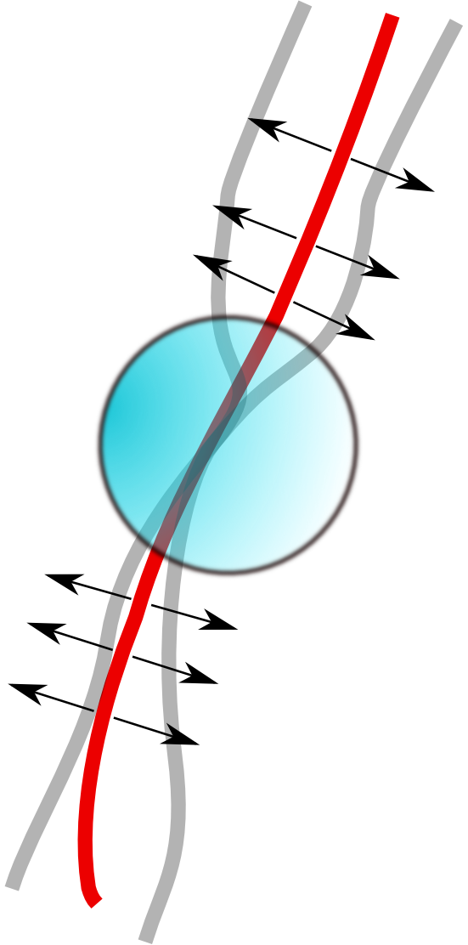

Lagrangian coherent structures (LCS)
$$t$$
Adapted from Haller
NLED web seminar
Hands-on Session 1 – May 5th 2015
Slides by Matteo Valerio Falessi
Matteo Valerio Falessi

Slide 39
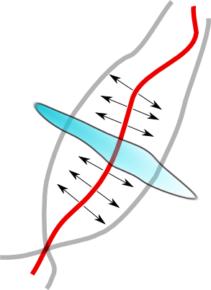

Lagrangian coherent structures (LCS)
$$t$$
$t+Δt$
Adapted from Haller
NLED web seminar
Hands-on Session 1 – May 5th 2015
Slides by Matteo Valerio Falessi
Matteo Valerio Falessi

Slide 40
Lagrangian coherent structures (LCS)
Repulsive LCS
$$t$$
$t+Δt$
Adapted from Haller
These generalized, finite time, structures are called LCS.
NLED web seminar
Hands-on Session 1 – May 5th 2015
Slides by Matteo Valerio Falessi
Matteo Valerio Falessi

Slide 41
Finite time Lyapunov exponents (FTLE)
Trajectories near a saddle point diverge faster;
NLED web seminar
Hands-on Session 1 – May 5th 2015
Slides by Matteo Valerio Falessi
Matteo Valerio Falessi

Slide 42

Finite time Lyapunov exponents (FTLE)
Trajectories near a saddle point diverge faster;
the separation between two points $δx\left(t\right)$ advected by the fluid is descripted by the Lyapunov exponent field ${σ^{Δt}}_{t}^{}(x,y)$
NLED web seminar
Hands-on Session 1 – May 5th 2015
Slides by Matteo Valerio Falessi
Matteo Valerio Falessi

Slide 43

Finite time Lyapunov exponents (FTLE)
Trajectories near a saddle point diverge faster;
the separation between two points $δx\left(t\right)$ advected by the fluid is descripted by the Lyapunov exponent field ${σ^{Δt}}_{t}^{}(x,y)$
$$\max_{δ\left(t\right)}\left\|δx(t+Δt)\right\|=e^{{σ^{Δt}}_{t}^{}}\left\|δx(t)\right\|$$
NLED web seminar
Hands-on Session 1 – May 5th 2015
Slides by Matteo Valerio Falessi
Matteo Valerio Falessi

Slide 44
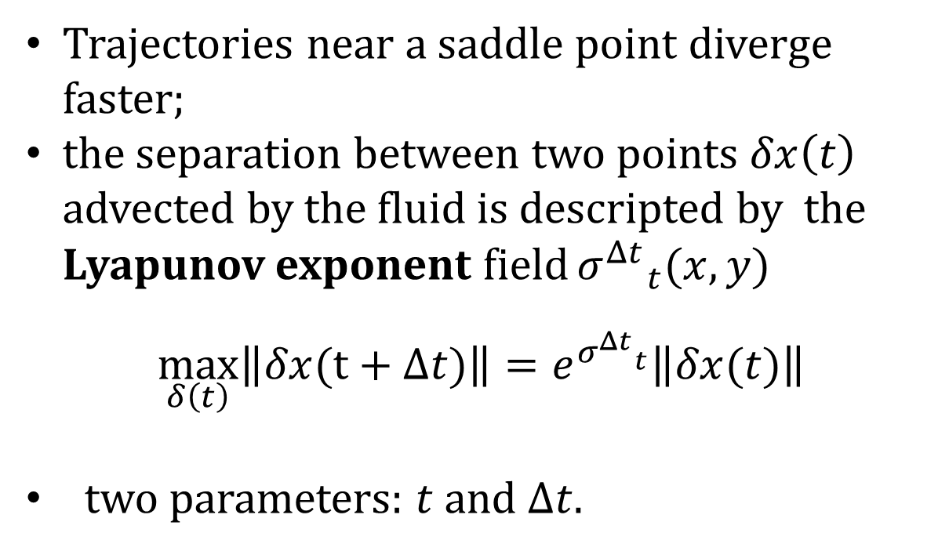
Finite time Lyapunov exponents (FTLE)
Trajectories near a saddle point diverge faster;
the separation between two points $δx\left(t\right)$ advected by the fluid is descripted by the Lyapunov exponent field ${σ^{Δt}}_{t}^{}(x,y)$
$$\max_{δ\left(t\right)}\left\|δx(t+Δt)\right\|=e^{{σ^{Δt}}_{t}^{}}\left\|δx(t)\right\|$$
two parameters: $t$ and $Δt$.
NLED web seminar
Hands-on Session 1 – May 5th 2015
Slides by Matteo Valerio Falessi
Matteo Valerio Falessi

Slide 45
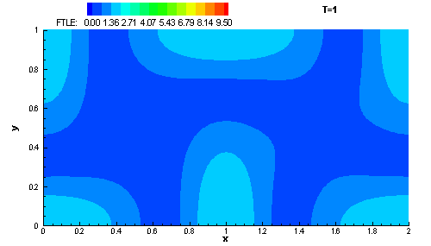
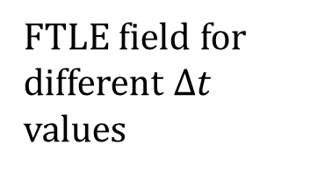
FTLE: steady double gyre
Shadden Physica D 212 (2005)
FTLE field for different $Δt$ values
NLED web seminar
Hands-on Session 1 – May 5th 2015
Slides by Matteo Valerio Falessi
Matteo Valerio Falessi

Slide 46
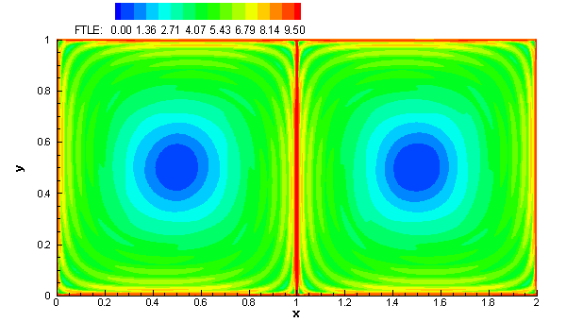

FTLE: steady double gyre
Shadden Physica D 212 (2005)
FTLE field for $Δt=17$
NLED web seminar
Hands-on Session 1 – May 5th 2015
Slides by Matteo Valerio Falessi
Matteo Valerio Falessi

Slide 47
FTLE: steady double gyre
Shadden Physica D 212 (2005)
FTLE field for $Δt=17$
What about the time dependent double gyre?
NLED web seminar
Hands-on Session 1 – May 5th 2015
Slides by Matteo Valerio Falessi
Matteo Valerio Falessi

Slide 48
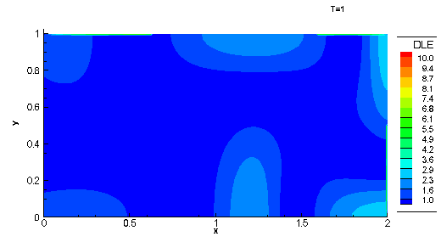
FTLE: time dependent double gyre
Shadden Physica D 212 (2005)
NLED web seminar
Hands-on Session 1 – May 5th 2015
Slides by Matteo Valerio Falessi
Matteo Valerio Falessi

Slide 49
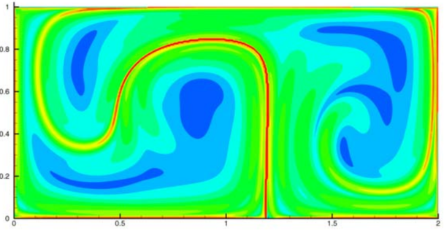

FTLE: time dependent double gyre
Shadden Physica D 212 (2005)
FTLE field for $Δt=10$
NLED web seminar
Hands-on Session 1 – May 5th 2015
Slides by Matteo Valerio Falessi
Matteo Valerio Falessi

Slide 50
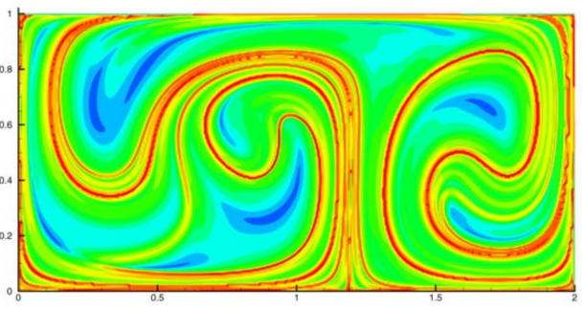

FTLE: time dependent double gyre
Shadden Physica D 212 (2005)
FTLE field for $Δt=20$
NLED web seminar
Hands-on Session 1 – May 5th 2015
Slides by Matteo Valerio Falessi
Matteo Valerio Falessi

Slide 51
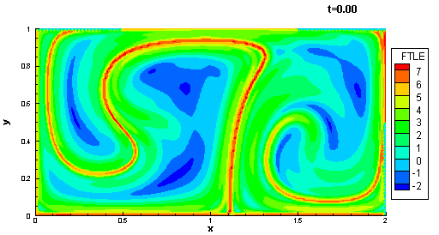

FTLE: time dependent double gyre
$$Δ t=10$$
Shadden Physica D 212 (2005)
NLED web seminar
Hands-on Session 1 – May 5th 2015
Slides by Matteo Valerio Falessi
Matteo Valerio Falessi

Slide 52
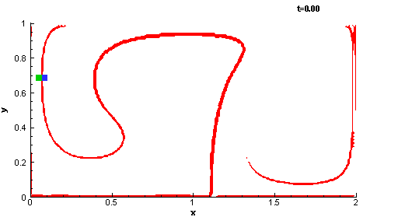
FTLE: time dependent double gyre
Shadden Physica D 212 (2005)
NLED web seminar
Hands-on Session 1 – May 5th 2015
Slides by Matteo Valerio Falessi
Matteo Valerio Falessi

Slide 53
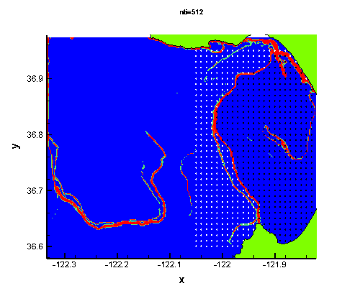
FTLE: Monterey bay
Lekien Physica D 210 (2005)
NLED web seminar
Hands-on Session 1 – May 5th 2015
Slides by Matteo Valerio Falessi
Matteo Valerio Falessi

Slide 54
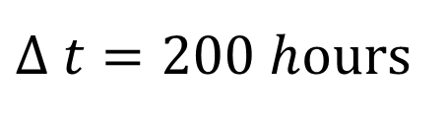
FTLE: Monterey bay
Recirculating
water
$Δ t=200 h$ours
Lekien Physica D 210 (2005)
NLED web seminar
Hands-on Session 1 – May 5th 2015
Slides by Matteo Valerio Falessi
Matteo Valerio Falessi

Slide 55
The beam plasma instability
Interaction of a monochromatic electron beam with a cold plasma;
O’Neil POF 14 (1971)
Hands-on Session 1 – May 5th 2015
NLED web seminar
Slides by Matteo Valerio Falessi
Matteo Valerio Falessi

Slide 56
The beam plasma instability
Interaction of a monochromatic electron beam with a cold plasma;
Langmuir resonant wave;
O’Neil POF 14 (1971)
Hands-on Session 1 – May 5th 2015
NLED web seminar
Slides by Matteo Valerio Falessi
Matteo Valerio Falessi

Slide 57
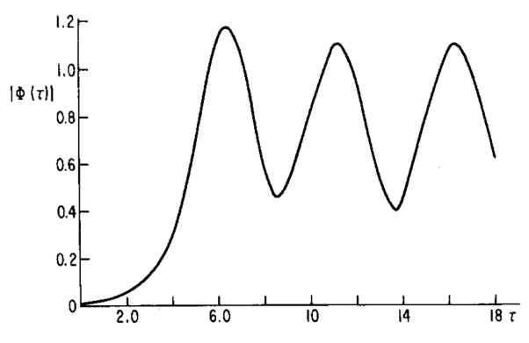
The beam plasma instability
Interaction of a monochromatic electron beam with a cold plasma;
Langmuir resonant wave;
O’Neil POF 14 (1971)
Hands-on Session 1 – May 5th 2015
NLED web seminar
Slides by Matteo Valerio Falessi
Matteo Valerio Falessi

Slide 58
The beam plasma instability
Interaction of a monochromatic electron beam with a cold plasma;
Langmuir resonant wave;
clump formation;
O’Neil POF 14 (1971)
Hands-on Session 1 – May 5th 2015
NLED web seminar
Slides by Matteo Valerio Falessi
Matteo Valerio Falessi

Slide 59
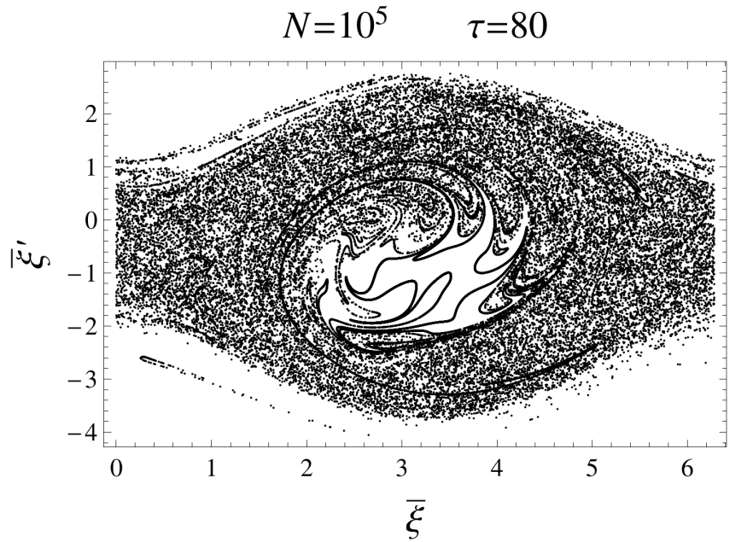
The beam plasma instability
Interaction of a monochromatic electron beam with a cold plasma;
Langmuir resonant wave;
clump formation;
O’Neil POF 14 (1971)
Hands-on Session 1 – May 5th 2015
NLED web seminar
Slides by Matteo Valerio Falessi
Matteo Valerio Falessi

Slide 60
The beam plasma instability
Interaction of a monochromatic electron beam with a cold plasma;
Langmuir resonant wave;
clump formation;
spatial bunching and trapped particles;
O’Neil POF 14 (1971)
Hands-on Session 1 – May 5th 2015
NLED web seminar
Slides by Matteo Valerio Falessi
Matteo Valerio Falessi

Slide 61
The beam plasma instability
Interaction of a monochromatic electron beam with a cold plasma;
Langmuir resonant wave;
clump formation;
spatial bunching and trapped particles;
transport processes in the phase space are not clear just by looking at snapshots of the simulation;
O’Neil POF 14 (1971)
Hands-on Session 1 – May 5th 2015
NLED web seminar
Slides by Matteo Valerio Falessi
Matteo Valerio Falessi

Slide 62
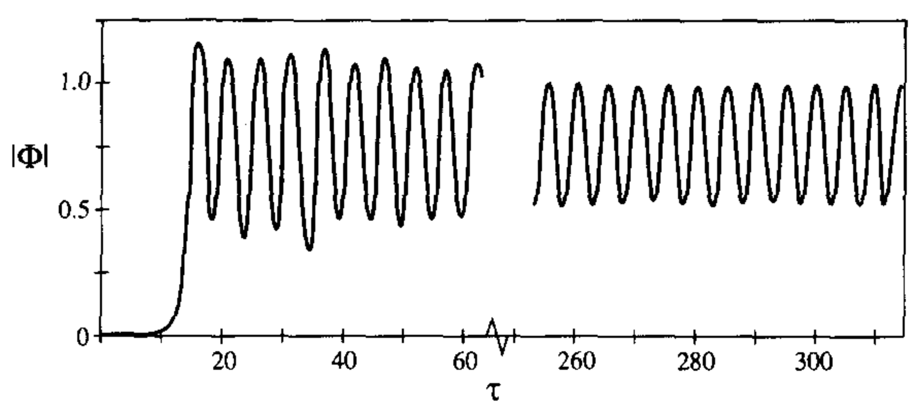
Poincaré map vs LCS
Tennyson Physica D 71 (1994)
Hands-on Session 1 – May 5th 2015
Slides by Matteo Valerio Falessi
NLED web seminar
Matteo Valerio Falessi

Slide 63
Poincaré map vs LCS
Tennyson Physica D 71 (1994)
Periodic behavior
Asymptotically periodic;
Hands-on Session 1 – May 5th 2015
Slides by Matteo Valerio Falessi
NLED web seminar
Matteo Valerio Falessi

Slide 64
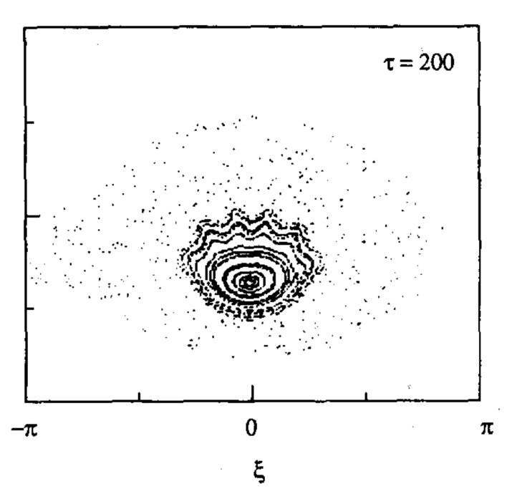
Poincaré map vs LCS
Tennyson Physica D 71 (1994)
Periodic behavior
Asymptotically periodic;
single particle motion described trough Poincaré map;
Hands-on Session 1 – May 5th 2015
Slides by Matteo Valerio Falessi
NLED web seminar
Matteo Valerio Falessi

Slide 65
Poincaré map vs LCS
Tennyson Physica D 71 (1994)
Periodic behavior
Trapped particles
Asymptotically periodic;
single particle motion described trough Poincaré map;
onset of the instability?
Hands-on Session 1 – May 5th 2015
Slides by Matteo Valerio Falessi
NLED web seminar
Matteo Valerio Falessi

Slide 66
Poincaré map vs LCS
Tennyson Physica D 71 (1994)
Aperiodic behavior
Periodic behavior
Trapped particles
Asymptotically periodic;
single particle motion described trough Poincaré map;
onset of the instability?
Hands-on Session 1 – May 5th 2015
Slides by Matteo Valerio Falessi
NLED web seminar
Matteo Valerio Falessi

Slide 67
Poincaré map vs LCS
Tennyson Physica D 71 (1994)
Aperiodic behavior
Periodic behavior
Trapped particles
Asymptotically periodic;
single particle motion described trough Poincaré map;
onset of the instability?
Multi-beams?
Hands-on Session 1 – May 5th 2015
Slides by Matteo Valerio Falessi
NLED web seminar
Matteo Valerio Falessi

Slide 68
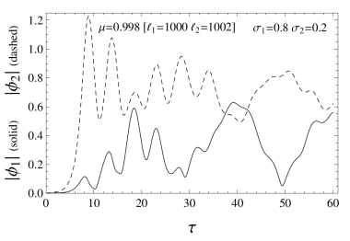
Poincaré map vs LCS
Tennyson Physica D 71 (1994)
Aperiodic behavior
Periodic behavior
Trapped particles
Asymptotically periodic;
single particle motion described trough Poincaré map;
onset of the instability?
Multi-beams?
Hands-on Session 1 – May 5th 2015
Slides by Matteo Valerio Falessi
NLED web seminar
Matteo Valerio Falessi

Slide 69
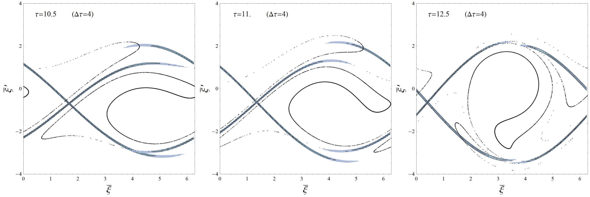
Beam plasma instability: FTLE profiles
Superimposition of the FTLE calculated with forward and backward time integrations: repulsive and attractive LCS;
NLED web seminar
Hands-on Session 1 – May 5th 2015
Slides by Matteo Valerio Falessi
Matteo Valerio Falessi

Slide 70
Beam plasma instability: FTLE profiles
Recirculating particles
Forward FTLE Contour plot
Backward FTLE Contour plot
Superimposition of the FTLE calculated with forward and backward time integrations: repulsive and attractive LCS;
NLED web seminar
Hands-on Session 1 – May 5th 2015
Slides by Matteo Valerio Falessi
Matteo Valerio Falessi

Slide 71
Beam plasma instability: FTLE profiles
Recirculating particles
Forward FTLE Contour plot
Backward FTLE Contour plot
Superimposition of the FTLE calculated with forward and backward time integrations: repulsive and attractive LCS;
phase space splitted into macro-regions with slow transport processes between them;
NLED web seminar
Hands-on Session 1 – May 5th 2015
Slides by Matteo Valerio Falessi
Matteo Valerio Falessi

Slide 72
Beam plasma instability: FTLE profiles
Recirculating particles
Forward FTLE Contour plot
Backward FTLE Contour plot
Superimposition of the FTLE calculated with forward and backward time integrations: repulsive and attractive LCS;
phase space splitted into macro-regions with slow transport processes between them;
no trapped particles (asymptotic) but recirculating ones.
NLED web seminar
Hands-on Session 1 – May 5th 2015
Slides by Matteo Valerio Falessi
Matteo Valerio Falessi

Slide 73
3-d Collisionless Magnetic reconnection
Transport phenomena during a 3-d collisionless magnetic reconnection process;
NLED web seminar
Hands-on Session 1 – May 5th 2015
Slides by Matteo Valerio Falessi
Matteo Valerio Falessi

Slide 74

3-d Collisionless Magnetic reconnection
Transport phenomena during a 3-d collisionless magnetic reconnection process;
two fluids, low $β$ model in slab geometry ($y,z$ periodicity) ;
NLED web seminar
Hands-on Session 1 – May 5th 2015
Slides by Matteo Valerio Falessi
Matteo Valerio Falessi

Slide 75

3-d Collisionless Magnetic reconnection
Transport phenomena during a 3-d collisionless magnetic reconnection process;
two fluids, low $β$ model in slab geometry ($y,z$ periodicity) ;
Magnetic field lines satisfy Hamilton equations with the helical flux function $Ψ$ as $H$;
NLED web seminar
Hands-on Session 1 – May 5th 2015
Slides by Matteo Valerio Falessi
Matteo Valerio Falessi

Slide 76
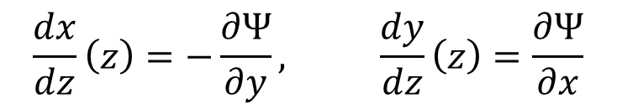
3-d Collisionless Magnetic reconnection
Transport phenomena during a 3-d collisionless magnetic reconnection process;
two fluids, low $β$ model in slab geometry ($y,z$ periodicity) ;
Magnetic field lines satisfy Hamilton equations with the helical flux function $Ψ$ as $H$;
$$\frac{dx}{dz}\left(z\right)=−\frac{∂Ψ}{∂y}, \frac{dy}{dz}\left(z\right)=\frac{∂Ψ}{∂x}$$
NLED web seminar
Hands-on Session 1 – May 5th 2015
Slides by Matteo Valerio Falessi
Matteo Valerio Falessi

Slide 77
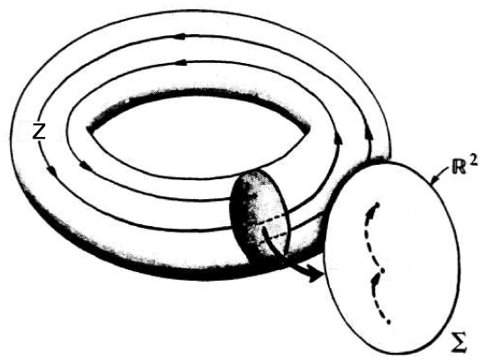
3-d Collisionless Magnetic reconnection
Transport phenomena during a 3-d collisionless magnetic reconnection process;
two fluids, low $β$ model in slab geometry ($y,z$ periodicity) ;
Magnetic field lines satisfy Hamilton equations with the helical flux function $Ψ$ as $H$;
$$\frac{dx}{dz}\left(z\right)=−\frac{∂Ψ}{∂y}, \frac{dy}{dz}\left(z\right)=\frac{∂Ψ}{∂x}$$
NLED web seminar
Hands-on Session 1 – May 5th 2015
Slides by Matteo Valerio Falessi
Matteo Valerio Falessi

Slide 78

3-d Collisionless Magnetic reconnection
Transport phenomena during a 3-d collisionless magnetic reconnection process;
two fluids, low $β$ model in slab geometry ($y,z$ periodicity) ;
Magnetic field lines satisfy Hamilton equations with the helical flux function $Ψ$ as $H$;
The advecting field is obtained extracting $Ψ(x,y,x;t)$ from the numerical simulation;
$$\frac{dx}{dz}\left(z\right)=−\frac{∂Ψ}{∂y}, \frac{dy}{dz}\left(z\right)=\frac{∂Ψ}{∂x}$$
NLED web seminar
Hands-on Session 1 – May 5th 2015
Slides by Matteo Valerio Falessi
Matteo Valerio Falessi

Slide 79
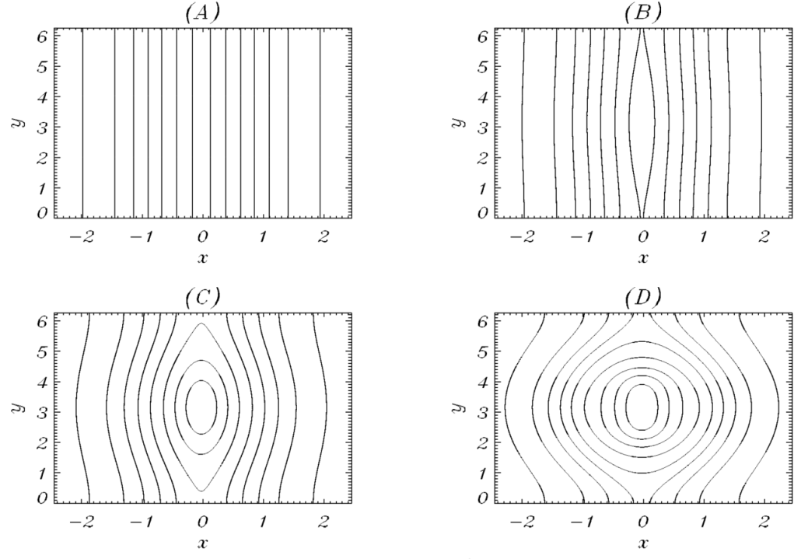
3-d Collisionless Magnetic reconnection
Transport phenomena during a 3-d collisionless magnetic reconnection process;
two fluids, low $β$ model in slab geometry ($y,z$ periodicity) ;
Magnetic field lines satisfy Hamilton equations with the helical flux function $Ψ$ as $H$;
The advecting field is obtained extracting $Ψ(x,y,x;t)$ from the numerical simulation;
$$\frac{dx}{dz}\left(z\right)=−\frac{∂Ψ}{∂y}, \frac{dy}{dz}\left(z\right)=\frac{∂Ψ}{∂x}$$
Califano lec.
NLED web seminar
Hands-on Session 1 – May 5th 2015
Slides by Matteo Valerio Falessi
Matteo Valerio Falessi

Slide 80

3-d Collisionless Magnetic reconnection
Transport phenomena during a 3-d collisionless magnetic reconnection process;
two fluids, low $β$ model in slab geometry ($y,z$ periodicity) ;
Magnetic field lines satisfy Hamilton equations with the helical flux function $Ψ$ as $H$;
The advecting field is obtained extracting $Ψ(x,y,x;t)$ from the numerical simulation;
The Stochasticity of the magnetic field develops from the interaction between chains of islands;
$$\frac{dx}{dz}\left(z\right)=−\frac{∂Ψ}{∂y}, \frac{dy}{dz}\left(z\right)=\frac{∂Ψ}{∂x}$$
Califano lec.
NLED web seminar
Hands-on Session 1 – May 5th 2015
Slides by Matteo Valerio Falessi
Matteo Valerio Falessi

Slide 81
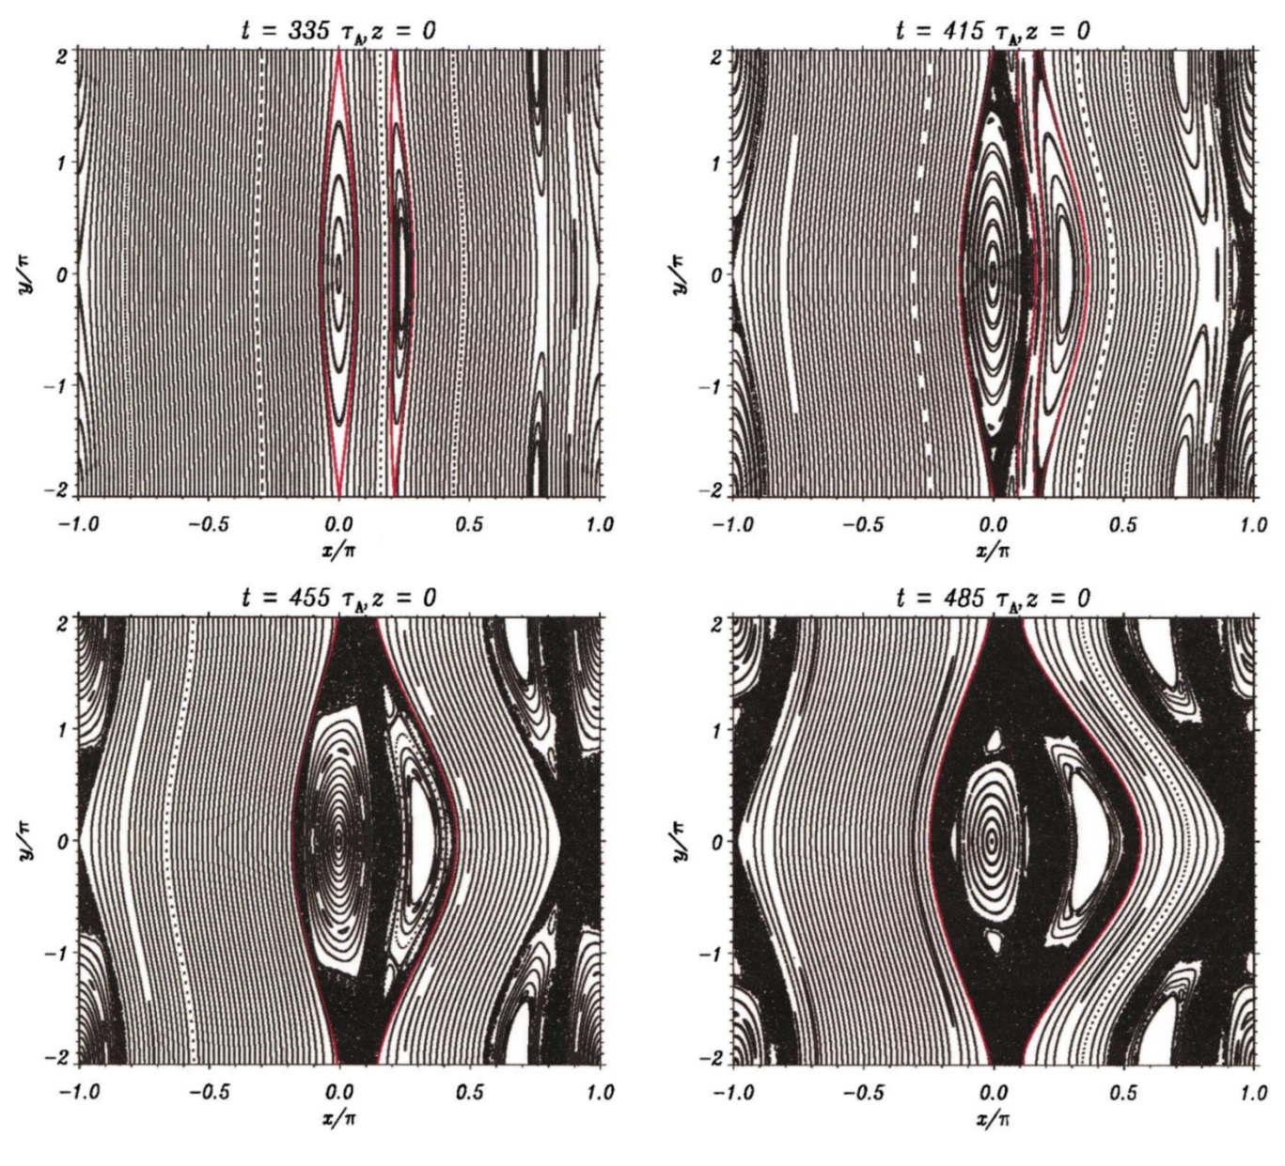
3-d Collisionless Magnetic reconnection
Borgogno POP 18 2011
NLED web seminar
Hands-on Session 1 – May 5th 2015
Slides by Matteo Valerio Falessi
Matteo Valerio Falessi

Slide 82
3-d Collisionless Magnetic reconnection
Borgogno POP 18 2011
Linear growth
NLED web seminar
Hands-on Session 1 – May 5th 2015
Slides by Matteo Valerio Falessi
Matteo Valerio Falessi

Slide 83
3-d Collisionless Magnetic reconnection
Borgogno POP 18 2011
Linear growth
Two separated chaotic regions
NLED web seminar
Hands-on Session 1 – May 5th 2015
Slides by Matteo Valerio Falessi
Matteo Valerio Falessi

Slide 84
3-d Collisionless Magnetic reconnection
Borgogno POP 18 2011
Linear growth
Two separated chaotic regions
The two regions merge
NLED web seminar
Hands-on Session 1 – May 5th 2015
Slides by Matteo Valerio Falessi
Matteo Valerio Falessi

Slide 85
3-d Collisionless Magnetic reconnection
Borgogno POP 18 2011
Linear growth
Two separated chaotic regions
The two regions merge
unique stochastic region
NLED web seminar
Hands-on Session 1 – May 5th 2015
Slides by Matteo Valerio Falessi
Matteo Valerio Falessi

Slide 86
3-d Collisionless Magnetic reconnection
Borgogno POP 18 2011
Linear growth
Two separated chaotic regions
The two regions merge
unique stochastic region
Electrons move along field lines
NLED web seminar
Hands-on Session 1 – May 5th 2015
Slides by Matteo Valerio Falessi
Matteo Valerio Falessi

Slide 87
3-d Collisionless Magnetic reconnection
Borgogno POP 18 2011
Linear growth
Two separated chaotic regions
The two regions merge
unique stochastic region
Electrons move along field lines
LCS have implications on plasma transport
NLED web seminar
Hands-on Session 1 – May 5th 2015
Slides by Matteo Valerio Falessi
Matteo Valerio Falessi

Slide 88
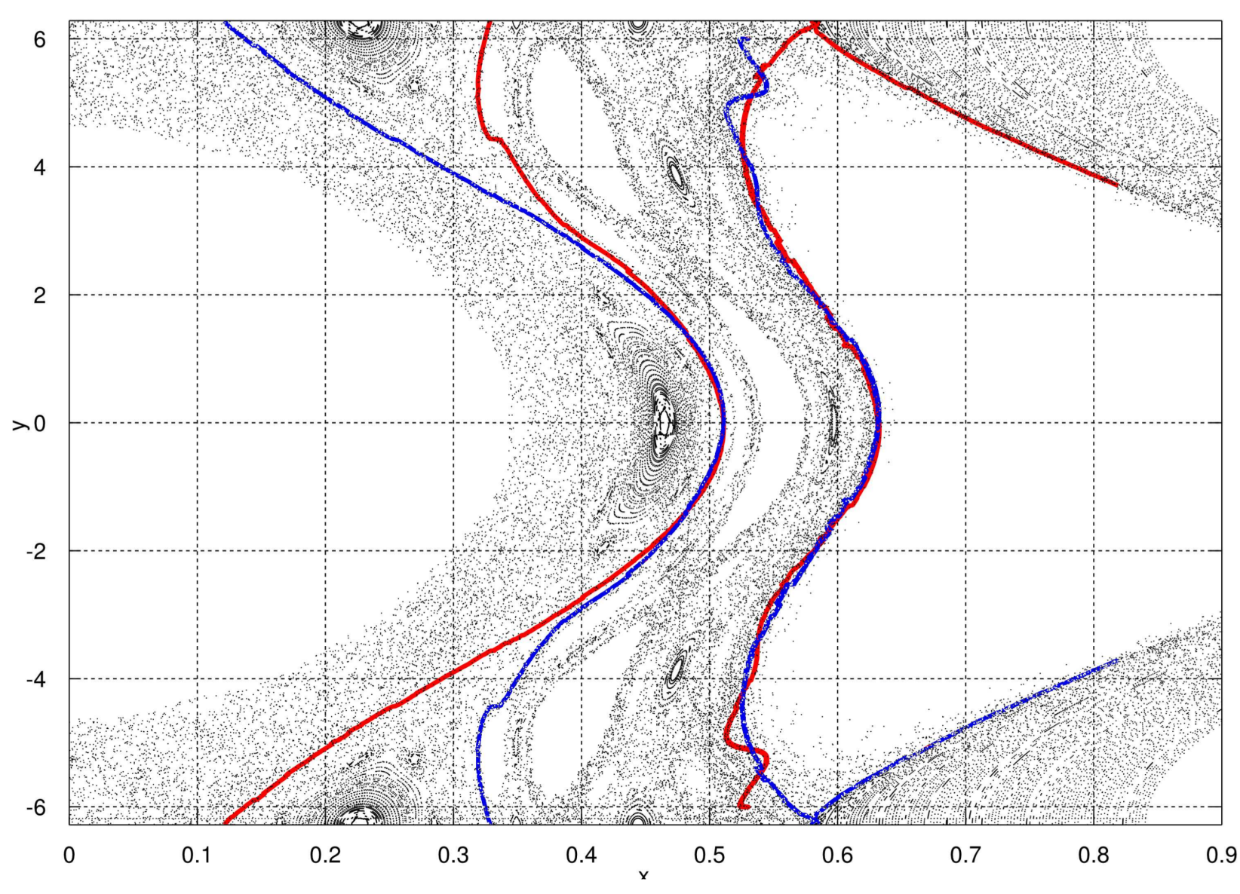
3-d Collisionless Magnetic reconnection
NLED web seminar
Hands-on Session 1 – May 5th 2015
Slides by Matteo Valerio Falessi
Matteo Valerio Falessi

Slide 89
3-d Collisionless Magnetic reconnection
Repulsive LCS
Attractive LCS
NLED web seminar
Hands-on Session 1 – May 5th 2015
Slides by Matteo Valerio Falessi
Matteo Valerio Falessi

Slide 90
3-d Collisionless Magnetic reconnection
Repulsive LCS
Recirculating regions
Attractive LCS
LCS act as transport barriers for $1000$ iterations of the map
NLED web seminar
Hands-on Session 1 – May 5th 2015
Slides by Matteo Valerio Falessi
Matteo Valerio Falessi

Slide 91
Summary
Studying transport processes in a plasma requires to deal with Lagrangian quantitities such as bundles of trajectories advected by the fields;
NLED web seminar
Hands-on Session 1 – May 5th 2015
Slides by Matteo Valerio Falessi
Matteo Valerio Falessi

Slide 92
Summary
Studying transport processes in a plasma requires to deal with Lagrangian quantitities such as bundles of trajectories advected by the fields;
in a time dependent, system we cannot quantify transport looking only at the evolution of the Eulerian fields;
NLED web seminar
Hands-on Session 1 – May 5th 2015
Slides by Matteo Valerio Falessi
Matteo Valerio Falessi

Slide 93
Summary
Studying transport processes in a plasma requires to deal with Lagrangian quantitities such as bundles of trajectories advected by the fields;
in a time dependent, system we cannot quantify transport looking only at the evolution of the Eulerian fields;
NLED web seminar
Hands-on Session 1 – May 5th 2015
Slides by Matteo Valerio Falessi
Matteo Valerio Falessi

Slide 94
Summary
Studying transport processes in a plasma requires to deal with Lagrangian quantitities such as bundles of trajectories advected by the fields;
in a time dependent, system we cannot quantify transport looking only at the evolution of the Eulerian fields;
it is not possible to split the domain into macro-regions which do not exchange tracers just by looking at the instantaneous velocity field;
Hands-on Session 1 – May 5th 2015
Slides by Matteo Valerio Falessi
NLED web seminar
Matteo Valerio Falessi

Slide 95
Summary
Studying transport processes in a plasma requires to deal with Lagrangian quantitities such as bundles of trajectories advected by the fields;
in a time dependent, system we cannot quantify transport looking only at the evolution of the Eulerian fields;
it is not possible to split the domain into macro-regions which do not exchange tracers just by looking at the instantaneous velocity field;
NLED web seminar
Hands-on Session 1 – May 5th 2015
Slides by Matteo Valerio Falessi
Matteo Valerio Falessi

Slide 96
Conclusions and future development
LCS generalize these structures in a time dependent system;
NLED web seminar
Hands-on Session 1 – May 5th 2015
Slides by Matteo Valerio Falessi
Matteo Valerio Falessi

Slide 97
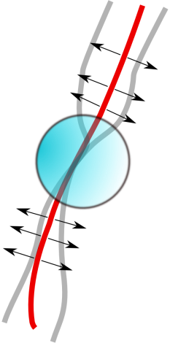


Conclusions and future development
LCS generalize these structures in a time dependent system;
$$t$$
$$t+Δt$$
NLED web seminar
Hands-on Session 1 – May 5th 2015
Slides by Matteo Valerio Falessi
Matteo Valerio Falessi

Slide 98

Conclusions and future development
LCS generalize these structures in a time dependent system;
they describe transport processes happening in a well defined, characteristic time, chosen tuning the parameter $Δt$;
$$t$$
$$t+Δt$$
NLED web seminar
Hands-on Session 1 – May 5th 2015
Slides by Matteo Valerio Falessi
Matteo Valerio Falessi

Slide 99

Conclusions and future development
LCS generalize these structures in a time dependent system;
they describe transport processes happening in a well defined, characteristic time, chosen tuning the parameter $Δt$;
LCS can be approximated studying the FTLE field ${σ^{Δt}}_{t}^{}(x,y)$;
$$t$$
$$t+Δt$$
NLED web seminar
Hands-on Session 1 – May 5th 2015
Slides by Matteo Valerio Falessi
Matteo Valerio Falessi

Slide 100
Conclusions and future development
LCS generalize these structures in a time dependent system;
they describe transport processes happening in a well defined, characteristic time, chosen tuning the parameter $Δt$;
LCS can be approximated studying the FTLE field ${σ^{Δt}}_{t}^{}(x,y)$;
$$t$$
$$t+Δt$$
NLED web seminar
Hands-on Session 1 – May 5th 2015
Slides by Matteo Valerio Falessi
Matteo Valerio Falessi

Slide 101

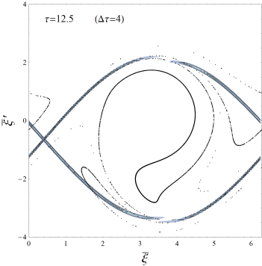

Conclusions and future development
LCS generalize these structures in a time dependent system;
they describe transport processes happening in a well defined, characteristic time, chosen tuning the parameter $Δt$;
LCS can be approximated studying the FTLE field ${σ^{Δt}}_{t}^{}(x,y)$;
in plasma physics they are relatively new and could be used as a post-processing diagnostic to study transport phenomena in simulations and experiments.
$$t$$
$$t+Δt$$
NLED web seminar
Hands-on Session 1 – May 5th 2015
Slides by Matteo Valerio Falessi
Matteo Valerio Falessi

