Slide 1
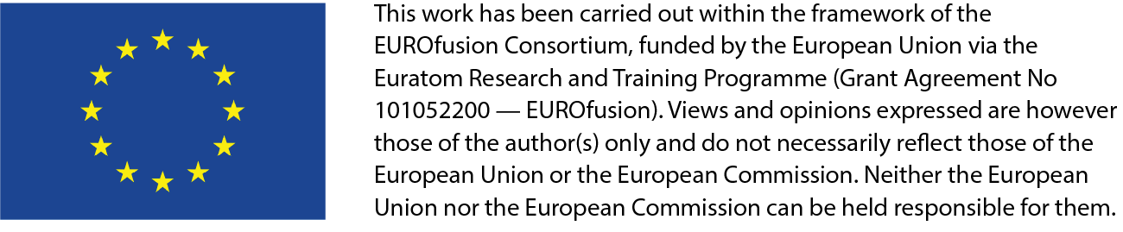


July 7th, 2026
Physics of Alfvén wave and energetic
particles in burning plasmas*
F. Zonca1,2
1Center for Nonlinear Plasma Science and ENEA C.R. Frascati, 00044 Frascati, Italy
2IFTS and School of Physics, Zhejiang University, Hangzhou, 310027 P.R. China
      *In collaboration with L. Chen, M. V. Falessi, Ph. Lauber, A. Mishchenko, Z. Qiu, X. Tao and G. Wei

Slide 2

Shear Alfvén waves and the physics of burning plasmas
Burning plasmas as complex self-organized systems:
[C&Z Rev. Mod. Phys. Review article]: Nonlinear gyrokinetic description]
Multi-spatiotemporal
scale fluctuations
Plasma and fusion
reactivity profiles
Turbulence & fluctuation
driven fluxes
Meso & macro-scale
distortion of equilibrium

Slide 3
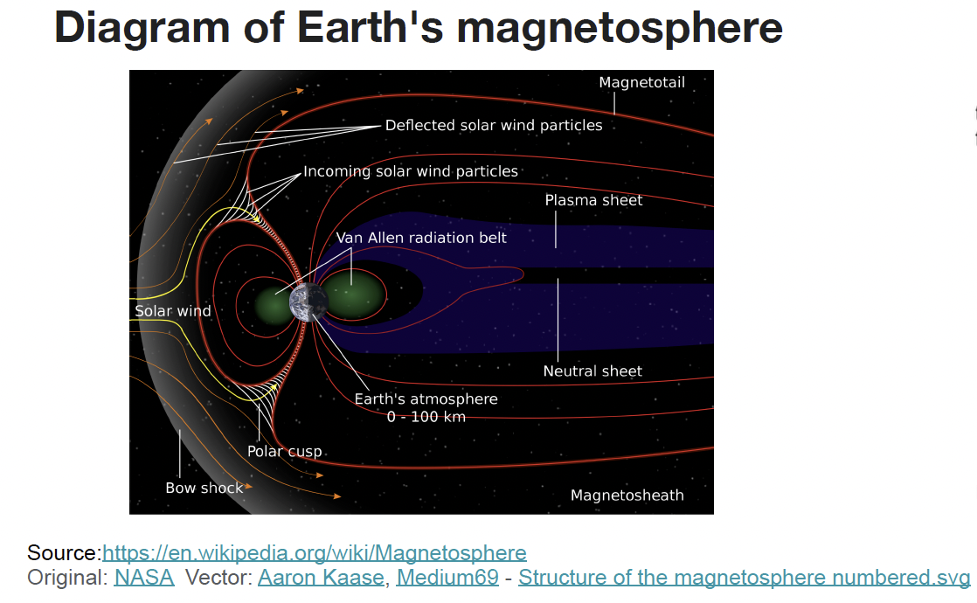
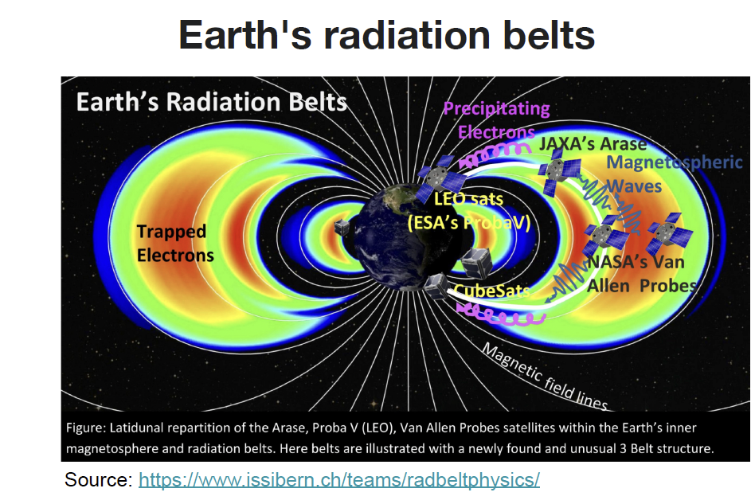
Broader relevance: Earth’s radiation belts
Significant MeV electron population
Formation mechanism?
Whistler mode chorus is responsible for electron acceleration to MeV energy in Earth’s radiation belts (R. B. Horne, Nature 2005)

Slide 4
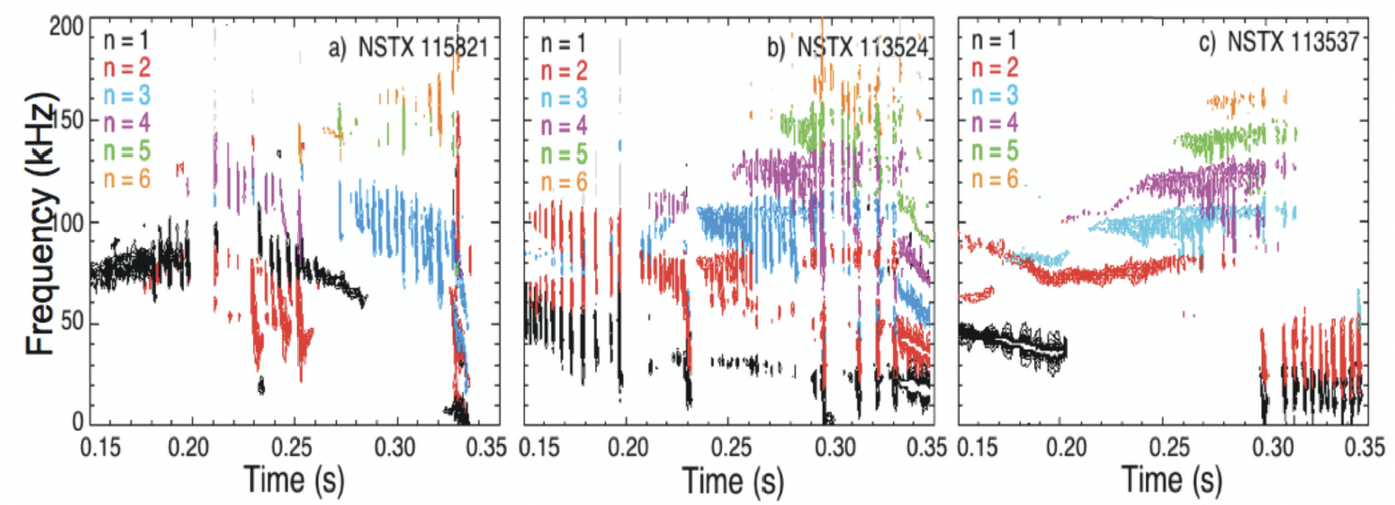
Experimental observations
Rich spectrum of Alfvénic fluctuations is observed experimentally (E. D. Fredrickson et al., Phys. Plasmas 2006)
Resonant excitation of Alfvén eigenmodes, EPM and fishbones by energetic particles and ensuing effects on transport

Slide 5
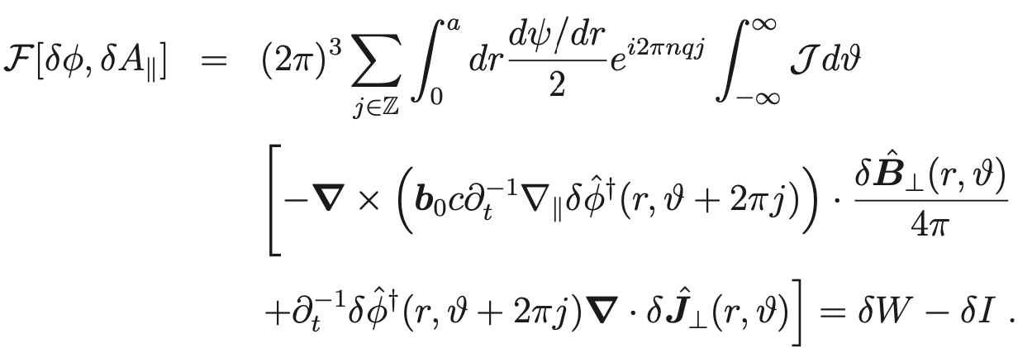
Unified theoretical approach
The general fishbone like dispersion relation (GFLDR) provides the unified description of spectral properties, mode structure, and resonant excitation by energetic particles in realistic nonuniform equilibria (Z&C Phys. Plasmas 2014)
Constructed from the GK energy functional (Hasegawa and Chen 1991)

Slide 6


The General fishbone like dispersion relation
The GFLDR can be cast as (Z&C Phys. Plasmas 2014)
“fluid” potential energy/MHD
generalized GK inertia
GK potential energy/compression
The GFLDR is a prediction first approach, which readily offers a falsification test to experimental observations
The GFLDR identifies spatiotemporal scales underlying relevant physics: it elevates interpretation of experimental observations and numerical simulation results

Slide 7
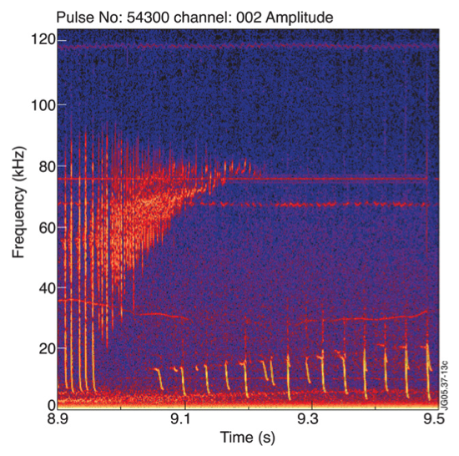
High frequency fishbones at JET
The GFLDR has successfully been applied to AUG, DIII-D, FTU, HL-2A, HL-3, JET, NSTX, DTT, …
Z&C et al 2009 Nuc. Fus. 49 085009
Shear Alfvén continuum accumulation
point is degenerate with GAM frequency
Thermal plasma kinetic effects set onset
threshold for high frequency fishbones
Courtesy of F. Nabais et al. 2005 Phys. Plasmas 12 102509

Slide 8
High frequency fishbones at JET
The GFLDR has successfully been applied to AUG, DIII-D, FTU, HL-2A, HL-3, JET, NSTX, DTT …
Z&C et al 2009 Nuc. Fus. 49 085009
Energetic particles provide effective drive
with strong ICRH in low-density plasma
Nonlinear chirping dynamics is consistent
with predicted evolution due to precession
resonance of EP tail
Courtesy of F. Nabais et al. 2005 Phys. Plasmas 12 102509

Slide 9

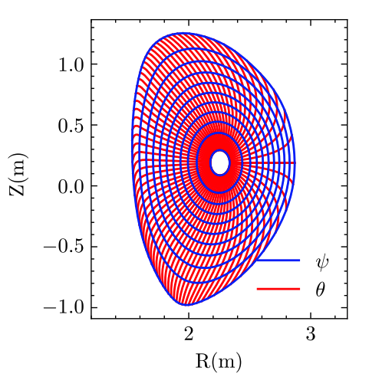



Importance of polarization
SAW-ISW (Shear Alfvén-Ion Sound) continuum computed by GFLDR for realistic DTT equilibrium
G. Wei et al. 2024 Phys. Plasmas 31 072505
Divertor Tokamak Test

Slide 10
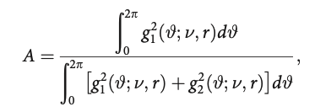
Importance of polarization
SAW-ISW (Shear Alfvén-Ion Sound) continuum computed by GFLDR for realistic DTT equilibrium
G. Wei et al. 2024 Phys. Plasmas 31 072505
Divertor Tokamak Test
Alfvénicity
M.V. Falessi et al. 2019 Phys. Plasmas 26 082502

Slide 11
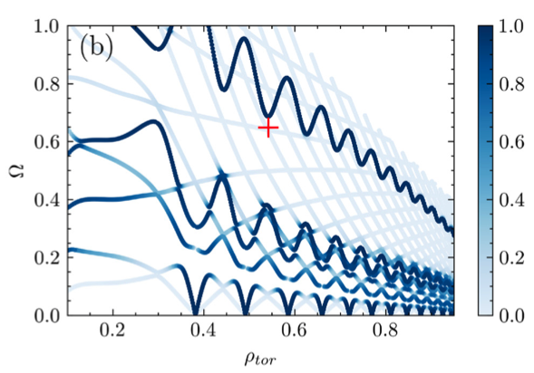
Importance of polarization
SAW-ISW (Shear Alfvén-Ion Sound) continuum computed by GFLDR for realistic DTT equilibrium
G. Wei et al. 2024 Phys. Plasmas 31 072505
Divertor Tokamak Test
Alfvénicity

Slide 12
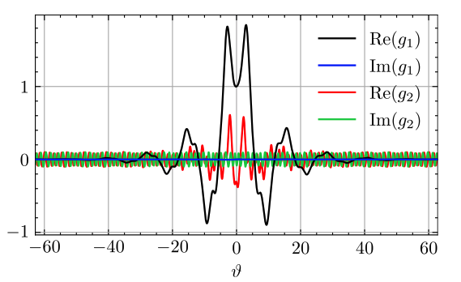
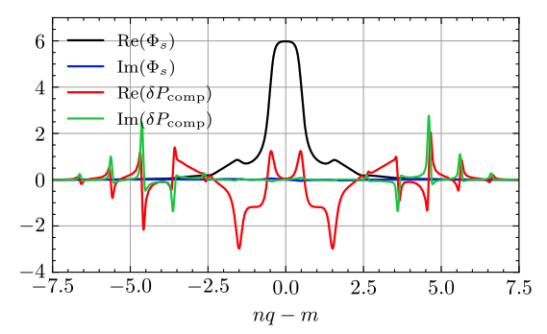
Crucial role of mode structures
Interaction of TAE with SAW-ISW continuum leads to resonant absorption and damping
G. Wei et al. 2024 Phys. Plasmas 31 072505
Mode structures in ballooning and real space are crucial for correct description of damping and drive

Slide 13
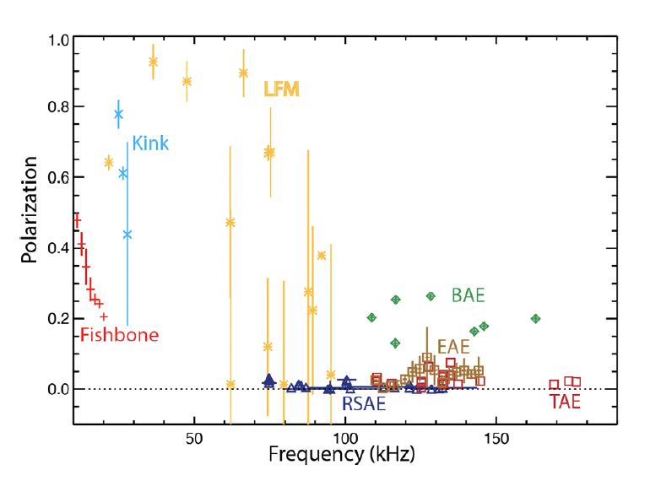
Recent experimental observations
Recent experimental observations from DIII-D capture mode polarization effects
W.W Heidbrink et al. 2025 Nucl. Fusion 65 112002
Polarization analogous to
Alfvénicity defined in
M.V. Falessi et al. 2019 Phys. Plasmas 26 082502
GFLDR provides precise prediction of experimental measurements and awaits for falsification test

Slide 14
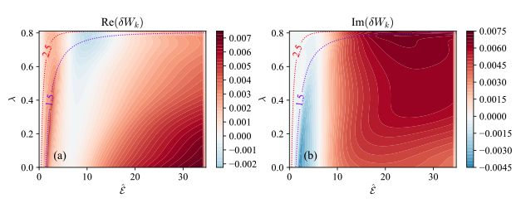
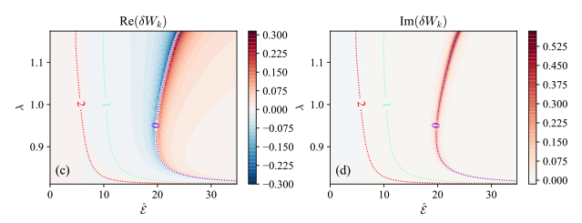
Crucial role of wave particle resonances
Mode structures in ballooning and real space also affect the wave-particle resonances and power exchange
G. Wei et al. 2025 Nucl. Fusion 65 106035
EP: isotropic
slowing down
Circulating
GFLDR synthetic
diagnostics
Trapped

Slide 15
Nonlinear dynamics and transport
Burning plasmas as complex self-organized systems:
[C&Z Rev. Mod. Phys. Review article]: Nonlinear gyrokinetic description]
Multi-spatiotemporal
scale fluctuations
Plasma and fusion
reactivity profiles
Turbulence & fluctuation
driven fluxes
Meso & macro-scale
distortion of equilibrium
NL wave-particle
Deviation from local
thermodynamic equilibrium
NL wave-wave

Slide 16
Phase space transport - I
12
A first-principle-based, self-consistent approach is crucial for developing a predictive capability of plasma behaviors on long time scales
Proper nonlinear equilibrium
      Long lived (undamped by collision) zonal e.m. fields and corresponding phase space zonal structures: Zonal State
      Must self-consistently compute Zonal State in the presence of finite level of fluctuations

Slide 17
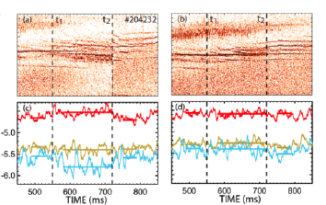
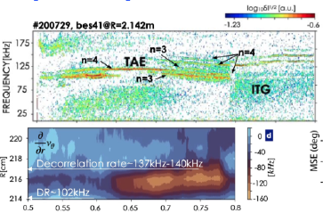
Phase space transport - I
12
A first-principle-based, self-consistent approach is crucial for developing a predictive capability of plasma behaviors on long time scales
Proper nonlinear equilibrium
      Long lived (undamped by collision) zonal e.m. fields and corresponding phase space zonal structures: Zonal State
      Must self-consistently compute Zonal State in the presence of finite level of fluctuations
      Routinely observed experimentally [zonal flows – X. Du et al. PRL 2025; zonal currents – W.W. Heidbrink et al. ITPEA EP 2026]
zonal flow
zonal current

Slide 18
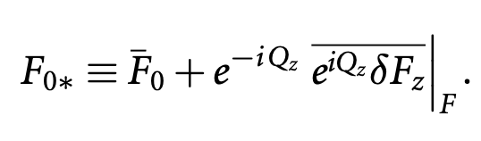
Phase space transport - I
12
A first-principle-based, self-consistent approach is crucial for developing a predictive capability of plasma behaviors on long time scales
Proper nonlinear equilibrium
      Long lived (undamped by collision) zonal e.m. fields and corresponding phase space zonal structures: Zonal State
      Must self-consistently compute Zonal State in the presence of finite level of fluctuations
    Separate macro-meso spatiotemporal scales from micro-meso scales
    Renormalized equilibrium accounting for self-interaction
_____________
(orbit averaging)
meso-macro
micro-meso

Slide 19
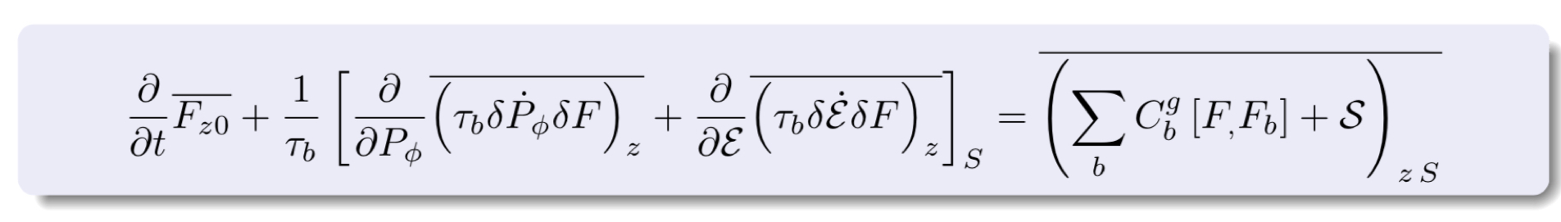
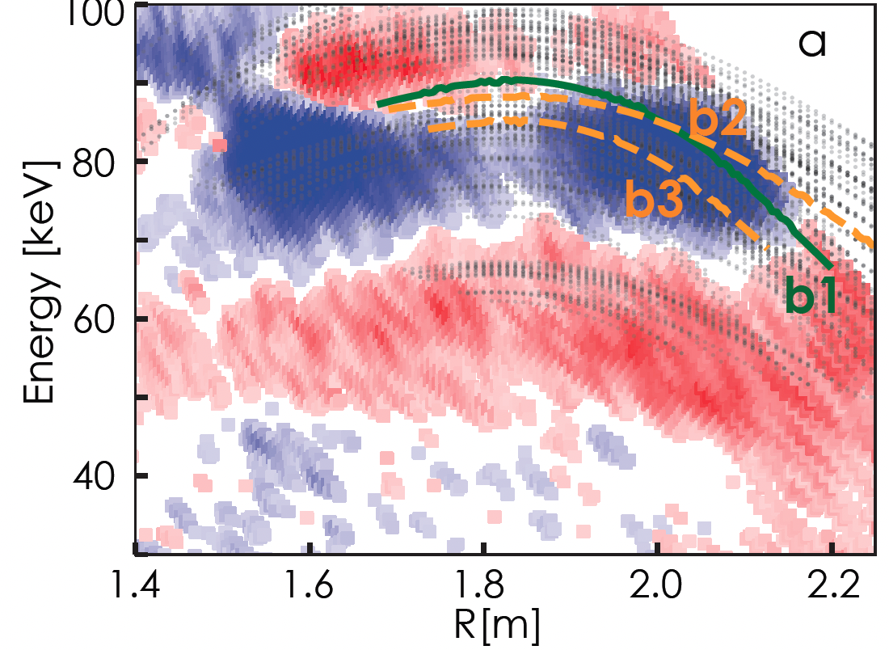
Phase space transport - II
13
    Phase space zonal structure (PSZS) evolution equation (nearly integrable system) [Falessi et al NJP 2023]
Measured RSAE induced flow
images along with the streamlines;
at INPA measured pitch of 0:78 in DIII-D
X. Du et al. 2021 Phys. Rev. Lett. 26 082502

Slide 20
Phase space transport - II
13
    Phase space zonal structure (PSZS) evolution equation (nearly integrable system) [Falessi et al NJP 2023]
    Intrinsically full-F [Falessi et al NJP 2023] but reduced to the 3D action space (contants of motion) ➔ verified numerically with HMGC+HYMAGYC codes [S. Briguglio and G. Vlad, 2020]
    Ready for implementation in non-linear GK codes, including thermal component if whole transport description is lifted to the phase space [S.J. Wang et al. PRL 2024, ITB by ITG]

Slide 21
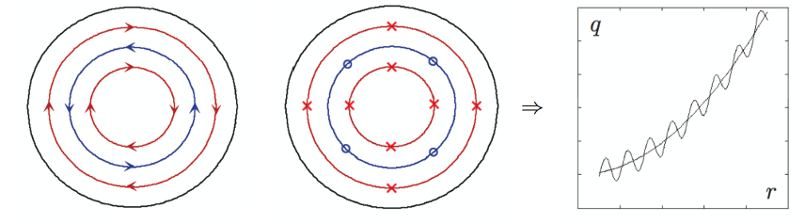
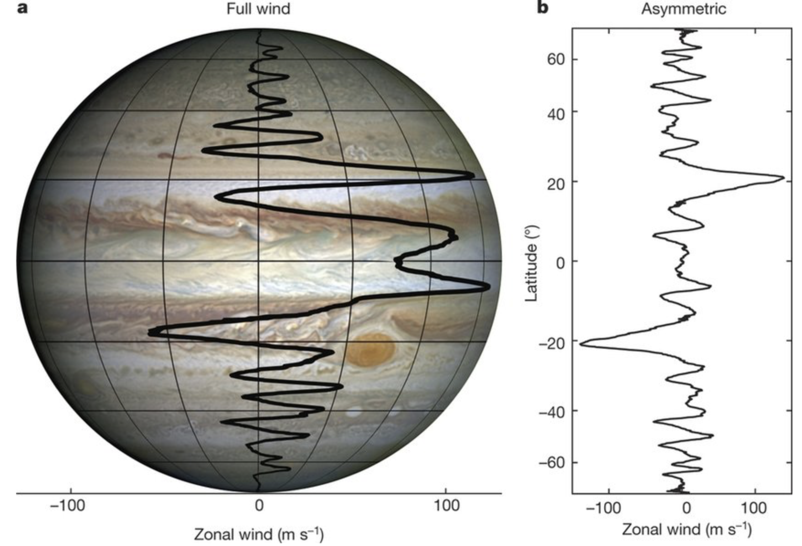
Zonal electromagnetic fields
Zonal flows and currents are equally important in NL dynamic evolution
C&Z. 2012 Phys. Rev. Lett.. 109 145002
Z. Qiu et al. 2013 Europhys. Lett.. 101 35001
Jupiter’s wind
zonal flow
zonal current
[Y. Kaspi et al 2018 Nature 555(7695):223-226]

Slide 22
Zonal electromagnetic fields
Zonal flows and currents are equally important in NL dynamic evolution
C&Z. 2012 Phys. Rev. Lett.. 109 145002
Z. Qiu et al. 2013 Europhys. Lett.. 101 35001
NOVEL FINDINGS
Chen et al. 2025 Nucl Fusion. 65 016018
zonal flow
zonal current
Core plasma also plays a crucial role in determining the properties of the zonal state
Reversed shear Alfvén eigenmodes (RSAE): paradigm for Alfvénic fluctuation dominating the core of reactor relevant plasmas

Slide 23
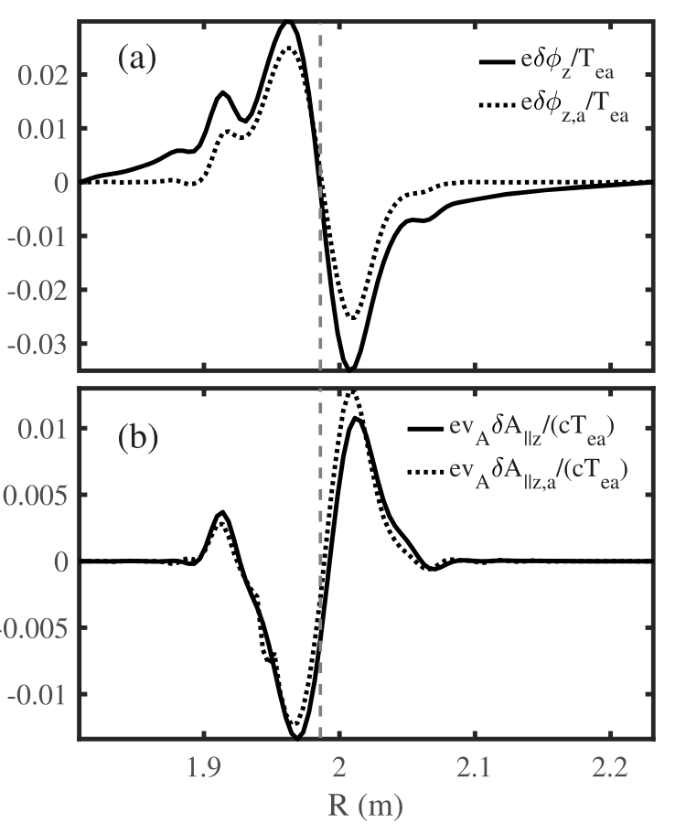
Zonal State: RSAE case
15
Core plasma also plays a crucial role in determining the properties of the zonal state
Reversed shear Alfvén eigenmodes (RSAE): paradigm for Alfvénic fluctuation dominating the core of reactor relevant plasmas
Theory and GTC code simulations of RSAE saturation show [Chen et al, Nucl. Fusion 65 (2025) 016018]
zonal flow has negligible effect on EP resonance detuning (shearing)
zonal e.m. fields enhance the EP drive via phase space zonal structures
zonal e.m. fields are dominated by zonal current
saturation takes place via downward frequency shift and enhanced damping due to core plasma effects (ongoing work)
_____ simulation
…….. theory
➔ contrary to common wisdom ⬅

Slide 24
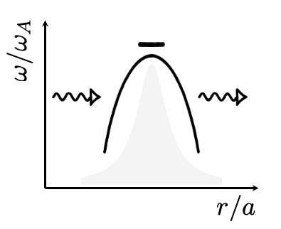
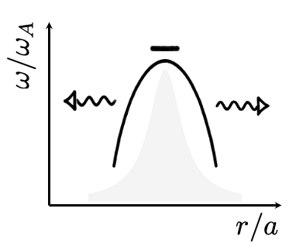
Importance of global kinetic approaches
Generation of zonal electromagnetic fields strongly depends on the spectral features of the underlying fluctuations
[F. Zonca et al., AAPPS-DPP 2025]
boundary
conditions
boundary
conditions
boundary
conditions
boundary
conditions
[local]
[global]
Kinetic Alfvén waves absorption and propagation properties must be described by proper global kinetic approaches.

Slide 25
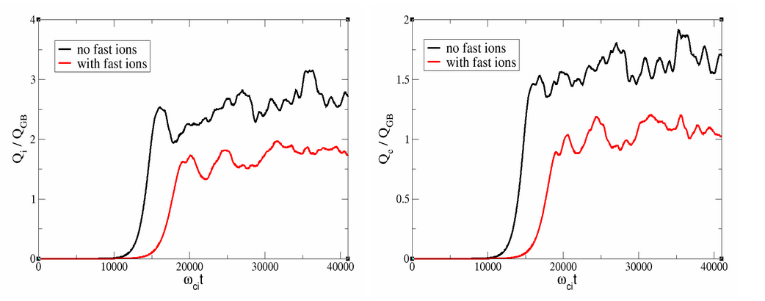
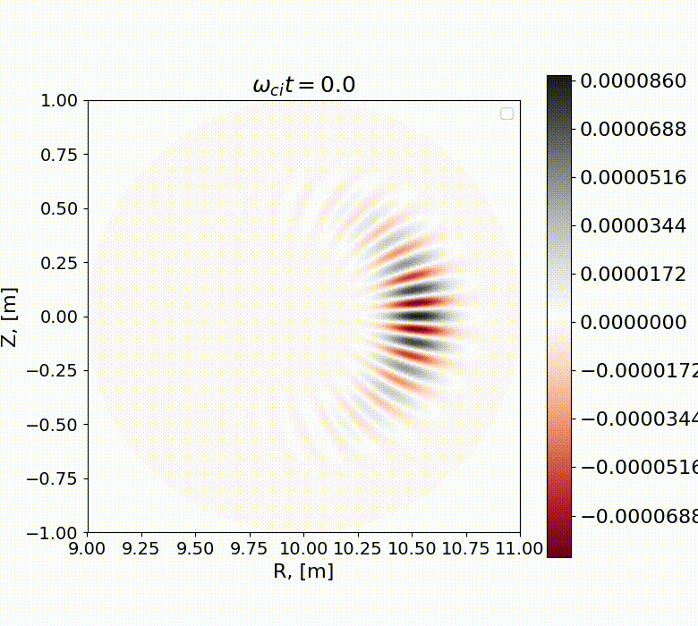
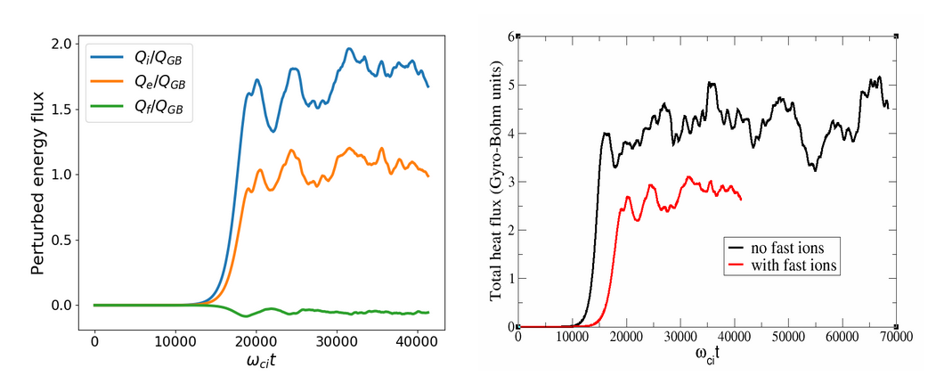
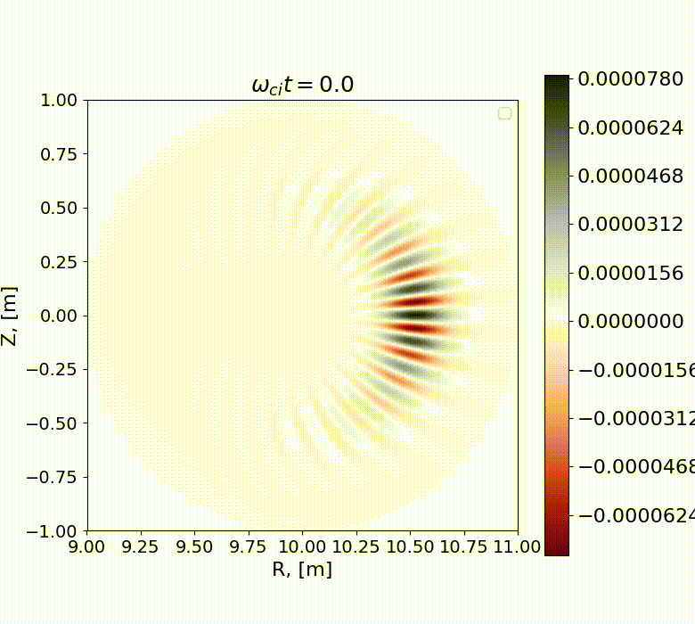
ORB5 code: core plasma confinement improvement
Nonlinear gyrokinetic simulations with ORB5 code demonstrate clear reduction in the heat flux for both the bulk ions and the electrons
[Courtesy A. Mishchenko and ORB5 Team 2025]
Total heat flux reduced by the fast ions! $β_{e}=0.1\%$

Slide 26
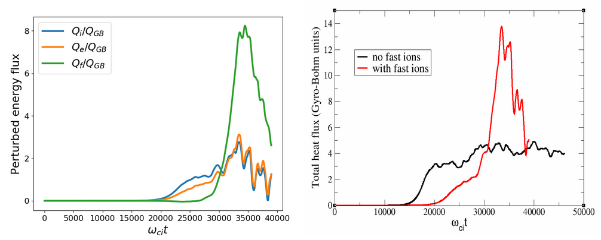

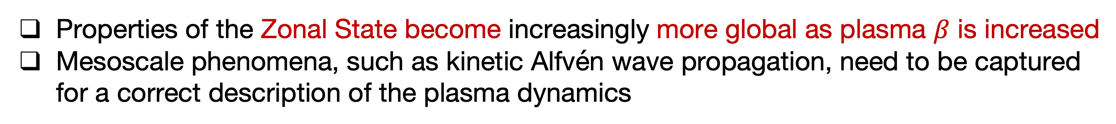
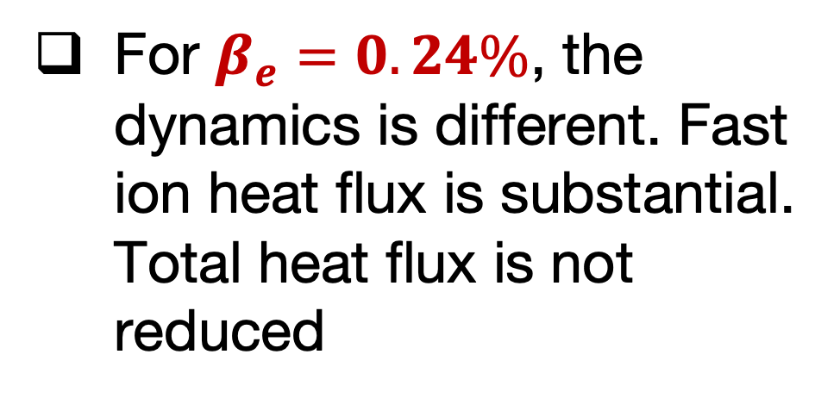
ORB5 code: AITG/KBM Zonal State
Properties of the Zonal State become increasingly more global as plasma $β$ is increased
Mesoscale phenomena, such as kinetic Alfvén wave propagation, need to be captured for a correct description of the plasma dynamics
[Courtesy A. Mishchenko and ORB5 Team 2025]
For $β_{e}=0.24\%$, the dynamics is different. Fast ion heat flux is substantial. Total heat flux is not reduced
without EP
with EP
Global Alfvenic mode (a BAE?) develops driving fast ion energy flux. Work in progress!

Slide 27
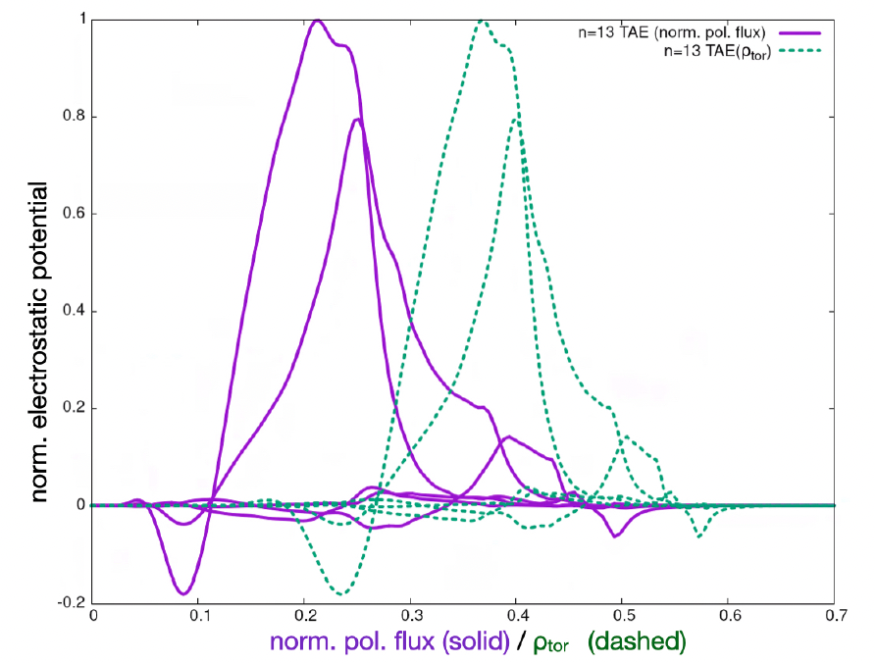
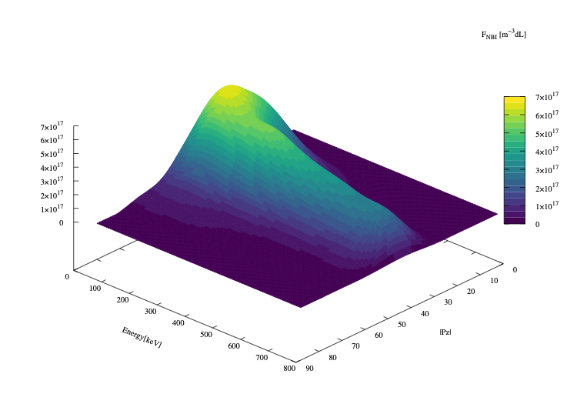
EP workflow: PSZS in LIGKA/HAGIS
Energetic Particle workflow fully integrated in IMAS
[EUROfusion Enabling Research project ATEP (Lauber/Falessi)]
[P. Lauber et al., NF 64, 096010 (2024)]
[Courtesy of Ph. Lauber; 2022]
[EFTC 2023 invited]
ITER 15MA case;
TAE n=13
f=75.5kHz
Computed by LIGKA
Using EP Workflow
ITER plasma from H&CD WF by M. Schneider

Slide 28
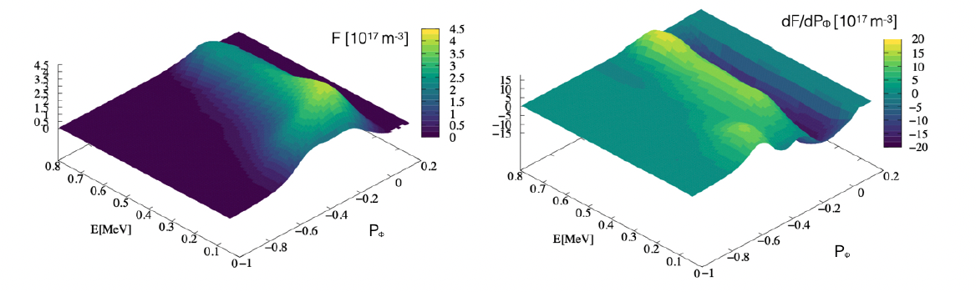
Distribution function representation
[P. Lauber et al., NF 64, 096010 (2024)]
original marker data as calculated by the NEMO/SPOT package
[Courtesy of Ph. Lauber]
Binning, smoothing and splining allow to construct regular derivatives in phase space

Slide 29
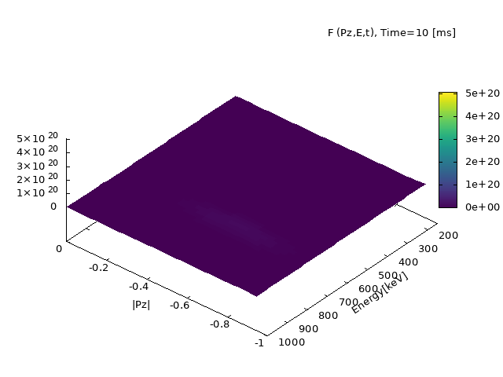
ATEP 3D code - I
ATEP: and advanced transport model for energetic particles
[Courtesy G. Meng]
[Invited EPS 2024]
Initial value problem solved with orbit averaged collision operator:
Source model: Gaussian function for NBI for comparison with SPOT

Slide 30
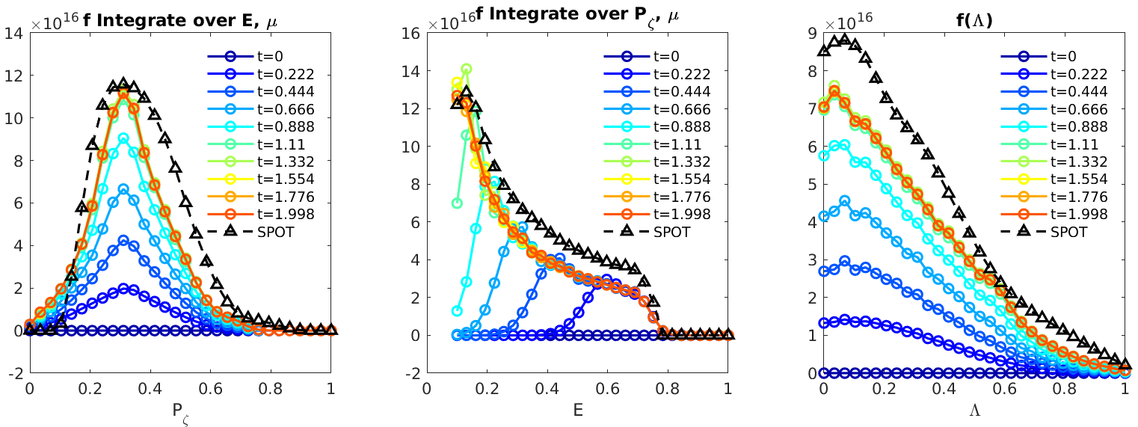
ATEP 3D code - II
Steady state solution obtained with sources and collisions
[Courtesy G. Meng]
[Invited EPS 2024]
[G. Meng et al., NF 64, 096009 (2024)]
Source model: Gaussian function for NBI
Comparison with SPOT, reasonable agreement
slowed-down in 1 second: transport time scale!
ATEP-3D, 30 mins/case
Monte-Carlo code, several days/case

Slide 31
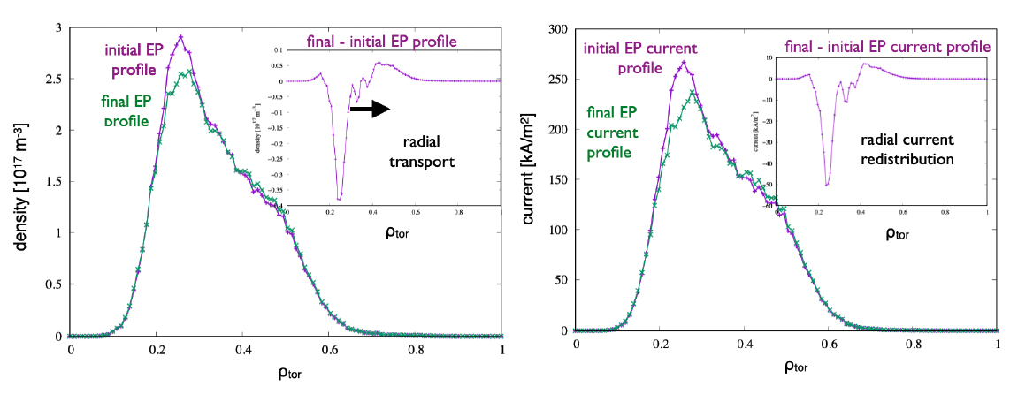
Off-axis beam relaxation in ITER
[P. Lauber et al., NF 64, 096010 (2024)]
ITER 15MA case;
TAE n=13
[Courtesy of Ph. Lauber]
Radial projection (ϱtor) of the distribution function of energetic
hydrogen particles, #100015/1, initial (as given by NEMO/SPOT) and final state after evolving the PSZS transport equation for 700ms (1000 time steps) with constant-amplitude TAE with δB/B = 10⁻⁵

Slide 32
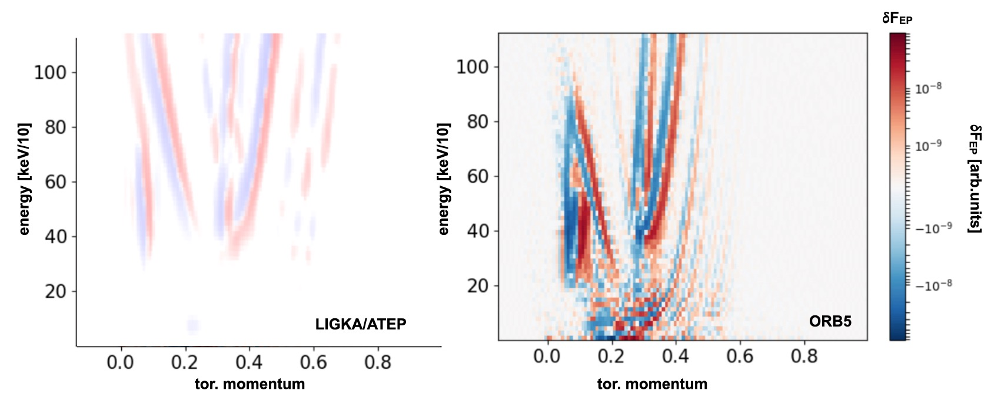
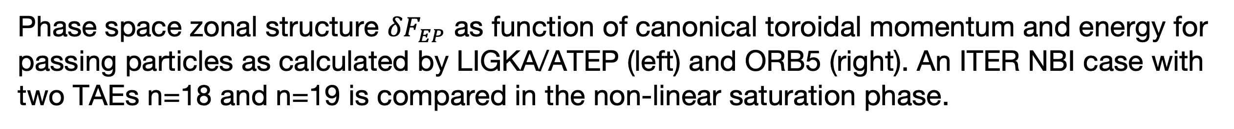
Verification of phase space fluxes
Phase space fluxes computed with ATEP 3D and ORB5 demostrate a good level of consistency
Phase space zonal structure $δF_{EP}$ as function of canonical toroidal momentum and energy for passing particles as calculated by LIGKA/ATEP (left) and ORB5 (right). An ITER NBI case with two TAEs n=18 and n=19 is compared in the non-linear saturation phase.

Slide 33
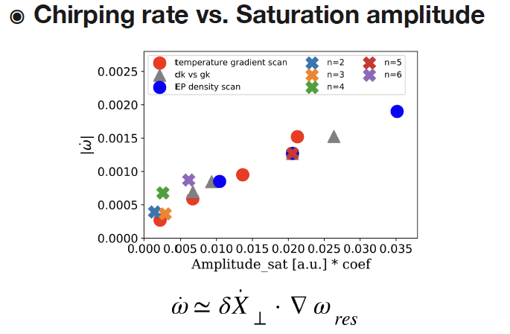
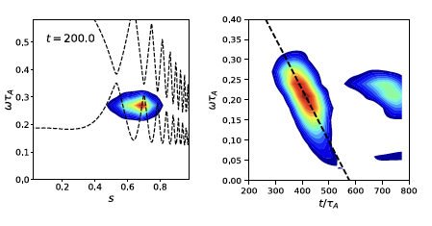
Numerical simulation of EPM chirping
PIC simulations in tokamaks show linear scaling of chirping rate with amplitude [X. Wang et al, EPS-DPP invited 2023]
intensity contour plot
⬅ theory prediction

Slide 34
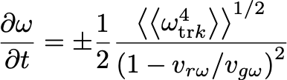
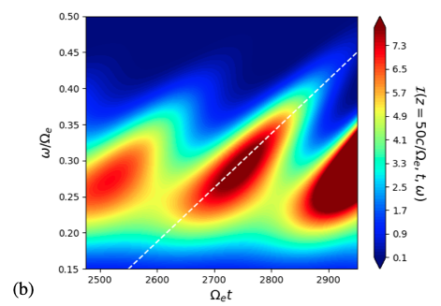
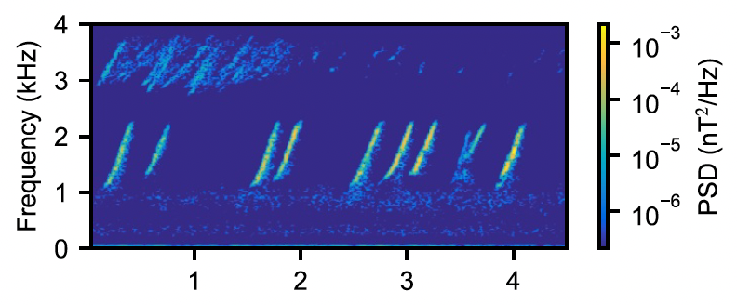
Earth’s chorus chirping
Adopt the general approach to construct the nonlinear growth rate and frequency shift
[Vomvoridis et al 1982]
X. Tao, F. Zonca, L. Chen, A “Trap-Release-Amplify” model of Chorus Waves, JGR: Space Physics, 126, e2021JA029585
F. Zonca, X. Tao, L. Chen, Nonlinear dynamics and phase space transport by chorus emission RMPP 5, 8; A theoretical framework of chorus wave excitation, JGR 127, e2021JA029760
Chorus Power Spectral Densities (PSD)
Van Allen probe [Mauk et al 2013]

Slide 35
Earth’s chorus chirping
Adopt the general approach to construct the nonlinear growth rate and frequency shift
[Vomvoridis et al 1982]
X. Tao, F. Zonca, L. Chen, A “Trap-Release-Amplify” model of Chorus Waves, JGR: Space Physics, 126, e2021JA029585
F. Zonca, X. Tao, L. Chen, Nonlinear dynamics and phase space transport by chorus emission RMPP 5, 8; A theoretical framework of chorus wave excitation, JGR 127, e2021JA029760
Chorus Power Spectral Densities (PSD)
Universality of chirping process
Van Allen probe [Mauk et al 2013]

Slide 36
Discussion and Conclusions
There exists an overarching and unified theoretical framework for self-consistent description of fluctuation spectra and corresponding transport in reactor-relevant fusion plasmas
Numerical applications have been made for selected reference cases and verification of the approach is complete
Applications to realistic cases of practical interest (ITER, JET, AUG, DTT, etc.) are in progress along with extension to 3D confinement systems [EUROfusion projects ATEP/TSVV#10/G (Lauber/Mishchenko); MAECI-NSFC projects (ENEA-SWIP)]
Main references are available at the CNPS site:
https://www.afs.enea.it/zonca/CNPS/

Slide 37
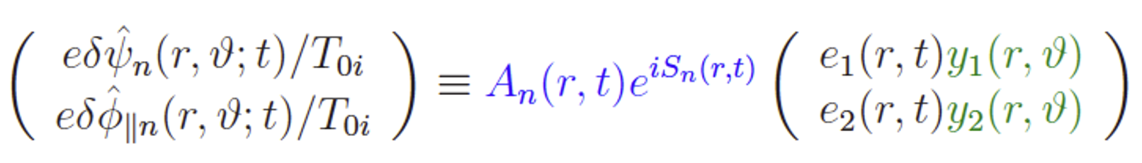
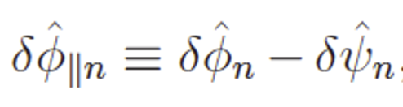
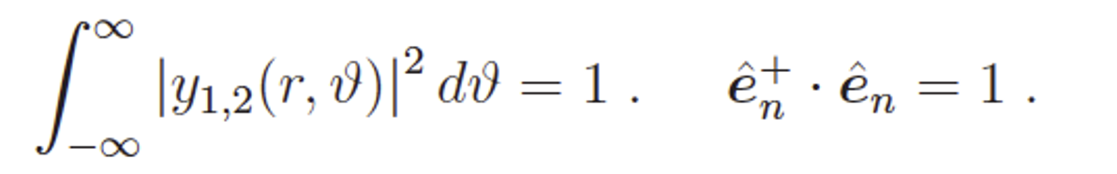
Extending the GFLDR to short wavelength
Separate linear and nonlinear responses and project on linear parallel mode structures to derive nonlinear envelope equations
[C&Z Rev. Mod. Phys. Review article]
linear response
nonlinear response
Introduced envelope $A_{n}\left(r,t\right)={\hat{e}}_{n}A_{n}\left(r,t\right)$, with polarization vector ${\hat{e}}_{n},$ eikonal representation and parallel mode structure, $y_{1,2}(r,θ)$

Slide 38
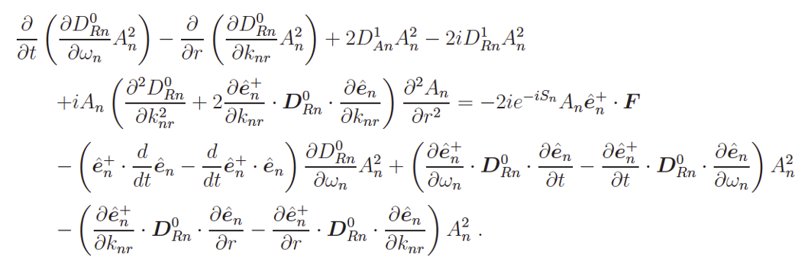

Extending the GFLDR to short wavelength
Nonlinear evolution equation has NLSE-like form
propagation
freq.shift/growth
dispersiveness
nonlinear/forcing
From local dispersion rel.
[FZ etal JPCS 2021]
By formal manipulation of spectral evolution and assumption on NL term it is possible to reduce this equation to a Stochastic Differential Equation (SDE)
➔
Presentation by H. Jhang

Slide 39
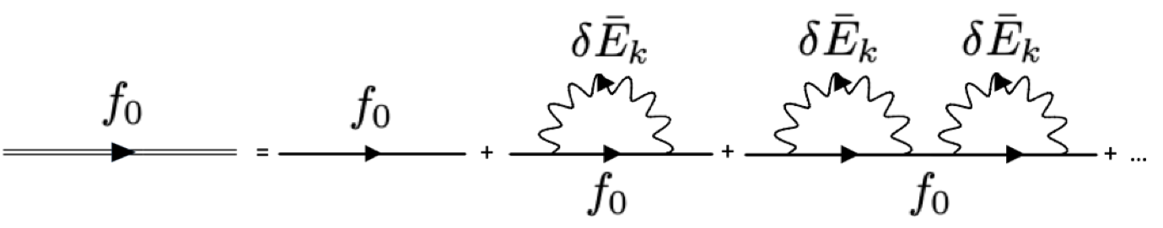
The Dyson-like equation
Evolution of PSZS are dominated by emission and absorption of same k
Slow terms generate “secularities”
Renormalization & Dyson like equation
Van Hove L (1955)
PrigogineI(1962)
BalescuR(1963)
      Principal series of secular terms

Slide 40

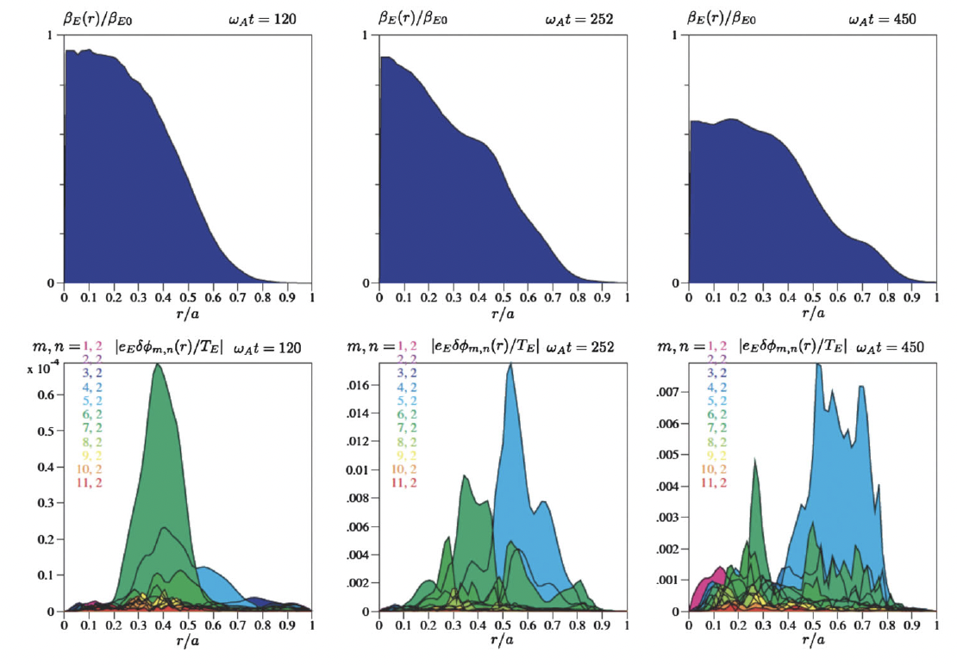








The Dyson Schrödinger Model
Combining the NLSE description of radial envelope and DSE for PSZS one can obtain description of EP avalanches and due to EPM evolution
Z&C equation
[C&Z Rev. Mod. Phys. Review article]
Radial group velocity of wave-packet maximizes wave-particle power transfer for chirping rate
From Vlad et al PPCF 2004

