Slide 1


December 1st, 2025
Recent advances in plasma physics
Fulvio Zonca
Center for Nonlinear Plasma Science and ENEA C.R. Frascati, 00044 Frascati, Italy
IFTS and School of Physics, Zhejiang University, Hangzhou, 310027 P.R. China
      Acknowledgments: S. Briguglio, L. Chen, M.V. Falessi, Ph. Lauber, G. Meng, A. Mishchenko, Z. Qiu, X. Tao, G. Vlad, X. Wang, G. Wei

Slide 2
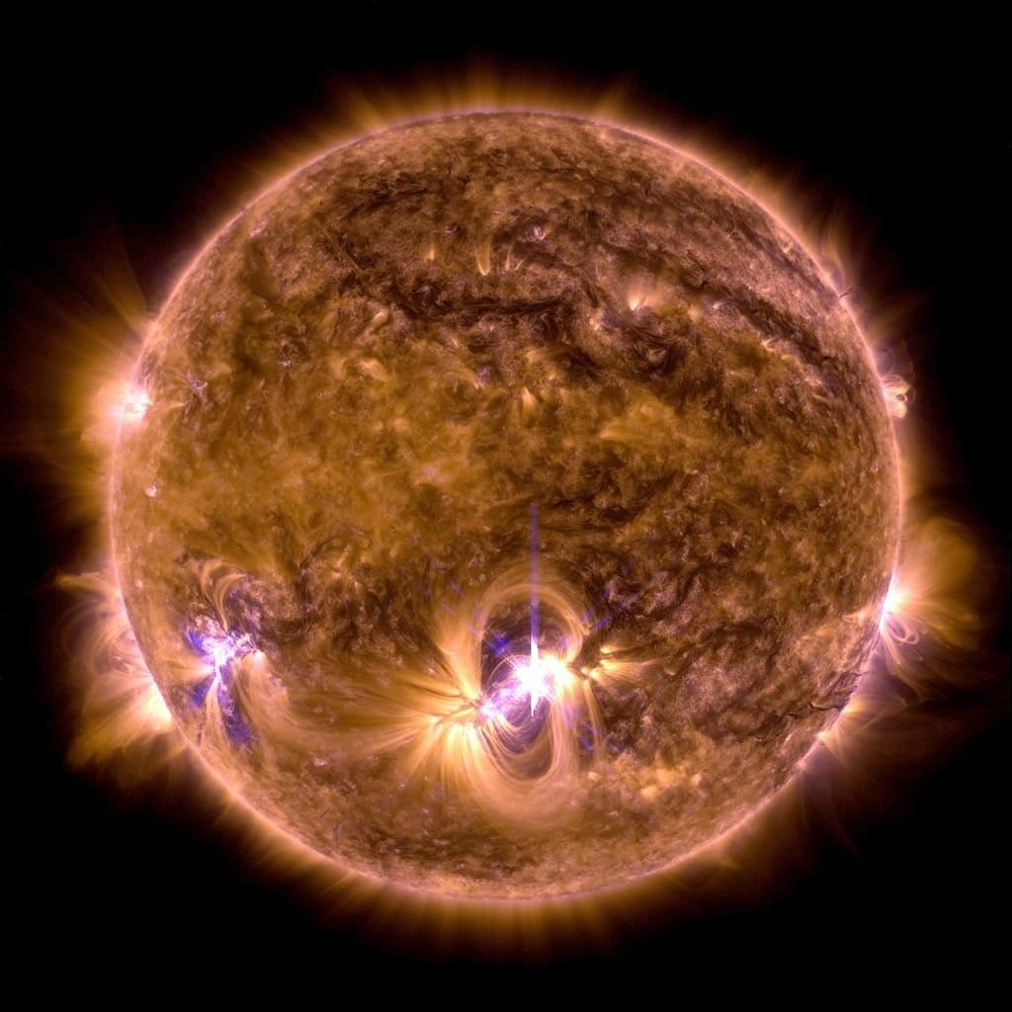
Plasma in nature…
Strong solar flare flashes
on the Sun
NASA's Solar Dynamics Observatory.
NASA/SDO
https://science.nasa.gov/universe/stars/

Slide 3
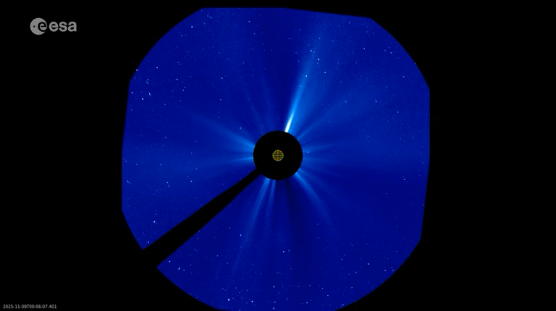
Plasma in nature…
SOHO’s view of the early November 2025 coronal mass ejections
https://www.esa.int/ESA_Multimedia/
Solar and Heliospheric Observatory spacecraft

Slide 4
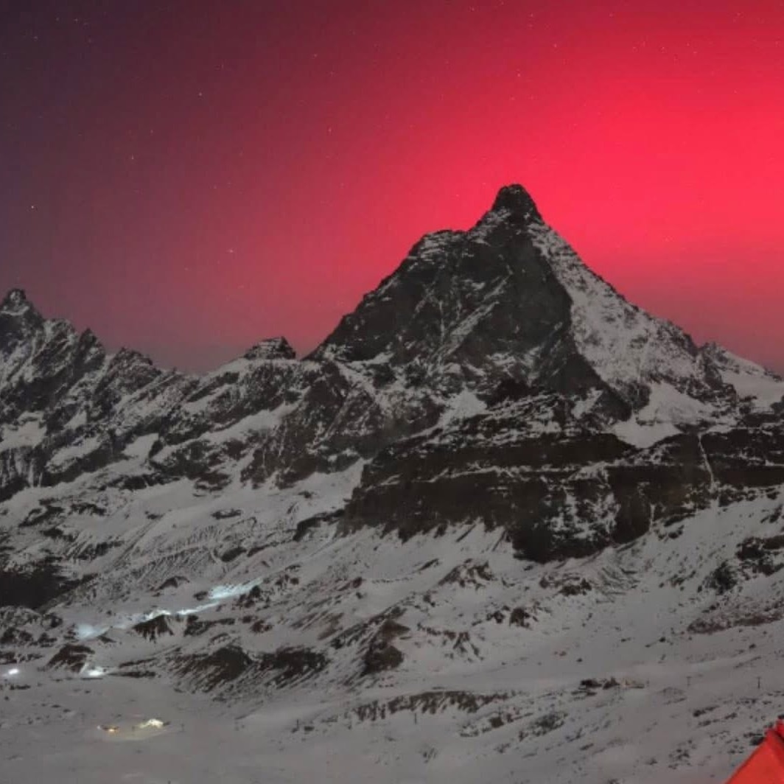

Plasma in nature…
Plateau Rosa in Cervinia
on Nov. 12th, 2025
Credit foto : Meteo Valle d'Aosta

Slide 5
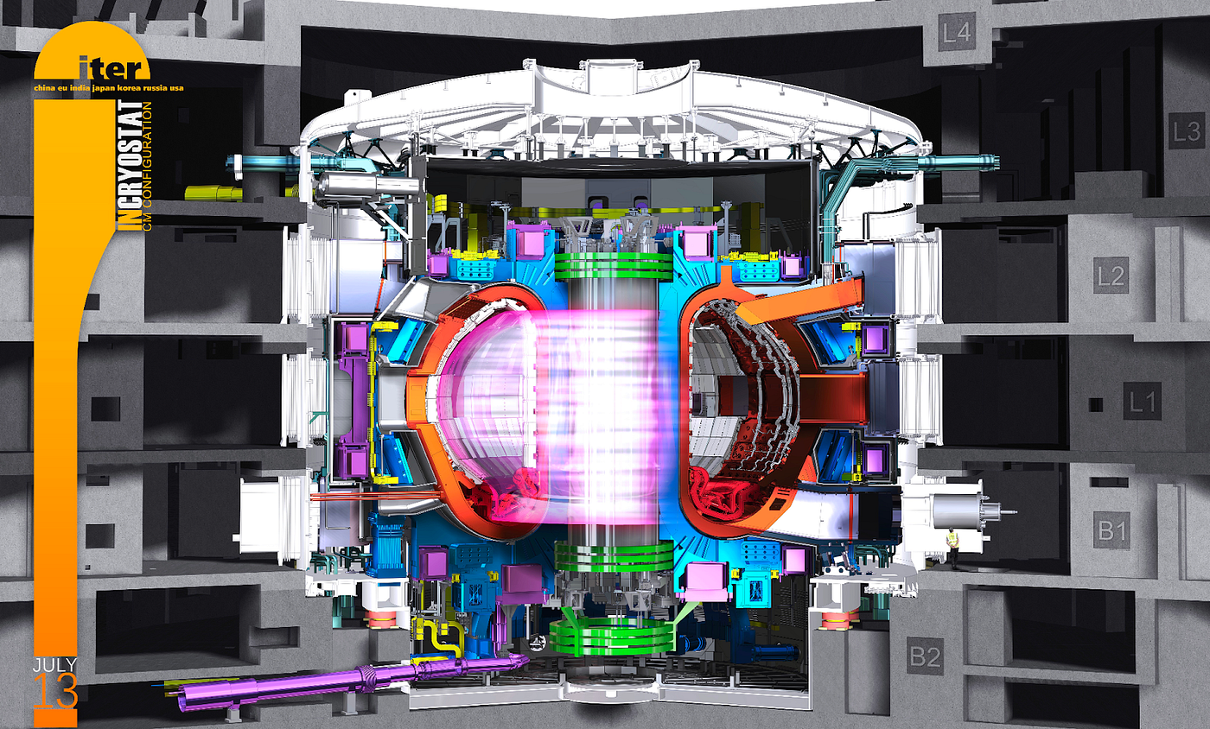
… and il laboratory
International Tokamak Experimental Reactor
https://www.iter.org

Slide 6
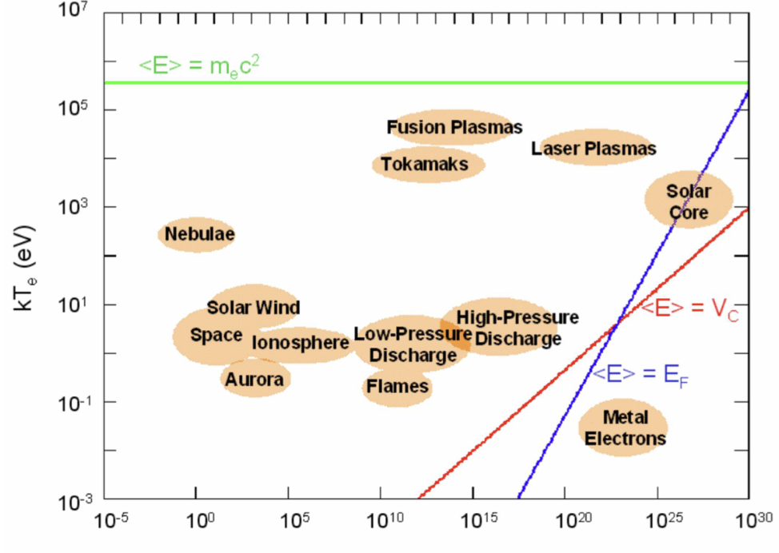

The plasma state
Plasma: a fully or partly ionized gas, which is generally neutral in average and exhibits collective behaviors
… and by the strength of inter-particle interactions relative to kinetic energy
Plasma main properties can be assigned by its particle density n and temperature T …

Slide 7
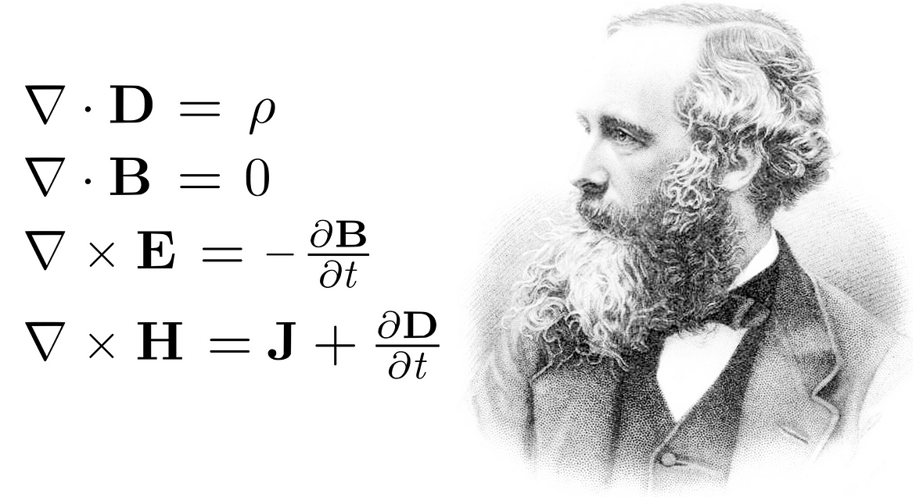
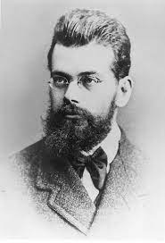

Theoretical framework
Need a comprehensive theoretical framework for the self-consistent description of fluctuation spectrum and corresponding fluctuation induced transport [C&Z Rev. Mod. Phys. Review article]
Boltzmann
Maxwell
Complexity and
Self-organization
Self-consistency

Slide 8
Outline
    Whistler waves in the Earth’s magnetosphere:
            what drives chorus frequency chirping
            particle acceleration and distribution in Earth’s radiation belts
        Burning plasmas as complex self-organized systems:
            nonlinear equilibrium: describing transport on long time scales ~τ_{E}
            workflow for computing equilibrium evolution on long scales
          Discussion and conclusions

Slide 9
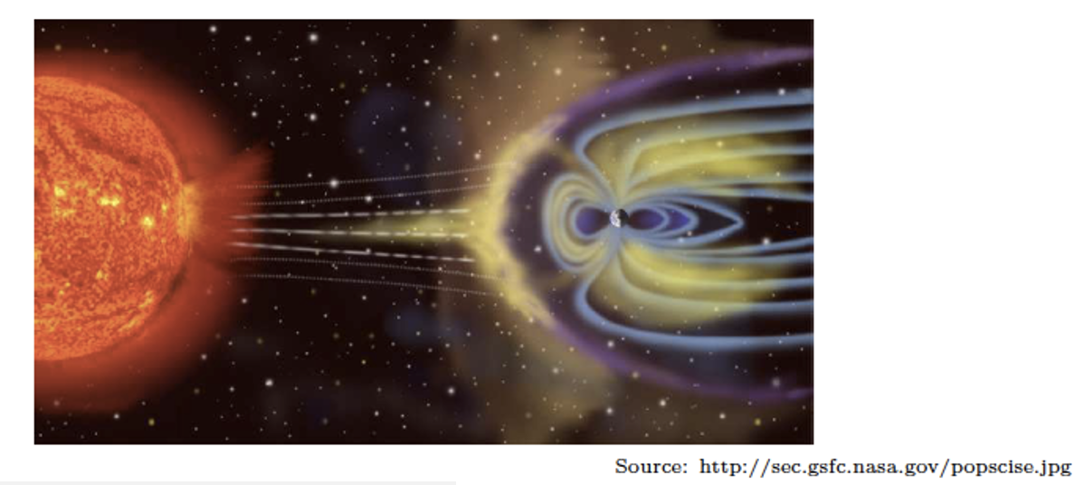
Whistler waves in the Eath’s magnetosphere
    The Earth’s magnetospheric plasma, under certain conditions, can amplify specific types of e.m. waves
    Whistler waves, as e.m. fluctuations propagating at less than the non-relativistic electron cyclotron frequency, can occur in ~0.1s bursts with either rising or falling tones

Slide 10
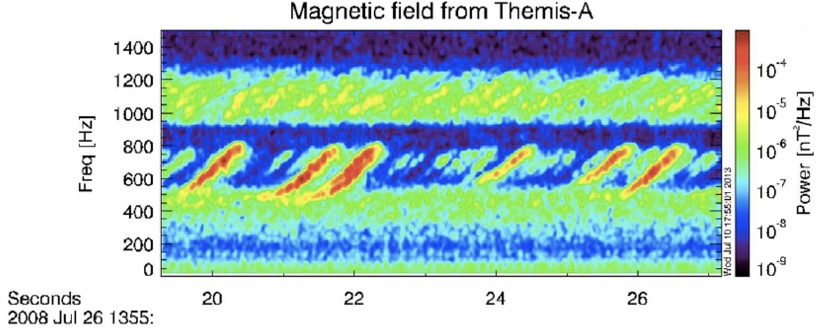
What is chorus?
    These bursts are known as chorus because of their characteristic frequency chirping
Angelopoulos V. 2008.
Space Sci Rev, 141: 5–34

Slide 11
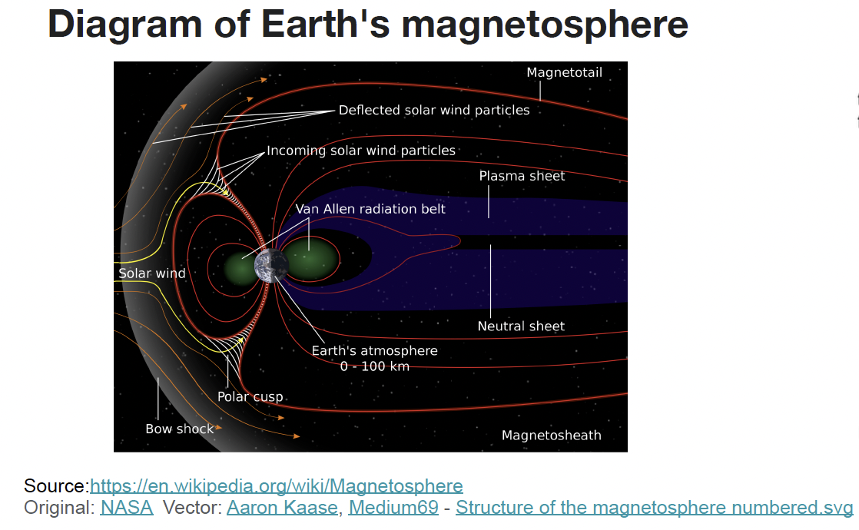
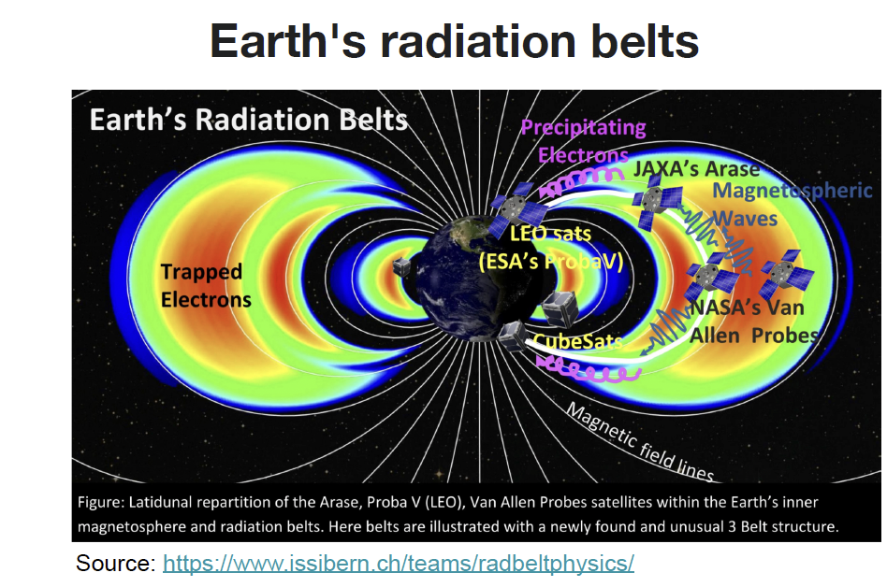
Earth’s radiation belts
Significant MeV electron
population
Formation mechanism?
Whistler mode chorus is responsible for electron acceleration to MeV energy in Earth’s radiation belts
(R. B. Horne, Nature 2005)

Slide 12
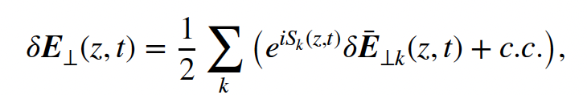
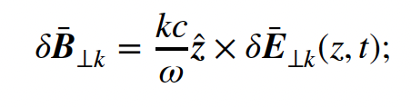
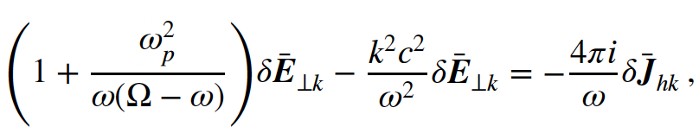

Wave packet evolution
Consider a parallel (to ambient B) propagating wave packet
From Faraday’s law (z being the unit vector along B)
Separate perturbed current density in thermal and “hot” components; and use Ampére’s law
= “hot” electron current

Slide 13

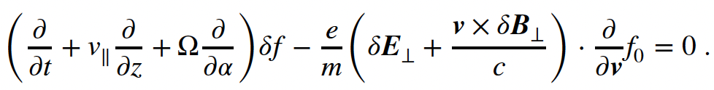


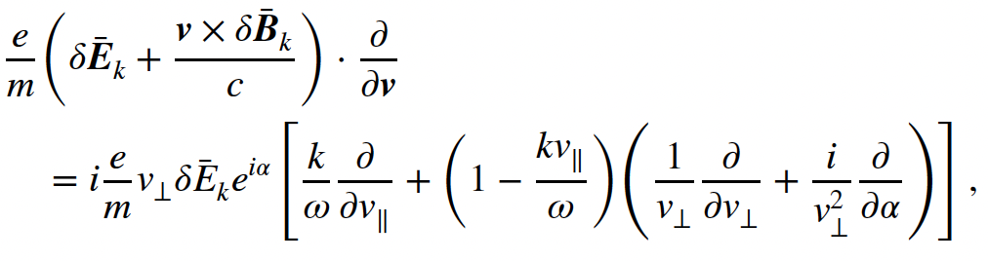

Hot electron response
Calculate hot electron response from linearized Vlasov equation with
Using cylindrical coordinates and
Resonance condition when

Slide 14
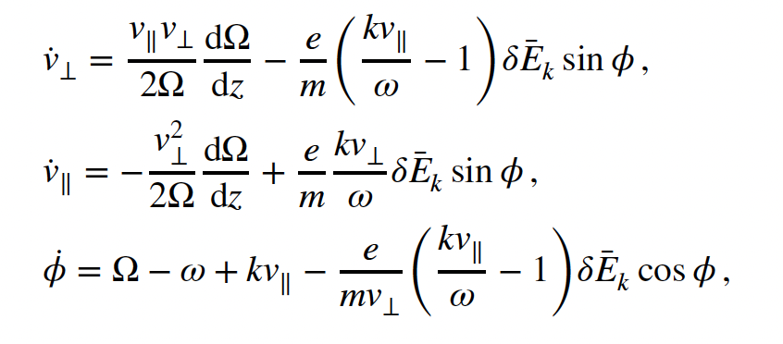

Nonlinear electron response
Single particle equations of motion for electrons interacting with whistler wave packet are the starting point to uncover nonlinear electron response
Effect of fluctuations and B-field nonuniformity
Can be cast as nonlinear pendulum equation with wave particle trapping frequency

Slide 15
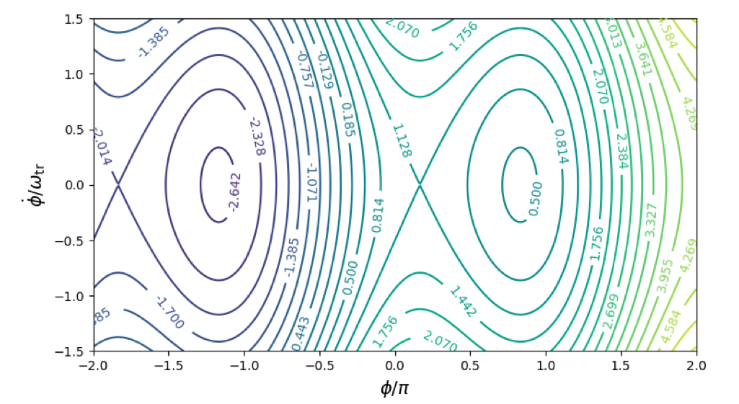




Phase space structures
Continuous emission & absorption

Slide 16

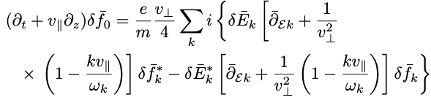


Nonlinear electron response
Renormalization via same-k interactions:
        Secular growth on short time scale

Slide 17
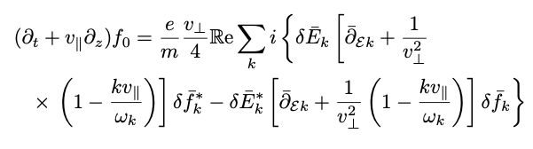
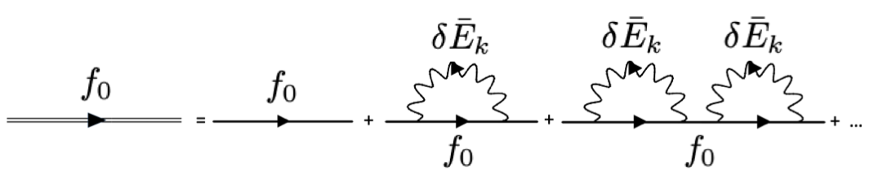
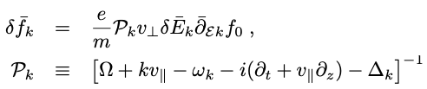
Nonlinear electron response
Renormalization via same-k interactions:
  By iterative solution one obtains the dominant renormalized response ➔ Dyson – like equation (DSE)
[JGR 2022 127:e2021JA029760]
[RMPP 2021 5:8]
resonance broadening

Slide 18
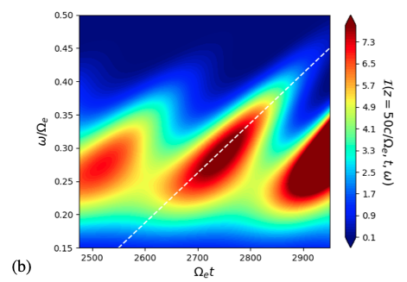
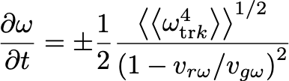
Earth’s chorus chirping
Adopt the general approach to construct the nonlinear growth rate and frequency shift
[Vomvoridis et al 1982]
X. Tao, F. Zonca, L. Chen, A “Trap-Release-Amplify” model of Chorus Waves, JGR: Space Physics, 126, e2021JA029585
F. Zonca, X. Tao, L. Chen, Nonlinear dynamics and phase space transport by chorus emission RMPP 5, 8; A theoretical framework of chorus wave excitation, JGR 127, e2021JA029760

Slide 19
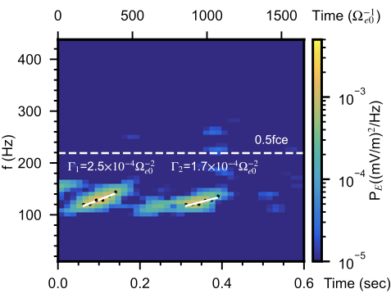
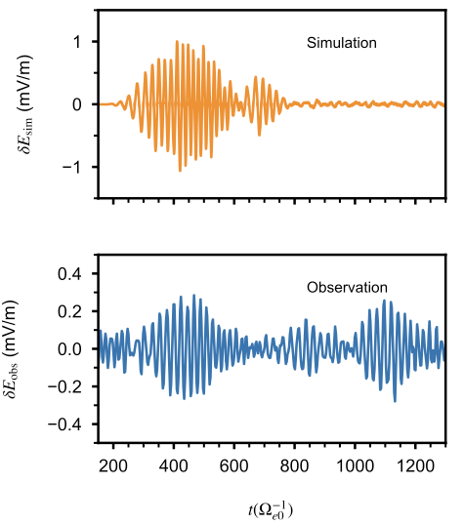
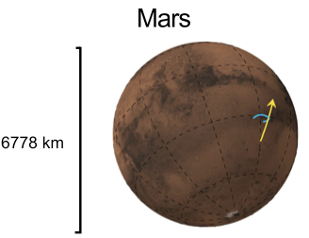
Chorus chirping at Mars
PIC simulations based on the same theoretical framework predict chorus chirping at MARS [Teng et al, Nat. Comm. 2023]
https://doi.org/10.1038/s41467-023-38776-z
Observation from
MAVEN

Slide 20
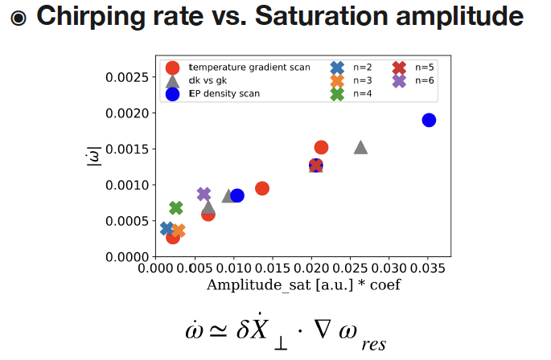
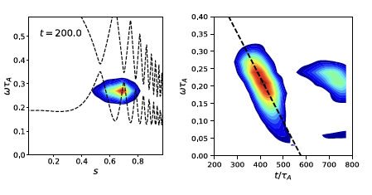
Universal process
PIC simulations in tokamaks show linear scaling of chirping rate with amplitude [X. Wang et al, EPS-DPP invited 2023]
intensity contour plot
⬅ theory prediction

Slide 21
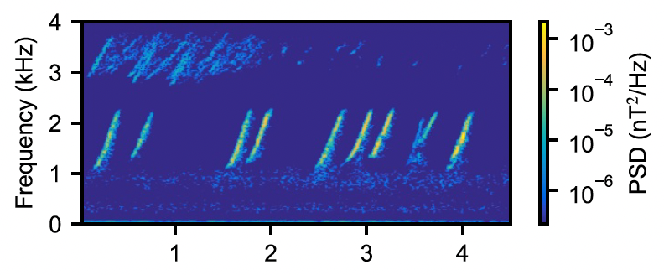
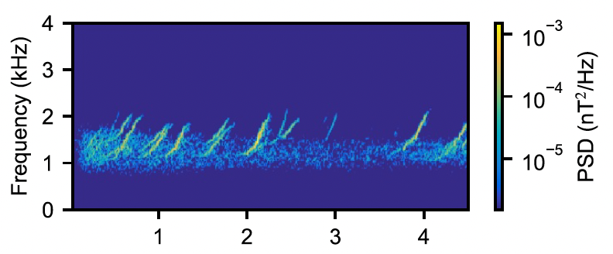

Electron dynamics in the Van Allen belts
[X.Tao et al. AGU Advances 2025]
Earth's radiation belts are regions of space filled with high‐energy electrons that can damage satellites and disrupt space‐based technologies.
Chorus is a major driver of changes in these belts whether these waves cause electrons to
Whether electrons change their motion gradually over time or through sudden, strong nonlinear jumps due to chorus has been debated for years
Van Allen probe [Mauk et al 2013]
PIC simulations
Chorus Power Spectral Densities (PSD)

Slide 22
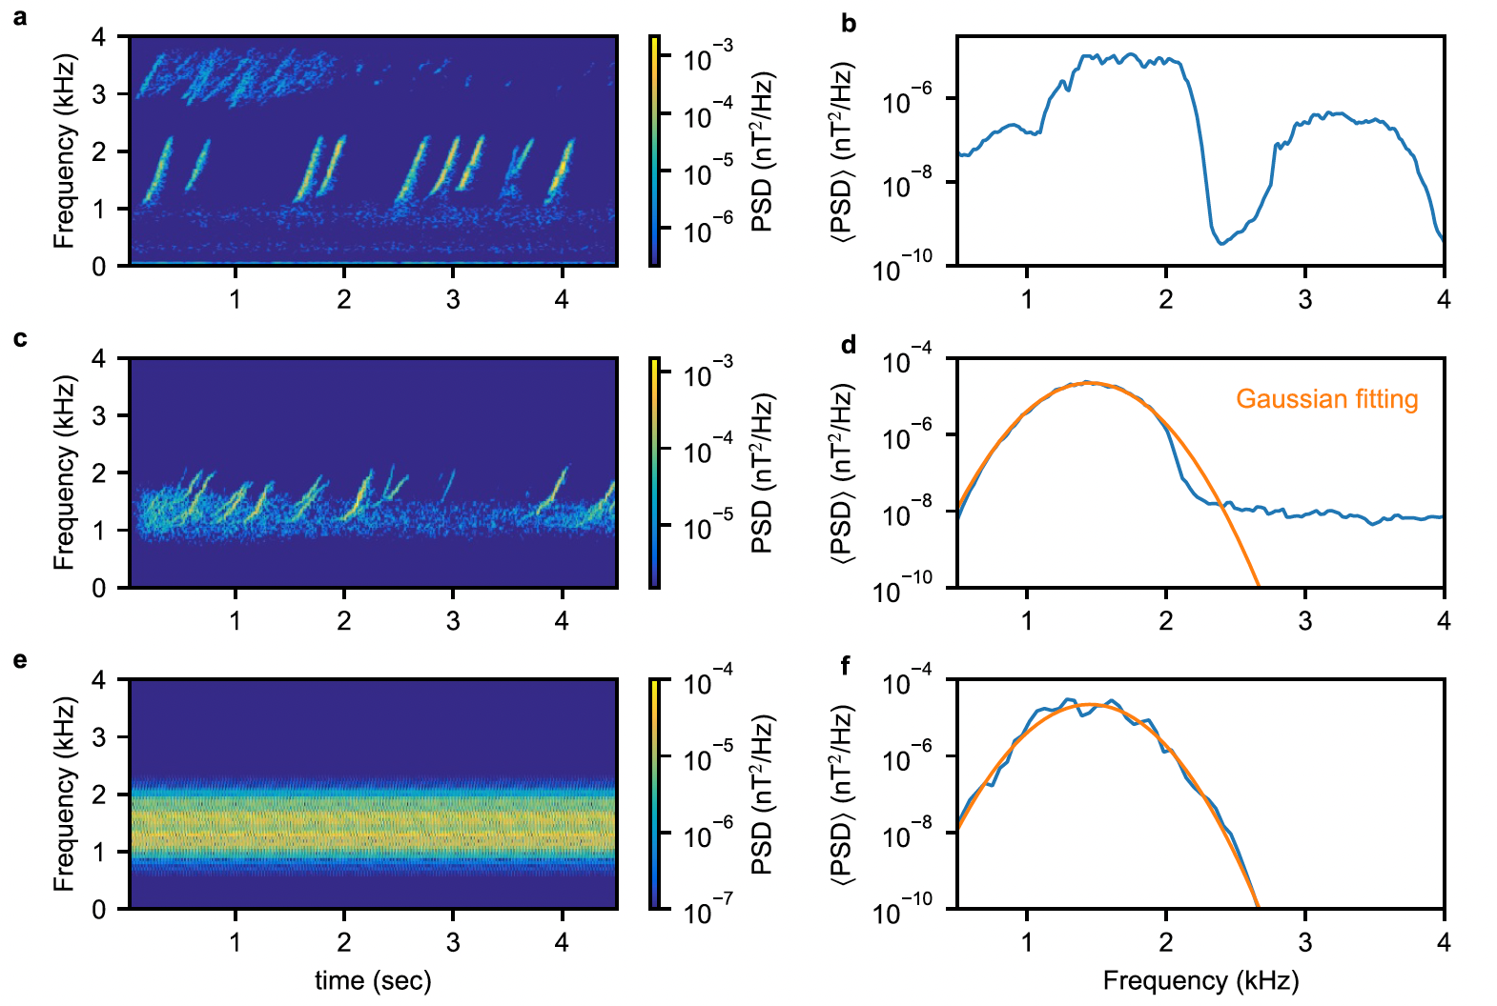
Electron dynamics in the Van Allen belts
[X.Tao et al. AGU Advances 2025]
Van Allen probe [Mauk et al 2013]
PIC simulations

Slide 23
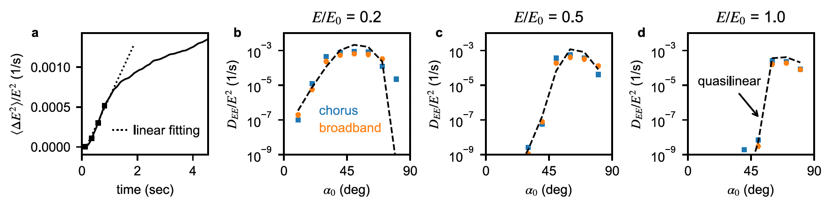
Electron dynamics in the Van Allen belts
[X.Tao et al. AGU Advances 2025]
[E₀ = 511keV; α₀ = equatorial pitch angle]
Realistic simulations show that chorus-driven electron dynamics transition from coherent to diffusive over time
Coherent interactions are important for wave–particle effects with timescales shorter than an electron bounce period
Chorus‐driven electron transport matches that from equivalent broadband waves and quasilinear theory over long timescales

Slide 24
Outline
    Whistler waves in the Earth’s magnetosphere:
            what drives chorus frequency chirping
            particle acceleration and distribution in Earth’s radiation belts
        Burning plasmas as complex self-organized systems:
            nonlinear equilibrium: describing transport on long time scales ~τ_{E}
            workflow for computing equilibrium evolution on long scales
          Discussion and conclusions

Slide 25
The physics of burning plasmas
Burning plasmas as complex self-organized systems:
Many interacting degrees of freedom yield a variety of interesting nonlinear behaviors characterized by a broad range of spatiotemporal scales
Turbulent and fluctuation induced transport dominate power losses (other than radiation)
Outstanding challenge: develop understanding of spatiotemporal cross-scale couplings and predictive capability of burning plasmas such as ITER/DEMO

Slide 26
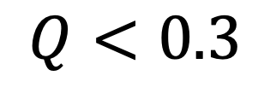
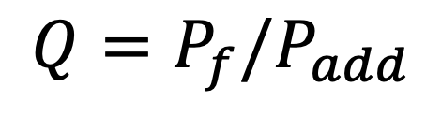
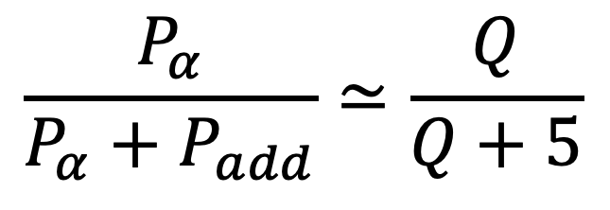
Recent JET results
Joint European Torus
Culham (Oxford), UK
Fusion Reactor Power density fraction
dominated by alpha particles:
achieved
$$Q<0.3$$
$$\frac{P_{α}}{P_{α}+P_{add}}≃\frac{Q}{Q+5}$$
$$Q=P_{f}/P_{add}$$

Slide 27
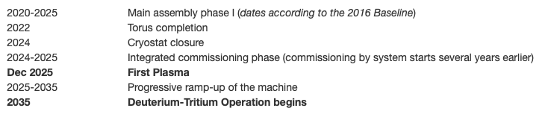
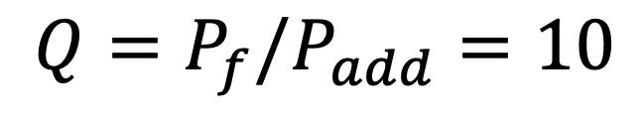
The ITER experiment
International Tokamak Experimental Reactor
$$Q=P_{f}/P_{add}=10$$
Construction in Cadarache
(Aix en Provence), France
China, the European Union, India, Japan,
Korea, Russia and the United States
EXPECTED COST ~ 20B€

Slide 28
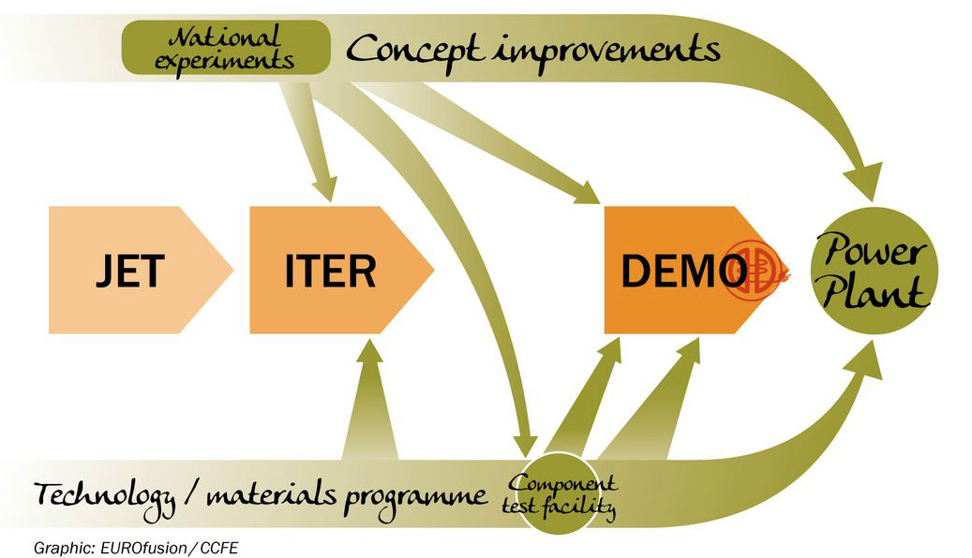
A roadmap to fusion energy…
69 MJ fusion energy
on Oct 3 2023
59 MJ fusion energy
on Dec 21 2021

Slide 29
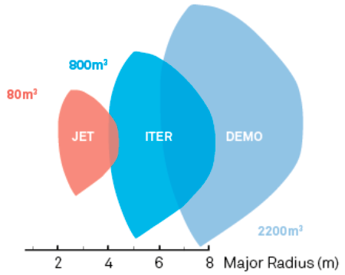
…increasing size/cost
…a challenge for technology
…and for physics

Slide 30
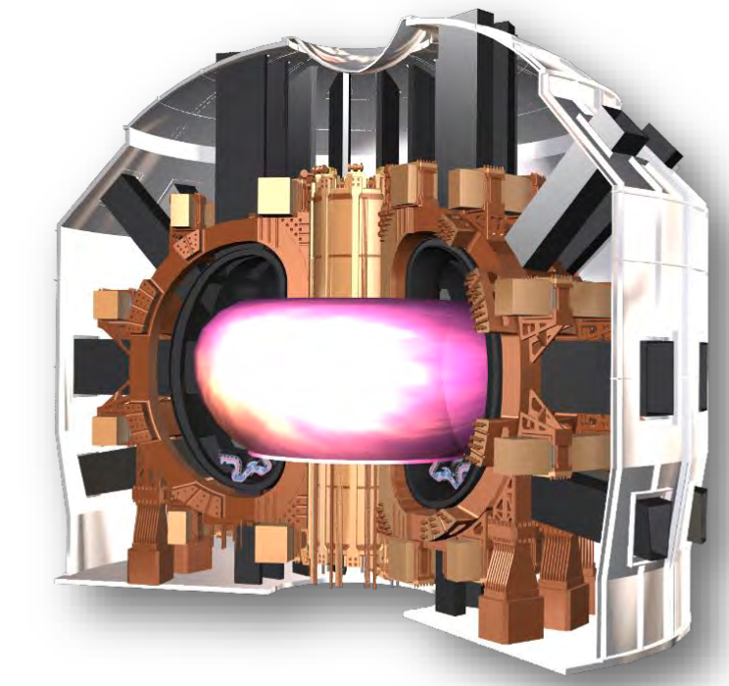
Divertor Tokamak Test facility
Divertor Tokamak Test (DTT) facility
Superconducting tokamak
Construction at ENEA Labs in
Frascati (Rome), Italy
First plasma expected
Fall 2031
Focus on power
particle exhaust
EXPECTED COST ~ 650M€

Slide 31

Divertor Tokamak Test facility
Divertor Tokamak Test (DTT) facility
One of the key issues towards demonstration of
fusion energy is Power & Particle EXhaust (PPEX)
Integration of various physics and technology aspects is crucial
Courtesy of B. Wan
3.rd Trilateral International
Workshop on EP Physics,
Nov 7-10, 2022

Slide 32

The physics of burning plasmas
Burning plasmas as complex self-organized systems:
Multi-spatiotemporal
scale fluctuations
Plasma and fusion
reactivity profiles
Turbulence & fluctuation
driven fluxes
Meso & macro-scale
distortion of equilibrium
NL wave-particle
Deviation from local
thermodynamic equilibrium
NL wave-wave

Slide 33
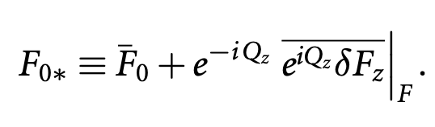
Phase space transport
Proper nonlinear equilibrium
      Long lived (undamped by collision) zonal e.m. fields and corresponding phase space zonal structures: Zonal State
      Must self-consistently compute Zonal State in the presence of finite level of fluctuations
    Separate macro-meso spatiotemporal scales from micro-scales
    Renormalized equilibrium accounting for self-interaction
meso-macro
micro

Slide 34
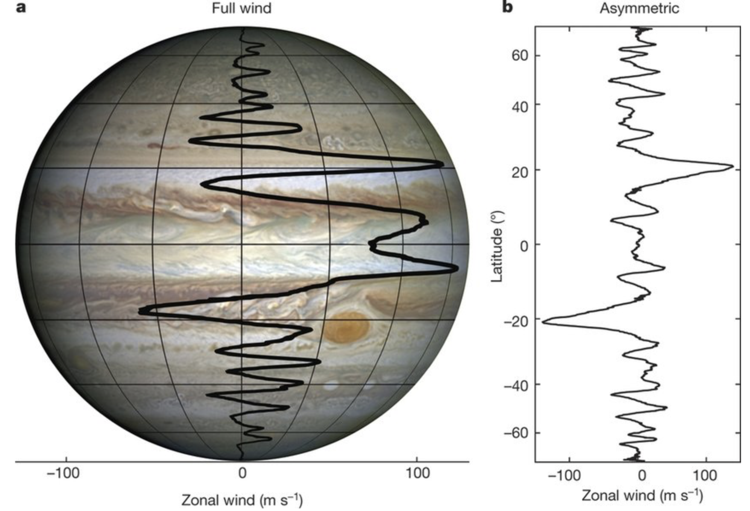
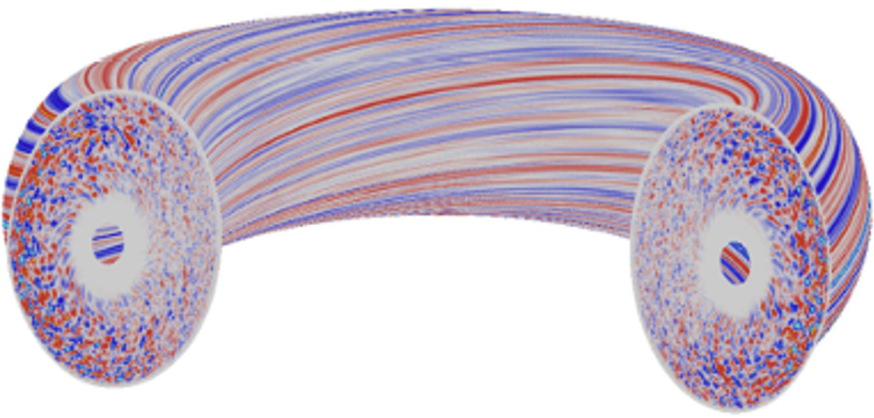
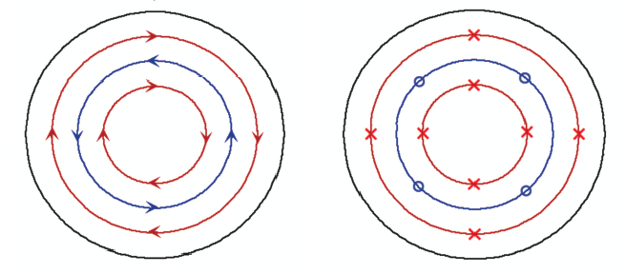
Zonal Structures
[Y. Xiao et al 2015 POP 22, 022516]
[Y. Kaspi et al 2018 Nature 555(7695):223-226]
Zonal e.m. Fields in a tokamak
➔
➔ Impact on phase space structures

Slide 35
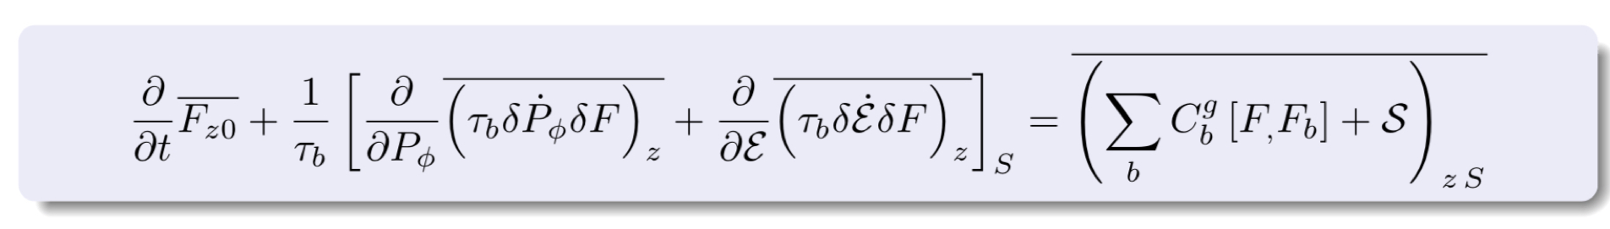
Phase space transport
    Phase space zonal structure evolution equation (nearly integrable system) [Falessi et al NJP 2023]
    Intrinsically full-F [Falessi et al NJP 2023] but reduced to the 3D action space (contants of motion)
    Ready for implementation in non-linear GK codes, including thermal component if whole transport description is lifted to the phase space [S.J. Wang et al. PRL 2024]

Slide 36
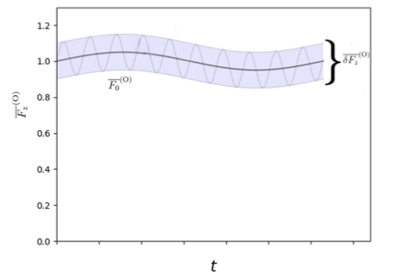
Phase space zonal structures
    Long time scale evolution due to transport is captured by
    equilibrium distortions preserving equilibrium symmetry
          Neighboring nonlinear equilibria [C&Z, NF 2007]

Slide 37
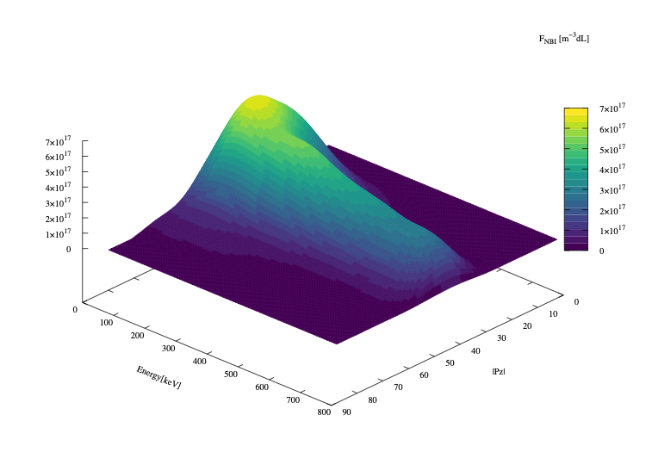
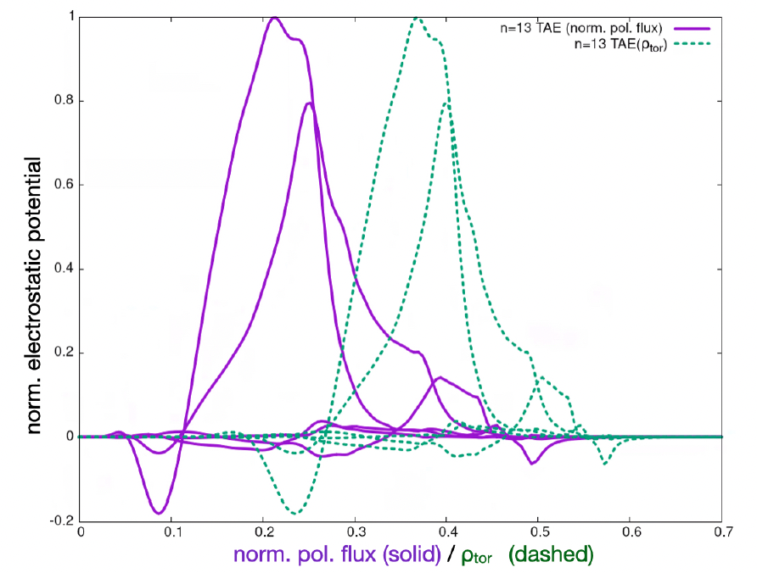
PSZS in LIGKA/HAGIS
[P. Lauber et al., NF 64, 096010 (2024)]
Toroidal Alfvén Eigenmodes in ITER
[Courtesy of Ph. Lauber; 2022]
[EFTC 2023 invited]
ITER 15MA case;
TAE n=13
f=75.5kHz
ITER plasma from H&CD WF by M. Schneider
Computed by LIGKA
Using EP Workflow

Slide 38
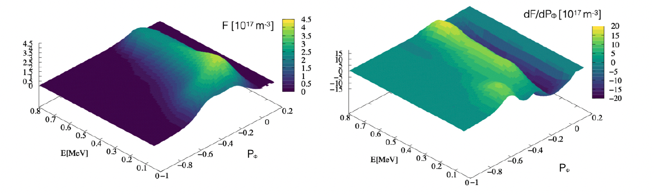
Distribution function representation
[P. Lauber et al., NF 64, 096010 (2024)]
original marker data as calculated by the NEMO/SPOT package
[Courtesy of Ph. Lauber]
Binning, smoothing and splining allow to construct regular derivatives in phase space

Slide 39

ATEP 3D code
Initial value problem solved with orbit averaged collision operator
[Courtesy G. Meng]
[Invited EPS 2024]
Source model: Gaussian function for NBI for comparison with SPOT

Slide 40

ATEP 3D code
Steady state solution obtained with sources
and collisions
[Courtesy G. Meng]
[Invited EPS 2024]
[G. Meng et al., NF 64, 096009 (2024)]
Source model: Gaussian function for NBI
Comparison with SPOT, reasonable agreement
slowed-down in 1 second: transport time scale!
ATEP-3D, 30 mins/case
Monte-Carlo code, several days/case

Slide 41

Off-axis beam relaxation in ITER
[P. Lauber et al., NF 64, 096010 (2024)]
ITER 15MA case;
TAE n=13
[Courtesy of Ph. Lauber]
Radial projection (ϱtor) of the distribution function of energetic
hydrogen particles, #100015/1, initial (as given by NEMO/SPOT) and final state after evolving the PSZS transport equation for 700ms (1000 time steps) with constant-amplitude TAE with δB/B = 10⁻⁵

Slide 42
Discussion and Conclusions
Weakly coupled plasmas exhibit complex, self-organizing collective behaviors across vast scales, providing a unifying framework for understanding phenomena in both planetary magnetospheres and fusion reactors.
New insights into whistler wave chorus dynamics illuminate mechanisms of frequency chirping and energetic electron phase space transport within Earth's radiation belts.
Advanced kinetic and phase-space models enable computationally validated predictive capabilities for reactor-relevant fusion plasmas, describing their long-time scale behavior as self-consistent nonlinear equilibria.
Plasma physics stands as a profoundly intellectually stimulating and practically important field, revealing fundamental principles of complex collective phenomena and self-organization that span diverse areas of physics, from understanding the cosmos to enabling clean energy solutions.

Slide 43

Backup slides

Slide 44

Inertial confinement fusion

Slide 45

Inertial confinement fusion

Slide 46

Inertial confinement fusion

Slide 47

Inertial confinement fusion
Recent NIF fusion gain records:
April 7, 2025: A new record gain of Q=4.13 was achieved, with a yield of 8.6 MJ from 2.08 MJ of laser energy.
February 23, 2025: A target gain of Q=2.44 was set with a 2.05 MJ shot producing 5.0 MJ.
December 5, 2022: This was the first time an experiment achieved a target gain greater than one, Q=1.54, producing 3.15 MJ from 2.05 MJ of laser energy.

