Slide 1


October 22nd, 2025
The Dyson-Schrödinger model: a paradigm for
predicting fusion reactor performance
Fulvio Zonca1,2, Liu Chen2,3,1, Matteo V. Falessi1, and Zhiyong Qiu4,1
1Center for Nonlinear Plasma Science and ENEA C.R. Frascati, 00044 Frascati, Italy
2IFTS and School of Physics, Zhejiang University, Hangzhou, 310027 P.R. China
3Dept. Physics and Astronomy, University of California Irvine, Irvine, CA, USA
4Key Laboratory of Frontier Physics in Contr. Nucl. Fusion and IPP, CAS, Hefei, PR China
      Acknowledgments: S. Briguglio, Ph. Lauber, A. Mishchenko, X. Tao, G. Vlad, X. Wang
      Support from: EUROfusion projects ATEP and TSVV#10
      National Science Foundation of China Project No. 12261131622
      Italian Ministry of Foreign Affairs and International Cooperation
      grant number CN23GR02

Slide 2
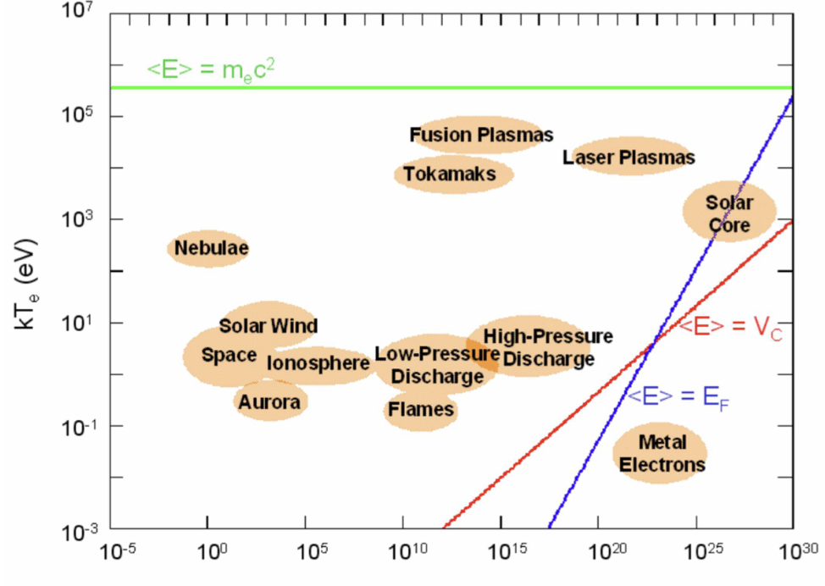

The plasma state
Plasma: a fully or partly ionized gas, which is generally neutral in average and exhibits collective behaviors
Plasma main properties can be assigned by its particle density n and temperature T

Slide 3
The physics of burning plasmas - I
Burning plasmas as complex self-organized systems:
Many interacting degrees of freedom yield a variety of interesting nonlinear behaviors characterized by a broad range of spatiotemporal scales
Turbulent and fluctuation induced transport dominate power losses (other than radiation)

Slide 4
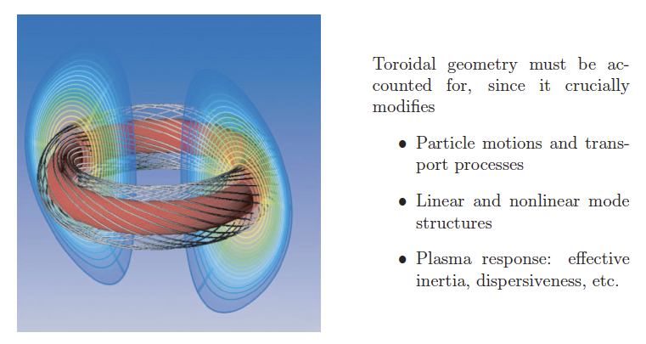
The importance of toroidal geometry

Slide 5
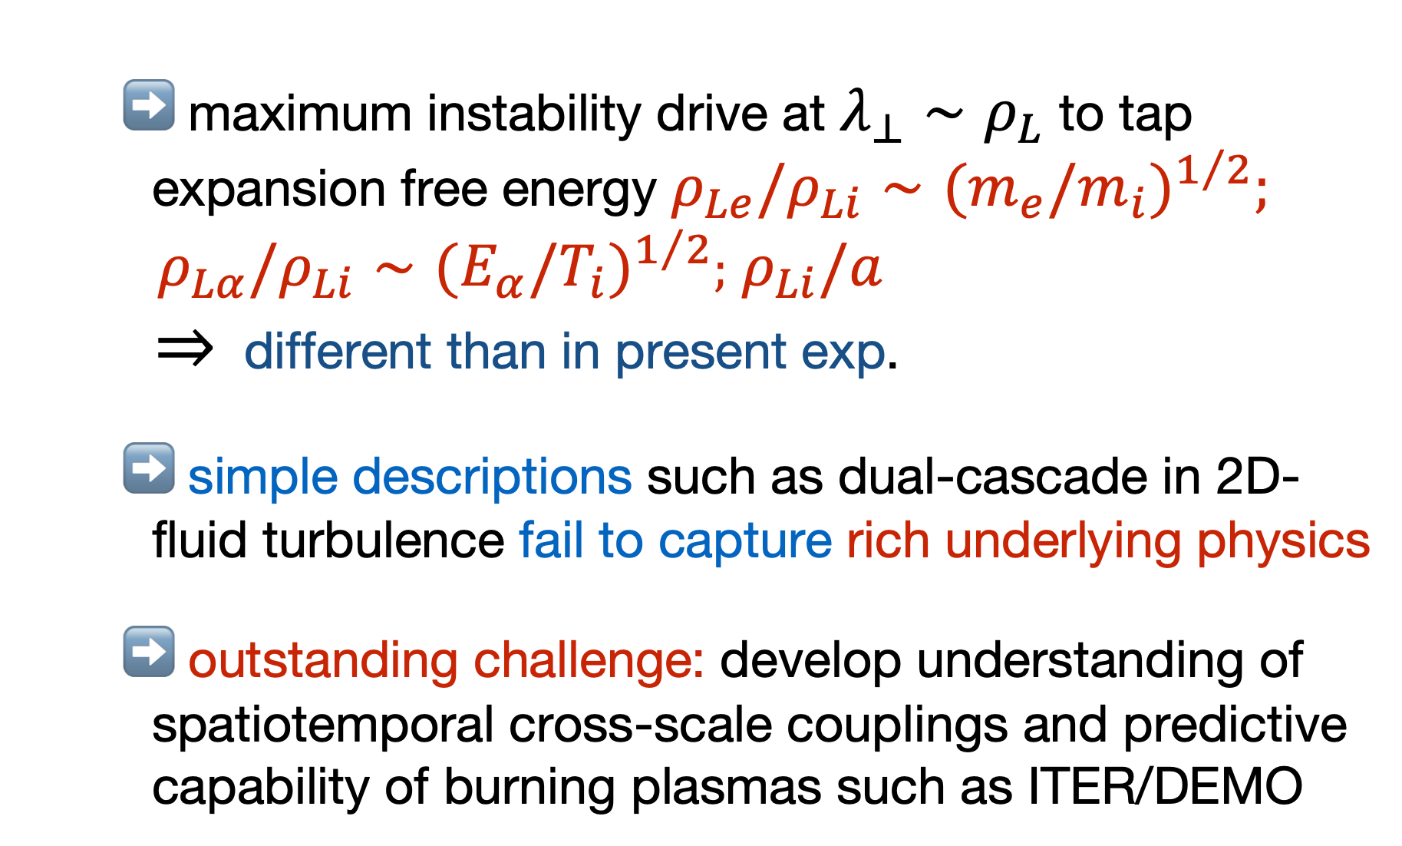
The physics of burning plasmas - II
Turbulent and fluctuation induced transport dominate power losses (other than radiation):
        maximum instability drive at $λ_{⊥}∼ρ_{L}$ to tap expansion free energy $ρ_{Le}/ρ_{Li}∼(m_{e}/m_{i})^{1/2};$
        $ρ_{Lα}/ρ_{Li}∼(E_{α}/T_{i})^{1/2};$ $ρ_{Li}/a$
        $⇒$ different than in present exp.
        simple descriptions such as dual-cascade in 2D-fluid turbulence fail to capture rich underlying physics
        outstanding challenge: develop understanding of spatiotemporal cross-scale couplings and predictive capability of burning plasmas such as ITER/DEMO

Slide 6
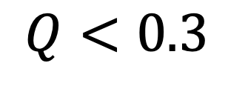
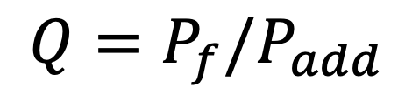
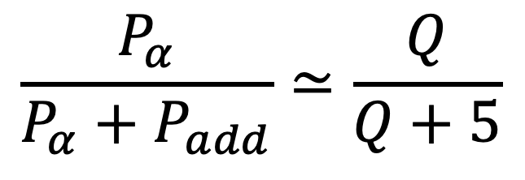
Recent JET results
Joint European Torus
Culham (Oxford), UK
Fusion Reactor Power density fraction
dominated by alpha particles:
achieved
$$Q<0.3$$
$$\frac{P_{α}}{P_{α}+P_{add}}≃\frac{Q}{Q+5}$$
$$Q=P_{f}/P_{add}$$

Slide 7
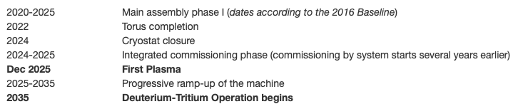
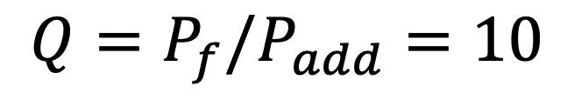
The ITER experiment
International Tokamak Experimental Reactor
$$Q=P_{f}/P_{add}=10$$
Construction in Cadarache
(Aix en Provence), France
China, the European Union, India, Japan,
Korea, Russia and the United States
EXPECTED COST ~ 20B€

Slide 8
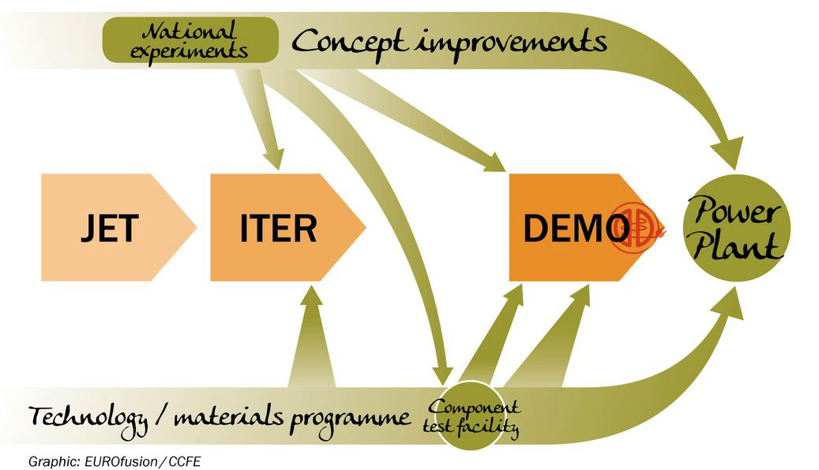
A roadmap to fusion energy…
69 MJ fusion energy
on Oct 3 2023
59 MJ fusion energy
on Dec 21 2021

Slide 9
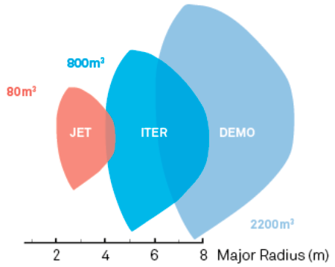
…increasing size/cost
…a challenge for technology
…and for physics

Slide 10
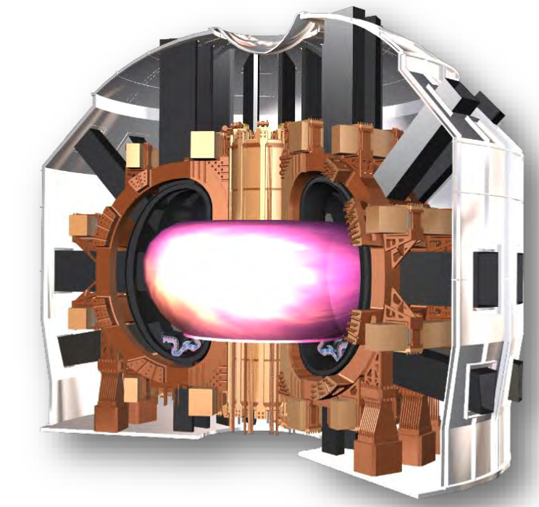
Divertor Tokamak Test facility
Divertor Tokamak Test (DTT) facility
Superconducting tokamak
Construction at ENEA Labs in
Frascati (Rome), Italy
First plasma expected
Fall 2031
EXPECTED COST ~ 650M€

Slide 11


The physics of burning plasmas - III
Burning plasmas as complex self-organized systems:
Multi-spatiotemporal
scale fluctuations
Plasma and fusion
reactivity profiles
Turbulence & fluctuation
driven fluxes
Meso & macro-scale
distortion of equilibrium
Deviation from local
thermodynamic equilibrium

Slide 12
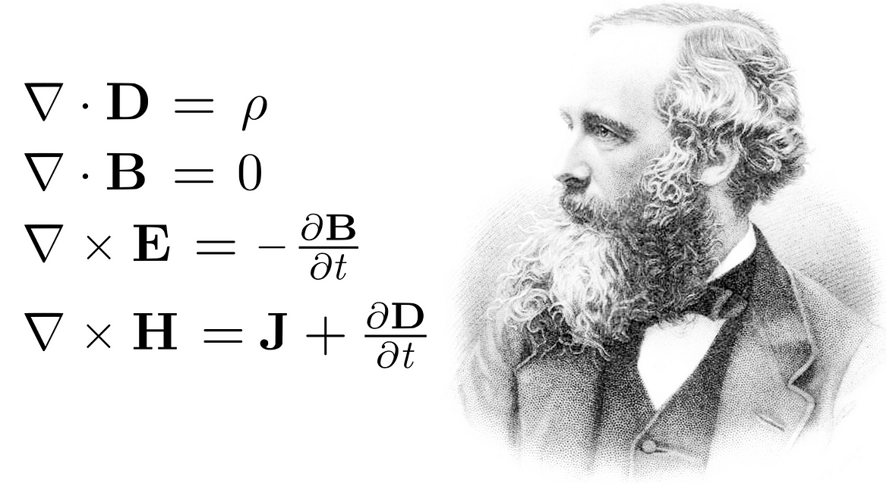
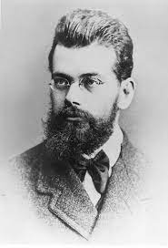

Theoretical framework
Need a comprehensive theoretical framework for the self-consistent description of fluctuation spectrum and corresponding fluctuation induced transport [C&Z Rev. Mod. Phys. Review article]
Boltzmann
Maxwell
Self-consistency

Slide 13
Outline
    Burning plasmas as complex self-organized systems
        Phase space transport and structure formation:
            nonlinear equilibrium: phase space zonal structures
                and zonal e.m. fields
            EP workflow for computing equilibrium evolution on
                long time scales ~τ_{E}
        Hierarchy of reduced models (within unified theoretical
        framework):
            full NL gyrokinetic description
            the Dyson-Schördinger Model
            Quasilinear limit and other reduced local models
          Discussion and conclusions

Slide 14
Outline
    Burning plasmas as complex self-organized systems
        Phase space transport and structure formation:
            nonlinear equilibrium: phase space zonal structures
                and zonal e.m. fields
            EP workflow for computing equilibrium evolution on
                long time scales ~τ_{E}
        Hierarchy of reduced models (within unified theoretical
        framework):
            full NL gyrokinetic description
            the Dyson-Schördinger Model
            Quasilinear limit and other reduced local models
          Discussion and conclusions

Slide 15
The physics of burning plasmas - IV
Burning plasmas as complex self-organized systems:
Multi-spatiotemporal
scale fluctuations
Plasma and fusion
reactivity profiles
Turbulence & fluctuation
driven fluxes
Meso & macro-scale
distortion of equilibrium
NL wave-particle
Deviation from local
thermodynamic equilibrium
NL wave-wave

Slide 16
Outline
    Burning plasmas as complex self-organized systems
        Phase space transport and structure formation:
            nonlinear equilibrium: phase space zonal structures
                and zonal e.m. fields
            EP workflow for computing equilibrium evolution on
                long time scales ~τ_{E}
        Hierarchy of reduced models (within unified theoretical
        framework):
            full NL gyrokinetic description
            the Dyson-Schördinger Model
            Quasilinear limit and other reduced local models
          Discussion and conclusions

Slide 17
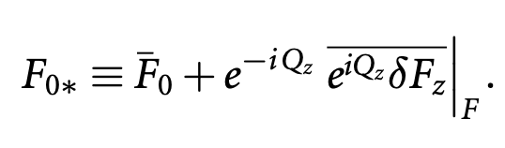
Phase space transport - I
Proper nonlinear equilibrium
      Long lived (undamped by collision) zonal e.m. fields and corresponding phase space zonal structures: Zonal State
      Must self-consistently compute Zonal State in the presence of finite level of fluctuations
    Separate macro-meso spatiotemporal scales from micro-scales
    Renormalized equilibrium accounting for self-interaction
meso-macro
micro

Slide 18
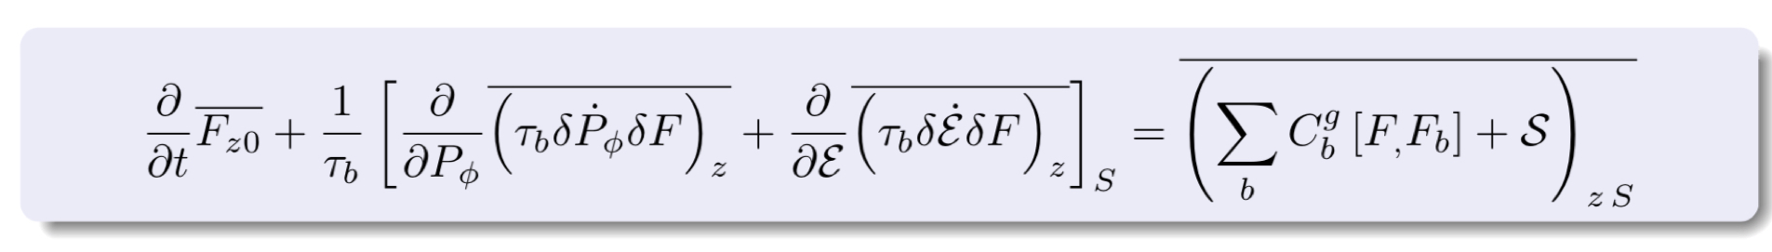
Phase space transport - II
    Phase space zonal structure evolution equation (nearly integrable system) [Falessi et al NJP 2023]
    Intrinsically full-F [Falessi et al NJP 2023] but reduced to the 3D action space (contants of motion)
    Ready for implementation in non-linear GK codes, including thermal component if whole transport description is lifted to the phase space [S.J. Wang et al. PRL 2024, ITB by ITG]

Slide 19
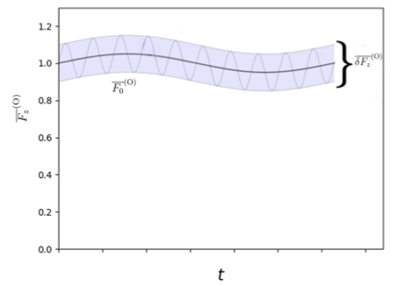
Phase space zonal structures
    Long time scale evolution due to transport is captured by
    equilibrium distortions preserving equilibrium symmetry
          Neighboring nonlinear equilibria [C&Z, NF 2007]

Slide 20
Outline
    Burning plasmas as complex self-organized systems
        Phase space transport and structure formation:
            nonlinear equilibrium: phase space zonal structures
                and zonal e.m. fields
            EP workflow for computing equilibrium evolution on
                long time scales ~τ_{E}
        Hierarchy of reduced models (within unified theoretical
        framework):
            full NL gyrokinetic description
            the Dyson-Schördinger Model
            Quasilinear limit and other reduced local models
          Discussion and conclusions

Slide 21
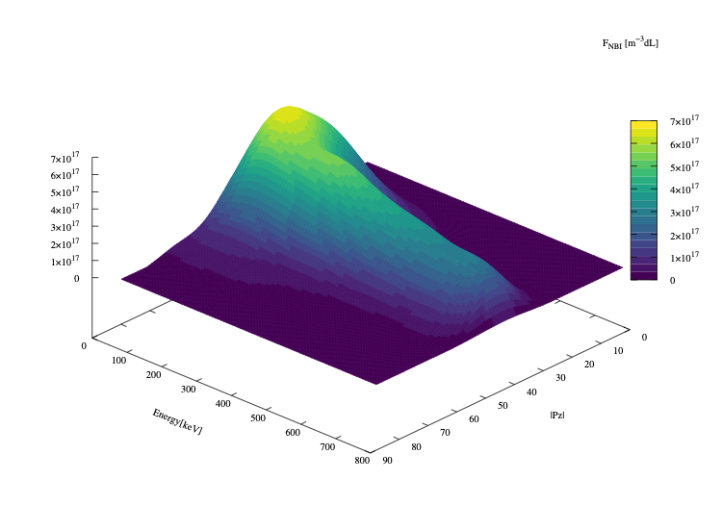
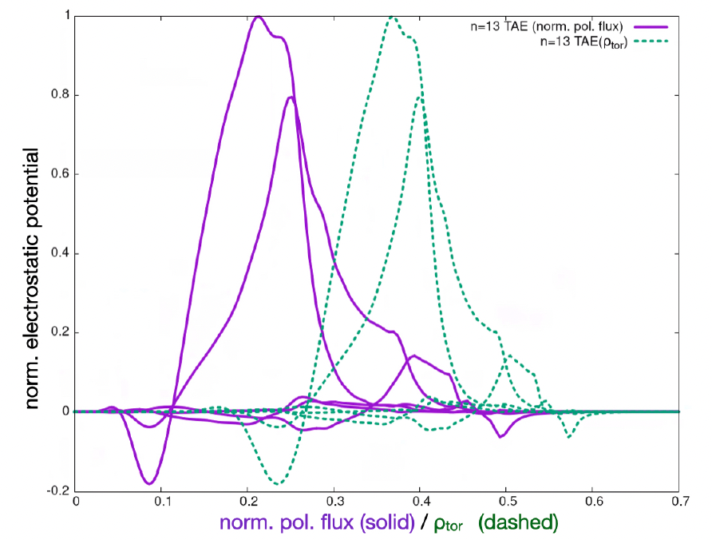
PSZS in LIGKA/HAGIS
[P. Lauber et al., NF 64, 096010 (2024)]
ITER 15MA case;
TAE n=13
[Courtesy of Ph. Lauber; 2022]
[EFTC 2023 invited]
f=75.5kHz
ITER plasma from H&CD WF by M. Schneider
Computed by LIGKA
Using EP Workflow

Slide 22
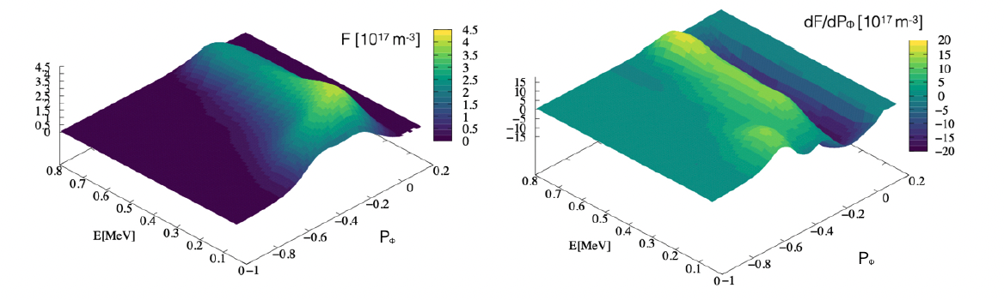
Distribution function representation
[P. Lauber et al., NF 64, 096010 (2024)]
original marker data as calculated by the NEMO/SPOT package
[Courtesy of Ph. Lauber]
Binning, smoothing and splining allow to construct regular derivatives in phase space

Slide 23
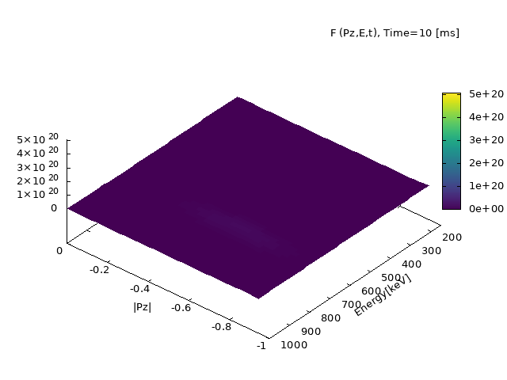
ATEP 3D code - I
Initial value problem solved with orbit averaged collision operator
[Courtesy G. Meng]
[Invited EPS 2024]
Source model: Gaussian function for NBI for comparison with SPOT

Slide 24
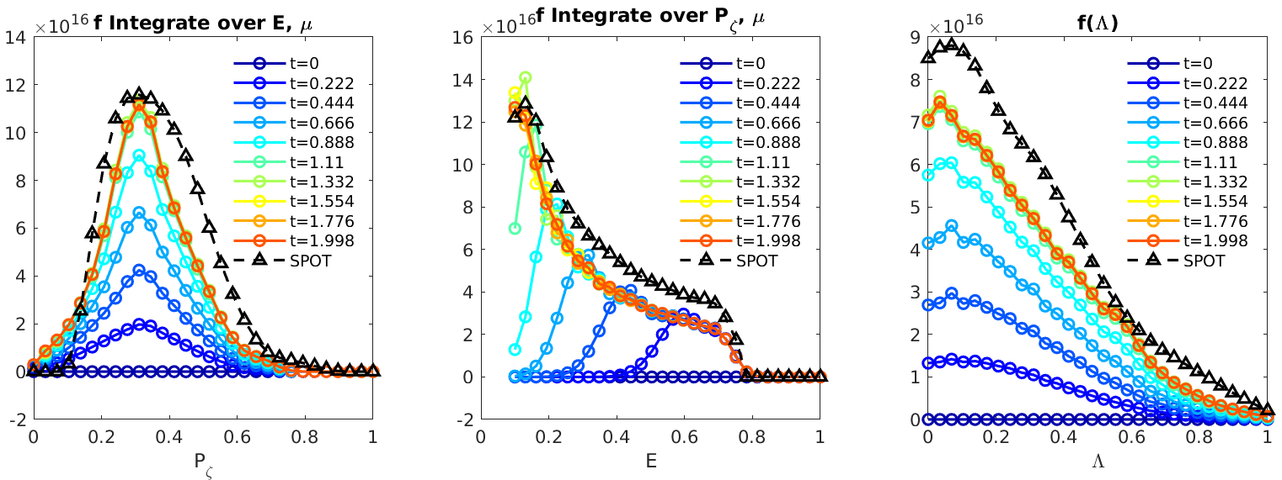
ATEP 3D code - II
Steady state solution obtained with sources
and collisions
[Courtesy G. Meng]
[Invited EPS 2024]
[G. Meng et al., NF 64, 096009 (2024)]
Source model: Gaussian function for NBI
Comparison with SPOT, reasonable agreement
slowed-down in 1 second: transport time scale!
ATEP-3D, 30 mins/case
Monte-Carlo code, several days/case

Slide 25
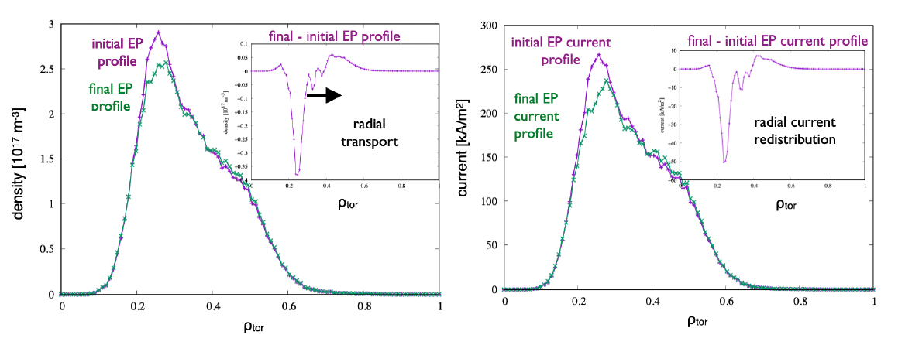
Off-axis beam relaxation in ITER
[P. Lauber et al., NF 64, 096010 (2024)]
ITER 15MA case;
TAE n=13
[Courtesy of Ph. Lauber]
Radial projection (ϱtor) of the distribution function of energetic
hydrogen particles, #100015/1, initial (as given by NEMO/SPOT) and final state after evolving the PSZS transport equation for 700ms (1000 time steps) with constant-amplitude TAE with δB/B = 10⁻⁵

Slide 26
Outline
    Burning plasmas as complex self-organized systems
        Phase space transport and structure formation:
            nonlinear equilibrium: phase space zonal structures
                and zonal e.m. fields
            EP workflow for computing equilibrium evolution on
                long time scales ~τ_{E}
        Hierarchy of reduced models (within unified theoretical
        framework):
            full NL gyrokinetic description
            the Dyson-Schördinger Model
            Quasilinear limit and other reduced local models
          Discussion and conclusions

Slide 27
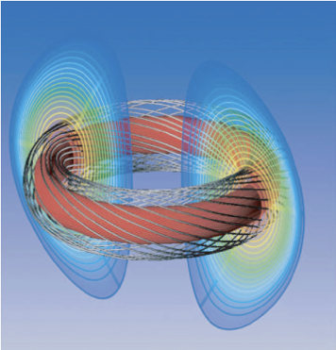
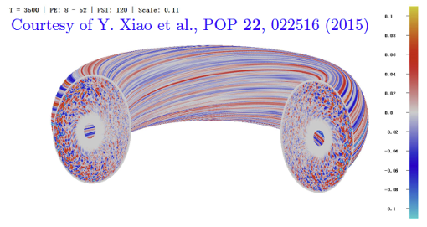
Structure formation in magnetized plasmas
Structures are dominated by
B field aligned filaments

Slide 28

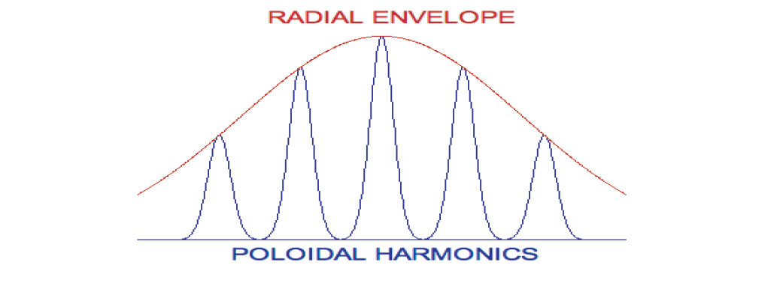
Dynamics of filament bundles
Determine internal
filament structure and
twisting
Determine
radial envelope
➔ fluctuation intensity
radial direction

Slide 29
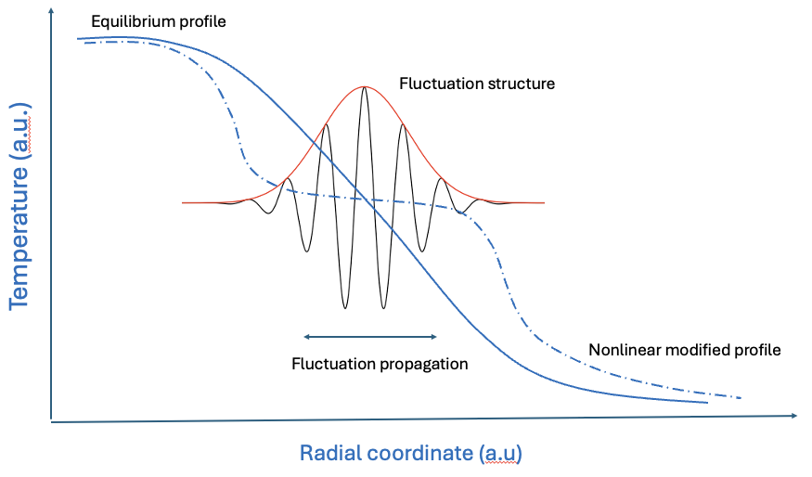
NL envelope evolution equation - I
Mesoscale structure formation is favored when radial propagation of wave-packets is slow, accounting for reflection
by plasma nonuniformity
Nonlinear Schrödinger
Equation (NLSE)

Slide 30
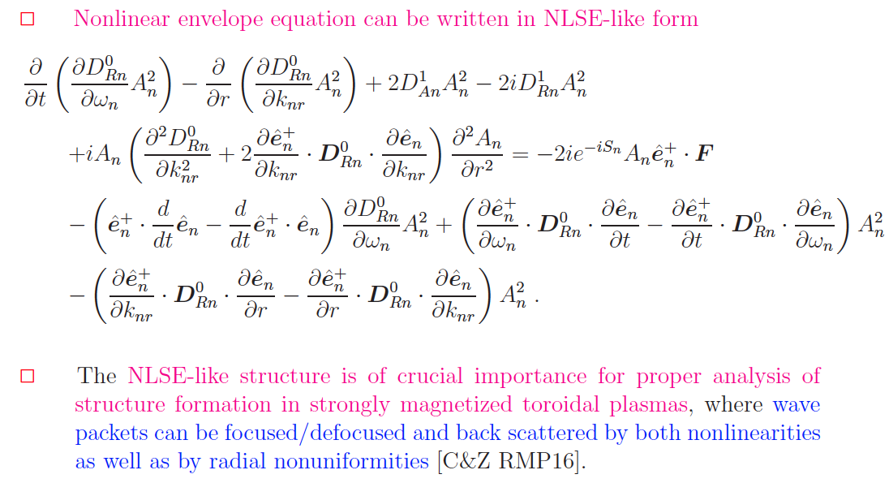

NL envelope evolution equation - II
Nonlinear evolution equation has NLSE-like form
propagation
freq.shift/growth
dispersiveness
nonlinear/forcing
From local dispersion rel.
[FZ etal JPCS 2021]
The NLSE-like structure is of crucial importance for the proper analysis of structure formation in strongly magnetized plasmas

Slide 31
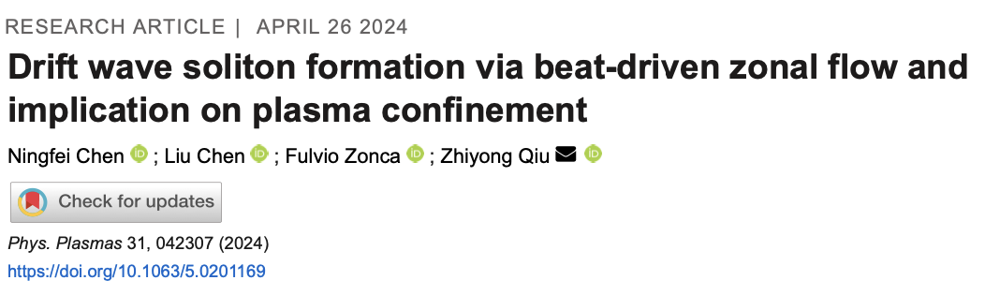
Turbulence spreading via soliton formation
Described by NLSE for wave action

Slide 32
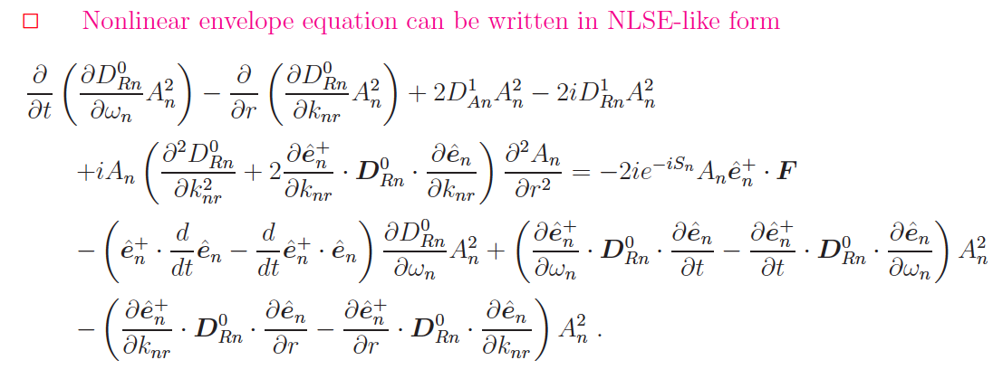
Relevant limits I
The wave kinetic equation
        Dispersive term is dropped
        Nonlinear term is simplified (k-space diffusion)
From local dispersion rel.
[FZ etal JPCS 2021]

Slide 33
Relevant limits II
The QL field amplitude equation
        Radial local limit
        Nonlinear term is simplified (QL diffusion equation)
From local dispersion rel.
[FZ etal JPCS 2021]

Slide 34
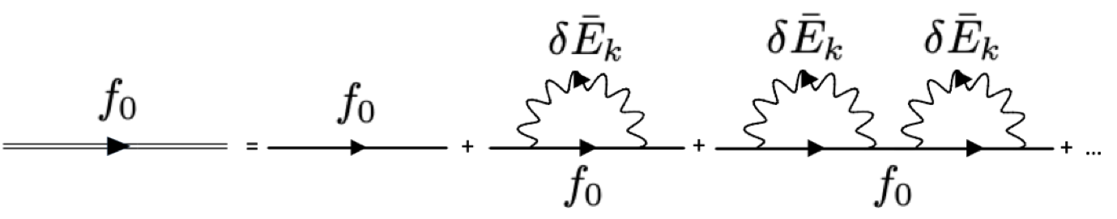
Dyson Schrödinger Model I
Conceptual steps
      Both “slow” (CGL equilibrium evolution) and “fast” (NL spatiotemporal scale; e.g. avalanches) evolution of PSZS are dominated by emission and absorption of same k
NL terms generate “secularities”
Renormalization & Dyson like equation
Van Hove L (1955)
PrigogineI(1962)
BalescuR(1963)
      Principal series of secular terms

Slide 35
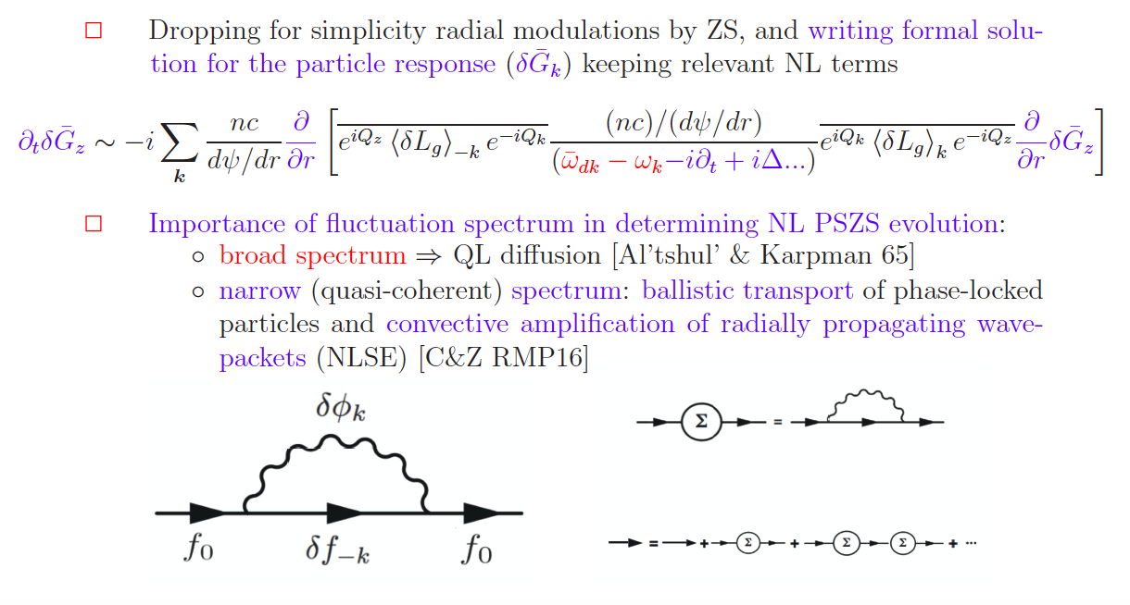
Dyson Schrödinger Model II
Milano, Sep. 5th, 2023

Slide 36
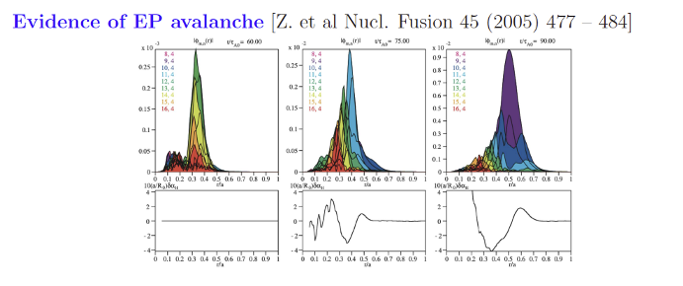
Energetic particle avalanches
Described by NLSE for wave action and self-consistent
energetic particle transport

Slide 37
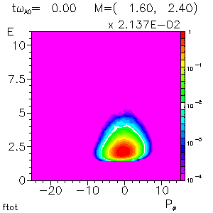




Phase space zonal structures - II
Numerical verification by HMGC + HYMAGYC codes [S. Briguglio
and G. Vlad, 2020 - EUROfusion project MET] - ongoing work within
EUROfusion projects ATEP (Lauber/Falessi) & TSVV#10 (Mishchenko)
Slow and fast spatiotemporal
responses
phase space flux

Slide 38
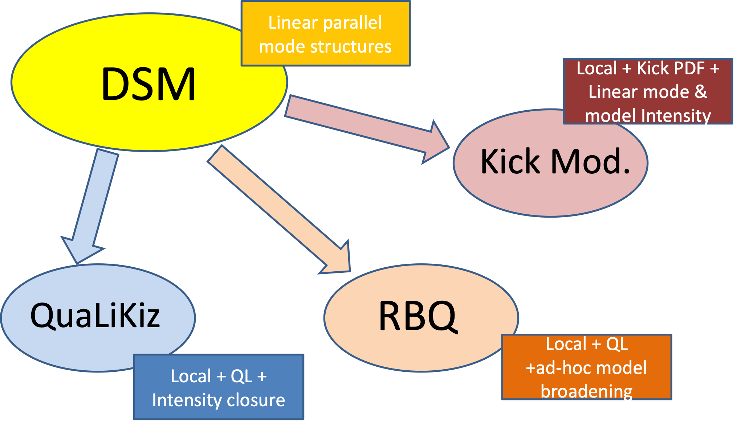

Dyson Schrödinger Model III
Recovering QL limit: … for a broad spectrum

Slide 39
Discussion and Conclusions
Overarching and unified theoretical framework for self-consistent description of fluctuation spectra and corresponding transport in reactor-relevant fusion plasmas
Numerical applications have been made for selected reference cases and verification of the approach is complete
Applications to realistic cases of practical interest (ITER, JET, AUG, DTT, etc.) are in progress along with extension to 3D confinement systems [EUROfusion projects ATEP/TSVV#10 (Lauber/Mishchenko); MAECI-NSFC projects (ENEA-SWIP)]
Main references are available at the CNPS site:
https://www.afs.enea.it/zonca/CNPS/

