Slide 1


CNPS – DTT MHD&TH Seminar - September 3rd, 2021
When the chorus sings …
… and laboratory plasmas join in (*)
Fulvio Zonca1,2, Xin Tao3 and Liu Chen2,1
1Center for Nonlinear Plasma Science and ENEA C.R. Frascati, 00044 Frascati, Italy
2IFTS and Dept. Physics, Zhejiang University, Hangzhou, 310027 P.R. China
3Department of Geophysics and Planetary Sciences, USTC, Hefei, P.R. China
(*) Contributions from: S. Briguglio, M.V. Falessi, G. Fogaccia, V. Fusco,
Z. Qiu, G. Vlad, X. Wang
Frascati, September 3rd 2021

Slide 2
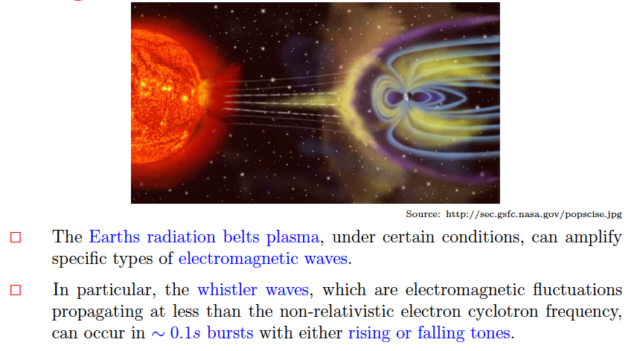
What is chorus
Earths magnetospheric plasma,

Slide 3
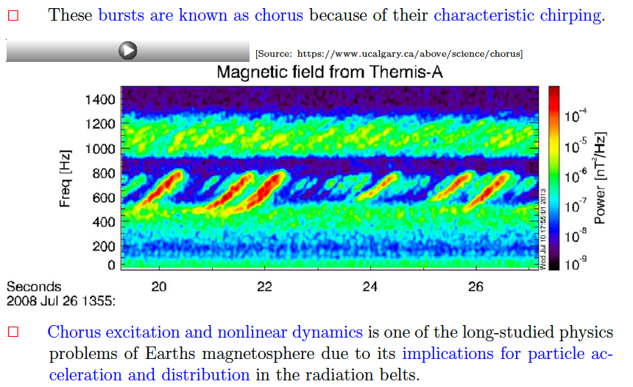

Chorus chirping

Slide 4
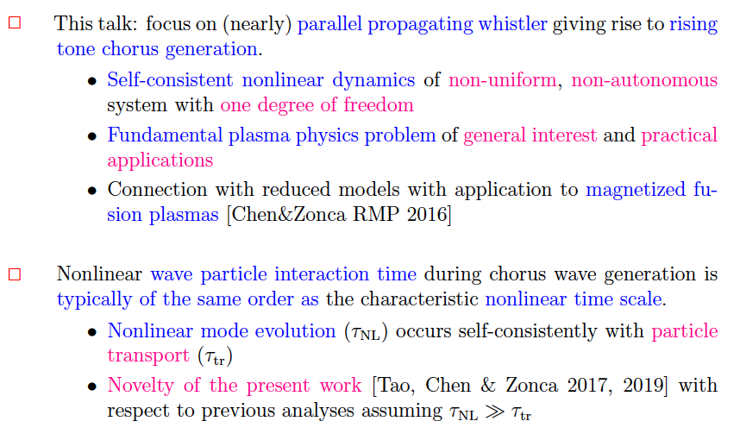
Chorus and fusion plasmas - I

Slide 5
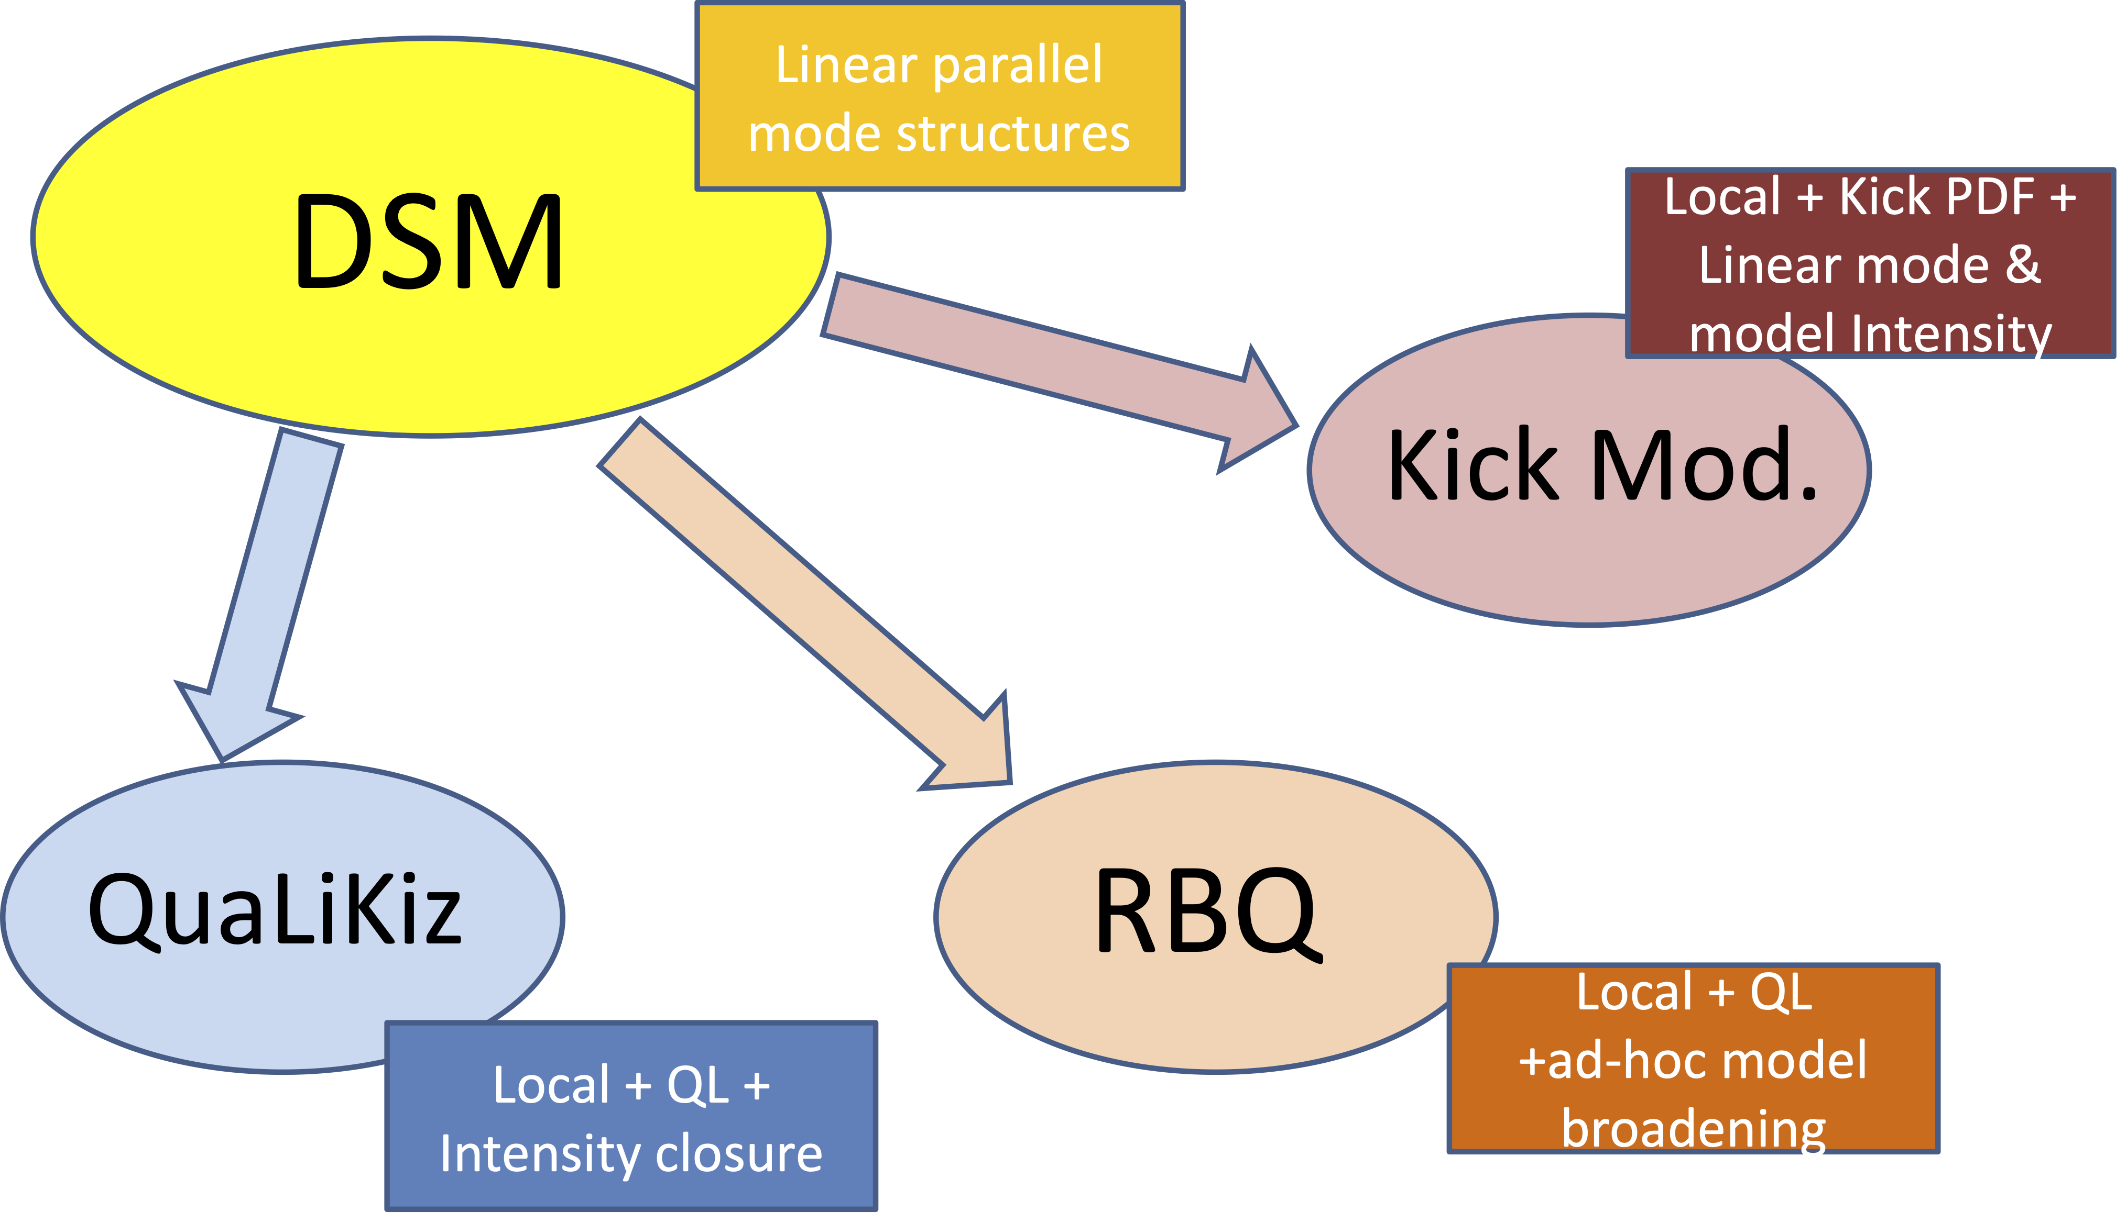
Chorus and fusion plasmas - II
Direct connection with Dyson Schrödinger Model (DSM) :
(ZCFQ seminar Nov 20/2020)

Slide 6

Numerical/Theoretical framework
Numerical simulation results summarized:
        A “Trap‐Release‐Amplify” Model of Chorus Waves, published in Journal of Geophysical Research: Space Physics (PDF)
Theoretical framework fully analyzed:
        A theoretical framework of chorus wave excitation (arXiv preprint arXiv:2107.03151; submitted to JGR; PDF)
        Nonlinear dynamics and phase space transport by chorus emission (arXiv preprint arXiv:2106.15026; tutorial submitted to RMPP; PDF)

Slide 7
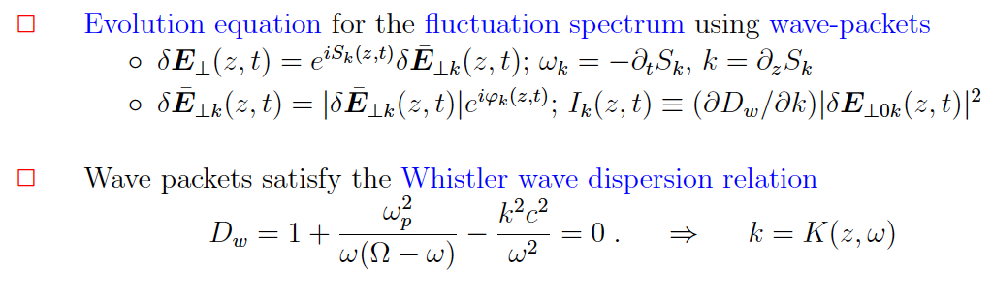

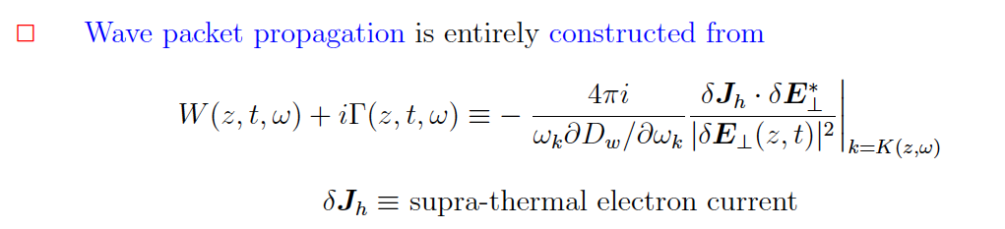
Wave packet evolution - I

Slide 8
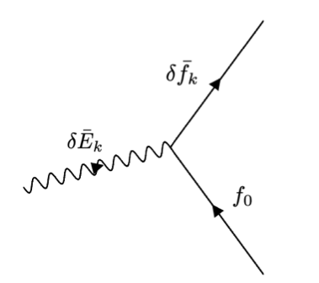

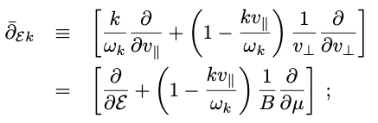


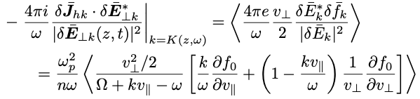
Linear electron response
Compute electron current from particle response:
Electron response
Linear propagator

Slide 9
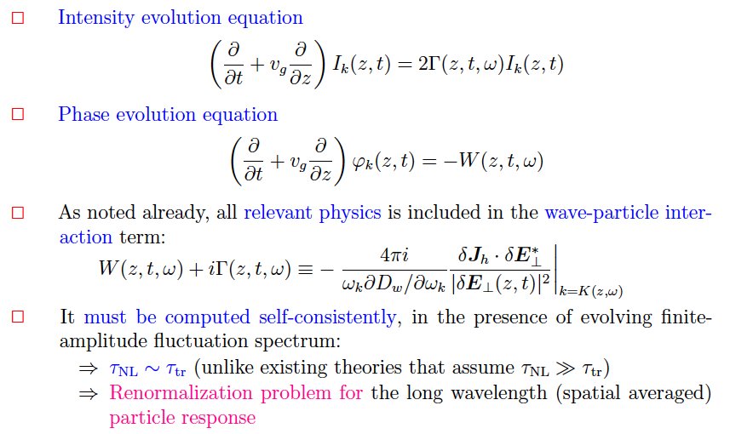
Wave packet evolution - II

Slide 10
Self consistent NL description
Basic underlying idea:
        We focus on the nonlinear particle response without fast temporal or spatial dependences, which correspond to the self-interaction of the wavenumber of interest with itself. (*)
        This nonlinear response obeys an evolution equation, which may look like a “quasilinear” description at first glance but is, indeed, much more general as will be shown and discussed in the following.
        The present approach has a close connection of with the Dyson equation and the so-called “principal series” of secular terms.
(*) Acknowledgment: D. F. Escande

Slide 11



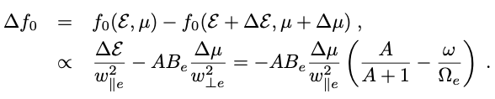
Holes and clumps
Formation of structures in phase space:
        For rising tone chorus, phase locked particles gain energy and momentum but loose parallel energy
        Structures are formed near resonance:
          Holes: lower density w.r.t. unperturbed surrounding
          Clumps: higher density w.r.t. unperturbed surrounding

Slide 12
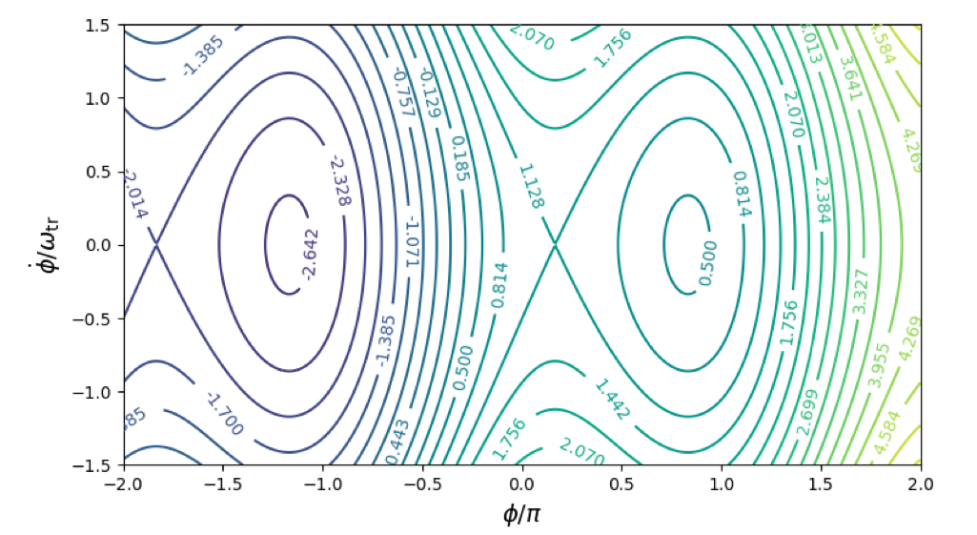



Holes and clumps

Slide 13



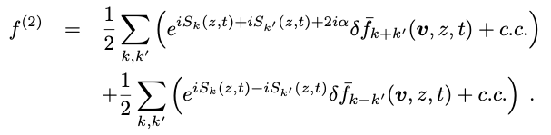
Self-consistent NL electron response
Asymptotic expansion:
        Formally solving NL Vlasov using small amplitude expansion

Slide 14
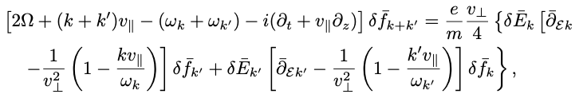
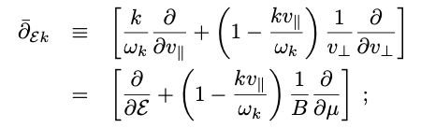
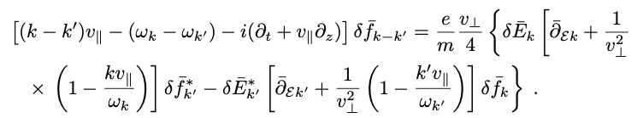
Nonlinear electron response
Asymptotic expansion:
        Formally solving NL Vlasov using small amplitude expansion
(52)

Slide 15
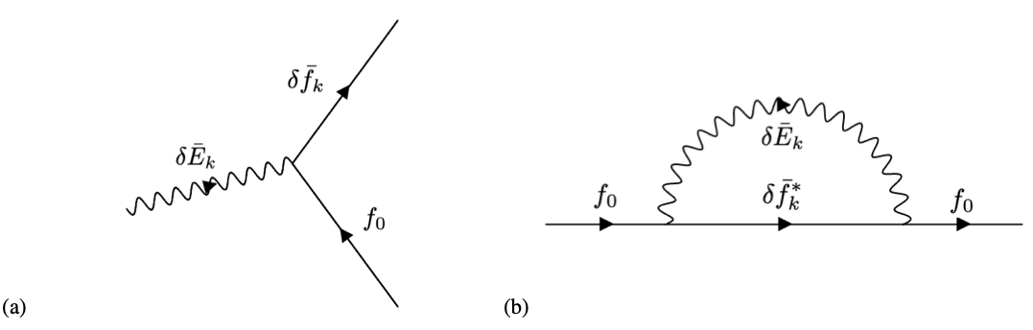
Nonlinear electron response
Renormalization via same-k interactions:
        Consider the NL contribution without fast spatiotemporal scales
        Effect of self-interactions of the wave number of interest with itself

Slide 16

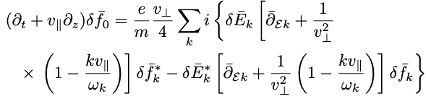
Nonlinear electron response
Renormalization via same-k interactions:
        Secular growth on short time scale

Slide 17
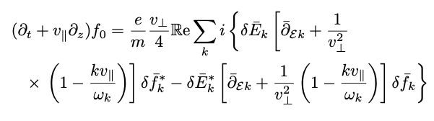
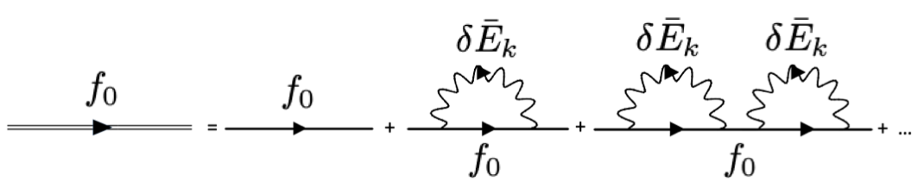
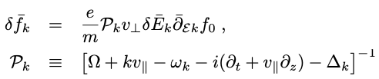
Nonlinear electron response
Renormalization via same-k interactions:
        By iterative solution one obtains the dominant renormalized response ➔ Dyson – like equation (DSE)
resonance broadening

Slide 18

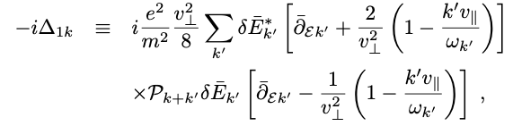
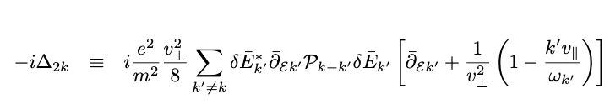
Resonance Broadening
Coupling of $δ\overline{f}k+k′$ with (k’)* and $δ\overline{f}k−k′$with k’ (Dupree 66):
resonance broadening

Slide 19
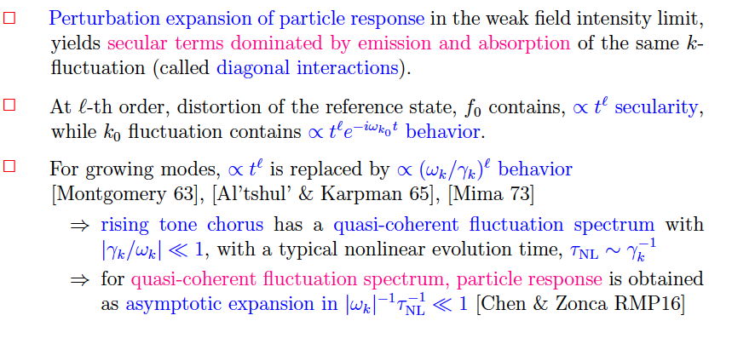
Self consistent NL description
Brief recap :

Slide 20
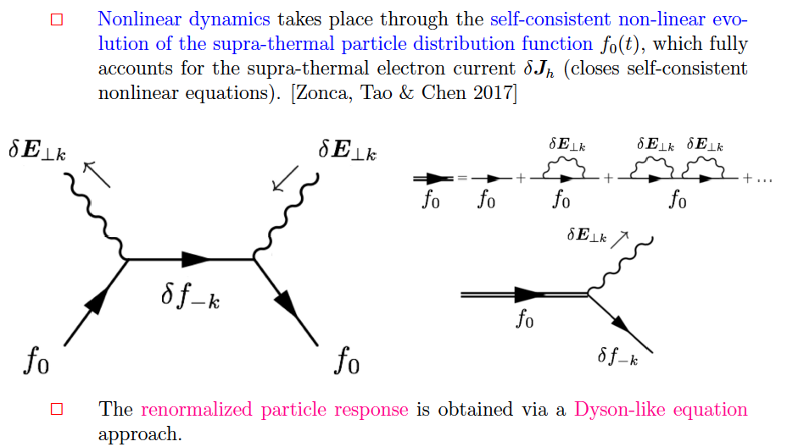
Renormalized particle response

Slide 21
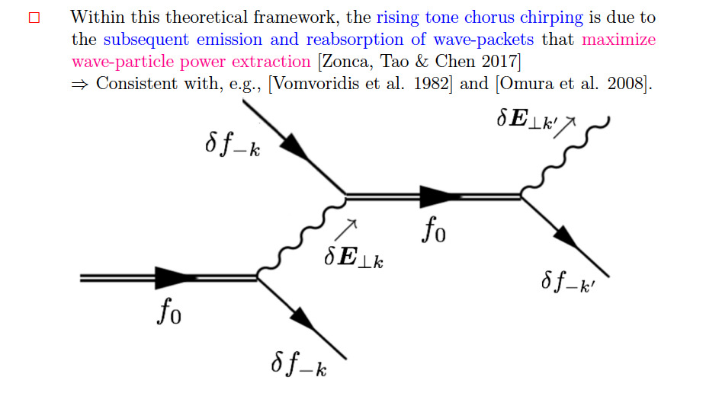
Dyson description of chorus chirping

Slide 22
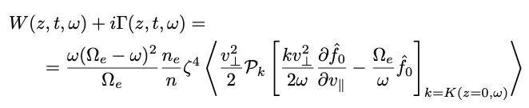
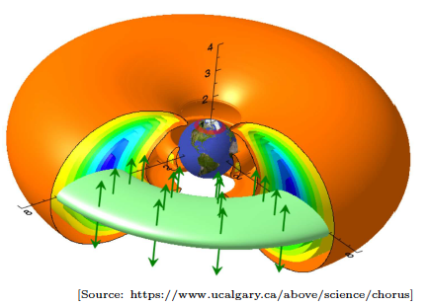
Reduced Dyson description
Reduced Dyson description:
        Derive evolution equation for nonlinear growth and frequency shift
        Based on the existence of a narrow (quasi-coherent) spectrum and its resonant excitation
        Use localized source to ignore magnetic field non-uniformity
propagator
resonance broadening

Slide 23
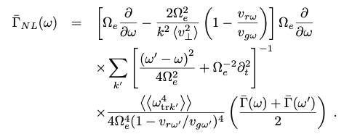
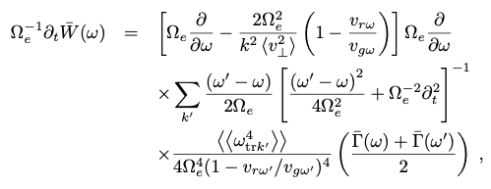


Reduced Dyson description
Reduced Dyson description:
Narrow spectrum: recovers Vomvoridis 1982
        Analytic result derived for the first time
        Self similar solution that ballistically propagates

Slide 24
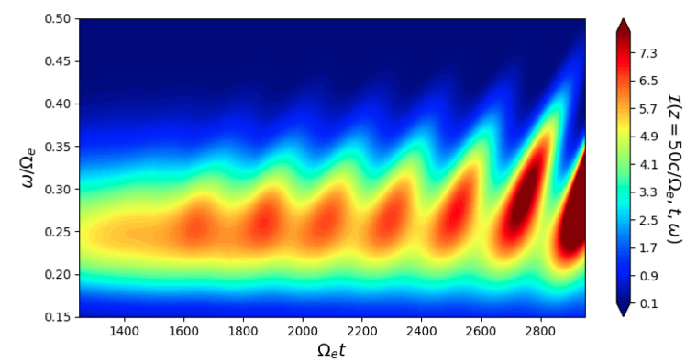
Numerical results
Reduced Dyson description:

Slide 25
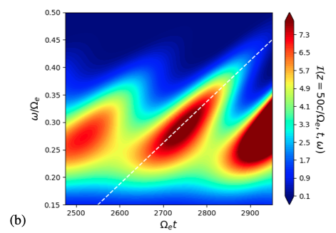
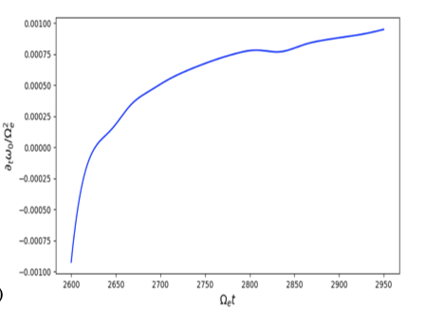
Numerical results
Reduced Dyson description
        Chirping rate 7.5 x 10-4 consistent with PIC simulation

Slide 26
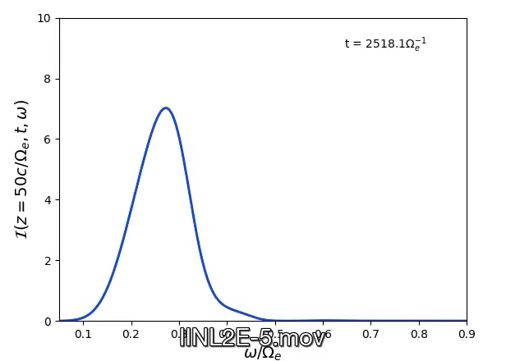
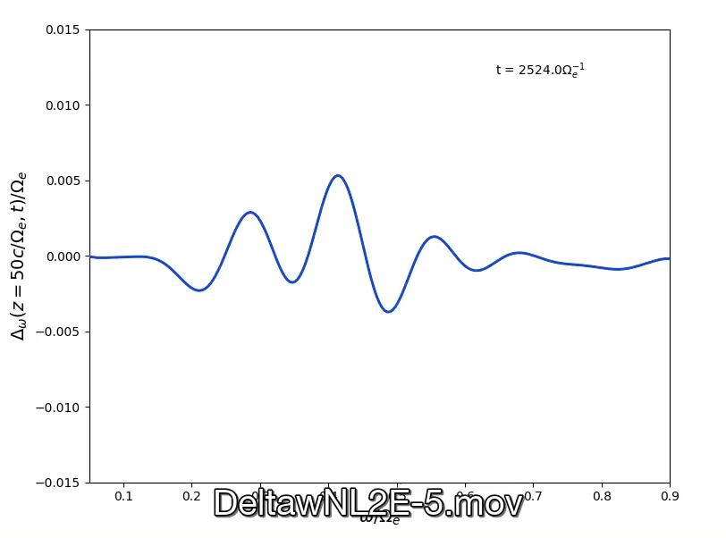
A one - chirp show
A one – chirp show: single chorus element

Slide 27
Universal chirping phenomena
L. Chen and F. Zonca, RMP 88, 015008 (2016)
Wide variety of frequency sweeping phenomena
Universal process when:
Spontaneous emission (instability)
Non-perturbative (dispersiveness, continuum)
Resulting in secular propagation of phase
space resonance structures at rate ~amplitude
E.g., chorus chirping (Vomvoridis, 1982; …)
        arXiv:2107.03151; PDF
        arXiv:2106.15026 PDF
Predicted and observed in fusion plasmas:
(EPM, fishbones)

Slide 28
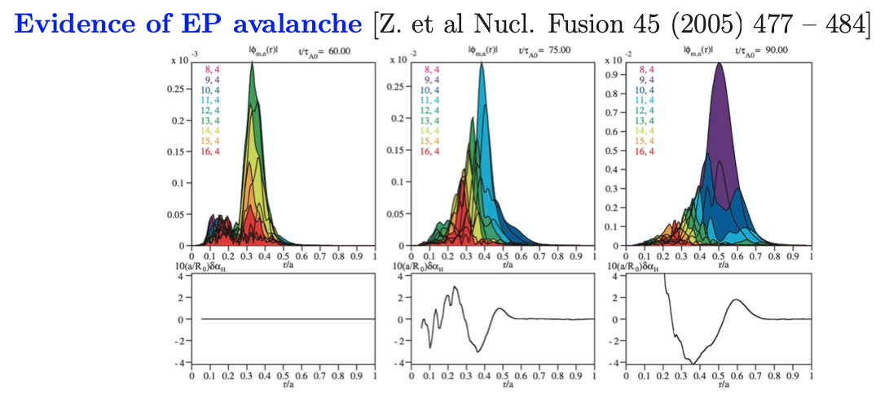
Back to fusion plasmas - EPM
Theoretical framework systematically verified by NL
Hybrid MHD GK simulations (HMGC): (Xin Wang seminar
Apr. 09/2021; Sergio Briguglio seminar Apr. 23/2021; Chirping explained)

Slide 29
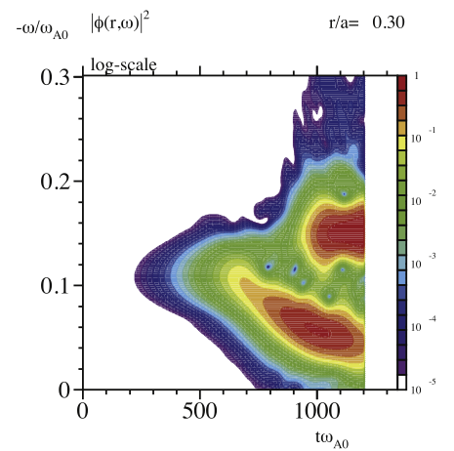
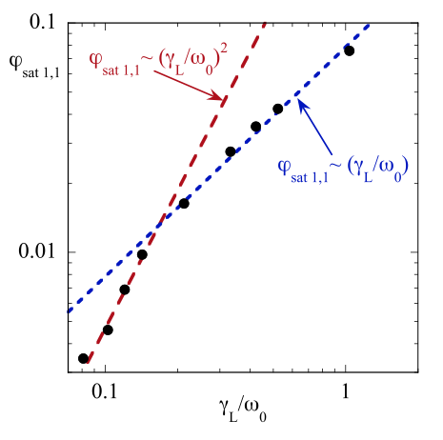
Back to fusion plasmas - fishbones
Theoretical framework systematically verified by NL
Hybrid MHD GK simulations (HMGC&HYMAGYC):
(G. Vlad et al. New J. Phys. 18 (2016) 105004)
XHMGC e-fishbones;
weakly hollow q profile

Slide 30
A hierarchy of models
Connecting Chorus with DSM:
The DSM is made of two components: the Dyson Schwinger
Equation (DSE) and NLSE
The NLSE evolves the spectrum consistent with the nonlinear
equilibrium solution; the DSE evolves the nonlinear equilibrium
given the spectrum
The chorus problem is the analogue of DSM, where
the NLSE is replaced by the WKE
Recovering Quasilinear from DSM:
This correspondence of DSM to chorus problem allows to
illustrate how Quasilinear description is recovered in the proper
limit

Slide 31

Quasilinear limit
Dyson – like equation (DSE)
resonance broadening
Closed by …
slow spatiotemporal dep.
Propagator becomes the linear one
The spectrum is considered broad (w.r.t. ω_{trap}) small Kubo #
Resonances overlap and ω_{trap} >> 1/τ_{diff} ~ 1/τ_{NL}
Near marginal stability: γ even smaller than 1/τ_{diff} ~ 1/τ_{NL}

Slide 32
Chorus and fusion plasmas - II
Direct connection with Dyson Schrödinger Model (DSM) :
(ZCFQ seminar Nov 20/2020)

Slide 33
Conclusions
The theoretical framework for chorus emission is fully
developed based on the DSE+WKE solution. Supported by
extensive numerical verification.
It describes universal chirping phenomena in space/lab plasmas
The chorus problem is the analogue of DSM, where
the NLSE is replaced by the WKE. This provides a direct route
to demonstration that the DSE+WKE/NLSE solution reduces to QL
in the proper limit
This illustrates the DSM as a rubust framework for a hierarchy of
reduced models, yielding QL and local CG
These results suggest the systematic application of DSM to a
broader class of problems dealing with transport in phase space
(beyond AE/EPM/fishbones) ➔ ATEP/TSVV#10 EUROfusion Proj.
THANK YOU!
Your questions are welcome

