Slide 1

March 20th, 2026
La collaborazione tra ENEA
e Chinese Academy of Sciences
Fulvio Zonca and ENEA Contributors
Center for Nonlinear Plasma Science and ENEA C.R. Frascati, 00044 Frascati, Italy
      Acknowledgments: G. Celentano, A. Del Nevo, M. V. Falessi, G. M. Polli, M. Tarantino

Slide 2

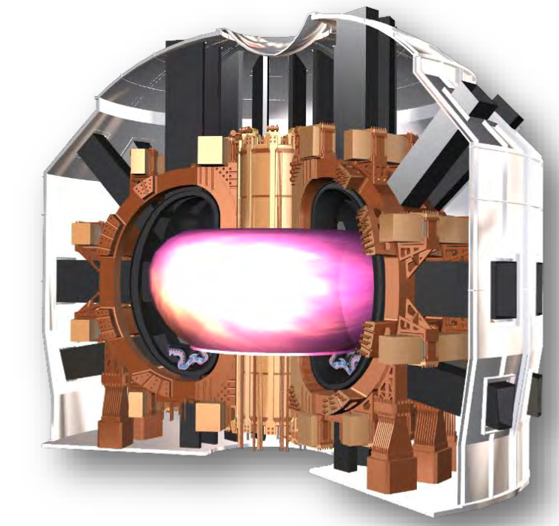
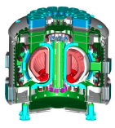

ENEA collaboration with CAS
Italian National Agency for New Technologies, Energy and Sustainable Economic Development
2024 ENEA and CAS extend and strengthen
the 2018 Memorandum of Understanding
2018 ENEA and CAS sign a MoU on fusion energy
deployment and increasing fission reactor safety
2012 ENEA signs a Memorandum of Understanding
with Hefei Institutes of Physical Science at CAS
2017 ENEA extends the Memorandum of Understanding
with Hefei Institutes of Physical Science at CAS
DTT
2008 China and the European Atomic Energy
Community sign a cooperation agreement
Emphasis on:
Divertor Tokamak Test facility (ENEA)
China Fusion Engineering Test Reactor
Generation IV lead-cooled fast reactors
CFETR
1998 China and Italy sign a general
Agreement on science and technology
1998
2008
2012
2017
2018
2024

Slide 3
Fusion and Fission
Establish a framework for joining knowledge and experience aiming at developing technologies for the deployment of fusion energy and increasing reactor safety
Particular emphasis on
The Divertor Tokamak Test (DTT) facility
The demonstrative Chinese fusion reactor CFETR
The Burning Experimental Superconducting Tokamak (BEST)
The lead cooled Gen-IV fission reactors

Slide 4
Divertor Tokamak Test facility
Divertor Tokamak Test (DTT) facility
Superconducting tokamak
Construction at ENEA Labs in
Frascati (Rome), Italy
First plasma expected 2032
Focus on power
particle exhaust
EXPECTED COST ~ 750M €

Slide 5


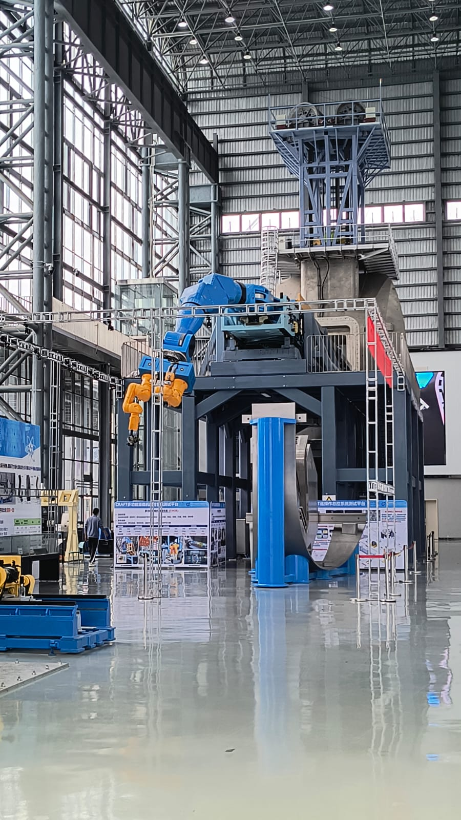
DTT – ASIPP collaboration
Prof. Jiangang Li, member of Chinese Academy of Engineering and also member of the DTT Technical and Scientific Committee since its establishment
Exchange of information in the design and fabrication of superconducting magnets in particular with regard to the hybrid solution (LTS and HTS) adopted for BEST and to be exported in DTT
Exchange of information in the design and fabrication of plasma facing components
Exchange of information for possible collaboration between on the feasibility study on a MMC power supply for NBI.
Exchange of information for possible collaboration in the filed of remote handling for DTT and CRAFT, the Comprehensive Research Facility for Fusion Technology, especially with regard to the pipe cut and welding.
Courtesy of Gian Mario Polli

Slide 6

EU – CN collaboration on magnets
In the EUROfusion framework, since 2020, ENEA has signed a collaboration agreement with ASIPP to develop the HTS technology for fusion magnets.
EUROfusion institutions: ENEA, EPFL, Uni. Twente, IPPLM, IAP, CEA, KIT
Chinese institution: ASIPP
The aim is to cooperate on High Temperature Superconducting (HTS) technologies for EU-DEMO, BEST and CFTER magnet systems to maximize the probability of success of these projects.
Exchange of personnel (including hosting PhD students and visiting researchers) is organized between ASIPP and EU Institutions.
Recently, the collaboration for defining the BEST Research Plan has started.
Courtesy of Giuseppe Celentano

Slide 7
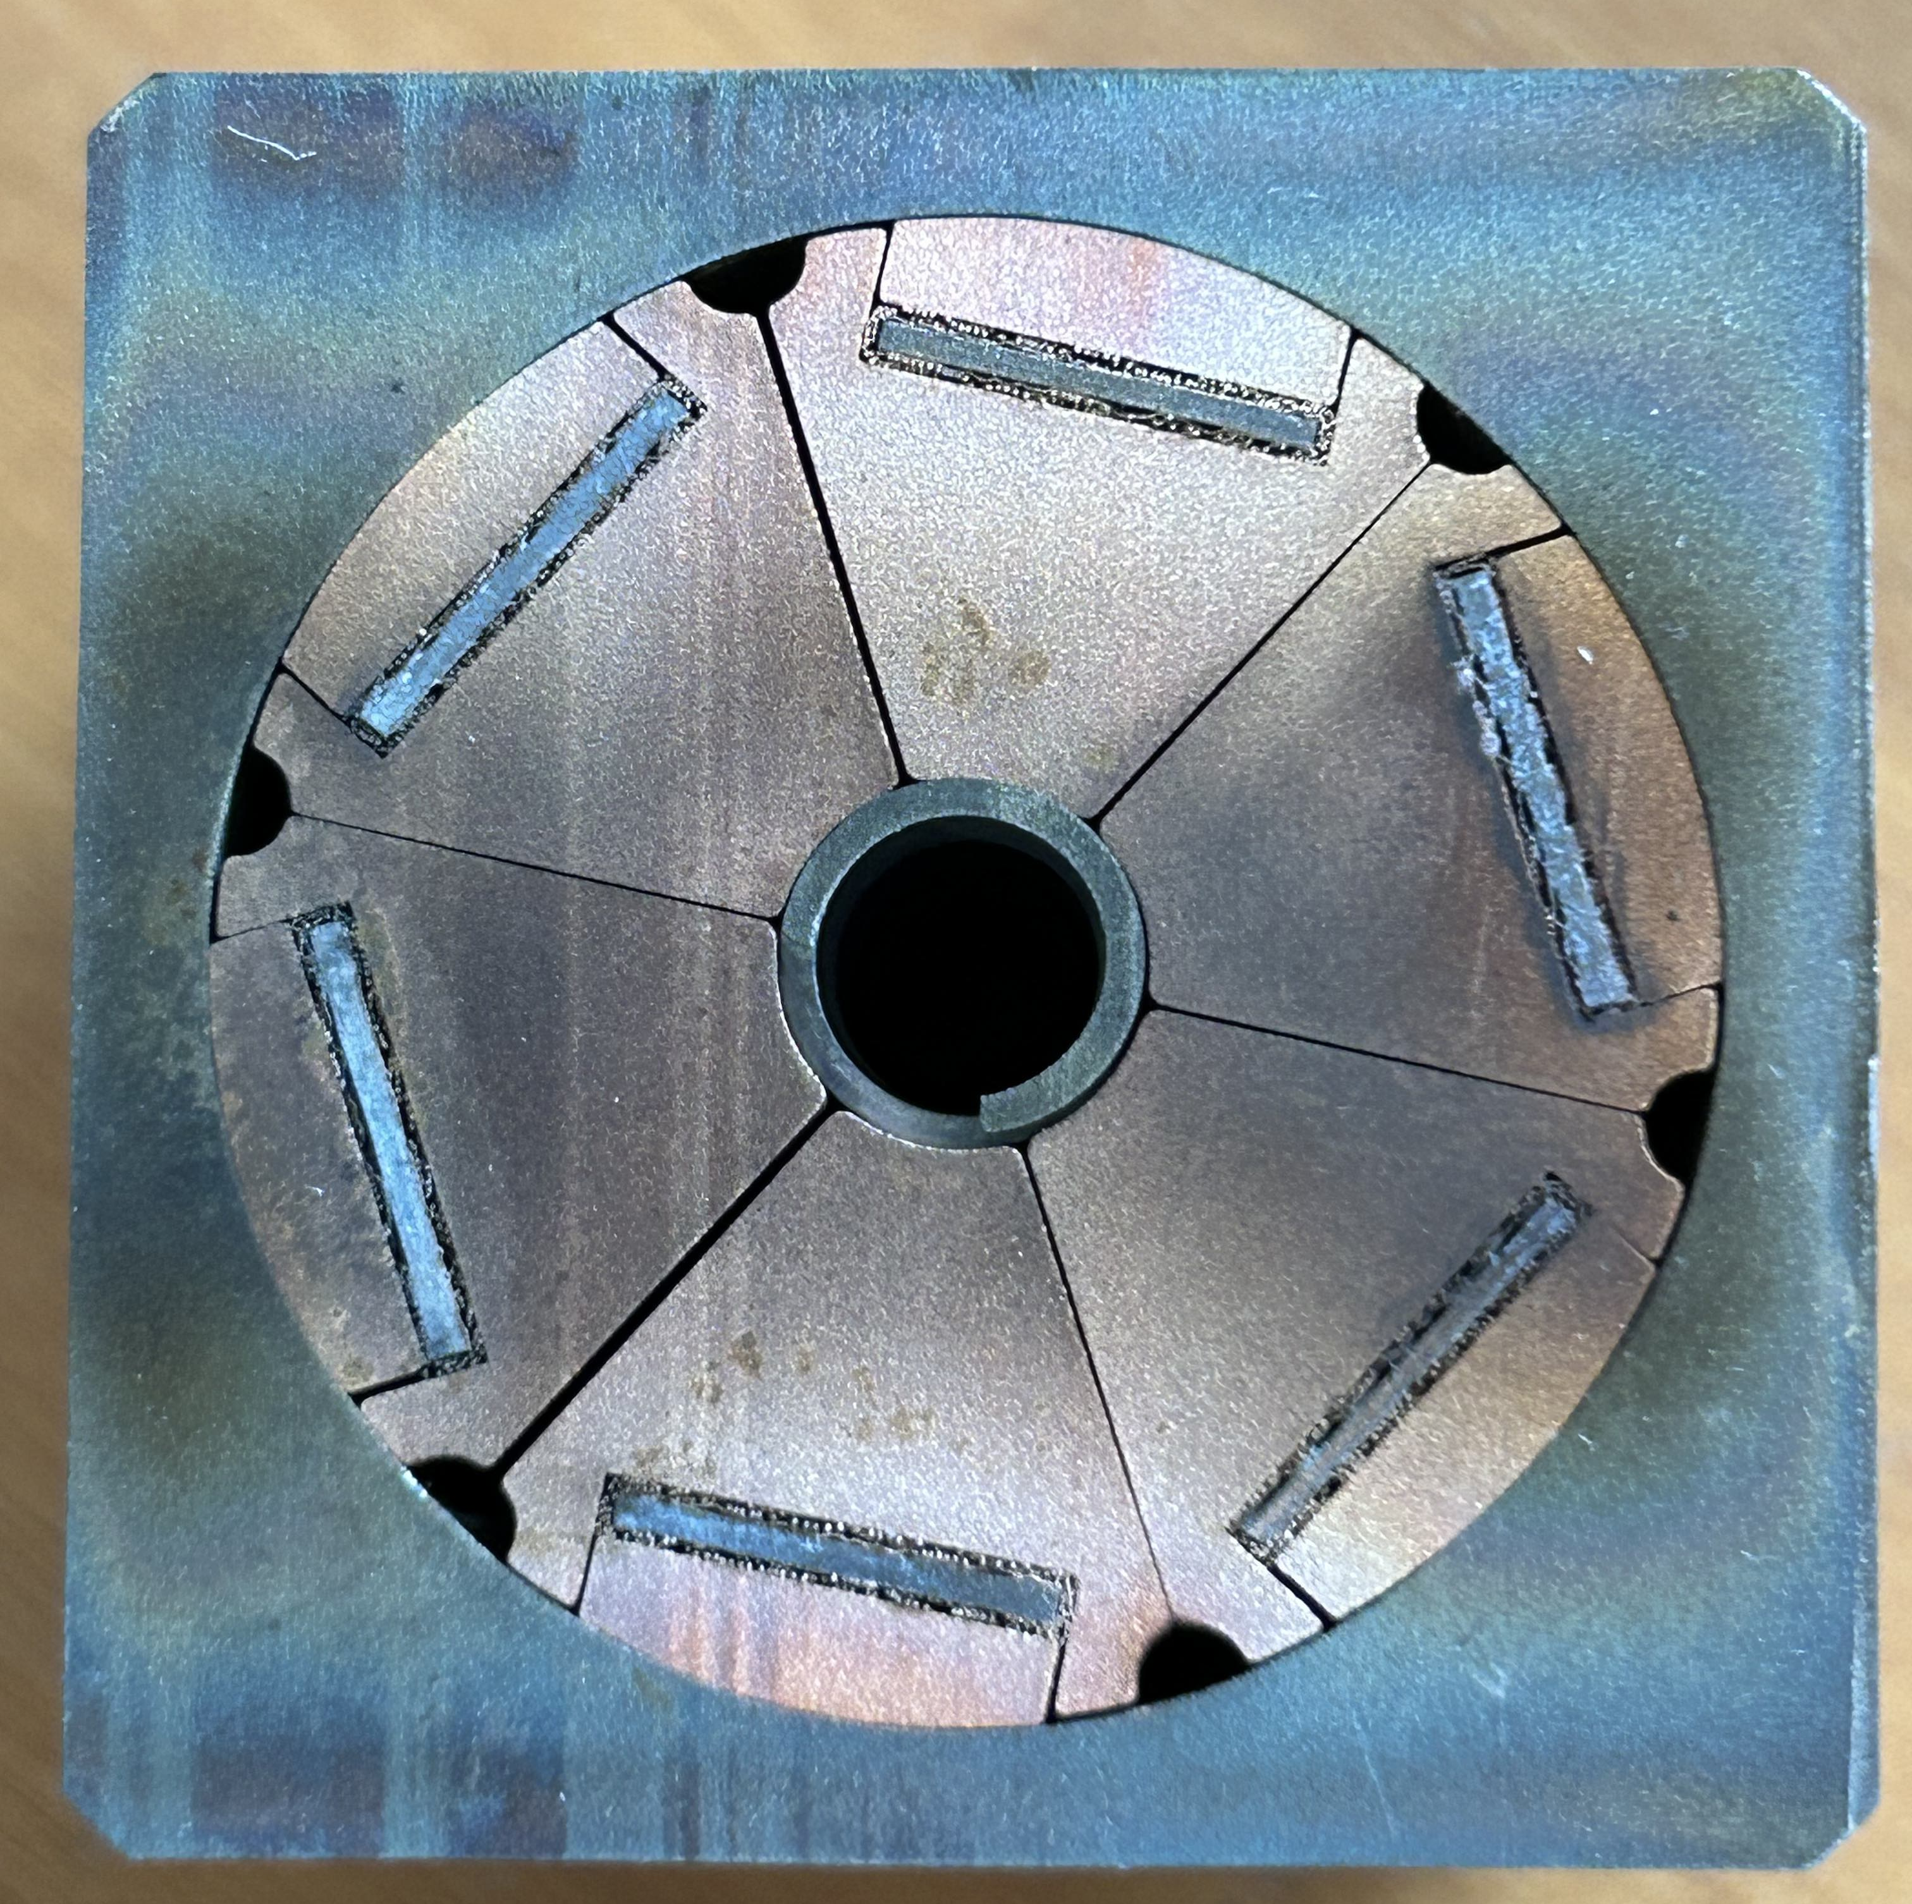
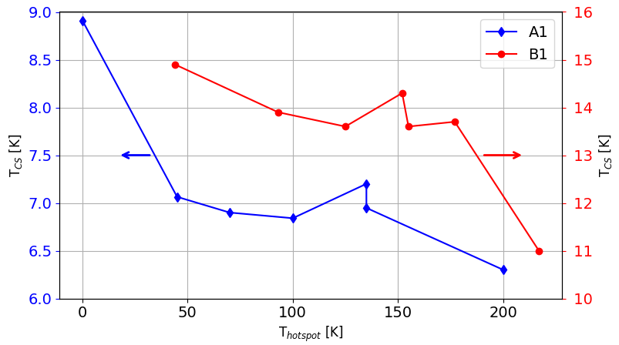
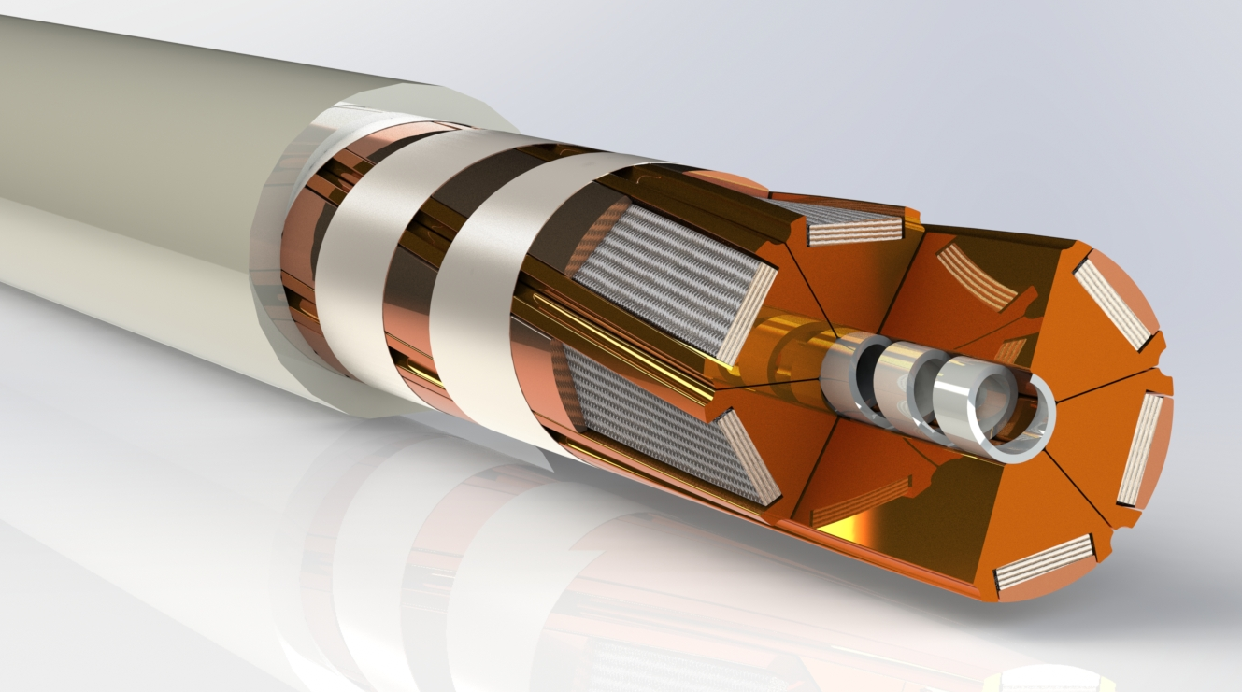
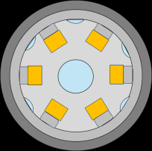
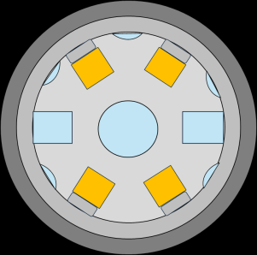
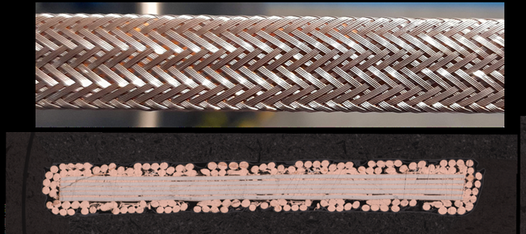
ENEA activities in EU – CN collaboration
Experiment to study the quench propagation on HTS conductors.
to quantify quench propagation velocity and effects of localized hot spot temperature
Assess the performance of HTS conductors with electromagnetic cycles (60kA, 18T, 4.5K).
SECtor ASsembled conductor
Steel Jacket
@ 15 kA, 10.85 T
@ 13 kA, 10.85 T
Cu profile
Steel Spiral
BRAided STAcks (BRAST) of REBCO tapes
Courtesy of Giuseppe Celentano

Slide 8
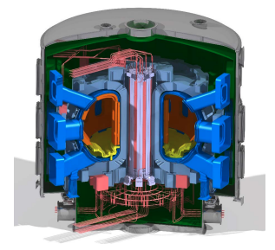
Burning Experimental Superconducting Tokamak
Burning plasma Experimental
Superconducting Tokamak
Superconducting tokamak
Construction at ASIPP Labs in
Hefei, China
First plasma expected 2028
Focus on D-T fuel cycle
and demonstration of
burning plasma conditions
EXPECTED COST ~ 8.5B CNY ~ 1.1B€

Slide 9
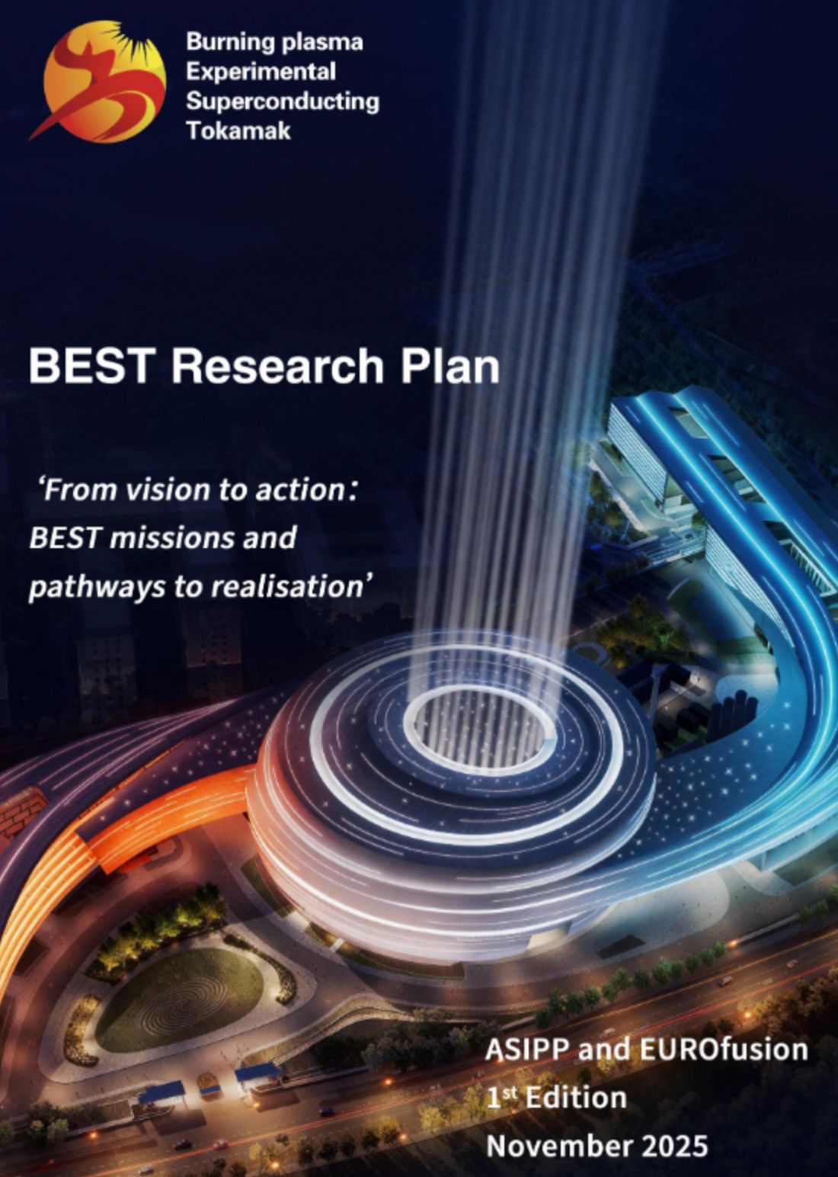
ENEA contribution to BEST
Programme developed with EUROfusion participation.
ENEA contributes with two experts; ENEA hosts one of the leading groups in burning plasma physics and also leading groups in fusion technologies
Results will support ITER and DTT physics, creating strong synergy between the devices.
Courtesy of Matteo Valerio Falessi

Slide 10
Opportunities, training and education
Deployment of fusion energy and research of Gen-IV fission reactors offers great opportunities of collaboration with China, involving National Labs., Universities and public-private partnership
This is carried out under the 2008 China–Euratom cooperation agreement
Long term commitment in these activities emphasizes the crucial importance of training and education as fundamental elements for promoting cooperation.
Training and education, as well as promotion of researcher mobility and of joint research and collaboration framework is specifically targeted by the Center for Nonlinear Plasma Science.

Slide 11
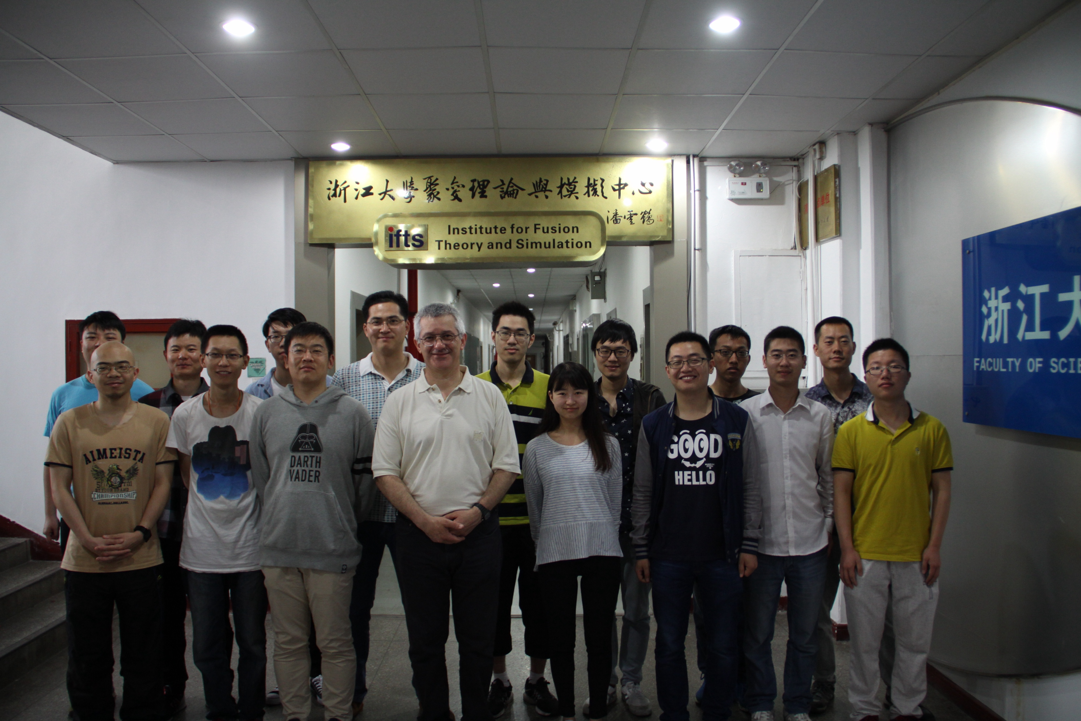
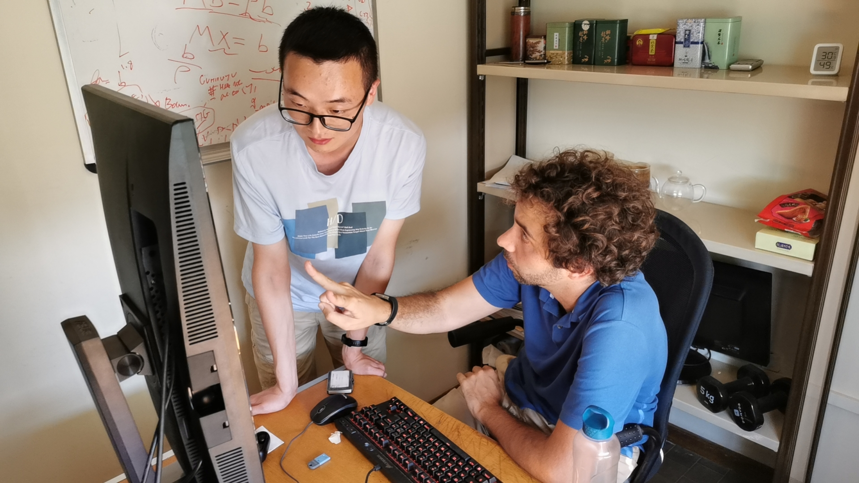

Center for Nonlinear Plasma Science
11
Center for Nonlinear Plasma Science (CNPS) @ ENEA Frascati:
Established in 2020 as "Virtual Center" based on two hubs, one located at the ENEA Frascati Research Center and another at the University of Science and Technology of China, Hefei (CAS) and Institute for Fusion Theory and Simulation
(School of Physics) at Zhejiang University, Hangzhou
To promote a joint research and collaboration network
Teaching at ZJU (since 2009)
Mentoring at ENEA

Slide 12
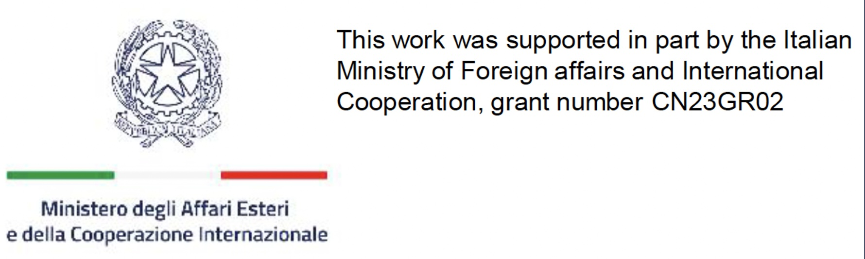
Collaborative framework on theory & simulation
12
Recent extensions and new CNPS hubs
Southwestern Institute of Physics, Chengdu, China, 2022
CREATE Consortium, Naples, Italy, 2022
Korea Institute of Fusion Energy, Daejeon, August 2023
Recent strengthening of CNPS collaboration at ASIPP:
Strong link with Key Laboratory of Frontier Physics in Contr. Nucl. Fusion
Strong collaboration with Theory Group on burning plasma physics
Project on “Turbulence and transport in burning plasmas” supported by MAECI and NSFC (2023-25)
Focus of future collaboration:
Development of predictive modelling of reactor relevant burning plasmas
Theory and simulation of EAST, BEST, DTT, CFETR

Slide 13
Fusion and Fission
Establish a framework for joining knowledge and experience aiming at developing technologies for the deployment of fusion energy and increasing reactor safety
Fusion
Fission
Fusion reactor concept design, including breeding blanket
as well as divertor technology

Slide 14
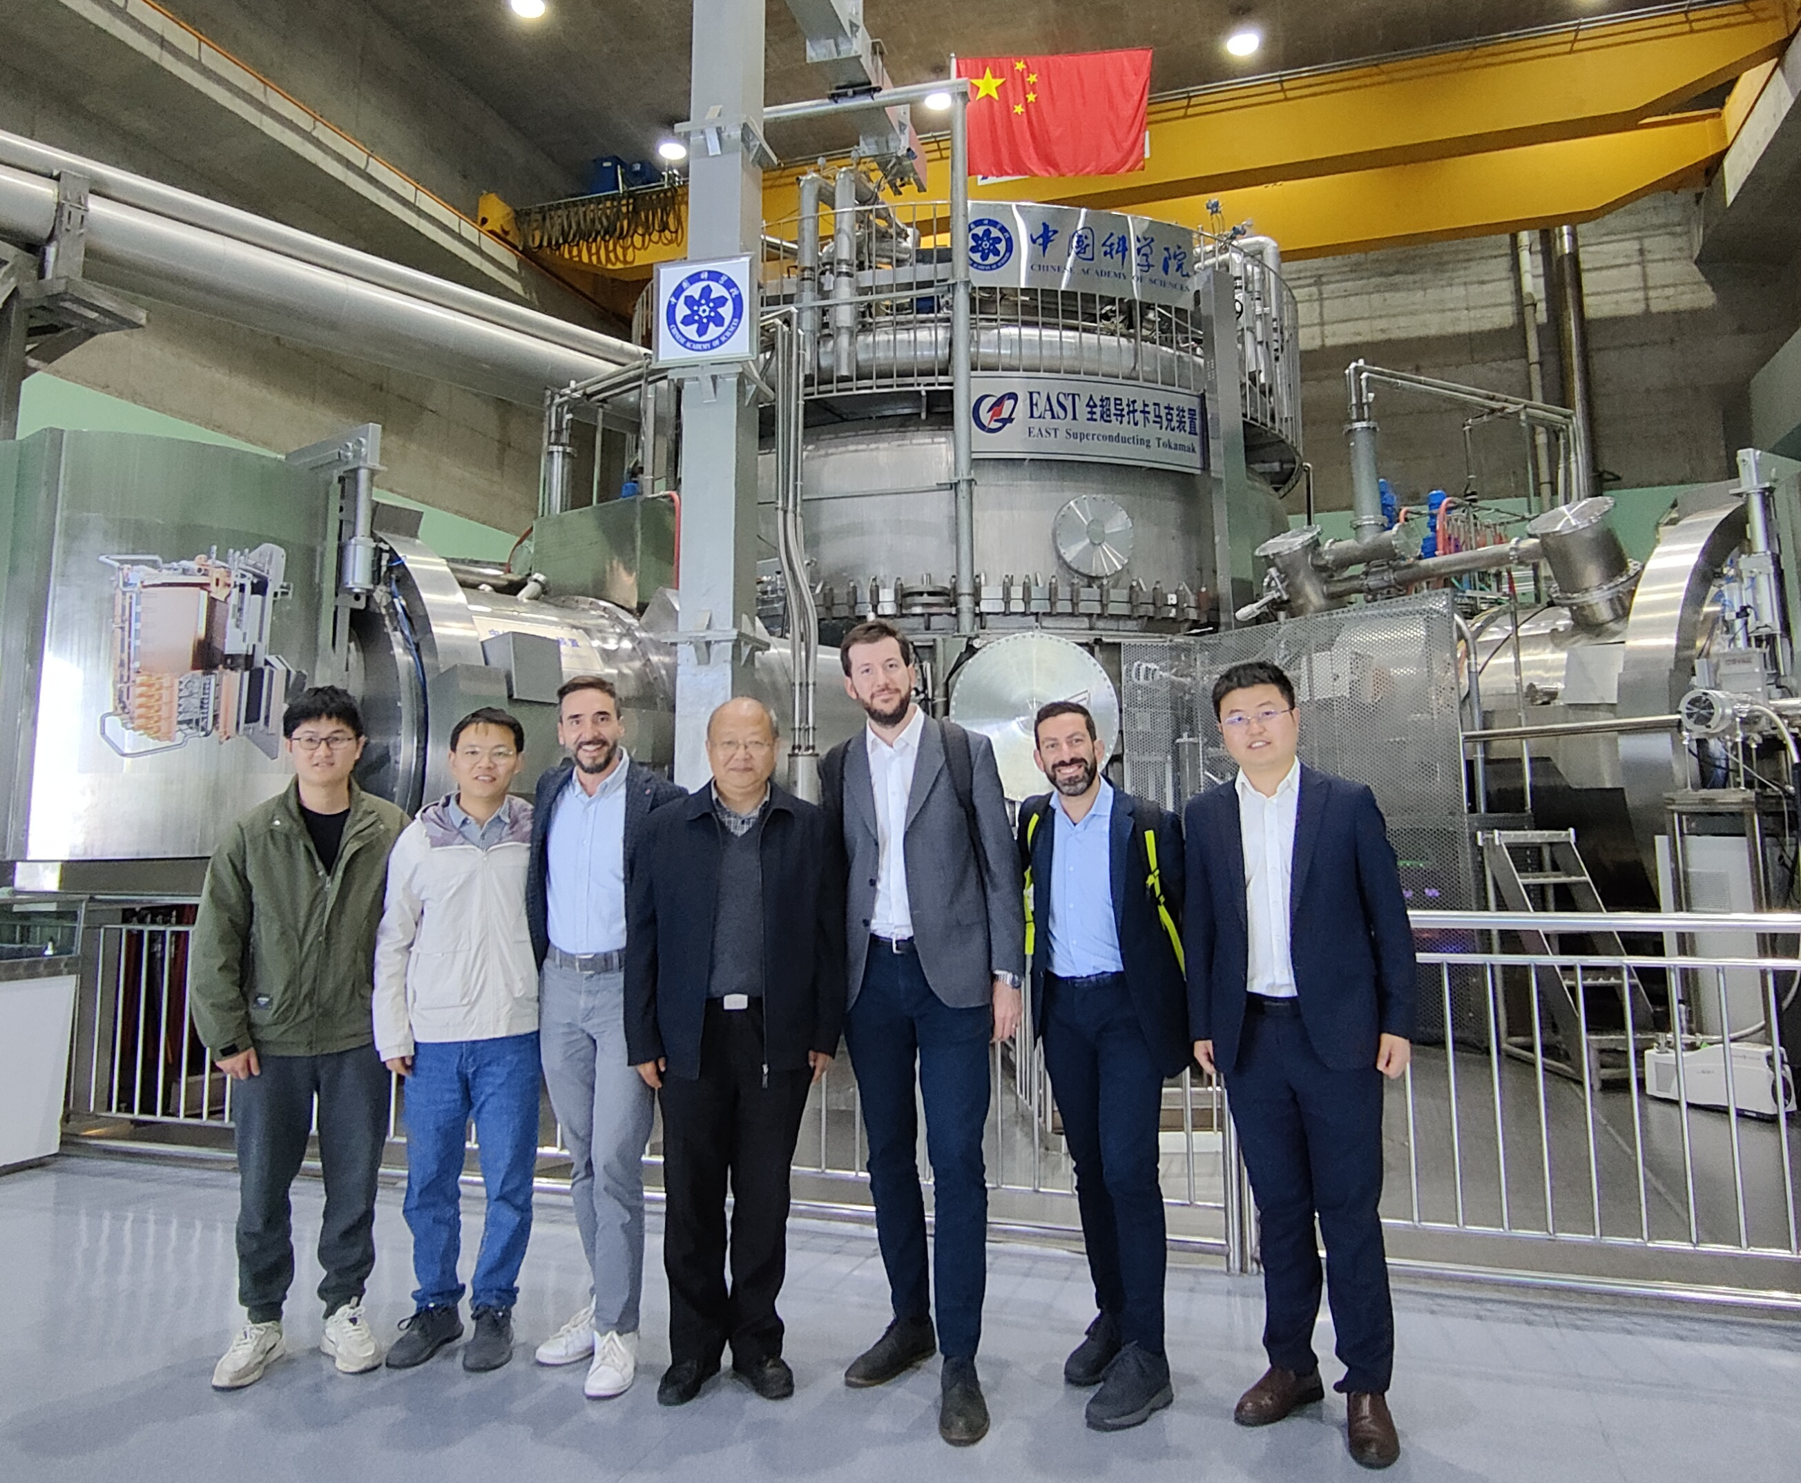
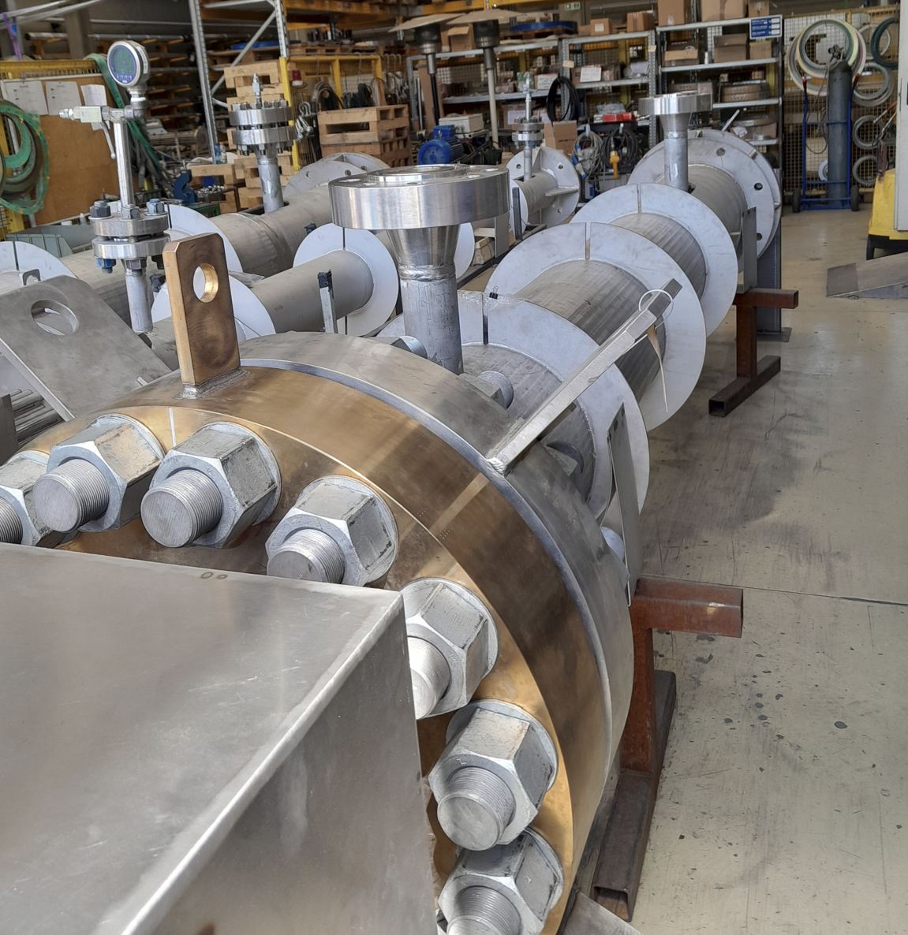
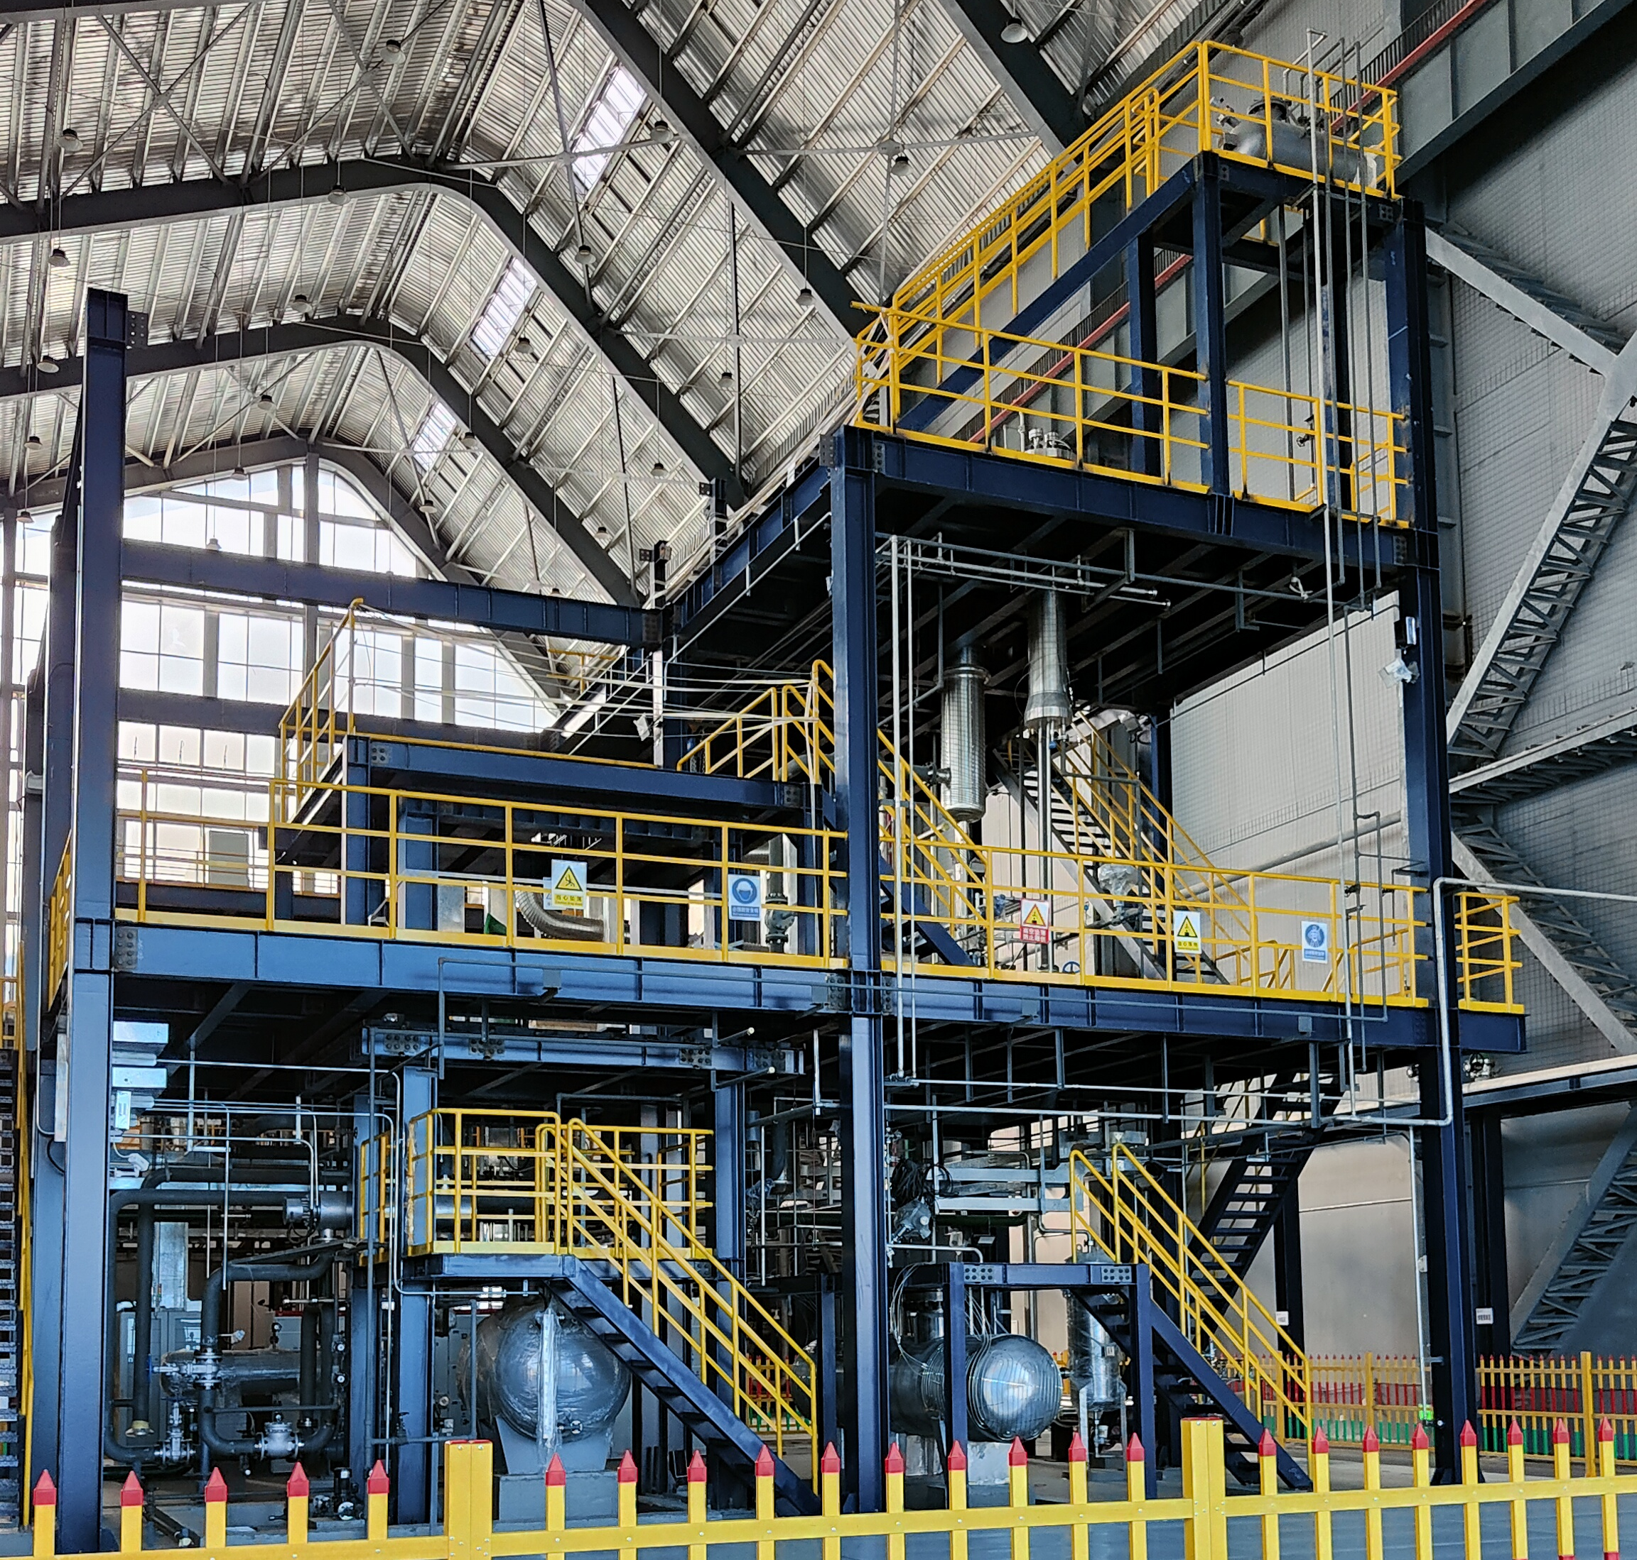
ENEA – ASIPP collaboration
EUROfusion – EU-China cooperation
  ENEA – ASIPP cooperation since 2017
  Breeding Blanket (and also BoP and safety)
  Focus on new experimental infrastructures for testing components and mock-ups
  Objective: 1) Maximize/optimize the use of experimental infrastructures (complementary experiments). 2) Exchange of information for accelerating development of technologies and validation of design.
ENEA C.R. Brasimone: experimental platform W-HYDRA (Water-Loop, STEAM and LIFUS5/Mod4 in construction
ASIPP- CRAFT campus, Hefei: PbLi loop and 2 Water-Loops constructed and commissioned
Italian and Chinese delegations -visit to EAST in Hefei (2024)
Water Loop 2x1700kWe electrical heaters
View on the Chinese Water-Loop in Hefei
Courtesy of Alessandro Del Nevo

Slide 15
Fusion and Fission
Establish a framework for joining knowledge and experience aiming at developing technologies for the deployment of fusion energy and increasing reactor safety
Lithium cooled Fast Reactor (LFR) is one of the most promising
concepts in the frame of Generation IV International Forum
Since 5th Framework Programme, EC has recognized the importance
of investigating Heavy Liquid Metal (HLM) technology in support of LFR
and Accelerator Driven Subcritical (ADS) reactors
Fission
Hefei Institutes of Physical Science are collaborating with ENEA
on the development of China Lead Alloy cooled Reactor (CLEAR) and
series of metal loops, lead-lithium, lead-bismuth, etc.

Slide 16

ENEA – INEST collaboration
Collaboration on Heavy Liquid Metal technology for Gen-IV Lead-cooled Fast Reactor development
  Lead-Bismuth/Lead technology
  Components & Systems Qualification
  Thermal-Hydraulics
  Materials & Chemistry
  Numerical Tools
  Training
  Research Infrastracture Development
Courtesy of Mariano Tarantino

Slide 17
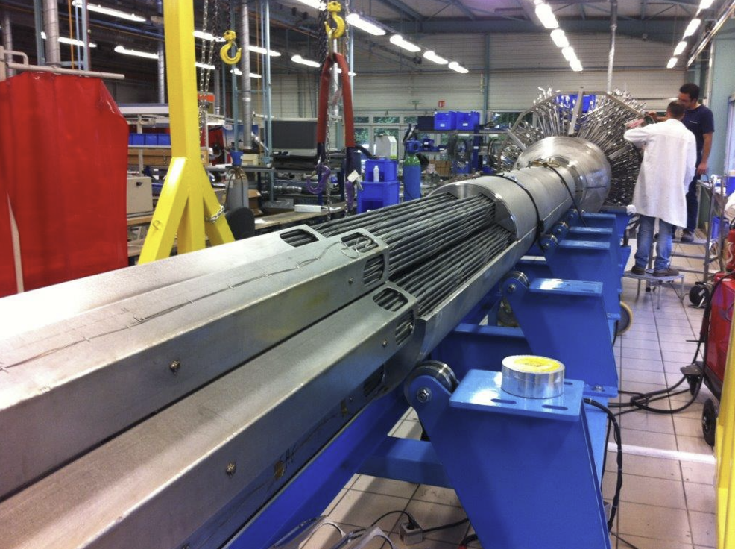
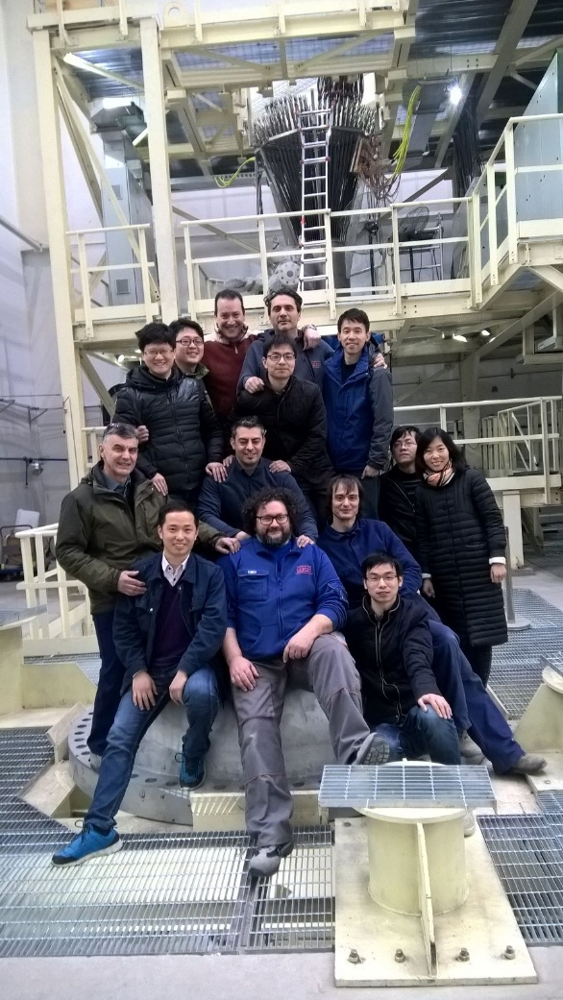
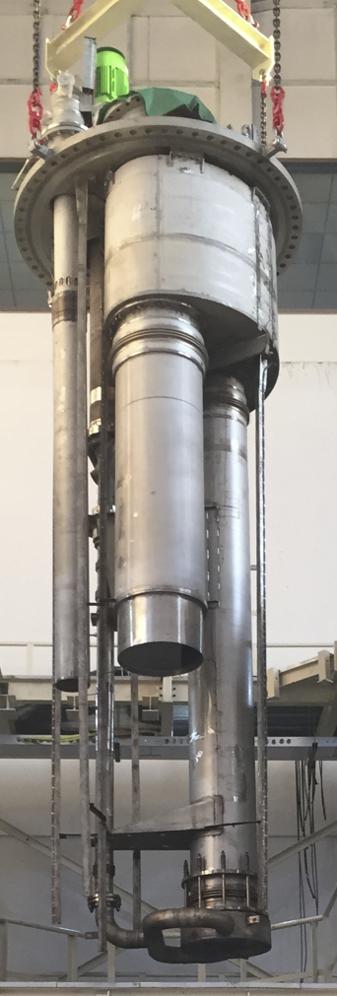
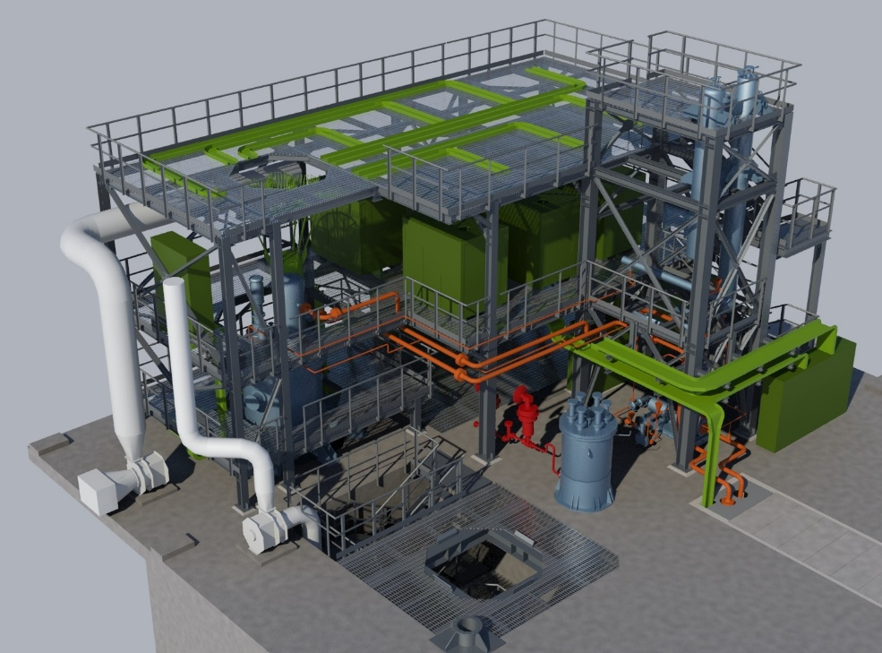
CLEAR-S Facility
LBE pool-type facility
400 tons of LBE
2,5 MW Thermal Power
LBE flowrate250 kg/s
Operating Temperature 250-550°C
Secondary Side with pressurized water @100 bar
Unique Facility in China
Strong involvement of Italian Supply Chain with SRS as Industrial Architecture
Test Section
CORE SIMULATOR
Joint Team
3D Layout
Courtesy of Mariano Tarantino

Slide 18
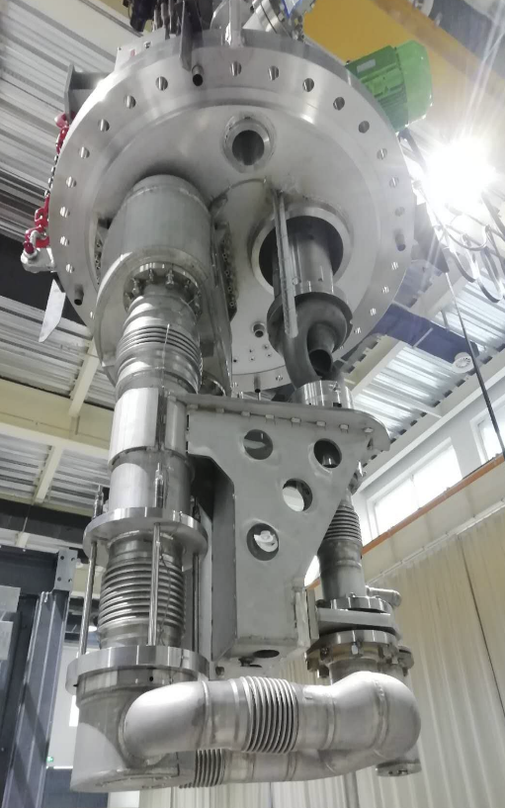
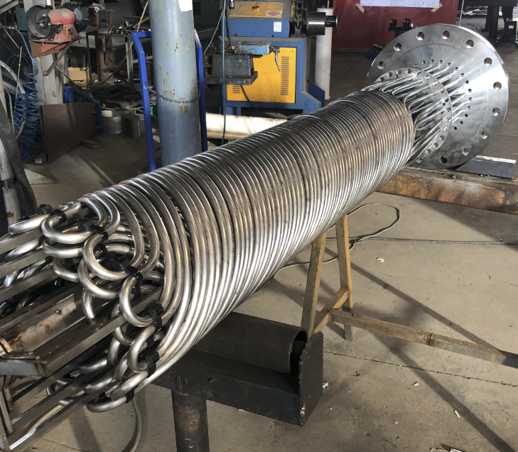
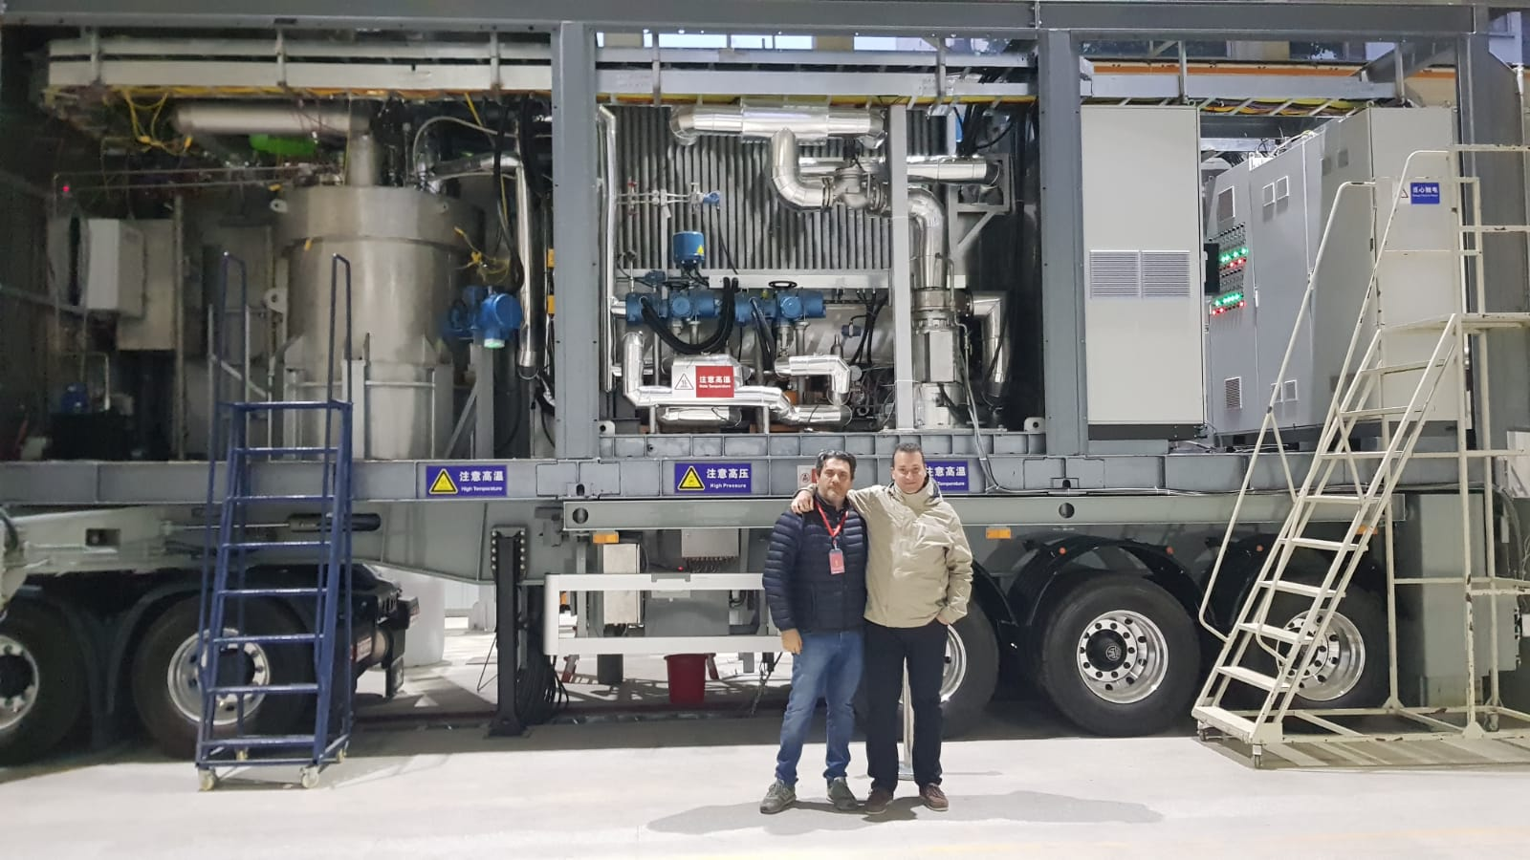
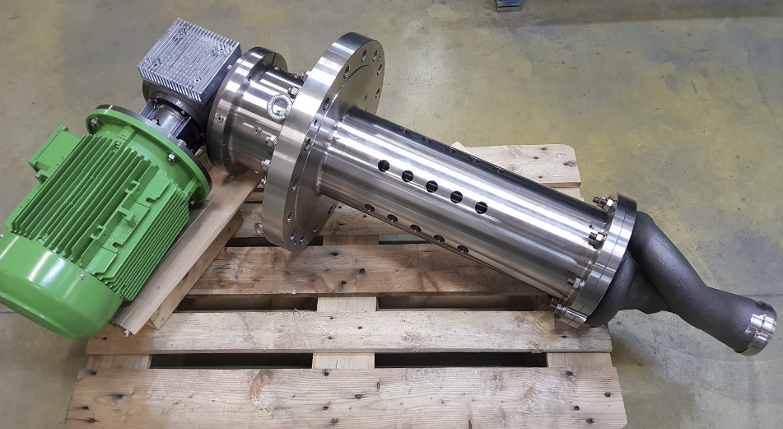
CLEAR-M1x Facility
LBE pool-type facility (movable facility installed on truck)
> tons of LBE
2,5 MW Thermal Power
LBE flowrate250 kg/s
Operating Temperature 250-550°C
Secondary Side with pressurized water @100 bar
Unique Facility in China
Strong involvement of Italian Supply Chain with SRS as Industrial Architecture
Test Section
Innovative Steam Generator
LBE-Pump
Facility Overview
Courtesy of Mariano Tarantino

Slide 19
Discussion and Conclusions
Collaboration between ENEA and CAS traces back more than two decades and encompasses scientific and technology research in the fields of controlled thermonuclear fusion and next generation fission reactors.
Existing collaborations focus on the realization of experimental infrastructures, such as BEST (ASIPP, Hefei) and DTT (Frascati), and studies of Gen-IV fission reactors
Common research projects offer rich opportunities for National Laboratories, Universities as well as public-private-partnership
Long term commitment in these activities emphasizes the crucial importance of training and education as fundamental elements for promoting cooperation.

