Slide 1
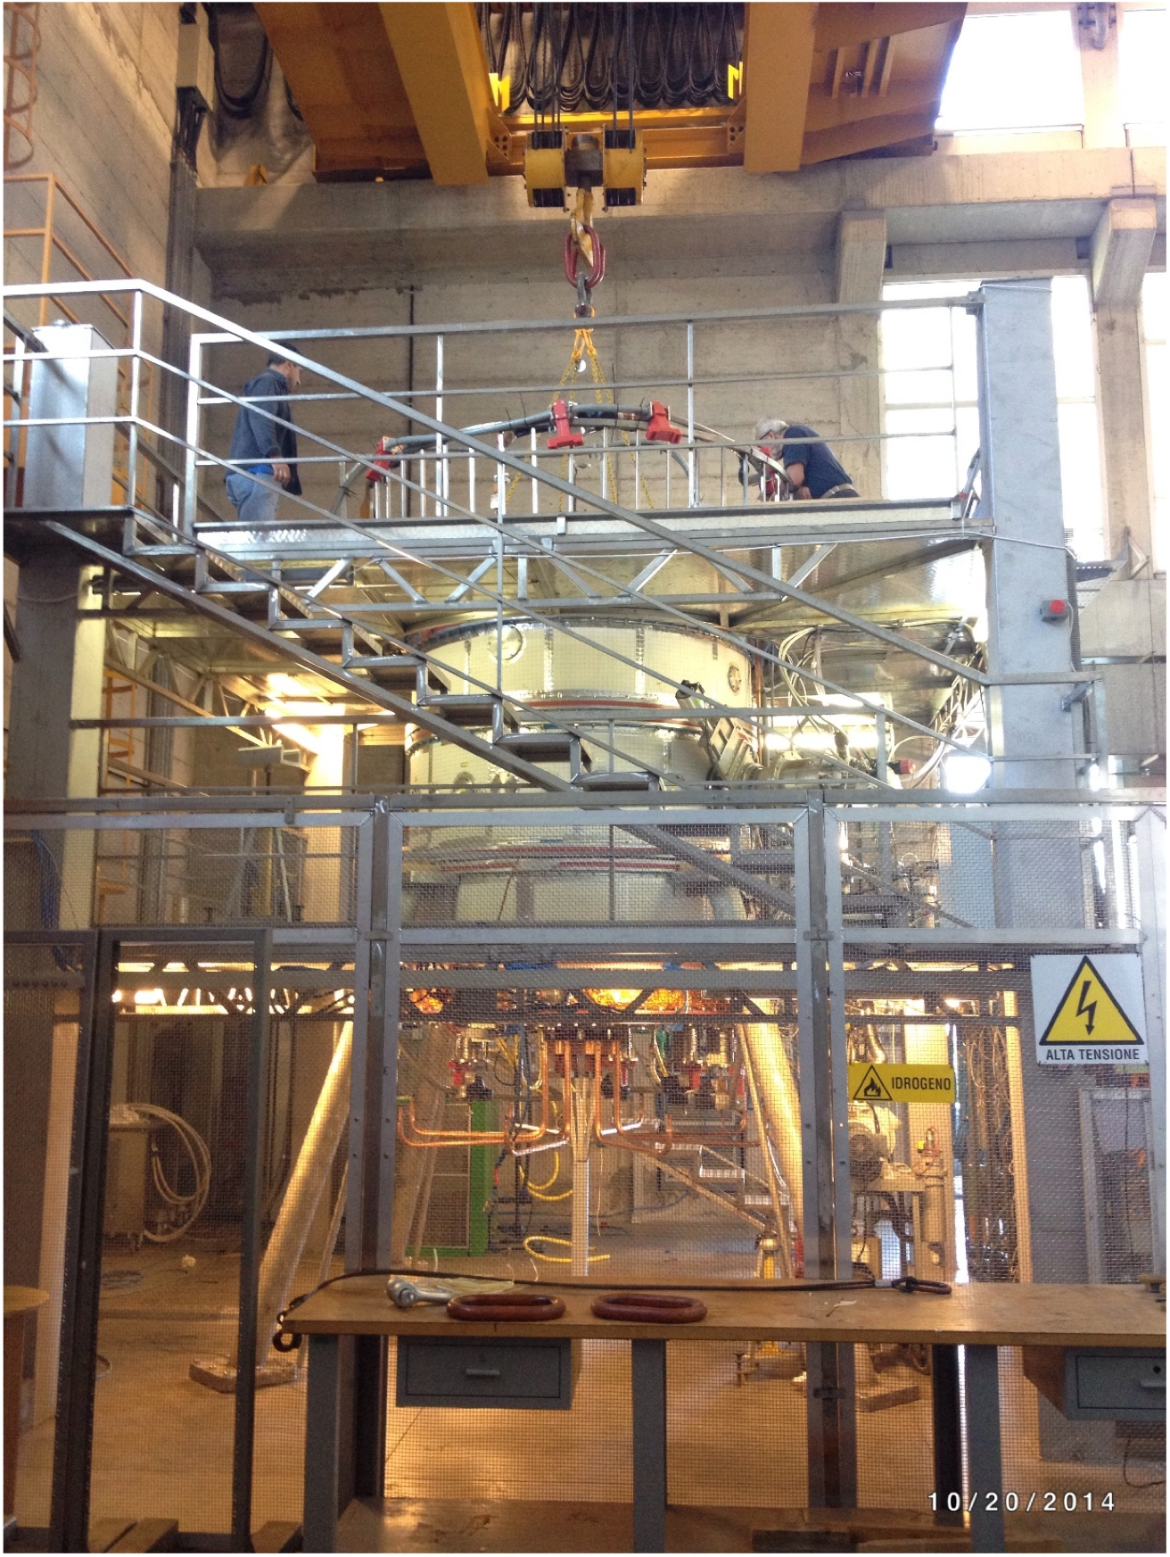
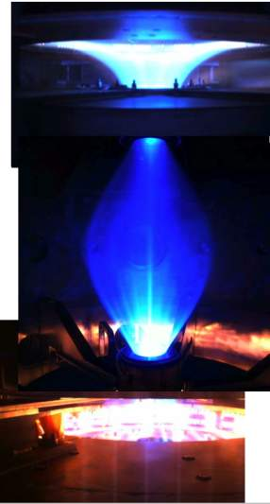

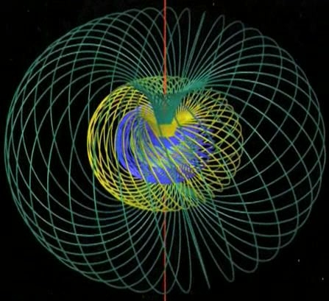
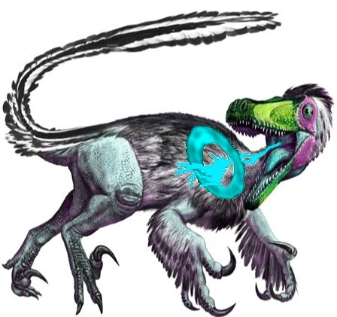


The plasma centerpost obtained in the PROTO-SPHERA experiment
F. Alladio, L.Boncagni, F.Causa, F.Crescenzi, E.Giovannozzi, A.Grosso, A.Lampasi,
G.Maffia, A.Mancuso, P.Micozzi, V.Piergotti, G.Rocchi, A.Sibio, B.Tilia, V.Zanza
Centro Ricerche ENEA, Frascati C.P. 65 (Roma) franco.alladio@enea.it
ICPP 2016, Kaohsiung, Taiwan A2P1-5 2016/6/28 MCP-Oral

Slide 2
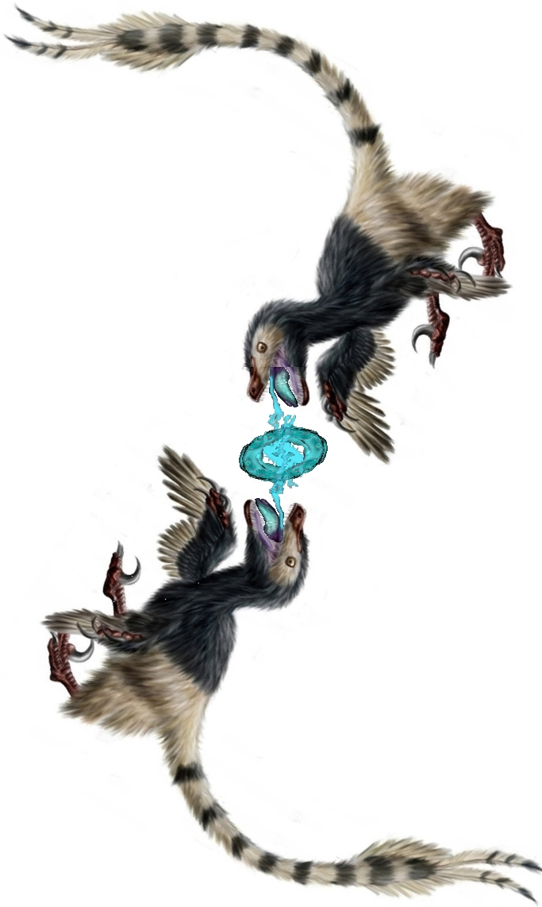
二龍戲珠 èrlóng xìzhū
…two dragons a playing with a pearl
Outline
How to form a Spherical Torus around a Plasma Centerpost:
1994-1997
Before the construction of the experiment
two issues were addressed: 1997-2002
• reliability of electrodes
• ideal MHD stability of the magnetic configuration
An old vacuum chamber, as a gift from Great Britain,
started the construction of the experiment: 2003-2013
PROTO-SPHERA got its first plasma centerpost: 2014-2015

Slide 3

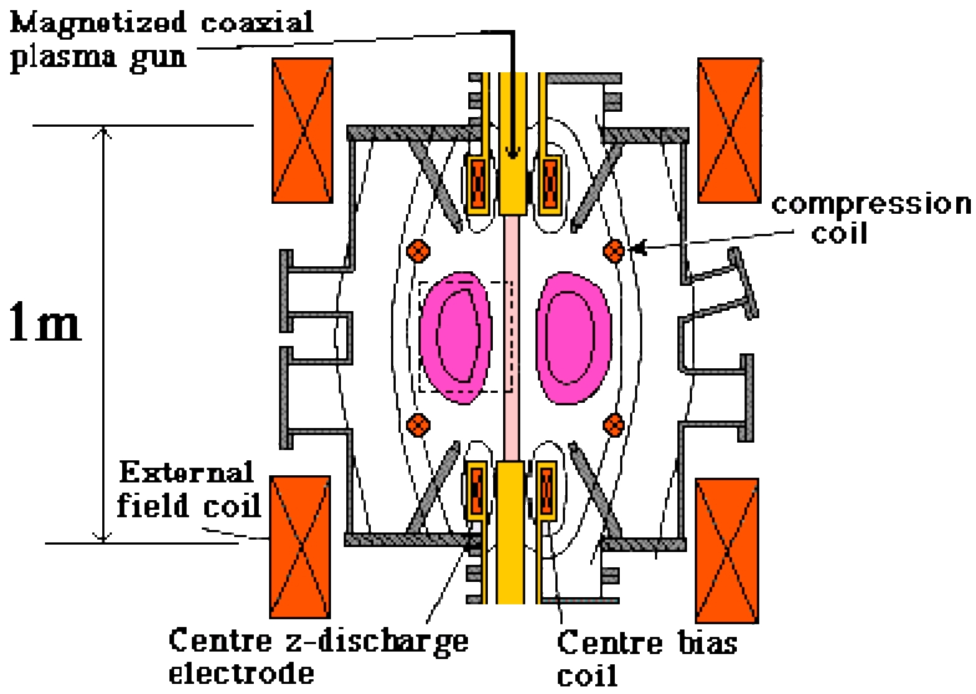
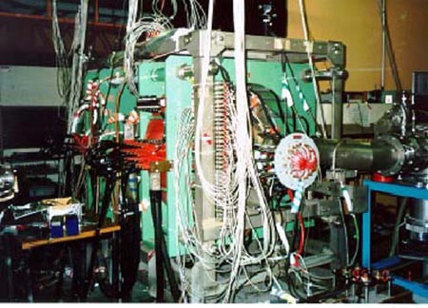
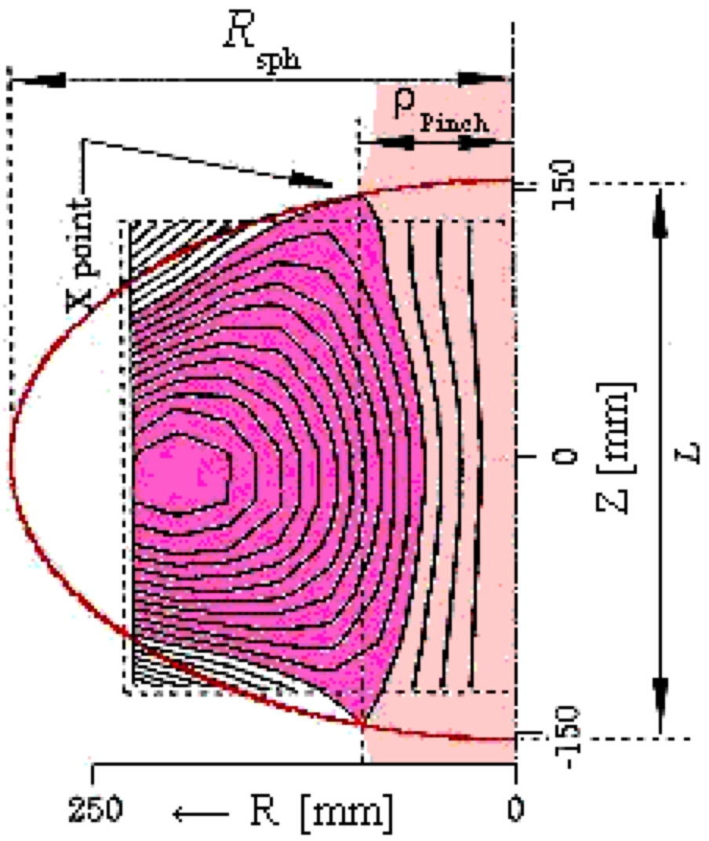
TS-3 experiment at the Tokyo University:
it studied magnetic reconnection of plasma toroids around a metal centerpost
Yasuchi Ono
In 1993 TS-3 removed the metal centerpost, applied 1kV
between two plasma guns (used as cylindrical electrodes) and produced a
”Plasma Centerpost” carrying a plasma current I_{e} =40kA,
which through non-linear “kink” instability engendered
around itself a Spherical Torus (ST)
carrying a toroidal plasma current 50 kA<I_{ST}< 100 kA
60 µs formation
20 µs sustainment
total duration 80 µs ∼100 τ_{Alfvén}<τ_{res} resistive time

Slide 4
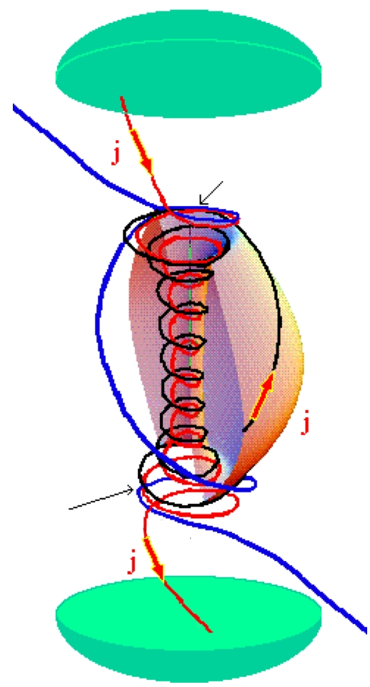
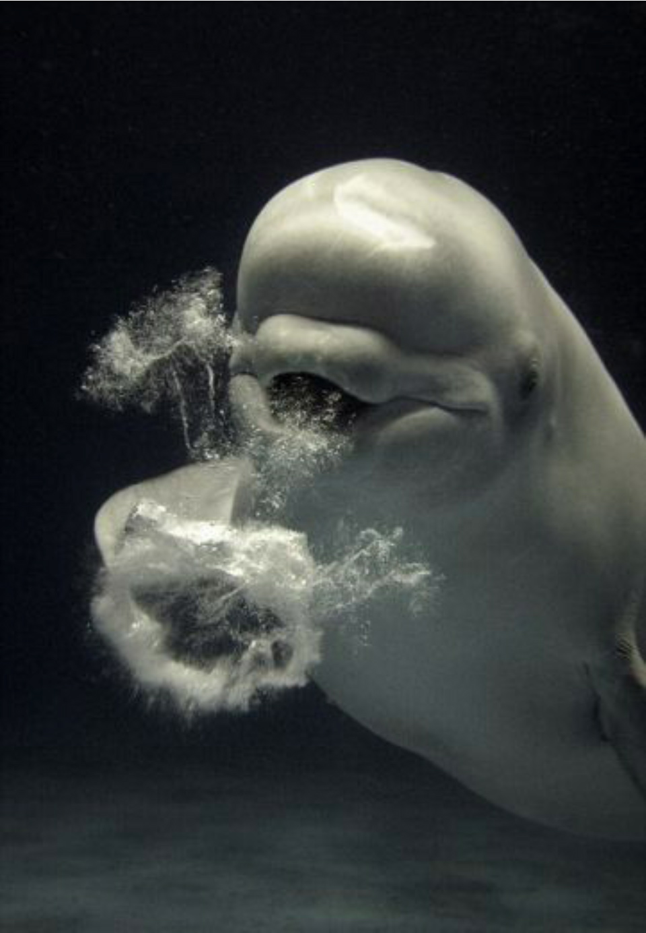
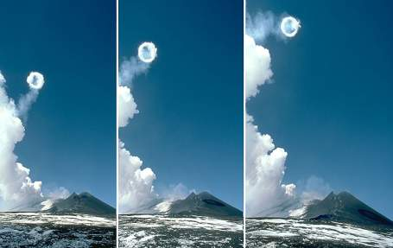
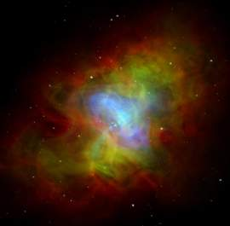

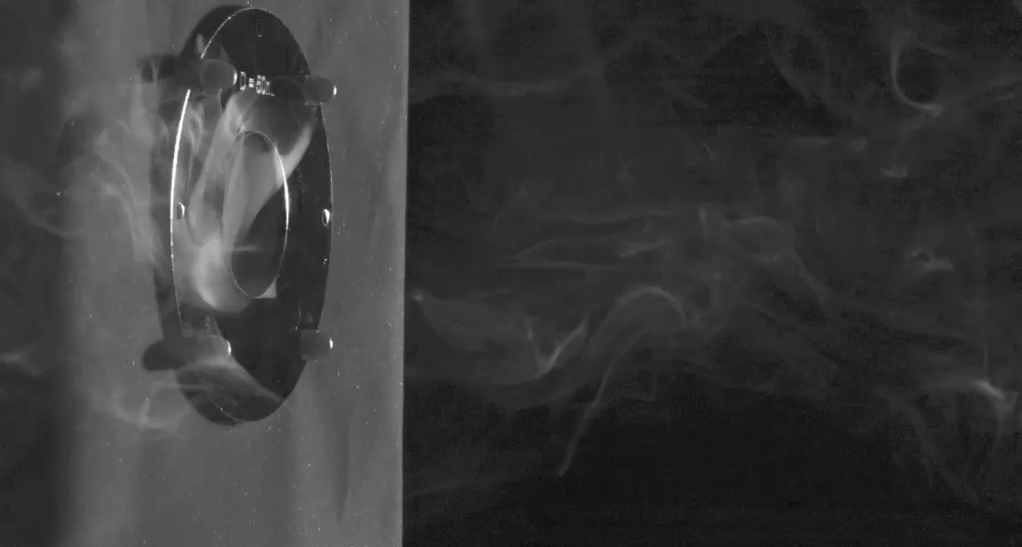
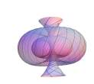
Helicity injection to sustain the plasma torus: relaxation of Plasma centerpost forms & sustains the ST (how efficiently? ...experiment!)
Anode
• in front of the electrodes: open magnetic field lines,
• open magnetic field lines wound in a circular direction too
• Magnetic reconnections convert open , lines into
closed , lines wrapped around a Spherical Torus (ST)
Magnetic
reconnection
ST
“Smoke-ring like
self-organization”
Etna Volcano
Magnetic
reconnection
Cathode
William Irvine-University of Chicago
Beluga
Crab Nebula

Slide 5
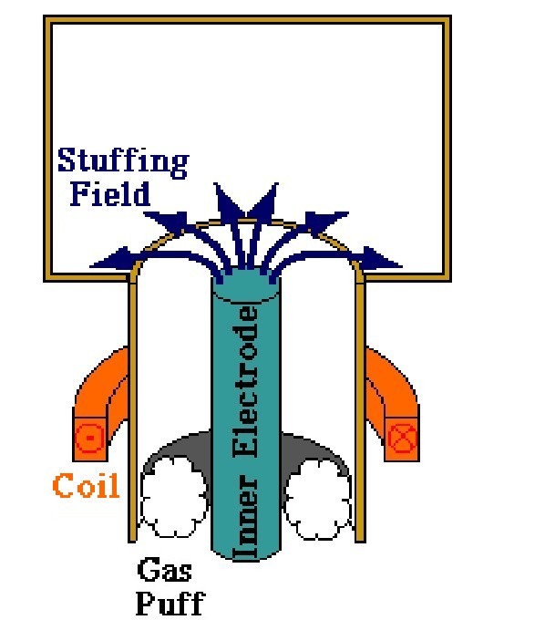
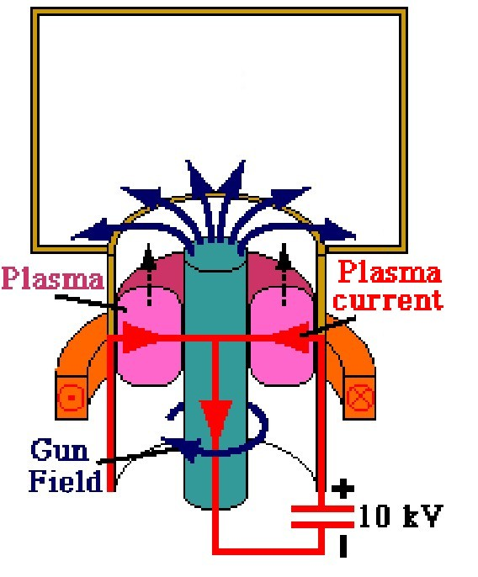
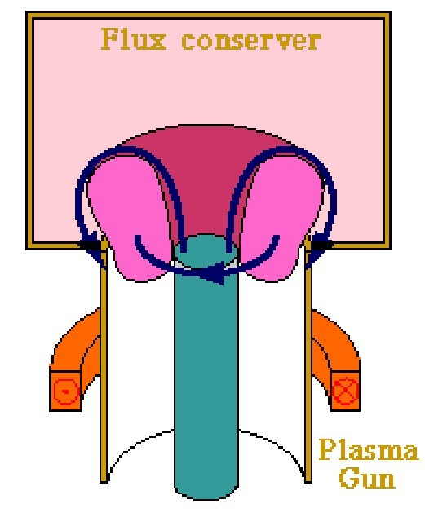
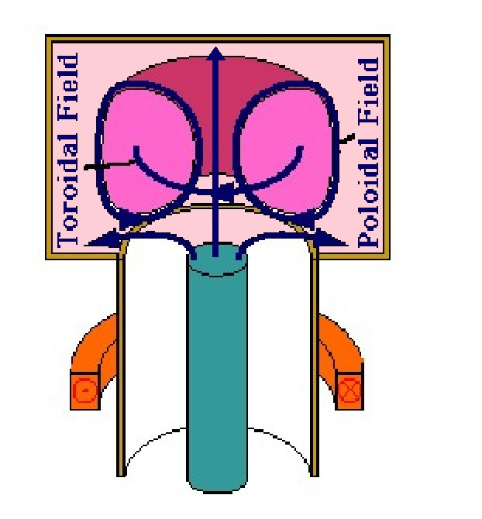
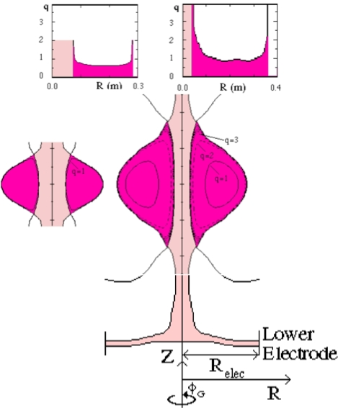
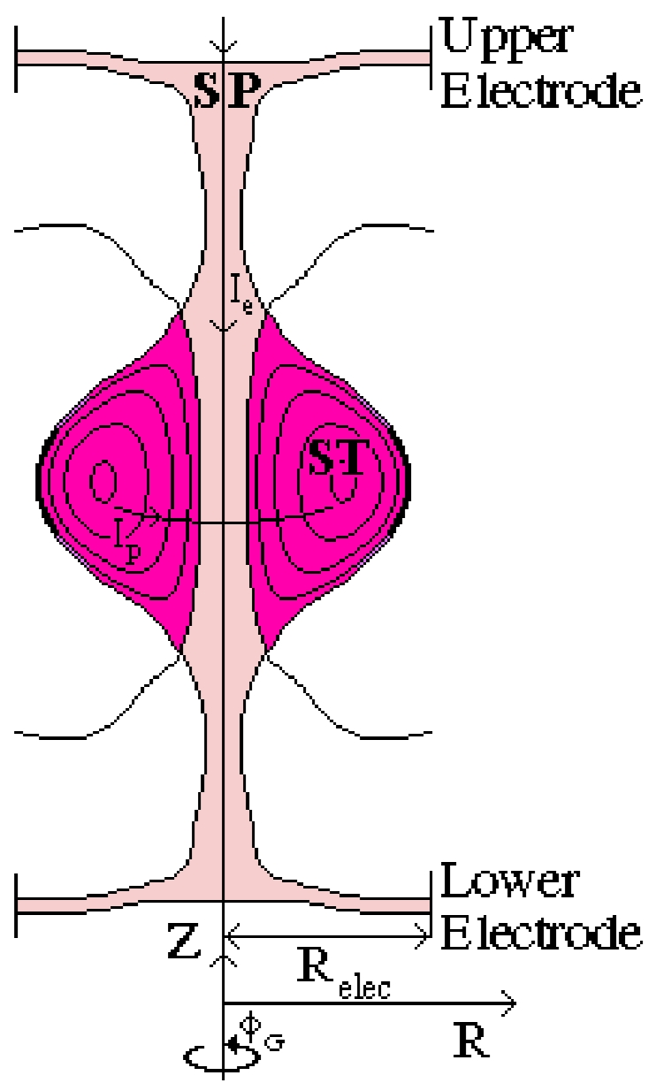
GUN INJECTED FLUX-CORE-SPHEROMAKS
Breakdown in small spaces, with extremely high filling pressures and many kV voltages
Neutrals and impurities are released from the gun
After the formation,
the Spheromak
is accelerated and expanded into a flux conserver
field errors already present in the gun are amplified
PROTO-SPHERA
Designed to get a Tokamak-like
MHD safety factor (q₀≥1, q_{edge}~3)
(A=R/a≥1.2, κ=b/a~2.3)
PROTO-SPHERA formed “slowly”
as a prolated low aspect ratio
Spherical Torus (ST) from the
pre-existing plasma centerpost
mushroom-shaped in front of electrodes
Breakdown at low voltage 100 V, big vessel
TS-3
PROTO-SPHERA

Slide 6
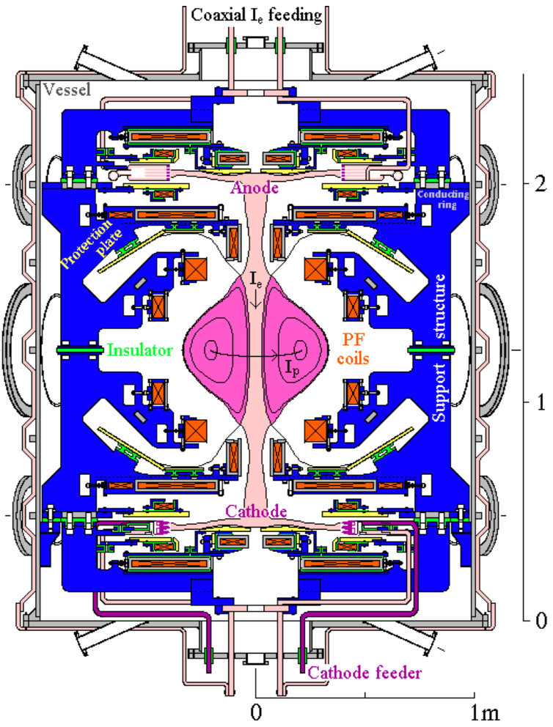
2001 PROTO-SPHERA final design report
PROTO-SPHERA parameters:
SP centerpost current I_{e}=60 kA
ST toroidal current I_{p}=120÷240 kA
ST diameter 2R_{sph}=0.7 m
MHD safety factor q₀≥1, q_{edge}~3
Sustainment τ_{res}>70 ms resistive time
(…experiment will tell)
Quasi-separate
chamber for anode
Spherical Torus
chamber
Electrode plasmas ~separated from main plasma: large number (18) of PF (poloidal field) coils
Quasi-separate
chamber for cathode
Two main problems had been solved:
• building durable electrodes
• restrictions imposed by the ideal MHD stability
F. Alladio, P. Micozzi and F. Rogier
Ideal MHD stability of flux-core spheromaks
ICPP2000, Quebec City (Canada)

Slide 7
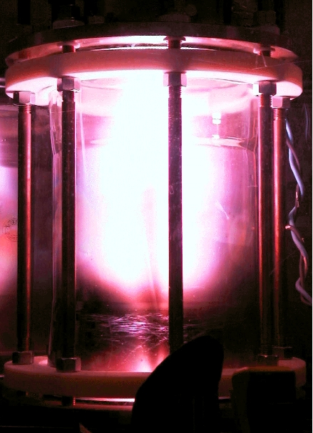
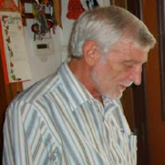
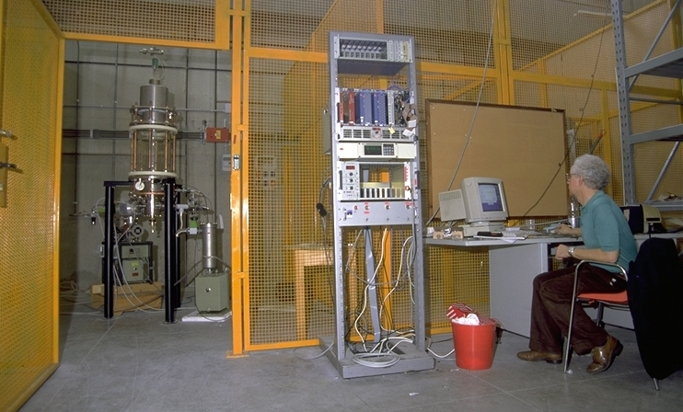
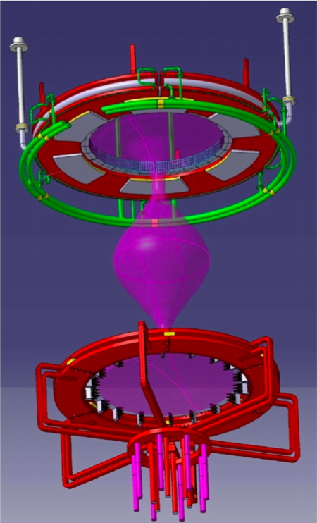
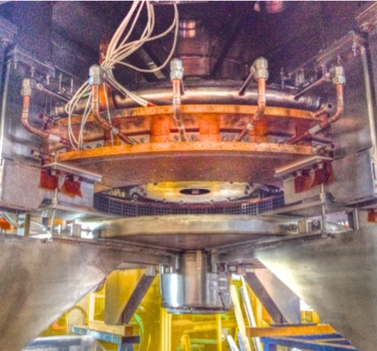
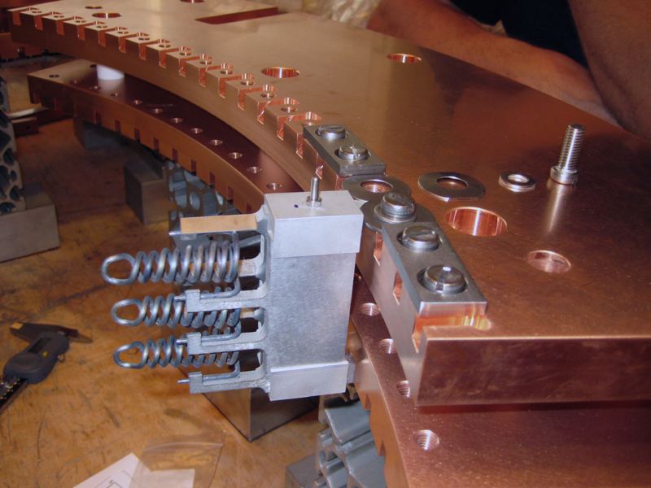
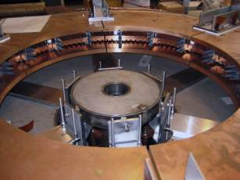
In the years 1998-2000,
PROTO-PINCH testbench
found the recipe for the
electrodes of PROTO-SPHERA.
although they were simple
cylindrical electrodes
Livio Bettinali ENEA
Alessandro Mancuso ENEA
• low (100-200 V) voltage on electrodes
• tokamak-like density
Gas puffed hollow anode
Modular annular electrodes:
plasma current density j_{e}=1MA/m²
power density P_{e}=20÷30 MW/m²
plasma centerpost at electrode
interfaces mushroom-shaped
W- directly heated cathode

Slide 8
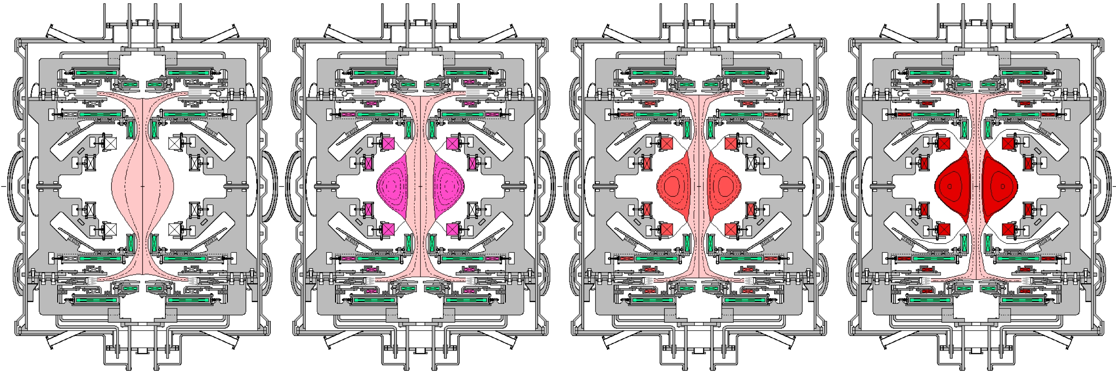
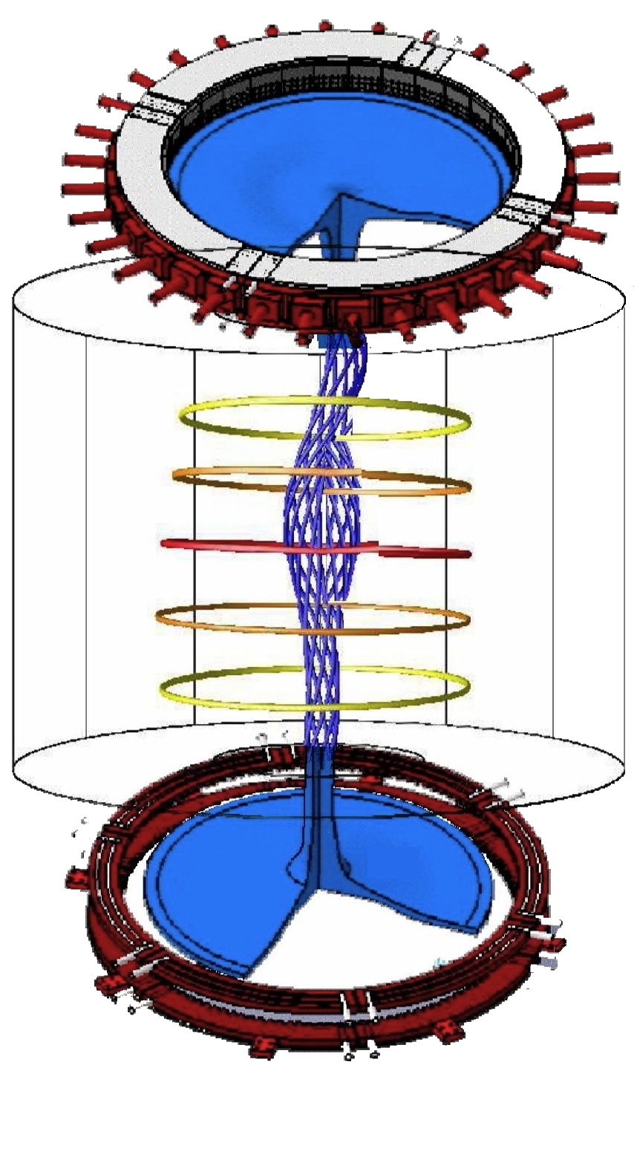
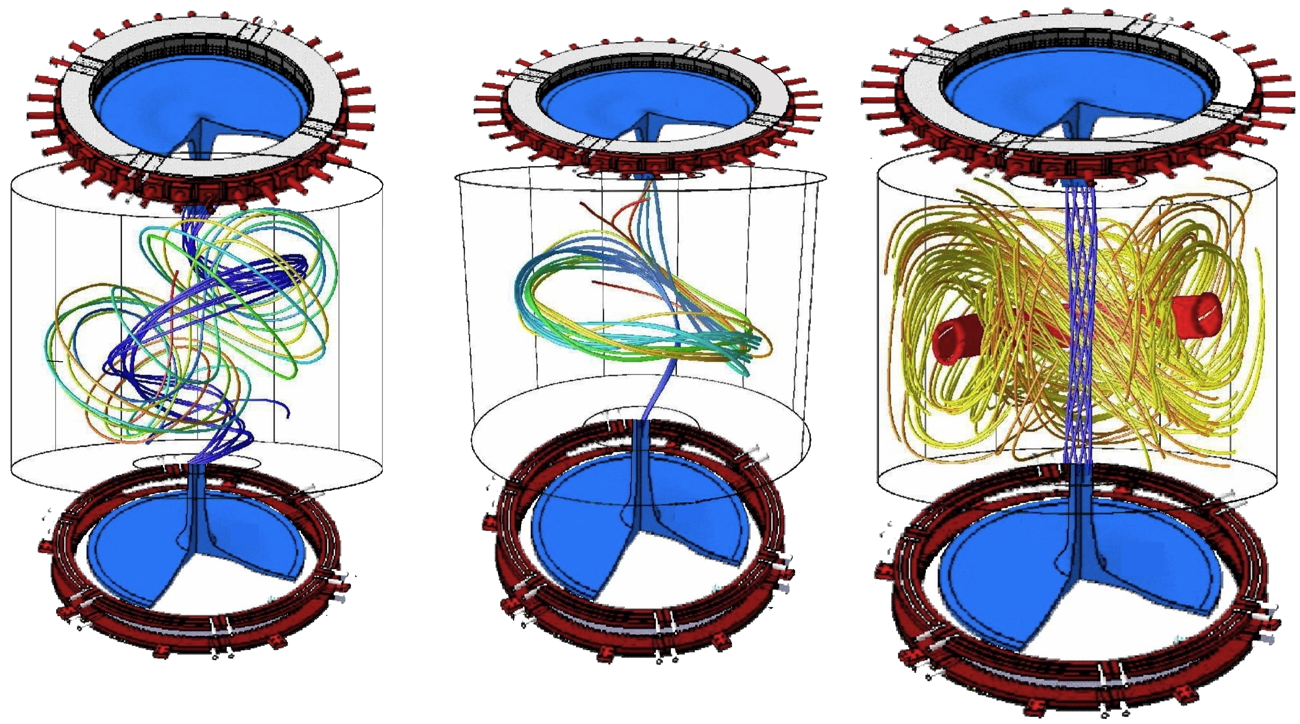
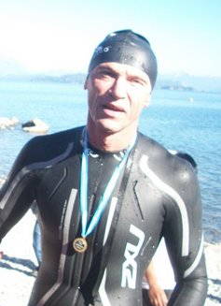
Plasma centerpost I_{e} 10 → 60 kA …ST plasma formation ... Calculated assuming axisymmetric equilibria
0.6 ms increase of Group A current induces in ST → I_{ST}=120kA, then Helicity Injection → I_{ST}=240kA
Formation time scale (τ_{Alfvén}•τ_{Resist})^{1/2} ~ 0.6 ms
from τ_{Alfvén} ~ 0.5 μs
τ_{Resist} ~ 70 ms
Resistive MHD
simulations of
ST formation
by Ricardo Farengo
(ISTW2008-Frascati)
Ricardo Farengo
CNEA Bariloche
(Argentina)
Non-axisymmetric calculation of ST formation

Slide 9
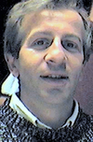
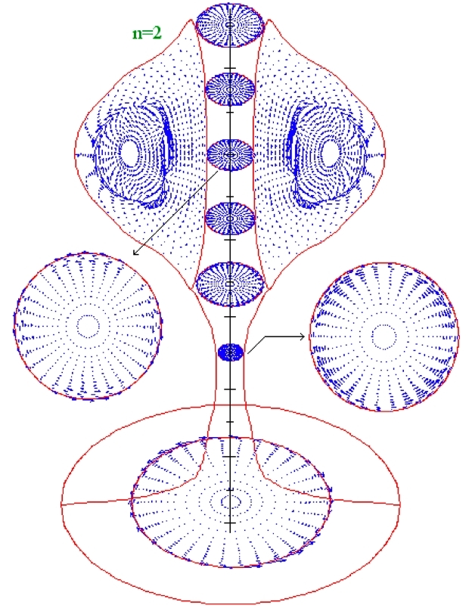
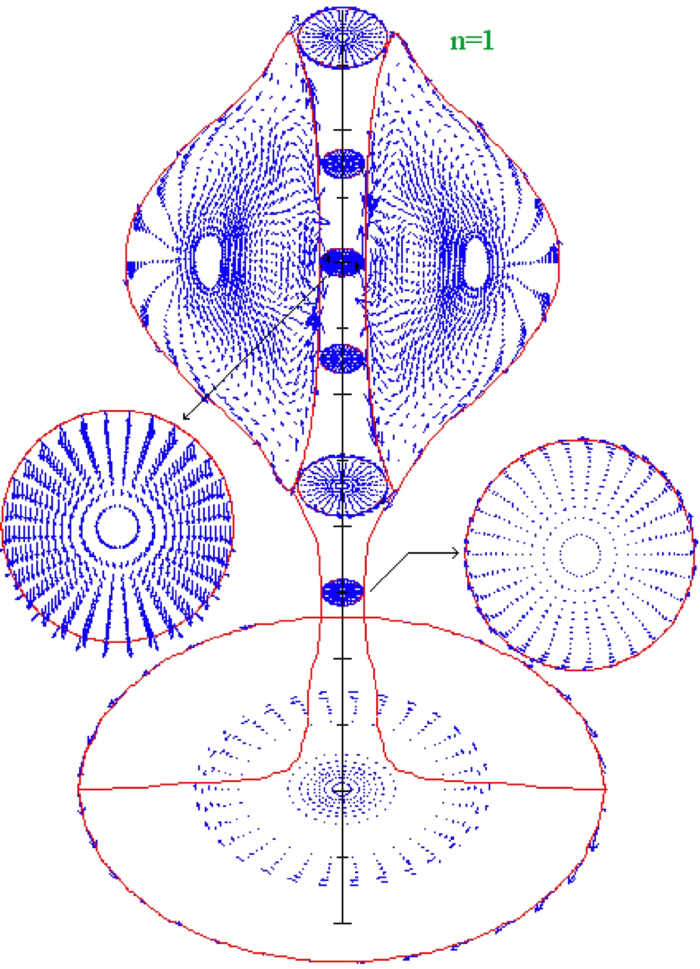
IDEAL MHD STABILITY of PROTO-SPHERA: the results
For low toroidal numbers n=1, 2 & 3
ideal MHD stability obtained
expressed with
ratio of the two plasma currents I_{ST} /I_{e}= toroidal ST current/centerpost current
up to β = 21÷26% , I_{ST}/I_{e}= 0.5 - 1
up to β = 14÷15% , I_{ST}/I_{e}= 2-4
expressed with
up to β_{T0}=28÷29% , I_{ST}/I_{e}= 0.5 - 1
up to β_{T0}=72÷84% , I_{ST}/I_{e}= 2-4
Ideal MHD analysis to assess I_{p}/I_{e} & β limits
(Micozzi P. et al., 2010 Nucl. Fusion 50 095004)
François Rogier
ONERA-Tolouse
Centerpost current I_{e}= 60 kA
and ST current I_{ST}= 120 kA: I_{ST}/I_{e}=2
The instability is limited to n=2, 3
driven by q=3/2 resonance at β = 25%
Centerpost current I_{e}= 60 kA
and ST current I_{ST}= 240 kA: I_{ST}/I_{e}=4
The instability extends to n=1
driven by centerpost kink at β = 23%
F. Alladio, A. Mancuso, P. Micozzi and F. Rogier
Ideal MHD stability calculations in presence of magnetic separatrices ICPP 2004, Nice (France)

Slide 10
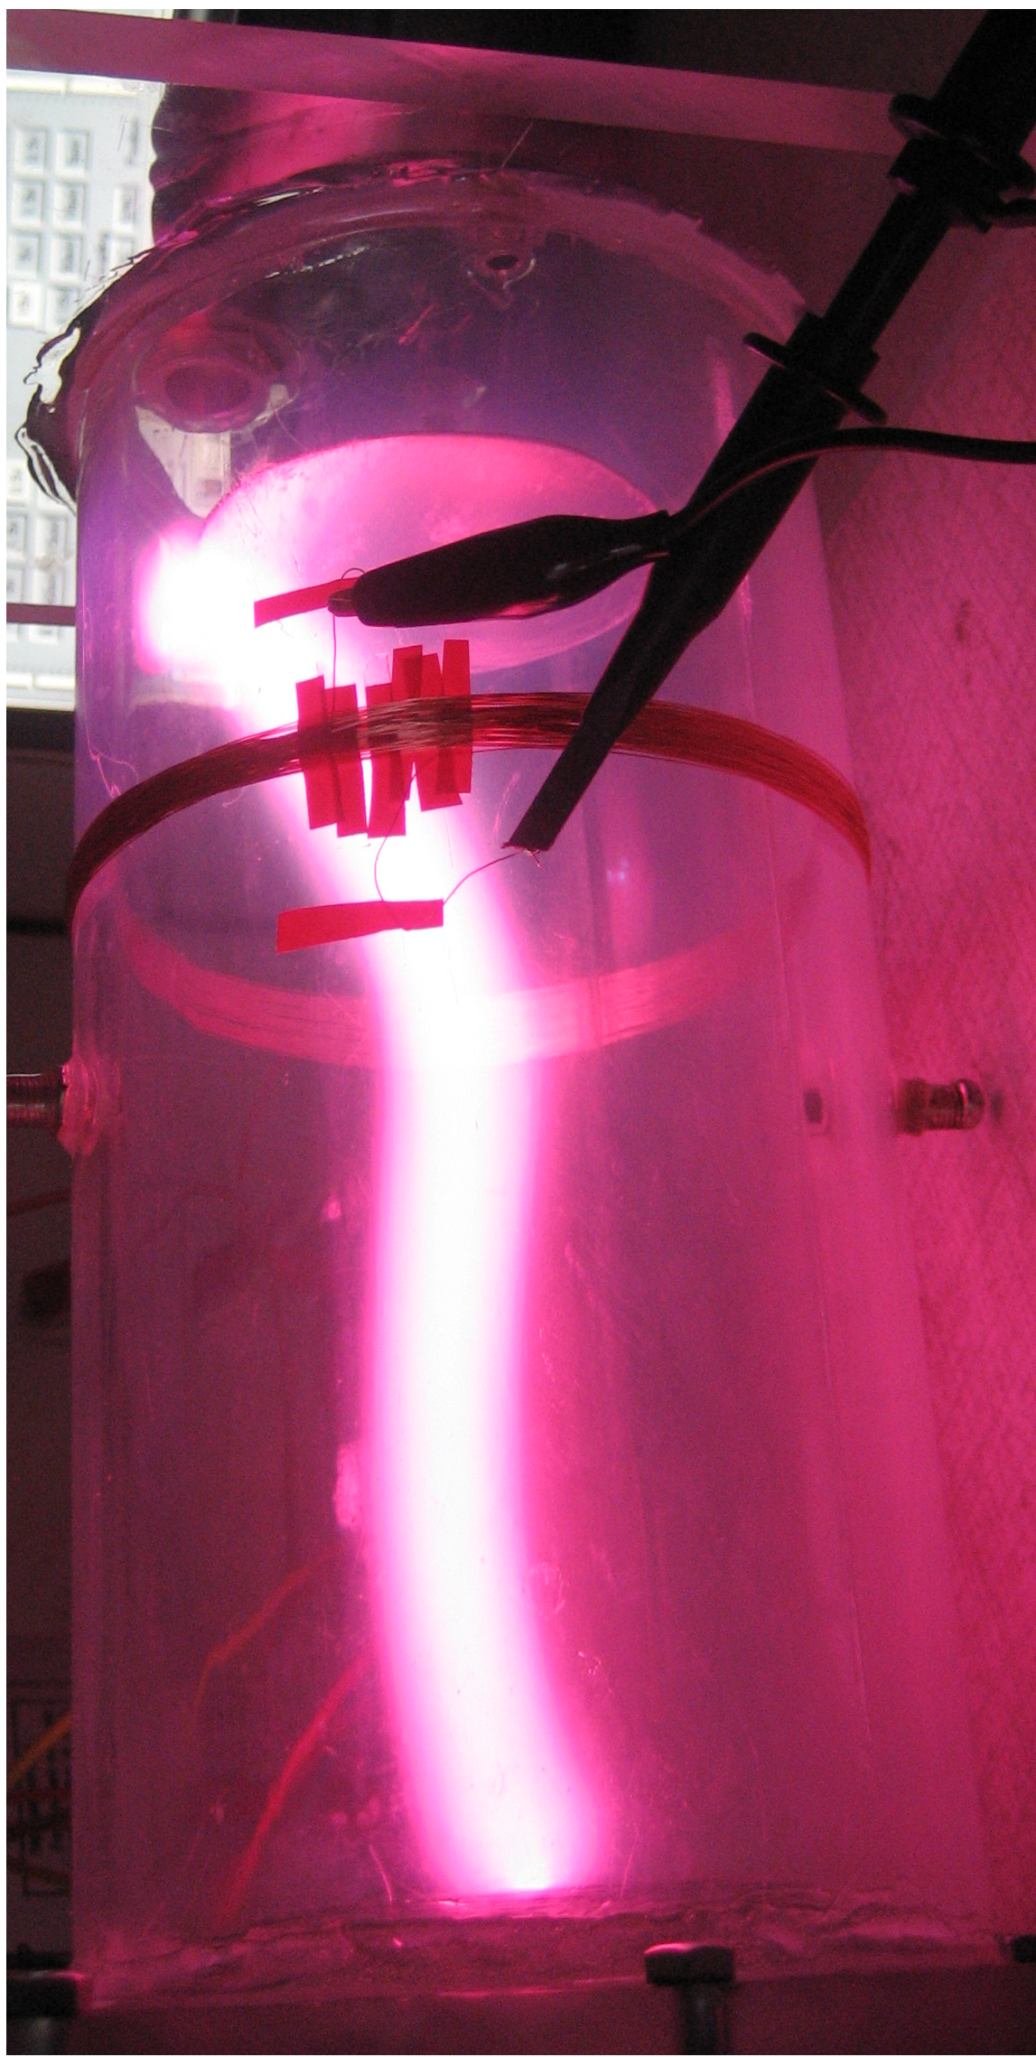
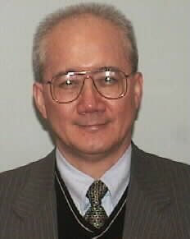
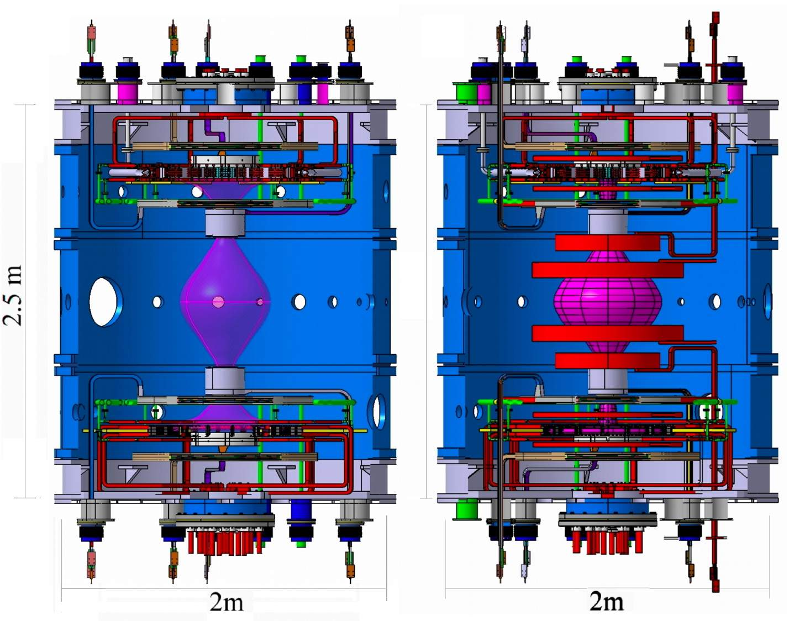
In 2002 at Frascati an International Workshop,
chaired by Martin Peng, advised to build in two steps:
• first step: check Plasma Centerpost’s feasibility
• second step: the machine would have been
completed such as to produce the Spherical Torus
Anode arc anchor
was feared, as it
is often observed
in arc welding,
plasma torches…
Martin Peng
Phase1: 8 PFcoils
Centerpost shape
Phase 2: 8 PF shaping coils
+ 10 PF compressing coils
The PF coils have been designed as two sets, each connected in series
Group B (4+4 coils): Centerpost shaping PF coils …thick AISI casings (τ~2ms), now inside machine
Group A (5+5 coils): ST compression PF coils …not yet built thin Inconel casings B diffusion in τ~200 µs

Slide 11
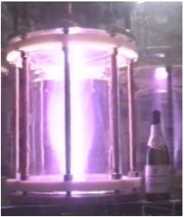
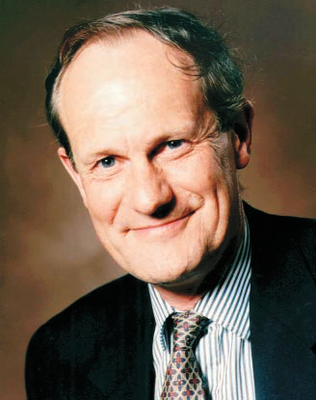
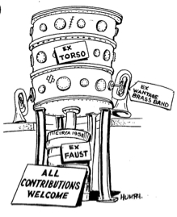
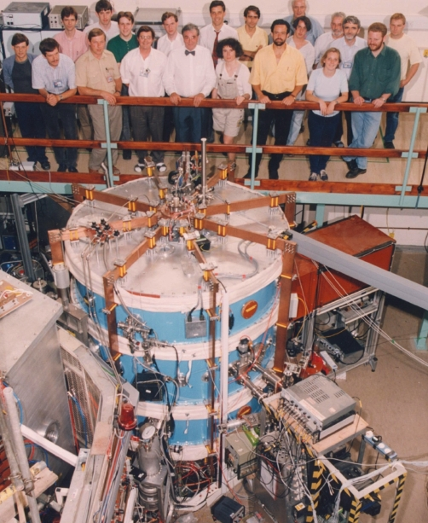
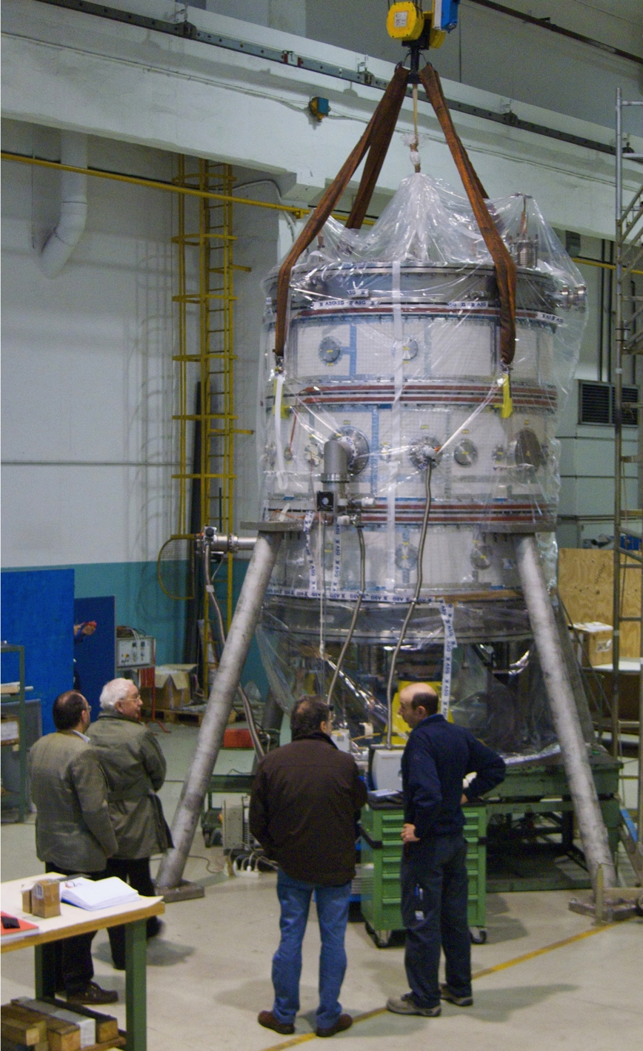
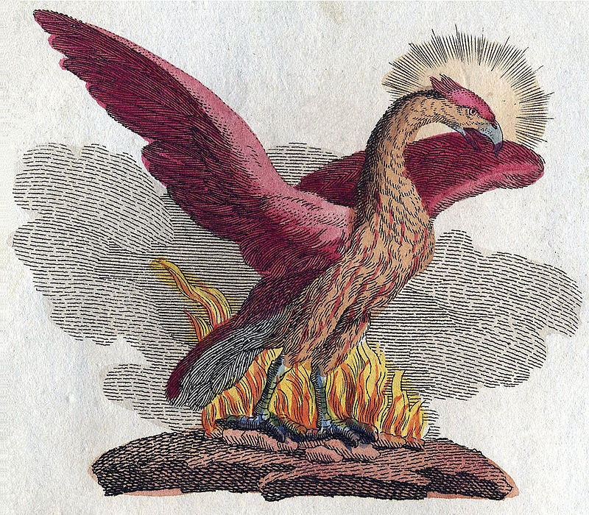
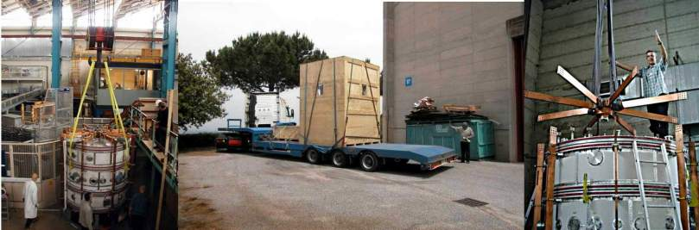
Derek Robinson
1941-2002
Derek Robinson (director of Culham from 1991)
was very interested in the “Champagne bottle”
experiment: in 1999 he proposed to build at
Culham PROTO-SPHERA inside the START vessel
PROTO-SPHERA 2010
Torsatron Torso (Culham) 1975
START 1991
From Culham the old vacuum vessel found its way to Frascati 2004

Slide 12
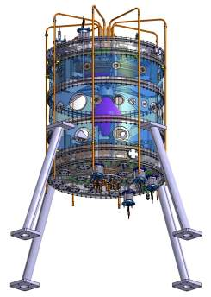
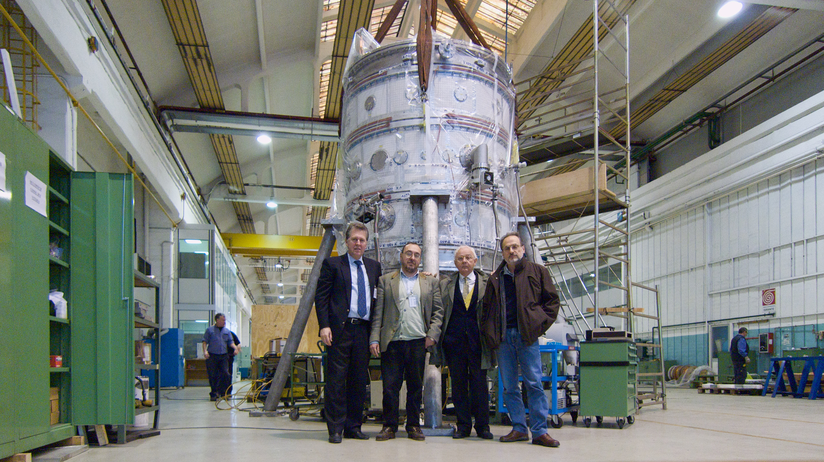
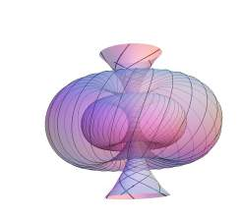
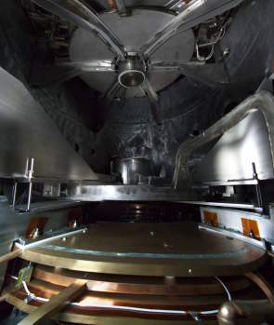
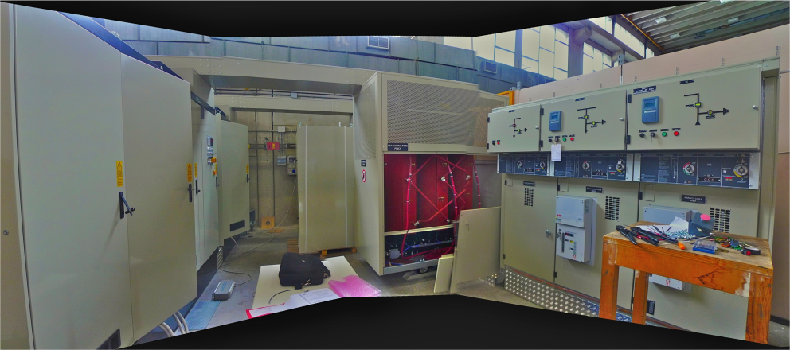
PROTO-SPHERA was built (2006-2009) by ASG Superconductors of Genoa, cost 1 M€
Years 2004 - 2010:
…from ideas …to detailed design …to hard metal
• Cathode heating 6 x(1.7 kA,25 V)rms
• PF coils: 2kA, 350 V
• Plasma centerpost: 10 kA, 350 V
Anode
PF2 coils
Throttles
Cathode
Electrical power supplies built by EEI of Vicenza, cost 0.7 M€
Years 2011 - 2014:

Slide 13





May 2015 annular
anode lowered
on top of machine
up: hollow gas-puffed anode
down: 3000º K heated cathode
present stage cathode
(18 x 3 emitters): aim 10 kA
final stage cathode, 6 x present
(108 x 3 emitters): aim 60 kA
“Caduceus”-like emitting spirals
have now survived > 1000 cycles

Slide 14



Only the PF coils necessary for setting up
the plasma centerpost have been built
8 PF coils in series
inside the machine
Stainless steel
up\down
new extensions
PF4up
anode
PF3up
PF2up
annular shape
Aluminium cylindrical
START vessel
Plasma current must run
through both PF2 throttles
PF2low
PF3low
annular shape
cathode
PF4low
Stainless steel
up\down new lids
vacuum vessel is GND potential PF coils casings built as floating,
can be connected to potentials: anode +， cathode -，vessel 0

Slide 15



A good surprise:
no anode arc anchoring
hollow annular anode performs
• plasma goes through both PF2 throttles
• plasma enters anode gas-puffing holes
• no sign (I < 3.5 kA) of anode attachment
• filling pressure 10⁻³ - 10⁻² mbar
Argon plasma: break-down 80 V
annular anode plasma is never filamented
whereas annular catode plasma is
filamented (due to sparse emitters）
anode camera
cathode camera
even plasma centerpost is in part filamented

Slide 16

Electrostatic plasma effects
The electrostatic potential distribution is dominated by the plasma
the magnetic field is up\down symmetric but the electrostatic field is not up\down symmetric
and is different near the anode or near the cathode
Plasma-induced electric potential:
near the annular anode
the E field is in part perpendicular
to the B field
... E X B azimuthal plasma rotation
… starting from PF2up throttle
v_{ExB}=(E/B) ~ 10⁴ m/s ~ v_{drift} ~ v_{thi}
near the annular cathode
the E field is parallel to B field
… no E X B plasma rotation
vacuum vessel at GND 0V

Slide 17









May 2015 annular anode experiment
half of the plasma current: (1kA\2kA)
was going around the required path due to
equatorial X-point inside the vessel
Argon plasma
breakdown 80V
Hydrogen plasma
breakdown 180V
Shot 78
discharges along field lines near X-point

Slide 18



The equatorial X –point has been removed from inside the vessel
4 external PF coils have been added (home-made from spare connection cables)
…and fed in series with the internal PF coils (PF coils power supply has sufficient margin)
4 external PF coils
plasma fired after 0.75 s of PF current to allow for skin currente diffusion in Al vessel and SS lids

Slide 19




October 2015 experiments with external PF coils:
Argon discharge reaching 3 kA for 0.15 s
the whole plasma current runs through both PF2 throttles
Shot 205
plasma fired after 0.75 s of PF current
(skin current time to remove X-point from inside vessel)

Slide 20


• straighter grounding of lower PF coils
• flowing current only in the two external PF coils nearer to equator
allows for a better filling of the cathode and quieter centerpost plasma
voltage spikes have been eliminated on PF2/3low,
after 1 V amplitude jump even small sparks vanish
Argon plasma 2kA
Shot 227

Slide 21



CKF configuration is a possible evolution of the Proto-Sphera concept
Degenerate X-points on Proto-Sphera anode (and cathode) are nozzles
Different orbits of co\counter-circulating charged fusion products
…preferential thrust through one of the two degenerate X-points
n_{α} charged fusion product density
2015 experiment
CKF found to be ideally MHD stable up to β=1
…promising for future fusion space thrusters?
F. Rogier, G. Bracco, A. Mancuso, P. Micozzi, F. Alladio
Simply Connected High-beta Magnetic
Configurations ICPP 2002, Sidney (Australia)
Proto-Sphera: a CKF whose
surrounding Plasma terminates upon electrodes
and whose Secondary Tori are substituted by PF2/3 coils

Slide 22

To be build after 10 kA plasma centerpost routinely achieved
Group B: shaping coils (4+4 series) …existing
Group A: ST compression coils (5+5 series)
Not yet built, but inner vessel ready to host
• high voltage (~20 kV) insulation
thin Inconel casings cost ~ 0.5M€
Tungsten filaments (54 → 324) cost ~ 0.2M€
Final Power Supplies for:
1) Group A PF coils cost ~ 0.1M€
2) Cathode (current 10 → 60 kA)cost ~ 0.2M€
3) Screw Pinch (I_{e} 10 → 60 kA) cost ~ 0.6M€
SuperCapacitors will be used
Cost up to now ~2.0 M€
Cost for final stage of experiment ~1.6 M€

Slide 23
Status
PROTO-SPHERA is producing its first centerpost plasmas …better late than never!
Hollow gas puffed anode is a success, no any anode arc attachment
(plasma induced electrostatic effect, E x B drift rotation of the plasma)
Target 8.5kA in plasma centerpost: 3.5 kA = 40% has been sustained in Argon plasma
To achieve full current of 8.5 kA boundary conditions must be adjusted:
• electrostatically by connecting PF coils casings, built floating with respect to the vessel
• magnetically by additional PF coils external to the vacuum vessel
After Argon centerpost is tamed (80 V breakdown), start fight with Hydrogen centerpost (180 V)
If full current of plasma centerpost(10 kA) is achieved and sustained with 54 sparcely spaced
emitting filaments, then full current (60 kA) will be even better achieved with 324 filaments
First stage of PROTO-SPHERA is only a first step …
…放龍入海! fànglóng rùhǎi
…give a chance to the dragon to show his endowments into the sea!

Slide 24
Perspective
Proto-Sphera will assess a new magnetic confinement configuration
• simply connected (easier construction & maintenance)
• with high plasma β capability
• sustained by magnetic helicity injection instead of ohmic drive
Proto-Sphera can develop this program:
at very low costs ( ~ 1.6M€ + 2M€ already spent)
in a flexible way (new components can be easily added)

Slide 25



















Other authors
(~all of them)

