Slide 1

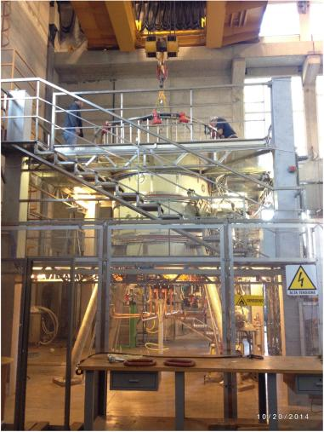
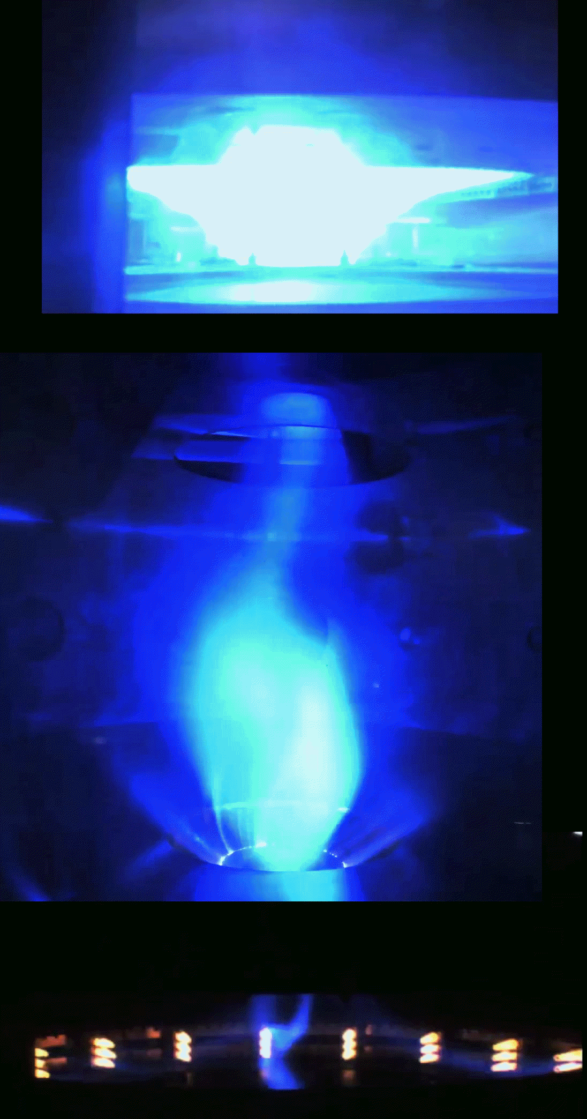
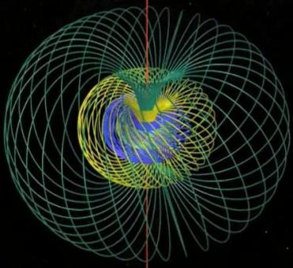
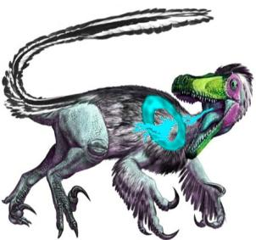

Obtainment of the Phase1 full performances in
PROTO-SPHERA and future perspectives of the experiment
P. Micozzi¹, F. Alladio, G. Apruzzese, L. Boncagni, O. D'Arcangelo, E. Giovannozzi, A. Grosso, M. Iafrati,
A. Lampasi, G. Maffia, A. Mancuso, V. Piergotti, G. Rocchi, A. Sibio, B. Tilia, O. Tudisco, V. Zanza
Centro Ricerche ENEA, Frascati C.P. 65, Rome, Italy ¹e-mail: paolo.micozzi@enea.it

Slide 2
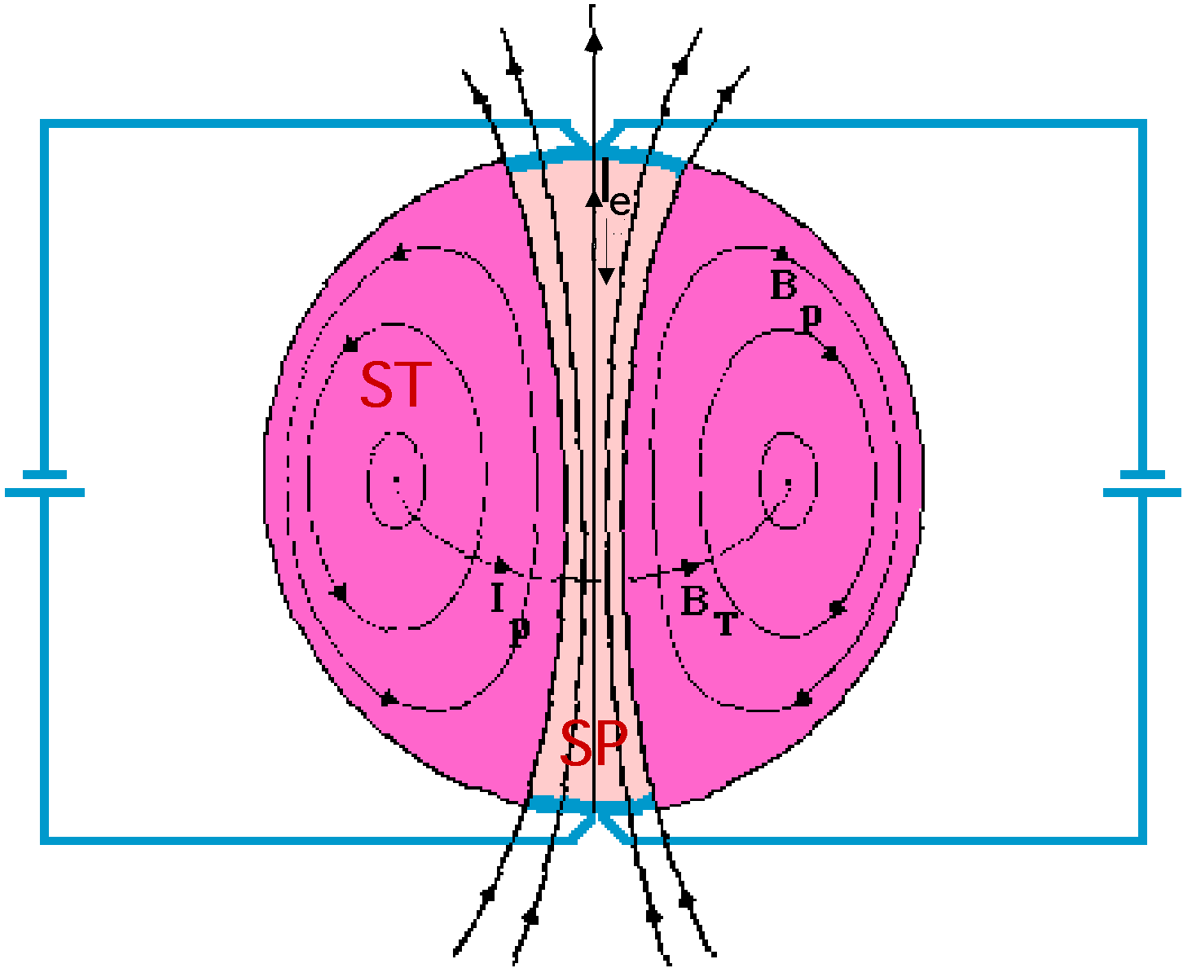
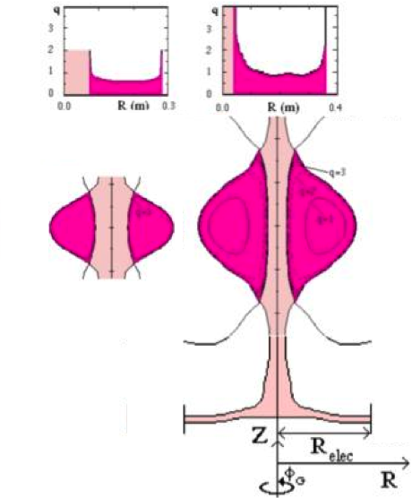
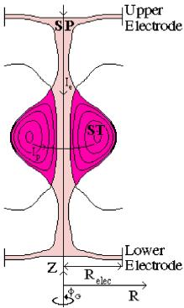
PROTO-SPHERA concept
Substitute the Spherical Tokamak central rod with a Screw Pinch plasma
(I_{TF} → I_{e})
Potentially two conventional ST problems solved:
• Simply connected configuration (no conductors inside)
• I_{p} driven by I_{e} (Helicity Injection from SP to ST)
But Flux Core Spheromaks are:
• injected by plasma guns
• formed by ~10 kV
voltage on electrodes
• high pressure prefilled
• with ST safety factor q≤1
Flux Core Spheromak (FCS)
Theory: Taylor & Turner, Nucl. Fusion 29, 219 (1989)
Experiment: TS-3; N. Amemiya, et al., JPSJ 63, 1552 (1993)
PROTO-SPHERA key differences:
• Designed for a Tokamak-like field-line
rotational trasform (q₀ ≥ 1, q_{edge}~ 3)
(aspect ratio A = R/a ≥ 1.2, elong. k = b/a ~ 2.3)
• PROTO-SPHERA formed “slowly”
as a prolated low aspect ratio
Spherical Torus from the
pre-existing plasma centerpost,
mushroom-shaped in front of electrodes
• At low voltage (~100 V), inside big vessel
TS-3
Tokio University
PROTO-SPHERA
2

Slide 3
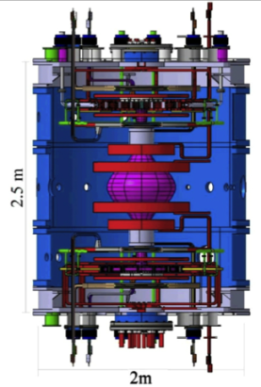
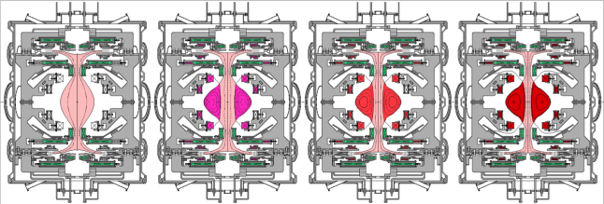
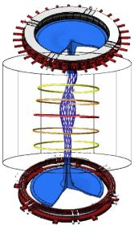
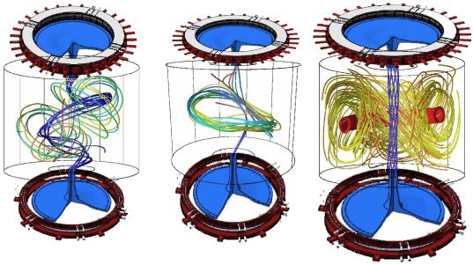
PROTO-SPHERA
Centerpost current I_{e}= 60 kA
ST toroidal current I_{p}= 120÷240 kA
ST diameter 2R_{sph}= 0.7 m
Axisymmetric simulation of ST formation
Formation time scale (τ_{Alfvén}•τ_{Resist})^{1/2} ~ 0.6 ms
from τ_{Alfvén} ~ 0.5 μs
τ_{Resist} ~ 70 ms
Resistive MHD
simulations of
ST formation
Garcia-Farengo, PoP 16,112508 (2009)
and
Ricardo Farengo, ISTW2008 - Frascati
Non-axisymmetric simulation of ST formation
3

Slide 4
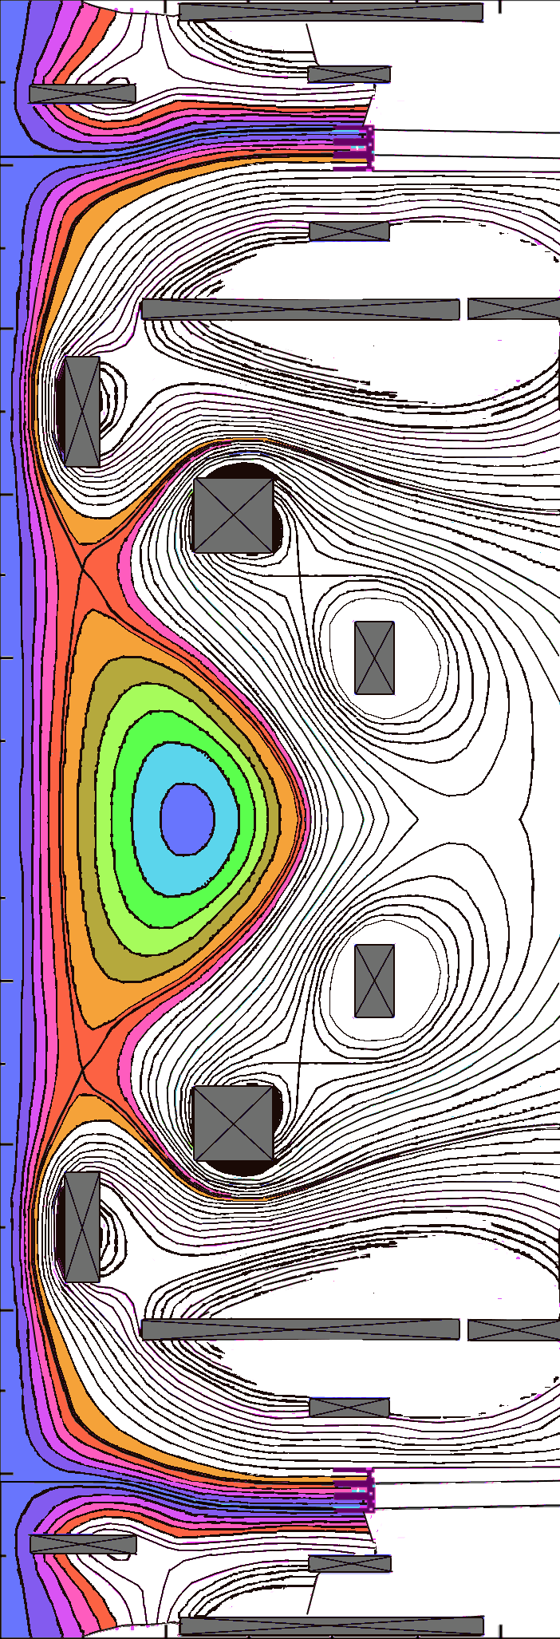
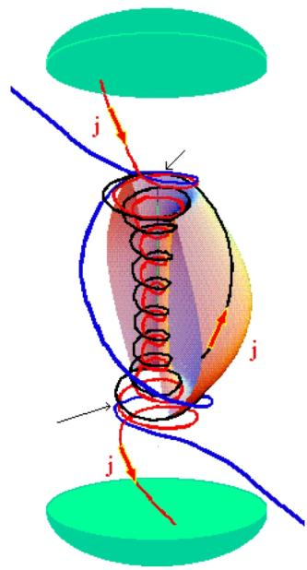
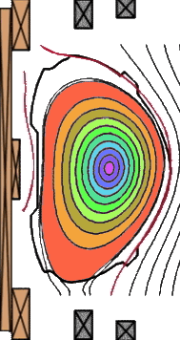


SUSTAIN THE CONFINING CURRENT:
by DC voltage from anode to cathode
Anode
• In front of the electrodes:
open magnetic field lines,
• Open magnetic field lines are wound
in a circular direction
Magnetic
reconnection
• Magnetic reconnections convert
open lines
into closed , lines
wrapped around the spherical torus
Critical points of PROTO-SPHERA:
• I_{ST}= 240 kA (4xI_{e}) really achievable?
• Can it be sustained by Helicity Injection
for at least τ_{R}~ 70 ms?
(machine designed for 1 sec sustainment!)
• Resistive MHD stability & confinement?
Magnetic
reconnection
Cathode
of Tokamaks relies on induction of PROTO-SPHERA relies on
efficient but not forever… associated with magnetic reconnections
HOW EFFICIENT THE SUSTAINMENT OF TOROIDAL CURRENT BY RECONNECTIONS?
4

Slide 5
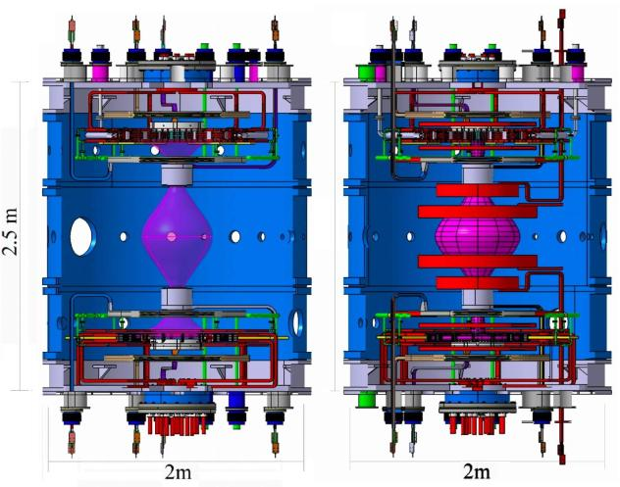
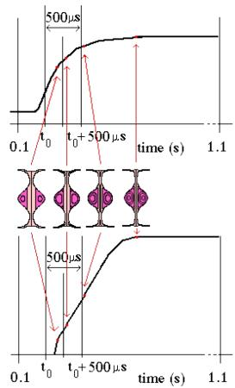

In 2002 at Frascati an International Workshop
advised to build the machine in 2 steps:
• Phase 1: demonstrate Plasma Centerpost’s feasibility
• Phase 2: machine completed such as to produce the Spherical Torus
Phase1: 8 PFcoils
Centerpost shape
Phase 2: 8 PF shaping coils
+ 10 PF compressing coils
ST compression
I_{e}=8.5 → 60kA
A=1.8
A→1.2
I_{p}=30 → 240kA
SP centerpost current I_{e}= 8.5 kA
No ST toroidal current
SP centerpost current I_{e}= 60 kA
ST toroidal current I_{p}= 120÷240 kA
5

Slide 6
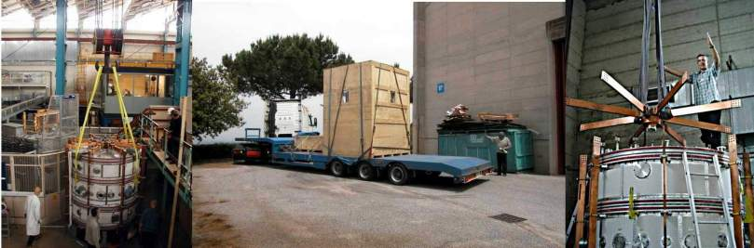
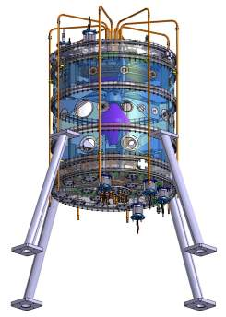
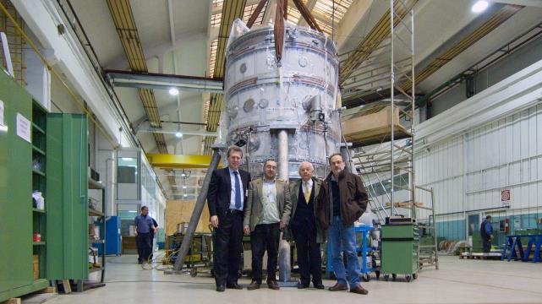
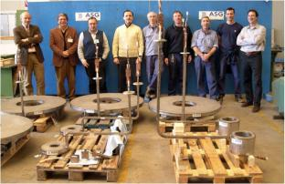
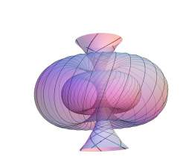
Cylindrical vacuum vessel was START vacuum vessel, donated by Culham in 2004
from Culham the old vacuum vessel found its road to Frascati
PROTO-SPHERA was built (2006-2009) by ASG Superconductors of Genoa, cost 1 M€
ASG 2007
ASG 2009
Years 2004 - 2010:
…from ideas …to detailed design …to hard metal
6

Slide 7
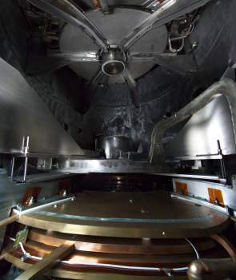
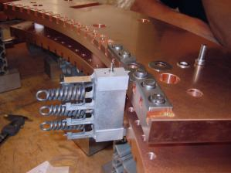
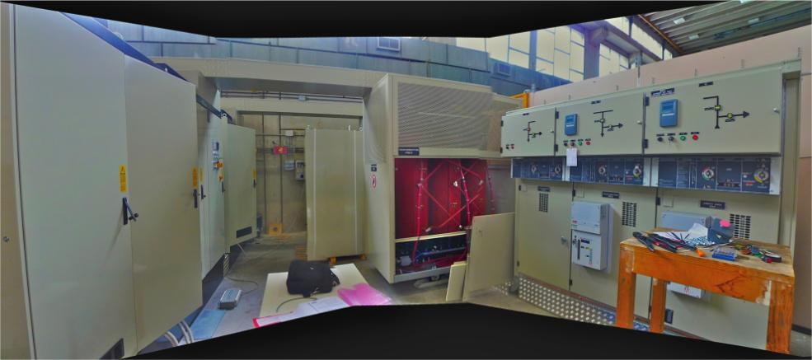
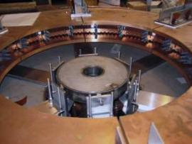
PROTO-SPHERA POWER SUPPLY
Anode
PF2 coils
throttles
Cathode
To fire the plasma centerpost (Phase1)
3 Power supplies are required
• Cathode heating rotating 6-phase: 6 x(1.7 kA,25 V) rms
(18 modulus i.e. 1/6 with respect to Phase2)
• PF coils: 2kA, 350 V DC current
• Plasma centerpost: 10 kA, 350 V DC current
Cathode
Electrical power supplies built by EEI of Vicenza, cost 0.7 M€
Years 2011 - 2014:
7

Slide 8
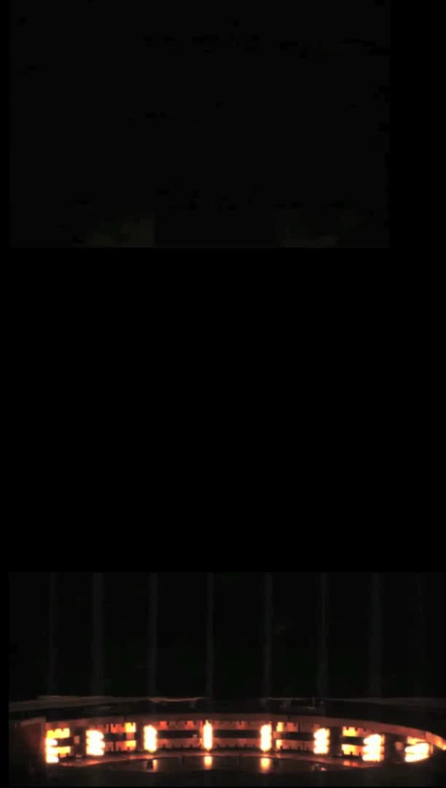
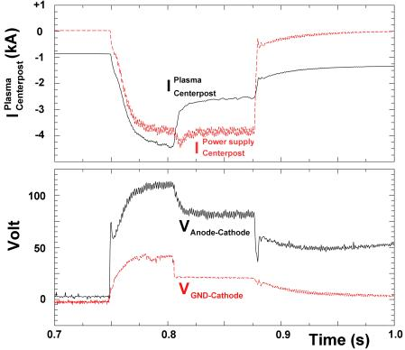
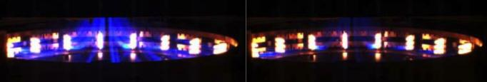
October 2015 / January 2016
experiments with external PF coils:
Plasma current outer paths for I > 3.5 kA
Status of art at EPR2016
Shot 208
Argon plasma
aiming to 4 kA
reaches 3.5 kA
PF2up
Shot 208
PF2up
~ 1.5 kA lost
from main plasma
in discharge from
cathode down to
lid\vessel
plasma fired after 0.75 s of PF current
(skin current time to remove X-point from inside vessel)
Also the Cathode emission lowers after 1.5 kA are lost
PF2low
Shot 208
PF2low
8

Slide 9
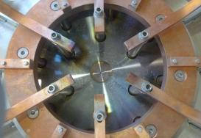
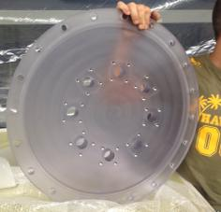
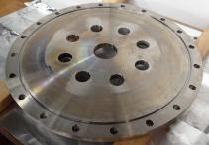

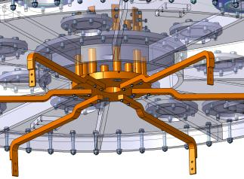
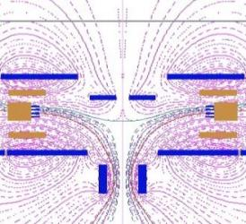
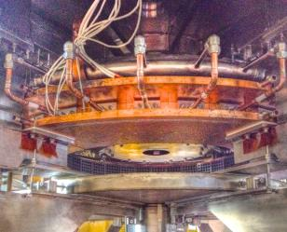
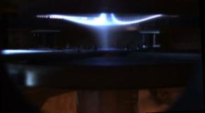
2015 experiments produced a heavy metallization on the top (anode) & bottom
(cathode) bus-bar vacuum entrance flanges, associated with magnetic “nozzles”
On the top (near anode) a SS flange, pierced by 8 bus-bars, such a flange substituted by a 4 cm thick Polycarbonate one
PF2up
Top flange view from plasma side
Bus-bars (top-anode)
Anode
Geometry of magnetic nozzle
PF2low
Anode exit of nozzle
9

Slide 10
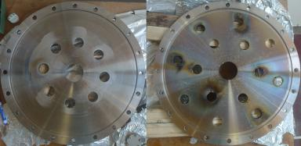
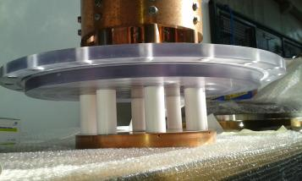
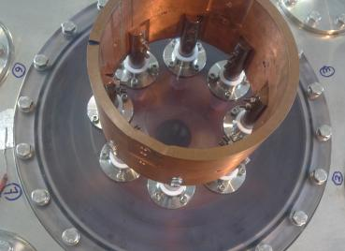
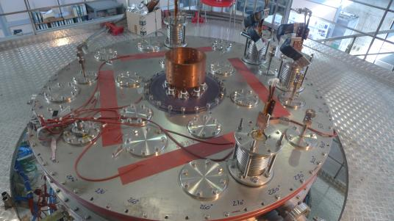
June 2016: insertion of Polycarbonate (transparent) anode bus-bar flange on top of machine
Heavily metallized
top & bottom bus-bar flanges
4 cm thick Polycarbonate
(required by atmospheric pressure)
PF2up
PF2low
10

Slide 11
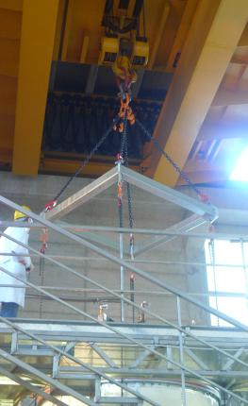
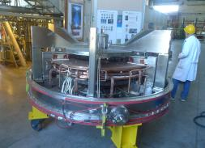
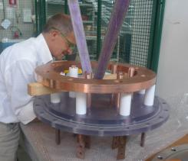
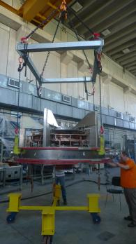
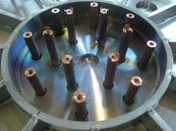
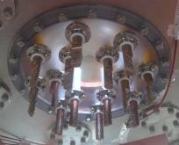
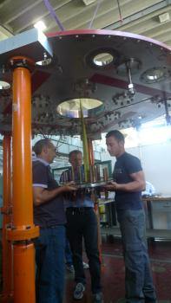
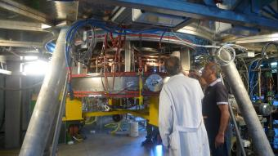
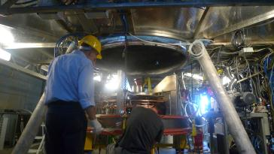
At the bottom (near cathode) a SS flange, pierced by 14 bus-bars,
such a flange has been substituted by a Polycarbonate one
PF2up
July 2016: Polycarbonate
flange on machine bottom
PF2low
11

Slide 12
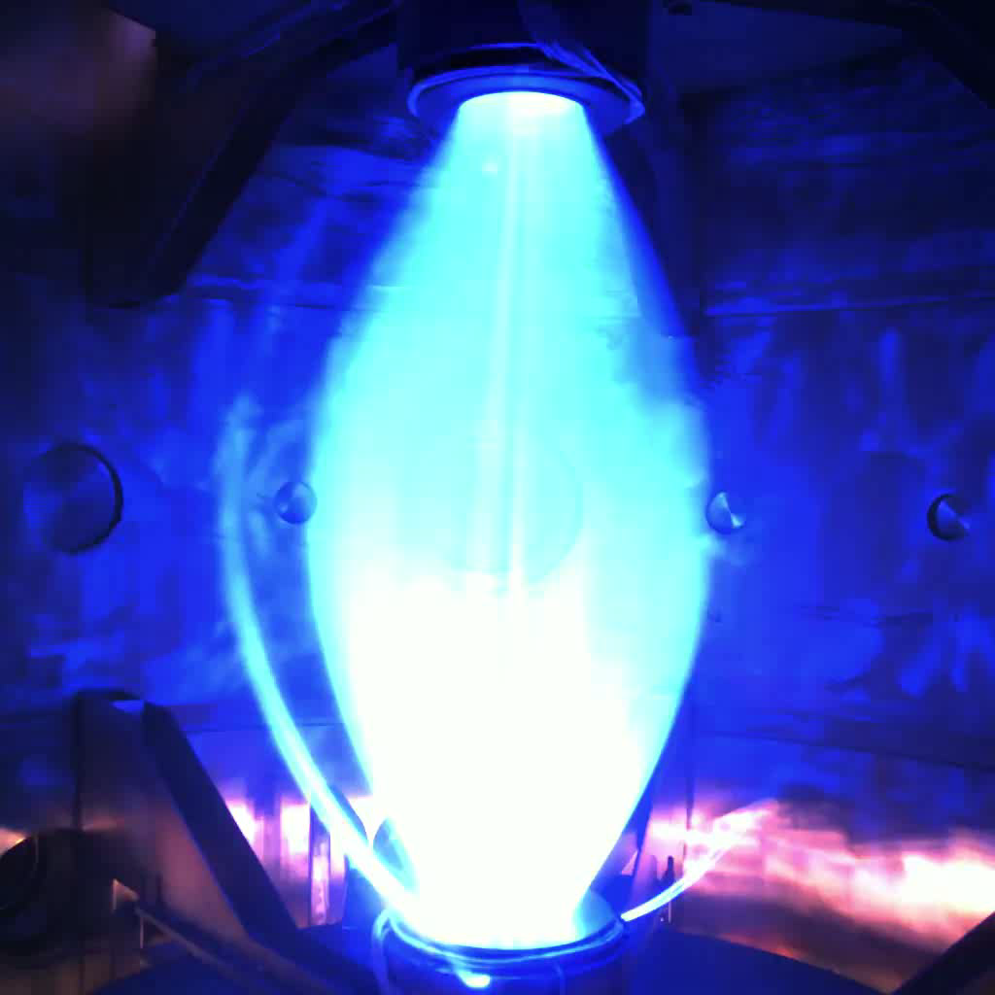
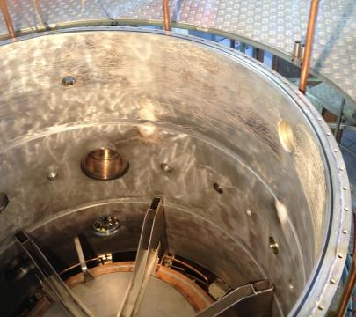


Secondary discharges from electrodes hitting Al vacuum vessel wall (plenty of scars!)
Shot 378
October
2016
PF2up
Polycarbonate flanges got rid of all metallization from bus-bars:
2mm thick Polycarbonate lining covers the Al vacuum vessel
secondary
2mm thick
Polycarbonate
screen
surrounds
rear of anode
December
2016
PF2low
12

Slide 13




Secondary discharges hitting vacuum vessel wall
have been cured by Polycarbonate lining, but
1) Spurious plasma currents still flow outside the centerpost (albeit inside the vacuum vessel)
Shot 591
January 2017
patterns of spurious
currents are
either diffused
or filamentary
Shot 591
PF2up
PF2up
Input 0.6 MW
7 kA from power supply
Centerpost drives 60%
Shot 591
crisis
Shot 597
PF2low
PF2low
13

Slide 14



January 2017
Secondary discharges hitting vacuum vessel wall
have been cured by Polycarbonate lining, but
2) in Hydrogen (250 V breakdown) there was still a problem of current through the vessel,
this was triggered in Argon (80 V breakdown), connecting the common star potential of the six-phased cathode power supply to the machine GND
PF2up
Most critical electric field is
at contact between SS upper
extension & Al vacuum vessel
Shot 567
A spacing insulating ring
was inserted in May 2017
PF2low
14

Slide 15




to avoid the bus-bar to vessel current flow an insulating
spacer ring has been inserted
PF2up
lower
diaphragm
To avoid the flowing of plasma currents outside the desired path of the plasma centerpost two large insulating polycarbonate diaphragm separators have been inserted
lower
diaphragm
Shot 567
Shot 567
Shot 567
May 2017: Insertion of
Polycarbonate lower diaphragm
lower
diaphragm
PF2low
Lower spacer ring not yet inserted
15

Slide 16




May 2017: Insertion of
Polycarbonate upper diaphragm
& Polycarbonate spacer ring
PF2up
spacer ring
spacer ring
upper
diaphragm
PF2up
Shot 567
upper diaphragm
1-2 mm clearance
Shot 567
Shot 567
1-2 mm clearance
lower diaphragm
PF2low
upper
diaphragm
PF2low
16

Slide 17



June 2017 Plasma with Polycarbonate two diaphragms & upper Polycarbonate spacer ring
High currents (8 kA), external PF coils are on
Some spurious and concentrated plasma current still sneaks through the narrow clearance (1-2 mm) between polycarbonate cylindrical lining and diaphragm,
plasma currents with 8.6 kA through PF2 are achieved
Power input 1.65 MW, Anode-cathode voltage 195 V
Shot 614
PF2up
PF2up
Shot 567
With currents through PF2 exceeding ~ 6kA the
rotational transform of plasma centerpost (q ~ 2.5-3)
becomes clearly visible…
The plasma centerpost seems to rotate azimuthally ( )
in clockwise direction (looking from above)
(…the six-phased cathodic rotation is switched off…)
Shot 567
Shot 567
PF2low
PF2low
the spurious plasma current closes on the
outside of PF2low, producing bright filaments
17

Slide 18



High currents (8 kA), switching on the external PF coils:
PF coils casings built as floating
Electrostatic potential is dominated by the plasma; PF coils casings better left floating!
Upper lid & extension also better left floating! through Polycarbonate spacer ring
Strong toroidal rotation due to
prevents any anchoring on Anode!
upper lid & extension float at 90 V
PF2up
PF4.2up
V_{PF4up} ~ 130 V
PF4.1up
V_{anode} ~ +150 V
Anode
V_{PF2-3up} ~ +75 V
PF3.1up
PF2up
Ext.Coil up
Shot 567
#614 8.6kA Argon
Plasma centerpost
June 2017
Ext.Coil low
Shot 567
PF2low
Shot
PF3.1low
V_{PF2-3low} ~ +20 V
Cathode
V_{cathode} ~ -45 V
PF4.1low
V_{PF4low} ~ -7 V
PF4.2low
PF2low
vacuum vessel at GND (0 V)
Lines: magnetic field Color contours: electrostatic potential, Arrows: E field
18

Slide 19


Shot 665
June 2017
Switching off the external PF coils it is possible to have a more uniform distribution of the spurious plasma current that sneaks through the narrow clearance (1-2 mm) between polycarbonate cylindrical lining and diaphragm, however in this
case the plasma currents through the PF2 coils reduces to ~ 6kA
It is quite evident that the plasma that sneaks through the upper narrow clearance corresponds to the bright filaments on the outside of PF2low, which diffuse towards the clearance
PF2up
PF2up
Shot 567
Shot 567
Shot
PF2low
PF2low
19

Slide 20


Lower currents, switching off the external PF coils:
PF coils casings built as floating
Electrostatic potential is dominated by the plasma; PF coils casings better left floating!
Upper lid & extension also better left floating! through Polycarbonate spacer ring
Strong toroidal rotation due to
prevents any anchoring on Anode!
upper lid & extension floating 78 V
PF2up
PF4.2up
V_{PF4up} ~ +98 V
PF4.1up
Anode
V_{anode} ~ +135 V
PF3.1up
V_{PF2-3up} ~ +65 V
PF2up
Ext.Coil up
(off)
Shot 567
#665 6kA Argon
Plasma centerpost
June 2017
Ext.Coil low
(off)
Shot 567
PF2low
Shot
PF3.1low
V_{PF2-3low} ~ +4 V
Cathode
V_{cathode} ~ -45 V
PF4.1low
V_{PF4low} ~ -13 V
PF4.2low
PF2low
vacuum vessel at GND (0 V)
Lines: magnetic field Color contours: electrostatic potential, Arrows: E field
20

Slide 21


Shot 644
June 2017
Lower currents, switching off the external PF coils
0.7 s long discharge
Switching off the external PF coils, long duration plasma centerposts have been obtained with plasma currents through the PF2 coils ~ 6 \ 7 kA
PF2up
This plasma centerpost discharge is quite near to
the rotational trasform value ι ~ ½ ➔ (q_{Pinch} ~ 2)
PF2low
21

Slide 22


Shot 645
June 2017
Kink destabilization maintained in 0.7s long discharge
The anode plasma wobbles gently
Reducing by a factor of 4 the magnetic field of the internal PF coils, the plasma centerpost has been destabilized
A long duration kink-bended plasma centerpost has been obtained with plasma currents through the PF2 coils ~ 5 \ 6 kA
PF2up
This plasma kink-bended centerpost discharge survives
at a rotational trasform value ι ~ 1.66 ➔ (q_{Pinch} ~ 0.6)
PF2low
Cathode plasma wobbles more than centerpost, but
the discharge survives till the DC voltage is applied!
22

Slide 23





Physics Design
1997-2008
PROTO-SPHERA
destabilization
Experiment
2017
23

Slide 24



The plasma current sneaking through the narrow clearance (1-2 mm)
between polycarbonate cylindrical lining and diaphragm induces damages
The narrow clearance has
to be closed completely by
a bonding material
able to sustain the diaphragms weight
The port where the polycarbonate lining was cut, in order to allow for
vacuum gauges measurements,
has to be closed
& the gauges moved elsewhere
24

Slide 25

Disaster if top lid & top extension are not floating!
#649 kA Argon Plasma centerpost (June 2017)
Polycarbonate spacer ring insulating top lid and top extension from vessel (GND)
have been put back in contact with vessel
Color contours: electrostatic potential, Arrows: E field Lines: magnetic field
25

Slide 26



June 2017: Polycarbonate spacer ring insulates top lid and top extension from vessel (GND)
if they are put back in contact with vessel, plasma centerpost current through PF2 is hampered
➔ Large part of current flows into vacuum vessel ➔ secondary discharges bus-bars ➔ vessel
Shot 649
Top extension
PF2up
spacer ring
Vessel (GND)
Plasma current reaches 6 kA,
but after secondary discharges current drops to 3 kA
To achieve full centerpost current in Hydrogen (250 V break-down) needs a new insulating vacuum vessel
PF2low
26

Slide 27


A new insulating & transparent vacuum vessel has to be built: will be Phase-2 ready
If whole current of power supply (10 kA) is successfully driven in the Argon centerpost plasma it will be necessary to substitute the Al vacuum vessel with
a Polymetacrylate (PPMA) transparent and insulating vessel (5 cm thick, 2m , 1.6 m high)
adding 2 further SS rings on top & bottom of the experiment,
keeping all internal components attached to the existing SS upper\lower lid and extension
then try Hydrogen plasma
Shot 649
PF2up
flanged PPMA cylinder carved PPMA cylinder
PF2low
27

Slide 28

To be build, after 10 kA plasma centerpost routinely achieved,
full PROTO-SPHERA load assembly and power supplies
Shot 649
Group A: ST compression coils (5+5 series)
Not yet built, but inner vessel ready to host
• high voltage (~ 20 kV) insulation
thin Inconel casings cost ~ 0.5M€
PF2up
Tungsten filaments (54 → 324) cost ~ 0.2M€
Final Power Supplies for:
1) Group A PF coils cost ~ 0.1M€
2) Cathode (I_{cath} 10 → 60 kA) cost ~ 0.2M€
3) Centerpost (I_{e} 10 → 60 kA) cost ~ 0.6M€
SuperCapacitors will be used
Cost up to now ~ 2.0 M€
Cost for final stage of experiment ~ 1.6 M€
PF2low
28

Slide 29
Status (June/July 2017)
• Hollow anode surprise, no anode arc attachment (electrostatic potential,
E x B plasma rotation)
• 8.6 kA achieved (10 kA available from power supply), 7 kA sustained 0.7 s in Argon plasma
• Preliminary measurements with Langmuir probes (in the anode zone): Te≈8-10 eV, n > 10¹⁹ m⁻³
• After Argon centerpost is tamed
(80 V break-down, 2 MW), build new insulating & transparent vessel, then tame Hydrogen centerpost
(250 V break-down, 3MW?)
• If full current of plasma centerpost
(10 kA) is achieved and sustained with 54 sparsely spaced emitting filaments, then full current (60 kA) will be even better achieved with 324 filaments
Perspectives
Proto-Sphera will assess a new magnetic confinement configuration, potentially stationary
Power injected into the centerpost
should be > 250 V • 60 kA = 15 MW…
It is a huge power into such a small plasma
…however how much will go into
the confining Spherical Torus,
through magnetic reconnections?
No one is able to predict:
• should it be zero, then ST plasma T = 10 eV
PROTO-SPHERA studies plasma-electrode interactions
• should it be 1 MW, then ST plasma T ~ 100 eV
PROTO-SPHERA studies magnetic reconnections
at relevant magnetic Lundquist number, S~10⁵
• should it be many MW, then ST plasma T ~ 1 keV
…β ~ 1 !
…would do as a Tokamak, but at 1/100 of the cost
Shot 649
PF2up
PF2low
29

Slide 30




































+ Other
authors
30

