Slide 1

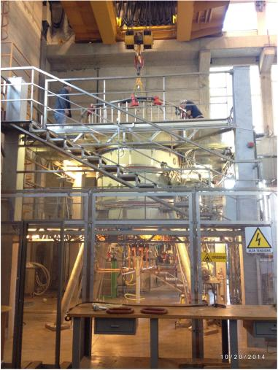
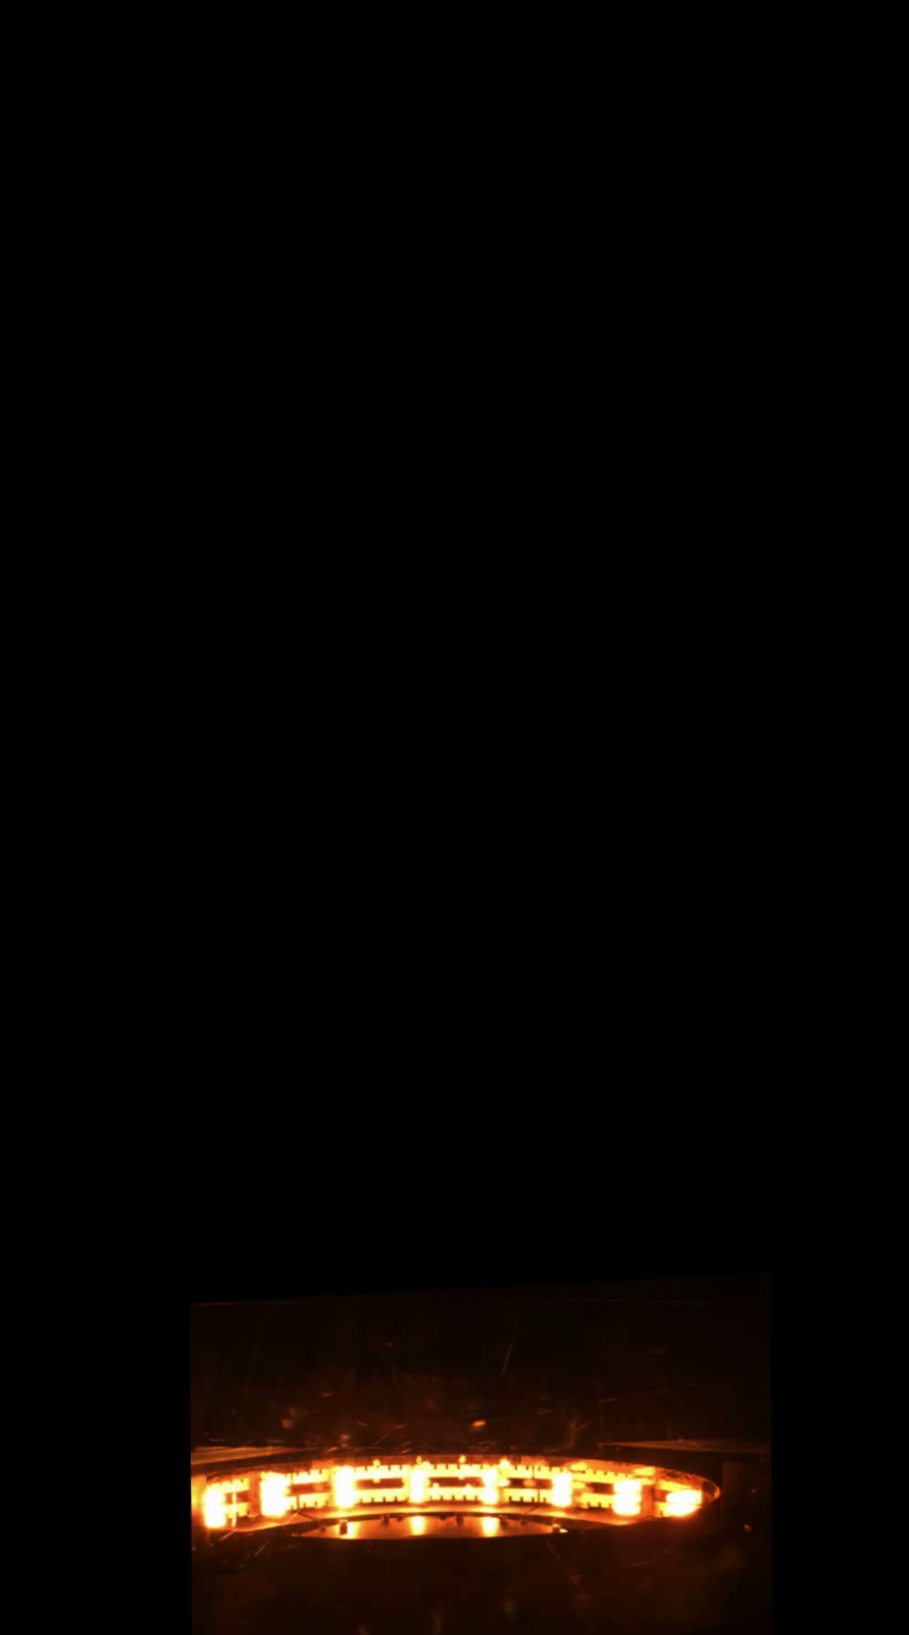
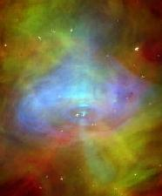
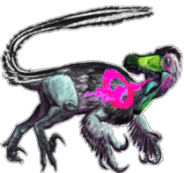
PROTO-SPHERA, without toroidal magnets, produces
and confines plasma tori inside magnetostatic fields
Franco Alladio, CR-ENEA Frascati, *e-mail: franco.alladio@enea.it
Crab Nebula

Slide 2
SUMMARY
PROTO-SPHERA has produced and sustained (½ sec)
axisymmetric magnetically confined current carrying Tori
around its Plasma-Centerpost
The Plasma-Centerpost is driven by a DC voltage applied
between electrodes (DC Helicity Injection) and the Tori are formed
in presence of a pre-existing axisymmetric magnetostatic field only and in absence of any toroidal magnet
These results provides the first hints that future Fusion machines could be built using permanent magnets only

Slide 3
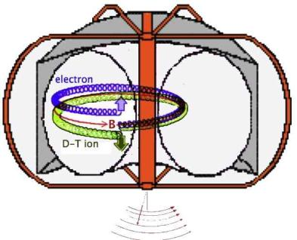
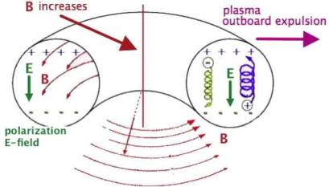
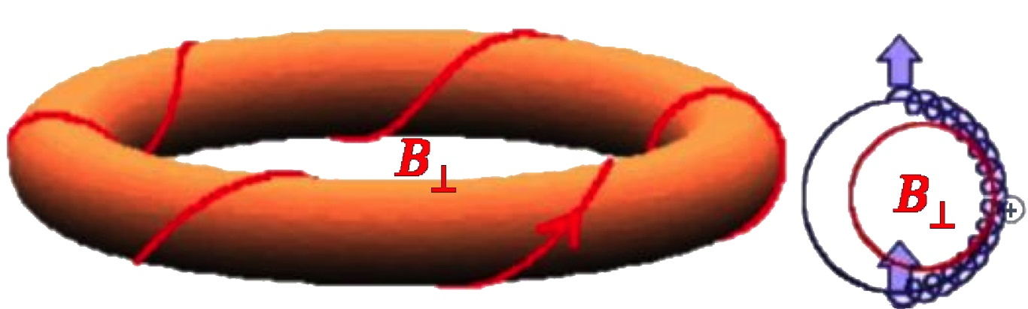
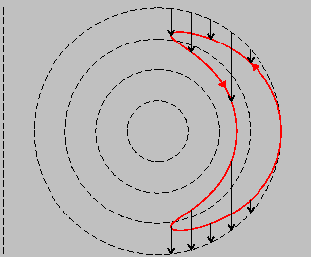
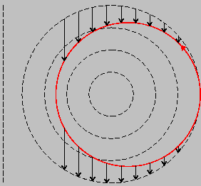
wind the magnetic field in the poloidal direction to contrast particle drifts
Toroidal magnetic trap:
the inhomogeneous B
separates charges
Magnetic Confinement basics
e.g. e⁻ → up
ions⁺ → down
B increases
E vertical field, through E∧B, …ejects plasma
Poloidal field drifts for particles
trapped & circulating

Slide 4
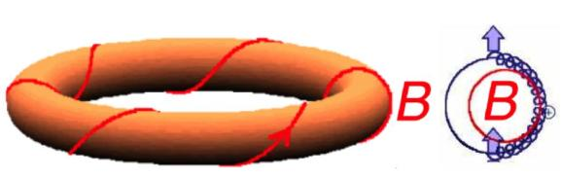
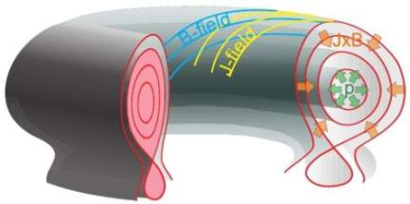
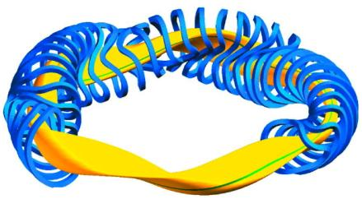
Magnetic Confinement basics
A poloidal magnetic field is required to contrast particle drifts
→ a toroidal current has to flow in an axisymmetric plasma
(magneto-hydrostatic equilibrium)
flux (…also p & j ) surfaces must be Tori
Stellarators can avoid toroidal currents:
non axisymmetric magnetic coils
engender a poloidally wound field
but a price has to be payed is:
the breaking of a symmetry

Slide 5
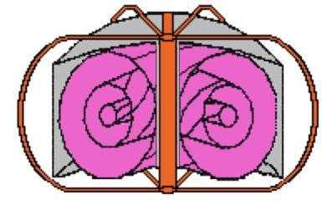
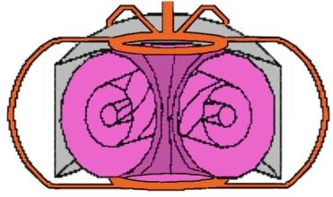
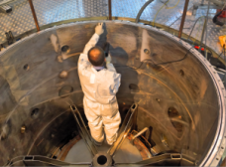
Main idea of PROTO-SPHERA
Conventional Tokamak:
magnetic surfaces of toroidal plasma
surround a “Metal Centerpost”
…toroidal geometry of Vacuum vessel
PROTO-SPHERA:
magnetic surfaces of toroidal plasma
surround a “Plasma Centerpost”; slim
metal external legs current returns
…cylindrical geometry of Vacuum vessel
Electric current flow
Cylindrical vacuum vessel geometry
has obvious advantages:
⬅ easy to access & to repair!

Slide 6
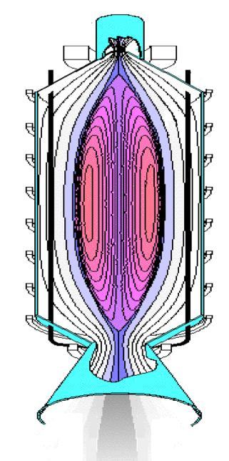
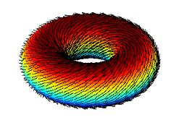
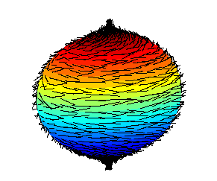

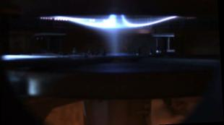
Last Confinement Surface spherical, but Tori inside
Poincare’ “Hairy-ball theorem”: no continuous field tangent to a sphere
unless there is at least upon one point and
degenerate X-points
a hairy torus
can be combed
a hairy sphere cannot!
One of the “tufts” of the sphere is predominant
in expelling charged fusion products
A SPACE-THRUSTER forerunner?
Nozzle observed in PROTO-SPHERA experiment (2015)

Slide 7
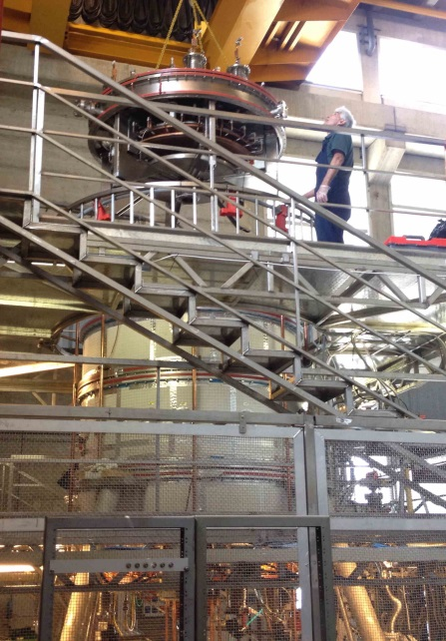
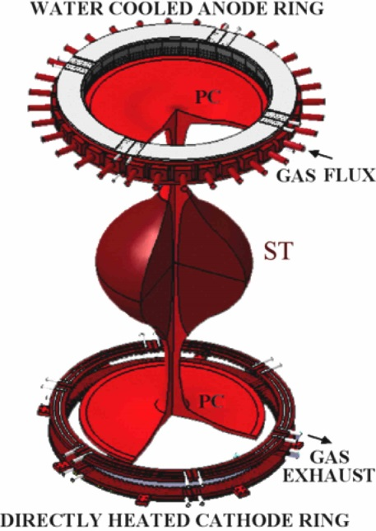
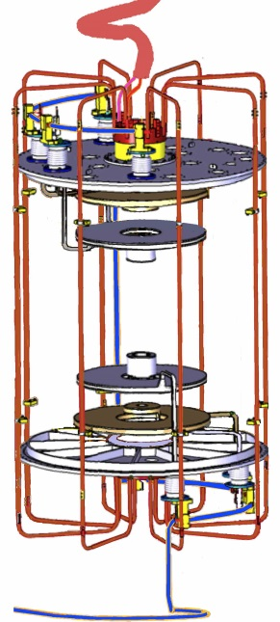
Main idea of
PROTO-SPHERA:
A current carrying
confined plasma Torus toroidal current I_{ST}
around a plasma Centerpost electrode current I_{e}
degenerate
X-points
cylindrical geometry
of Vacuum vessel ,
…but electrodes required inside vessel
slim metal external legs return the current
(outside the vessel & reminiscent of a toroidal magnet in a Tokamak)

Slide 8
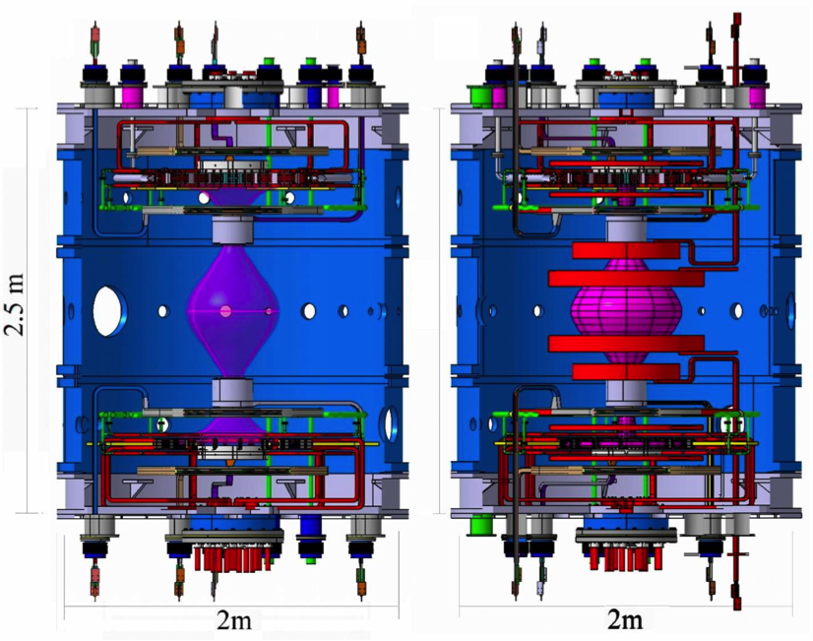
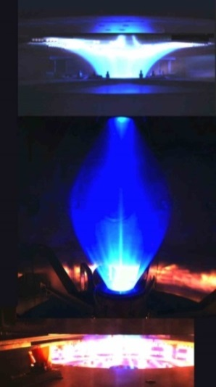
Phase-1 & Phase-2 of the experiment
The experiment now in Phase-1 is a partial set-up of the final machine
Phase-1: 8 PF coils
Group-B shaping coils
Phase-2: 8 PF coils + 10 PF
Group-A compressing coils
Gas-puffed
anode
2900ºC
heated cathode
Centerpost I_{e}= 10 kA
…2018 Torus I_{ST}= 7 kA…!
Centerpost I_{e}= 60 kA
ST current I_{ST}= 240 kA

Slide 9
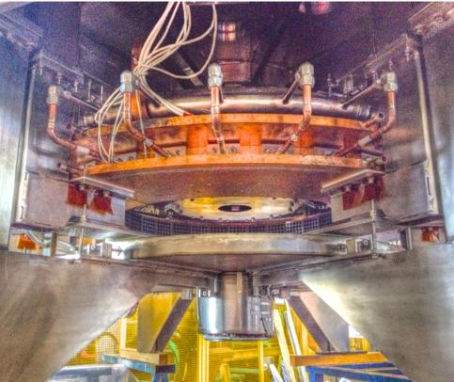
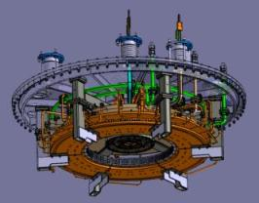
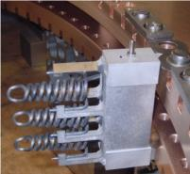
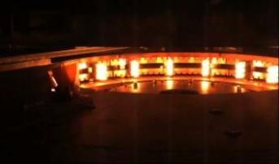
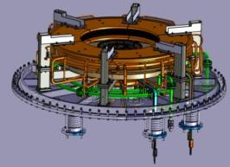
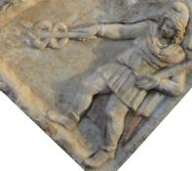
PROTO-SPHERA Electrodes
Up: hollow gas-puffed anode
Down: 3000º K heated cathode
Phase-1 (present) cathode
(54 = 18 x 3 W emitters): aim 10 kA
Phase-2 cathode, 6 x Phase-1
(324 = 108 x 3 W emitters): aim 60 kA

Slide 10
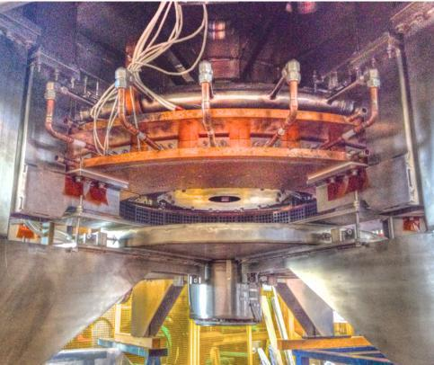


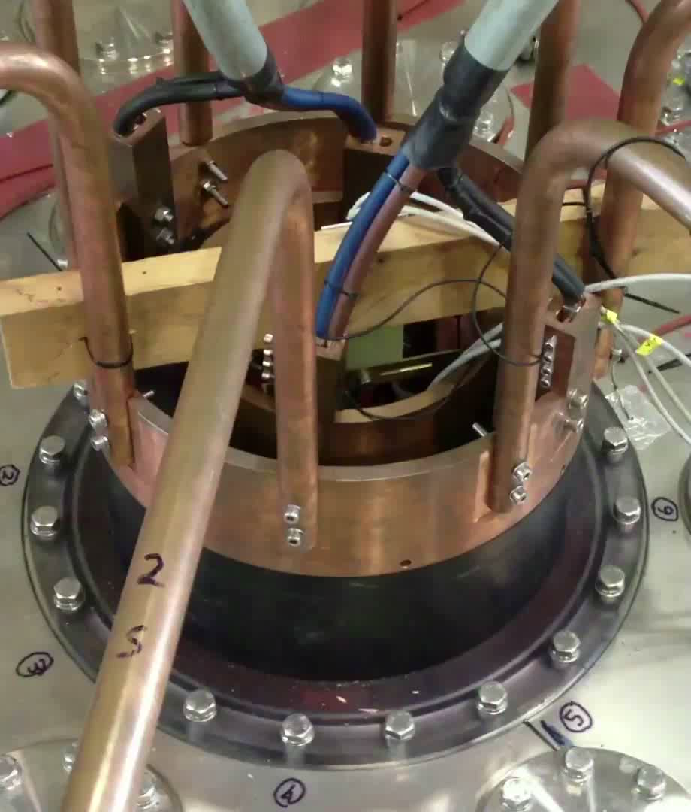
The gas-puffed hollow anode
On top of the anode
degenerate X-point
acts as “plasma-nozzle”
#954 Argon
Copper-Tungsten faces plasma
gas puffed from 100s holes
…plasma enters into holes
plasma “nozzles”
produced a metallization on anode & cathode bus-bar flanges:
Polycarbonate electrode bus-bar flanges
had to be introduced on top & bottom
#567 Argon

Slide 11
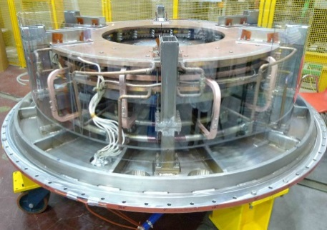
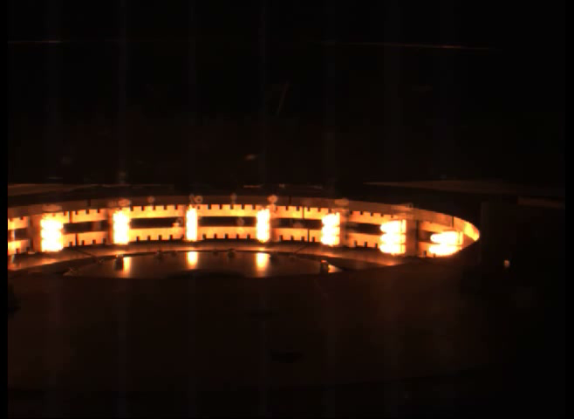
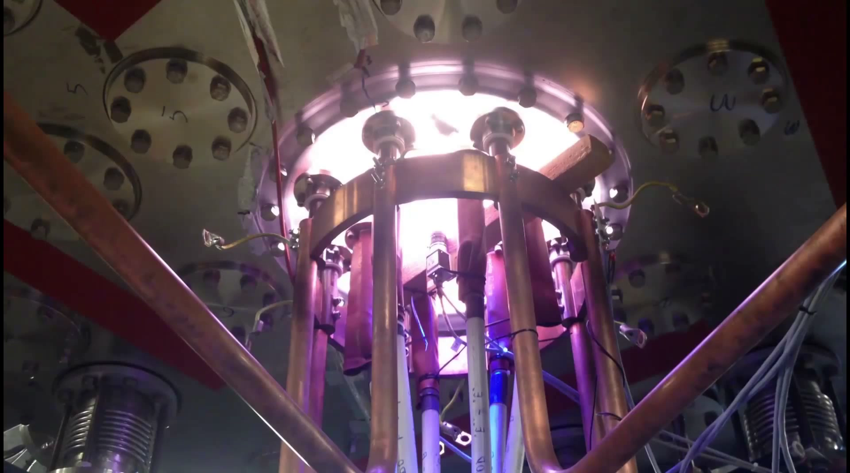
The directly heated cathode
#954 Argon
Directly heated Phase-1 cathode only partially filled
with doubly wound Tungsten-VM filament modules
To obtain the Plasma-Centerpost:
Cathode heated ~30 sec before the plasma,
when at 2900 ºC the Group-B-PFInt coils fired, within ~10’s ms the Centerpost power supply fired and the screw pinch plasma is produced
#569 Argon

Slide 12
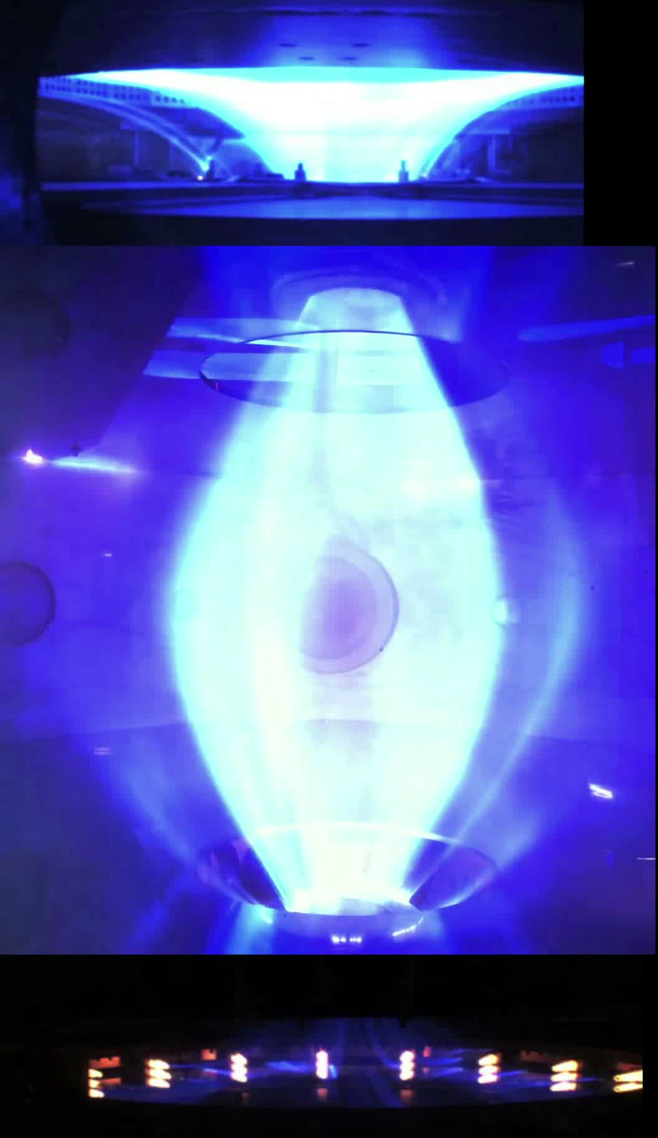
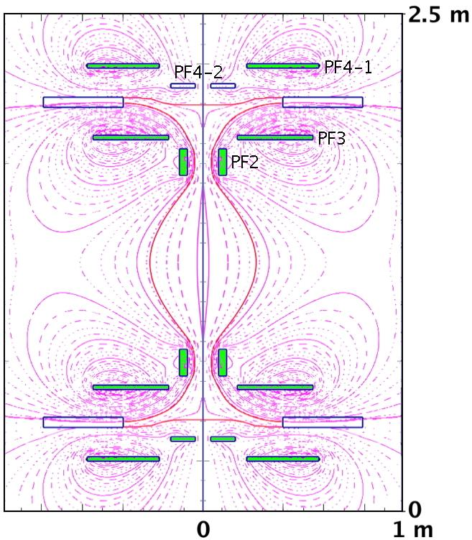
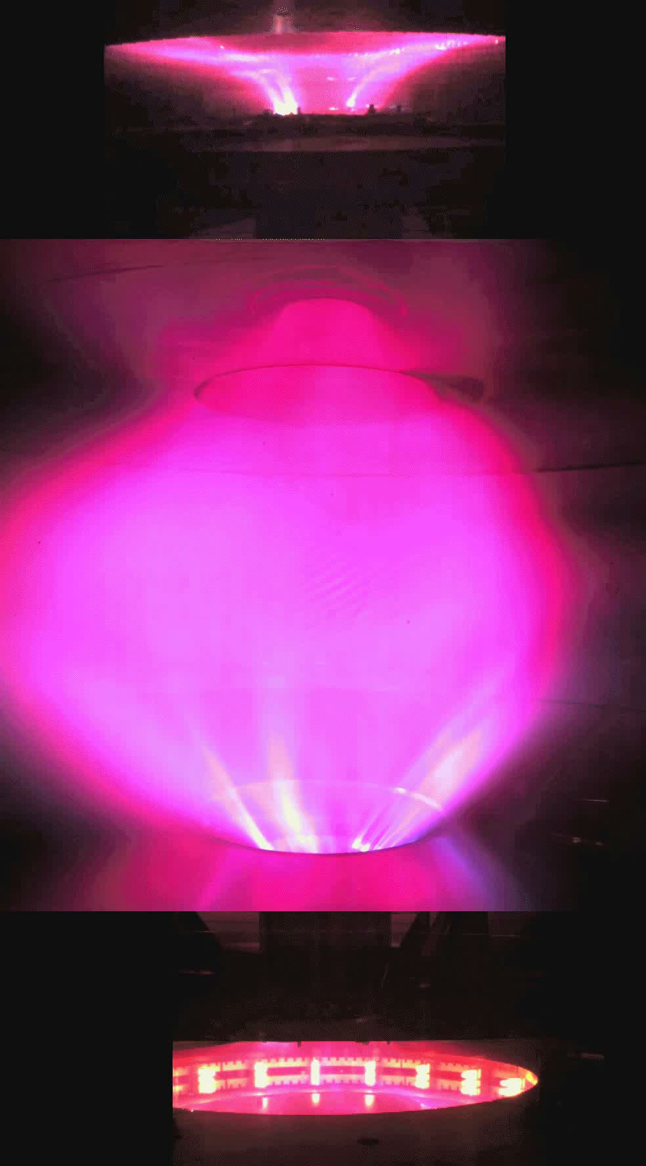
The Plasma-Centerpost produced in Phase-1
Shaping field produced inside
the 4 cm thick Aluminum vessel
#614
anode-to-cathode voltage
break-down ~90 V
increases up to ~200 V at 10 kA
in Argon, equatorial line-averaged electron density <n_{e}> ∝ I_{e} <n_{e}>=4•10²⁰ m⁻³ at I_{e}=10 kA
The Plasma-Centerpost rotates
at ω ~ 2π (500) radians/sec
#977
anode-to-cathode voltage
break-down ~320 V
decreases up to ~220 V at 10 kA
in Hydrogen, equatorial line-averaged
electron density <n_{e}>=1.5•10²⁰ m⁻³ at I_{e}=10 kA
These are high-field Tokamak densities!

Slide 13
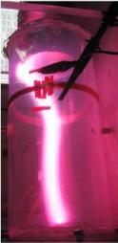
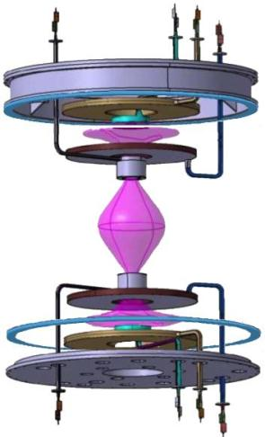
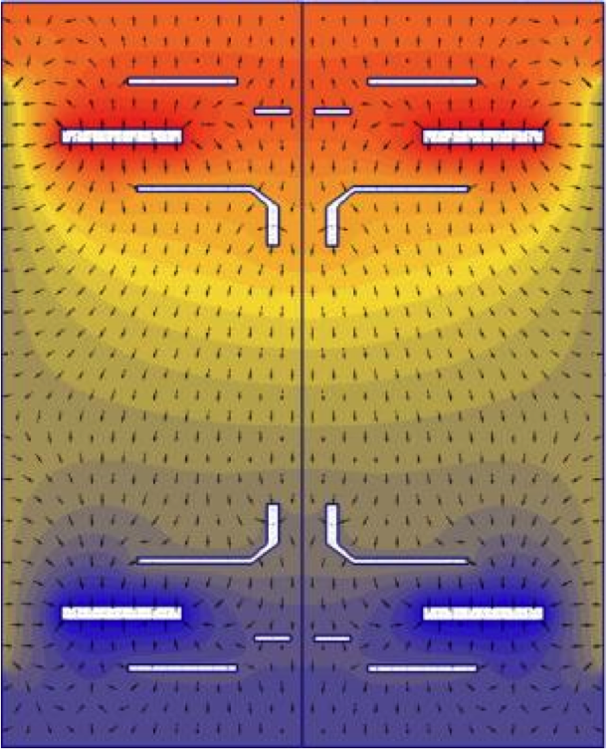
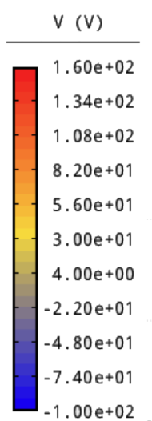
plasma rotation: no anode-arc-anchoring
PF coils casings built as floating, charged by the plasma
also upper\lower extensions & lids are floating
magnetic field is up\down symmetric but electrostatic field not up\down symmetric
B
E
insulator
PF4up
anode
PF3up
PF2up
PF2low
PF3low
insulator
cathode
PF4low
E ∧ B drift opposite in the anode and cathode region, but not compensated:
the top anode dominates & determines a clockwise plasma rotation (from top of machine)

Slide 14
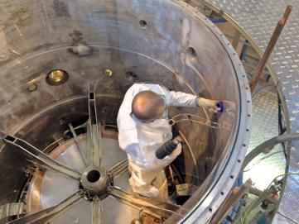
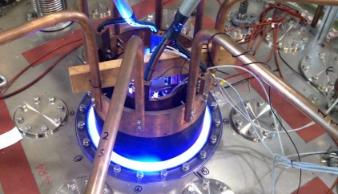
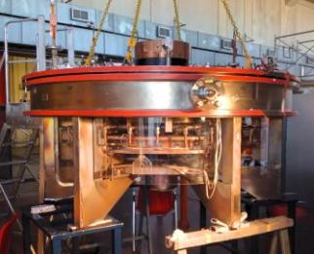
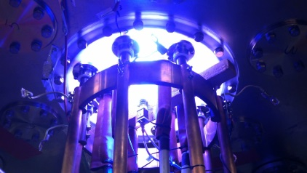
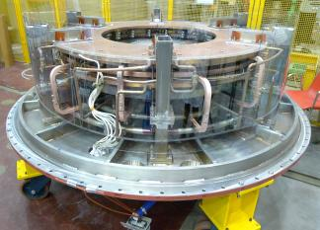
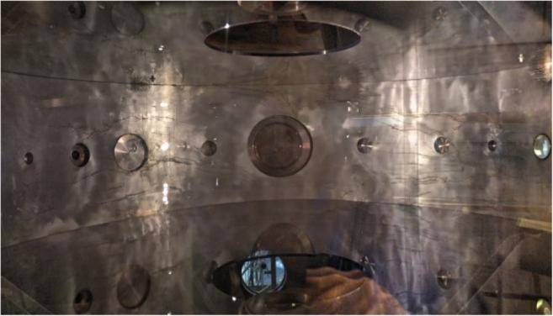
Taking care of electrostatic boundary conditions
2mm thick Polycarbonate linings for:
*internal Al vessel
*4cm thick
Polycarbonate
flanges
for bus-bars
*rear of anode
*rear of cathode
*upper
insulating ring
2 insulating rings section
the conducting vessel
PF2up
*lower insulating
ring
upper diaphragm
clearance glued
*2 Polycarbonate diaphragms glued to the internal lining
lower diaphragm
clearance glued
January 2018:
all these cures allowed to obtain Hydrogen plasmas
PF2low

Slide 15
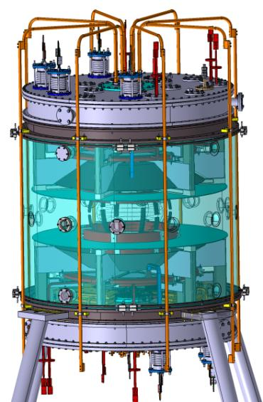

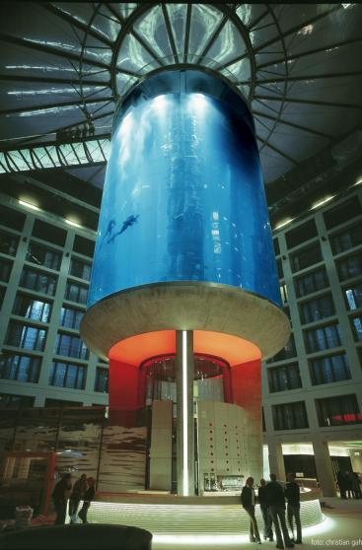
Insulating & transparent new vessel in 2019
will substitute the Aluminum vacuum vessel with a Poly methyl methacrylate (PMMA)
transparent and insulating vessel (9.5 cm thick, 2m , 1.7 m high), endowed with 20 ports
adding 2 further SS rings on top & bottom of the experiment
keeping all internal components attached to the existing SS upper\lower lid and extension

Slide 16




Magnetic Boundary Conditions changed
4 external PF coils added …fed in series with the Group-B-PFInt coils,
from April 2018 a further Super-Capacitor power
supply feeds some of the PFExt coils
Plasma fired after 0.60 s of PF current
to allow for skin current diffusion in Al vessel
Hydrogen Centerpost
at full current =10 kA
seemed quite inclined
to eject a Torus
…an added vertical field
…was used as midwife!
#983, 10 kA Hydrogen
4 external PFExt (each 16 wires 25 mm²)

Slide 17



Plasma tori foreseen for Phase-2 tryed in Phase-1
4 external PFExt coils added
in 2 PFExt near equator
current flows in
opposite direction to toroidal
current inside Plasma-Centerpost
Phase-2 Spherical Torus:
Phase-1 Centerpost I_{e}=8.5kA,
then in 1 ms up to I_{e} =60kA
along with increase of coil current in Group-A-PFInt
If torus forms, outward force
due to toroidal plasma current
enlarges Plasma-Centerpost
into a portion of sphere
Plasma fired after 0.60 s of PF current (skin current diffusion in Al vessel)
limits torus duration to 0.5 sec and imposes static magnetic field at torus formation

Slide 18


Argon tori not obtained below I_{e} current threshold
If the torus does not appear, the calculated equilibrium of
Plasma-Centerpost has 2 ordinary X-points (B_{pol}=0) on equator
~32 cm from symmetry axis, a quite narrow Plasma-Centerpost
threshold expressible as
(rotational transform =toroidal turns of lines of force from cathode to anode)
#1098
I_{e}~3 kA
below electrode plasma current
threshold I_{e}~ 8.5kA narrow
Plasma-Centerpost
ι
e

Slide 19



Argon tori obtained above I_{e} current threshold
When the current exceeds I_{e} ~ 8.5 kA, rotational transform of the Plasma-Centerpost
Argon Centerpost takes the shape due to the torus formation
in presence of an axisymmetric
double-null (DN) divertor
#1160
#1149 & #1160
break-down ~ 200V with torus (80 without)
increases up to ~220 V at 10 kA (200 without)
Argon tori have been sustained up to 0.5 sec
fitting the distance between
the 2 X-points of the divertor:
I_{ST}=5 kA in the Argon-torus

Slide 20




The SuperCapacitor power supply allowed for H-tori
A new Super-Capacitor power supply
(90 V, 2 kA, many sec) essential for Hydrogen Tori: Group-B-PFInt power supply was already delivering its maximal Voltage & Current,
an additional + 25% Amperes•turns were fed by Super-Capacitor
The production of Argon Tori was obtained fine tuning by -12.5% the maximum Ampere•turns of the Group-B-PFInt power supply:
$\frac{1.25 Bvert}{0.825 Bvert}$ = $\frac{\text{7} \text{kA} \text{in} \text{H}\text{−}\text{tori}}{\text{5 }\text{kA} \text{in} \text{Ar}\text{−}\text{tori} }$
upper PFExt: + 8 turns•1.9 kA in series PFInt
upEquator PFExt: -8 turns•1.9 kA in series PFInt
PFExt: -4 turns•1 kA SuperCap
downEquator PFExt: -4 turns•1 kA SuperCap
PFExt: -8 turns•1.9 kA in series PFInt
lowest PFExt: + 8 turns•1.9 kA in series PFInt

Slide 21



Hydrogen tori
5 ms after break-down, I_{e} reaches flat-top in ~6 msec
#1202
$$\frac{1 frame}{ms}$$
Hydrogen-tori most evident shortly after the plasma break-down
or during its ramp-down
#1224 10 kA Hydrogen
Switching off in ~ 3 ms
#1219 10 kA Hydrogen, Hα filter

Slide 22


Toroidal current is confined
#1219, 10 kA Hydrogen, Hα filter, but shown by cold-warm color involution
The confined toroidal current flowing inside the torus persistence longer than
the current flowing between electrodes: the torus in the last ms is kink unstable: $\frac{\text{torus} \text{poloidal} \text{field}}{\text{torus} \text{toroidal} \text{field}}$ = $\frac{\text{toroidal} \text{confined} \text{current}}{\text{Plasma}\text{−}\text{Centerpost} \text{current}}$ becomes too large

Slide 23



The dominance of the lower (cathode) divertor fan
Tori are limited by a magnetic separatrix with 2 conical divertor fans.
In Argon Hydrogen the lower (cathodic) divertor fan divertor is dominant
#1202
#1280
#1280
lower divertor with lower
polycarbonate diaphragm
(April 2018)
lower divertor with lower
AISI304 divertor plate
(July 2018)
fitting the distance between
the 2 X-points of the divertor:
I_{ST}=7 kA in the Hydrogen-torus
spurious plasma current path: lower divertor -> plate -> cathode by local sparks on PF2 coil all open spaces between the PF2 and the PF3 coils will be closed

Slide 24


Torus persists till anode-cathode voltage is applied
#1280 with AISI340 divertor plate
break-down ~ 360V with torus (320 without)
increases up to ~ 250 V at 10 kA (220 without)
Hydrogen tori have been sustained up to 0.25 sec
(to avoid damages due to spurious plasma current)
Slim tori aspect-ratio A=R/a~7
& elongation b/a=κ~3.5
…in a Tokamak could not
even be produced & sustained
a
R
b

Slide 25

Same sign $j∙B \text{all} \text{over} \text{the} \text{plasma}\text{: }\text{helicity} \text{injection}$
direction of $j$in the plasma torus: opposite to direction of $j$in equatorial PFExt coils
sign of $j∙B<0$ is negative in the Plasma-Centerpost
sign of $j∙B<0$ is negative as well in the plasma torus
B
B
j
B
j
B
B
B
This is a clear sign that DC Helicity Injection is in charge
of transferring plasma current from the centerpost to the torus,
just as it was imagined when the PROTO-SPHERA experiment was designed

Slide 26



PROTO-SPHERA driven by
DC currents & reconnections
Anode
Anode
• In front of the electrodes:
open magnetic field lines
Magnetic
reconnection
• Open magnetic field lines are wound
in a circular direction
• Magnetic reconnections convert
open lines
into closed , lines
wrapped around the spherical torus
Cathode
Magnetic
reconnection
Cathode
of Tokamaks relies on induction of PROTO-SPHERA relies on efficient but it is not forever… associated with magnetic reconnections
STEADY SUSTAINMENT OF TOROIDAL CURRENT BY RECONNECTIONS OBTAINED in 2018

Slide 27





Reconnection bursts shake the plasma, every 2-3 ms
#1280
H-alpha
filter
#1219
Visible
light
2D approx. magnetic reconnections at ordinary X-points
3D effects: diffused (ergodic) character of the X-points

Slide 28



Major surprise: current carrying torus formed and sustained in an external magnetostatic B *
Slow rise of currents will ease Phase-2 operations,
which will produce Spherical Tori with I_{ST}= ¼ MA
from now
I_{ST} = 5-7 kA
to Phase-2
I_{ST} = ¼ MA
In 2019, with new insulating PMMA Vessel
substitute present impromptu PFExt coils
with larger cross-section (240 mm²) flexible cables
8+12+12+8 turns (top to bottom, flexible turn number)
fed at 2 kA by existing Super-Capacitor power supply
• will allow to form from preexisting Plasma Centerpost
Hydrogen Tori with 20 ms rise time, try and assess
differences between static and 20 ms Torus formation
*A Magnetic Confinement scheme sustainable by permanent magnets?

Slide 29




Plasma is resilient to
double & lop-sided tori
With a vertical field in slight excess (+10%) of optimal value, the Plasma-Centerpost produces odd configurations like Double-Tori
#1225
#1211
and Lop-sided-Tori,
all with visible helical components
however the plasma never disrupts
The only occurrence you should never ever consider is plasma disruption: gone for good!

Slide 30



Metamorphosis of an hexapolar cusp into a torus
With even larger vertical fields:
the plasma exhibits an hexapolar cusp shape & a reduced current start-up: I_{e}<5 kA
such state can last up to 0.15 sec,
later the centerpost current reaches I_{e}=10 kA
and a proper Plasma-Centerpost+Torus
#1221
#1219

Slide 31


From hexapolar cusp to compressed torus
#1221
the plasma discharge has a part with current flowing
in the Plasma-Centerpost
but the rest of the plasma
is trapped in a configuration
~axisymmetric-toroidal-cusp
proper Plasma-Centerpost + Torus
is narrower due to higher B_{vert}
#1221

Slide 32

Feedback-controlled Spherical-Torus formation?
Also the poloidal field required for PROTO-SPHERA in Phase-2, for shaping and compressing the Spherical-Torus at I_{ST}=¼ MA, has an hexapolar character,
but the two electrodes are magnetically disconnected from each other
field in absence of plasma I_{ST}=¼ MA plasma configuration
it is possible that PROTO-SPHERA in Phase-2 will form up increasing:
the Plasma-Centerpost current I_{e} to 60 kA & the current in the Group-A-PFInt coils
…but on a slow time scale ~20 msec
this opens the possibility of a feedback-controlled Spherical-Torus formation

Slide 33
Conclusions: dispensability of toroidal magnet
& formation in magnetotatic field
Toroidal magnet are dispensable for producing magnetically confined tori:
a Plasma-Centerpost discharge, sustained by DC voltage electrodes, is sufficient
The tori are produced in a pre-existing axisymmetric magnetostatic poloidal field:
no variations are needed in the poloidal fields containing the plasma (virial theorem)
The confined tori are sustained until anode-to-cathode DC voltage is applied:
magnetic reconnections provide a steady-state current drive to the toroidal plasma
No disruption phenomena occur in the PROTO-SPHERA configuration:
it can produce tori at aspect ratio A=7 & elongation κ=3.5, that Tokamaks could never do

Slide 34
Can magnetic reconnections be put to work?
Magnetic reconnections are the nightmare of magnetic containment schemes …but
has a useful application of such plasma phenomena appeared in magnetic confinement?
Hopefully this will be confirmed by more powerful plasma discharges in the near future &
a vigorous self-organized plasma heating could be obtained in Phase-2 of PROTO-SPHERA,
where a total power of ~15 MW is expected to be input into the overall plasma
To assess the potential of this new configuration, Phase-2 will increase from <8% to >95%. the flux surfaces volume the torus carves from the spherically shaped Plasma-Centerpost
If the properties observed in Phase-1 will be confirmed and the energy confinement time will be long enough, this configuration could solve many issues pending in Tokamaks:
the removal of the disruption problem
the necessity of powerful plasma heating and current drive that, instead of requiring
complex external systems, will become embedded into the magnetic configuration itself
and will rely upon the spontaneous natural phenomenon of magnetic reconnections

Slide 35
Magnetic confinement by permanent magnets?
The dispensability of toroidal magnet & the confined tori formed in a magnetostatic field
hint that magnetic confinement devices for Controlled Fusion could in principle be built using axisymmetric permanent magnets only, able to provide a poloidal magnetostatic field pre-existent to the plasma
A Plasma-Centerpost fed by two electrodes will produce and sustain the confined torus in such a poloidal field; in case the two electrodes become disconnected from each other, in terms of the pre-imposed field configuration, currents of short duration, in simply conducting coils, could be required in addition
However the currents of these coils would be gradually switched off after the plasma break-down and would vanish when the final confinement configuration, to be sustained by permanent magnets only, is achieved

Slide 36

Metamorphosis of Tokamaks into
permanent magnet confined tori

Slide 37
FSN Department, CR-ENEA Frascati
Franco Alladio, Paolo Micozzi, Alessandro Mancuso^{retired}, Vincenzo Zanza^{retired}, Fabrizio Andreoli, Gerarda Apruzzese, Luca Boncagni, Paolo Buratti, Fabio Crescenzi, Ocleto D’Arcangelo, Edmondo Giovannozzi, Luigi Andrea Grosso, Alessandro Lampasi, Violeta Lazic, Simone Magagnino, Valerio Piergotti, Mario Pillon, Selanna Roccella, Giuliano Rocchi, Alessandro Sibio, Benedetto Tilia, Angelo Tuccillo, Onofrio Tudisco
FSN Department, CREATE Consortium and retired from CR-ENEA Frascati
Giuseppe Maffia
FSN Department, CREATE Consortium, Physics Department Università Roma-1, la Sapienza
Brunello Tirozzi
PlasmaTech Spin-off of Pisa University and Pisa University
Francesco Giammanco, Paolo Marsili
Pisa University
Danilo Giulietti
Università di Padova e Consorzio RFX and FSN Department, CR-ENEA Frascati
Giuseppe Galatola Teka, Matteo Iafrati

