Slide 1
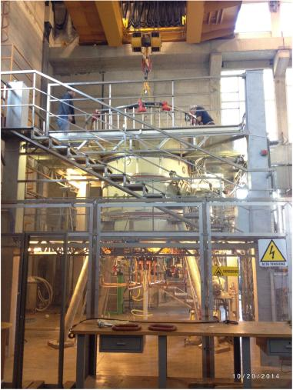
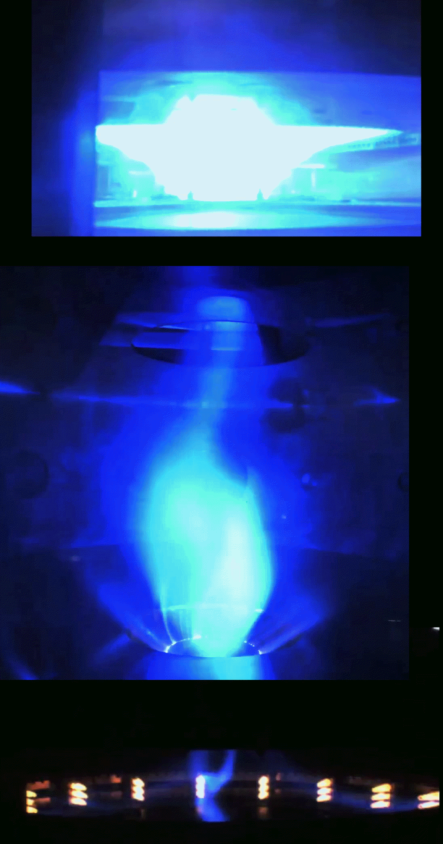
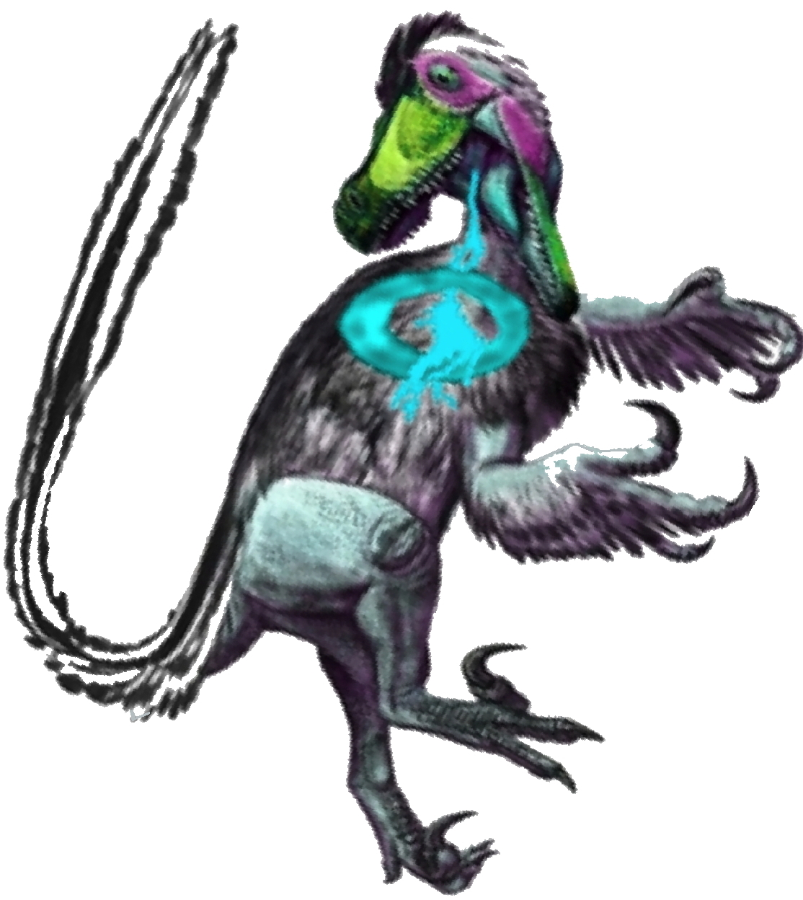

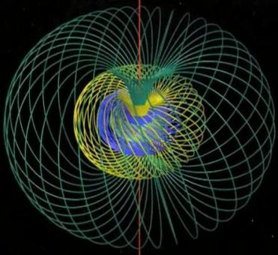

The PROTO-SPHERA experiment, an innovative confinement scheme for Fusion
Franco Alladio¹, P. Micozzi, G. Apruzzese, L. Boncagni, O. D'Arcangelo, E. Giovannozzi, A. Grosso, M. Iafrati,
A. Lampasi, G. Maffia, A. Mancuso, V. Piergotti, G. Rocchi, A. Sibio, B. Tilia, O. Tudisco, V. Zanza
CR-ENEA Frascati, ¹franco.alladio@enea.it
19th International Spherical Torus Workshop (ISTW 2017), Seoul National University, 18-22 September 2017

Slide 2
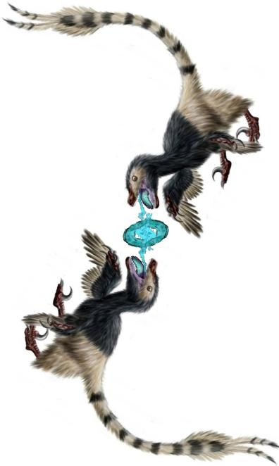
Outline
A Spherical Torus whose Centerpost is a Plasma discharge
Why a new and different magnetic confinement device?
• Possible unlimited sustainment of plasma current by DC voltage
• Natural examples of rings emitted by jets in fluids & plasmas
• High β value ~ 1 calculated for its ideal MHD stability
• If successful it could be the engine of a Fusion Space Thruster
Present experiment produces only Plasma Centerpost
• Modifications of boundary conditions:
- additional external PF coils
- insulating materials near the plasma,
have allowed achievement of full plasma current in Argon
• Plasma configuration resilient to operation accidents
• Spontaneous rotation of Plasma Centerpost
• Mixed magnetic & electrostatic confinement
• A new vacuum vessel for Hydrogen discharges?
• Perspective
。。。二龙抢珠 èrlóng qiǎngzhū
Two Dragons are snapping at a pearl!

Slide 3
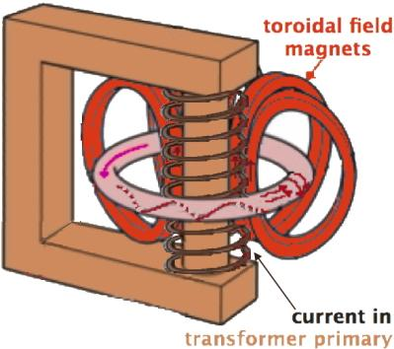
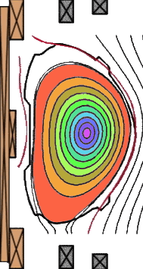

Therefore a plasma confining current has to flow inside the Torus:
such a current has to be induced and sustained by a transformer
whose current varies in time …but there are limits: the transformer will break beyond a given current limit…
The plasma ohmic drive in a Tokamak can be seen as motion of closed flux surfaces, that from outside ‘feed’ the plasma, which dissipates them while they move toward the magnetic axis
In tokamaks this process is due to the transformer current change:
Tokamaks cannot have steady drive!

Slide 4
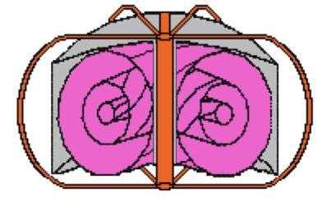
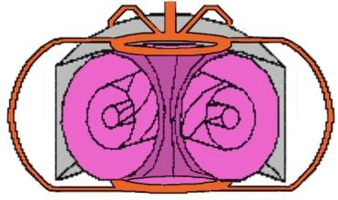
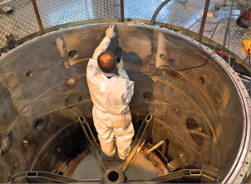
The main idea of PROTO-SPHERA
“Conventional Tokamak”: magnetic
  surfaces of toroidal plasma surround
a “Metal Centerpost”
• Vacuum vessel has toroidal geometry
PROTO-SPHERA: magnetic surfaces
of toroidal plasma surround
a “Plasma Centerpost”; only current
return external legs are made of metal
Vacuum vessel has cylindrical geometry
…but electrodes are required inside vacuum
Electric current flow
Abandon vacuum vessel complicated geometry,
move to a cylindrical vacuum vessel!
→ easy of access & of repair…

Slide 5
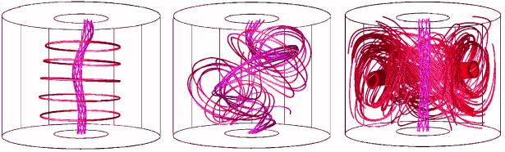
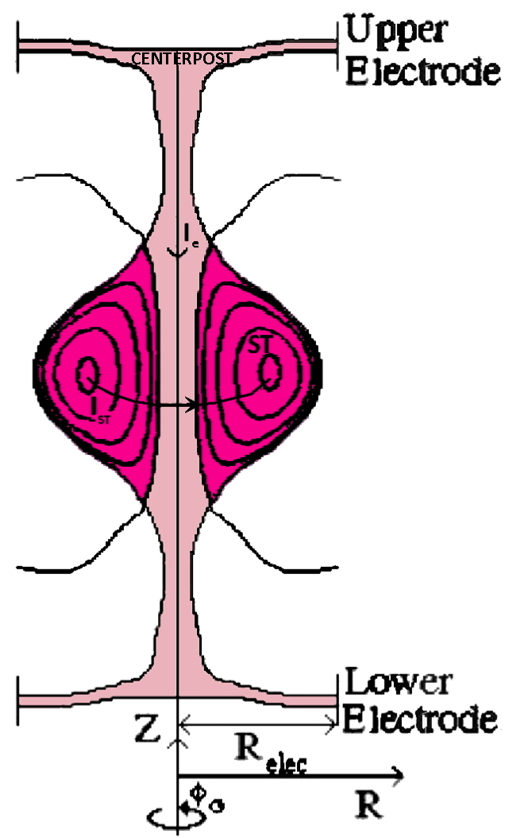
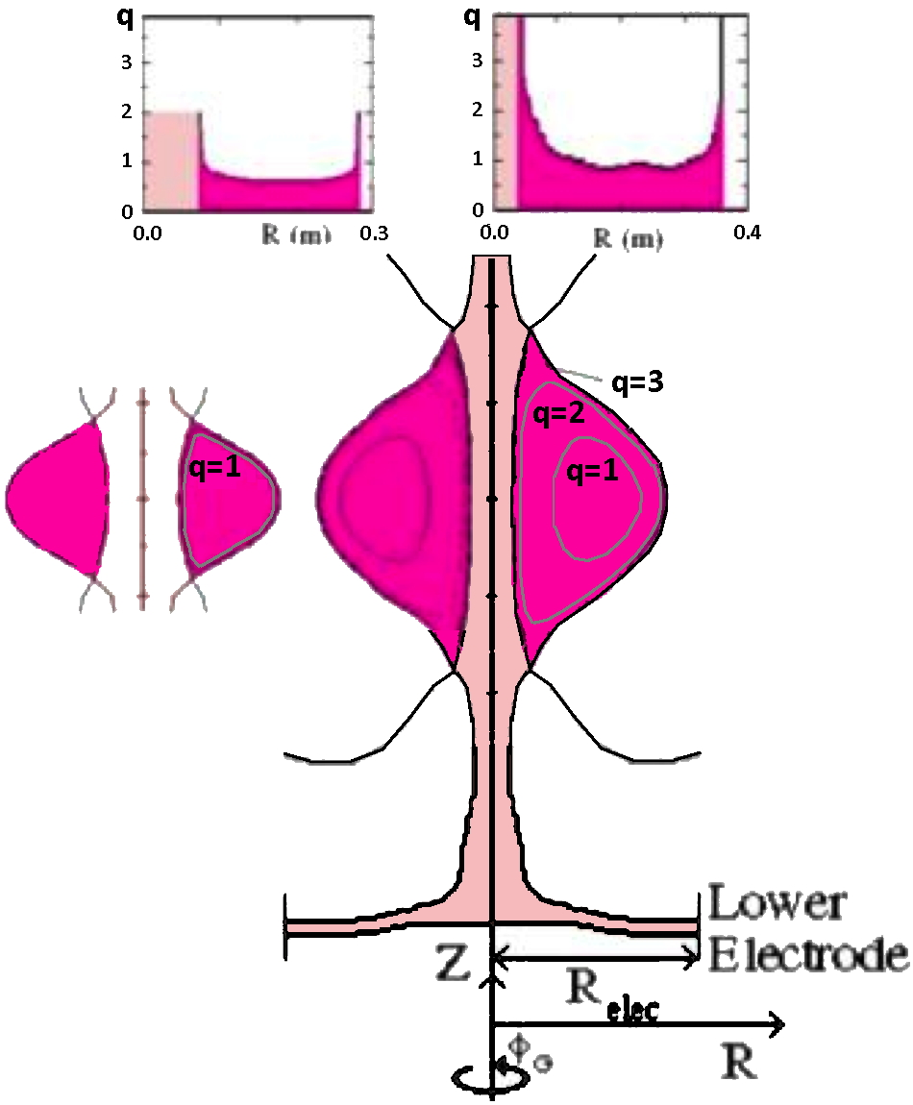
PROTO-SPHERA Japanese precursor
TS-3 (Tokyo University): 1993 removed the metal centerpost, applied 1kV between two plasma guns, produced a I_{e} = 40 kA Plasma Centerpost, non-linear “kink” instability formed a Spherical Torus toroidal plasma current 50 kA < I_{ST} < 100 kA
60 µs formation
20 µs sustainment
total duration 80 µs ∼ 100 τ_{Alfvén} (short but significant…)
PROTO-SPHERA key differences
• Designed for a Tokamak-like field-line
rotational trasform (q₀ ≥ 1, q_{edge}~ 3)
(aspect ratio A = R/a ≥ 1.2, elong. k = b/a ~ 2.3)
• PROTO-SPHERA formed “slowly”
as a prolated low aspect ratio
Spherical Torus from the
pre-existing plasma centerpost,
mushroom-shaped in front of electrodes
• At low voltage (100 V), inside big vessel
TS-3
PROTO-SPHERA

Slide 6
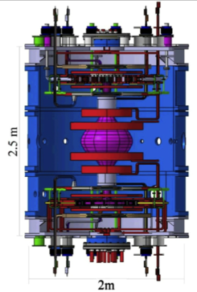
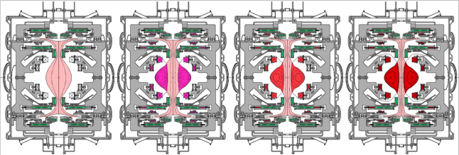
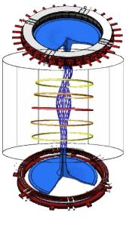
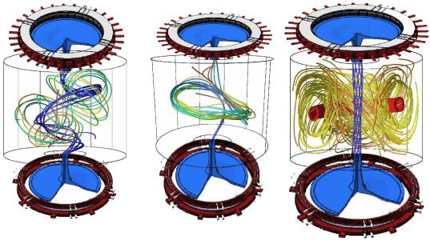
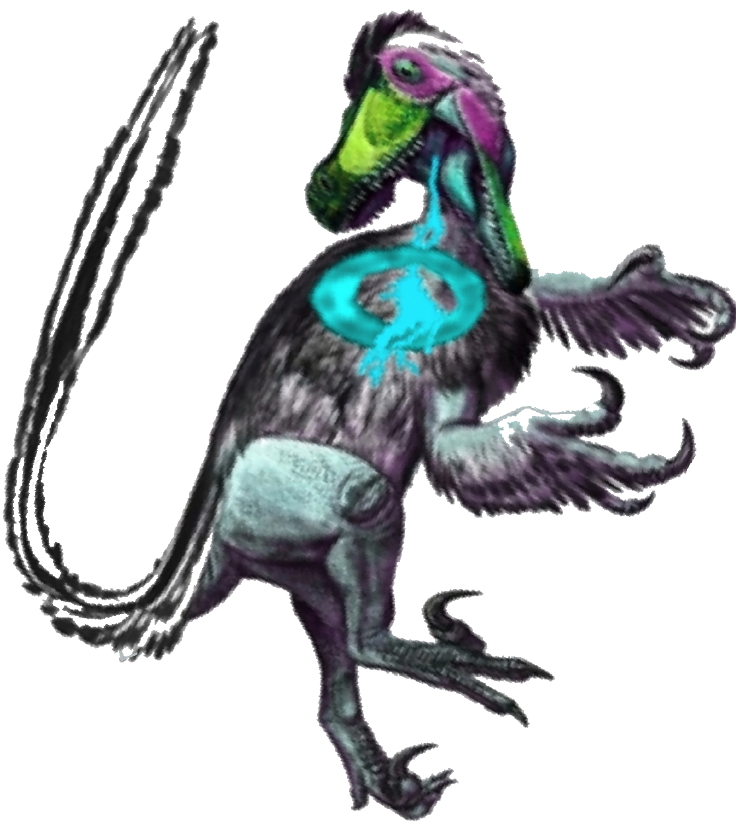
PROTO-SPHERA main design parameters:
Centerpost current I_{e}= 60 kA
ST toroidal current I_{ST}= 120÷240 kA
ST diameter 2R_{sph}= 0.7 m
Axisymmetric simulation of ST formation
Formation time scale (τ_{Alfvén}•τ_{Resist})^{1/2} ~ 0.6 ms
from τ_{Alfvén} ~ 0.5 μs
τ_{Resist} ~ 70 ms
Resistive MHD
simulations of
ST formation
by Ricardo Farengo
(ISTW2008-Frascati)
Non-axisymmetric simulation of ST formation
Garcia-Farengo, PoP 16,112508 (2009)

Slide 7
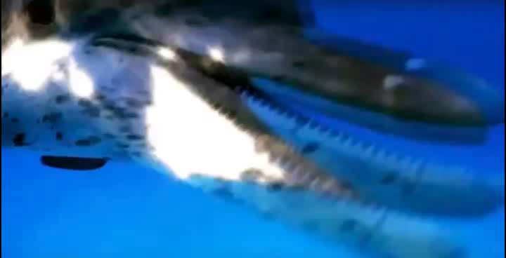
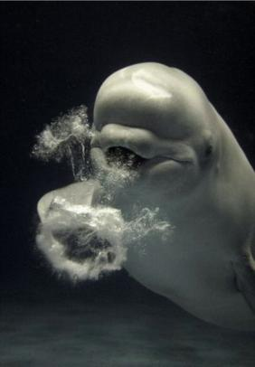
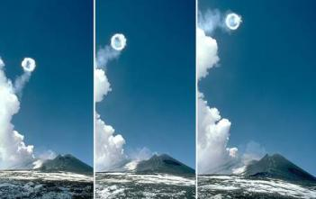
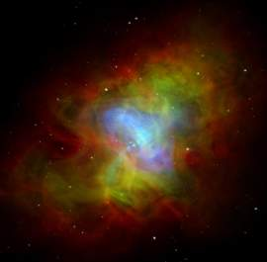

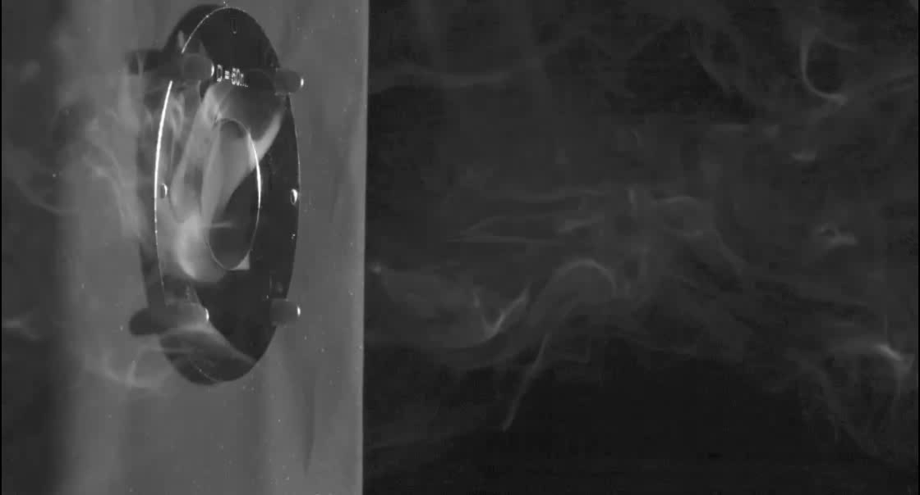
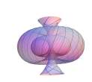
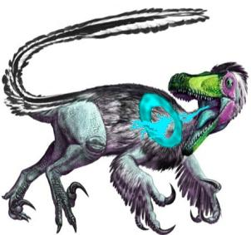
Formation & sustainment of Rings from
Jets is a common occurrence in Nature!
Aim is to sustain the Plasma Torus
for at least 1 resistive timescale: τ_{Resist} ~ 70 ms
…but PROTO-SPHERA designed for 1 sec sustainment!
“Smoke-ring like
self-organization”
Etna Volcano
Fluid dynamics examples
Plasma dynamics example
William Irvine-University of Chicago
Beluga
Crab Nebula

Slide 8
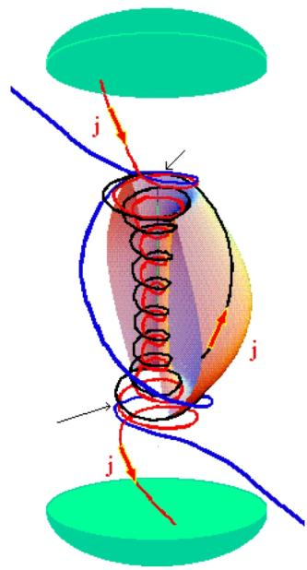
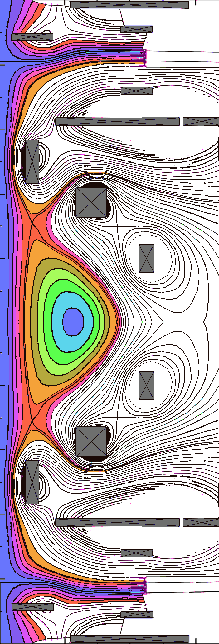
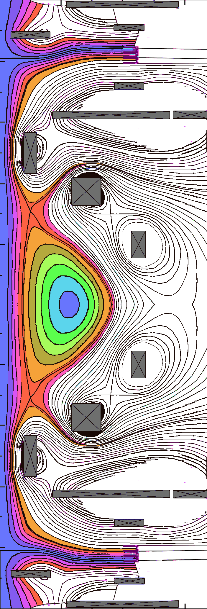
SUSTAIN THE CONFINING CURRENT
by DC voltage from anode to cathode
Anode
• In front of the electrodes:
open magnetic field lines,
Magnetic
reconnection
• Open magnetic field lines are wound
in a circular direction
• Magnetic reconnections convert
open lines
into closed , lines
wrapped around the spherical torus
Cathode
Magnetic
reconnection
Cathode
of Tokamaks relies on induction of PROTO-SPHERA relies on
efficient but not forever… associated with magnetic reconnections
HOW EFFICIENT THE SUSTAINMENT OF TOROIDAL CURRENT BY RECONNECTIONS?

Slide 9
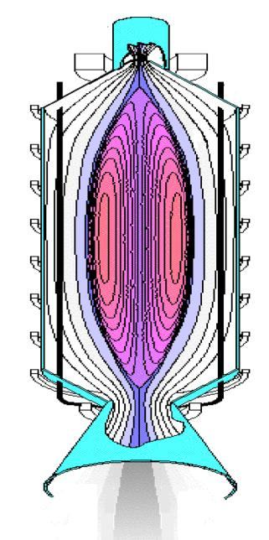
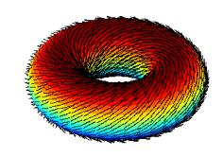
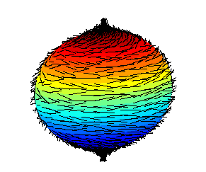

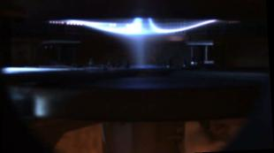
Space Thruster?
abandon vacuum vessel toroidal geometry, move to cylindrical one
… → natural expulsion of charged fusion products (Space Thruster)
Due to filamentary nature of B field
a fundamental mathematical difference appears:
a hairy torus
can be combed
a hairy sphere cannot!
From one of the “tufts” of the sphere (…not combed)
very high velocity (~ MeV) charged fusion products emerge
Possible future application as a Space Fusion Thruster…
Nozzle observed in PROTO-SPHERA experiment (2015)

Slide 10
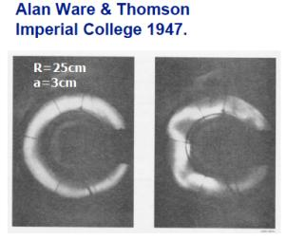
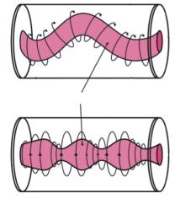
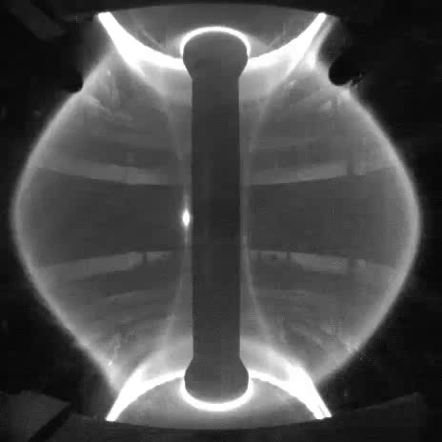
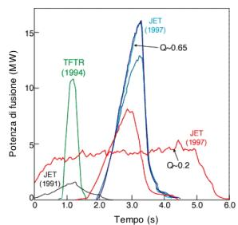
... Even if the muttered mantra is that Tokamak physics is perfectly known ...
Why a new and different magnetic confinement device? one reason is …"disruption"
MHD instabilities appeared since the earliest toroidal magnetic confinement devices
kink
sausage
Mast 2004
…the problem of disruption has not yet been solved
... Only Stellarator configurations (no net toroidal current!) avoid this inconvenience
In D - T experiments:
JET 1991- TFTR 1994
JET 1997
The highest neutron yield
…terminates in a disruption

Slide 11
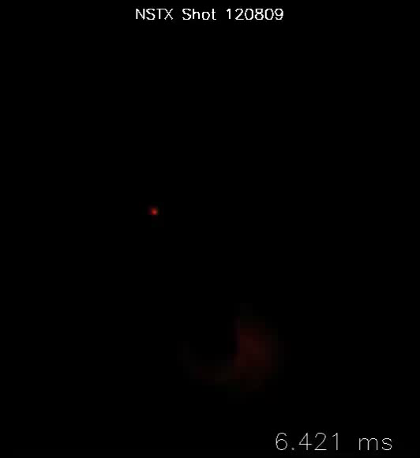
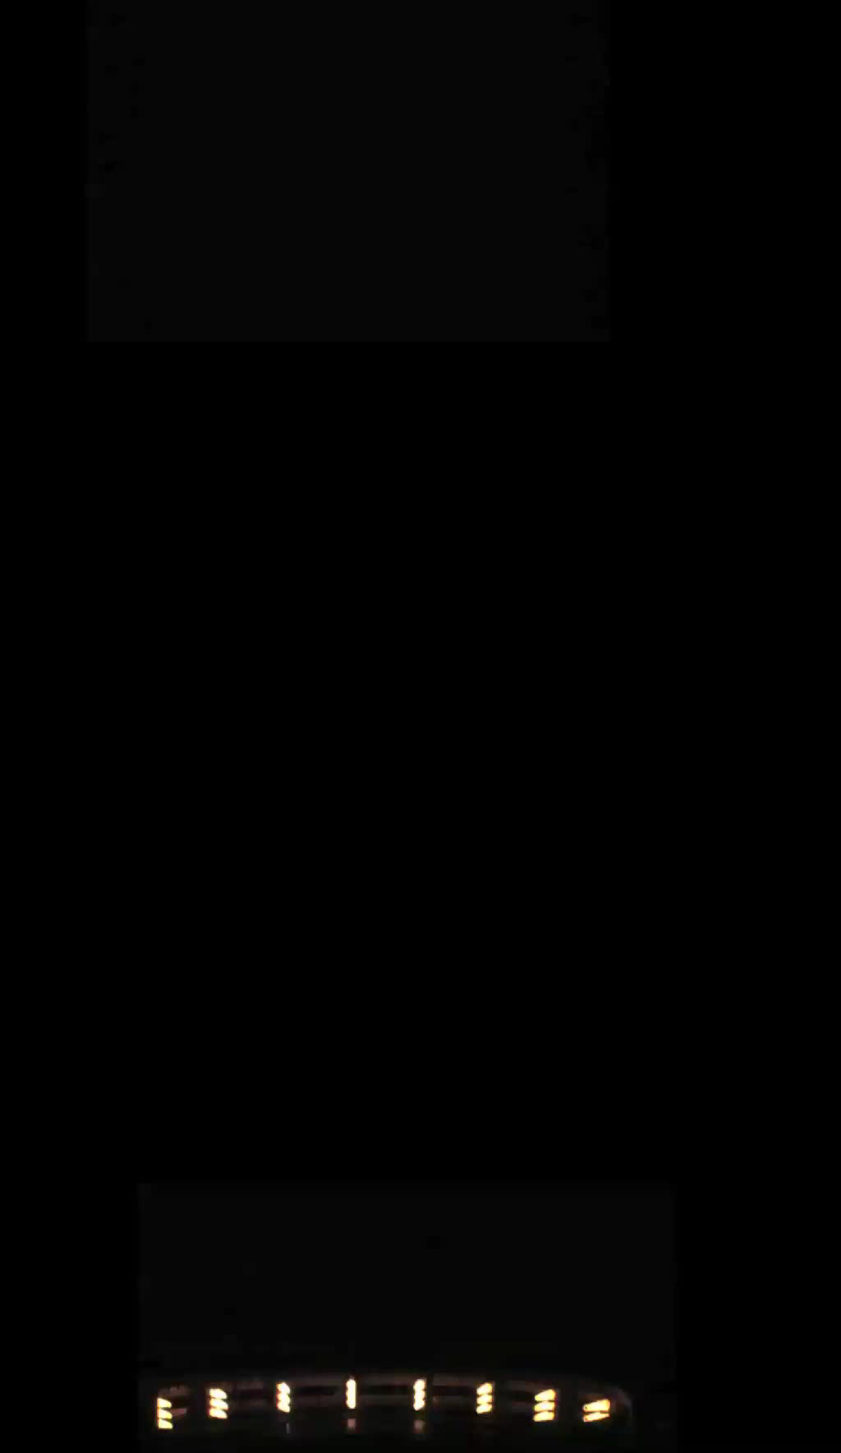
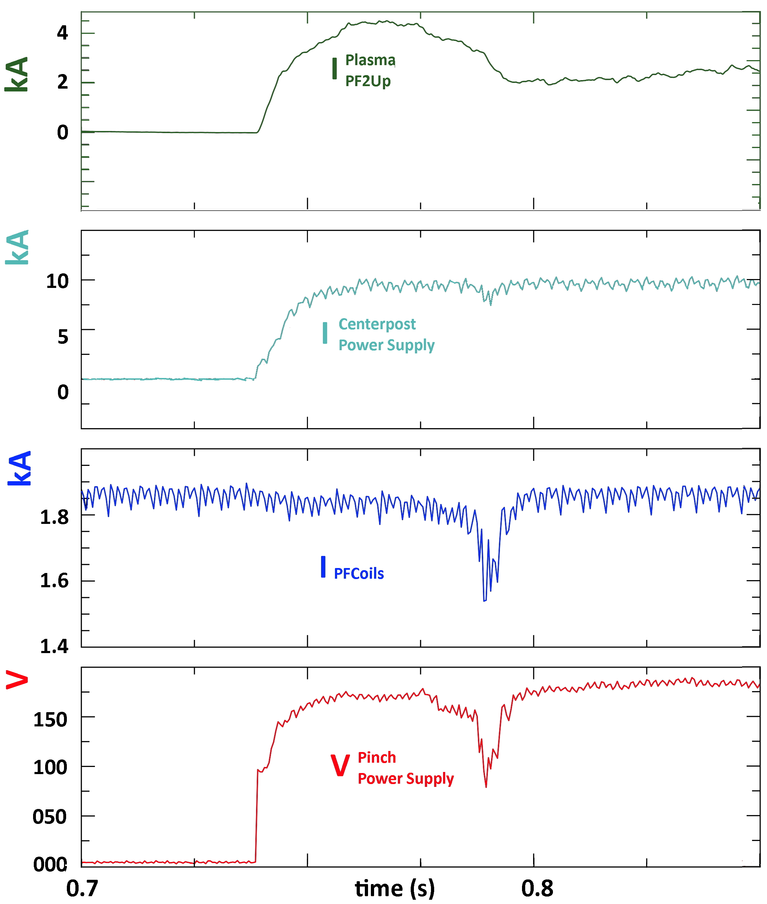
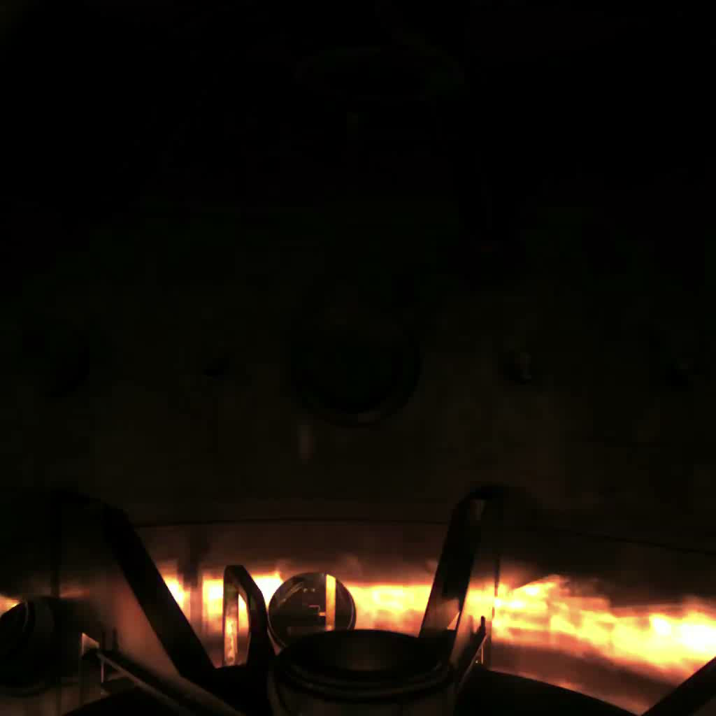
• Disruptions …toroidal plasma vanishes → damages, very long plasma restart, …
DC helicity injection in NSTX Spherical Tokamak (with metal centerpost)k
plasmoids are “born & reborn”
PROTO-SPHERA shot #364 (2016)
Plasma started without B field
Centerpost forms when B field is on
shot #734 (2017)
Langmuir probe
accident
In case of disappearance of toroidal current the configuration can reappear

Slide 12
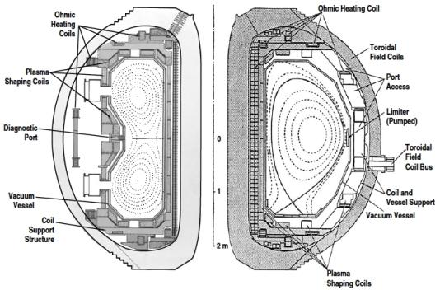
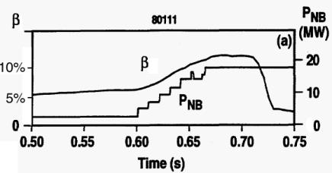
Why a new and different magnetic confinement device?
another reason is ... "β limit"
... Even if the muttered mantra is that tokamak physics is perfectly known ...
β = plasma beta =
but in tokamak experimental data one often uses β_{T0}
where B_{T0} is the vacuum field on the axis of the plasma
DIII-D in 1994 reached the highest value of β in conventional Tokamaks
DIII-D reached β_{T0} = 12.5%,
but…the plasma “disrupted”
vanished in ~ 1 msec !

Slide 13
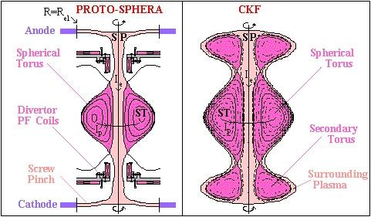
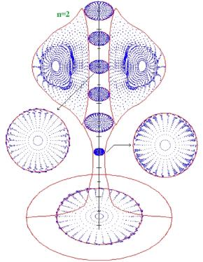
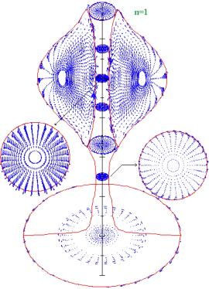
• Beta …plasma pressure few % of magnetic pressure → cost, size, …
Chandrasekhar-Kendall-Furth configuration
CKF an extrapolation of PROTO-SPHERA:
• internal PF coils replaced by
secondary Tori of Plasma
• Centerpost hitting electrodes replaced by Surrounding Plasma
CKF are ideally MHD stable up to β =1
but also PROTO-SPHERA can approach β =1
For low toroidal numbers n=1, 2 & 3
ideal MHD stability obtained
expressed with
ratio of the two plasma currents
I_{ST} /I_{e} = toroidal ST current/centerpost current
up to β = 21÷26% , I_{ST}/I_{e} = 0.5 - 1
up to β = 14÷15% , I_{ST}/I_{e} = 2-4
expressed with
up to β_{T0} =28÷29% , I_{ST}/I_{e} = 0.5 - 1
up to β_{T0} =72÷84% , I_{ST}/I_{e} = 2-4

Slide 14
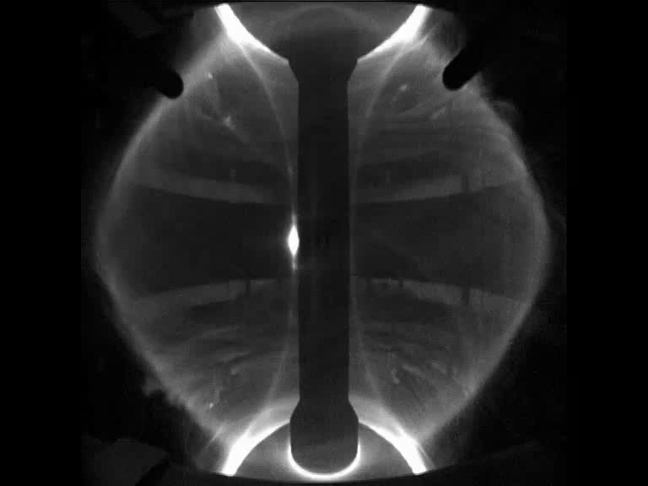
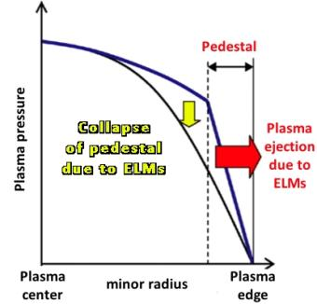
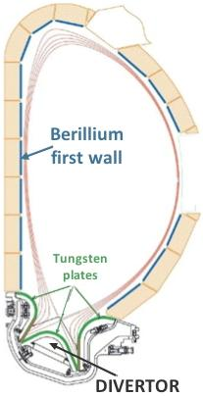
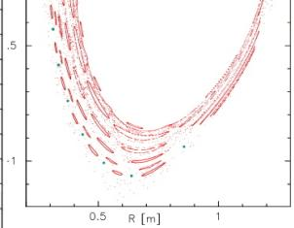
Why a new and different magnetic confinement device? still other reason are…
"ELMs" (unstable edge localized modes)
“ELM” mode throw upon the divertor a sizeable portion
(~ 20%) of the energy in the pressure pedestal
Energy flows
here
This happens in a
very short time (250 µs) as
the plasma edge becomes ergodic
(ELM filaments carry current)
On ITER an ELMs carrying > 3% of pedestal energy can even
melt or sublimate the Tungsten of the Divertor plates

Slide 15
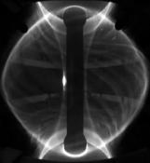





"ELMs" (unstable edge localized modes):
can these spontaneous filamentations (which in Tokamaks are only dangerous)
be put to fruition in PROTO-SPHERA?

Slide 16



Plasma rotation in Tokamaks is extremely
advantageous, as it stabilizes the torus
Plasma rotation induced by additional heatings
(Neutral Beam Injection, NBI), becomes more & more
difficult on larger tokamak experiments
Plasma Centerpost of PROTO-SPHERA rotates!
Operational experience in Tokamaks shows that the
best way of puffing fuel is from the high field side
Gas puffed hollow anode

Slide 17



IDEAL MHD STABILITY of PROTO-SPHERA
Spheromak tilt instability is due to
dipole of containing field opposite to toroidal plasma current dipole
“Group A” PF coils (compression coils)
has dipole moment opposite to Plasma
but “Group B” PF coils (shaping coils)
has dipole moment aligned to Plasma
disk-shaped CENTERPOST plasma: important for the ideal MHD stability
Cutting shorter & shorter
the plasma centerpost
PROTO-SPHERA at 120 kA
gets destabilized
Stable ← → Unstable

Slide 18





May 2015 annular
anode lowered
on top of machine
Up: hollow gas-puffed anode
Down: 3000º K heated cathode
present stage cathode
(54 = 18 x 3 emitters): aim 10 kA
final stage cathode, 6 x present
(324 = 108 x 3 emitters): aim 60 kA
“Caduceus”-like emitting spirals
have now survived > 1000 cycles

Slide 19



INSULATIONS
Only the PF coils necessary for setting up
the plasma centerpost have been built
8 PF coils in series
inside the machine
Stainless steel
up\down
new extensions
PF4up
anode
PF3up
PF2up
annular shape
Aluminium cylindrical
START vessel
Plasma current must run
through both PF2 throttles
PF2low
PF3low
annular shape
cathode
PF4low
Stainless steel
up\down new lids
vacuum vessel is GND potential PF coils casings built as floating,
can be connected to potentials: anode +， cathode -，vessel 0

Slide 20



No Anode Arc Attachment!
Hollow annular anode performs
• plasma goes through both PF2 throttles
• plasma enters anode gas-puffing holes
• no sign (I_{e} < 8.6 kA) of anode attachment
• filling pressure 10⁻³ - 10⁻² mbar
Argon plasma: break-down 80 V
annular anode plasma is never filamented
whereas annular catode plasma is
filamented (due to sparse emitters）
anode camera
cathode camera
even plasma centerpost is in part filamented
(…cathode switched off before the plasma…)

Slide 21


No Anode Arc Attachment: Electrostatic plasma effects!
PF coils casings built as floating, can be connected to: anode +， cathode -，vessel 0
Electrostatic potential is dominated by the plasma; PF coils casings better left floating!
the magnetic field is up\down symmetric but electrostatic field not up\down symmetric
vacuum vessel at GND 0V
V_{PF4up} ~ +78 V
V_{anode} ~ +121 V
V_{PF2-3up} ~ +49 V
#649 6kA Argon
Plasma centerpost
(June 2017)
X-point
V_{PF2-3low} ~ -8 V
V_{cathode} ~ -51 V
V_{PF4low} ~ -20 V
Line contours: magnetic field
Color contours: electrostatic potential, Arrows: E field

Slide 22

Color contours: electrostatic potential, Arrows: E field
Plasma-induced electric potential:
near the annular anode
the E field is in part perpendicular
to the B field
... azimuthal plasma rotation
… starting from PF2up throttle
v_{ExB} = (E/B) ~ 10² - 10³ m/s
near the annular cathode
the E field is ~ parallel to B field
… less plasma rotation
Self-organization at work inside
annular electrodes plasma
#649, 6 kA Argon
Line contours: magnetic field

Slide 23



The equatorial X –point has been removed from inside the vessel
4 External PF coils have been added (home-made from spare connection cables)
…and fed in series with the internal PF coils (PF coils power supply has sufficient margin)
X
4 External PF coils
Plasma fired after 0.75 s of PF current to allow for skin current diffusion in Al vessel and SS lids
Within 2017 a new Super-capacitor based Power Supply for External PF coils should operate!

Slide 24





2015/16 experiments produced a heavy metallization on top
(anode) & bottom (cathode) bus-bar vacuum entrance flanges,
associated with magnetic “nozzles”
June 2016: insertion of Polycarbonate (transparent) anode bus-bar flange on top of machine
Heavily metallized
top & bottom bus-bar flanges
4 cm thick Polycarbonate
(required by atmospheric pressure)

Slide 25









At the bottom (near cathode) a SS flange, pierced by 14 bus-bars,
such a flange has been substituted by a Polycarbonate one
July 2016: Polycarbonate
flange on machine bottom

Slide 26




Secondary discharges from electrodes hitting Al vacuum vessel wall (plenty of scars!)
Shot 378
I_{e}= 2.7 kA
Polycarbonate flanges got rid of all metallization from bus-bars:
2mm thick Polycarbonate lining covers the Al vacuum vessel
secondary
2mm thick
Polycarbonate
screen
surrounds
rear of anode
December
2016

Slide 27




Shot 591
Secondary discharges hitting vacuum vessel wall
have been cured by Polycarbonate lining, but
Spurious plasma currents still flow outside the centerpost (albeit inside the vacuum vessel)
PF2up
January 2017
patterns of spurious
currents are
either diffused
or filamentary
Shot 597
Input 0.6 MW
7 kA from power supply
Centerpost drives 60%
Shot 597
crisis
Shot 597
PF2low

Slide 28


January 2017
Secondary discharges hitting vacuum vessel wall
have been cured by Polycarbonate lining, but
In Hydrogen (250 V breakdown) there was still a problem of current through the vessel,
this was triggered in Argon (80 V breakdown), connecting the common star potential of the six-phased cathode power supply to the machine GND
PF2up
Most critical electric field is
at contact between SS upper
extension & Al vacuum vessel
Shot 567
A spacing insulating ring
was inserted in May 2017
PF2low

Slide 29




to avoid the bus-bar to vessel current flow an insulating
spacer ring has been inserted
lower
diaphragm
To avoid the flowing of plasma currents outside the desired path of the plasma centerpost two large insulating polycarbonate diaphragm separators have been inserted
lower
diaphragm
May 2017: Insertion of
Polycarbonate lower diaphragm
lower
diaphragm
Lower spacer ring not yet inserted

Slide 30




May 2017: Insertion of
Polycarbonate upper diaphragm
& Polycarbonate spacer ring
spacer ring
spacer ring
upper
diaphragm
PF2up
upper diaphragm
1-2 mm clearance
1-2 mm clearance
lower diaphragm
upper
diaphragm
PF2low

Slide 31


June 2017: Plasma with Polycarbonate two diaphragms & upper Polycarbonate spacer ring
Shot 614
High currents, external PF coils are on
Some spurious and concentrated plasma current still sneaks through the narrow clearance (1-2 mm) bet’wn polycarbonate cylindrical lining and diaphragm,
plasma currents with 8.6 kA through PF2 are achieved
Power input 1.65 MW, Anode-cathode voltage 195 V
PF2up
With currents through PF2 exceeding ~ 6kA the
rotational transform of plasma centerpost
(q_{Centerpost} ~ 2) becomes clearly visible
The plasma centerpost seems to rotate azimuthally
in clockwise direction (looking from above)
PF2low
the spurious plasma current closes on the ouside of PF2low, producing bright filaments

Slide 32


High currents (8 kA), switching on the external PF coils:
PF coils casings built as floating
Electrostatic potential is dominated by the plasma; PF coils casings better left floating!
SS upper lid & upper extension also better left floating! through Polycarbonate spacer ring
upper lid & extension float at 90 V
V_{PF4up} ~ 130 V
V_{anode} ~ +150 V
V_{PF2-3up} ~ +75 V
#614, 8kA Argon
Plasma centerpost
June 2017
V_{PF2-3low} ~ +20 V
V_{cathode} ~ -45 V
V_{PF4low} ~ -7 V
vacuum vessel at GND (0 V)
Line contours: magnetic field Color contours: electrostatic potential, Arrows: E field

Slide 33


External PF coils are off, lower currents,
0.7 s persisting discharge
Shot 644
Switching off the external PF coils, long duration plasma centerposts have been obtained with plasma currents through the PF2 coils ~ 6÷7 kA
PF2up
The plasma centerpost discharge is quite near to the
rotational trasform value ι ~ ½ ➔ (q_{Centerpost} ~ 2)
PF2low
Autumn 2017: the narrow clearances will be closed completely by a bonding material
(able to sustain the diaphragms’ weight)

Slide 34


Kink destabilization persists for 0.7 s
Shot 645
The anode plasma wobbles gently
Reducing by a factor of 4 the magnetic field of the internal PF coils, the plasma centerpost has been destabilized
A long duration kink-bended plasma centerpost has been obtained with plasma currents through the PF2 coils ~ 5÷6 kA
PF2up
This plasma kink-bended centerpost discharge survives
at a rotational trasform value ι ~ 1.66 ➔ (q_{Centerposth} ~ 0.6)
PF2low
Cathode plasma wobbles more than centerpost, but
the discharge survives till the DC voltage is applied!

Slide 35





Physics Design
1997-2008
Langmuir probe
measurements give
10÷3 eV temperature
2÷5•10¹⁹ m⁻³ density
at edge of anodic
plasma mushroom
PROTO-SPHERA
destabilization
Experiment
2017

Slide 36



The plasma current sneaking through the narrow clearance (1-2 mm)
between polycarbonate cylindrical lining and diaphragm induces damages
The narrow clearance has
to be closed completely by
a bonding material
(able to sustain the diaphragms weight)
The port where the polycarbonate lining was cut, in order to allow for
vacuum gauges measurements,
has to be closed
& the gauges moved elsewhere

Slide 37


A new insulating & transparent vacuum vessel has to be built: will be Phase-II ready
If whole current of power supply (10 kA) is successfully driven in the Argon centerpost plasma it will be necessary to substitute the Al vacuum vessel with a
a Polymetacrylate (PPMA) transparent and insulating vessel (5 cm thick, 2m , 1.6 m high)
adding 2 further SS rings on top & bottom of the experiment,
keeping all internal components attached to the existing SS upper\lower lid and extension
then try Hydrogen plasma
flanged PPMA cylinder carved PPMA cylinder

Slide 38

To be build, after 10 kA plasma centerpost routinely achieved,
full PROTO-SPHERA load assembly and power supplies
Group A: ST compression coils (5+5 series)
Not yet built, but inner vessel ready to host
• high voltage (~ 20 kV) insulation
thin Inconel casings cost ~ 0.5M€
Tungsten filaments (54 → 324) cost ~ 0.2M€
Final Power Supplies for:
1) Group A PF coils cost ~ 0.1M€
2) Cathode (I_{cath} 10 → 60 kA) cost ~ 0.2M€
3) Centerpost (I_{e} 10 → 60 kA) cost ~ 0.6M€
SuperCapacitors will be used
Cost up to now ~ 2.0 M€
Cost for final stage of experiment ~ 1.6 M€

Slide 39


No additional heatings for PROTO-SPHERA?
…magnetic reconnections quite efficient in heating up the Solar Corona!
Power injected into the centerpost
should be > 250 V • 60 kA = 15 MW…
It is a huge power into such a small plasma
…however how much will go into
the confining Spherical Torus,
through magnetic reconnections?
No one is able to predict:
• should it be ~ zero, then ST plasma T = 10 eV
PROTO-SPHERA studies plasma-electrode interactions
• should it be 1 MW, then ST plasma T = 100 eV
PROTO-SPHERA studies magnetic reconnections
at relevant magnetic Lundquist number, S=10⁴
• shoud it be many MW, then ST plasma T = 1 keV
…β ~ 1 !
…would do as a Tokamak, but at 1/100 of the cost

Slide 40
。。。放龙如海! fànglóng rùhǎi
…set free the Dragon into the sea!
Perspective
Proto-Sphera will assess a new magnetic confinement configuration
• simply connected (easier construction & maintenance)
• sustained (indefinitely?) by helicity injection, through magnetic reconnections
• mixed magnetic & electrostatic confinement, major role of plasma velocity?
• (if magnetic reconnection efficient) high plasma beta? (minimal geometrical size)
Proto-Sphera can develop this program:
at very modest costs ( ~ 1.6 M€ ); in a flexible way (new components can be easily added)
PROTO-SPHERA Phase2 will be much more demanding in manpower and effort
than the present Phase1 of PROTO-SPHERA with Centerpost plasma only
Will be an experiment as much challenging for Frascati as START was for Culham
• with sophisticated control requests (very fast rise of currents for Torus formation)
• with demanding diagnostic requests
• challenging physicists, engineers and technologists creativity with its adaptability
• easily modifiable and therefore an ideal ground for student and PhD theses
Fasten seatbelts: surprises along the road!

Slide 41





































+ Other
authors

