Slide 1
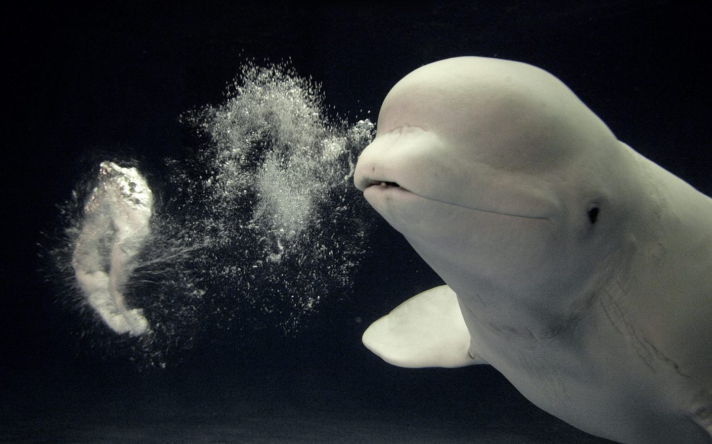
First results of MultiPinch
with final annular anode
Franco Alladio
Luca Boncagni, Federica Causa, Edmondo Giovannozzi, Andrea Grosso, Alessandro Lampasi, Giuseppe Maffia, Alessandro Mancuso^{retired},
Paolo Micozzi, Valerio Piergotti, Giuliano Rocchi, Alessandro Sibio,
Benedetto Tilia, Vincenzo Zanza^{retired}
WiP – 10 Luglio 2015

Slide 2
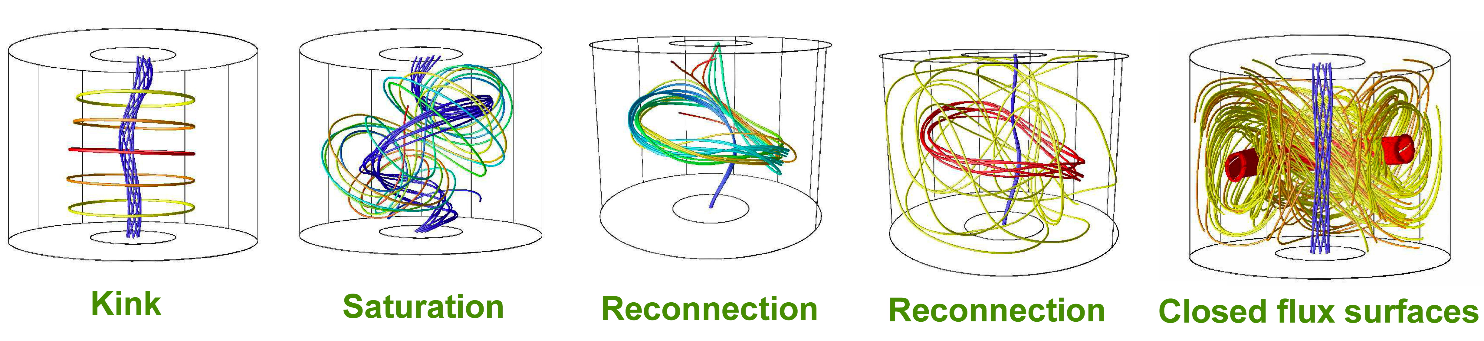
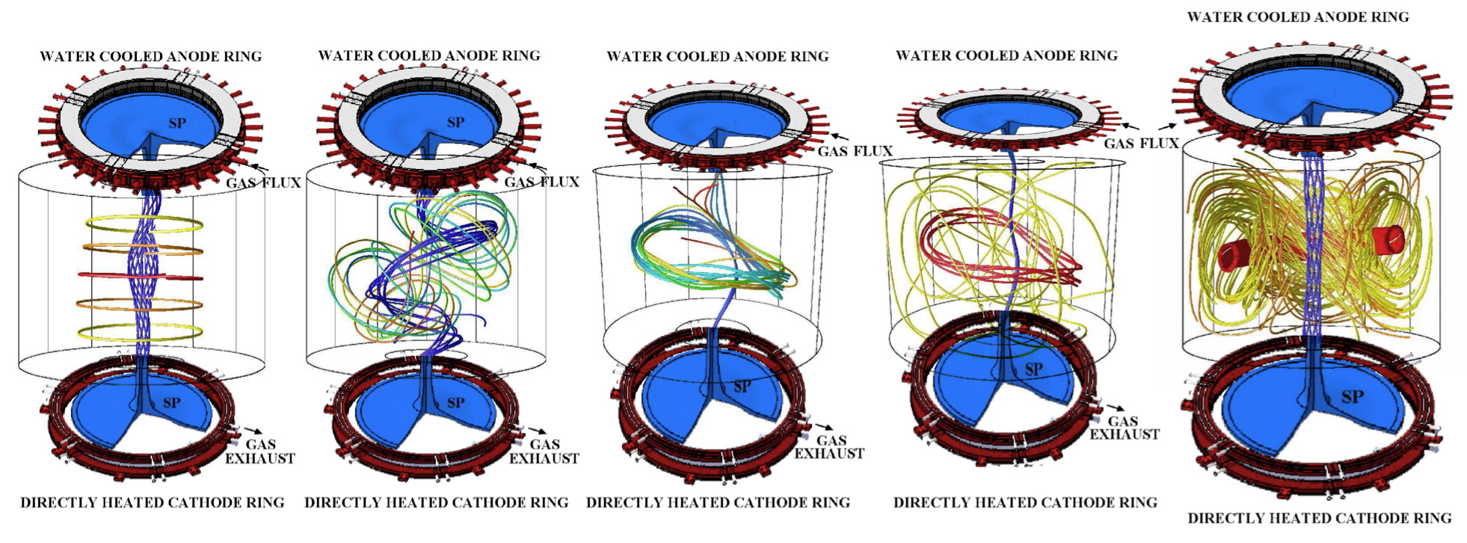
PROTO-SPHERA immediate aim
A spherical tokamak where the metal centerpost is replaced by a plasma centerpost:
will the plasma centerpost be able to produce and drive the plasma ring?
anode and cathode needed for setting up the configuration

Slide 3
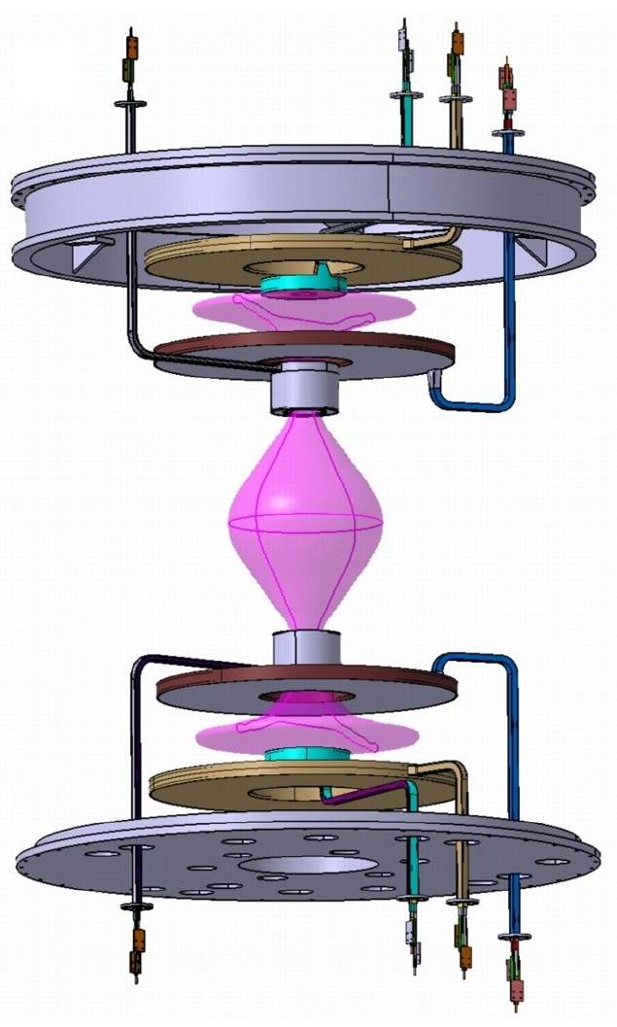
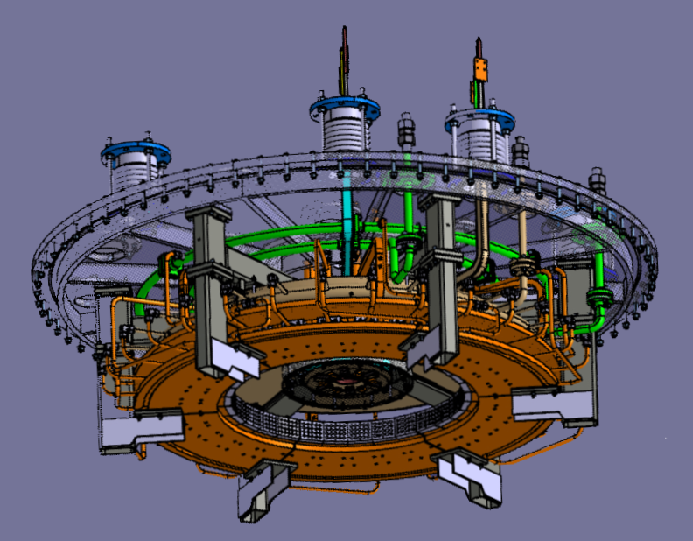
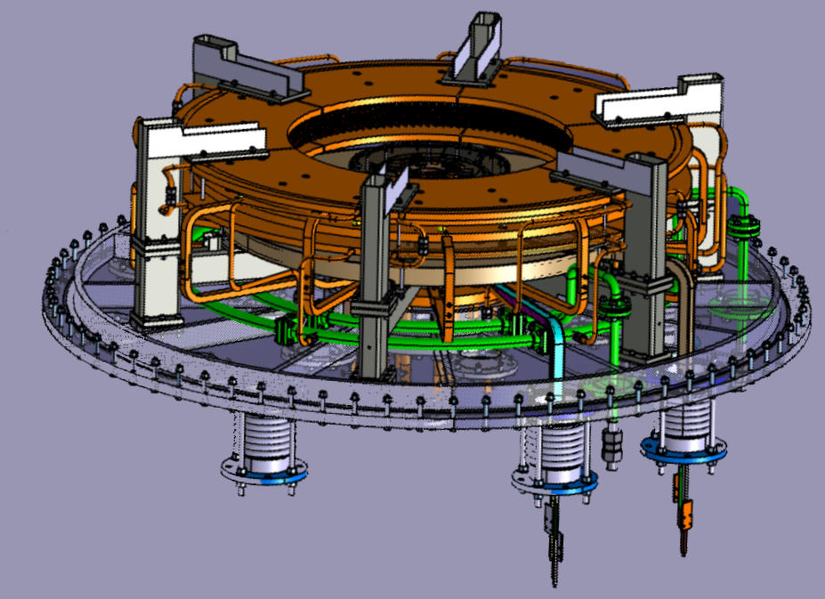
Vacuum Vessel is GND potential
PF coils casings can be at floating potential,
PF coils casings can as well be connected to:
Anode +
Cathode -
Vessel 0
Annular Anode: components built in ASG (Genoa)
remained to be assembled in the machine
PF4up
PF3up
PF2up
Anode
Plasma current must run
through both PF2 throttles
PF2low
PF3low
Cathode
PF4low
But machine can operate (worse) with
Cathode at Vessel (GND) potential
Annular Cathode for 6-phased (rotating) heating
power supply on the machine, as built in ASG

Slide 4
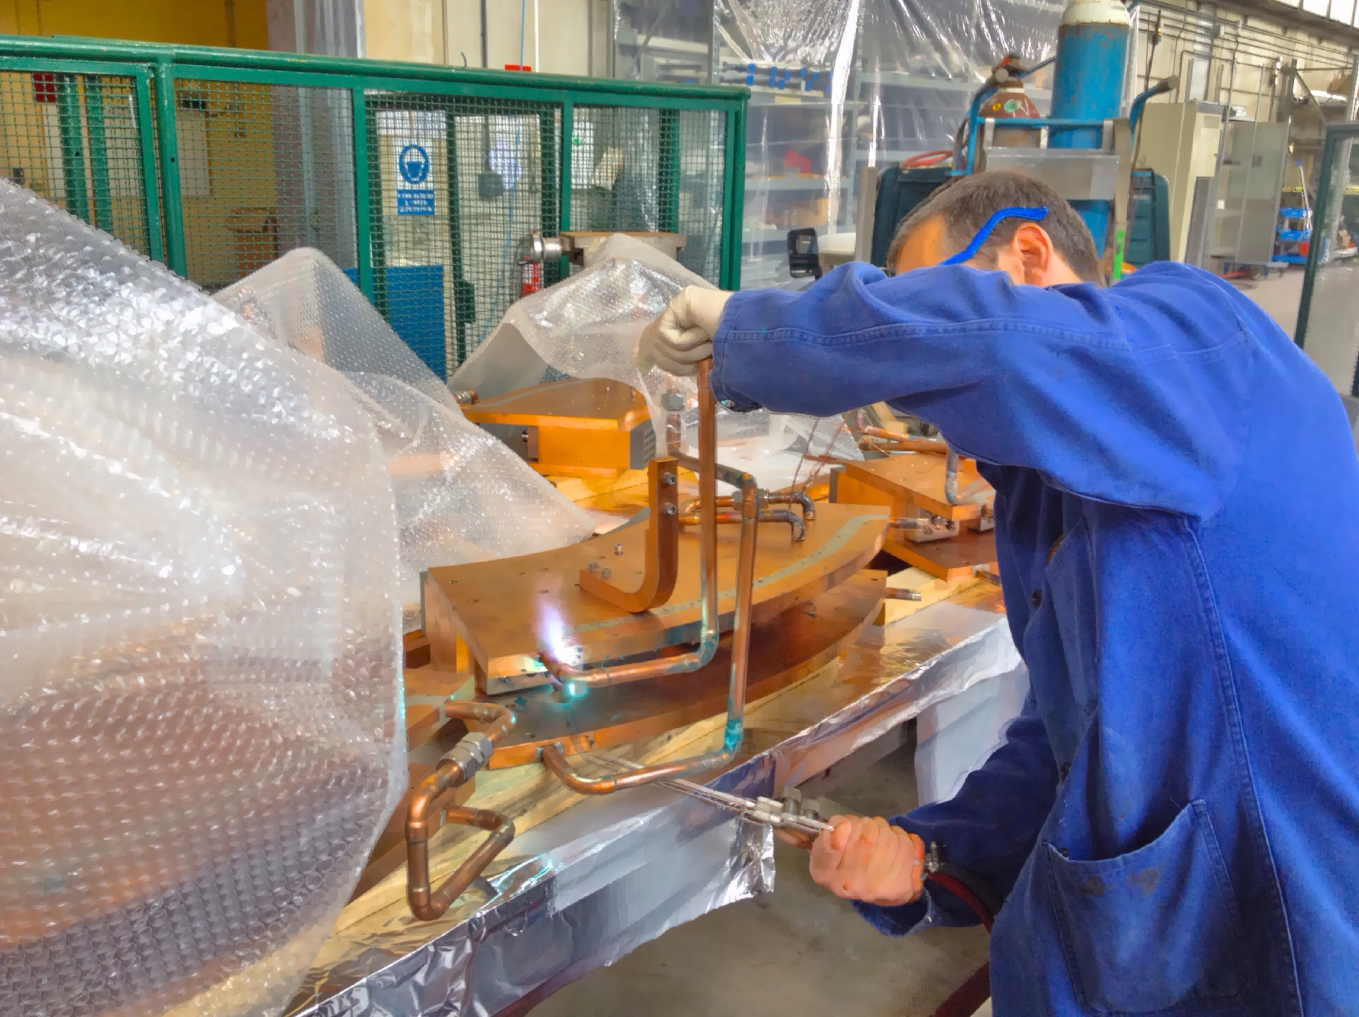
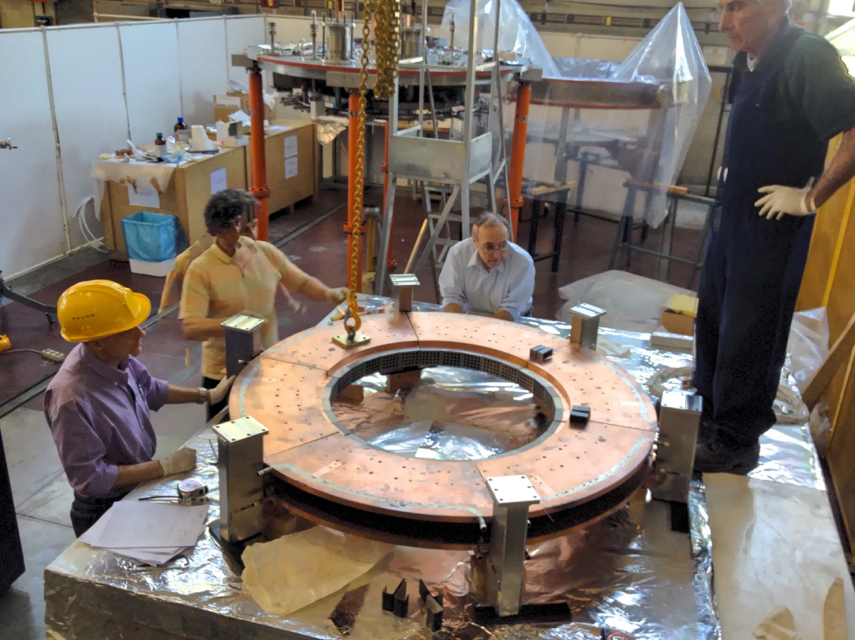
Annular Anode simplified:
• cooling system removed (PROTO-SPHERA)
• hollow Anode gas feeding system modified
Annular Anode pre-assembled
on its own, …better procedure

Slide 5
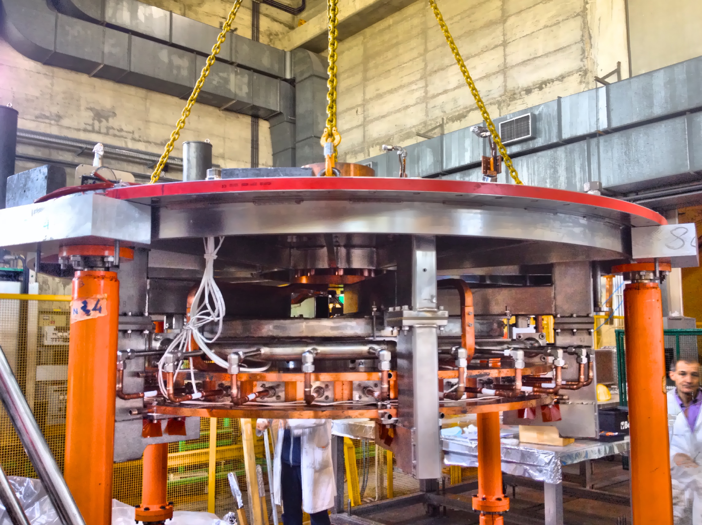
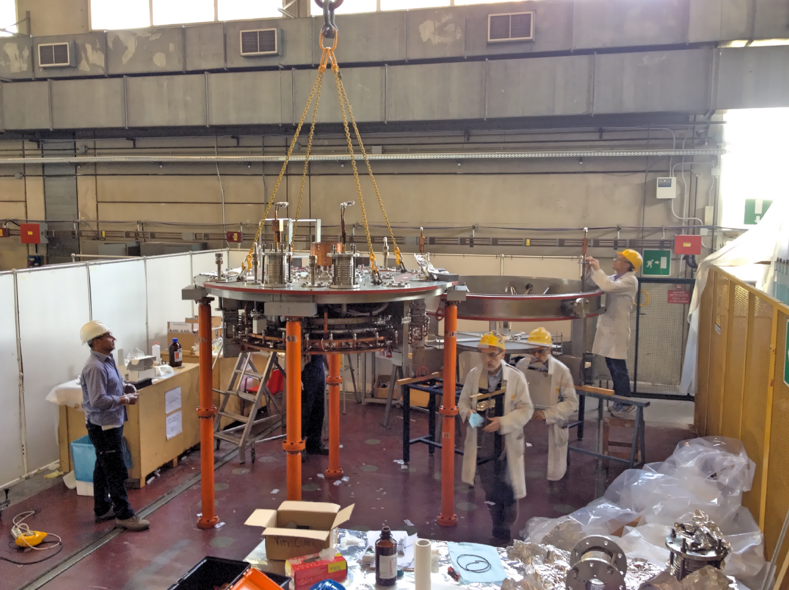
Top lid of machine lowered upon
pre-assembled Annular Anode
Top lid and Anode lowered
upon PF2/PF3 upper coils

Slide 6
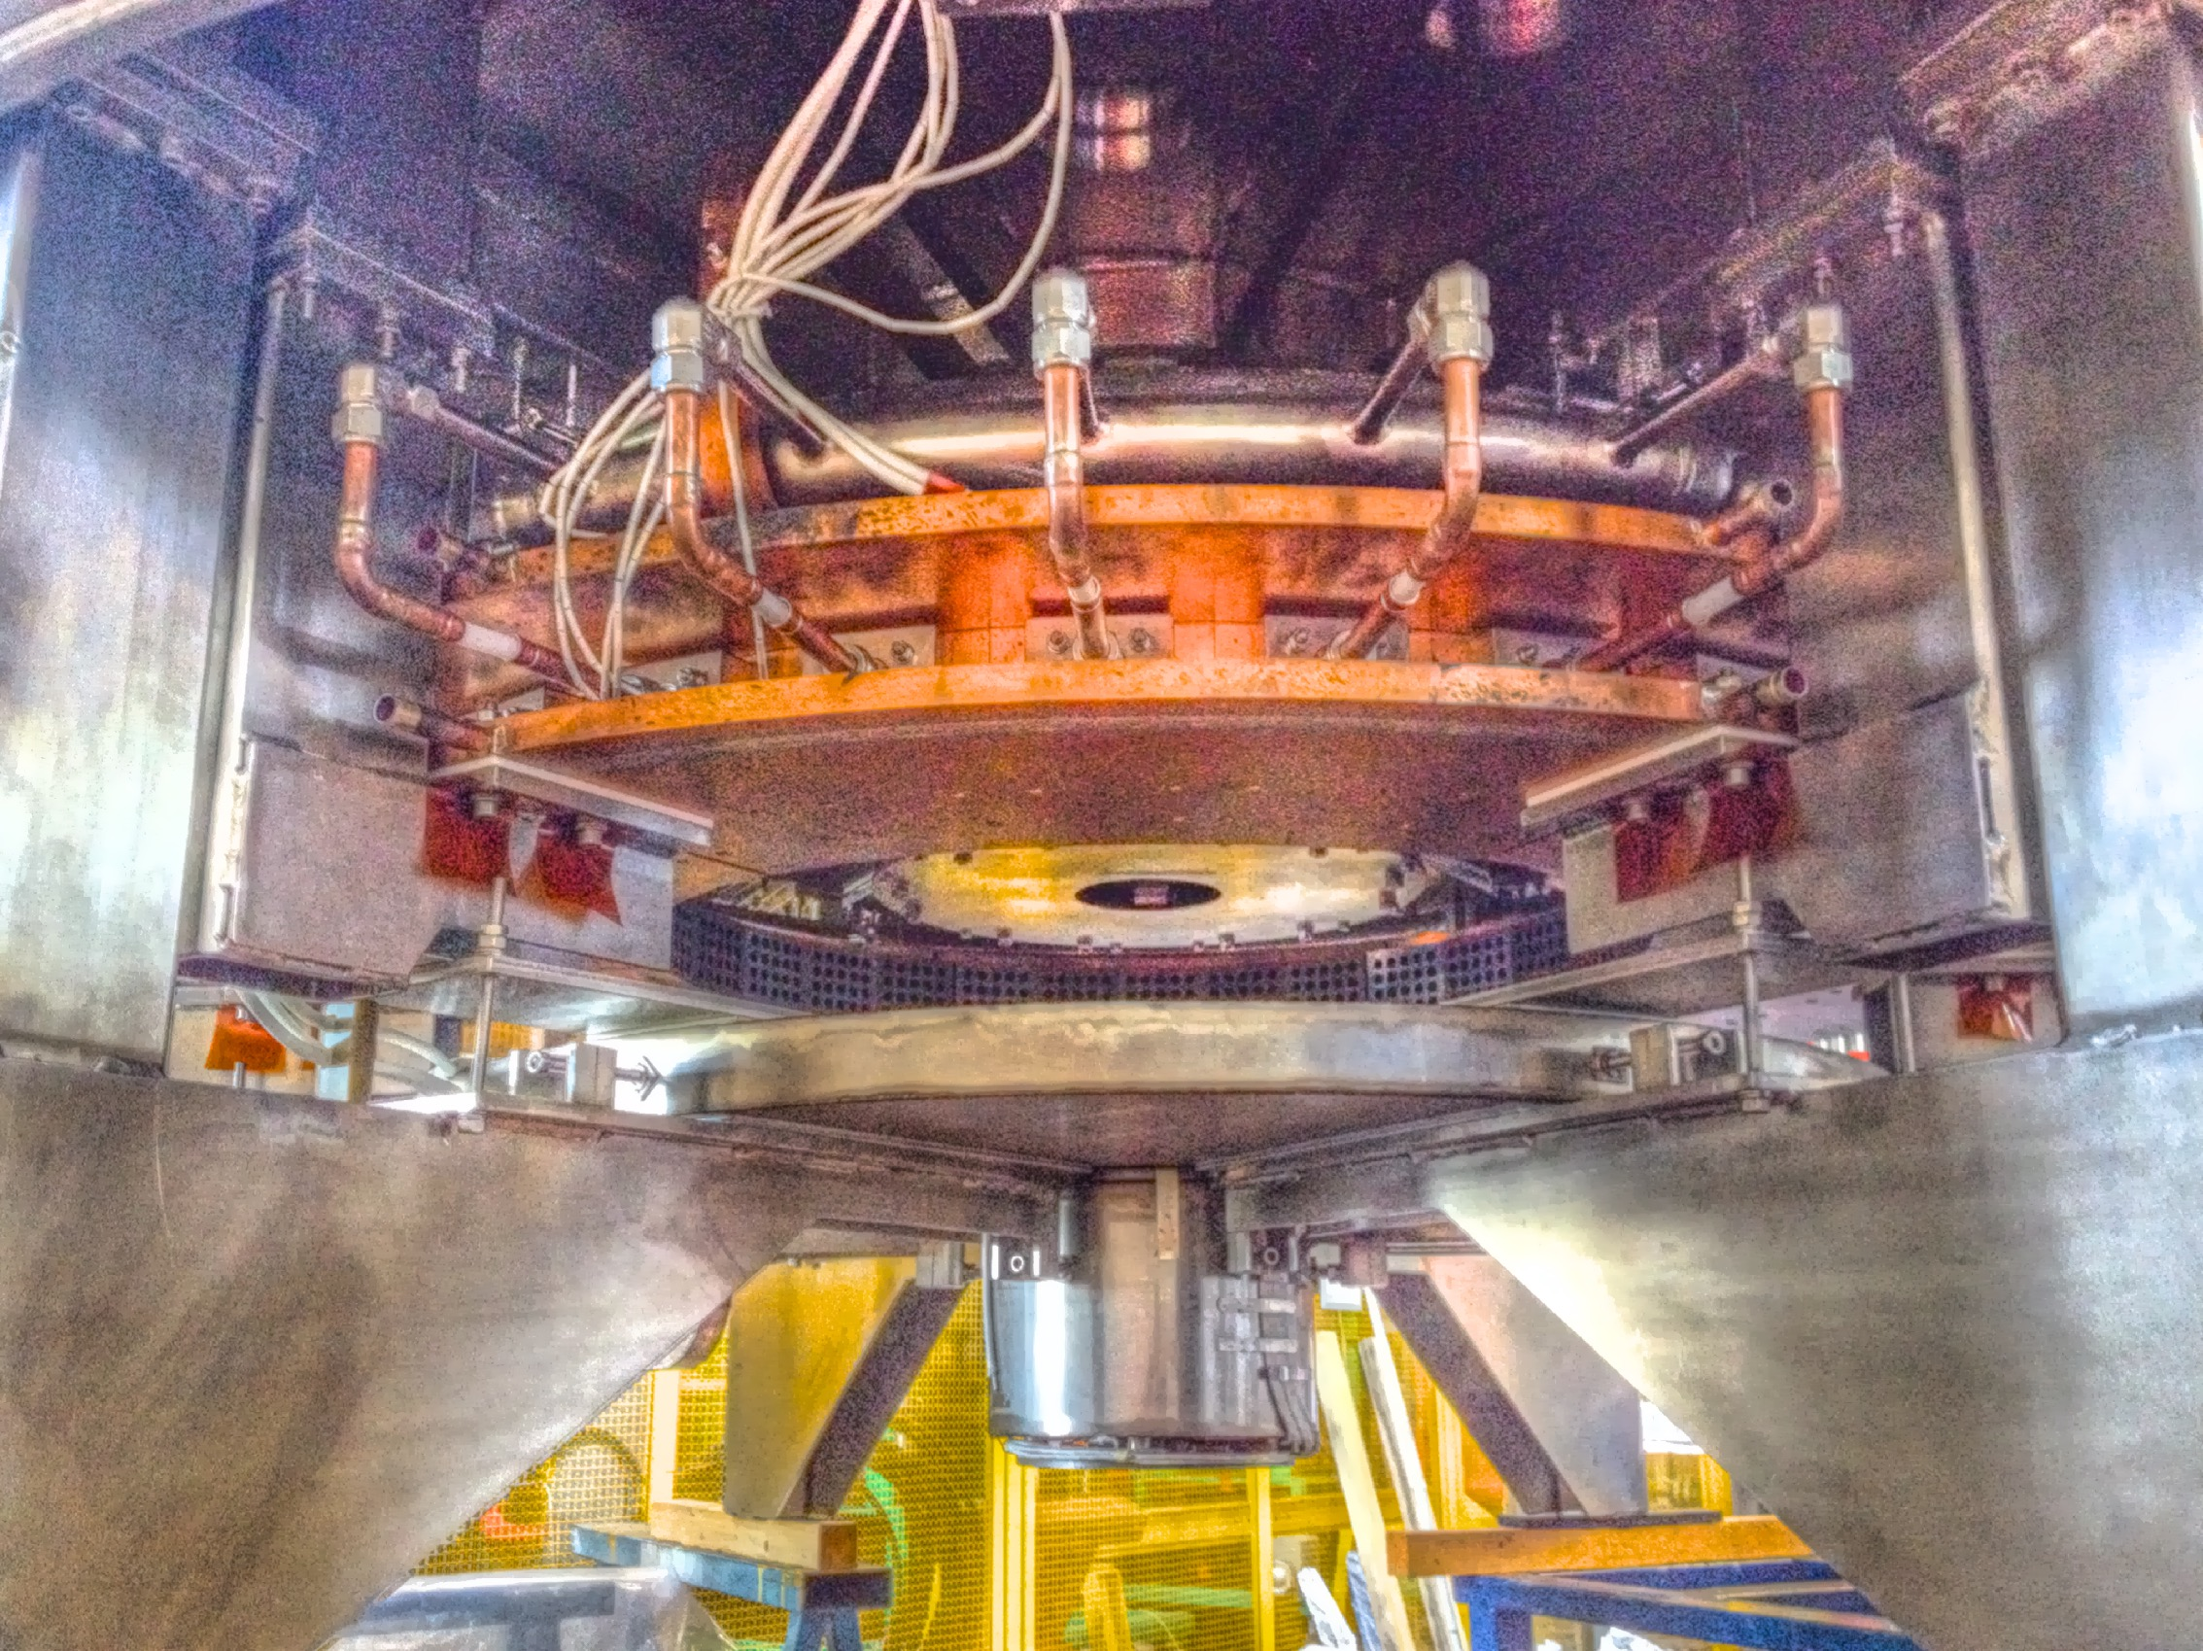
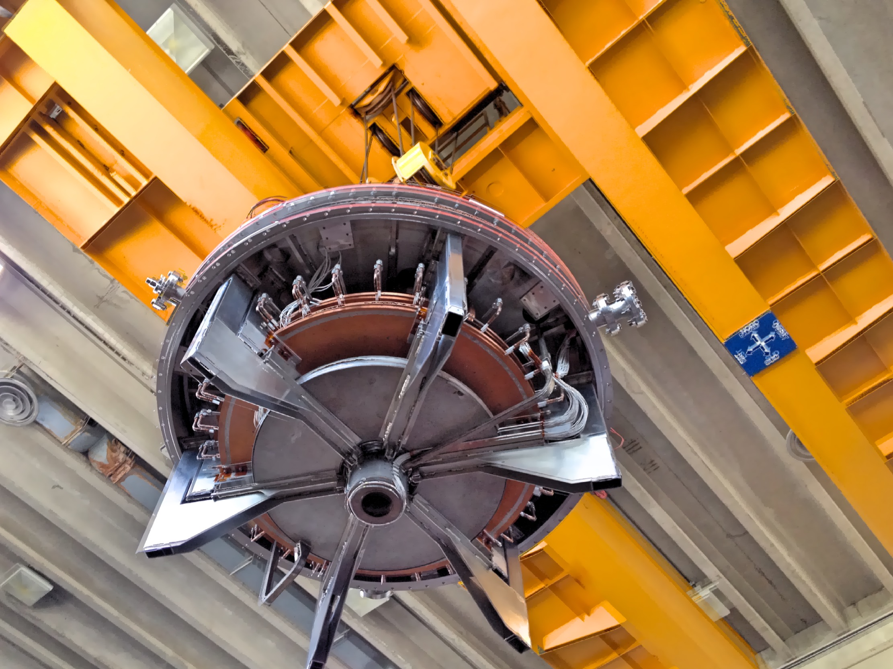
Top part of machine with Anode
Top part of machine flies
to comforting cylindrical Heaven…
It has so far withstood 160
plasma discharges

Slide 7
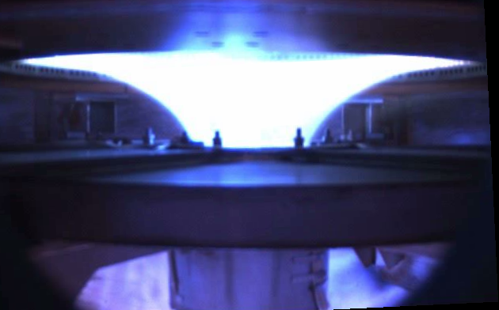
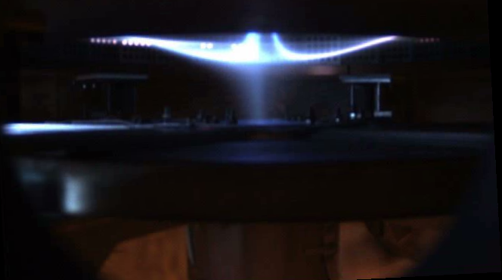
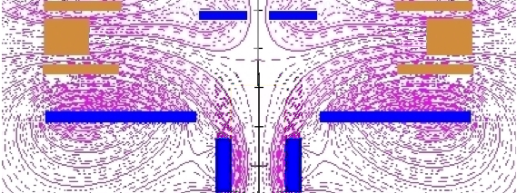
Shot #117 – Argon Plasma
Hollow annular Anode works:
• Plasma current path through PF2
• Plasma enters Anode holes
• No sign up yet (< 1.7 kA)
of Anode Arc Anchoring
A simply connected configuration particularly suitable for magnetic fusion space propulsion:
charged fusion products would emerge in jets through triple X-point: high efficiency for thrust

Slide 8
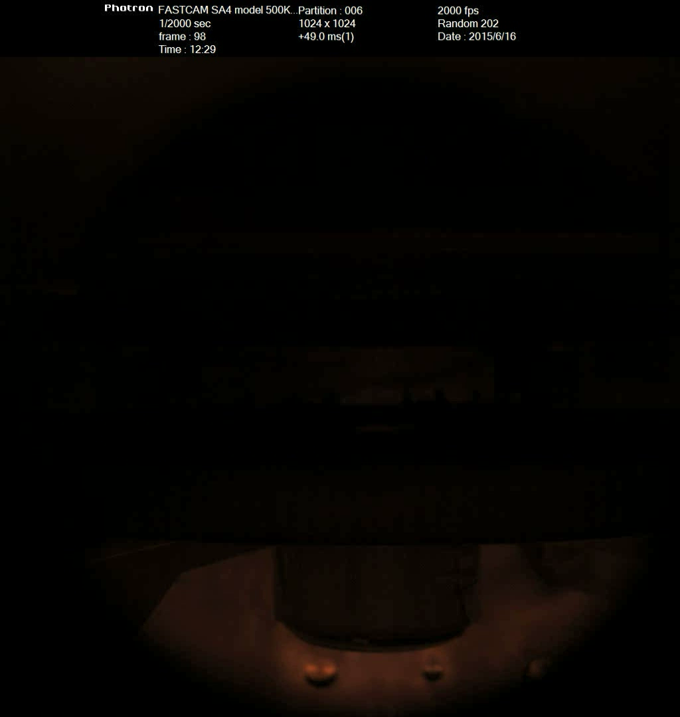
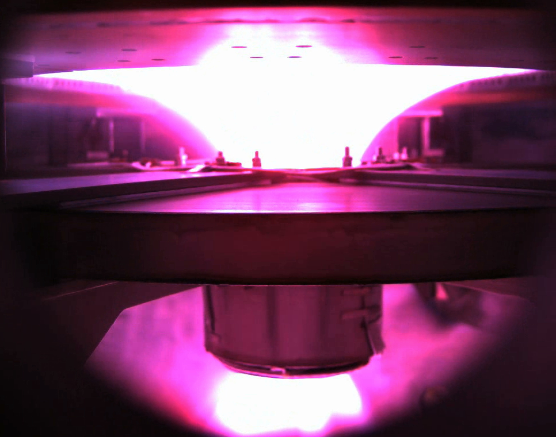
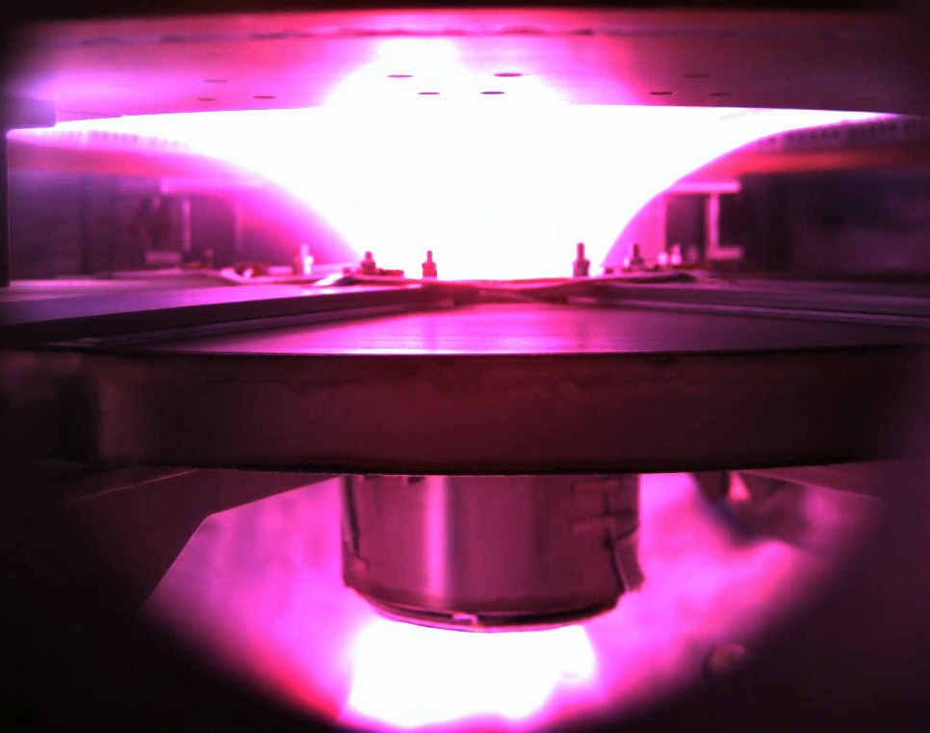
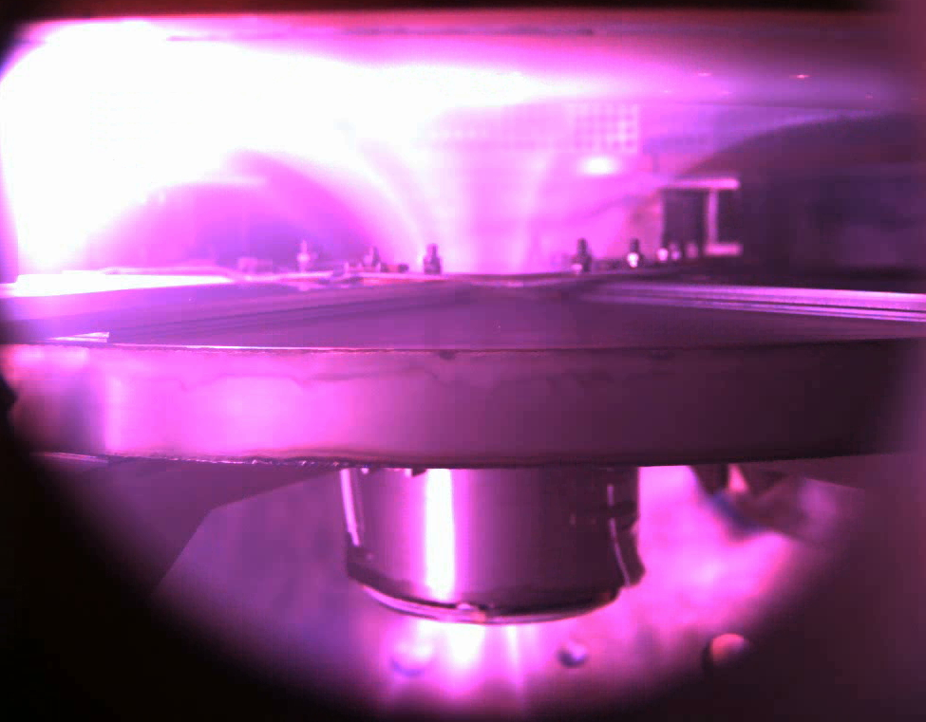
Shot #053, H Plasma, with Cathode (-) decoupled from Vessel (Ground)
time
Precursor of surrounding discharge path is a H_{α} light flash from the cathode,
(seen on PF2up) surrounding discharge path from Anode’s rear is a consequence

Slide 9
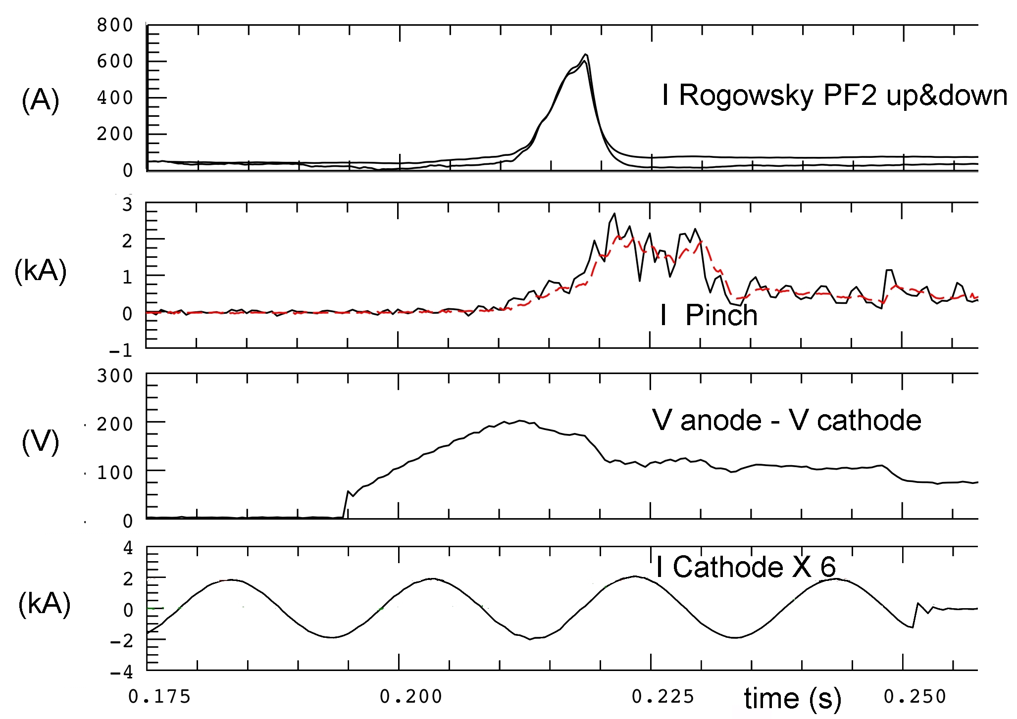
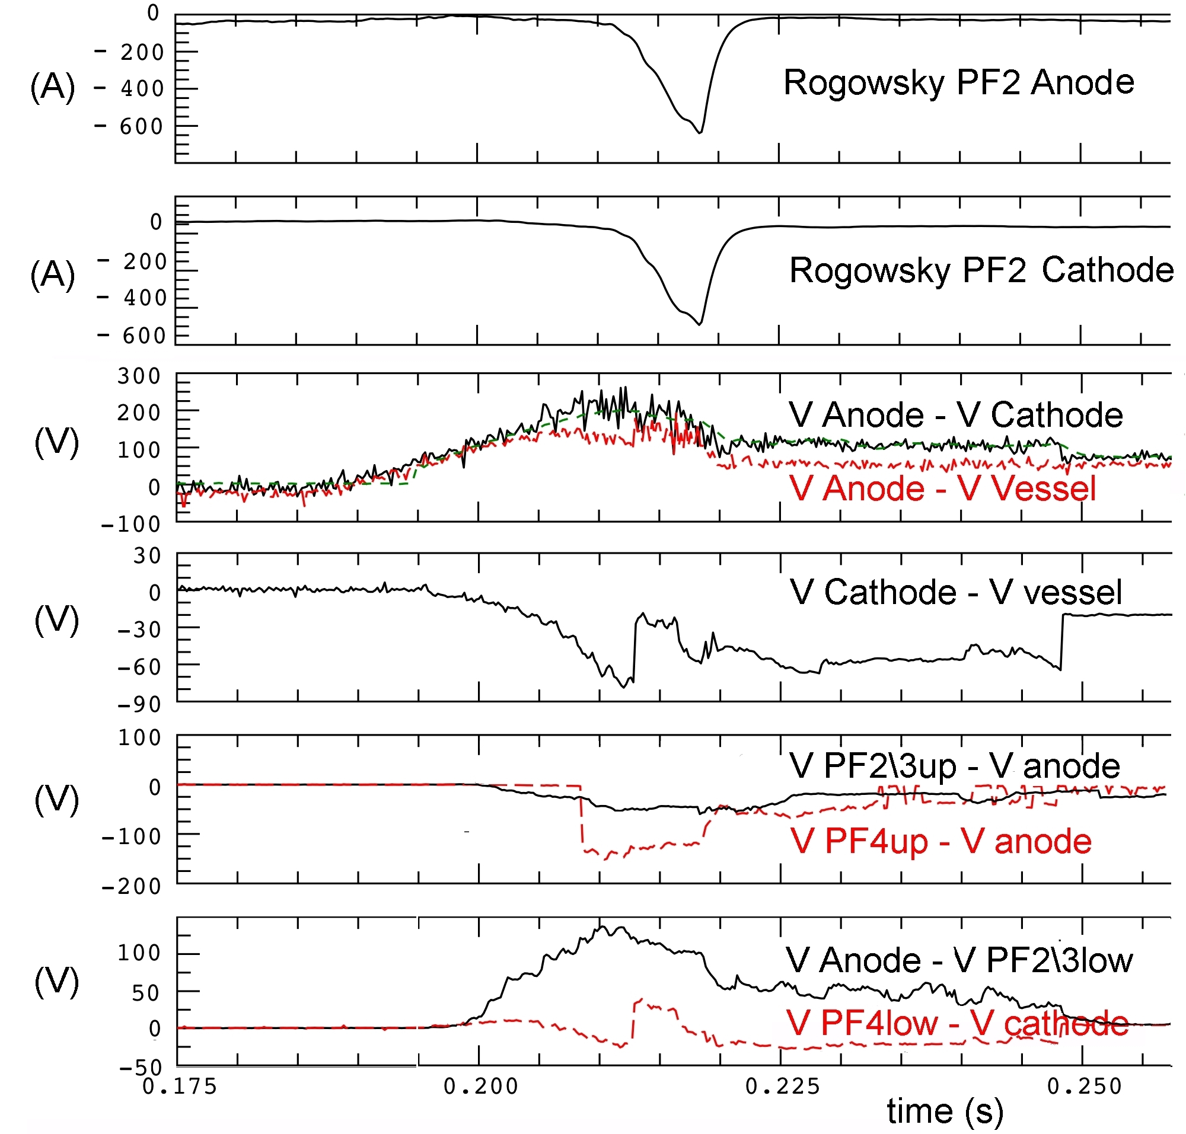
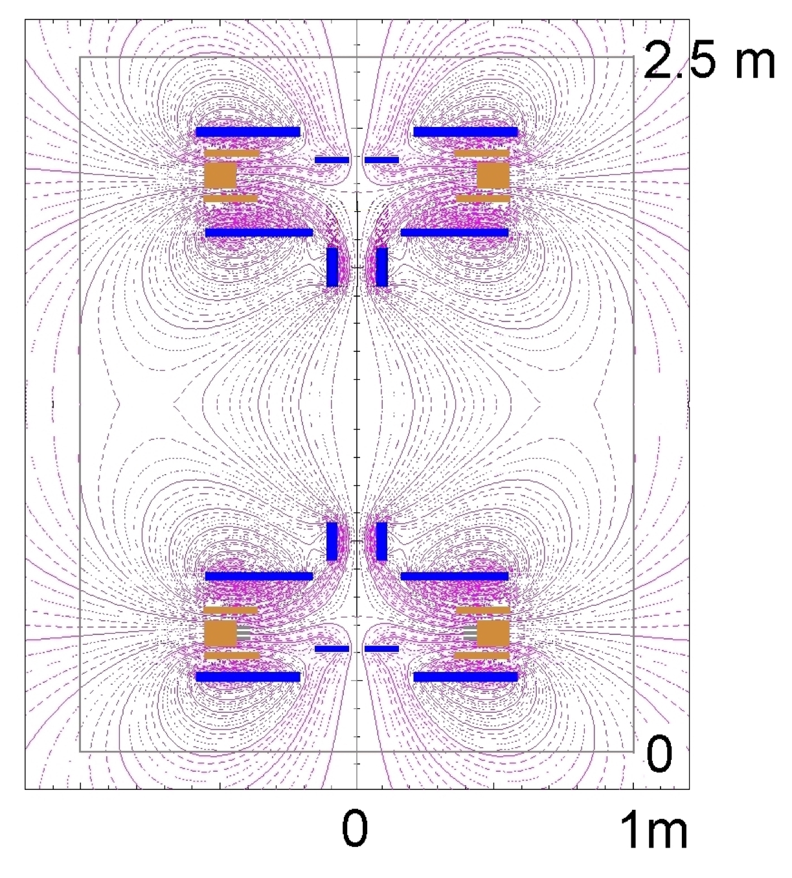
Shot #053, H Plasma, 600 A trough PF2 path
Cathode (-) decoupled from Vessel (Ground)
PF23up to Anod(10 Ω)\PF4up to Cath(10 Ω)
PF23low to Anod(10 Ω)\PF4low to GND(100 Ω)
H breakdown at 170-180 V
Electric potential distribution in the machine
V_{PF4up} ~ +30 V
V_{anode} ~ +150 V
V_{PF2-3up} ~ +100 V
V_{vessel} = 0 V (ground)
V_{PF2-3low} ~ +50 V
V_{cathode} ~ -30 V
V_{PF4low} ~ 0 V

Slide 10
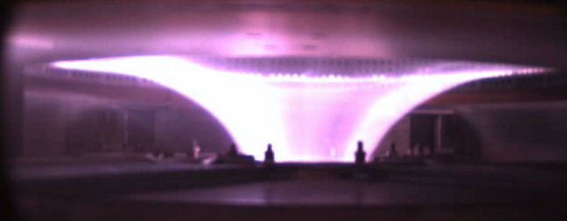
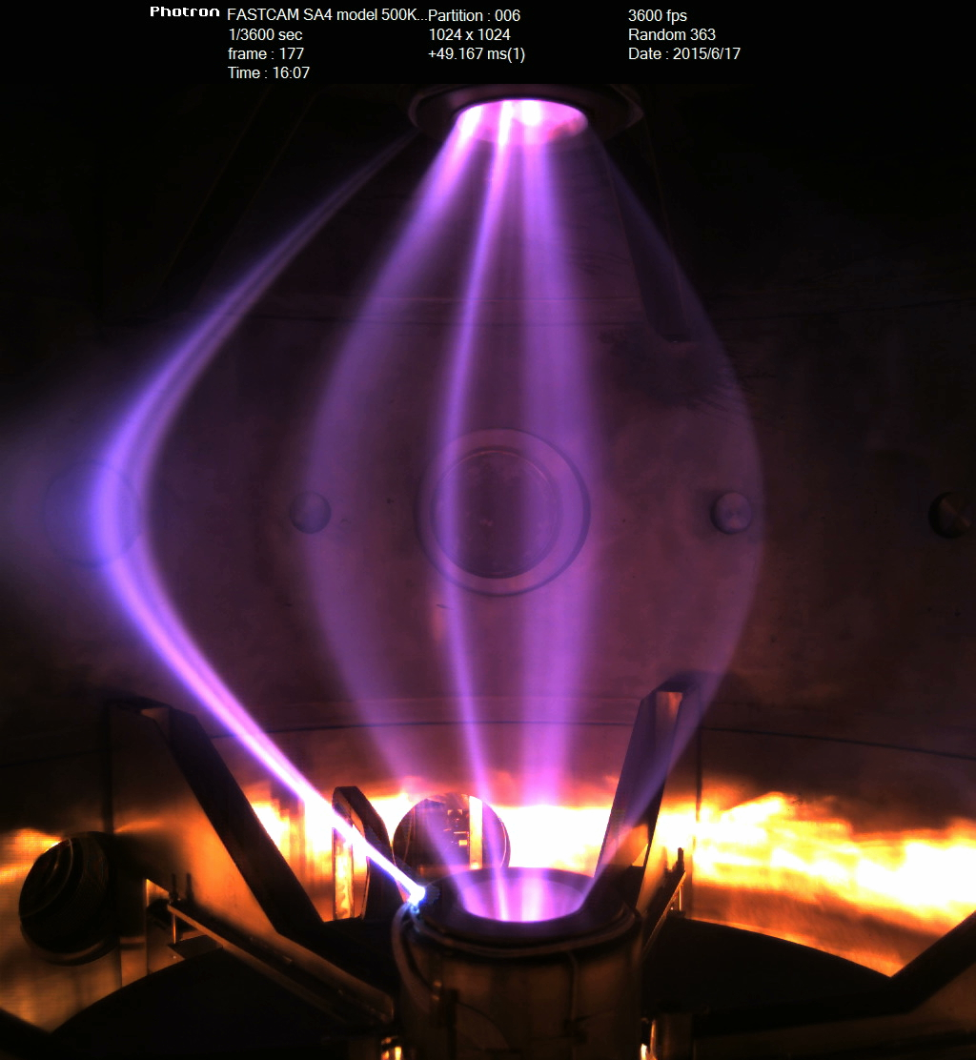
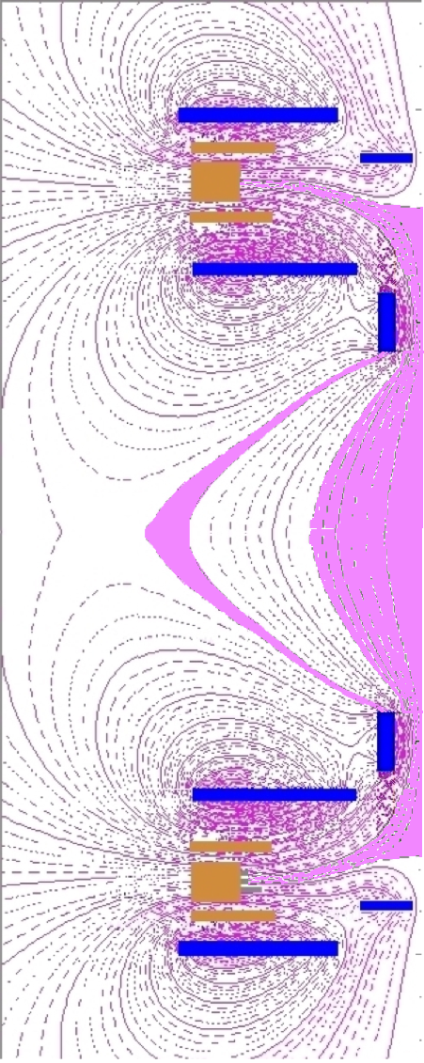
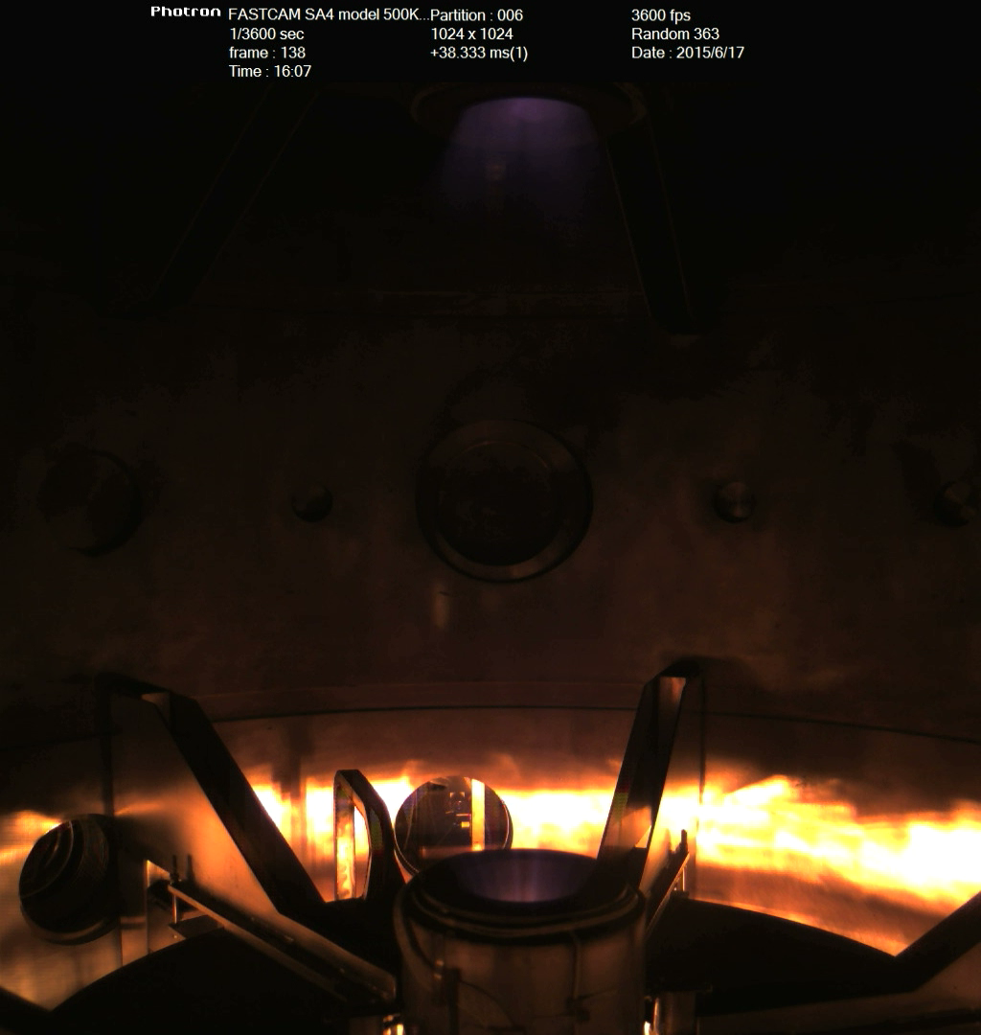
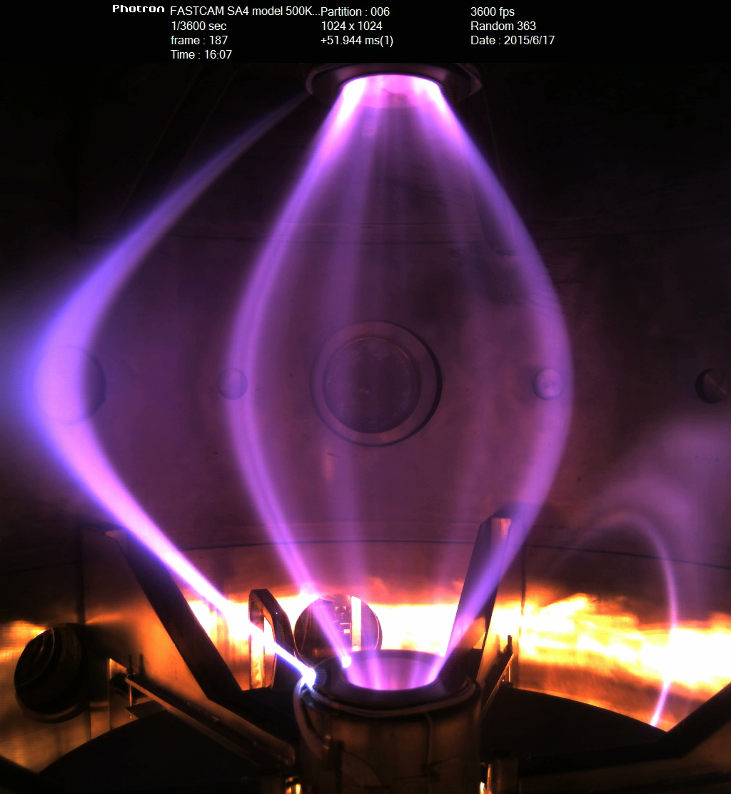
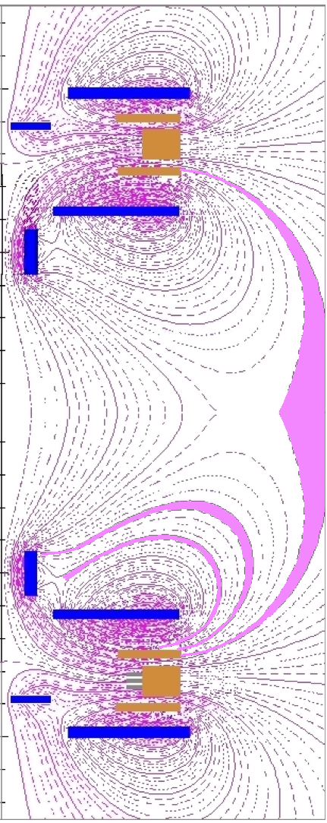
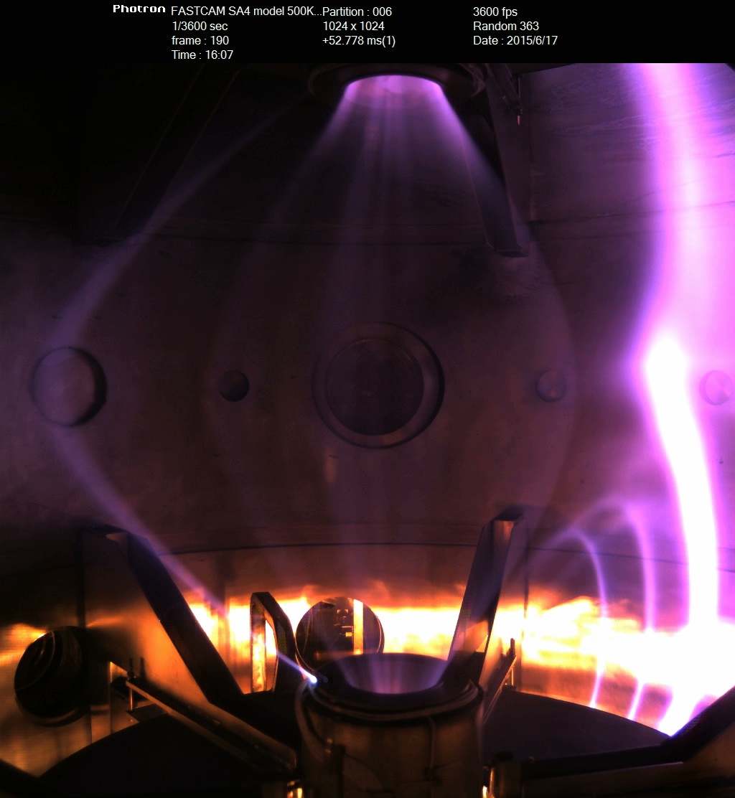
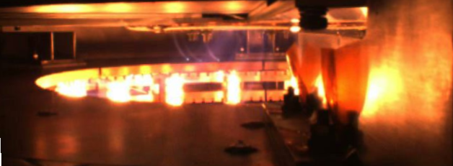
Shot #078 H Plasma, with Cathode
decoupled from Vessel (Ground)
X-point is
the problem…
Tube discharges between up & down PF2

Slide 11
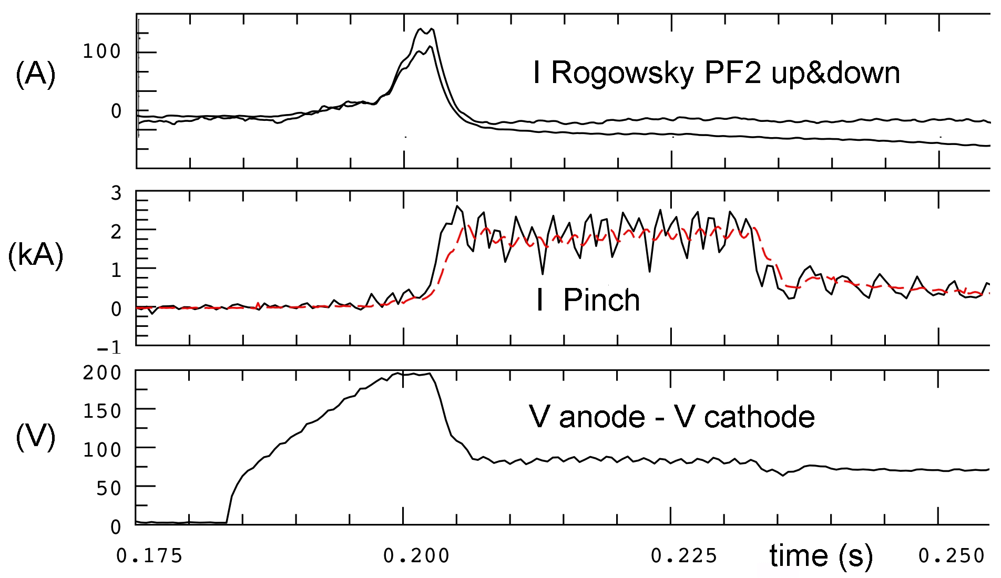
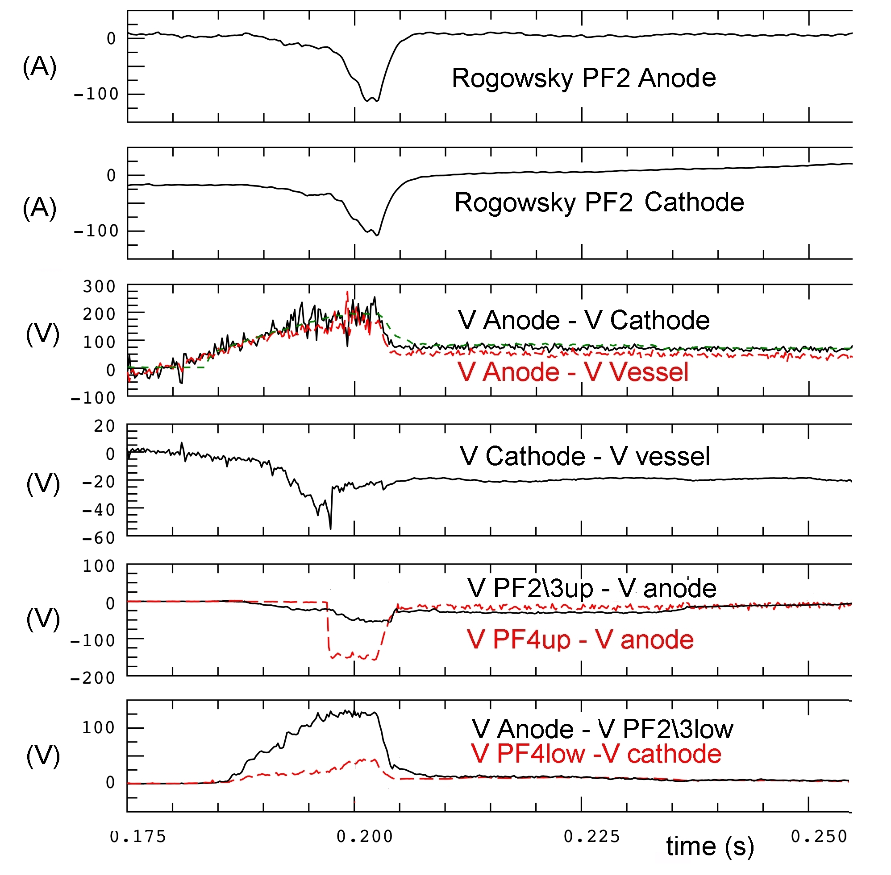
Shot #078, H Plasma, Cathode
decoupled from Vessel (Ground)
PF23up to Anod(10 Ω)\PF4up to Cath(10 Ω)
PF23low to Anod(10 Ω)\PF4low to GND(100 Ω)
Electric potential distribution in the machine
V_{PF4up} ~ +20 V
V_{anode} ~ +170 V
V_{PF2-3up} ~ +120 V
V_{vessel} = 0 V (ground)
V_{PF2-3low} ~ +50 V
V_{cathode} ~ -30 V
V_{PF4low} ~ +10V

Slide 12
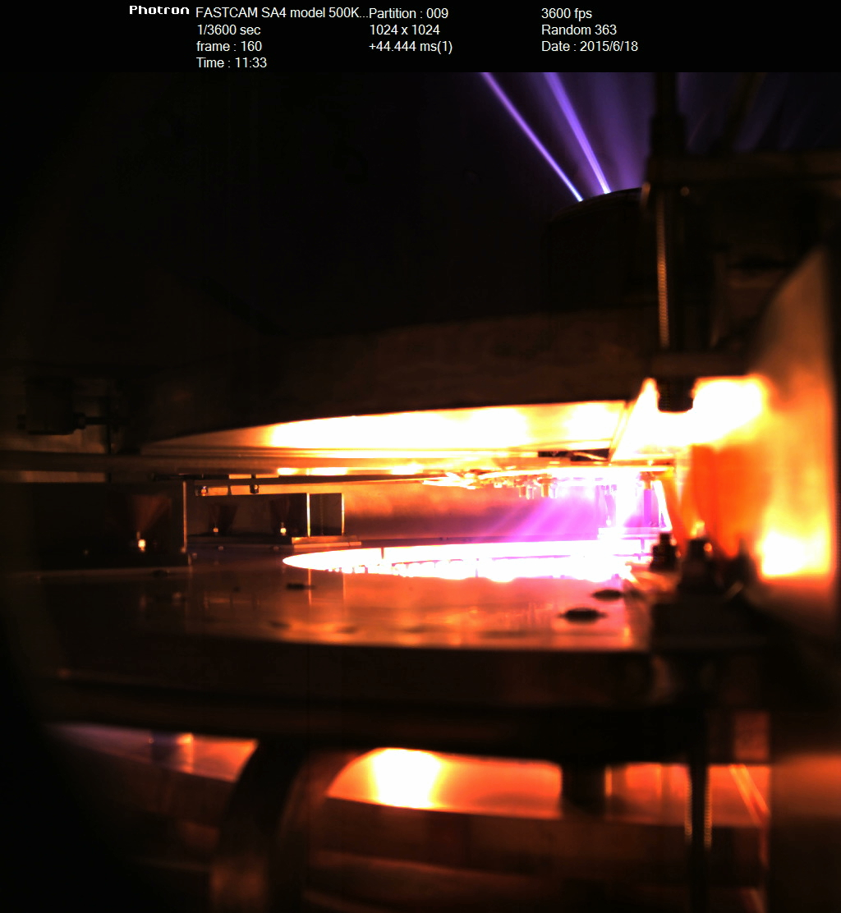
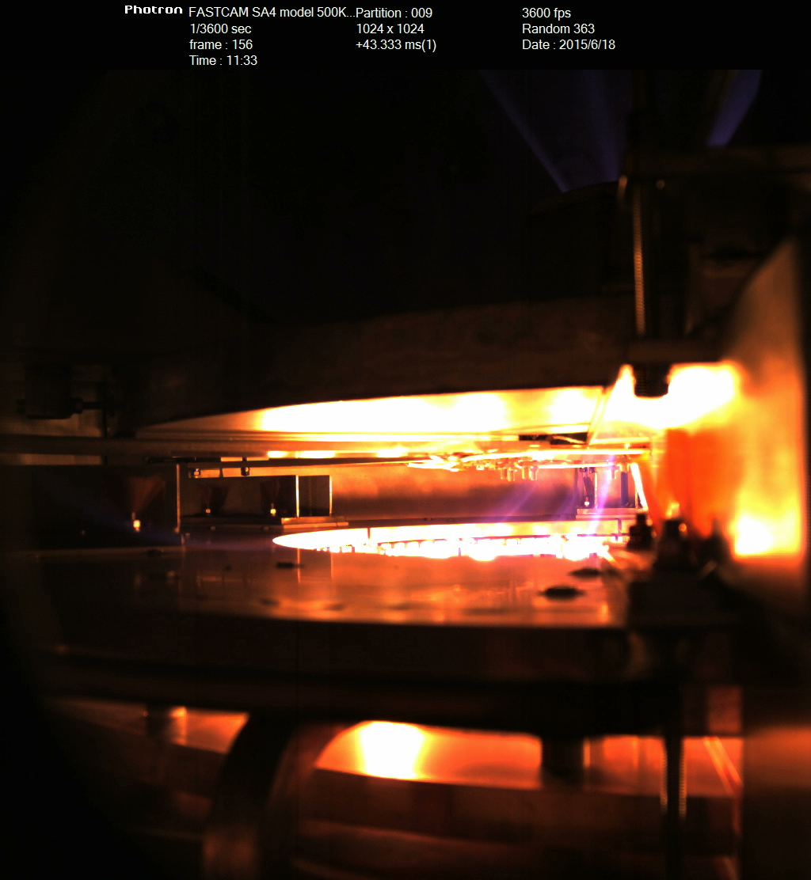
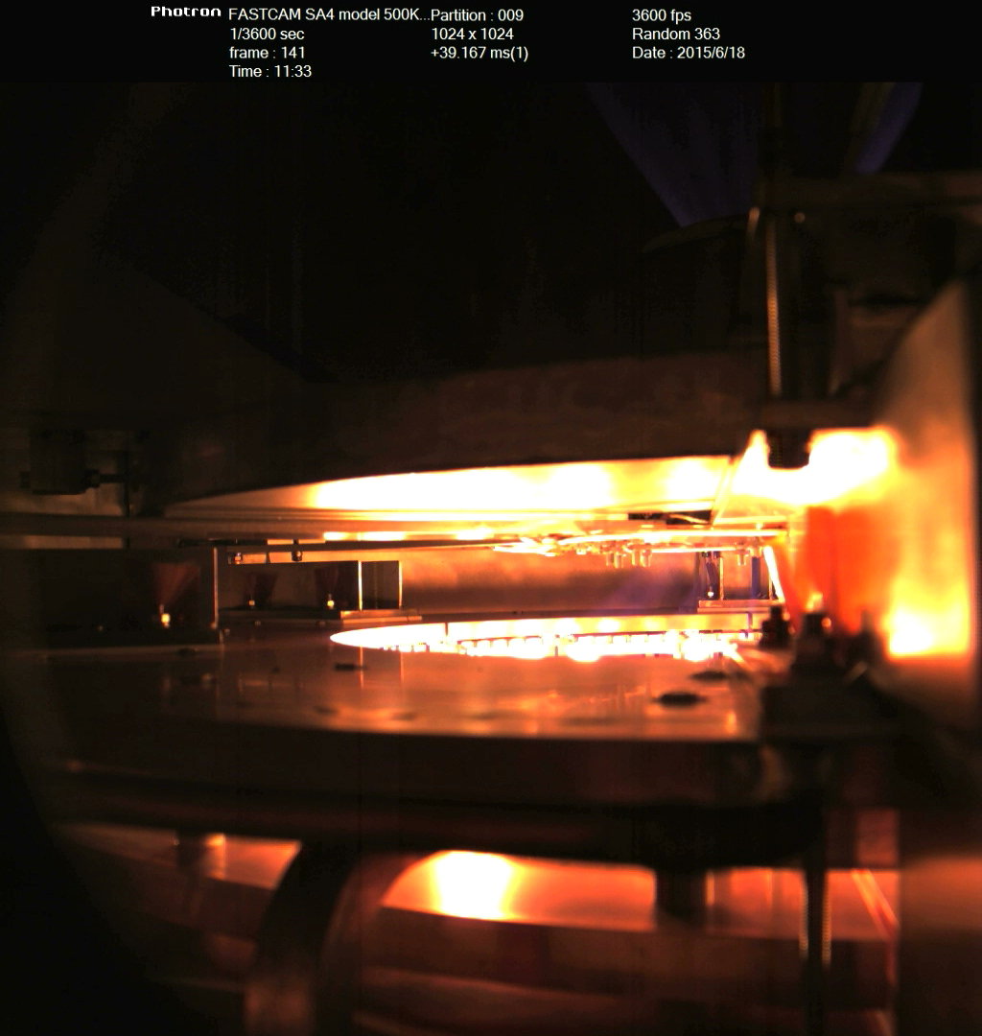

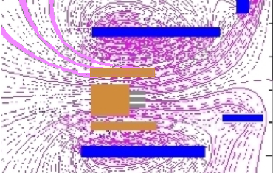
Shot #089 H Plasma, with
Cathode (-) decoupled from Vessel (Ground)
PF23up to Anod(10 Ω)\PF4up to Cath(10 Ω)
PF23low to Anod(10 Ω)\PF4low to Cath(100 Ω)
Cathode rear discharges earlier than surrounding discharge path

Slide 13
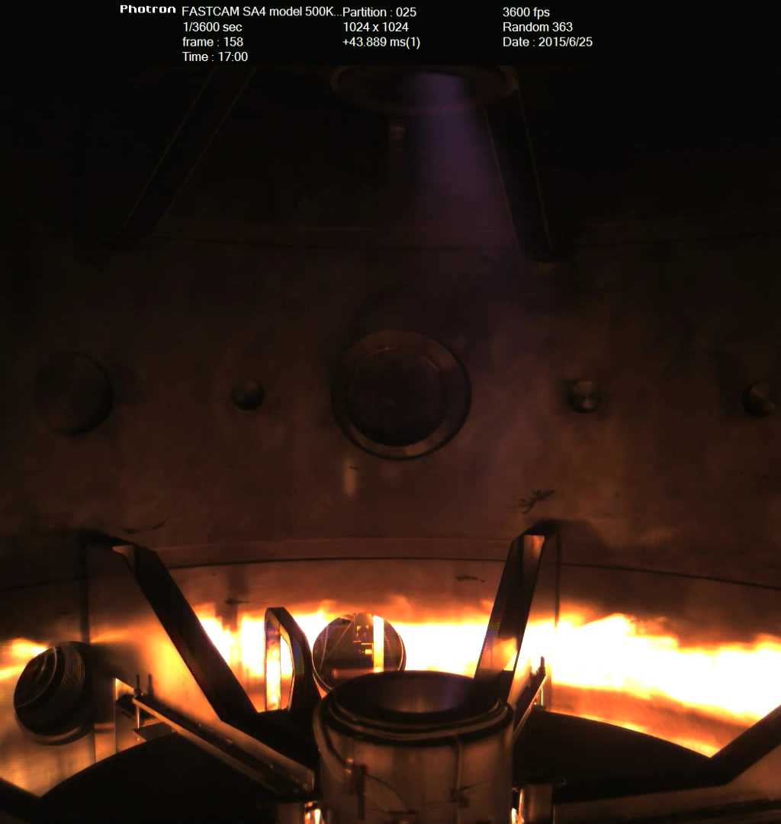
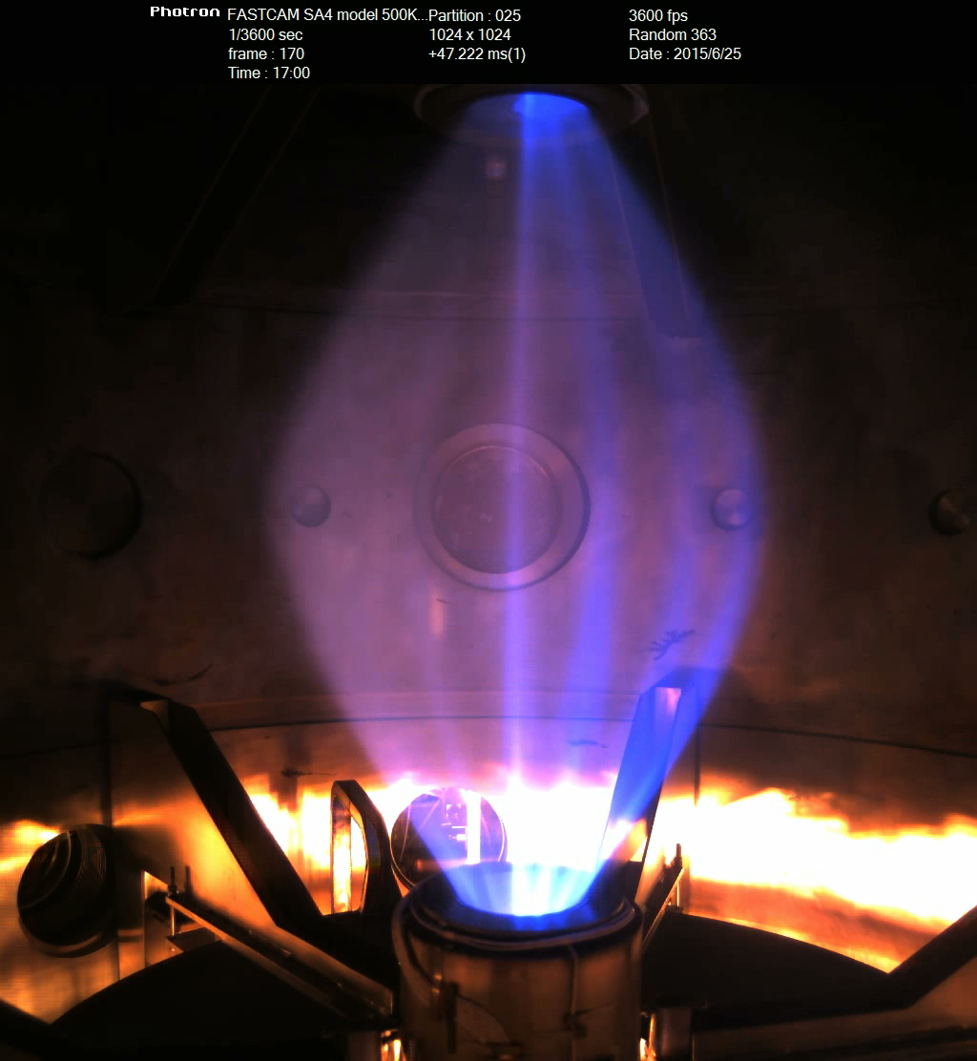
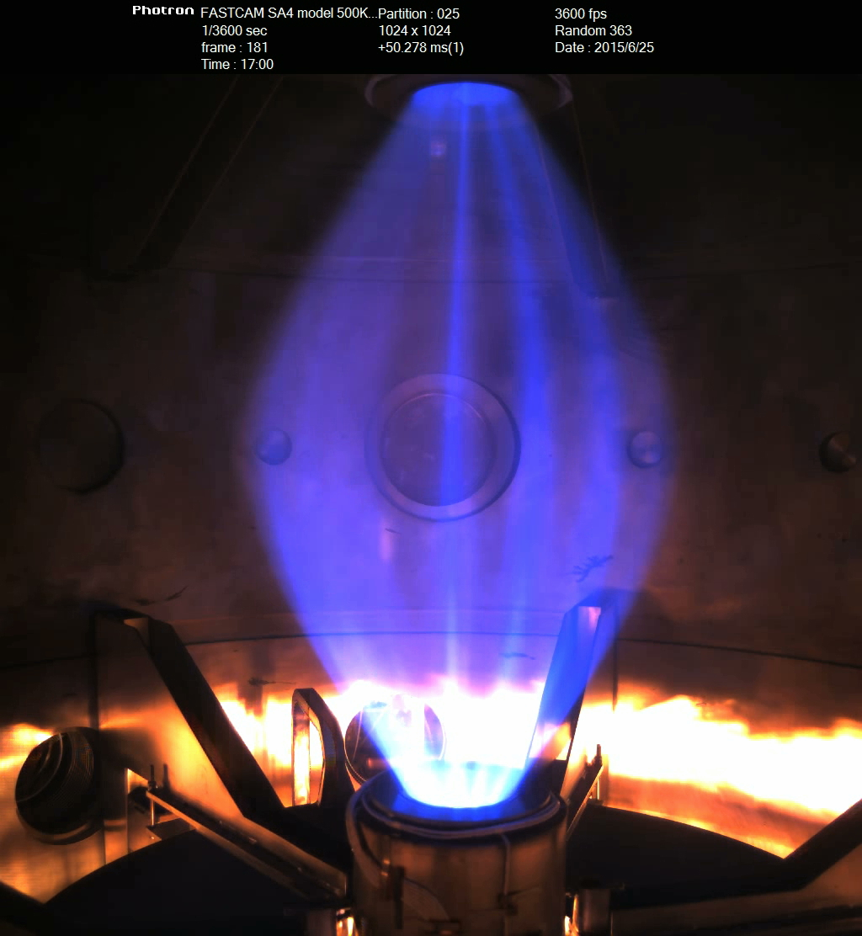
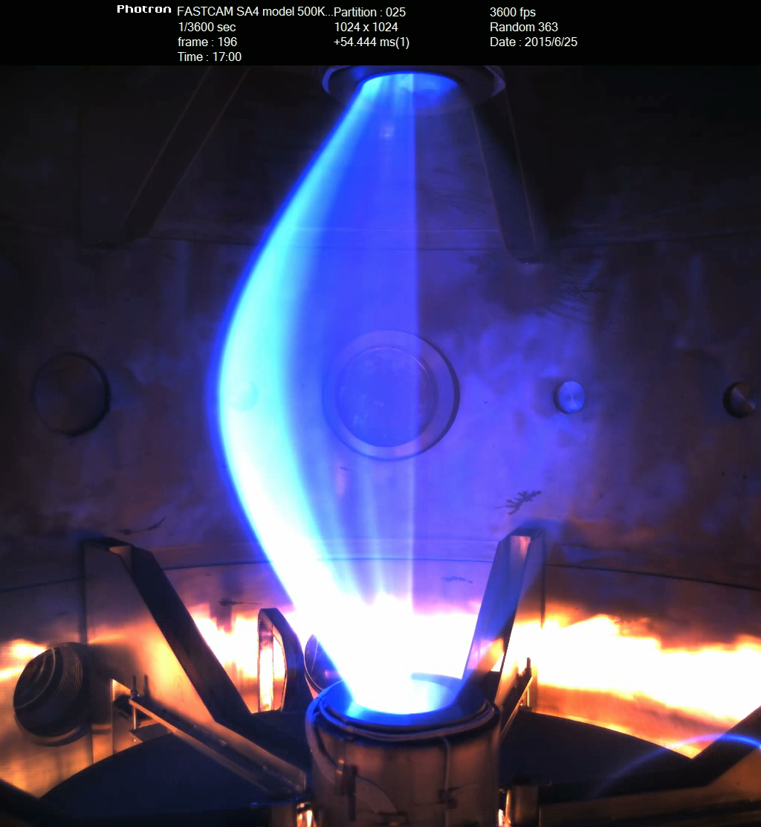
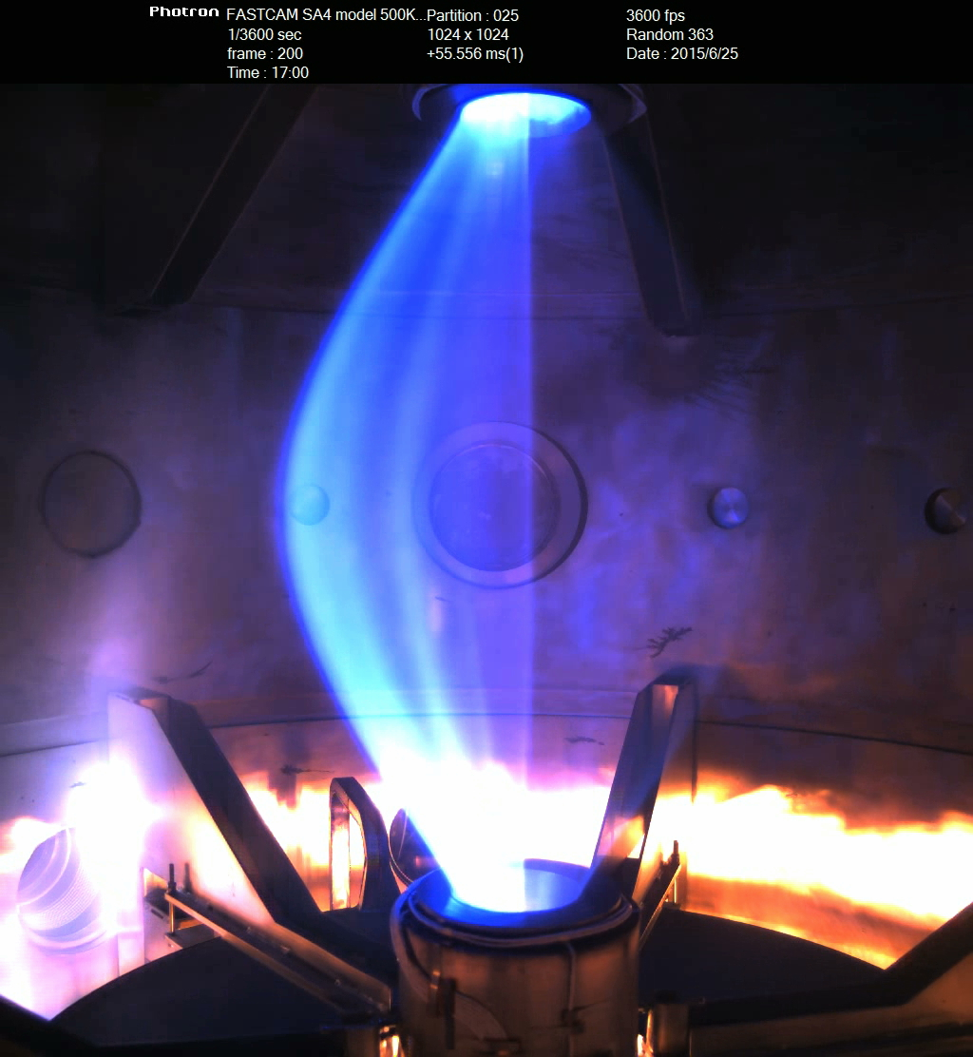
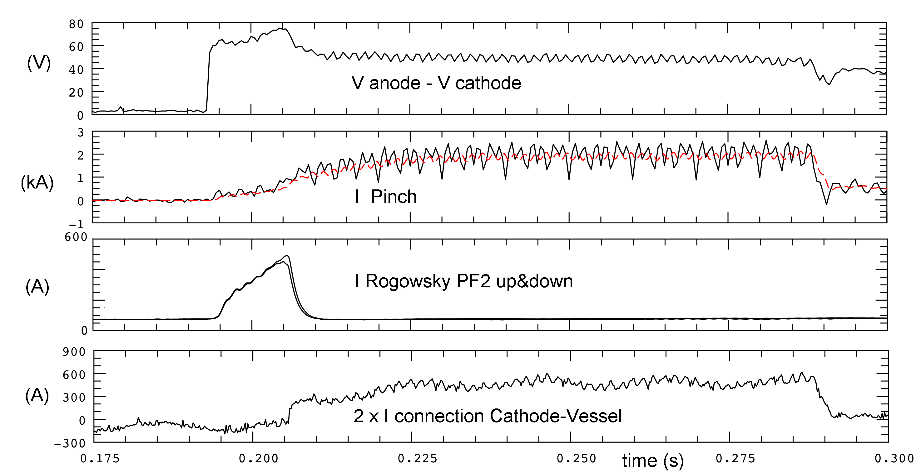
~Plasma
btw. PF2s
X-point
effect
From shot #120 Argon Plasma, with
Cathode coupled to Vessel (GND)
Argon breakdown at 70 V (H 180 V)
cleaner waveforms than in H, but
surrounding discharge paths remain

Slide 14
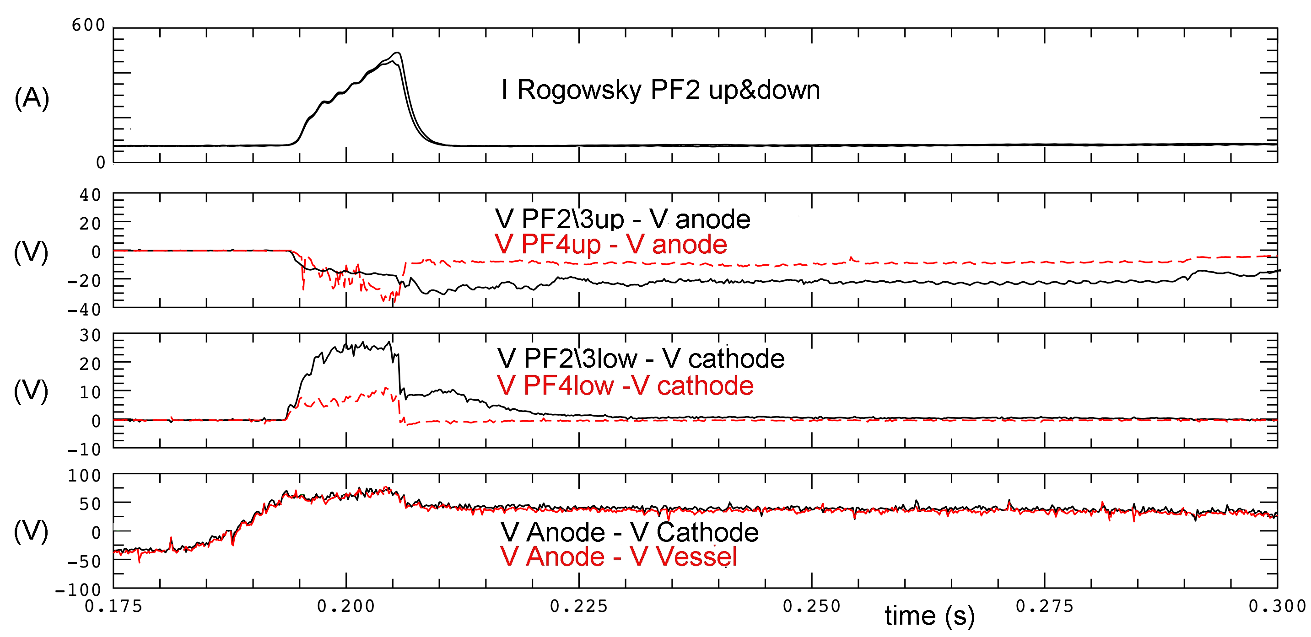
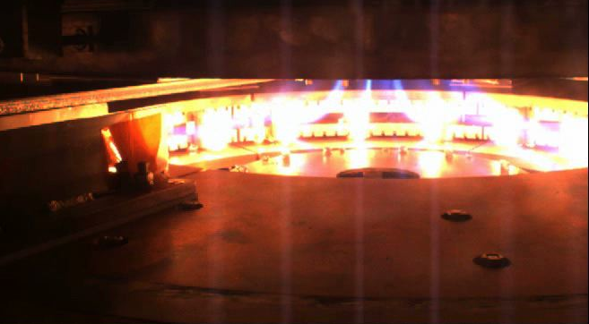
Shot #120, Argon
Cathode coupled
to Vessel (GND)
400 A through PF2
Electric potential
distribution in
the machine
PF23up to Anod(10 Ω)\PF4up to Cath\GND(10 Ω)
PF23low to Cath=GND (10 Ω)\PF4low to Cath=GND(100 Ω)
V_{PF4up} ~ +45 V
V_{anode} ~ +75 V
V_{PF2-3up} ~ +60 V
V_{vessel} = 0 V (ground)
V_{PF2-3low} ~ +25 V
V_{cathode} ~ 0 V
V_{PF4low} ~ +10V
From shot #120 Cathode heating 16 V->18 V

Slide 15
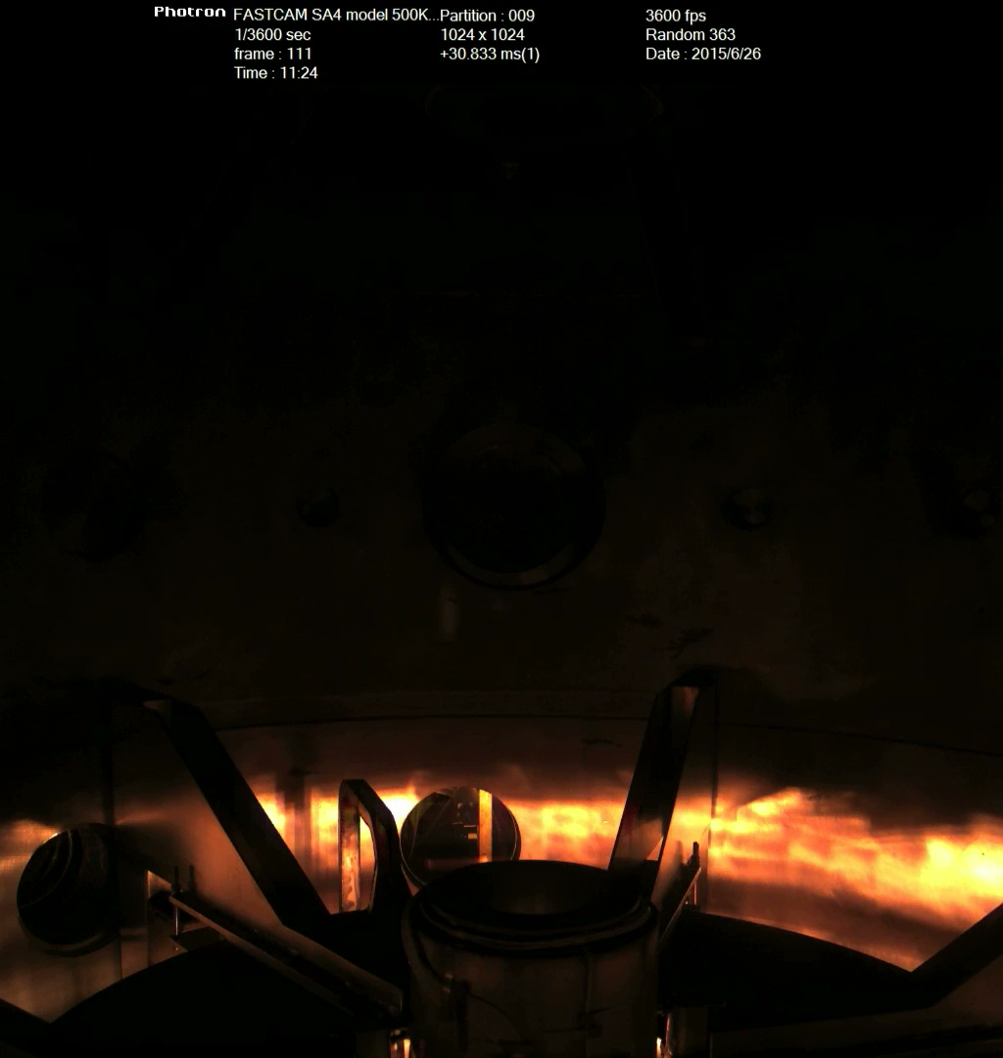
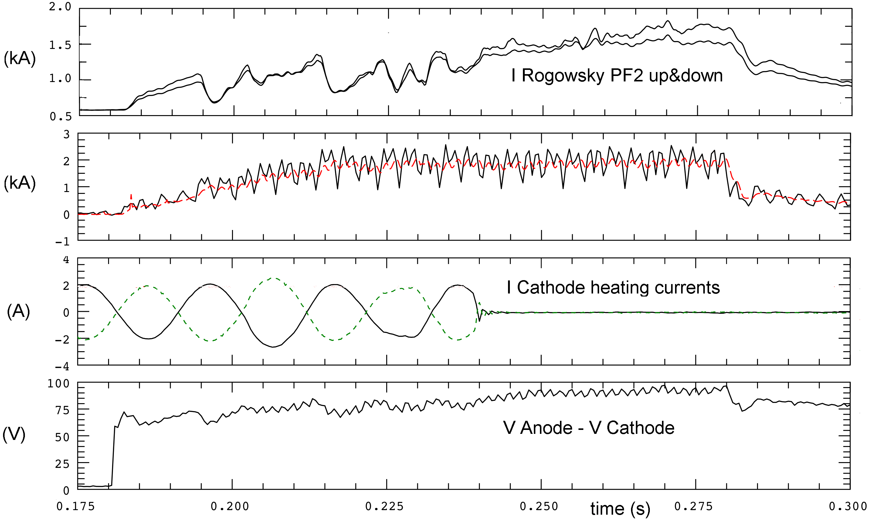
Shot #130 Argon Plasma, with Cathode (-) decoupled from Vessel (GND): 1kA discharge path through PF2 throttles in Argon does not disappear, discharge survives indefinitely
PF23up to Anod(10 Ω)\PF4up to Cath(10 Ω)
PF23low to GND(10 Ω)\PF4low to Cath(100 Ω)
From shot #122 Cathode decoupled from Ground
Surrounding discharges become less localized
after Cathode heating current is
terminated by power supply protection
At this stage 6-phased rotating cathode heating
field not particularly helpful: …only adds up
perturbations to surrounding discharge paths
From shot #135 Cathode heating current is switched off at least 50 ms before break-down

Slide 16
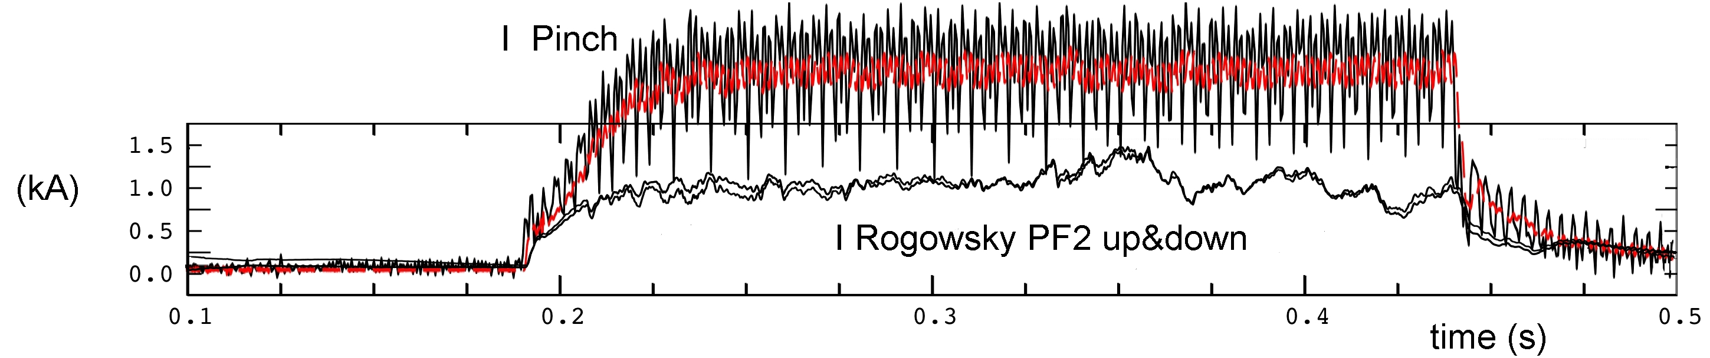

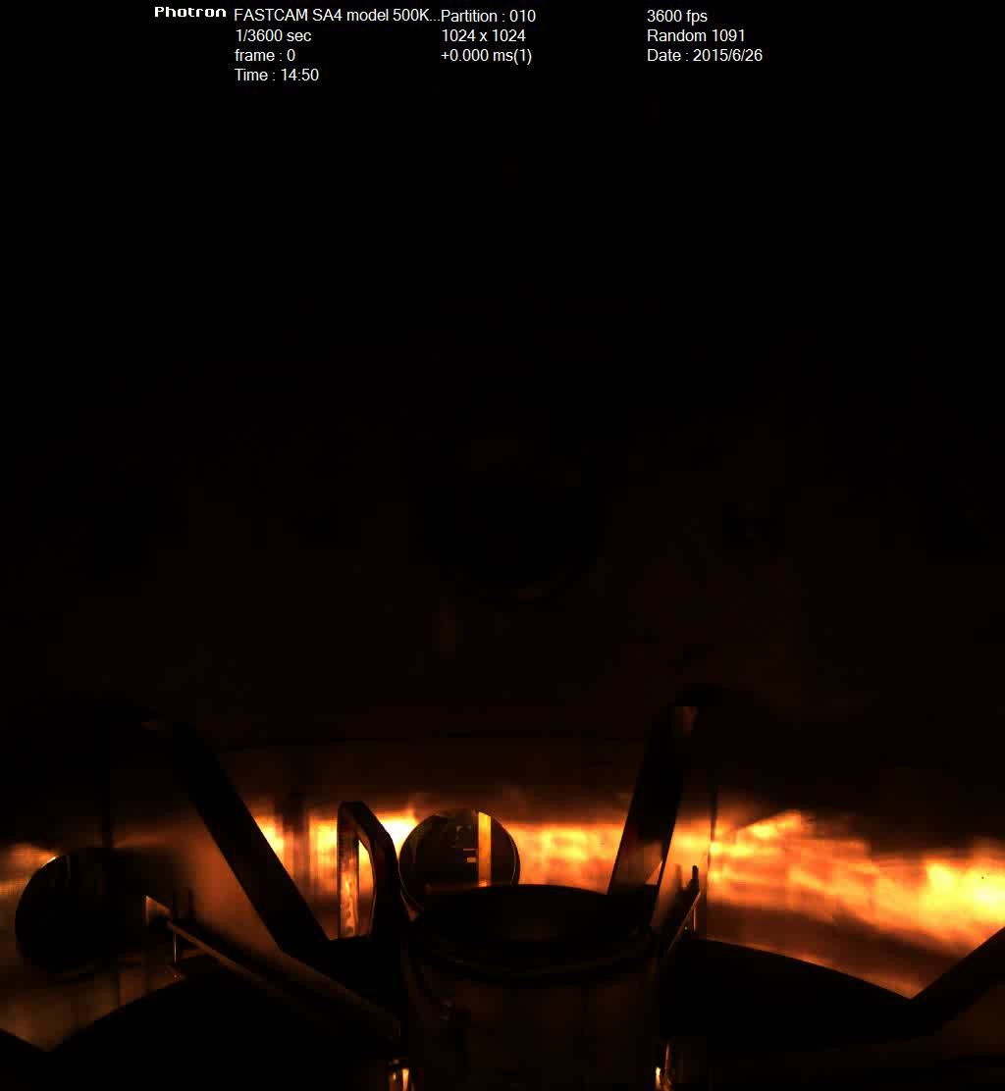
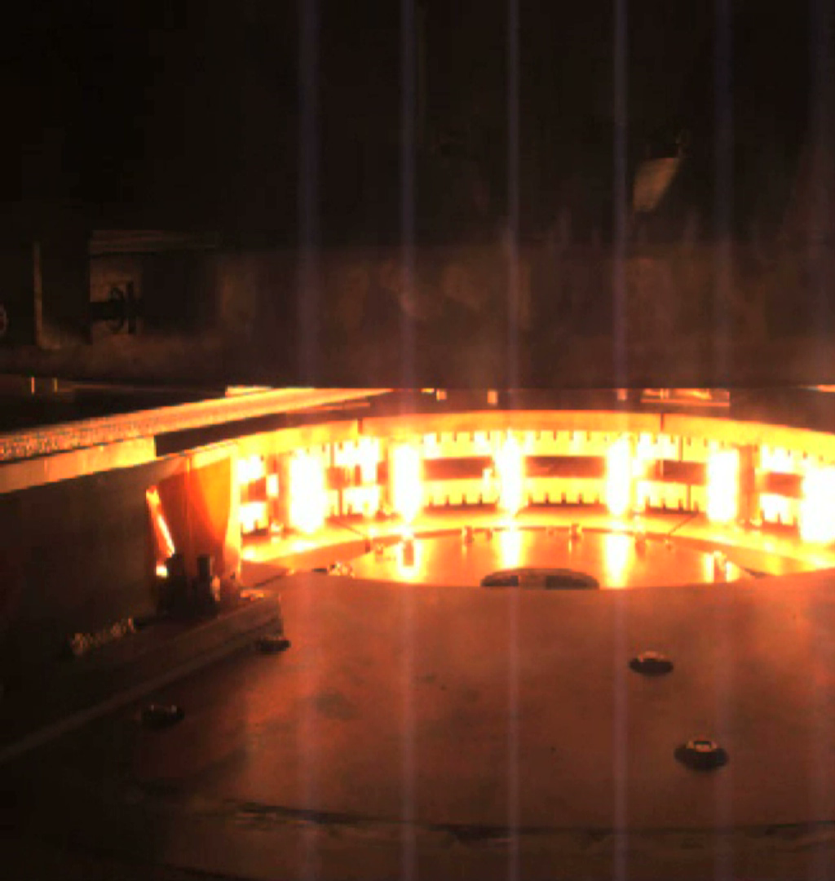
Shot #141 Argon Plasma, lasts 300 ms, drives (½ I_{Pinch}) through PF2s throttles
PF23up to Anod(10 Ω)\PF4up to Cath(10 Ω)
PF23low to GND(10 Ω)\PF4low to Cath(100 Ω)

Slide 17
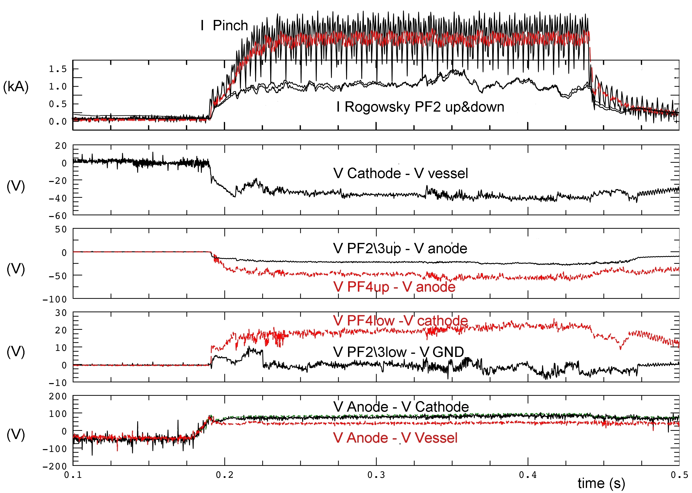
Shot #141 Argon Plasma, lasts 300 ms
drives (½ I_{Pinch}) through PF2s throttles
PF23up to Anod(10 Ω)\PF4up to Cath(10 Ω)
PF23low to GND(10 Ω)\PF4low to Cath(100 Ω)
Electric potential distribution
in the machine
V_{PF4up} ~ +0 V
V_{anode} ~ +45 V
V_{PF2-3up} ~ +25 V
V_{vessel} = 0 V (ground)
V_{PF2-3low} ~ 0 V
V_{cathode} ~ -35 V
V_{PF4low} ~ -15 V

Slide 18




Shot #151 Argon Plasma, PF casings connected
to potentials by smaller resistances ~ 1 Ω
PF23up to Anod(1 Ω)\PF4up to Cath(10 Ω)
PF23low to GND(1 Ω)\PF4low to Cath(0.5 Ω)
>(½ I_{Pinch}) through
PF2s throttles,
in the first 25 ms whole current in PF2 throttles
No concentrated but diffused
surrounding discharge path

Slide 19

Shot #151 Argon Plasma, PF casings connected
to potentials by small resistances ~ 1 Ω
PF23up to Anod(1 Ω)\PF4up to Cath(10 Ω)
PF23low to GND(1 Ω)\PF4low to Cath(0.5 Ω)
Electric potential distribution
in the machine
V_{PF4up} ~ +5 V
V_{anode} ~ +55 V
V_{PF2-3up} ~ +40 V
V_{vessel} = 0 V (ground)
V_{PF2-3low} ~ +5 V
V_{cathode} ~ -35 V
V_{PF4low} ~ -25 V

Slide 20

Shot #155 Argon Plasma, with PF2\3low connected trough 1 Ω to Anode (+) potential
V_{PF4up} ~ +0 V
V_{anode} ~ +50 V
V_{PF2-3up} ~ +35 V
PF23up to Anod(1 Ω)\PF4up to Cath(10 Ω)
PF23low to Anod(1 Ω)\PF4low to Cath(0.5 Ω)
V_{vessel} = 0 V (ground)
Electric potential distribution in the machine
Connecting PF2/3 to Anode simply
shifts down 5 Volts all PF coils casings potentials
with respect to connecting PF2/3 to GND:
It is the plasma that dictates the electric potential
inside the machine…
V_{PF2-3low} ~ 0 V
V_{cathode} ~ -40 V
V_{PF4low} ~ -30 V

Slide 21

Why Annular Anode does not show
Anode Arc Anchoring?
Why furthermore Annular Anode
is never filamented?
whereas
Annular Catode (sparse emitters)
and even main plasmaare filamented?

Slide 22

Self-organization at work inside annular electrodes plasma…
Plasma-induced Electric Potential
in the Annular Anode is such that
E-field is perpendicular to B-field
…E x B azimuthal plasma rotation
…since PF2up throttle
Plasma-induced Electric Potential
in the Annular Cathode is such that
E-field is parallel to B-field
…no E x B plasma rotation

Slide 23

Magnetic therapy for for surrounding discharge path from Cathode’s rear…
The magnetic lines of force have to be removed from the cylindrical part of the vessel
4 external PF coils are going to be added (home-made from spare connection cables)
…we shall feed them in series with the internal PF coils (PF coils power supply is adequate)
4 additional external PF coils
(Paolo Micozzi proposal)
the external PF coils would also eliminate the detrimental X-point effect

Slide 24



Inox divertor supports
Should magnetic cure be non sufficient
lower Inox divertor support will be built
it can be put to GND together with Vessel

Slide 25


…but metallization of Cathode busbars…
now insulation between Cathode & Vessel reduced to 50 Ω
if it deteriorates it could prevent operation of the machine
with floating Cathode (best results), lower lid opening…
Tools for opening the lower lid of the machine
designed by Alessandro Mancuso and Paolo Rossi
but never built…
Actions to be undertaken:
• Build tools for bottom lid removal (negligible cost)
• Maintenance contract with power supply producer (EEI) (15 k€ cost)
• Build lower Inox Divertor Support …even if magnetic cure works… (10 k€ cost)

Slide 26
Conclusions:
Annular anode results:
Annular anode works better than expected: Plasma-induced Electric Potential
does (E x B) rotate Anode facing plasma & does not allow for Anode arc anchoring…
…but up to now Current is limited (< 1.7 kA, …8.5 kA required) by surrounding discharge path from Cathode’s rear, magnetic therapy is coming soon
What’s next, apart from magnetic therapy:
Argon operation only, until full current achieved, then back to Hydrogen operation
More diagnostics should be coming: interferometer &…
Insert lower Inox Divertor Support in the machine, assess best combination of both therapies (mechanical & magnetic) for surrounding discharge path from Cathode’s rear

