Slide 1
1
Ideal MHD Stability Boundaries of the PROTO-SPHERA Configuration
F. Alladio, A. Mancuso, P. Micozzi, F. Rogier*
Associazione Euratom-ENEA sulla Fusione, CR Frascati C.P. 65, Rome, Italy
*ONERA-CERT / DTIM / M2SN 2, av. Edouard Belin - BP 4025 – 31055, Toulouse, France

Slide 2
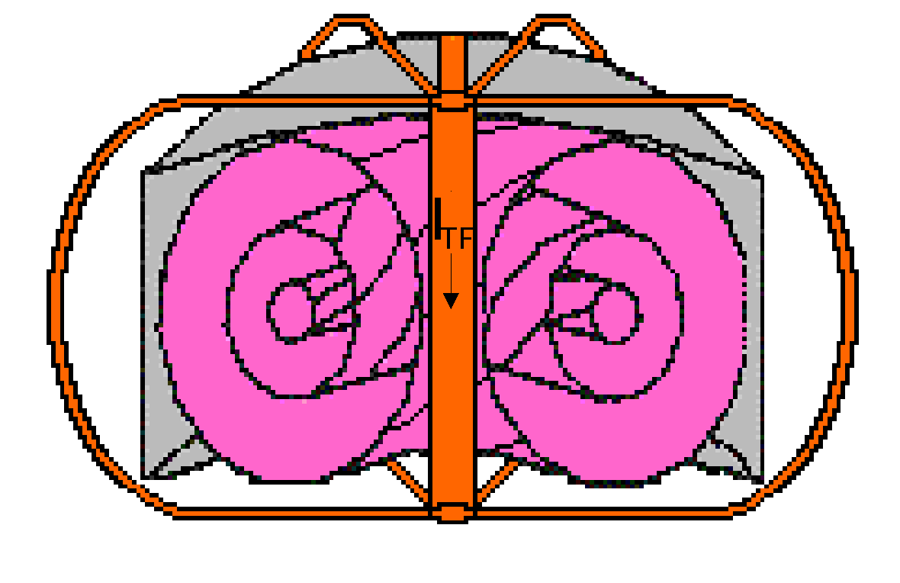
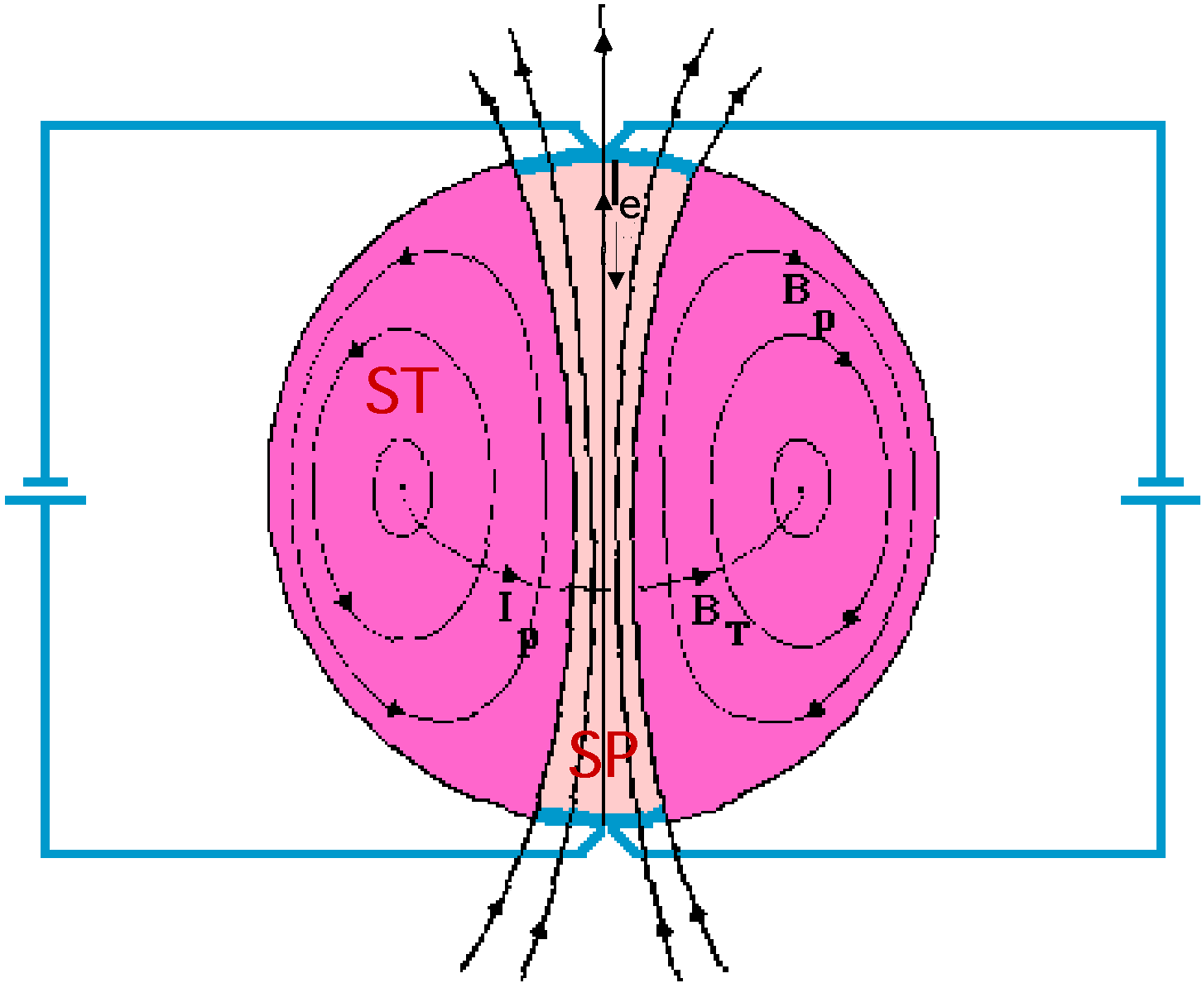
2
Spherical Tokamaks allow to obtain:
• High plasma current I_{p} (and high <n>) with low B_{T}
• Plasma β much higher than Conventional Tokamaks
• More compact devices
But, for a reactor/CTF extrapolation:
• No space for central solenoid (Current Drive requirement more severe)
• No neutrons shield for central stack (no superconductor/high dissipation)
Intriguing possibility ⇒ substitute central rod with Screw Pinch plasma
(I_{TF} → I_{e})
Potentially two problems solved:
• Simply connected configuration (no conductors inside)
• I_{p} driven by I_{e} (Helicity Injection from SP to ST)
Flux Core Spheromak (FCS)
Theory: Taylor & Turner, Nucl. Fusion 29, 219 (1989)
Experiment: TS-3; N. Amemiya, et al., JPSJ 63, 1552 (1993)

Slide 3
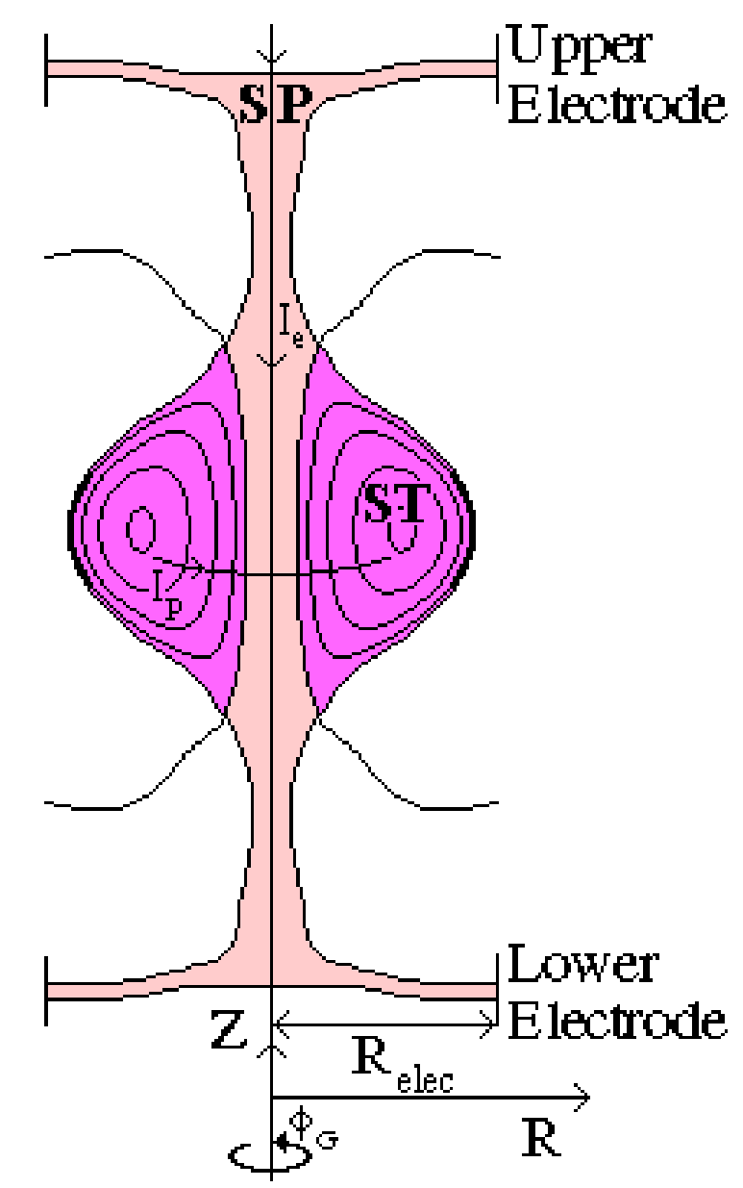
3
But Flux Core Spheromaks are:
• injected by plasma guns
• formed by ~10 kV voltage on electrodes
• high pressure prefilled
• with ST safety factor q≤1
New configuration proposed:
PROTO-SPHERA
“Flux Core Spherical Tokamak” (FCST), rather than FCS
Disk-shaped electrode driven Screw Pinch plasma (SP)
Prolated low aspect ratio ST (A=R/a≥1.2, κ=b/a~2.3)
to get a Tokamak-like safety factor (q₀≥1, q_{edge}~3)
SP electrode current I_{e}=60 kA
ST toroidal current I_{p}=120÷240 kA
ST diameter R_{sph}=0.7 m
⇓
Stability should be improved and helicity drive may be less disruptive than in conventional Flux-Core-Spheromak

Slide 4
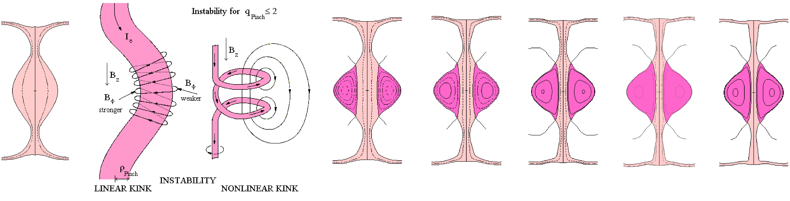
4
PROTO-SPHERA formation follows TS-3 scheme (SP kink instability)
Tunnelling (ST formation)
ST compression (I_{p}/I_{e} ⇑, A ⇓ )
T0
I_{e}=8.5 kA
T3
I_{p}=30 kA
A=1.8
T4
I_{p}=60 kA
A=1.5
T5
I_{p}=120 kA
A=1.3
T6
I_{p}=180 kA
A=1.25
TF
I_{p}=240 kA
A=1.2
I_{e} 8.5⇒60 kA
• I_{p}/I_{e} ratio crucial parameter
(strong energy dissipation in SP)
• MHD equilibria computed both with
monotonic (peaked pressure)
as well as
reversal safety factor profiles
(flat pressure, μ=J·B/B² parameterized)
Some level of low n resistive instability needed
(reconnections to inject helicity from SP to ST)
but
SP+ST must be ideally stable at any time slice
⇓
Ideal MHD analisys to assess I_{p}/I_{e} & β limits

Slide 5
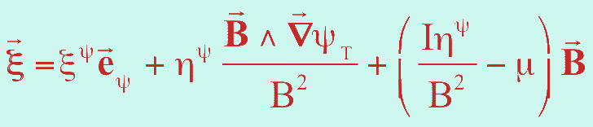

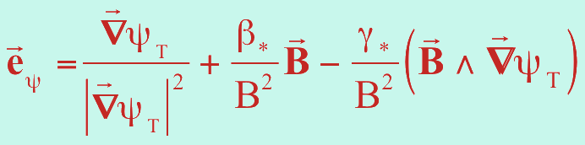
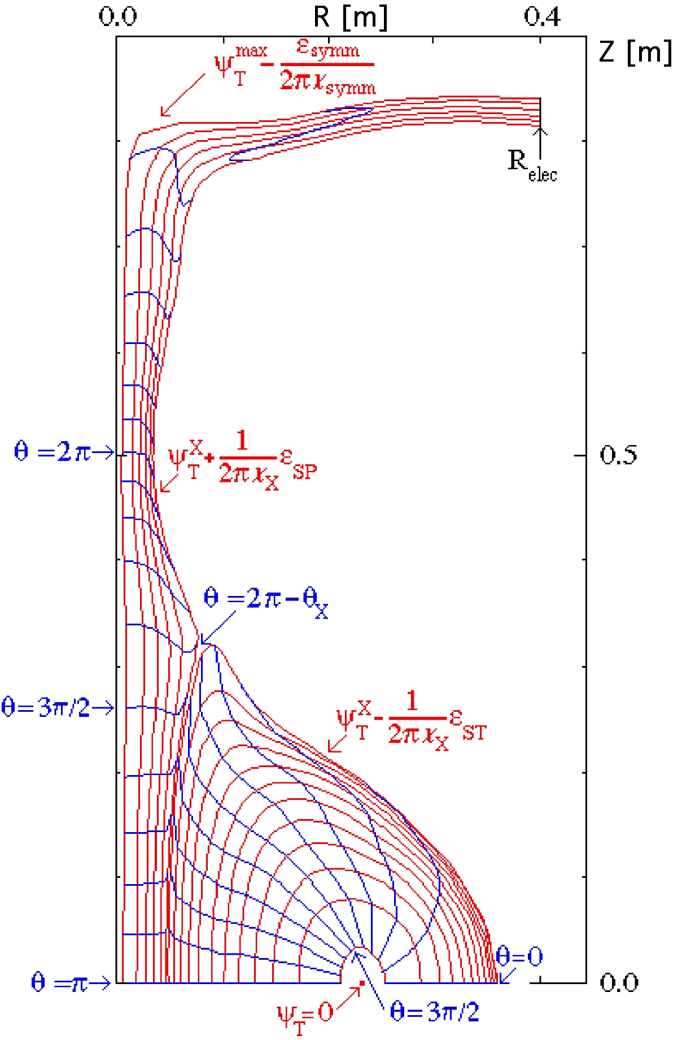



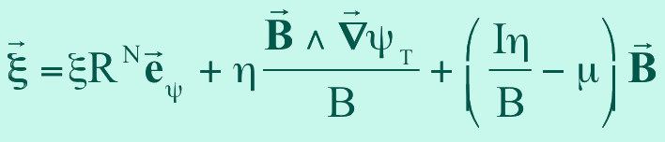
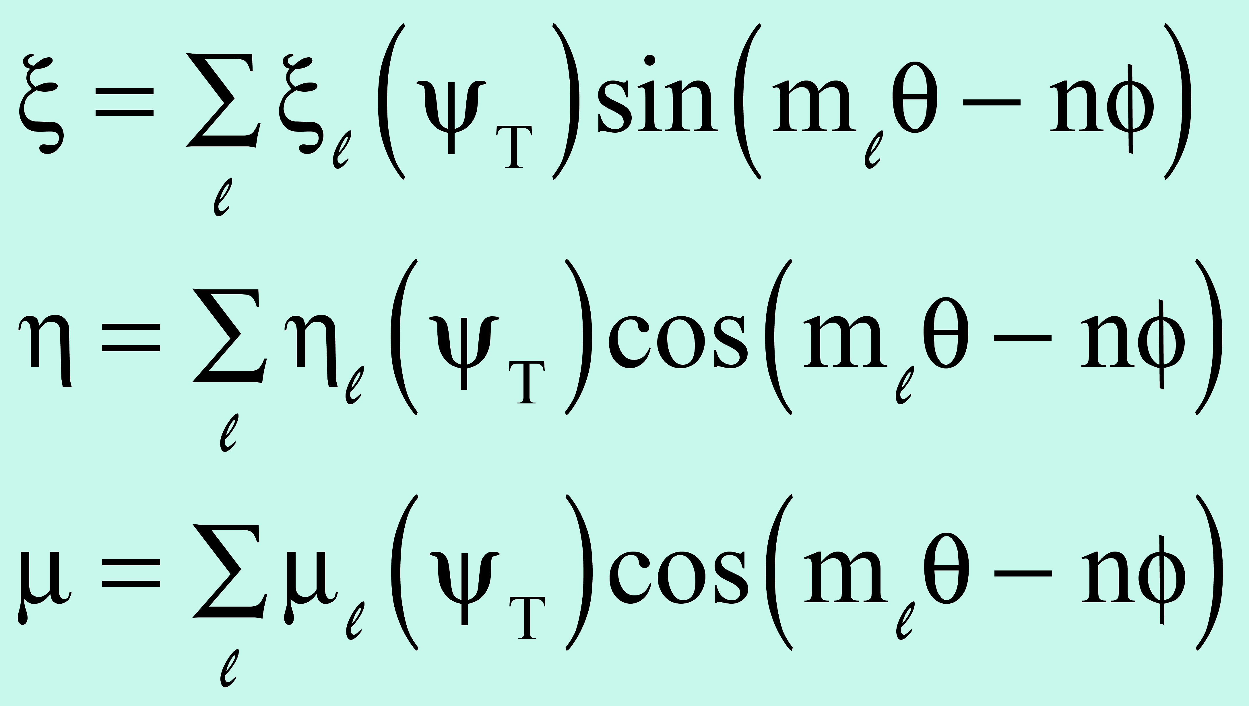
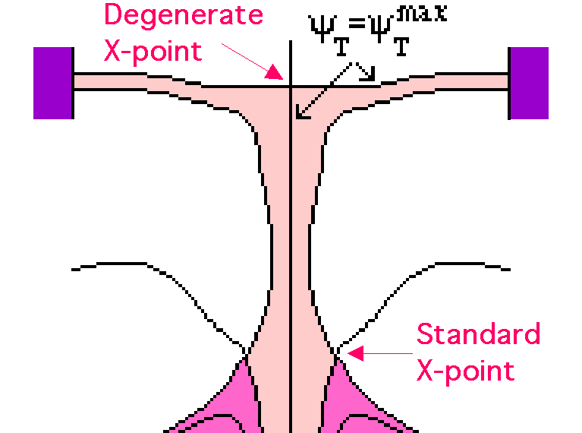

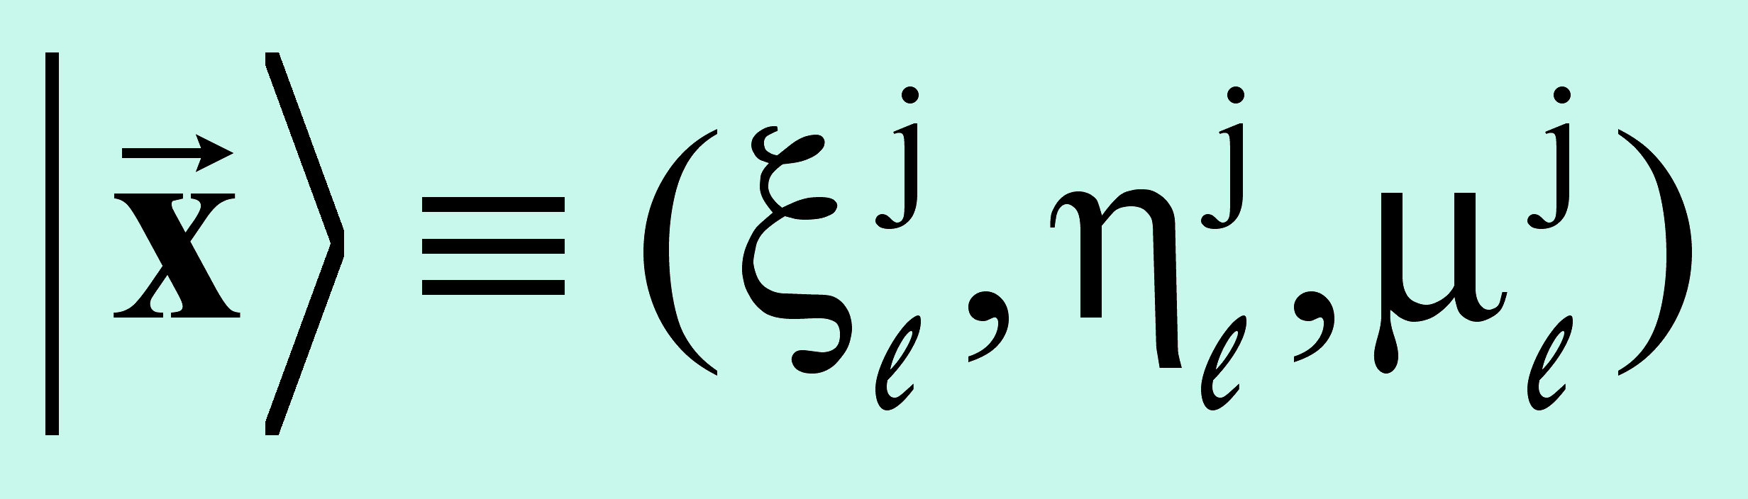

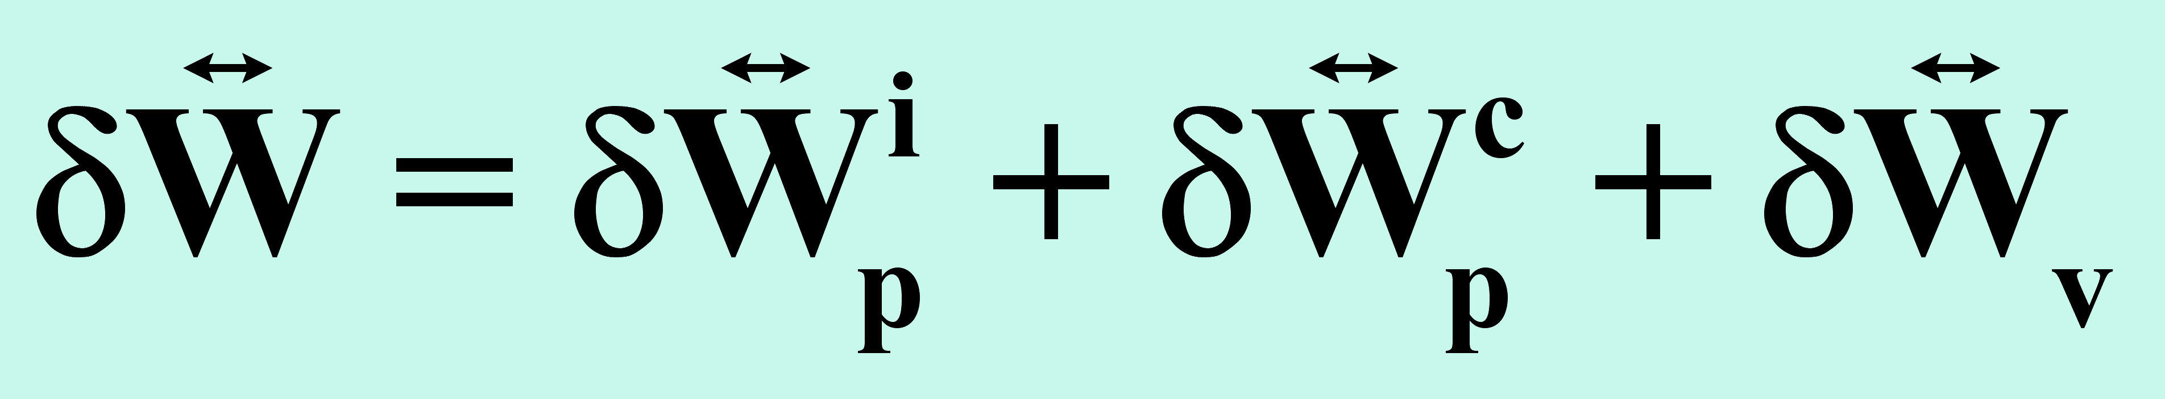
5
Characteristics of the free-boundary Ideal MHD Stability code
Plasma extends to symmetry axis (R=0) | Open+Closed field lines | Degenerate |B|=0 & Standard X-points
Boozer magnetic coordinates (ξ_{T},θ,ϕ)
joined at SP-ST interface
to guarantee ξ^{ψ} continuity
Standard decomposition
inappropiate
like
but, after degenerate X-point (|B|=0), ψ_{T}= ≠ R=0:
ξ^{ψ}( )=0 cannot be imposed
Solution: ξ^{ψ}=ξR^{N} (N≥1); η^{ψ}=ηB
⇓
Fourier analysis of:
Normal Mode equation
solved by 1D finite element method
Kinetic Energy
Potential Energies

Slide 6
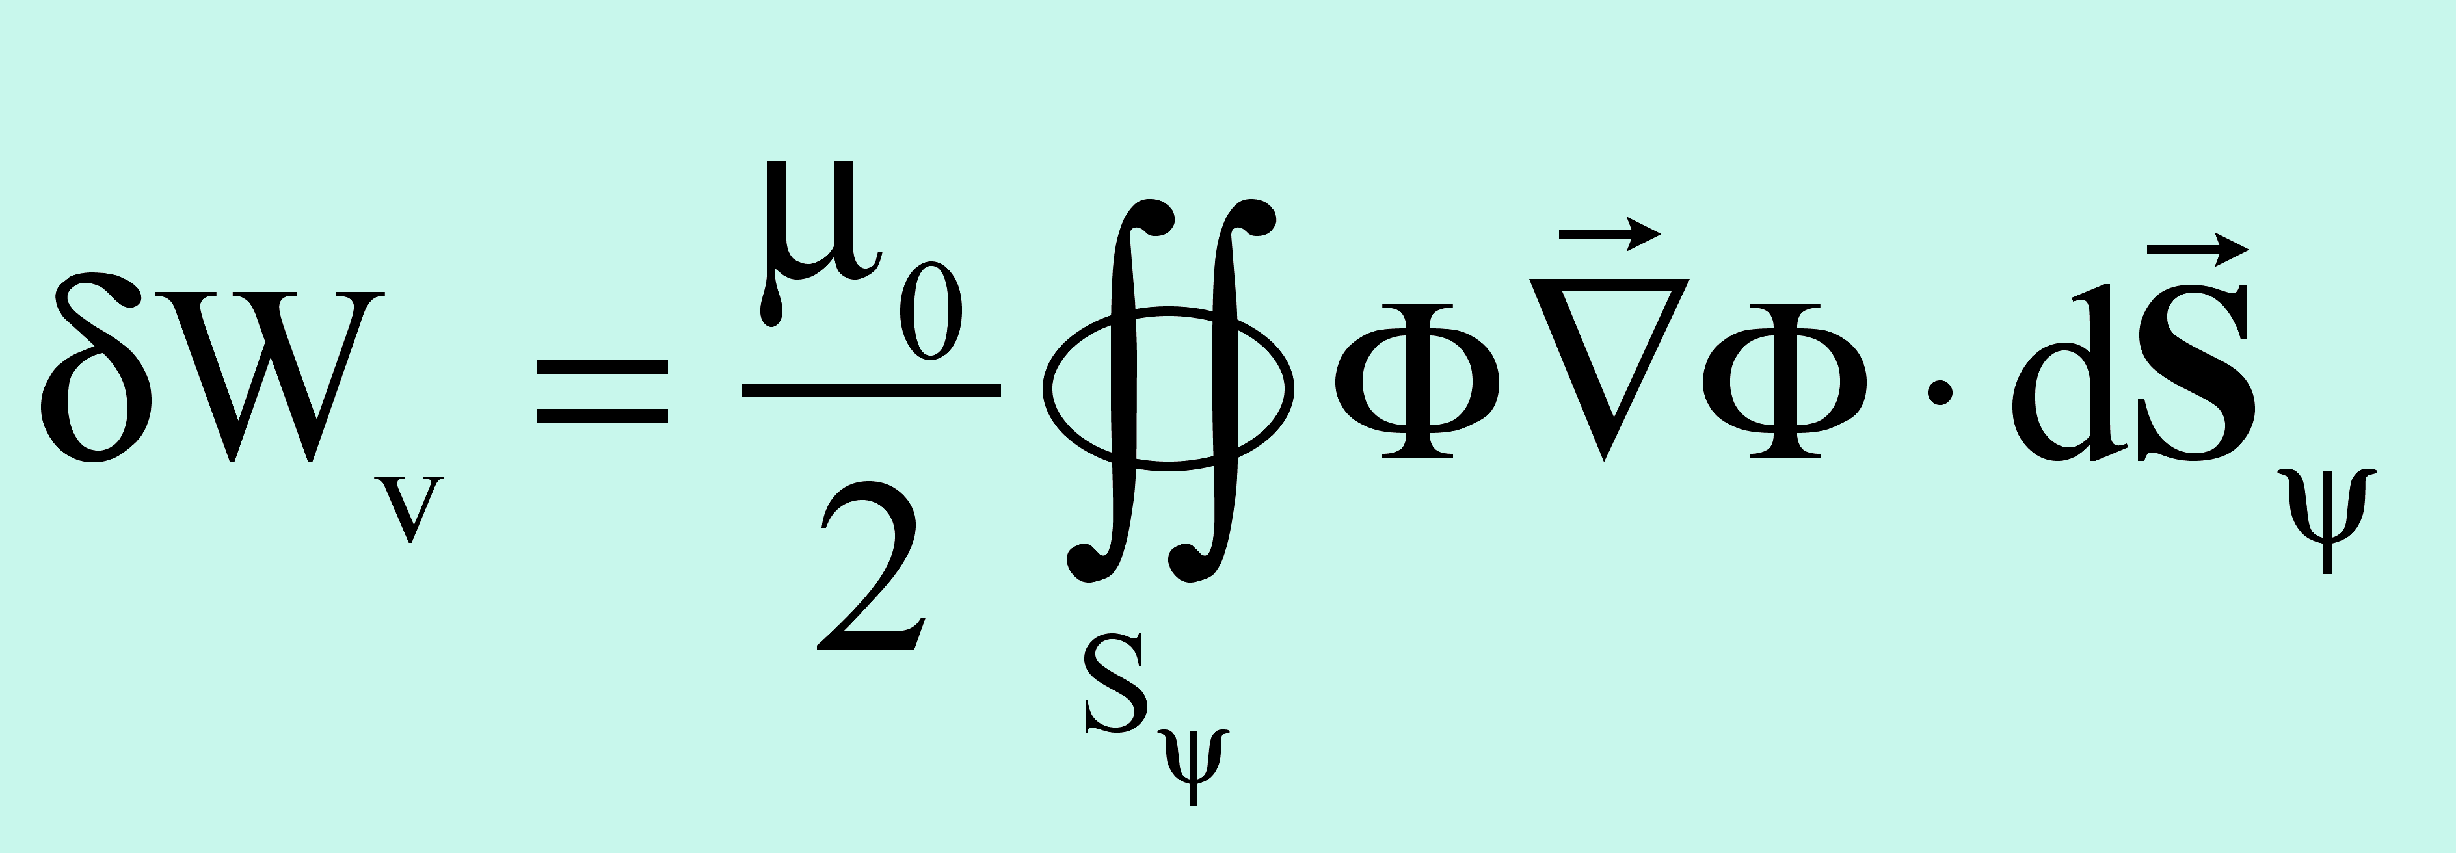

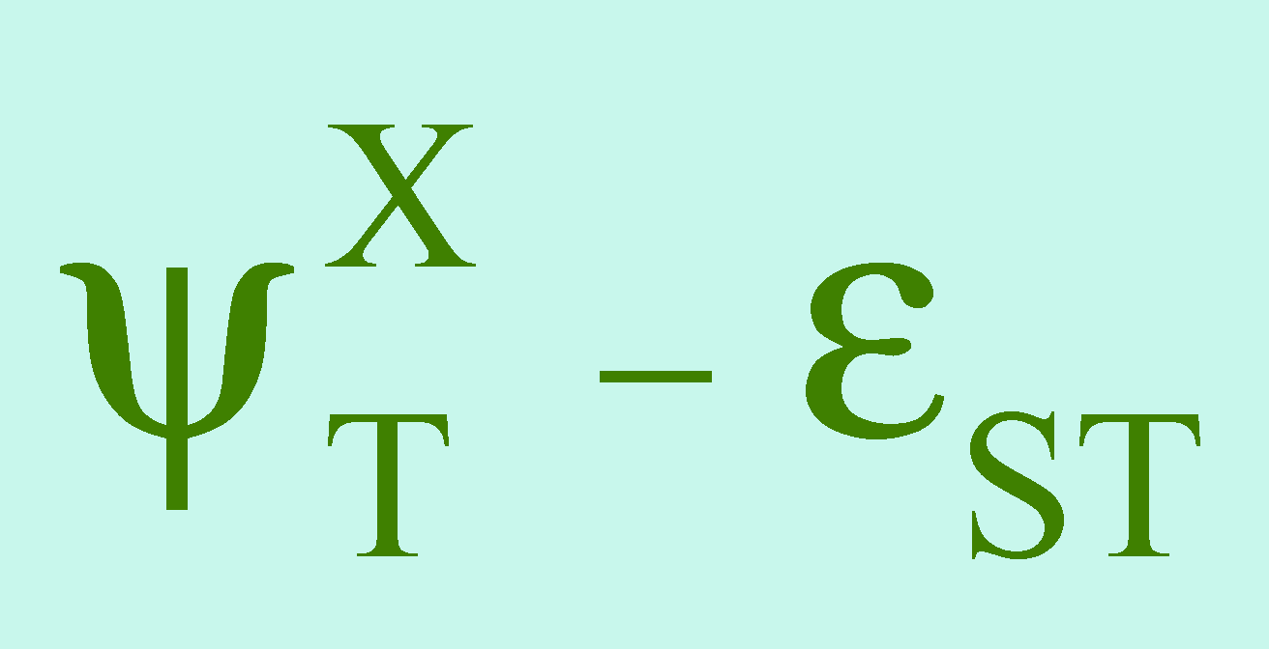
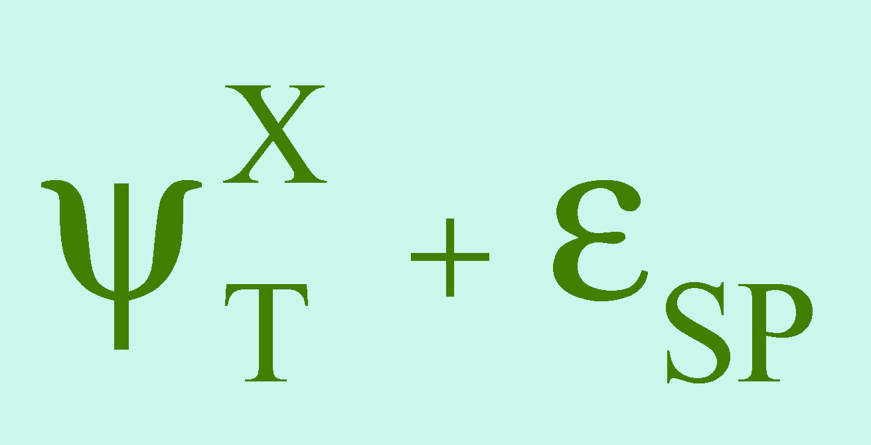
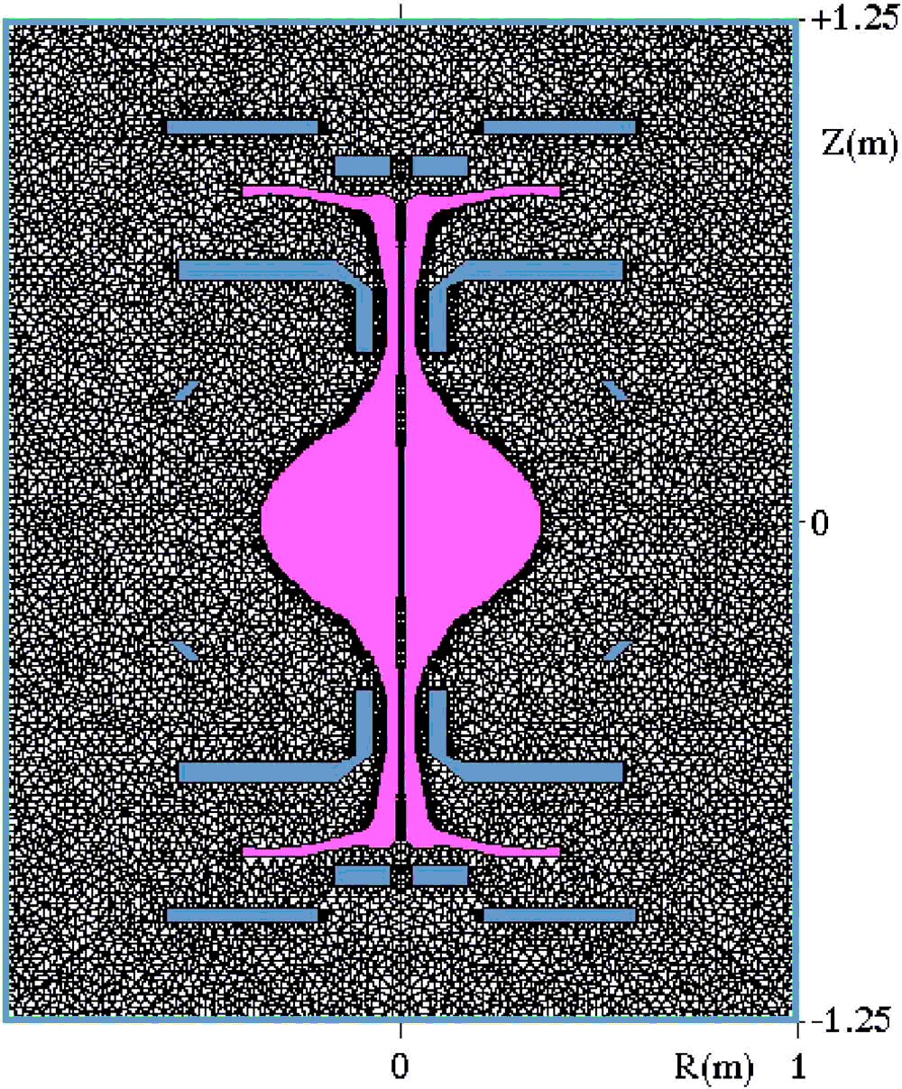
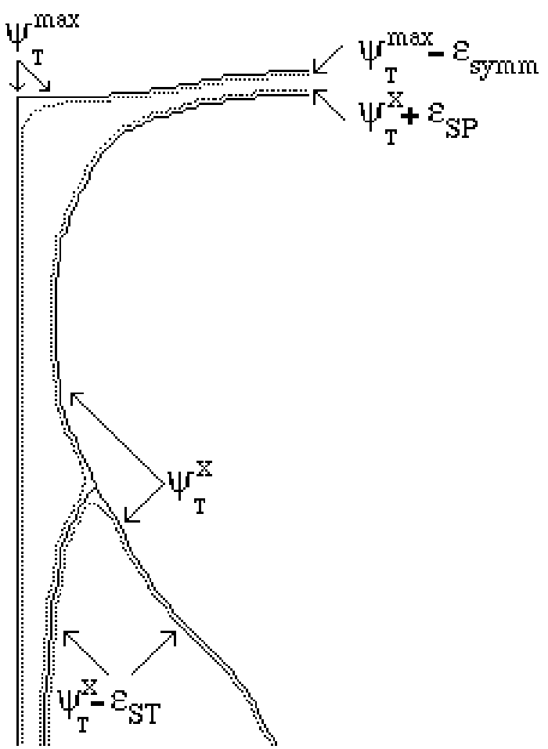
6
Vacuum term computation (multiple plasma boundaries)
Using the perturbed scalar magnetic potential Φ, the vacuum contribution
is expressed as an integral over the plasma surface:
Computation method for δW_{v} based on 2D finite element:
it take into account any stabilizing conductors
(vacuum vessel & PF coil casings)
Vacuum contribution to potential energy not only affect ψ_{T} = :
contribution even to the radial mesh points ψ_{T}= and

Slide 7
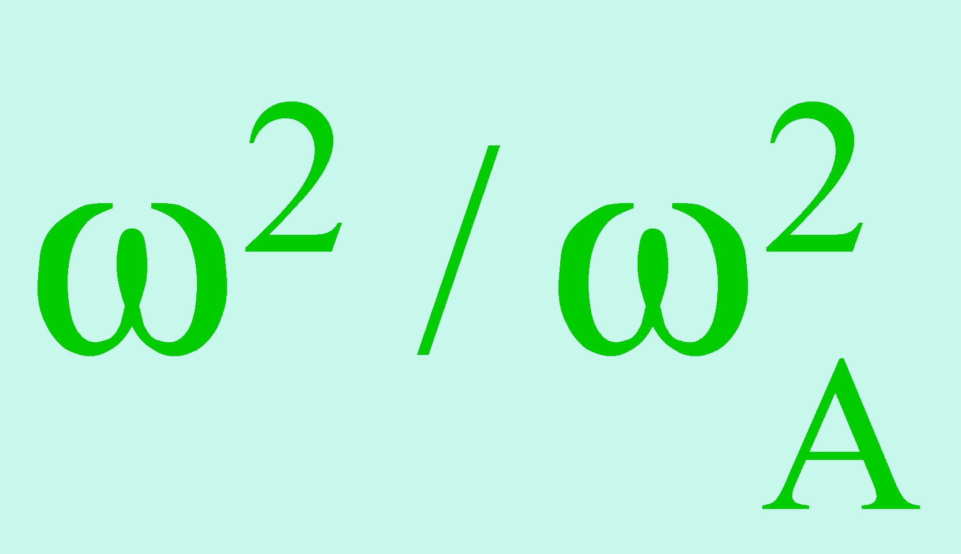
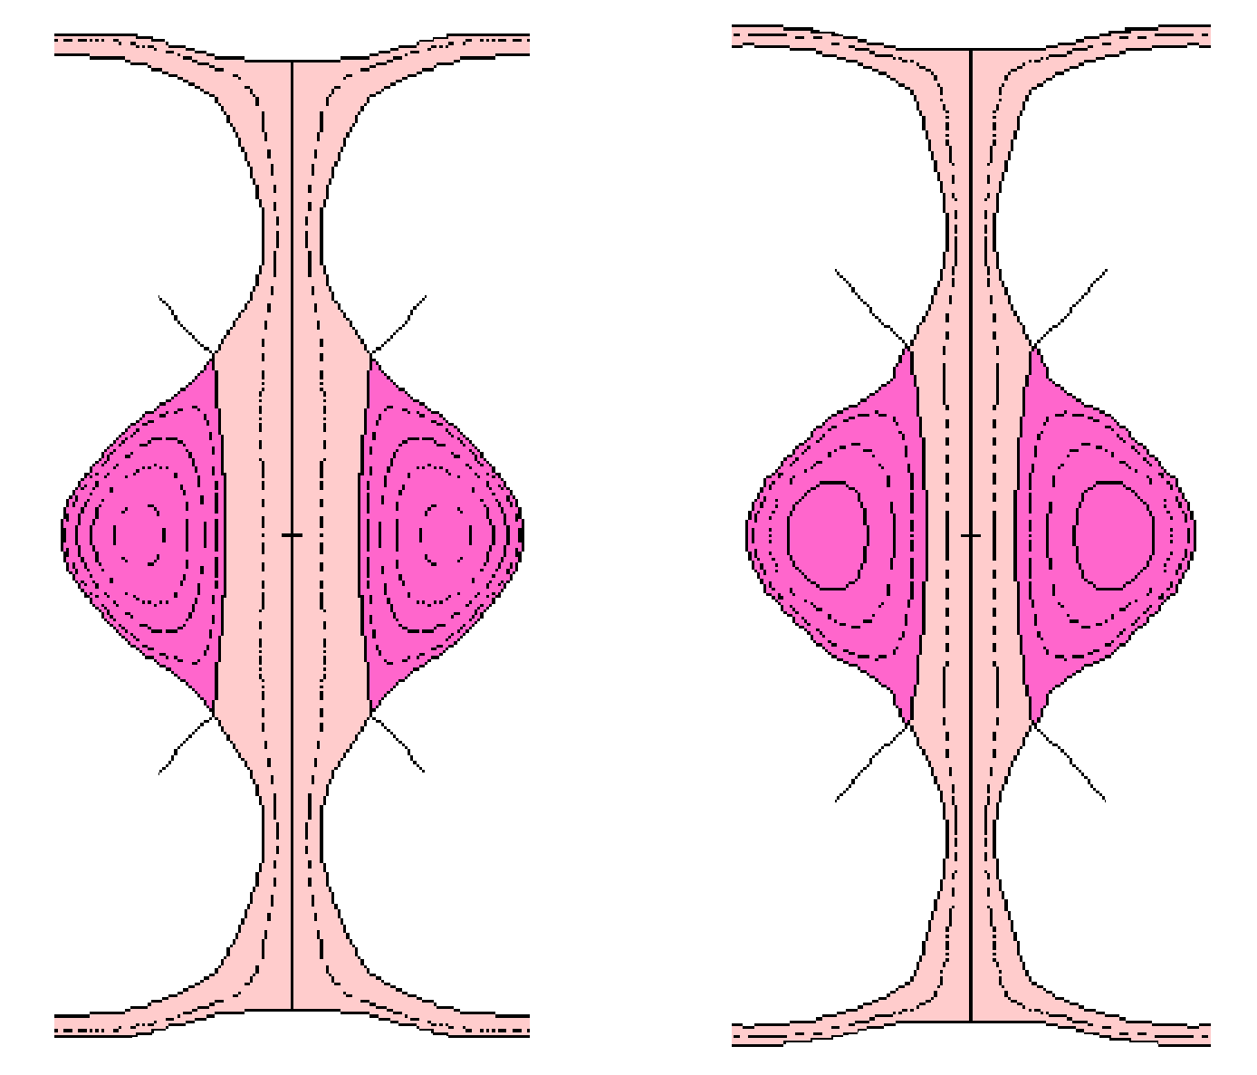
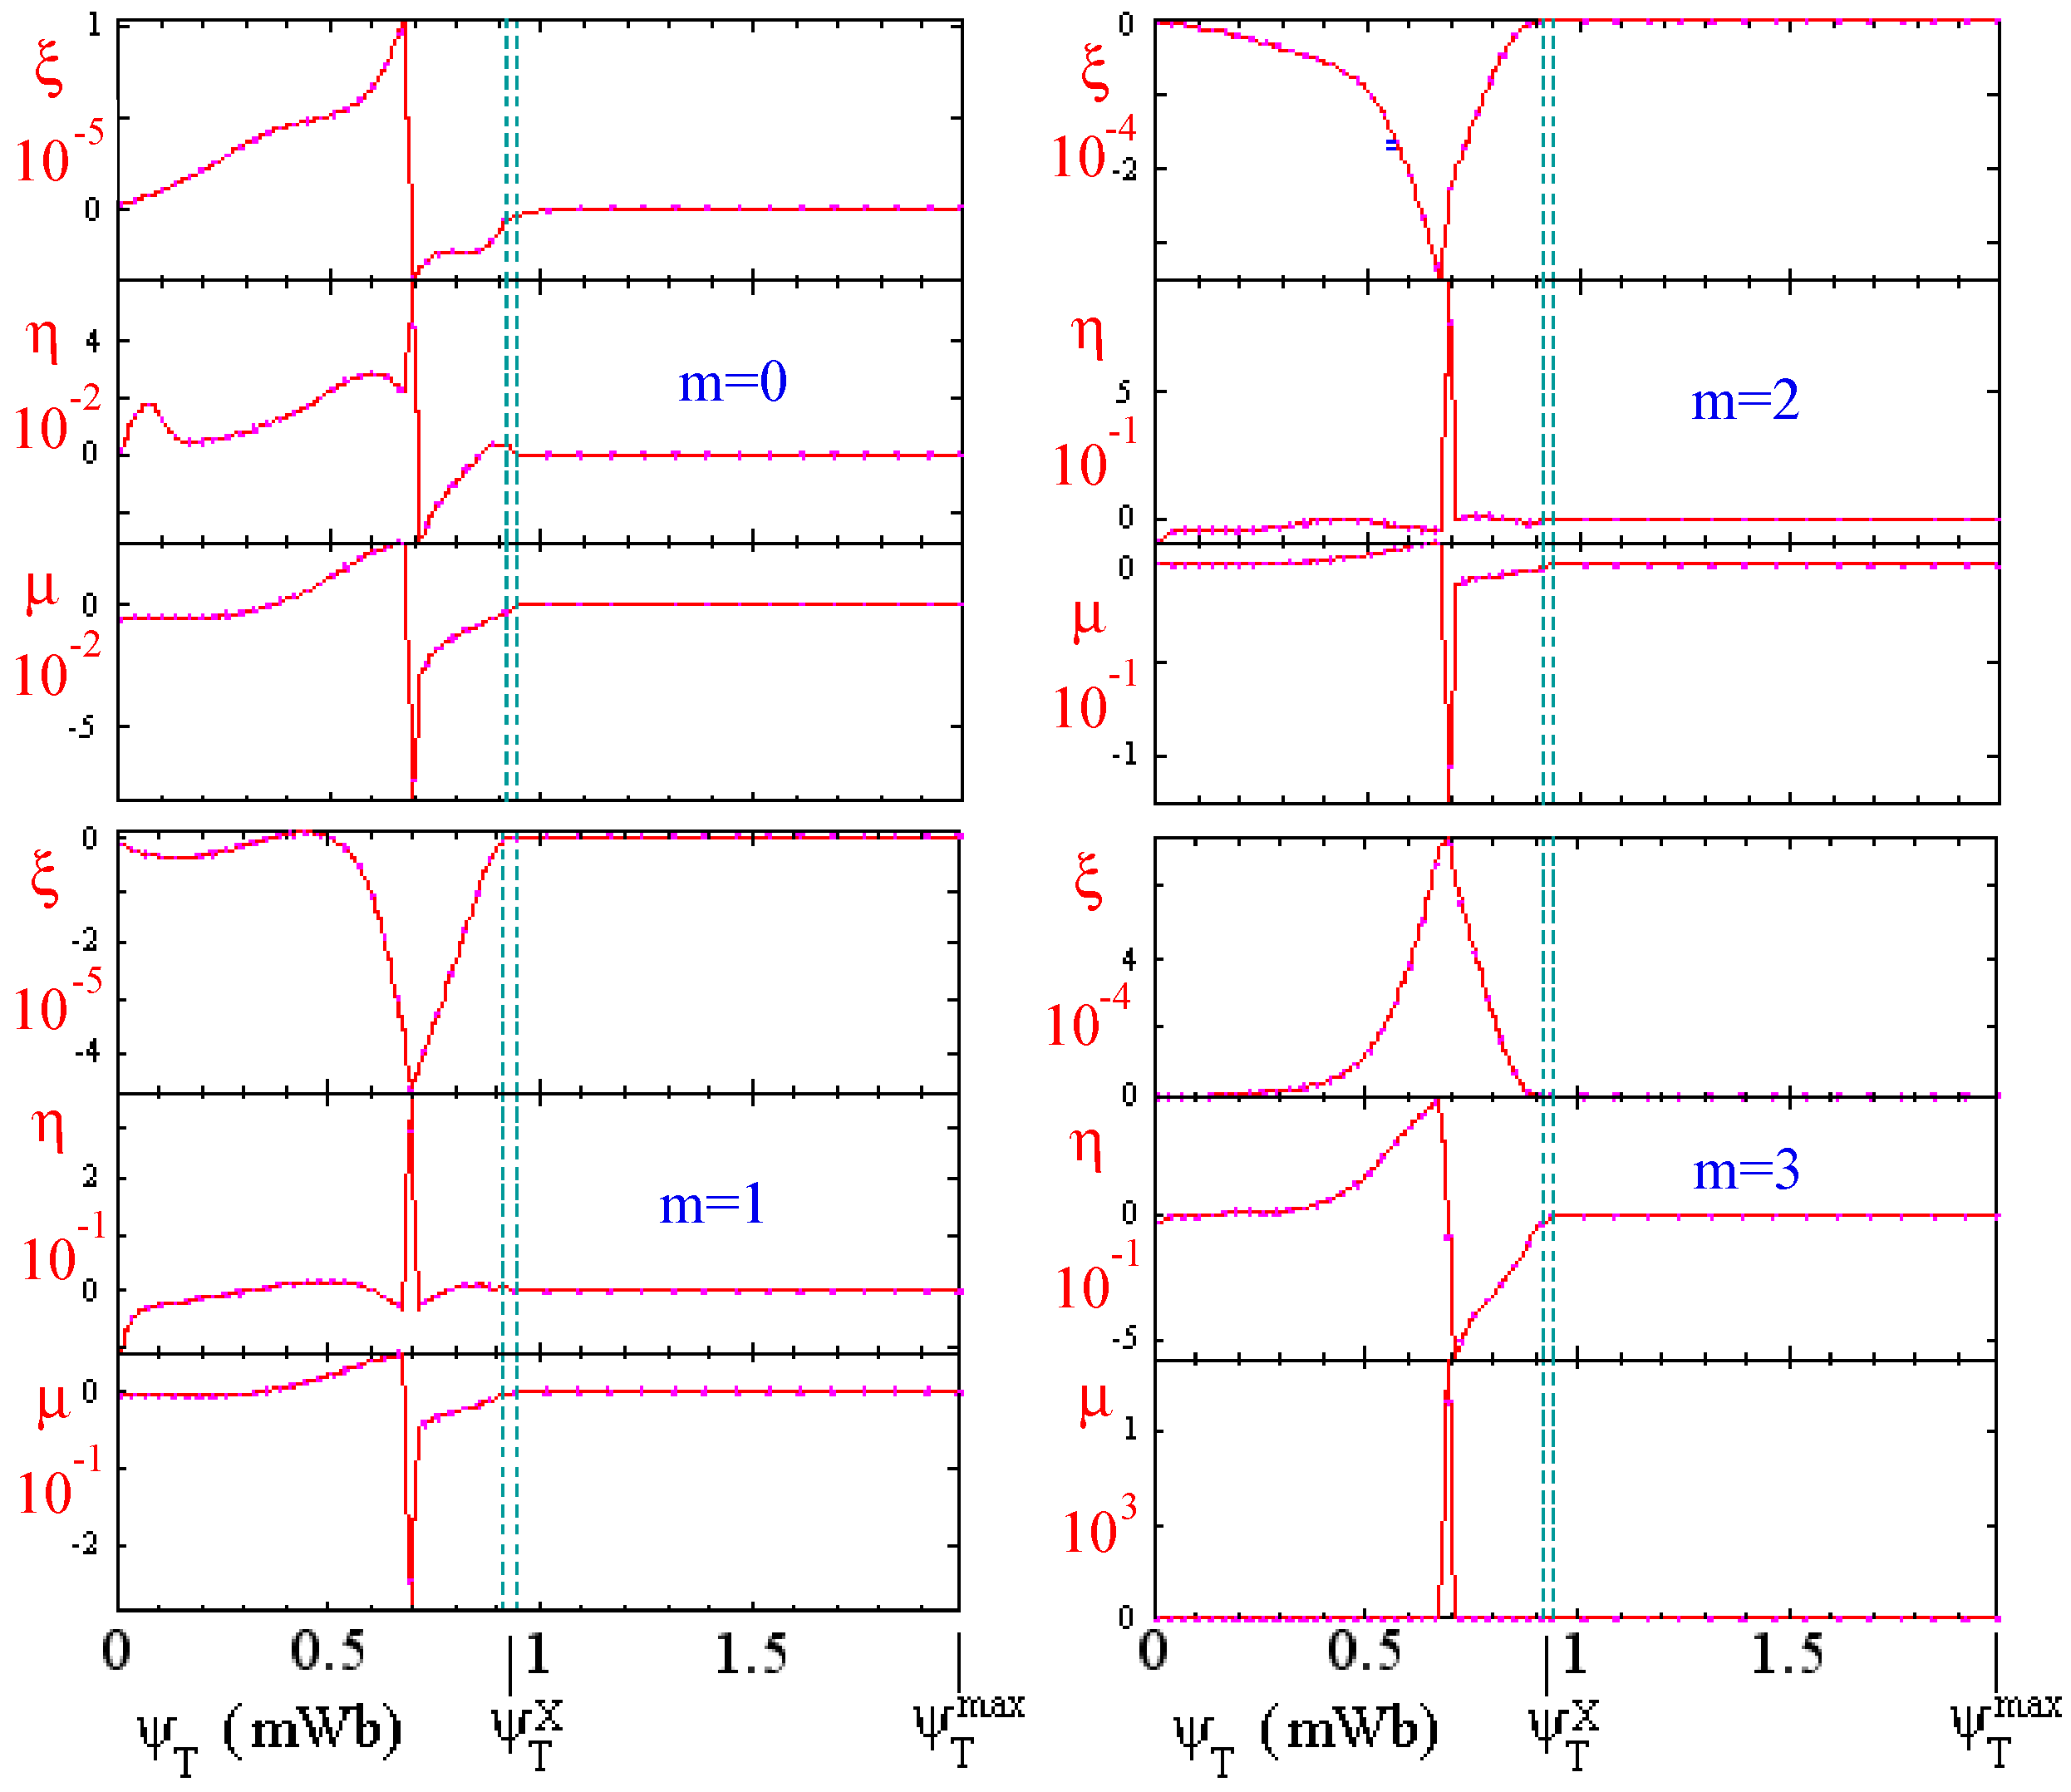
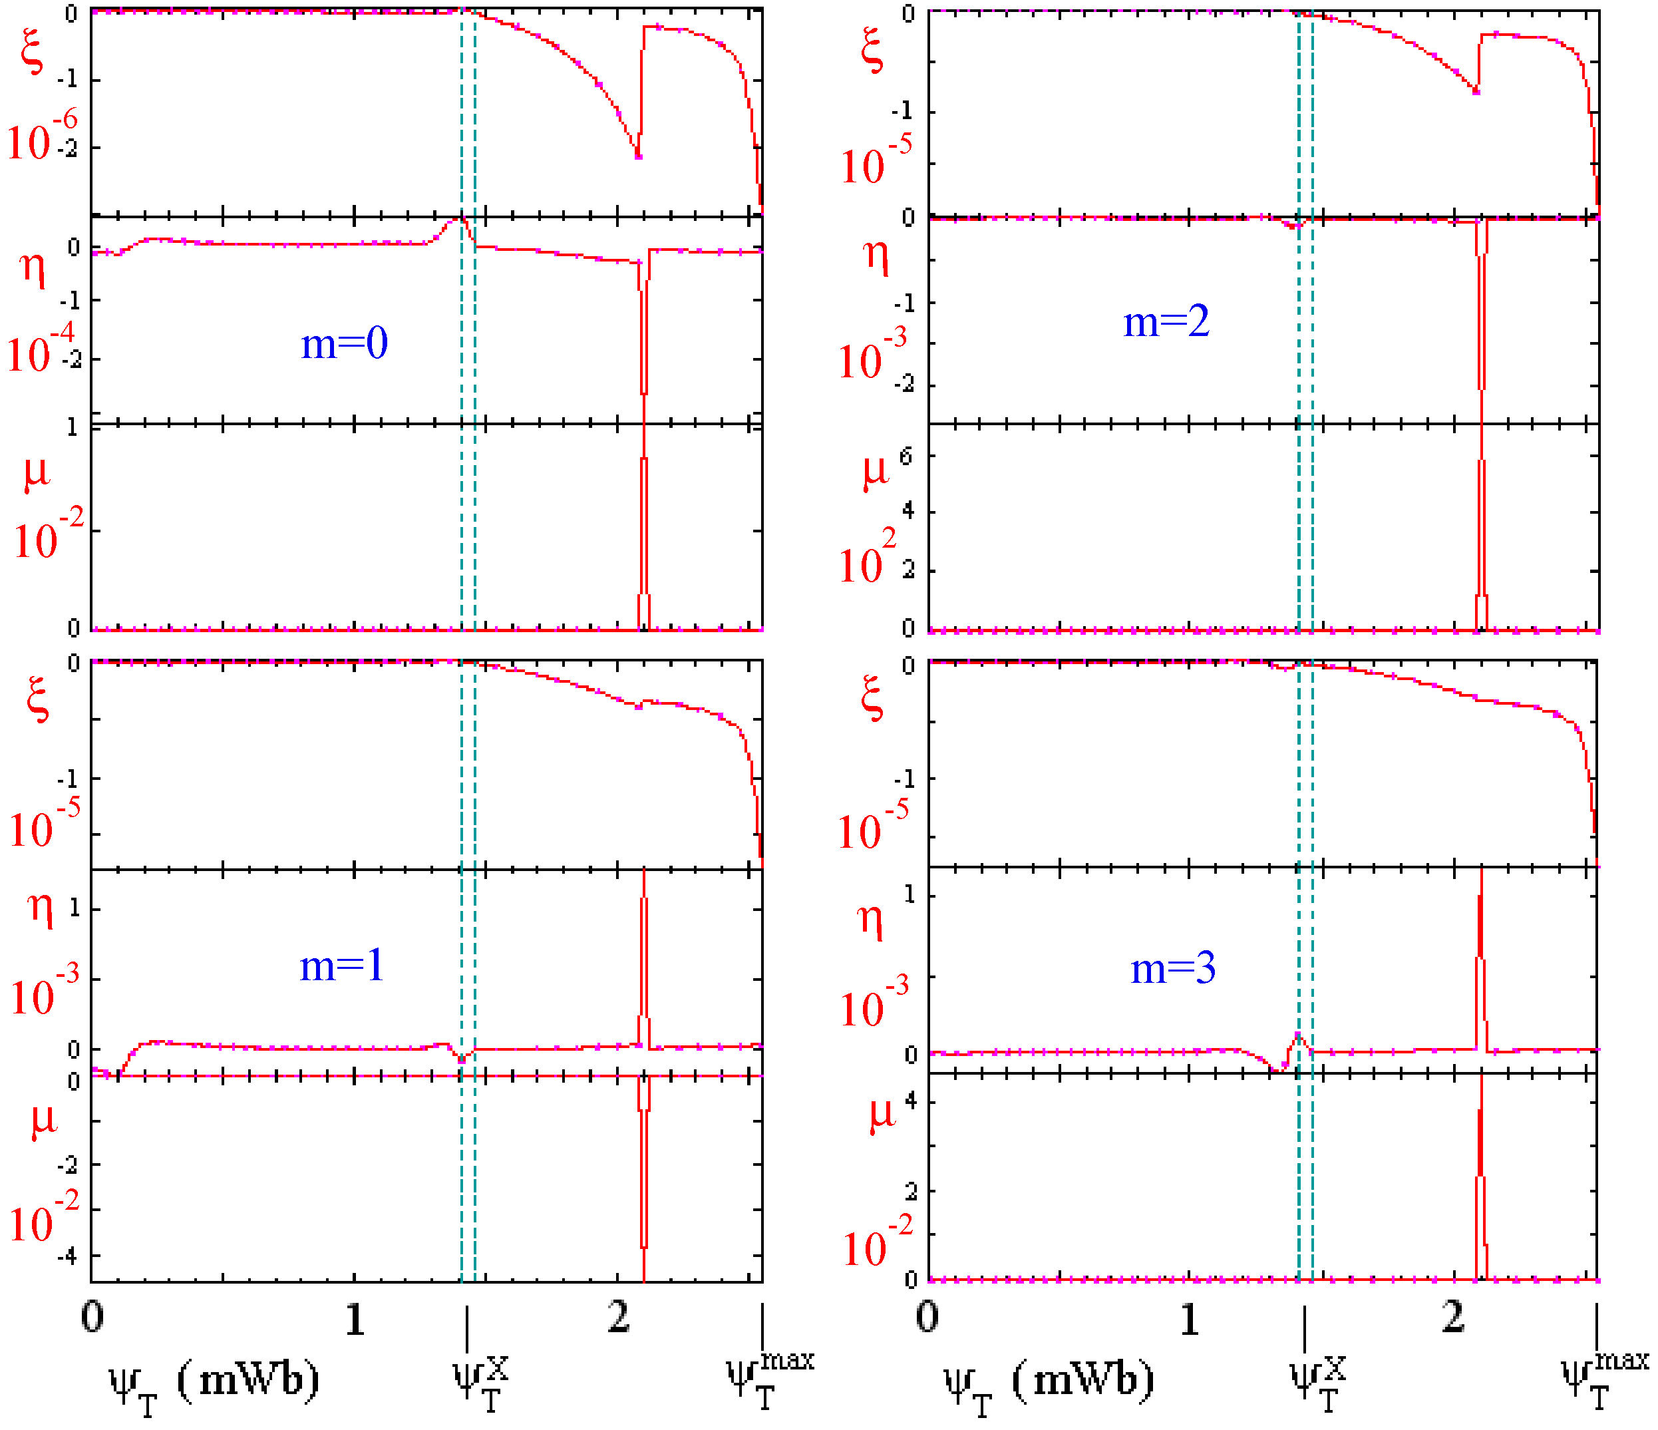
7
Stability results for time slices T3 & T4
⇓
⇓
Both times ideally stable ( >0) for n=1,2,3
(q profile monotonic & shear reversed)
Oscillations on
resonant surfaces
Equilibrium parameters:
T3: I_{p}=30 kA, A=1.8(1.9), κ=2.2(2.4), q₉₅=3.4(3.3), q₀=1.2(2.1), β_{p}=1.15 and β=22(24)%
T4: I_{p}=60 kA, A=1.5(1.6), κ=2.1(2.4), q₉₅=2.9(3.1), q₀=1.1(3.1), β_{p}=0.5 and β=21(26)%
I_{p}/I_{e}=0.5
I_{p}/I_{e}=1
T3
n=1
n=1
T4
ST
SP
ST
SP
ST
SP
ST
SP

Slide 8
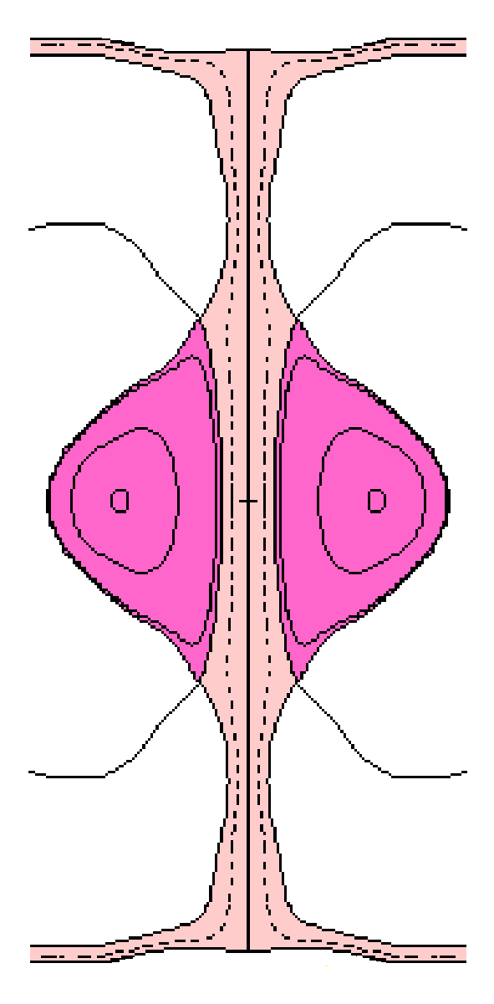
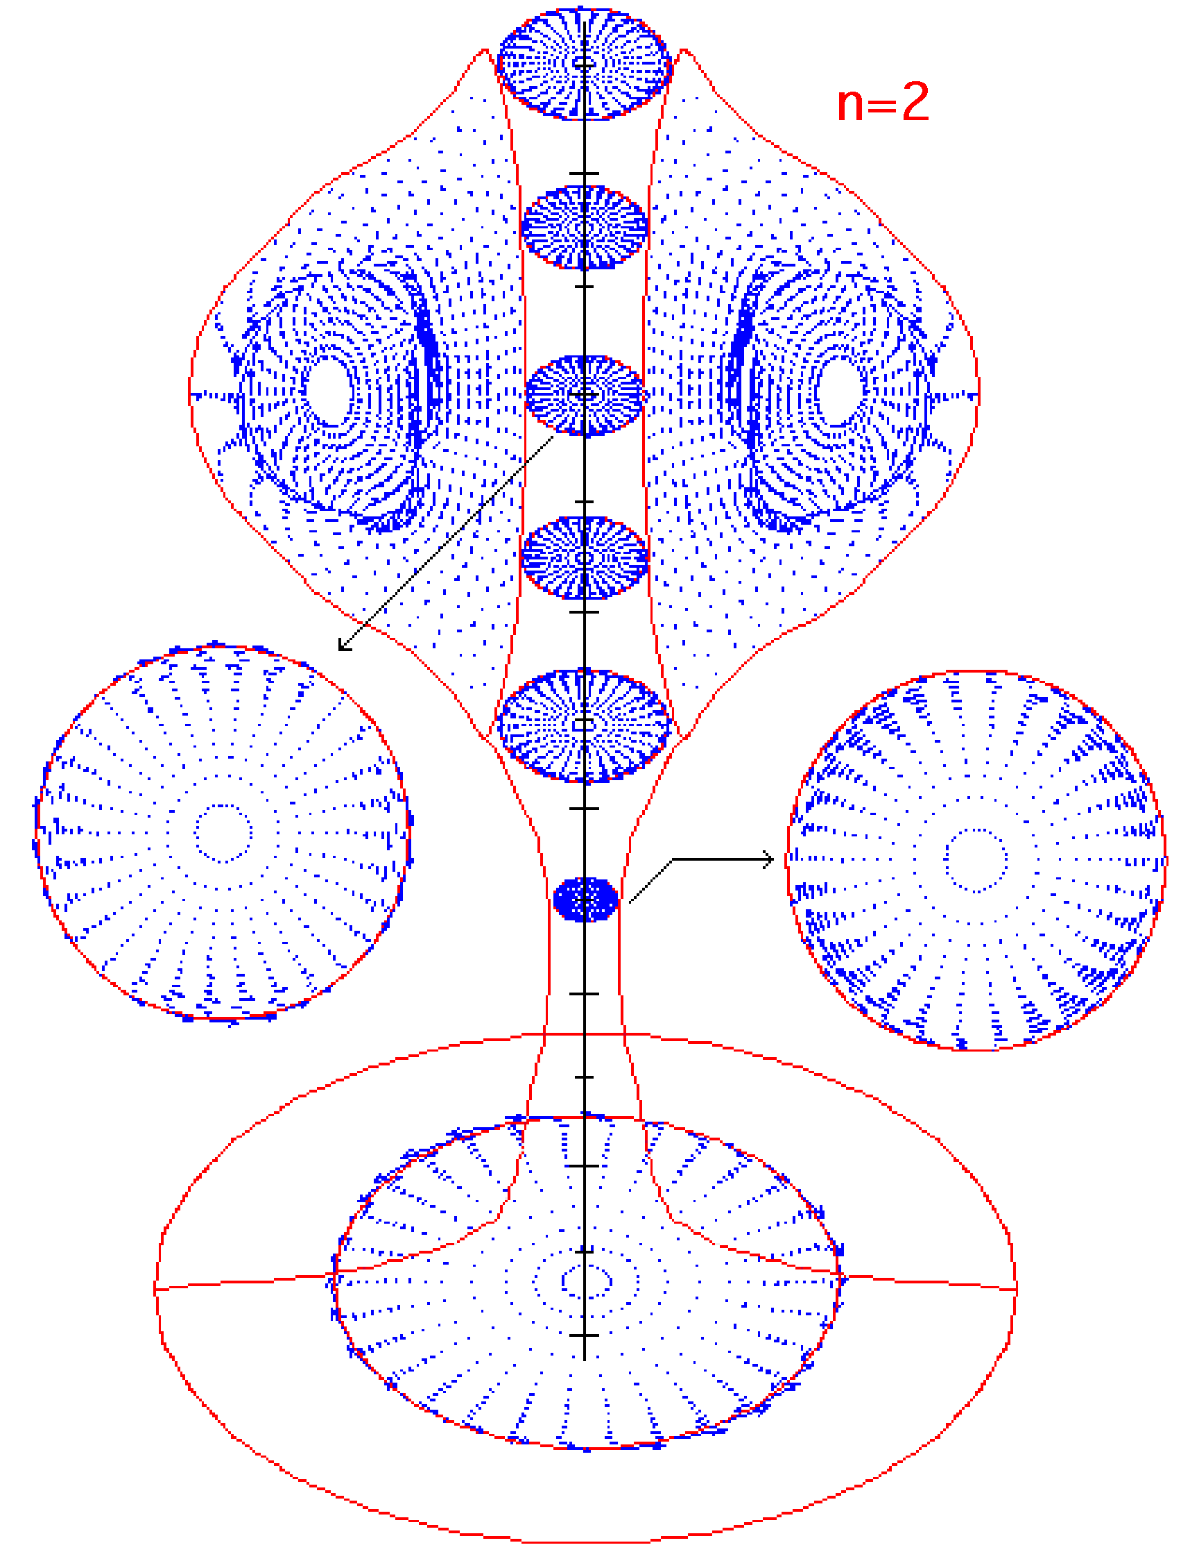
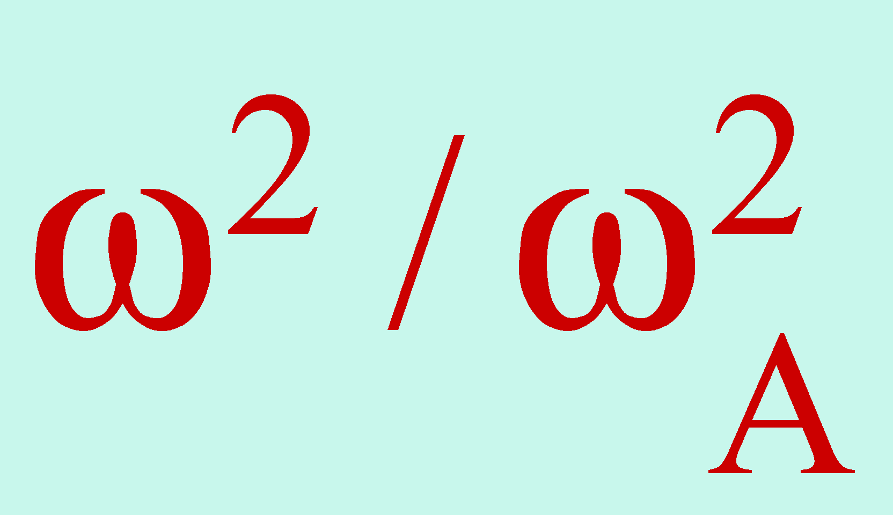
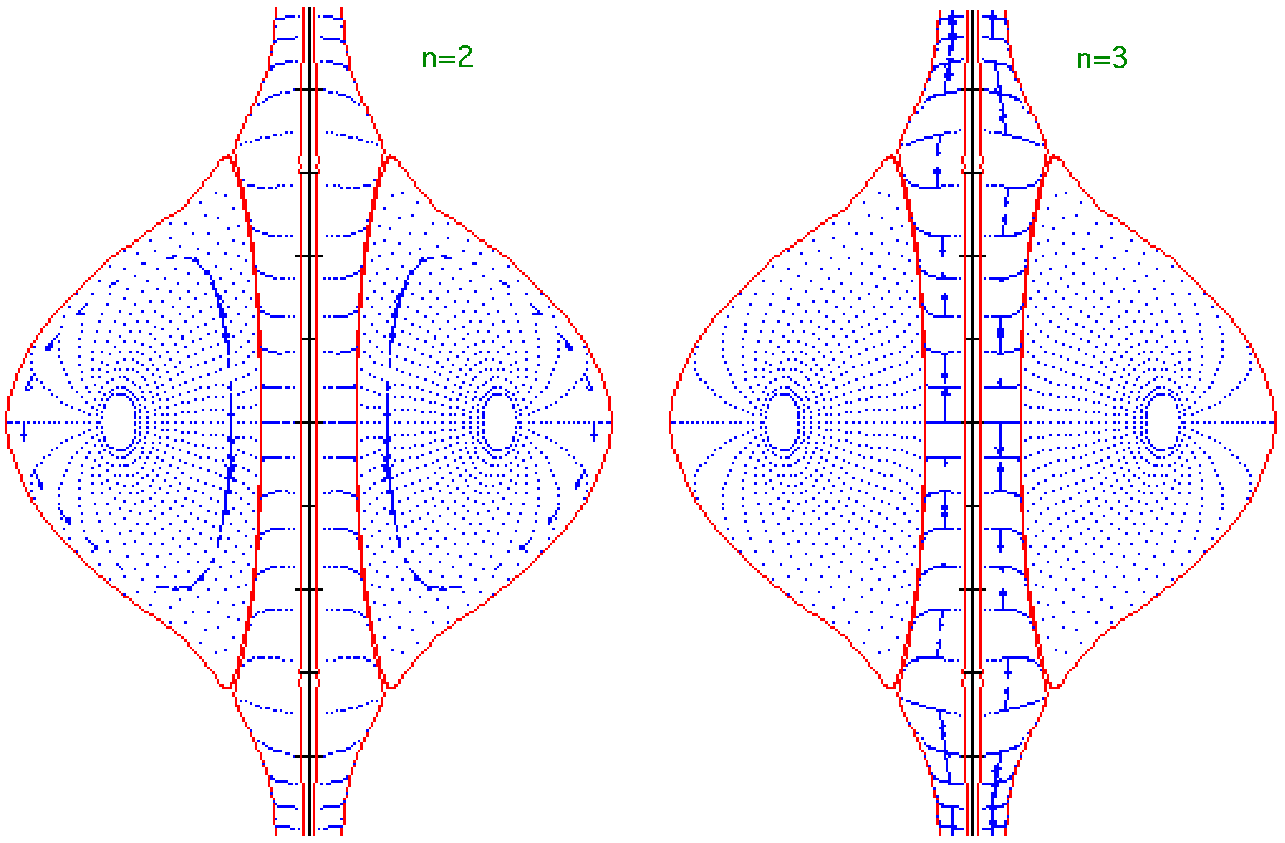
8
Stability results for time slices T5
With “reference” β_{p}=0.3 ⇒n=1 stable, n=2 & 3 unstable
Equilibrium parameters:
T5 (monothonic q): I_{p}=120 kA, A=1.3, κ=2.1, q₉₅=2.8, q₀=1.0, β=25%
T5 (reversed q): I_{p}=120 kA, A=1.4, κ=2.5, q₉₅=3.5, q₀=2.8, β=33%
I_{p}/I_{e}=2
ST drives instability: only perturbed
motion on the ST/SP interface
Stability restored with β_{p}=0.2
Equilibrium parameters:
T5 (monothonic q): I_{p}=120 kA, A=1.4, κ=2.2, q₉₅=2.7, q₀=1.2, β=16%
T5 (reversed q): I_{p}=120 kA, A=1.4, κ=2.4, q₉₅=2.7, q₀=1.9, β=18%
Stable oscillation on the resonant q surfaces
<0
Monothonic q
Monothonic q

Slide 9
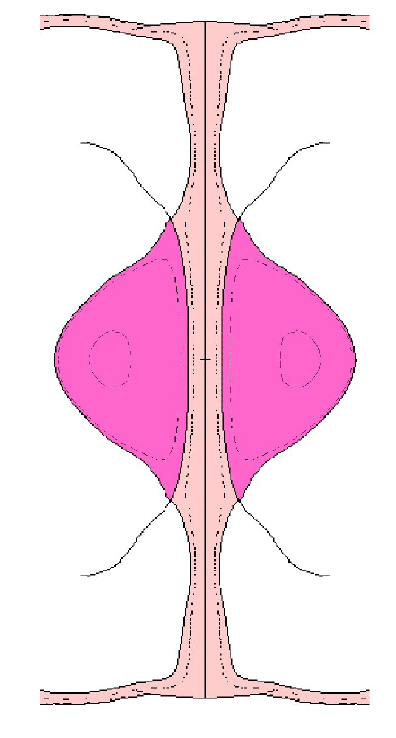
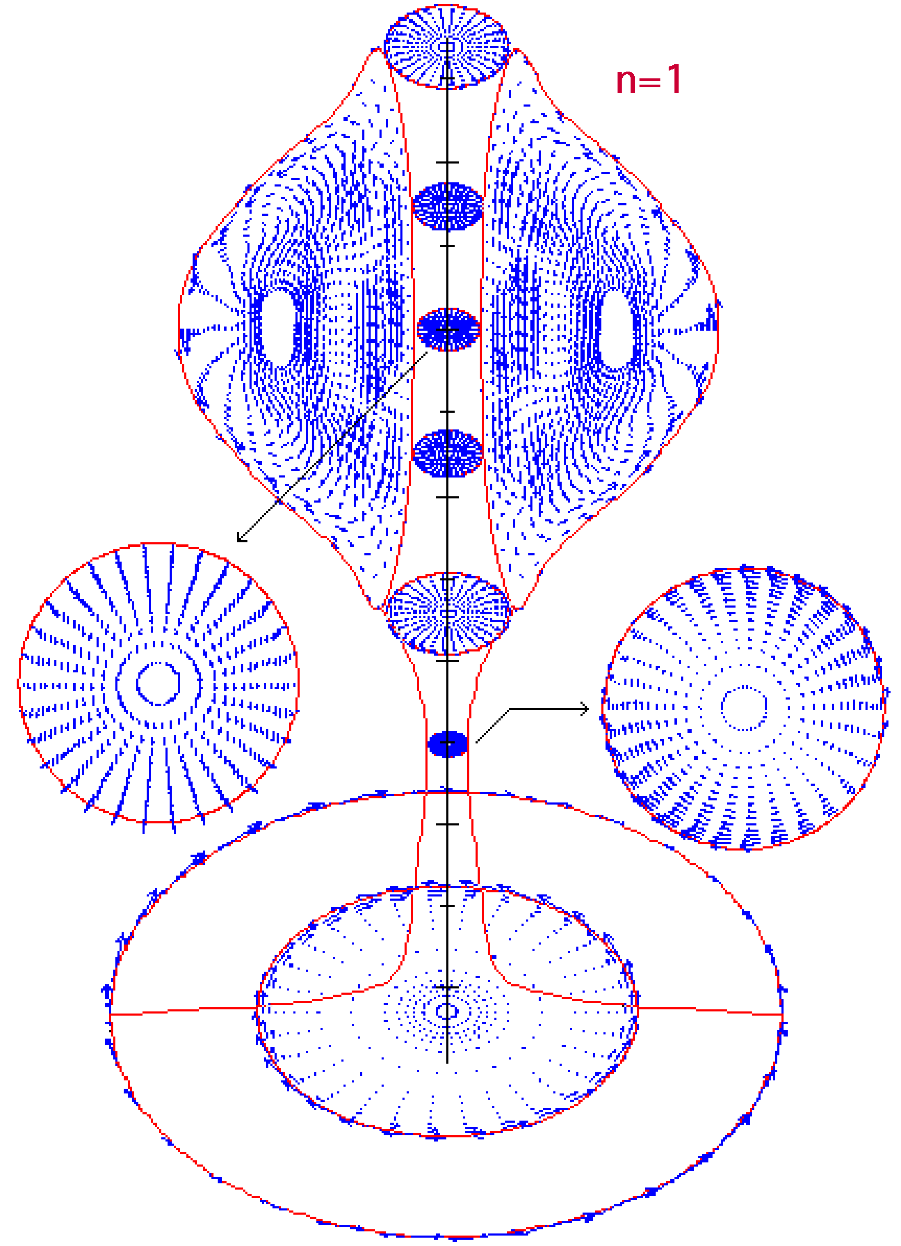
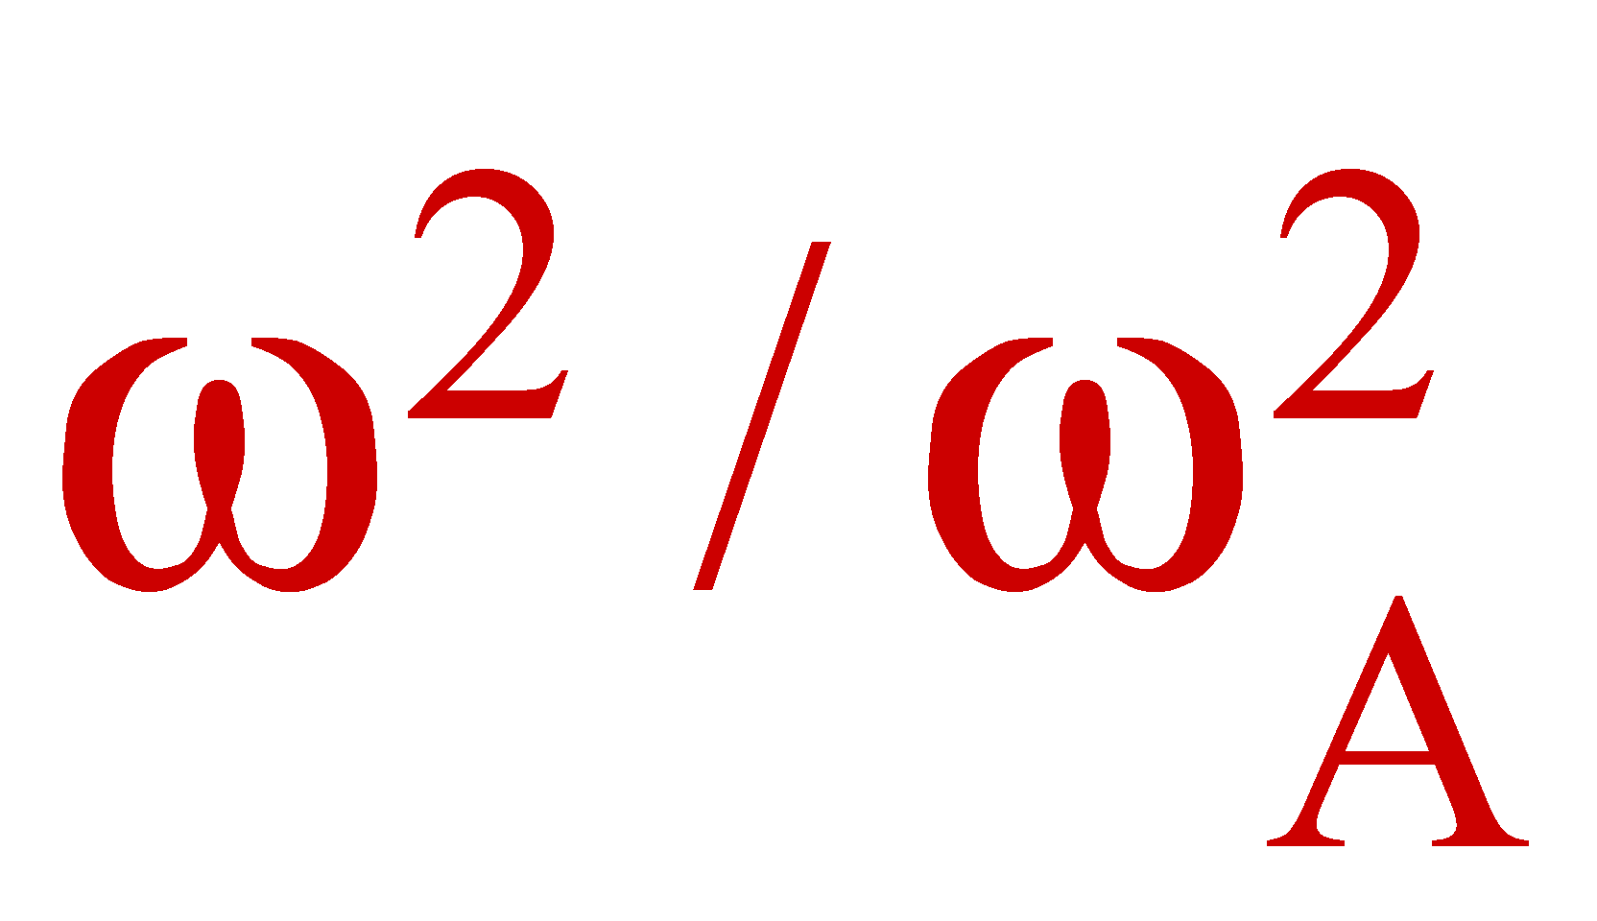
9
Stability results for time slices T6
Screw Pinch drives instability:
ST tilt induced by SP kink
With “reference” β_{p}=0.225:
=-6.8•10⁻⁴
Monothonic q → n=1 stable, n=2 & 3 unstable
Equilibrium parameters:
T6: I_{p}=180 kA, A=1.25, κ=2.2, q₉₅=2.6, q₀=0.96, β=25%
Reversed q → n=1, n=2 & 3 unstable
Equilibrium parameters:
T6: I_{p}=180 kA, A=1.29, κ=2.5, q₉₅=3.2, q₀=2.3, β=33%
I_{p}/I_{e}=3
Weak effect of vacuum term:
for n=1 -6.8•10⁻⁴ → -7•10⁻⁴ if PF coil casings suppressed
With “lower” β_{p}=0.15:
Monothonic q → n=1,2,3 stable
Equilibrium parameters:
T6: I_{p}=180 kA, A=1.29, κ=2.2, q₉₅=2.5, q₀=1.12, β=15%
Reversed q → n=1,2,3 stable
Equilibrium parameters:
T6: I_{p}=180 kA, A=1.32, κ=2.5, q₉₅=2.5, q₀=1.83, β=19%
Reversed q

Slide 10
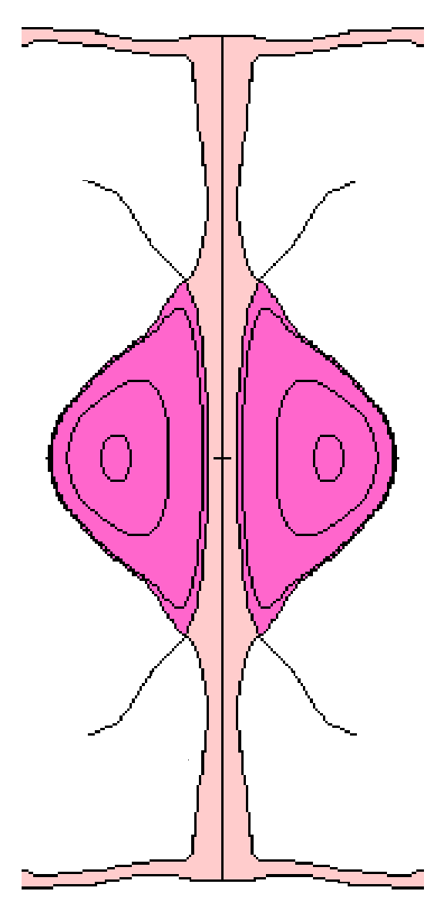
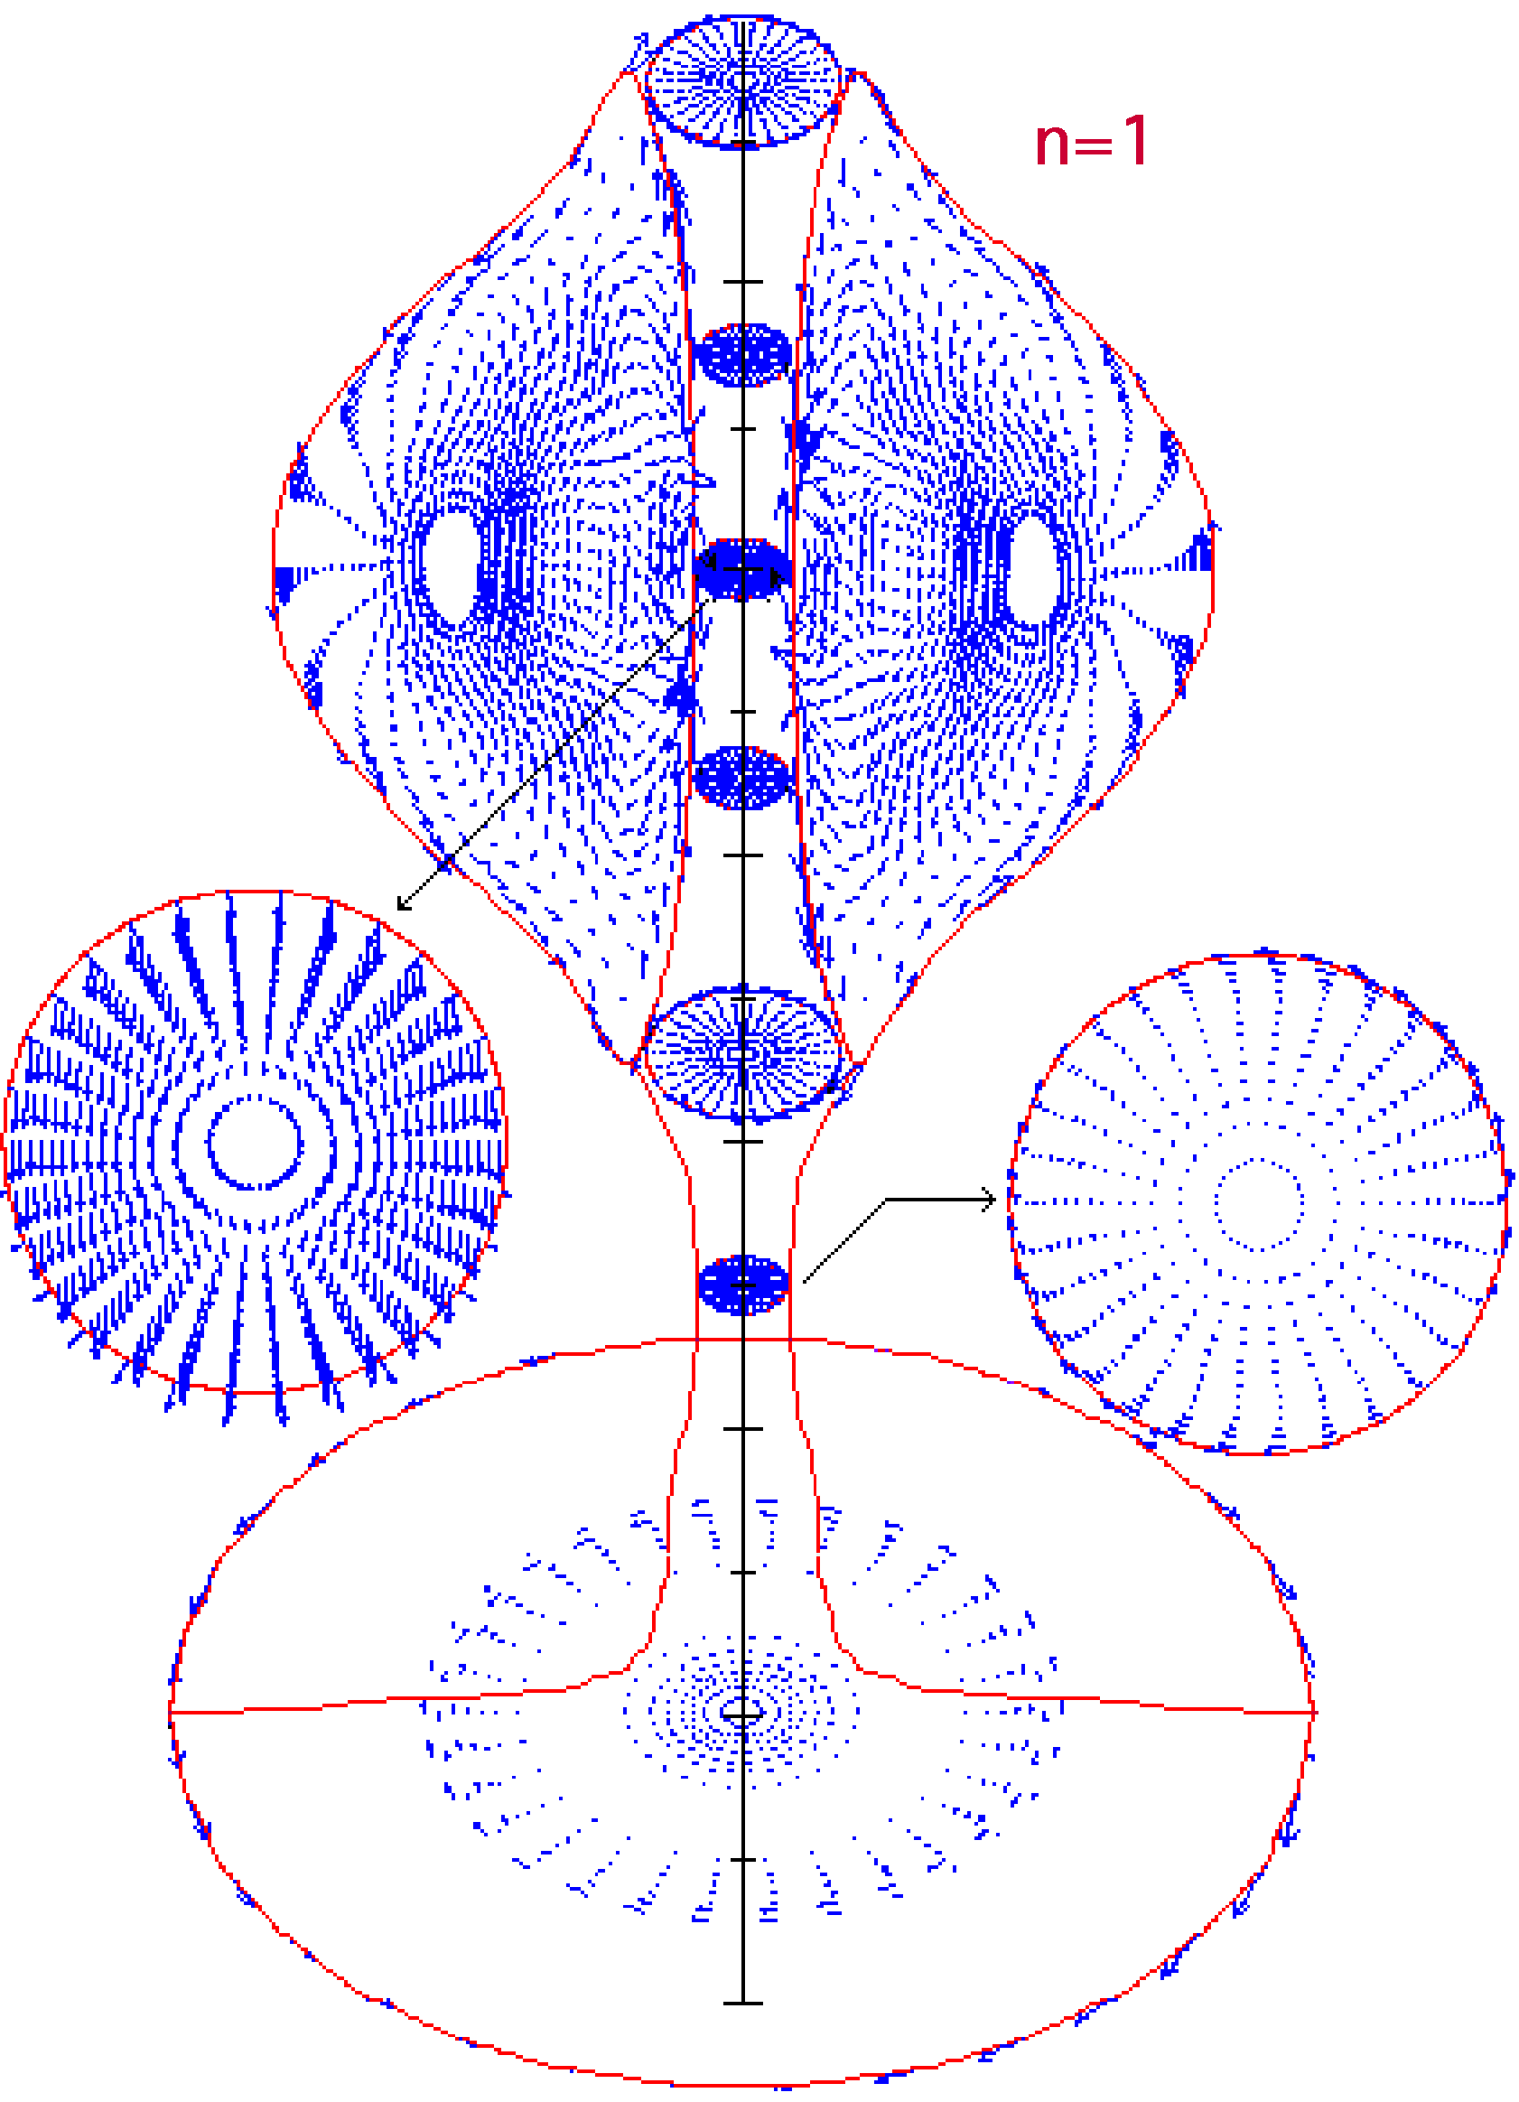
10
Stability results for time slices TF
Screw Pinch drives instability:
ST tilt induced by SP kink
(kink more extended with respect to T6)
With “reference” β_{p}=0.225:
=-1.5•10⁻³
Monothonic q → n=1 stable, n=2 & 3 unstable
Equilibrium parameters:
TF: I_{p}=240 kA, A=1.22, κ=2.2, q₉₅=2.65, q₀=1.04, β=19%
Reversed q → n=1 & 2 unstable, n=3 stable
Equilibrium parameters:
TF: I_{p}=240 kA, A=1.24, κ=2.4, q₉₅=2.89, q₀=1.82, β=23%
I_{p}/I_{e}=4
With “lower” β_{p}=0.12
Monothonic q → n=1,2,3 stable
Equilibrium parameters:
TF: I_{p}=240 kA, A=1.24, κ=2.3, q₉₅=2.55, q₀=1.13, β=16%
With further lowered β_{p}=0.10
Reversed q → n=1,2,3 stable
Equilibrium parameters:
TF: I_{p}=240 kA, A=1.26, κ=2.4, q₉₅=2.55, q₀=1.64, β=14%
Reversed q
Reversed shear profiles less effective in stabilizing SP kink

Slide 11
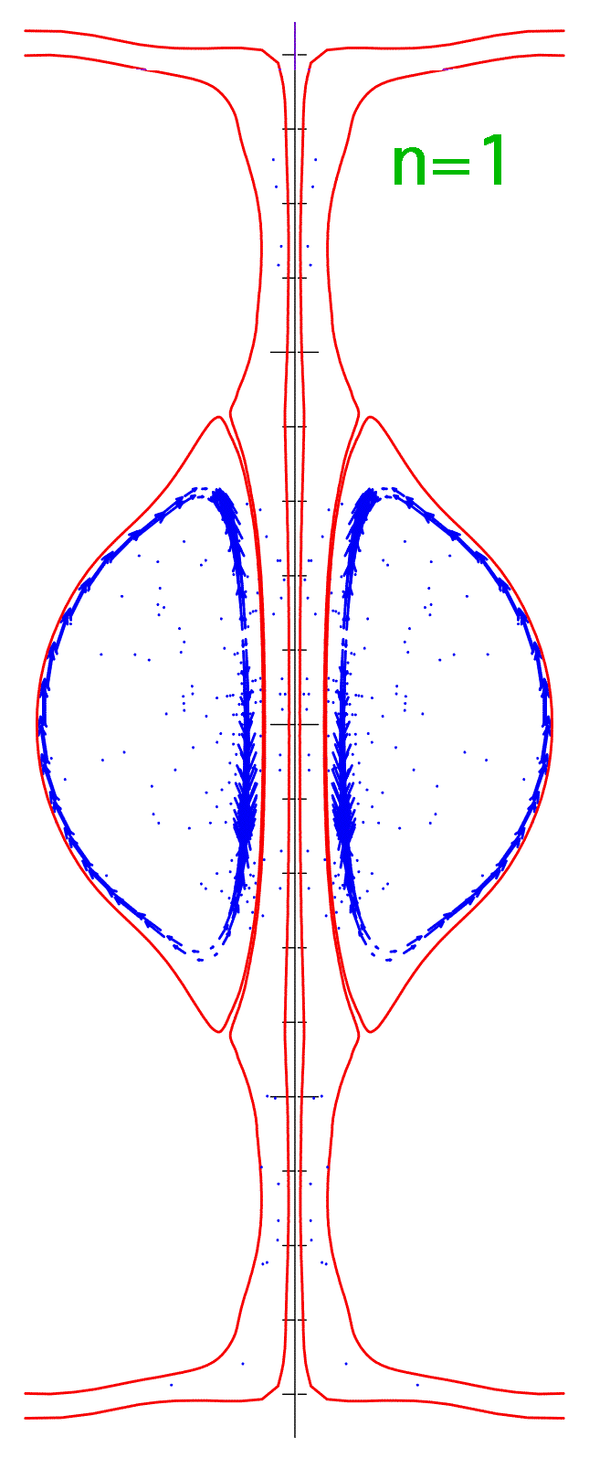
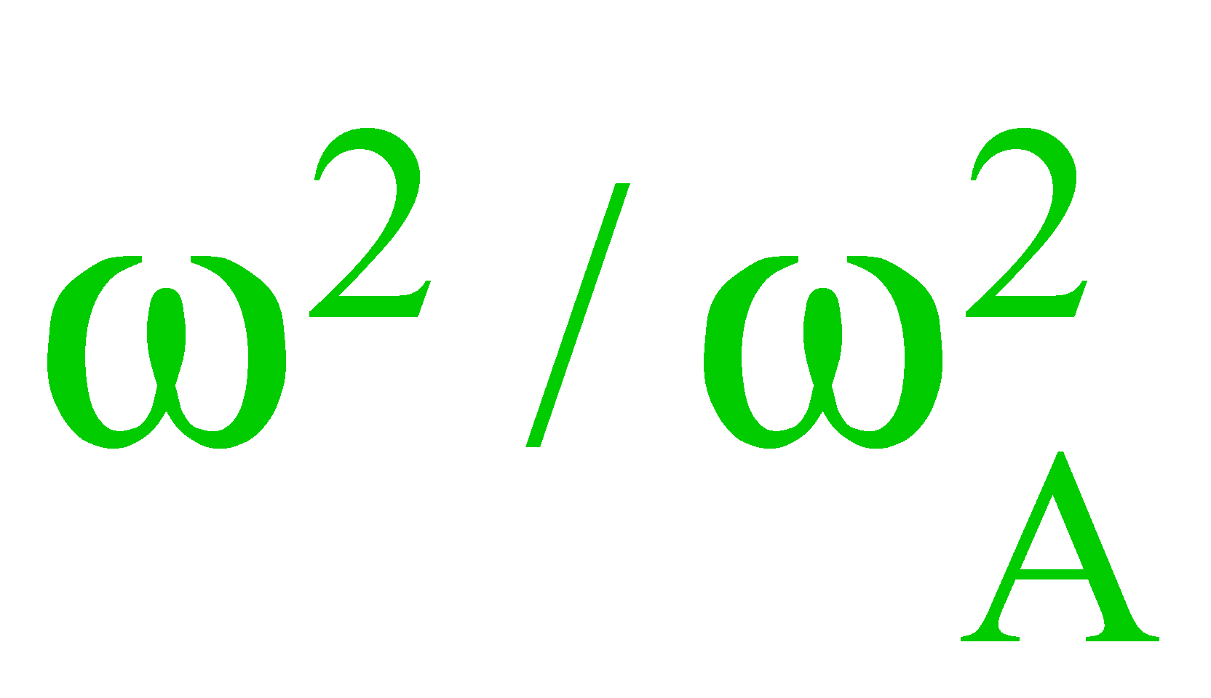
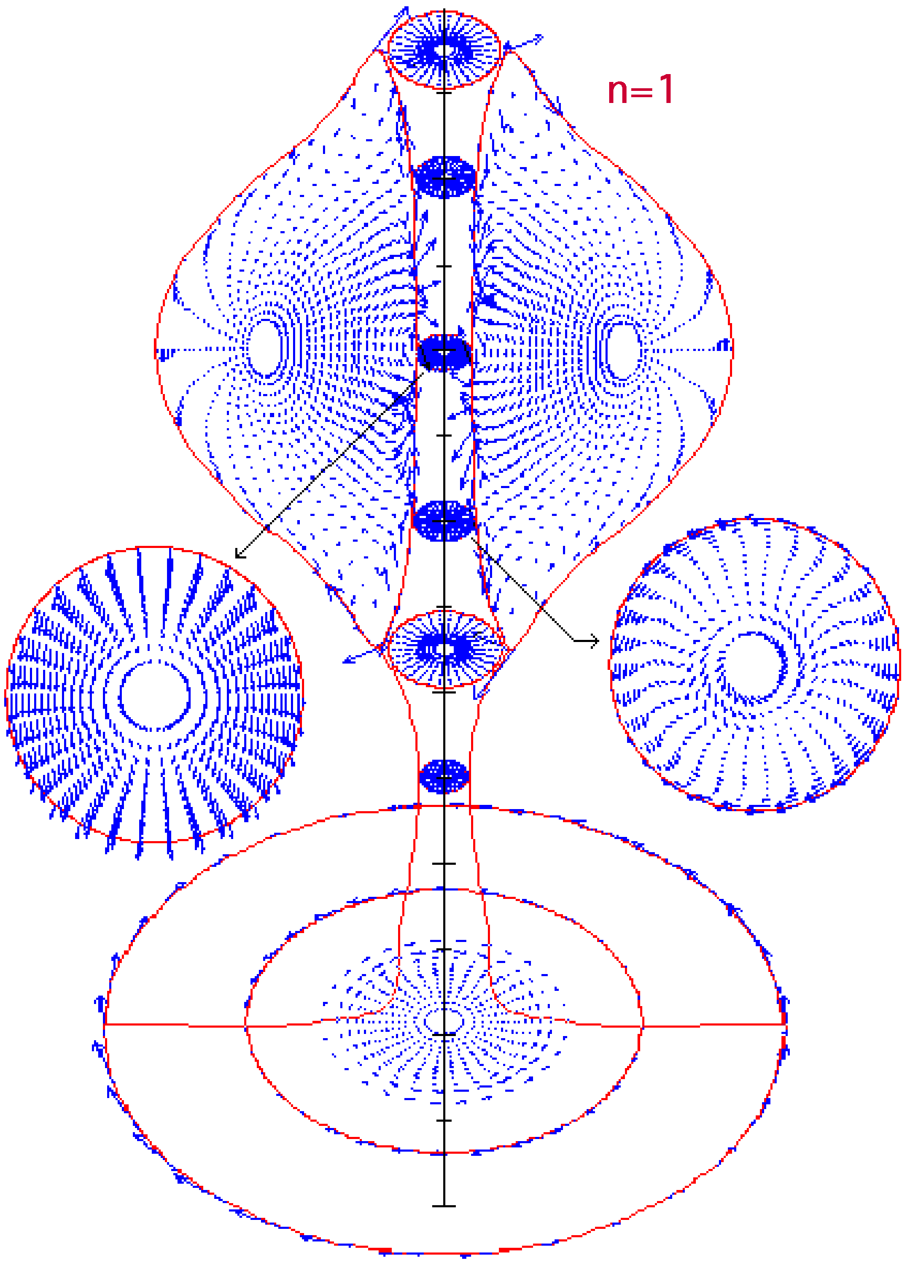
11
Effect of ST elongation on I_{p}/I_{e} limits
>0
PROTO-SPHERA
(b/a≈3)
Stable for n=1,2,3
Equilibrium parameters:
I_{p}=329 kA
I_{e}=60 kA
A=1.23
κ=3.0
q₉₅=2.99, q₀=1.42
β=13%
(monothonic q)
I_{p}/I_{e}=5.5
Increasing κ allow for higher I_{p}/I_{e} ratio
PROTO-SPHERA
(standard b/a)
Unstable for n=1
Stable for n=2 & 3
Equilibrium parameters:
I_{p}=300 kA
I_{e}=60 kA
A=1.20
κ=2.3
q₉₅=2.7, q₀=1.15
β=15%
(monothonic q)
I_{p}/I_{e}=5
=-4.4•10⁻²

Slide 12
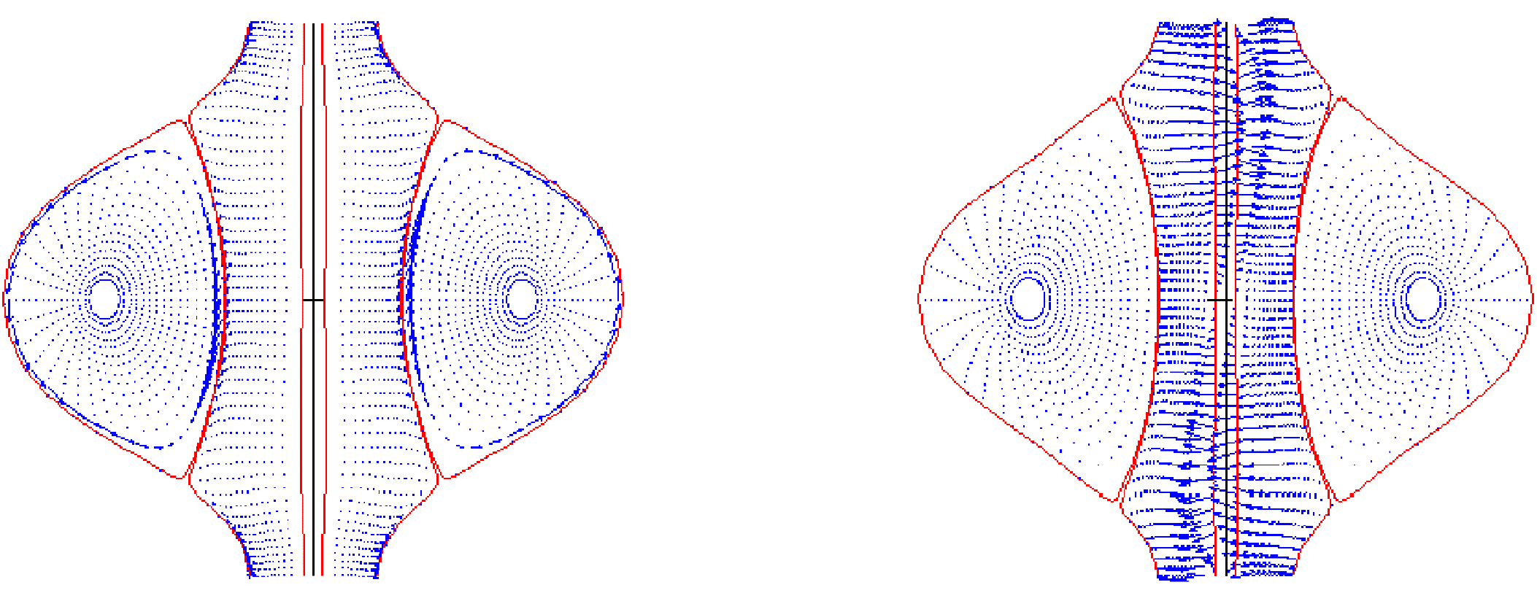
12
Comparison with TS-3 (1)
Tokio Device had:
Simple “linear” electrodes
Oblated Spherical Torus
q<1 all over the ST (Spheromak)
I_{p}=50 kA, I_{e}=40 kA
I_{p}/I_{e}~1 , A~1.8
I_{p}=100 kA, I_{e}=40 kA
I_{p}/I_{e}~2 , A~1.5
n=1
Code confirms
experimental results
n=1
>0
Stable q=1 resonance
Strong SP kink, ST tilt
=-1.05

Slide 13
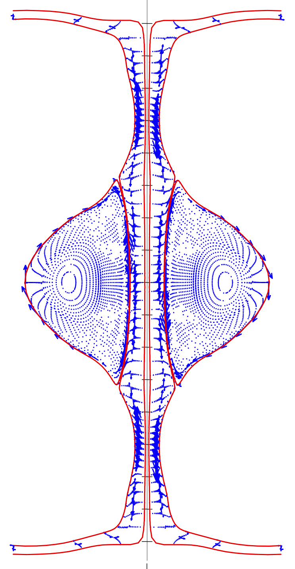
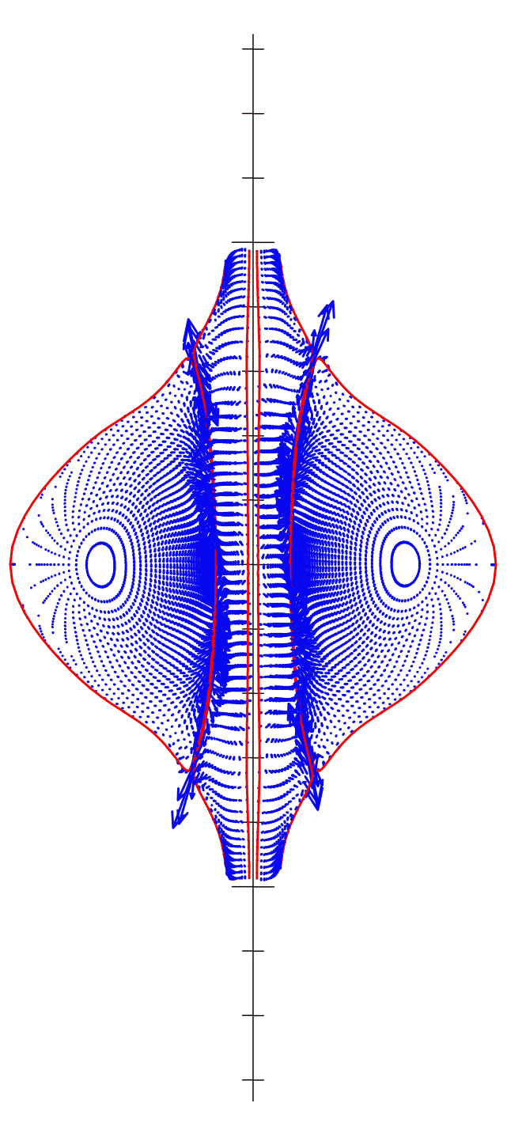
13
Comparison with TS-3 (2)
(effect of the SP shape)
T5 (β=16%)
I_{p}=120 kA, I_{e}=60 kA
I_{p}/I_{e}=2 , A~1.3
T5-cut (β=16%)
I_{p}=120 kA, I_{e}=60 kA
I_{p}/I_{e}=2 , A~1.3
n=1
n=1
If the fully stable T5 is “artificially cut”
to remove degenerate X-points
as well as disk-shaped SP
⇓
Strong n=1 instability appears,
despite higher β & q₉₅
>0
Stable q=3
resonance
Strong SP kink,
ST tilt
=-0.17

Slide 14
14
Conclusions
Ideal MHD stability results for PROTO-SPHERA
•PROTO-SPHERA stable at full β 21÷26% for I_{p}/I_{e}=0.5 & 1, down to 14÷16% for I_{p}/I_{e}=4
(depending upon profiles inside the ST)
Comparison with the conventional Spherical Tokamak with central rod:
β_{T0}=28÷29% for I_{p}/I_{e}=0.5 to β_{T0}=72÷84% for I_{p}/I_{e}=4
•Spherical Torus dominates instabilitiy up to I_{p}/I_{e}≈3; beyond this level of I_{p}/I_{e},
dominant instability is the SP kink (that gives rise to ST tilt motion)
• Spherical Torus elongation κ plays a key role in increasing I_{p}/I_{e}
• Comparison with TS-3 experimental results:
disk-shaped Screw Pinch plasma important for the configuration stability
Ideal MHD stability of Flux Core Spherical Torus rather insensitive to internal ST profiles
⇒ configuration quite robust from an ideal point of view
Resistive instabilities behaviour is the main experimental point of PROTO-SPHERA

