Slide 1

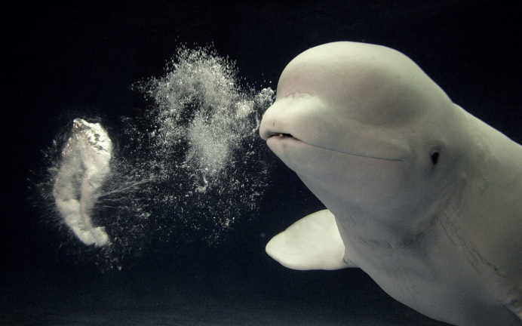
First results of plasma centerpost in PROTO-SPHERA
F. Alladio¹, L. Boncagni, F. Causa, E. Giovannozzi, A. Grosso, A. Lampasi, G. Maffia,
A. Mancuso^{retired}, P. Micozzi, V. Piergotti, G. Rocchi, A. Sibio, B. Tilia, V. Zanza^{retired}
Centro Ricerche ENEA, Frascati C.P. 65, Rome, Italy ¹e-mail: franco.alladio@enea.it

Slide 2
Summary
History of construction of PROTO-SPHERA
Cylindrical anode experiments (2014)
Annular anode experiments (2015)
Absence of anode attachment due to electrostatic potential
Tailoring of electrostatic potential by connecting PF coils casings, built as floating
Tailoring of magnetic field through additional PF coils external to the vessel
Conclusions

Slide 3
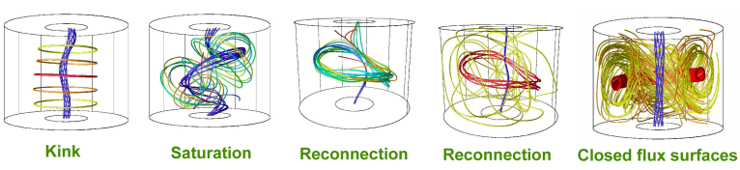
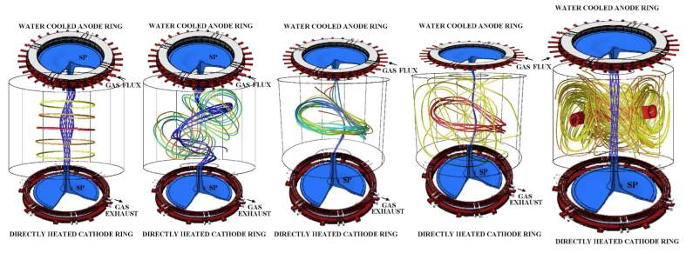
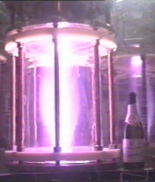
PROTO-SPHERA aim
A spherical tokamak with metal centerpost replaced by a plasma centerpost:
anode and cathode needed for setting up the configuration
Present stage
Next stage
2.5 m
vessel
Plasma current 10 kA
in centerpost, no torus
Plasma current 60 kA in centerpost,
240 kA in spherical torus
Experiments began in 2014 on plasma centerpost only; aim is 10 kA, 1 s
Years 1995 - 2002: Idea & design Years 1997 - 2000: Test of electrodes
1995 - 2nd ST Workshop Princeton in “Champagne bottle experiment”
2002 - International Workshop Frascati (late Derek Robinson, Prague EPS98)

Slide 4
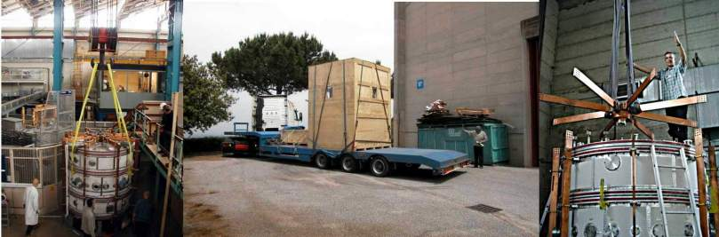
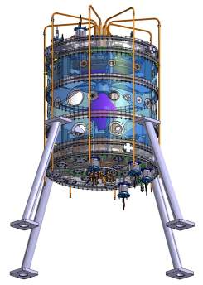
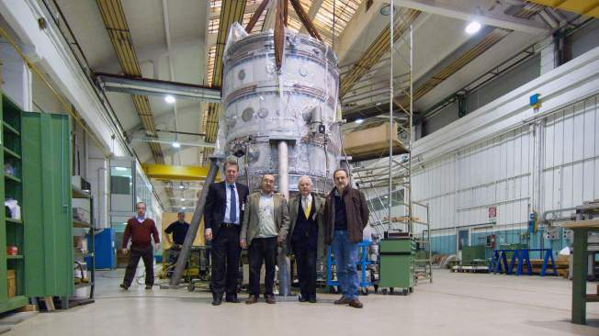
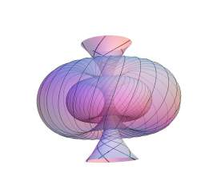
Cylindrical vacuum vessel was START vacuum vessel, donated by Culham in 2004
PROTO-SPHERA was built (2006-2009) by ASG Superconductors of Genoa, cost 1 M€.
Years 2004 - 2010:
…from ideas …to detailed design …to hard metal

Slide 5
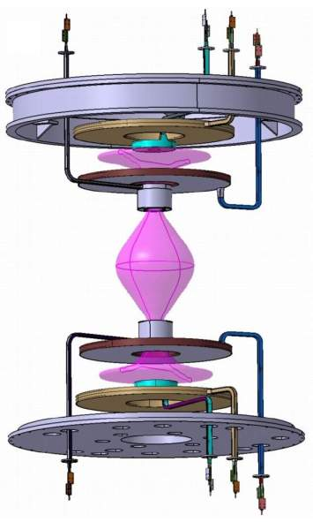
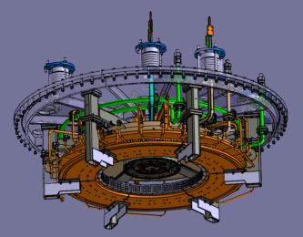
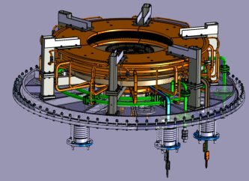
Only the PF coils necessary for setting up
the plasma centerpost have been built
annular anode
8 PF coils in series
inside the machine
Stainless steel up\down
new extensions
PF4up
PF3up
PF2up
anode
Aluminium cylindrical
START vessel
plasma current must run
through both PF2 throttles
PF2low
PF3low
cathode
PF4low
Stainless steel up\down new lids
annular cathode
vacuum vessel is GND potential
PF coils casings built as floating, can be connected to potentials: anode +, cathode -, vessel 0

Slide 6
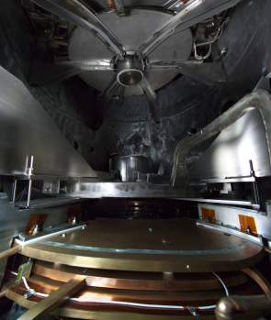
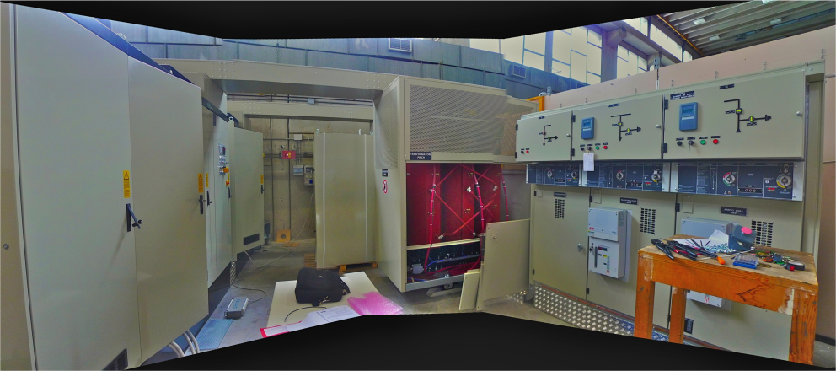
Anode
PF coils
Cathode
To fire the plasma centerpost
3 Power supplies are required
• Cathode heating, rotating 6-phase: 6 x(1.7 kA,25 V)rms
• PF coils: 2kA, 350 V
• Plasma centerpost: 10 kA, 350 V
Electrical power supplies built by EEI of Vicenza, cost 0.7 M€
Years 2011 - 2014:

Slide 7
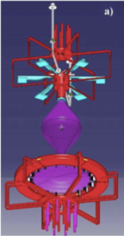
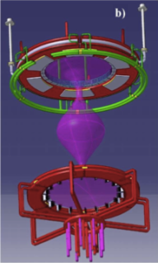
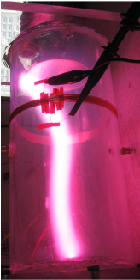
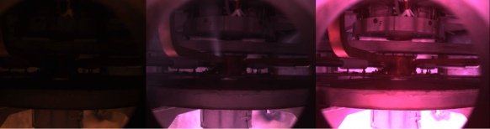
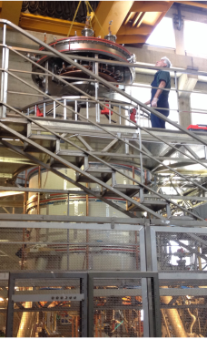
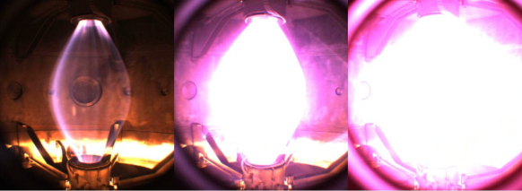
2014 cylindrical anode
2015 annular anode
Being afraid of anode attachment,
often observed in arc discharges
(arc welding, plasma torches)
the first rounds of experiments
had a simple cylindrical anode
break-down was easily achieved,
apart from this the cylidrical anode was just a source of troubles
cylindrical cathode results
Hydrogen plasma
break-down 170 V +10 ms, 500 A +20 ms, 1.5 kA
anode camera
centerpost camera
May 2015 annular
anode lowered
on top of machine

Slide 8
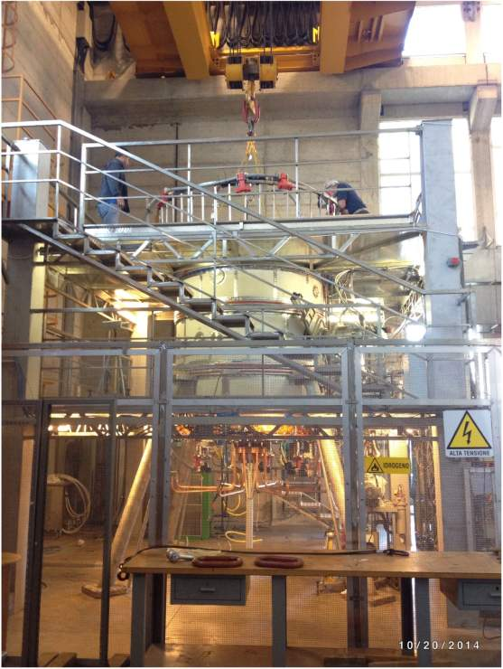
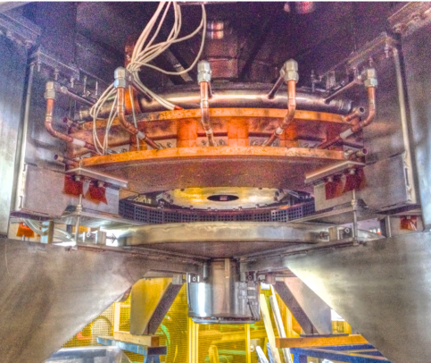
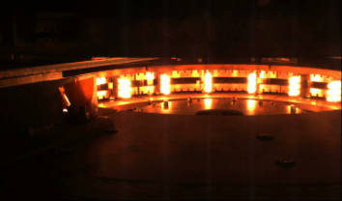
up: hollow gas-puffed anode
down: 3000º K heated cathode
present stage cathode
(18 x 3 emitters): aim 10 kA
final stage cathode, 6 x present
(108 x 3 emitters): aim 60 kA
PROTO-SPHERA CR-ENEA Frascati
“Caduceus”-like emitting spirals
have survived ~ 1000 cycles

Slide 9
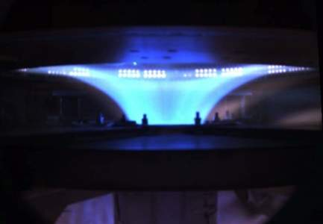
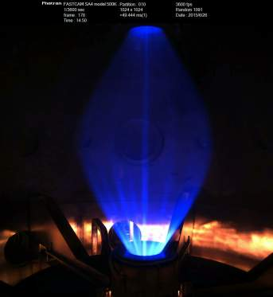
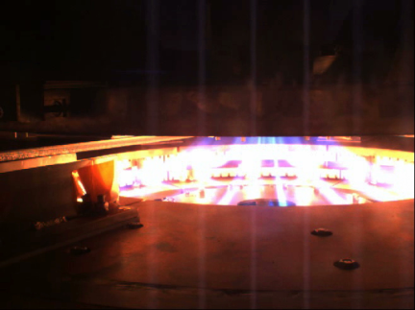
hollow annular anode performs
• plasma goes through both PF2 throttles
• plasma enters anode gas-puffing holes
• no sign (I < 3.5 kA) of anode attachment
• filling pressure 10⁻³ - 10⁻² mbar
Argon plasma: break-down 80 V
annular anode plasma is never filamented
anode
camera
cathode
camera
whereas annular catode plasma (sparse emitters)
and even plasma centerpost are filamented

Slide 10
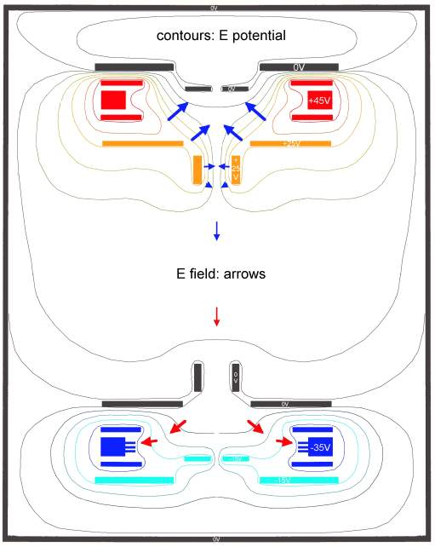
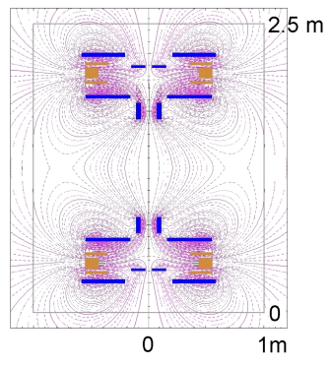
Electrostatic plasma effects
vacuum vessel at GND
PF coil casings can either be
at floating potential or can be connected to:
anode +, cathode -, vessel 0
through ~ 1 Ω resistors
but the electric potential distribution
is dominated by the plasma
PF2\3up to anode (1 Ω)\PF4up cathode (10 Ω)
V_{PF4up} ~ 0 V
V_{anode} ~ +45 V
V_{PF2-3up} ~ +25 V
V_{vessel} = 0 V (ground)
V_{PF2-3low} ~ 0 V
V_{cathode} ~ -35 V
V_{PF4low} ~ -15 V
distribution of electric potential is not up-down symmetric: near both anode and cathode the uppermost PF coil casings is at GND
PF2\3low to GND (1 Ω)\PF4low cathode (0.5 Ω)

Slide 11
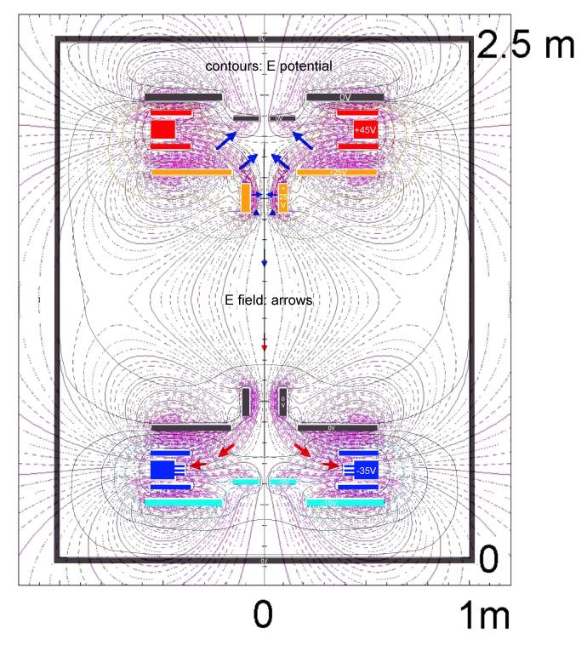
plasma-induced electric potential
near the annular anode :
E-field is perpendicular to B-field
…E x B azimuthal plasma rotation
…starting from PF2up throttle
v_{ExB}=(E/B) ~ 10⁴ m/s ~ v_{drift} ~ v_{thi}
plasma-induced electric potential
near the annular cathode:
E-field is parallel to B-field
…no E x B plasma rotation
self-organization at work inside
annular electrodes plasma…

Slide 12
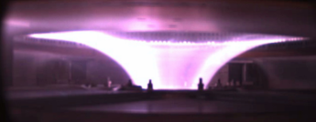
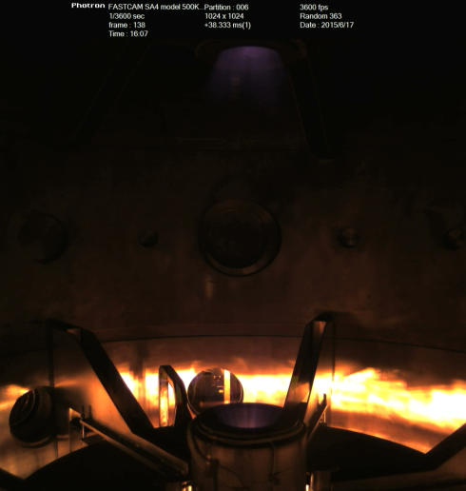
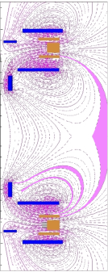
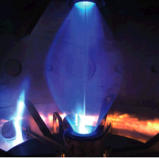
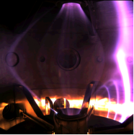
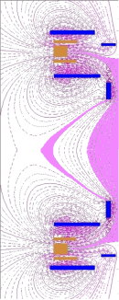
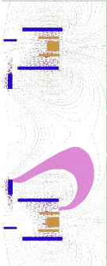
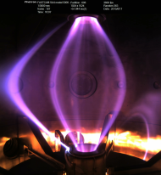
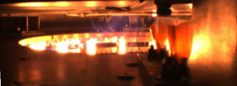
May 2015 annular anode experiment
half of the plasma current: (1kA\2kA)
was going around the required path due to
equatorial X-point inside the vessel
Argon plasma
Hydrogen plasma
Shot 78
discharges along field lines near X-point

Slide 13
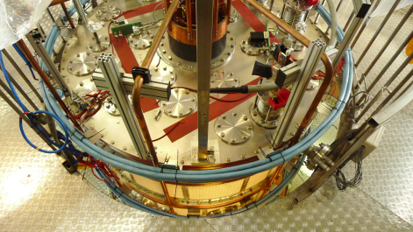
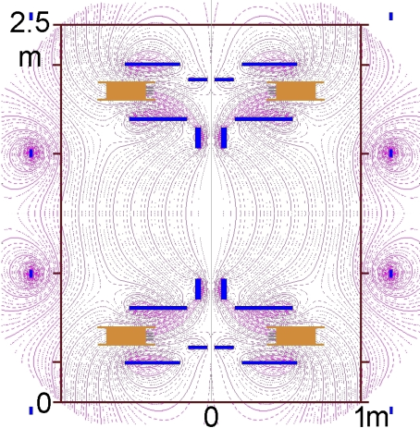
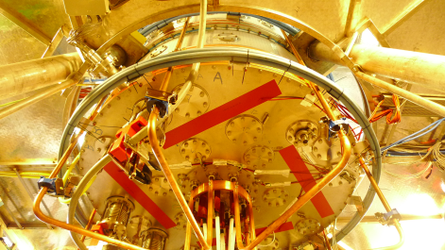
The equatorial X –point has been removed from inside the vessel
4 external PF coils have been added (home-made from spare connection cables)
…and fed in series with the internal PF coils (PF coils power supply has sufficient margin)
4 additional external PF coils
plasma fired after 0.75 s of PF current to allow for skin currente diffusion in Al vessel and SS lids

Slide 14

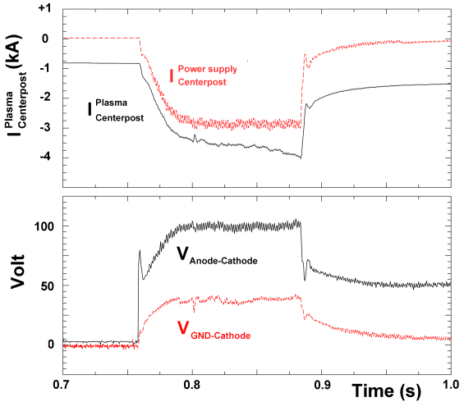
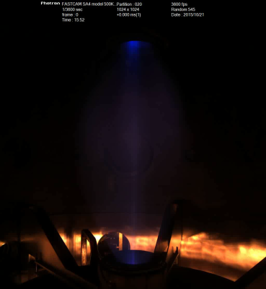
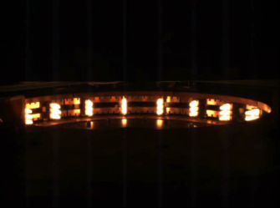
October 2015 experiments with external PF:
Argon discharge reaching 3 kA for 0.15 s
the whole plasma current runs through both PF2 throttles
Shot 205
plasma fired after 0.75 s of PF current
(skin current time to remove X-point from inside vessel)

Slide 15
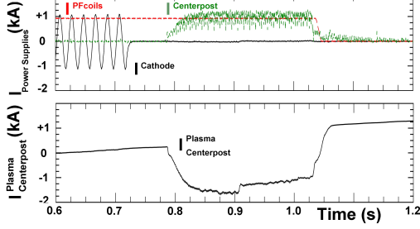
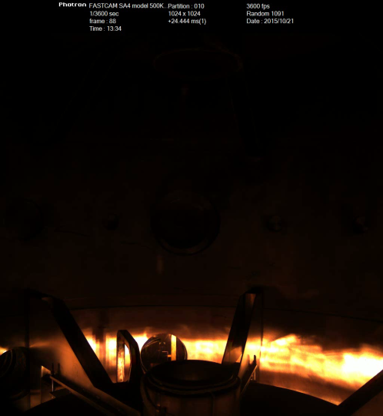
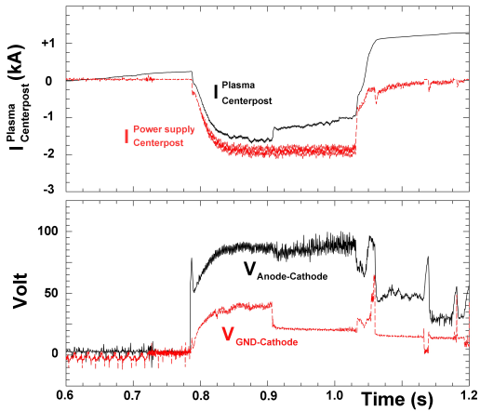
cathode is switched off < 0.1 s before plasma current
October 2015, external PF
Argon discharge sustained at 2 kA for ~ 0.3 s
Plasma fired after 0.75 s of PF current
Shot 197
however equatorial hot spots appear and a few
hundreds Ampere are lost from main plasma

Slide 16

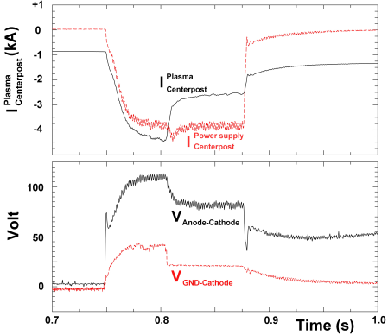
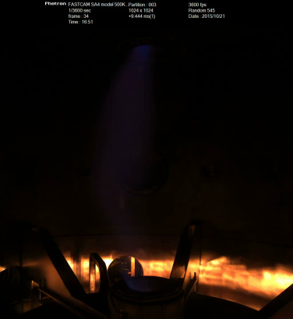
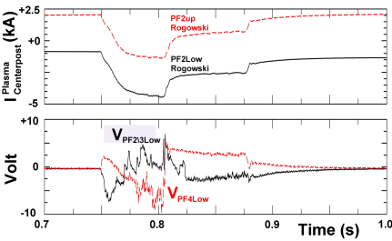
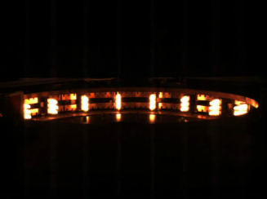
Plasma current outer paths for I > 3 kA
Argon plasma
aiming to 4 kA
reaches 3.5 kA
~ 1.5 kA lost
from main plasma
in discharge from
cathode down to
lid\vessel
Shot 208
plasma current
lost on both
PF2 throttles
10 V spikes appearing on floating voltages on lower PF coils
are associated with plasma current outer path

Slide 17


Removal of equatorial hot spots through straighter grounding of low PF coils
Argon discharge at 2 kA
to avoid voltage spikes on low PF coils
PF2\3low + PF4low connected to GND
through much smaller (16 mΩ) resistors
Shot 222
Equatorial hot spot eliminated, voltage spikes have been reduced to 1 V amplitude on PF2/3low
only small sparks from PF2/3low remain in correspondence to 1V PF2/3low spikes

Slide 18




Magnetic tayloring in order to have a better filling of electrodes
when plasma current takes outer path cathode seems less emitting
plasma current 3.5 kA
plasma current 2kA, 1.5 kA lost
Shot 208
current flows only in external PF near equator
cathode seems better filled at all times
Shot 227

Slide 19


Straighter grounding of lower PF coils and better filling of cathode
flowing current only in the two external PF coils nearer to equator
voltage spikes have been eliminated on PF2/3low,
after 1 V amplitude jump even small sparks vanish
voltage jump does not lose plasma current
very quiet plasma at 2 kA after voltage jump
Argon discharge at 2 kA
Shot 227

Slide 20
Conclusions
20 years after 2nd ST Workshop – Princeton (1995) the “aggressive proposal” PROTO-SPHERA
is producing its first centerpost plasmas …better late than never! …迟到总比不到好！
Hollow anode surprise, no anode arc attachment (electrostatic potential, E x B plasma rotation)
(1/3) of the due current (10 kA) achieved, 3 kA sustained in Argon plasma
To achieve full current of 10 kA requires patient learning of how to tailor boundary conditions:
• electrostatic potential by connecting PF coils casings, built floating with respect to the vessel
• magnetic field by additional coils external to the vessel
After Argon centerpost is tamed (80 V breakdown), start fight with Hydrogen centerpost (180 V)
If full current of plasma centerpost(10 kA) is achieved and sustained with 54 sparcely spaced
emitting filaments, then full current (60 kA) will be even better achieved with 324 filaments
First stage of PROTO-SPHERA is only an appetizer for the production of the Spherical Torus
…放龙入海! …give a chance to the dragon to show his endowments into the sea!

