Slide 1
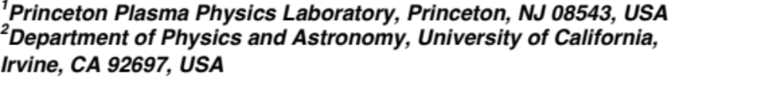
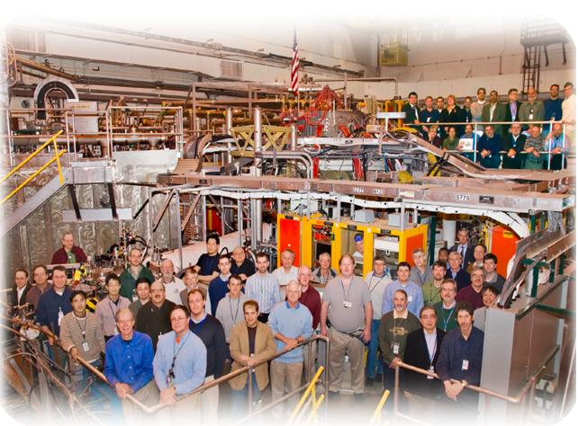
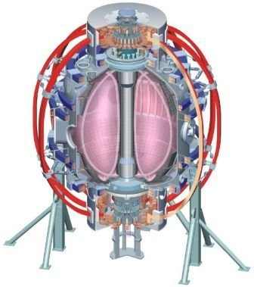
NSTX
Supported by
Implementation of a 3D halo neutral model in the TRANSP code and application to projected NSTX-U plasmas
College W&M
Colorado Sch Mines
Columbia U
CompX
General Atomics
INEL
Johns Hopkins U
LANL
LLNL
Lodestar
MIT
Nova Photonics
New York U
Old Dominion U
ORNL
PPPL
PSI
Princeton U
Purdue U
SNL
Think Tank, Inc.
UC Davis
UC Irvine
UCLA
UCSD
U Colorado
U Illinois
U Maryland
U Rochester
U Washington
U Wisconsin
S. S. Medley¹, D. Liu², M. V. Gorelenkova¹,
W. W. Heidbrink², L. Stagner²
Culham Sci Ctr
U St. Andrews
York U
Chubu U
Fukui U
Hiroshima U
Hyogo U
Kyoto U
Kyushu U
Kyushu Tokai U
NIFS
Niigata U
U Tokyo
JAEA
Hebrew U
Ioffe Inst
RRC Kurchatov Inst
TRINITI
KBSI
KAIST
POSTECH
ASIPP
ENEA, Frascati
CEA, Cadarache
IPP, Jülich
IPP, Garching
ASCR, Czech Rep
U Quebec
18th International ST Workshop
November 3 - 6, 2015
Princeton NJ

Slide 2
Abstract
Implementation of a 3D halo neutral model in the TRANSP code and application to projected NSTX-U plasmas, S.S. Medley, D. Liu, M.V. Gorelenkova, W.W. Heidbrink and L. Stagner
A 3D halo neutral code developed at the Princeton Plasma Physics Laboratory and implemented for analysis using the TRANSP code is applied to projected National Spherical Torus eXperiment-Upgrade (NSTX-U plasmas). The legacy TRANSP code did not handle halo neutrals properly since they were distributed over the plasma volume rather than remaining in the vicinity of the neutral beam footprint as is actually the case. The 3D halo neutral code uses a “beam-in-a-box” model that encompasses both injected beam neutrals and resulting halo neutrals. Upon deposition by charge exchange, a subset of the full, one-half and one-third beam energy components produce first generation halo neutrals that are tracked through successive generations until an ionization event occurs or the descendant halos exit the box. The 3D halo neutral model and Neutral Particle Analyzer (NPA) simulator in the TRANSP code have been benchmarked with the Fast-Ion D-Alpha simulation (FIDAsim) code, which provides Monte-Carlo simulations of beam neutral injection, attenuation, halo generation, halo spatial diffusion, and photoemission processes. When using the same atomic physics database, TRANSP and FIDAsim simulations get excellent agreement on the spatial profile and magnitude of beam and halo neutral densities and the NPA energy spectrum. The simulations show that the halo neutral density can be comparable to the beam neutral density. These halo neutrals can double the NPA flux, but they have minor effects on the NPA energy spectrum shape. The TRANSP and FIDAsim simulations also suggest that the magnitudes of beam and halo neutral densities are relatively sensitive to the choice of the atomic physics databases.

Slide 3
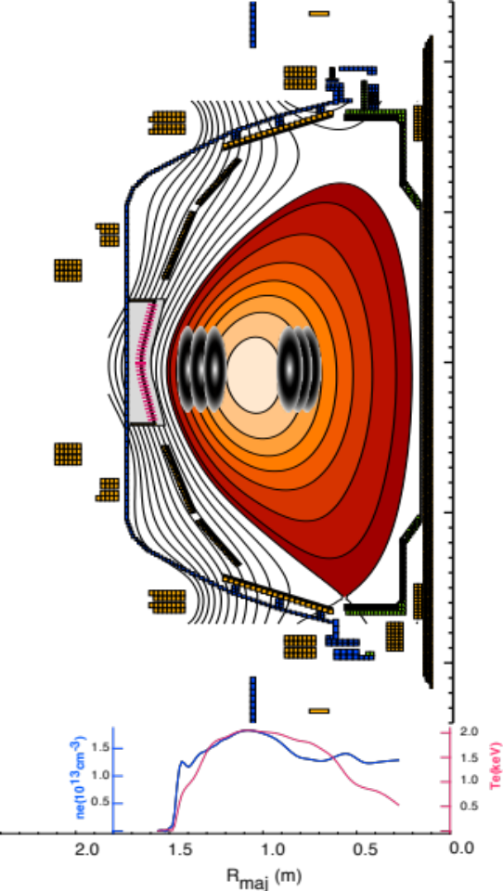
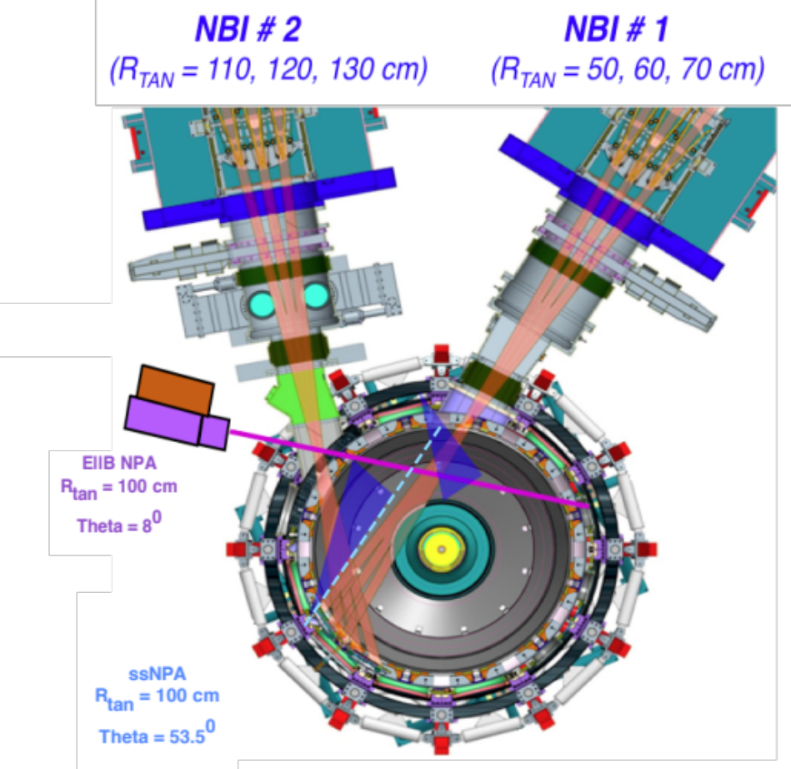
Arrangement of the NPA Sightlines on NSTX-U
• The solid-state Neutral Particle Analyzer (ssNPA) diagnostics (blue arrays) view across both NBI #1 and NBI #2 in the horizontal midplane. Both of the sightlines measure predominantly passing energetic ions. .

Slide 4
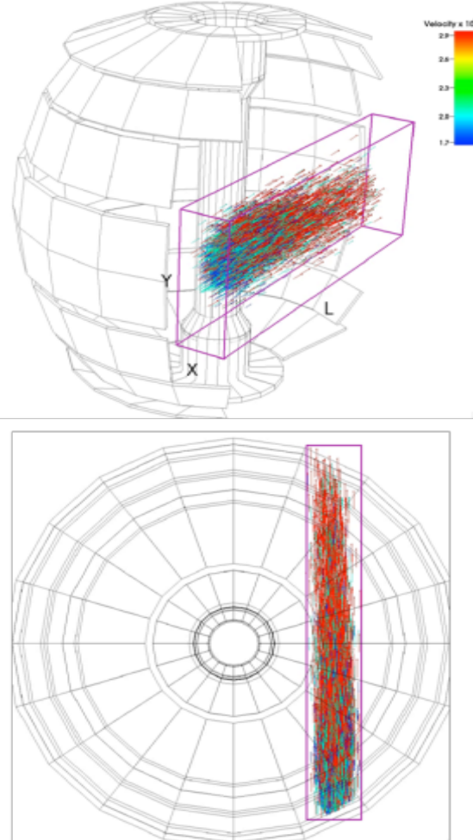
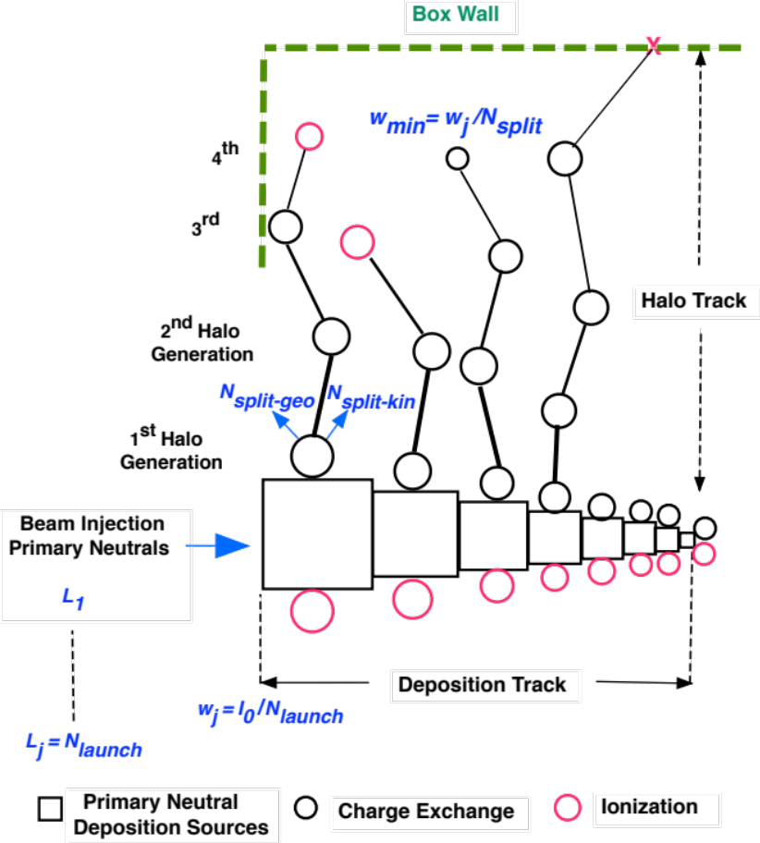
Illustration of “beam-in-box” model for the
TRANSP 3D halo neutral code
Note only beam primary neutrals are shown.
Schematic of the 3D halo neutral generation process

Slide 5
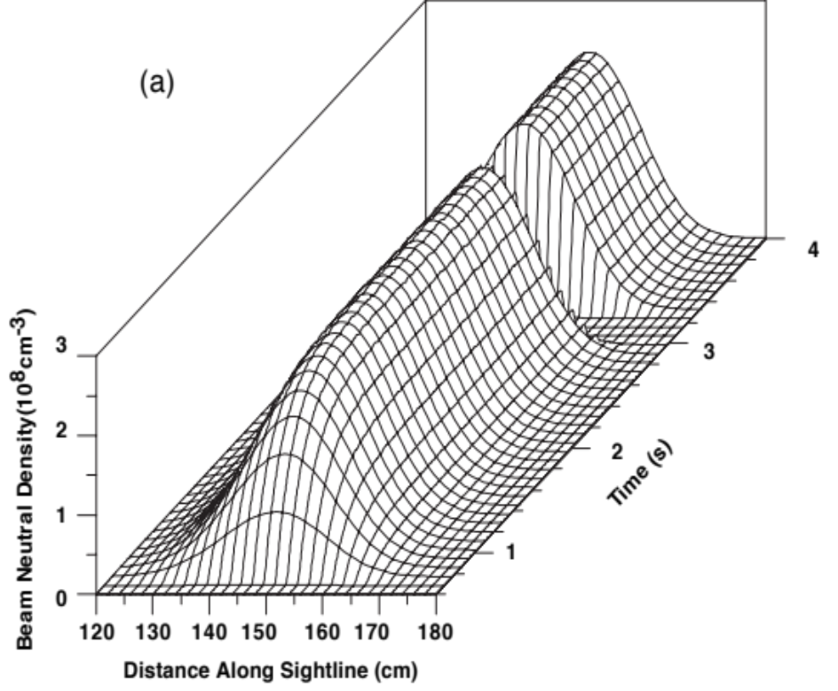
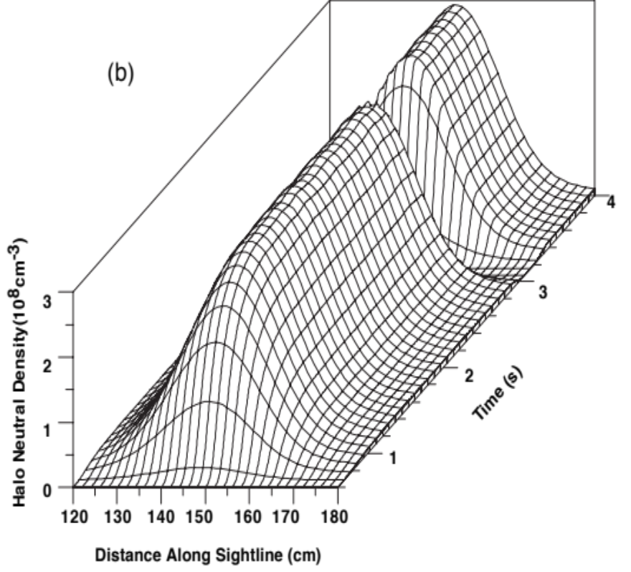
Injected beam neutral density (a) and halo neutral density (b) as a function of distance along the E||B NPA sightline

Slide 6
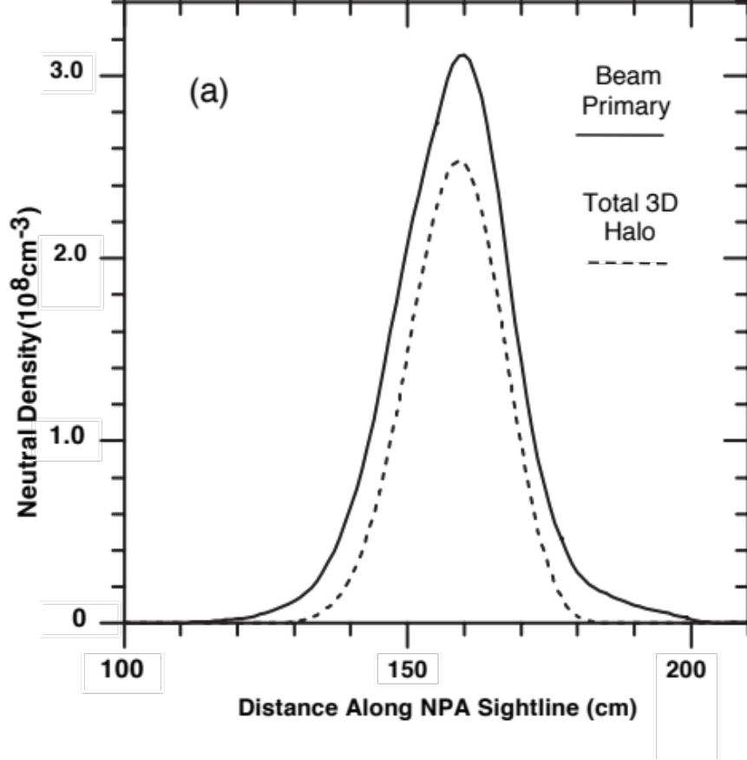
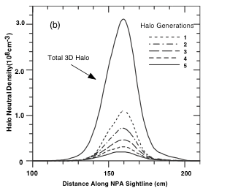
Beam primary and 3D halo neutral density profiles
• Comparison of beam primary and total halo neutral densities (a) and the composition of the halo neutral density over multiple generations (b) along the E||B NPA sightline.

Slide 7
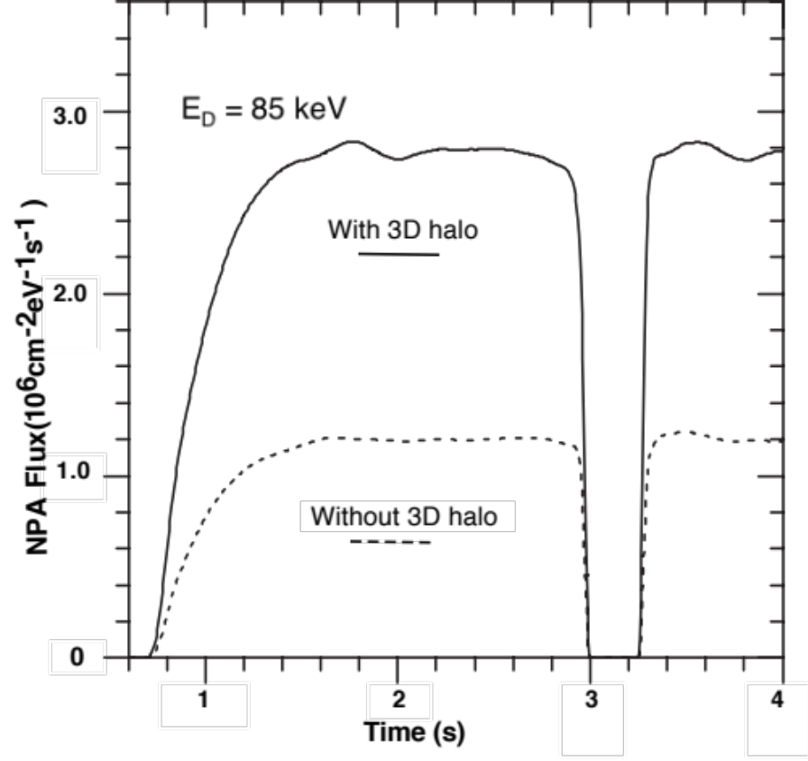
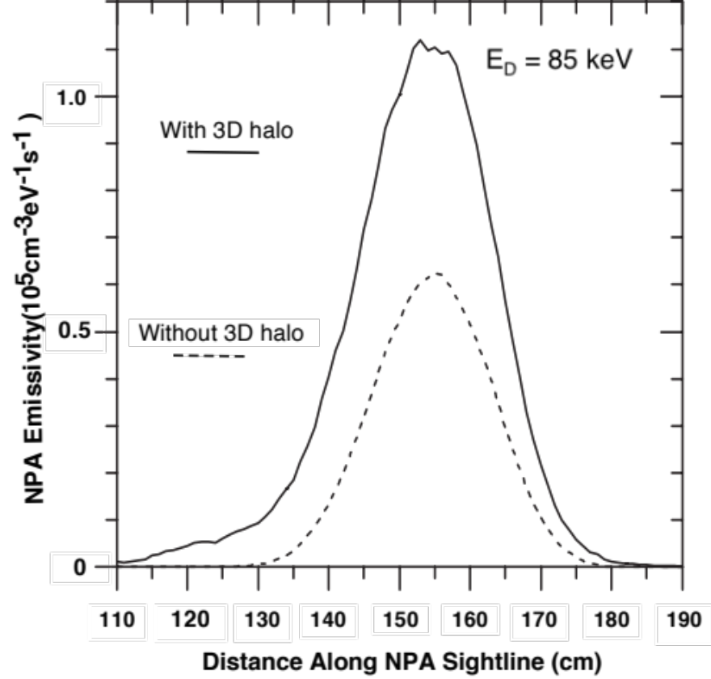
Comparison of E||B NPA signals with and without 3D halo neutrals.
•Comparison of the charge exchange neutral flux time evolution
•Comparison of the charge exchange neutral emissivity along the NPA sightline
Notes:
Note absence of slowing down buildup in this case.

Slide 8
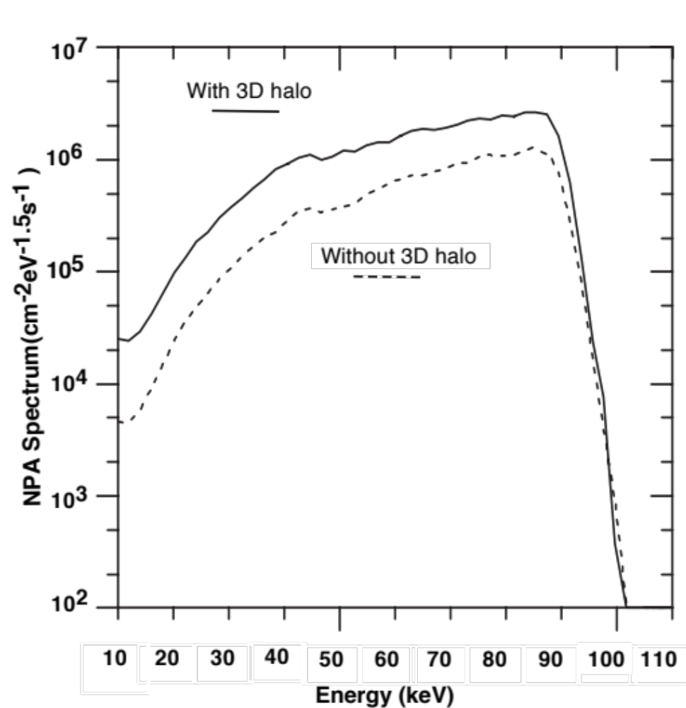
Comparison of the charge exchange energy spectra for the E||B NPA sightline with and without 3D halo neutrals
Notes:
It is interesting that the HEF peak ‘saturates’ quickly, but slowing down evolves on a long time scale. Could it be that a ‘bottleneck’ occurs where the supply of HEF ions is limited and the slowing down evolves slowly
as ions make it through the bottleneck.

Slide 9
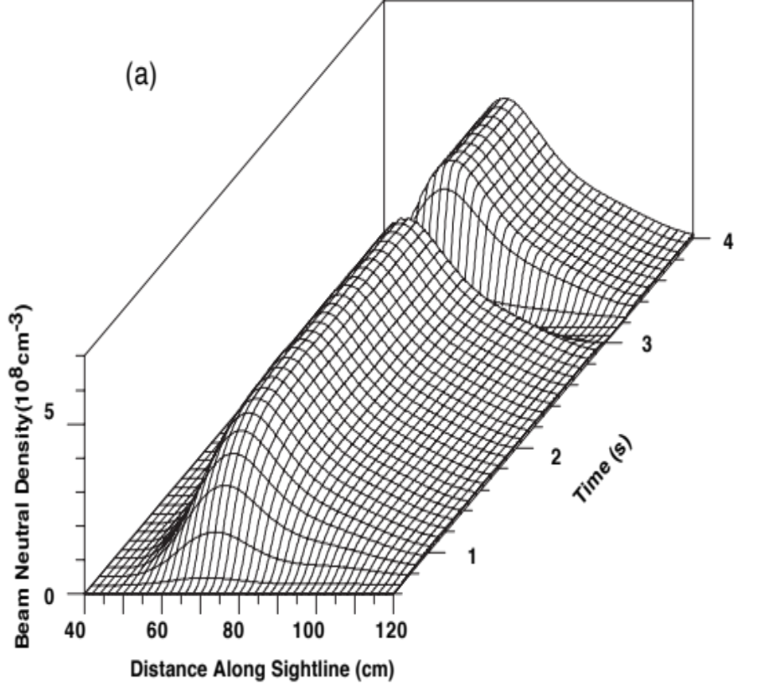
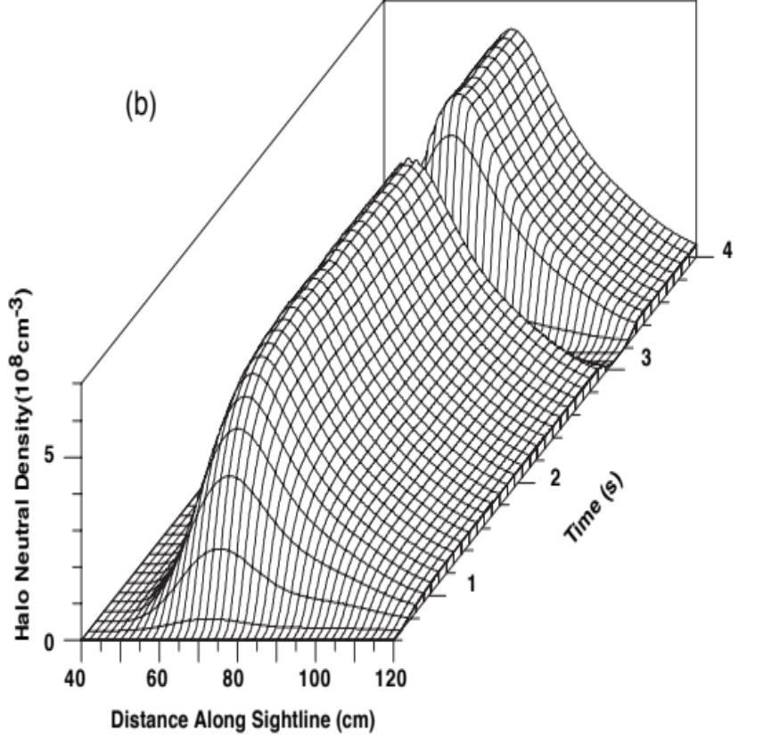
Injected beam neutral density (a) and halo neutral density (b) as a function of distance along the ssNPA NPA sightline

Slide 10
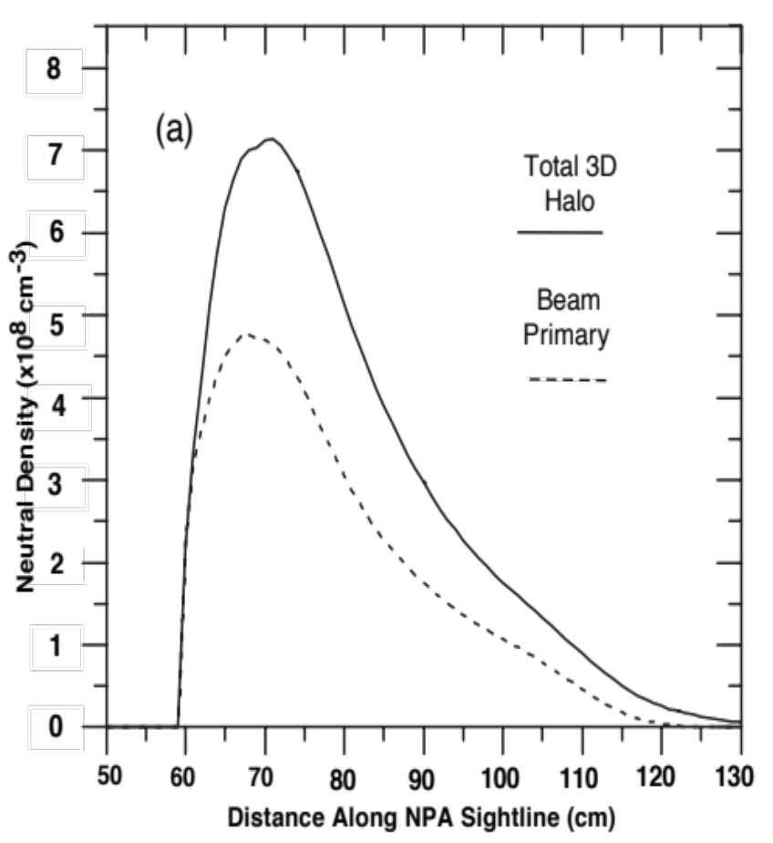
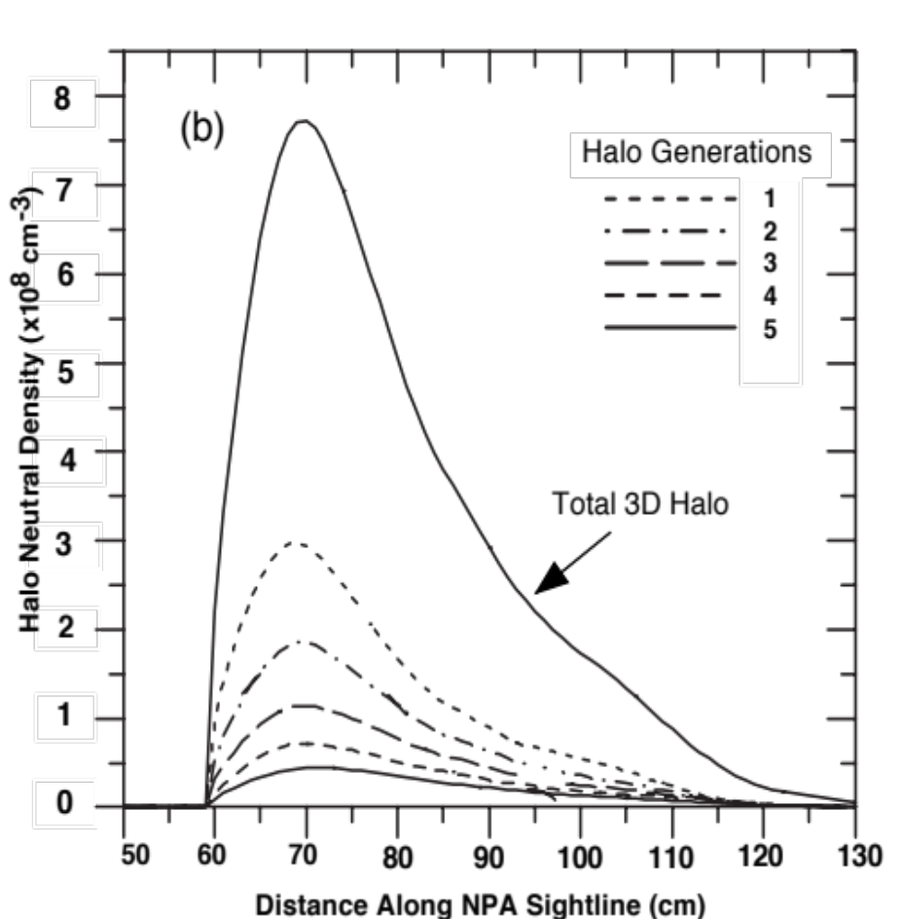
Beam primary and 3D halo neutral density profiles
• Comparison of beam primary and total halo neutral densities (a) and the composition of the halo neutral density over multiple generations (b) along the ssNPA sightline.
Notes:
TAE/Kink existence is based on NSTX Mirnov mode spectrogram wall display. In fact, TAEs do exist below some δB ~ 40 mGauss. MPTS and CHERS measurements are at R ~ 132 cm. The CHERS changes occur on the same time scale as the HRF:I.e. the profile changes do not precede or “cause” the HEF.

Slide 11
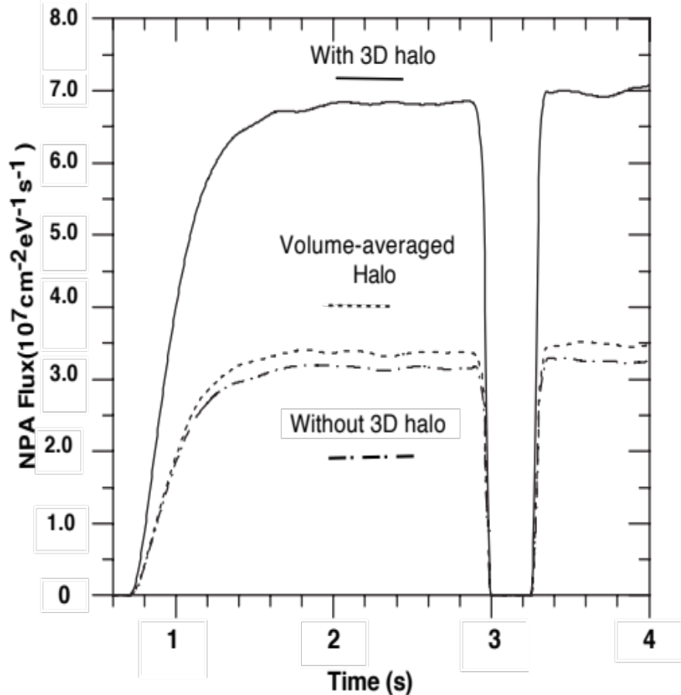
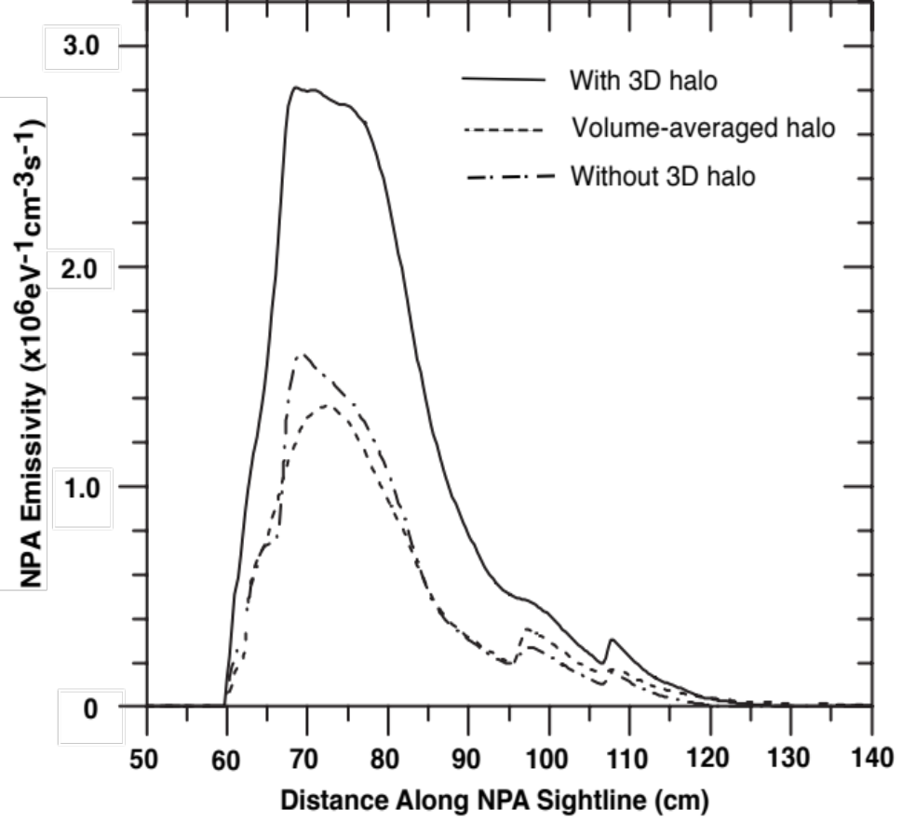
Comparison of ssNPA signals with and without 3D halo neutrals.
•Comparison of the charge exchange neutral flux time evolution
•Comparison of the charge exchange neutral emissivity along the NPA sightline
Notes:
The flux increase for 132800 is ~ 100 counts which is ~ 10x typical.

Slide 12
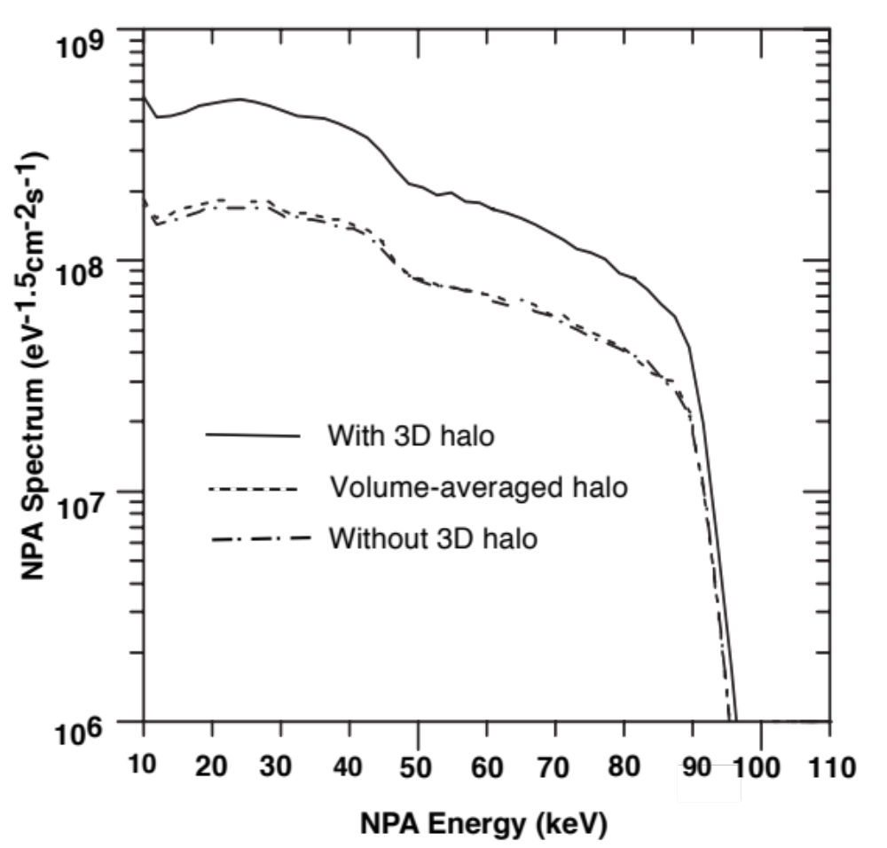
Comparison of the charge exchange energy spectra for the ssNPA sightline with and without 3D halo neutrals

Slide 13
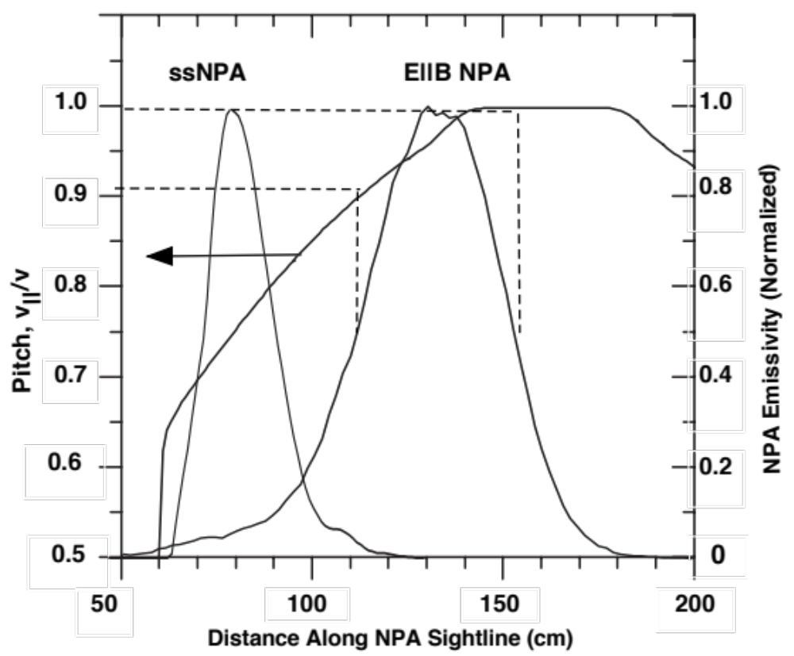
Comparison of particle pitch, v||/v, for the ssNPA and E||B NPA emissivity
distributions along the sightlines depicted in the NSTX-U layout
Notes:
On TFTR, axisymmetric beam driven modes were identified but seemed to have little effect on the fast ion distribution. N=0 are toroidally symmetric and breathe in and out like an ellipse with the major axis changing from horizontal to vertical. N= -10 means the mode propagates in the NB direction, opposite to the ‘normal’ CAE anti-NB propagation.

Slide 14
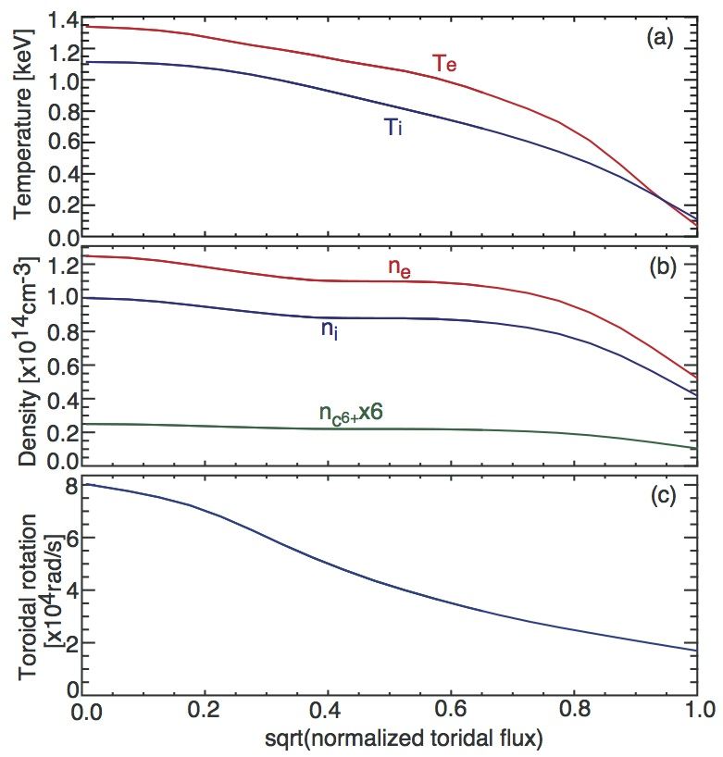
Main input plasma profiles of
TRANSP and FIDAsim simulations
•Profiles of (a) temperature, (b) electron density, ion density, and impurity density and (c) toroidal rotation are shown for a projected NSTX-U discharge at t=2.5s.

Slide 15
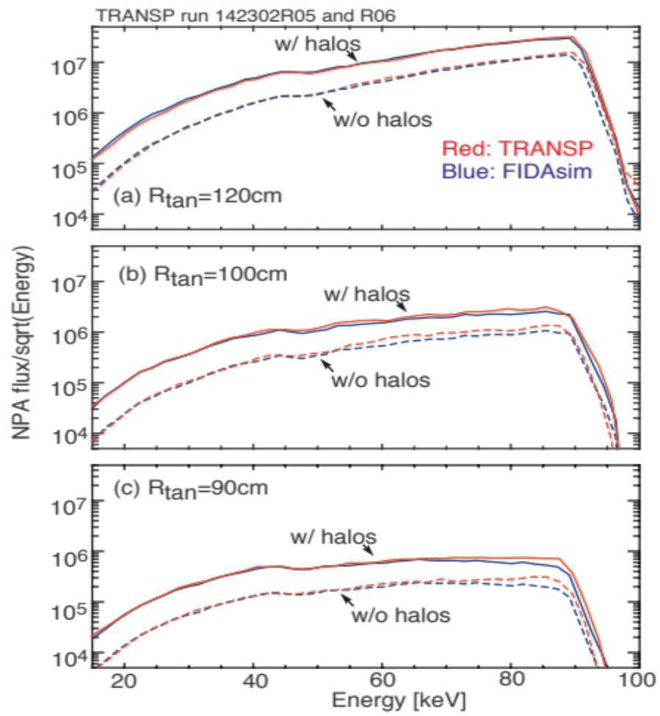
Comparison of NPA energy spectrum at t = 2.5 s
with and without halo neutrals for the captioned NPA sightlines.
The TRANSP simulation results are shown in red, and the FIDAsim simulation results are plotted in blue. The TRANSP and FIDAsim simulations results overlap.

Slide 16
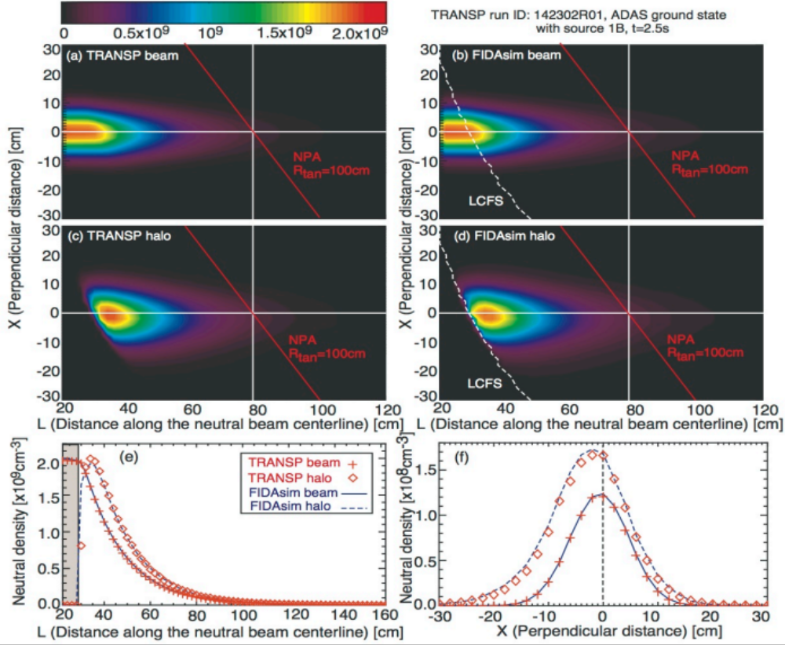
Benchmarking of beam and halo neutral densities calculation
in TRANSP and FIDAsim codes with a NSTX-U projected discharge
Notes:
No correlation observed in counts versus CAE amplitude plot.

Slide 17
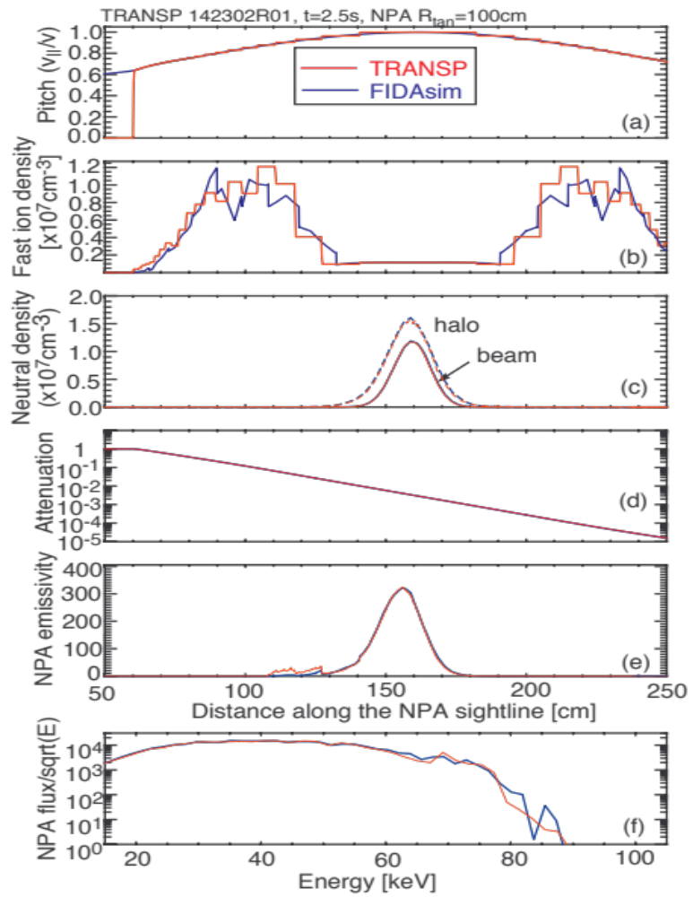
Benchmarking of the NPA simulator in the TRANSP and FIDAsim codes
with a projected NSTX-U discharge
Notes:
Some shots in MHD tabulation were omitted in above plots because the HEF event coincided with a NB turn on.

Slide 18
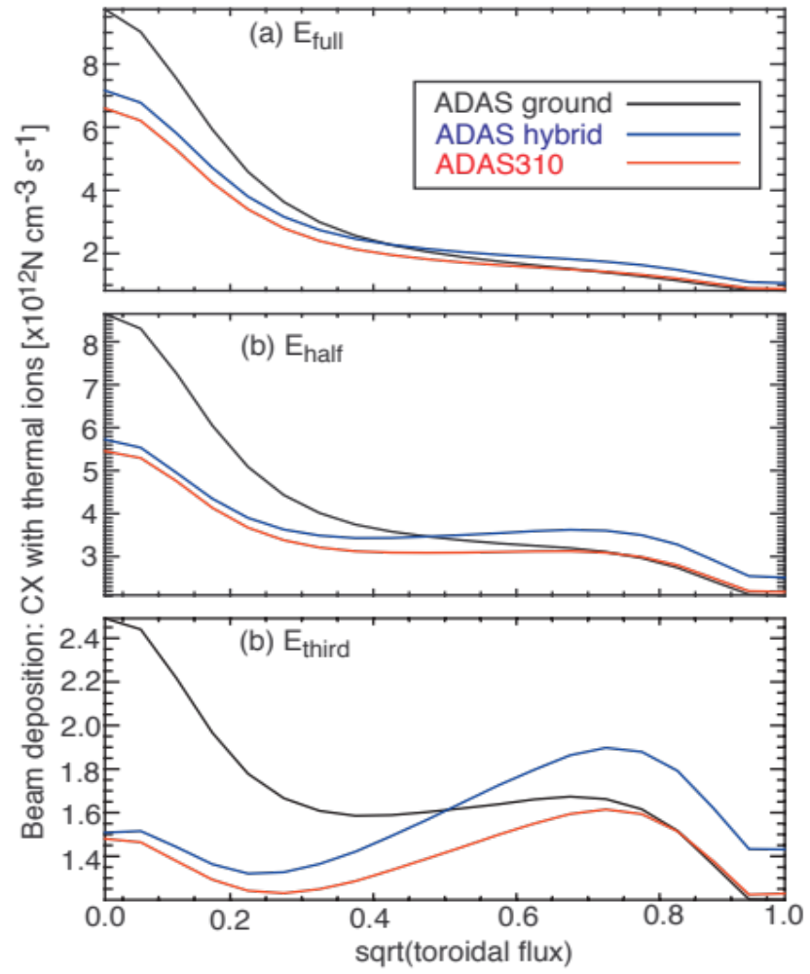
Beam deposition through charge exchange with thermal ions
• (a) full energy c, (b) half energy, and (c) third energy components
Notes:
Some shots in MHD tabulation were omitted in above plots because the HEF event coincided with a NB turn on.

Slide 19
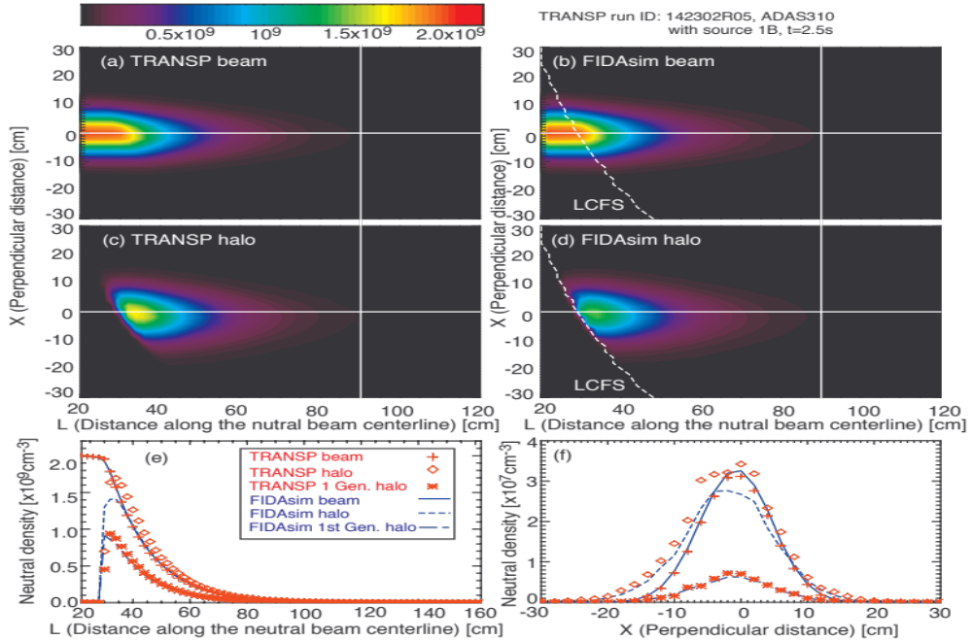
Comparison of TRANSP and FIDAsim beam and halo neutral densities
the codes use their own standard cross section tables
• TRANSP uses ADAS310, while FIDAsim mainly uses ADAS and Janev 2004 report.
Notes:
In the table, #/# means measured/TRANSP. The two cases that agree well are circled.

Slide 20
Summary
An upgrade to the halo neutral simulation in the TRANSP code has been completed using a 3D halo neutral “beam-in-a-box” model that encompasses both injected beam and halo neutrals.
A subset of the full, half and one-third beam components produce halo neutrals upon deposition by charge exchange that are tracked through multiple generations until the halo neutrals are ionized or exit the box.
The TRANSP NPA simulator was used to show that the 3D halo neutrals increase the NPA flux by factors ~ 2.3 – 2.8 above charge exchange on the beam primary neutrals alone, depending on the elected NPA sightline.

