Slide 1


Study on non-inductive EBW Heating using direct XB mode conversion in VEST
Hyunyeong Lee, J. G. Jo, S. H. Kim, K. J. Chung and Y. S. Hwang
Center For Advanced Tokamak Study
Department of Nuclear Engineering Seoul National University
18th ISTW 2015
November 4th, 2015
NUPLEX, Dept. of Nuclear, Seoul National University,
San 56-1, Shillim-dong, Gwanak-gu, Seoul 151-742, Korea
brbbebbero@snu.ac.kr

Slide 2
Outline
Introduction
EBW Heating Experiments in linear device
  EBW heating by collisional damping with direct XB conversion
  Direct XB mode conversion via multiple wall reflection
EBW Heating Experiments in VEST
  EBW collisional heating in pure TF and TPC pre-ionization
  Low loop voltage startup with EBW collisional heating
Summary & References

Slide 3
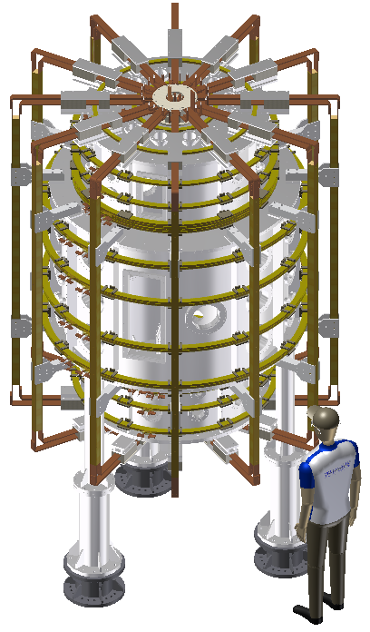
Introduction
VEST : the first Spherical Torus in Korea
Versatile Experiment Spherical Torus
Objectives
Basic research on a compact, high-β ST (Spherical Torus)
Study on innovative start-up, non-inductive H&CD, and innovative divertor concept, etc
Specifications
 | Initial Phase | Future
Chamber Radius [m] | 0.8 : Main Chamber 0.6 : Upper & Lower Chambers
Chamber Height [m] | 2.4
Toroidal B Field [T] | 0.1 | 0.3
Major Radius [m] | 0.43 | 0.4
Minor Radius [m] | 0.33 | 0.3
Aspect Ratio | >1.3 | >1.3
Plasma Current [kA] | ~70 kA | 100
Elongation | ~1.6 | 2.5
Safety factor, q_{a} | ~3.5 | ~3

Slide 4
Introduction
Motivation & Objective
Electron Cyclotron Heating(ECH) is widely used for various purposes in fusion device that the pre-ionization, local heating and current drive. Especially non-inductive current drive and startup using ECH is essential for Spherical Torus (ST) which has lack of space for the center stack. But ECH in ST shows the limitations due to low toroidal field.
An EBW(Electron Bernstein Wave) which has no cutoff density, has been proposed as a promising alternative for heating and current drive in ST that it is impossible for ECH due to density limit.
EBW | OXB (O cutoff & UHR) | OXB (CS & UHR) | XB (UHR)
Pros | Excellent results in theory and experiment |  | Simple design Single Mode conversion
Cons | Complex Scenario Density fluctuation Angular dependant | Complex Scenario Need : polarizer Limit of O cutoff | Limit of R cutoff – tunneling effect Control on density profile
Device | MAST[1], NSTX[2], QUEST[3] |  | LATE[4], TST-2[5], CDX-U[6]

Slide 5
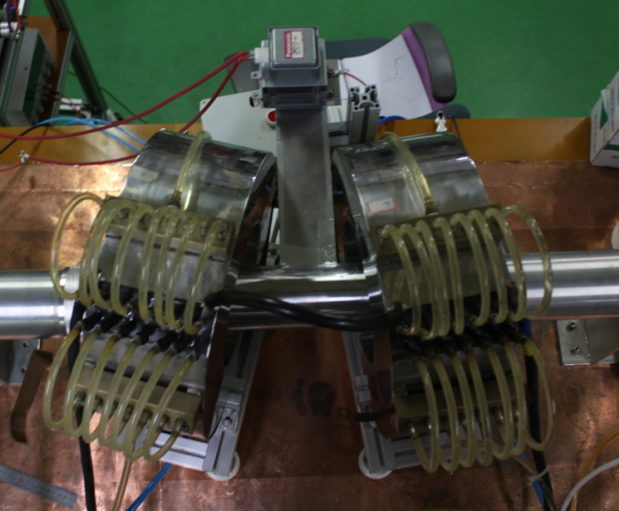
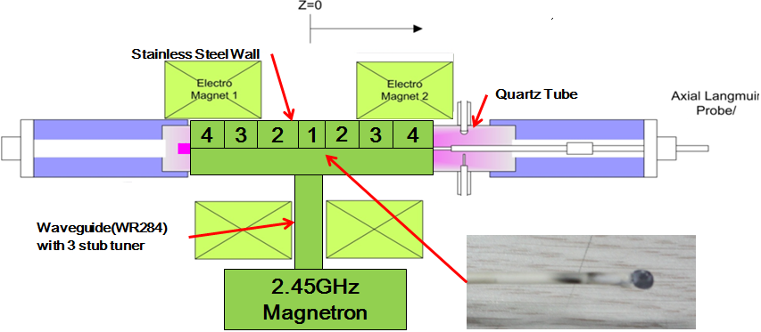


EBW Heating Experiments in linear device
Experimental Setup
Bent Magnetic Field(B_{T})
HFS Injection
Bent Magnetic Field(B_{T})
Magnetron
Quartz Tube
Pump
System
Stainless Steel Wall
`
Hydrogen Injection
W
R
2
8
4
MW Loss Protection
LFS Injection
3 Stub
Tuner
Objectives : To find the feasibility of ECH from EBW via XB mode conversion.
Small cylindrical device with axial magnetic field bent similar to tokamak
Possible to change the direction of MW injection mode – LFS&HFS
Easily changeable of magnetic field and MW power – movable location of ECR
Antenna : open waveguide(WR284)
Quartz
Quartz
2.45 GHz
Magnetron
875G
HFS
LFS

Slide 6
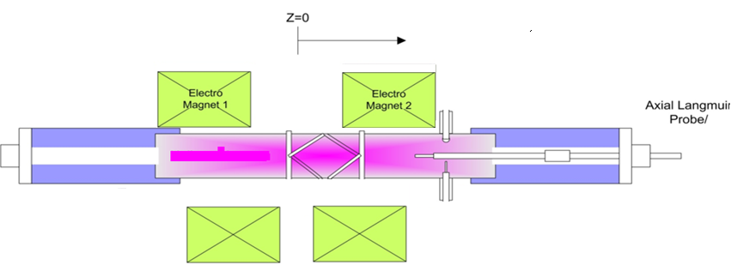
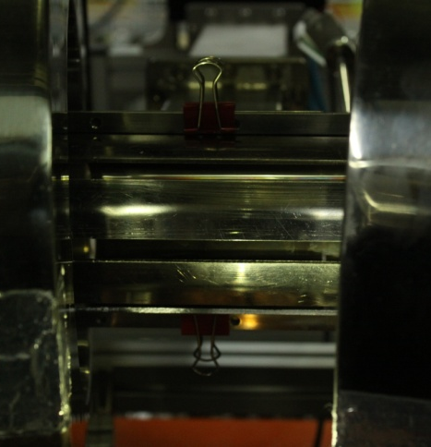
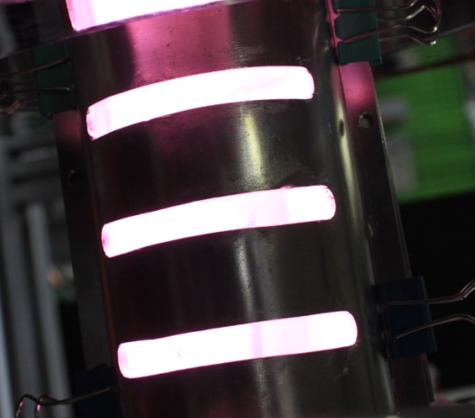
EBW Heating Experiments in linear device
Experimental Setup : Wall with X/O Polarized Slit
Center
Pump
System
Hydrogen Injection
Axial
Probe
Radial
Probe
O slit wall
2.45GHz
Objective
  Confirm the effect of EBW mode conversion on the wall reflection with polarized slit
The wall is possible to change the position along the injection and opposite side.
X/O slit : The wall with slits that reflects the X/O mode wave
  Formation of polarized wave with specific direction to radiate the electric field of wave perpendicular/parallel on the magnetic field
  The other wave with different direction will pass through the slit
∥
B_{t}
E₁
E₁┴B_{t}
_{perpendicular}
X slit wall

Slide 7


ECH Experiment in linear device
Over-dense plasma generation
: Cutoff(reflection)
: XB conversion
O cut off
X(L) cut off
HFS
Resonance
1
UHR
Diagnostics – measured at r = 0
The plasma with higher electron density generates from LFS X mode than from HFS X mode.
As shown in CMA diagram, LFSX/HFSX injection does not exceed R/L cutoff but in the experiment LFSX injection overcomes the L cutoff.
The feasibility of EBW via XB mode conversion might be shown.
LFS
X(R) cutoff
1

Slide 8
EBW Heating Experiments in linear device
The n_{e} & T_{e} Profile along the MW Power
ECR
ECR
T_{e} Increase
LFSX
LFSX
UHR
UHR
Over-dense plasma generation and electron temperature increase near ECR
  To confirm the feasibility of XB conversion
  At the lower power, density peak does not exist but when the MW power increases, over-dense plasma generates and density peak forms between UHR and ECR – Steep density gradient near UHR
  EBW collisional damping propagating to ECR in low T_{e} [7~9]
  T_{e} increase near ECR : ECH effect from some part of the converted EBW

Slide 9
EBW Heating Experiments in linear device
The n_{e} & T_{e} Profile along the Magnetic field
3cmL
ECR
1cmL
ECR
1cmR
ECR
3cmL
ECR
1cmL
ECR
1cmR
ECR
T_{e} Increase
LFSX
LFSX
UHR
UHR
Over-dense plasma generation and temperature increase near ECR
  Over-dense plasma : EBW collisional damping propagating to ECR in low T_{e}
  Generation of higher density plasma at the lower magnetic field
    The higher density near UHR at the lower magnetic field
  Movement of the electron temperature rising region along ECR layer
  Feasibility of plasma heating by EBW collisional damping with XB conversion

Slide 10
EBW Heating Experiments in linear device
LFSX Injection with Polarized Wall
Xslit
Oslit
LFSX
ECR
O cut off
X(L) cut off
Resonance
The effect of wall reflection : over dense plasma
Oslit wall : similar to the none wall
  No effect of the reflected O wave
  Single pass absorption(Direct XB)
Xslit wall – similar to the full wall (VEST)
  Multi pass absorption(reflected X wave)
The XB mode conversion in VEST to make over dense plasma (power density : ~5.0×10¹⁵ #/m³·W)
1
UHR
LFS
R(X) cutoff
1

Slide 11
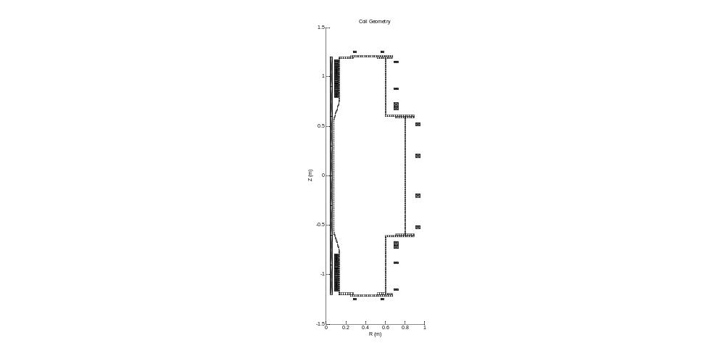
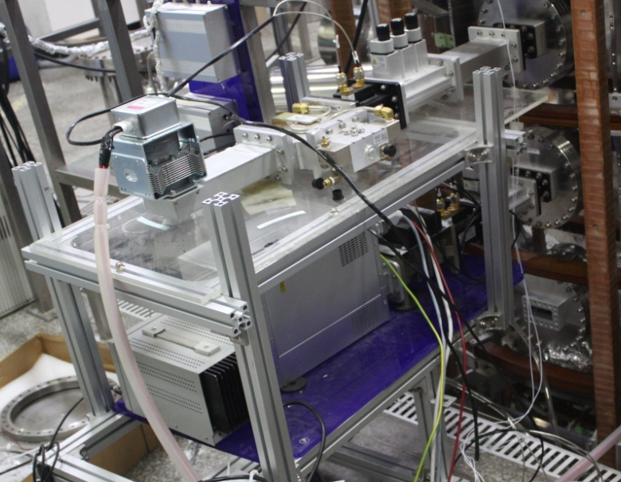
EBW Heating Experiments in VEST
2.45 GHz CW ECH System of VEST
3 stub tuner
Circulator
Directional Coupler
6kW CW
Magnetron
2.45GHz
ECH
CW ECH System
Pulse ECH System
Commercial microwave power supply
(6 kW 2.45 GHz: 1ea)
Low field side launching
For main chamber
X/O mode injection
Cost-effective homemade magnetron power supplies
(10 kW : 1ea, 3 kW : 4ea)
Low field side launching
Easily movable (upper, main and lower chamber)
X/O mode injection
Pulse duration, trigger time

Slide 12
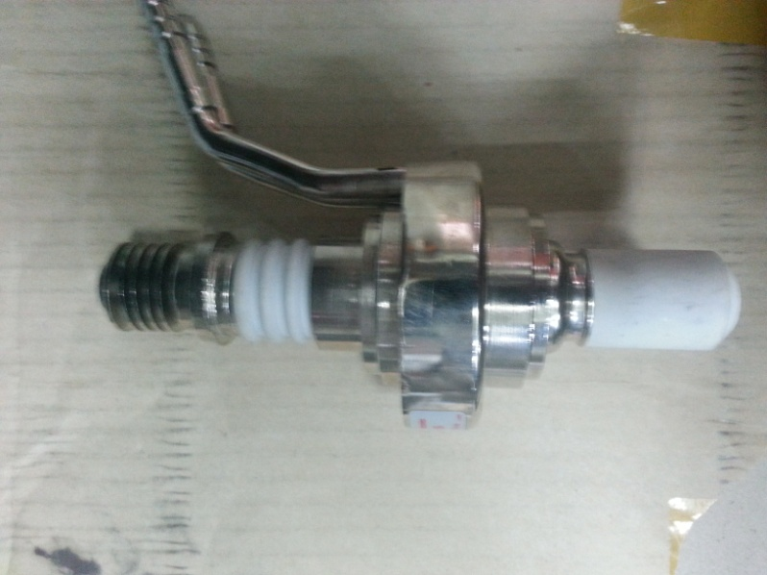
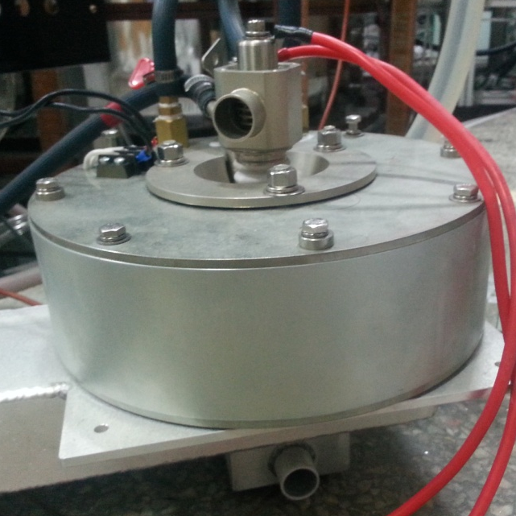
EBW Heating Experiments in VEST
2.45 GHz pulse ECH System of VEST
Filament Heating
10 kW Magnetron
Cathode
Anode
MOSFET Switch
Electromagnet
Antenna
20 kΩ
110 kΩ
300 Ω
11 kV
Pneumatic Switch
Pneumatic Switch
220 uF
13 V
53 A

Slide 13
EBW Heating Experiments in VEST
Pre-ionization Experiment – MW power
UHR
ECH pre-ionization experiment using only TF field in VEST
  Based on the linear device results, the pre-ionization experiments are performed.
  At the lower power, density peak exists near ECR but when the MW power increases that means the electron density buildup, the density peak moves – Steep density gradient near UHR
  Density peak formation between UHR and ECR : EBW collisional damping propagating to ECR in low T_{e} [7~9]
  T_{e} increase near ECR : ECH effect from some EBW and non-converted X wave

Slide 14
EBW Heating Experiments in VEST
ECH Pre-ionization Experiment with Pure TF
Pure TF + ECH pre-ionization experiment
  In case of 3.8 kA, high density plasma generates near ECR with ECH 6 & 10 kW
  In case of 8.2 kA, over dense plasma generation over L cut off density and plasma density peak exists near UHR : Collisional damping with XB conversion
  Power density in the linear device (~6.0×10¹⁶ #/m³·W) :
    It is expected that higher pre-ionization density with higher ECH 10 kW power
  In case of 3.8 kA, the density peak exists near the ECR layer but in case of 8.2 kA, the mode conversion efficiency increases that in the similar position of UHR and cutoffs and collisional damping of EBW makes the density peak.

Slide 15
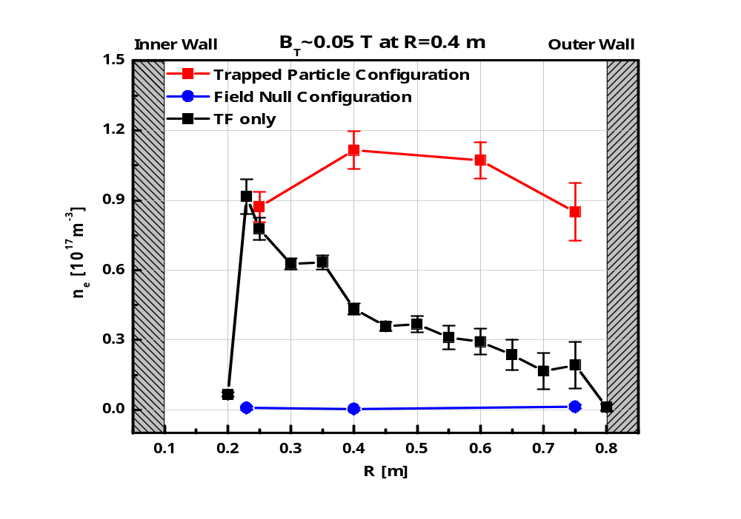
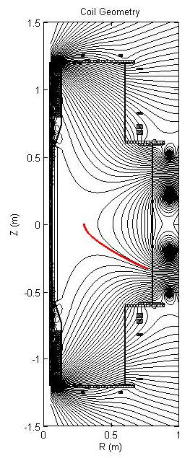
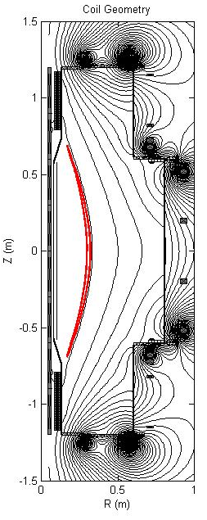
EBW Heating Experiments in VEST
Enhancement of pre-ionization under TPC
Field Null
Configuration
Significant enhancement of pre-ionization under TPC (Trapped Particle Configuration)
Trapped Particle
Configuration
LFSO
LFSX
Severe degradation of pre-ionization
under field null

Slide 16
EBW Heating Experiments in VEST
EBW collisional heating in TPC pre-ionization plasma
TF 3.8 kA
TF 8.2 kA
EBW collisional heating occurs with TPC pre-ionization plasma
  The mode conversion efficiency is calculated with 1-d full wave simulation[10]
    In case of TF 3.8 kA, broad density profile makes low MC conversion coefficient (0.0105) but in case of TF 8.2 kA, steep density gradient exists near UHR and relatively high MC coefficient (0.2625)
  Additional 10 kW pulse ECH power is supplied when TPC enhances pre-ionization plasma
    Over dense plasma generation near UHR showing collisional EBW heating
    In case of 3.8 kA, low MC efficiency (0.0105→0.4819) has slight increase in density but in case of 8.2 kA, high MC efficiency (0.2526→0.756) has large rise in density due to steep density gradient and magnetic field.
Notes:
퓨어 tf에서 10키로가 나왔을 때

Slide 17
EBW Heating Experiments in VEST
EBW collisional heating during TPC startup (1)
TF 3.8 kA
TF 8.2 kA
EBW collisional heating occurs during TPC startup
  The low loop voltage startup experiments using TPC have been performed.
  The mode conversion efficiency is calculated with 1-d full wave simulation when the plasma density reaches the density peak[10]
    The MC coefficient of TF 3.8 kA (0.3655) has larger than that of TF 8.2 kA (0.1536) due to the pre-ionization density near inboard that has strong loop voltage and it shows the different plasma current ramp-up rate

Slide 18
EBW Heating Experiments in VEST
EBW collisional heating during TPC startup (2)
R = 0.5 m
EBW collisional heating occurs during TPC startup
  13858 (TPC startup with 6 kW), 13888 (TPC startup with 6 & 10 kW)
  The additional 10 kW pulse ECH injection has occurred at 402 ms.
    In case of TF 8.2 kA, the MC coefficient has dramatically increased (0.1536 →0.966) and the electron density and temperature increases rapidly (405 ~ 407 ms)
    The feasibility of strong heating in the closed flux surface (R=0.5 m) is confirmed and EBW collisional damping (density increase) and temperature rise near ECR layer shows the evidence of EBW heating.

Slide 19
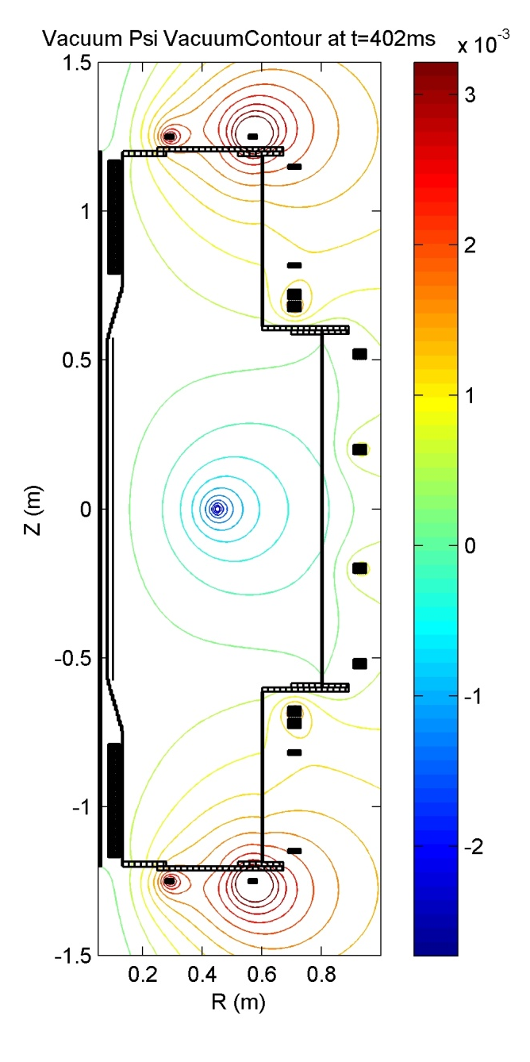
EBW Heating Experiments in VEST
EBW collisional heating during TPC startup (3)
TF 3.8 kA
EBW collisional heating occurs during TPC startup
  The plasma current has the increase at the time additional 10 kW pulse ECH injection as well as electron density and temperature.
  Also the plasma current has the longer pulse duration with EBW heating.

Slide 20
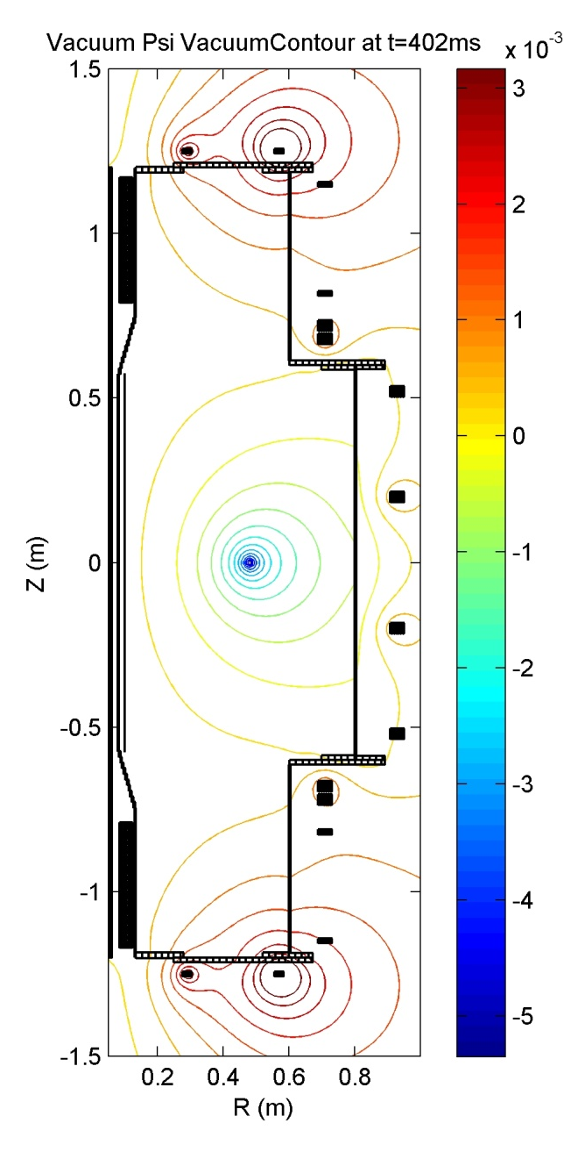
EBW Heating Experiments in VEST
EBW collisional heating during TPC startup (4)
TF 8.2 kA
EBW collisional heating occurs during TPC startup
  The plasma current has the increase at the time additional 10 kW pulse ECH injection as well as electron density and temperature.
  Also the plasma current has the longer pulse duration with EBW heating.

Slide 21
Summary
In the linear device, over dense plasma is generated by LFS X mode injection and the electron temperature peaks near ECR, indicating the presence of direct XB mode conversion and EBW collisional heating and the wall reflection with O/X polarized slit has affected to the ECH power absorption via single and multi pass, showing the feasibility of the heating of reflected X mode microwave and direct XB mode conversion.
  Based on the linear devices experiment results, the VEST pre-ionization experiments have been performed and increase of T_{e} near ECR and n_{e} near UHR is occurred at the similar result in linear device and enhanced pre-ionization plasma using TPC has been strengthened via direct XB mode conversion and collisional heating near outboard region compared to the MC efficiency from 1-d full wave simulation.
The EBW heating experiment has been performed in low loop voltage startup using TPC and it is observed that the strong heating in the closed flux surface (R=0.5 m), EBW collisional damping (density increase), temperature rise near ECR layer and plasma current & duration increases that tells EBW heating during startup.

Slide 22
Reference
[1] V. F. Shevchenko et al., Nucl. Fusion, 50 022004 (2010)
[2] A. K. Ram et al., Phys. Plasmas, 7 4084 (2000)
[3] Idei Hiroishi et al., FEC2012, EX/P6-17 (2012)
[4] Uchida Masaki et al., FEC2012, EX/P6-18 (2012)
[5] S. Shiraiwa et al., Phys. Rev. Lett., 96, 185003 (2006)
[6] G. Taylor et al., Rev. Sci. Instrum. 72, 285 (2001)
[7] S. Pesic, Physica C, 125, 118-126 (1984)
[8] Josef Preinhaelter et al., Rev. Sci. Instrum. 77, 10F524 (2006)
[9] S. J. Diem et al., Rev. Sci. Instrum. 79, 10F101 (2008)
[10] S. H. Kim et al., Physics of Plasmas, 21, 062108 (2014)

Slide 23
Backup
Back up

Slide 24
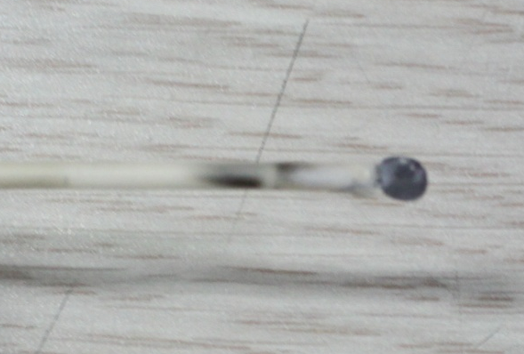
ECH Experiment in linear device
Experimental Setup - diagnostics
Interferometer
Radial
Probe
4
3
2
1
2
3
4
Axial
Probe
Diagnostics – Radial Langmuir probe
  Movable radial direction to measure profile
  Planar type tip(r=1.5mm)
  Measured in Z=0cm from the center
Comparison between Interferometer & Probe
  To confirm the density measurement
  Assuming that parabolic density profile due to the line integrating density using interferometer
  In this presentation the diagnostics was utilized by this probe.

Slide 25
ECH Experiment in linear device
The n_{e} & T_{e} Profile along the Pressure
ECR
ECR
T_{e} Increase
UHR
UHR
Over-dense plasma generation and electron temperature increase near ECR
  The lower pressure makes lower plasma density and higher temperature
  Steep density gradient near UHR : XB mode conversion
  Over-dense plasma : EBW collisional damping propagating to ECR in low T_{e}
  T_{e} increase near ECR : ECH effect from some part of the converted EBW
  Strong heating in higher pressure : It might be that MC efficiency from steep density gradient.

Slide 26
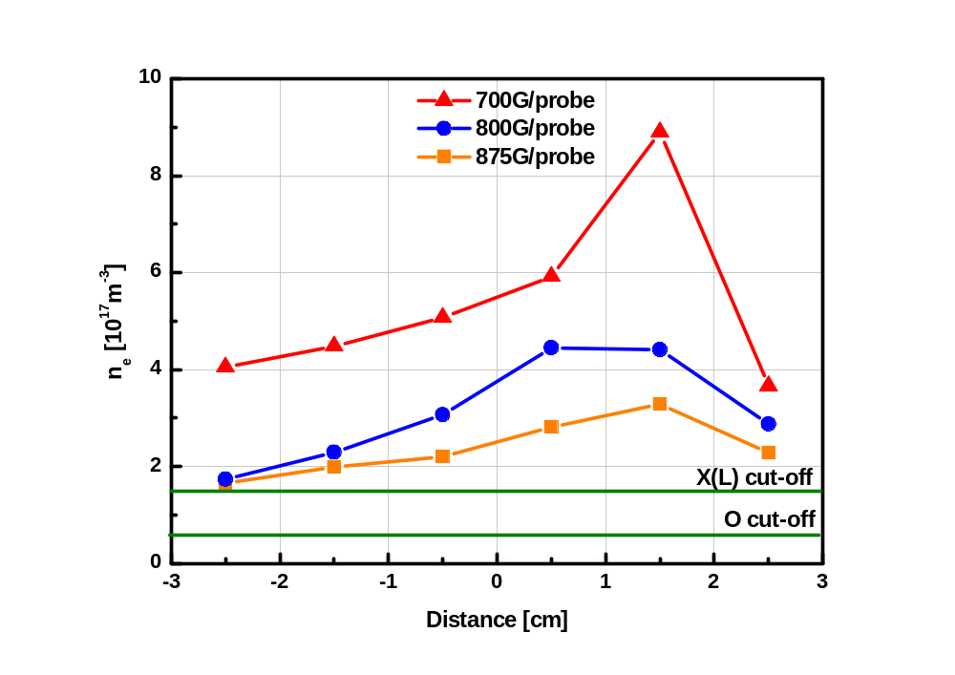
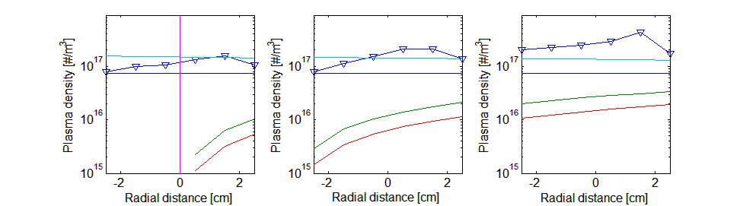
EBW Heating Experiments in linear device
XB Mode Conversion with wall reflection
자기장에 따른 플라즈마 밀도 변화
1세부 실험 결과를 2세부가 해석
자기장이 낮은 경우 더 밀도가 높은 것은 UHR 영역 밀도가 높기 때문
(VEST 전이온화 실험과 일치함)
모드 변환과 에너지 흡수가 일어나는 UHR 영역은 아래 그림의 점선 부분임
700W
LFSX injection
875 Gauss
800 Gauss
700 Gauss
L(X) cut-off
L(X) cut-off
L(X) cut-off
O cut-off
O cut-off
UHR
O cut-off
UHR
UHR
R(X) cut-off
R(X) cut-off
R(X) cut-off
Notes:
월이 있을 때 없을 때 MC 컨버젼 효율 논의
측정 위치 자장 값이 언제 인지

Slide 27
Experiment Result
HFSX Injection
Injection
Opposite
HFSX
ECR
O cut off
X(L) cut off
HFSX
Resonance
1
UHR
In case of HFSX injection, the density does not exceed the X(L) cutoff layer.
In all cases of injection side wall, opposite side wall and both wall, the density has the similar tendency – single pass absorption.
R(X) cutoff
1

Slide 28
Experiment Result
LFSO Injection – OXB Mode Conversion
Opposite
Injection
LFSO
ECR
O cut off
X(L) cut off
Resonance
1
Opposite side & both wall
  The feasibility of OXB mode conversion
  OX conversion : wall reflection and O cutoff
  Some part of injected MW : Tunneling cutoff
  XB conversion : over dense plasma
  Multi pass absorption due to the wall
Injection side & None wall
  Single pass absorption : not exceed cutoff
UHR
LFS
R(X) cutoff
1

Slide 29
EBW Heating Experiments in linear device
XB Mode Conversion with wall reflection
Opposite
Injection
900 W
LFSX
ECR
O cut off
X(L) cut off
Resonance
1
The effect of wall reflection in mode conversion
Over dense plasma generation : XB conversion
The wall positioned in the opposite side of the wave injection affects to the mode conversion
  Both & Opposite : multi pass absorption
    (Similar condition in VEST)
  Injection & None : single pass absorption
    (No effect of reflected wave)
UHR
LFS
R(X) cutoff
1
Notes:
월이 있을 때 없을 때 MC 컨버젼 효율 논의
측정 위치 자장 값이 언제 인지

Slide 30
Experiment Result
LFSO Injection with Polarized Slit
Xslit
Oslit
LFSO
ECR
O cut off
X(L) cut off
Resonance
1
In case of LFSO injection
Xslit & Full wall
  The feasibility of OXB mode conversion
  the similar density tendency
Oslit & None wall
  No existence of the reflected X wave
  XB conversion does not occurs.
UHR
LFS
R(X) cutoff
1

Slide 31
ECH Experiment in VEST
ECH Pre-ionization Experiment – Budden Analysis
Distance between the UHR and R-cutoff can be expressed by density scale length and magnetic field within the limit of .
(k, L_{n}: evaluated at the R-cutoff)
TF Current | T | R | C
8.2kA | 0.2754 | 0.5251 | 0.1995
6.7kA, 5.4kA | 0.05 | 0.9 | 0.05
3.8kA | 0.123 | 0.7691 | 0.1079
Budden Parameter
Budden analysis[2]
  EBW mode conversion coefficient calculation
  possible to use in doublet case(R-cutoff and UHR)
When the TF current is 8.2 kA, conversion coefficient shows that some MW converted to EBW and it makes density peak between UHR and ECR.
Especially in case of TF current 3.8 kA, reflected wave from inner wall of the chamber makes situation similar to triplet(L-cutoff, UHR, R-cutoff) not in doublet case.
High density plasma is produced when the peak of density profile is near the inner wall or outer wall with the aid of high XB mode conversion efficiency.

Slide 32
ECH Experiment in VEST
Change of the T_{e} profile along the magnetic field
1st
2nd
1st
2nd
B₀ ~ 0.1 T
1st
1st
2nd

Slide 33
EBW Heating Experiments in VEST
Change of the n_{e} profile along the magnetic field
Density peak exists between ECR and UHR
  Some part of EBW has collisional damping propagating to ECR in low T_{e}
  In case of 5.4 kA and 6.7 kA, no density peak exists : moderate density gradient near UHR
  Especially in case of 3.8 kA, high density plasma generates near ECR

Slide 34
EBW Heating Experiments in VEST
Comparison of LFSX and LFSO injection
LFSO
LFSX
The density and temperature of LFS O mode injection is similar to LFS X.
Reflected X wave affects to XB mode conversion to show multi pass absorption in VEST.
O wave reflects in the O cutoff and wall and it converts to the X wave.

Slide 35
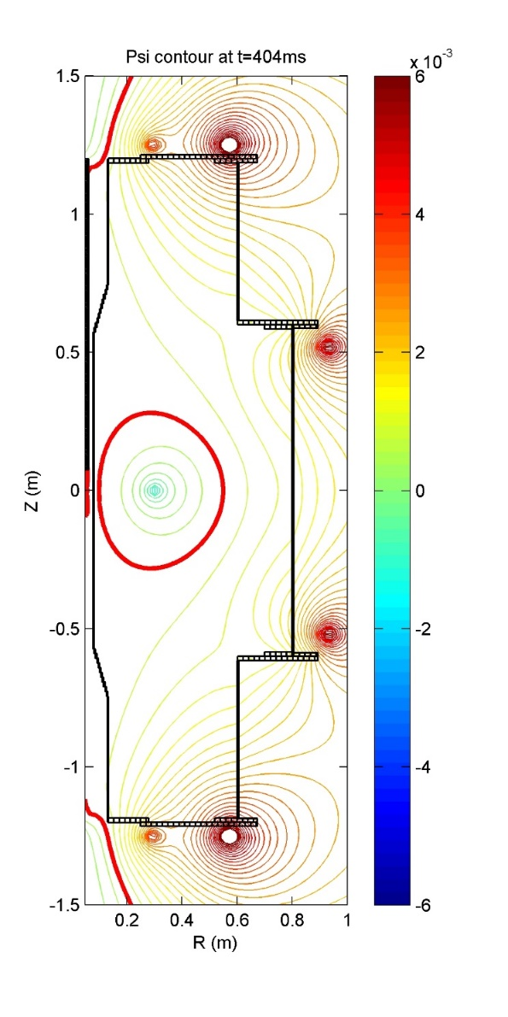
ECH Experiment in VEST
ECH/EBW heating during startup
As TF current is lower, the plasma current is higher and has the longer duration.
Plasma density is measured by movable triple probe.
The feasibility of the EBW heating(over dense plasma)
  Low B : EBW mode conversion efficiency
  ECR : EBW heating position
ECR
Closed flux surface and the density profile shows the plasma position.

Slide 36
ECH Experiment in VEST
Feasibility of ECH/EBW heating during startup
When ECH power turns off, the plasma pressure has degradation near UHR during plasma startup.
Future Work
  Relatively low ECH power : Power upgrade and low plasma current scenario
  MC efficiency
    Density scale length : near CFS with TPC, Startup near inboard(Bt etc.)
    Magnetic field scale length : outer PF startup

Slide 37
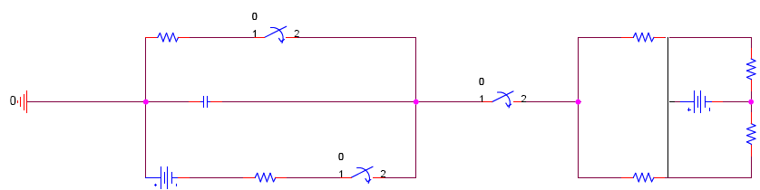
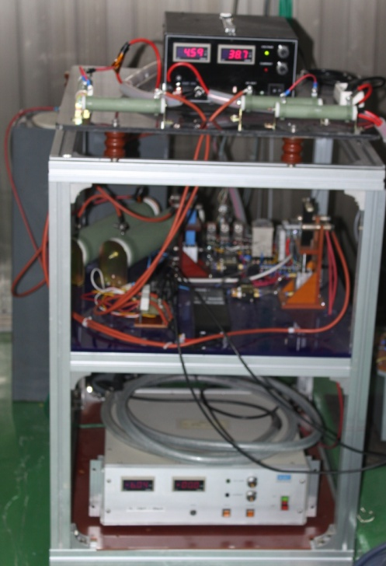
Operation System of 3kW ECH Magentron
Specifications of 3kW Magnetron
Operation Circuit for 3kW Magnetron
Modifications of magnetron operation circuit
Cost effective ECH system using capacitor
Isolated transformer needed
Easily changeable power control(Resistors)
Available for 4 magnetrons simultaneously
Item | Value
Filament Voltage | 4.6Vac
Filament Current | 19.5A
Anode Current | 900mA
Anode Voltage | 5.4kV
Anode Input Power | 4.8kW
Output Power | 3000W
Frequency | 2.45GHz
Dummy
Filament Heating
Resistors
Pneumatic
Switch
20kΩ
1.5kΩ
Discharge
Magnetron
110μF
MOSFET
Switch
5V 40A
Magnetron
-6kV
10kΩ
Pneumatic
Switch
1.5kΩ
Capacitor
Charge

Slide 38
Operation Result of 3kW ECH Magentron
Dummy
Specifications of 3kW Magnetron
Current
Voltage
Filament Heating
Pneumatic
Switch
Item | Value
Filament Voltage | 4.6Vac
Filament Current | 19.5A
Anode Current | 900mA
Anode Voltage | 5.4kV
Anode Input Power | 4.8kW
Output Power | 3000W
Frequency | 2.45GHz
20kΩ
Discharge
1.5kΩ
Magnetron
110μF
MOSFET
Switch
5V 40A
Magnetron
-6kV
10kΩ
Pneumatic
Switch
1.5kΩ
Capacitor
Resistors
Charge

Slide 39
Preliminary Test Result of 10kW Magnetron
Anode Voltage : 10.5 kV, Heater Current :53 A
Anode Voltage : 11 kV, Heater Current :53 A

Slide 40
ECH Experiment in VEST
ECH/EBW heating during startup(1)
Plasma current of ~8kA is sustained with low loop voltage of ~1V using vertical field for force balance.
EBW heating may make plasma density increase and it will affect the plasma current ramp-up rate.
Increase of pulse length in low TF strength indicate that possibility of EBW heating effect.
~400ms

Slide 41
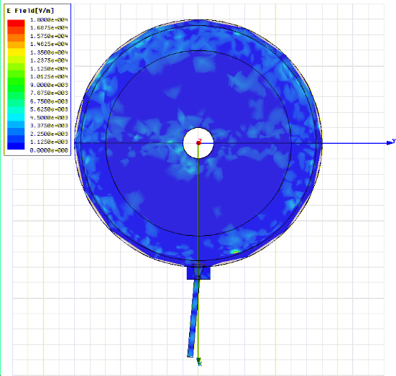
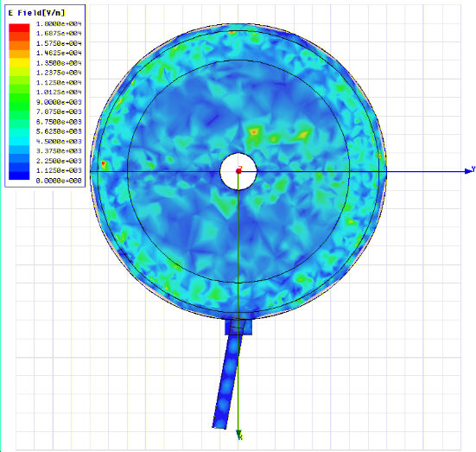
O mode $R=75 mm, θ=15 deg, φ=5 deg$
X mode$R=50 mm, θ=5 deg, φ=10 deg$

