Slide 1

Effect of thermal particles collisionality on resistive wall mode in tokamak
G.Z. Hao¹, Y.Q.Liu^{2,4} S.X.Yang³, S.Wang⁴, D.Y.Liu¹, Z.X.Wang³, A.K. Wang⁴
¹ UC Irvine, CA,USA
² CCFE,Abingdon, UK
³ DUT, Dalian,China
⁴ SWIP, Chengdu, China

Slide 2
Outline
Motivation
Theory model
  Obtain the dispersion relation from an energy principle
  Collisionality model used in theory model
Analytical results
  Mode-particle resonance destabilizes a new branch
  Effect of collisionality on the RWM
Numerical results from MARS-K
Summary

Slide 3
Motivation
RWM is a kind of external kink instability, which needs to be suppressed in advanced tokamak, such as ITER.
The devices, such as ITER, NSTX-U, will have low collisionality operation, with different rotation levels.
The role of thermal particle collisionality on RWM requires further investigation, based on the self-consistent computation.

Slide 4
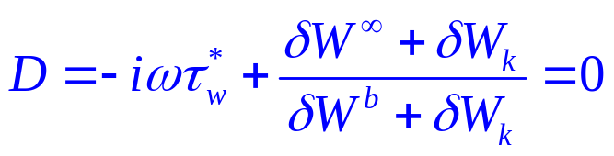
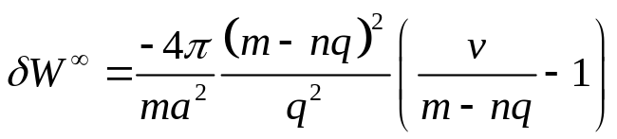
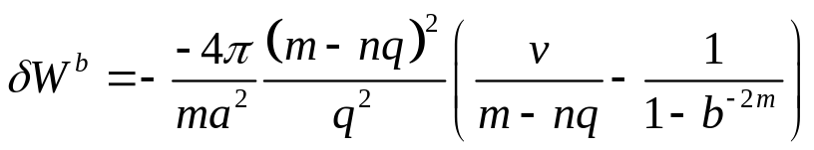
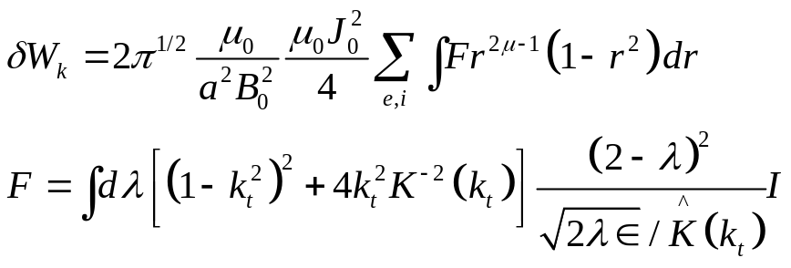
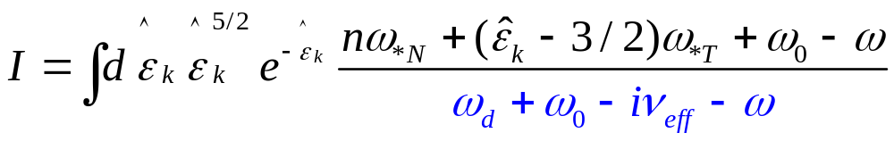
Obtain the dispersion relation from an energy principle
Dispersion relation:
Y.Q.Liu,et.al. PoP,2008, S.X.Yang,et.al. PoP,2015
Perturbed potential energy
without wall :
Perturbed potential energy
with ideal wall localized at b:
Kinetic contribution from thermal particles:
Mode eigenvalue
Drift freq.
Rotation
collisionality
Resonance factor Q

Slide 5
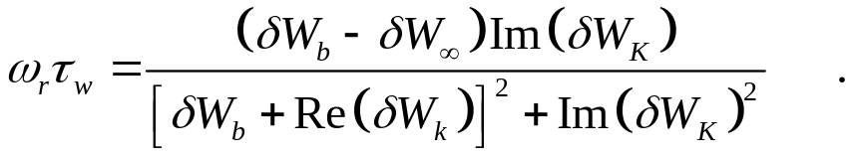
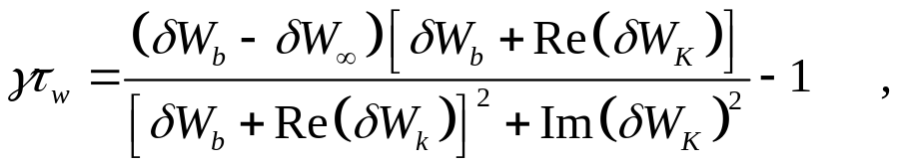


Obtain the dispersion relation from an energy principle
Dispersion relation can be rewritten as :
Always have stabilization on the instability

Slide 6
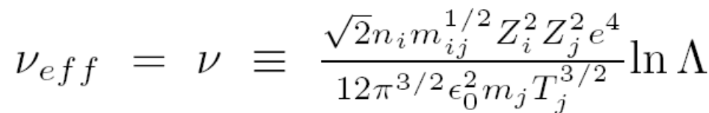
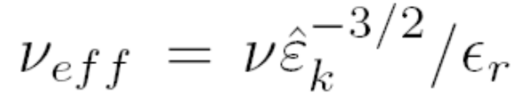
Collisionality model used in theory model
Two simple collisionality models:
Energy-independent model
Energy-dependent model

Slide 7
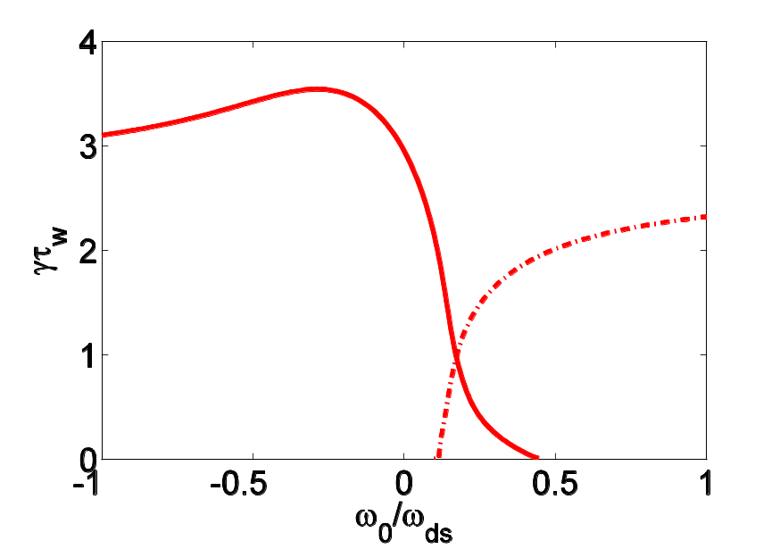
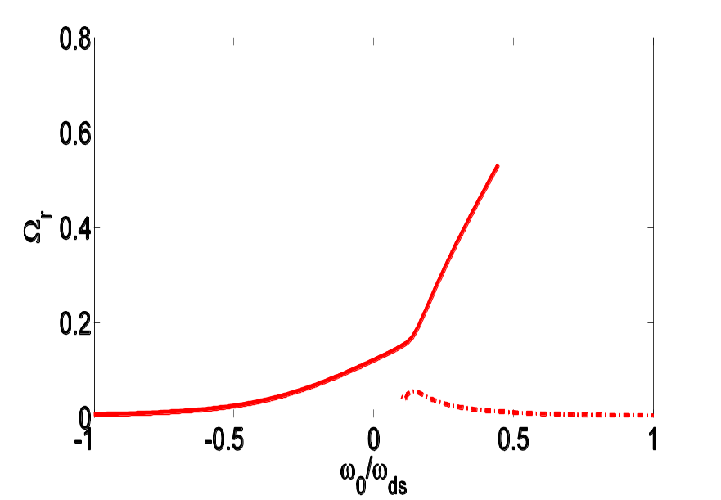

  Mode-particle resonance destabilizes a new branch
Growth rate
Real frequency
Branch B
Branch A
Branch A
Branch B
(normalized rotation)
Eddy current decay time of resistive wall
W/O kinetic effect, normalized growth rate of RWM ~3.5, labeled by blue solid circle
Growth rate is sensitivity to the plasma rotation in the gray region, since the resonance between the mode and precession drift motion of trapped thermal ions
The mode-particle resonance can stabilize branch A, however, also trigger branch B as rotation exceeds a critical value.
Here, no collisionality is included. We assume flat plasma rotation.
Branch A with higher real frequency which is close to plasma rotation frequency
Branch B with lower real frequency which decreases as increasing plasma rotation

Slide 8
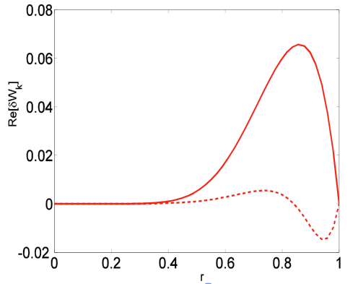
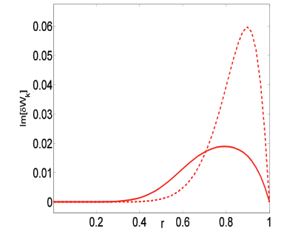




Eigenvalue of two branches depends on the mode-particle resonance
Branch B
Branch A
Choose rotation :
profile of branch A is very different with that of branch B, which is related to the mode-particle resonance.
Branch A has larger and smaller , which in turn determines the lower growth rate and larger real frequency of Branch A, though the RWM dispersion relation. As a analogy, Branch B has larger growth rate and smaller real frequency.
For Branch A, profile of precession drift frequency of particles in pitch angle space has a dominant effect on profile of

Slide 9
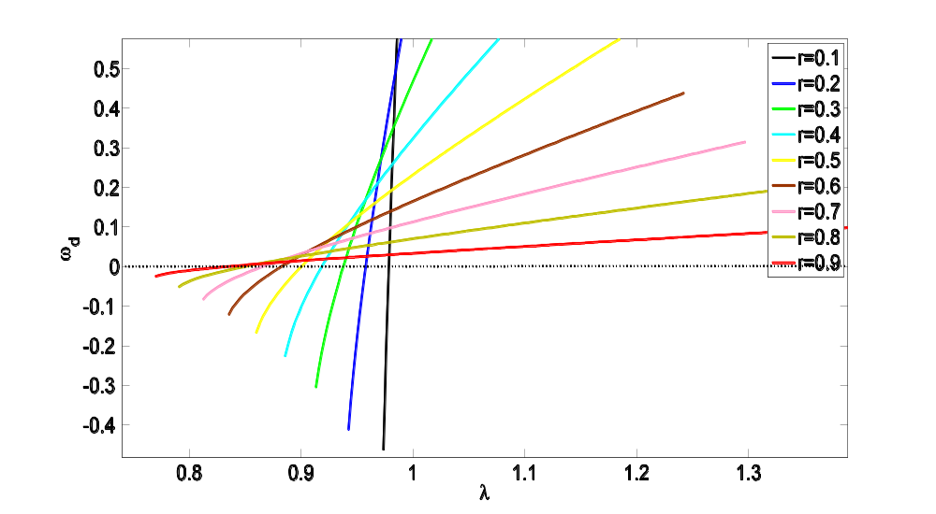

precession drift frequency profile in pitch angle space
At given minor radius, precession drift frequency changes its sign at a certain value of pitch angle. For the branch with higher frequency(Branch A ), this profile of drift frequency strongly enhances , and reduces , which in turn contributes damping on the mode.
: pitch angle. The ratio of the magnetic momentum to particle energy.

Slide 10

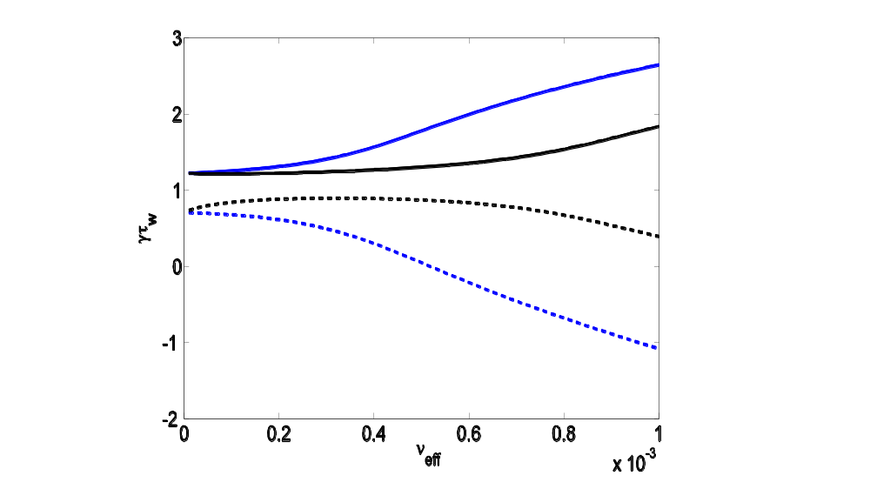
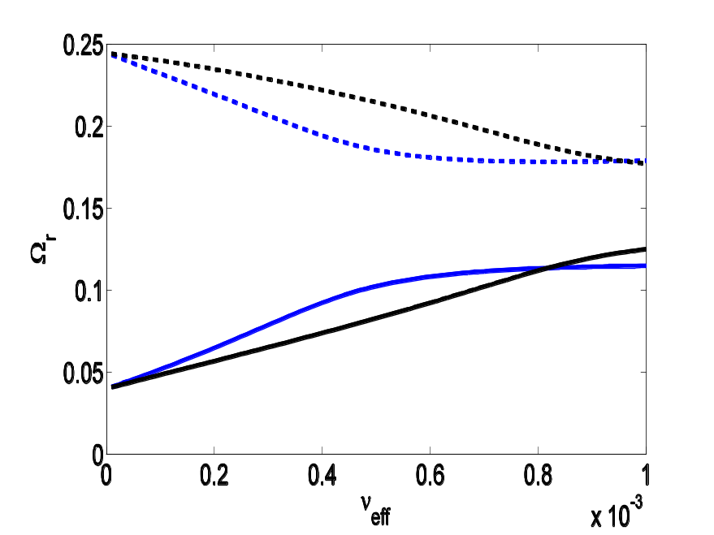
Collisionality can be either stabilizing or destabilizing
Choose rotation :
Branch B
Branch A
black curve: energy-dependent collisional model
Blue curve: energy-independent collisional mode
For branch A: collisionality has stabilization effect on the mode
For branch B: collisonality has destabilization influence on the mode
The above effects are insensitive to the choice of the collisionality model
Collisionality can be either stabilizing or destabilizing, depending on the value of mode frequency and plasma rotation.

Slide 11
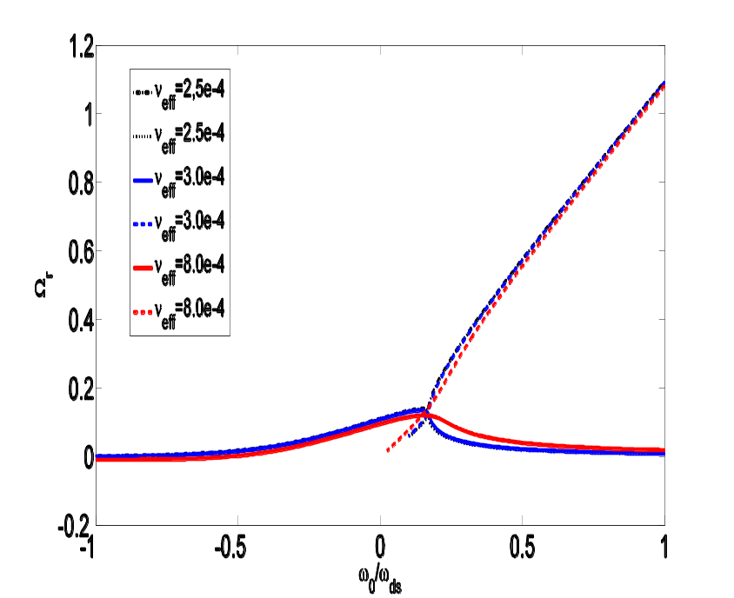
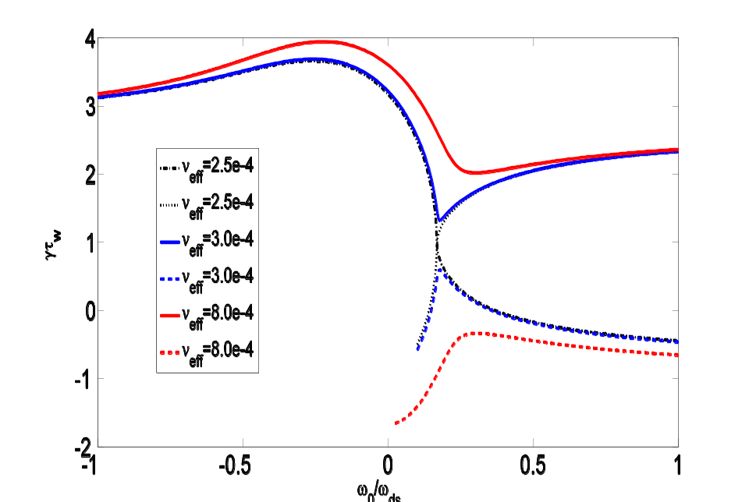
Collisionality can be either stabilizing or destabilizing
Growth rate
Real frequency
Increase collisionality
With increasing collision frequency, the two branches shown in slide 7 merge and form two new branches.
Collison frequency contributes destabilization effect on upper branch(blue curve); however, has stabilization effect on the lower branch

Slide 12
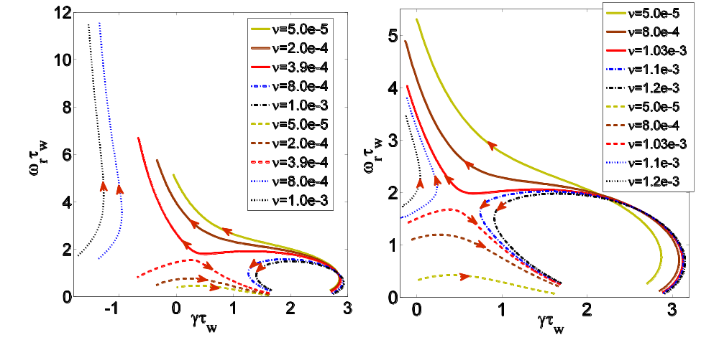


Collisionality can be either stabilizing or destabilizing
Plot the branches in (growth rate, real-freq) domain.
Red arrow: increase of plasma rotation
S.X.Yang,et.al.POP, 2015
The merge and re-form of branches are insensitive to the collisional model
The behavior of RWM , with varying plasma rotation, is rather different depending on the collisional regime
In the low collisional regime, the plasma flow significantly stabilizes one branch, while destabilizes another one .
At high collisionality, the plasma rotation does not generally change the stability of either of the branches.
Notes:
随着等离子体碰撞的增加，存在两条分界线，把复平面分为四部分，对应的两支解落在分界线的两侧。
分叉现象在碰撞率与捕获粒子的能量有依赖关系的情况下仍然可以出现。

Slide 13
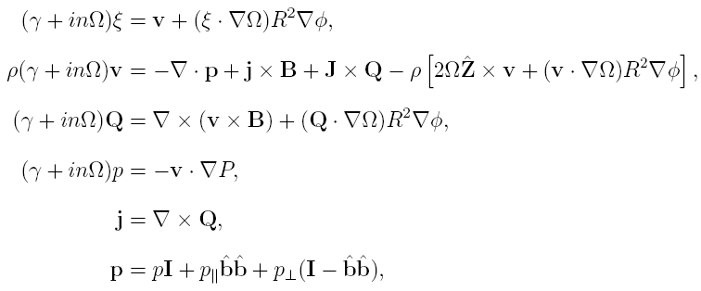
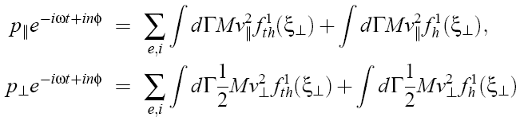
Numerical results from MARS-K code
Basic formulations:
Single MHD:
Kinetic contribution from particles:
MARS-K: full toroidal geometry, self-consistent computation of the kinetic effect of the particles on MHD instability effect
Notes:
Incompressible model, thermal displacement on perp direction, and the motion of EP.
13

Slide 14
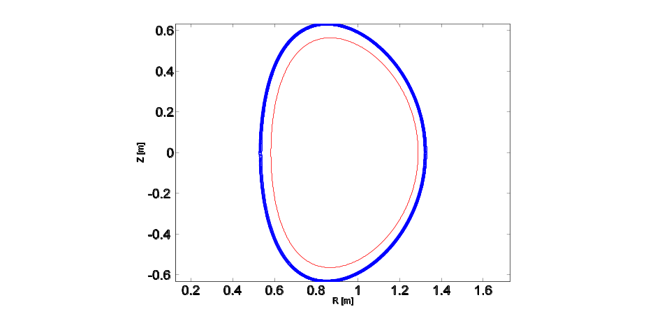
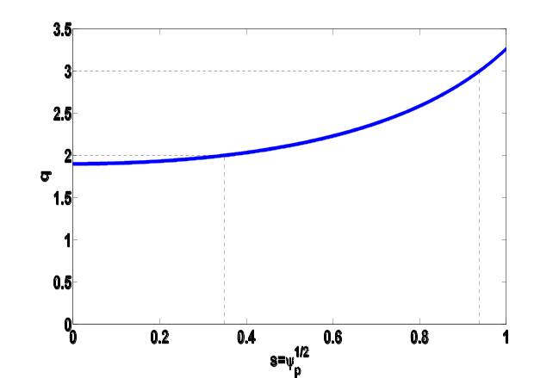
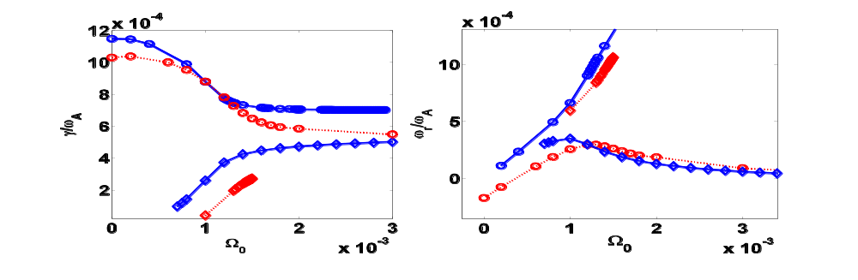
Numerical results consistent with analytical results
wall
Safety factor profile
Plasma surface
Upper branch
Lower branch
Red curves: ion collision frequency = 3E-4; Blue curves: no collisionality
w/o collisionality, there exist two branches when plasma flow exceeds a critical value
Collisionality stabilizes the lower branch, but destabilizes the upper one

Slide 15
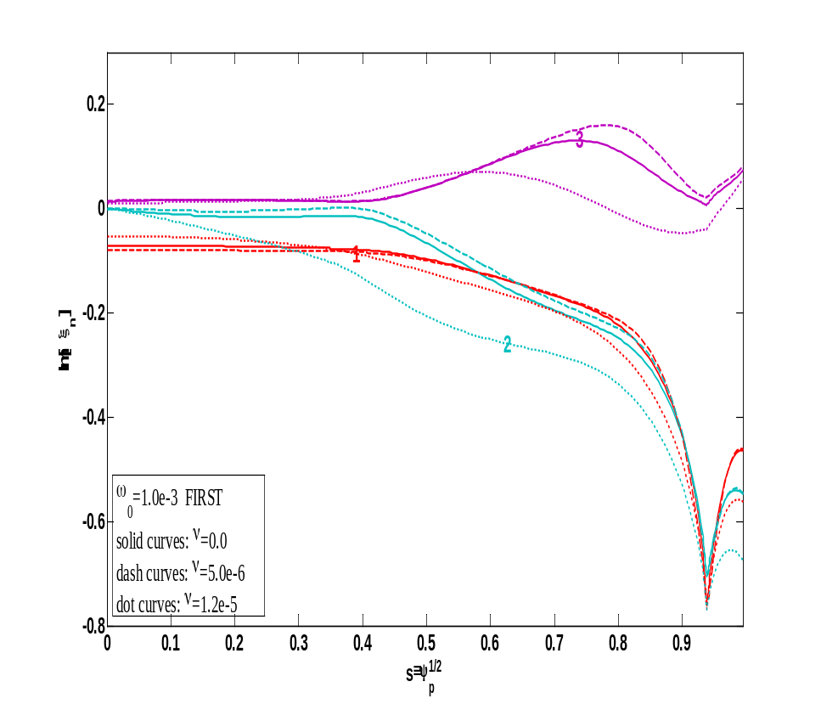
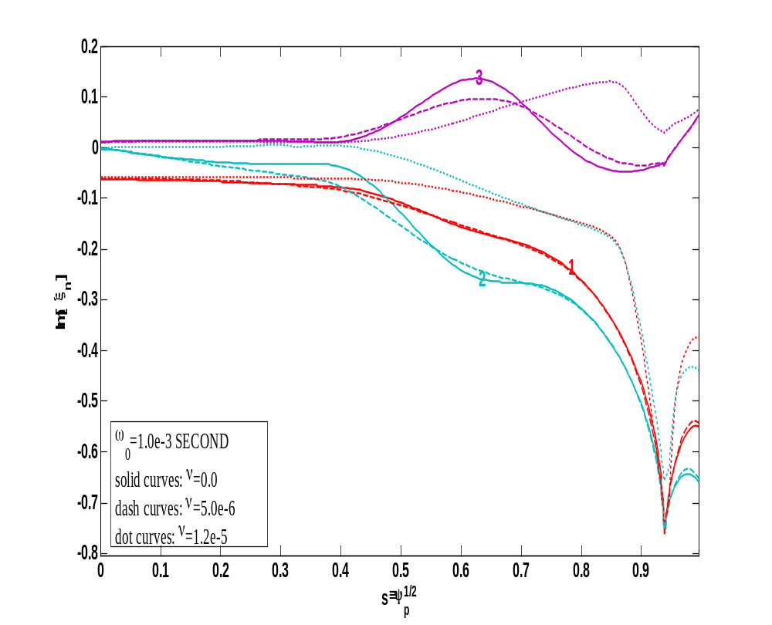
Collisionality globaly affect the mode structure
Upper branch
Lower branch
For upper/lower branch, collisionality slightly pushes the mode perturbation to the core/edge plasma region

Slide 16
Summary
The resonance between the mode and precession drift frequency of trapped thermal ions is stabilizing; however, the resonance destabilizes a new branch when the rotation exceeds a critical value
Collisionality can be either stabilizing or destabilizing, depending on the value of mode frequency and plasma rotation.
In the low collisionality regime, plasma flow stabilizes one branch but destabilizes another
The numerical results of full toroidal, self-consistent computation using MARS-K confirms the main conclusion of analytical model
The main conclusion is still kept, when electron kinetic effect is included.
The results expand the zoology of RWM behavior in low collisionality tokamaks such as NSTX-U

