Slide 1


Modifications to Ideal Stability by Kinetic Effects for Disruption Avoidance
J.W. Berkery, S.A. Sabbagh, and Y.S. Park
Columbia University
R.E. Bell, S.P. Gerhardt, B.P. LeBlanc, and J.E. Menard
Princeton Plasma Physics Laboratory
18th International Spherical Torus Workshop
Princeton, New Jersey
November 3-6, 2015

Slide 2
Abstract
Marginal stability points of global modes during high beta operation in NSTX can be found by computing kinetic modifications to ideal magnetohydrodynamic limits on stability. Calculations with the DCON code for nearly five thousand experimental equilibria show that the no-wall beta limit decreased with increasing aspect ratio and increasing broadness of the pressure profile, which has implications for NSTX-U. Kinetic modification to ideal limits calculations for several discharges as computed using the MISK code predict a transition from damping of the mode to growth as the time approaches the experimental time of marginal stability to the resistive wall mode. The main stabilization mechanism is through rotational resonances with the ion precession drift motion of thermal particles in the plasma, though energetic particles also contribute to stability. To determine RWM marginal stability for use in disruption avoidance, ideal stability limits need to be modified by kinetic effects in order to reproduce experimental marginal stability points. Guided by the full calculations, reduced stability models are investigated to inform automated disruption characterization and prediction analyses presently being developed using NSTX data for application to NSTX-U.

Slide 3
Near 100% disruption avoidance is an urgent need for ITER; NSTX-U is planning a disruption avoidance system
The new “grand challenge” in tokamak stability research
  Can be done! (JET: < 4% disruptions w/C wall, < 10% w/ITER-like wall)
    ITER disruption rate: < 1 - 2% (energy load, halo current); << 1% (runaways)
  Disruption prediction, avoidance, and mitigation (PAM) is multi-faceted, best addressed by focused, national effort (multiple devices/institutions)
Disruption prediction by multiple means will enable avoidance via profile or mode control or mitigation by MGI
Predictors (Measurements)
Eq. properties (β, l_{i}, V_{loop},…)
Profiles (p(r), j(r), v_{φ}(r),…..)
Plasma response (RFA, …)
Plasma Operations
Disruption Warning
System
Control Algorithms: Steer
Towards Stable Operation
Locked Mode, NTM avoidance,
RWM, dynamic EF, state-space
control (plasma response)
Avoidance Actuators
q, v_{φ}, p control
3D fields: EF, v_{φ} control
n=1-3 feedback
Mitigation
Early shutdown
Massive Gas Injection

Slide 4
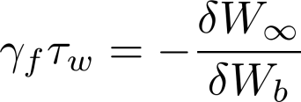
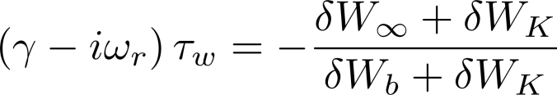
RWM dispersion relation evaluated with ideal and kinetic components allows for passive stabilization of the RWM
Resistive Wall Mode (RWM) fluid dispersion relation:
Ideal Kink Mode
Resistive Wall Mode
γ
~τ_{w}⁻¹
unstable
0
τ_{w}⁻¹ is slow enough for active stabilization (feedback)
stable
However, experiments operate above the no-wall limit without active control!
β_{N}^{no-wall}
β_{N}^{with-wall}
Ideal Stability
Kinetic Effects
Passive stabilization
  Collisional dissipation
  Rotational stabilization
    Models with scalar “critical rotation” for stability could not explain experiments
[B. Hu et al., Phys. Rev. Lett. 93, 105002 (2004)]
[S. Sabbagh et al., Nucl. Fusion 50, 025020 (2010)]

Slide 5
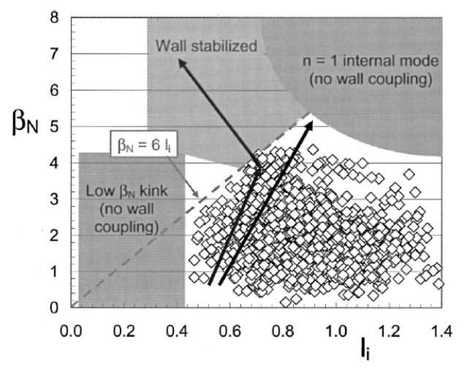
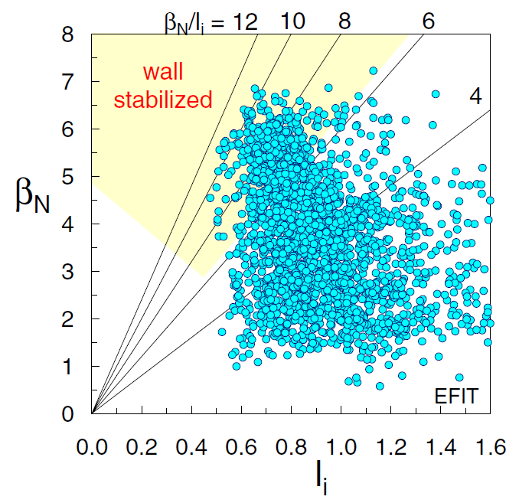
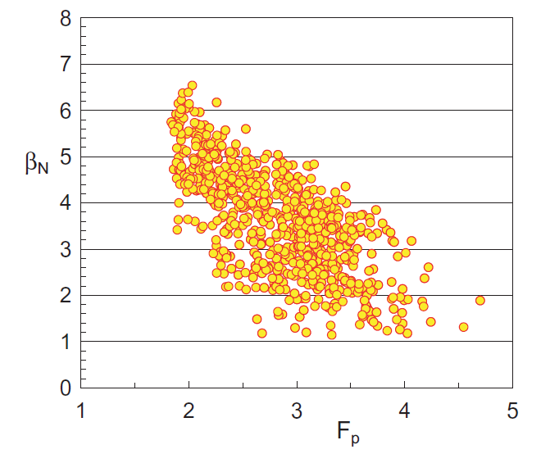
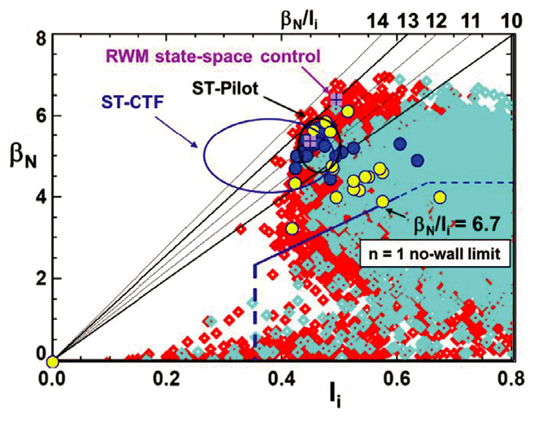
NSTX steadily progressed above the no-wall limit, adding improved active control, understanding of passive stability
Active control
  Dual sensor (B_{p} + B_{r}) proportional gain
  State space control with model of conducting structures and plasma mode
Passive stability
  Kinetic effects in the RWM dispersion relation
  Stabilizing rotational resonances between particles and mode
[S. Sabbagh et al., Phys. Plasmas 9, 2085 (2002)]
l_{i}
[S. Sabbagh et al., Nucl. Fusion 46, 635 (2006)]
active control
passive
Pressure peaking factor
[S. Sabbagh et al., Nucl. Fusion 44, 560 (2004)]
[S. Sabbagh et al., Nucl. Fusion 53, 104007 (2013)]

Slide 6
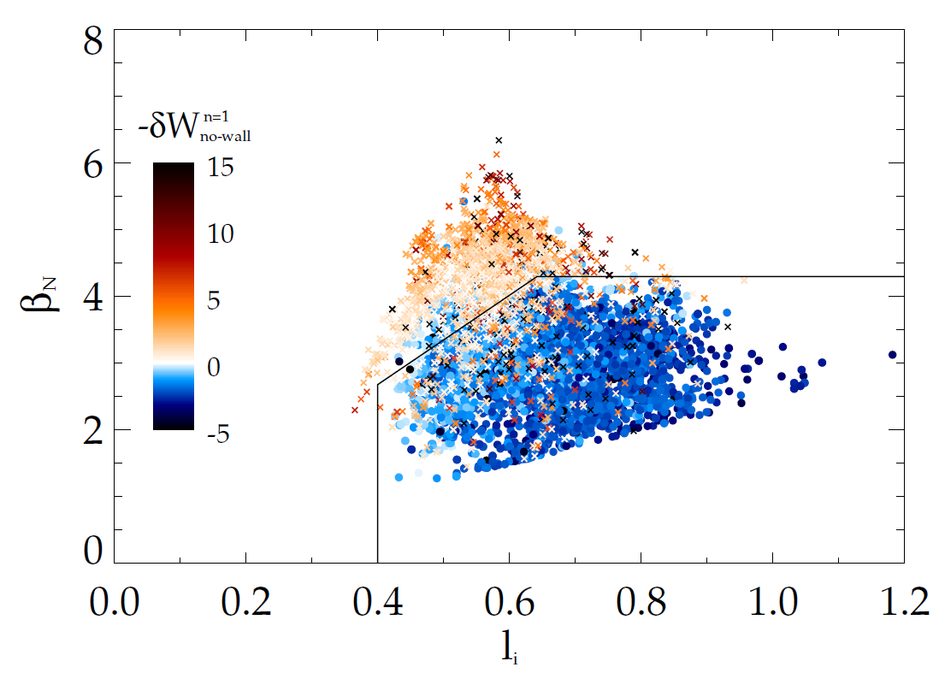
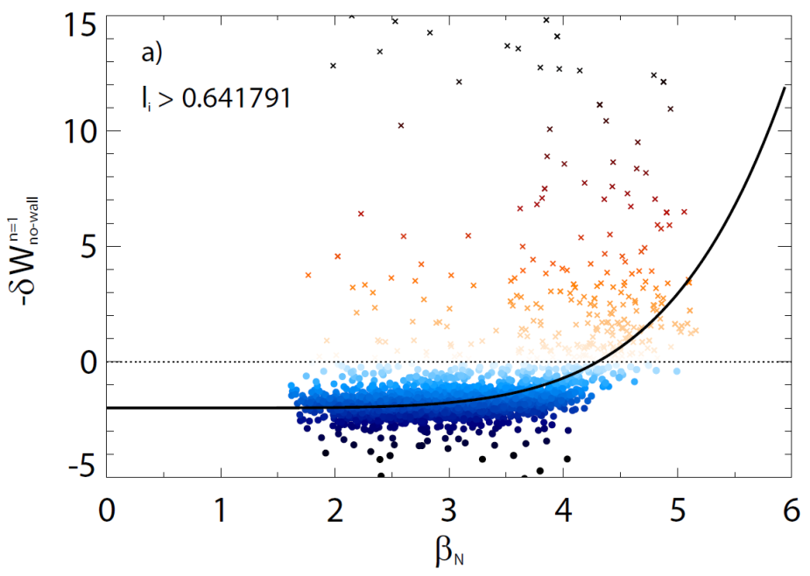
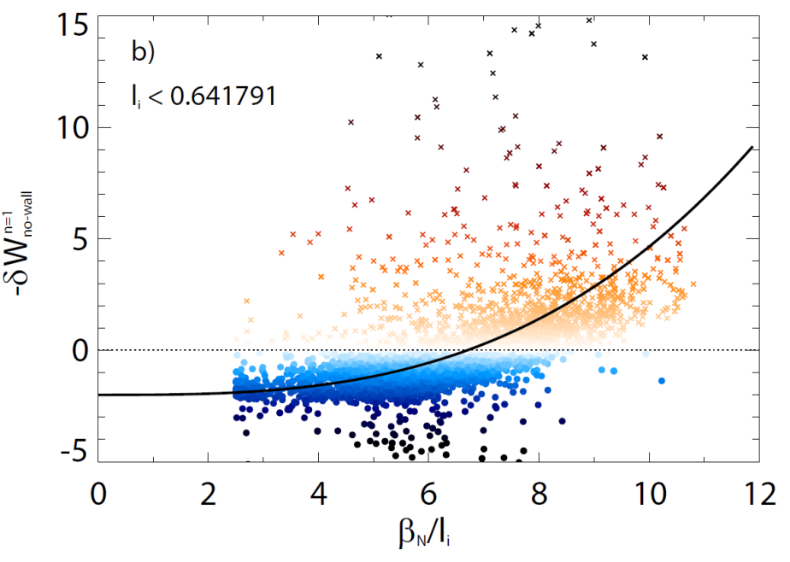
New, expansive DCON calculations confirm previous assessment of the NSTX ideal n=1 no-wall limit
DCON assessment of the NSTX no-wall limit (as of 2013)
Above the no-wall limit
β_{N} ≈ 4.3
β_{N} ≈ 4.3
β_{N}/l_{i} ≈ 6.7
β_{N}/l_{i} ≈ 6.7
Below the no-wall limit
  DCON runs with consistent settings: Ψ_{high} < 0.992, dm_{lim} = 1.10 (truncates at q = X.1)
  4784 equilibria from 349 discharges from 2010, all in the flat-top, all with β_{N}/l_{i} > 2.5
[J. Berkery et al., Nucl. Fusion 55, 123007 (2015)]

Slide 7
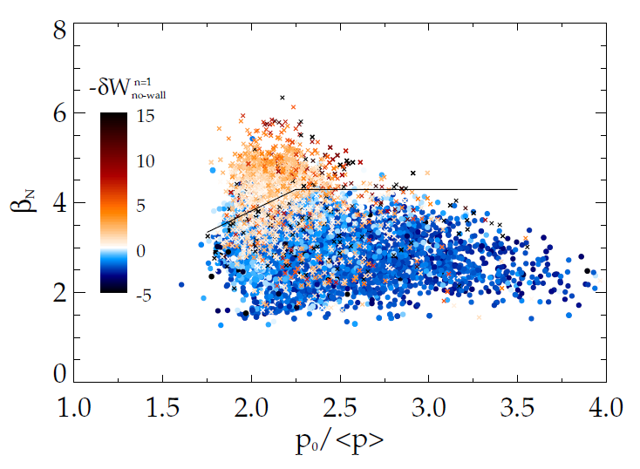
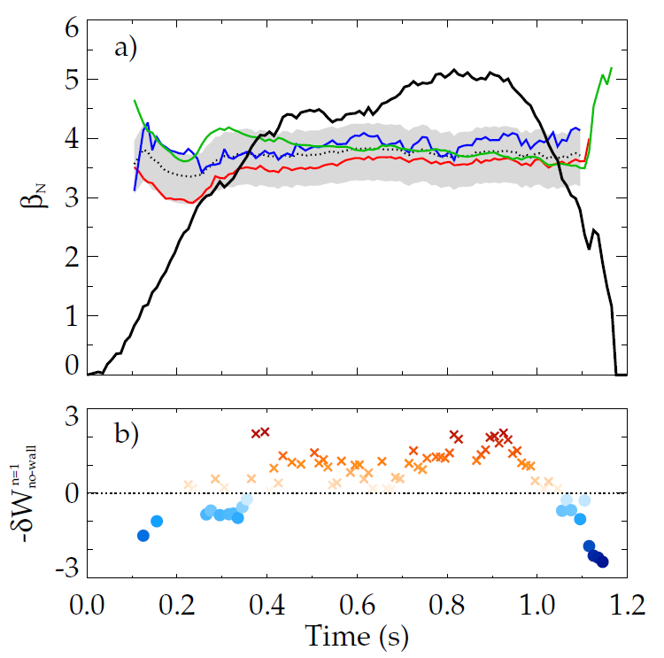
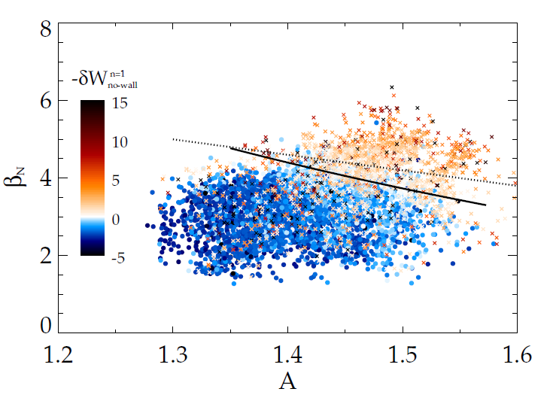
The ideal no-wall limit is estimated through dependence on internal inductance, pressure peaking, aspect ratio
kinetically stabilized
operational boundary
β_{N} = 6.7l_{i}
β_{N} = 1.9111(p₀/<p>)
β_{N} = 14(A⁻¹-0.4)
Composite estimate
[J. Berkery et al., Nucl. Fusion 55, 123007 (2015)]
ideal n = 1 no-wall limit
Example: NSTX discharge 138556
kinetically stabilized
DCON

Slide 8
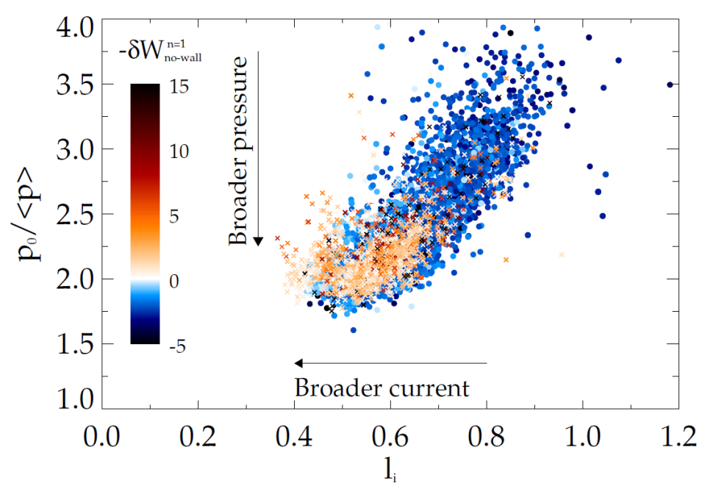
No-wall limit dependencies on internal inductance, pressure peaking, and aspect ratio have implications for NSTX-U
New neutral beams:
Broader current and pressure profiles
New center stack:
Larger aspect ratio
(NSTX-U: ~2x higher B_{T}, I_{p}, P_{NBI} and ~5x pulse length vs. NSTX)
Both new capabilities mean NSTX-U no-wall beta limit should be lower than NSTX
BUT ideal stability is, of course, not the full picture! Kinetic effects must be included…
[J. Berkery et al., Nucl. Fusion 55, 123007 (2015)]

Slide 9
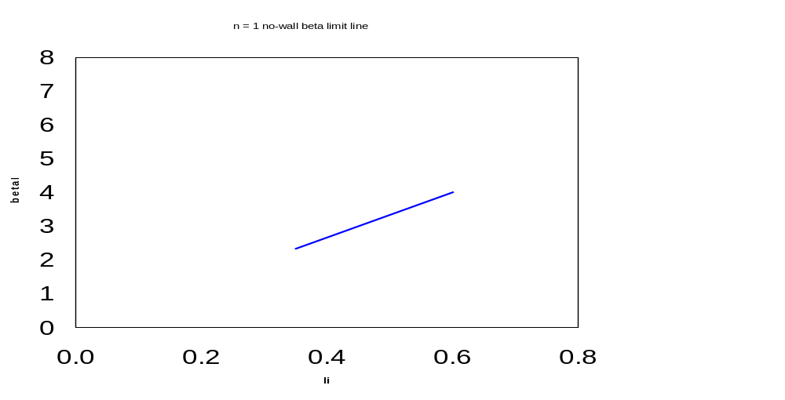
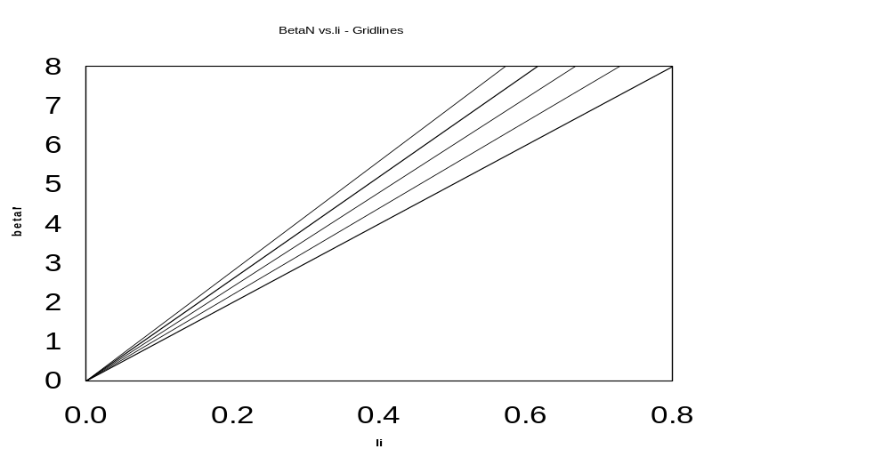
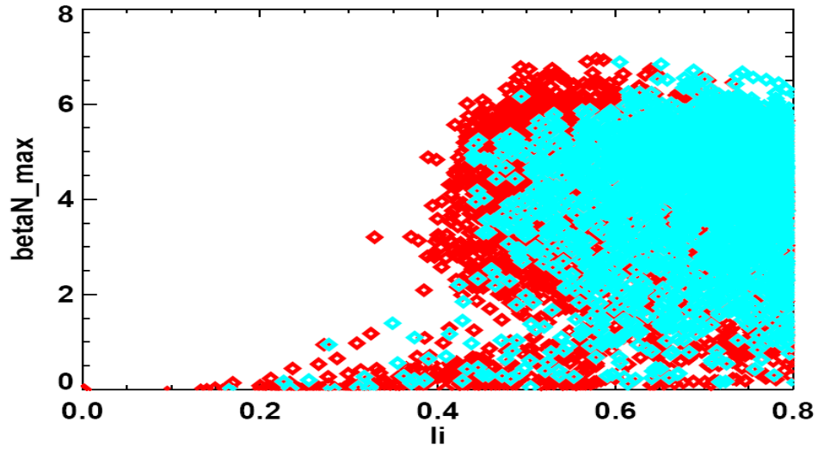
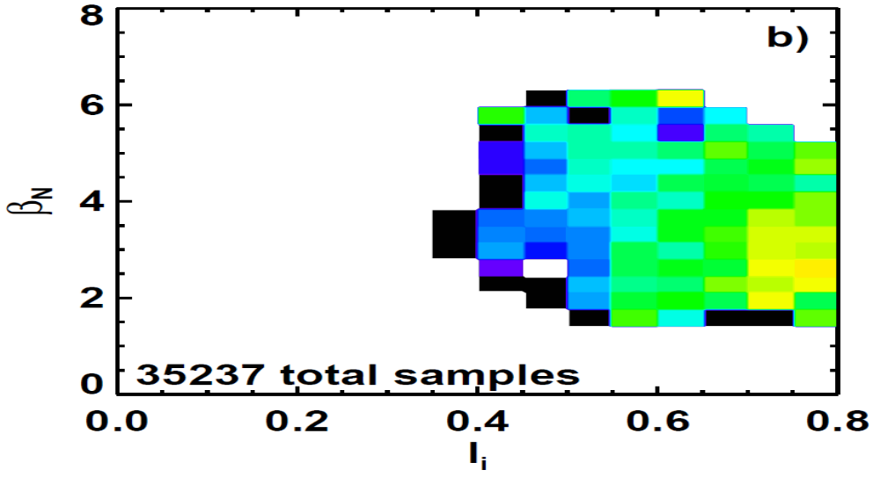
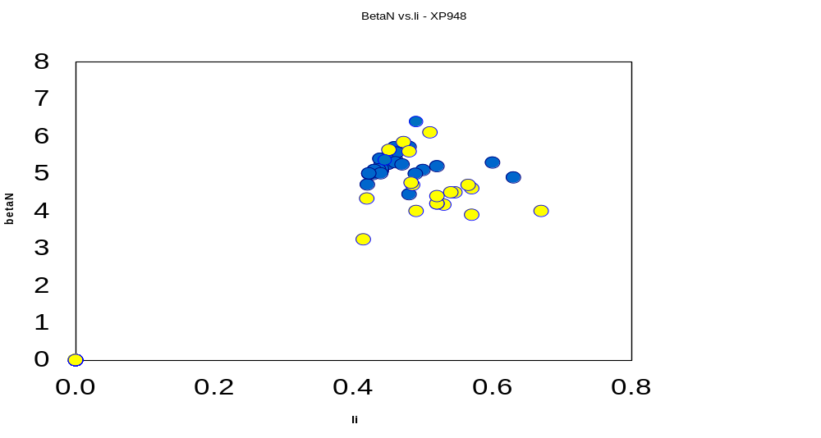

NSTX reaches high β_{N}, low l_{i} range of next-step STs and the highest β_{N}/l_{i} is not the least stable
β_{N}/l_{i}
14
13
12
11
10
8
Disruptivity
β_{N}/l_{i}
14
13
12
11
10
8
Unstable RWM
Stable/Controlled RWM
6
6
β_{N}
β_{N}
4
4
2
β_{N}/l_{i} = 6.7 : computed
NSTX n = 1 no-wall limit
2
0
0
0.0
0.2
0.4
l_{i}
0.6
0.8
0.0
0.2
0.4
l_{i}
0.6
0.8
[S. Sabbagh et al., Nucl. Fusion 53, 104007 (2013)]
[S. Gerhardt et al., Nucl. Fusion 53, 043020 (2013)]
NSTX can reach high β, low l_{i} range where next-step STs aim to operate
  High β_{N} for fusion performance, high non-inductive fraction for continuous operation
    High bootstrap current fraction -> Broad current profile -> Low l_{i} = <B_{p}²>/<B_{p}>_{ψ}²
  Unfavorable for ideal stability since low l_{i} reduces the ideal n = 1 no-wall beta limit
The highest β_{N}/l_{i} is not the least stable in NSTX
  In the overall database of NSTX disruptions, disruptivity deceases as β_{N}/l_{i} increases
  Passive stability of the resistive wall mode (RWM) must be explained
[J. Berkery et al., Phys. Plasmas 21, 056112 (2014)]

Slide 10
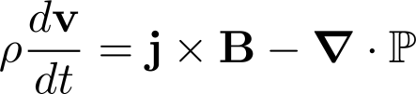
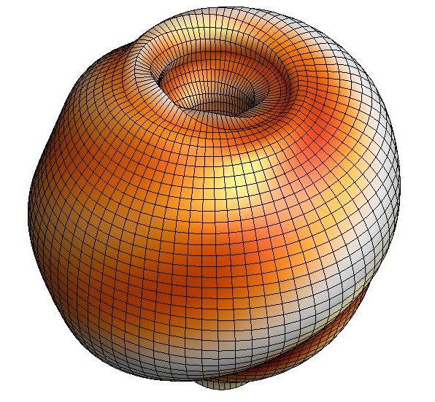

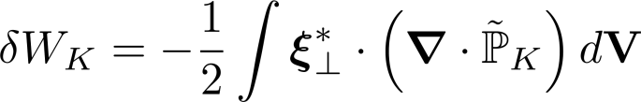


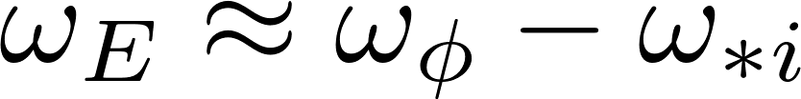
Kinetic effects arise from the perturbed pressure, are calculated in MISK from the perturbed distribution function
Force balance:
leads to an energy balance:
Kinetic Energy
Fluid terms
Change in potential energy due to perturbed kinetic pressure is:
is solved in MISK by using from the drift kinetic equation for
~ Plasma Rotation
Precession Drift
Collisionality

Slide 11
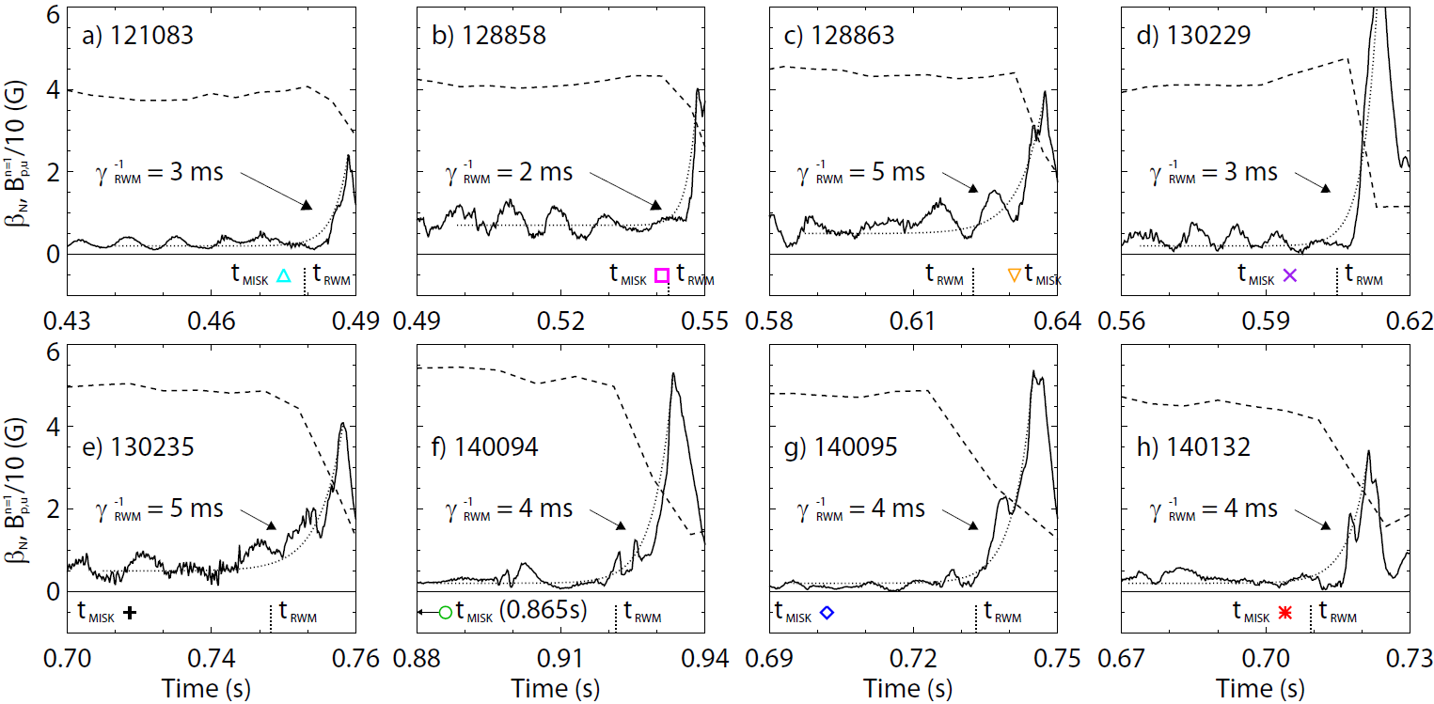
MISK calculations are grounded in validation against unstable experimental plasmas
NSTX
MISK calculations (at t_{MISK}) include kinetic effects, have been tested against many marginally stable NSTX experimental cases
[J. Berkery et al., Nucl. Fusion 55, 123007 (2015)]

Slide 12
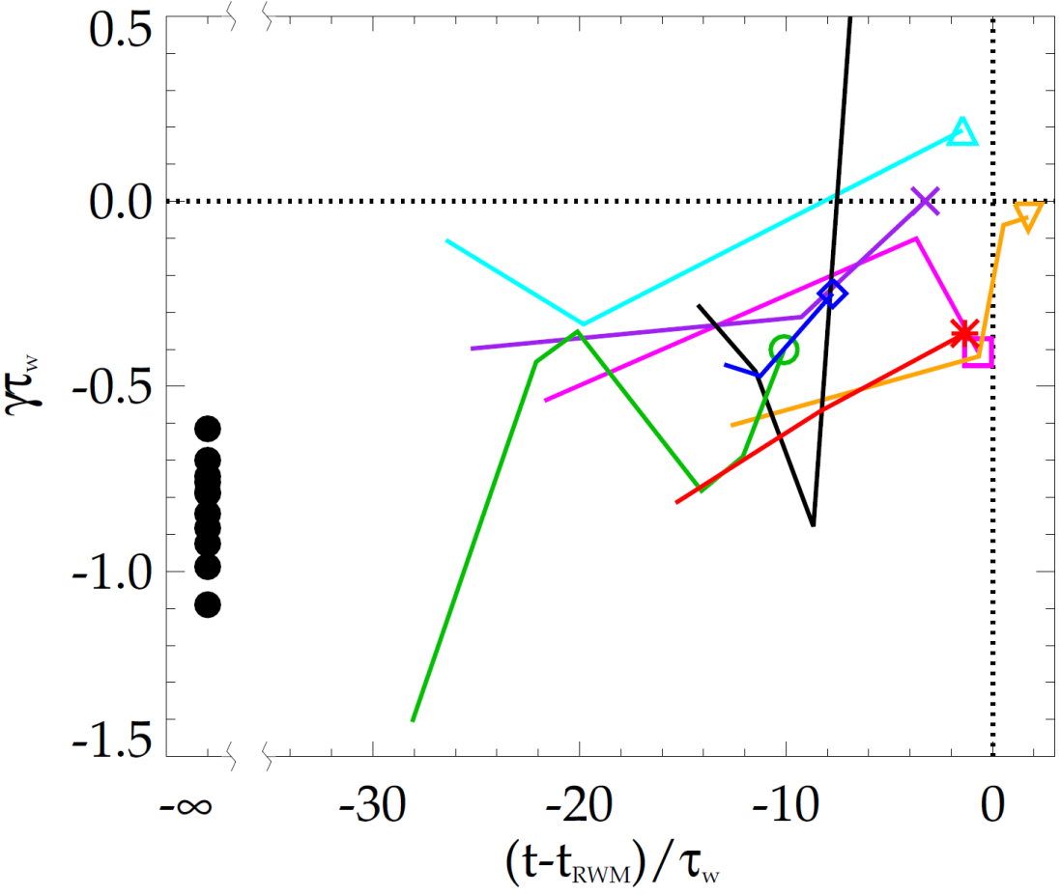
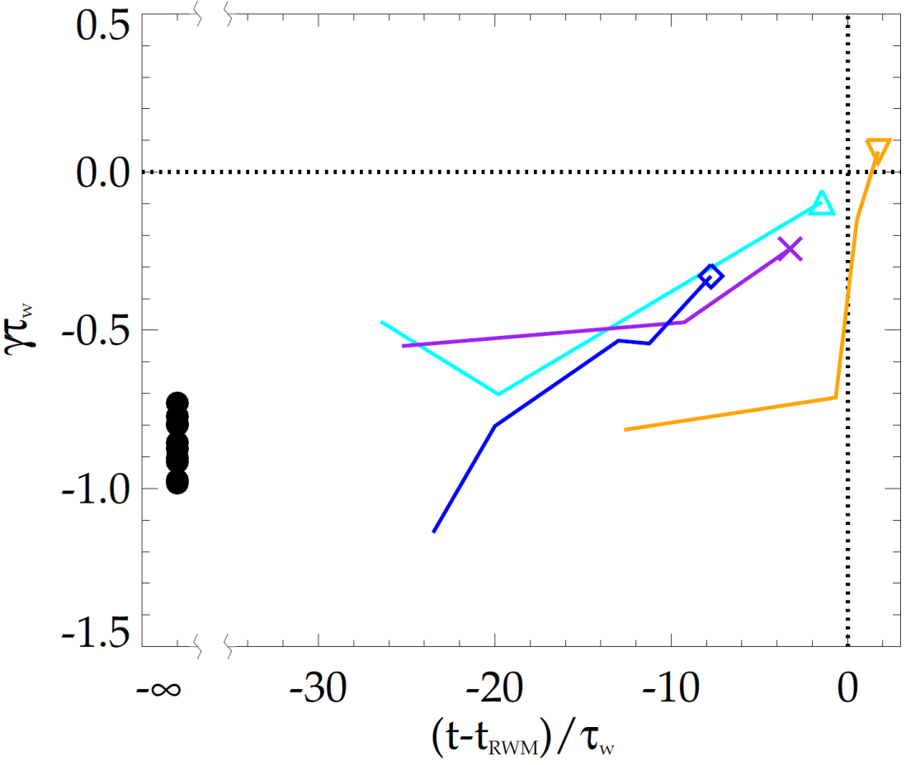
MISK calculations generally reproduce the approach towards marginal stability seen in experiments
NSTX
NSTX
unstable
unstable
stable
stable
Thermal particles
with energetic particles
In each case, the calculations trend towards instability (γτ_{w} = 0) as the time approaches the time of experimental RWM instability growth
  Twelve equilibria from discharges with no RWM show no trend and are more stable in the calculations
[J. Berkery et al., Nucl. Fusion 55, 123007 (2015)]

Slide 13
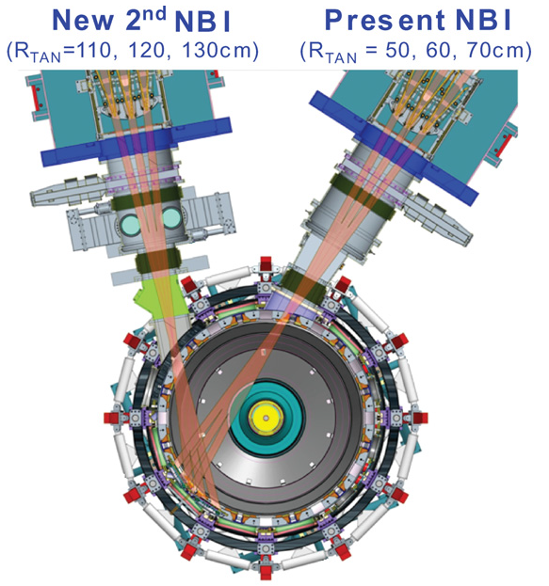
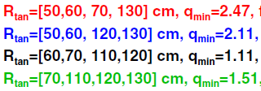
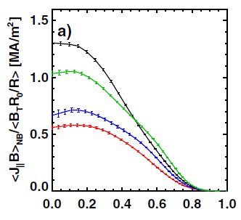
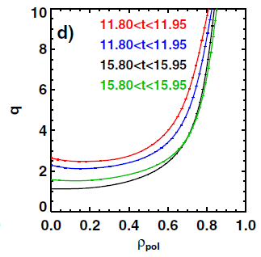
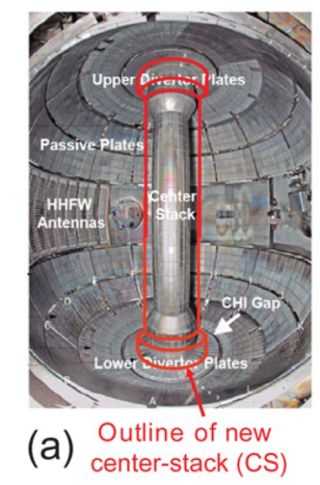
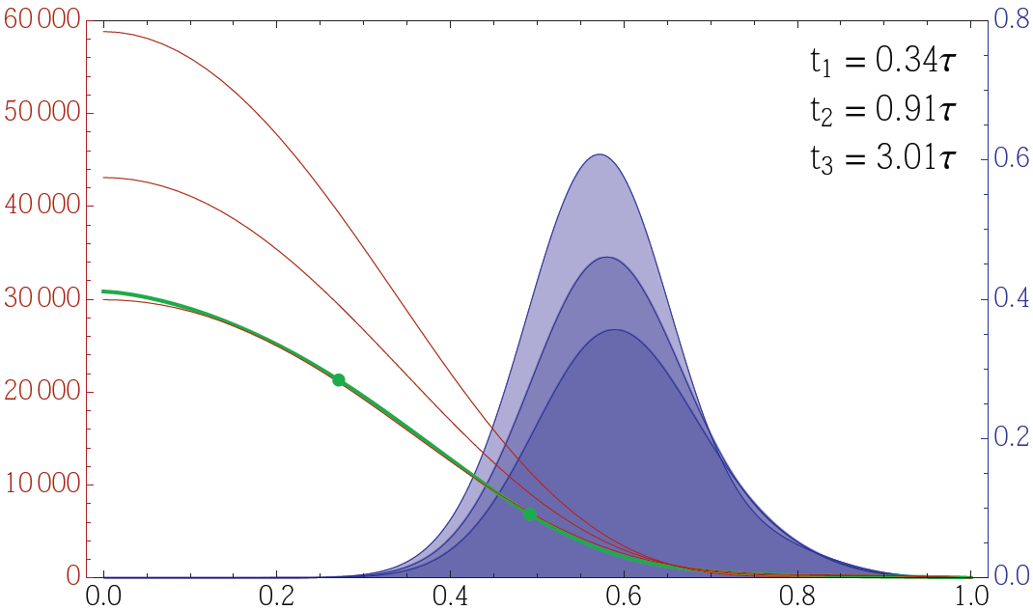
NSTX-U has new capabilities that impact stability or can be utilized for disruption avoidance
New neutral beams:
- Higher power
- Broader current and pressure profiles
[S.P. Gerhardt et al., Nucl. Fusion 52, 083020 (2012)]
NSTX-U state-space ω_{φ} controller w/NTV as actuator
New center stack:
- Higher current, field yields lower collisionality
- Test physics at larger aspect ratio
6
10⁴
t₁
t₂
4
t₃
NTV
region
Plasma rotation (rad/s)
NTV torque density (N/m²)
2
desired ω_{φ}
0
Radial coordinate
[S.A. Sabbagh et al., IAEA FEC paper EX/1-4 (2014)]

Slide 14
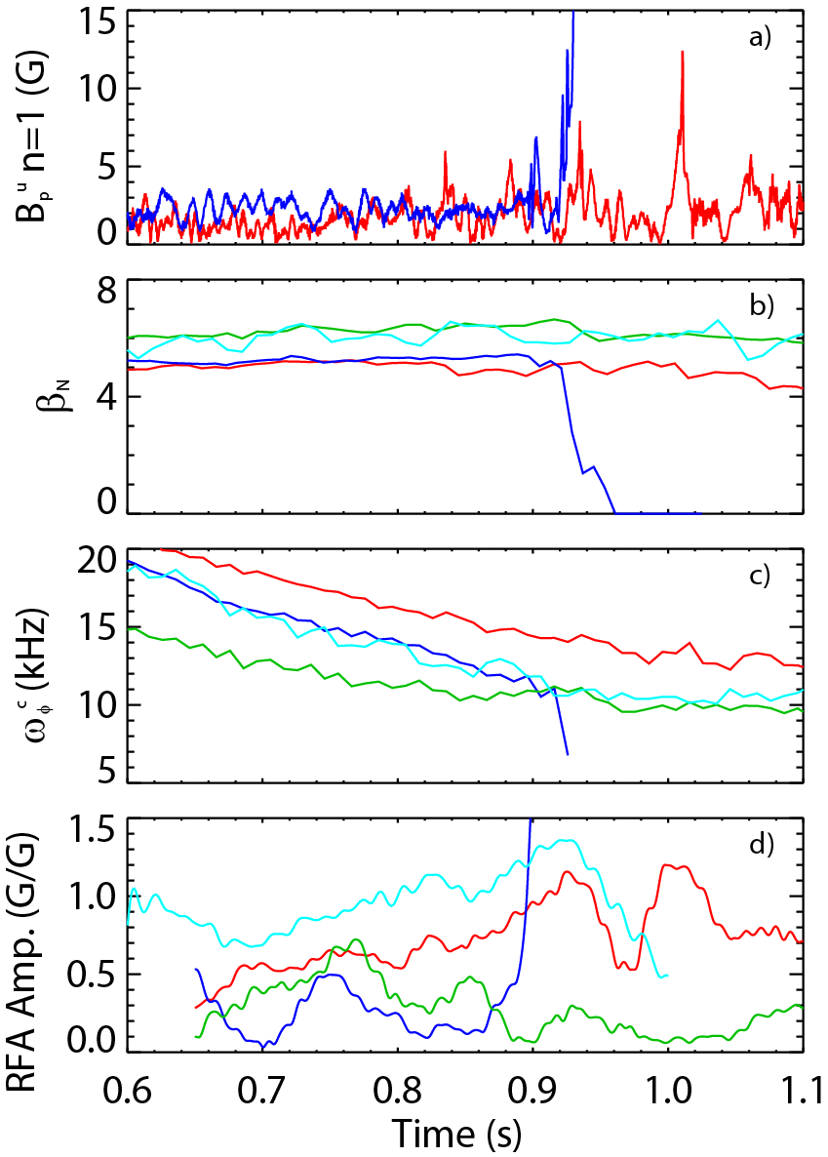
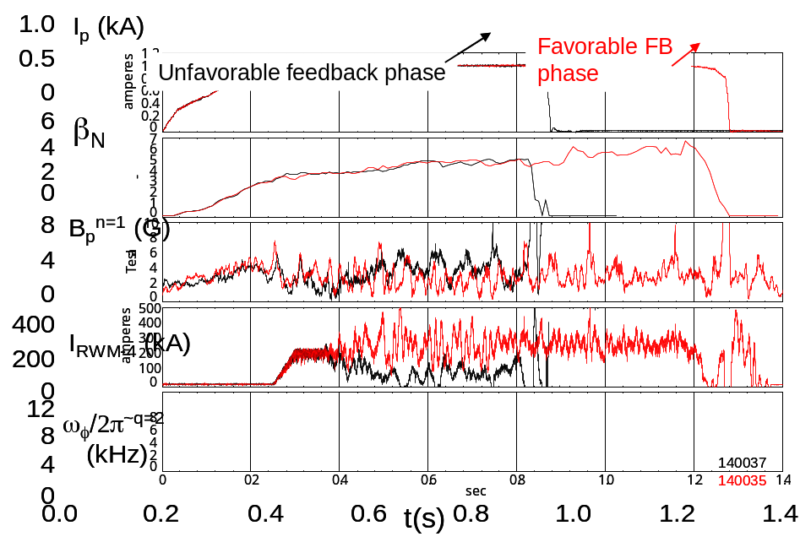
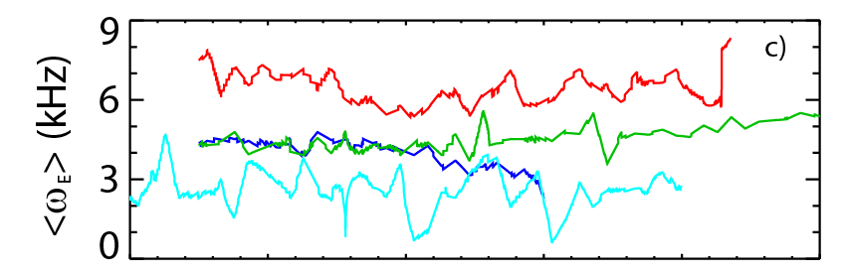
Real-time MHD spectroscopy, active control, or kinetic physics can be used for disruption avoidance in NSTX-U
MHD Spectroscopy
  Use real-time MHD spectroscopy while varying ω_{φ} and β_{N} to predict disruptions
  Disadvantage: plasma stability can change when kinetic profiles change, but MHD spectroscopy is limited in frequency
I_{p} (MA)
Active Control
  Combined Br + Bp feedback reduces n = 1 field amplitude, improves stability
  RWM state space controller sustains low l_{i}, high β_{N} plasma
Kinetic Physics
  Need real-time control of plasma rotation to stay in favorable kinetic stability range
  Evaluate simple physics criteria for global mode marginal stability in real-time (<ω_{E}> on resonance)
too high
safe
too low

Slide 15
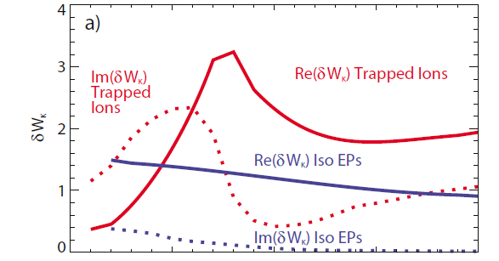
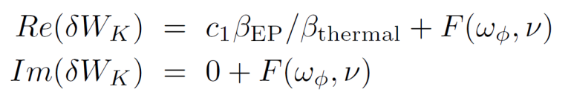
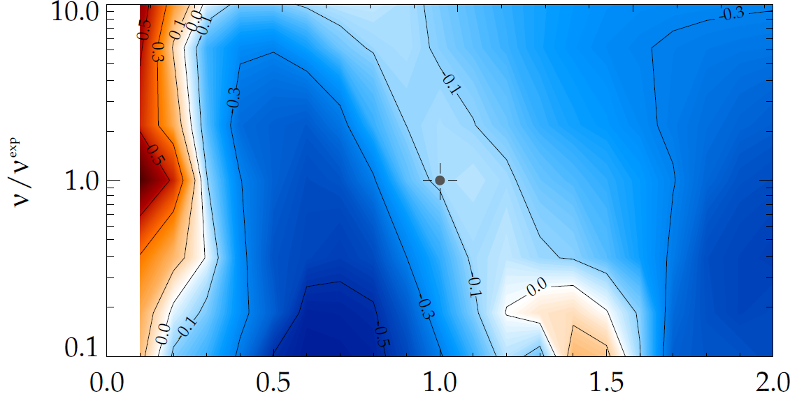
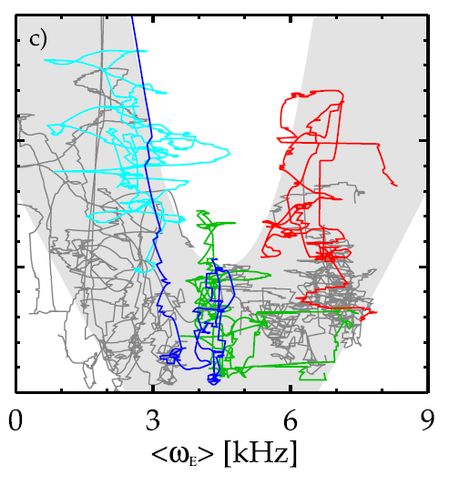
Reduced RWM kinetic stability model for disruption prediction
Simple expression for δW_{K} = F(ω_{φ}) will approximate these curves, with simple expressions for precession and bounce frequencies… and with collisionality included
[J. Berkery et al., Phys. Rev. Lett. 104, 035003 (2010)]
ω_{φ}/ω_{φ}^{exp}
γτ_{w} contours vs. ν and ω_{φ}
MISK code
[J. Berkery et al., Phys. Plasmas 17, 082504 (2010)]
Precession
Bounce
(marginal stability)
Plasma evolution
Precession drift resonance stabilization
Marginal stability
Bounce/transit resonance stabilization
ν_{eff}/ν^{exp (marginal stability)}
Resonant Field
Amplification (~1/δW_{K})
instability
(experiment)
NSTX 121083
unstable
ω_{φ}/ω_{φ}^{exp (marginal stability)}
unstable
Rotation, collisionality dependencies not so easily separable, but simplified, analytical models for these
have been proposed as well.
[J. Berkery et al., Phys. Plasmas 21, 056112 (2014)]
[J.W. Berkery et al., Phys. Plasmas 18, 072501 (2011)], [Y.Q. Liu et al., Phys. Plasmas 16, 056113 (2009)]

Slide 16
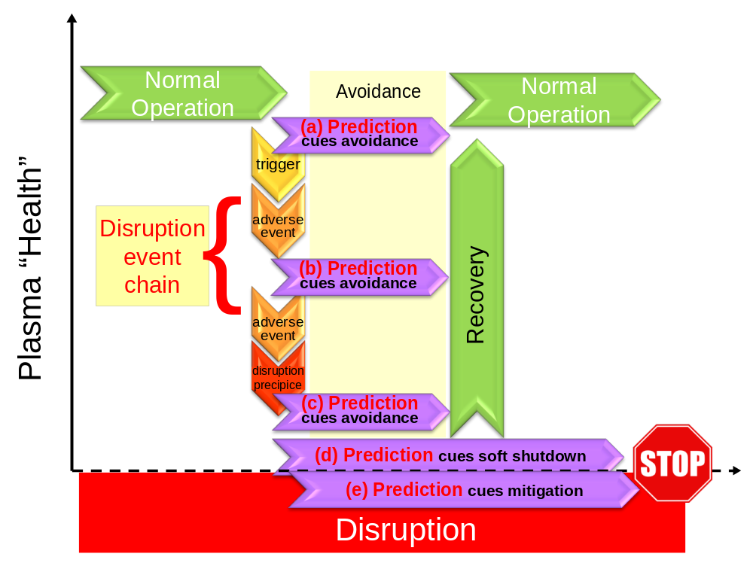
Disruption event chain characterization capability started for NSTX-U
Approach to disruption prevention
  Identify disruption event chains and elements
  Predict events in disruption chains
    Example: RWM marginal stability from kinetic model
    Attack events at several places
    Give priority to early events
  Provide cues to avoidance system to break the chain
  Provide cue to mitigation system if avoidance deemed untenable
t
[DOE report on Transient events (2015 - in final preparation)]
Disruption Event Characterization And Forecasting (DECAF) code written to address the first step – initial test runs started using NSTX data

Slide 17
Significant physics research is needed to predict opportunities for avoidance in disruption event chain
Example: A typical global MHD mode disruption event chain
trigger
possible (but not required) non-linear global mode initiation by bursting MHD event
n > 0 MHD mode
computed linear kinetic MHD instability limit surpassed, leading to exponential mode growth, or saturated rotating mode slows plasma rotation
excessive δB/B or lock
if n > 0 mode grows, plasma disruption occurs at excessive mode amplitude
if rotating mode locks, will grow to excessive amplitude
global mode may trigger an NTM, spawns an NTM disruption event chain
Examples of gaps in physics understanding
  Prediction of stability in low rotation plasmas
  Accurate non-ideal MHD stability maps
  Physical understanding of how mode locking produces disruption
  More comprehensive, validated physical understanding of role of rotation and profile in MHD stability

Slide 18
Disruption Event Characterization And Forecasting (DECAF) code is structured to ease parallel development
Physical event modules
Physical event modules separated
  Present grouping follows work of deVries – BUT, is easily appended or altered
Warning algorithm
  Present approach follows work of Gerhardt, et al. – BUT is easily appended or altered
General idea:
  Build from successful foundations – BUT keep approach flexible
Code control workbooks
Density Limits
Confinement
Main data structure
Technical issues
Tokamak dynamics
Output processing
Power/current handling
Mode stability
Kinetic RWM analysis will be used in DECAF as a reduced stability model

Slide 19
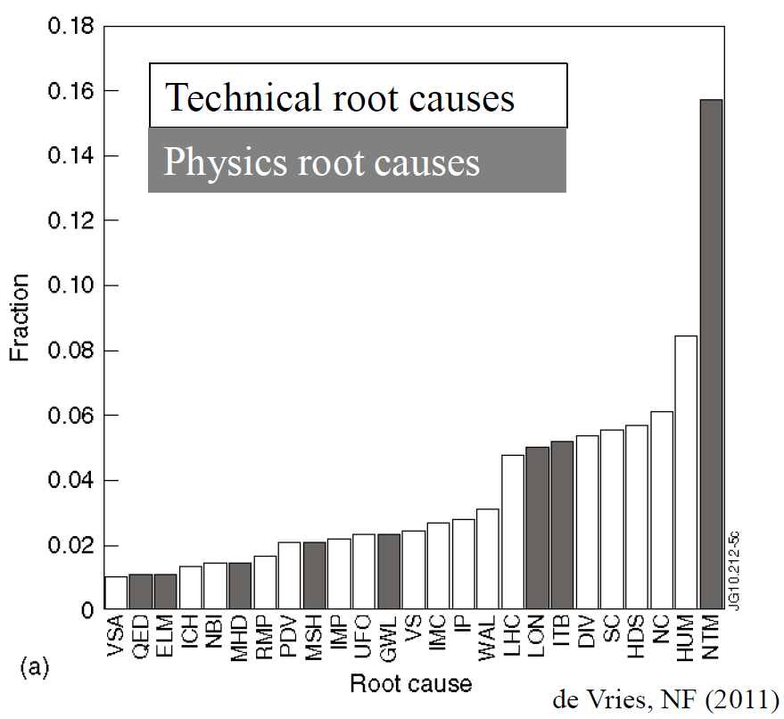
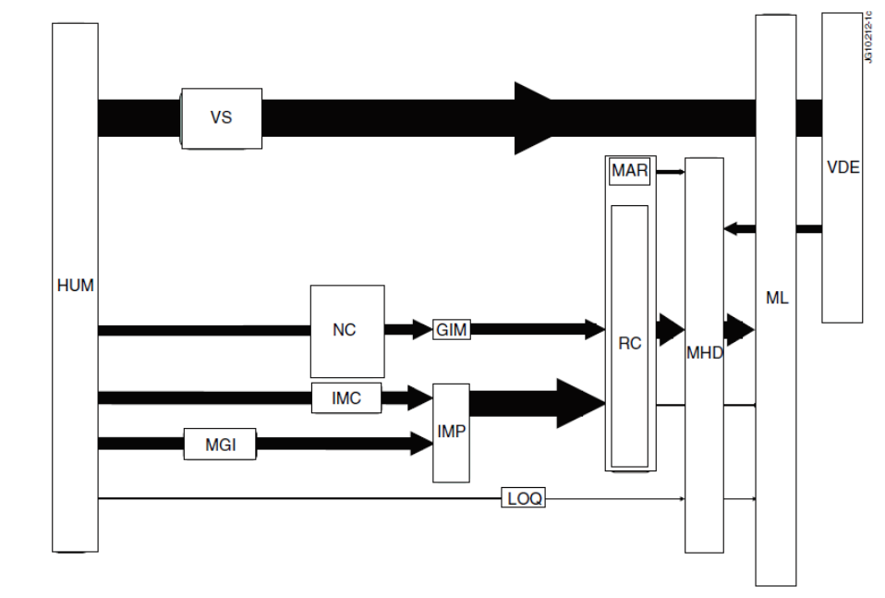
JET disruption event characterization provides framework to follow for understanding / quantifying DPAM progress
JET disruption event chains
Related disruption event statistics
[P.C. de Vries et al., Nucl. Fusion 51 (2011) 053018]
P. de Vries disruption event chain analysis for JET performed by hand – need to automate

Slide 20
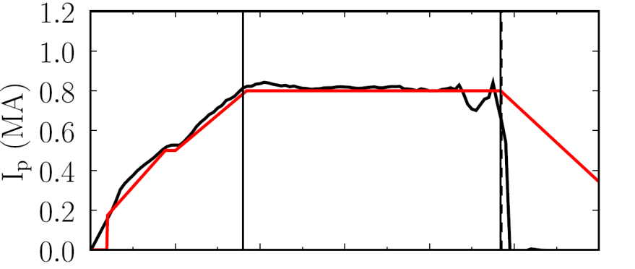
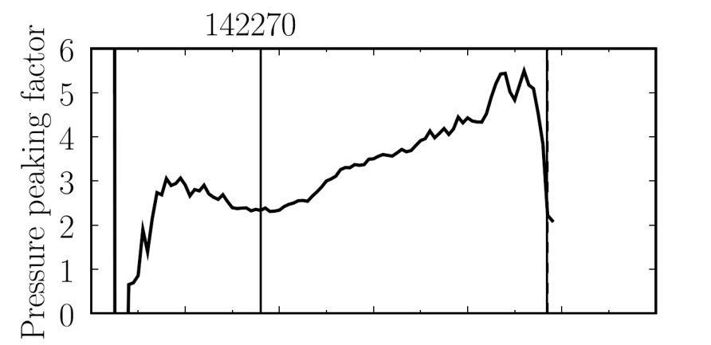

DECAF code yielding initial results: disruption event chains, with quantitative warnings
10 physical events are presently defined in code with quantitative warning points
  Easily expandable, portable to other tokamaks
This example: Pressure peaking (PRP) disruption event chain identified by code
  (PRP) Pressure peaking warnings identified first
  (VDE) VDE condition subsequently found 20 ms after last PRP warning
  (SCL) Shape control warning issued
  (IPR) Plasma current request not met
Kinetic RWM stability model will be implemented in (RWM) event
NSTX
142270
Disruption
PRP warnings
Event chain
PRP
VDE
SCL
IPR
Detected at: 0.420s
0.475s
0.485s
0.440s

Slide 21
Research in today’s presentation is part of NSTX-U’s evolving capabilities for disruption prediction/avoidance
Sensor/predictor (CY available) | Control/Actuator (CY available)
Low frequency MHD (n=1,2,3): 2003 | Physics model-based RWM state-space control (2010)
Low frequency MHD spectroscopy (open loop: 2005) | Dual-component RWM sensor control (closed loop: 2008)
r/t RWM state-space controller observer (2010) | NTV rotation control (open loop: 2003) (+NBI closed loop ~ 2017)
Real-time rotation measurement (2015) | Safety factor control (closed loop ~ 2016-17)
Kinetic RWM stabilization real-time model (2016-17) | Control of β_{N} (closed loop: 2007)
MHD spectroscopy (r/t) (in NSTX-U 5 Year Plan) | Upgraded 3D coils (NCC) (in NSTX-U 5 Year Plan)

Slide 22
Reduction of plasma disruptivity in NSTX-U will require implementing global stability models
Ideal stability is necessary, but not sufficient to explain stability
  Detailed DCON calculations confirm that previous calculations of the no-wall limit for NSTX were relatively accurate
Stabilizing kinetic resonances between plasma rotation and particle motions explain RWM stability
  Addition of kinetic effects yields agreement with marginal point in NSTX
  A real-time estimate of ExB frequency can determine if the plasma rotation is unfavorable and rotation control will return the plasma to a stable state
Disruption Event Characterization And Forecasting (DECAF) code written to identify disruption event chains
  Disruption categories and their sequential connections analogous to those used on JET are adopted, with warning algorithm for NSTX-U
  Reduced marginal stability models from kinetic RWM theory will be implemented in this framework

Slide 23
Sign up for Electronic Copy of Presentation
Please Include Name and Email Address
Or pick up a reprint…

Slide 24
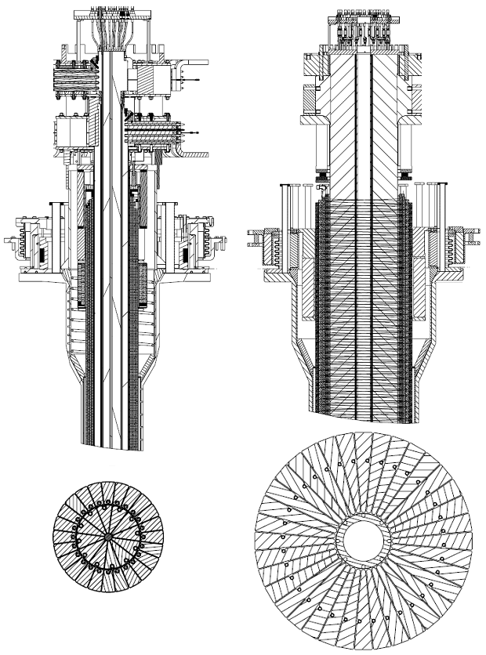
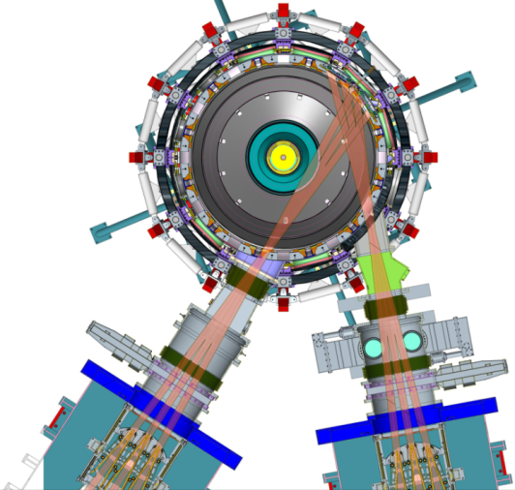
The National Spherical Torus Experiment Upgrade (NSTX-U) at the Princeton Plasma Physics Lab
Previous
center-stack
New
center-stack
New center column doubles toroidal magnetic field, plasma current
  Access conditions closer to FNSF
  Pulse lengths increase from 1 to 5 seconds
Second neutral beam injection system
  Doubles heating power, increases flexibility available for experiments
  More tangential injection improves current drive, especially at small plasma current
Increased flexibility in divertor configuration
TF OD = 20cm
TF OD = 40cm
Present NBI
New 2nd NBI

Slide 25
Disruption Prediction is a Multi-disciplined Task
Theoretical investigation
  Understanding of underlying physics of triggers and events required to create and extrapolate prediction algorithms to unexplored frontiers of next-step tokamak operation
Tokamak experiments
  Validate theory and determine reproducibility of the events
Modeling at several levels (e.g. quasi-empirical, linear, non-linear)
  Connect theory and experiment – the basic component of creating prediction algorithms; from r/t modeling coupled to sensors, etc. - to full non-linear MHD
Diagnostics
  Develop sensors required for advanced prediction algorithms in present tokamaks; to survive harsher conditions in next-step, fusion-producing devices
Control theory and application
  Design/test the compatibility and success of the coupled prediction and avoidance elements in the real-time disruption avoidance systems
Predictive analytics
  Use data, statistical algorithms and machine-learning techniques to identify the likelihood of future outcomes based on historical trends (AND physical models)

Slide 26
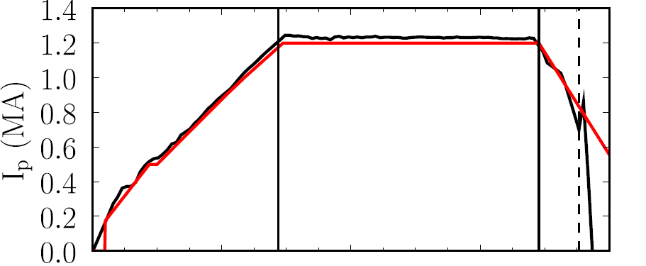
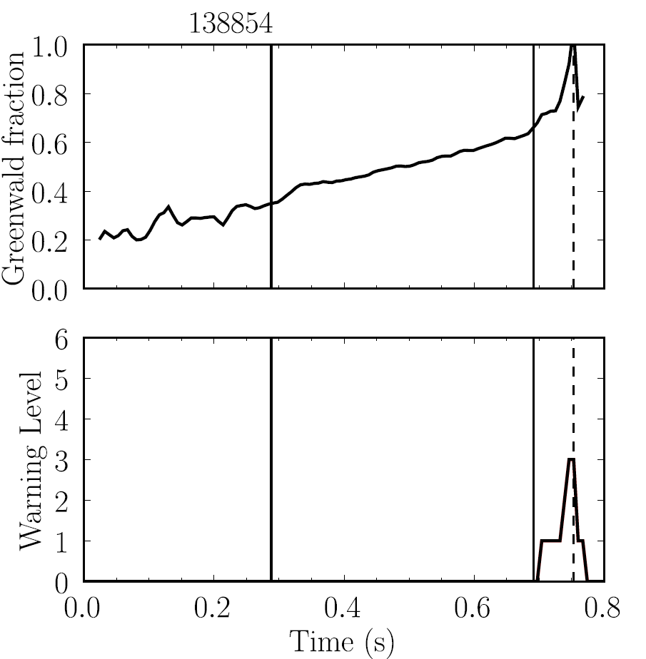
Disruption Event Characterization And Forecasting (DECAF) code yielding initial results: disruption event chains, with quantitative warnings (2)
NSTX
138854
This example: Greenwald limit warning during I_{p} rampdown
  (GWL) Greenwald limit warning issued
  (VDE) VDE condition then found 7 ms after GWL warning
  (IPR) Plasma current request not met
Disruption during
I_{p} ramp-down
GWL warnings
Event chain
GWL
VDE
IPR
Detected at: 0.746s
0.753s
0.753s

