Slide 1
Recent Progress in the SUNIST Spherical Tokamak
18th International Spherical Torus Workshop, Nov. 3-6, 2015
Princeton University, USA
Y. Tan¹, Z. Gao¹, W. H. Wang¹, A. H. Zhao¹, H. Q. Xie¹, Y. Q. Liu¹, Y. Z. Jiang¹, S. Chai¹, R. Ke¹, H. Zhong¹, W. B. Liu¹, S. Z. Wang¹, G. Li¹, Y. Li¹, Z. Y. Liu¹, X. Y. Guo¹, Y. H. Luo¹, C. H. Feng², L. Wang², X. Z. Yang²
¹Department of Engineering Physics, Tsinghua University, Beijing, China
²Institute of Physics, Chinese Academy of Sciences, Beijing, China
This work was supported by NSFC, under Grant Nos. 11261140327, 11325524, and 11475102, MOST of China, under Contract Nos. 2013GB112001and 2013GB107001, Tsinghua University Initiative Scientific Research Program and 221 Program.
* Email: tanyi@sunist.org

Slide 2
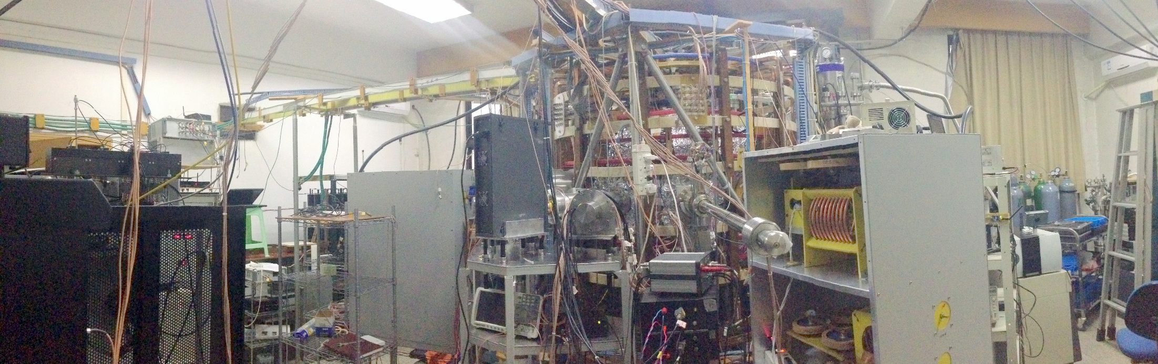
SUNIST (Sino-UNIted Spherical Tokamak)
The SUNIST spherical tokamak
Main parameters
  Major radius (R₀): 0.3 m
  Minor radius (a): 0.23 m
  Aspect ratio: ~ 1.3
  Elongation: ~ 1.8
  Toroidal field at R₀: < 0.15 T
  Plasma current: ~ 50 kA
  Pulse duration: ~ 15 ms (Ohmic)
  n_{e}: 0.2 ~ 3×10¹⁹ m⁻³
  T_{e}: ~ 100 eV
Main objectives
  Non-inductive startup and current drive
But
  Hardware of RF waves are experiencing difficulties
Current main topics
  Plasma properties in I_{P} ramp up/down phases of ohmic discharges

Slide 3
Outline
Effects of gas puffing on the repeatability of ohmic startup
Eddy current analysis and measurements
Test of a super fast reciprocating probe
Energy transfer of electrostatic turbulence
High frequency MHD activities
Summary

Slide 4
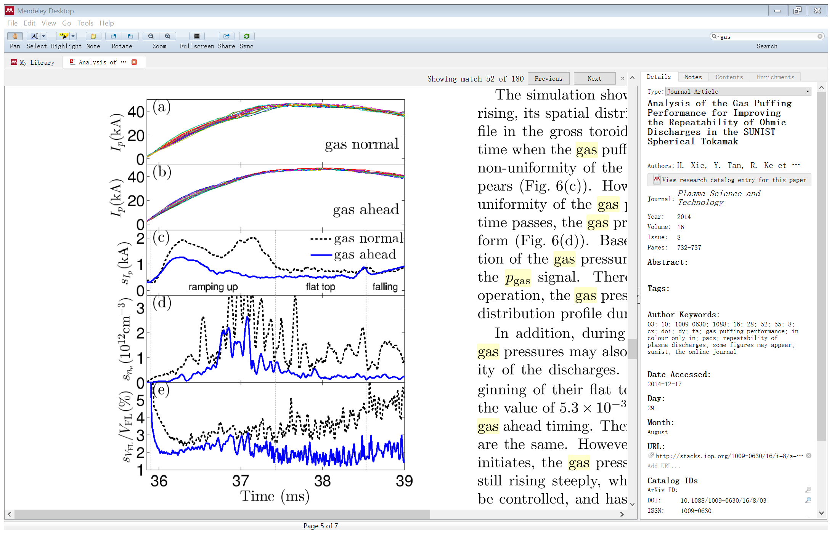
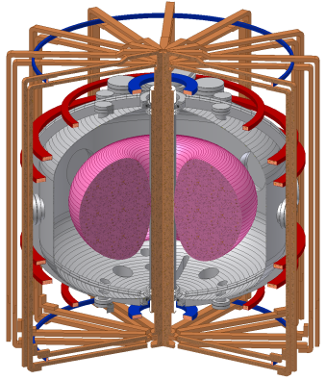
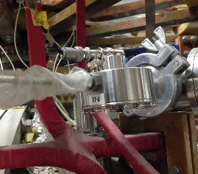
Effects of gas puffing on repeatability (1)
The repeatability of ohmic startup is not acceptable
  Although OH/VF/TF fields are almost identical in all shots
Gas puffing may be responsible for it
  Outboard puffing
  From the top
  By a piezo-valve
Cross section of SUNIST
Piezo-Valve

Slide 5
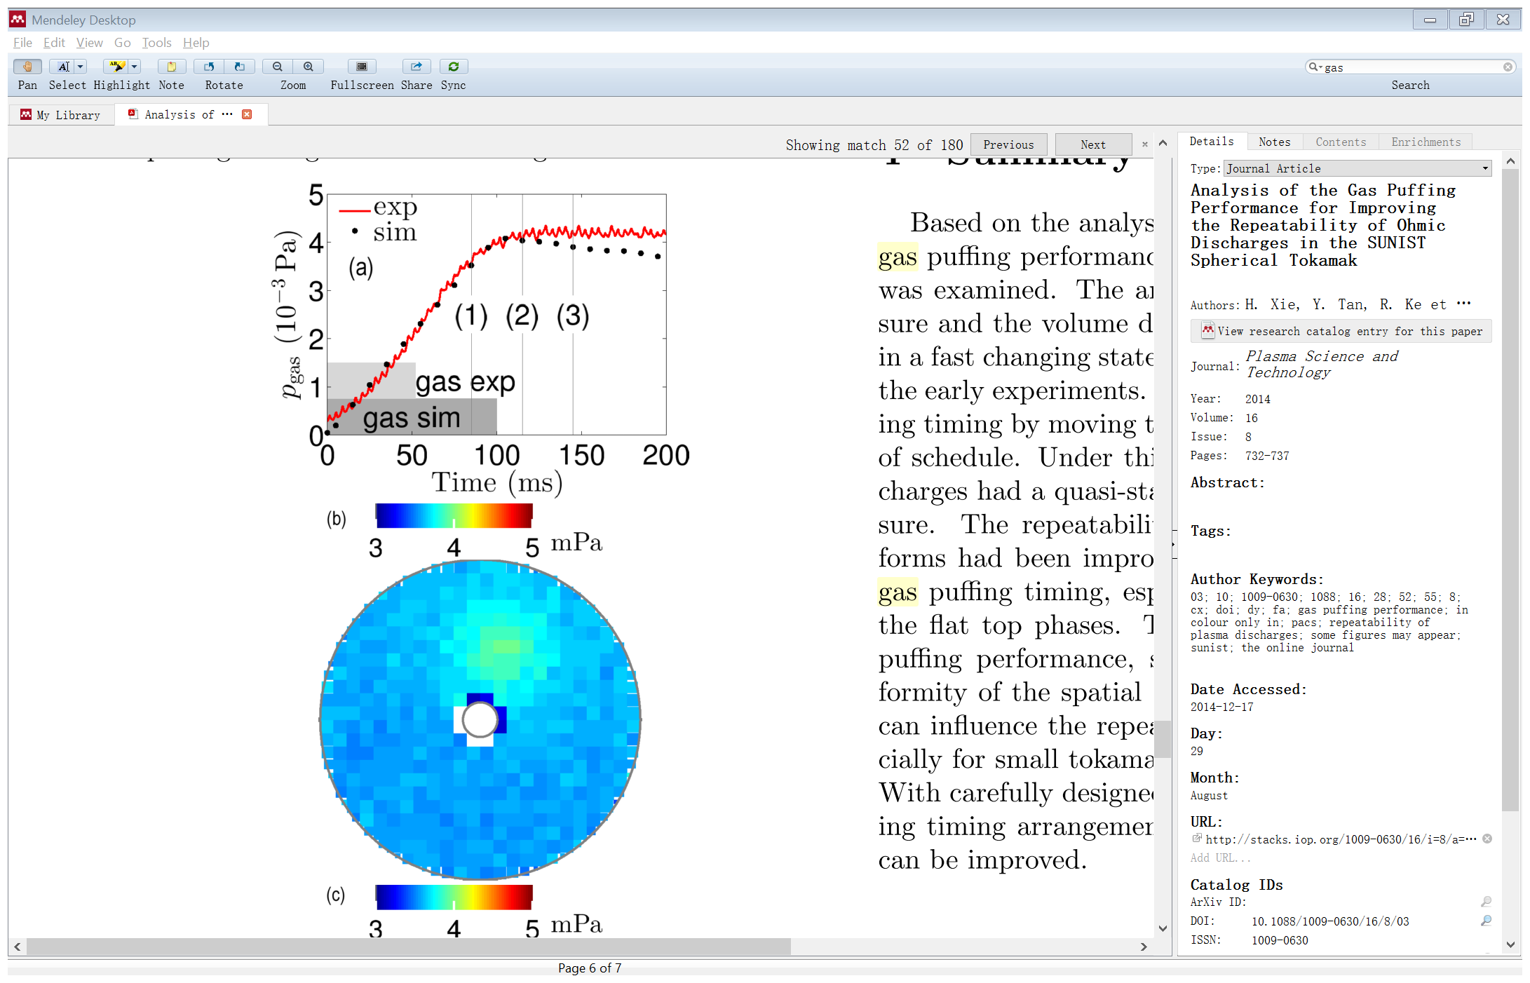
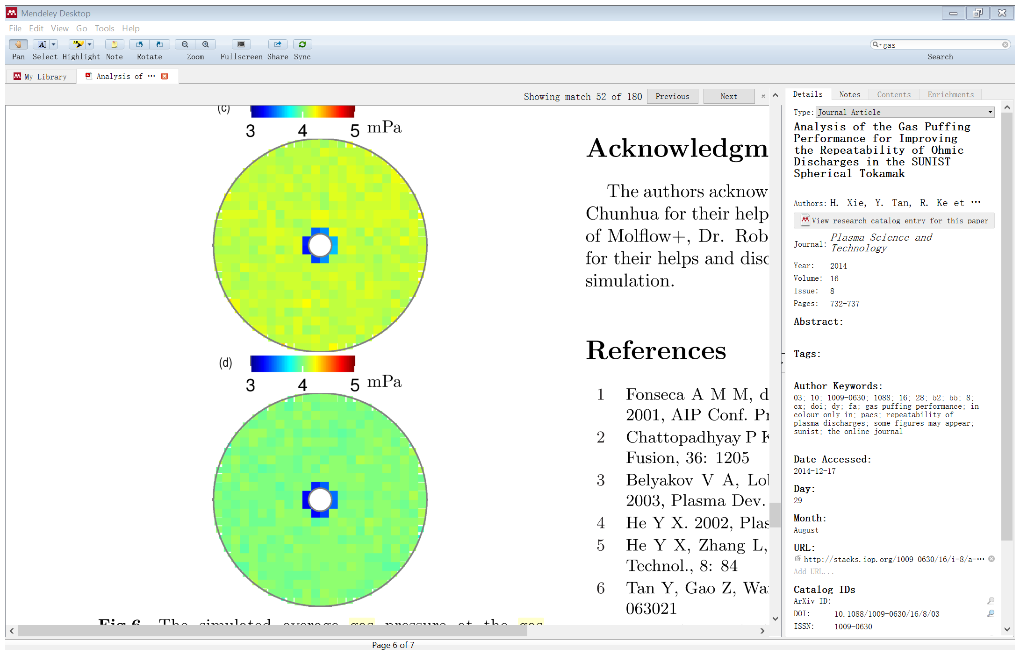
Effects of gas puffing on repeatability (2)
The distribution of gas pressure is analyzed by Molflow+
Significant time is needed to get the in-vessel gas pressure distribution uniform
Non-uniform distribution caused the unrepeatability
breakdown starts here
average gas pressure at the main pumping port
the gas pressure distribution in the equatorial plane at (1), (2) and (3)

Slide 6
Effects of gas puffing on repeatability (3)
Solution to improve repeatability
  Adjust the gas puffing timing
Better repeatability has been obtained
  Standard deviations of I_{P}, n_{e} and V_{loop} have been reduced obviously
Xie, PST, 2014

Slide 7
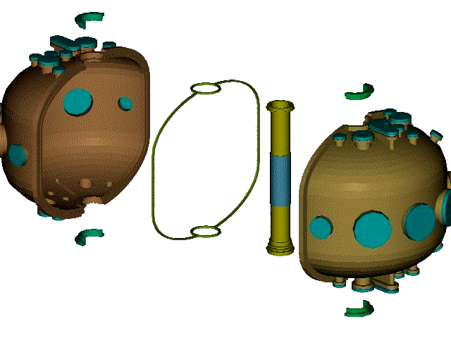
Eddy current study (1): motivation
SUNIST has a split vacuum vessel to save ohmic flux
Viton seal
The vacuum vessel of SUNIST is separated into three insulated parts.
Topview, the toroidal eddy current is blocked

Slide 8
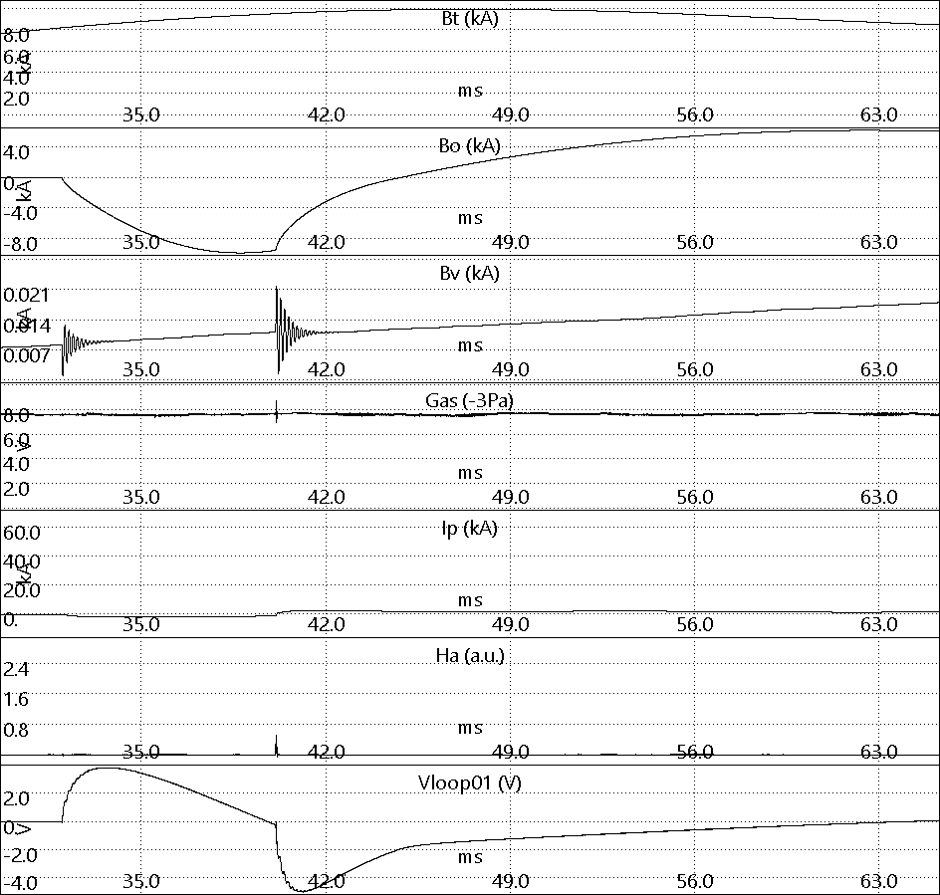
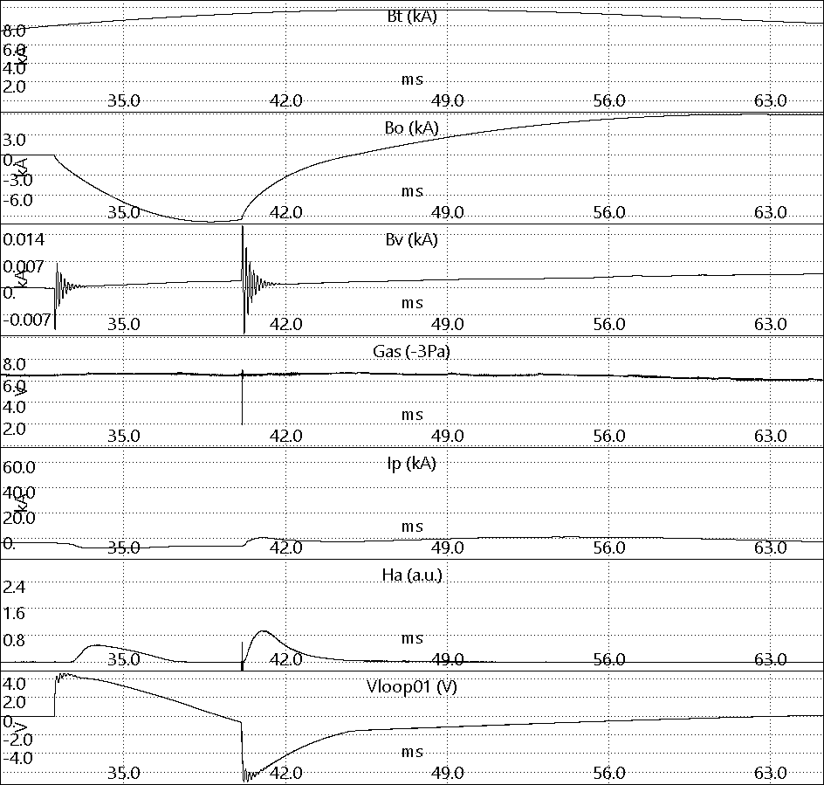
Eddy current study (2): motivation
It is effective! Breakdown is more easy in the insulated vacuum vessel
Same Bt, ohmic
field and gas puffing
No H_{α} (no breakdown)
H_{α} observed
(breakdown happened)
Soft rising of Vloop
Hard rising of Vloop
Connected
Disconnected

Slide 9
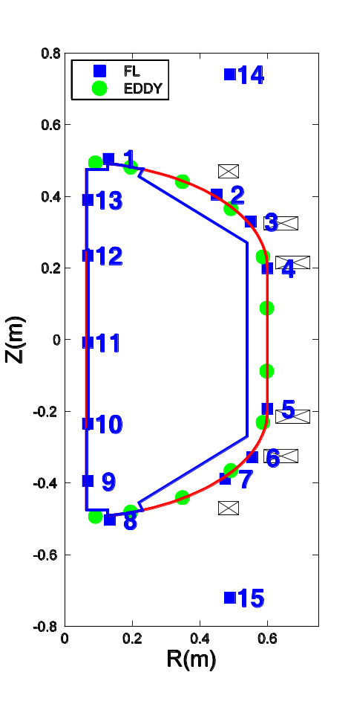
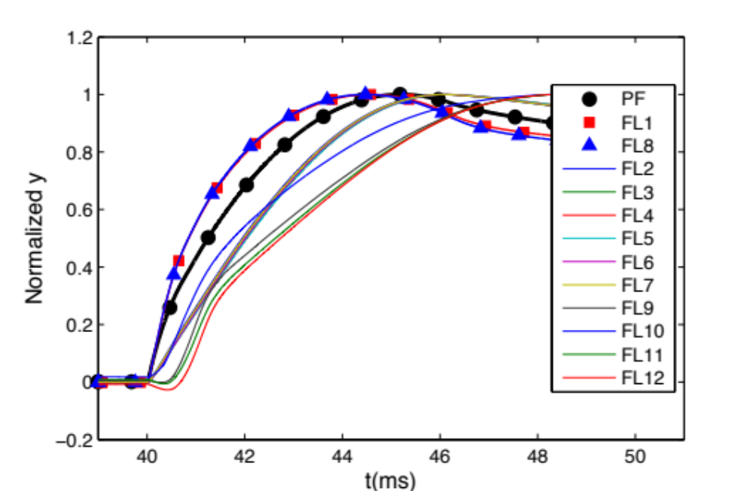
Eddy current study (3): motivation
However, some magnetic diagnostic signals are distorted. The equilibrium analysis becomes more complicated.
Abnormal leading phase of the flux signals at top/bottom
PF coils
Temporal evolution of the measured fluxes and the current in PF coils
Flux loops installed in SUNIST
Notes:
STs are intrinsically difficult to start up and to drive current by the limited ohmic flux

Slide 10
Eddy current study (4): motivation
Generally, eddy currents always tended to cancel the effects of primary currents.
→ They should rather delay the induced signals than lead.
→ Eddy current may have a different pattern
Need to seriously study the eddy current in the vacuum vessel of SUNIST!
Notes:
STs are intrinsically difficult to start up and to drive current by the limited ohmic flux

Slide 11
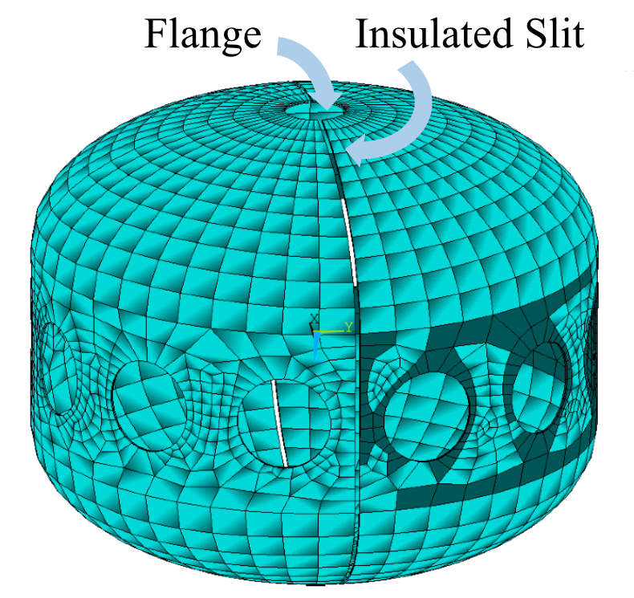
Eddy current study (5): simulation
Method: 3D finite element
Modeling: 7 mm thick stainless steel, D = 200 mm windows included, top/bottom flanges, the insulated slit
Excitation: PF coils with 1000 A / 100 or 1000 Hz sinusoidal current
The mesh of the vacuum vessel in the model
Notes:
STs are intrinsically difficult to start up and to drive current by the limited ohmic flux

Slide 12
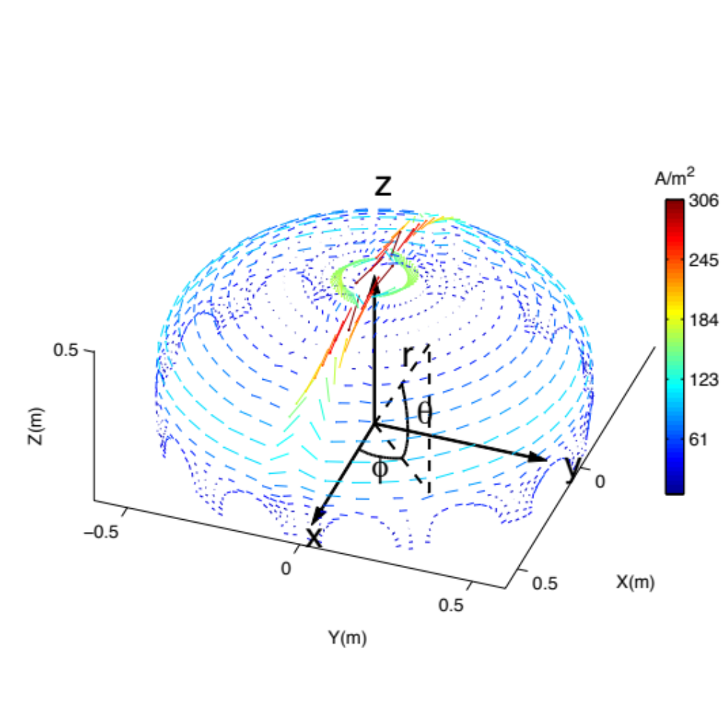
Eddy current study (6): simulation
Direction and distribution of the eddy current
The opposite direction of the eddy current at the top/bottom is responsible to the leading phases.
The path of eddy current in a hemisphere
Notes:
STs are intrinsically difficult to start up and to drive current by the limited ohmic flux

Slide 13
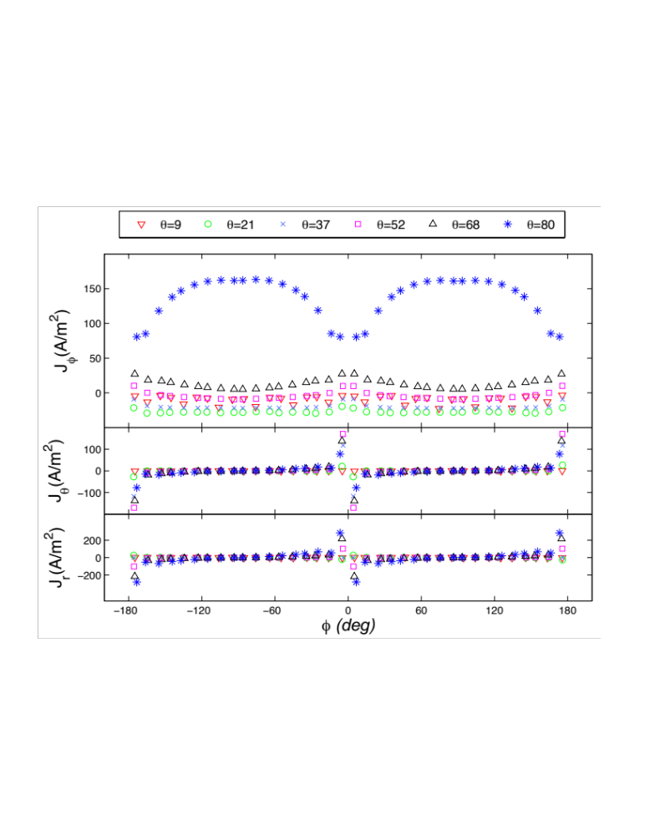
Eddy current study (7): simulation
Not cancel but enhance the excitation
Current distribution in virtual toroidal eddy current loops
Co-excitation
Cntr.-excitation
θ
Eddy current distribution along toroidal planes
Notes:
STs are intrinsically difficult to start up and to drive current by the limited ohmic flux

Slide 14
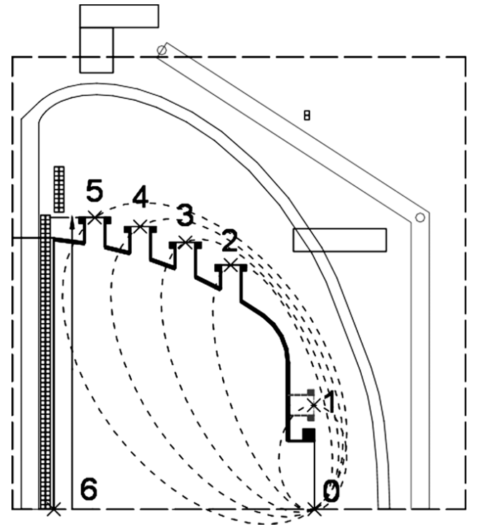
Eddy current study (8): the measurement method
Limitations of the simulation:
  Not real
  Temporal evolution far from reality
Methods to measure eddy current in the wall
  Direct method: Rogowski coils (in the air)
  Indirect method: magnetic probes array
  Place a pair of orth probes as close to the surface as possible
Flexible Rogowski Coils
B_{φ}
B_{tan}
r
θ
φ
Eddy current measurement in ETE
(G.O. Ludwig NF 2006)
Orth-probes to measure surface current
Notes:
STs are intrinsically difficult to start up and to drive current by the limited ohmic flux

Slide 15
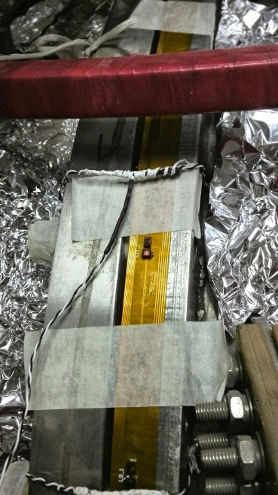
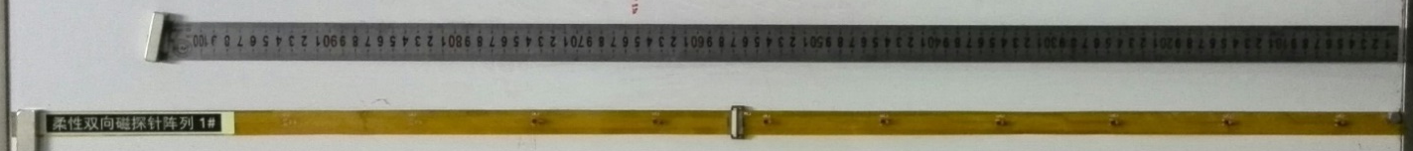
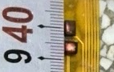
Eddy current study (9): the measurement method
The orth-probes array: Chip inductors soldered on a flexible PCB
  Flexible, fit the surface of the vacuum vessel well
  The inductors has good consistency
Totally 10 ortho-probes, covering > ¼ edge of the cross section
…
B_{φ}
#10
B_{tan}
#6
#5
…
#3
100 mm equally spaced
The wall of the vacuum vessel of SUNIST
Zoom in
The array installed near the slit
#2
Z = 0
#1
Start from -42.6 mm
Length of the array >1 m
Notes:
STs are intrinsically difficult to start up and to drive current by the limited ohmic flux

Slide 16
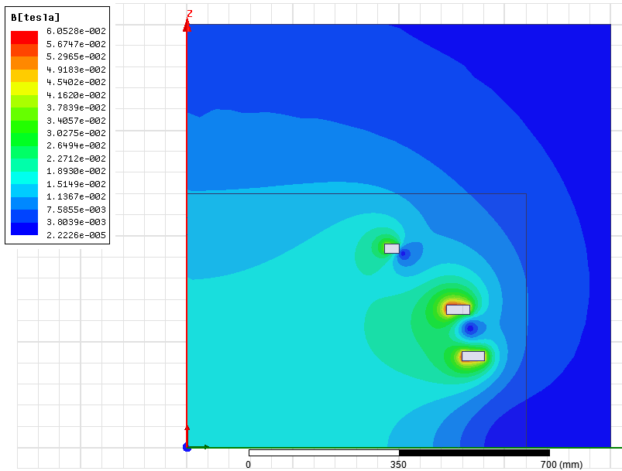
Eddy current study (9): the measurement method
If poloidal field coils are discharged → B_{measured} = B_{PF} + B_{eddy}
  B_{PF} can be calculated with acceptable precision
  Specifically,
  B_{φ} = B_{eddy, poloidal}
  B_{tan} = B_{PF} + B_{eddy, toroidal}
B_{φ}
B_{tan}
The magnetic field generated by the PF coils
Notes:
STs are intrinsically difficult to start up and to drive current by the limited ohmic flux

Slide 17
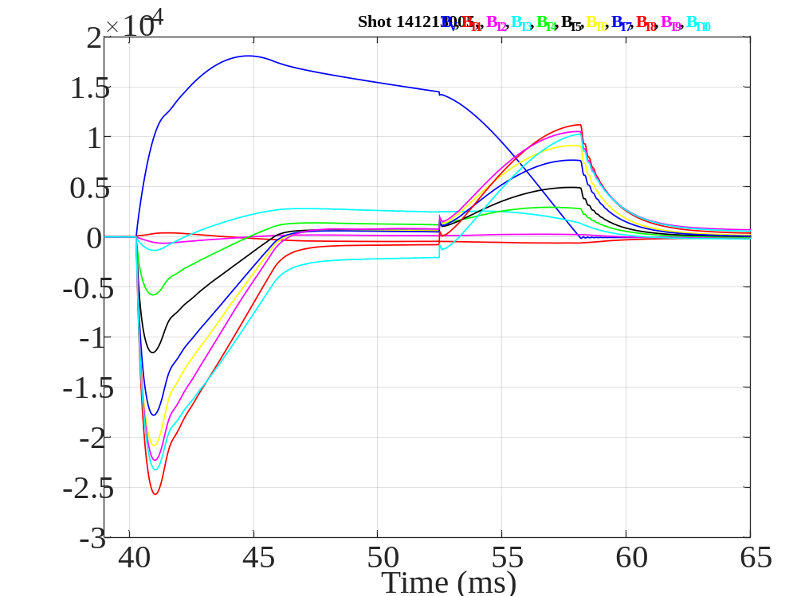
Eddy current study (10): the results
Jiang, RSI, 2014
Li, RSI, 2015
Poloidal eddy current near the slit
Patterns agree with simulation results
Temporal evolutions obtained
z
#1
#2
#3
#4
#5
#6
#7
#8
#9
#10
B_{V}
J_{eddy}
B_{φ} generated by poloidal eddy current
O
φ
Pattern of the poloidal eddy current near the slit
The temporal evolution of toroidal field generated by the eddy current induced by PF coils
Notes:
STs are intrinsically difficult to start up and to drive current by the limited ohmic flux

Slide 18
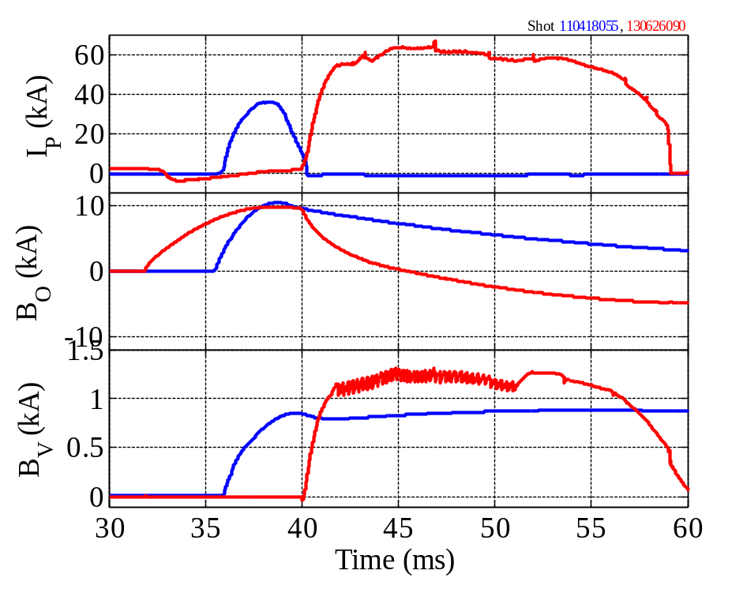
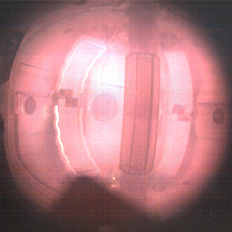
A super fast reciprocating probe (1): requirements
To simply get a profile of basic parameters with low damage to both plasmas and probes
Pulse length <20 ms, minor radius ~23 cm
A practical fast reciprocating probe: move 5~10 cm in 5 ms → 10~20 m/s !
Typical discharge image of SUNIST

Slide 19
A super fast reciprocating probe (2): available tech
The widely used fast reciprocating probes are too slow, << 10 m/s
20 m/s is really super fast!
Typical fast reciprocating probes
Machine | Driver | Practical speed | Ref.
EAST | AC servo motor | 2 m/s | Zhang, W. et al., 2010. RSI
NSTX | pneumatic | 2~3 m/s | Boedo, J. et al., 2009. RSI
HL-2A | pneumatic | 1 m/s | Yan, L. et al., 2005. RSI
TEXTOR | pneumatic | 2~3 m/s | Boedo, J. et al., 1998. RSI Xu, Y. et al., 2011. PPCF
JT-60U | pneumatic | 1.5 s / 25 cm | Asakura, N. et al., 1995. RSI

Slide 20
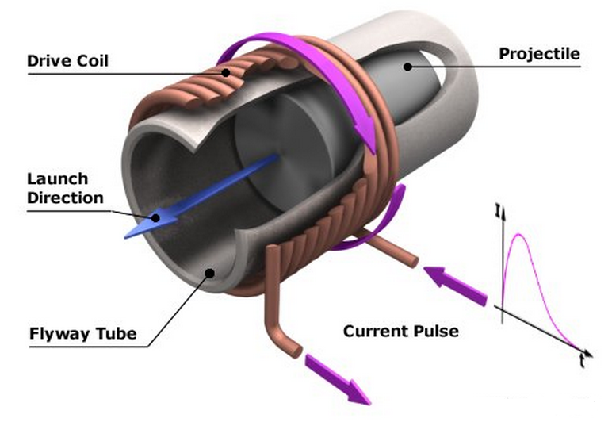
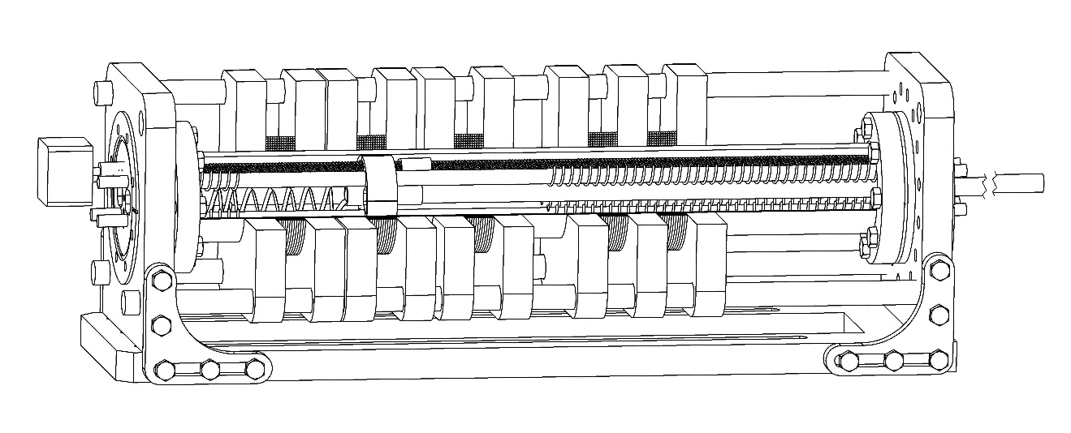
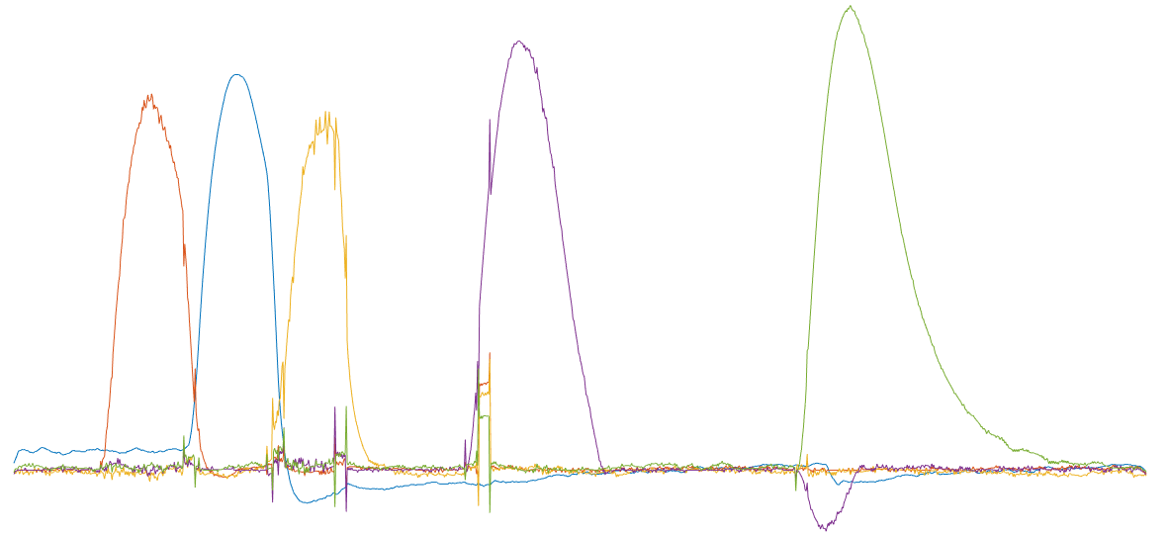
A super fast reciprocating probe (3): design
Like a tandem coils gun, magnetic drive
The moving parts are simplified, as light as possible, ~ 500 g
Three accelerating coils (#1, #2, #3) plus two braking coils (#4, #5)
CF100
http://www.coilgun.eclipse.co.uk/coilgun_basics_1.html
Reset mechanism
550 mm
projectile
#1
#2
#3
#4
#5
1000 A
Coil current waveforms
0
37 ms
t

Slide 21
A super fast reciprocating probe (4): test results
Maximum speed: > 20 m/s
Vibration is acceptable (hard to be detected by a fast camera working at 4000 fps)
Finalizing, to be installed on SUNIST in this year
Speed and position vs time
Speed (m/s)
Position (mm)
Time (ms)

Slide 22
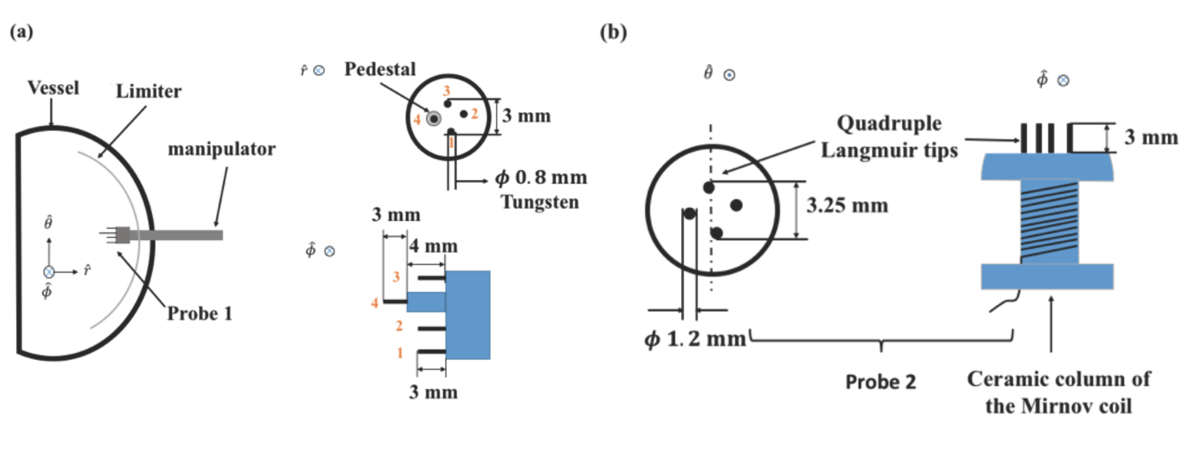
Energy transfer of electrostatic turbulence(1)
A combined probe, including a quadruple Langmuir tips and a Mirnov coil, is installed on SUNIST
Measure electrostatic turbulences and magnetic fluctuations simultaneously
Able to study the relationship between electrostatic turbulences and magnetic fluctuations
The reference Langmuir probes (left) and the combined probe set (right)

Slide 23
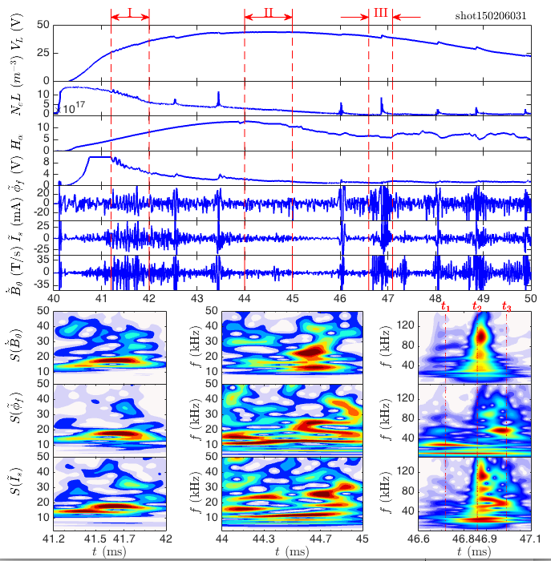
Energy transfer of electrostatic turbulence(2)
Quite different power spectrums of V_{f}, I_{si} and dB/dt are found at ramp-up (I), flat-top (II) and IRE (III) phases
But at each phases, the power spectrums of V_{f}, I_{si} and dB/dt have some similarities
Are there any relationships among them?
We focus on the ramp-up phase (I)
Typical waveforms of V_{f}, I_{si} and dB/dt at different stages

Slide 24
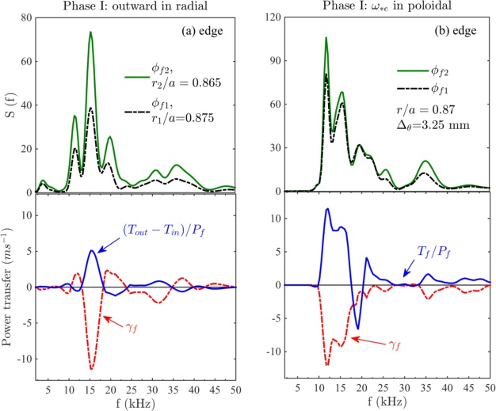
Energy transfer of electrostatic turbulence(3)
The linear and nonlinear transfer rates of turbulence propagating from t to t+τ are calculated
The highest fluctuation power occurs in the frequency band of negative linear growth rate in both radial and poloidal directions, indicating turbulence linear stability
That is, energy of turbulence is generated from nonlinear coupling
Radial (left) and poloidal (right) total power spectrum of V_{f}, linear growth rate (red) and nonlinear transfer rate (blue)

Slide 25
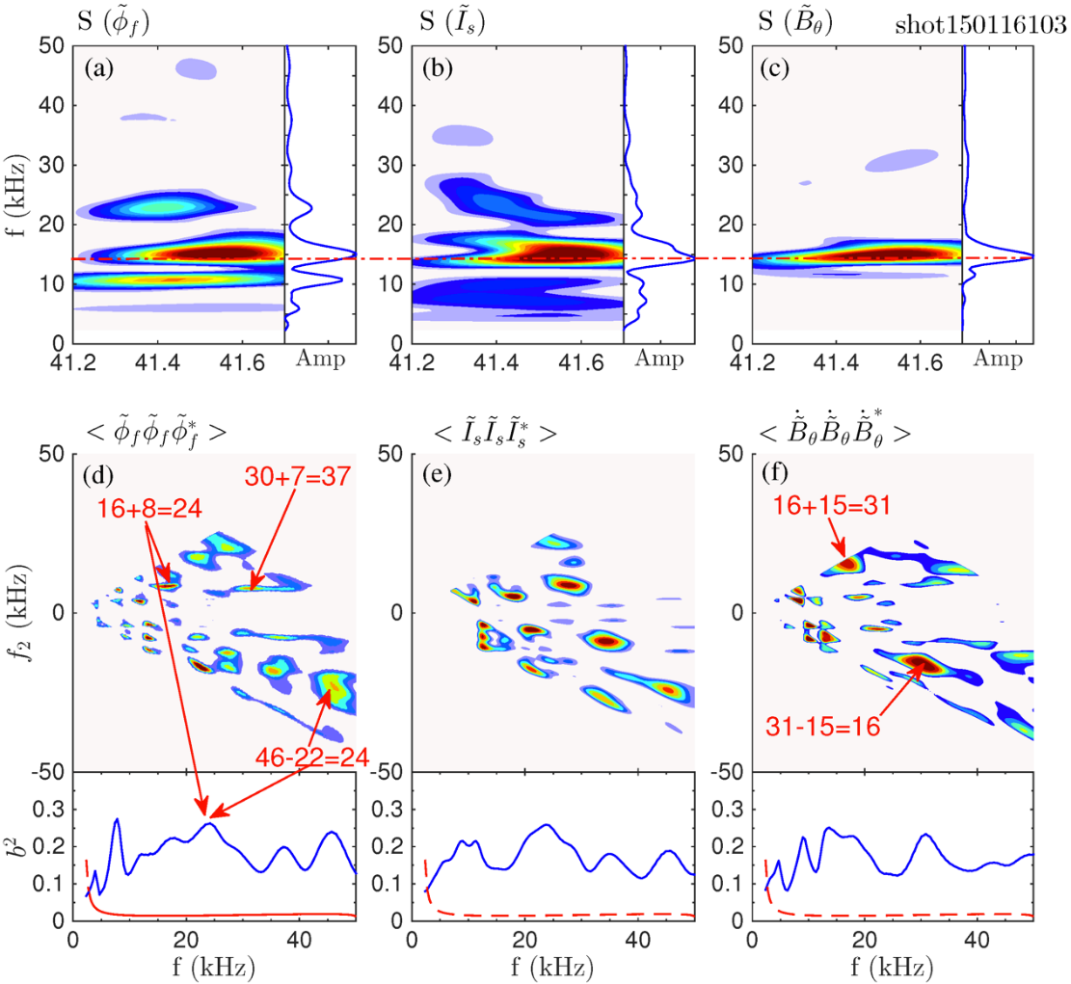
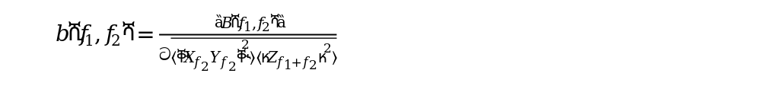
Energy transfer of electrostatic turbulence(4)
Does the energy of electrostatic turbulences and magnetic fluctuations come from the nonlinear coupling of themselves?
Seems not. No corresponding frequency peaks are found in the bi-coherence spectrums.
Wavelet spectrograms V_{f} (a), I_{si} (b), dB/dt (c), their three wave interactions and total bi-coherence (d - f) in phase I

Slide 26
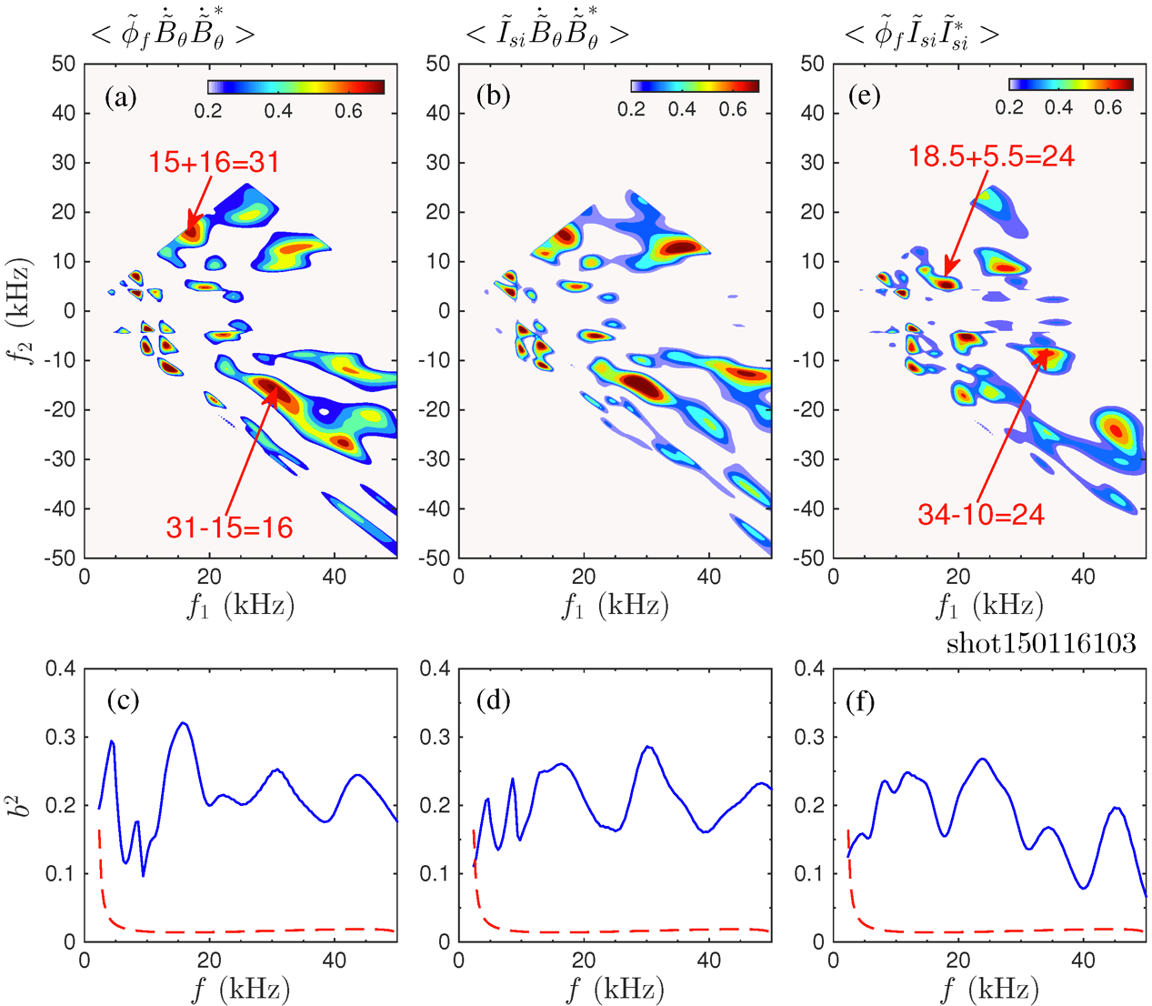
Energy transfer of electrostatic turbulence(4)
However, corresponding frequency peaks are found in the cross bi-coherence spectrums
Turbulence energy is not generated via auto bi-coherence but cross tree-wave coupling between V_{f} and dB/dt.
Energy is transferred from magnetic fluctuations to electrostatic turbulences
Wavelet spectrograms V_{f} (a), I_{si} (b), dB/dt (c), their three wave interactions and total cross bi-coherence (c, d, f) in phase I

Slide 27
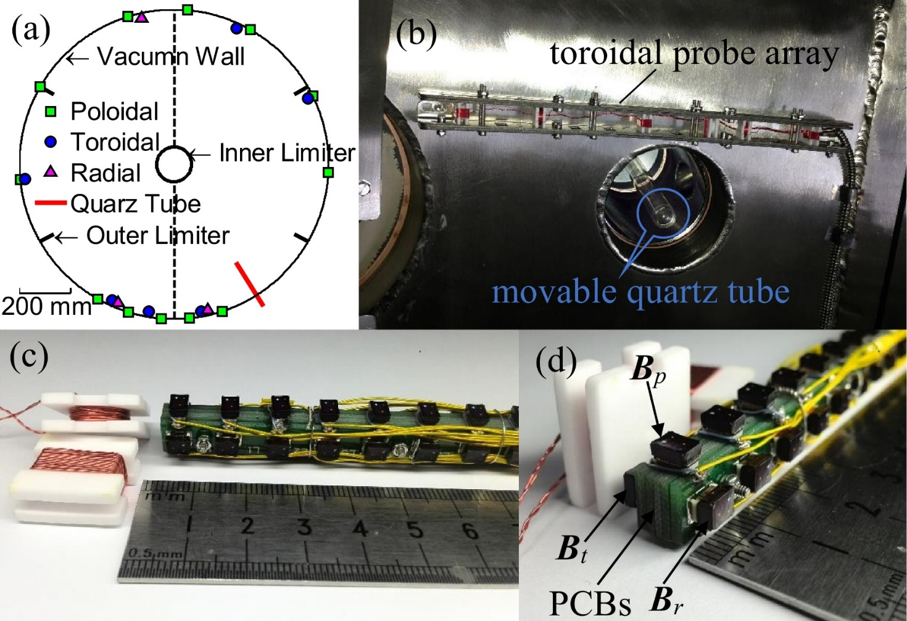
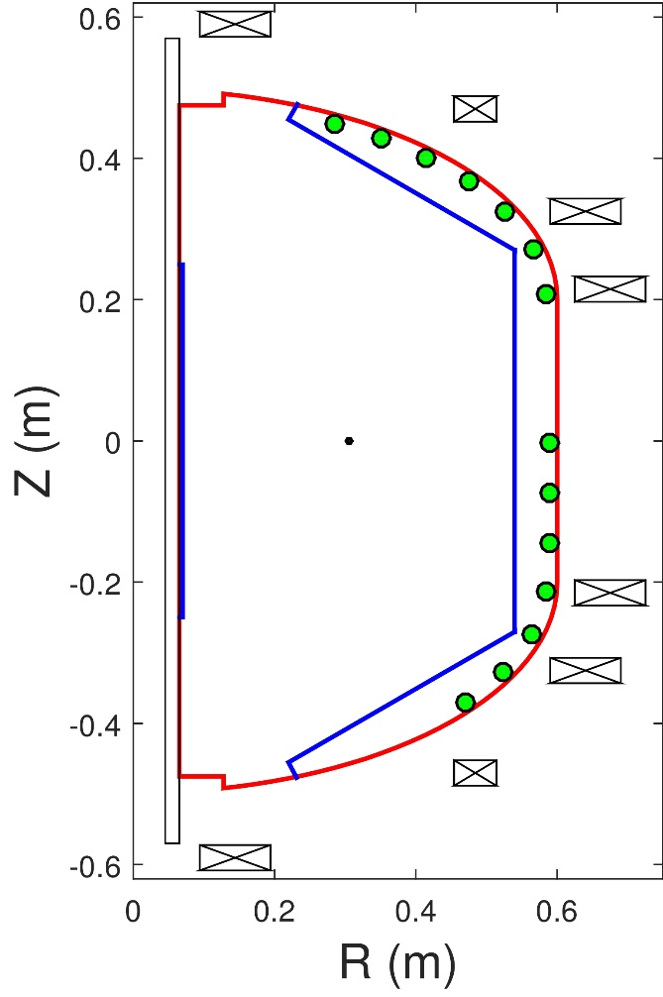
High frequency MHD activities (1): HFMP
Poloidal distribution
(a) Schematic toroidal distribution, (b) in-vessel view and (c) dimension of HFMPs in the SUNIST tokamak. (d) Chip inductors mounted on five printed circuit boards.
Liu Y.Q. RSI, 2014

Slide 28
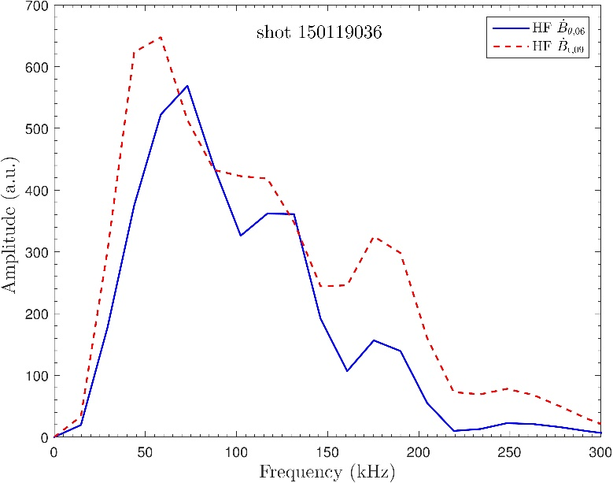
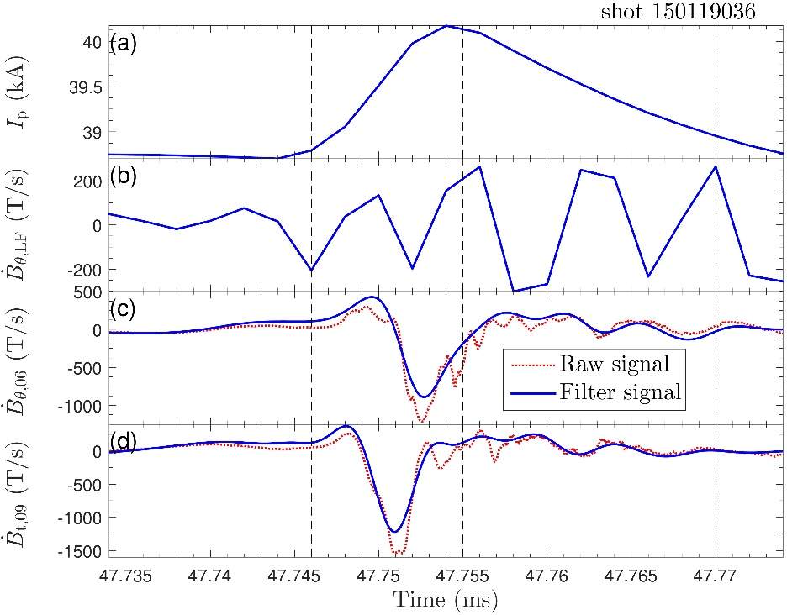
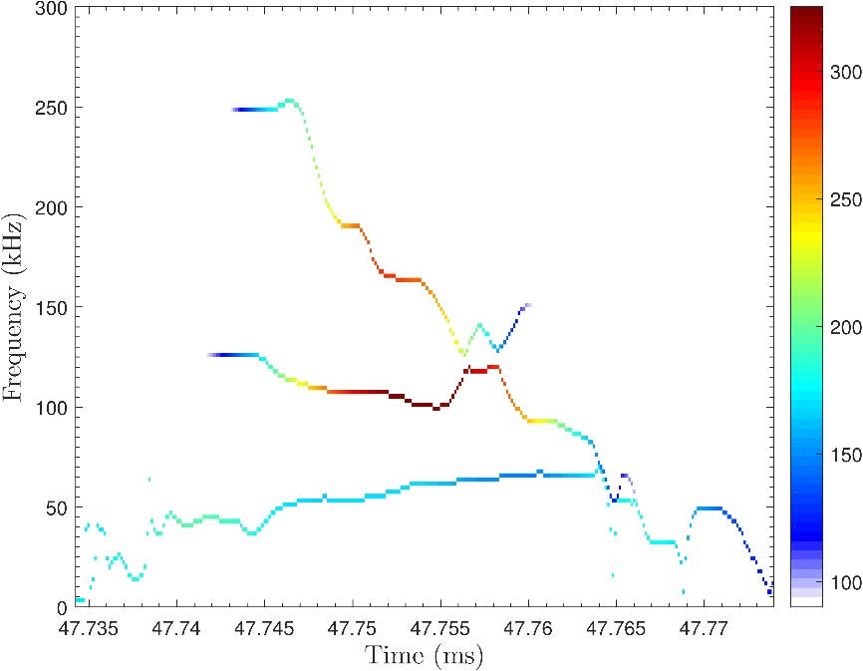
High frequency MHD activities (2): IRE
Strong high frequency MHD appears in the current jump of IREs
Frequency range is wide: 20-200kHz

Slide 29
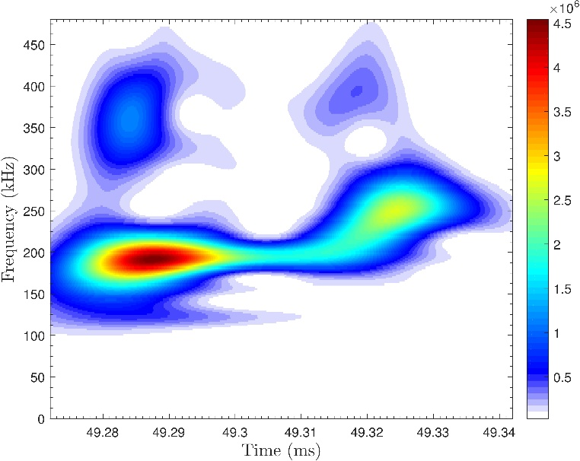
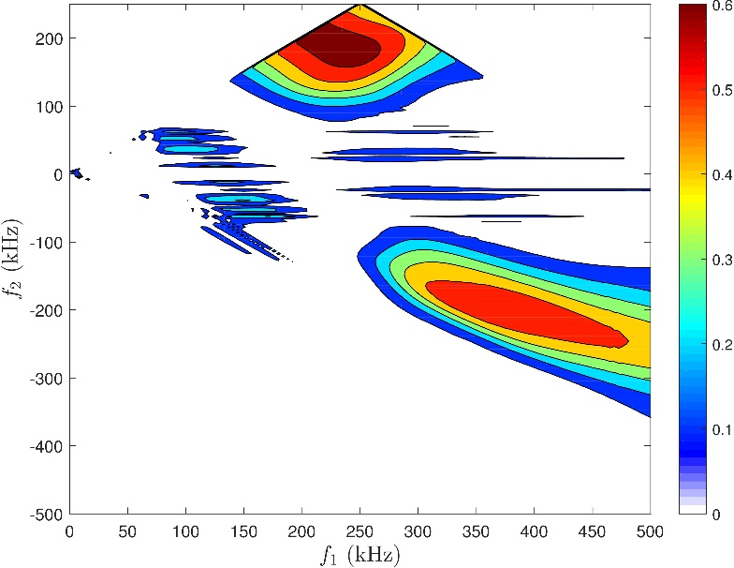
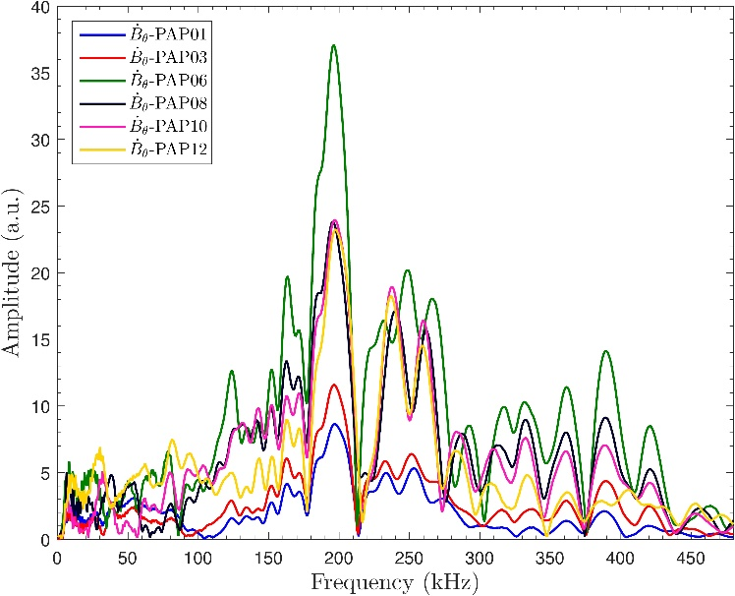
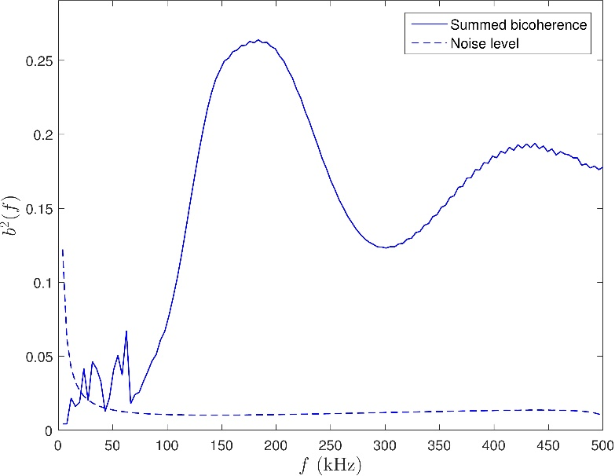
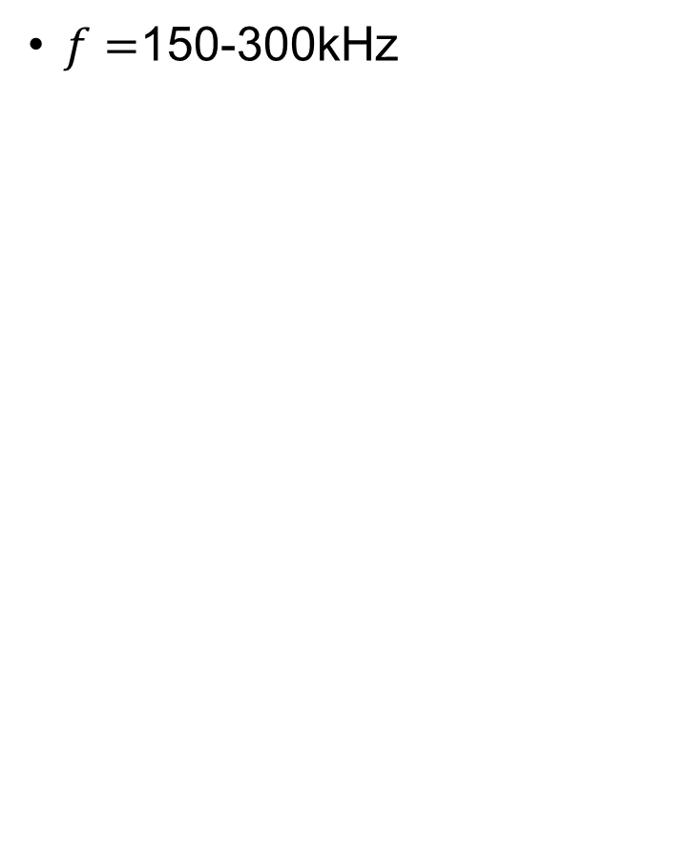
High frequency MHD activities (3): TAEs
$f=$150-300kHz
Strong nonlinear coupling
Auto bi-coherence
(200kHz, 200kHz)
(400kHz, -200kHz)

Slide 30
Summary
Startup repeatability has been improved by carefully adjust the gas puffing timing
Eddy current is calculated by finite 3D analysis and is measured by orth-probes array
A super fast reciprocating probe with speed up to 20 m/s is developed
Energy of electrostatic turbulences was found to be transferred from magnetic fluctuations at the ramp-up phase
20 – 200 kHz MHD is found in IREs and 150-300 kHz TAEs are found in minor disruptions

Slide 31
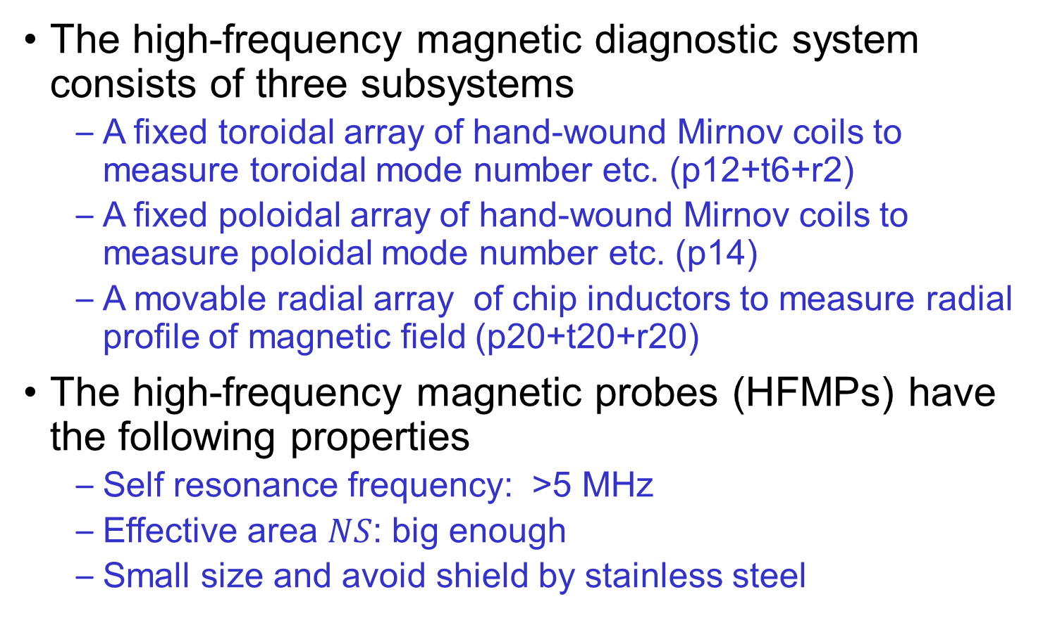
Design and Construction of HFMPs
The high-frequency magnetic diagnostic system consists of three subsystems
  A fixed toroidal array of hand-wound Mirnov coils to measure toroidal mode number etc. (p12+t6+r2)
  A fixed poloidal array of hand-wound Mirnov coils to measure poloidal mode number etc. (p14)
  A movable radial array of chip inductors to measure radial profile of magnetic field (p20+t20+r20)
The high-frequency magnetic probes (HFMPs) have the following properties
  Self resonance frequency: >5 MHz
  Effective area $NS$: big enough
  Small size and avoid shield by stainless steel

Slide 32
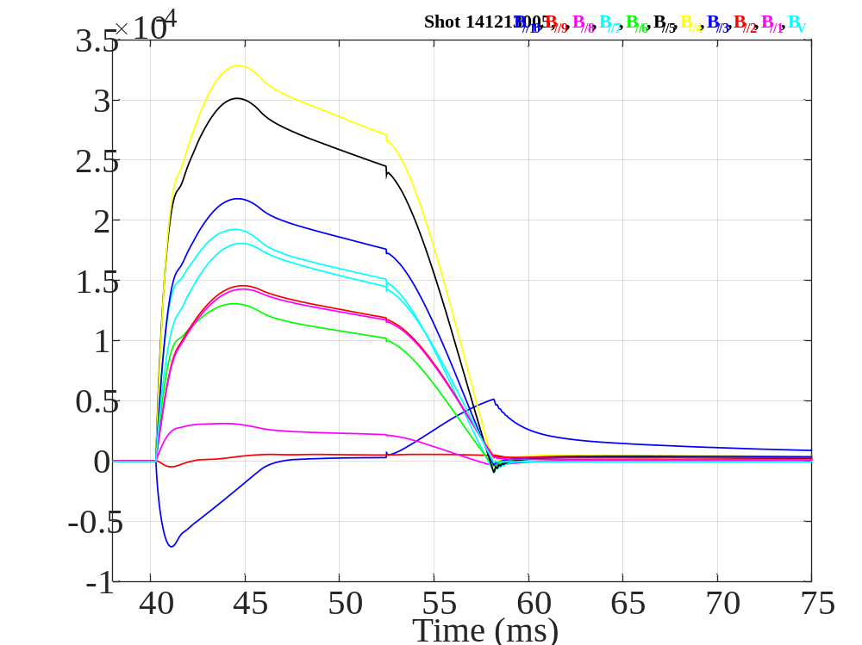
Toroidal eddy current
More complicated
Toroidal eddy current near the slit is small
→change the position of flexible orth-probes array
B_{V}
B_{tan} generated by toroidal eddy current and PF coils
The temporal evolution of toroidal field generated by the eddy current and PF coils
Notes:
STs are intrinsically difficult to start up and to drive current by the limited ohmic flux

Slide 33
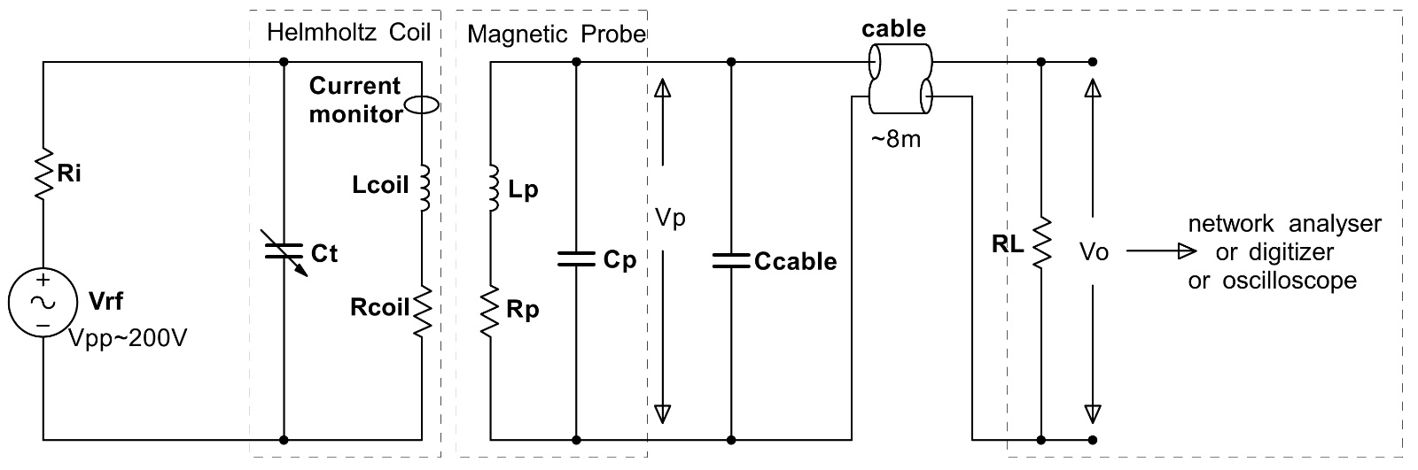
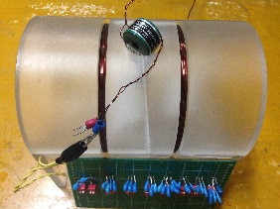
Calibration of HFMPs
Calibration: effective area, frequency response
Circuit Components
  A high voltage source: generate ~200 V sine wave
  A Helmholtz coil: generate known amplitude and frequency magnetic field (n=12, R=6 cm, 1.8 G/A)
  Current monitor (Pearson Electronics model 2877): measure I_{coil} accurately
Circuit diagram of the HFMP calibration

Slide 34
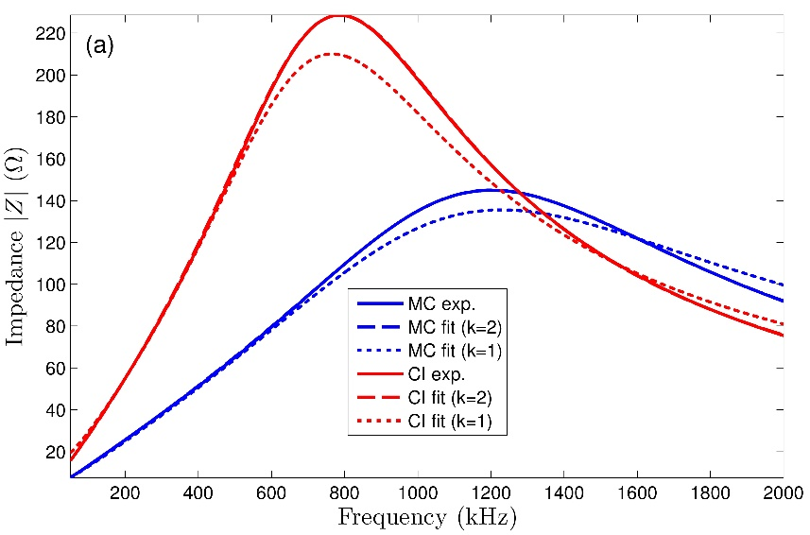
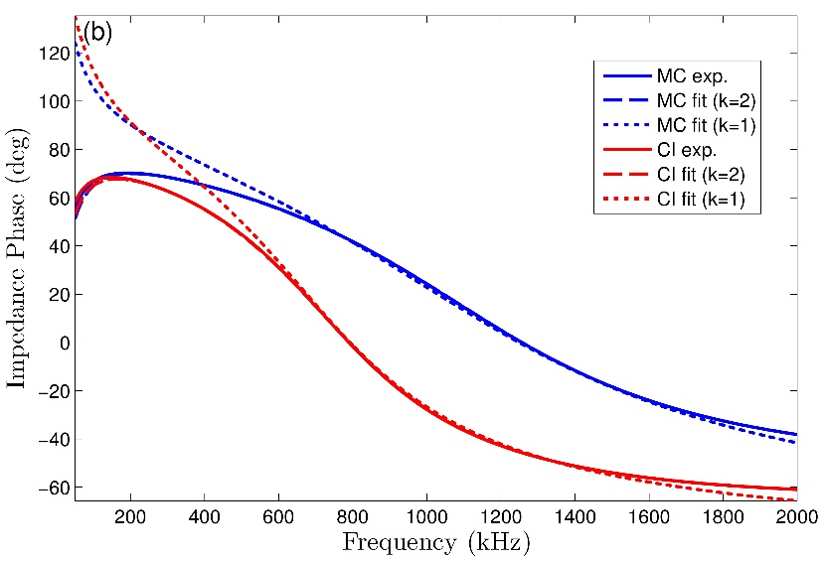
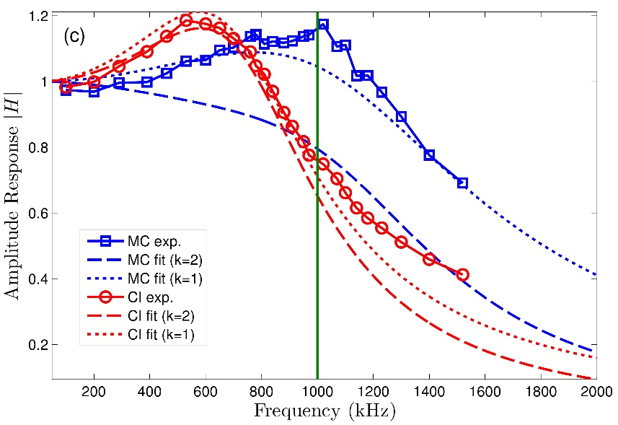
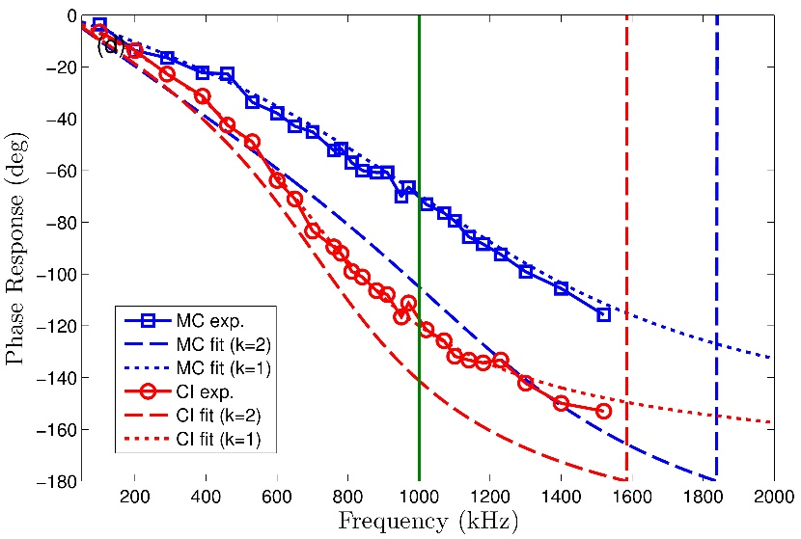
Calibration of HFMPs (cont.)
Experimental and calculated results of (a) amplitude and (b) phase of impedance Z ; (c) amplitude and (d) phase of transfer function H in parallel with $Z_{L}$

Slide 35
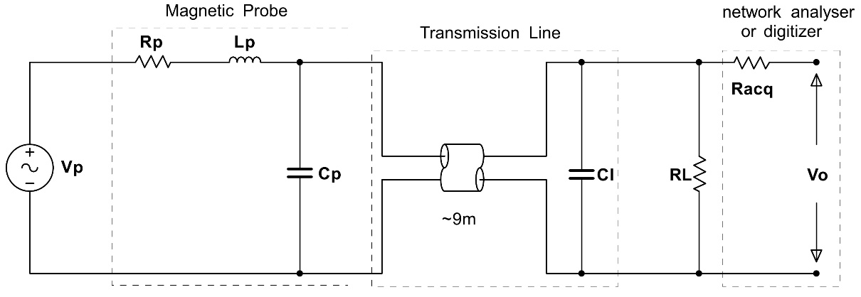


Calibration of HFMPs (cont.)
Lumped-circuit model
  “Match” load in the end
  $R_{L}\sim \sqrt{L_{p}/C_{cable}}$
Transmission-line model

Slide 36

Internal Reconnection Events in SUNIST
The most noticeable relaxation phenomenon
Plasma current is not terminated
Characteristic features
  rapid fall in the density and the temperature at the core
  rapid increase in the plasma current and the edge activity
  a large axis-asymmetric deformation in overall shape
  large scale (low wavenumber) precursor
  strong resilience after the collapse
Observed in START, CDX-U, NSTX, MAST, TST-2
Typical burst

Slide 37



Low-frequency MHD Activities during Ip Ramp-up
Time evolution of signals

Slide 38



High-frequency MHD Activities during IRE
Time evolution of signals

Slide 39



Middle-frequency MHD Activities before IRE
Time evolution of signals

Slide 40



High-frequency MHD Activities during IRE
Time evolution of signals

Slide 41




High-frequency MHD Mode Structure during IRE
$Δθ\sim 56°,Δφ_{p}\sim 180°$
$m\sim 4$
$Δφ\sim 180°,Δφ_{t}\sim 180°$
$n\sim 1$

Slide 42

High-frequency MHD Mode Damping Rate
IRE: burst occurs then damps

Slide 43
High frequency MHD during IRE
MHD Frequency in SUNIST
  Low frequency MHD ~ 20 kHz
  IRE precursor ~ 40 kHz
  IRE ~ 30-100 kHz
Chirping modes - evidence for fast ions?
During IRE plasma energy is lost along magnetic field lines through fast parallel transport
Ion temperature increase during IRE In SUNIST

Slide 44




Ion Temperature Increase during IRE
Use H$α$ Dopler broadening to measure plasma edge temperature $T_{i}$
Gain coefficient of PMT: a little uncertainty
Poloidal magnetic energy decrease while ion temperature increase

Slide 45



Safety Factor Profile during IRE
$q\left(r\right)=\frac{{rB}_{t}}{R_{0}B_{p}}\frac{1+κ^{2}}{2}\frac{1.17−0.68ε}{{\left(1−ε^{2}\right)}^{2} }$
$q_{edge}={rB}_{t}/R_{0}B_{p}$ ($r>a$used here)
limiter

Slide 46
Summary and Discussions
Summary
  A new high-frequency magnetic diagnostics system was designed, installed and calibrated in the SUNIST
  High-frequency MHD activities during IRE are studied
Future work
  Analyze IRE in different plasma parameters
  Investigate the high-frequency MHD mode (pressure driven mode?)
  Install a Langmair probe array to measure the elongation change during IRE

Slide 47
Thanks for Your Attention!
Questions, comments and suggestions are welcome!

Slide 48
A Fixed Toroidal Array
Installed in the midplane
Consists of 12 poloidal probes, 6 toroidal probes and 3 radial probes
Vacuum enameled wires wound on ceramic bobbins (18 mm × 18 mm × 7 mm)
NS ~ 40 cm²
Probe Parameters
  Poloidal or radial probes (marked by MC1): N = 40, Lp ~ 16.7 µH , Rp ~ 2 Ω for toroidal
  Toroidal probes (marked by MC2): N = 50, Lp ~ 27.4 µH, Rp ~ 2 Ω
Probes were located as close as possible to the plasma and carefully shielded to reduce the attenuation

Slide 49
A Movable Radial Array
60 Chip inductors (CIs) (manufactured by Coilcraft Inc., model 1812CS-333X L ) are mounted on custom designed printed circuit boards (PCBs)
Five PCBs, each 8 mm in width and 700 mm in length, are connected together to support chip inductors and inserted into a thin quartz tube
The cylindrical quartz tube is 1 mm thick with a 17 mm outer diameter and moves along radial direction
20 radial positions (Δr=1 cm) to measure the radial profile of poloidal, toroidal and radial magnetic fields
The nominal dimensions of the CIs: 4.85 mm × 3.81 mm × 3.43 mm
The parameters of CIs: NS ~ 20 cm², Lp ~ 43.6 µH, Rp ~ 7.3 Ω

