Slide 1

Overview of Research
Plans for NSTX Upgrade*
Jonathan Menard, PPPL
For the NSTX-U Research Team
18th International ST Workshop
Princeton University
November 3rd, 2015
*This work supported by the US DOE Contract No. DE-AC02-09CH11466

Slide 2
Outline
NSTX-U Mission and Motivation
NSTX/NSTX-U Research Highlights and Goals
  Global MHD Stability
  Transport and Turbulence
  Energetic Particles
  Power Exhaust
  Plasma Start-up
Brief Summaries of NSTX-U Research Plans
Summary

Slide 3
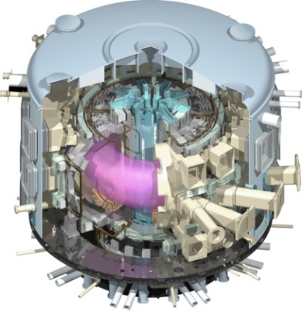
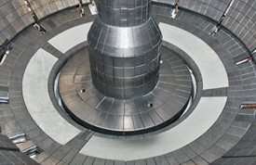
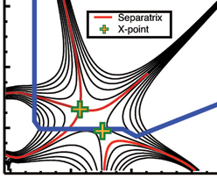
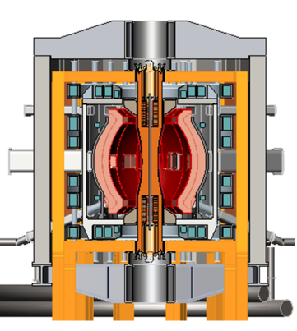
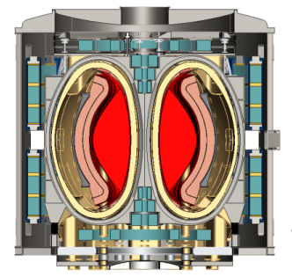
NSTX-U Mission Elements:
Explore unique ST parameter regimes to advance predictive capability - for ITER and beyond
Develop solutions for the plasma-material interface (PMI) challenge
Advance ST as candidate for Fusion Nuclear Science Facility (FNSF)
Develop ST as fusion energy system
ITER
Liquid metals / Lithium
“Snowflake”
ST-FNSF / Pilot-Plant

Slide 4
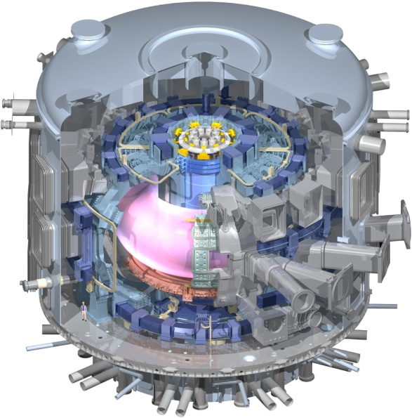
Unique ST properties support ITER
ST Extends Predictive Capability for ITER and Toroidal Science
  High β physics, rotation, shaping extend stability, transport knowledge
  STs can more easily study electron scale turbulence at low collisionality → important for all magnetic fusion
  NBI fast-ions in present STs mimic DT fusion product parameters in ITER → study burning plasma science
  Access ITER-level divertor heat fluxes → study SOL / detachment physics
Burning Plasma Physics - ITER

Slide 5
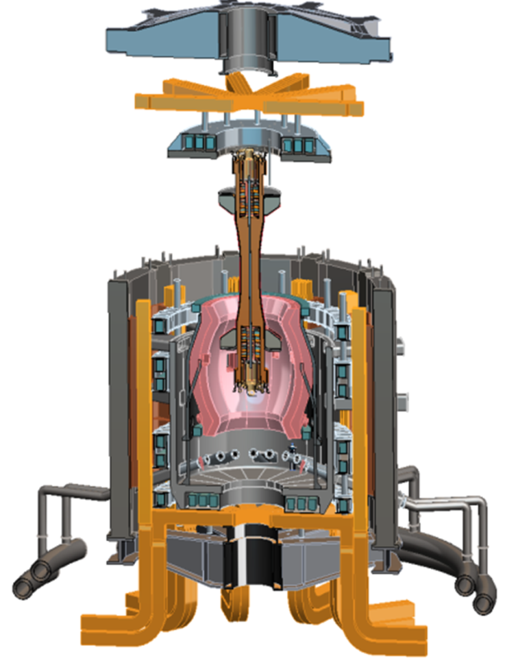
Design studies show ST potentially attractive
as Fusion Nuclear Science Facility (FNSF)
  FNSF can help develop reliable fusion nuclear components
  Substantial integrated R&D, testing needed to develop components
  An FNSF facility should be: modest cost, low T, and reliable
ST-FNSF projected to access high neutron wall loading at moderate size and fusion power
  W_{n} ~ 1-2 MW/m² , R ~ 0.8-1.8m, P_{fusion} ~ 50-200MW
Modular, simplified maintenance
Tritium breeding ratio (TBR) ≈ 1
  Using only/primarily outboard breeding requires sufficiently large R, careful design
PPPL ST-FNSF concept

Slide 6
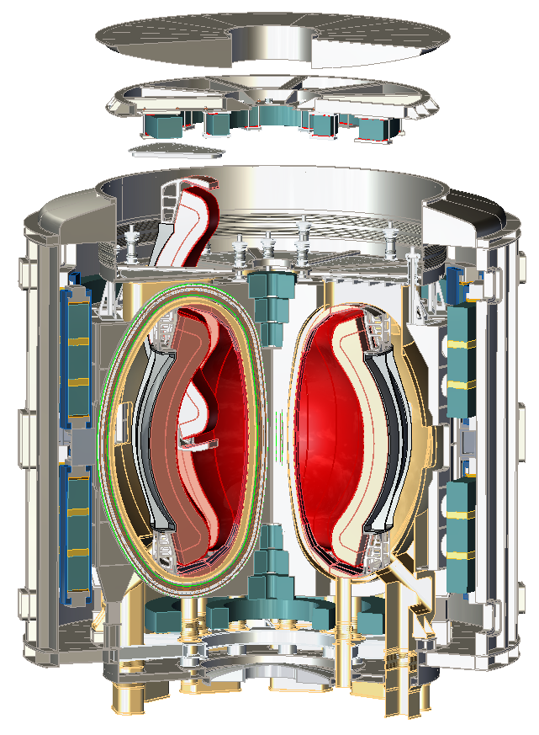
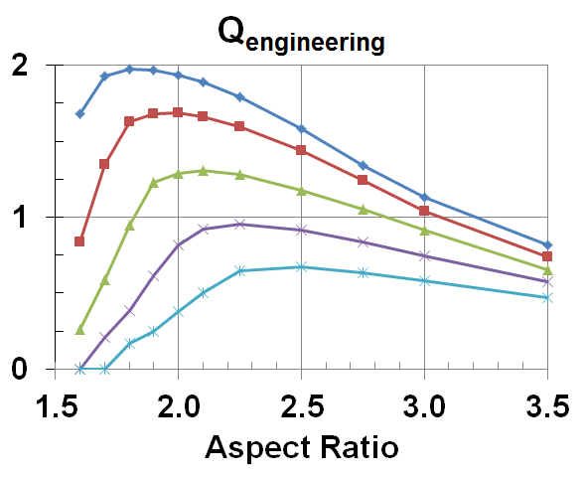

High Temperature Superconductors (HTS) attractive for ST* (~10× lower magnet cooling power vs. Cu, less thermal shielding required)
Net electricity easiest near A=2 if:
Inboard T breeding minimized / eliminated
Central solenoid minimized / eliminated
Q_{engineering} = P_{electric} / P_{consumed}
Δ_{shield} / R₀
0.12
0.16
0.20
0.24
0.28
*Work supported by Tokamak Energy (UK) - 2014
R₀ = 1.4m, B_{T} = 3.2-4T, I_{P} = 7-8MA, P_{fusion-DT} = 100MW
H_{98y2} = 1.7-2, H_{ST} ~ 1, A = 1.8-2, κ ~ 2.5-2.7, δ ~ 0.5
Magnet lifetime increases exponentially with Δ_{shield}

Slide 7
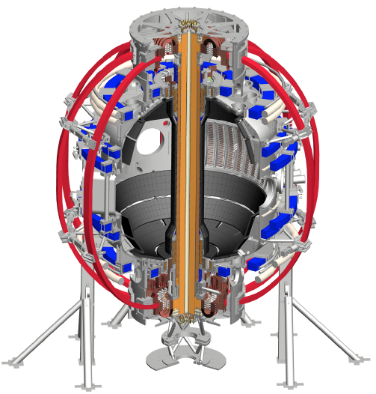
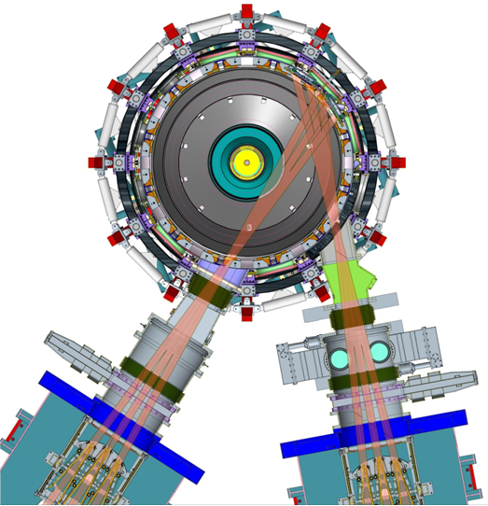
Upgrade of NSTX has 2 major elements
New Centerstack Magnet
Original NBI
New 2nd NBI
Access high β, high T, low collisionality
2× higher toroidal field (0.5 → 1T)
2× higher plasma current (1 → 2MA)
5× longer pulse (1 → 5s)
Tangential 2nd NBI increases current drive for non-inductive sustainment

Slide 8
Outline
NSTX-U Mission and Motivation
NSTX/NSTX-U Research Highlights and Goals
  Global MHD Stability
  Transport and Turbulence
  Energetic Particles
  Power Exhaust
  Plasma Start-up
Brief Summaries of NSTX-U Research Plans
Summary

Slide 9
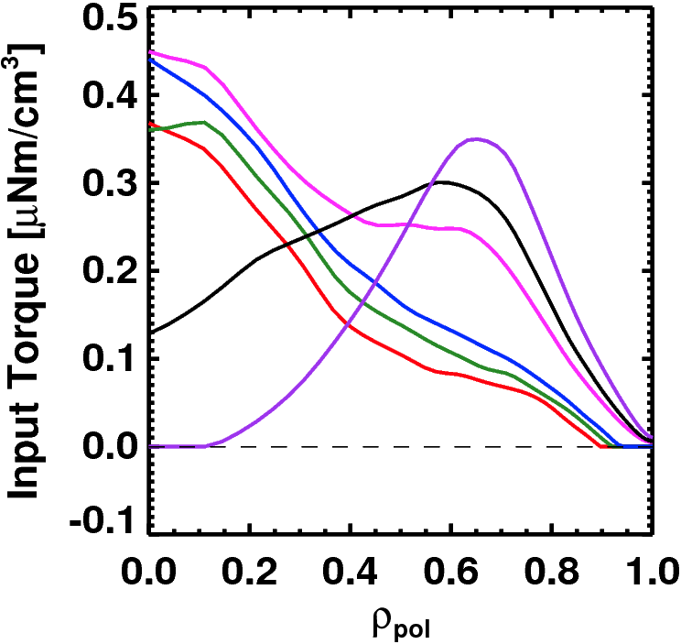
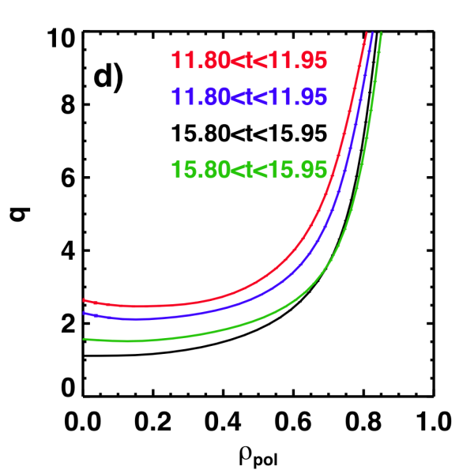
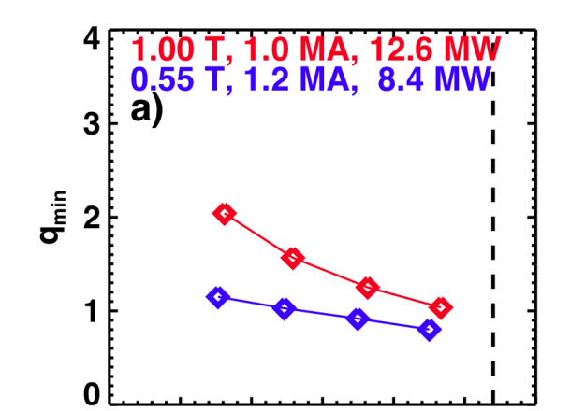
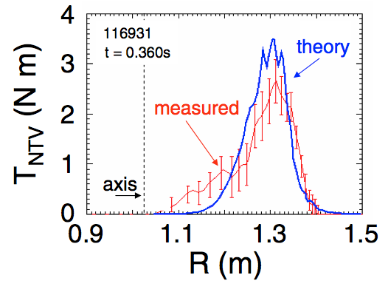
NSTX-U developing a range of profile control actuators for physics studies, scenario optimization for FNSF/Pilot
q-Profile Actuators
Rotation Profile Actuators
Variations in Beam Sources
800 kA Partial Inductive, 87% < f_{NI} < 100%
Torque Profiles From 6 Different NB Sources
Largest R_{tan}
800 kA and 1 T
[50,60,70,130] cm
[50,60,120,130] cm
[60,70,110,120] cm
[70,110,120,130] cm
Neutral
Beams
(TRANSP)
Smallest R_{tan}
Measured and Calculated Torque Profiles from 3D Fields
Variations in Outer Gap
(n=3)
27 22 17 12 7 2
Outer Gap [cm]

Slide 10
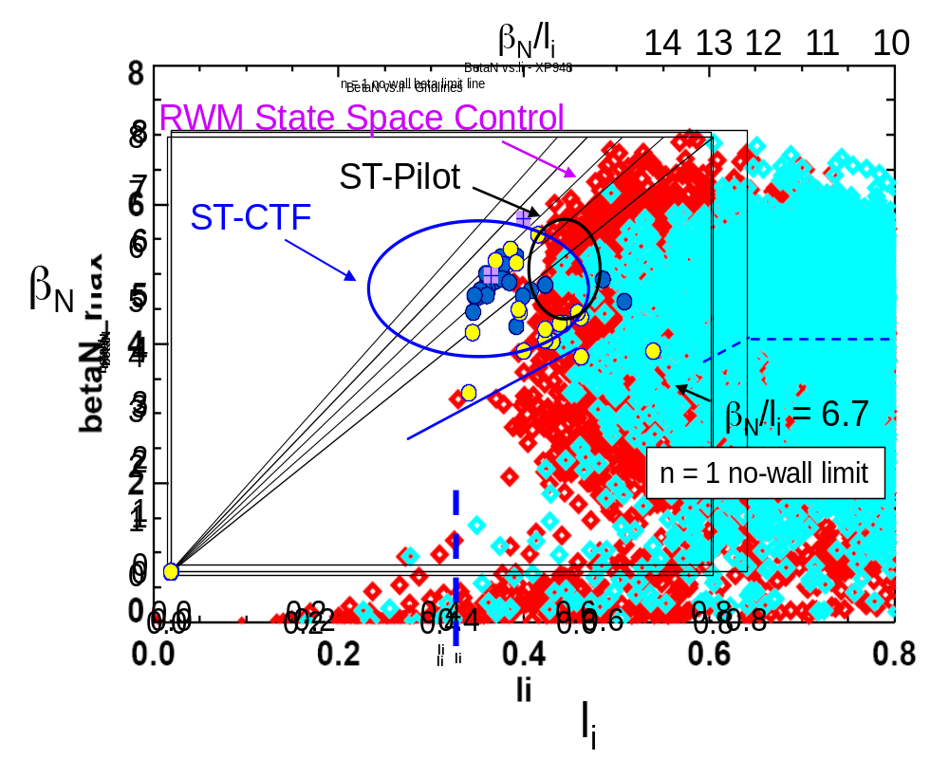
Record β_{N} and β_{N} / l_{i} accessed in NSTX using passive + active resistive wall mode stabilization
High β_{N} regime important for self-generated bootstrap current generation
High β_{N} / l_{i} regime important since high f_{bootstrap} has low internal inductance l_{i}
ST-FNSF
Unstable RWM
Stable / controlled RWM
S. Sabbagh, PRL 2006
J. Berkery, PRL 2011
W. Zhu, PRL 2006
Internal inductance l_{i}
Goal: Achieve fully non-inductive operation at high β_{N} and high β_{T}

Slide 11
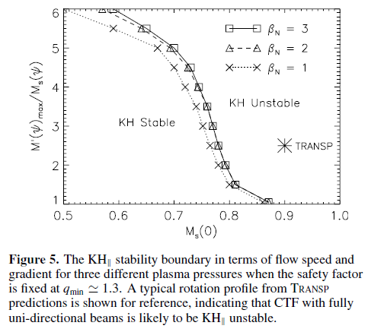
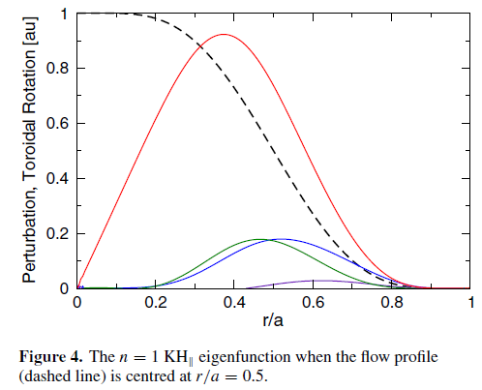
Kelvin-Helmholtz (KH) instabilities predicted when central sound-speed Mach number M_{s} ≈ 0.7-0.8
Rotation profile
n=1 K-H
Eigenfunction
I. Chapman, NF 2012

Slide 12
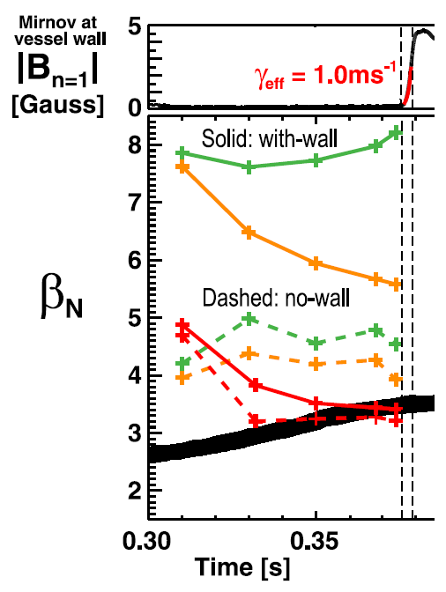
Rotation shear and fast-ion population both reduce stability of global pressure-driven kink mode
Hybrid MHD-drift-kinetic MARS-K consistent with NSTX Ideal Wall Mode onset at high rotation, β_{fast}
Low-rotation fluid with-wall limit is very high → marginal β_{N} ~ 7-8
Increasing rotation lowers max β_{N} to ~5.5 at mode onset time
Full kinetic treatment including fast-ions → marginal β_{N} ~3.5 → most consistent with experiment
Experimental β_{N}
Goal: Use 2nd NBI + 3D fields to optimize rotation shear, fast-ion profiles for RWM, IWM
J. Menard, PRL 2014

Slide 13
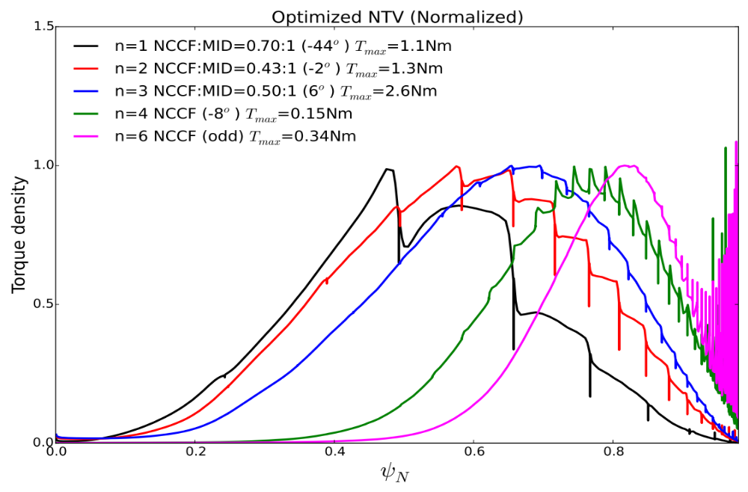
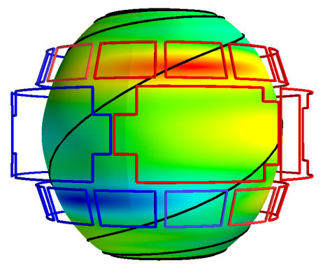
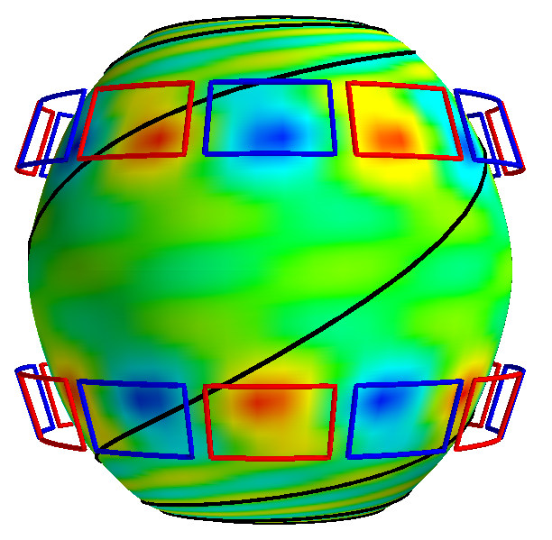
Non-axisymmetric Control Coil (NCC) physics design completed: Optimized for NTV braking using IPECOPT
NCC and midplane coils can be combined to remove the dominant resonant modes up to the second, giving the optimized NTV for core
  NCC 2x12 provides n=1,2,3,4,6 optimized NTV, and 2x6 provides n=1,2,6
  Optimized NTV can be used to control local torque with minimized resonance
n=1
*Ratio of coil currents (phasing)
*T_{max} is based on max. 3kAt
Higher n’s
n=6
NSTX-U / PPPL
Theory Partnership

Slide 14
Outline
NSTX-U Mission and Motivation
NSTX/NSTX-U Research Highlights and Goals
  Global MHD Stability
  Transport and Turbulence
  Energetic Particles
  Power Exhaust
  Plasma Start-up
Brief Summaries of NSTX-U Research Plans
Summary

Slide 15
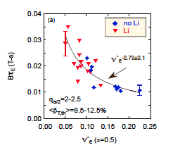
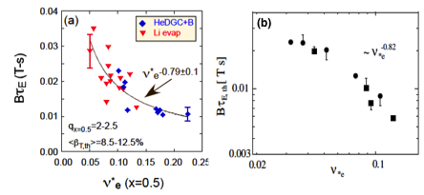
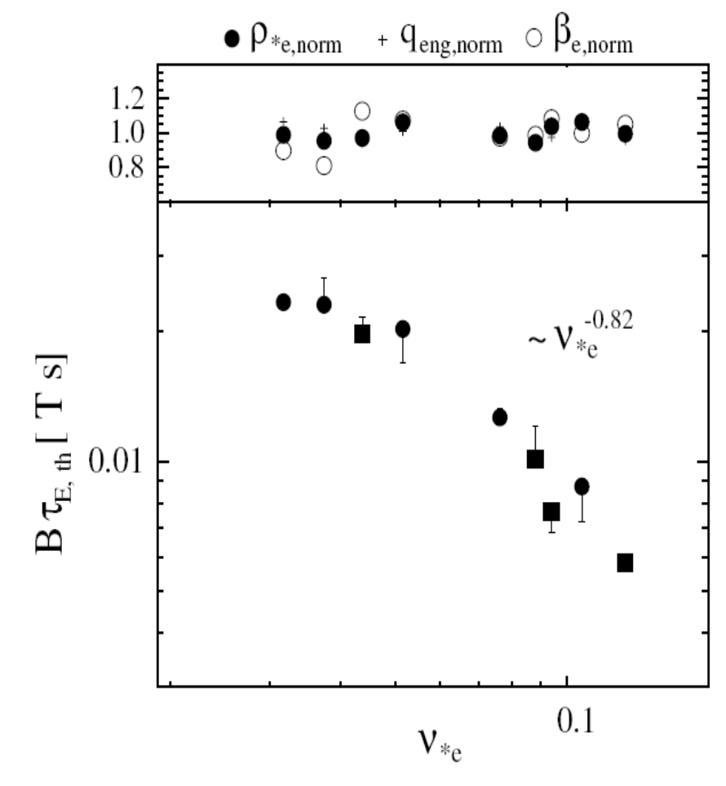

Favorable confinement trend with collisionality, β found
Important implications for future ST FNSF, Demo with lower ν*
τ_{E, th} ∝ ν_{*e}^{-0.1} β^{-0.9} tokamak empirical scaling (ITER 98_{y,2})
τ_{E, th} ∝ ν_{*e}^{-0.8} β^{-0.0} ST scaling (NSTX and MAST)
NSTX
Fig. 70. (a) Normalized confinement time as a function of collisionality at mid-radius in NSTX. Blue points are from discharges that used HeGDC+B wall conditioning, while red points are from discharges that used Li. Reprinted with permission from S.M. Kaye et al., Nucl. Fusion 53 063005 (2013). Copyright (2013). Institute of Physics.
(b) Collisionality scan of thermal energy confinement time in MAST. Reprinted with permission from M. Valovic et al., Nucl. Fusion 51 073045 (2011). Copyright (2011) Institute of Physics.
NSTX
MAST
~ ν_{*e} ^{-0.82}
B τ_{E,th} [ T s]
ν_{*e}
S.M. Kaye, NF 2007, 2013
M. Valovic, NF 2011
Goal: Assess if favorable collisionality scaling continues on NSTX-U/MAST-U

Slide 16
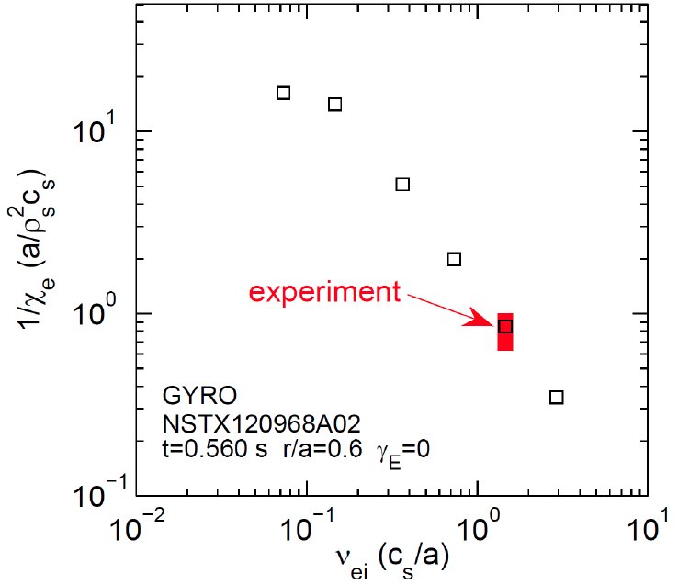


Micro-tearing-driven (MT) transport
may explain ST τ_{E} collisionality scaling
MT-driven χ_{e} vs. ν_{ei} using the GYRO code
Micro-tearing growth rate decreases with reduced collisionality in qualitative agreement with the NSTX experiment
New: Dissipative Trapped Electron Mode (DTEM) has similar ν* scaling (GTS - W. Wang)
NSTX-U
W. Guttenfelder, PoP 2013, PoP 2012, PRL 2011
NSTX
Goal: Identify micro-instabilities responsible for collisionality scaling

Slide 17
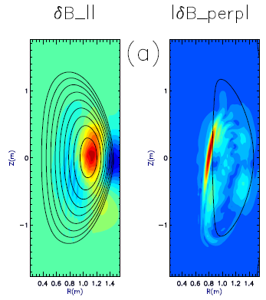
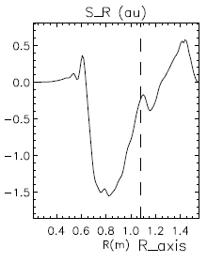
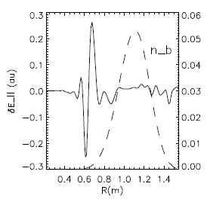
CAE mode-conversion to kinetic Alfvén waves (KAW) predicted to transfer core NBI power to mid-ρ electrons
GAE/CAEs cause large χ_{e} through stochastic orbits (N. Gorelenkov, NF 2010)
CAEs also couple to KAW - Poynting flux redistributes fast ion energy near mid-radius, E|| resistively dissipates energy to thermal electrons
  P_{CAE→KAW} ~ 0.4 MW from QL estimate + experimental mode amplitudes
  P_{e,NBI} ~ 1.7 MW for ρ <0.3, NBI power deposited on core electrons
Radial Poynting flux
⟨E×B⟩_{R}
CAE
(n=8)
KAW
Up to 25% of electron heating power transferred to KAW off-axis
~ρ_{beam}
HYM code
E. Belova, PRL 2015
ω_{A}(R,Z)=ω_{CAE}

Slide 18
Outline
NSTX-U Mission and Motivation
NSTX/NSTX-U Research Highlights and Goals
  Global MHD Stability
  Transport and Turbulence
  Energetic Particles
  Power Exhaust
  Plasma Start-up
Brief Summaries of NSTX-U Research Plans
Summary

Slide 19
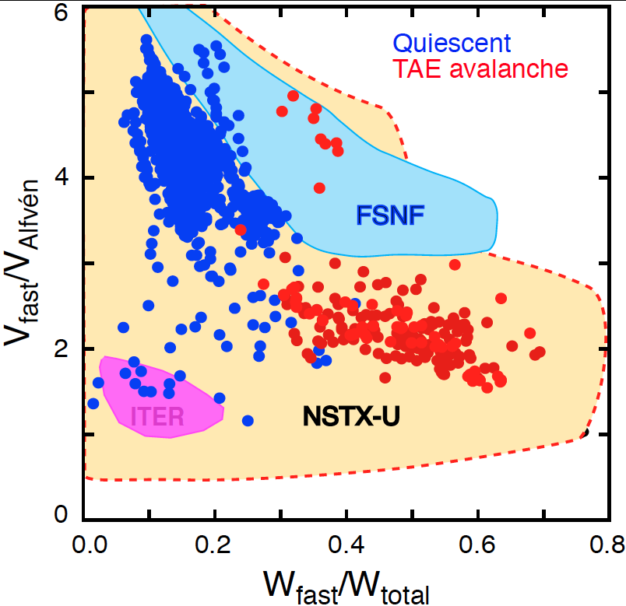
NBI-heated STs excellent testbed for α-particle physics
Alfvenic modes readily accessible due to high V_{fast} > V_{Alfvén}
α-particles couple to Alfvénic modes strongly when V_{α} > V_{Alfven} ~ β^{−0.5} C_{sound}
V_{α} > V_{A} in ITER and reactors: condition easily satisfied in ST due to high β
Fast-particle-driven Alfvén Eigenmodes: Toroidal, Global, Compressional
EP parameter space
NSTX data:
2× higher toroidal field → NSTX-U will also explore V_{fast} < V_{A} regime
2nd NBI → much more flexibility in fast-ion distribution function
  E. Fredrickson, NF 2013

Slide 20
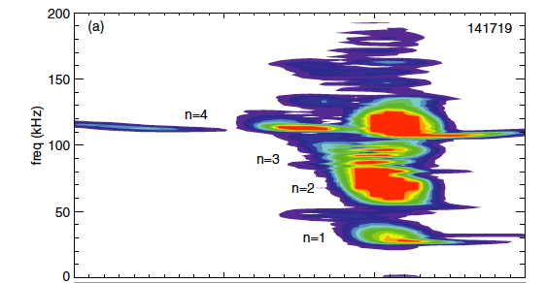
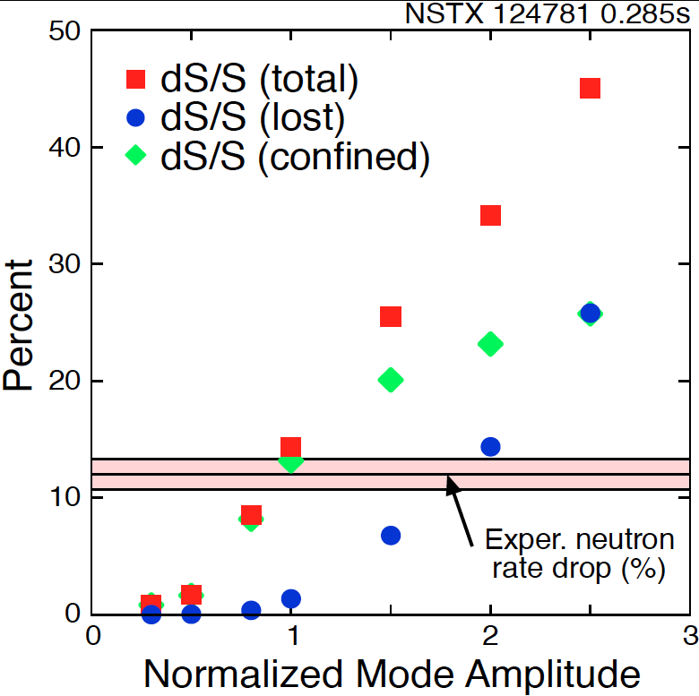
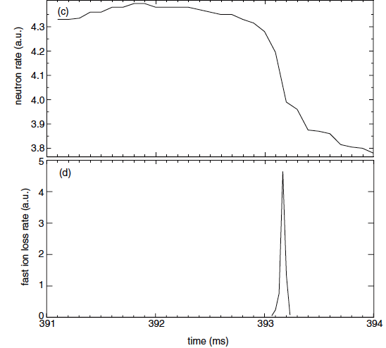
“TAE avalanche” shown to cause energetic particle loss
Uncontrolled α-particle loss could cause reactor first wall damage
Multi-mode TAE avalanche can cause significant EP losses as in “sea”of TAEs expected in ITER
Progress in simulation of neutron rate drop
due to TAE avalanche
(a)
Frequency (kHz)
Neutron rate (a.u.)
Fast ion loss rate (a.u.)
Time (ms)
Time (ms)
  E. Fredrickson, NF 2013
D.S. Darrow, NF (2013)

Slide 21
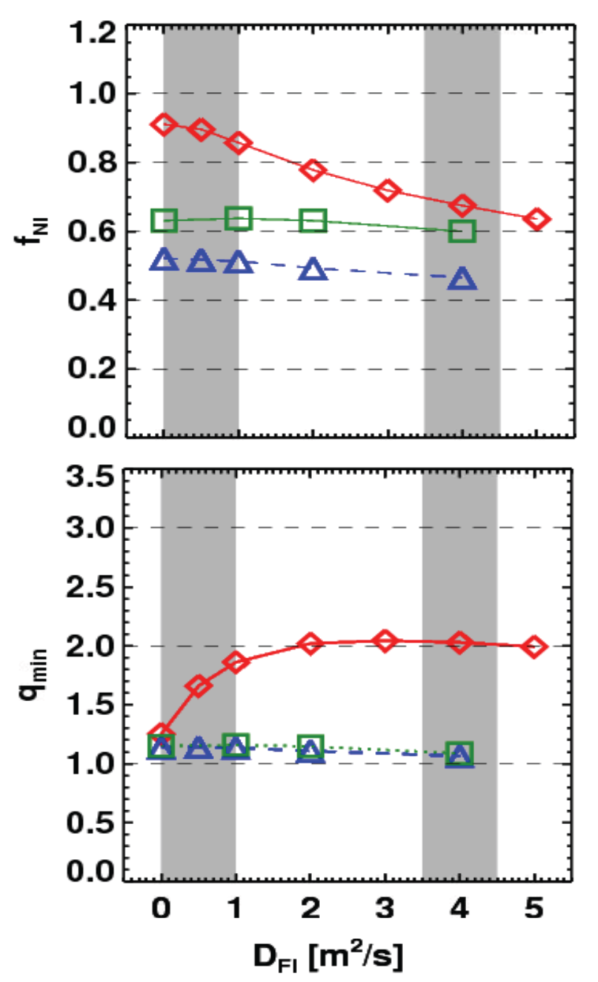
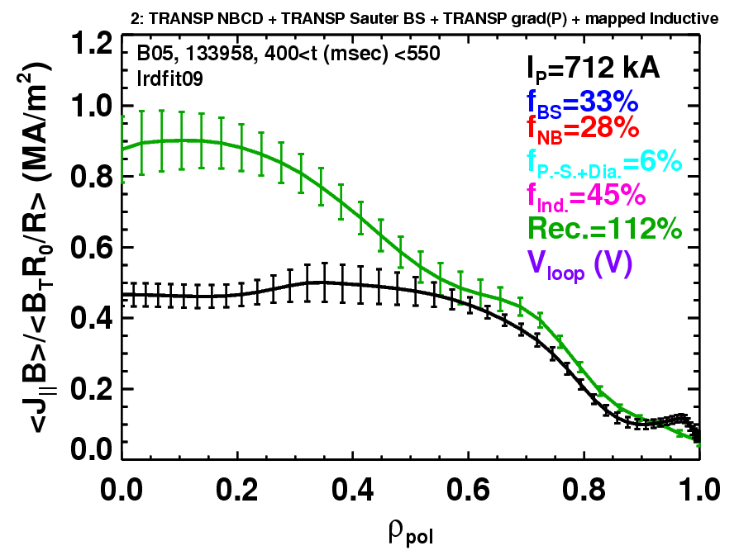
Goal: Assess if / how TAE “avalanches” impact NBI current-drive in advanced scenarios for NSTX-U, FNSF, ITER AT?
NSTX-U TRANSP simulations
NSTX: rapid avalanches can lead to
redistribution/loss of NBI current drive
Discrepancy between reconstruction and total assuming
classical J_{NBCD}
1 MA, 1T, H₉₈=1, near non-inductive
1.6 MA, 1T, partial inductive
1.2 MA, 0.55T, high β_{T}
All: f_{GW}=0.7, H₉₈=1
Minor radius
700kA high-β_{P} plasma with rapid
TAE avalanches has time-average D_{FI} = 2-4m²/s
S. Gerhardt NF 2011, NF 2012

Slide 22
Outline
NSTX-U Mission and Motivation
NSTX/NSTX-U Research Highlights and Goals
  Global MHD Stability
  Transport and Turbulence
  Energetic Particles
  Power Exhaust
  Plasma Start-up
Brief Summaries of NSTX-U Research Plans
Summary

Slide 23
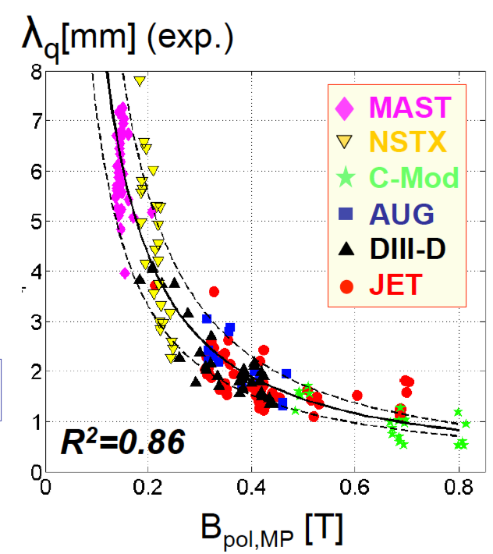
Tokamak + ST data: power exhaust width varies as 1 / B_{poloidal}
Will previous ST trend continue at 2× I_{P} , B_{P} , B_{T}, power?
ST data breaks aspect ratio degeneracy of data set
Issue: If peak heat flux in divertor region exceeds 10 MW/m² → material damage
Goal: Assess heat-flux width scaling at higher I_{P}, B_{T} – different than A=3?

Slide 24
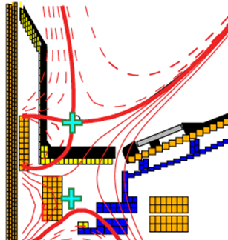
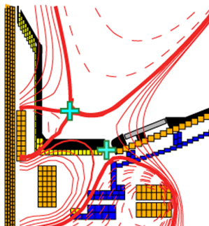
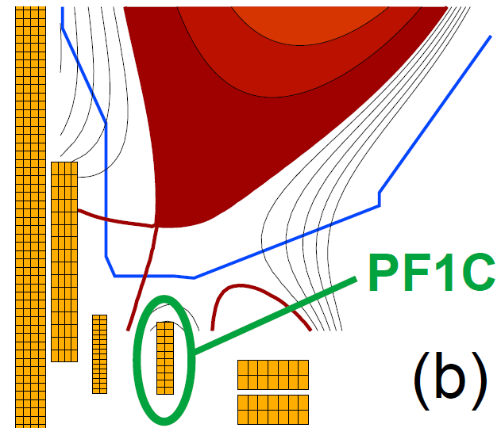
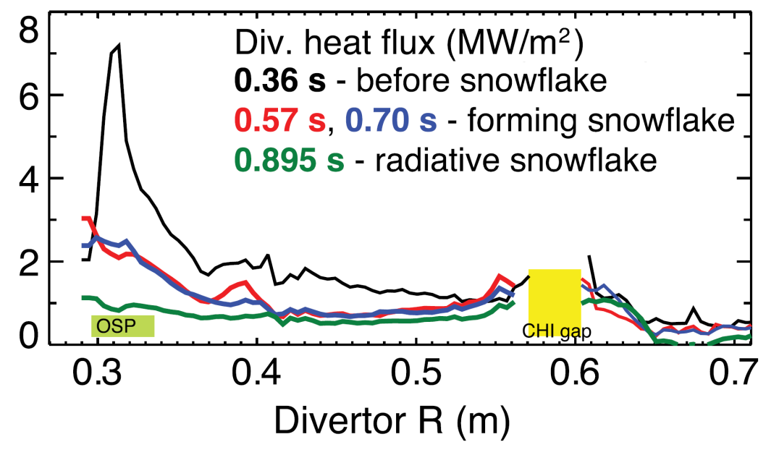
Goal: Test ability of radiation and advanced divertors to mitigate very high heat-fluxes
NSTX: reduced heat flux 2-4×via radiation (partial detachment)
Additional null-point in divertor expands field, reduces heat flux
NSTX-U peak heat fluxes will be up to 4-8× higher than in NSTX
Up to 40-60MW/
Standard Divertor
Snowflake/X Divertor
NSTX-U has additional coils for up-down symmetric snowflake/X, improved control

Slide 25
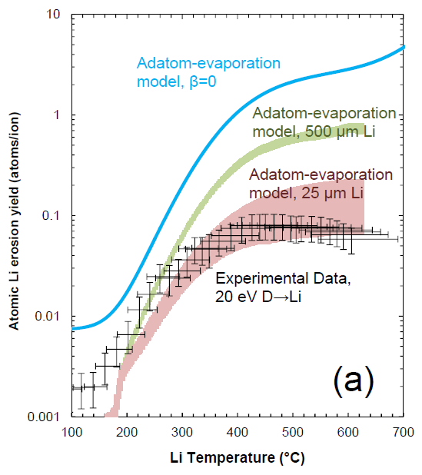


Discovery: Suppressed Li erosion and trapping at target observed in MAGNUM-PSI linear plasma device
Mixed-material effect reduces erosion due to LiD formation
Plasma pre-sheath potential well large enough to retain eroded Li
Significant implications for evaporative cooling concepts
T. Abrams 2014 PhD Princeton U.,
T. Abrams 2015 Nucl. Fusion submitted,
M. Chen 2015 Nucl. Fusion submitted.
Li-I emission, t=2.5s
Neutral Li emission
Li Trapping
Plasma
Target
T>700C
Neutral D emission
10 mm
Jaworski, 3rd ISLA, 2013

Slide 26
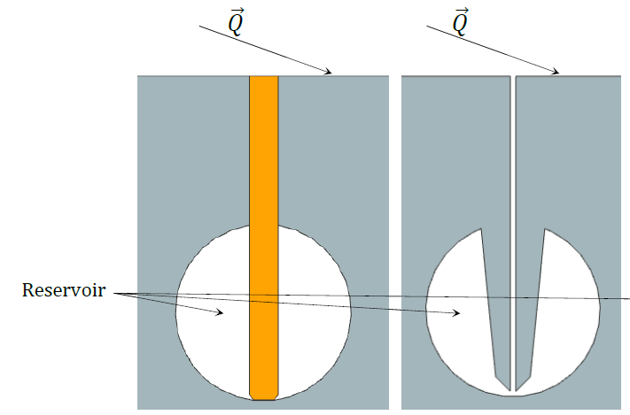
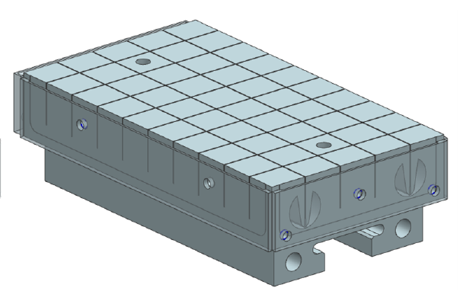
Goal: Begin to assess high-Z and liquid metal PFCs
Developing pre-filled target integrating Li reservoir w/ high-Z tile
Similar to Capillary Porous System (CPS) device but applicable as divertor PFC
Utilizes wire-EDM fabrication to obtain complex geometry
Emphasizes passive replenishment via capillary action
Textured
surface
Wick Structure
Reservoir
P. Rindt, TU/Eindhoven Thesis Project (advisor: M. Jaworski)

Slide 27
Outline
NSTX-U Mission and Motivation
NSTX/NSTX-U Research Highlights and Goals
  Global MHD Stability
  Transport and Turbulence
  Energetic Particles
  Power Exhaust
  Plasma Start-up
Brief Summaries of NSTX-U Research Plans
Summary

Slide 28
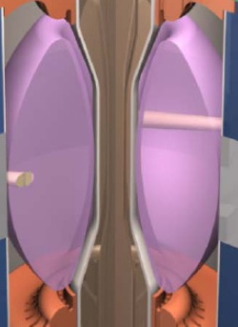
I_{P} Start-up/Ramp-up Critical Issue for ST-FNSF/Demo
Compact ST-FNSF has no/small central solenoid
ST-FNSF Scenarios
high β_{T}, β_{N}, κ, disruption avoidance, high H, heat flux mitigation
I_{P} [MA]
Current ramp-up and profile control
NBI
Solenoid-free
Start-up
HHFW
EC/EBW, HI, PF
Time
• Two novel techniques for solenoid-free start-up and ramp-up will be investigated
  RF: ECH/EBW and HHFW
  Helicity Injection
~ 1-2 MA of solenoid-free start-up current needed for FNSF
Notes:
ST has been addressing critical issues for FNSF: A compact FNSF facility does not have solenoid. So, the solenoid-free start-up is a critical issue for ST-FNSF. But solenoid-free start-up is attractive for tokamak reactor design as well. Other issues are ramp-up….

Slide 29
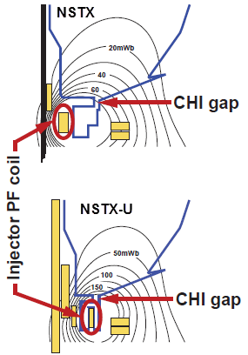
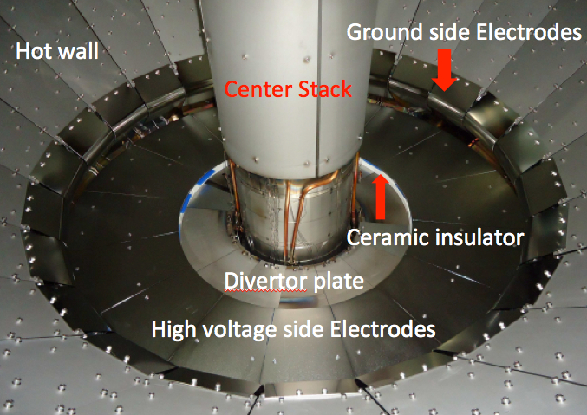
Collaborating with QUEST to explore CHI + ECH solenoid-free start-up in support of ST-FNSF
NSTX-U CHI Start-Up
QUEST CHI Implementation
showing installed electrodes
• Inj. Flux in NSTX-U is about 2.5 times higher than in NSTX
• NSTX-U coil insulation greatly enhanced for higher voltage ~ 3 kV operation
R. Raman, Univ. Washington
Preparing for CHI experiments on both NSTX-U and QUEST in 2016

Slide 30
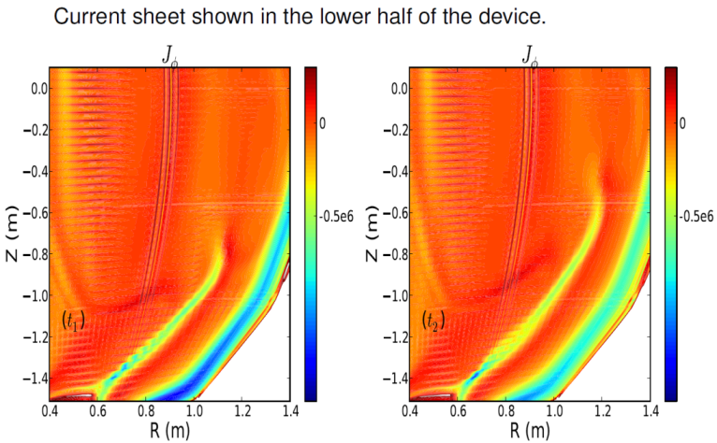
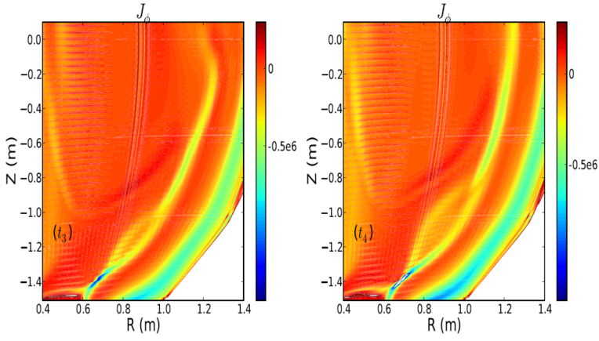
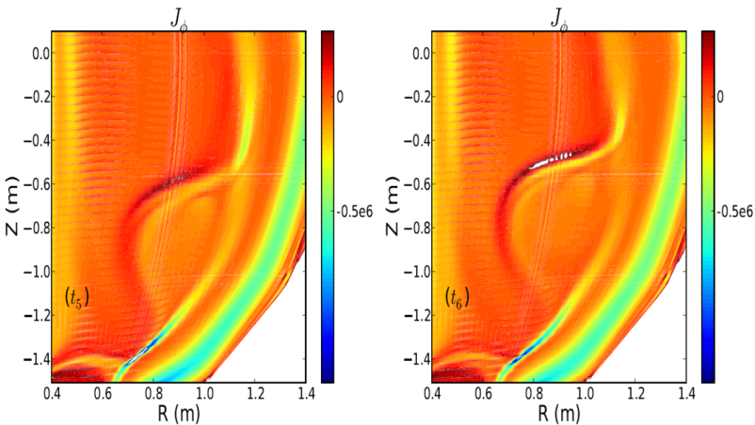
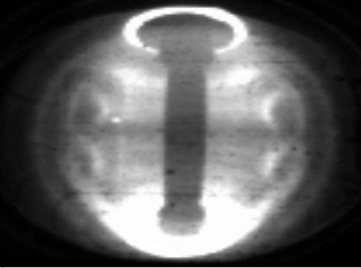
Discovery: Formation of “plasmoids” found in NIMROD simulations of Coaxial Helicity Injection (CHI) start-up
Sweet-Parker reconnection basis for CHI flux closure
  Break-up of S-P thin current layer leads to formation of plasmoids, which are inferred in expt
NIMROD simulations (Ebrahimi et al., PoP 2013, PRL 2015) shown below:
NSTX
Goal: Determine if plasmoids impact CHI start-up extrapolation to FNSF/Pilot

Slide 31

NSTX achieved 70% “transformer-less” current drive
Will NSTX-U achieve 100% as predicted by simulations?
TRANSP Contours of Non-Inductive Fraction
H_{98y2}
ITER H-mode confinement scaling multiplier
I_{P}=1 MA, B_{T}=1.0 T, P_{NBI}=12.6 MW
Goal: Assess viability and performance of 100% non-inductive ST

Slide 32
Outline
NSTX-U Mission and Motivation
NSTX/NSTX-U Research Highlights and Goals
  Global MHD Stability
  Transport and Turbulence
  Energetic Particles
  Power Exhaust
  Plasma Start-up
Brief Summaries of NSTX-U Research Plans
Summary

Slide 33
Brief Overview of FY2016-18 NSTX-U Goals
FY2016
  Obtain first data at 60% higher field/current, 2-3× longer pulse:
    Re-establish sustained low l_{i} / high-κ operation above no-wall limit
    Study thermal confinement, pedestal structure, SOL widths
    Assess current-drive, fast-ion instabilities from new 2nd NBI
FY2017
  Extend NSTX-U performance to full field, current (1T, 2MA)
    Assess divertor heat flux mitigation, confinement at full parameters
  Access full non-inductive, test small current over-drive
  First data with 2D high-k scattering, prototype high-Z tiles
FY2018
  Assess causes of core electron thermal transport
  Test advanced q profile and rotation profile control
  Assess CHI plasma current start-up performance
  Study low-Z and high-Z impurity transport
    Possibly test/compare pre-filled liquid-Li tiles/PFCs vs. high-Z solid

Slide 34
NSTX-U 5 year goal: Develop physics/scenario understanding needed to assess ST viability as FNSF/DEMO, support ITER
2016 | 2017-18 | 2019 | 2020 | 2021
Max B_{T} [T], I_{P} [MA]
0.8, 1.6
1, 2
Structural force
and coil heating
limit fractions
0.5, 0.5
1.0, 0.75
1.0, 1.0
Nominal τ_{pulse} [s]
1 – 2
2 – 4
4 – 5
Sustained β_{N}
3 – 5
4 – 6
NCC
5 – 6
ν* / ν* (NSTX)
0.6
0.4
Cryo
0.3 – 0.2
0.2 – 0.1
Inform choice
of FNSF/DEMO
aspect ratio
and divertor
Non-inductive
fraction (Δt ≥ τ_{CR})
70 – 90%
80 – 110%
90 – 120%
100 – 140%
NBI+BS I_{P} ramp-up: initial → final [MA]
0.6 → 0.8
0.5 → 0.9
0.4 → 1.0
CHI closed-flux
current [MA]
0.15 – 0.2
0.2 – 0.3
ECH / EBW
0.3 – 0.5
0.4 – 0.6
P_{heat} [MW] with
q_{peak} < 10MW/m²
8
10
15
20
Divertor heat-flux control
Snowflake and radiative divertor exhaust location
Lower
Lower or Upper
Lower + Upper
Cryo: access lowest ν*, compare to Li
ECH / EBW: bridge T_{e} gap from start-up to ramp-up
Off-midplane non-axisymmetric control coils (NCC): rotation profile control (NTV), sustain high β_{N}

Slide 35
10 year goal: Integrate high-performance core + metal walls
NSTX-U 5 year goal: Establish ST-FNSF physics/scenarios
2016-2020
2021-2025
Establish ST physics / scenarios:
High-performance + metal walls
Non-inductive start-up, ramp-up
Confinement vs. β , collisionality
Sustain high β with advanced control
Mitigate high heat fluxes
Test high-Z divertor, Li vapor shielding
Convert all PFCs from C to high-Z
Static → flowing Li divertor module(s), full toroidal flowing Li divertor, high T_{wall}
5s → 10-20s for PFC/LM equilibration
Assess ST with high-Z, high-Z + Li
Inform choice of
FNSF configuration:
Inform choice of FNSF / DEMO
plasma facing materials:
Lower A or higher A?
Standard, snowflake, Super-X (MAST-U)?
High-Z acceptable? or need high-Z + Li?
Assess for both divertor and first-wall

Slide 36
Summary
NSTX-U will provide many opportunities to study toroidal confinement physics in novel regimes:
  Low aspect ratio, strong shaping, high β, low collisionality
  Access strong fast-ion instability drive, high rotation
  Advanced divertors, high-Z walls, lithium walls
NSTX-U/ST results will support ITER, develop PMI solutions, and inform optimal divertor configuration and aspect ratio for next-step devices
Physics research to begin in December 2015
Thank you! Any questions?
Notes:
Here is the outline of this review to give you an overview of the world ST research.

Slide 37
Backup

Slide 38

Kinetic RWM theory consistent with RWM destabilization at intermediate plasma rotation; stability altered by collisionality
γτ_{w} contours vs. ν and ω_{φ}
MISK code
(marginal stability)
Plasma evolution
Precession drift resonance stabilization
Marginal stability
Bounce/transit resonance stabilization
ν_{eff}/ν^{exp (marginal stability)}
instability
(experiment)
unstable
NSTX 121083
unstable
ω_{φ}/ω_{φ}^{exp (marginal stability)}
Destabilization appears between precession drift resonance at low ω_{φ}, bounce/transit resonance at high ω_{φ}
Destabilization moves to increased ω_{φ} as ν decreases
S. Sabbagh, NF 2010
J. Berkery, PRL 2010

Slide 39





M3D-C¹ modeling of Vertical Displacement
Events (VDEs) has been extended to 3D
Implemented arbitrary thickness resistive wall, giving 3 region computational space (vacuum, RW, plasma)
3D modeling of NSTX VDE with realistic wall resistivity (Jardin, Ferraro)
  n=1 growth slow during drift (RWM?), growth then accelerates (external kink?)
  Halo currents begin to form when plasma makes contact with vessel
RB_{T} t = 2850
RB_{T} t = 2875
NSTX Discharge 132859
Disruption phase 2700 < t < 2950
Contours of RB_{T} show halo currents
RB_{T} t = 2900
RB_{T} t = 2918
NSTX-U / PPPL
Theory Partnership

Slide 40

M3D-C¹ with resistive wall capability will be used to determine optimal placement of new halo sensors
Dynamics of halo currents and forces critical for ITER: particular concern are halo current asymmetries and rotation
New sensors will measure halo currents, B-fields and JxB forces in NSTX-U
Critical theoretical issues: (i) role of boundary conditions (ii) halo current distributions in 3D conducting structures (new post-doc D. Pfefferle)
NSTX-U / PPPL
Theory Partnership
  R15/16-3, 17-2, 18-2, 2016 JRT

Slide 41


Study of RMP characteristics with NCC extended with TRIP3D (T. Evans, GA) – 2x12 NCC (and 2x7) favorable for RMP
Vacuum Island Overlap Width (VIOW) analysis shows full NCC 1kAt can produce sufficient VIOW in a wide range of q₉₅, but partial NCC needs more currents with low q₉₅ targets
  Also shows 2x7, with “one” more additional array upon partial NCC can provide the greater VIOW by toroidal coupling (n=2,4,9)

Slide 42

Major motivation for NSTX/MAST Upgrades: Determine if confinement trend continues, or is like conventional A
ST-FNSF
constant q, β, ρ∗
NSTX Upgrade
?
NSTX
ITER-like scaling
Normalized electron collisionality ν_{e}* ∝ n_{e} / T_{e}²
Favorable confinement results could lead to more compact ST reactors

Slide 43


High confinement multiplier H needed for compact ST
Fusion gain Q depends strongly on “H”, Q ∝ H ⁵⁻⁷
• Ion energy transport in H-mode ST plasmas near neoclassical level due to high shear flow and favorable curvature
• Electron energy transport anomalous (as for all tokamaks)
Enhanced pedestal H-mode (EPH) has H up to 1.5-2 → attractive for ST-FNSF
NSTX
NSTX
EPH
ST-FNSF
H-mode
R. Maingi, PRL 2010
S. Gerhardt NF 2014
Y. Ren (PPPL)

Slide 44


Electron and ion τ_{E} scale differently in ST, and different than at higher aspect ratio
Ions: τ_{E} ∼ I_{p}
Ion τ_{E} ∼ I_{P}, consistent with neoclassical ion transport
  Implies ion turb. suppressed by high E×B shear → possibility of isolating causes of e-transport
Electron τ_{E} ∼ B_{T}
  Could imply Electron Temperature Gradient (ETG) modes, and/or electromagnetic turbulence
Neoclassical
(r/a=0.5-0.8)
Electrons: τ_{E} ∼ B_{T}
3.5 kG
5.5 kG
S.M. Kaye, PRL 2007

Slide 45
Progress in predicting T_{e} using reduced χ_{e} models in regimes where single micro-instability is dominant
Linear gyrokinetic simulations find microtearing unstable in mid-radius region of high-collisionality H-modes
Micro-tearing
  Other micro-instabilities subdominant at this location for this class of discharge
ExB
Reduced model for micro-tearing χ_{e} (Rebut-Lallia-Watkins (RLW) - 1988) shows reasonable agreement between predicted & measured T_{e} for r/a > 0.3
  χ_{e} >> RLW must be used in core to match central T_{e} - may be due to GAE/CAE
Reduced ETG models in low-β L-modes also show reasonable T_{e} agreement for r/a > 0.3 (not shown)
r/a
ν
H
*
i
g
h
H
-
0
M
o
d
e
.
8
1
2
0
9
6
7
0
.
5
1
s
)
V
M
e
a
s
u
r
e
e
d
k
(
P
r
e
d
i
c
t
0
e
d
.
e
4
T
A
d
χ
-
h
o
c
e
2
0
2
-
3
0
m
/
(
s
G
A
E
p
r
o
x
y
)
χ
R
L
W
0
e
(
)
.
0
0
.
0
0
.
2
0
.
4
0
.
6
0
.
8
1
.
0
S. Kaye
r/a

Slide 46





Strong flow shear can destabilize Kelvin-Helmholtz (K-H) instability in NSTX (Wang, TTF 2014)
K-H instability expected for |ML_{n}/L_{ω}|>1 from linear analytic theory (Catto, 1973; Garbet, 1999)
K-H identified in global electrostatic ITG simulations for NSTX low β L-mode (Ren, 2013)
  Mostly unstable K-H modes have finite k|| (shifted away from nq=m)
K-H/ITG + neoclassical close to experiment χ_{i}
  χ_{e} underpredicted
  ETG possibly important
GTS code
nq=m
Nonlinear ETG simulations to be run in FY14-15 to investigate contribution in NSTX L-modes

Slide 47

New “kick” model for fast-ion transport predicts different
J_{NB}, ion/electron power split, inferred thermal transport

Slide 48



Linear stability analysis of fishbones with M3D-K finds rotation / rotation shear destabilizing at elevated q
Guoyong Fu, Feng Wang
NSTX-U / theory partnership
Eigenfunction broadens with rotation
  Enhanced fast-ion transport or triggering / seeding of tearing modes?
  Next step: investigate with non-linear runs.

Slide 49

All modern tokamaks / STs use a “divertor” to control where power and particles are exhausted
Power exhaust width outside main plasma can be very narrow (few mm)
Power / particles contact target plates here

Slide 50


FY15 modelling → outboard row of high-Z tiles can access high heat-flux, maintain operational flexibility
High-performance discharge
Shape developed to perform dedicated tests on outboard PFCs
  ISOLVER free-boundary solver utilized with specified β_{N}
  0D-analysis obtains heating power for assumed confinement multiplier H_{98y2}
Zero-radiation power exhaust provides heat flux figure-of-merit (FOM)
  FOM calculates incident power accounting for magnetic shaping only
  High-Z shape FOM is 66% of similar full-power, high-triangularity scenario
FOM ~ 60 MW/m²
High-Z reference discharge
FOM ~ 40 MW/m²

Slide 51



Helicity Injection is efficient method for current initiation
Coaxial Helicity Injection (CHI) concepts being developed
CHI developed on HIT, HIT-II
Transferred to NSTX / NSTX-U
Discharge evolution of 160 kA closed flux current produced by CHI alone in NSTX
R. Raman et al., PRL 2006

Slide 52


CHI in NSTX has resemblance to 2D Sweet-Parker reconnection (NIMROD simulations)
Toroidal electric field generated in injector region by reduction of injector voltage and current
  E_{toroidal} × B_{poloidal} drift brings oppositely directed field lines closer and causes reconnection, generating closed flux
Direction of plasma flows
In Injector Region only
Elongated Sweet-Parker-type current sheet
n > 0 modes / MHD not strongly impacting 2D reconnection
Current
sheet
F. Ebrahimi, PoP 2013, PoP 2014

Slide 53






Five Year Facility Enhancement Plan (green = ongoing)
2015: Engineering design for high-Z tiles, Cryo-Pump, NCC, ECH
Fiscal Year:
2015 | 2016 | 2017 | 2018 | 2019
Major enhancements:
Base funding
+15% incremental
Upgrade Outage
1.5 → 2 MA, 1s → 5s
Run Weeks:
14-16
16-18
12-16
10-12
New
center-stack
Pulse-burst MPTS
Lower divertor cryo-pump
Boundary Science
+ Particle Control
Boronization
High-Z tile row on lower OBD
High-Z PFC diagnostics
Li granule injector
Upward
LiTER
LLD using bakeable cryo-baffle
MAPP
MGI disruption mitigation
Upgraded halo sensors
Off-midplane 3D coils (NCC)
Core Science
δB diag. - incremental
Enhanced MHD sensors
Laser blow-off
42 ch MPTS
DBS, PCI, or other intermediate-k
48 ch BES
High k_{θ}
MSE/LIF
Charged fusion product
Neutron collimator
4 coil AE antenna
Establish control of:
Rotation
q_{min}
HHFW limiter upgrade
Snowflake
Integrated Scenarios
FIReTIP
n_{e}
Divertor P_{rad}
2nd NBI
1 MW ECH/EBW
Upgraded CHI for ~0.5MA
0.5-1 MA CHI
up to 1 MA plasma gun

Slide 54
NSTX-U Milestone Schedule for FY2016-18
FY2016
FY2017
FY2018
Run Weeks:
Incremental
14
16
16
18
12
16
R16-1
R17-1
R18-1
Boundary Science
+ Particle Control
Assess H-mode confinement, pedestal, SOL characteristics at higher B_{T}, I_{P}, P_{NBI}
Assess scaling, mitigation of steady-state, transient heat-fluxes w/ advanced divertor operation at high power density
Assess impurity sources and edge and core impurity transport
R17-2
IR18-1
Assess high-Z divertor PFC performance and impact on operating scenarios
Investigation of power and momentum balance for high density and impurity fraction divertor operation
R16-2
R17-3
IR18-2
Assess effects of NBI injection on fast-ion f(v) and NBI-CD profile
Assess τ_{E} and local transport and turbulence at low ν* with full confinement and diagnostic capabilities
Assess role of fast-ion driven instabilities versus micro-turbulence in plasma thermal energy transport
Core Science
Begin ~1 year outage for
major facility enhancement(s) sometime during FY2018
IR17-1
R18-2
R16-3
Assess fast-wave SOL losses, core thermal and fast ion interactions at increased field and current
Control of current and rotation profiles to improve global stability limits and extend high performance operation
Integrated Scenarios
Develop physics + operational tools for high-performance: κ, δ, β, EF/RWM
R17-4
R18-3
Develop high-non-inductive fraction NBI H-modes for sustainment and ramp-up
Assess transient CHI current start-up potential in NSTX-U
FES 3 Facility Joint Research Target (JRT)
C-Mod leads JRT
DIII-D leads JRT
NSTX-U leads JRT
Assess disruption mitigation, initial
tests of real-time warning, prediction
TBD… possibly something
on energetic particles
TBD

