Slide 1


Global MHD Mode Stabilization and Control for Disruption Avoidance
S.A. Sabbagh¹, J.W. Berkery¹, J.M. Bialek¹, J.M. Hanson¹, C. Holcomb²,
M. Austin³, D. Battaglia⁴, R.E. Bell⁴, K. Burrell³, R. Buttery³, N. Eidietis³,D.A. Gates⁴, S.P. Gerhardt⁴, B. Grierson⁴, I. Goumiri⁵, G. Jackson³, R. La Haye³, J. King³, E. Kolemen⁴, M.J. Lanctot², M. Okabayashi⁴, T. Osborne³, Y.S. Park¹, C. Rowley⁵, E. Strait³
¹Department of Applied Physics, Columbia University, New York, NY, ²Lawrence Livermore National Laboratory, Livermore, CA, ³General, Atomics, San Diego, CA, ⁴Princeton Plasma Physics Laboratory, Princeton, NJ, ⁵Princeton University, Princeton, NJ
18th International ST Workshop
Princeton University
11/4/15
V1.4

Slide 2
Talk Outline
Prediction, stabilization, and control of global MHD instabilities – synergizing elements in NSTX-U
Kinetic resistive wall mode stabilization – unification of understanding
Plasma rotation control in NSTX-U for disruption avoidance
Active RWM control capabilities and expansion plans

Slide 3
Disruption avoidance is a critical need for future tokamaks; NSTX-U is focusing stability research on this
The new “grand challenge” in tokamak stability research
  Can be done! (JET: < 4% disruptions w/C wall, < 10% w/ITER-like wall)
    ITER disruption rate: < 1 - 2% (energy load, halo current); << 1% (runaways)
Strategic plan: utilize/expand stability/control research success
  Disruption prediction, avoidance, and mitigation (DPAM) is multi-faceted, best addressed by a focused, (inter)national effort (multiple devices/institutions)
FESAC 2014 Strategic Planning report defined “Control of Deleterious Transient Events” highest priority (Tier 1) initiative
NSTX-U will allow focused research on disruption avoidance with quantitative measures of progress
  Builds on success in MHD stability and control research

Slide 4
Research in today’s presentation is part of NSTX-U’s evolving capabilities for disruption prediction/avoidance
Sensor/predictor (CY available) | Control/Actuator (CY available)
Low frequency MHD (n=1,2,3): 2003 | Dual-component RWM sensor control (closed loop: 2008)
Low frequency MHD spectroscopy (open loop: 2005) | Control of β_{N} (closed loop: 2007)
r/t RWM state-space controller observer (2010) | Physics model-based RWM state-space control (2010)
Real-time rotation measurement (2016) | Plasma rotation control (NTV rotation control open loop: 2003) (+NBI closed loop ~ 2017)
Kinetic RWM stabilization initial real-time model (2016-17) | Safety factor control (closed loop ~ 2016-17)
MHD spectroscopy (real-time) (in NSTX-U 5 Year Plan) | Upgraded 3D coils (NCC) (in NSTX-U 5 Year Plan)
  +New Disruption Event Characterization and Forecasting code, initial results

Slide 5
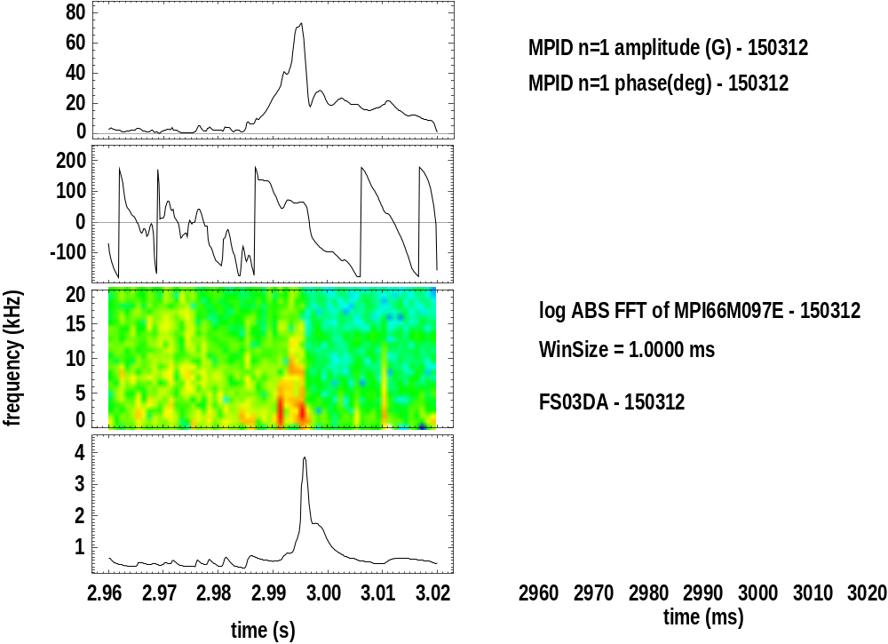
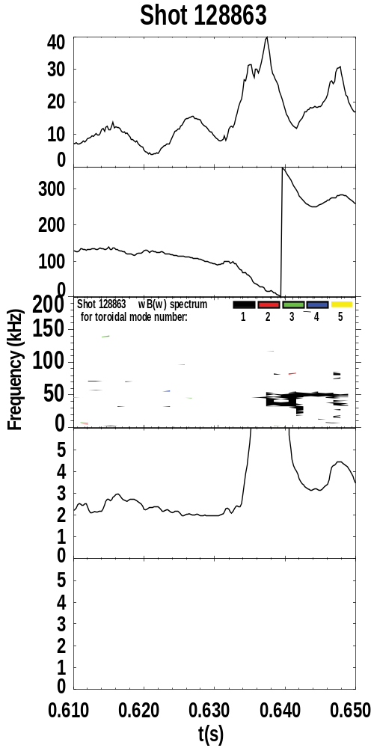
Joint NSTX / DIII-D experiments and analysis gives unified kinetic RWM physics understanding for disruption avoidance
RWM Dynamics
  RWM rotation and mode growth observed
  No strong NTM activity
  Some weak bursting MHD in DIII-D plasma
    Alters RWM phase
  No bursting MHD in NSTX plasma
DIII-D (β_{N} = 3.5)
NSTX (β_{N} = 4.4)
rotation
growth
rotation
growth
ΔB_{p}^{n=1}(G)
amplitude
amplitude
phase
phase
φ_{Bp}^{n=1}(deg)
toroidal magnetics
toroidal magnetics
Frequency (kHz)
D_{α}
D_{α}
(arb)
S. Sabbagh et al., DIII-D/NSTX experiments
S. Sabbagh et al., APS Invited talk 2014
t (s)
t (s)

Slide 6
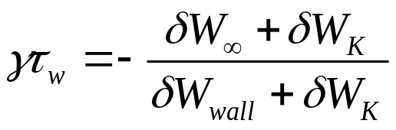
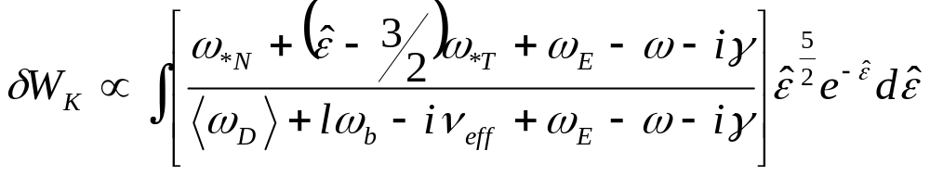
Modification of Ideal Stability by Kinetic theory (MISK code) is used to determine proximity of plasmas to stability boundary
Initially used for NSTX since simple critical scalar ω_{φ} threshold stability models did not describe RWM stability
Kinetic modification to ideal MHD growth rate
  Trapped / circulating ions, trapped electrons, etc.
  Energetic particle (EP) stabilization
Stability depends on
  Integrated ω_{φ} profile: resonances in δW_{K} (e.g. ion precession drift)
  Particle collisionality, EP fraction
Sontag, et al., Nucl. Fusion 47 (2007) 1005
Hu and Betti, Phys. Rev. Lett 93 (2004) 105002
ω_{φ} profile (enters through ExB frequency)
Trapped ion component of δW_{K} (plasma integral over energy)
Some NSTX / MISK analysis references
J. Berkery et al., PRL 104, 035003 (2010)
S. Sabbagh, et al., NF 50, 025020 (2010)
J. Berkery et al., PRL 106, 075004 (2011)
J. Berkery et al., PoP 21, 056112 (2014)
J. Berkery et al., PoP 21, 052505 (2014)
(benchmarking paper)
precession drift
bounce
collisionality

Slide 7
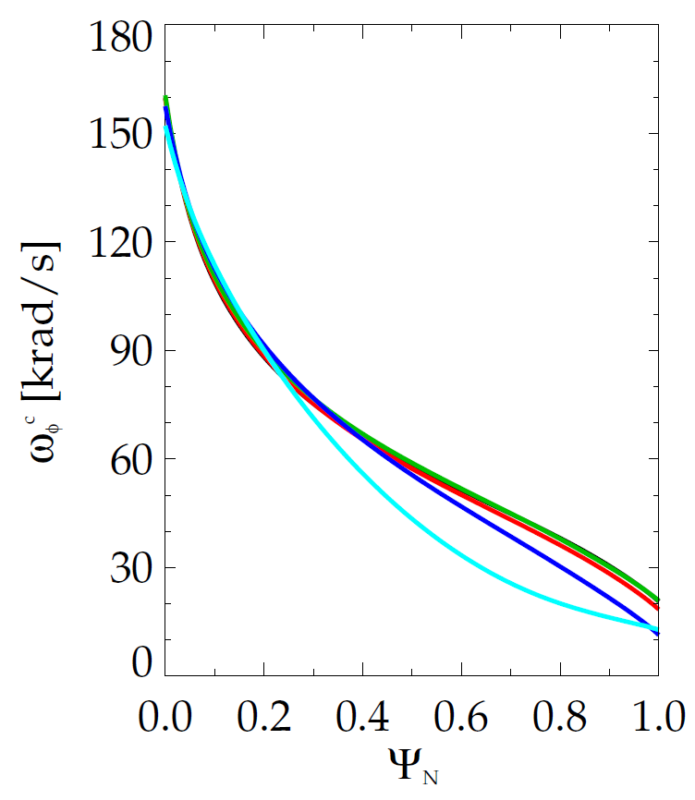
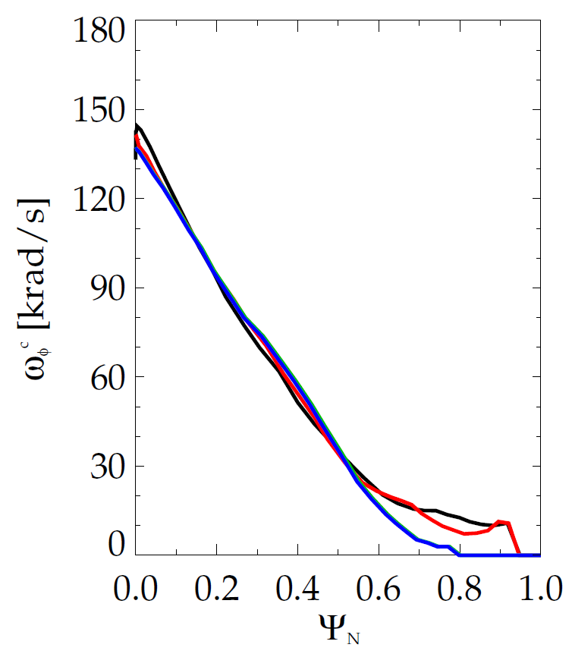
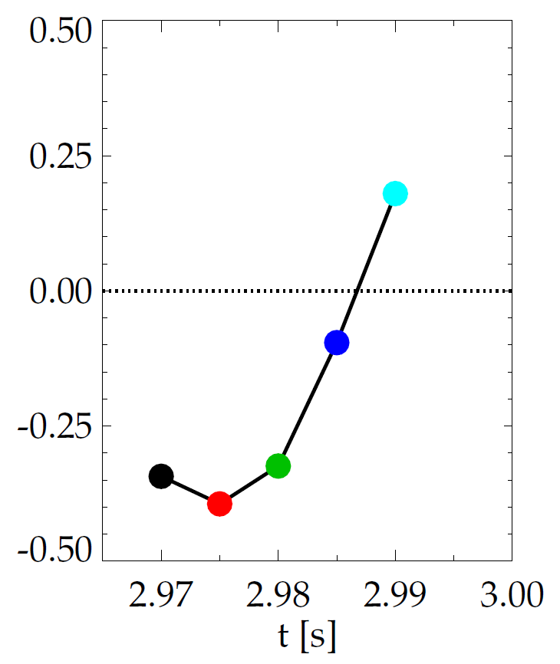
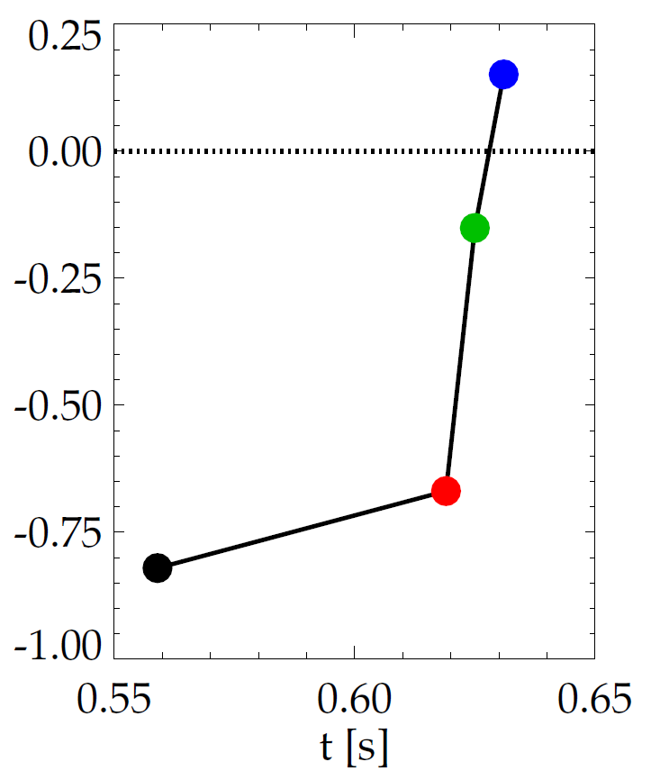
Evolution of plasma rotation profile leads to linear kinetic RWM instability as disruption is approached
DIII-D (minor disruption)
NSTX (major disruption)
unstable
stable
γτ_{wall}
unstable
γτ_{wall}
stable
MISK
MISK
increasing time
increasing time
S. Sabbagh et al., APS Invited talk 2014
Also see J.W. Berkery et al., ISTW 2015 poster for NSTX

Slide 8
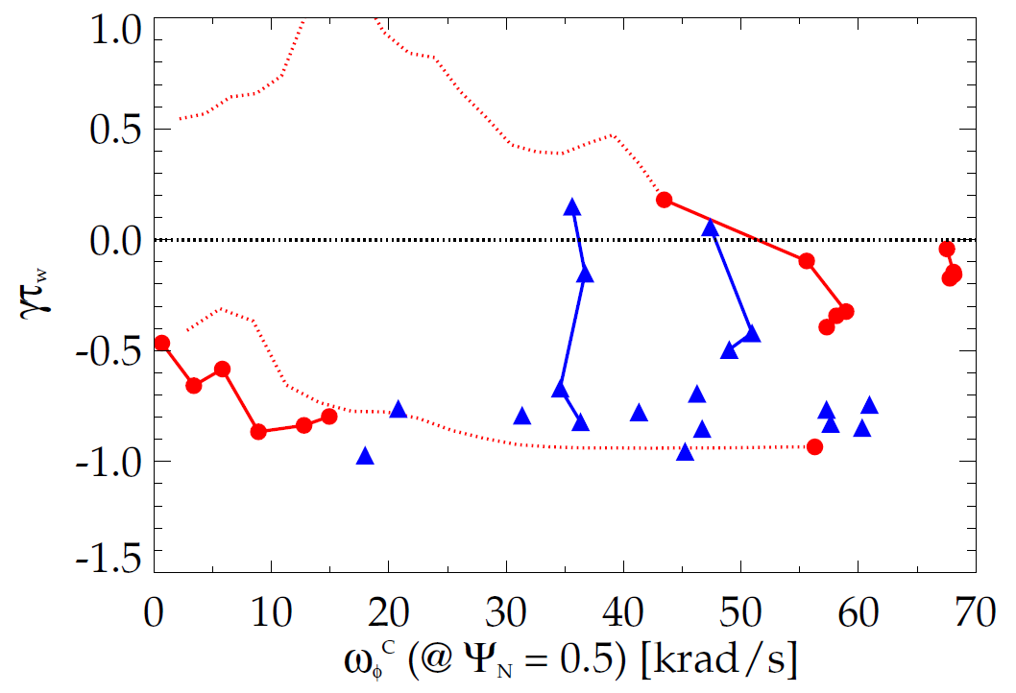
Kinetic RWM stability evaluated for DIII-D and NSTX plasmas, reproduces experiments over wide rotation range
Kinetic RWM stability analysis for experiments (MISK)
Summary of results
  Plasmas free of other MHD modes can reach or exceed linear kinetic RWM marginal stability
  Bursting MHD modes can lead to non-linear destabilization before linear stability limits are reached
  Extrapolations of DIII-D plasmas to different V_{φ} show marginal stability is bounded by 1.6 < q_{min} < 2.8
DIII-D
NSTX
q_{min} = 2.8
unstable
Normalized growth rate (γτ_{w})
“weak stability” region
q_{min} = 1.6
major disruption
minor disruption
extrapolation
stable
Plasma rotation [krad/s] (ψ_{N} = 0.5)
Reduced models of kinetic RWM stability now being investigated to support real-time disruption avoidance (e.g. by rotation profile control) (J.W. Berkery et al., ISTW 2015)
J.W. Berkery, J.M. Hanson, S.A. Sabbagh (Columbia U.)

Slide 9
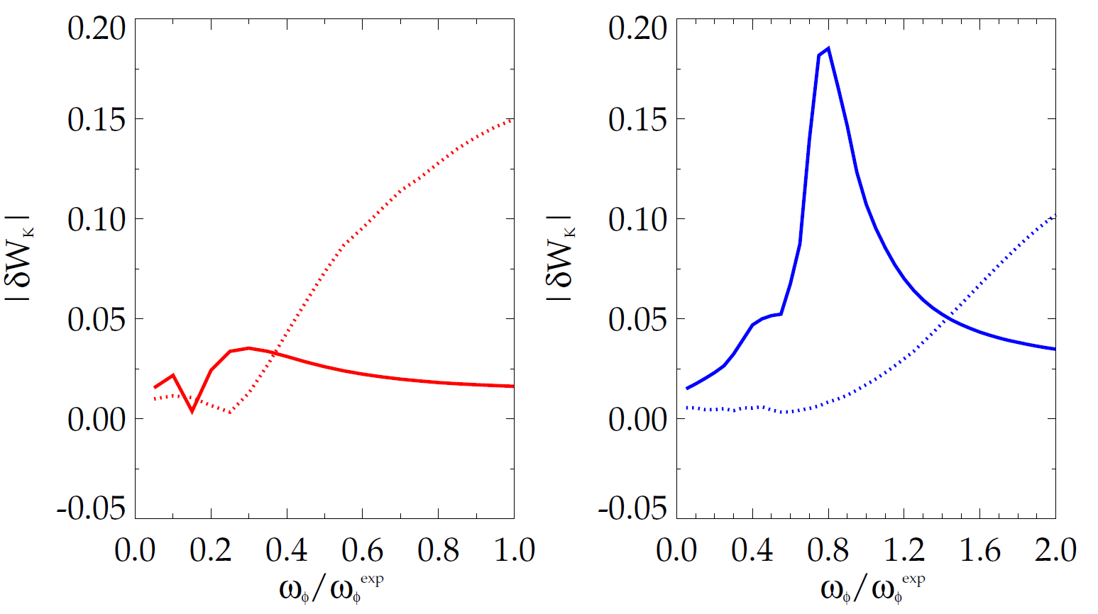
Bounce resonance stabilization dominates for DIII-D vs. precession drift resonance for NSTX at similar, high rotation
|δW_{K}| for trapped resonant ions vs. scaled experimental rotation (MISK)
DIII-D
precession
resonance
NSTX
bounce / circulating
resonance
bounce / circulating
resonance
precession
resonance
133103 @ 3.330 s
stable plasma
133776 @ 0.861 s
stable plasma
DIII-D experimental rotation profile
NSTX experimental rotation profile

Slide 10
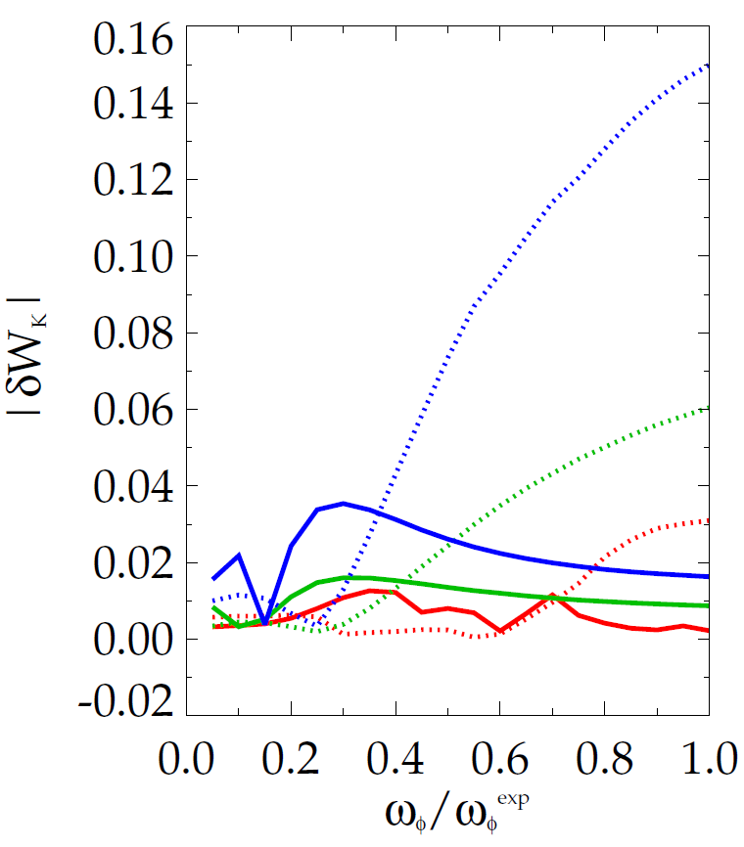
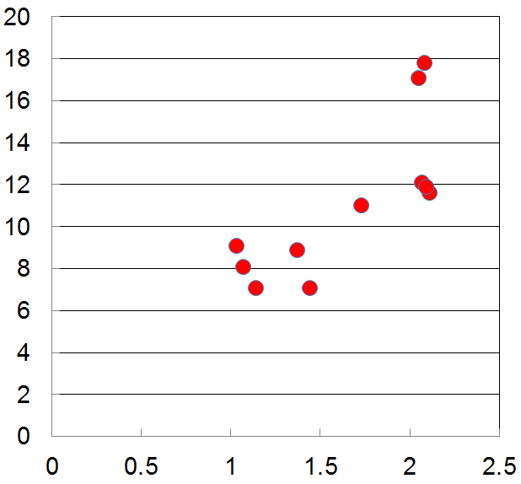

Increased RWM stability measured in DIII-D plasmas as q_{min} is reduced is consistent with kinetic RWM theory
|δW_{K}| for trapped resonant ions vs. scaled experimental rotation (MISK)
Measured plasma response to 20 Hz, n = 1 field vs q_{min}
DIII-D (q_{min} = 1.2)
DIII-D (q_{min} = 1.6)
DIII-D (q_{min} = 2.8)
less stable
bounce /
circulating
resonance
precession drift
resonance
n = 1 |δB_{p} | (G/kA)
q_{min}
Bounce resonance dominates precession drift resonance for all q_{min} examined at the experimental rotation
DIII-D experimental rotation profile

Slide 11
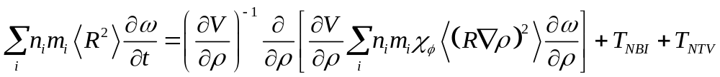
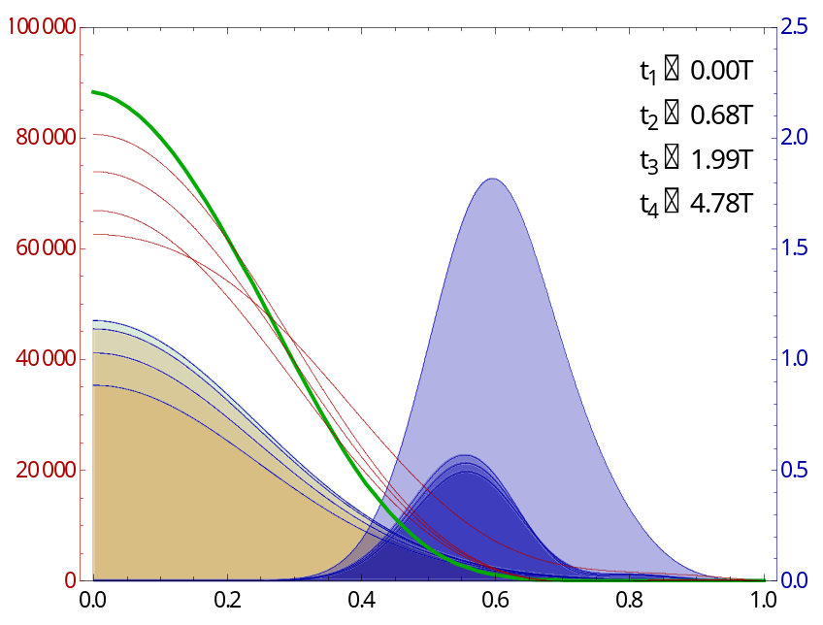
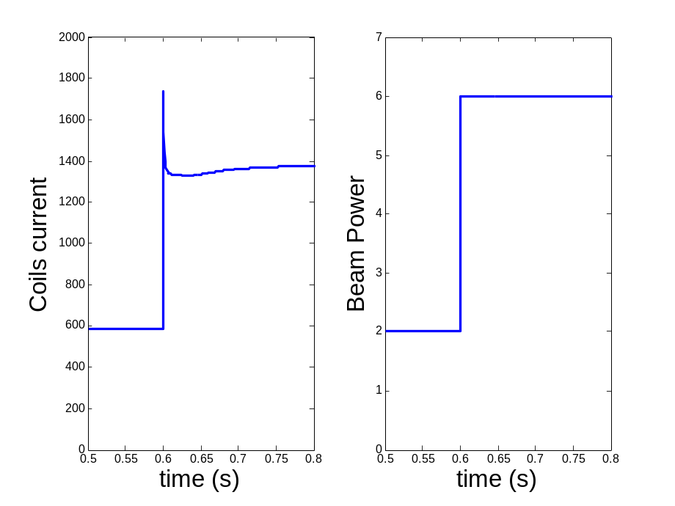
Rotation feedback controller designed for NSTX-U using non-resonant NTV and NBI used as actuators
Momentum force balance – ω_{φ} decomposed into Bessel function states
NTV torque:
(non-linear)
Rotation evolution and NBI and NTV torque profiles
3D coil current and NBI power (actuators)
10
2.5
2
7
10⁴
desired ω_{φ}
t₁ = 0.00τ_{m}
t₂ = 0.68τ_{m}
t₃ = 1.99τ_{m}
t₄ = 4.78τ_{m}
6
8
t₄
2.0
5
6
t₁
1.5
4
1
NBI power (MW)
3D Coil Current (kA)
Plasma rotation (rad/s)
NBI, -NTV torque density (N/m²)
3
4
-NTV
torque
1.0
2
2
NBI
torque
0.5
feedback on
1
feedback on
0
0.0
0
0
0.0
0.2
0.4
ψ_{N}
0.6
0.8
1.0
0.5
0.6
0.7
0.8
0.5
0.6
0.7
0.8
t (s)
t (s)
I. Goumiri (Princeton student), S.A. Sabbagh (Columbia U.), C. Rowley (P.U.), D.A. Gates, S.P. Gerhardt (PPPL)

Slide 12
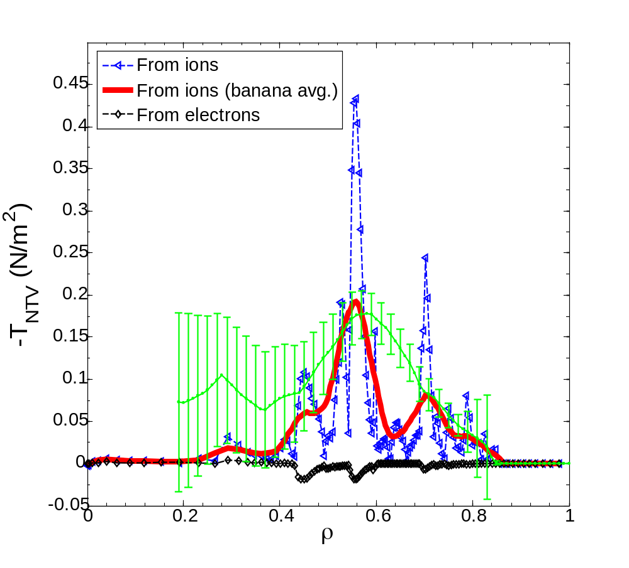
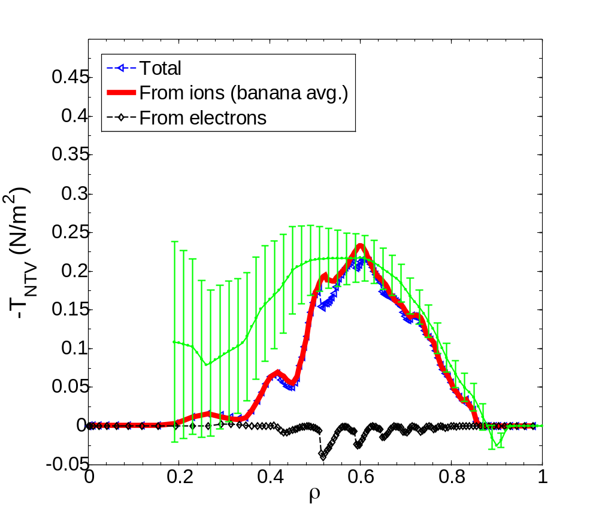
NTV physics studies for rotation control: measured NTV torque density profiles quantitatively compare well to theory
n = 3 coil configuration
n = 2 coil configuration
NSTX
NSTX
x1.7
x0.6
Experimental
-dL/dt
Experimental
-dL/dt
NTVTOK
NTVTOK
ψ_{N}
ψ_{N}
T_{NTV} (theory) scaled to match peak value of measured -dL/dt
  Scale factor ((dL/dt)/T_{NTV}) = 1.7 and 0.6 for cases shown above – O(1) agreement
S. Sabbagh et al., IAEA FEC 2014 (EX/1-4)

Slide 13
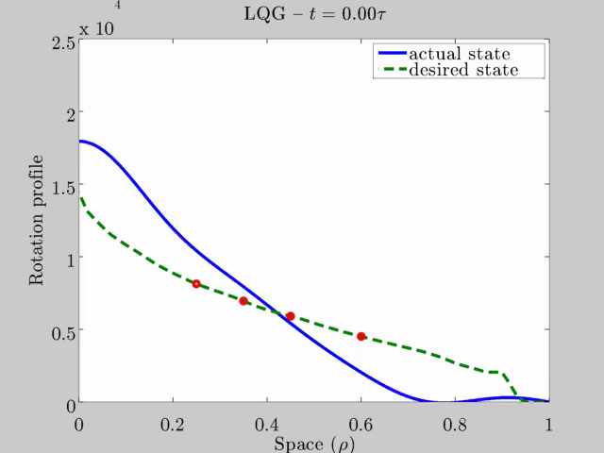
Rotation feedback controller designed for NSTX-U can evolve plasma rotation profile toward global mode stability
NSTX-U (6 NBI sources and n = 3 NTV)
Recall:
NSTX (major disruption)
25
unstable
20
stable
Steady-state reached in ~ 3τ_{m}
γτ_{wall}
15
Plasma rotation (kHz)
MISK
10
stable
stable
5
marginally
stable
marginally
stable
0
0.0
0.2
0.4
ψ_{N}
0.6
0.8
1.0
I. Goumiri (Princeton student), S.A. Sabbagh (Columbia U.), C. Rowley (P.U.), D.A. Gates, S.P. Gerhardt (PPPL)

Slide 14
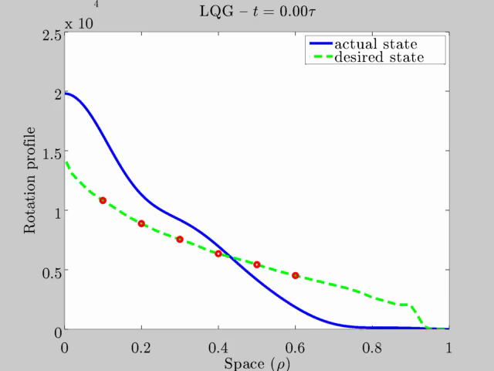
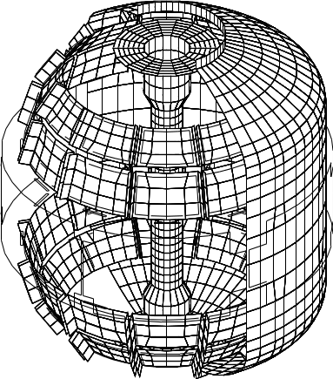
With NCC coil upgrade, rotation feedback controller can reach desired rotation profile faster, with greater fidelity
NSTX-U ω_{φ} control with
  6 NBI sources
  NTV possible from planned NCC upgrade
Better performance
  Faster to target t ~ 0.5τ_{m}
  Matches target ω_{φ} better
25
20
15
Plasma rotation (kHz)
10
Planned NCC upgrade
stable
5
marginally
stable
0
0.0
0.2
0.4
ψ_{N}
0.6
0.8
1.0
I. Goumiri (Princeton student), S.A. Sabbagh (Columbia U.), C. Rowley (P.U.), D.A. Gates, S.P. Gerhardt (PPPL)

Slide 15
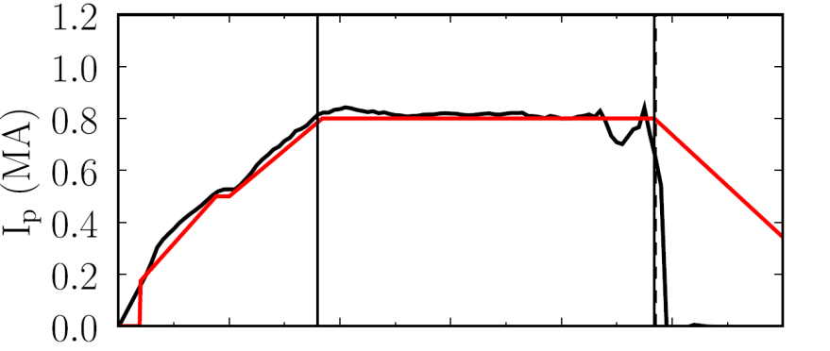
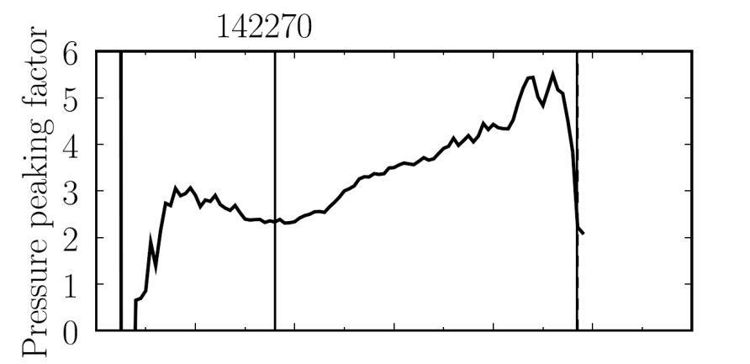

Disruption Event Characterization And Forecasting Code (DECAF) yielding initial results (pressure peaking example)
35 physical disruption chain events identified; 12 technical/human error events
10 physical events are presently defined in code with quantitative warning points
  Code written to be easily expandable and portable to other tokamaks
This example: Pressure peaking (PRP) disruption event chain identified by code before disruption
  (PRP) Pressure peaking warnings identified first
  (VDE) VDE condition subsequently found 19 ms after last PRP warning
  (IPR) Plasma current request not met
  (SCL) Shape control warning issued
NSTX
142270
Disruption
PRP warnings
Event chain
PRP
VDE
IPR
SCL
Detected at: 0.4194s
0.4380s
0.4522s
0.4732s
J.W. Berkery, S.A. Sabbagh, Y.S. Park (Columbia U.)
and the NSTX-U Disruption PAM Working Group

Slide 16
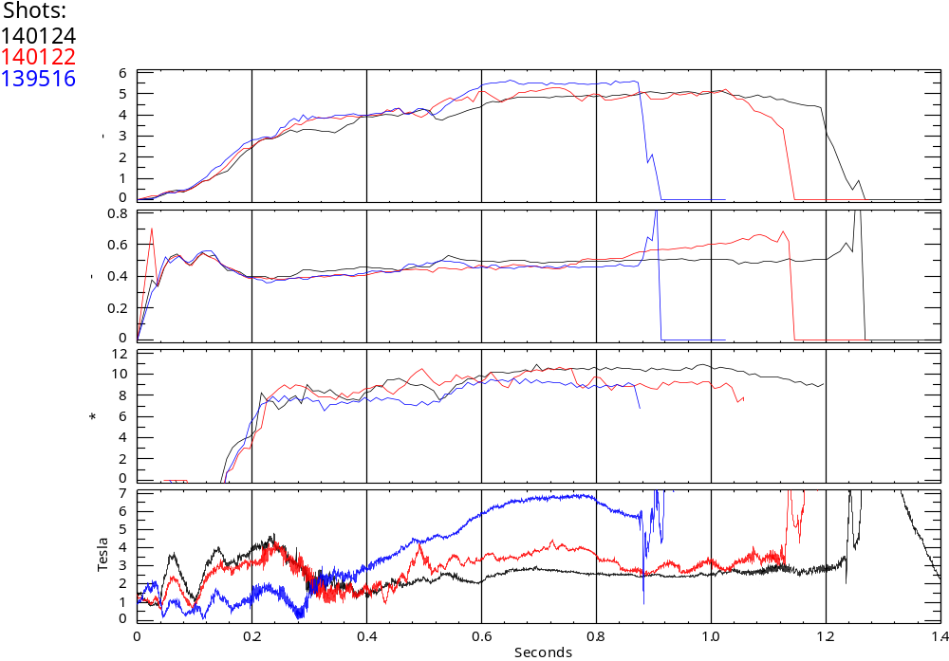
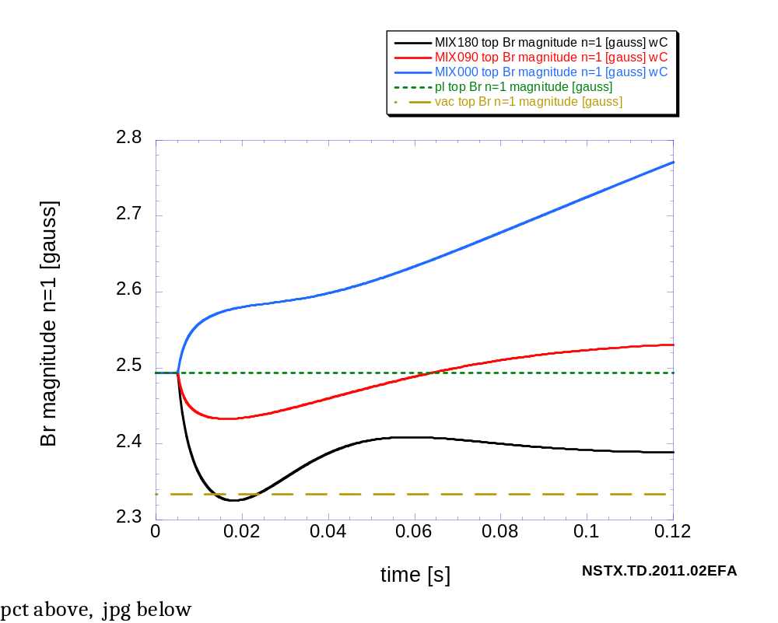
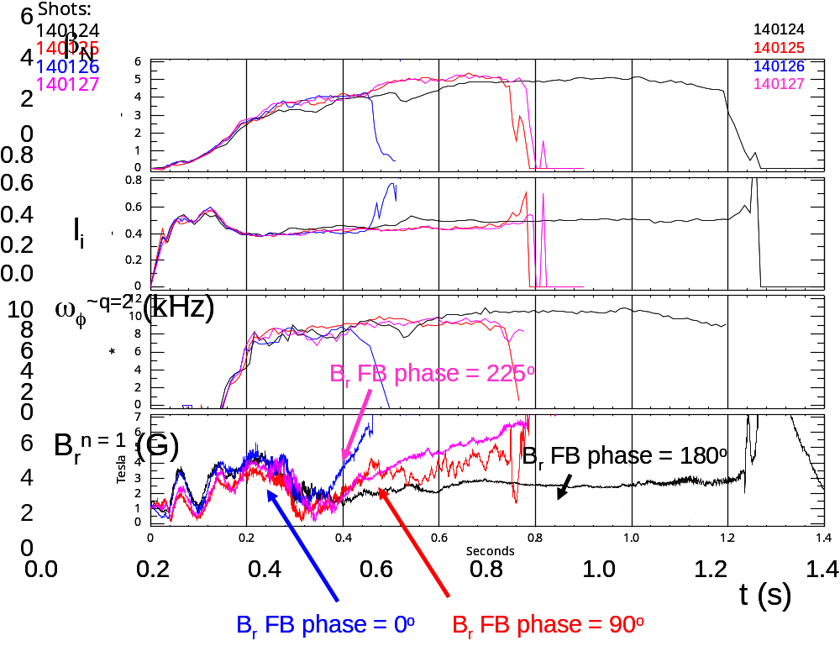
Active RWM control: dual B_{r} + B_{p} sensor feedback gain and phase scans produce significantly reduced n = 1 field
6
β_{N}
140124
140122
139516
β_{N}
Favorable B_{p} + B_{r} feedback (FB) settings found (low l_{i} plasmas)
Time-evolved theory simulation of B_{r}+B_{p} feedback follows experiment
4
2
0
B_{r} gain scan
0.8
0.6
0.4
l_{i}
l_{i}
No B_{r} feedback
B_{r} Gain = 1.0
0.2
0.0
B_{r}^{n = 1} (G)
S. Sabbagh et al., Nucl. Fusion 53 (2013) 104007
6
6
4
4
2
2
B_{r} Gain = 1.50
0
Simulation of B_{r} + B_{p} control (VALEN)
0.0
0.2
0.4
0.6
0.8
1.0
1.2
1.4
t (s)
Feedback on
0 deg FB phase
B_{r} FB phase scan
Radial field n = 1 (G)
90 deg FB phase
Vacuum error field
+ RFA
180 deg FB phase
Vacuum error field
Δt (s) (model)

Slide 17
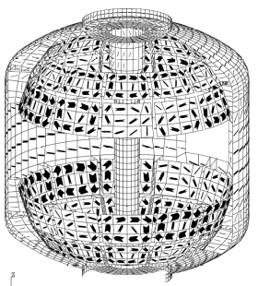
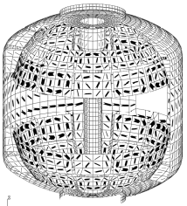
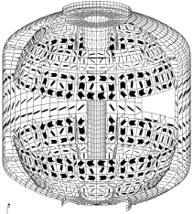



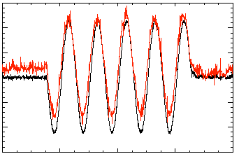
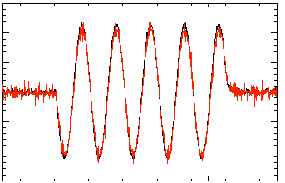
Model-based RWM state space controller including 3D model of plasma and wall currents used at high β_{N}
Full 3-D model
~3000+ states
State reduction (< 20 states)
RWM
eigenfunction(2 phases, 2 states)
Balancing
transformation
…
Controller reproduction of n = 1 field in NSTX
Controller model can compensate for wall currents
  Includes plasma mode-induced current
Potential to allow more flexible control coil positioning
  May allow control coils to be moved further from plasma, and be shielded (e.g. for ITER)
  Straightforward inclusion of multiple modes (with n = 1, or n > 1) in feedback
150
5 states
used
100
50
Sensor Difference (G)
0
Controller
(observer)
-50
-100
118298
-150
Measurement
150
100
50
10 states
used
Katsuro-Hopkins, et al., NF 47 (2007) 1157
0
Sensor Difference (G)
-50
-100
118298
(only wall states used)
-150
0.2
0.4
0.6
0.8
1.0
t (s)

Slide 18
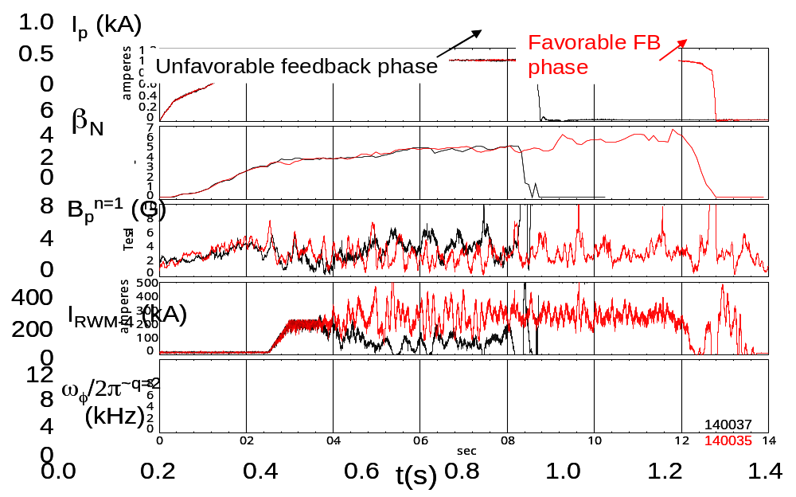
NSTX RWM state space controller sustains high β_{N}, low l_{i} plasma – available for NSTX-U with independent coil control
RWM state space feedback (12 states)
NSTX Experiments
I_{p} (MA)
n = 1 applied field suppression
  Suppressed disruption due to n = 1 field
Feedback phase scan
  Best feedback phase produced long pulse, β_{N} = 6.4, β_{N}/l_{i} = 13
(A)
Run time has been allocated for continued experiments on NSTX-U in 2016
S. Sabbagh et al., Nucl. Fusion 53 (2013) 104007

Slide 19
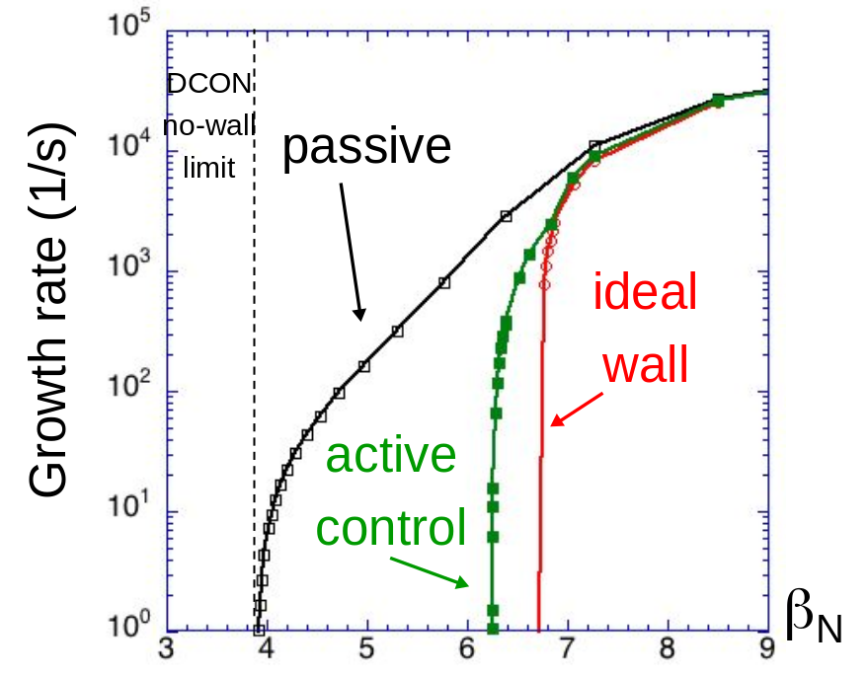
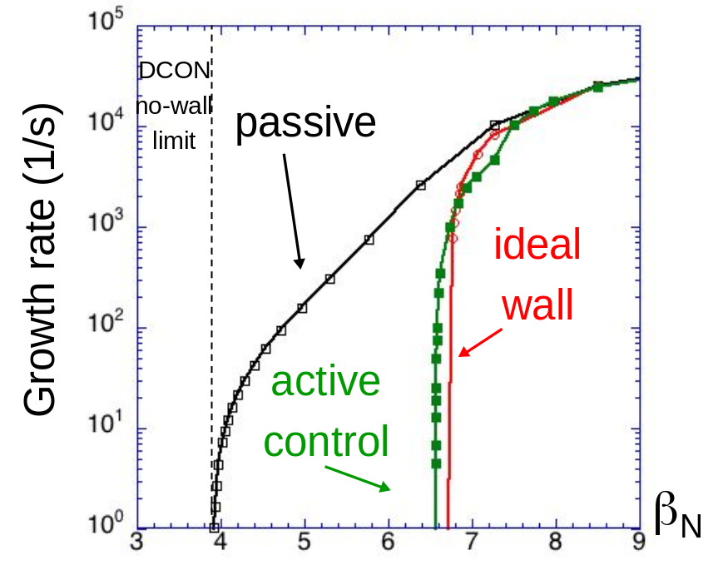
Active RWM control design study for proposed NSTX-U 3D coil upgrade (NCC coils) shows superior capability
NCC 2x6 odd parity, with favorable sensors
NCC 2x12 with favorable sensors, optimal gain
NCC (plasma facing side)
Full NCC coil set allows control close to ideal wall limit
  NCC 2x6 odd parity coils: active control to β_{N}/β_{N}^{no-wall} = 1.58
  NCC 2x12 coils, optimal sensors: active control to β_{N}/β_{N}^{no-wall} = 1.67

Slide 20
Global MHD mode stabilization understanding and control will synergize in NSTX-U for disruption avoidance
Physics Understanding
  Unification of DIII-D / NSTX experiments and analysis gives improved RWM understanding for disruption avoidance
  Linear kinetic RWM marginal stability limits can describe disruptive limits in plasmas free of other MHD modes
  Complementarity found: at similar high rotation, kinetic RWM stabilization physics is dominated by bounce orbit resonance in DIII-D, and by ion precession drift resonance in NSTX
  New Disruption Event Characterization and Forecasting code (initial results)
Stability Control
  Rotation profile control has potential to steer away from unstable profiles
  Model-based RWM state-space controller, and dual field component PID control available; development to further improve performance
  Further improvements to rotation profile, active mode control possible with planned NCC 3D coil upgrade

Slide 21
Supporting slides follow

Slide 22
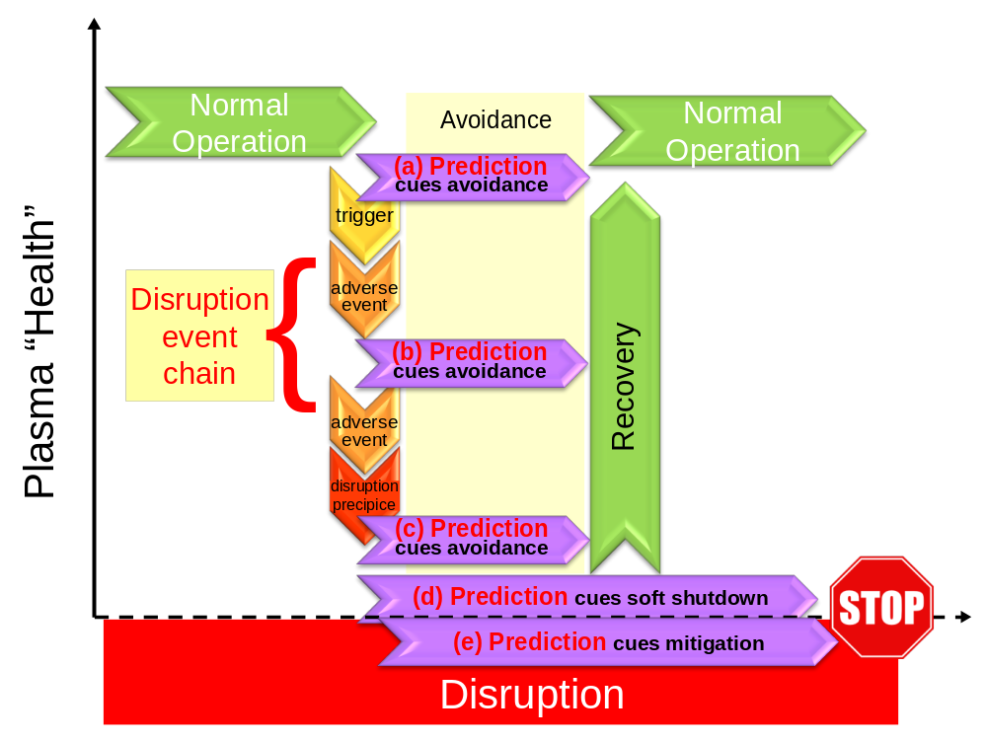
Disruption event chain characterization capability started for NSTX-U as next step in disruption avoidance plan
Disruption prediction framework from upcoming DOE “Transient Events” report
Approach to disruption prevention
  Identify disruption event chains and elements
  Predict events in disruption chains
    Attack events at several places
    Give priority to early events
  Provide cues to avoidance system to break the chain
  Provide cue to mitigation system if avoidance deemed untenable
t
S.A. Sabbagh (for Disruption Prediction panel)

Slide 23
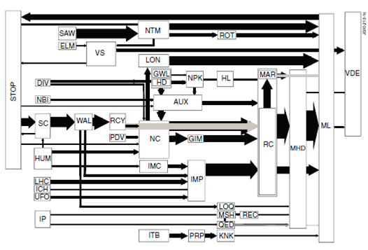
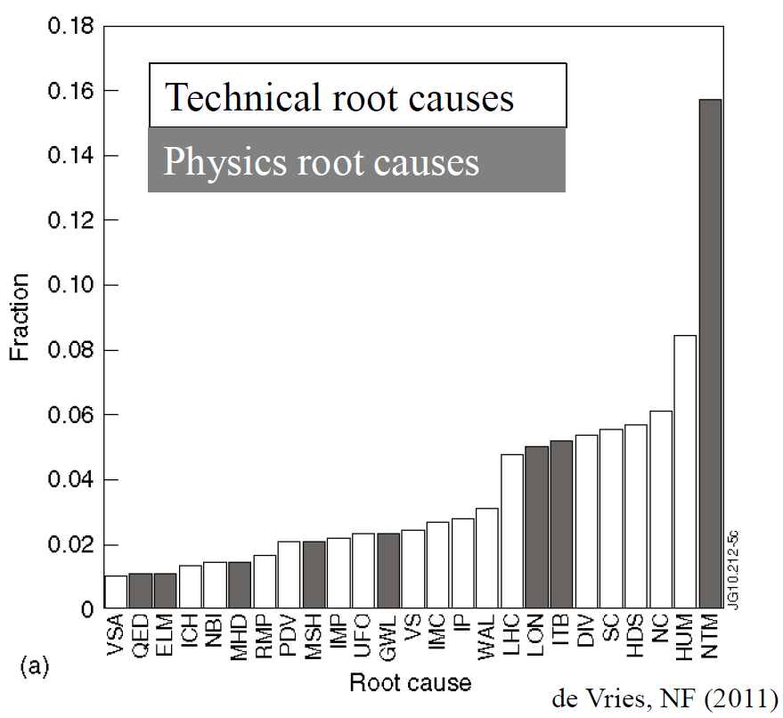
JET disruption event characterization provides framework to follow for understanding / quantifying DPAM progress
JET disruption event chains
Related disruption event statistics
P.C. de Vries et al., Nucl. Fusion 51 (2011) 053018
JET disruption event chain analysis performed by hand, desire to automate
General code written (DECAF) to address the first step – test runs started using NSTX data

Slide 24
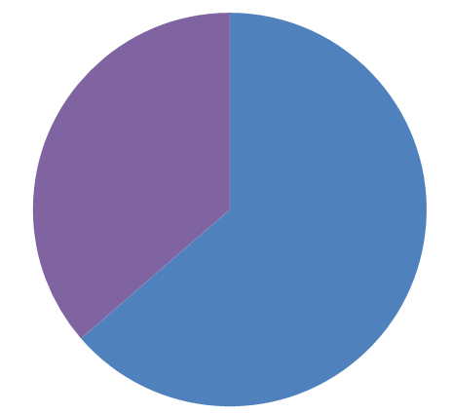
(Although thresholds are not at all optimized yet) what did DECAF show when applied to this 44 shot NSTX database?
These events found for all shots
  DIS: Disruption occurred
  RWM: RWM event warning
    Note: this module is not smart enough yet to distinguish RWM from locked TM
  VDE: VDE warning (42 shots)
  IPR: Plasma current request not met
  LOQ: Low edge q warning
Very simple RWM event criteria
  RWM B_{P}^{n=1} lower sensor amplitude used
  Simple criterion + no threshold optimization at all ➔ “false positive” rate is high; adjust criteria to reduce it
Code already sees common disruption event chains
  (event)➔VDE➔SCL➔IPR occurs in 52% of the shots
  “false positives” on VDE affecting this %
“RWM event” warning timing
(simple criterion, no optimization)
Before 100 ms of DIS
(36%)
Within 100 ms of DIS
(64%)
Common event chain
(event)
VDE
SCL
IPR
J.W. Berkery, S.A. Sabbagh (Columbia U.)

Slide 25
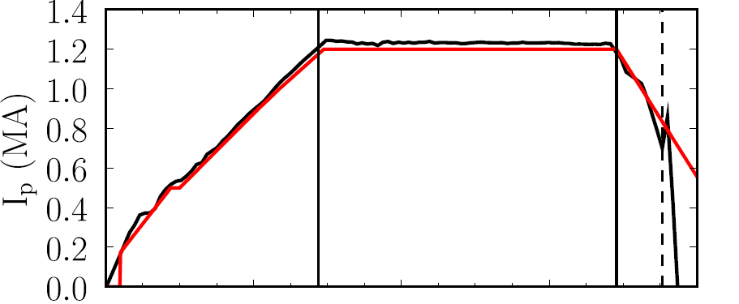
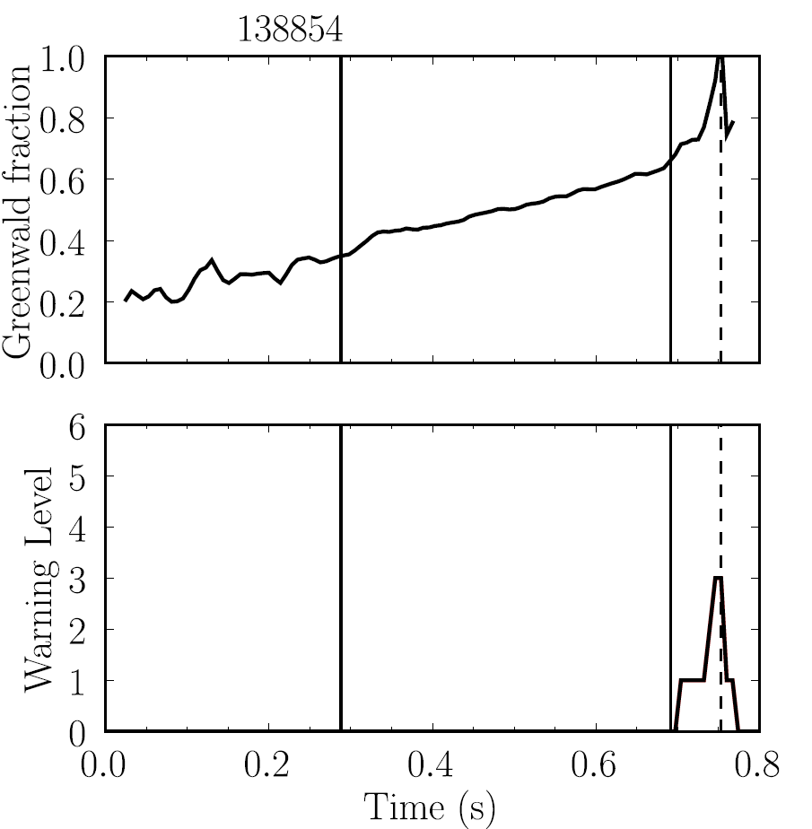
Disruption Characterization Code now yielding initial results: disruption event chains, with related quantitative warnings (2)
NSTX
138854
This example: Greenwald limit warning during I_{p} rampdown
  (GWL) Greenwald limit warning issued
  (VDE) VDE condition then found 0.6 ms after GWL warning
  (IPR) Plasma current request not met
Disruption during
I_{p} ramp-down
GWL warnings
Event chain
GWL
VDE
IPR
Detected at: 0.7442s
0.7448s
0.7502s
J.W. Berkery, S.A. Sabbagh, Y.S. Park

Slide 26
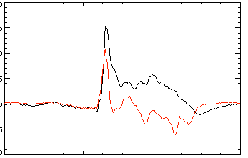
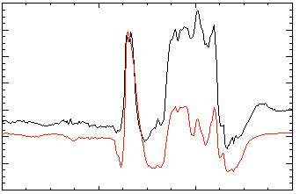
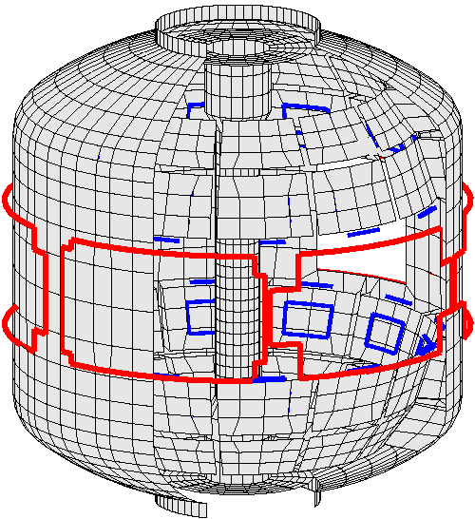
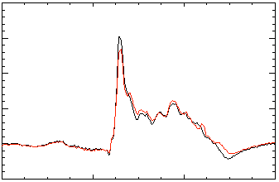
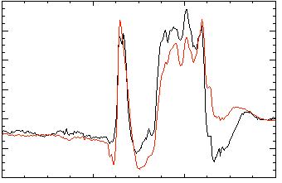
Open-loop comparisons between measurements and RWM state space controller show importance of states and model
A) Effect of Number of States Used
B) Effect of 3D Model Used
2 States
Measurement
No NBI Port
200
δB_{p}¹⁸⁰
RWM
Controller (observer)
80
δB_{p}⁹⁰
100
40
0
0
-100
-40
137722
0.56
0.58
0.60
0.62
0.56
0.58
0.60
0.62
t (s)
t (s)
RWM Sensor Differences (G)
7 States
With NBI Port
200
δB_{p}¹⁸⁰
80
δB_{p}⁹⁰
100
40
0
0
-100
-40
137722
0.56
0.58
0.60
0.62
0.56
0.58
0.60
0.62
t (s)
t (s)
Improved agreement with sufficient number of states (wall detail)
3D detail of model important to improve agreement

Slide 27
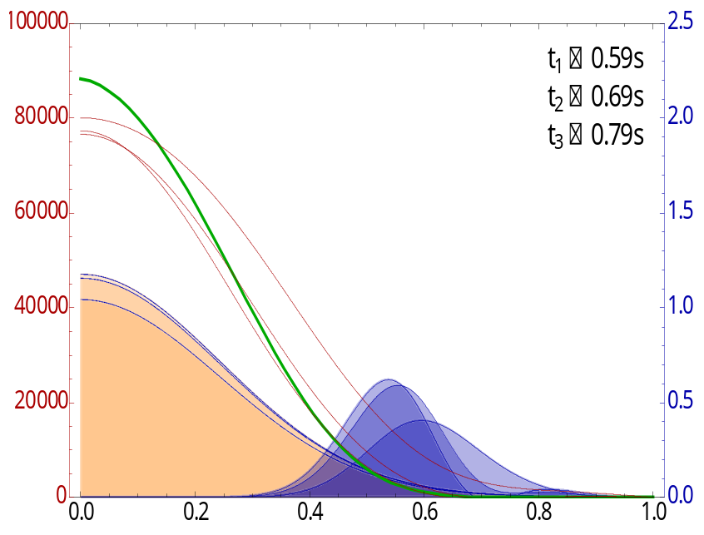
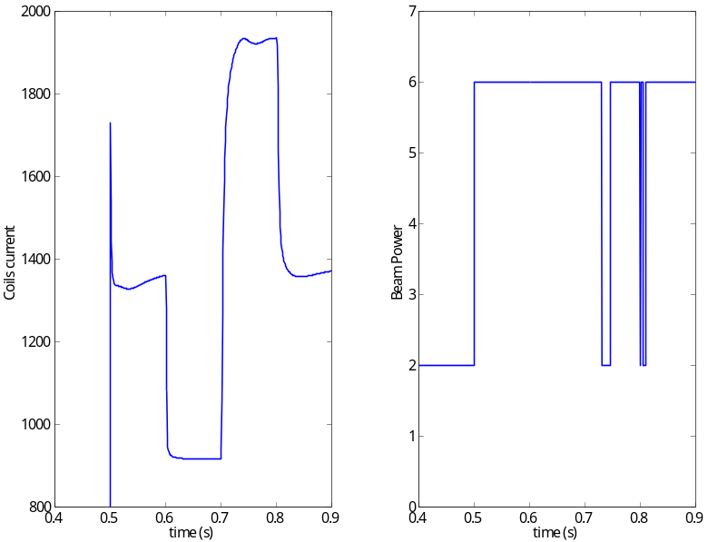
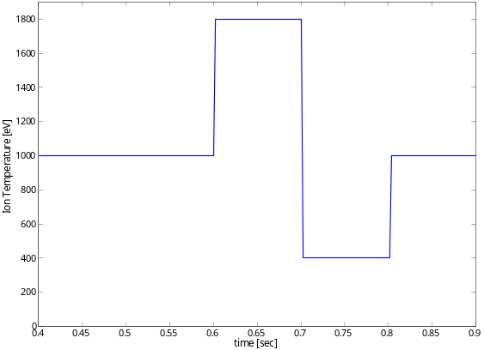
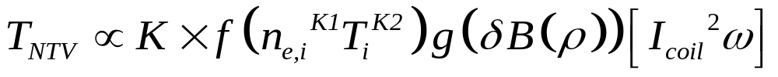
When T_{i} is included in NTV rotation controller model, 3D field current and NBI power can compensate for T_{i} variations
Rotation evolution and NBI and NTV torque profiles
3D coil current and NBI power (actuators)
10
2.0
7
2.5
10⁴
desired ω_{φ}
t₁ = 0.59s
t₂ = 0.69s
t₃ = 0.79s
1.8
6
8
2.0
5
t₃
1.6
6
1.5
4
t₂
NTV
torque
1.4
NBI power (MW)
3D Coil Current (kA)
NBI, NTV torque density (N/m²)
3
Plasma rotation (rad/s)
t₁
t₂
4
t₃
1.0
1.2
t₂
2
2
t₁
t₁
0.5
1.0
1
NBI
torque
t₃
0.8
0
0
0.0
0.5
0.7
0.9
0.5
0.7
0.9
0.0
0.2
0.4
0.6
0.8
1.0
t (s)
t (s)
ψ_{N}
1.8
1.2
T_{i} (keV)
K1 = 0, K2 = 2.5
0.6
NTV torque profile model for feedback dependent on ion temperature
t₁
t₂
t₃
t (s)
0.0
0.4
0.5
0.6
0.7
0.8
0.9

Slide 28
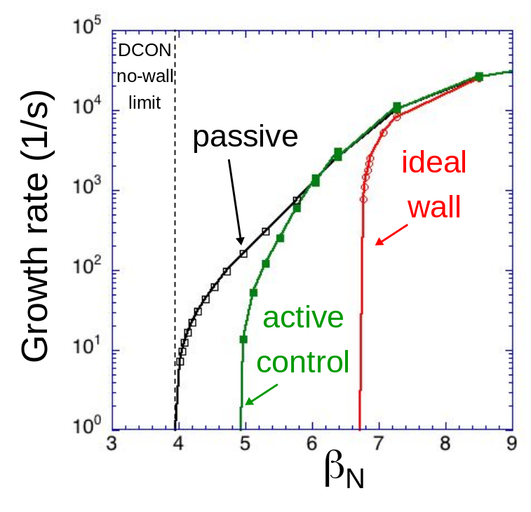
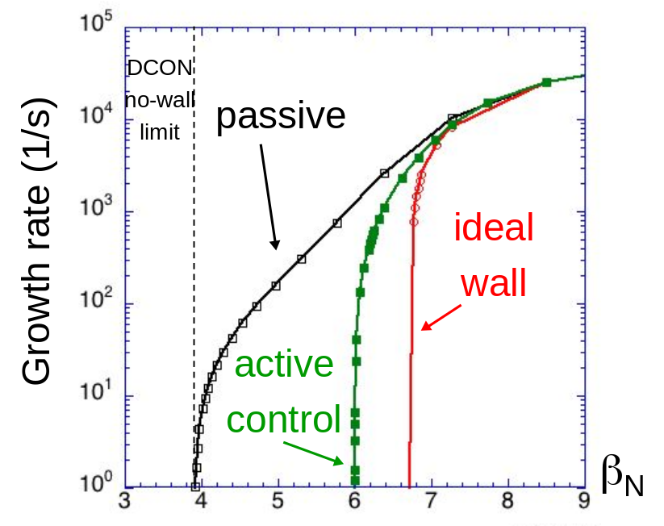
NSTX-U: RWM active control capability increases as proposed 3D coils upgrade (NCC coils) are added
Using present midplane RWM coils
Partial NCC 1x12 (upper), favorable sensors
NCC upper (1x12) (plasma facing side)
Partial 1x12 NCC coil set significantly enhances control
  Present RWM coils: active control to β_{N}/β_{N}^{no-wall} = 1.25
  NCC 1x12 coils: active control to β_{N}/β_{N}^{no-wall} = 1.52
Existing
RWM
coils

