Slide 1
New Results from Non-solenoidal Startup via Local Helicity Injection on Pegasus and Projections for NSTX-U
Joshua Reusch
J.L. Barr, G.M. Bodner, M.W. Bongard, M.G. Burke, R.J. Fonck, E.T. Hinson, B.T. Lewicki, J.M. Perry, D.J. Schlossberg
And the Pegasus team
18th International Spherical Torus Workshop
Princeton, NJ
Nov. 6th, 2015

Slide 2
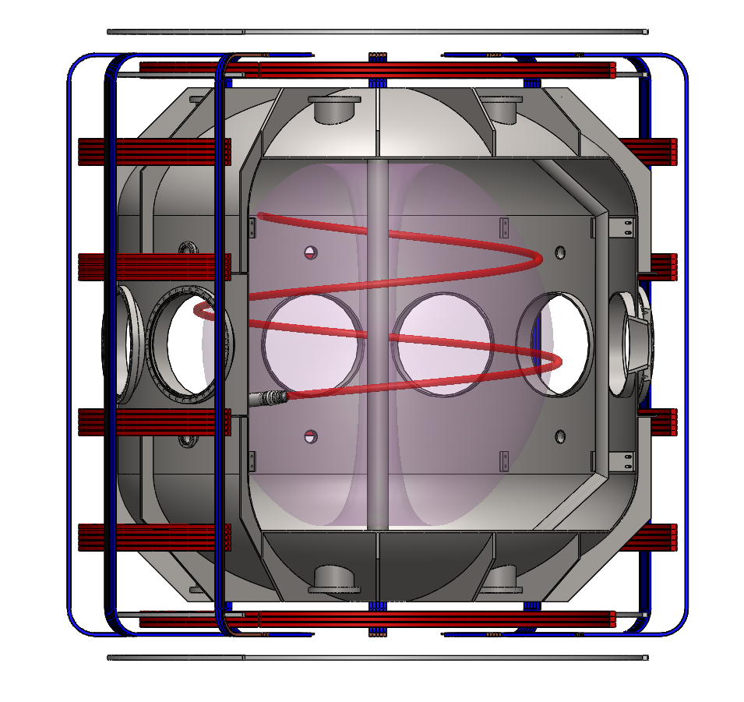
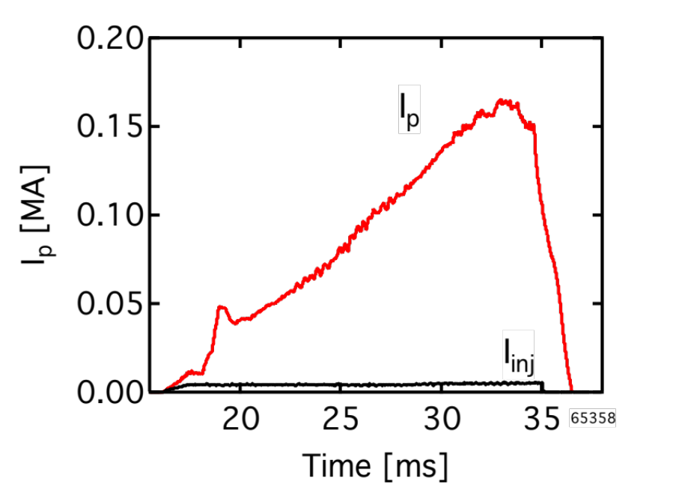
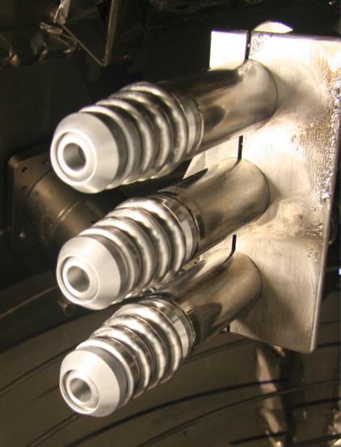
Local Helicity Injection (LHI) is a Scalable
Non-solenoidal Startup Technique
Current injected from local plasma source
I_{p} ≤ 0.18 MA (I_{inj} = 5 kA)
Injected Current Stream
Local Helicity Injectors
2 m
Unstable current streams form tokamak-like state via Taylor relaxation
Compact, modular, and appears scalable to MA-class startup
2

Slide 3
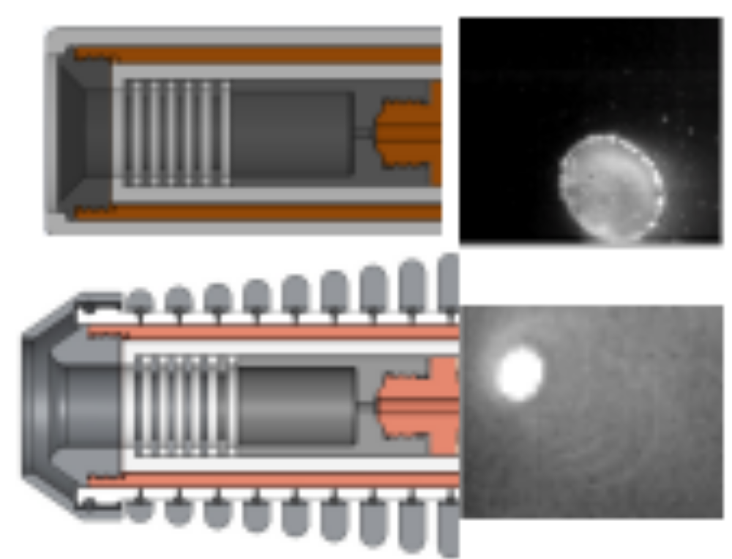
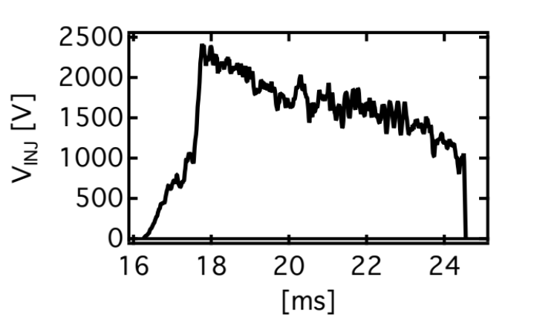
Multi-year Technology Development has Produced Robust, High Performance Injectors
Injector requirements are formidable:
  I_{inj} > 2kA, V_{inj} > 1kV
  High J_{inj} (~ 1kA/cm²)
  1-2 cm from LCFS
  No deleterious PMI
Robust high V_{inj} achieved
  Cathode shaping and shielding mitigate cathode spots
  Shield rings and local limiter (not shown) prevent arc-back
  ~3x increase in helicity input
Cathode Shield
Arc Anode /
Injection Cathode
Shield Rings
Arc Cathode
Gas Feed
Injector Voltage
3

Slide 4
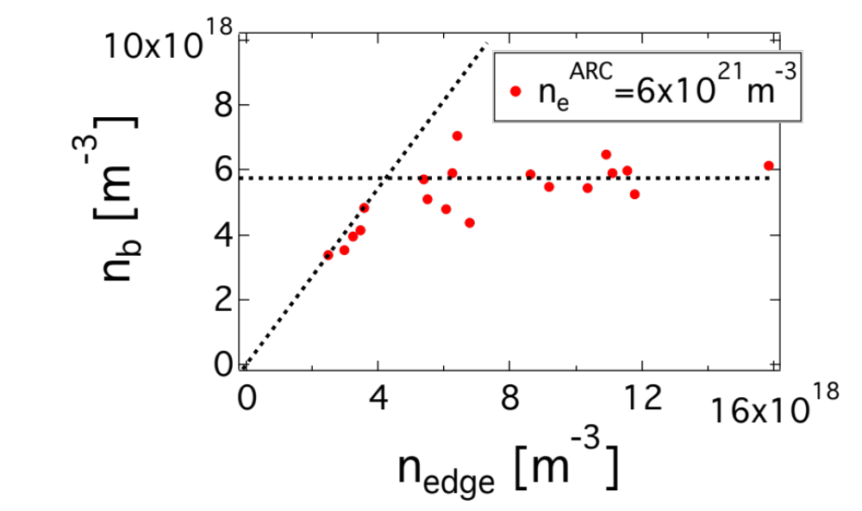
Injector Impedance Model Supports Extrapolation to Larger Scale
Injector impedance model developed and tested*
  Quasi-neutrality (I_{inj} ~ n_{edge}V_{inj}^{0.5}), expanding double layer (I_{inj}~n_{arc}V_{inj}^{0.5})
Strong influence on injector design and operation (V_{LHI} ~ V_{inj})
  Sets power supply requirements
  Model gives control actuator for V_{LHI}(t) I_{p}(t)
10
Impedance Model:
(a.u.)
4
* E.T. Hinson, Ph.D. Thesis, UW-Madison, 2015.

Slide 5
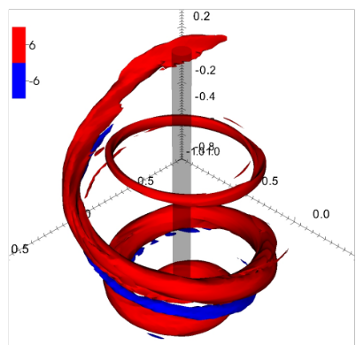


Physics of LHI Encapsulated in a
Hierarchy of Models
Taylor Relaxation
Helicity Conservation
Maximum I_{p} limits*
0-D power-balance I_{p}(t)
3D Resistive MHD (NIMROD)**
-
;
Reconnecting LHI Current Stream
*D.J. Battaglia, et al. Nucl. Fusion 51 (2011) 073029.
*N.W. Eidietis, Ph.D. Thesis, UW-Madison, 2007.
**J. O’Bryan, Ph.D. Thesis, UW-Madison, 2014.
**J. O’Bryan, C.R. Sovinec, Plasma Phys. Control. Fusion 56 064005 (2014)
5

Slide 6
0-D Power Balance Model Tracks the Dynamic LHI I_{p}(t) Evolution
Lumped parameter model:
  Inputs: R₀(t), I_{p}(0), η₀, κ(t), a(t), ℓ_{i} (t)
  Analytic low-A descriptions of L_{p}*, B_{z}**, V_{eff}(t)
-
V_{IND} = V_{PF} + V_{geo}
LHI
IR
-
6
*S.P. Hirshman and G.H. Nielson 1986 Phys. Fluids 29 790
**O. Mitarai and Y. Takase 2003 Fusion Sci. Technol.

Slide 7
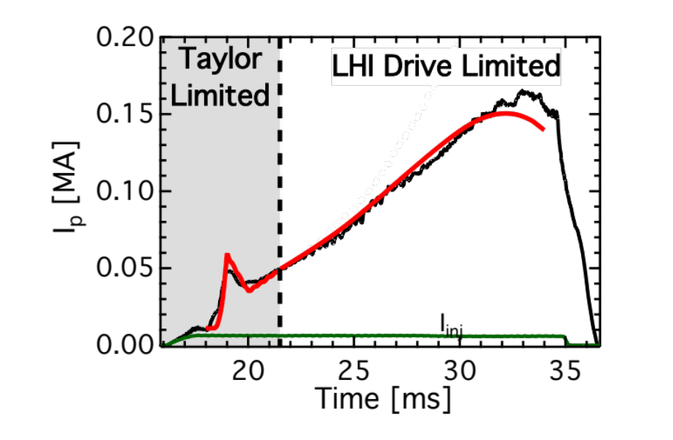
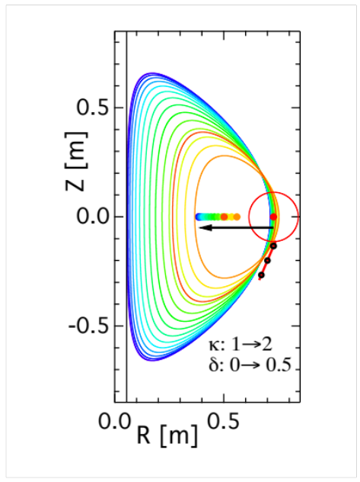
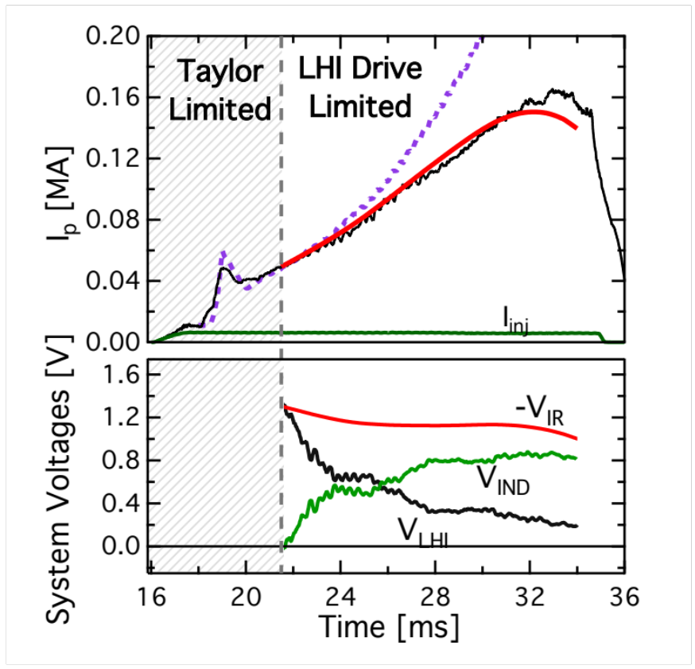
0-D Power Balance Model Tracks the Dynamic LHI I_{p}(t) Evolution
Model elements:
  Inputs: <η(t)>, R₀(t), shape(t), V_{inj}(t), l_{i}(t)
  <η> calculated from Spitzer assuming characteristic <T_{e}>
All of this hinges on understanding of V_{IR} term
-
;
Model provides relative contribution from V_{LHI} and V_{IND}
  Significant V-s from Shape(t)
Shape(t)
<T_{e}> = 60eV
System Voltages [V]
7

Slide 8
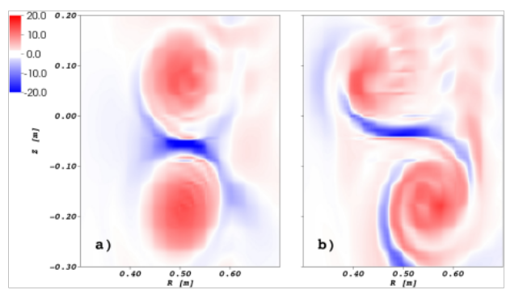
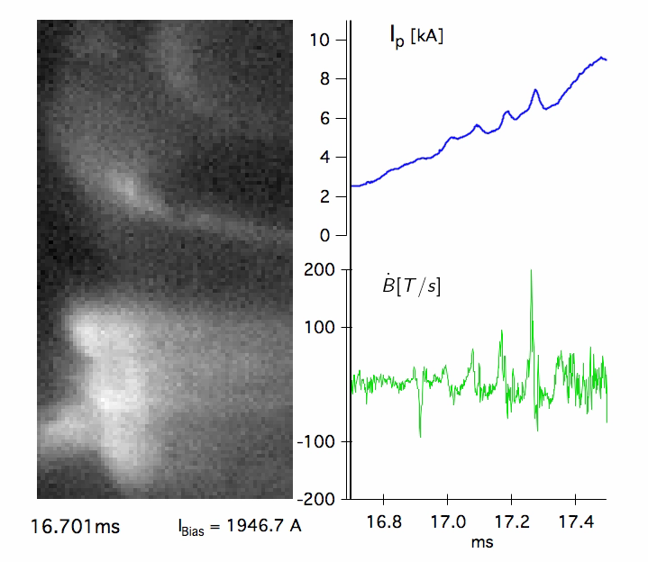
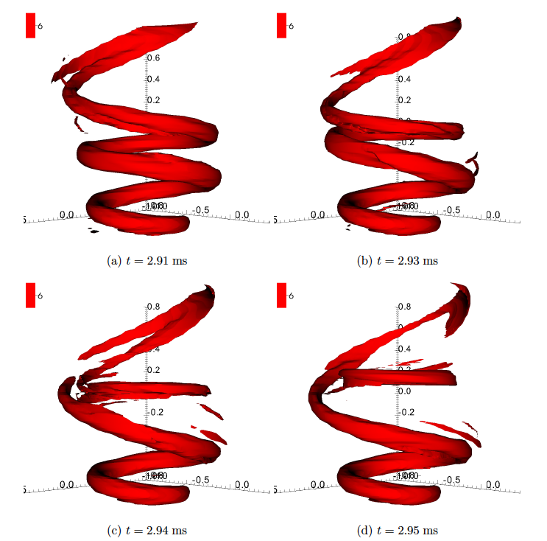
NIMROD Describes Edge Reconnection Current Drive Mechanism
Current rings in NIMROD*
Observed current rings in Pegasus
(pre-tokamak plasma)
Injected current ring
At high I_{p}: streams persist in NIMROD; no visible streams in Pegasus
Reconnection localized to edge, field most stochastic at edge
8
* J. O’Bryan, et al., Physics of Plasmas, 19, 080701 (2012)
J. O’Bryan, C.R. Sovinec, Plasma Phys. Control. Fusion 56 064005 (2014)
Notes:
Video at ~350kHz

Slide 9
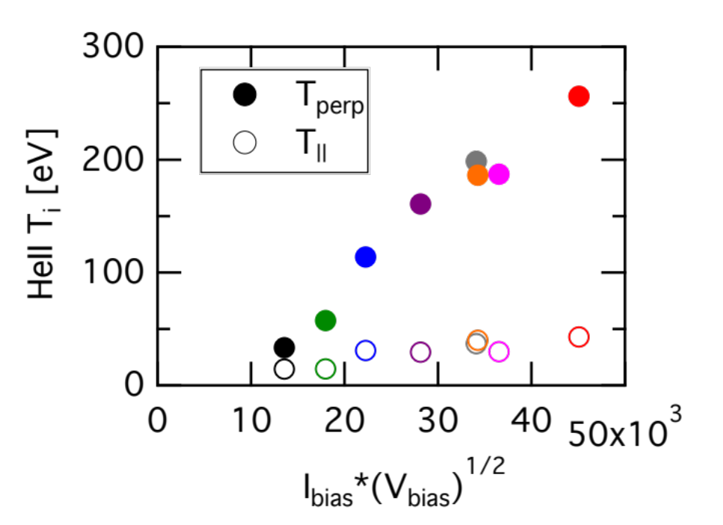
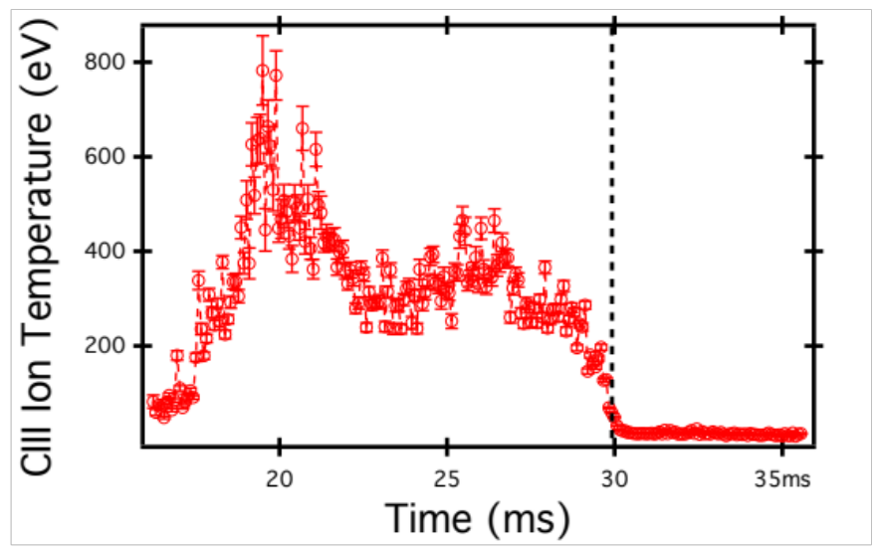
Anomalous Ion Heating Confirms Existence of Strong Reconnection Activity
T_{i} scales with expectations from reconnection experiments*
  T_{i} ~ B²/<n_{e}> ~ I_{inj}V_{inj}^{0.5}
⊥
LHI – OH
Handoff
inj
inj
Anomalous heating (T_{i} > T_{e}) persists through LHI phase
9
* J. Yoo, et al., Phys. Rev. Lett., vol. 110, no. 21, p. 215007, May 2013
Y. Ono, et al., Plasma Phys. Control. Fusion, vol. 54, no. 12, p. 124039, Dec. 2012.

Slide 10
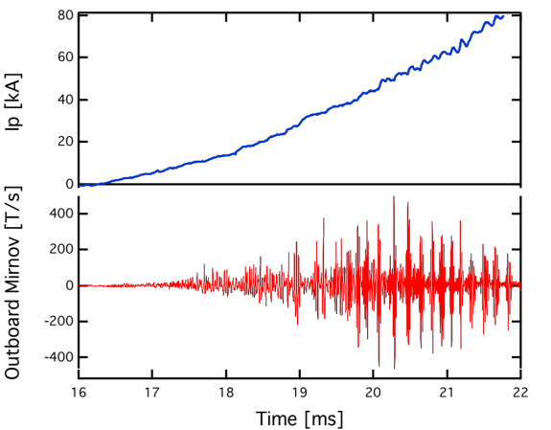
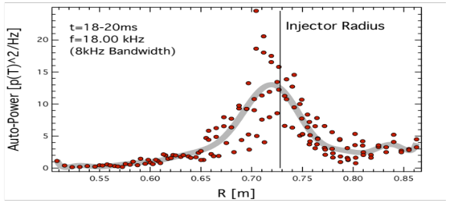
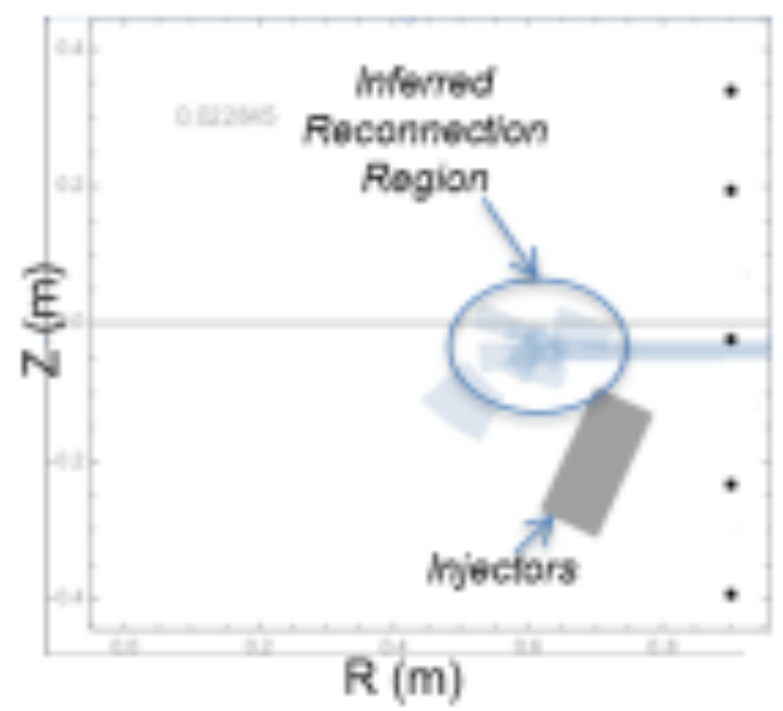
Stream Interaction Manifests as Edge Localized MHD Burst
Pegasus
MHD bursts accompany I_{p} growth
  n=1 line tied kink structure
  Localized in edge
MHD analysis confirms existence of unstable current streams in edge*
  Coherent streams persist at high I_{p}, consistent with NIMROD
  Reconnection event at peak of MHD burst
Suggests that majority of stochastic region localized to edge
20
Auto-Power
0
0.55
0.70
0.85
R [m]
Inferred stream
location
Z [m]
0.4
-0.4
10
0.0
R [m]
0.85
* E.T. Hinson, Ph.D. Thesis, UW-Madison, 2015.

Slide 11
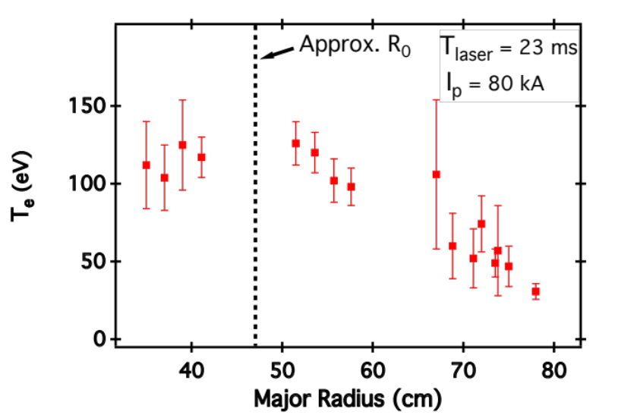
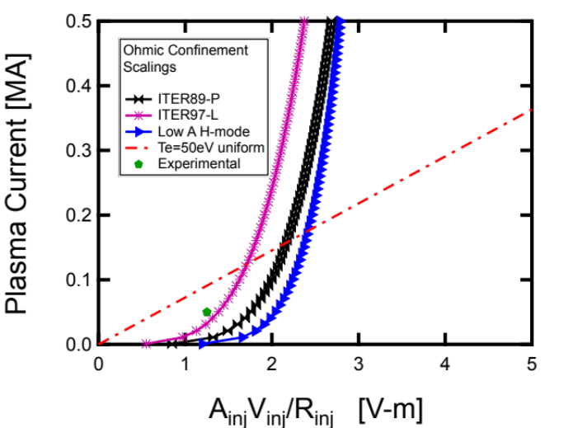
Edge Localized Reconnection and Strong V_{IND} may Support Good Core Confinement, Scaling
Thomson Scattering Profile
First TS profile: peaked in core
  Does not appear highly stochastic across profile
  Comparable to Ohmic L-mode
  Drive: V_{IND} (across plasma)
  V_{LHI} (edge)
Projections to NSTX-U, beyond depend critically on confinement
  Two zone (edge vs. core) confinement?
R₀
<T_{e}> ~ 57eV
Effect of Confinement Scaling
Ohmic
Scalings
Highly
stochastic
11
Normalized Helicity Injection Rate

Slide 12
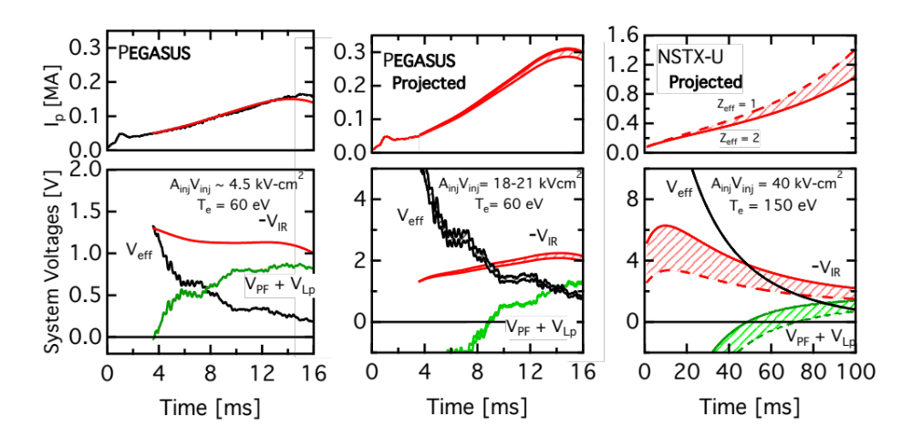
Gaps in Understanding Must be Addressed for Extrapolation to NSTX-U and Beyond
Pegasus: V_{LHI} < V_{IND}
NSTX-U: V_{LHI} ≳ V_{IND}
LHI
LHI
V_{IND}
V_{IND}
Critical issue: unraveling effect of strong inductive drive
Other important issues include: B_{TF}, I_{p} scalings; Long pulse performance
12

Slide 13
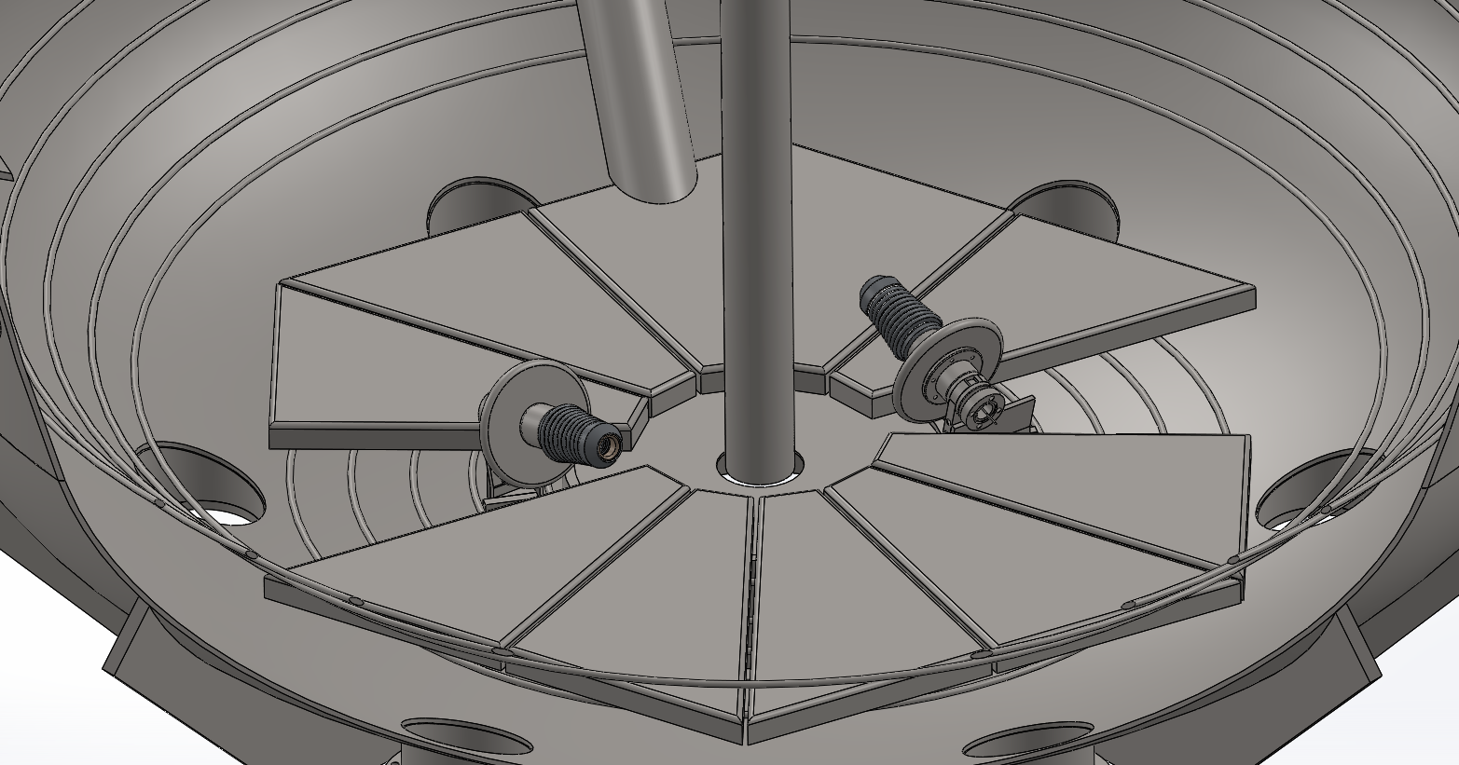
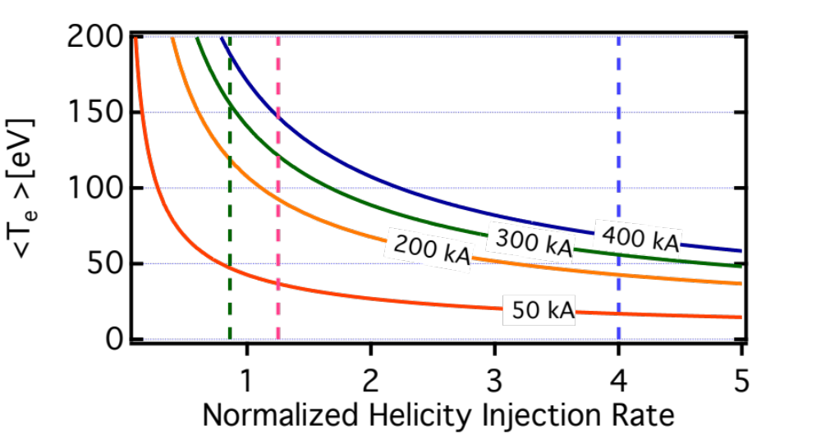
Divertor Injection: Vary Injector Geometry to Separate Inductive and Helicity Drive Effects
Divertor Injector CAD
3-4x increased helicity input
Minimal inductive drive: ~ fixed geometry
  Separates effects: edge reconnection Vs. inductive drive
  Confinement measurements in transport equilibrium
Lower R increased B_{TF} test
Allows higher I_{p} startup
Projected I_{p} with Divertor Injection
13

Slide 14
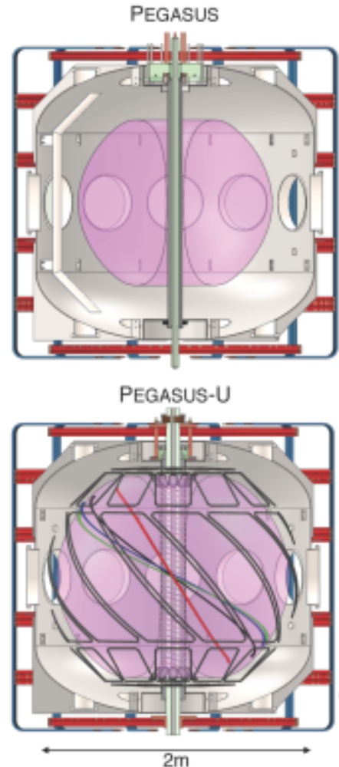
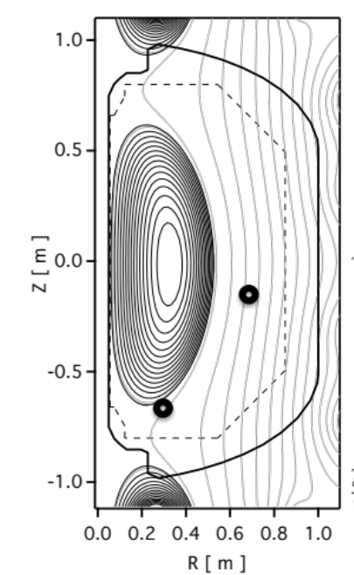
Critical Issues for LHI Predictive Understanding Addressed by Pegasus-Upgrade
Projected LHI Equilibrium
Outboard
Injector
Location
Divertor
Injector
Location
Increased B_{TF}, t_{pulse} extends scalings to NSTX-U relevant levels
  Injector B_{TF} ~ 0.8T: reconnection current drive; poloidal null formation; injector physics
  Pulse length ~100 ms: variable inductive drive; injector integrity
  Diagnostics: CHERS via DNB; multi-point probe arrays, SXR camera
14

Slide 15
Progress in Experiment and Modeling: Moving Towards MA-class Non-solenoidal Startup
Improved injectors: robust operation at > 1kV
  Injector impedance model gives actuator for V_{LHI}, PS design point
0-D power balance model provides prediction of I_{p}(t)
  Input power primarily from V_{IND} in present tests
  Confinement scaling is critical unknown
Surprisingly good core confinement indicated by TS
  Peaked core T_{e} ~ 120 eV comparable to Ohmic L-mode
  Coupled with NIMROD picture, may indicate 2-zone confinement
Divertor injectors and Pegasus-U to address critical scaling issues for NSTX-U and beyond
15

Slide 16
Backup

Slide 17
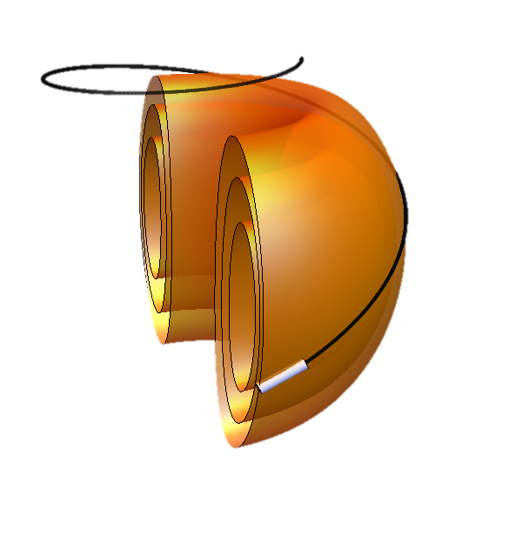
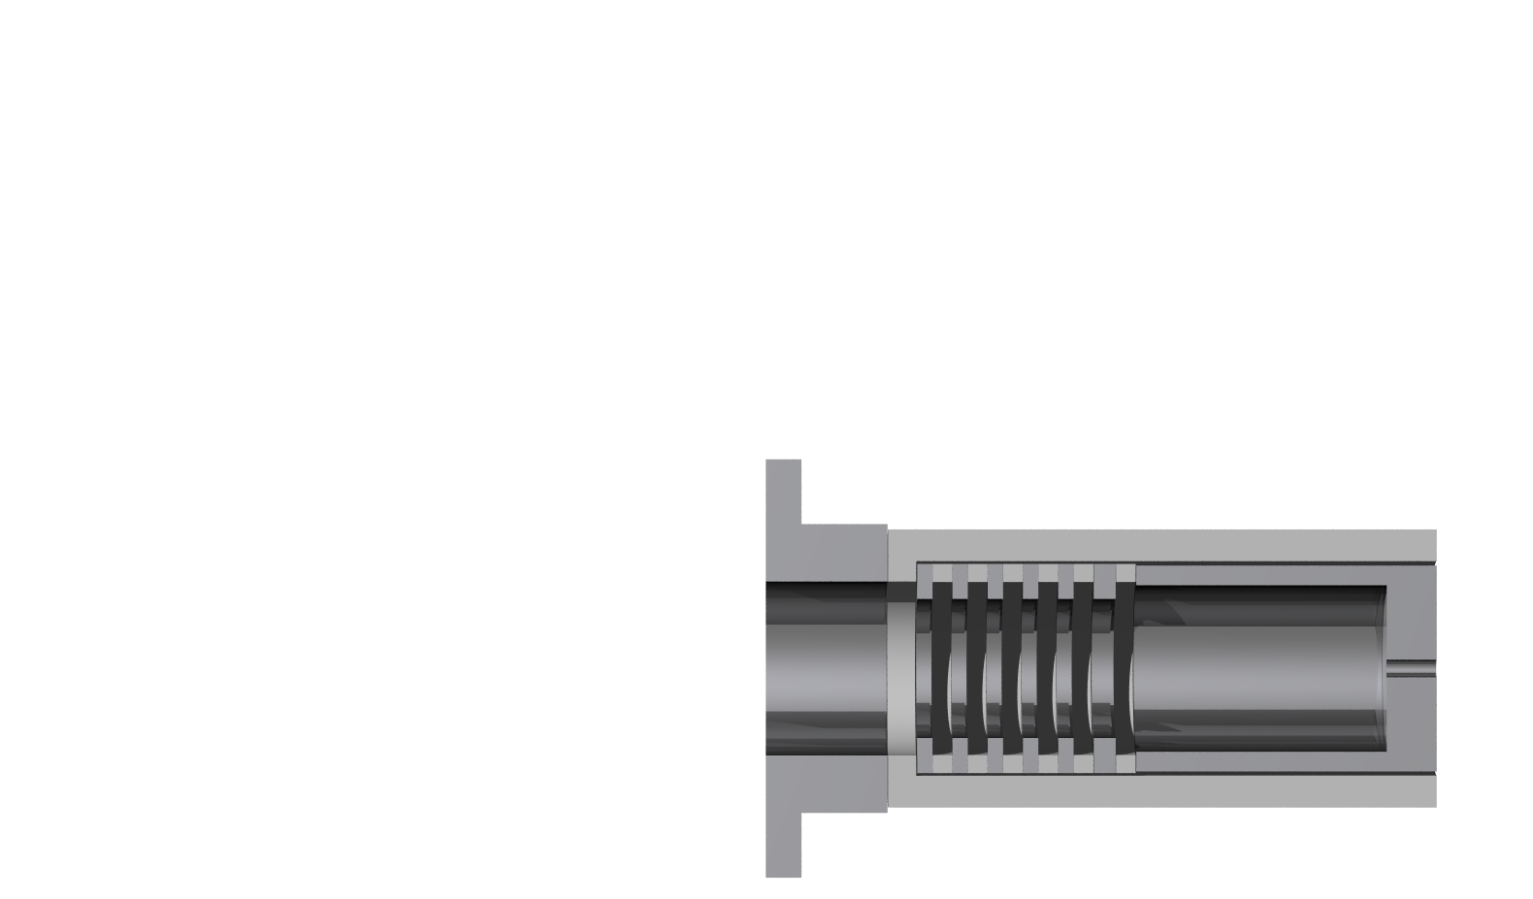
LHI on Pegasus utilizes small active arc current sources located in the SOL
Injectors are washer gun style plasma arc sources
2-stage circuit: arc and injection circuits “daisy chained”
Uses current stiff source, voltage set by plasma physics
ARC
INJECTION
D₂
Arc Plasma
Beam Drift Space, B ≈ 0.1 T
Arc Cathode
Arc Anode /
Injection Cathode
Vacuum Vessel /
Injection Anode

Slide 18
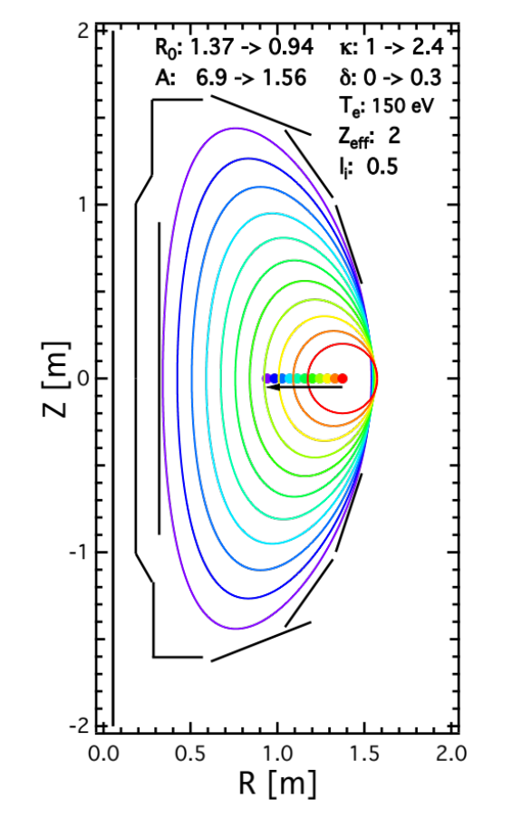
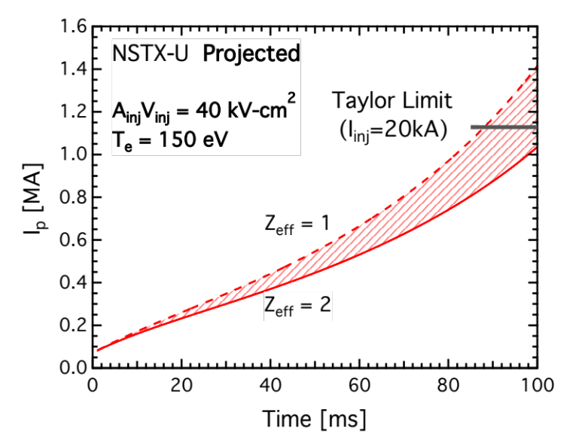
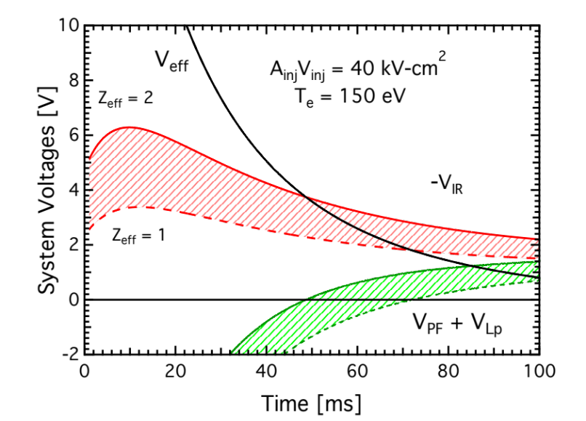
Model Applied to NSTX-U Geometry for
Initial I_{p}~1 MA Start-up Scenario Prediction
Significant LHI drive required to achieve I_{p} ~ 1 MA
  Predicted A_{inj} V_{inj} requirement estimates: ~ 40 cm²-kV
*C. Neumeyer et all (2009) 23rd IEEE/NPSS Symposium on Fusion Engineering
**C. Neumeyer (2001) “NSTX Internal Hardware Dimensions”
http://nstx.pppl.gov/nstx/Engineering/NSTX_Eng_Site/Technical/Machine/NSTX_Engr_Machine_Dims_cm.html

Slide 19
Indirect evidence of localized current filaments throughout the LHI drive phase also observed.
NIMROD predicts streams remain coherent in the edge at high I_{p}
Bulk plasma current sustained by continued reconnection events
Inferred current
stream location
Correlation analysis of edge Mirnov array show source is localized in space

