Slide 1

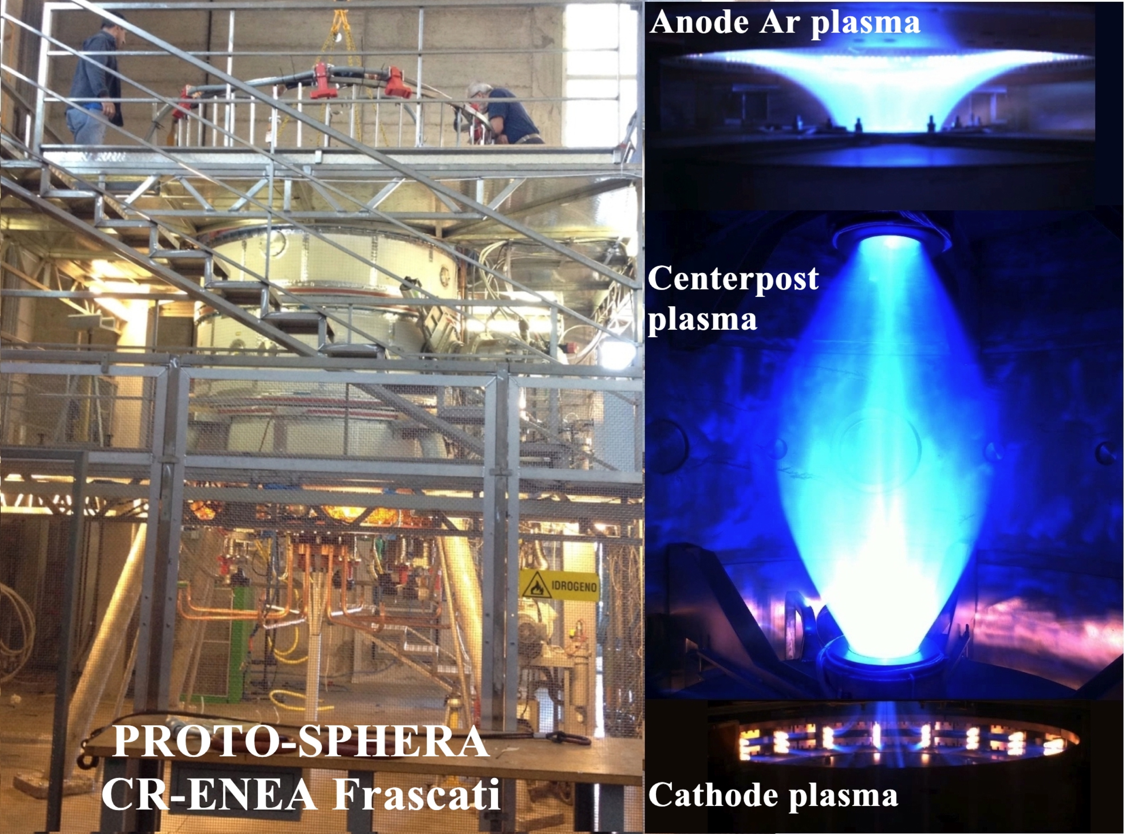
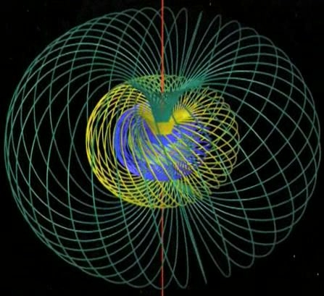
First results and perspectives
of the PROTO-SPHERA experiment
P. Micozzi¹, F. Alladio, L. Boncagni, F. Causa, E. Giovannozzi, A. Grosso, A. Lampasi,
G. Maffia, A. Mancuso^{retired}, V. Piergotti, G. Rocchi, A. Sibio, B. Tilia, V. Zanza^{retired}
Centro Ricerche ENEA, Frascati C.P. 65, Rome, Italy ¹e-mail: paolo.micozzi@enea.it

Slide 2
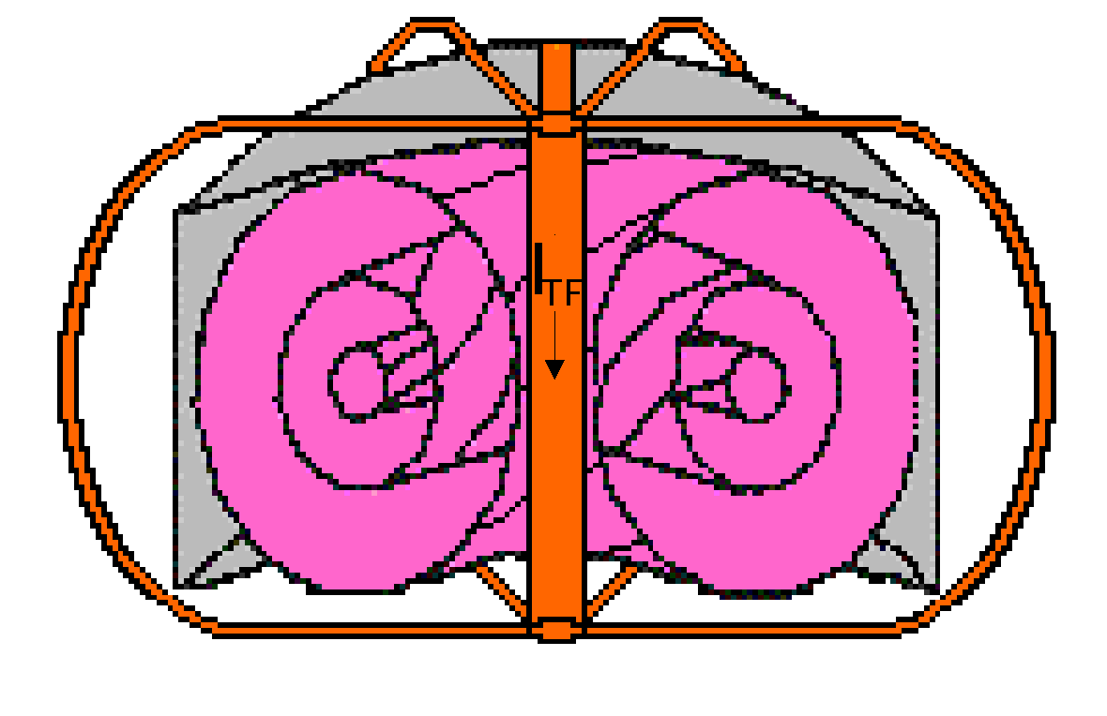
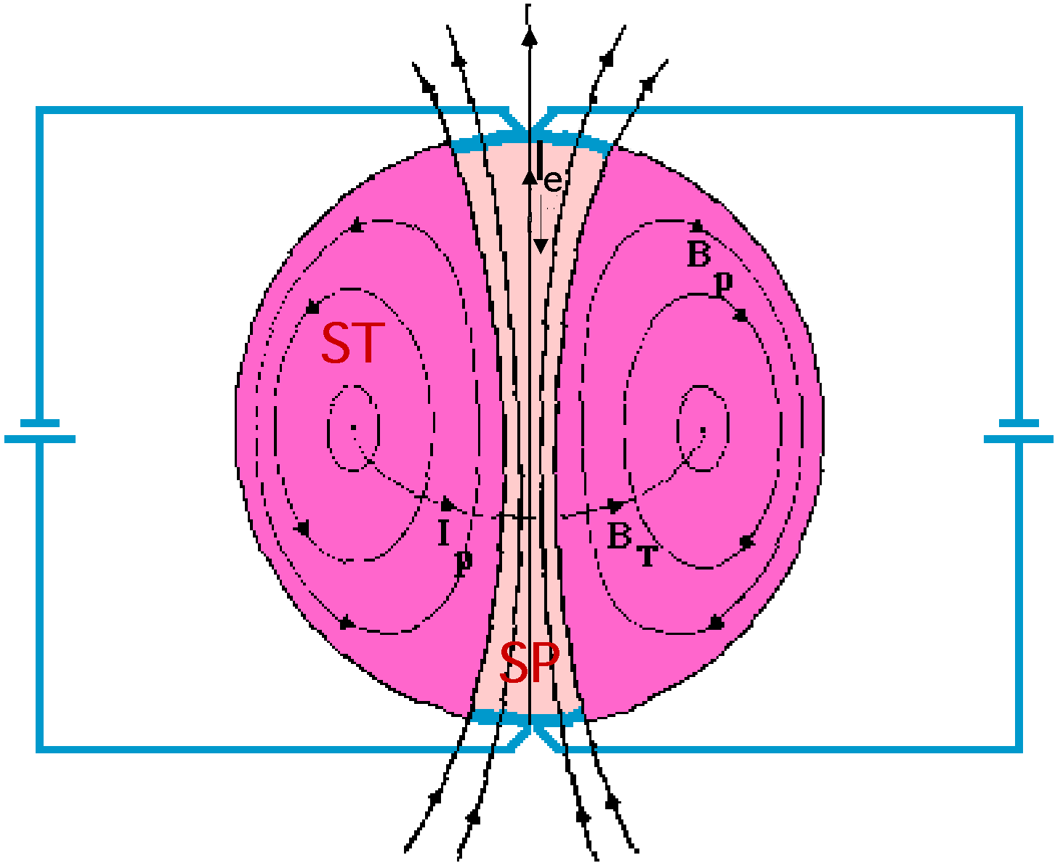
Spherical Tokamaks allow to obtain:
High plasma current I_{p} with low B_{T}, high β and more compact devices
But, for a reactor/CTF extrapolation:
• No space for central solenoid (Current Drive requirement more severe)
• No neutrons shield for central stack (no superconductor/high dissipation)
Intriguing possibility ⇒ substitute central rod with Screw Pinch plasma
(I_{TF} → I_{e})
Potentially two problems solved:
• Simply connected configuration (no conductors inside)
• I_{p} driven by I_{e} (Helicity Injection from SP to ST)
Flux Core Spheromak (FCS)
Theory: Taylor & Turner, Nucl. Fusion 29, 219 (1989)
Experiment: TS-3; N. Amemiya, et al., JPSJ 63, 1552 (1993)
2
2

Slide 3
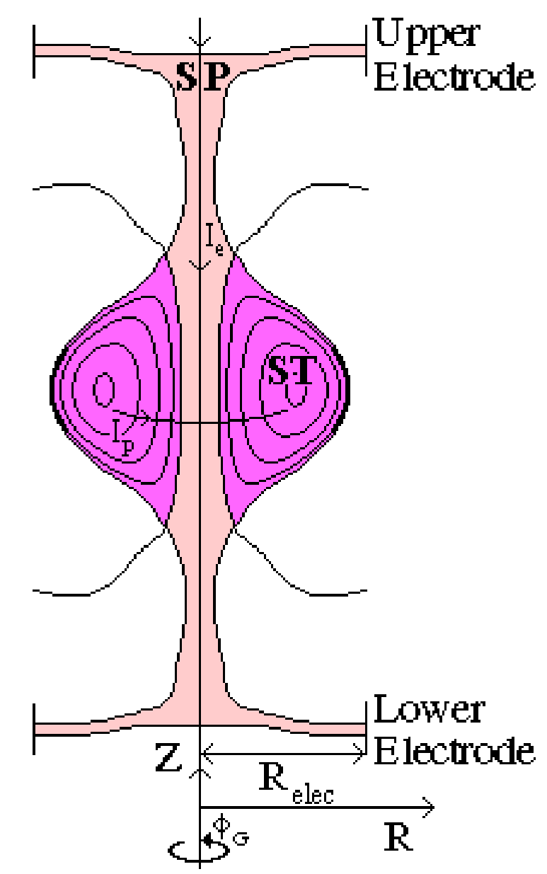
But Flux Core Spheromaks are:
• injected by plasma guns
• formed by ~10 kV voltage on electrodes
• high pressure prefilled
• with ST safety factor q≤1
New configuration proposed
(Alladio F. et al. 2006 Nucl. Fusion 46 S613):
PROTO-SPHERA
“Flux Core Spherical Tokamak” (FCST), rather than FCS
Disk-shaped electrode driven Screw Pinch plasma (SP)
Prolated low aspect ratio ST (A=R/a≥1.2, κ=b/a~2.3)
to get a Tokamak-like safety factor (q₀≥1, q_{edge}~3)
SP electrode current I_{e}=60 kA
ST toroidal current I_{p}=120÷240 kA
ST diameter R_{sph}=0.7 m
⇓
Stability should be improved and helicity drive may be less disruptive than in conventional Flux-Core-Spheromak
3

Slide 4
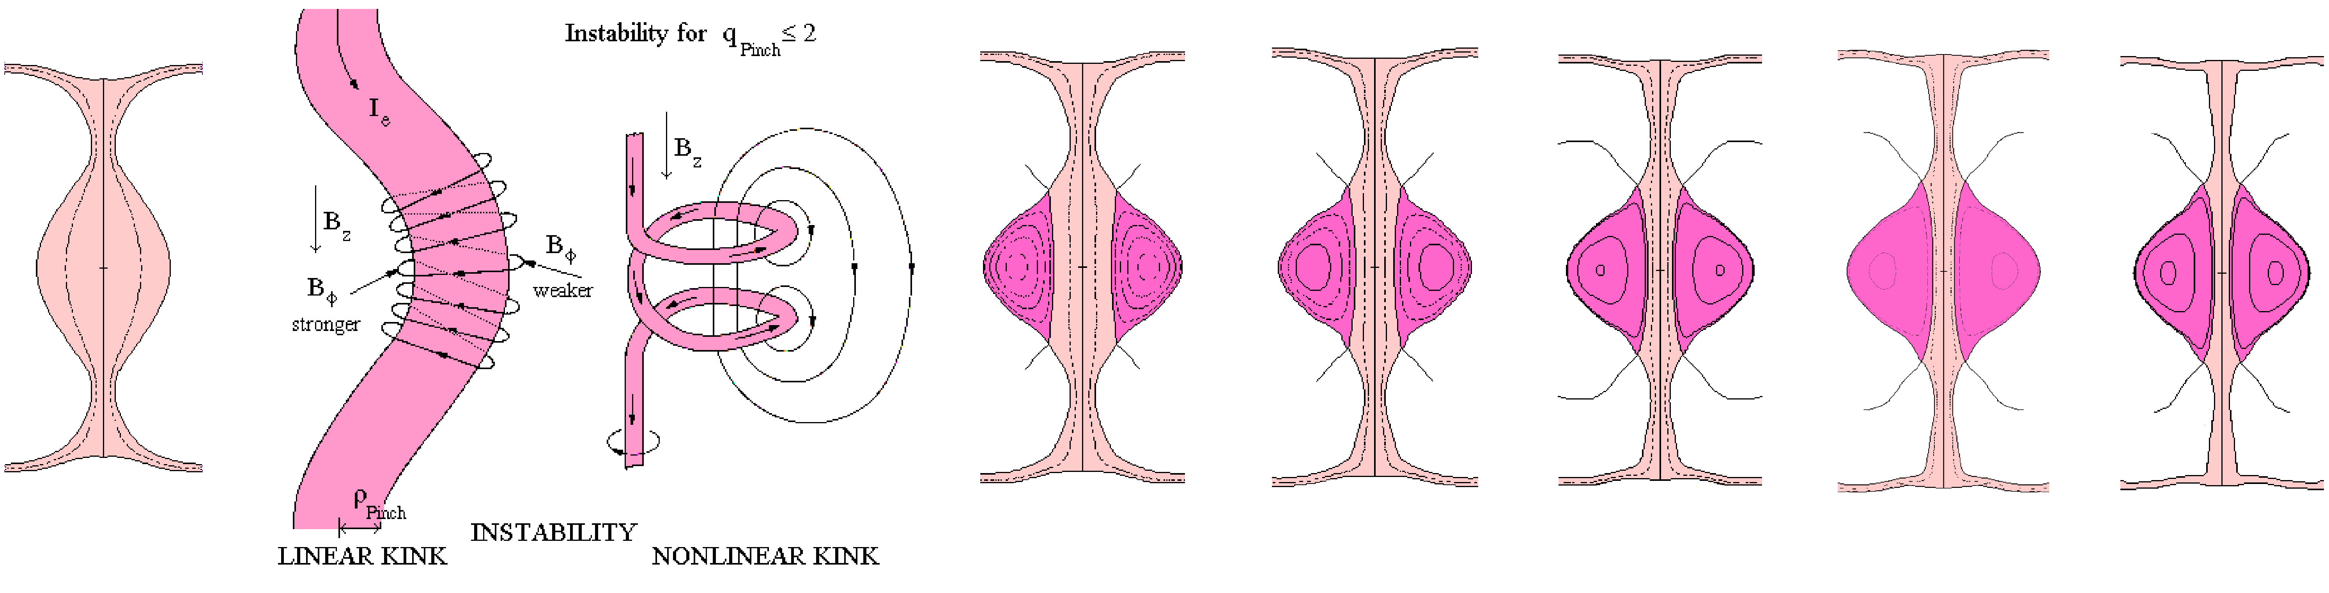
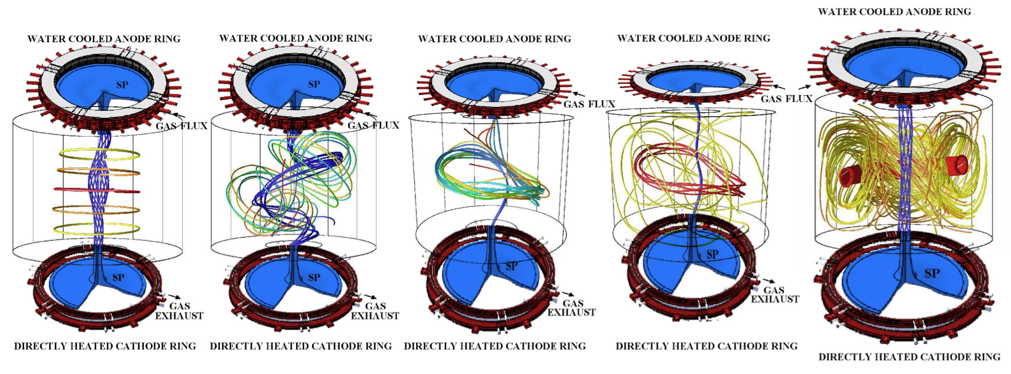
PROTO-SPHERA formation follows TS-3 scheme
(SP kink instability)
Tunneling (ST formation)
ST compression (I_{p}/I_{e}↑, A ↓ )
T0
I_{e}=8.5 kA
T3
I_{p}=30 kA
A=1.8
T4
I_{p}=60 kA
A=1.5
T5
I_{p}=120 kA
A=1.3
T6
I_{p}=180 kA
A=1.25
TF
I_{p}=240 kA
A=1.2
I_{e} 8.5→60 kA
Formation time scale:
Alfvén MHD growth time τ_{A}~ 0.5 μs
Resistive diffusion time τ_{R}~ 70 ms
(τ_{R}τ_{A})^{1/2}~ 0.6 ms for I_{ST}=120 kA (2xI_{e})
Garcia-Farengo, PoP 16,112508 (2009)
and
Farengo, ISTW2008 - Frascati
Smoke-ring-like formation
4

Slide 5
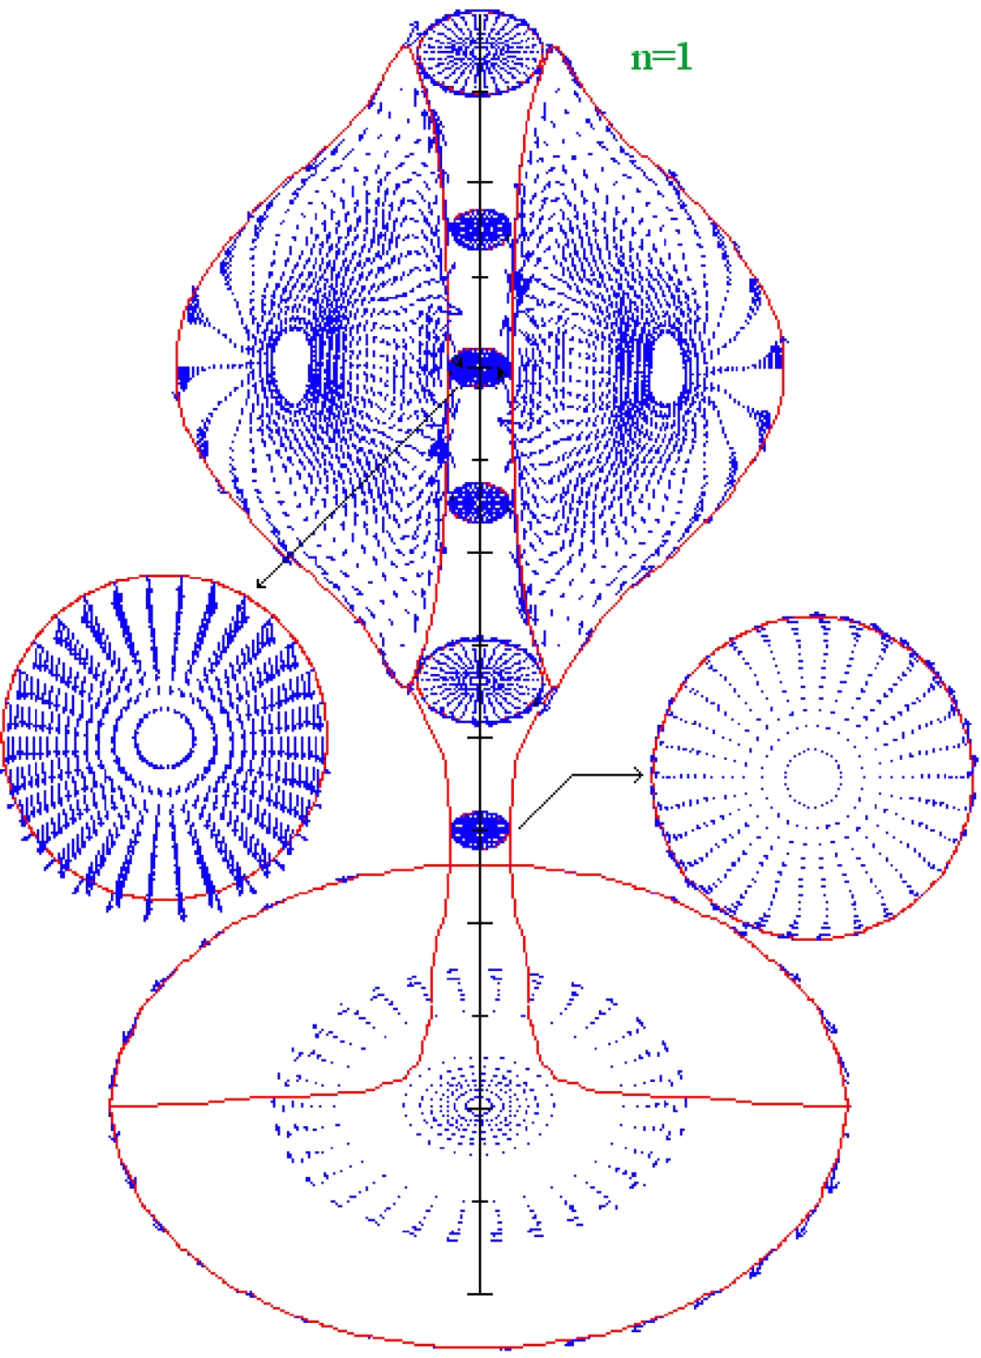
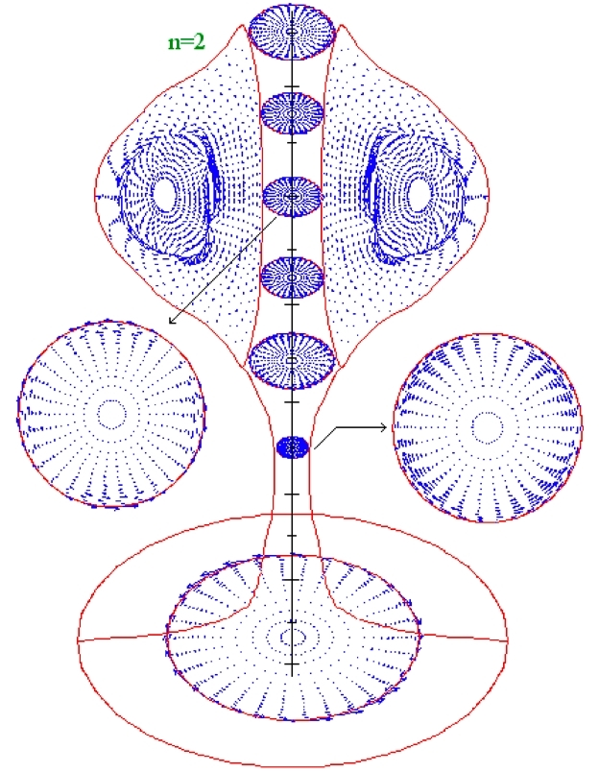
Key points of proto-sphera design
• Stable Screw Pinch formed at Tokamak pressures (10⁻³÷10⁻² mbar) and with low voltage break-down (100-200 V)
• I_{p}/I_{e} ratio relevant parameter
(strong energy dissipation in SP)
• MHD equilibria computed both with
monotonic
as well as
reversal safety factor profiles
⇓
magnetic configuration is quite robust
Some level of low n resistive instability needed
(reconnections to inject helicity from SP to ST)
but
SP+ST must be ideally stable at any time slice
⇓
Ideal MHD analysis to assess I_{p}/I_{e} & β limits
(Micozzi P. et al., 2010 Nucl. Fusion 50 095004)
⇓
For low toroidal numbers n=1, 2 & 3
ideal MHD stability obtained
expressed with
up to β = 21÷26% , I_{ST}/I_{e}= 0.5-1
up to β = 14÷15% , I_{ST}/I_{e}= 2-4
expressed with
up to β_{T0}=28÷29% , I_{ST}/I_{e}= 0.5-1
up to β_{T0}=72÷84% , I_{ST}/I_{e}= 2-4
Examples of n=1&2
instabilities at high β
5

Slide 6
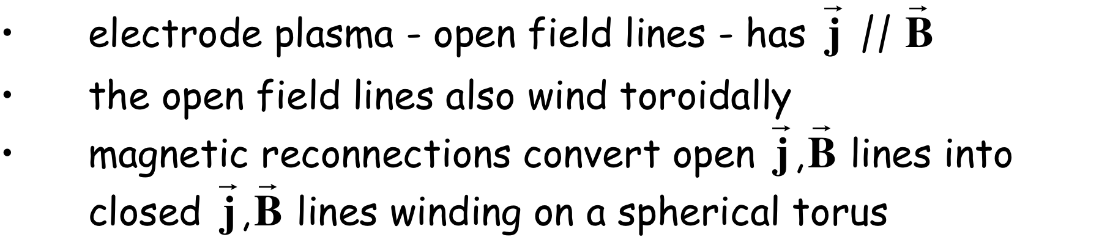
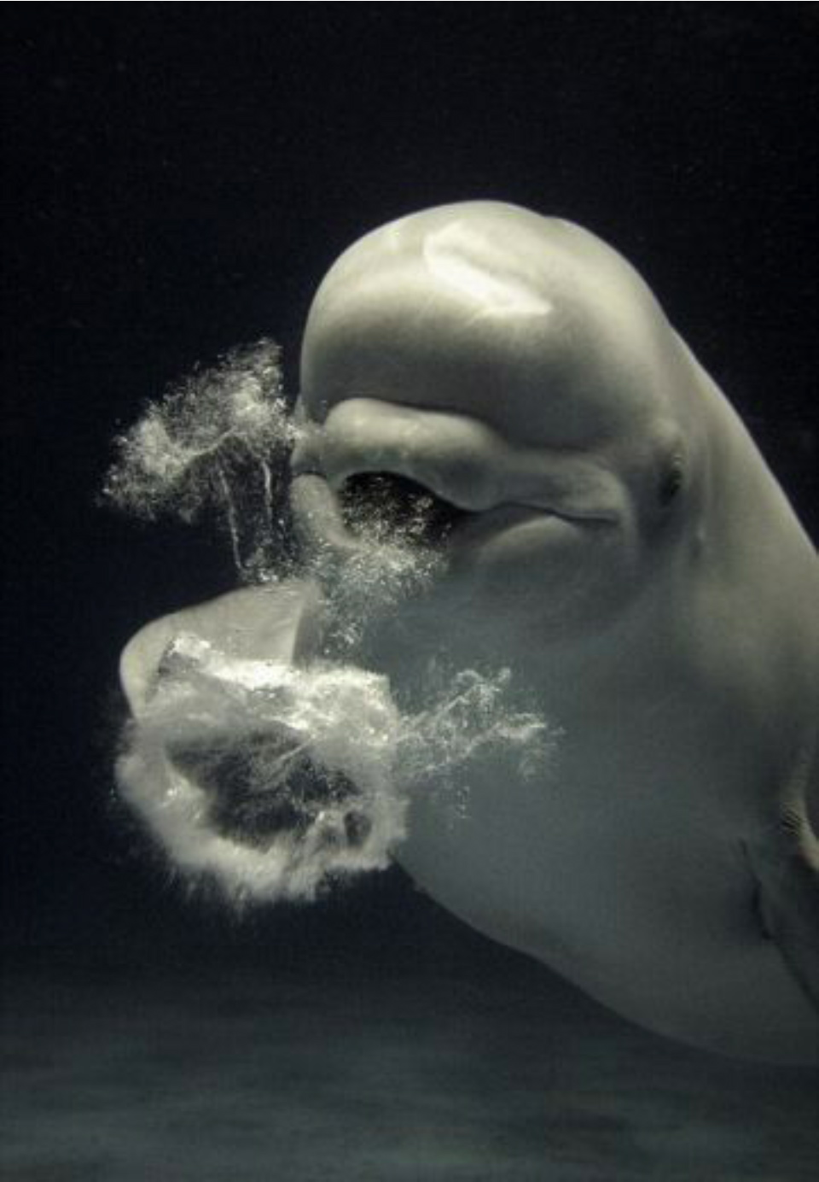
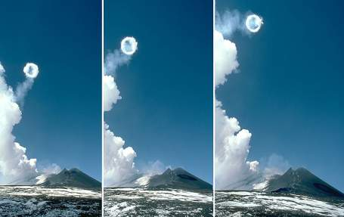
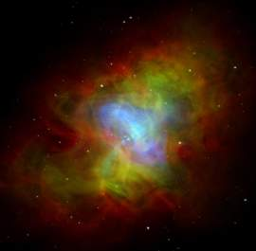
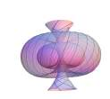
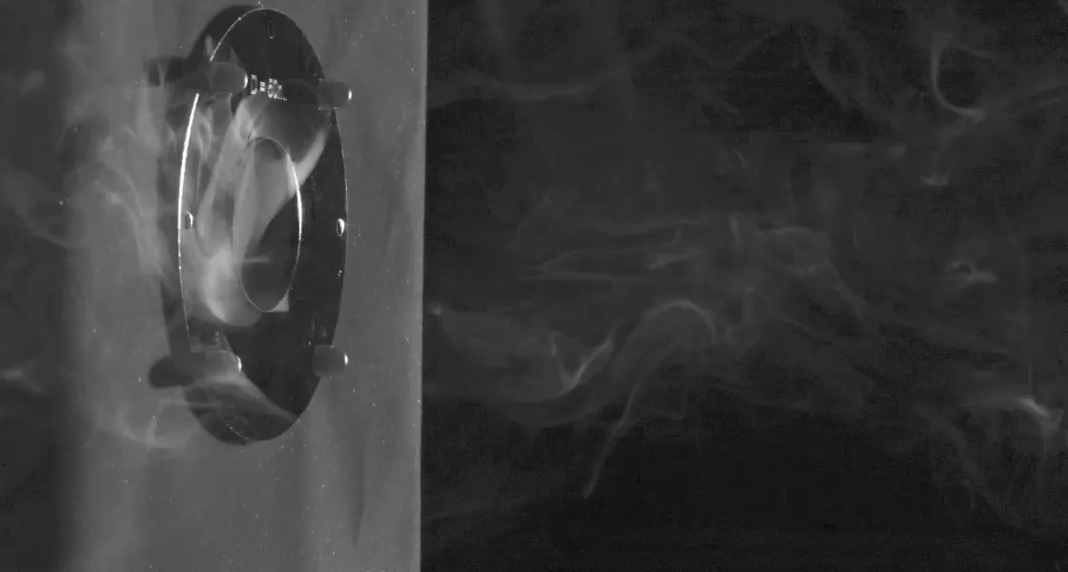
Critical points of PROTO-SPHERA
Helicity injection to sustain the plasma torus:
driven relaxation of Plasma Central Column forms & sustains the ST
Anode
• I_{ST}= 240 kA (4xI_{e}) really achievable?
• Can it be sustained by H.I. for at least τ_{R}~ 70 ms?
• Resistive MHD stability & confinement?
“Smoke-ring like
self-organization”
Etna volcano
Cathode
Crab Nebula
magnetized configuration
produced by Supernova explosion
William Irvine-University of Chicago
Beluga
6

Slide 7
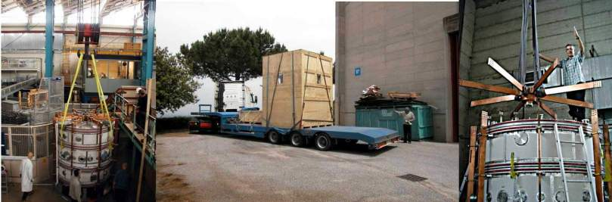
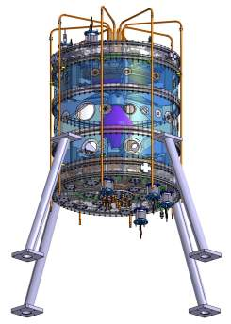
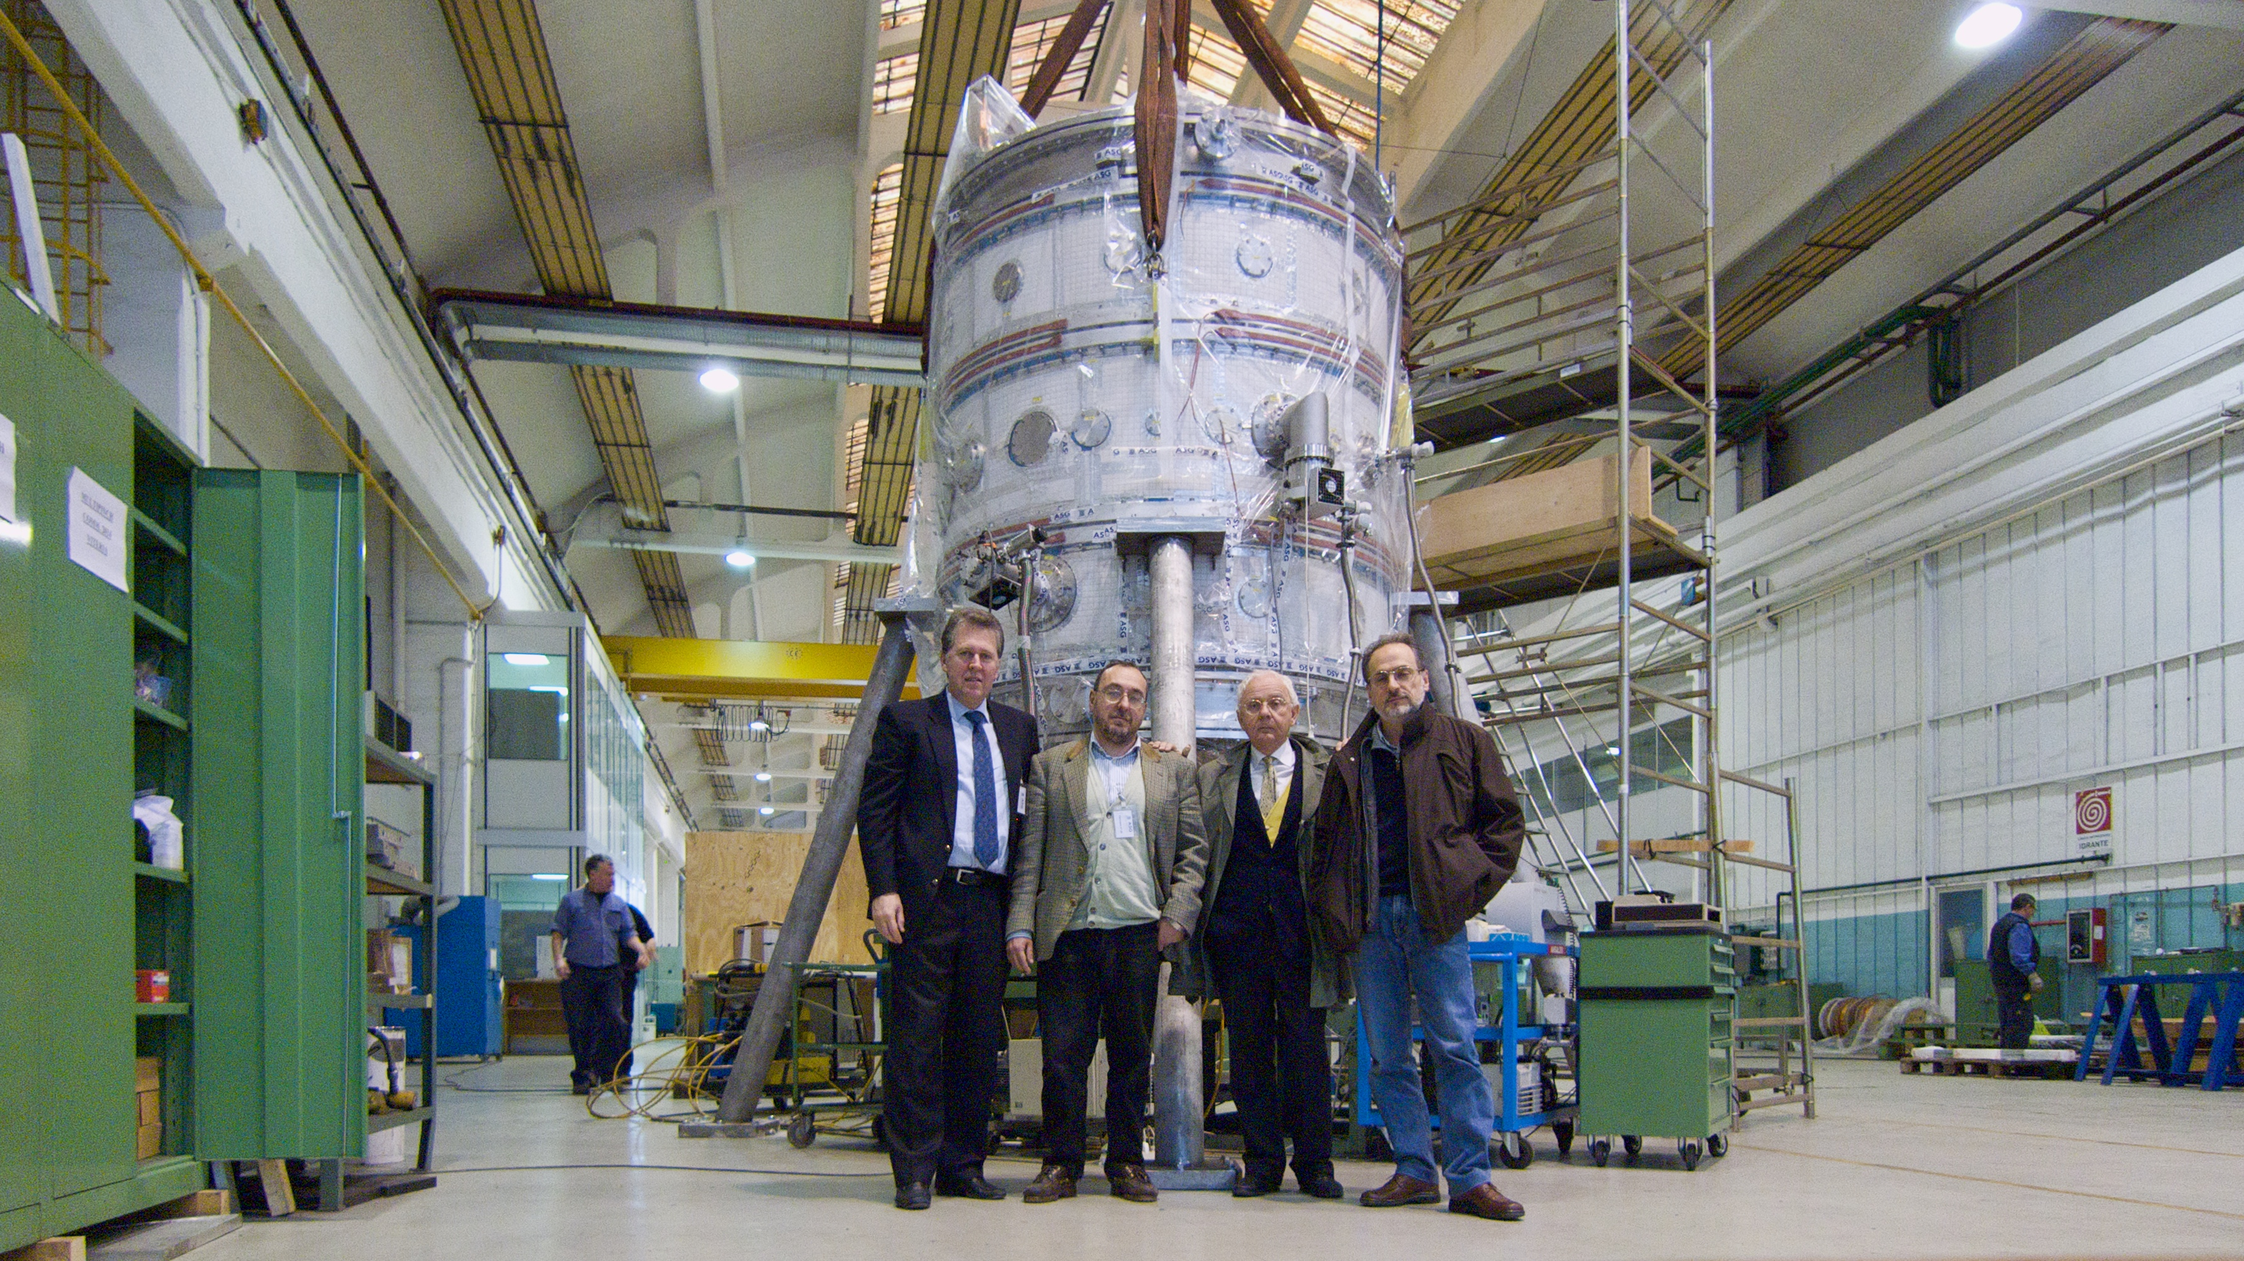
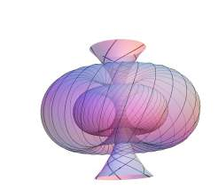
Cylindrical vacuum vessel was START vacuum vessel, donated by Culham in 2004
Culham …to Frascati the old vacuum vessel found its way…
PROTO-SPHERA was built (2006-2009) by ASG Superconductors of Genoa, cost 1 M€
Years 2004 - 2010:
…from ideas …to detailed design …to hard metal
7

Slide 8

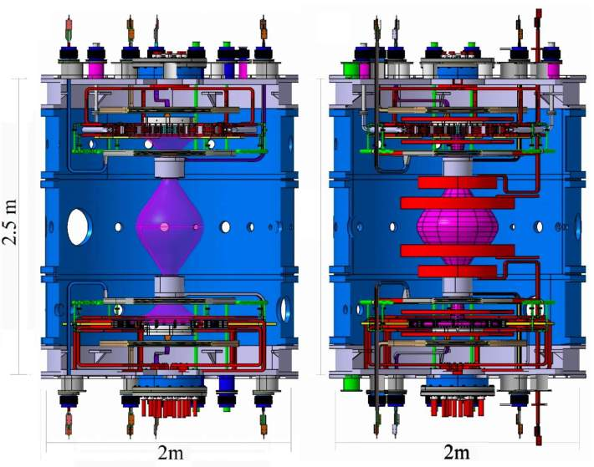
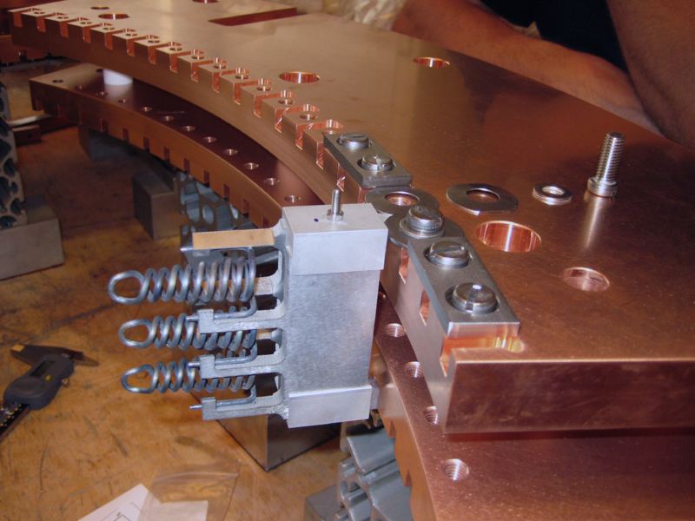
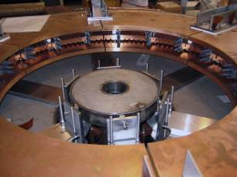
Proto-Sphera Phase-1
Aims:
1) Breakdown
2) Stable formation of plasma ‘mushrooms’
3) Stable (≈1 s) achievement of I_{e} = 8.5 kA
Proto-Sphera Phase-2
Aims: ST formation, compression & sustainment
(All parts will be reused)
By adding:
5 pair of new PF coils
New power supplies
Full amount of Tungsten wires (324 Vs 54) on the directly heated cathode
now only partially filled
8 PF coils
Centerpost only
8 + 10 PF coils
8

Slide 9
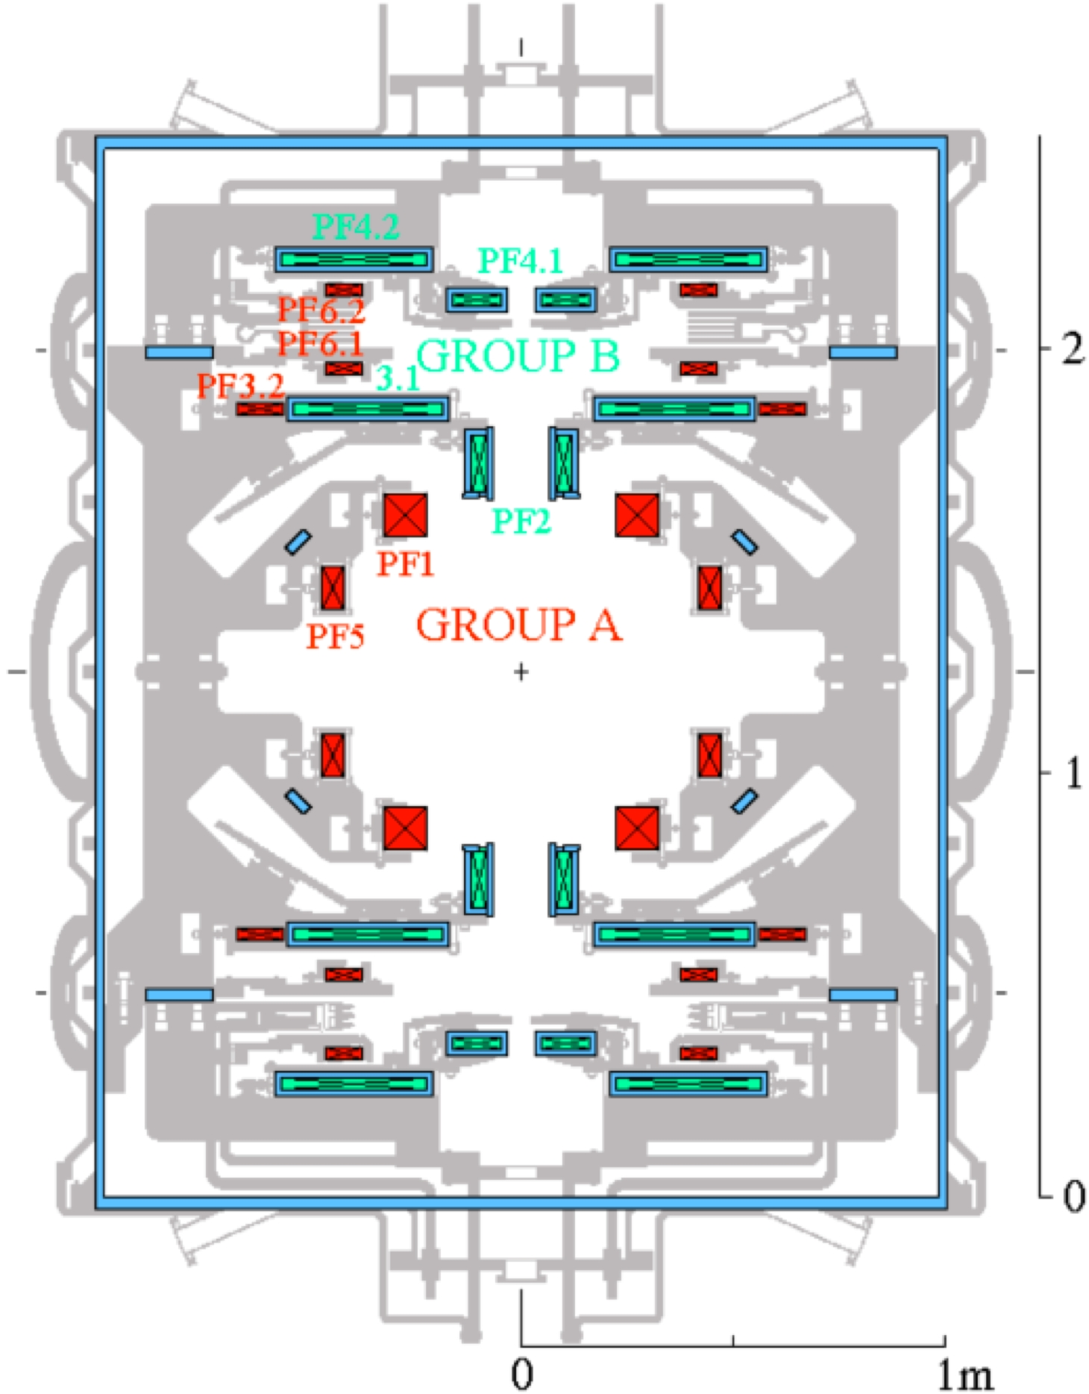
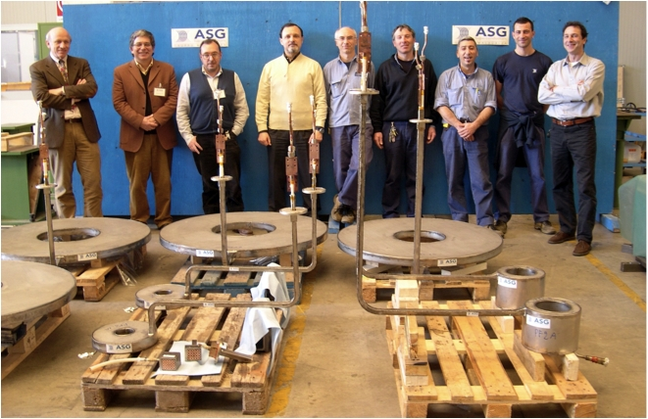
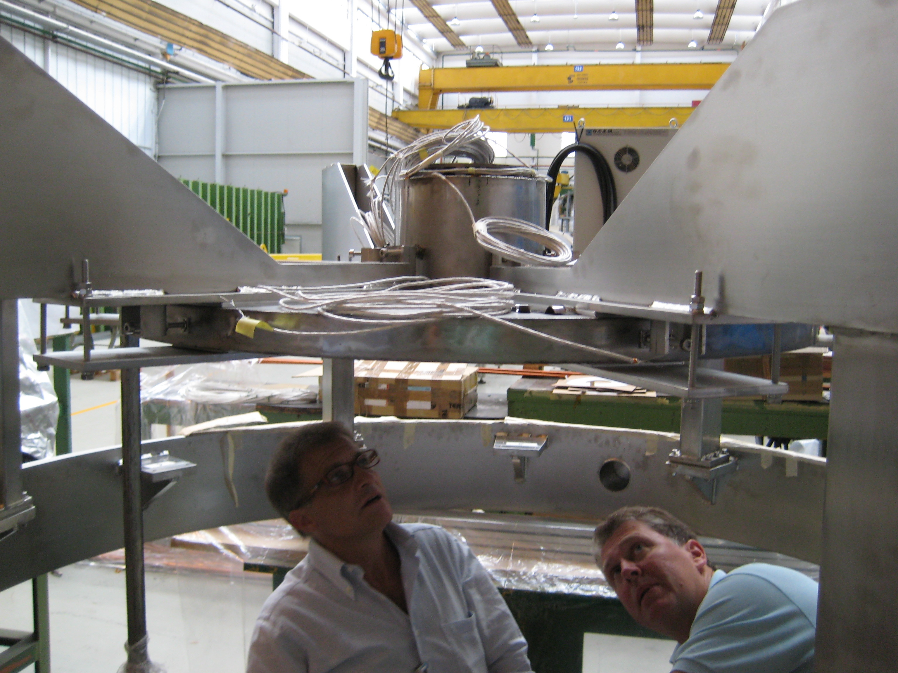
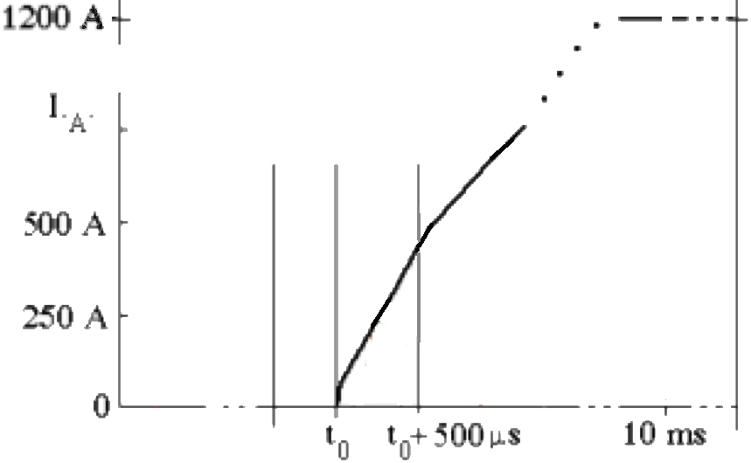
The poloidal field (PF) coils designed as two sets each connected in series
Group B (4+4 coils): Centerpost shaping PF coils …thick AISI casings (τ~2ms), now inside machine
To fire the plasma centerpost
3 Power supplies have been built
• Cathode heating
6 x(1.7 kA,25 V)rms
• PF coils: 2kA, 350 V
• Plasma centerpost: 10 kA, 350 V
(cost 700 k€)
ASG 2007 Genova
ASG 2009
Paradigm reversal:
ohmic drive followed
by Helicity Injection
…waveform of Group A
current provides ohmic
drive to torus up to 120 kA
Group A (5+5 coils): Spherical Torus compression PF coils …not yet built
• High voltage (∼20 kV) insulation: fast current increase (0.5 ms)
Thin Inconel casings to allow for B diffusion in τ~200 µs across them
9

Slide 10
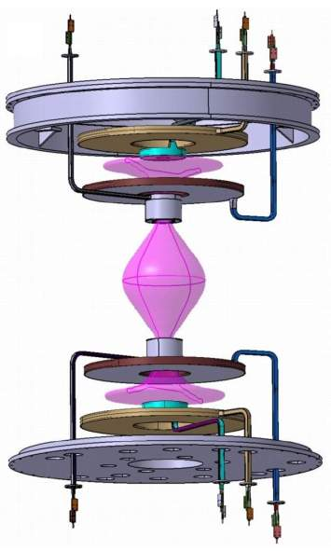
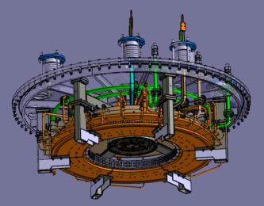
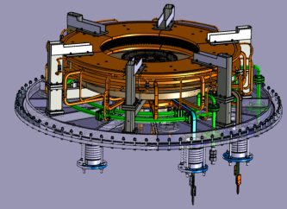
Only the PF coils necessary for setting up
the plasma centerpost have been built
annular anode
(gas puffed)
8 PF coils in series
inside the machine
Stainless steel up\down
new extensions
PF4up
PF3up
PF2up
anode
Aluminium cylindrical
START vessel
plasma current must run
through both PF2 throttles
PF2low
PF3low
cathode
PF4low
Stainless steel up\down new lids
annular cathode
vacuum vessel is GND potential
PF coils casings built as floating, can be connected to potentials: anode +, cathode -, vessel 0
10

Slide 11
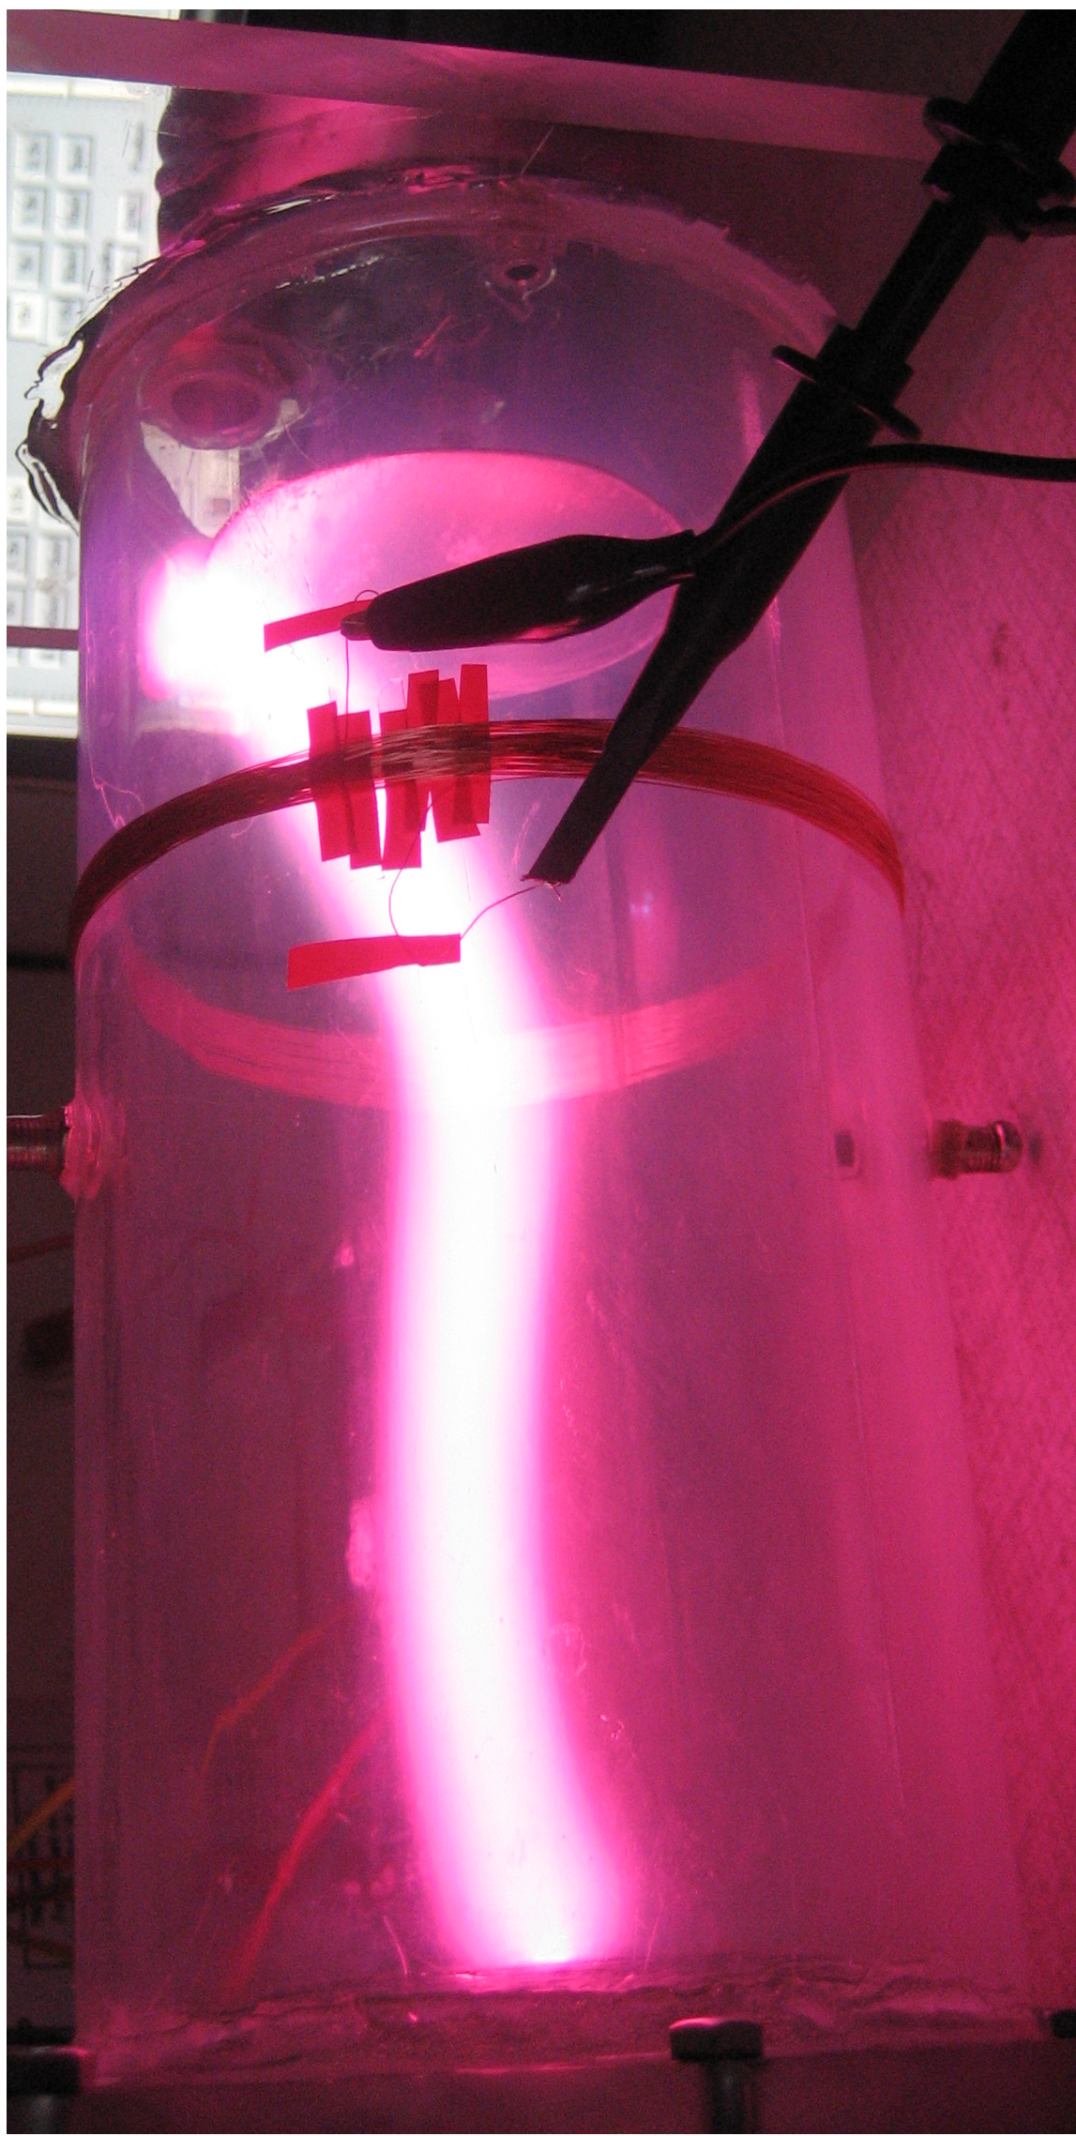
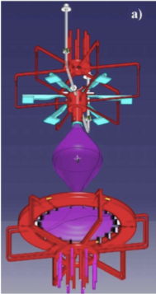
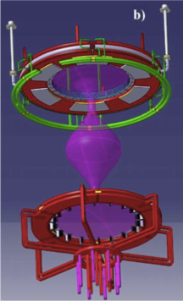
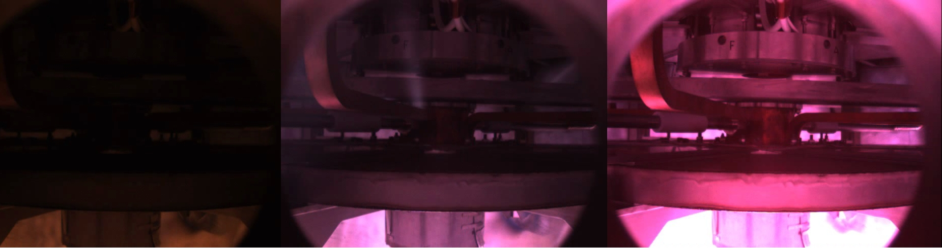
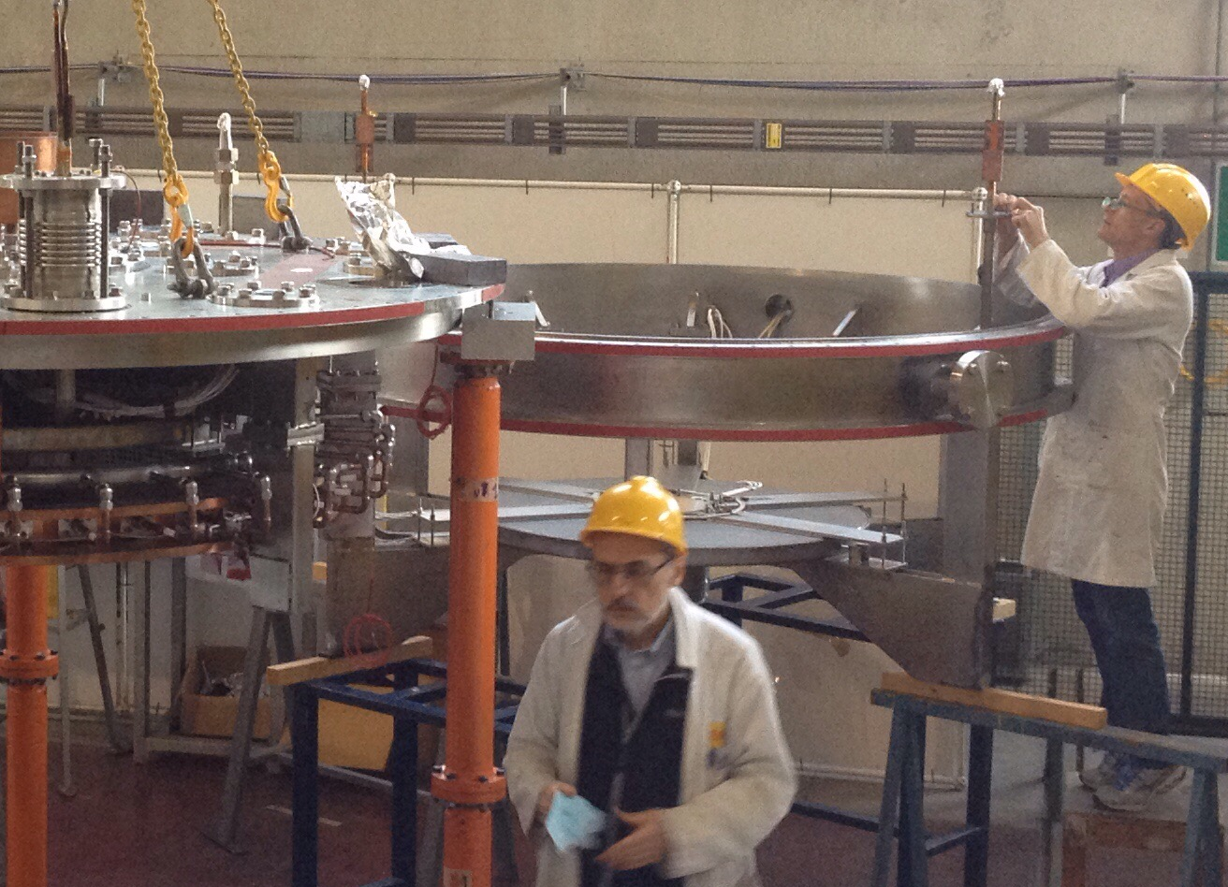
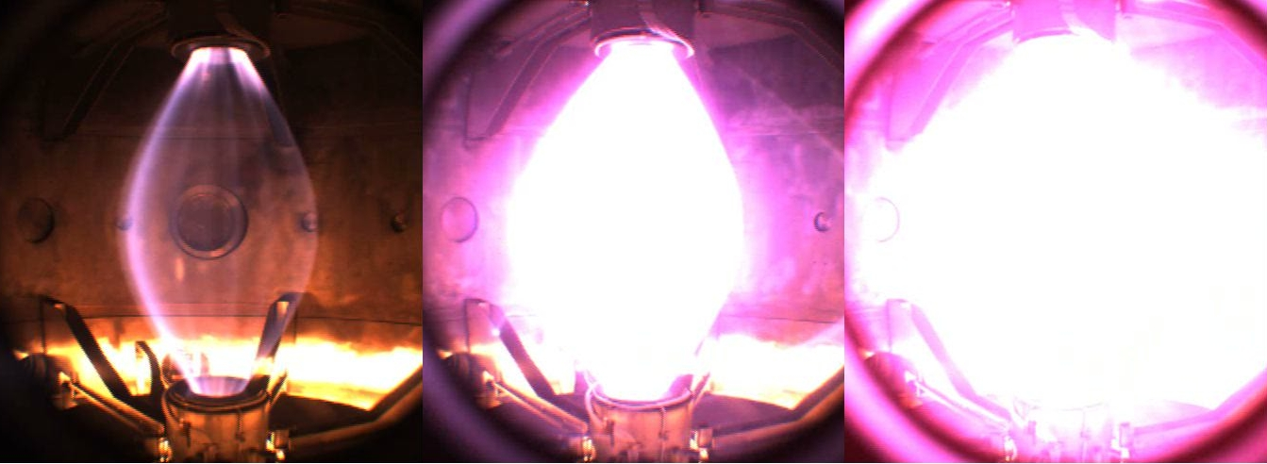
2014 cylindrical anode
Being afraid of anode attachment,
often observed in arc discharges
(arc welding, plasma torches)
the first rounds of experiments
had a simple cylindrical anode
break-down was easily achieved,
apart from this the cylindrical anode was just a source of troubles
2015 annular anode
Cylindrical cathode results
April 2015 annular
anode installed
break-down 170 V +10 ms, 500 A +20 ms, 1.5 kA
Anode camera
Centepost camera
11

Slide 12
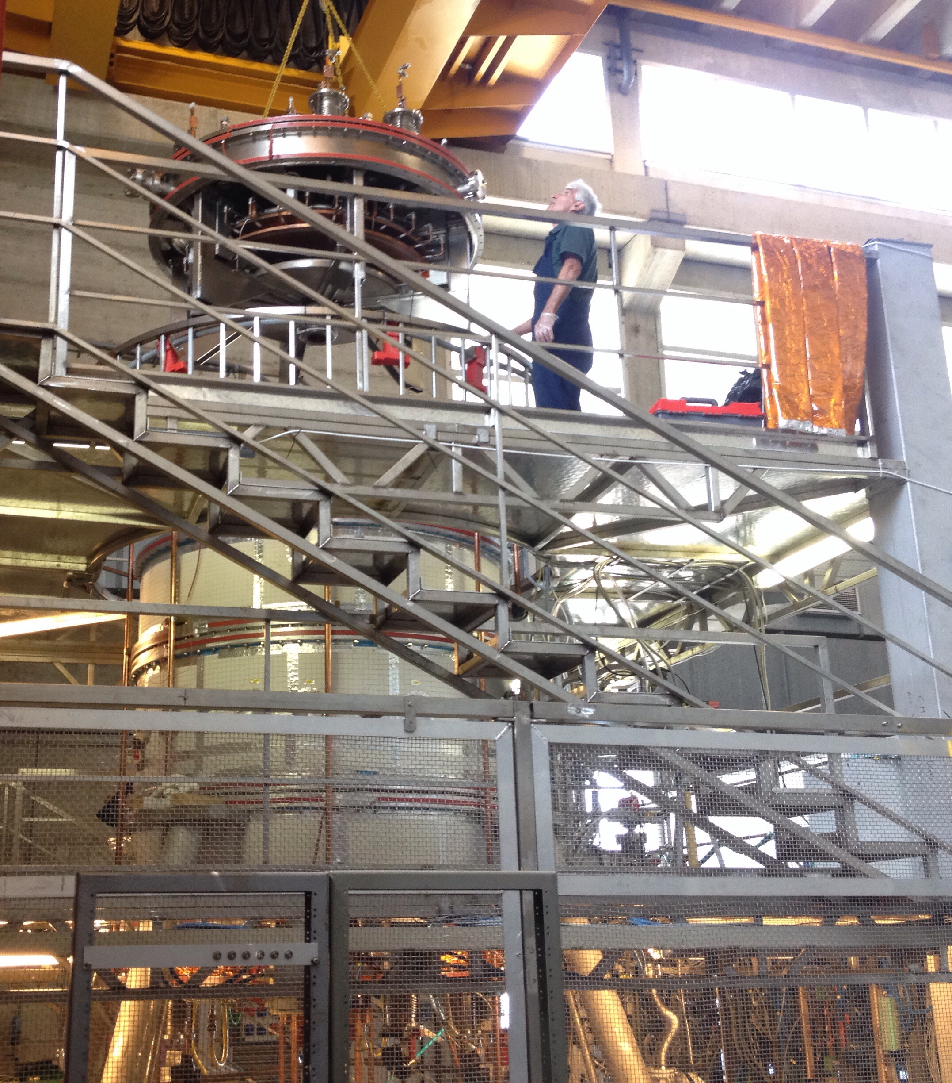
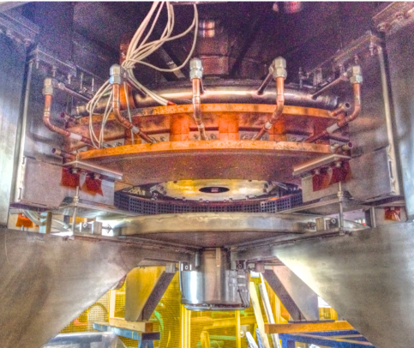
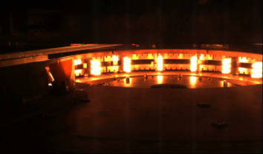
May 2015 annular
anode lowered
on top of machine
up: hollow gas-puffed anode
down: 3000°K heated cathode
present stage cathode
(18 x 3 emitters): aim 10 kA
final stage cathode, 6 x present
(108 x 3 emitters): aim 60 kA
Emitting W spirals up to now survived ~ 1000 cycles
12

Slide 13
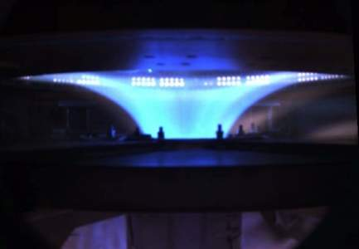
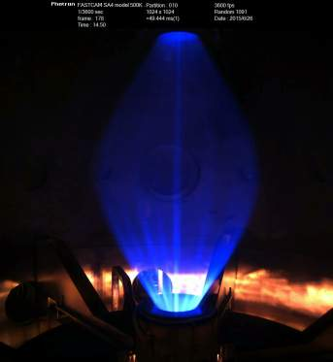
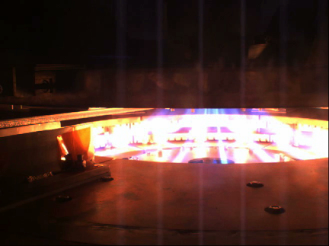
hollow annular anode performs
• plasma goes through both PF2 throttles
• plasma enters anode gas-puffing holes
• no sign (I < 3.5 kA) of anode attachment
• filling pressure 10⁻³ - 10⁻² mbar
Good surprise!
Argon plasma: break-down 80 V
annular anode plasma is never filamented
Cathode
plasma
filaments
disappear
going
towards
anode
anode
camera
cathode
camera
whereas annular cathode plasma (sparse emitters)
and even plasma centerpost are filamented
13

Slide 14
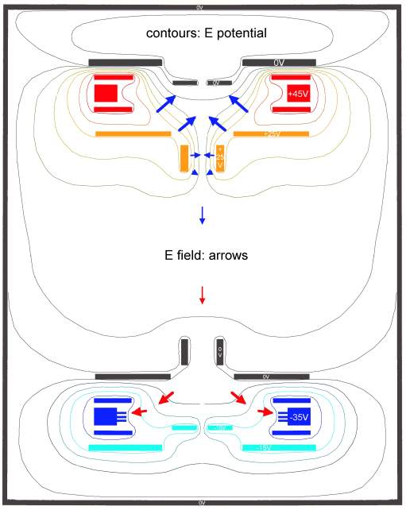
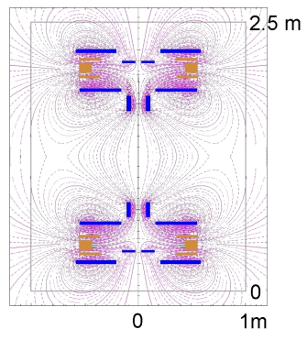
Electrostatic plasma effects
vacuum vessel at GND
PF coil casings can either be
at floating potential or can be connected to:
anode +, cathode -, vessel 0
through ~ 1 Ω resistors
but the electric potential distribution
is dominated by the plasma
PF2\3up to anode (1 Ω)\PF4up cathode (10 Ω)
V_{PF4up} ~ 0 V
V_{anode} ~ +45 V
V_{PF2-3up} ~ +25 V
V_{vessel} = 0 V (ground)
V_{PF2-3low} ~ 0 V
V_{cathode} ~ -35 V
V_{PF4low} ~ -15 V
distribution of electric potential is not up-down symmetric: near both anode and cathode the uppermost PF coil casings is at GND
PF2\3low to GND (1 Ω)\PF4low cathode (0.5 Ω)
14

Slide 15
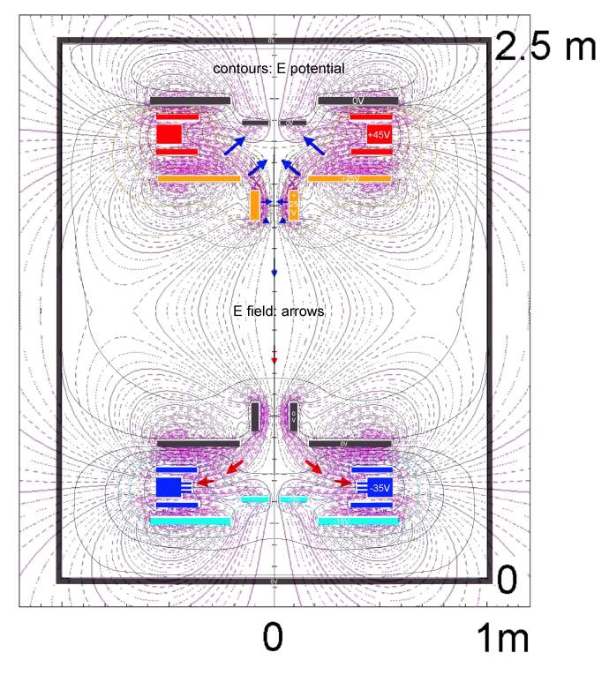
plasma-induced electric potential
near the annular anode:
E-field is perpendicular to B-field
…E ∧ B azimuthal plasma rotation
…starting from PF2up throttle
v_{E∧B}=(E/B) ~ 10⁴ m/s ~ v_{drift} ~ v_{thi}
plasma-induced electric potential
near the annular cathode:
E-field is parallel to B-field
…no E ∧ B plasma rotation
self-organization at work inside
annular electrodes plasma…
15

Slide 16
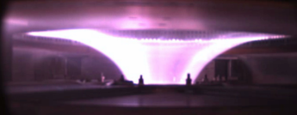
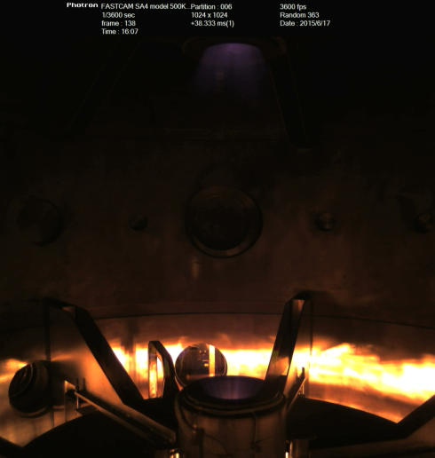
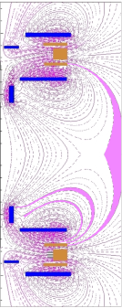
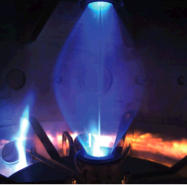
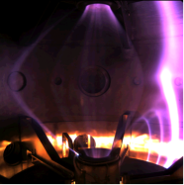
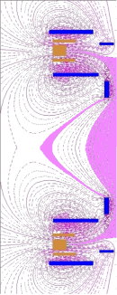



May 2015 annular anode experiment
half of the plasma current: (1kA\2kA)
was going around the required path due to
equatorial X-point inside the vessel
Argon plasma
Hydrogen plasma
Shot 78
discharges along field lines near X-point
16

Slide 17



The equatorial X –point has been removed from inside the vessel
4 external PF coils have been added (home-made from spare connection cables)
…and fed in series with the internal PF coils (PF coils power supply has sufficient margin)
4 additional external PF coils
plasma fired after 0.75 s of PF current to allow for skin current diffusion in Al vessel and SS lids
17

Slide 18




October 2015 experiments with external PF:
Argon discharge reaching 3 kA for 0.15 s
the whole plasma current runs through both PF2 throttles
Shot 205
plasma fired after 0.75 s of PF current
(skin current time to remove X-point from inside vessel)
18

Slide 19





Plasma current outer paths for I > 3 kA
Argon plasma
aiming to 4 kA
reaches 3.5 kA
~ 1.5 kA lost
from main plasma
in discharge from
cathode down to
lid\vessel
Shot 208
plasma current
lost on both
PF2 throttles
10 V spikes appearing on floating voltages on lower PF coils
are associated with plasma current outer path
19

Slide 20




Magnetic tailoring in order to have a better filling of electrodes
when plasma current takes outer path cathode seems less emitting
plasma current 3.5 kA
plasma current 2 kA, 1.5 kA lost
Shot 208
current flows only in external PF near equator
cathode seems better filled at all times
Shot 227
20

Slide 21


Straighter grounding of lower PF coils and better filling of cathode
flowing current only in the two external PF coils nearer to equator
voltage spikes have been eliminated on PF2/3low,
after 1 V amplitude jump even small sparks vanish
voltage jump does not lose plasma current
very quiet plasma at 2 kA after voltage jump
Argon discharge at 2 kA
Shot 227
21

Slide 22

• Spherical Torus Compression PF Coils
• 324 W filaments (full filling of cathode)
• Final Power supplies
To be build after 10 kA
plasma centerpost achieved
Group A: ST compression coils (5+5 series)
Not yet built, but inner vessel ready to host
• high voltage (~20 kV) insulation
thin Inconel casings cost ~ 0.5M€
Tungsten filaments (54 → 324)
Replica of existing (all replaced) cost ~ 0.2M€
Final Power Supplies for:
1) Group A PF coils cost ~ 0.1M€
2) Cathode (I_{cath} 10 → 60 kA) cost ~ 0.2M€
3) Screw Pinch (I_{e} 10 → 60 kA) cost ~ 0.6M€
SuperCapacitors will be used
Cost up to now ~2.0 M€
Cost for final stage of experiment ~1.6 M€
22

Slide 23


Proto-Sphera power supplies: Supercapacitors will be used
Screw Pinch
PF coils ‘A’
60 kA
200 μs
I_{e}
1200 A
10 ms
q_{Pinch}=0.45
SC based P.S.
40 kA
800 A
q_{Pinch}=0.98
Same simulation results
with very different
arc V/I characteristics
L_{coils} = 14.2 mH
R_{coils} = 70 mΩ
20 kA
q_{Pinch}=2.08
400 A
Existing P.S.
0 A
0 kA
Maxwel Technologies SC
(C=63 F , V=125 V)
Advantages:
• No connection to 20 kV substation and no the step-down transformers
• Standard SCR Controller
(no thyristor bridges)
• Very reduced cost!
For the “PF coils A” P.S. a small
conventional capacitor bank (Ducati)
must be added
Phase-1
Phase-1
G. Maffia et al., EEEIC 2015, Rome
Cost ≈ 0.6M$
Cost: less than 0.1M$
23

Slide 24

Status
20 years after 2nd ST Workshop – Princeton (1995) the “aggressive proposal” PROTO-SPHERA
is producing its first centerpost plasmas …better late than never!
Hollow anode surprise, no anode arc attachment (electrostatic potential, E∧B plasma rotation)
(1/3) of the due current (10 kA) achieved, 3 kA sustained in Argon plasma
To achieve full current of 10 kA requires patient learning of how to tailor boundary conditions:
• electrostatic potential by connecting PF coils casings, built floating with respect to the vessel
• magnetic field by additional coils external to the vessel
• new Anode/Cathode “feed through” flanges in Polycarbonate, now in progress
After Argon centerpost is tamed (80 V breakdown), start fight with Hydrogen centerpost (180 V)
If full current of plasma centerpost (10 kA) is achieved and sustained with 54 sparsely spaced
emitting filaments, then full current (60 kA) will be even better achieved with 324 filaments
First stage of PROTO-SPHERA only an appetizer for the production of the Spherical Torus
…放龙入海!
…give a chance to the dragon to show his endowments into the sea!
24

Slide 25
Perspective
Proto-Sphera will assess a new magnetic confinement configuration
• simply connected (easier construction & maintenance)
• with high plasma beta (minimal geometrical size)
• sustained by helicity injection
Proto-Sphera can develop this program:
at very modest costs (~ 1.6M€); in a flexible way (new components can be easily added)
Final PROTO-SPHERA will be much more demanding in manpower and effort
than the present phase-1 of PROTO-SPHERA with Centerpost plasma only
Will be an experiment even more challenging than START was for Culham
• with sophisticated control requests (very fast rise of currents for Torus formation)
• with demanding diagnostic requests
• challenging physicists, engineers and technologists creativity with its adaptability
25

Slide 26



CKF configuration: a possible evolution of Proto-Sphera
Degenerate X-point on Proto-Sphera anode is a nozzle?
?
Different orbits of co- & counter-
circulating charged fusion products:
…preferential thrust through
one of the two degenerate X-points
2015 experiment
CKF found to be ideally MHD stable up to β=1
…promising for future fusion space thrusters?
How to drive the ST current?
In a D-He₃ reactor the co-& counter- circulation of charged fusion products could produce the sustainment current of the surrounding plasma…
Proto-Sphera: a CKF whose Surrounding Plasma terminates upon electrodes
and whose Secondary Tori are substituted by PF2/3 poloidal field coils
26

Slide 27

CKF configuration: a possible evolution of Proto-Sphera
(continue…)
Proto-Sphera load assembly could in principle
accommodate a CKF, with some changes, in order to
investigate formation, stability and β level before the resistive decay
A pair of new coils, same electrodes:
smaller but hotter?
Same coils, new electrodes:
bigger but colder?
27

Slide 28

Having produced a plasma, albeit only the centerpost one, we finally got our star
at the 2015 Princeton International Spherical Torus Workshop!
28

