Slide 1
Risultati della fase 1 di Multipinch
Franco Alladio
WiP – 14 Luglio 2014

Slide 2
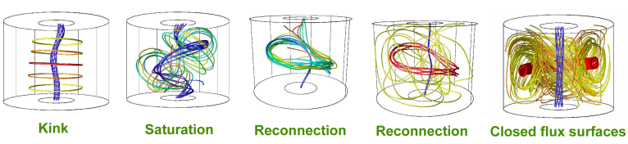
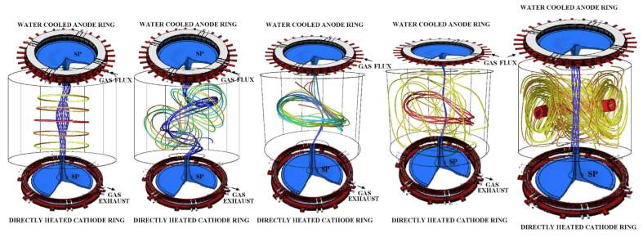
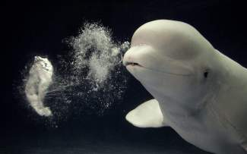
PROTO-SPHERA
A spherical tokamak where the metal centerpost is replaced by a plasma centerpost:
will the plasma centerpost be able to produce and drive the plasma ring?
Anode and Cathode needed for setting up the configuration

Slide 3
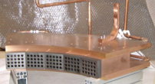
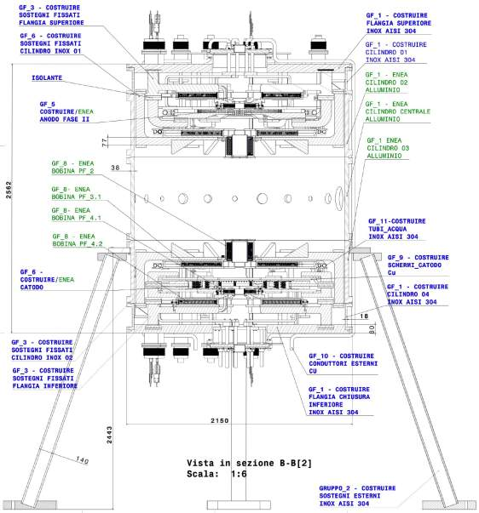
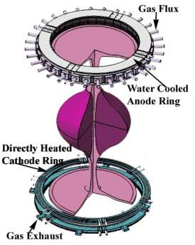
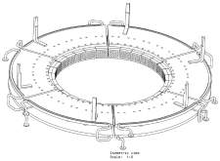
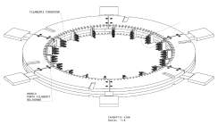
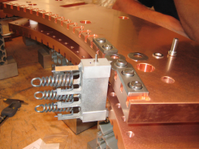
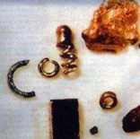
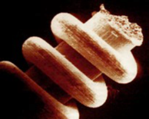
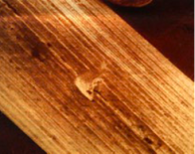
Directly heated W-Mo cathode, hollow gas puffed W-Cu anode
Anode
Cathode
Ural spirals
OOPartifacts
150 ky old?
W & Mo
cathodes very similar to
‘ice-age’ Ural spirals!

Slide 4
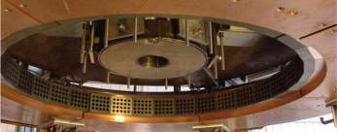
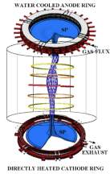
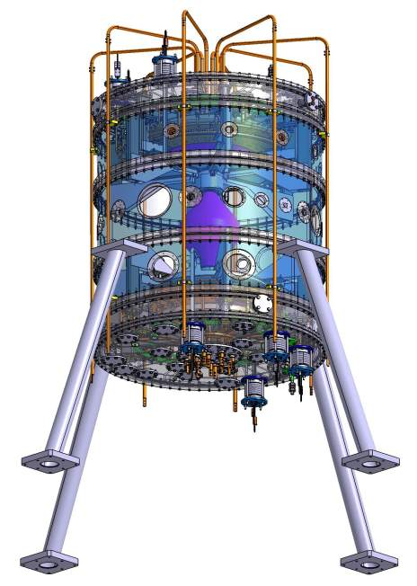
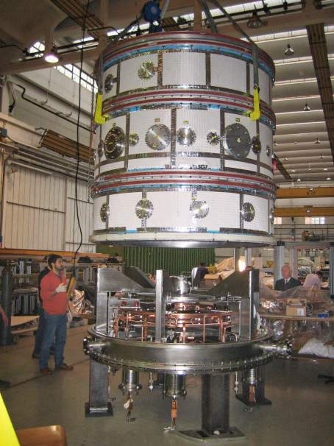

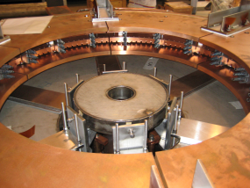
First load assembly tests central plasma column
“Multipinch”, no compression PF coils, no torus
only shaping PF coils, pinch current < 10 kA
Annular hollow anode
Annular heated cathode
6 Cathode modules with rotating AC heating field

Slide 5
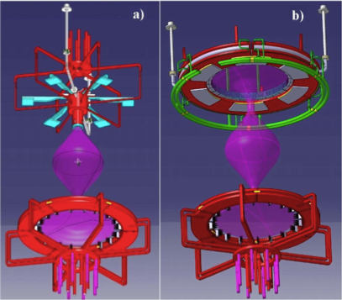
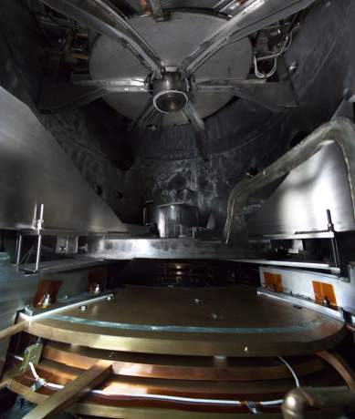
Phase 1 Simple cylindrical element as anode: aim of first experiment was plasma breakdown*
PROTO-SPHERA Part 1a: annular cathode, cylindrical anode
PROTO-SPHERA Part 1b: annular cathode, annular anode
*risk of annular anode is plasma arc anchoring

Slide 6
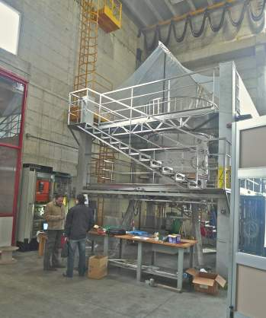
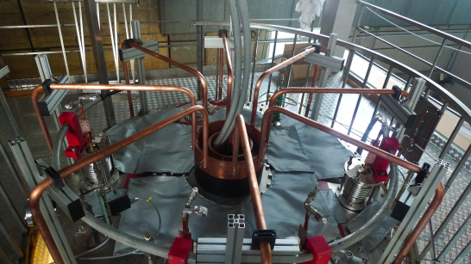
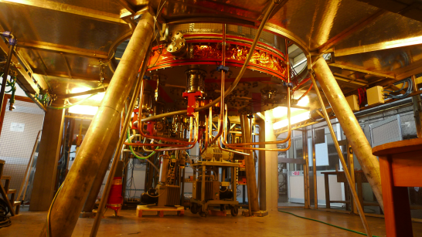
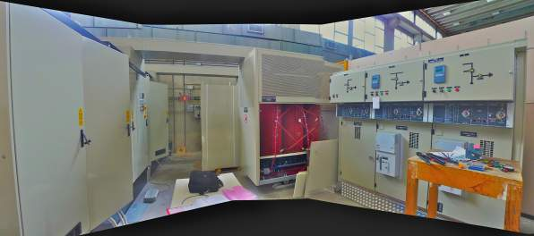
Present status of hardware
3 Power supplies: Cathode AC 6-phased heaters, PF Coils & Pinch ←→ Load assembly
Cathode heating
power supply
Pinch & PF coils
currents power supplies

Slide 7
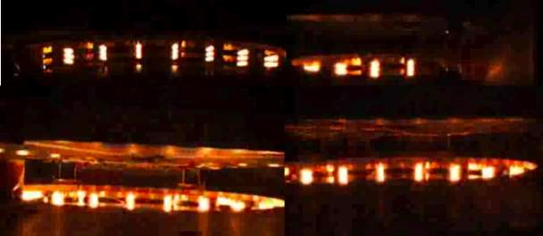
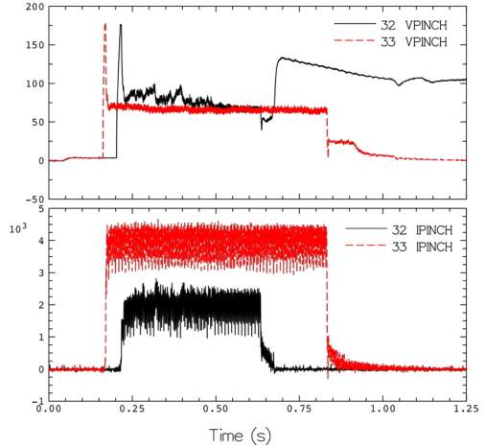
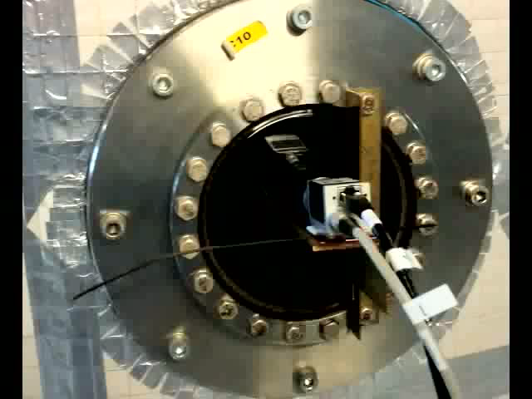
Cathode heated > 50 cycles:
no problems whatsoever
Breakdown July 3 2014, anode at 170 V (half of 350 V max of power supply)
then plasma sustained by 65-75 V
but… true breakdown
lost at the third shot!

Slide 8
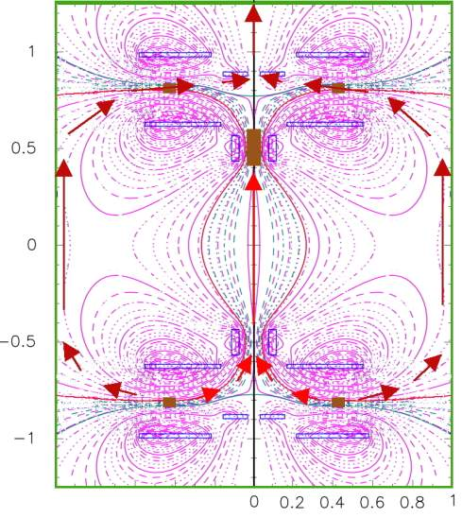

Parasitic current path near inner vessel
evidence from light emission & magnetic measurements

Slide 9
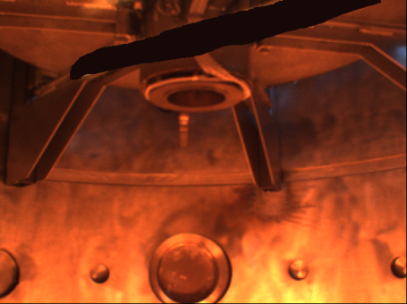
Evidence of parasitic current paths
from sparks near vessel
and light and near vessel

Slide 10
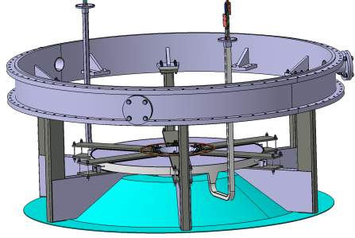
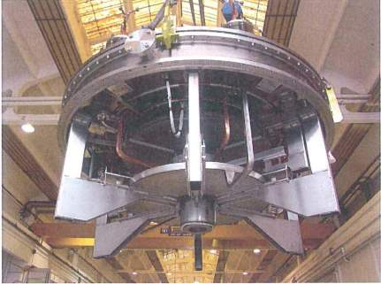
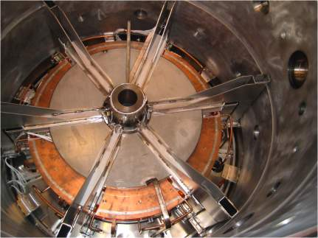
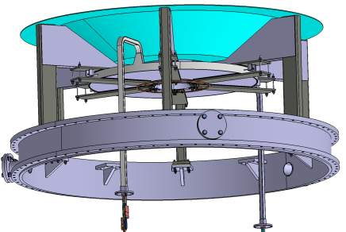
Inox
divertor supports
Proposed cure for parasitic current path:
build & install immediately PROTO-SPHERA
divertor supports, machine ready to host them
Vacuum vessel will become thrice-partitioned

Slide 11
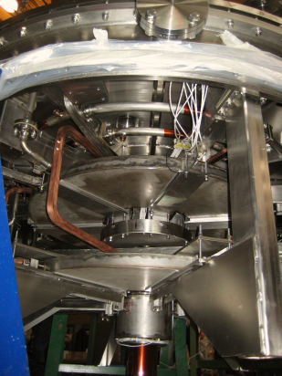
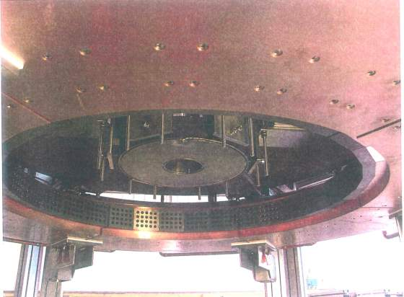
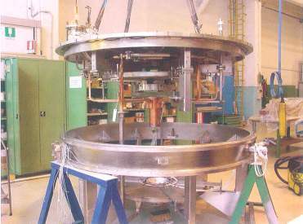
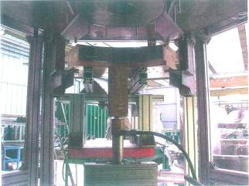
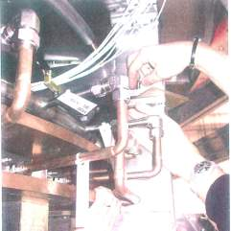
Move from cylindrical to annular anode at the same time

Slide 12
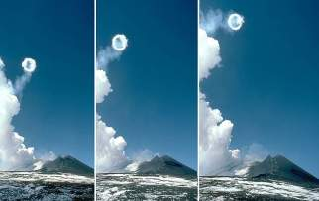
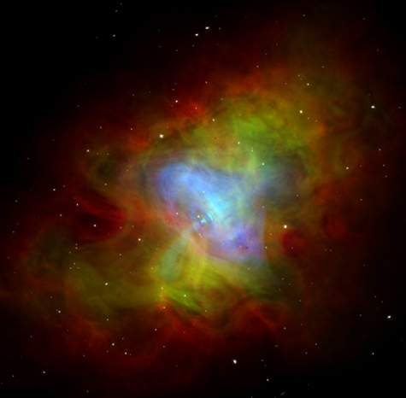
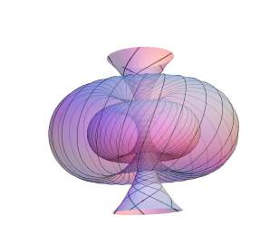
Smoke rings, air bubble rings, plasma rings: a jet drives them all
Hopf foliations
(4D sphere projected in 3D)
Crab Nebula

