Slide 1

Laser-Driven Electron and Ion Acceleration:
Established Results and Progress
M. Salvadori, F. Avella, F. Baffigi, G. Bandini, F. Brandi, G. Cristoforetti, M. Ezzat, A. Fregosi, L. Fulgentini, D. Gregocki, L. Labate, P. Koester, D. Palla, S. Piccinini, S. Vlachos and L. A. Gizzi
Conferenza Italiana sui Plasmi (CIP) 2026, Frascati

Slide 2

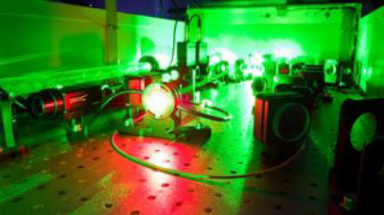
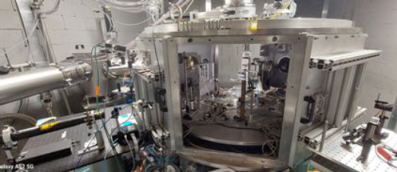
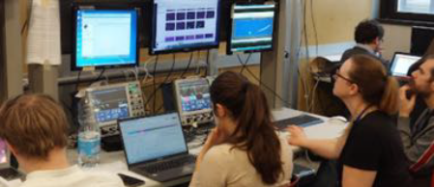
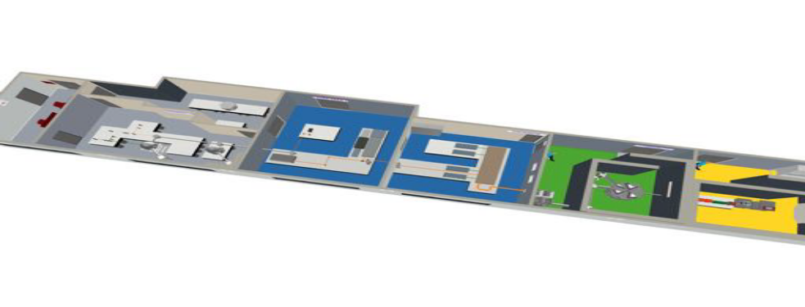
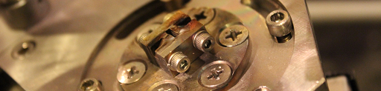
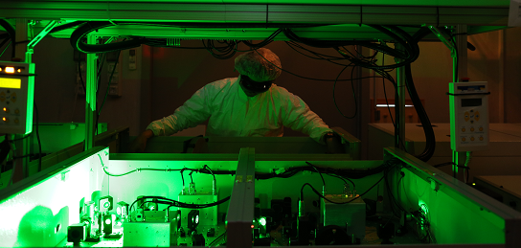
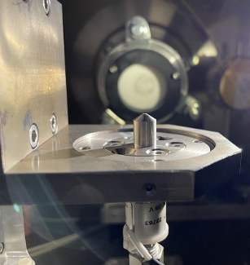
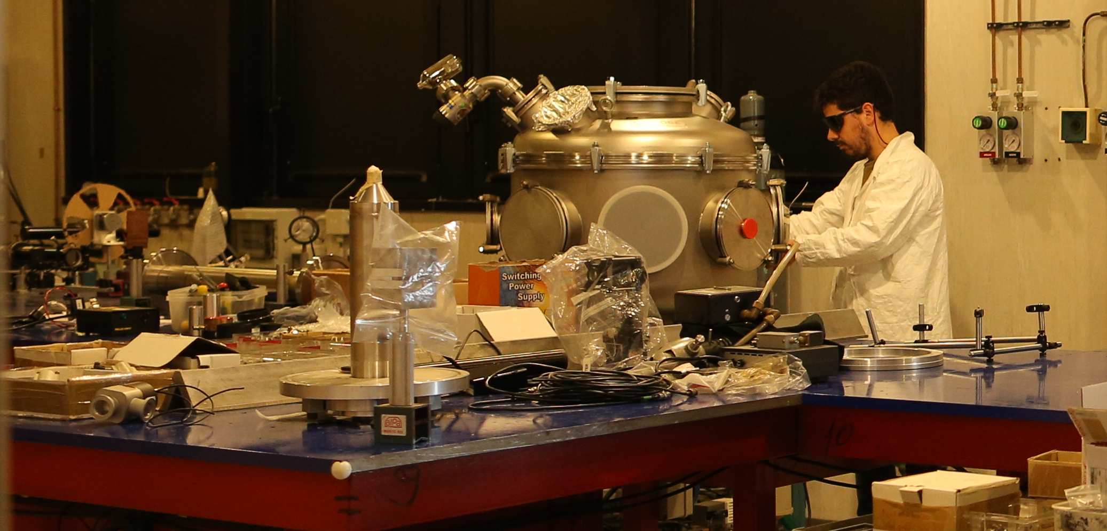







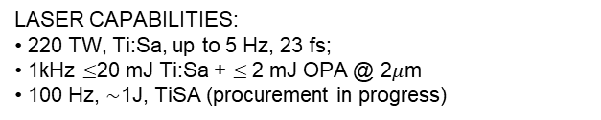
Intense Laser Irradiation Laboratory (ILIL)
LASER DEV. LAB
Relatore:
Nome relatore
USER CONTROL
ROOM
TESTING AND PROTOTYPING
LASER FRONT END
NEW HIGH DOSE UNDERGROUND BUNKER
POWER AMPLIFIER Up to 240 TW
LASER CAPABILITIES:
• 220 TW, Ti:Sa, up to 5 Hz, 23 fs;
• 1kHz $≤$20 mJ Ti:Sa + $≤$2 mJ OPA @ 2$μ$m
• 100 Hz, $∼$1J, TiSA (procurement in progress)
SHIELDED TARGET AREA FOR PARTICLE ACCELERATION
Evento:
NEW BEAMLINE FOR PRE-CLINICAL STUDIES
L. A. Gizzi et al., High Power Laser Science and Engineering, 9 e10 (2021)

Slide 3
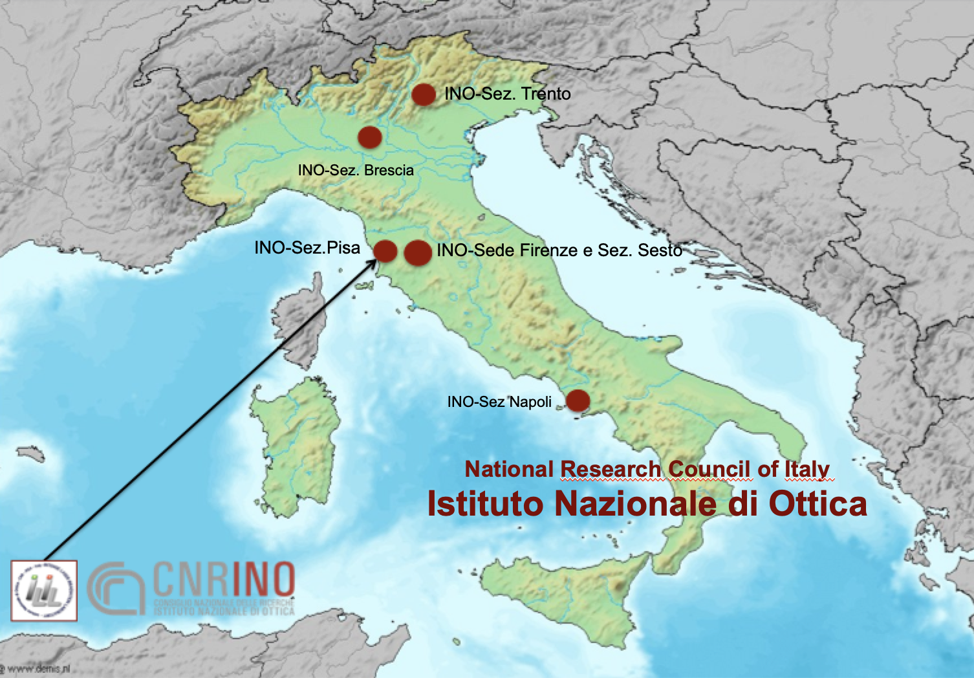
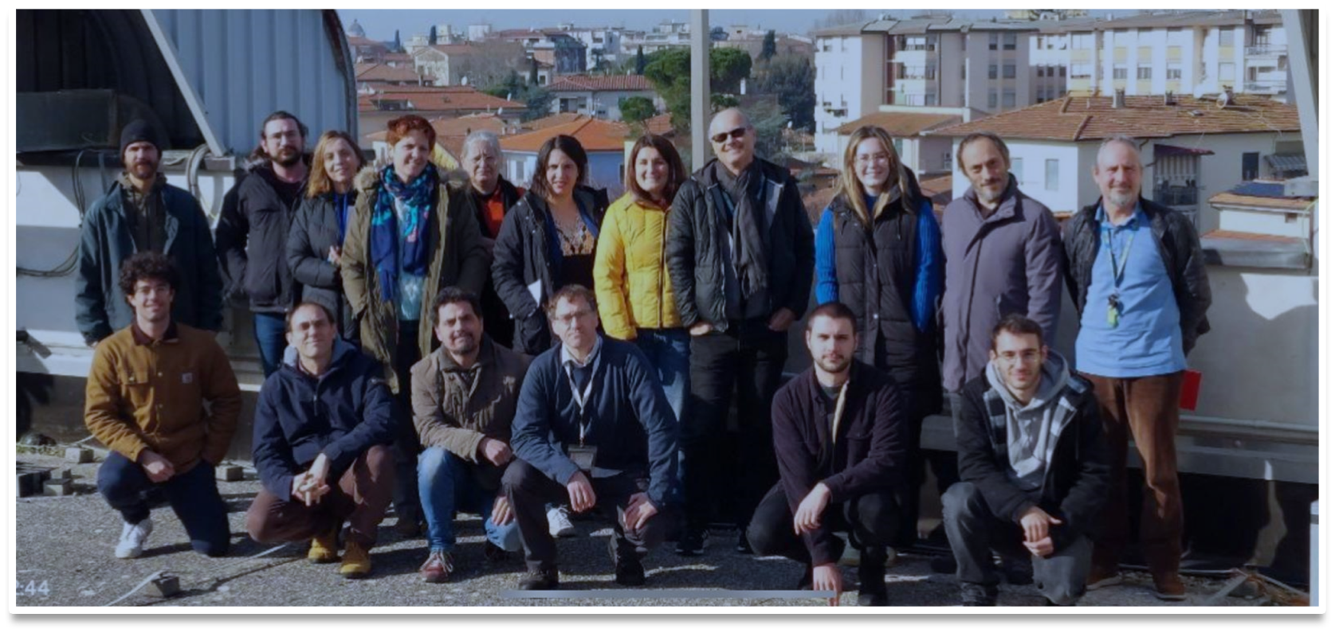
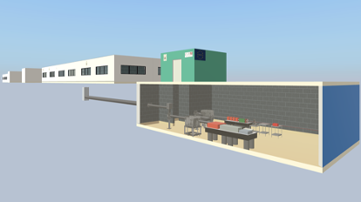
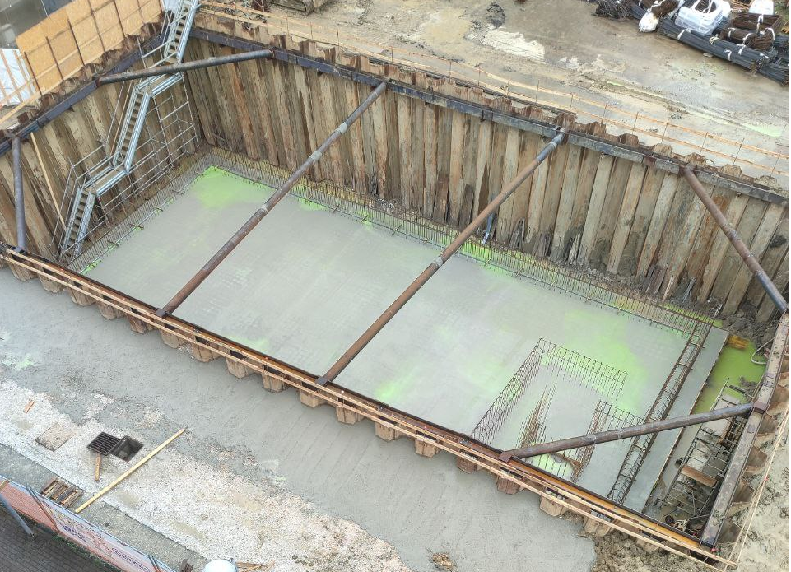
ILIL: Group Members and Activities
Main Activities carried out in our group
→ Laser-Plasma Interaction in condition relevant for ICF
→ Laser-driven electron acceleration and applications
→ Laser-driven Ion acceleration and applications
→ Laser developments
New high-dose underground
bunker
Leonida A. GIZZI* (Head of lab)
Fernando BRANDI
Gabriele CRISTOFORETTI
Petra KOESTER
Luca LABATE*
Federica BAFFIGI
Lorenzo FULGENTINI
Gabriele BANDINI (term)
Mohamed EZZAT (term)
Alessandro FREGOSI (term)
Daniele PALLA (term)
Simona PICCININI (term)
Martina SALVADORI (term)
Federico AVELLA (PhD student)
David GREGOCKI (PhD student)
Simon VLACHOS (PhD student)
Caterina MOZZO (PhD student)
Gianluca CELLAMARE (associated)
Evento:
construction undergoing as we speak…
*also at INFN

Slide 4
ILIL: Group Members and Activities
Main Activities carried out in our group
→ Laser-Plasma Interaction in condition relevant for ICF
→ Laser-driven electron acceleration and applications
→ Laser-driven Ion acceleration and applications
→ Laser developments
Follow P. Koester Talk on Thursday 5th at 10 am
«Fusion energy research with high power lasers in Europe: the HiPER+ programme»
New high-dose underground
bunker
Leonida A. GIZZI* (Head of lab)
Fernando BRANDI
Gabriele CRISTOFORETTI
Petra KOESTER
Luca LABATE*
Federica BAFFIGI
Lorenzo FULGENTINI
Gabriele BANDINI (term)
Mohamed EZZAT (term)
Alessandro FREGOSI (term)
Daniele PALLA (term)
Simona PICCININI (term)
Martina SALVADORI (term)
Federico AVELLA (PhD student)
David GREGOCKI (PhD student)
Simon VLACHOS (PhD student)
Caterina MOZZO (PhD student)
Gianluca CELLAMARE (associated)
Evento:
construction undergoing as we speak…
*also at INFN

Slide 5
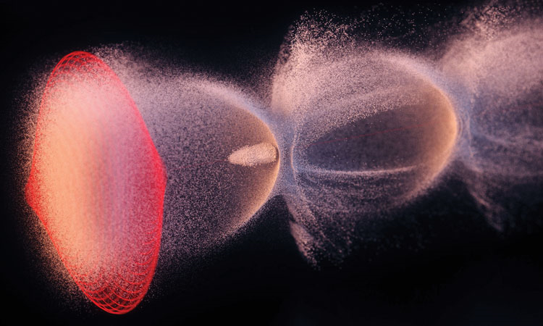
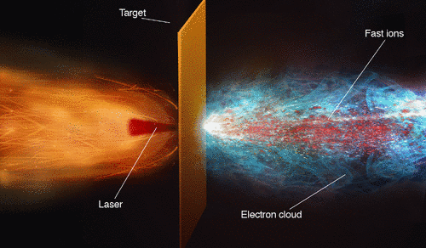
In this Talk:
Laser Driven Electron Acceleration
Brief Introduction and Basic concepts
Application to UHDR radiotherapy
DESY/Science Communication Lab
Laser Driven Ion Acceleration
    Brief Introduction and Basic concepts
    Applications Material Analysis & Radioisotope production
A. Macchi, Rev. Mod. Phys. 85, 751

Slide 6


Laser-Driven electron Acceleration: wake field generation
Why plasma-based accelerator ?
• Possibility to reach extremely high acceleration gradients → Compactness
• Short temporal duration of the accelerated e⁻ bunch
The acceleration mechanism relies on the excitation of plasma waves: In laser-driven acceleration the driver of the perturbation is the laser.
wake
The electric field of the laser exerts a force on
ions and electrons
Electrons, being lighter, cover a larger distance
→Charge separation is induced
Laser
Electrons starts to oscillate around the equilibrium position with the characteristic $ω_{p}$
Underdense Plasma

Slide 7


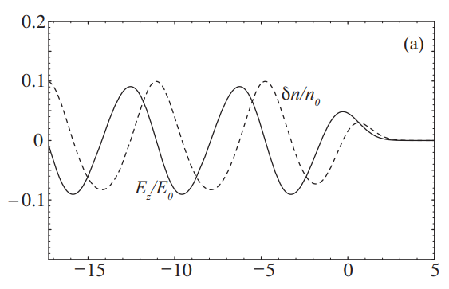
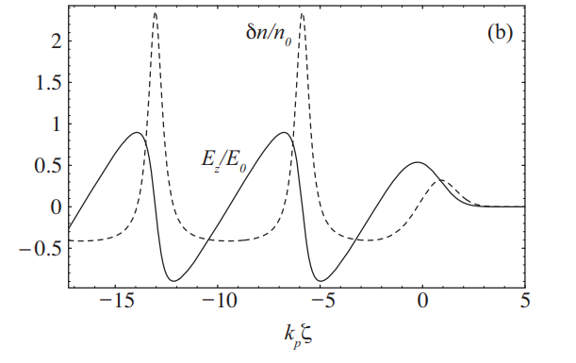





Laser-Driven electron Acceleration: wakefield generation
According to the laser intensity it is possible to distinguish among two different regimes:
• Linear regime $a_{o}= \frac{eE_{L}}{m_{e}ω_{L}c }≪1$
• Non- Linear regime $a_{o}≥1$
$$a_{0}=0.5$$
$$a_{0}=2$$
Wavebreaking
E. Esarey et al., RevModPhys 81 (2009)

Slide 8
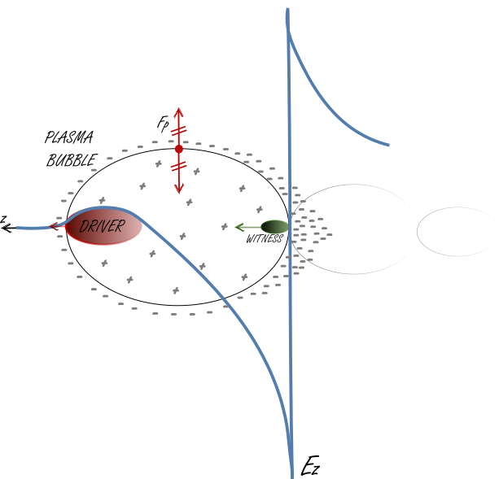
Laser wakefield acceleration: Blow-out Regime and Self Injection
High intensity laser exerts ponderomotive forces on plasma charges, the high intensity allows for complete depletion of electrons from the axis.
The empting zone is referred to as the «bubble»
As the laser pulse propagates in the plasma, electrons are accumulated at the rear side of the bubble
In this region the accelerating electric field can be strong enough to trap background plasma electrons in the bubble → Self Injection

Slide 9
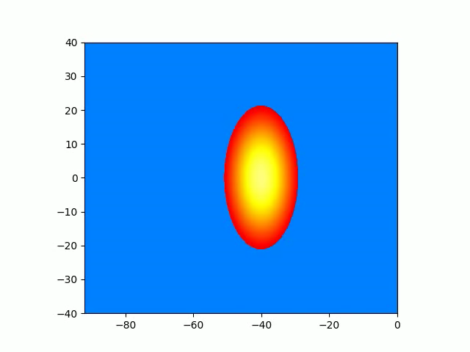
Laser wakefield acceleration: Blow-out Regime
Laser propagation direction
Courtesy of F. Avella.

Slide 10
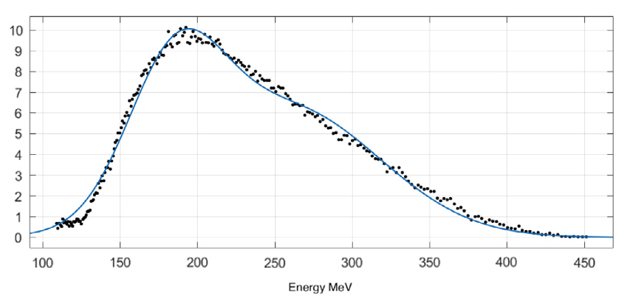
Laser wakefield acceleration: Blow-out Regime
self injection relies on trapping background plasma electrons → electrons on the tail of thermal distribution may have a sufficient momentum to be on a trapped orbit
Laser propagation direction
Courtesy of F. Avella.
→ High energy spread and emittance
G. Costa NIMA 909 (2018)
Different methods have been proposed to control the injection process so to achieve higher quality electron bunches (i.e. laser triggered injection, density tailoring…)

Slide 11
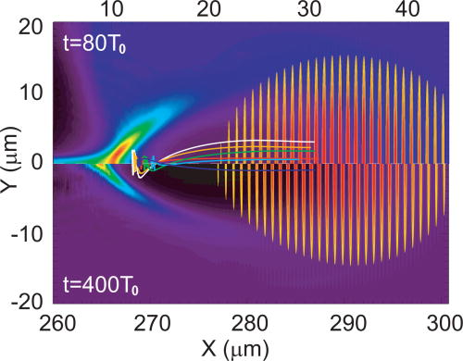
Laser wakefield acceleration: Ionization Injection
Ionization triggered injection is achieved by ionizing deeply bounded electrons of an high atomic number gas at a proper phase inside the laser driven wakefield
→ The idea is to irradiate a gas mixture made primarly of a low Z gas (i.e. 99% H) with a small amount of a high Z gas (i.e. 1% N).
The ionization of the low Z gas, achieved by the leading edge of the laser, will generate the plasma wave oscillations. On the other hand, the inner shell electrons of the high-Z gas require an higher electric field to be ionized → near the peak of the laser intensity. Therefore they are ionized, pomptly trapped and accelerated.
→ high quality beams with lower energy spread and emittance of accelerated electrons is achieved
Chen, PoP 19,033101 (2012)

Slide 12
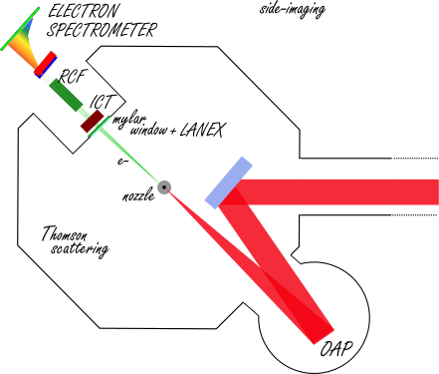
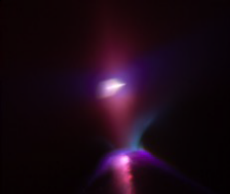
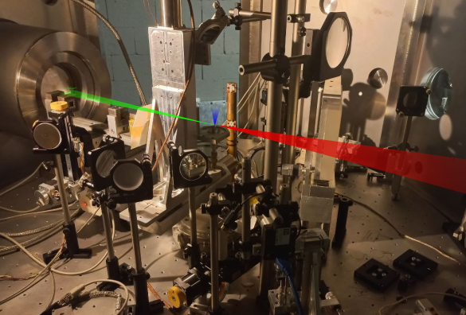
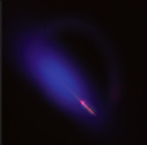
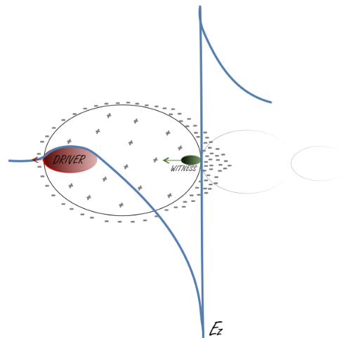
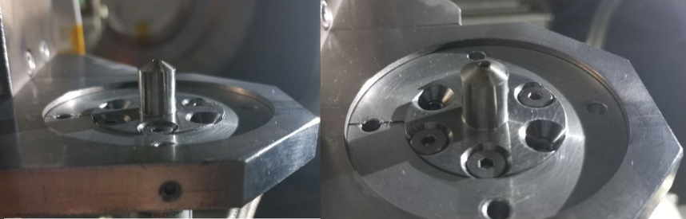
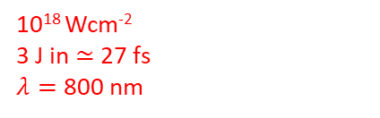

Laser Wakefield Acceleration at ILIL
Interaction Chamber
Output window
e⁻
10¹⁸ Wcm⁻²
3 J in $≃$27 fs
$λ=$ 800 nm
Beam Charge
Beam Spectra
Circular aperture 2 mm
Beam Size and Pointing
Supersonic flow of Helium Gas with 1% Nitrogen
Dose and DPP
LWFA Ionization Injection
Operative electron density $≃{10}^{18} cm^{−3}$

Slide 13
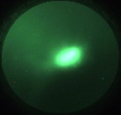
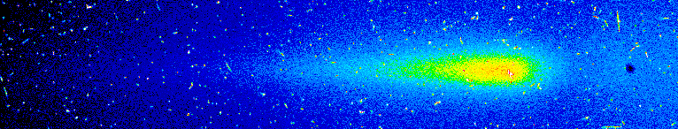
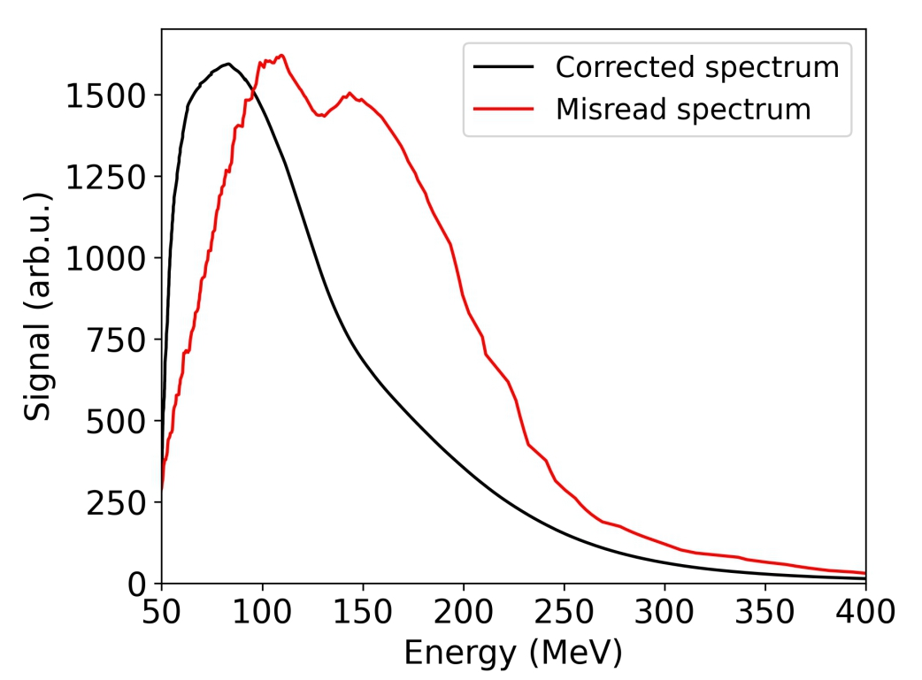
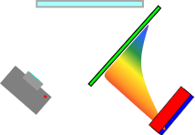
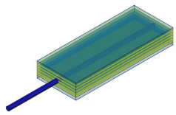
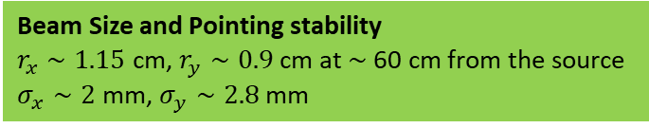

Laser Wakefield Acceleration at ILIL
Beam Spectra
Dose and DPP
S.G. Vlachos NIMA 1082:2 (2026)
Courtesy of S. Piccinini
Cumulating 120 shots
Mirror
Lanex
Magnetic
dipole
Camera
collimator
Beam Size and Pointing stability
$r_{x}∼1.15$ cm, $r_{y}∼0.9$ cm at $∼$60 cm from the source
$σ_{x}∼2$ mm, $σ_{y}∼2.8$ mm
Beam Charge $≃ 150 pC$
D. Gregocki Instruments 2025, 9(4), 25

Slide 14
Laser Wakefield Acceleration at ILIL
Beam Spectra
Dose and DPP
S.G. Vlachos NIMA 1082:2 (2026)
Courtesy of S. Piccinini
Cumulating 120 shots
Mirror
Lanex
Magnetic
dipole
Approaching regimes relevant for radiotherapy in Ultra High dose Rate and FLASH regime with VHEE
Camera
collimator
Beam Size and Pointing stability
$r_{x}∼1.15$ cm, $r_{y}∼0.9$ cm at $∼$60 cm from the source
$σ_{x}∼2$ mm, $σ_{y}∼2.8$ mm
Beam Charge $≃ 150 pC$
D. Gregocki Instruments 2025, 9(4), 25

Slide 15
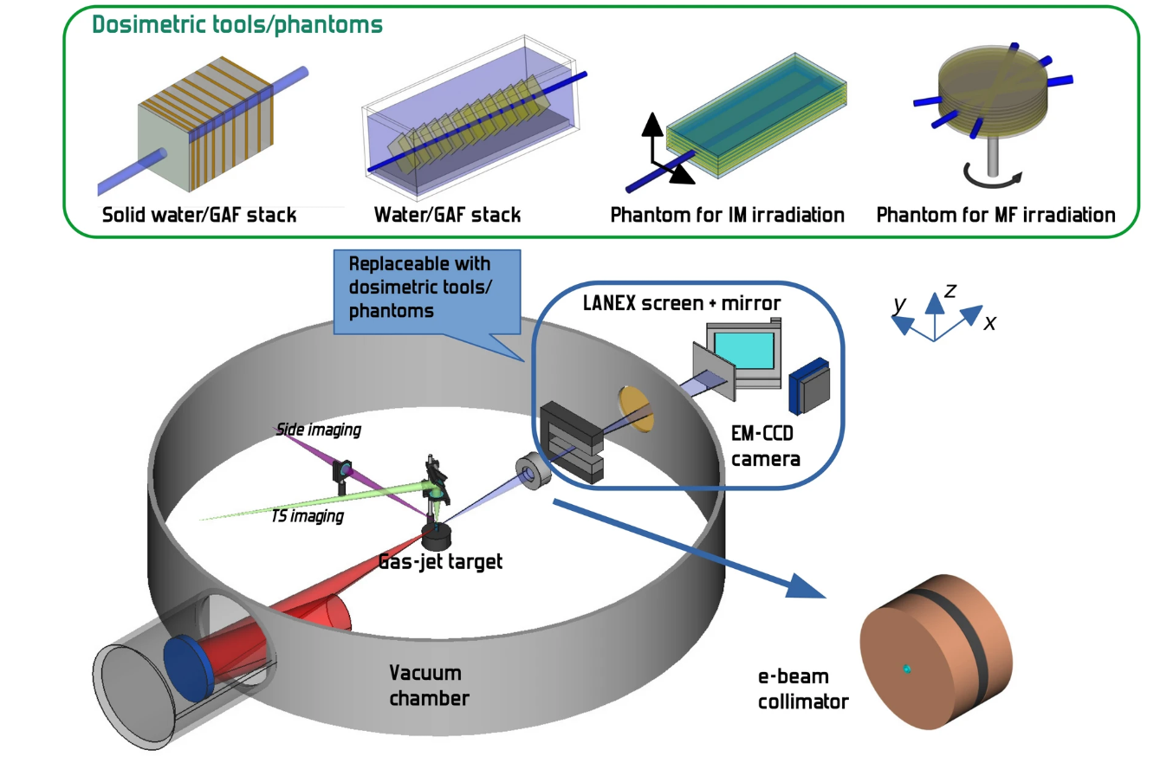
LWFA VHEE for UHDR radiotherapy
VHEE (50 MeV < E < 250 MeV):
+ Suitable for deep-seated tumors
+ Sharp beam penumbra
+ Low sensitivity to inhomogeneities
- High entrance and exit dose
Main objective: damage enhancement to the targeted volume (cancer cells) while sparing the nearby tissues and OAR (organ at risk)
→ Need for dosimetric characterization
Investigation of dose deposition in complex geometry such as Multi Field Irradiation (MFI) and Intensity Modulation (IM) schemes.
120 pc/shot
Spectral energy distribution within 50-250 MeV
L. Labate et al, Sci Rep 10, 17307 (2020).
C. M. V. Panaino Cancers 2025, 17(2), 181

Slide 16
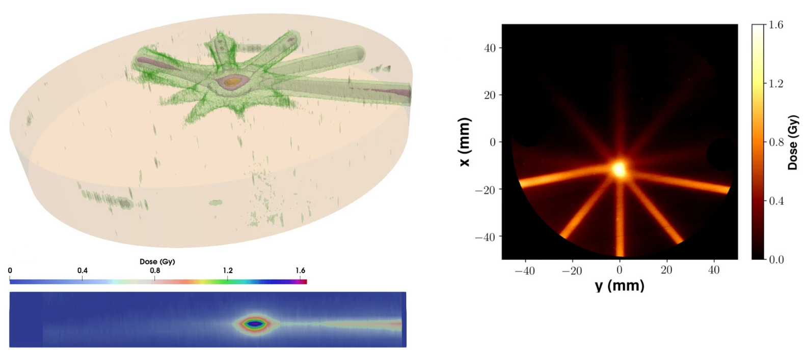
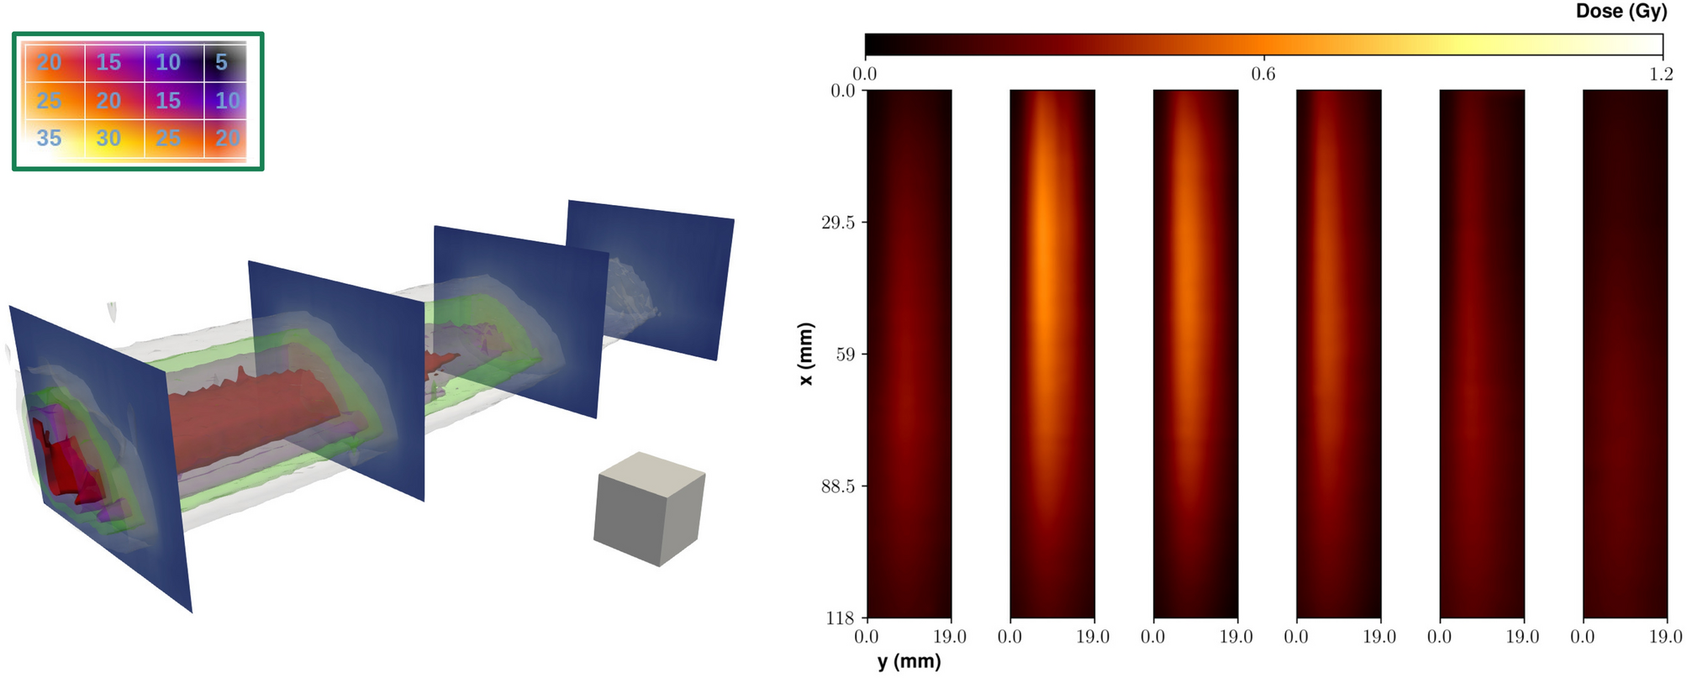
LWFA VHEE for UHDR radiotherapy
Multi Field Irradiation
Intensity Modulation
Irradiation Map → 3 mm x 4 mm matrix
Each slot received a different number of shots
GAF chromic sandwiched in 2 mm Polycarbonate disks
Rotating Cylinder along the z-axis,
accumulating same number of shots every 40 rotation
Measured dose gradient both in the x and y direction
Targeted volume received:
→ 2.5 times the entrance dose,
→ 3-4 times the dose in the surrounding volume,
→ 16 times the exit dose.
→ Possibility to have a localized dose deposition
L. Labate et al, Sci Rep 10, 17307 (2020).

Slide 17
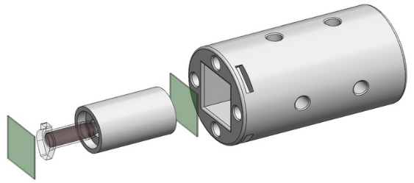
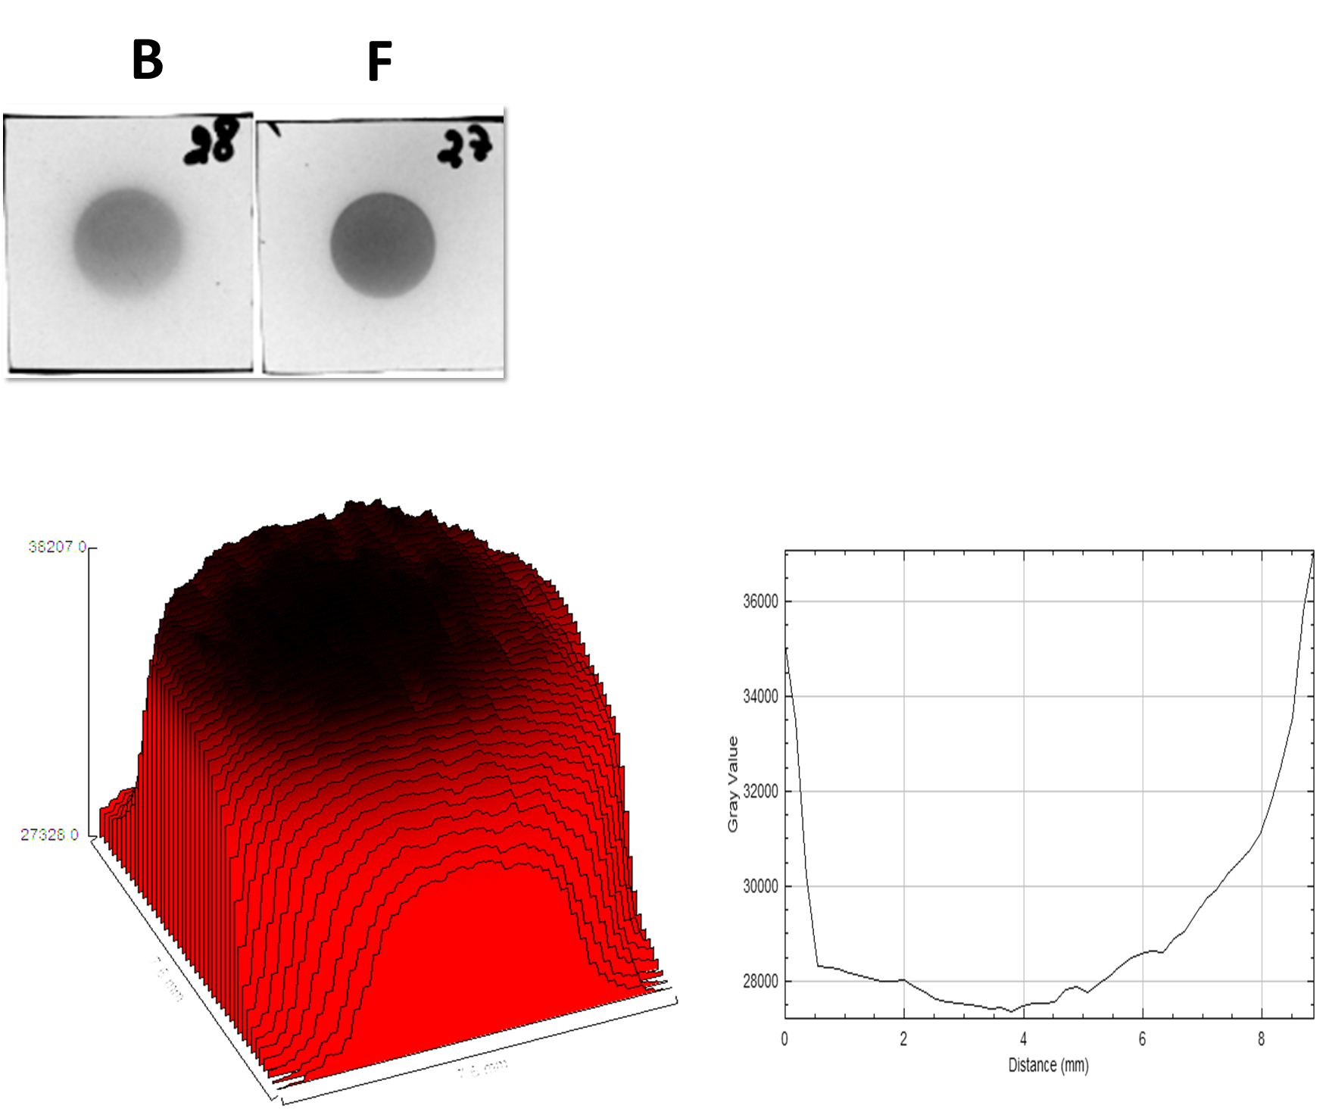
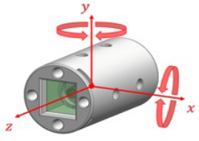
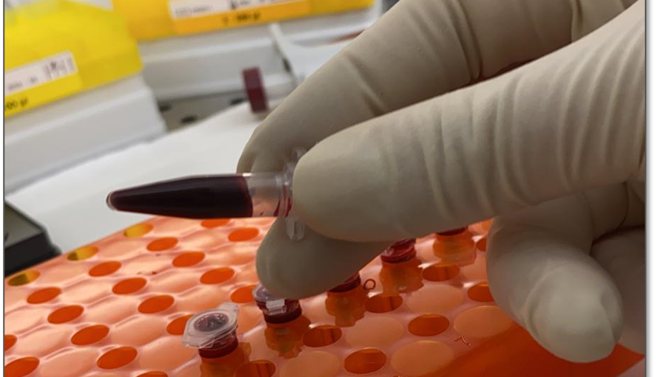
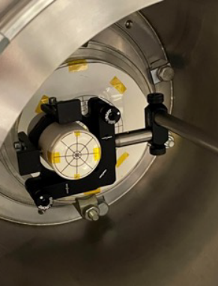
VHEE for FLASH radiotherapy
Radiochromic Films
FLASH-RT: delivering high doses in an extremely short irradiation time (Dose rate > 40 Gy/s)
e- beam
Sample
LWFA-VHEE → Extremely short bunch duration
VHEE FLASH-RT → dosimetric characteristic combined to the sparing capability of FLASH
Courtesy of G. Bandini
Human peripherical blood irradiation
Output window
Evaluation of the dose-response curve of Peripheral blood lymphocytes DNA damage due to laser-guided ultra-high dose rate VHEE pulses irradiation
Radiobiological endpoints
Micronucleus Test
Sample holder
with lanex screen
Telomere Shortening

Slide 18
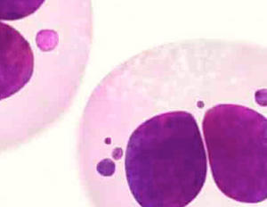
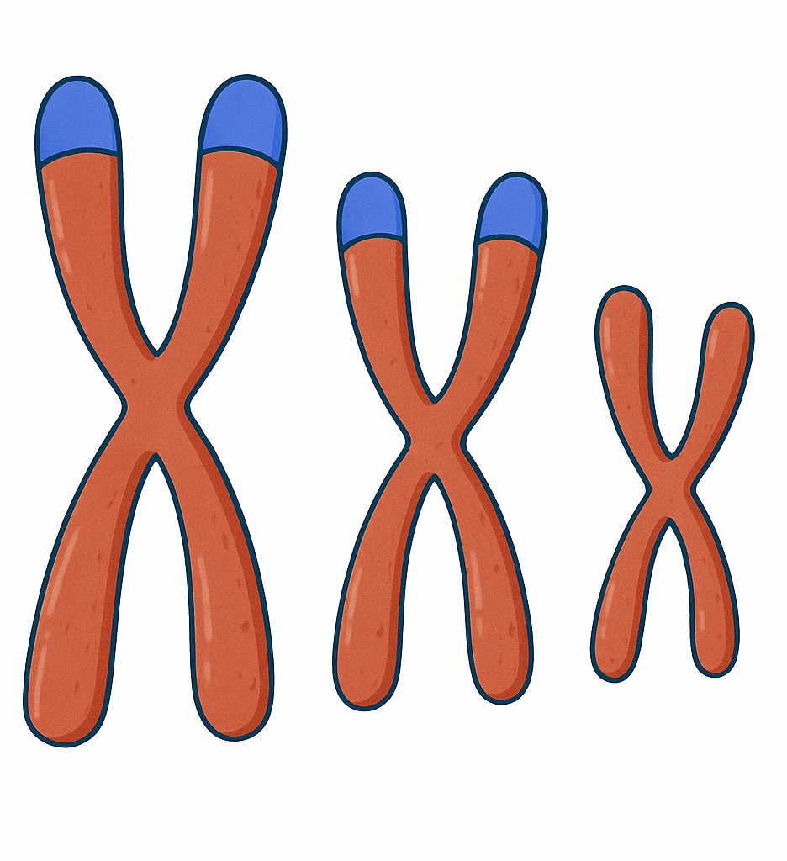
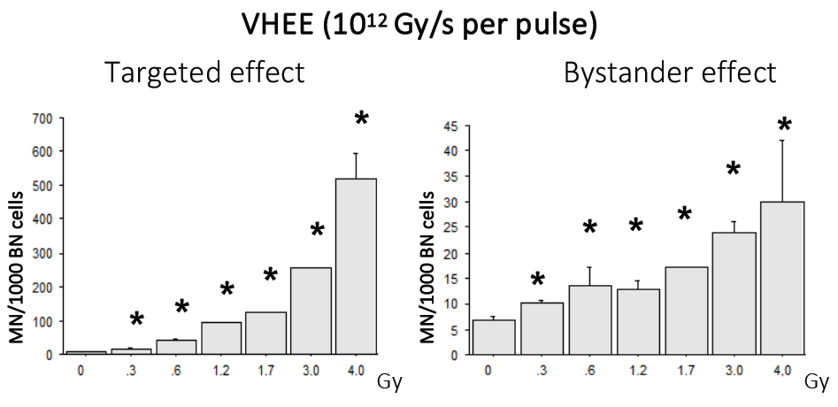
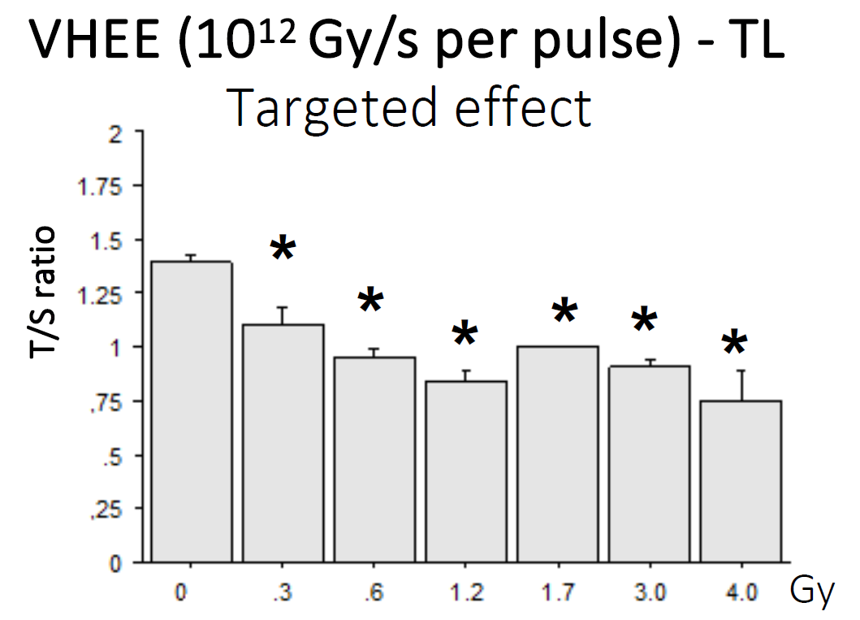
LWFA for FLASH radiotherapy
Micronucleus Test: gold standard for evaluating radiation-induced chromosomal damage.
The assessment cover both targeted and bystander effects.
Telomere Shortening: Analysis of telomere length as an indicator of radiation-induced genomic instability.
* All p<0.05 vs. control value
Courtesy of S. Piccinini, A. Borghini

Slide 19
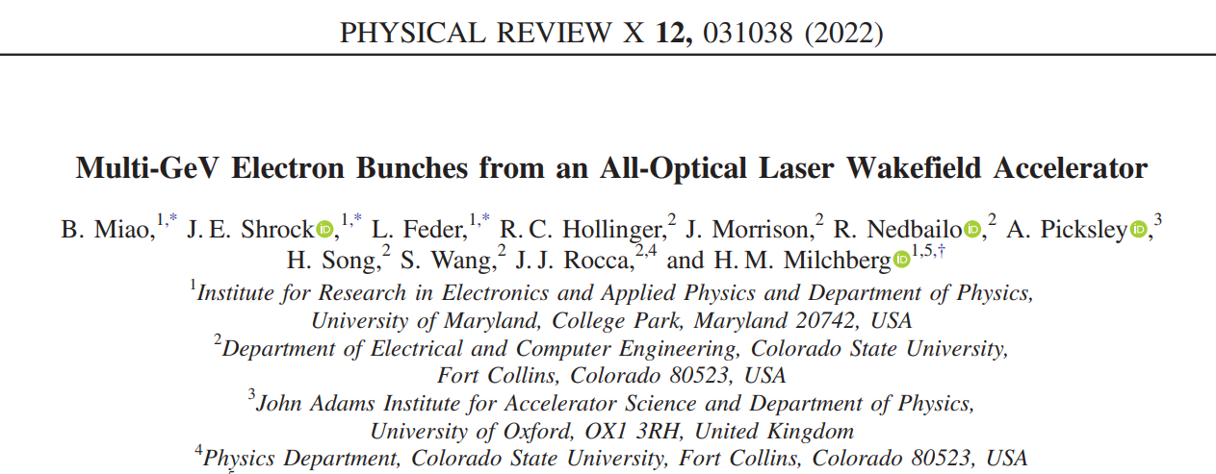
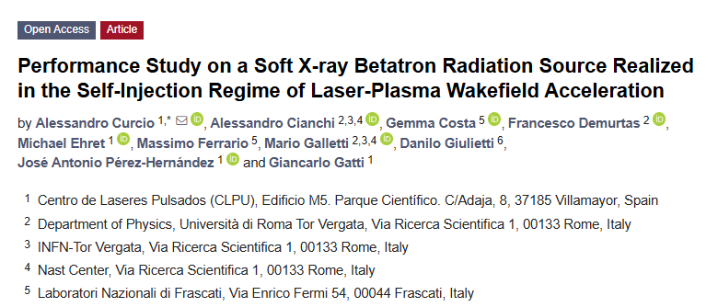
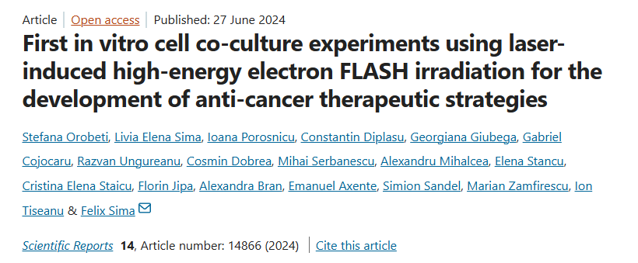
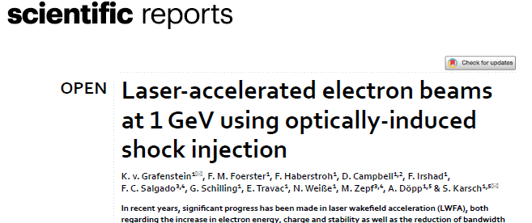




Many mechanisms investigated, many results obtained…

Slide 20

Laser Driven Ion Acceleration
Short, high power laser interacting with solid thin targets (flat foil, nanostructured, ultrathin foil…)
Depending on the specific laser parameters and target characteristics different acceleration mechansim can prevail
TNSA
F. Albert et al 2021 New J. Phys. 23 031101

Slide 21


Laser Driven Ion Acceleration
Most commn properties in Laser-accelerated protons:
→ Broad energy spectra (exponential-like)
→ Ultrashort duration near the source
→ Up to 10¹³ accelerated protons
→ Energy dependent beam divergence
Typical TNSA spectrum
H. Daido et al Rep. Prog. Phys. 75 056401 (2012)

Slide 22

Laser Driven Ion Acceleration
Most commn properties in Laser-accelerated protons:
→ Broad energy spectra (exponential-like)
→ Ultrashort duration near the source
→ Up to 10¹³ accelerated protons
→ Energy dependent beam divergence
Typical TNSA spectrum
M.Zepf et al. 37th EPS Conference on Plasma Physics (2010)
H. Daido et al Rep. Prog. Phys. 75 056401 (2012)
But there are exception, RPA and CSA provide peaked spectra

Slide 23
Application of Laser-driven protons
Material Science
→ Damage study
→ Ion Beam Analysis:
    Particle Induced X-Ray Emission
Medical
→ Hadrontherapy
→ Radioisotope production for PET scan
Neutron science
→ Compact neutron source
Fusion
→ Fast Ignition Scheme
→ Proton-Boron scheme
And many others….

Slide 24
Application of Laser-driven protons
Material Science
Laser-driven proton beam is used to irradiate the sample to characterize. The energetic particles generates inner-shell vacancies with subsequent emission of characteristic radiation during the de-excitation.
→ Damage study
→ Ion Beam Analysis:
    Particle Induced X-Ray Emission
Medical
→ Hadrontherapy
→ Radioisotope production for PET scan
Laser-driven proton beam is used to irradiate a volume of enriched water inducing the ¹⁸O(p,n)¹⁸F reaction.
Neutron science
→ Compact neutron source
Fusion
→ Fast Ignition Scheme
→ Proton-Boron scheme
And many others….

Slide 25



Particle Induced X-ray Emission
Energetic particles are used to irradiate the sample to characterize. The impinging particles interacting with the material generate inner-shell vacancies as a consequence of the ejection of an electron. The vacancy is filled via the transition from an upper level with subsequent emission of characteristic radiation during the de-excitation.
The Analysis of the emitted characteristic radiation allows to retrieve both the chemical elements in the sample and their concentrations.
K-shell
L
M
$$N_{X}∝N_{el}∫dEN_{p}\left(E\right)σ_{K}(E)$$
Proton energies in the range 2-5 MeV are suitable for this application
Technique relevant for Cultural Heritage, Industry, biology, forensic analysis…
Several shots are needed to reach resolution comparable to existing technique → toward high rep rate

Slide 26








Particle Induced X-ray Emission
Brass Sample
CCD-X
TNSA-Target
MBL
OAP
M2
M1
LASER
400 mJ on target
27 fs temporal duration
I $≃$ 4 $×$ 10¹⁹ Wcm⁻²
$$\frac{N_{PIXE, Cu}}{N_{PIXE, Zn}}=\frac{Y_{Cu}}{Y_{Zn}}\frac{\overline{σ_{Zn}}}{ \overline{σ_{Cu }}}$$
$$\overline{σ}=\frac{∫N_{p}\left(E\right)σ\left(E\right)dE}{∫N_{p}\left(E\right)dE}$$
M. Salvadori et al, Phys. Rev. Applied 21, 064020 (2024), F. Brandi et al., Appl. Sci., 11(14), 6358 (2021)

Slide 27






Radioisotope production for PET
Short-lived radioisotope production for Positron Emission Tomography (PET) ¹¹C , ¹⁸F , ¹³N , ¹⁵O …
Main proton Spectral range contributing to the reaction
Sample of enriched water
$≃$2.5 MeV production treshold
$${}_{8}^{18}{O+{}_{1}^{1}p→ {}_{9}^{18}{F+{}_{0}^{1}n+γ}}$$
Fluorine-18 combined with 2-deoxyglucose: FDG → FDG absorbed and 18F decays:
Laser-driven proton source
on site and on demand production
$${}_{9}^{18}{F→ {}_{1}^{0}e+ {}_{8}^{18}O }$$
${}_{1}^{0}e$ annihilates emitting $2γ$ with 511 keV energy in opposite directions
E. Hess Radiochim. Acta 89,
357 (2001)
No $γ$ emission during the decay
$τ_{\frac{1}{2}}≃110$ min: reduced patient exposition
Non toxic
${}_{1}^{0}e$ low energy, short range before annihilation
M. Conti et al. EJNMMI Physics 3, 8 (2016), M. Seimetz et al. IEEE –NSS/MIC (2015), Z. Sun AIP Advances 11, 040701(2021)

Slide 28





Radioisotope production for PET
3 J on target
27 fs duration
$∼$ 2$×$10²⁰ Wcm⁻²
@ 0.3 Hz
Production of small (single-patient), «on demand» doses using microfluidic chips
sample
Irradiation
Activity
15.6 uL of
[¹⁸O]-H₂O @98%
50 um Mylar window
85 shots accum.
5 (0.6) Bq
45 minutes
0.03 Hz

Slide 29


Radioisotope production for PET
3 J on target
27 fs duration
$∼$ 2$×$10²⁰ Wcm⁻²
@ 0.3 Hz
Production of small (single-patient), «on demand» doses using microfluidic chips
Results used as benchmark for Montecarlo Simulation to evaluate the capabilities in terms of sample activation employing the 1J, 25 fs laser operating at 100 Hz (currently under procurement)
Tens of MBq activities are foreseen
sample
Irradiation
Activity
15.6 uL of
[¹⁸O]-H₂O @98%
Suitable to be used with novel Total Body PET machine
50 um Mylar window
85 shots accum.
5 (0.6) Bq
45 minutes
0.03 Hz

Slide 30
CONCLUSION
A (very) brief description of the main mechanisms underlying particle acceleration driven by laser has been given. For electrons we focus on Laser-wakefield acceleration in the bubble regime exploiting self and ionization injection. For protons, Target Normal Sheath Acceleration has been taken as reference, being the most studied and robust technique, since routinely achievable in laboratories.
Laser-driven particle accelerators can be fruitfully used for diverse applications ranging from material studies for cultural heritage to medicine. In this talk a brief overview of those that are being explored at the Intense Laser Irradiation Laboratory of the CNR-INO in Pisa was given.
Ongoing laser systems and laboratory major upgrade aims primarily at enabling applications requiring a high average flux of particles exploiting high repetition rate systems.

Slide 31





Infrastructure Development
Laser Development
This work was supported by the PNRR MUR project IR0000016-I-PHOQS, funded by the European Union –Next Generation EU.
This work was supported by the EU Horizon IFAST, under Grant Agreement No.101004730
Experimental investigation on biomedicine
And EuPRAXIA Advanced Photon Sources - EuAps (IR0000030, CUP I93C21000160006).
This work was supported by the PNRR MUR project IR0000016-I-PHOQS, funded by the European Union –Next Generation EU.
Advanced Photon Sources

Slide 32

Laser-Driven electron Acceleration: wakefield generation
According to the laser intensity it is possible to distinguish among two different regimes:
• Linear regime $a_{o}= \frac{eE_{L}}{m_{e}ω_{L}c }≪1$
The density perturbation, as well as the axial wakefield $E_{z}$ (accelerating field), have a sinusoidal form characterized by the plasma wavelength
$$λ_{p}\left[μm\right]≃33×{\left(n_{e}\left[{10}^{18}cm^{−3}\right]\right)}^{−\frac{1}{2}}$$
The amplitude of the accelerating field:
$$E\left[Vm^{−1}\right]≃96{\left(n_{e}\left[cm^{−3}\right]\right)}^{\frac{1}{2}}\frac{δn_{e}}{n_{e}}$$
→ $E_{0}[Vm^{−1}]$ $≃96{\left(n_{e}\left[cm^{−3}\right]\right)}^{\frac{1}{2}}$
$$a_{0}=0.5$$
Cold non-relativistic wakebreaking field
E. Esarey et al., RevModPhys 81 (2009)

Slide 33
Laser-Driven electron Acceleration: wakefield generation
According to the laser intensity it is possible to distinguish among two different regimes:
• Linear regime $a_{o}= \frac{eE_{L}}{m_{e}ω_{L}c }≪1$
• Non- Linear regime $a_{o}≥1$
$$a_{0}=0.5$$
$$a_{0}=2$$
E. Esarey et al., RevModPhys 81 (2009)

Slide 34

Laser-Driven electron Acceleration: wakefield generation
According to the laser intensity it is possible to distinguish among two different regimes:
• Non- Linear regime $a_{o}≥1$
The density profile steepens becoming highly peaked → The axial electric field approaches a «sawtooth» profile
In this regime $\frac{E_{z}}{E_{0}}≥1$ → electrons oscillation become so large that electrons can escape the collective motion (wavebreaking)
$$a_{0}=2$$
E. Esarey et al., RevModPhys 81 (2009)

Slide 35



LWFA: main limitations and maximum energy gain
Diffraction
$w\left(z\right)=w_{o}\sqrt{1+{\left(\frac{Z_{R}}{z}\right)}^{2}}$
$Z_{R}=\frac{πω_{0}}{λ}$

Slide 36









LWFA: main limitations and maximum energy gain
Diffraction
$w\left(z\right)=w_{o}\sqrt{1+{\left(\frac{Z_{R}}{z}\right)}^{2}}$
Maximum energy gain: an ideal estimate
$Z_{R}=\frac{πω_{0}}{λ}$
→ Can be obtained multiplying the accelerating field with the maximum accelerating length, i.e. the shorter between $L_{d}, L_{dp}$ and $Z_{R}$ → $ΔW=eE_{Z}L_{acc}$
Dephasing Lenght $L_{d}$
As the electron gain energy it will approach the limit $v_{z}→c.$ Since the phase velocity of the plasma wave is lower than the speed of light, the electrons will reach a decelerating region of the plasma wave
$$ΔW_{R}\left(MeV\right)≃740\frac{λ}{λ_{p}}{\left(1+\frac{a_{0}^{2}}{2}\right)}^{−\frac{1}{2}}P(TW)$$
Diffraction
limited
$L_{d}≃\frac{λ_{p}^{3}}{2λ_{L}^{2}}$ per $a_{0}≪1$
$L_{d}≃\frac{λ_{p}^{3}}{2λ_{L}^{2}}\frac{\sqrt{2}}{π}\frac{a}{N_{P}}$ per $a_{0}≫1$
Relativistic Self Focusing
Issue mitigation →
Pump Depletion $L_{dp}$
Preformed plasma channel
As the laser propagates in the plasma, it transfers its energy to the plasma wave. The pump depletion length is defined as the distance over which the laser has lost its power
Beam Loading
The accelerated electron bunch will, in turn, generate a wake. This will be out of phase with respect to the laser-driven wake → limitation on beam current and bunch quality
$L_{dp}≃\frac{λ_{p}^{3}}{λ_{L}}\frac{2}{a_{0}}$ per $a_{0}≪1$
$L_{dp}≃\frac{λ_{p}^{3}}{λ_{L}^{2}}\frac{\sqrt{2}}{π}a_{0}$ per $a_{0}≫1$

Slide 37

VHEE spectrum UHDR

Slide 38







Electron Beam manipulation: Magnetic Beamline
C. M. V. Panaino
L. Labate
Magnetic Beamline main effects:
Enhance pointing stability
Energy selector
Reducing beam size
Pointing stability deviations:
Average beam size:
0.60 $×$ 0.44 cm
$σ_{x}=0.55$ mm, $σ_{y}=$ 0.46 mm
Geant4

