Slide 1

TotalView Debugger
Dr. Fabrizio Gala
Dipartimento di Scienze di Base e Applicate
Per l’Ingegneria – Sezione di Fisica
Via Scarpa 14-16 00141 Rome, Italy

Slide 2
Outline
Starting TotalView on CRESCO
Basic Debugging
  Root Window
  Stepping Toolbar
  Action Points
  Visualizing Arrays
  Visualizing C++ Sturctures
MPI Debugging
  Message Queue Graph
Memory Menagement
  Memory Debugging
  Segmentation Faults
  Memory Leaks
Online Informations

Slide 3
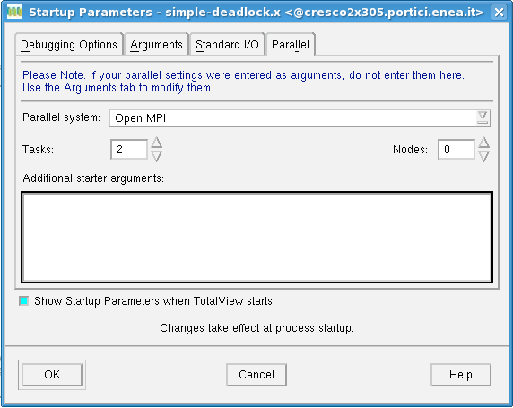
Starting TotalView on CRESCO
Open a terminal through FARO
Compile the code to debug
Load the TotalView module
Submit the job
PARALLEL
ENVIRONMENT
http://www.cresco.enea.it/nx.html
mpicc –g –O0 –o myprogram.x myprogram.c
~/> module load totalview
bsub –n #_{procs} -I –a tv –q #_{queue} totalview #_{exe}
MPI TASK NUMBER

Slide 4
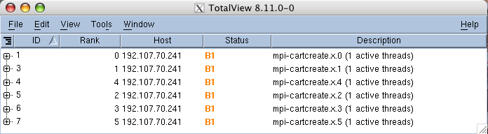
Root Window
The Root Window contains a list of all the processes and threads you are currently debugging.
ROOT
WINDOW
T = sTopped
B = Breakpoint
E = Error
W = Watchpoint
R = Running
M = Mixed
ACTION POINT
ID NUMBER
STATUS INFO :
4

Slide 5

Stepping Toolbar
Go : run the program
Halt : pause the execution
Kill : ends the process
Restart : equal to Kill plus Go
Next : executes all code on a line (i.e. a subroutine call)
Step : executes the line
Out : run up to return of a subroutine
Run to : runs to a selected line
5

Slide 6
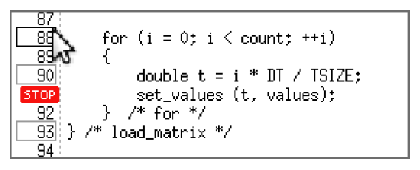
Action Points
To set an action point, click on the line number in the source panel and then choose what kind of action you need.
SOURCE
PANEL
The basic action points are:
Breakpoint : stops execution of the processes of threads that reach it,
Evaluation point : executes a code fragment when it is reached,
Process Barrier Point : hold each process when it reaches the barrier point until all process in the group have reached the barrir point
6

Slide 7
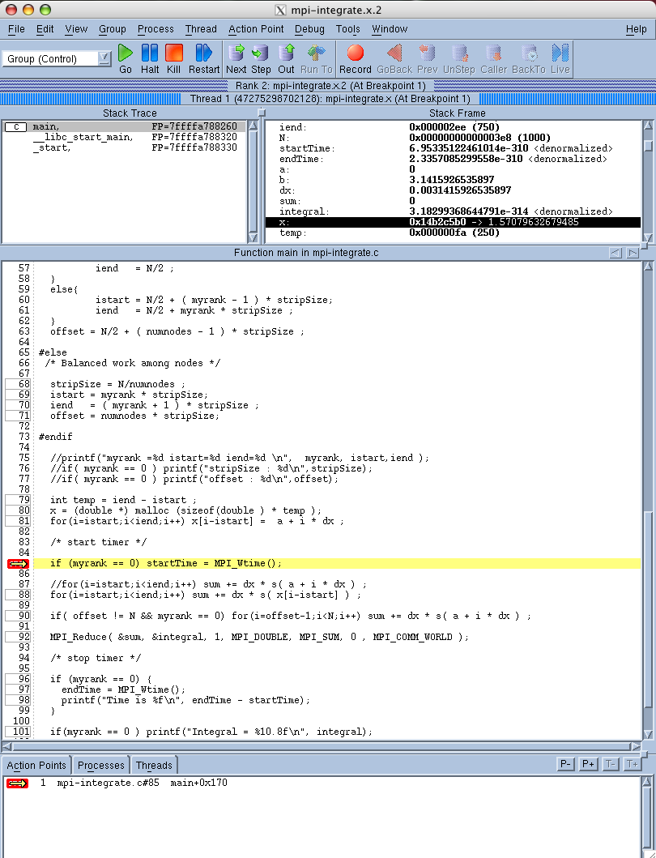
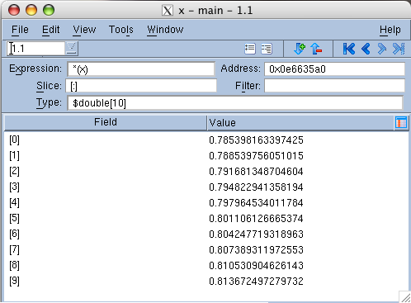
Visualizing Arrays
STACK FRAME PANEL
After having set a breakpoint, it is possible to have a look inside a variable, by simply selecting the variable in the Stack Frame Panel and then diving by a double-click.
This can be useful if one wants to explore a variable among different threads.
THREAD INDEX
7

Slide 8
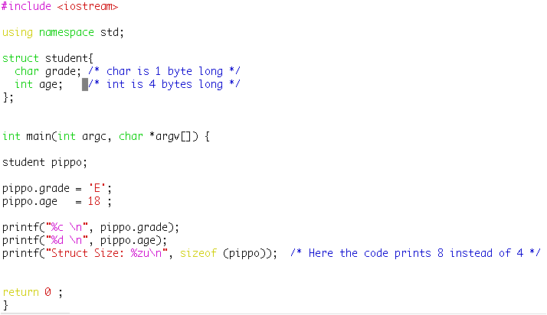
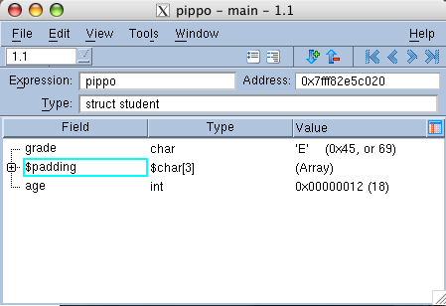
Visualizing C++ Structures
To calculate the size of any object type, the compiler must take into account any address
alignment that may be need to meet efficiency or achitectural constraints.
The compiler accomplishes this task by inserting unused padding bytes between members as needed to satisfy the alignment requirements. There may also be padding at the end of a structure to ensure proper alignment in case the structure is ever used as an element of an array.
Selecting View > Padding gives:
CODE
8

Slide 9
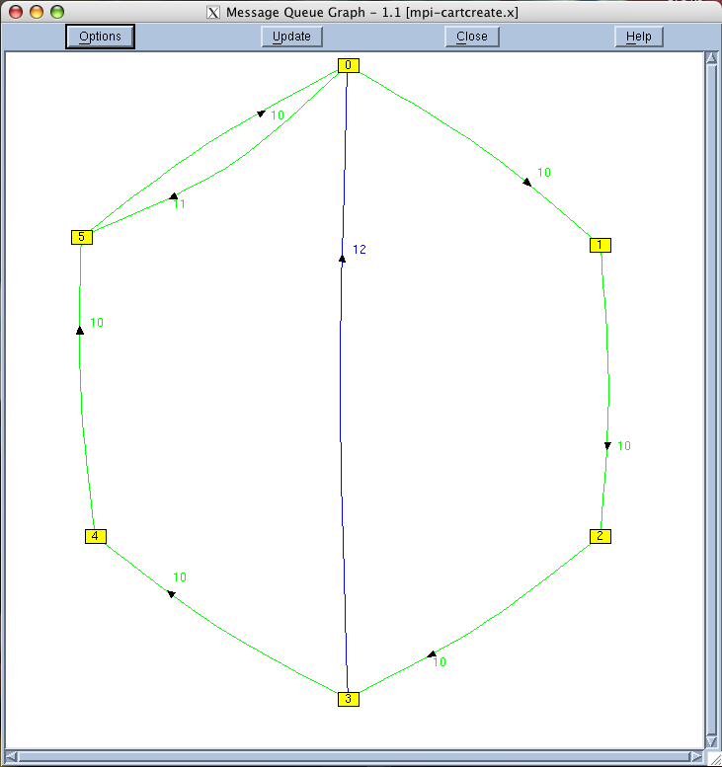
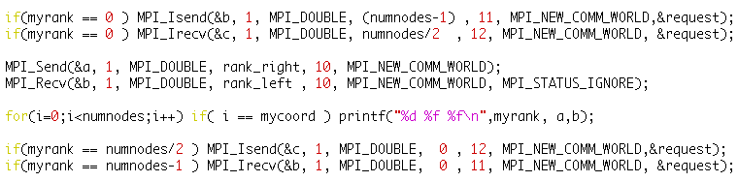
Message Queue Graph (1)
Tools > Message Queue Graph displays a window that shows a graphic representation
of the state of message queue information. This graph shows you the state of your
program at a particular instant.
WARNING:
WORKS only ON CRESCO 1 or 2
MPI MESSAGE
TAG
GREEN Pending Sends
BLUE Pending Receives
RED Unespected Msgs
STATUS INFO :
PROC ID
9
PSEUDO
CODE

Slide 10
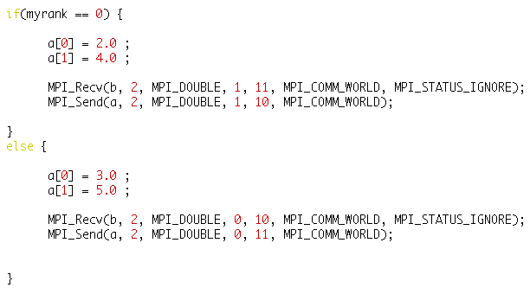
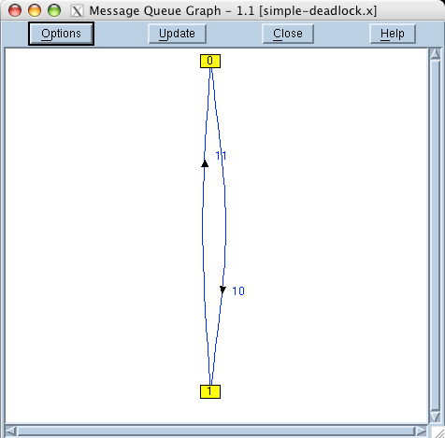
Message Queue Graph (2)
Pending messages often indicate that a process can't keep up with the amount of work it is expected to perform.These messages indicate places where you may be able to improve your program's efficiency.
Unexpected messages can indicate that something is wrong with your program because the receiving process doesn't know how to process the message.
Loops in the graph may indicate deadlocks.( Cycles can be highlited by Options > Cycle Detection)
PSEUDO
CODE
DEADLOCK
EXAMPLE
10

Slide 11
Memory Debugging (1)
Select the Debug > Enable Memory Debugging command before starting the program.
When the program makes a memory request, MemoryScape records the stack frames
that existed when the action occurred.
MemoryScape stops the program execution when one of the following events occurs:
Freeing memory that is already freed,
Freeing the wrong address
Freeeing an interior pointer,
Misaligning blocks
WARNING:
NOT WORKING correclty with OpenMPI compiled with intel
11

Slide 12
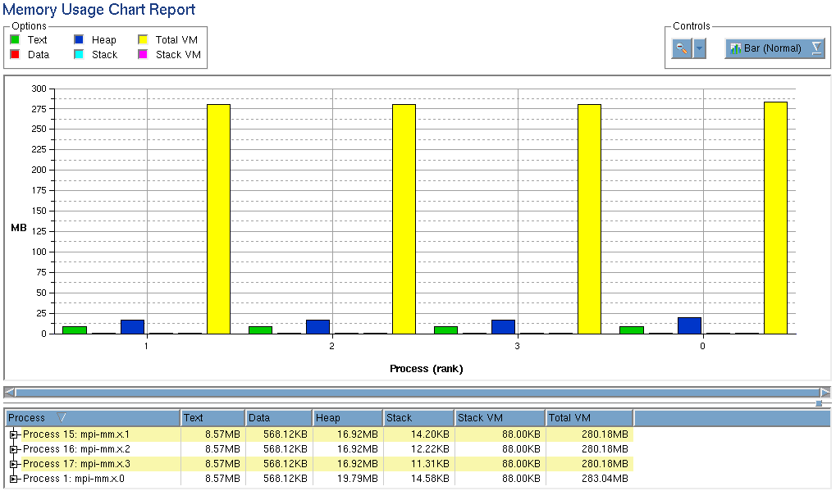
Memory Debugging (2)
Memory Usage Chart Report displays the memory occupied by each process:
TEXT: The amount of memory used for storing
the program's machine code instructions.
DATA: The amount of memory used for storing
uninitialized and initialized data.
HEAP: The amount of memory currently being
used for data created at runtime
(i.e. allocated pointers).
STACK: The amount of memory used by the
currently executing routine and all the
routines in its backtrace.
12

Slide 13
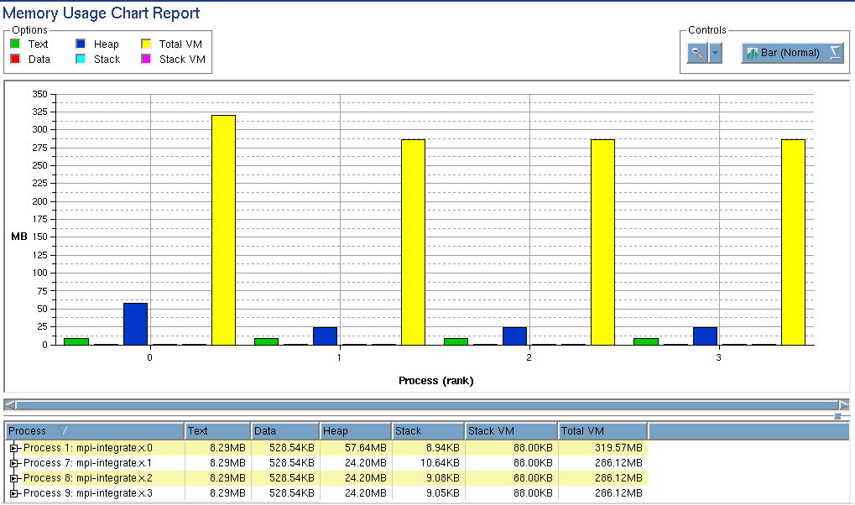
Memory Debugging (3)
Looking at how the program is using memory may help in understanding where parallelization can be improved.
UNBALANCED MEMORY OCCUPANCY
AMONG PROCESSES
13

Slide 14
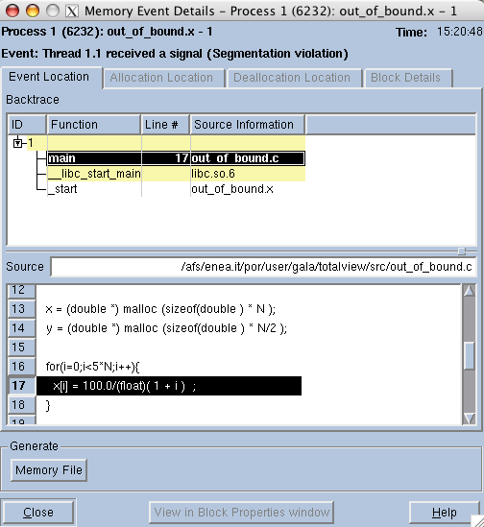
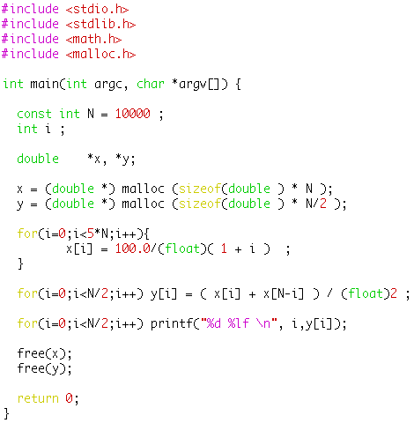
Segmentation Faults
When a Segmentation Fault occurs, MemoryScape keeps track of the event, you can have a look at it in Debug > Memory Event Details )
14
CODE

Slide 15
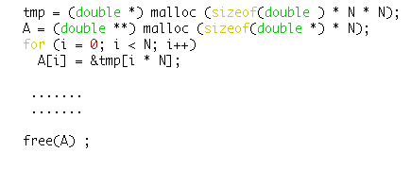
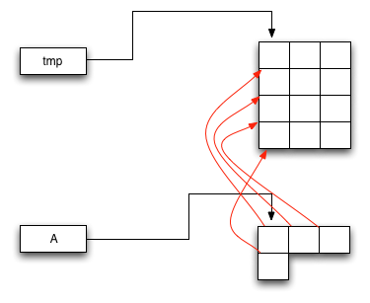
In Leak Detection Reports > Source Report
Memory Leaks (1)
A memory leak occurs when the program incorrectly menages memory allocations.
As a consequence, a memory leak can diminish the performance by reducing the amount of available memory. Eventually, in the worst case, too much of the available memory may become allocated and all or part of the system e stops working correctly, the application fails, or the system slows down unacceptably.
POINTERS
ALLOCATION
MEMORY
PSEUDO
CODE
The instruction here frees only A, not tmp
MEMORY LEAK
15

Slide 16
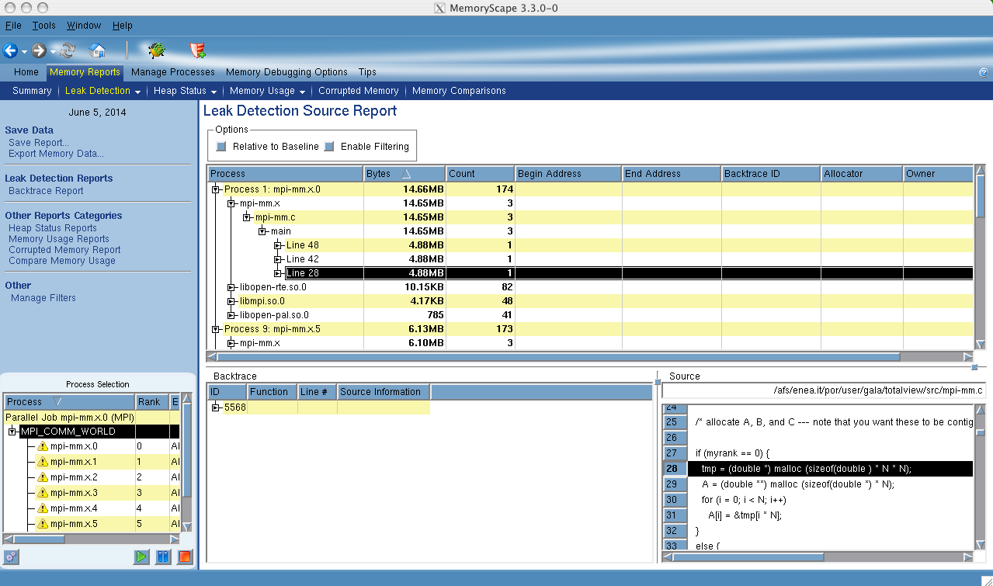
Memory Leaks (2)
In Leak Detection Reports > Source Report in fact tells us :
sizeof (double)
16

Slide 17
Online Information
TotalView documentation can be found here:
http://www.roguewave.com/support/product-documentation/totalview.aspx
THANKS TO Prof. G. ZOLLO and Dr. A. SCHIAVI
&
THANK YOU TO EVERYBODY FOR THE ATTENTION
17

