Slide 1
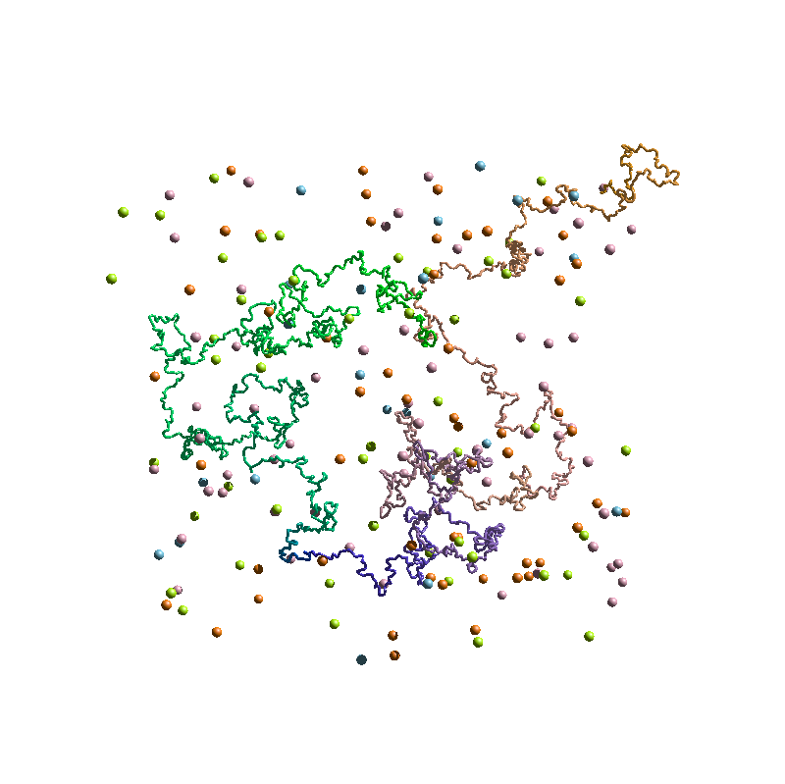





Chromatin architecture code inferred by machine learning and polymer physics
Andrea Esposito
Head Prof. Mario Nicodemi
ENEA in Portici (NA), 25/02/2019

Slide 2
OUTLINE
Biological background and 3C technologies: a new way to look into the cell nucleus
Hi-C technique; TADs and meta-TADs.
Polymer physics and machine learning as instruments to investigate the genome architecture
The String&Binders Switch (SBS) Model and the PRISMR method.
Describing the folding of real genomic regions
The Sox9 locus; genome-wide description of the mouse genome.
Predicting the effects of genomic rearrangements on the 3D chromatin structure
The human Epha4 structural variants; the Pitx1 case study.
Conclusions and outlooks

Slide 3
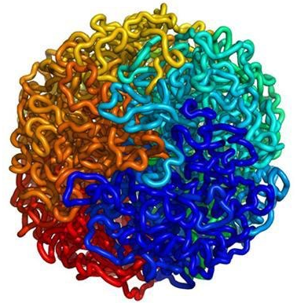
INSIDE THE CELL NUCLEUS
DNA is organized in chromosomes, stored in the cell nucleus
The physical proximity enables the transcriptional regulation of genes from gene-distal enhancers.
Enhancer
DNA
Enhancer
Gene
DNA
Gene
Inactive
Active

Slide 4
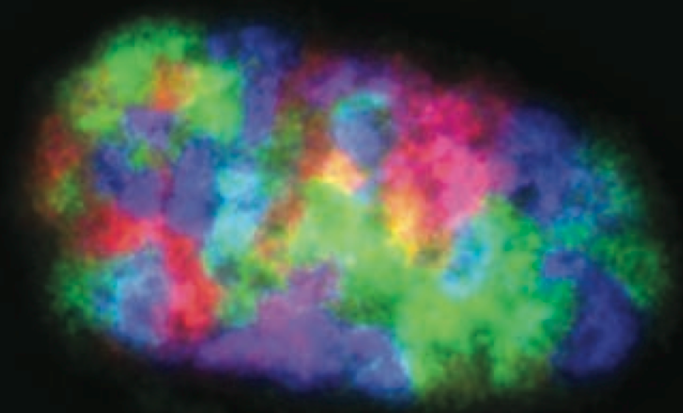

CHROMOSOME CONFORMATION CAPTURE (3C)
Hi-C
The spatial arrangement of the chromatin within the nucleus is not random.
chr. X (150Mb)
Nucleus
Chromosomes form territories
Contact Matrix
i
boundary
Chromosomes contacts have a functional role
2 Mb
TADs
TAD1
chr. X
s
chr. X
TAD boundary
j
Hi-C contact
frequency =
TAD2
Liebermann-Aiden et al. (Science, 2009)
Dixon et al. (Nature , 2012)

Slide 5
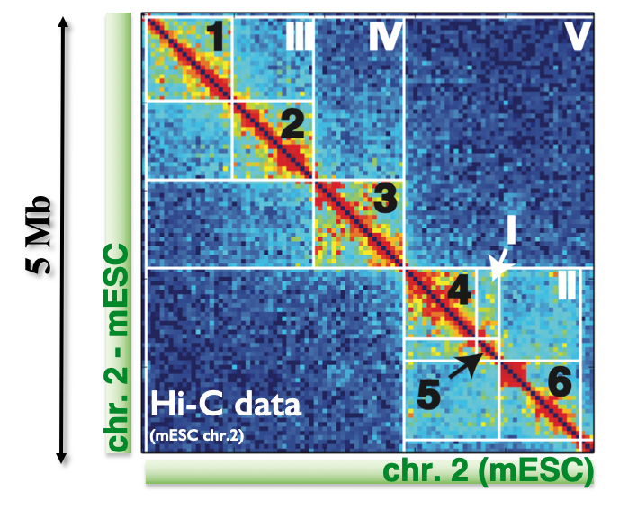
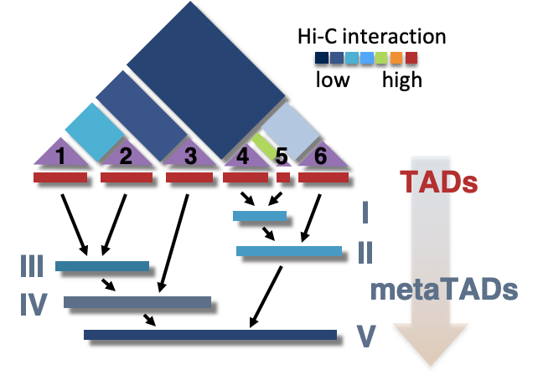
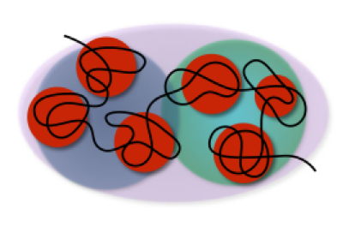
THE GENOME HAS A COMPLEX HIERARCHICAL STRUCTURE
TADs interact with each other giving rise to higher order structure, named meta-TADs.
The meta-TADs organization changes during cell differentiation and helps to regulate the transcriptional states of the cell.
Fraser et al. (Molecular system biology, 2015)

Slide 6
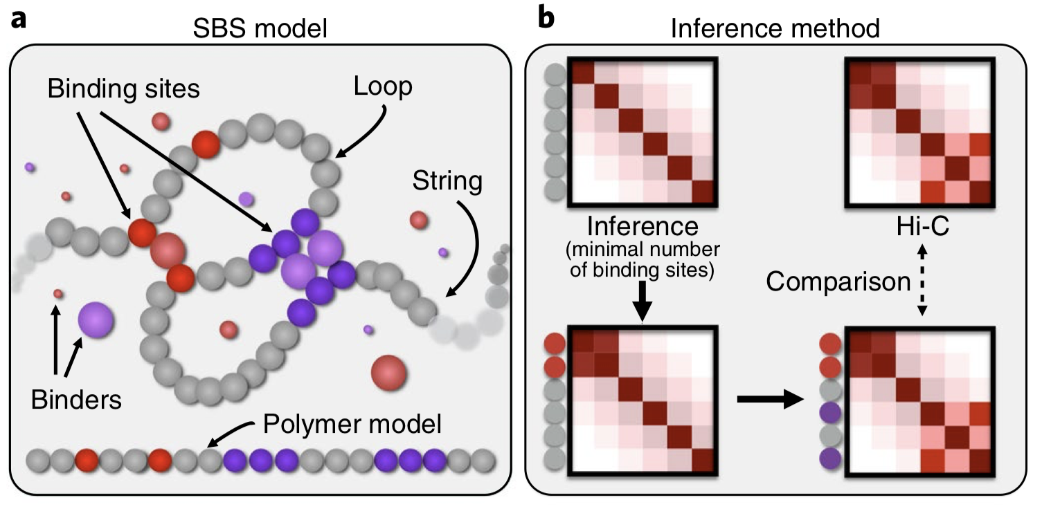
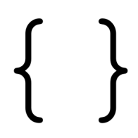
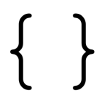
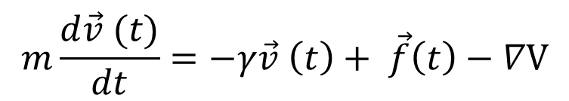
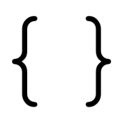
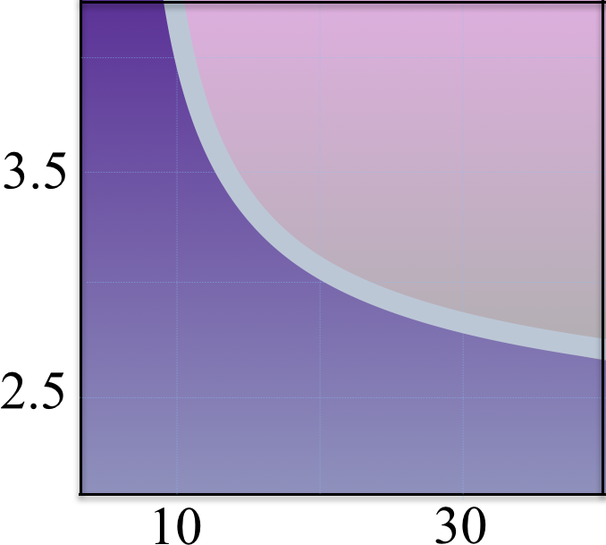
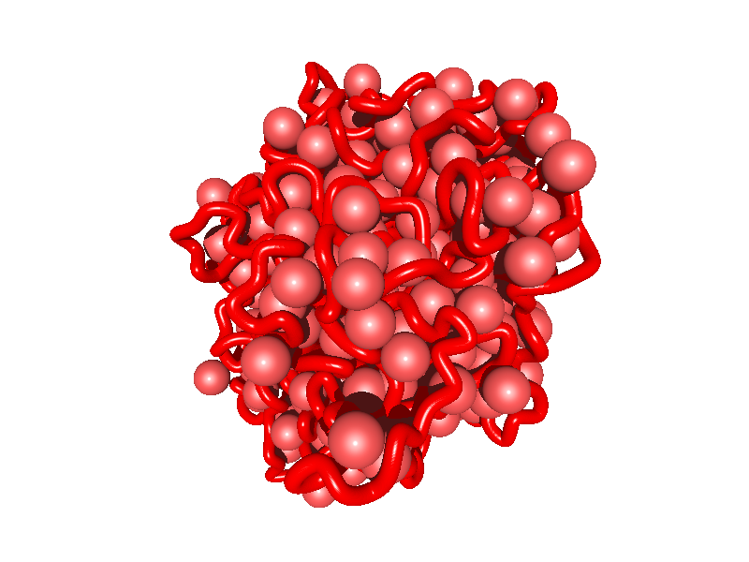
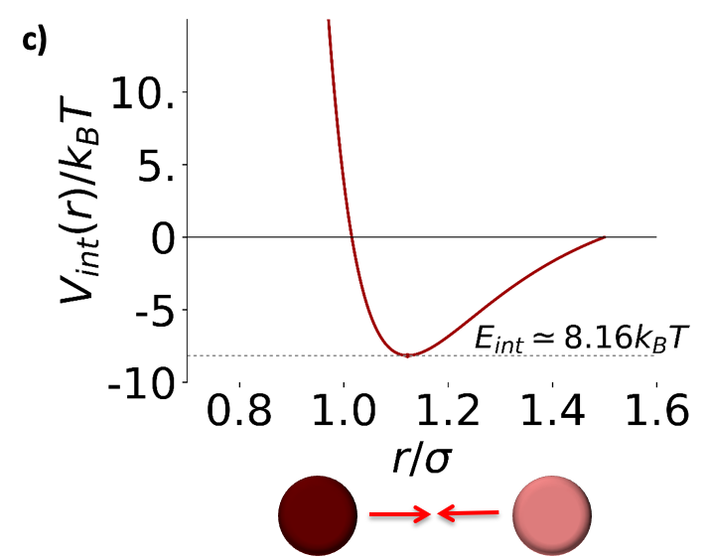
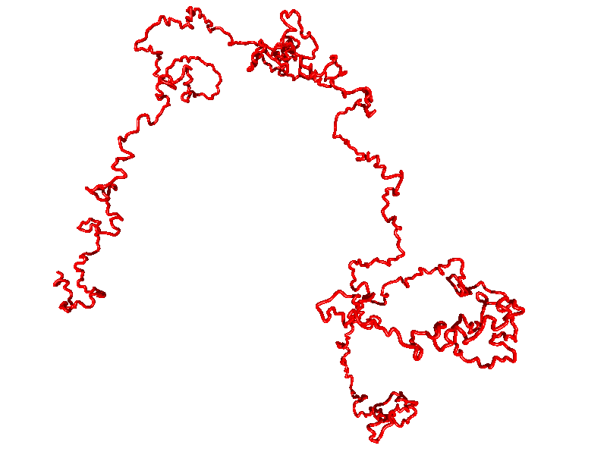
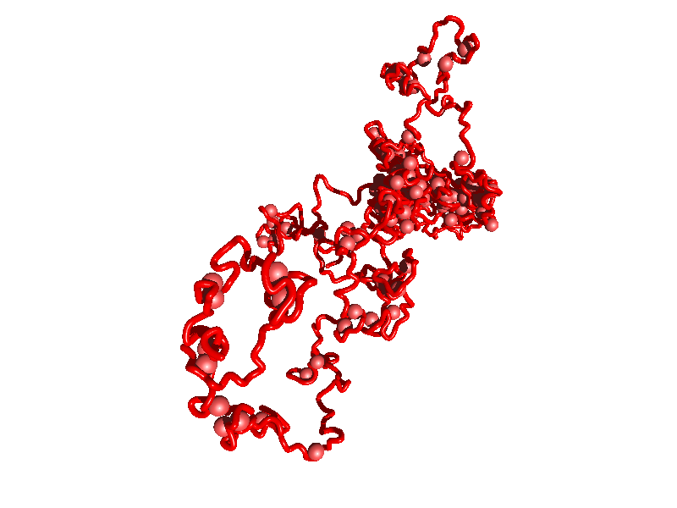
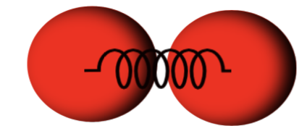

THE STRING&BINDERS SWITCH MODEL OF CHROMATIN
A chromatin filament is represented as a
self-avoiding string of beads.
A fraction of beads (binding sites) can interact with diffusing molecules (binders) of the same type.
Different types of binding sites and molecular binders (different colors) are present.
Viscous
force
Pair potential
term
To study the dynamic of such a system we use a standard Molecular Dynamic approach:
Stochastic force
Steric interaction among all particles
GLOBULE
Θ point
Non elastic bond between consecutive beads
Binder affinity
[Eint / kBT]
COIL
Attractive potential between beads and cognate binders
Binder concentration
[nmol/l]
Barbieri et al. (PNAS, 2012
Chiariello et al. (SciRep, 2016)

Slide 7
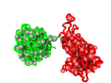
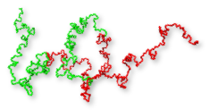
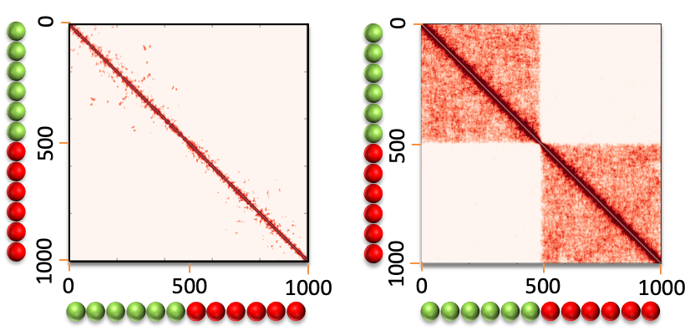
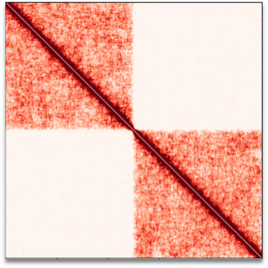
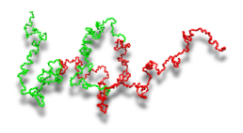
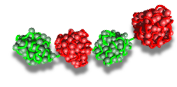
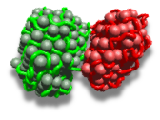

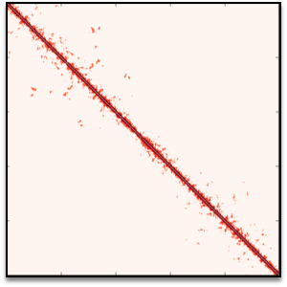
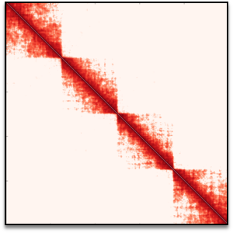
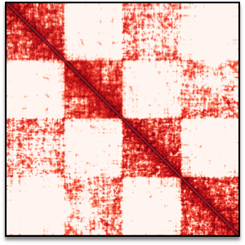

TADs AND META-TADs FORMATION
Initial state
Equilibrium state
Chiariello et al., (SciRep, 2016)
Annunziatella et al. (PRE, 2016)

Slide 8
THE PRISMR METHOD
PRISMR (Polymer-based Recursive Statistical inference Method) infers the minimal polymer model that best explains a given contact matrix
INPUT
INFERENCE METHOD (PRISMR)
OUTPUT
Hi-C
I Iteration
II Iteration
Final state
…
binding
sites
No prior knowledge
of binding sites
comparison
POLYMER
MD SIMULATIONS
3D STRUCTURES
binding
sites
Bianco et al. (Nature Genetics, 2018)

Slide 9

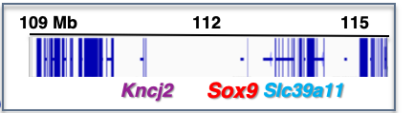
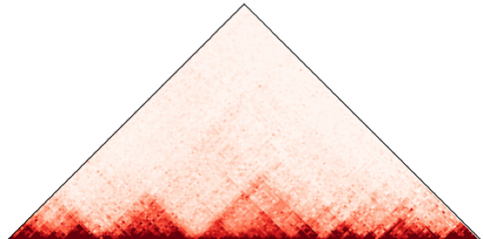
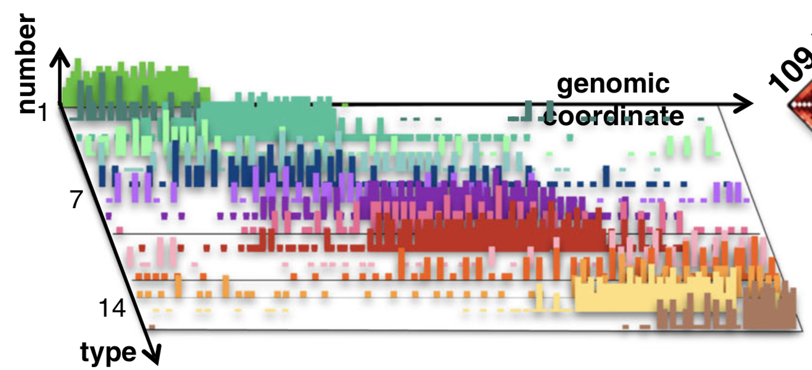
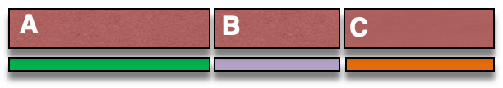
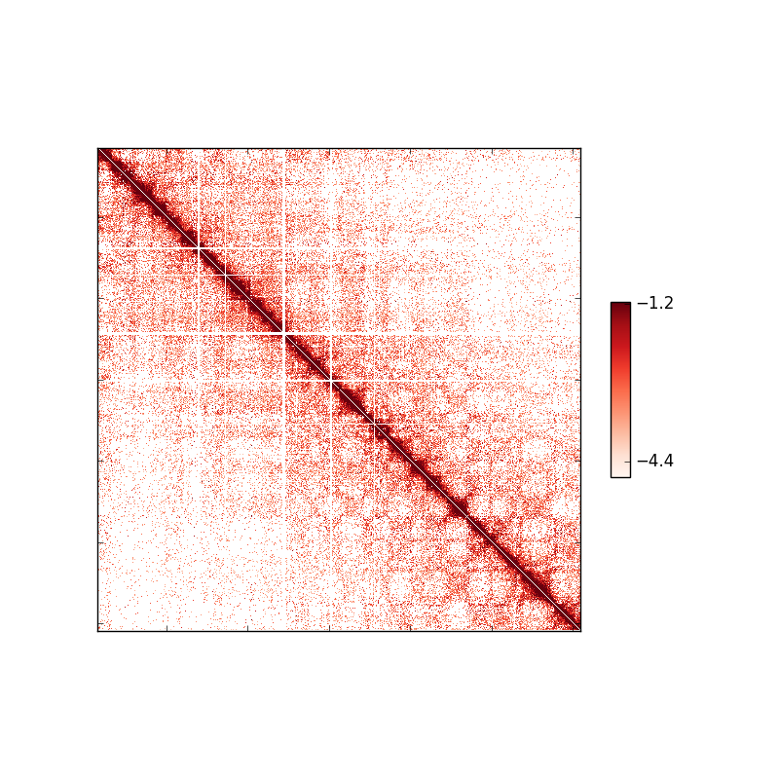
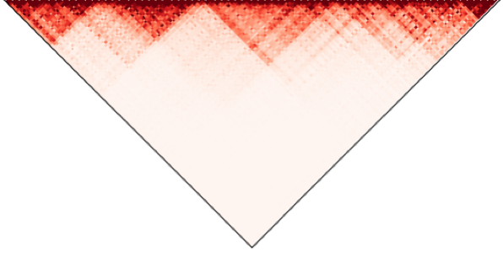

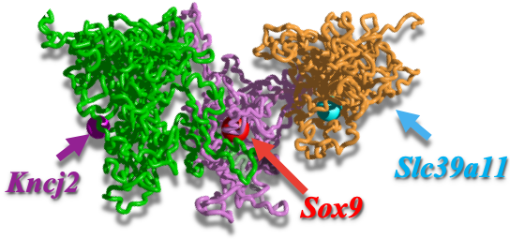
THE SOX9 LOCUS 3D STRUCTURE
Hi-C Dixon
(40 kb res.)
corr. = 95%
95%
0%
SBS Model
Chiariello et al. (SciRep, 2016)

Slide 10
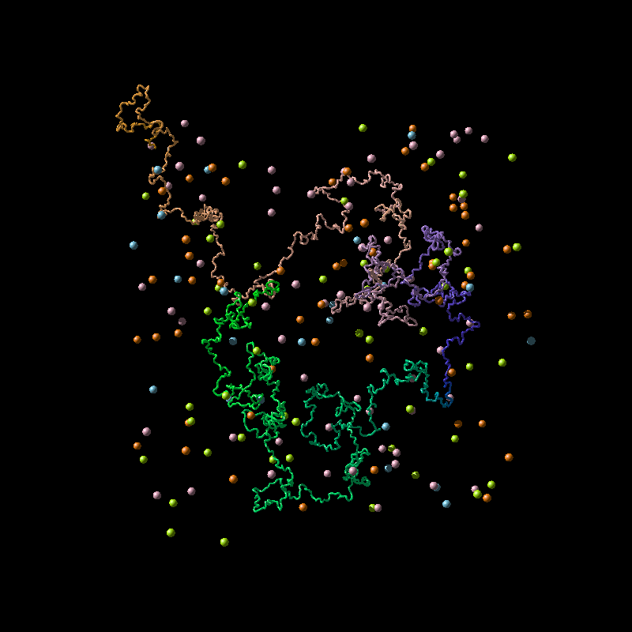
THE SOX9 LOCUS 3D STRUCTURE
Hi-C Dixon
(40 kb res.)
corr. = 95%
95%
0%
Sox9 folding dynamics
SBS Model
Chiariello et al. (SciRep, 2016)

Slide 11
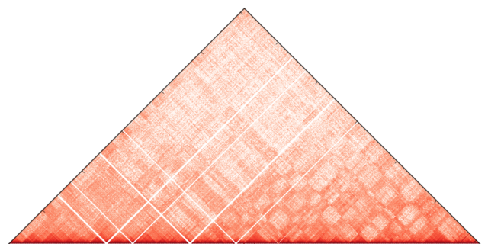
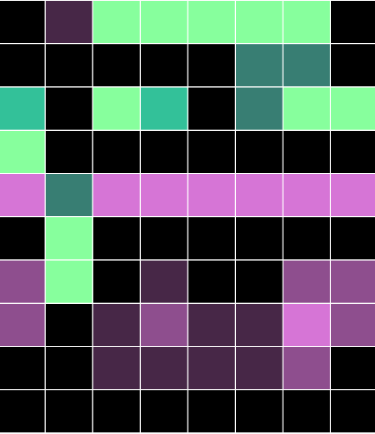
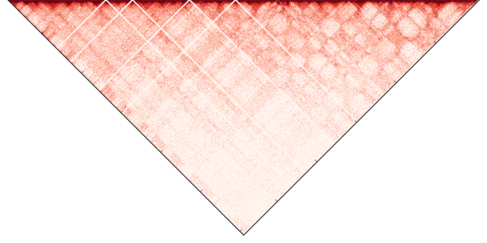


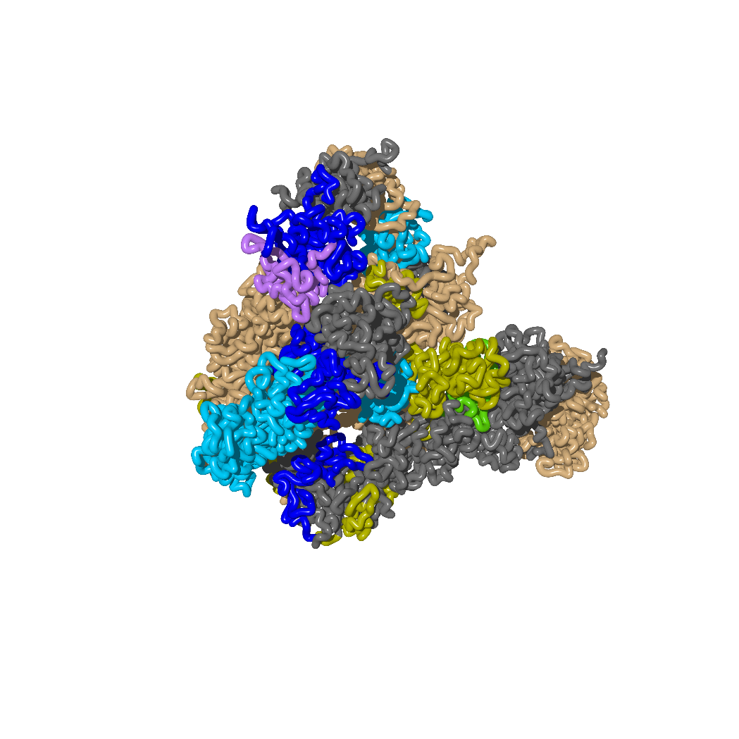
DESCRIBING THE FOLDING AT A GENOMIC LENGTH SCALE
Model
corr. = 95%
1)
2)
3)
4)
5)
6)
7)
8)
9)
10)
Active 1
3 Mb
Chr11
122 Mb
95%
Active 2
Bivalent
K27 repres.
0%
K9 repres. 1
10 main classes of
binding domains
K9 repres. 2
K9 repres. 3
Repressed 1
Experiment
Hi-C 40Kb res.
(from Dixon 2012)
Repressed 2
Low signal
H3K27me3
H3K9me3
H3K4me3
H3K9ac
H3K27ac
H3K36me3
H3K4me1
-0.2
0
0.2
H2AUb
significant correlation
1μm
Esposito et al., Nat. Comm. (Under Review)

Slide 12
SBS PREDICTIONS ON STRUCTURAL VARIANTS
Deletion
Inferred WT polymer
Duplication
Inversion
Deletion
Inferred WT contact map
Duplication
Inversion

Slide 13
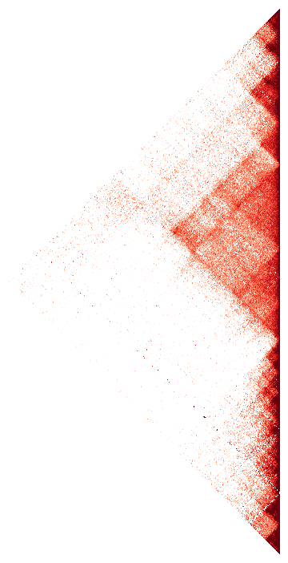
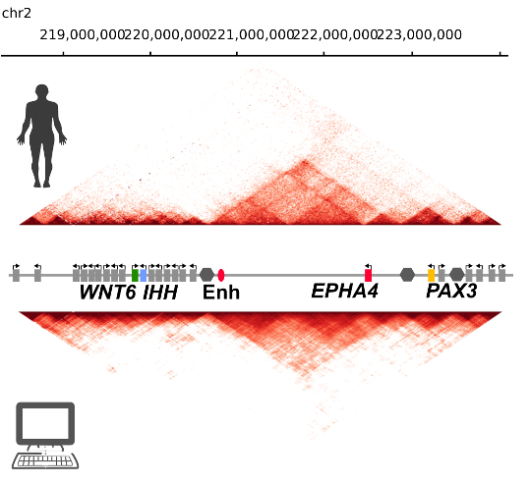
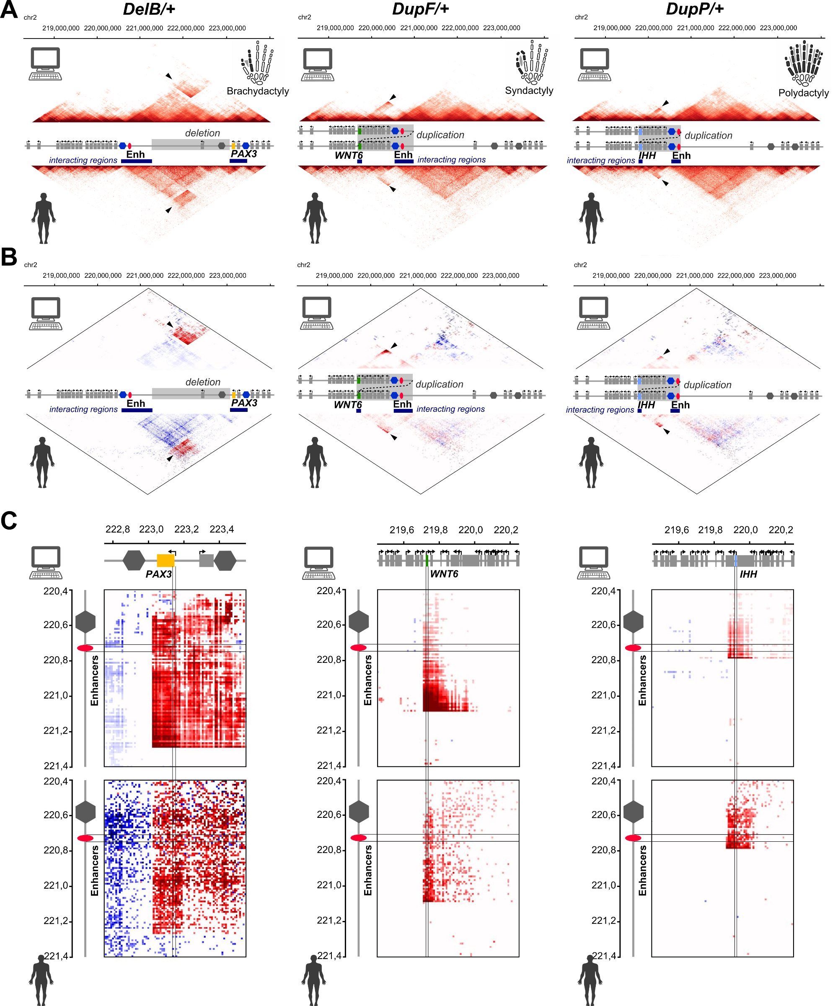
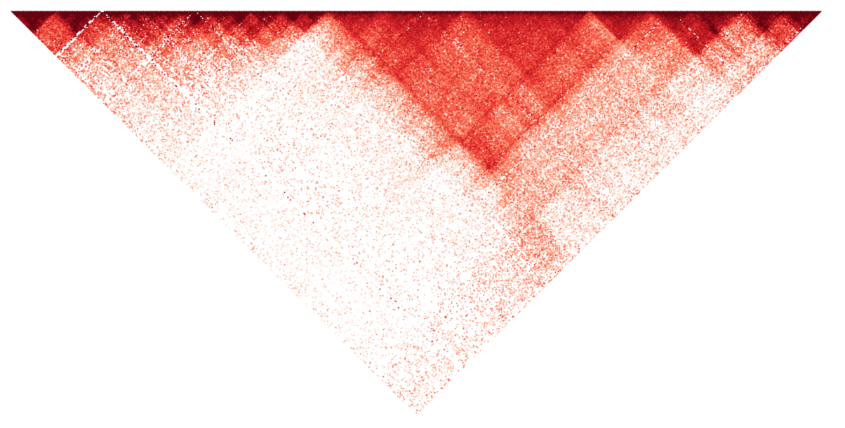

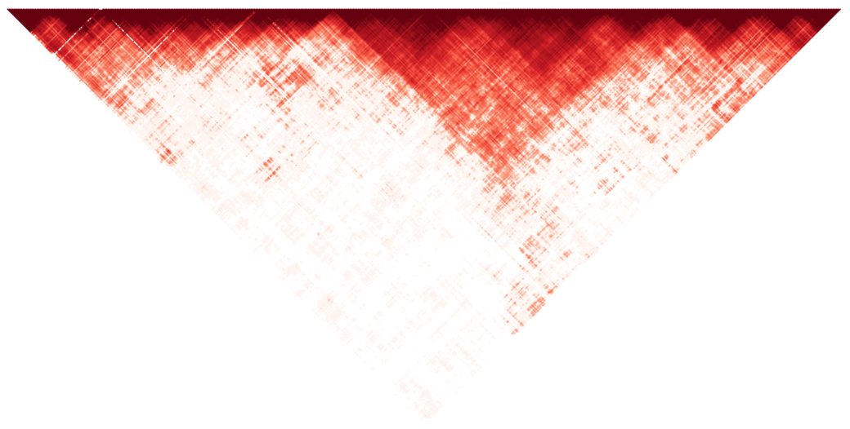

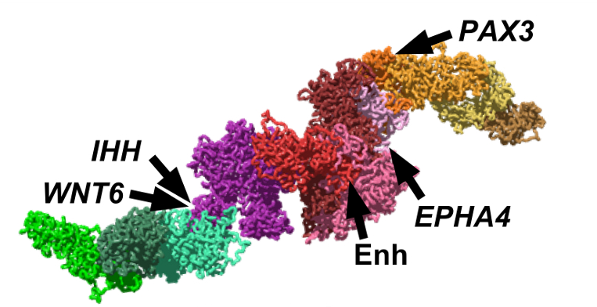











EPHA4 STRUCTURAL VARIANTS IN HUMANS
Healthy control
“DelB” deletion
“DupF2” duplication
cHi-C
Model
Model
Model
1
30
cHi-C
cHi-C
corr. = 93%
corr. = 93%
corr. = 90%
PAX3
WNT6
Healty control
Healty control
DelB
DupF
Healty control
Healty control
DelB
DupF
cHi-C data from
Stefan Mundlos group
(Max Planck Institute, Berlin)
Bianco et al. (Nature Genetics, 2018)

Slide 14
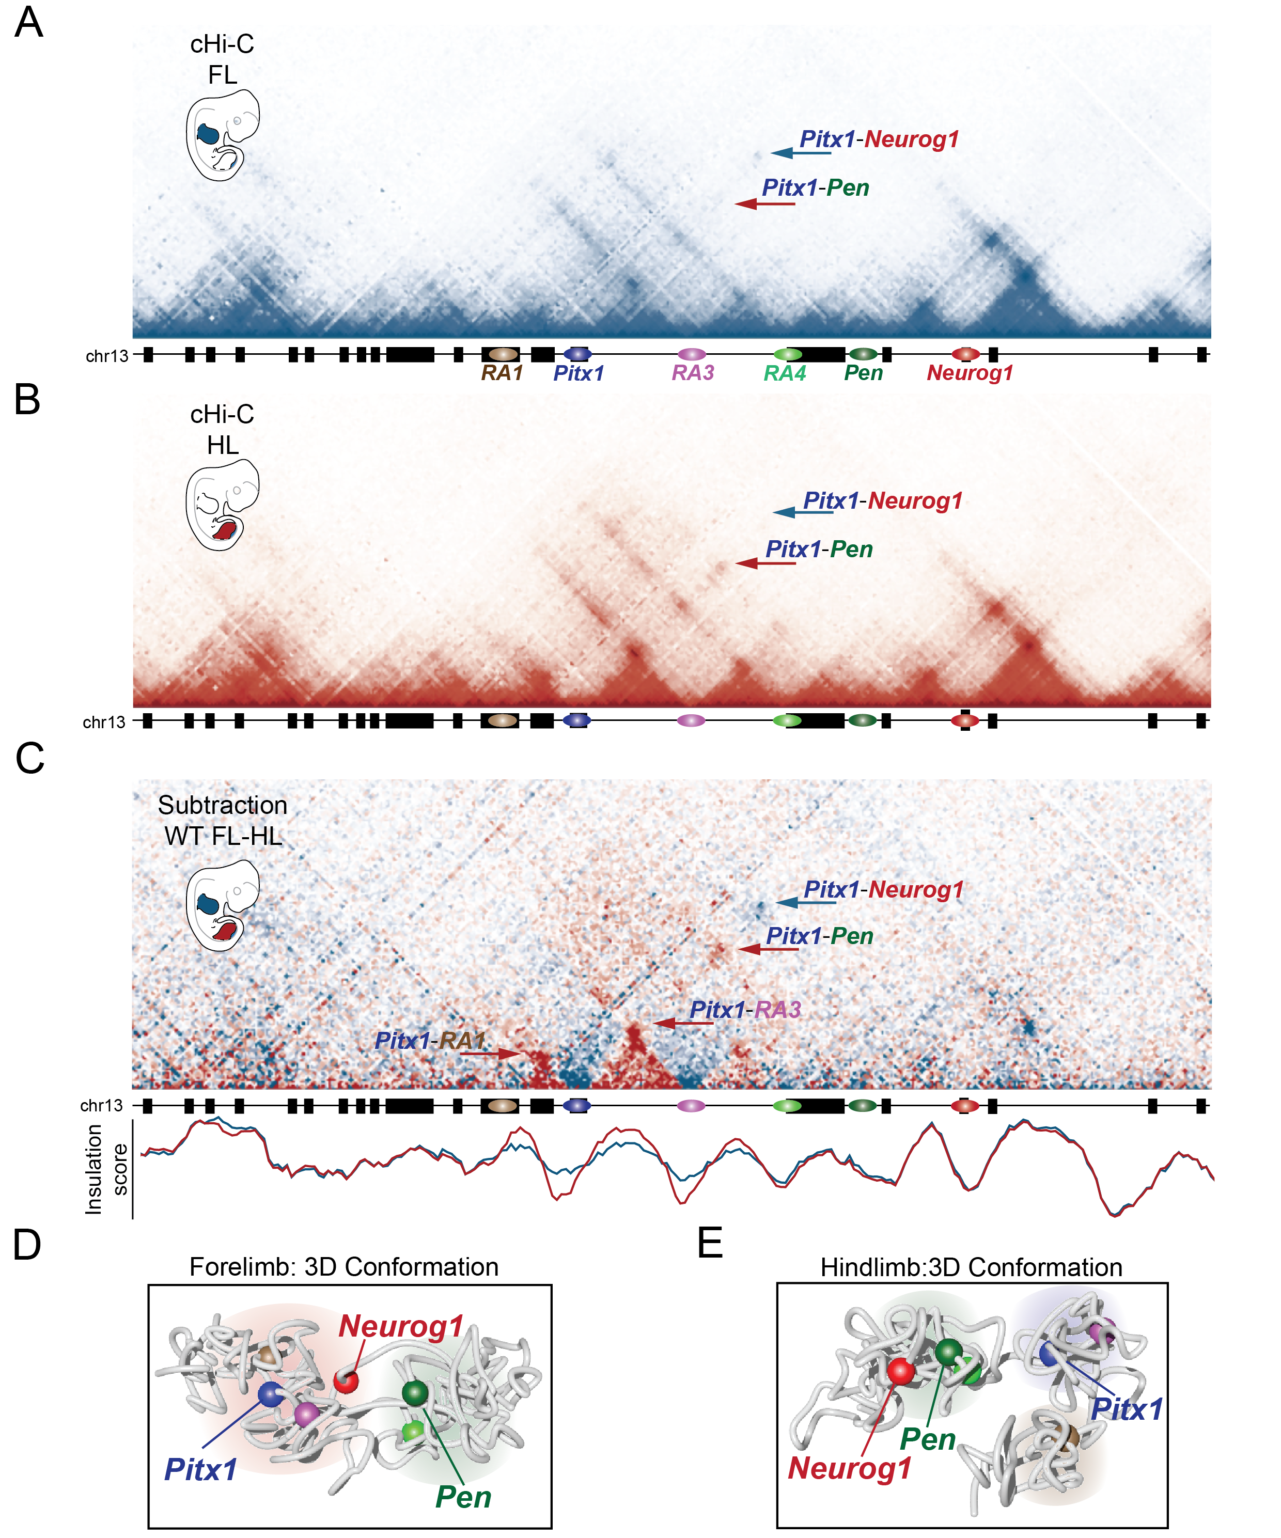
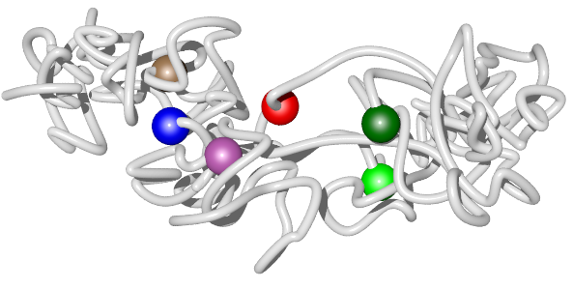
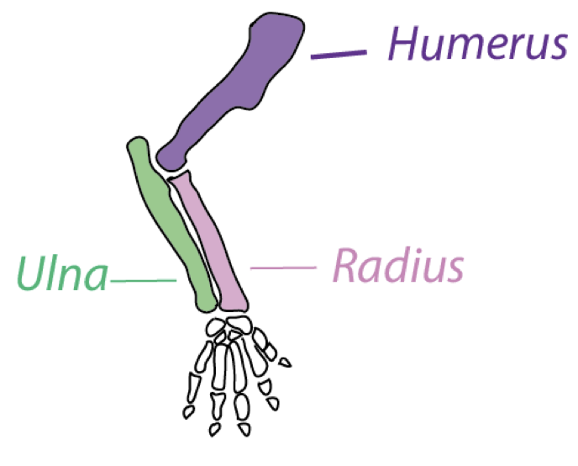
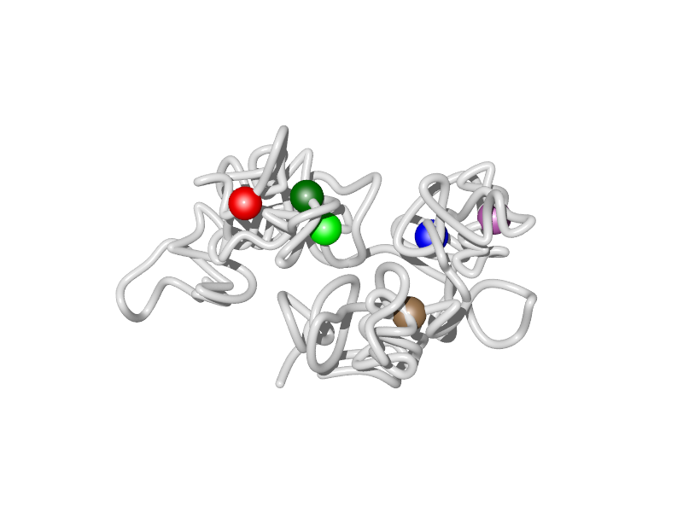
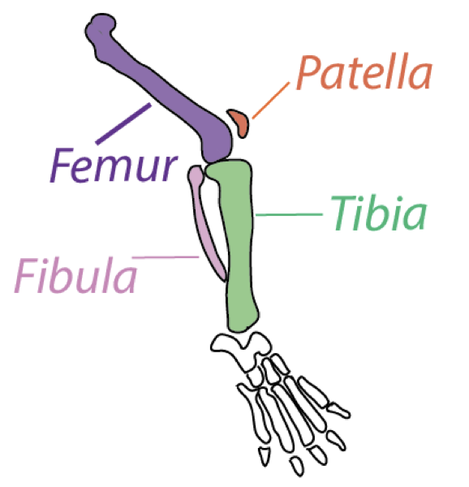
CHROMATIN STRUCTURE MUTES ENHANCER ACTIVITY (I)
cHi-C forelimb (FL)
wild-type (WT)
Pitx1 is inactive
FL WT 3D structure
Neurog1
WT Arm
cHi-C hindlimb (HL)
wild-type (WT)
200 kb
Pitx1 is active
Pitx1
Pen
inactive conformation
HL WT 3D structure
Pen
Pitx1
WT Leg
Neurog1
active conformation
Kragesteen et al., Nature Genetics (2018)

Slide 15
CHROMATIN STRUCTURE MUTES ENHANCER ACTIVITY (II)
cHi-C forelimb (FL)
wild-type (WT)
Pitx1 is inactive
FL WT 3D structure
Neurog1
WT Arm
cHi-C hindlimb (HL)
wild-type (WT)
200 kb
Pitx1 is active
Pitx1
Pen
inactive conformation
HL WT 3D structure
Pen
Pitx1
WT Leg
inverted region
Neurog1
active conformation
Pitx1 is ectopically activated in forelimb
Kragesteen et al., Nature Genetics (2018)

Slide 16




CHROMATIN STRUCTURE MUTES ENHANCER ACTIVITY (III)
FL WT 3D structure
HL WT 3D structure
FL Inv. 3D structure
WT Arm
WT Leg
Arm-to-Leg
transformation
inactive conformation
active conformation
endogenous Pitx1 activation

Slide 17
CONCLUSIONS AND OUTLOOKS
The SBS model, and generally polymer physics, is a powerful tool to understand key mechanisms of the genome spatial organization.
We developed a machine learning method, PRISMR, based on the SBS model, to obtain highly accurate 3D reconstructions of real genomic loci.
Our findings demonstrate that changes in 3D chromatin structures can act as an active component of gene regulation, sufficient to change basic developmental programs such as the morphogenetic identity of fore- vs. hindlimbs.
As a next step we are going to apply our methods to novel high-resolution HiC data during cellular development from embryos to full differentiated cells.
Our results hint to new personalized diagnostic tools for disease linked to chromatin mis-folding.

Slide 18
Acknowledgements
Nicodemi’s group:
Andrea M. Chiariello
Simona Bianco
Carlo Annunziatella
Andrea Esposito
Luca Fiorillo
Mattia Conte
Alfonso Corrado
Francesco Musella
Renato Sciarretta
Ana Pombo Lab, Max-Delbrück Center, Berlin
Stefan Mundlos Lab, Max Planck Institute, Berlin

Slide 19
SUPPLEMENTARY SLIDES

Slide 20



Chromatin structure mutes enhancer activity
S
Average Relative Distance Changes
RA1
RA2/Pitx1
RA3
RA4
RA5/Pen
Neurog1
3%
Closer in hindlimb
RA1
RA2/Pitx1
RA3
0
RA4
RA5/Pen
Neurog1
-3%
Closer in forelimb
chr13
55,700,000
55,900,000
56,100,000
56,300,000
56,500,000
RA1
RA3
Ra5/Pen
RA2/Pitx1
RA4
Neurog1

Slide 21


CHROMOSOME ARCHITECTURE: TADs AND META-TADs
TADs are almost conserved across different species
An example of meta-TADs structure: A/B Compartments
Chr10
95
96
Genomic Coordinates [Mb]
Dixon TADs
Chr12
91
92
Genomic Coordinates [Mb]
Dixon TADs

Slide 22







TRIPLET CONTACTS INVOLVING HOXD GENES
Viewpoint
Hoxd13
Hoxd9
Hoxd1
viewpoint
viewpoint
viewpoint
⩾2%
mESC
0%
Cortex
73 Mb
73 Mb
73 Mb
76
76
76
Annunziatella et al., (Cell Reports - submitted, 2018)

Slide 23







FITTING THE EXPERIMENTAL DATA: PC(S)
A single chromosome is likely to be a mixture of a variety of different folded regions, each belonging to one of the predicted conformational classes.
Open State
Closed Ord.
Closed Disord.
Chiariello et al., (SciRep, 2016)

Slide 24

Hi-C technique
Cell are crosslinked with formaldehyde, resulting in covalent links between spatial adjacent chromatin segments;
Chromatin is digested by restriction enzyme (HindIII);
The resulting sticky ends filled with biotynalated nucleotides;
Crosslinked fragments are then ligated to form unique hybrid DNA molecules;
The DNA is purified and analysed.

