Slide 1


Numerical Simulation of Combustion Processes in ENEA
Eugenio Giacomazzi
Sustainable Combustion Processes Laboratory (COMSO)
Unit of Advanced Technologies for Energy and Industry (UTTEI)
ENEA - C.R. Casaccia, Rome, ITALY
ENEA Headquarter, Rome – Italy
11 July 2013
Sustainable Combustion
Processes Laboratory
Notes:
1

Slide 2
Outline of Presentation
  Who we are.
  What we do.
  Computational Fluid Dynamics in ENEA-COMSO.
  Why investing on “combustion dynamics” research.
  Performance analysis of the HeaRT code on CRESCO2-3 and Shaheen (Blue Gene/P) parallel machines.

Slide 3



“Combustion Fundamentals”-Based Structure of COMSO
THEORY
AND
OBSERVATION
(Small and large scale plants)
Sustainable Combustion
Processes Laboratory
SYNTHETIC VIEW
AND
UNDERSTANDING
S Y N E R G Y
MODELLING
AND
SIMULATION
(RANS, LES, DNS, CHEMISTRY)
EXPERIMENTAL
DIAGNOSTICS
(LDA, CARS, LIF, PIV, …)
DESIGN AND DEVELOPMENT OF NEW TECHNOLOGIES
DEVELOPMENT OF CONTROL SYSTEMS
Notes:
3

Slide 4
COMSO’s CFD Resources and Activities
CFD
People working in CFD: 7 / 3 Ph.D.
Modelling capability: yes.
Numerical Code(s):
  HeaRT (in-house) for LES.
  FLUENT/ANSYS (commercial) for RANS and first attempt LES ➔ moving to OpenFOAM.
Computing Power:
  CRESCO2 supercomputing platform: 3072 cores, 24 TFlops;
  CRESCO3 supercomputing platform: 2016 cores, 20 TFlops;
  many smaller clusters and parallel machines.
Current Issues:
  Steady and unsteady simulations of turbulent reactive and non-reactive, single- and multi-phase flows, at low and high Mach numbers.
  Combustion dynamics and control.
  Development of subgrid scale models for LES.
  Premixed and non-premixed combustion of CH₄, H₂, syngas with air at atmospheric and pressurized conditions of combustors present in literature, in our laboratories or in industries.
  Development of advanced MILD combustion burners.
  Pressurized multi-phase combustion of a slurry of coal (coal, steam, hot gases).
  Implementation and development of numerical techniques (numerical schemes, complex geometry treatment, mesh refinement).

Slide 5
Description of the Numerical Code: HeaRT
CFD
Implementation
  Fortran 95 with MPI parallelization.
  Genetic algorithm for domain decomposition.
Numerics
  structured grids with possibility to use local Mesh Refinement (in phase of validation);
  conservative, compressible, density based, staggered, (non-uniform) FD formulation
  [S. Nagarajan, S.K. Lele, J.H. Ferziger, Journal of Computational Physics, 191:392-419, 2003];
  3rd order Runge-Kutta (Shu-Osher) scheme in time;
  2nd order centered spatial scheme;
  6th order centered spatial scheme for convective terms (in progress);
  6th order compact spatial scheme for convective terms (in phase of validation);
  3rd order upwind-biased AUSM spatial scheme for convective terms;
  5th-3rd order WENO spatial scheme for convective terms for supersonic flows (S-HeaRT);
  finite volume 2nd order upwind spatial scheme for dispersed phases (HeaRT-MPh);
  explicit filtering of momentum variables (e.g., 3D Gaussian every 10000 time-steps);
  selective artificial wiggles-damping for momentum, energy and species equations;
  extended NSCBC technique at boundaries considering source terms effect;
  synthetic turbulence generator at inlet boundaries
  [Klein M., Sadiki A., Janicka J., Journal of Computational Physics, 186:652-665, 2003].
Complex Geometries
  Immersed Boundary and Immersed Volume Methods (3rd order for the time being).
  IV is IB rearranged in finite volume formulation in the staggered compressible approach.

Slide 6
Description of the Numerical Code: HeaRT
CFD
Diffusive Transports
  Heat: Fourier, species enthalpy transport due to species diffusion;
  Mass diffusion: differential diffusion according to Hirschfelder and Curtiss law;
  Radiant transfer of energy: M1 diffusive model from CTR [Ripoll and Pitsch, 2002].
Molecular Properties
  kinetic theory calculation and tabulation (200-5000 K, ΔT=100 K) of single species
  Cp_{i}, μ_{i}, κ_{i} (20% saving in calculation time with respect to NASA polynomials);
  Wilke’s law for μ_{mix}; Mathur’s law for κ_{mix}; Hirschfelder and Curtiss’ law for D_{i,mix} with binary diffusion D_{i,j} estimated by means of stored single species Sc_{i} or via kinetic theory.
Turbulence and Combustion Models
  subgrid kinetic energy transport equation;
  Smagorinsky model;
  Fractal Model (modified) for both turbulence and combustion closures;
  flamelets - progress variable - mixture fraction - flame surface density - pdf approaches;
  Germano’s dynamic procedure to estimate models’ constants locally;
  Eulerian Mesoscopic model for multi-phase flows.
Chemical Approach
  single species transport equation;
  progress variable and its variance transport equations;
  reading of chemical mechanisms also in CHEMKIN format.

Slide 7
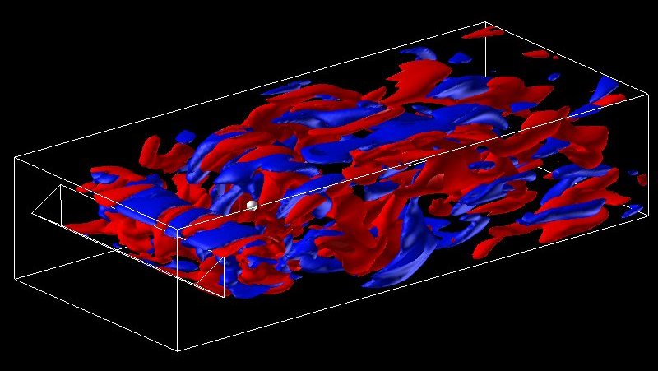
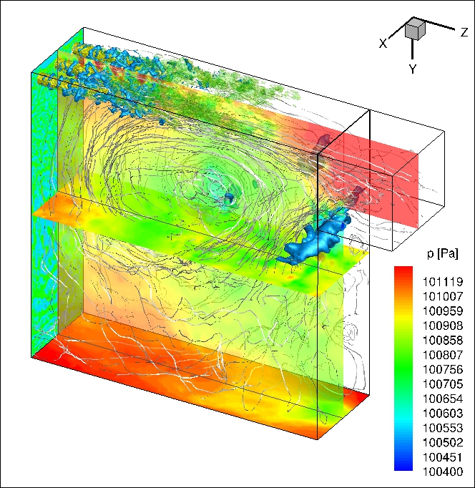
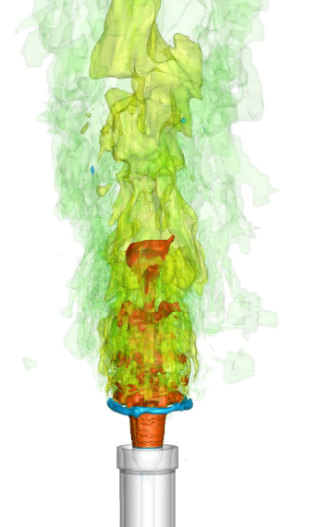
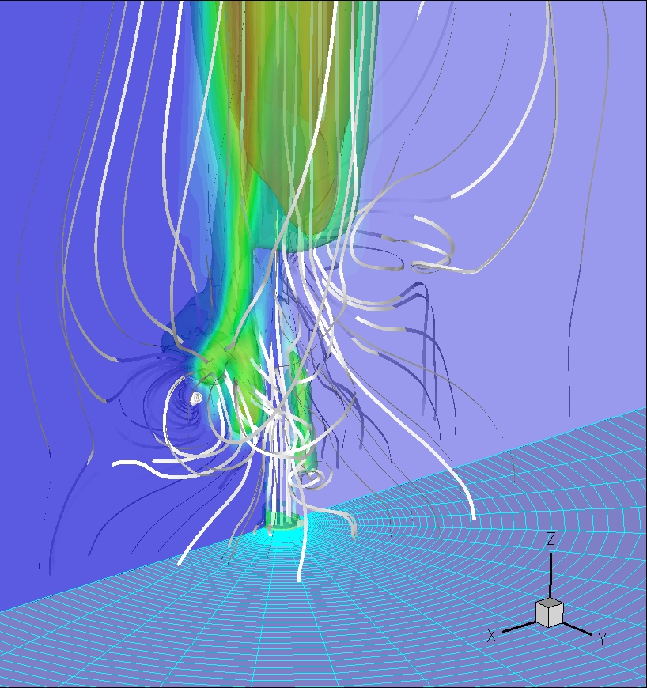
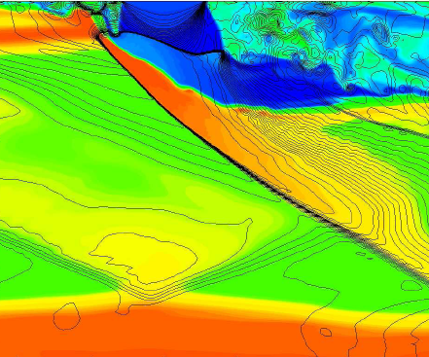
Combustion Dynamics in VOLVO FligMotor
C3H8/Air Premixed Combustor
[E. Giacomazzi et al., Comb. and Flame, 2004]
CFD
Some Examples
CH4/Air Premixed Comb.
in DG15-CON [ENEA]
[D. Cecere et al., Flow
Turbul. and Comb., 2011]
Acoustic Analysis in a TVC
[D. Cecere et al., in progress]
H2 Supersonic Combustion
in HyShot II SCRAMJET
[D. Cecere et al.,
Int. J. of Hydrogen Energy, 2011
Shock Waves, 2012]
SANDIA Syngas Jet Flame “A”
[E. Giacomazzi et al.,
Comb. Theory & Modelling, 2007
Comb. Theory & Modelling, 2008]
Notes:
7

Slide 8
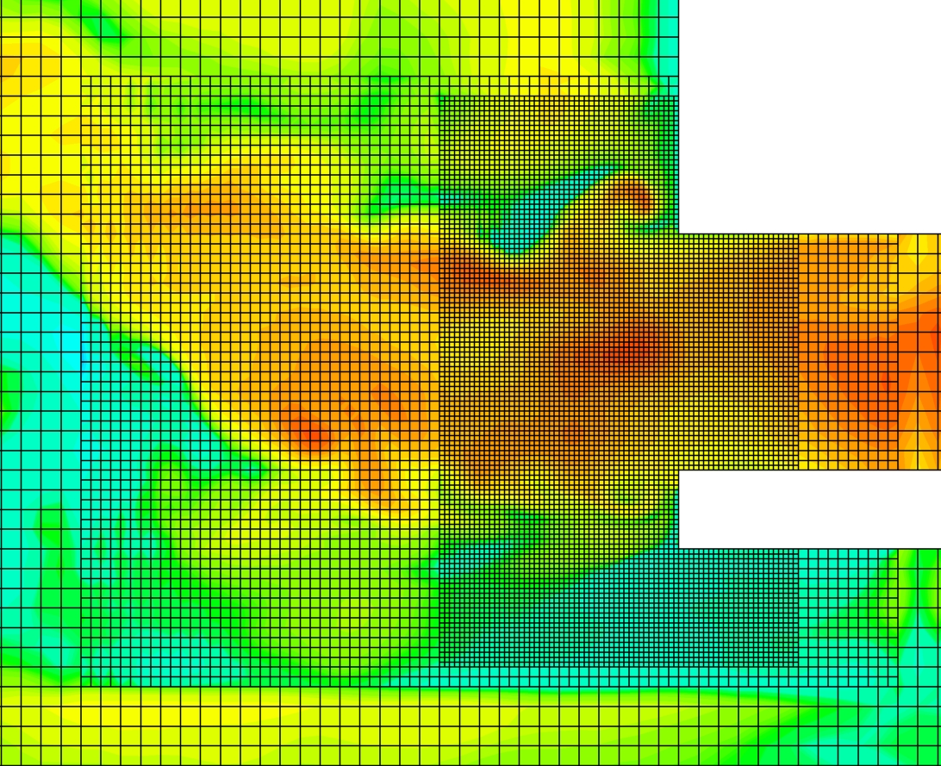
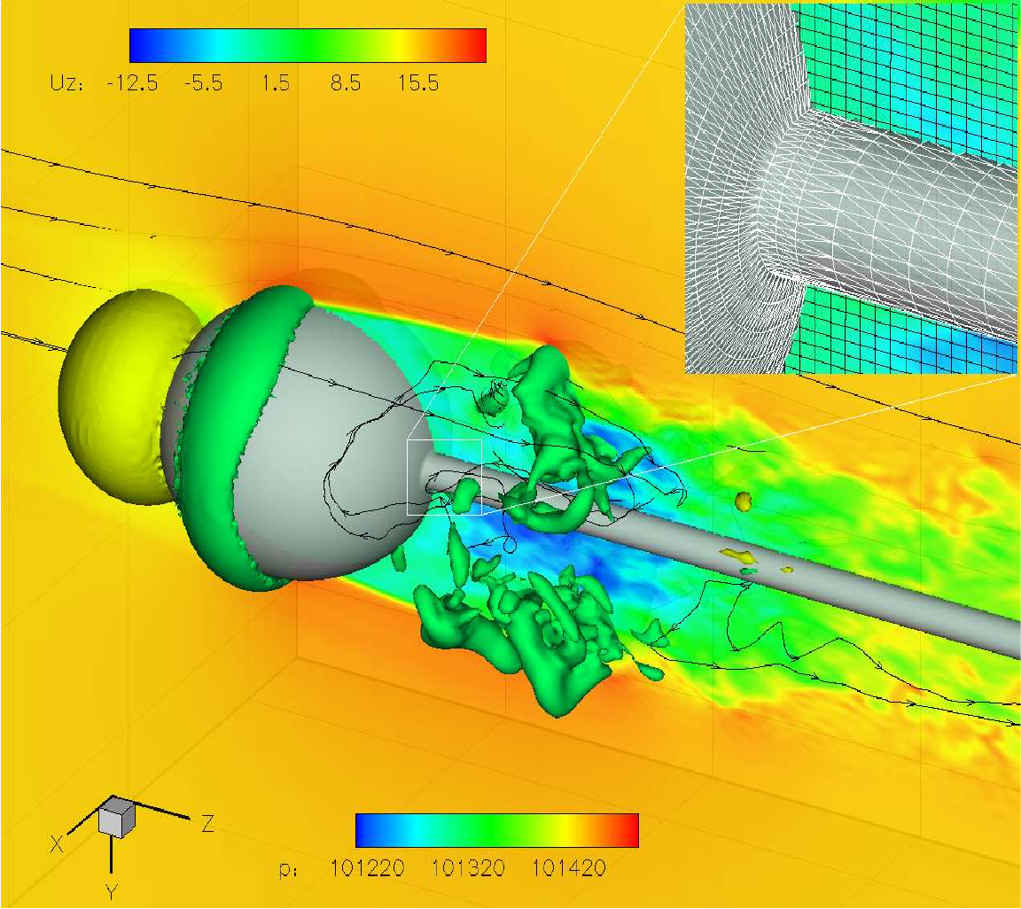
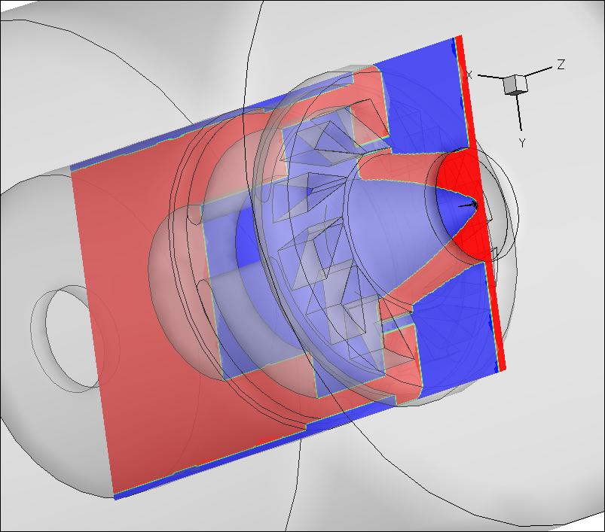
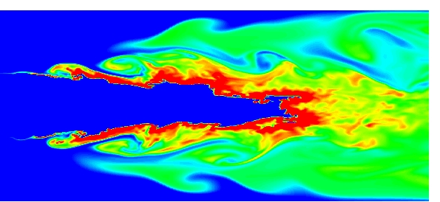
Mesh Refinement
in LES Compressible Solvers
[G. Rossi et al., in progress]
CFD
Immersed Volume Method
for Complex Geometry Treatment
Using Structured Cartesian Meshes
and a Staggered Approach
[D. Cecere et al., submitted to Computer Methods
in Applied Mechanics and Engineering, 2013]
Thermo-Acoustic Instabilities in the
PRECCINSTA Combustor
[D. Cecere et al., in progress]
Some Examples
PSI Pressurized Syngas/Air Premixed
Combustor
[E. Giacomazzi et al., in progress]
Notes:
8

Slide 9
  Importance of Combustion Dynamics
  Decarbonization
  Security of energy supply
    Clean and efficient power generation
    Safe operation
    Availability and reliability
  EU Energy RoadMap 2050
  Alternative fuels
  CCS
  Power2Gas
  H₂-blends
  Renewables
  Lack of a gas quality harmonization code
  Electricity grid fluctuations
  Fuel-flexibility
  Load-flexibility
  ENHANCED COMBUSTION DYNAMICS

Slide 10
Combustion Dynamics Activities in ENEA
  Coordination of a Project Group within ETN: “Dynamics, Monitoring and Control of Combustion Instabilities in Gas Turbines”.
  Collaboration Agreement with ANSALDO ENERGIA: combustion monitoring and thermo-acoustic instabilities detection in the COMET-HP plant equipped with the ANSALDO V64.3A.
    Optical and acoustic sensors
    LES simulations
  Collaboration Agreement with DLR (Stuttgart, DE): validation of the HeaRT LES code by simulating thermo-acoustic instabilities in the PRECCINSTA combustor.
    Marie Curie ITN Project “Dynamics of Turbulent Flames in Gas Turbine Combustors Fired with Hydrogen-Enriched Natural Gas” (on both numerics and diagnostics expertise)
      Partners: DLR, Imperial College, ENEA, LAVISION, SIEMENS, INCDT COMOTI, TU Delft, NTNU, INSA Rouen
      Associated Partners: Purdue Univ., Duisburg-Essen Univ., E.ON
  Collaboration Agreement with KAUST (Saudi Arabia): LES of thermo-acoustic instabilities in gas turbine combustors. Porting of the HeaRT code onto Shaheen (Blue Gene - 64000 cores) already done. Executive Project due in September.

Slide 11
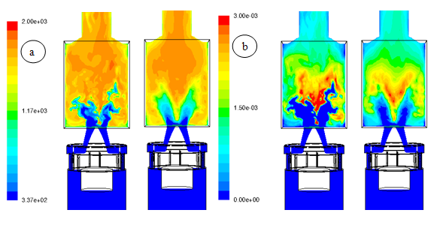
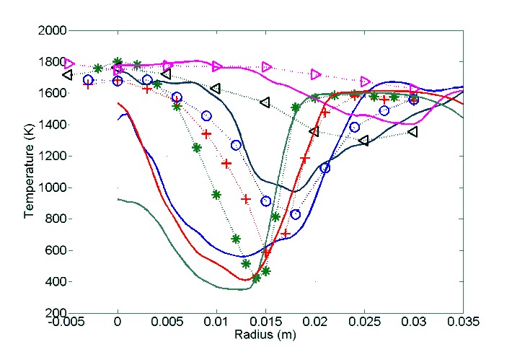
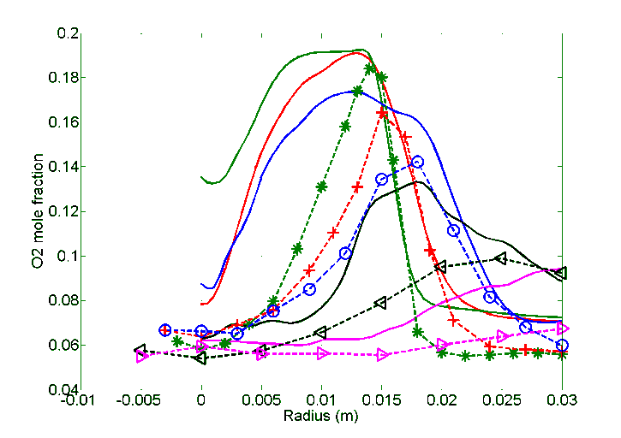
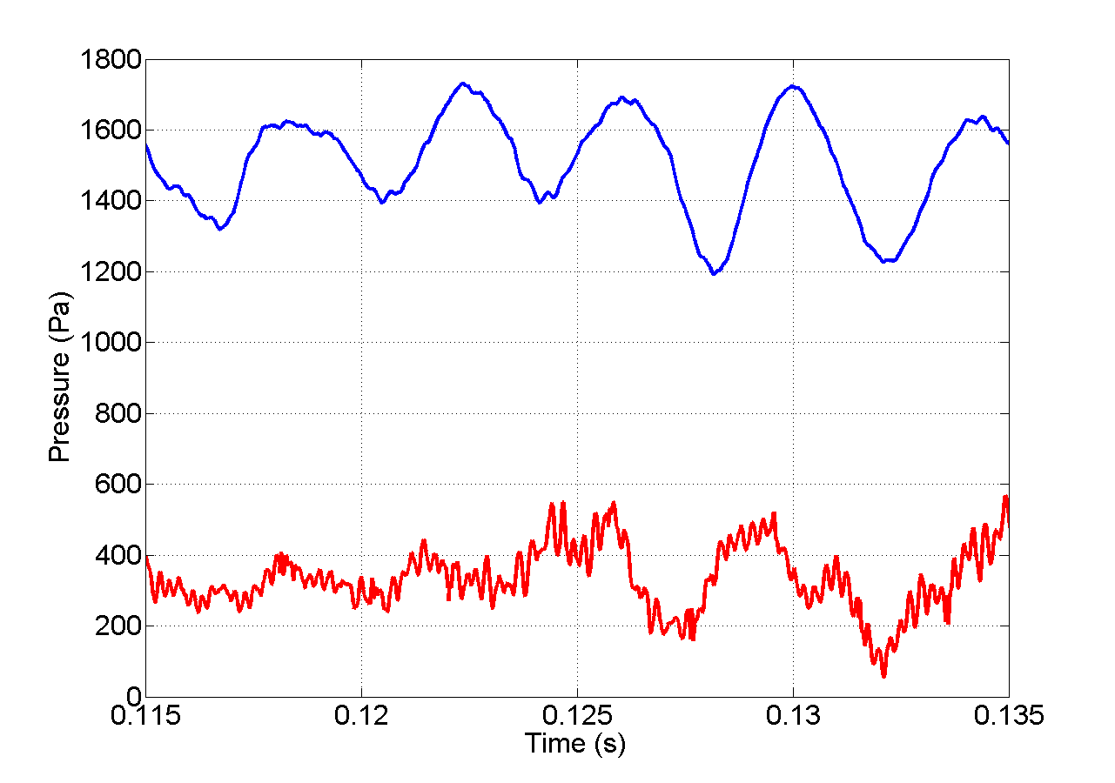
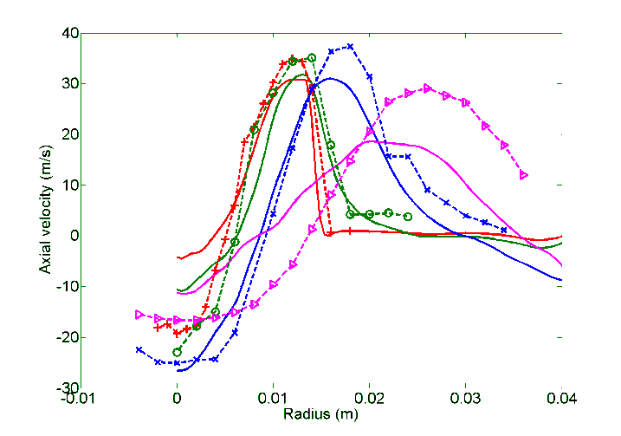
First Predictions on PRECCINSTA Combustion Dynamics via FLUENT/ANSYS
T (K)
Φ = 0.7 (25 kW)
Reynolds 35000-swirl number 0.6
EXP
* 6 mm
+ 10 mm
o 15 mm
< 40 mm
> 60 mm
Instantaneous (left) and mean (right) temperature (a) and OH mass fraction (b).
EXP
+ 1.5 mm
o 5mm
x 15 mm
> 35 mm
250 Hz
Temperature (top) and O₂ mole fraction (bottom) radial profiles
Pressure signal in the plenum and in the chamber
Axial velocity profiles

Slide 12
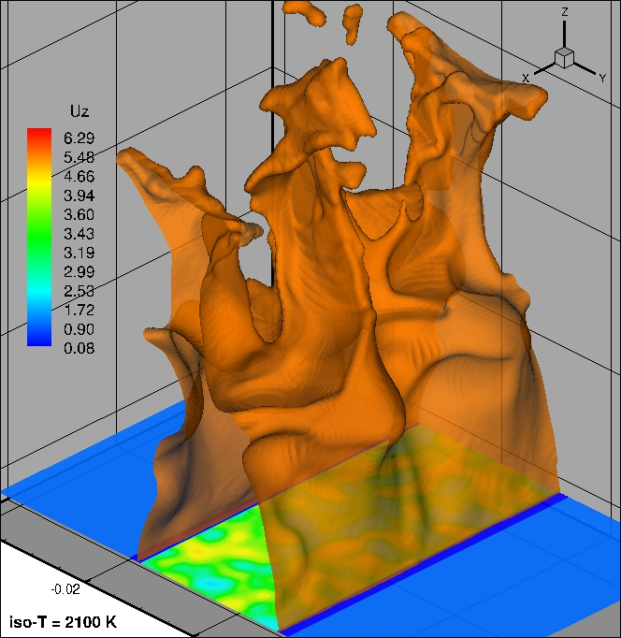
HeaRT Performance: Test Case Description
  Three slot premixed burners
    Stoichiometric CH₄/Air
    Central Bunsen flame
    Flat flames at side burners
    2mm side walls separation
  Computational domain
    10 x 7.5 x 5 cm³ (Z x Y x X)
  SMALL case
    250x202x101 = 5100500 nodes
  BIG case
    534x432x207 = 47752416 nodes
  Aims
    Single zone performance analysis.
    Validation of a new SGS turbulent combustion model.

Slide 13
HeaRT Performance: Machines’ Description
 | NODES | ARCH. | PROC. | CLOCK | TOT. CORES | RAM | NETWORK
CRESCO2 24 TFlops | 256 | Dual-Proc 4 cores 64-bit | Intel Xeon 5345 (Clovertown) | 2.33 GHz | 2048 | 16 GB/node 4 TB | IB QDR 20 Gbps 8 cores sharing: 2.5 Gbps/core
 | 56 | Dual-Proc 4 cores 64-bit | Intel Xeon 5530 (Nehalem) | 2.4 GHz | 448 | 16 GB/node 0.875 TB
 | 28 | Dual-Proc 4 cores 64-bit | Intel Xeon 5620 (Westmare) | 2.4 GHz | 224 | 16 GB/node 0.4375 TB
CRESCO3 20 TFlops | 84 | Dual-Proc 12 cores 64-bit One FP unit shared each 2 cores | AMD Opteron 6234 (Interlagos) | 2.4 GHz | 2016 | 64 GB/node 5.25 TB | IB 40 Gbps 24 cores sharing: 1.67 Gbps/core
Shaheen (Blue Gene/P) 222 TFlops | 16384 | Single-Proc 4 cores 32-bit | PowerPC 450 | 850 MHz | 65536 | 4 GB/node 64 TB | 3D “torus”

Slide 14
HeaRT Performance: Speed-Up and Efficiency
TEST CASE: BELL BIG C2nd_QdM
Cresco2, Cresco3, Shaheen

Slide 15
HeaRT Performance: Speed-Up and Efficiency
TEST CASE: BELL BIG C2nd_QdM
Shaheen

Slide 16
HeaRT Performance: Wall-Time per Time-Step
TEST CASE: BELL BIG C2nd_QdM
Cresco2, Cresco3, Shaheen

Slide 17
HeaRT Performance: Speed-Up and Efficiency
TEST CASE: BELL AUSM_QdM, BIG vs SMALL
Cresco2, Cresco3
Wall-Time per Time-Step

Slide 18
Conclusions
  Blue Gene machines: large number of cores, but 32 bit (on Shaheen) and with low CPU frequency to limit cooling costs.
  ENEA’s choice: smaller number of cores with higher CPU frequency and 64 bit processors.
    Prefer machine homogeneity
    Avoid machine partitioning
      Management: serial and high-parallelism job policy
    Avoid floating point unit sharing
    Prefer the highest CPU frequency

Slide 19
Main Publications of the Combustion CFD Group
“Large Eddy Simulation of the Hydrogen Fuelled Turbulent Supersonic Combustion in an Air Cross-Flow”, D. Cecere, A. Ingenito, E. Giacomazzi, C. Bruno, Shock Waves, Springer, accepted on 13 September 2012.
“Non-Premixed Syngas MILD Combustion on the Trapped-Vortex Approach”, A. Di Nardo, G. Calchetti, C. Mongiello, 7th Symposium on Turbulence, Heat and Mass Transfer, Palermo, Italy, 24-27 September 2012.
“Hydrogen / Air Supersonic Combustion for Future Hypersonic Vehicles”, D. Cecere, A. Ingenito, E. Giacomazzi, C. Bruno, International Journal of Hydrogen, Elsevier, 36(18):11969-11984, 2011.
“A Non-Adiabatic Flamelet Progress-Variable Approach for LES of Turbulent Premixed Flames”, D. Cecere, E. Giacomazzi, F.R. Picchia, N. Arcidiacono, F. Donato, R. Verzicco, Flow Turbulence and Combustion, Springer, 86/(3-4):667-688, 2011.
“Shock / Boundary Layer / Heat Release Interaction in the HyShot II Scramjet Combustor”, D. Cecere, A. Ingenito, L. Romagnosi, C. Bruno, E. Giacomazzi, 46th AIAA/ASME/SAE/ASEE Joint Propulsion Conference & Exhibit, Nashville, Tennessee, USA, 25-28 July 2010.
“Numerical Study of Hydrogen MILD Combustion”, E. Mollica, E. Giacomazzi, A. Di Marco, Thermal Science, Publisher Vinca Institute of Nuclear Sciences, 13(3):59-67, 2009.
“Unsteady Simulation of a CO/H2/N2/Air Turbulent Non-Premixed Flame”, E. Giacomazzi, F.R. Picchia, N. Arcidiacono, D. Cecere, F. Donato, B. Favini, Combustion Theory and Modeling, Taylor and Francis, 12(6):1125-1152, December 2008.
“Miniaturized Propulsion”, E. Giacomazzi, C. Bruno, Chapter 8 of "Advanced Propulsion Systems and Technologies, Today to 2020", Progress in Astronautics and Aeronautics Series, vol. 223, Edited by Claudio Bruno and Antonio G. Accettura, Frank K. Lu, Editor-in-Chief, Published by AIAA, Reston, Virginia, 2008 (founded on work of the ESA project "Propulsion 2000”).
“A Review on Chemical Diffusion, Criticism and Limits of Simplified Methods for Diffusion Coefficients Calculation”, E. Giacomazzi, F.R. Picchia, N. Arcidiacono, Comb. Theory and Modeling, Taylor and Francis, 12(1):135-158, 2008.
“The Coupling of Turbulence and Chemistry in a Premixed Bluff-Body Flame as Studied by LES”, E. Giacomazzi, V. Battaglia, C. Bruno, Combustion and Flame, The Combustion Institute, vol./issue 138(4):320-335, 2004.
Third in the TOP 25 (2004) of Comb. and Flame. Abstracted in Aerospace & High Technol. CSA Database: http://www.csa.com.
“Fractal Modelling of Turbulent Combustion”, E. Giacomazzi, C. Bruno, B. Favini, Combustion Theory and Modelling, Institute of Physics Publishing, 4:391-412, 2000.
The most downloaded in year 2000 (electronic format from IoP web-site).
“Fractal Modelling of Turbulent Mixing”, E. Giacomazzi, C. Bruno, B. Favini, Combustion Theory and Modelling, Institute of Physics Publishing, 3:637-655, 1999.
Notes:
19

Slide 20
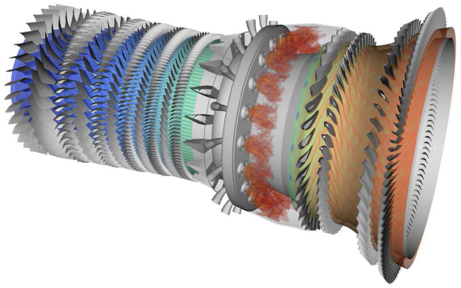
Contact
Contact
ITALIAN NATIONAL AGENCY
FOR NEW TECHNOLOGIES, ENERGY AND
SUSTAINABLE ECONOMIC DEVELOPMENT
Numerical Combustion Team
Arcidiacono Nunzio
Calchetti Giorgio
Cecere Donato
Di Nardo Antonio
(Donato Filippo)
Giacomazzi Eugenio
Picchia Franca Rita
UTTEI | – Unit of Advanced Technologies for Energy and Industry
COMSO | – Sustainable Combustion Processes Laboratory
Eugenio Giacomazzi
Ph.D., Aeronautic Engineer
Researcher
ENEA – C.R. Casaccia, UTTEI-COMSO, S.P. 081
Via Anguillarese, 301
00123 – S. M. Galeria, ROMA – ITALY
Tel.: +39.063048.4649 / 4690 – Fax: +39.063048.4811
Mobile Phone: +39.3383461449
E-Mail: eugenio.giacomazzi@enea.it
COMSO
Thanks for your attention!
Eugenio.Giacomazzi@ENEA.it

