Slide 1
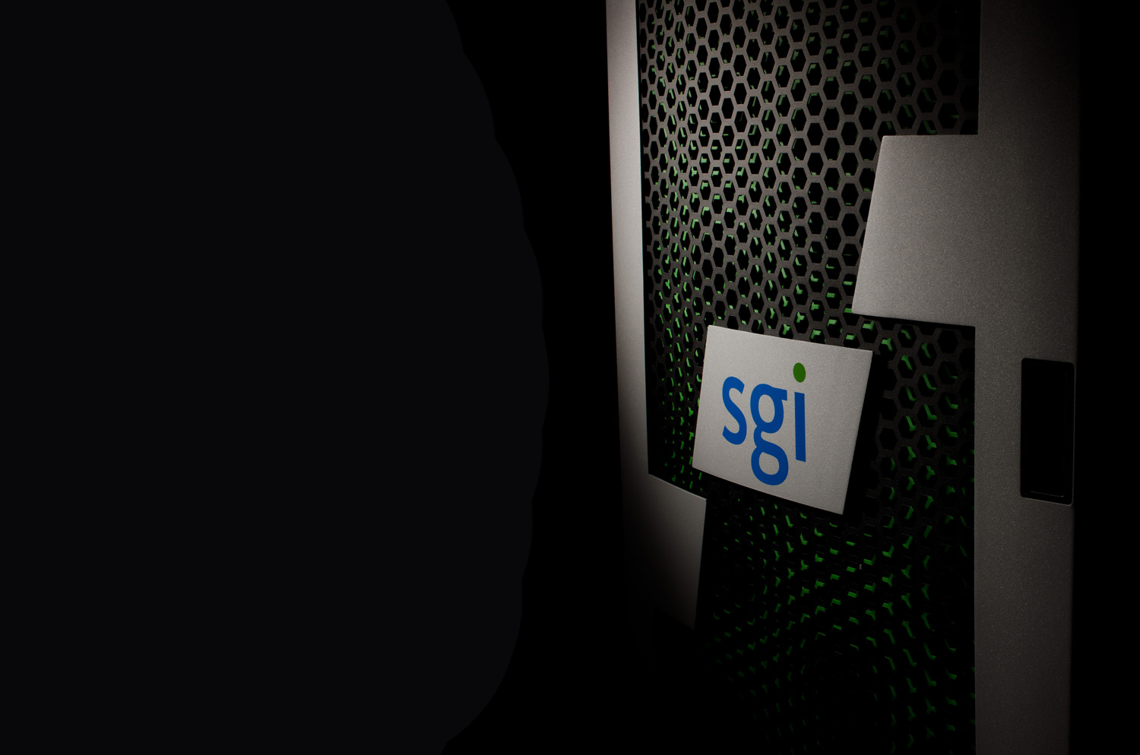
ENEA – Roma - 03/07/2012
SGI – HPC roadmap
Marc Simon : Technical Director (Southern Europe)

Slide 2






Our Strategy
The Trusted Leader in Technical Computing
Business
Applications
Big
Data
Technical
Applications
Business Computing
Technical Computing
Redundancy
Workload Optimized
Scale & Speed

Slide 3

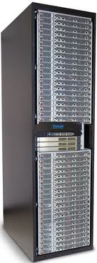
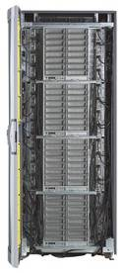
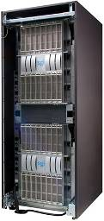


SGI® Servers for Speed and Scale
HPC
Commercial
Scientific
Modeling & Simulation
Big Data
Hadoop
In-Memory Analytics Archive
Cloud
Public
Private
Government
SGI® ICETM
Rackable™
SGI® UVTM
Rackable™
CloudRack™ C2

Slide 4
Introducing the
SGI ICE-X
Product Family

Slide 5
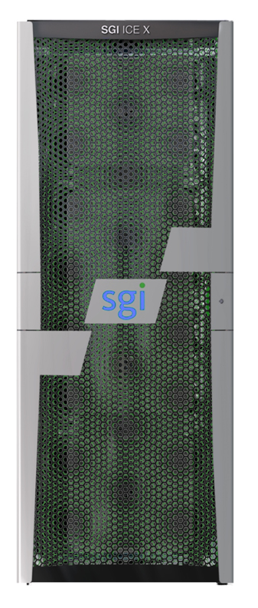
Introducing SGI ICE X…
Fifth Generation ICE System
The world’s fastest supercomputer just got faster!
The world-renowned SGI quality and performance you love
Flexible to fit your workload
Notes:
5
The world’s fastest supercomputer just got faster!
Largest performance boost ever - up to 5x performance density improvement over previous industry-leading generation - with Intel® Xeon® processor E5 family
Key design innovations and increased flexibility through enhanced R&D investment
The world-renowned SGI quality and performance you love
Entirely built on industry-standard hardware and software components, enabling access to the full spectrum of the Linux ecosystem
Only system in its class that installs production-ready in hours or days, not weeks or months
Flexible to fit your workload
Ultimate configuration flexibility in topology/interconnect, power, cooling, CPUs and memory
Seamless scalability from tens of teraflops to tens of petaflops
Expandability within and across technology generations while maintaining uninterrupted production workflow

Slide 6
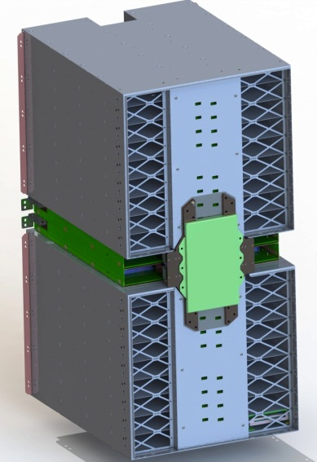
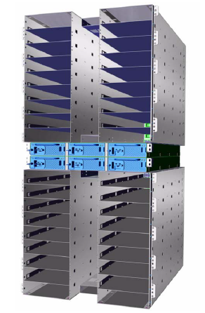
SGI ICE X Enclosure Design Building Block Increments of Two Blade Enclosures - “One Enclosure Pair”
Features per Enclosure Pair:
  36 blade slots
  Four fabric switch slots
  Four chassis management controller slots
  Unified backplane
  19” rack mount enclosure*
17.7
Rear View
16.59
(9.5U)
21U
“Building
Block”
1.75
(1U)
Separable Power Shelf
* Verify fit into third party racks
Unified Backplane
Notes:
6

Slide 7
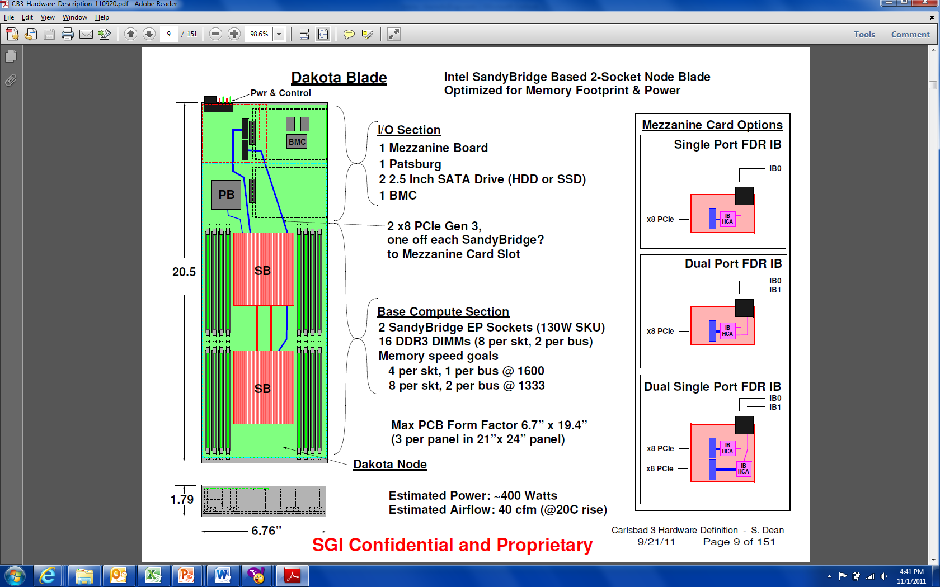
SGI ICE X Compute Blade
IP-113 (Dakota) for “D-Rack”
FDR Mezzanine
Card Options
Main Features:
Supports single or dual plane FDR InfiniBand
Supports two Intel® Xeon® processor E5-2600 family CPUs
Supports up to eight DDR3 DIMMs per socket @ 1600 MT/s
Houses up to two 2.5” SATA drives for local swap/scratch usage
Utilizes traditional heat sinks
Notes:
7

Slide 8
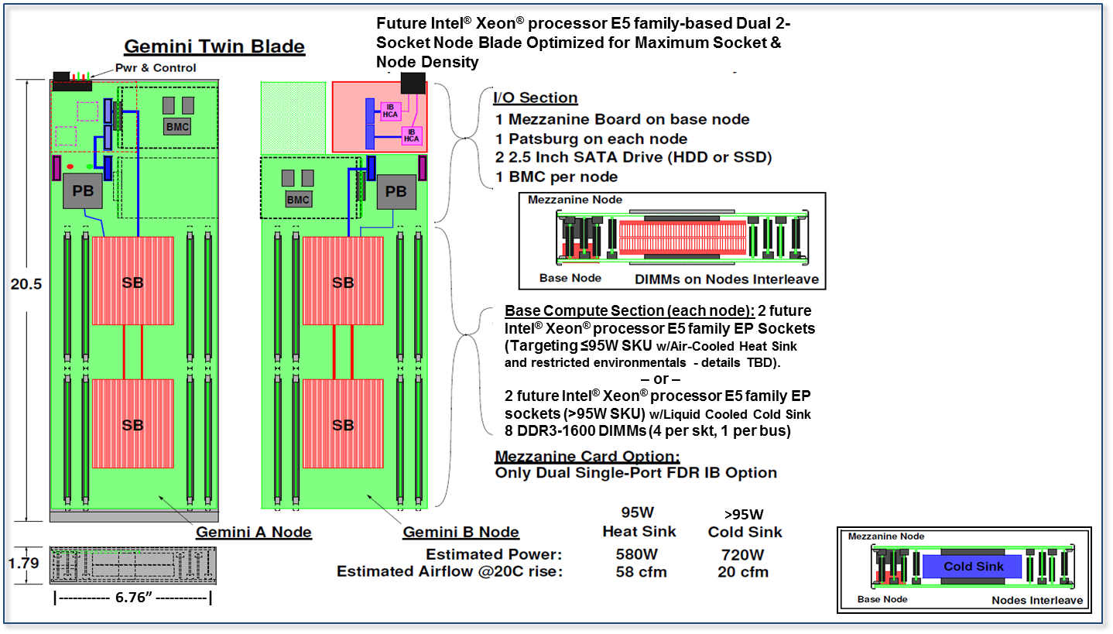
SGI ICE X Compute Blade
IP-115 (Gemini Twin) for “M-Rack”
Main Features:
Two dual socket nodes
  Supports four Intel® Xeon® processor E5-2600 family CPUs
Supports single plane FDR InfiniBand
Supports four DDR3 DIMMs per socket @
1600 MT/s
Houses up to two 2.5” SATA drives for local swap/scratch usage
    One per node
Utilizes cold sinks
Notes:
8

Slide 9
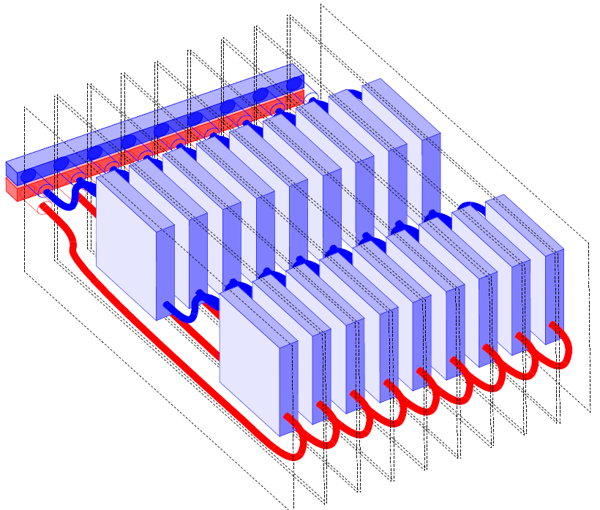
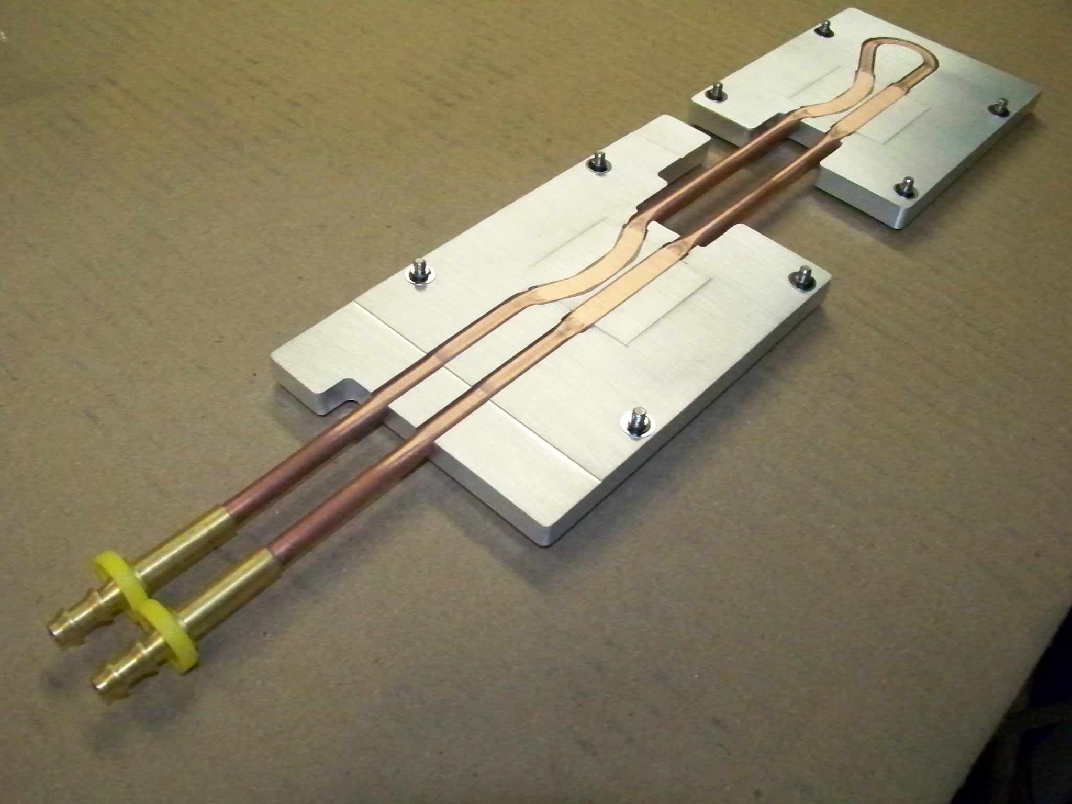
On-Socket Water-Cooling Detail
Used for “Twin” blades; replaces the traditional air-cooled heat sinks on the CPUs
Resides between the pair of node boards in each blade slot (“M-Rack” deployment)
Enables highest watt SKU support (e.g., 135W TDPs)
Utilizes a liquid-to-water heat exchanger that provisions the required quantity of flow to the M-Racks for cooling
Notes:
Reformat text in the top – lop it off and add to bottom
Used for IP-115 Gemini “twin” blades; replaces the traditional air-cooled heat sinks on the CPUs to enable highest watt SKU support
Resides between the pair of node boards in each blade slot (“M-Rack” deployment)
Enables highest watt SKU support (e.g., 130W TDPs)
Utilizes a liquid-to-water heat exchanger that provisions the required quantity of flow to the M-Racks for cooling
9

Slide 10
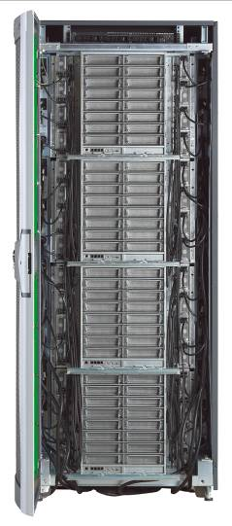
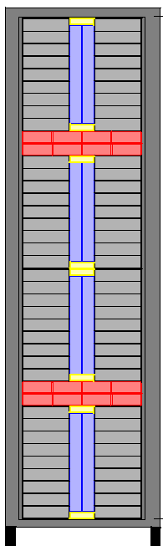
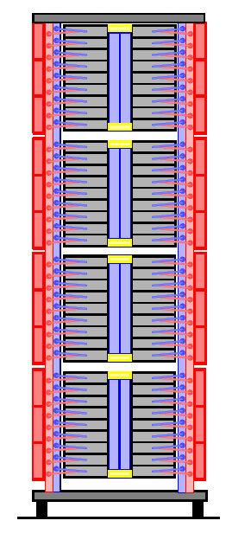
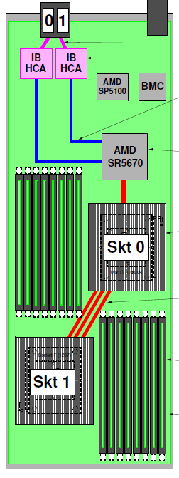
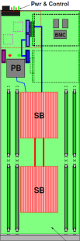
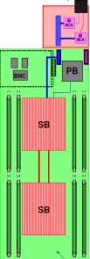
Dialing Up The Density!
SGI ICE 8400 → SGI ICE X
SGI ICE 8400 = 64N
(128 Sockets)
D-Rack = 72N
(144 Sockets)
M-Rack 72 x 2 = 144N
(288 Sockets)
30” Width
24” Width
28” Width
Notes:
10

Slide 11
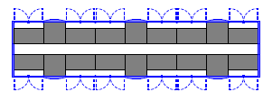
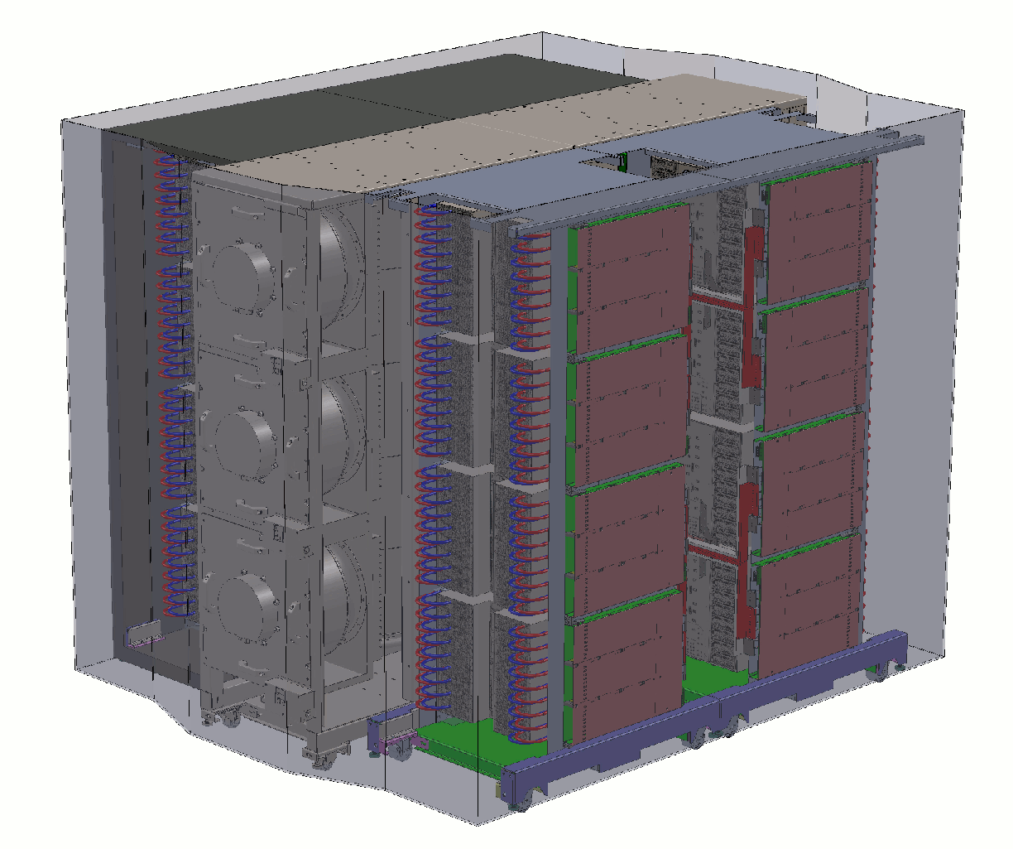
Notable Features of a “Cell”
D-Cell and M-Cell
One Compute Rack
One Cooling Rack
“Closed-Loop Airflow” Environment
Supports Warm Water Cooling
Contains Large, “Unified” Cooling Racks for Efficiency
One Complete Cell
Notes:
“Closed-Loop Airflow” Environment
Integrated hot aisle containment
No air from within the cell is mixed with the data center air wherein the cell is installed (versus a hot/cold aisle arrangement - open loop airflow - wherein the air is mixed)
Always water-cooled
Supports Warm Water Cooling
Broad range of acceptable temperatures for additional cost savings
Contains air-to-water heat exchanger
Contains a liquid-to-water heat exchanger when cold sinks are deployed
Contains Large, “Unified” Cooling Racks for Efficiency
Compute racks do not have their own cooling at the rack level
Decreases power costs associated with cooling
All cooling elements utilize one water source
11

Slide 12
Common Topologies
All-to-All | Fat Tree (CLOS Networks) | Hypercube | Enhanced Hypercube | Mesh or Torus (2, 3 or more dimensions)
 |  |  |  | Will support when in OFED
Supported on SGI ICE 8400 and SGI ICE X
Notes:
12

Slide 13
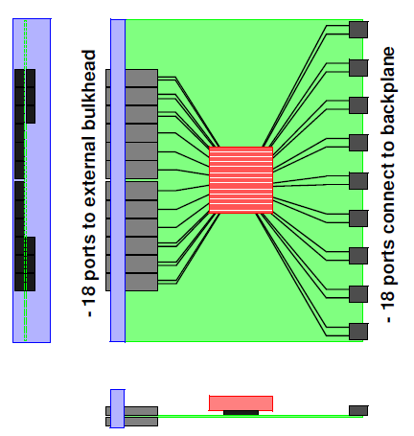
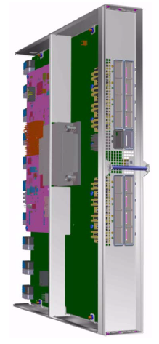
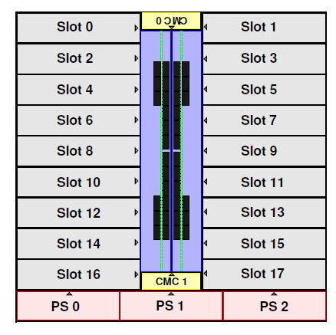
SGI ICE X “Standard” IB Switch Blade
1SW18x18 – Single IB Switch ASIC
Single port FDR IB switch ASIC
18 ports connect to backplane
18 ports to external bulkhead QSFP connectors (18)
Optimal for building fat tree and all-to-all topologies
  Can also build smaller hypercube or enhanced hypercube systems
36-Port
Front
View
Switch Blade – Plan View
Enclosure Front View
Side View

Slide 14
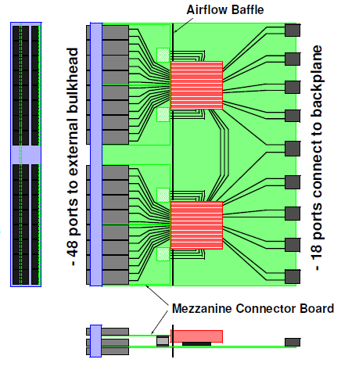
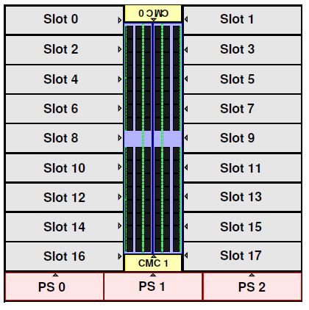
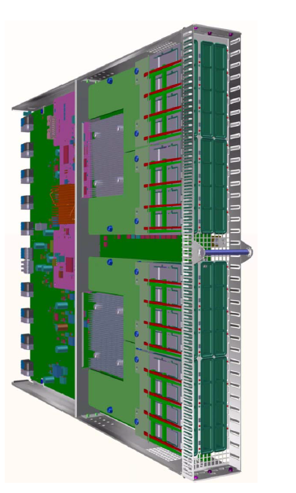
SGI ICE X “Premium” IB Switch Blade 2SW9x27 – Dual IB Switch ASIC
1st Dimension Cabling Within the Switch
Dual 36 port FDR IB Switch ASICs
Each Switch ASIC:
  9 ports connect to backplane
  3 ports connect to adjacent Switch
  24 ports to external bulkhead
  Optimal for building larger scale hypercube/enhanced hypercube
48 ports per switch to external bulkhead
36-Port
36-Port
Front
View
Side View
Enclosure Front View

Slide 15

SGI: InfiniBand Clustering Experts! www.sgi.com/pdfs/4312.pdf
InfiniBand now easily dominates the Top 100 of the TOP500 list.
Scaling by cluster size will remain the simplest way to grow computational capacity to meet ever larger grand-challenge problems.
Choosing the optimum InfiniBand topology can be difficult with trade-offs in terms of scalability, performance and cost.
SGI ICE X provides: Ultimate configuration flexibility including InfiniBand topologies to enable optimized performance!
Notes:
SGI…
Is an expert in the design and deployment of the InfiniBand clusters.
Has done extensive performance testing of various InfiniBand topologies.
Can help organizations make informed choices regarding the best topology versus other vendors’ limitations that drive them to push one topology choice above others.
15

Slide 16
SGI ICE X
Cool Customers

Slide 17

Understanding the Interaction of Solar Wind
With the Magnetosphere
NASA Advanced Supercomputing Division
SGI® ICE
Image courtesy NASA
Notes:
17

Slide 18
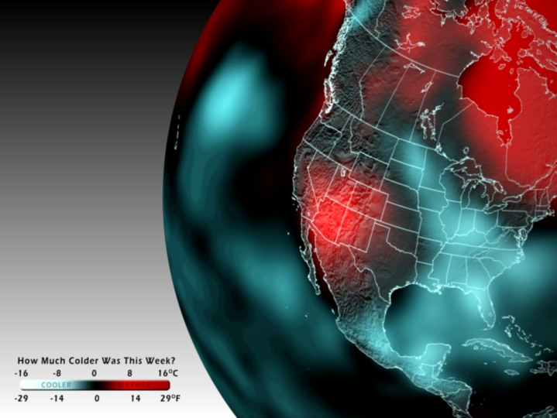
Modeling the World’s Climate
Nat’l. Oceanic & Atmospheric Administration
SGI® ICE
Image courtesy NOAA

Slide 19
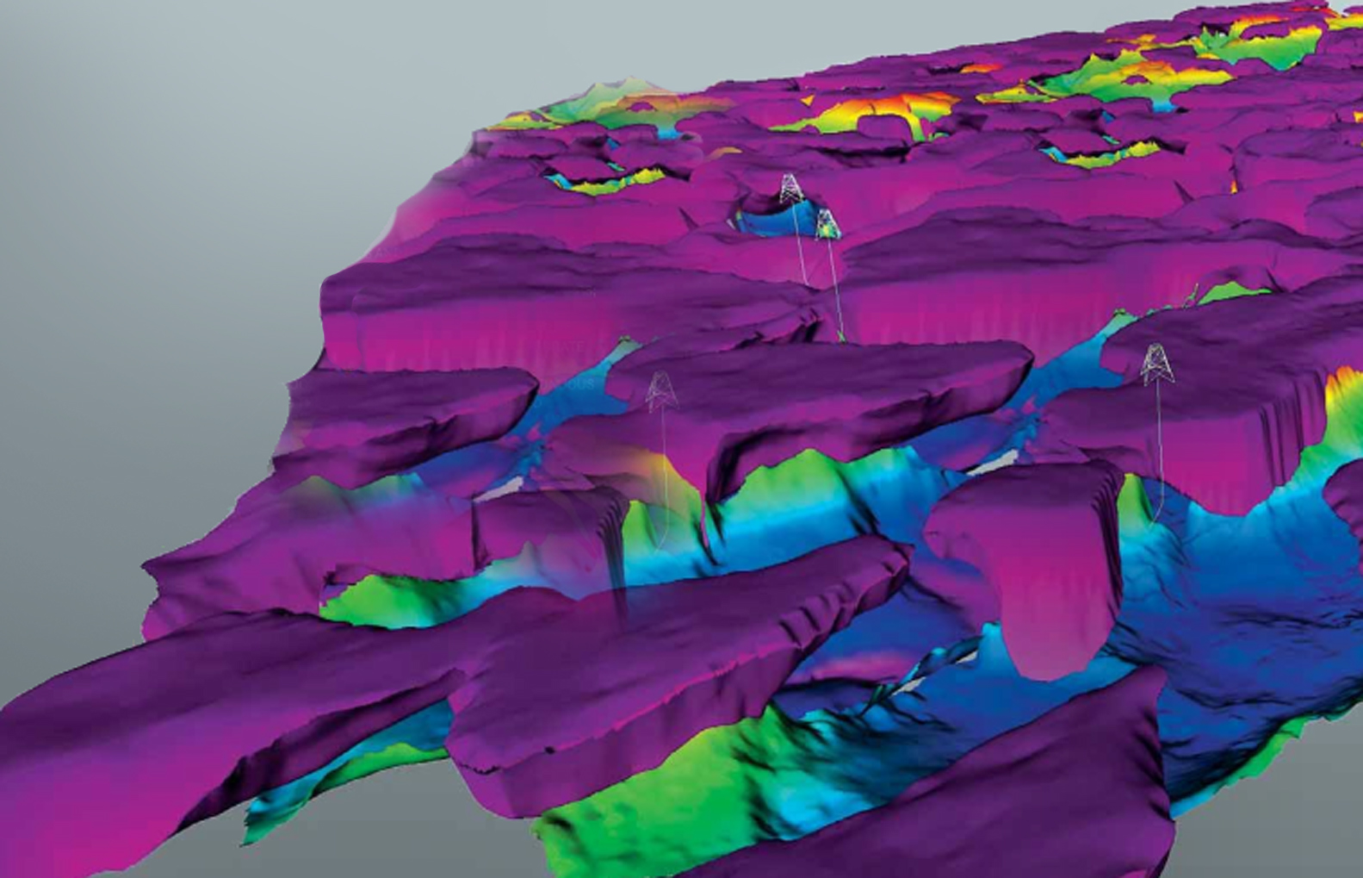
Advanced Energy Exploration and
Production
Total: World's Largest Commercial HPC System (2.3 PF)
SGI ICE
Image courtesy NOAA

Slide 20
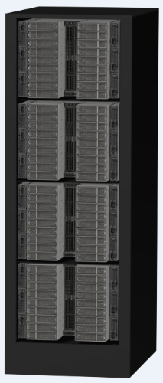
SGI ICE X
Design Innovations Summary
IP-115 Twin-Node Compute Blade Options
Independently Scalable Power Architecture
Separable Cooling Solutions
Unified Backplane Fabric
Multiple Data Center Environment Support
Notes:
IP-115 Twin-Node Compute Blade Options
36 compute nodes per Enclosure
Ability to support accelerators in dense packaging
Independently Scalable Power Architecture
Separable Cooling Solutions
Air-cooled for lower power blades
Options for open-loop chilled-water or closed-loop warm water cooling
Options for integrated liquid cooling (cold sinks) at the node level
Unified Backplane Fabric
Single enclosure pair solution
Fabric switches enable topology choices
Multiple Data Center Environment Support
Traditional hot/cold aisle
High density closed-loop cooling
Large scale container solution
20

Slide 21
Introducing the
SGI UV 2
Product Family

Slide 22
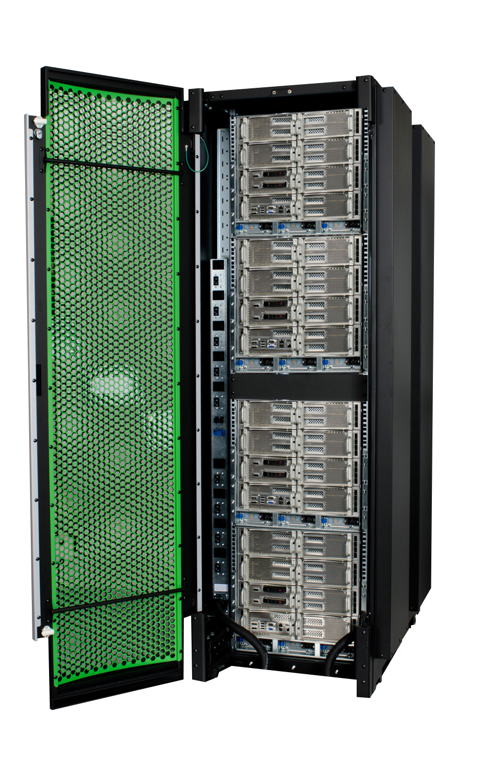
SGI UV 2: The Big Brain Computer
World-leading Capability for Data Intensive Work, now with Intel® Xeon® Processor E5-4600 Product Family.
Focus on Solving Your Problems, Not IT Problems
No-Limit Computing, Built on Industry Standards
World's Largest In-Memory System for Data-Intensive Applications
Available Now

Slide 23
SGI UV2
Only Intel E5 system to scale >4CPU, 1.5TB.
SGI UV 2 Technology Advances
 | UV1 | UV2
CPU | Intel Xeon E7 | Intel Xeon E5
Architecture | NUMAlink® 5 | NUMAlink® 6 > FDR IB
Entry Price | $50,000 | $30,000
IO performance | Gen 2 PCIe | Gen 3 PCIe - to 4TB/s
Single Coherent System up to | 2048 cores 16 TB memory | 4096 cores 64 TB memory
Architecture scalability | To 16,384 sockets and 8PB shared memory
Entry configuration at standard SGI discount – 16 cores, 32GB memory

Slide 24
Focus on Solving Your Problems, Not IT Problems

Slide 25
SGI UV 2
      Single-node to manage, use – far less complex than scale-out systems with many nodes.
Commodity Scale-out/Cluster
SGI UV 2 Big Brain
InfiniBand or Gigabit Ethernet
SGI NUMAlink® 6 Interconnect
Mem
~64GB
mem
mem
mem
mem
Global shared memory to 64TB
system
+
OS
system
+
OS
system
+
OS
system
+
OS
...
system
+
OS
System to 4096 thread
+
OS – one instance
Off-node data access requires inter-node messaging scheme
All data transparently accessible to all processors (standard load/store)

Slide 26
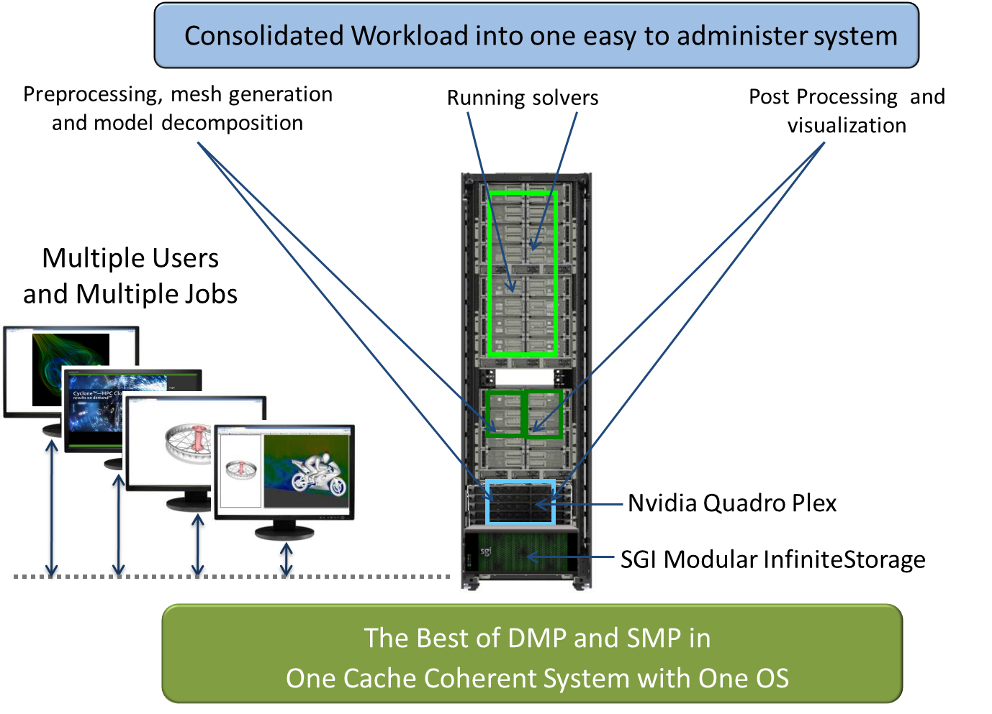
SGI UV 2
      Consolidate workflows to speed business processes.
        Run any type, size of job
        Faster time-to-solution
        Avoid data movement
        Reduce server sprawl
Example: Virtual Product Design
      “They can test out their ideas quickly without spending a lot of time or money. We’re giving them the freedom to fail or succeed faster.” 3M

Slide 27
No-Limit Computing;
Built on Industry Standards

Slide 28
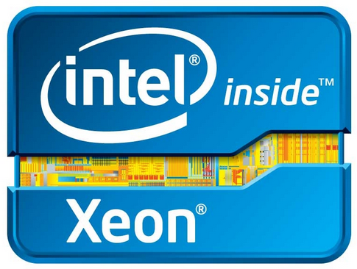


SGI UV 2
Open platform -- Intel® Xeon® processor E5-4600 product family and off-the-shelf Linux®.
Intel® Xeon® Processor E5-4600 product family
SGI is major Linux contributor
  Red Hat® Enterprise Linux 6
  SUSE® Linux® Enterprise Server 11
Runs Linux SW off-the-shelf, unmodified
Standard Management, Storage Interfaces
  SGI Infinite Storage Solutions
  Interface with common management software schemes

Slide 29
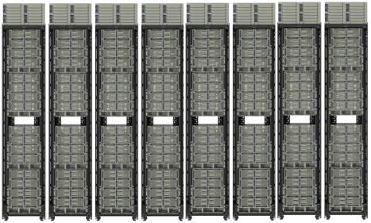
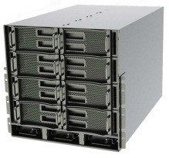
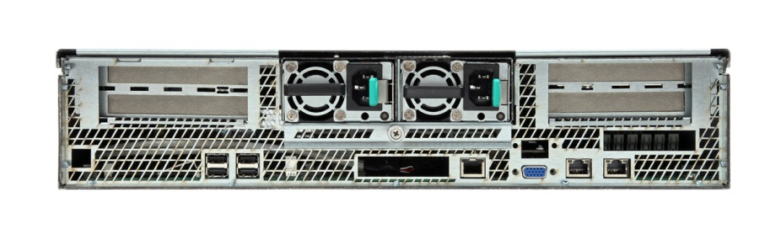
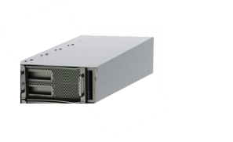
SGI UV 2
Start small and grow … or start big.
UV 2000
Modular Design,
Configuration Flexibility
Supports GPU, Intel MIC
64-512 core 256GB-16TB
256- 4096 core Up to 64TB
UV 20
16-128 core 32GB-4TB
16-32 core 32GB-1.5TB

Slide 30

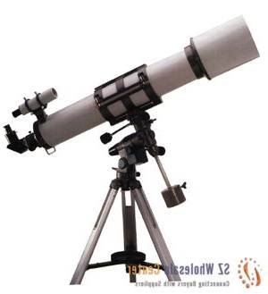
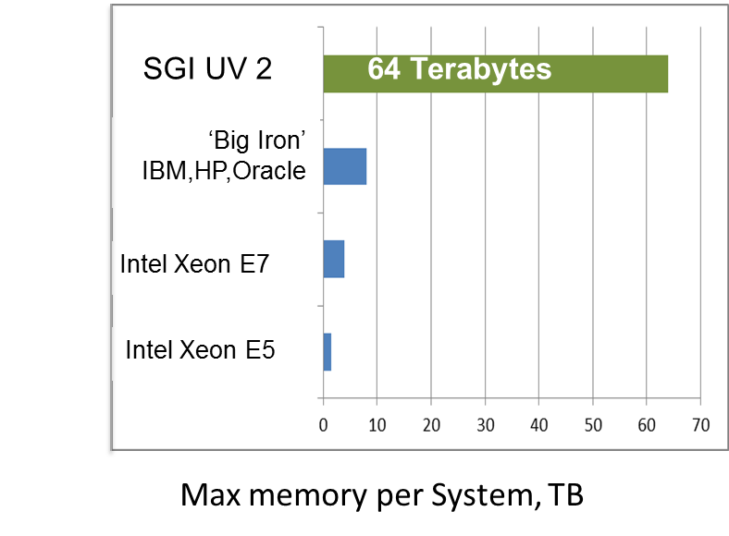



SGI UV 2
Leave the node memory limits of scale-out computing behind.
“SGI UV frees us from memory constraints.”
Human Genome Center, U Tokyo
“..significantly enhance the capabilities of the NSF to see and understand large volumes of data…” Oak Ridge Nat’l Labs

Slide 31
World’s Most Capable In-Memory System for Data Intensive Workloads

Slide 32
SGI UV 2
From 16 to 4096 cores in one balanced, single system – efficient scale for any type of app.
"It is an HPC system that is one step ahead in the consolidation and scalability of computing services for the research community.“ Catalonia SC Center
SGI UV 2000
STREAM Triad Benchmark
System Memory Bandwidth
Closest SGI competitor published result
Source: U Virginia
768
Number of Threads in System

Slide 33


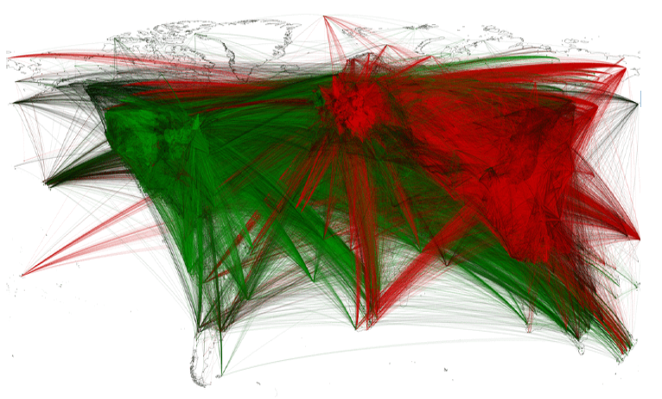

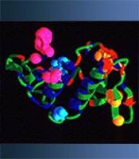
SGI UV 2
Fastest path to solve tough problems.
Ideal for complex analytics, fraud/threat detection, rapid prototyping, integrative simulation or analysis.
UCSD
U of IL
Denmark Tech. U
Cntr for Bio Sequencing
Major WW Courier
200TB space weather simulations protect power and satellite grids
Political revolt is predictable with fast analysis of 100M web postings
Speed time-to-market with 50% performance boost, fewer servers
Cancer takes a hit as cell network simulation goes from weeks to hours
$Millions saved as 38X speedup makes fraud detection real-time

Slide 34

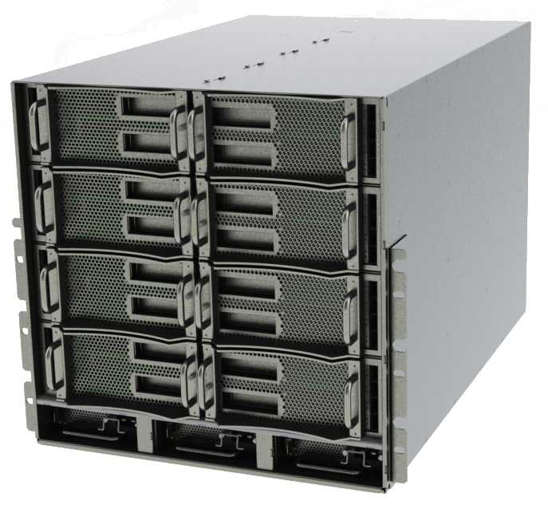
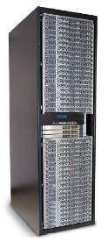
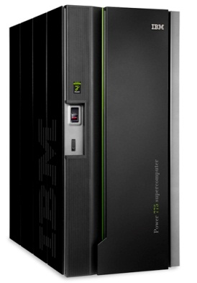
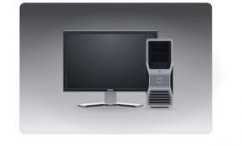
Big Brain Computer
SGI UV
“No Limit Computing: Anything is possible”
SGI® UVTM 2000
Commodity Clusters
Enterprise
SMP
Workstation
“Anything Is Possible … with Effort”
“Anything Is Possible … at a Price”
“Some Things are Possible”

Slide 35
SGI UV 2 - Only System that:
Leverages Intel’s latest CPU beyond 4 sockets and 1TB
Runs anything: desktop apps to common scale-out apps to the most demanding data-intensive problems.
Offers seamless scale without the complexity of multi-instance software or multiple server platforms
  From 16 to 4096 threads, 32GB to 64TB memory, to 4TB/s IO
  Start small and add hardware as needed: investment protection
Delivers proven, world-leading performance for demanding, real-world problems

Slide 36

Curing Cancer
The Institute of Cancer Research
SGI® UVTM
Image courtesy The Institute of Cancer Research
Notes:
36

Slide 37

Developing Instruments for Space Missions
University of Valencia
SGI® UVTM
Image courtesy University of Valencia: www.uv.es/daa
Notes:
37

Slide 38
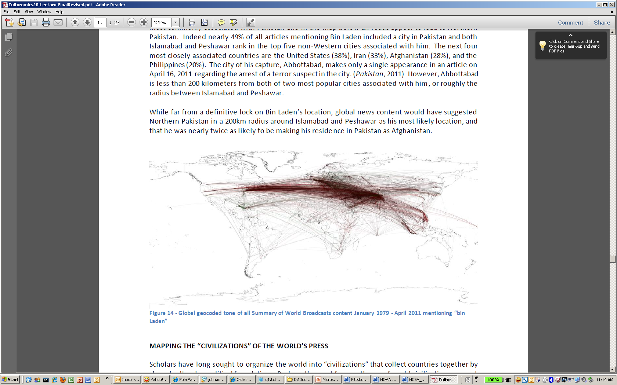
Hunting for Terrorists
Nat’l. Center for Supercomputing Applications
SGI® UVTM
Global geocoded tone of all Summary of World Broadcasts content January 1979-April 2001 mentioning “bin Laden”
Culturomics 2.0: Forecasting Large-Scale Human Behavior Using Global News Media Tone in Time and Space,
Kalev H. Leetaru, University of Illinois, leetaru@illinois.edu

Slide 39
Thank You

