Slide 1
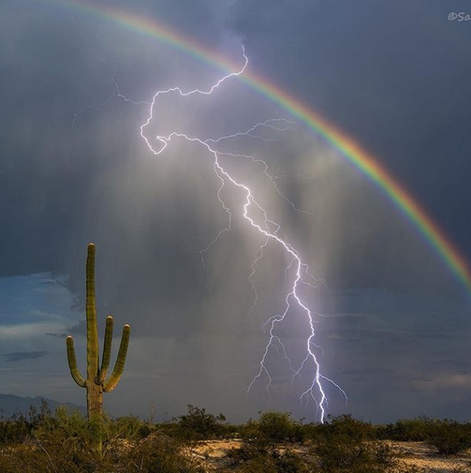

Francesco Leone
Catania University - Department of Physics and Astronomy
INAF - Catania Astrophysical Observatory
PLUS – July 27, 2020
High-Resolution Spectropolarimetry
from Astrophysics to Laboratory Plasma
and back

Slide 2
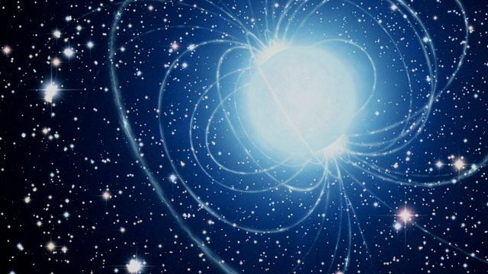
Background: Astrophysics
Stellar Magnetic Fields
Radiative Transfer in Magnetised Atmospheres

Slide 3
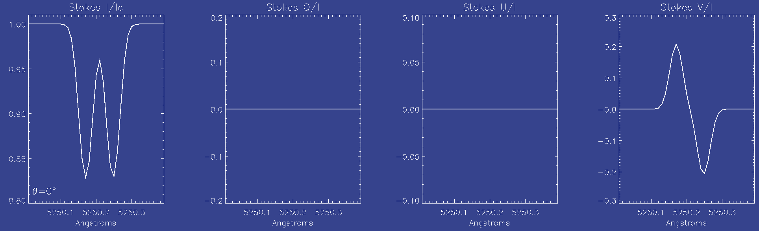
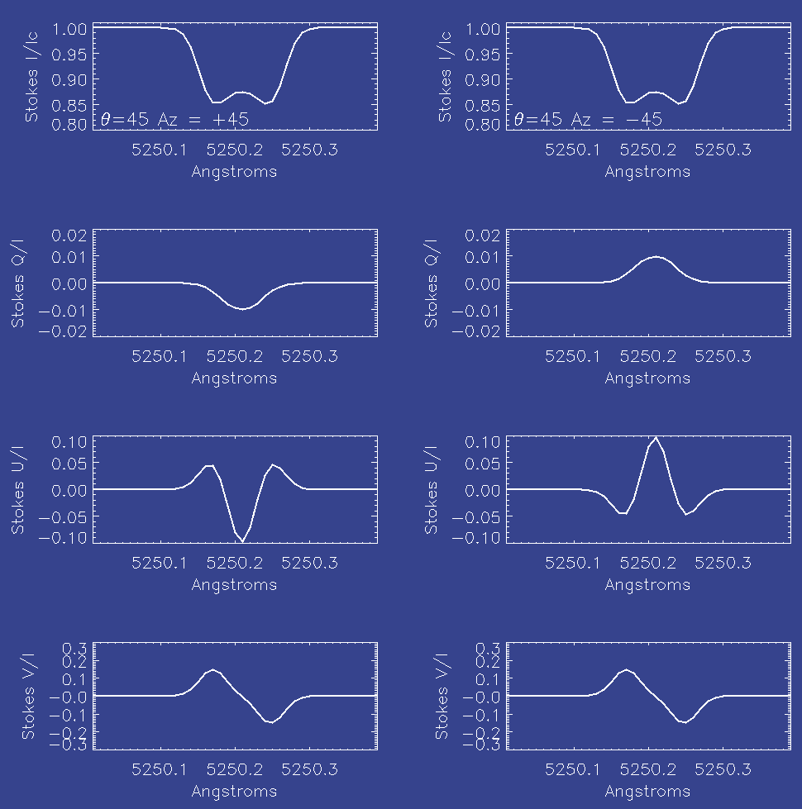
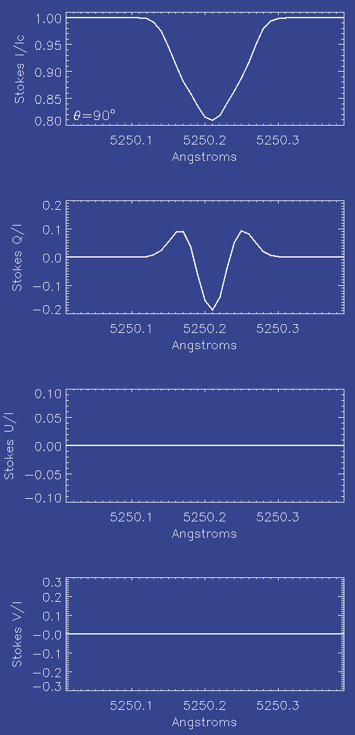
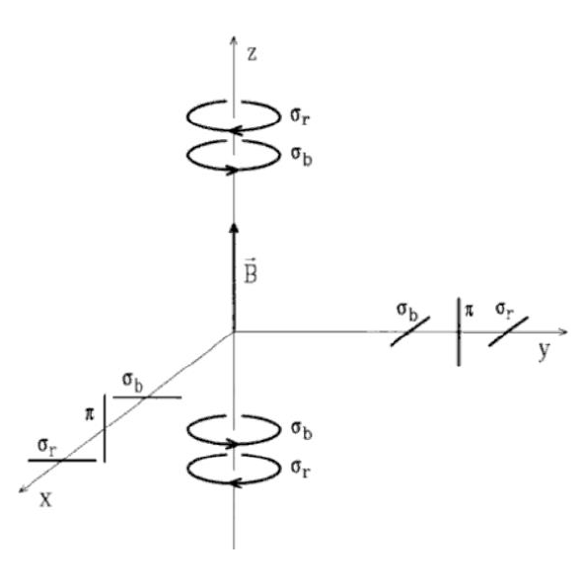
High Resolution Spectropolarimetry to Detect and Measure Cosmic Magnetic FIelds
Stokes profiles
Δλ = 4.67 10⁻¹³ λ²g_{eff} B

Slide 4
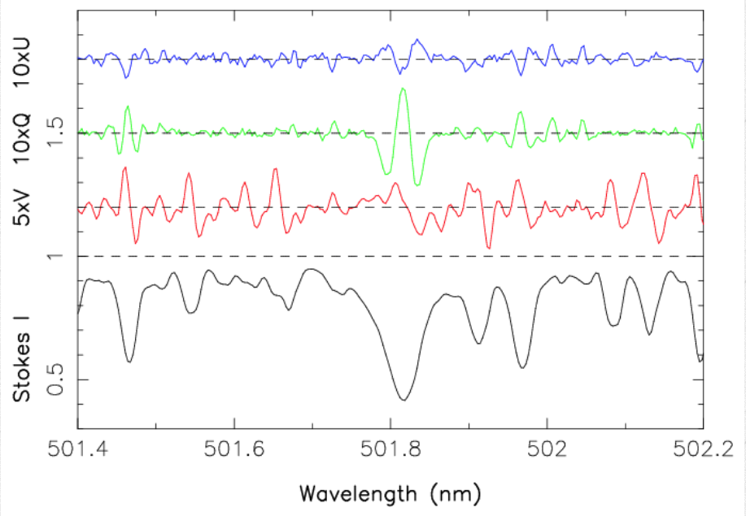
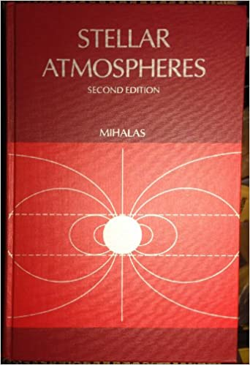

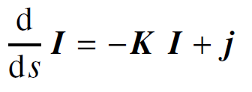

Information on Magnetic Fields are coded in
high resolution Stokes profiles of spectral lines
1978
2004

Slide 5
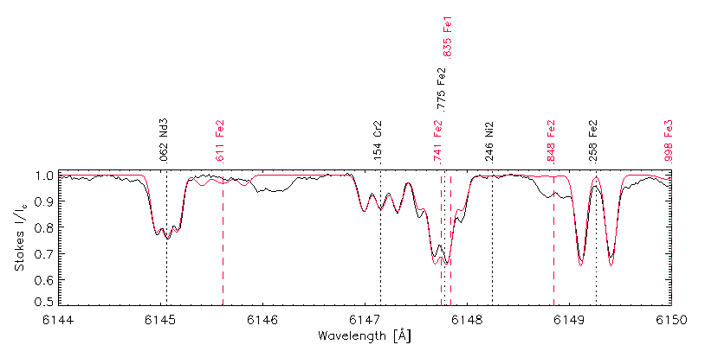
COSSAM
COdice per la Sintesi Spettrale nelle Atmosfere Magnetiche
LTE approximation
Zeeman Splitting
Polarised Radiative Transfer
Stift, Leone & Cowley 2012, MNRAS 419, 2912
observed
synthetic
|B|= 5 kG

Slide 6
HD94660
V=6.08 vsin(i)=3km/s B|| = -2.8kG

Slide 7
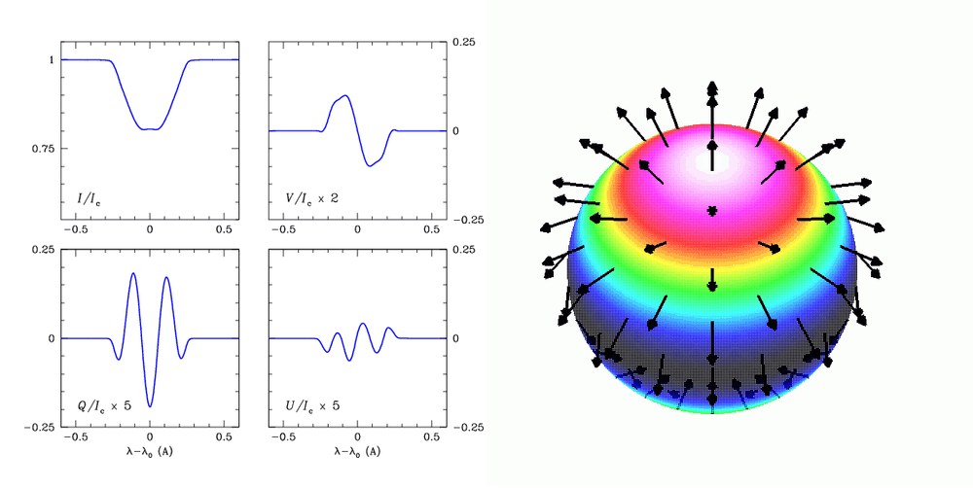
Recovering magnetic geometries

Slide 8

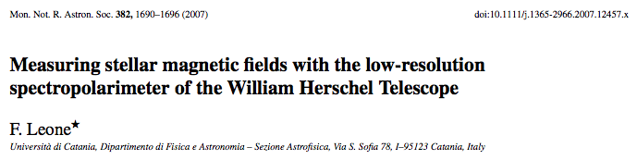
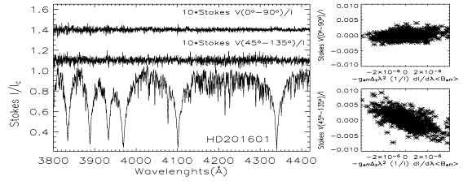
If High Res is not possible:

Slide 9
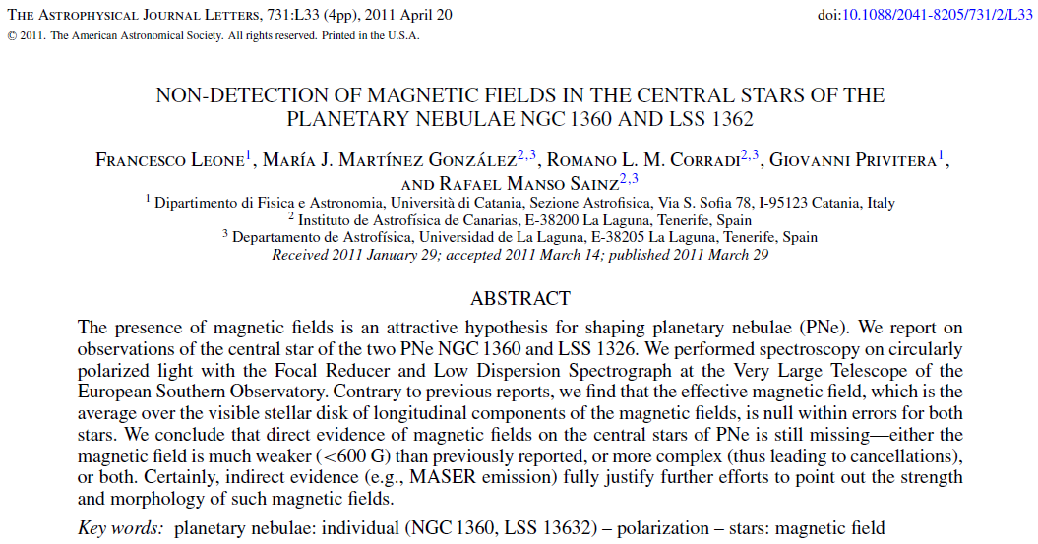
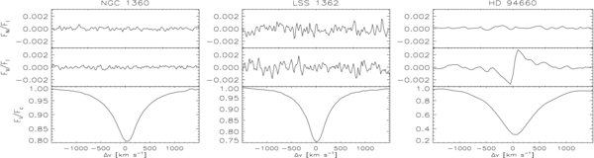
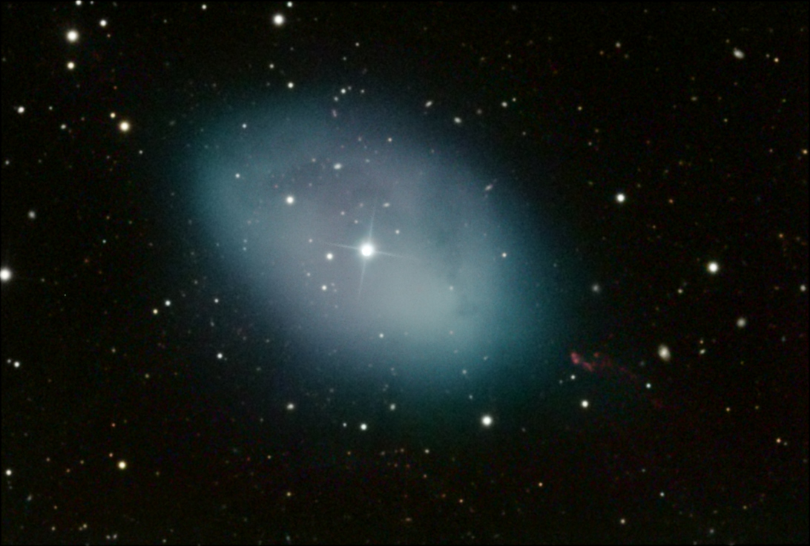
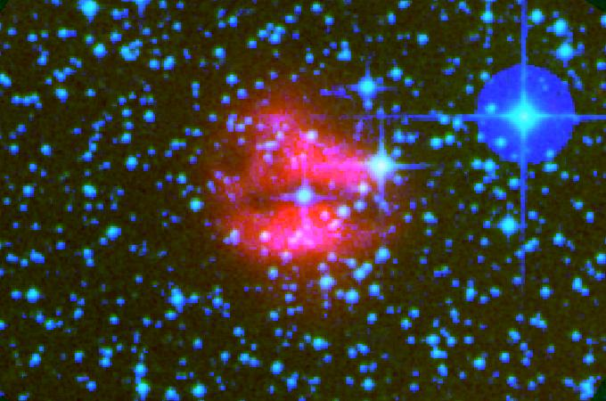
If S/N is low: we co-add spectral lines

Slide 10
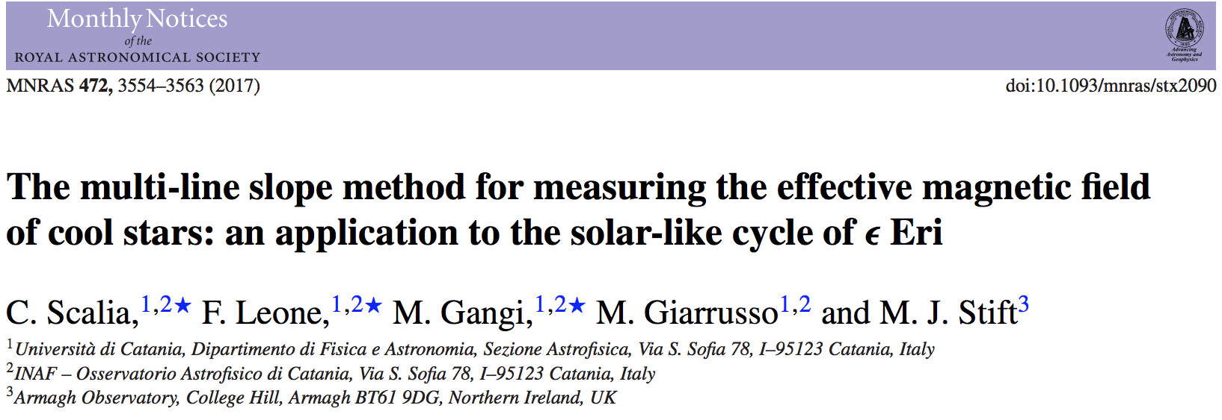
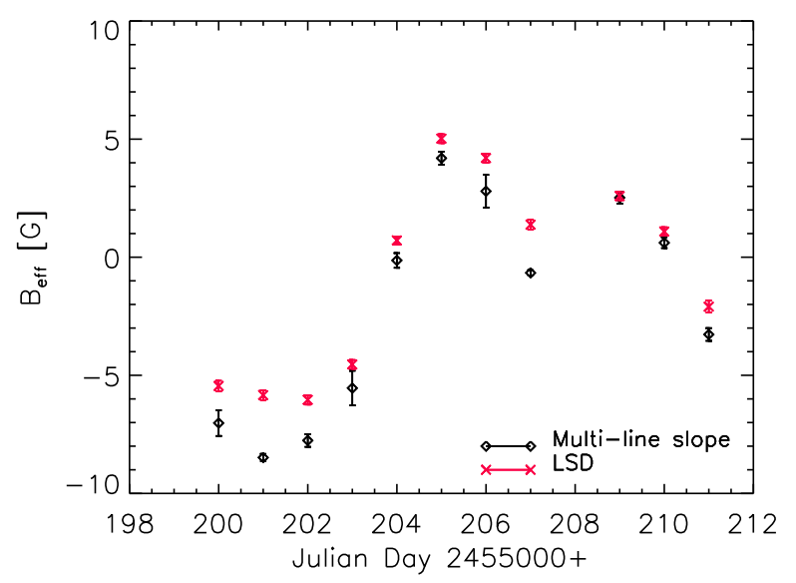

Slide 11
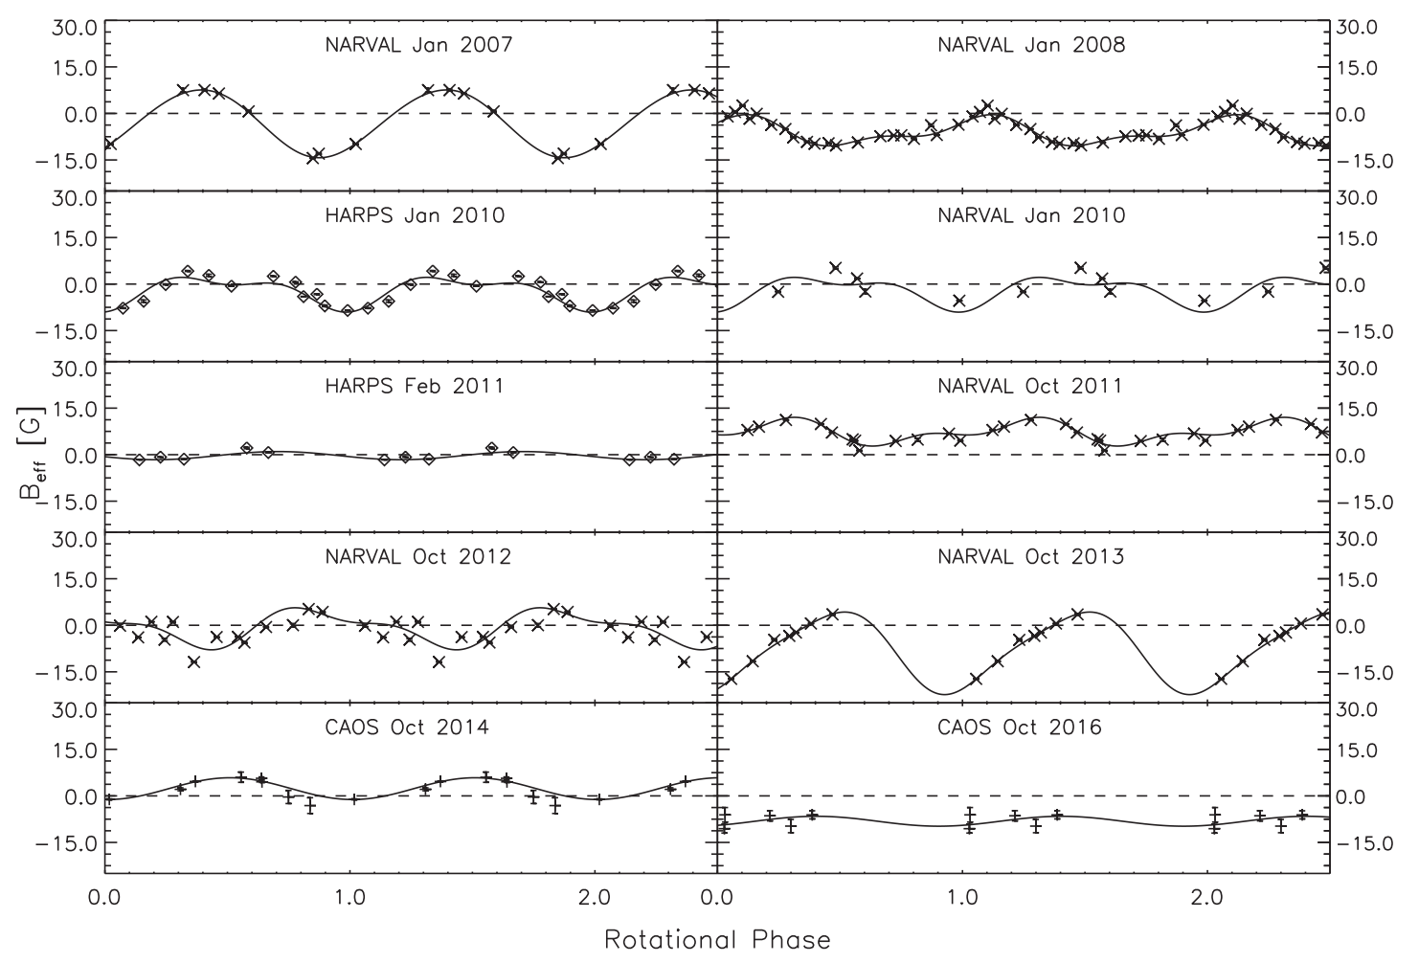
P_{rot} = 11.5 days
P_{cycle} = 2.95 years

Slide 12
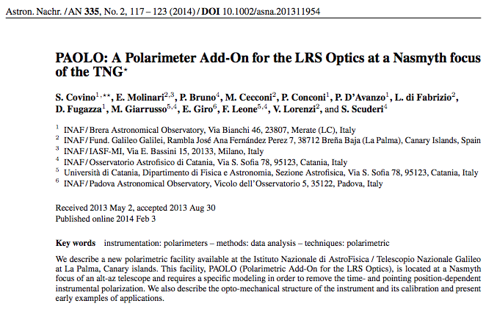
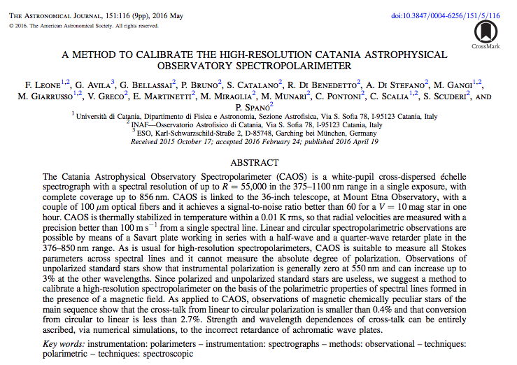
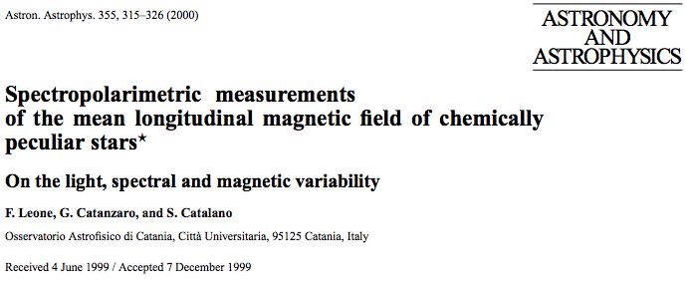
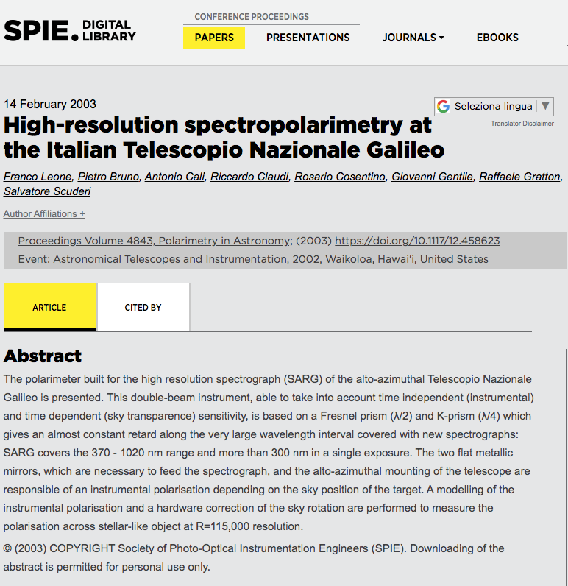
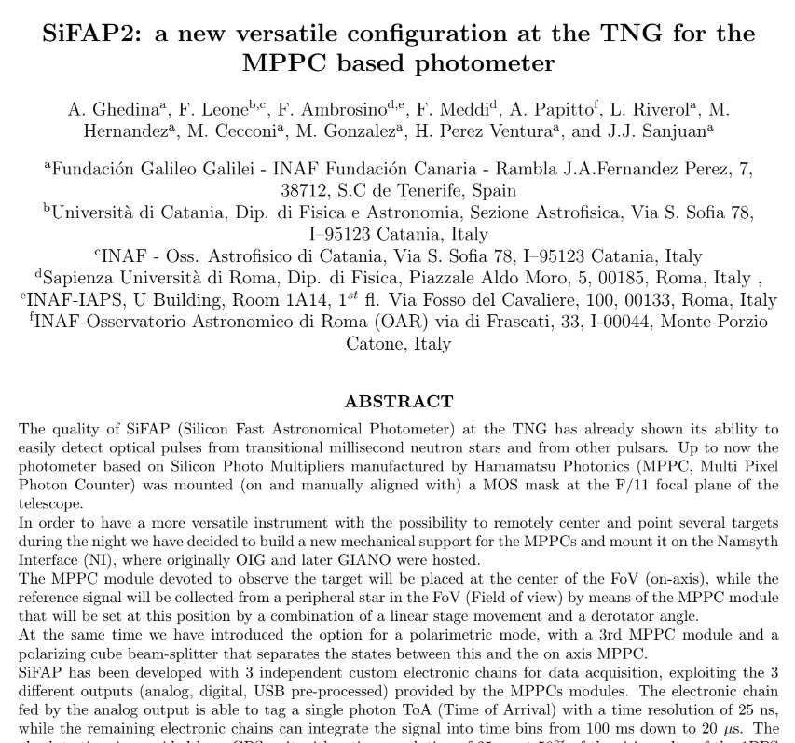
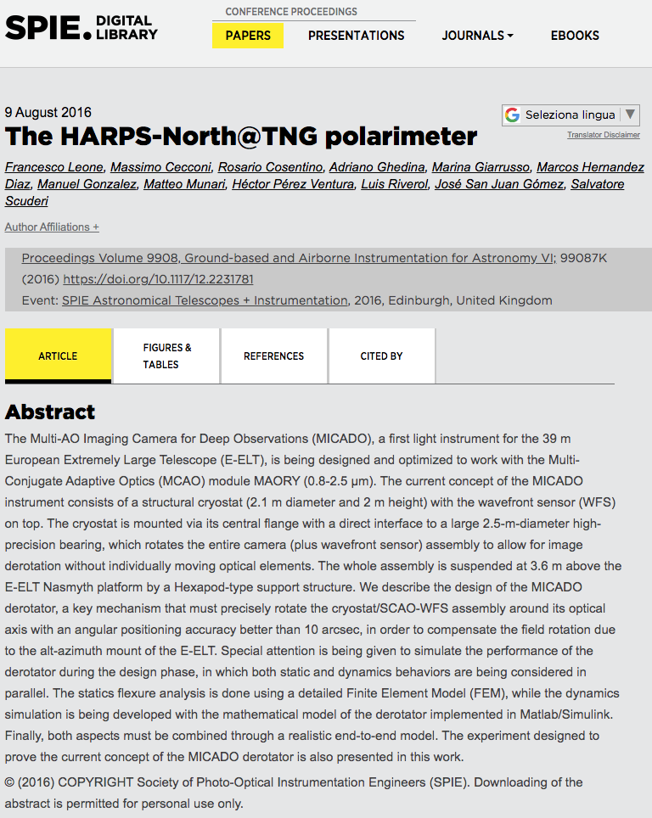
Instrumental Background: High Resolution Spectropolarimetry
1999 2001 2012 2014 2016 2019
High time resolution
photopolarimeter

Slide 13
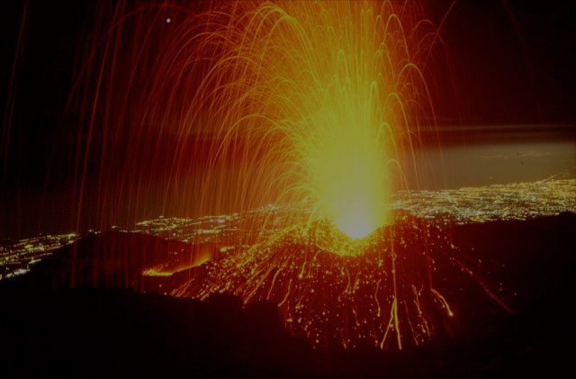
In 2016
High-Resolution Spectropolarimetry from Astrophysics to Laboratory Plasma

Slide 14
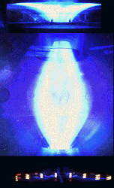
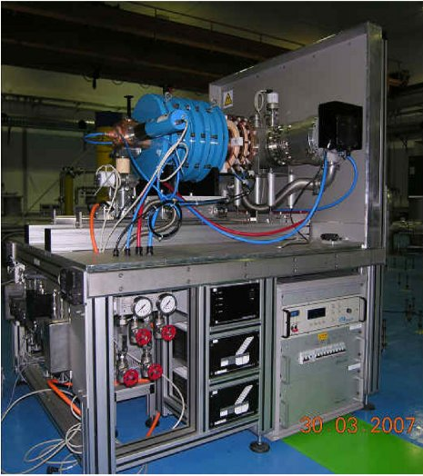
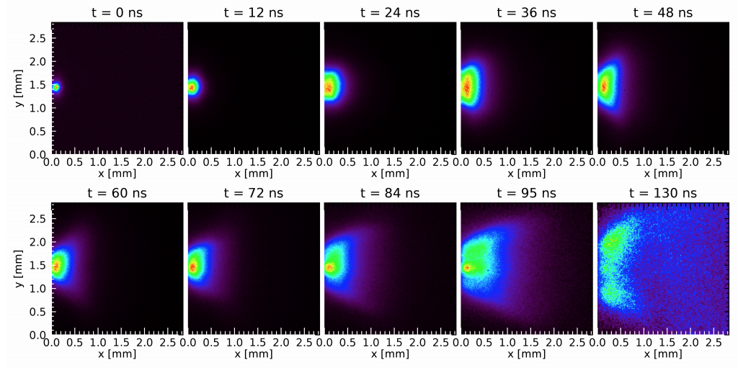
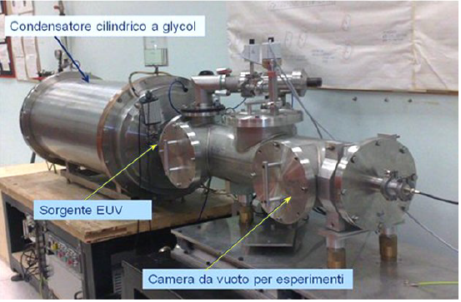
We are full of Laboratory Plasmas
Electron Cyclotron Resonance Plasma
Centro Nazionale di Adroterapia Oncologica - Pavia
Magnetic Confinement Plasma
Proto-Sphere
ENEA - Frascati
Laser Produced Plasma
INFN - Catania
Discharge Produced Plasma
ENEA - Frascati

Slide 15
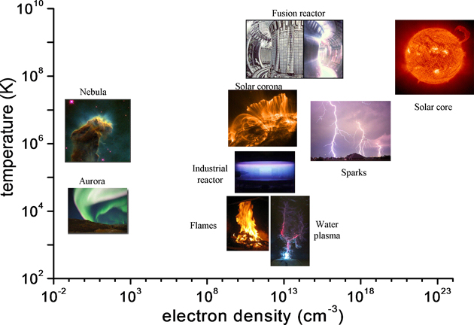
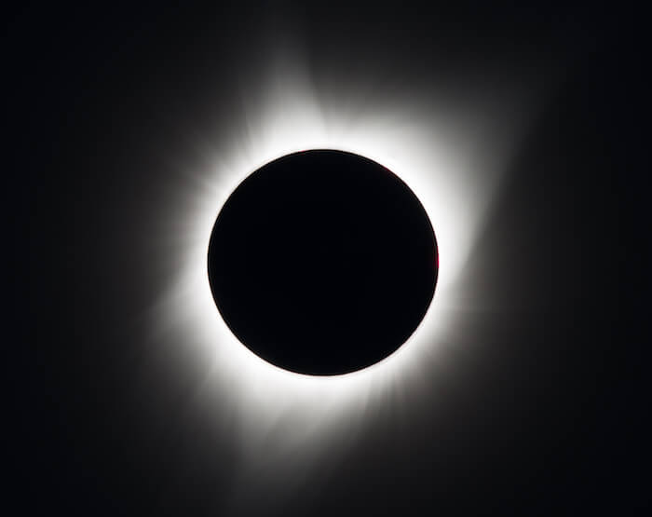
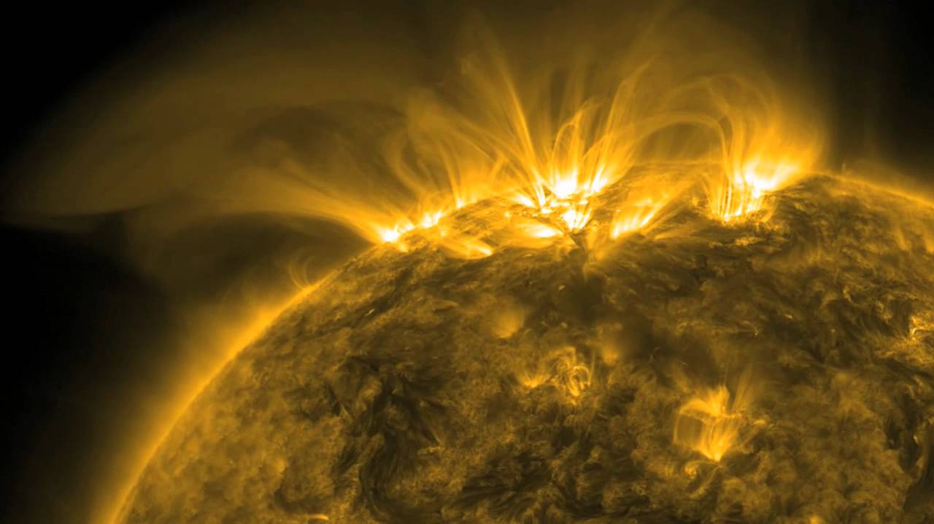
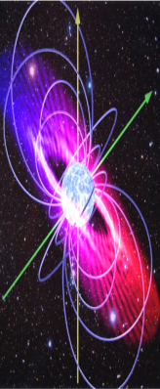
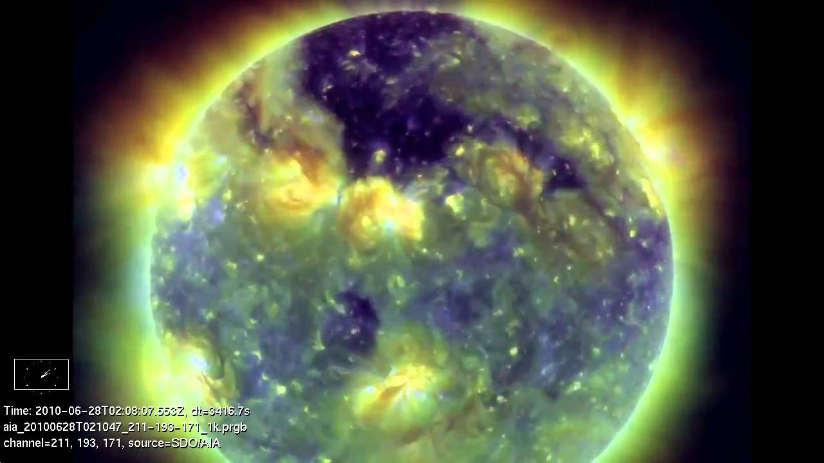
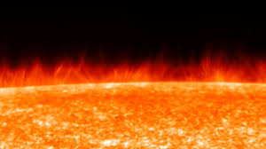
Laboratory and Astrophysical Plasmas
ECR
PLASMAS
AISHa
Solar
Corona
Magnetic
Reconnection
electron temperature (K)
Stellar Atmospheres
FPT
Laser plasma
DPP
Stellar
Magnetospheres
Chromosphere and Transition Region
electron density (cm⁻³)

Slide 16
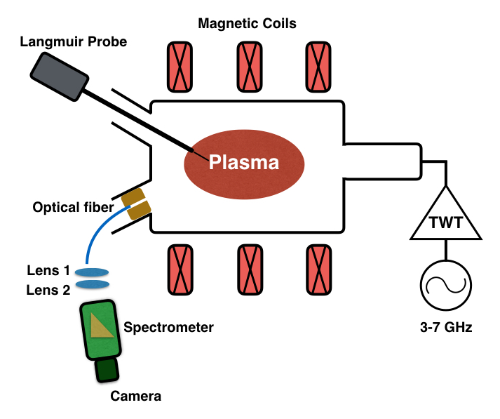
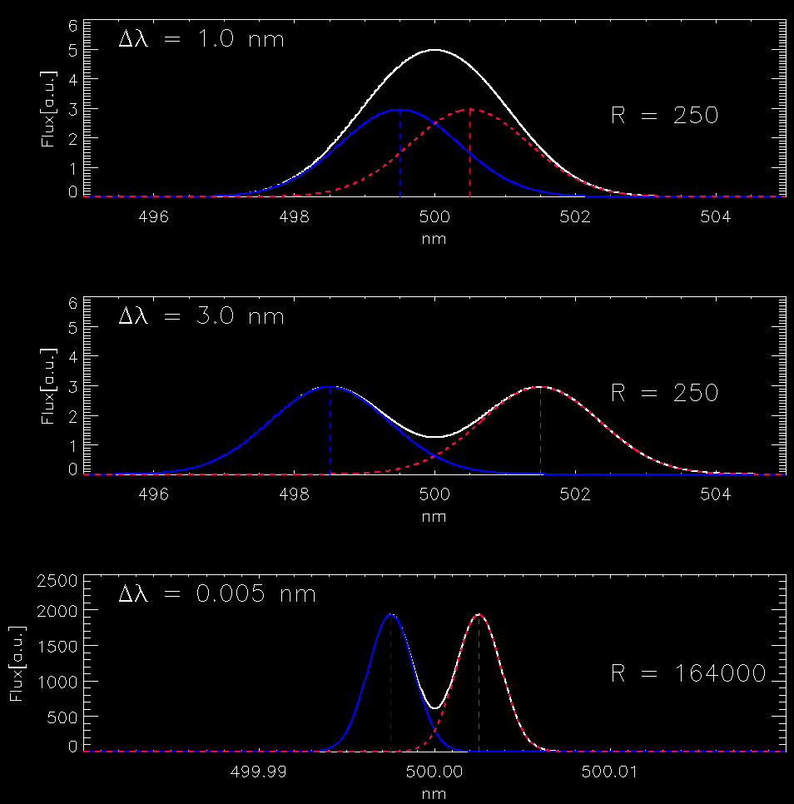
From Astrophysics to Laboratory Plasma
STATE OF THE ART
Limits of present Optical Emission Spectroscopy
100
R = λ/Δλ = 250
H
]
80
656 nm
.
H
U
.
A
60
486 nm
[
Field of view
y
t
i
s
n
e
40
t
H₂
Fulcher band
600-640 nm
n
H
I
20
434 nm
0
400
450
500
550
600
650
700
Wavelength [nm]
No spatial information
lines from cold and hot regions
no emitters localisation
Spectral Low-Resolution
R =λ/Δλ = 250: no identification of lines
separated less than 2 nm at 500 nm
R = 250
Δλ = 2 nm

Slide 17
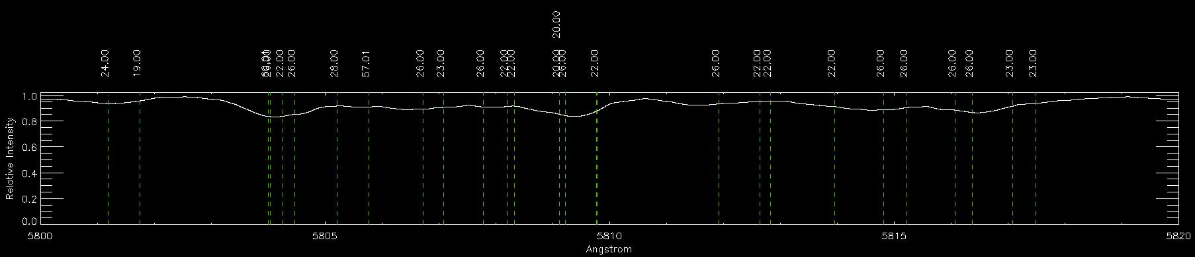
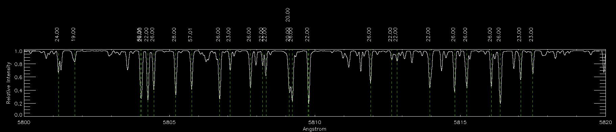
The importance of spectral high resolution
Spectral line identification
Solar Spectrum
R = λ/Δλ = 5000
R = 100000

Slide 18
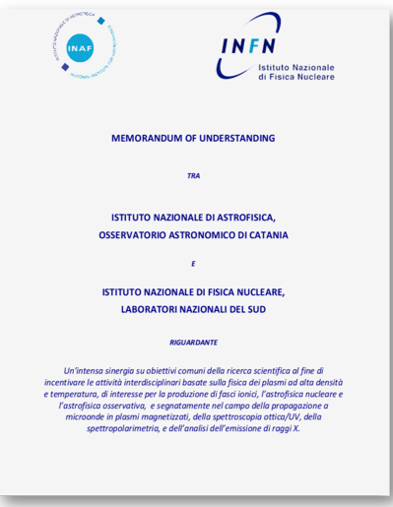


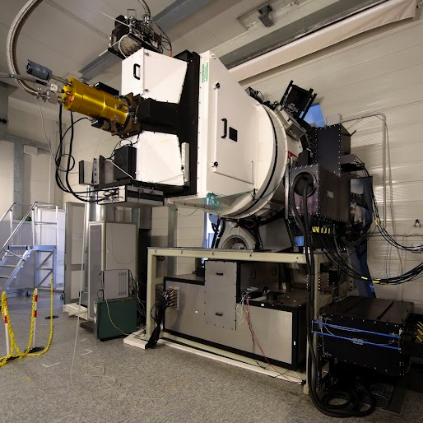
From Astrophysics to Laboratory Plasma
Spettrografo Alta Risoluzione Galileo
Catania
August 2017
R =λ/Δλ= 164000
Δλ = 0.003 nm
370-1000 nm

Slide 19
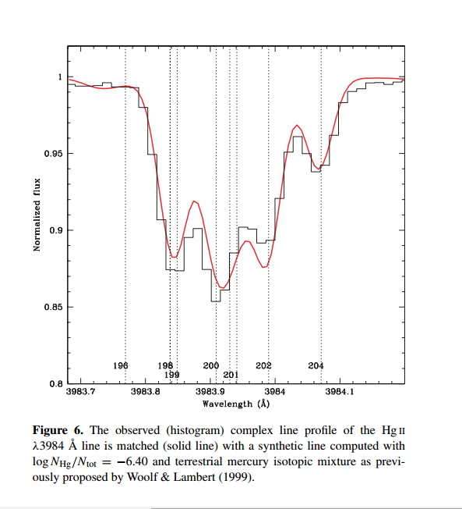
The importance of spectral high resolution
Spectral line identification
Isotopic shift
Hg II
R = 180 000
Δλ_{isot} < 0.01 nm
Δλ = λ/R ≤ Δλ_{isot}
λ = 400 nm
R = 250 → Δλ = 1.6 nm
0.007 nm
74 Aqr
R = 100000 → Δλ = 0.004 nm
[Catanzaro & Leone 2006, MNRAS, 373, 330]

Slide 20
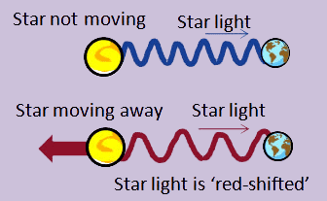
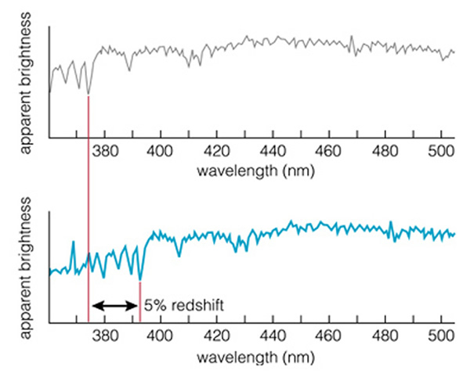
The importance of spectral high resolution
Plasma bubble at rest
light
Spectral line identification
Isotopic shift
Velocity fields
(Doppler shift)
fiber
light
v
fiber
v
v = c Δλ_{D} /λ
Plasma bubble
moving away
Δλ ≤ Δλ_{D}
v_{min} = c Δλ/λ = c/R
Synthetic
min. measurable
Kinetic Energy
for plasma of ⁴⁰Ar
500 501 502 503 504 505 506 507 508 509 510 511 512 513
R = 250 → v_{min} = 1200 km/s → K_{min} = 3 × 10⁵ eV
R = 5000 → v_{min} = 60 km/s → K_{min} = 750 eV
R = 10000 → v_{min} = 30 km/s → K_{min} = 190 eV
R = 100000 → v_{min} = 3 km/s → K_{min} = 1.9 eV
Observed
Δλ_{D}
500 501 502 503 504 505 506 507 508 509 510 511 512 513

Slide 21
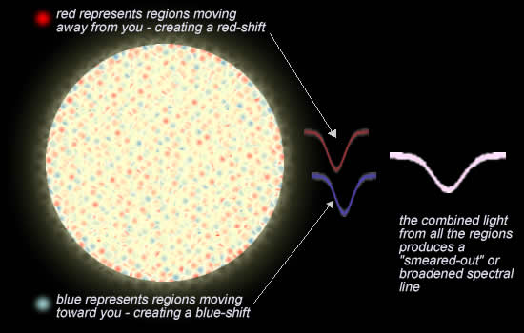
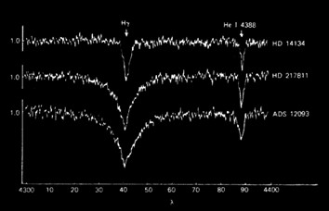
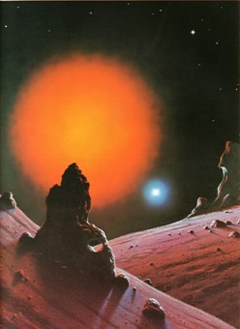
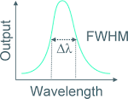
The importance of spectral high resolution
Thermal
Spectral line identification
Isotopic shift
Velocity fields
Line broadening (cold n_{e})
λ = 500 nm, Δλ = FWHM
R = 250 → FWHM_{min} = 2 nm
R = 5000 → FWHM_{min} = 0.1 nm
R = 10000 → FWHM_{min} = 0.05 nm
R = 100000 → FWHM_{min} = 0.005 nm
Collisional
H_{γ}
He I λ4388 Å
Δλ ≤ FWHM
rarefied
dense
λ ⎡Å]

Slide 22


From Astrophysics to Laboratory Plasma
Notes:
Spettroscopia ad alta risoluzione sulla riga del Deuterio alpha

Slide 23


From Astrophysics to Laboratory Plasma
MAPS – 3D
MAgnetised Plasma Spectropolarimetry – 3D
grant-giovani CSN5-INFN, PI M. Giarrusso
2018
Three polarimeters
fiber-linked to
SARG
to point-by-point (1 mm³)
map the
FPT
magnetic field
Notes:
Nel mio progetto si propone invece la realizzazione di 3 polarimetri che verranno disposti perpendicolarm.
L’INAF-OACT si occuperà della realizzazione di 3 polarimetri fiber-linked, che verranno implementati nella FPT al fine di ottenere una caratterizzazione 3D del c.m. attraverso l’emissione spettropolarimetrica del plasma (l’analisi dei Parametri di Stokes)

Slide 24

From Astrophysics to Laboratory Plasma
Polarimeters@Osservatorio Astrofisico di Catania
Spectra of hollow cathode Th-Ne lamp
with FRESCO (R=20000)
without B
with |B|≈ 100 G, along B

Slide 25
COSSAM
COdice per la Sintesi Spettrale nelle Atmosfere Magnetiche
LTE populations
Zeeman Splitting
Polarised Radiative Transfer
Stift, Leone & Cowley 2012, MNRAS 419, 2912
1939
2004
observed
synthetic
|B|= 5 kG

Slide 26






CHIANTI
non-LTE populations
Unpolarised Radiative Transfer
SOHO (Dec. 1995)

Slide 27
From Astrophysics to Laboratory Plasma
Magnetised Plasmas
Merging CHIANTI & COSSAM
CHIANTI
non-LTE populations
Unpolarised Radiative Transfer
COSSAM
LTE populations
Zeeman Splitting
Polarised Radiative Transfer
Z-CHIANTI
non-LTE populations
Zeeman Splitting
Polarised Radiative Transfer

Slide 28





CHIANTI
Zeeman CHIANTI
Fe XXIV 8194.0889 Å
Fe XXIV 8194.0889 Å, |B|=5 Tesla, θ=30°, χ=50°
θ
B
χ

Slide 29




Zeeman CHIANTI – The four Stokes profiles
I
Q
U
V

Slide 30




From Astrophysics to Laboratory Plasma
LASER PLASMAS
High spatial, temporal and spectral resolution Spectroscopy
Theory well known
Best match for
T_{e} = 2.5 eV
n_{e}= 10¹⁸ cm⁻³

Slide 31

From Astrophysics to Laboratory Plasma
An application to X-ray spectra from Frascati Tokamak Unit

Slide 32


Back to Astrophysics
In 1814 the Fraunhofer solar spectra were unknown unknowns
Notes:
Cose di cui non abbiamo la consapevolezza di non conoscere

Slide 33



Slide 34


Nowdays, solar and the stellar spectra are known knowns
thanks to
an almost complete atomic database for interpretation of spectral lines
of neutral and low ionised species
observed
Solar Spectrum
synthetic
λ log(gf) el E₁ E₂ g₁ g_{2 …}

Slide 35



Atomic data for
highly ionised species
are current
unknown knowns

Slide 36



Atomic data for
highly ionised species
are current
unknown knowns
Electron Beam Ion Trap

Slide 37






Primary Goal: An atomic database for highly ionised species
SARG dal
LNS-INFN
TNG
Gennaio 2018
Grant INFN
3D plasma Spectropolarimetty
Gennaio 2018
Multi-Band High Time Resolution
Plasma Imaging
Settembre 2019
Plasma Traps @ LNS
n_{e}=10¹⁰-10¹³
T_{e}=0.1 – 100 keV
Plasma Synthetic Spectra
Grant ASI-INAF (12/2019)
UV spectrograph
70-400 nm @ R=20,000
Agosto 2017
TIME

Slide 38

In a step-by-step approach
Building an Atomic Database for UV transitions
for present space missione

Slide 39


Building an Atomic Database for UV transitions
LAPSUS
LAboratory Plasma Spectroscopy for Ultraviolet Space
PI M. Giarrusso
(grant “Analisi Dati, Modellistica, Analisi in laboratorio e/o su campo, Ricerca e Sviluppo”
under the ASI-INAF agreement n.2018-16-HH.0, experimental program 2020-2022)
WP: PLASMA TRAPS
WP: SPECTROSCOPY
Spectra in three ranges
700 – 1000 Å
1000 – 2400 Å
2400 – 4200 Å
Element-by-element
plasma emission
WP: UV SPECTROGRAPH
New Atomic Data
UV èchelle spectrograph
700 – 4200 Å
R = λ/Δλ = 20000

Slide 40

Grazie

