Slide 1

Nuovi rivelatori per nuove diagnostiche in Astronomia X
Marco Feroci
Istituto di Astrofisica e Planetologia Spaziali (IAPS)
Istituto Nazionale di Astrofisica (INAF)
Roma – Tor Vergata

Slide 2
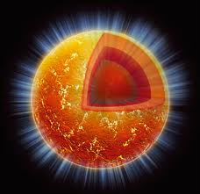
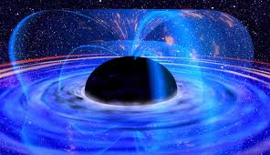
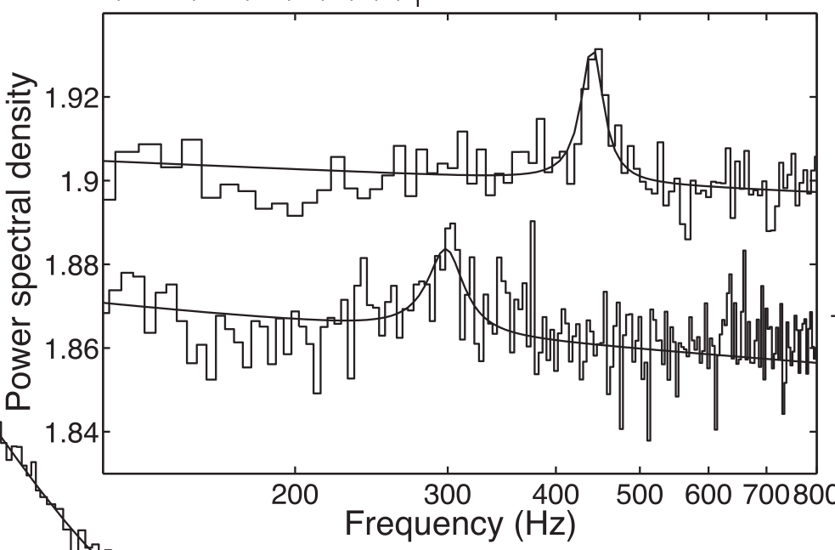
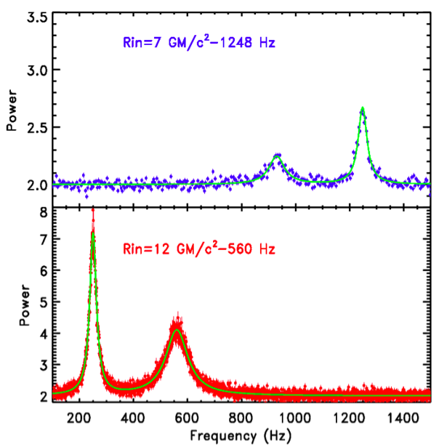
Science Drivers
Study of matter under extreme conditions of gravity, density and magnetism: simultaneous, high-throughput spectral, timing and polarimetry observations.
eXTP:
10x the signal to noise
Motta et al. 2013

Slide 3
Outline
Silicon Drift Detectors
  Large-area SDD
  PixDD
Gas Pixel Detectors
Applications to space astronomy
  eXTP (enhanced X-ray Timing and Polarimetry) mission
  IXPE (Imaging X-ray Polarimetry Explorer)

Slide 4
Enabling Technology: Large-area Silicon Drift Detector e PixDD
Diagnostics: High-throughput X-ray spectral-timing (0.5-30 keV)

Slide 5
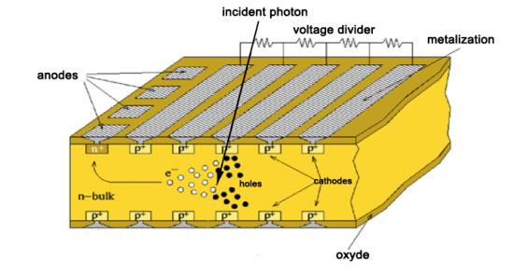
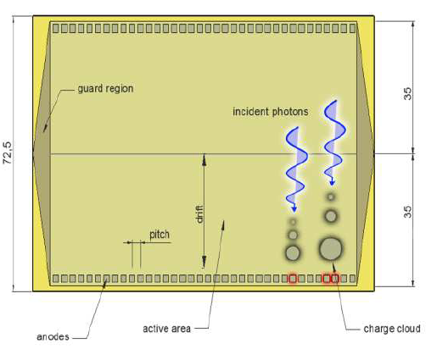
The large-area
Silicon Drift Detector
SDDs
Heritage of ALICE ITS (LHC) → particle tracking (~1.5 m² – 300 units, operating since 2008)
R&D INFN, INAF & FBK for X-ray detection
Advantages:
solid state detector
e⁻ drifted and collected by small (~1 mm²) anodes → low capacitance → low series noise
extremely small intrinsic leakage current (< 0.05 nA/anode @ 22° C) → low parallel noise
1D read-out (low power, reduced number of channels)
short drift time (5 µs for 35 mm drift length) → 100% CCE

Slide 6
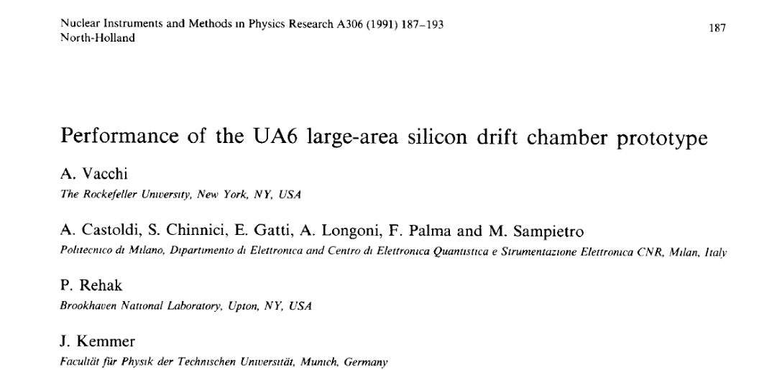
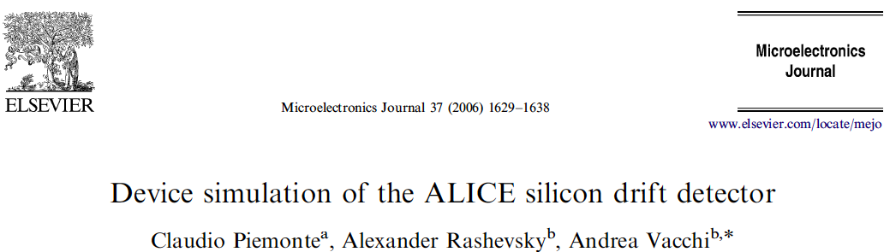
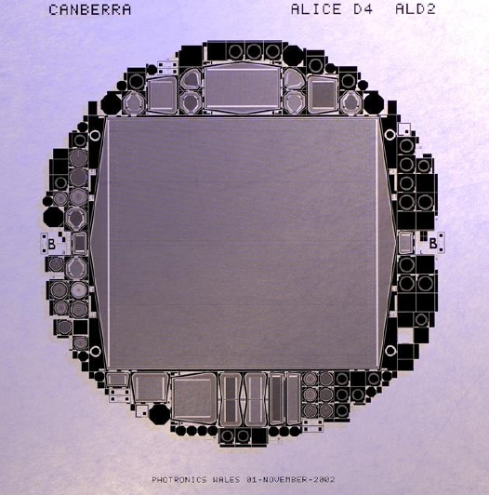
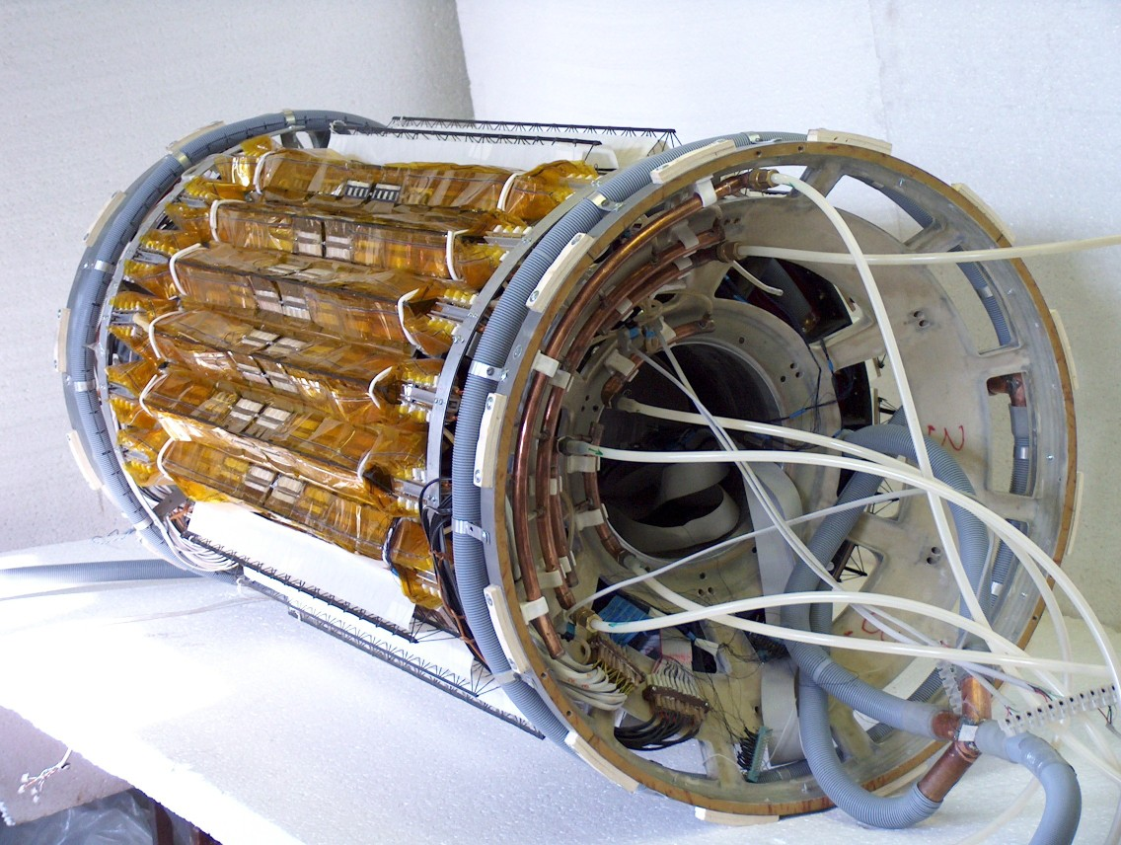
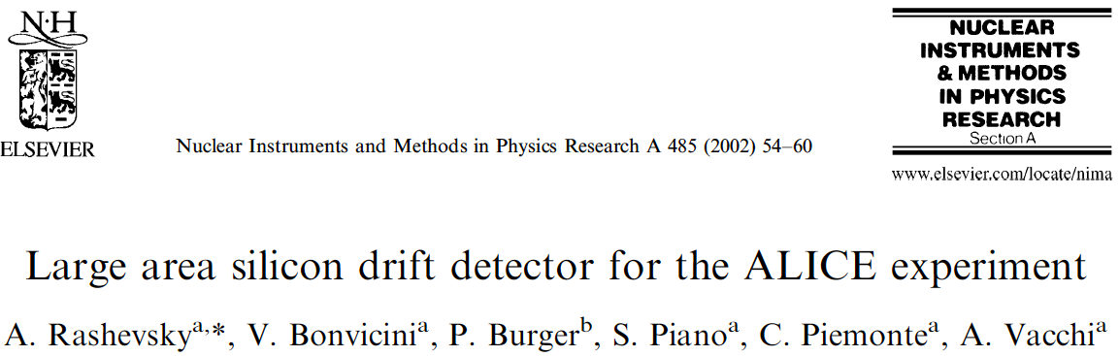
SILICON DRIFT DETECTOR
HERITAGE LARGE AREA SDD 25 years of progressive developments
1991
ALICE ITS @ CERN
2002
2007

Slide 7
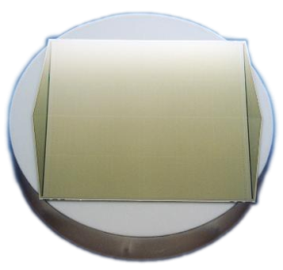
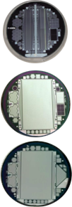
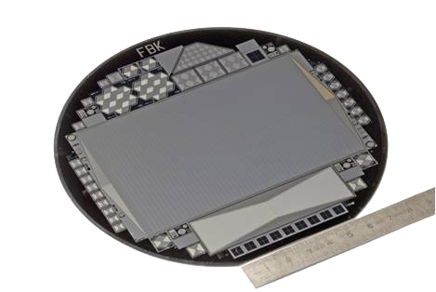
The LAD large-area
Silicon Drift Detectors
ALICE
2002
ALI2
2010/11
Power, Thickness
XDXL1
2011/12
Low-E QE
XDXL2
2012
Pitch
ReDSoX
2014/17
Size
Low-I_{leak}

Slide 8
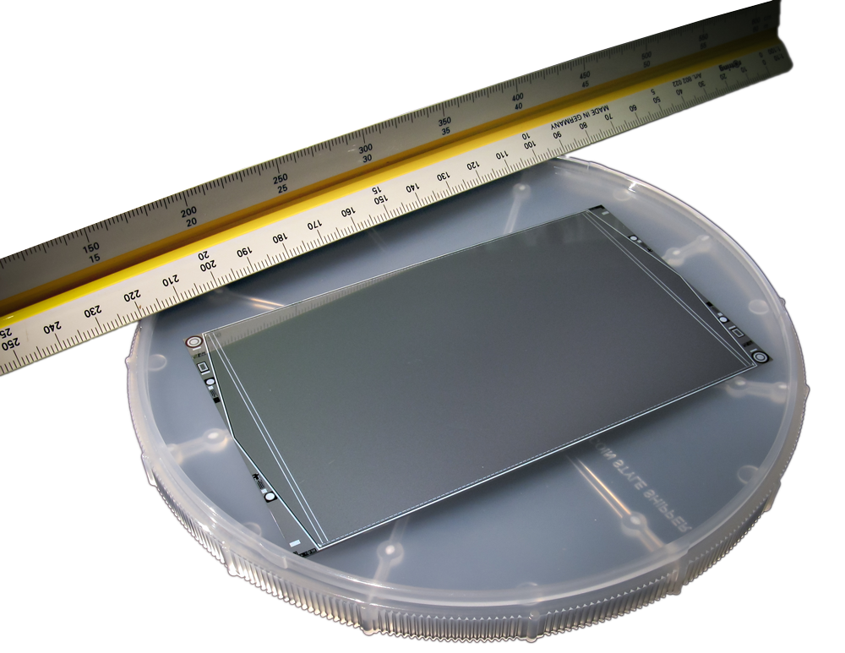
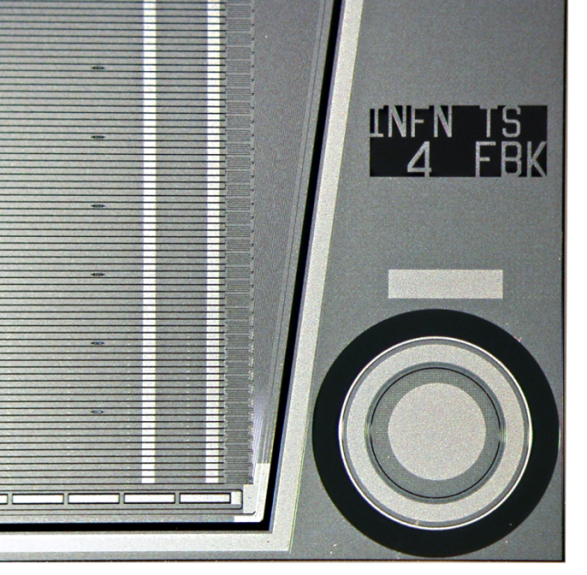
The LAD large-area
Silicon Drift Detectors
ALICE
2002
ALI2
2010/11
Power, Thickness
XDXL1
2011/12
Low-E QE
XDXL2
2012
Pitch
ReDSoX
2014/17
Size
Low-I_{leak}
First full-scale prototypes produced 2014
Cut out from 6” wafer
Geometric area: 120.3 x 72.5 mm²
Sensitive area: 108.5 X 70.0 mm²
Leakage current: <200 pA/cm² @ T_{room}

Slide 9
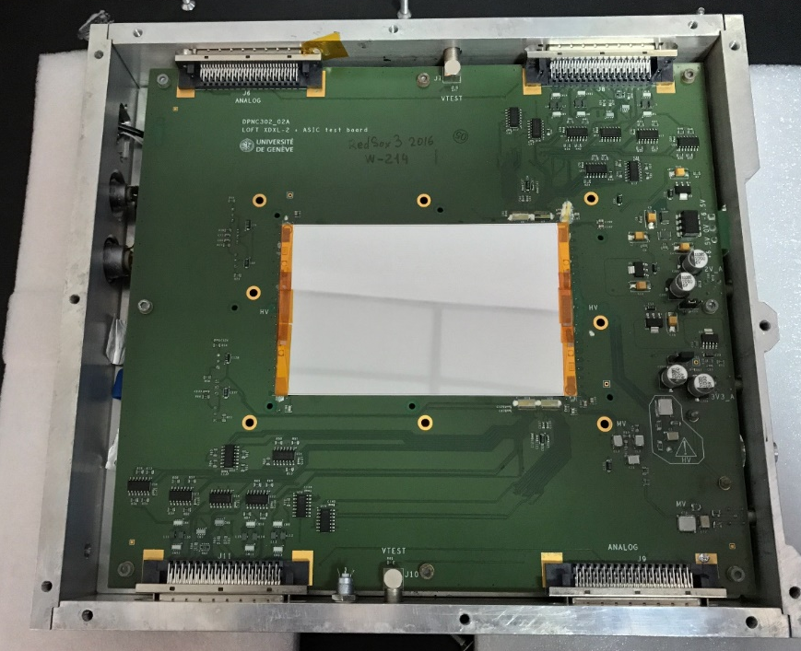
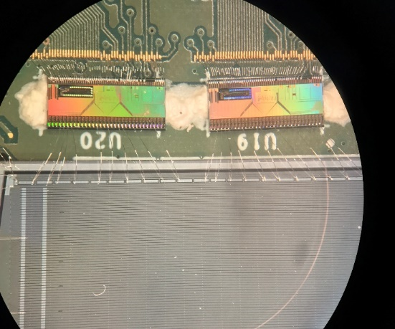
Large-area SDD – Performance tests
VEGA ASIC (Bertuccio et al.)
U19 ASIC Channel | FWHM @ 5.9 keV [eV]
01 | (220.4 ± 2.0)
08 | (234.5 ± 3.0)
17 | (231.0 ± 2.5)
18 | (236.4 ± 2.1)
22 | (237.5 ± 2.2)
26 | (240.5 ± 1.9)
27 | (218.4 ± 2.0)
28 | (218.8 ± 1.9)

Slide 10
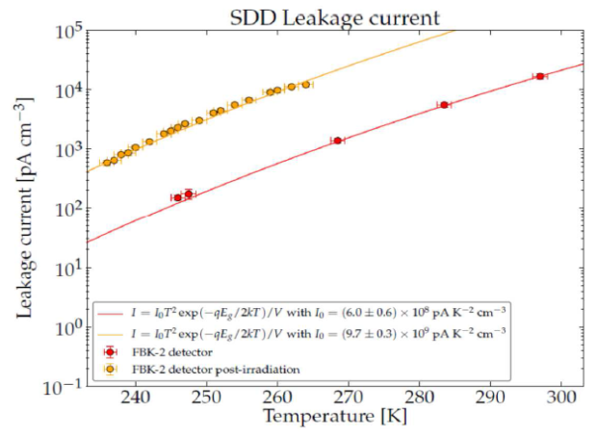
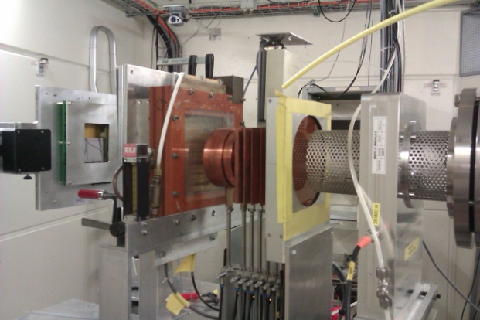
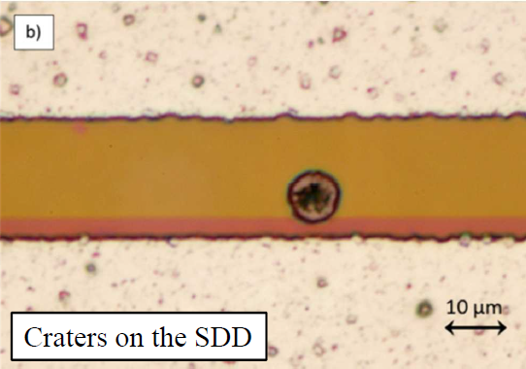
Large-area SDD – Radiation tests
NIEL from 11 MeV and 50 MeV protons:
PSI – Zurich
[E. Del Monte et al. 2014, JINST 9]
NIEL from soft protons (800 keV p+):
Tubingen
Variation of the CCE (11 MeV p+)
PSI – Zurich
[Del Monte et al. 2015, JINST 10]
Hypervelocity impacts from debris (0.5-3 mm diameter):
MPIK - Heidelberg
[G. Zampa et al. 2014, JINST 9]

Slide 11

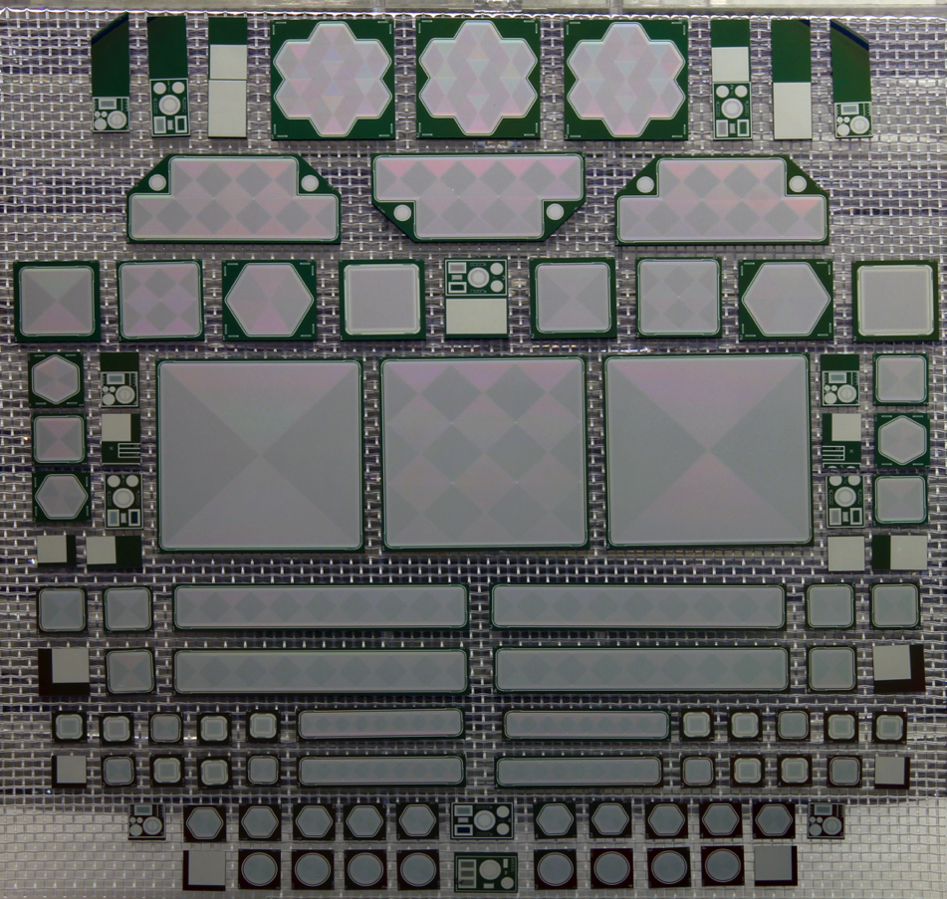
SDD within Collaboration
SDD Quantum Efficiency (QE) > 80%
Low anode capacitance (few tens of fF)
Low leakage current (tens of pA/cm²)
Notes:
Tecnologia SDD principio di funzionamento e caratteristiche e FEE giusta
Descrizione redsox come temi di apllicazione
Dal disegno al prodotto finito

Slide 12


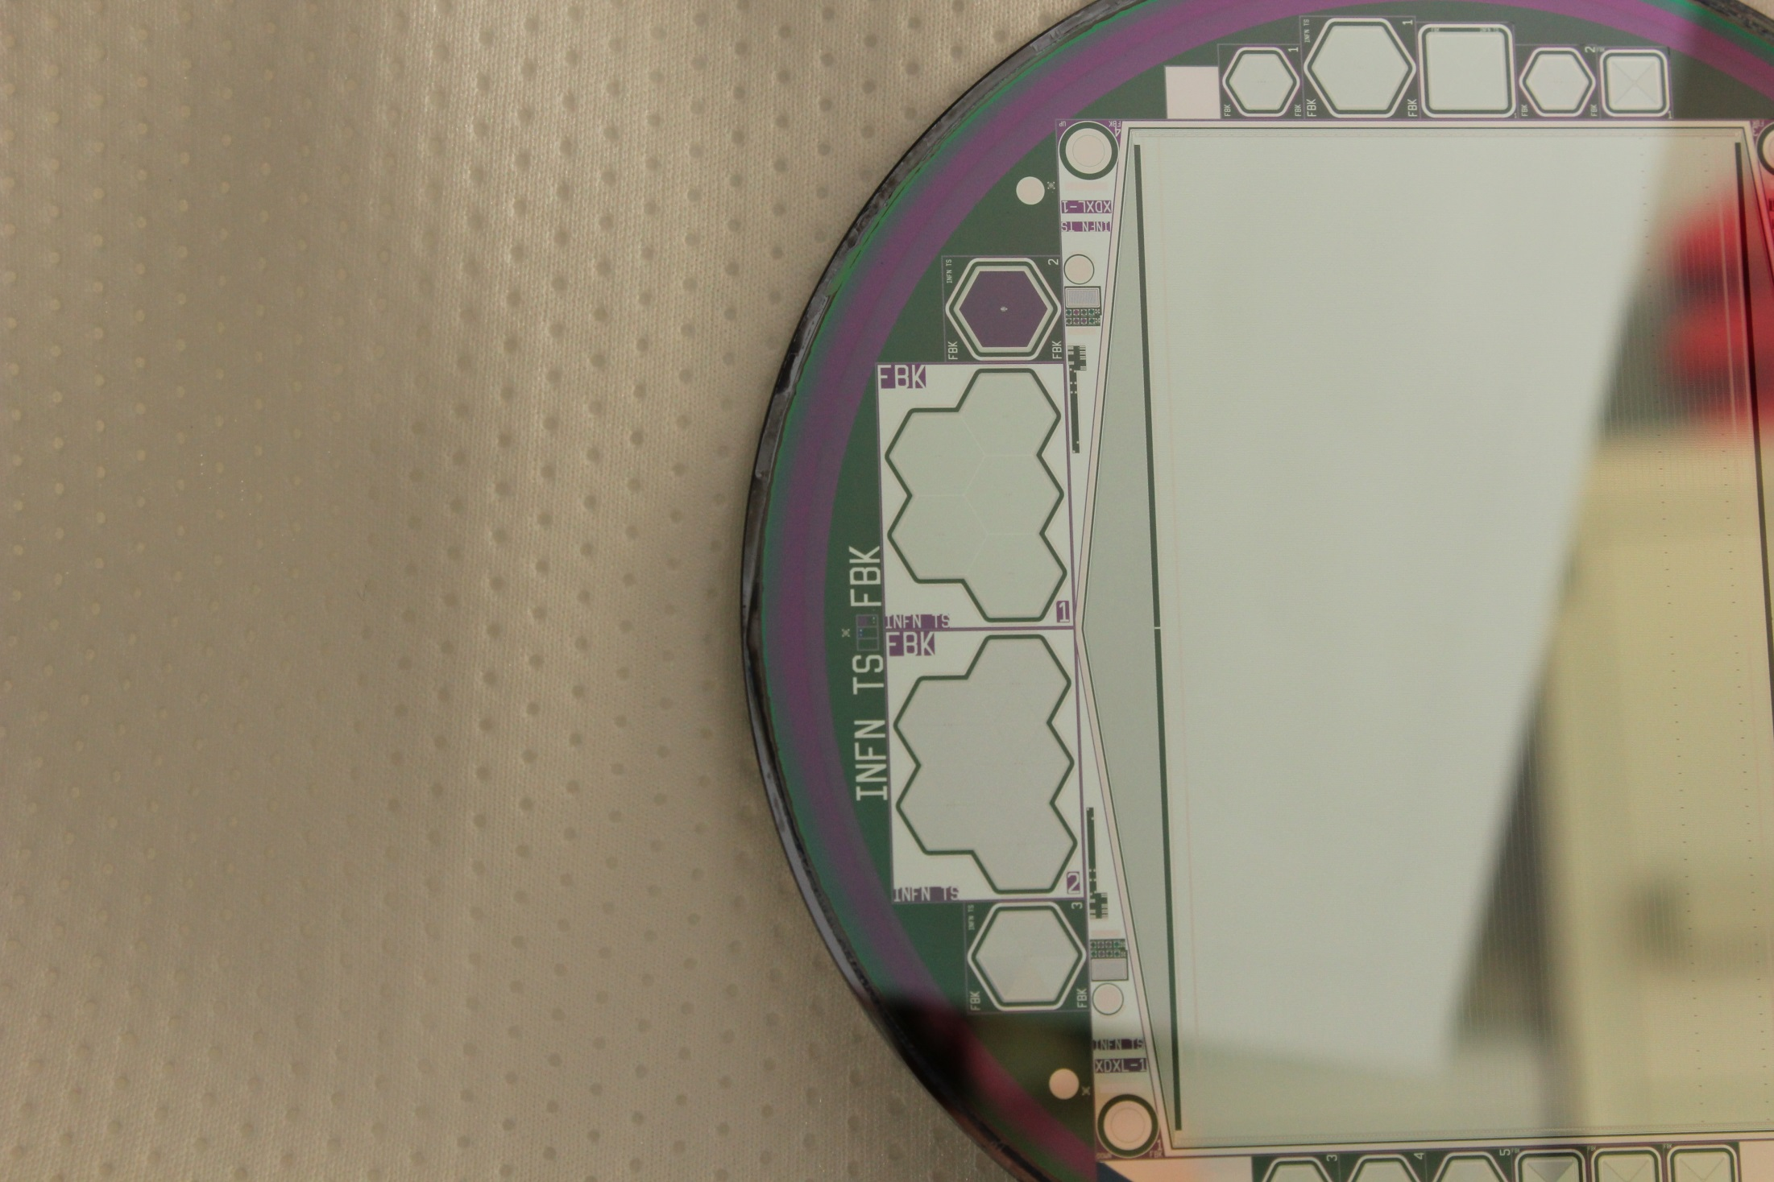
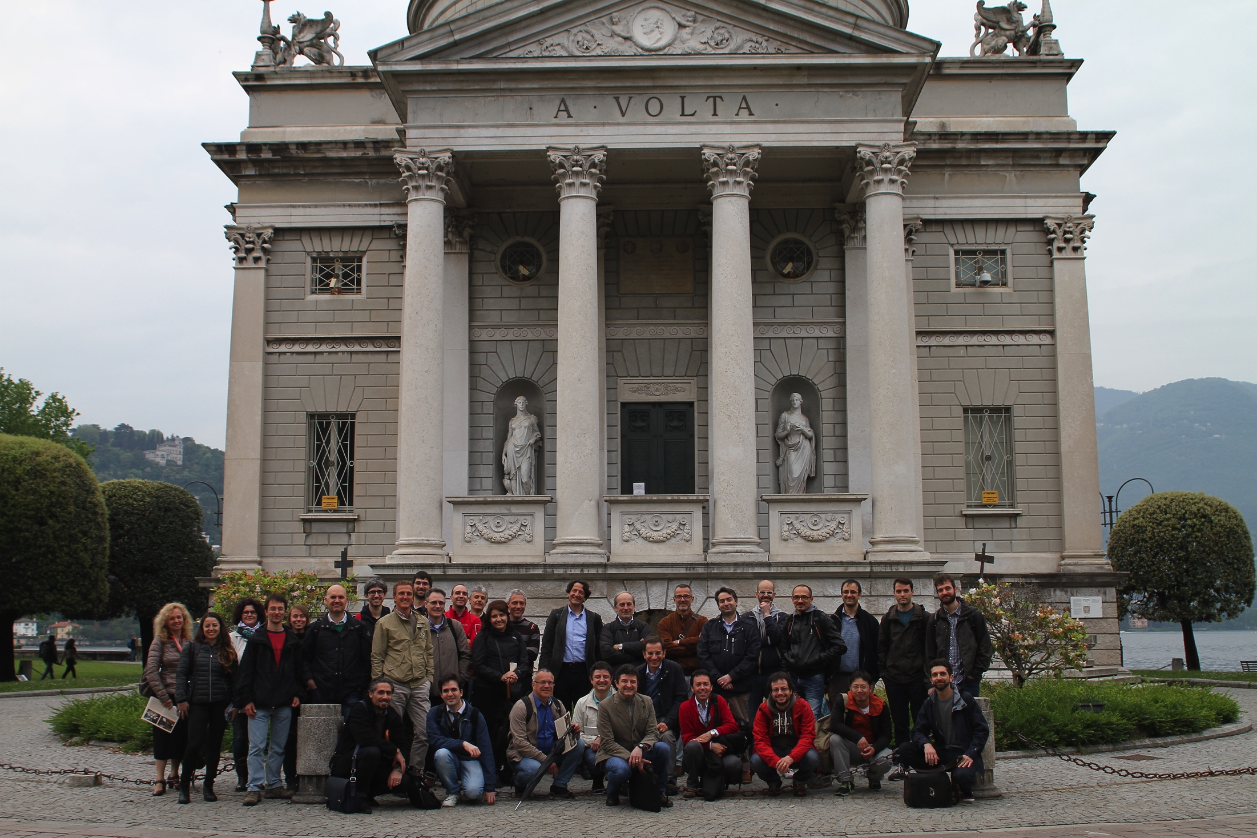
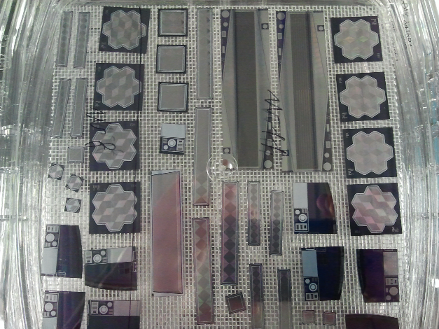

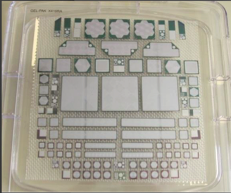
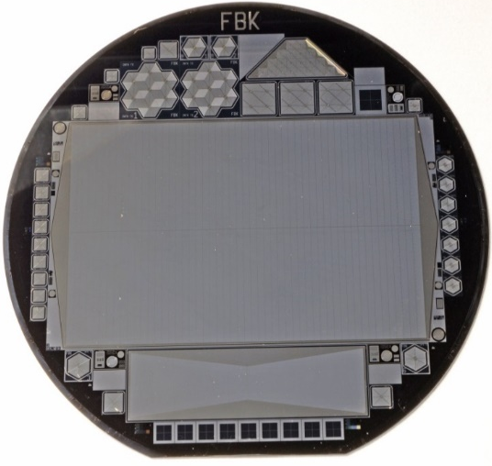
State of the art SDD for eXTP
Since more than 10 years a collaboration of about 40 people is working on general SDD development for various state of the art applications with considerable cross fertilization.
The collaboration is led by INFN-Ts and include: INAF (IAPS-Rm and OAS-Bo), FBK, Politecnico di Milano, Università di Pavia, Elettra Sincrotrone Trieste, Università e INFN di Bologna, ...
Un poco di storia
Familiarizziamo con il principio
ALICE più di 1 m²
raggi X di bassa energia
  Gli sviluppi per Sorgenti di Luce Avanzata
  Gli sviluppi per il passaggio a 6” e la tecnologia LOFT
INFN Trieste
FBK Trento
Elettra Sincrotrone Trieste
INAF IASF INFN Roma 2
INFN INAF Bologna
INFN Pavia
INFN TIFPA Trento
ICTP Mlab Trieste
INFN Firenze Labec
Poli Milano El.&Det.

Slide 13
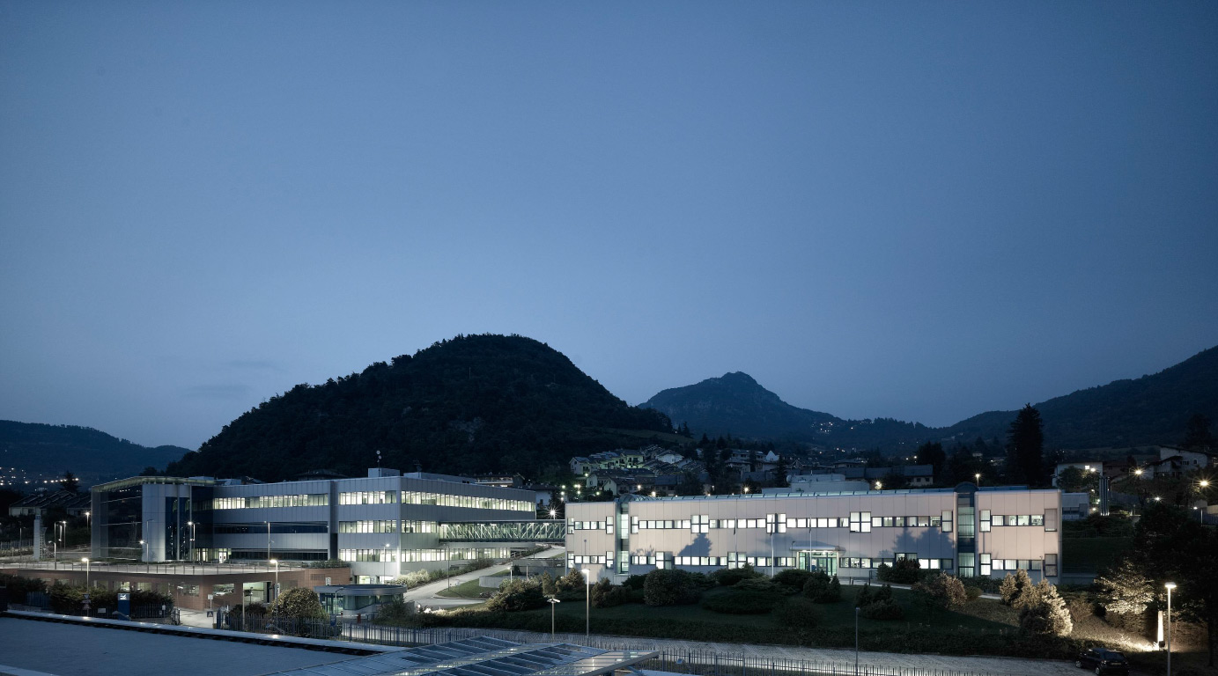



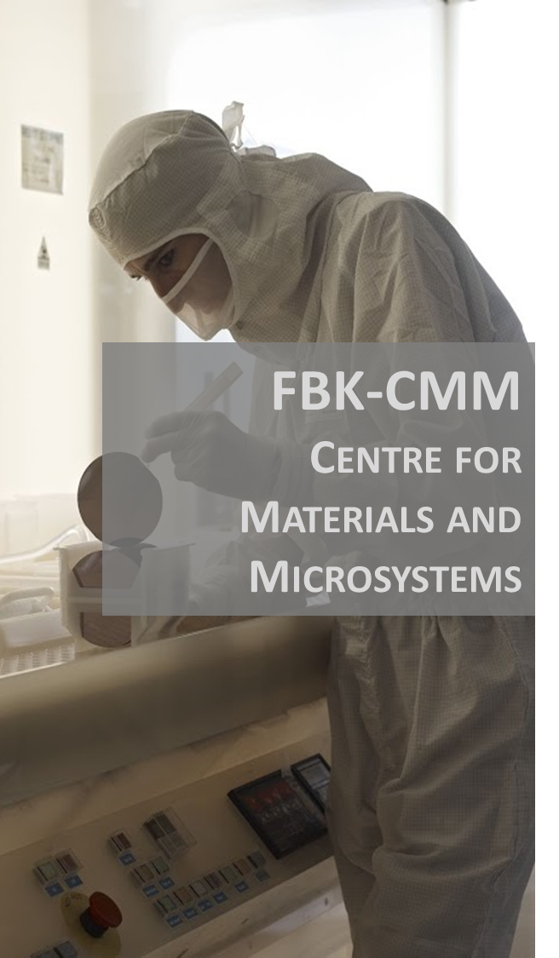
Fondazione Bruno Kessler (FBK)Trentino, Italy

Slide 14
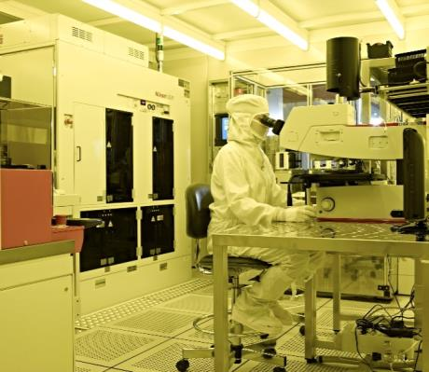
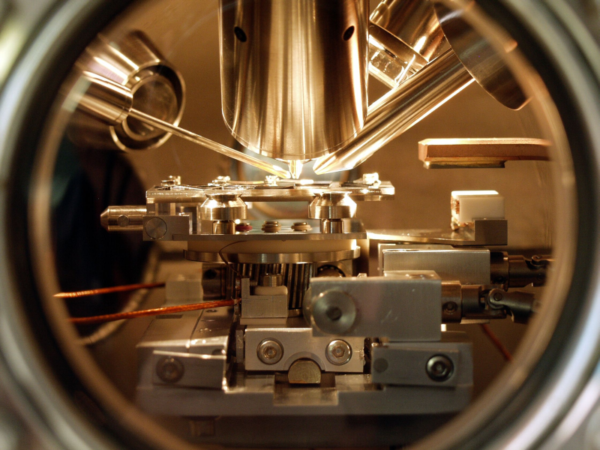
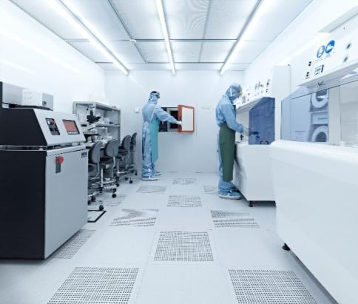
MNF infrastructure
  Over 1200 square metres of laboratories:
  2 separated microfabrication cleanrooms (detectors and MEMS)
  1 integration/packaging cleanroom
  1 parametric testing area
  1 materials characterization area
page
014

Slide 15
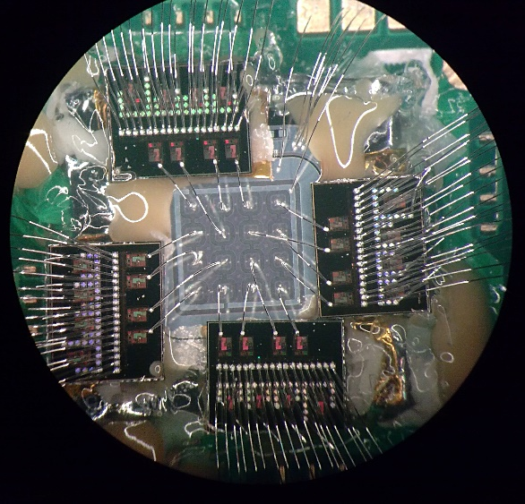
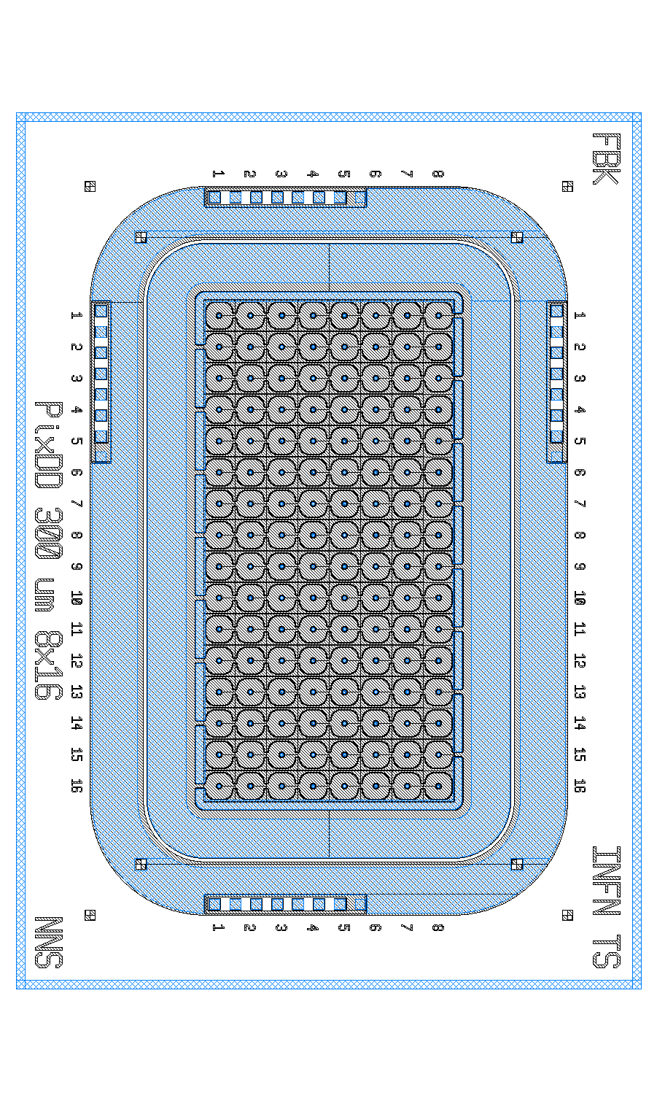
PixDD - a multi-pixel
Silicon Drift Detector

Slide 16
Enabling Technology: Gas Pixel Detector
Diagnostics: X-ray (linear) polarimetry
(2-10 keV)

Slide 17
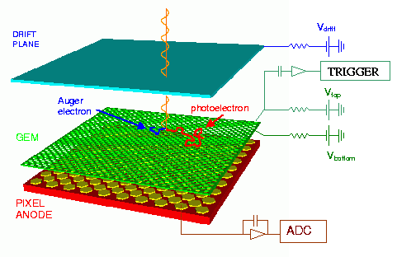
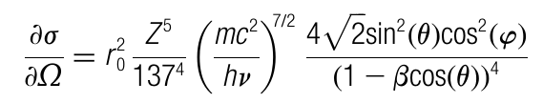
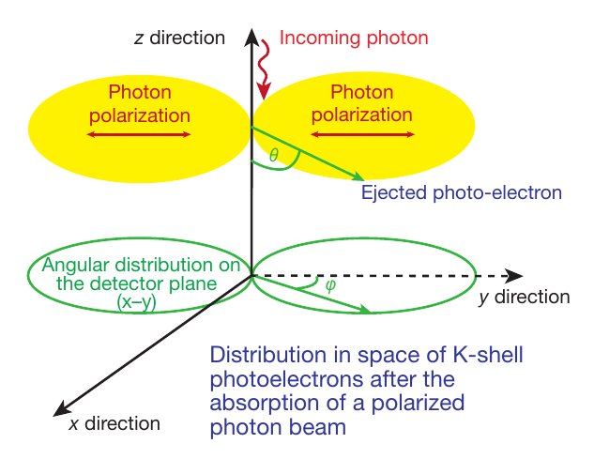
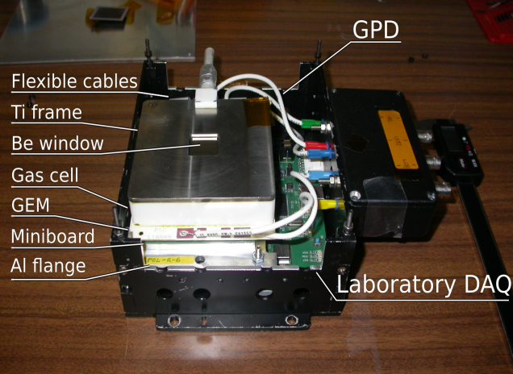
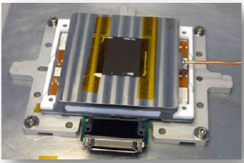
The Gas Pixel Detector
We developed at this aim a polarization-sensitive instrument capable of imaging, timing and spectroscopy
The photoelectric effect
The Gas Pixel Detector
E. Costa et al. 2001, Bellazzini 2006, Bellazzini 2007

Slide 18
GPD – Gas Pixel Detector
GEM - Gas Electron Multiplier
Read-out ASIC

Slide 19
GPD – Gas Pixel Detector

Slide 20
GPD – Gas Pixel Detector

Slide 21
GPD – Gas Pixel Detector

Slide 22
GPD – Gas Pixel Detector

Slide 23
GPD – Gas Pixel Detector

Slide 24
GPD – Gas Pixel Detector

Slide 25
Applications to X-ray astronomy

Slide 26
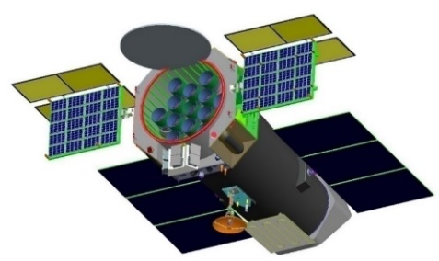
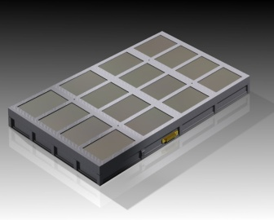
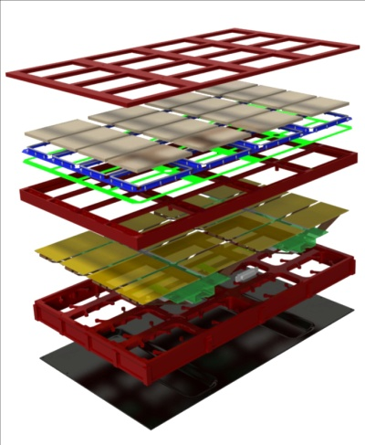
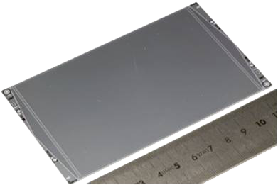
The LAD instrument concept
Frame
Collimators
Clamps
SDDs + FEEs
Frame
The Key to LAD:
low weight/power/volume per unit eff. area
unprecedented large effective area
CCD class energy resolution
instrinsic modularity: 40 modules made of 16 SDDs (640 tot.)
542
Radiator
329

Slide 27
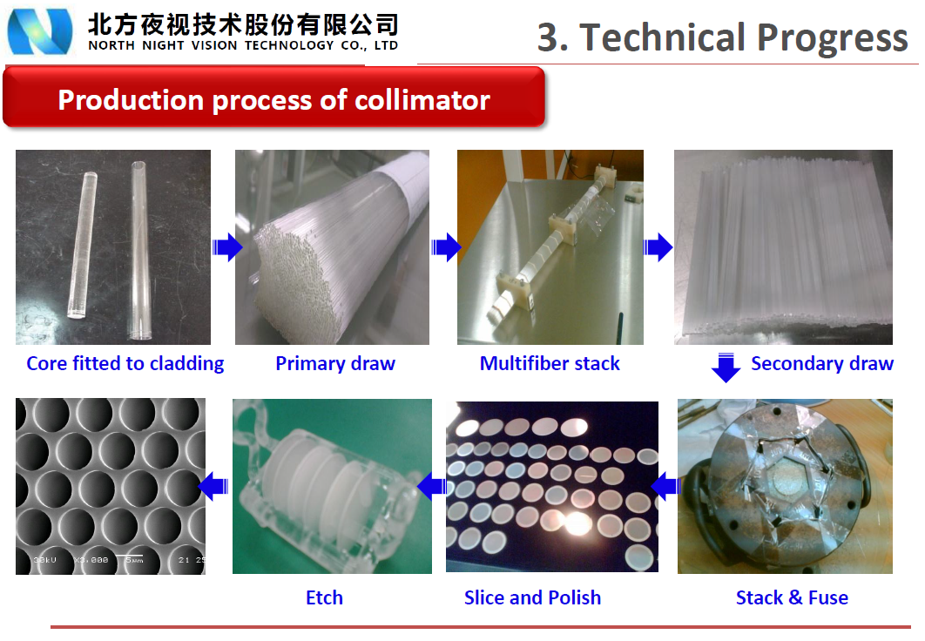
Capillary plate collimators

Slide 28
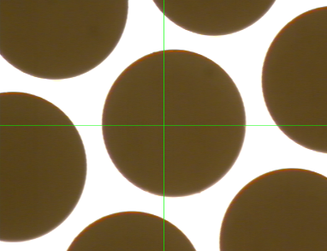
Capillary plate collimators
Key requirements:
- Lead glass
- Large size: 111 mm x 72 mm monolithic
- 60:1 aspect ratio (83 µm pore, 5 mm thickness)
- High Pb content (>40%)
- Low radioactivity (⁴⁰K)
- High Open Area Ratio (75%)
- High roughness (>13 nm rms)
- Pore-to-pore alignment (~arcmin)
- Pore-to-surface alignment (~arcmin)
North Night Vision Technology (Nanjing, China)
Full-size, 75% OAR
6.4 keV
17.5 keV
Alternative (proven) technologies:
- Photonis (France)
- Hamamatus (Japan)

Slide 29
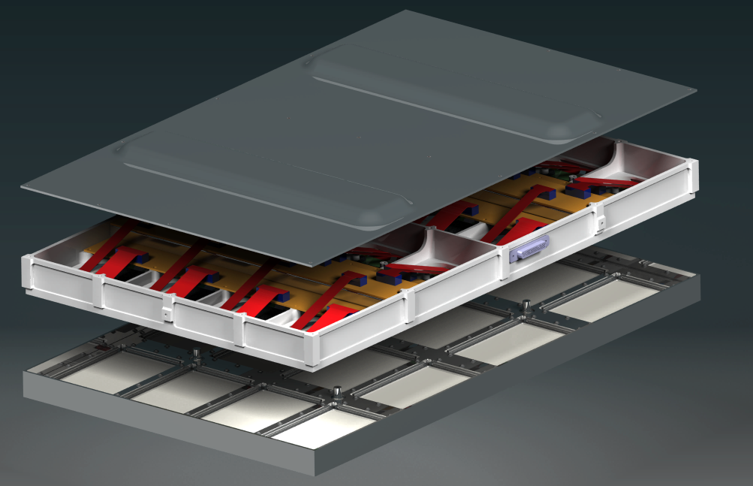
LAD Module
.....

Slide 30
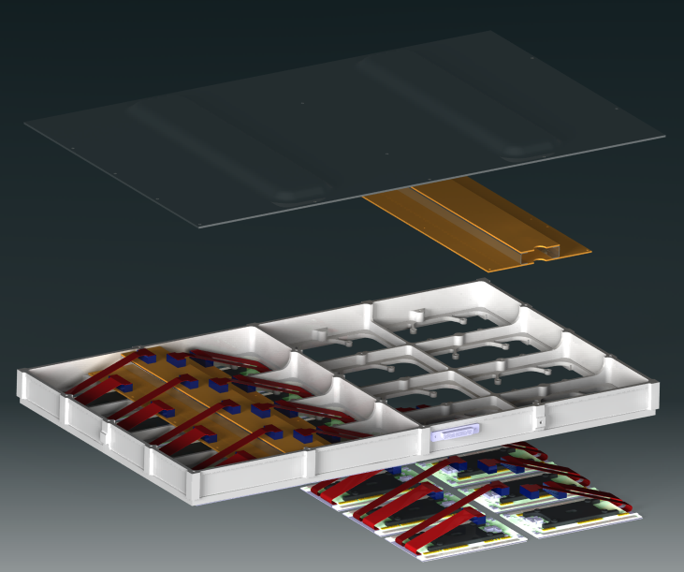
LAD Module

Slide 31
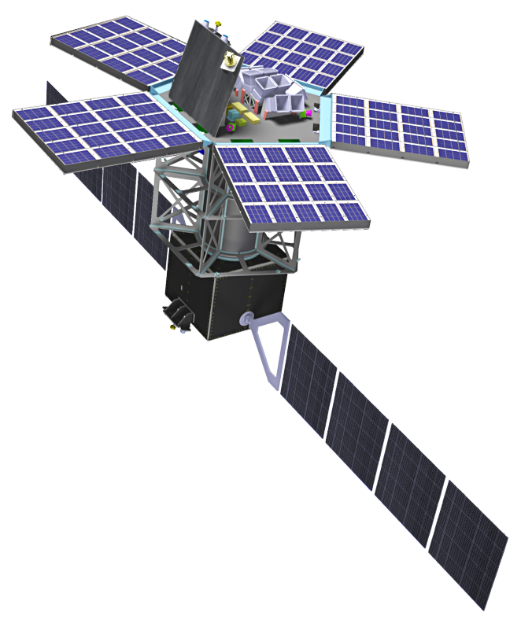

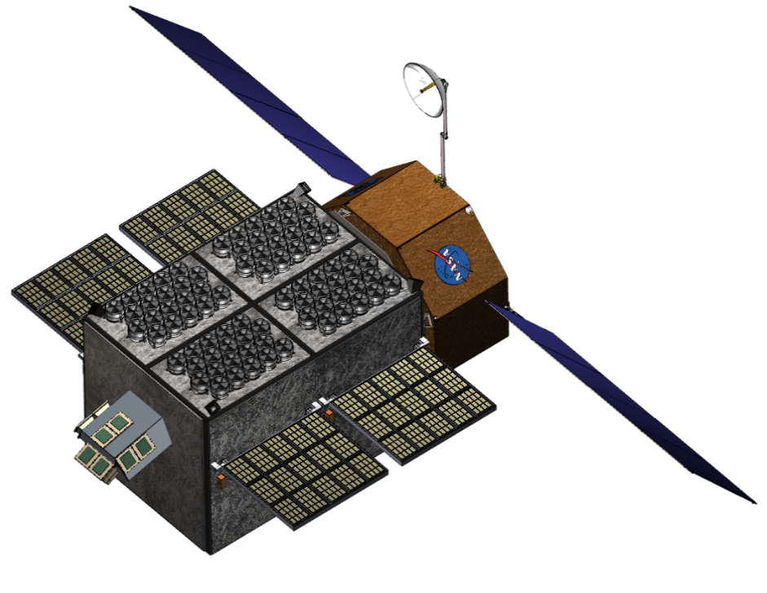
LOFT, eXTP, STROBE-X
LOFT (ESA)
eXTP (CAS)
STROBE-X (NASA)

Slide 32

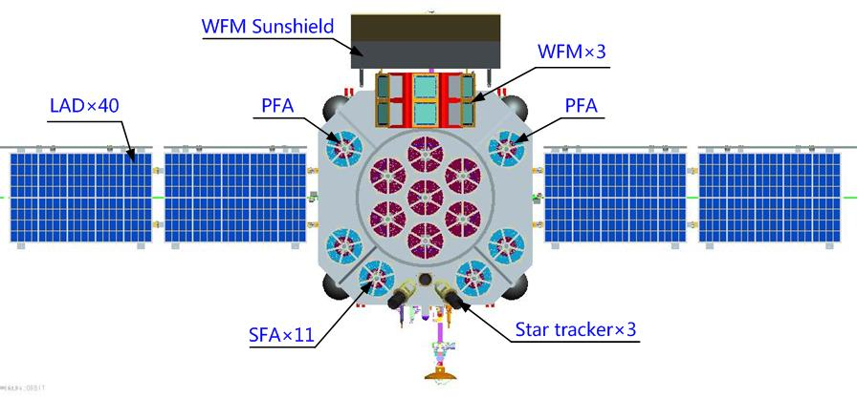

eXTP Scientific Payload
LAD – Large Area Detector
x4
Total effective area: 3.4 m² @8 keV
Energy band: 2-30 keV
Energy resolution: <240 eV FWHM @6 keV
Based on the LOFT/LAD design
40 Modules on 2 deployable panels
Collimated, large-area SDD detector. Single photon, <10µs

Slide 33



eXTP Scientific Payload
PFA – Polarimetry Focusing Array
Focal plane imaging polarimeter: 4 optics with 5.25m FL
Imaging, PSF 20 arcsec HPD
Total effective area: 900 cm² @2 keV (includes QE)
Gas Pixel Detector: single photon, <100µs
Energy band: 2-10 keV
Energy resolution: 20% FWHM @6 keV

Slide 34

XIPE, IXPE
IXPE (NASA)
XIPE (ESA)

Slide 35





Payload Components
Accomplish the science through integrated system of Telescopes and structure alignment components.
Telescopes (3)
X-Ray Shields
Mirror Module Assembly (3)
(3) Detector Units
MMSS Deck
Metrology Camera
MMSS Center Tube
Tip-Tilt-Rotate Mechanism
Deployable Boom with Thermal Sock
Detectors Service Unit
(3) MMSS Launch Locks
(3) MMSS Bipods
Metrology Target

Slide 36

Detector Unit: Grand Summary
Stray-light collimator
INFN
  GPD and associated thermal ctrl
  DAQ and low-voltage boards and associated backplane (through OHB-I)
  Stray-light collimator
IAPS
  Calibration set
  UV filter
OHB-I
  High-voltage board
  Filter and calibration wheel
Filter and Calibration wheel
Housing
GPD
Back-end electronics

Slide 37
Grazie dell’attenzione
marco.feroci@iaps.inaf.it

Slide 38

Dense Matter White Paper
QCD diagram
M-R
eXTP
eXTP
Neutron Stars

Slide 39


Strong force, equation of state, and mass-radius relation
Stellar structure equations
EOS
Mass-Radius (M-R)
LOFT must measure both M and R to high precision
(low statistical and systematic errors) for a range of M.
Notes:
How do we translate this into observables?
Animate (1): Fortunately the stellar structure equations (hydrostatic equilibrium) means that there is a direct, and unique relation between the EOS and the mass-radius relation of NS. Each line in left panel corresponds to a line in the right hand panel.
Thus by measuring MR we uniquely determine the EOS.
What do we need to do this? 1. We need both M and R simultaneously. 2. We need multiple measurements, over a range of M. 3. We need small error bars – for any method or source type we need to think about both statistical errors (e.g. do we have enough photons) and systematic errors (in which I include standard systematics, and model dependencies). For the latter, where they exist, aim to mitigate by independent and cross checks.
MR (Mass-Radius)

Slide 40


Spectral-Timing for strong field gravity
General Relativity predicts precise
orbital and epicyclic frequencies
at each radius
Motta et al. 2013
eXTP:
10x the signal to noise
SFA → 1 keV
Strong gravity dynamical frequencies just detected in current (RXTE) data
eXTP diagnoses strong field gravity very precisely by:
  timing of the flux variations
  time resolved spectroscopy
  at very high signal to noise
Uses known phenomena
Wellons et al. 2013
Orbiting inhomogeneities make frequencies observable
Notes:
Time series different at different energies
Fourier analysis
15 times the s/n mean 1 sigma effect becomes 15 sigma!
you measure it in 1/225 of the time

Slide 41




Frame dragging in BHB
Flux
Energy
Tell-tale sign of precession: a rocking iron line
https://www.youtube.com/watch?v=e1QmLg5mGbU
Ingram & Done (2012)

Slide 42
Fe-line Tomography with eXTP
QPO phase-selected spectroscopy (here 2 phases shown)
130 ks XMM + 70 ks NuSTAR
H 1743-322
30 ks LAD simulation
GX 339-4
Courtesy: Adam Ingram

Slide 43

Simultaneous polarization variability in LFQPOs
Newtonian
GR
ψ (degrees)
www.youtube.com/watch?v=ieZYYfCapJg&feature=youtu.be
Ingram et al (2015)
Notes:
This is the result of one our our calculations. On the left, we see flux and polarization (position=angle, size=degree). All GR effects are included, and a=0.998 id assumed to wash out variability as much as possible to get a conservative estimate.

Slide 44

QPO Phase folding: LAD+SFA+PFA

Slide 45

The LAD instrument concept
200 eV
Peak effective area: 3.4 m² @8 keV
Energy resolution: <240 eV FWHM @6 keV
40 Modules on 2 deployable panels

Slide 46
Benefit of an equatorial orbit

Slide 47




Optical-thermal filters
Key requirements:
- Guarantee the light tightness of the SDD (10⁻⁶ attenuation in visible light), while guaranteeing >90% transparency at 2 keV
- Large size (112 mm x 73 mm), monolithic
- Participate in the thermal balance of the LAD Module
Technology at IHEP/CAS (Beijing, China)
Heritage: HXMT filter (1 year in orbit)
Development: full-size prototype already produced. Tests ongoing.
Implementation:
- 1 µm thick Polymide
- 120 nm one-sided Al coating

Slide 48
GPD – Gas Pixel Detector

Slide 49
GPD – Gas Pixel Detector

Slide 50
eXTP concept
Payload concept
  Short focal-length for multiple modules
  Deployable panel for collimated modules
  Polarimeter with imaging capability
  Wide field monitor
x4
x9

Slide 51



eXTP Science Drivers
Study of matter under extreme conditions of gravity, density and magnetism: simultaneous, high-throughput spectral, timing and polarimetry observations.
Wide-field monitoring for transients (and e.m. counterparts of GWs) and rapid follow-up.
Large Science Working Groups.
Five white papers for eXTP science case:
Dense Matter 😀 accepted
Strong Field Gravity 😊 under revision
Strong Magnetism 😀 accepted
Obs. Science Paper 😀 accepted
Instrument and mission 😒 to be submitted soon

