Slide 1
Free Electron Lasers :
Theory Challenges?
G. Dattoli

Slide 2
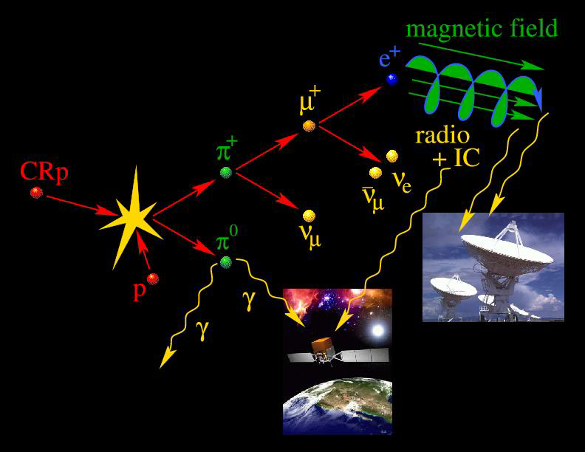
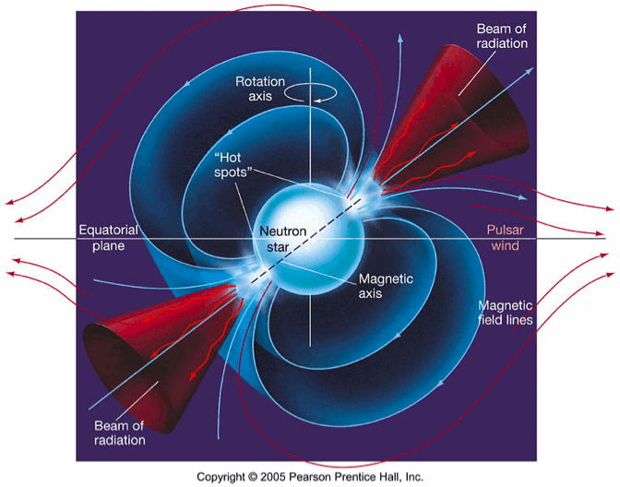
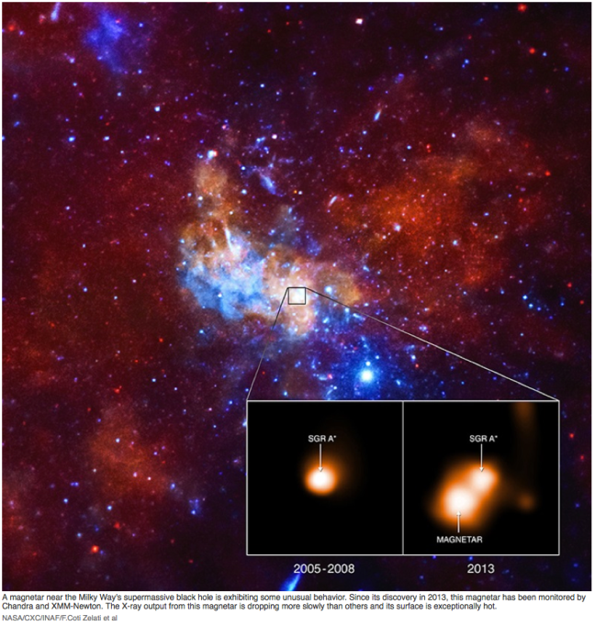
Syncchrotron Radiation …an old Story

Slide 3
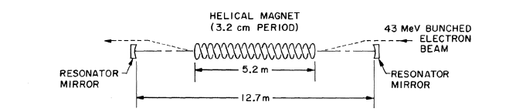
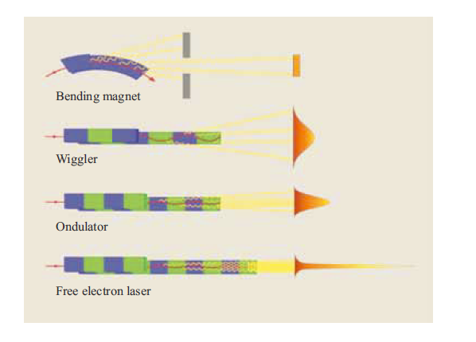
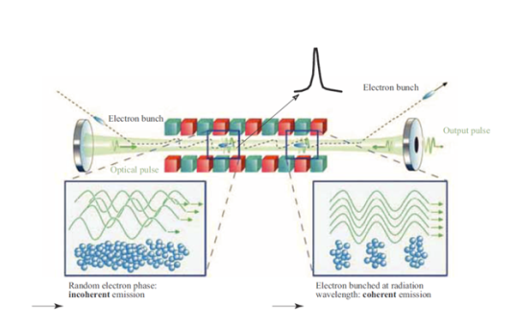
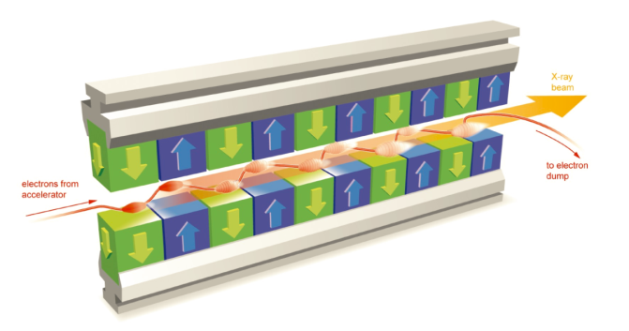
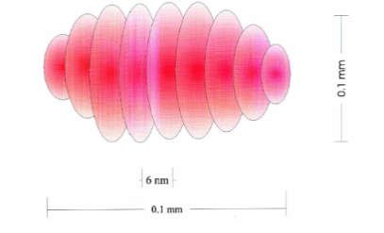
Synchrotron Radiation an old story started before Laser( also on human scale)
Radiation emitted by charged particles moving in magnets

Slide 4
What is a Free Electron Laser?
A Tool to transform the kinetic energy of an electron beam into electromagnetic radiation with
Laser like properties

Slide 5
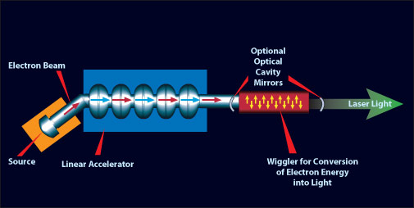
What are the basic elements of a FEL?
A) An accelerator Capable of providing an e-beam with «suitable» characteristics
B) An undulator
C) An Optical Cavity if the device is operated as an Oscillator

Slide 6
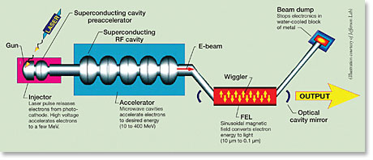
What is the Role of the accelerator?
An RF Accelerating system brings to a relativistic Energy E an electron Beam of current I
The power associated to the e-beam is
PUMP POWER

Slide 7
Energy and frequency
Letardi -Chart

Slide 8
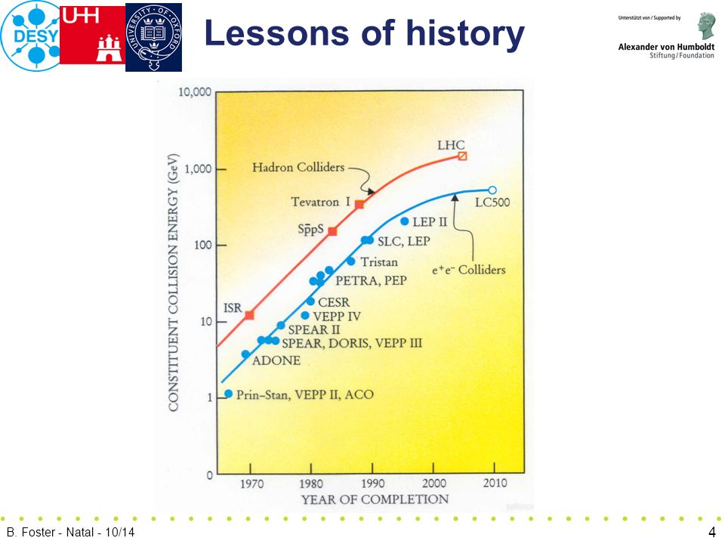

Slide 9
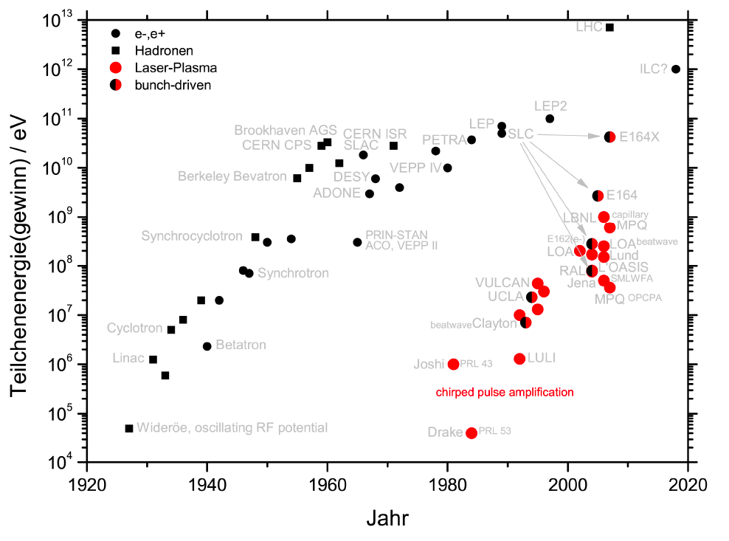
The New Livingston Plot
B. Hidding

Slide 10
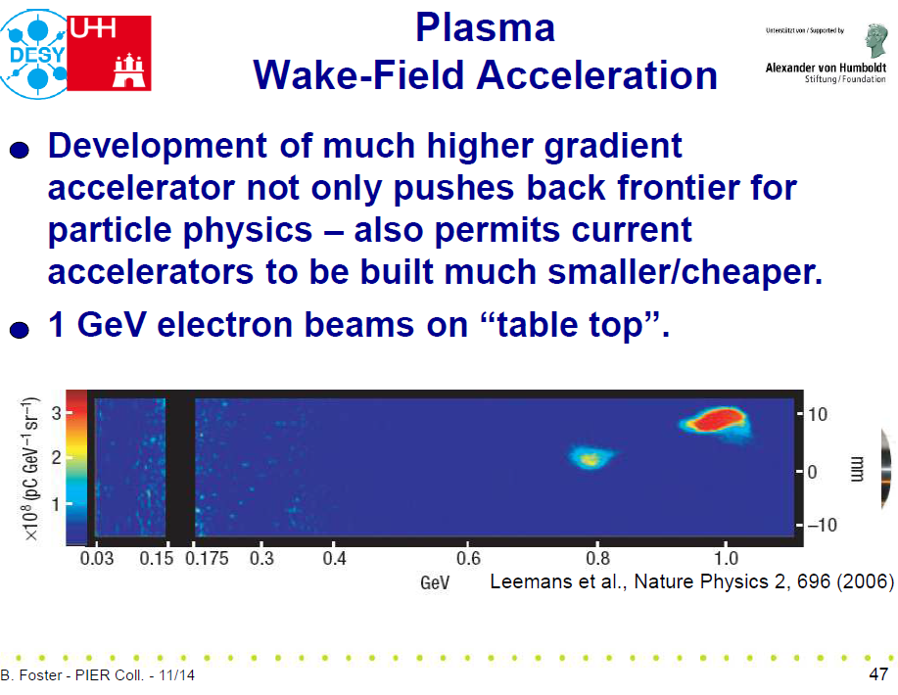
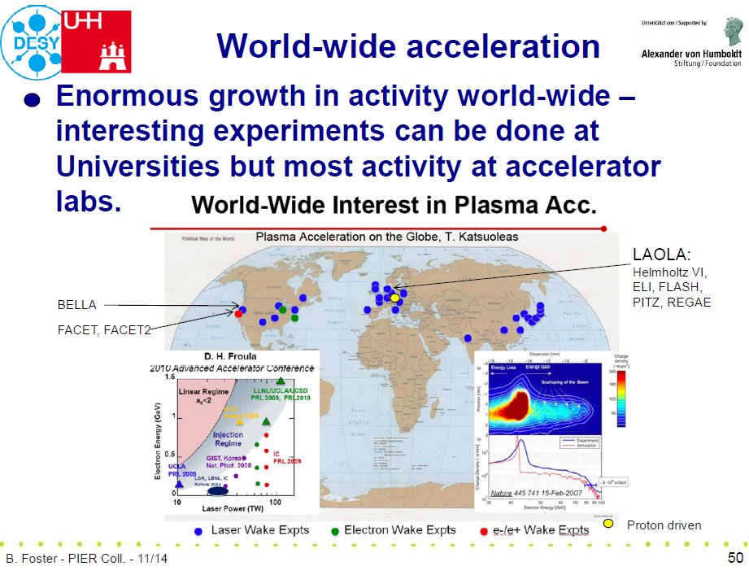
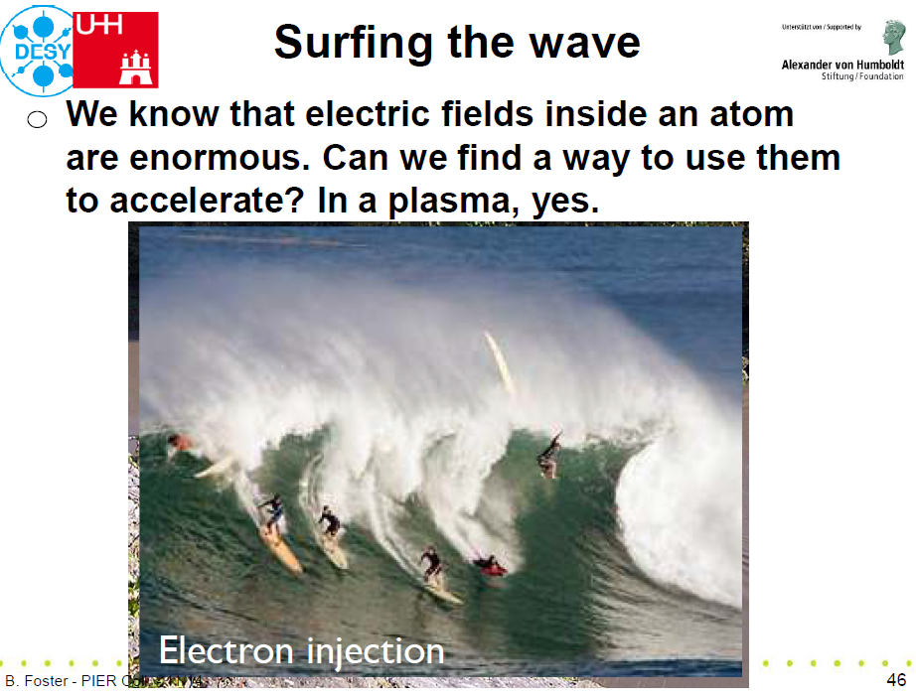
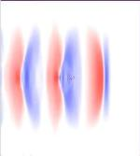
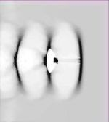
new scheme: PDPWFA
simulation
TeV p-bunches are available from conventional accelerators
PDPWA accelerates e- in the wake of such p bunches to TeV energy over a few 100 m
electric fields = 100 x ILC or CLIC
Allen Caldwell, K. Lotov, A. Pukhov, F. Simon, Nat. Phys. 5 (2009) 363.
electric field
electron density
accelerated bunch
e- energy vs
distance
e- energy spread
vs distance

Slide 11
new scheme: PDPWFA
simulation
TeV p-bunches are available from conventional accelerators
PDPWA accelerates e- in the wake of such p bunches to TeV energy over a few 100 m
electric fields = 100 x ILC or CLIC
Allen Caldwell, K. Lotov, A. Pukhov, F. Simon, Nat. Phys. 5 (2009) 363.
electric field
electron density
accelerated bunch
e- energy vs
distance
e- energy spread
vs distance

Slide 12
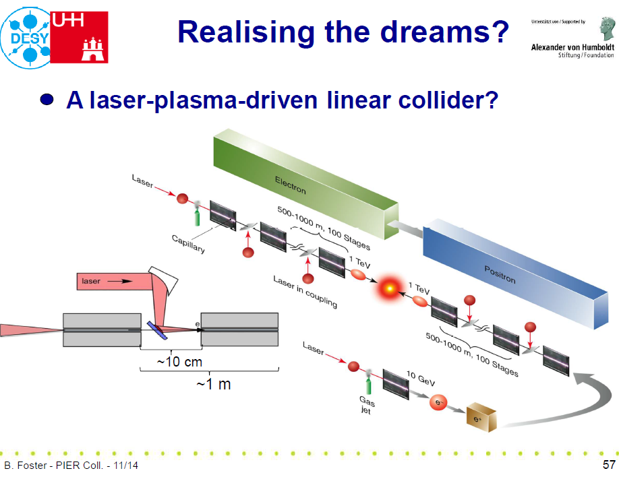
The Challenges
A) Reduce the costs
B) reduce the sizes
C) Improve the «light» coherence properties
D) Increase the number of experimental stations
……

Slide 13

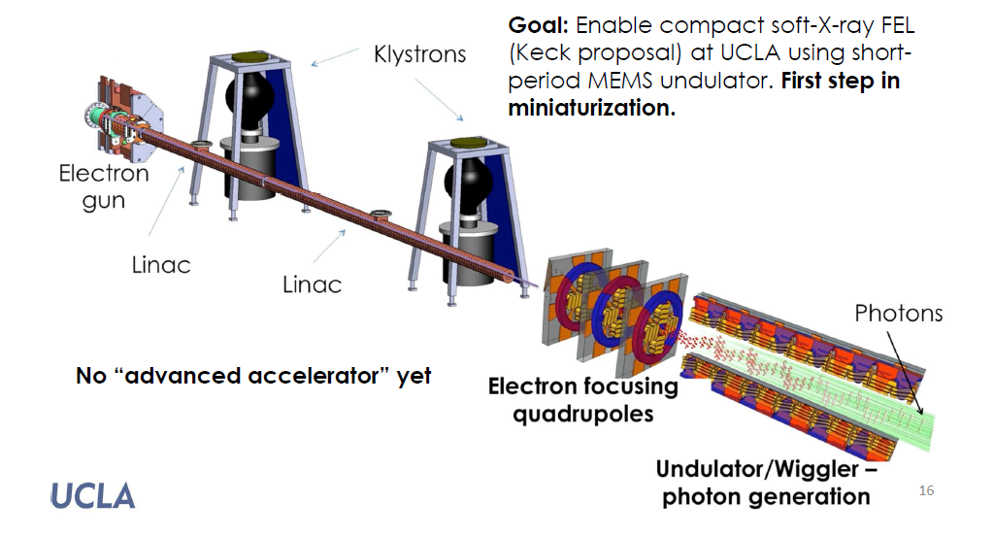
Towards «Bonsai» FEL

Slide 14
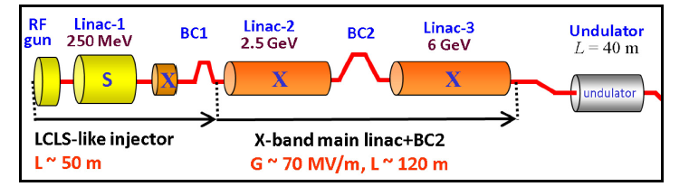
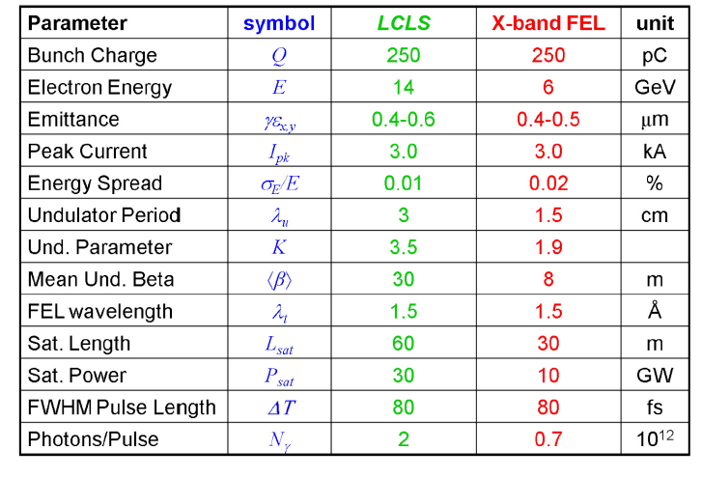

An exercise: X-Band LINAC
(70 MeV/m)

Slide 15
ELEMENTS FOR A STRATEGY
A) Reduce the undulator length using exotic devices
(Laser Wave undulators, R.F. Undulators,….)
B) Reduce the size of the accelerator using different acceleraing schemes
(High gradient, Plasma accelerators,…)

Slide 16
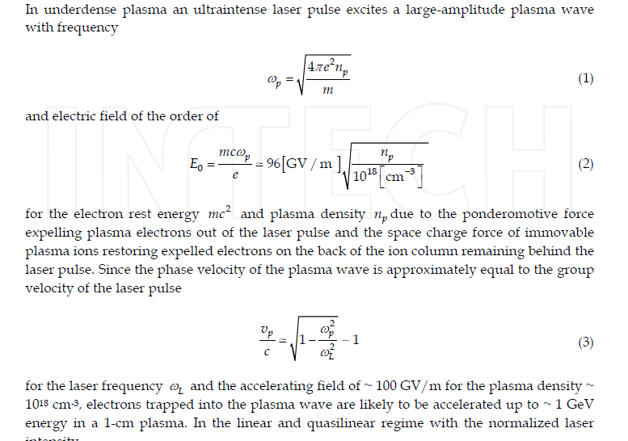
Plasma accelerating schemes

Slide 17
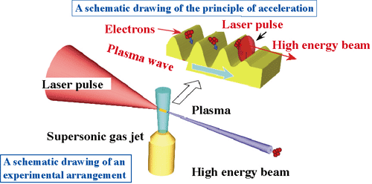
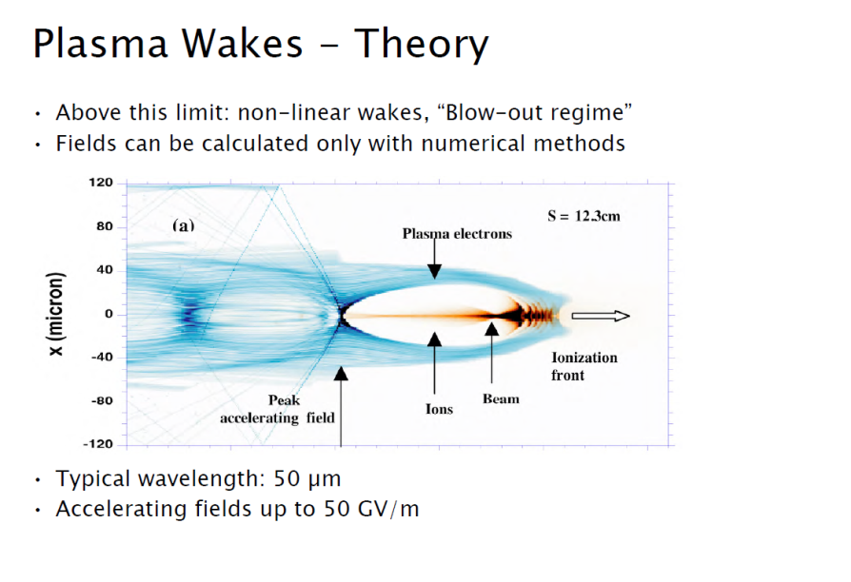
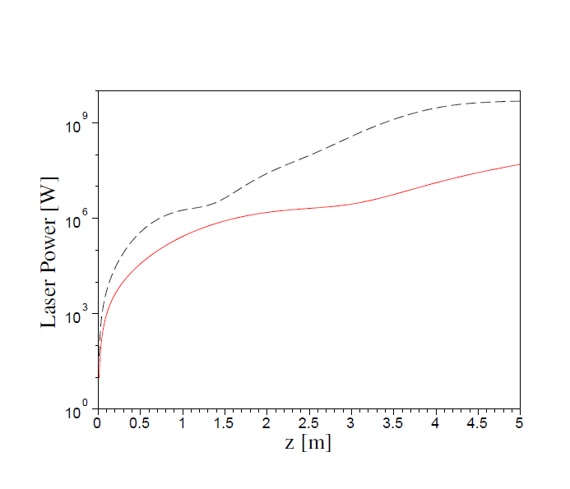
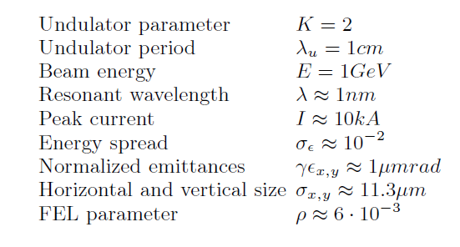
Plasma accelerating scheme

Slide 18
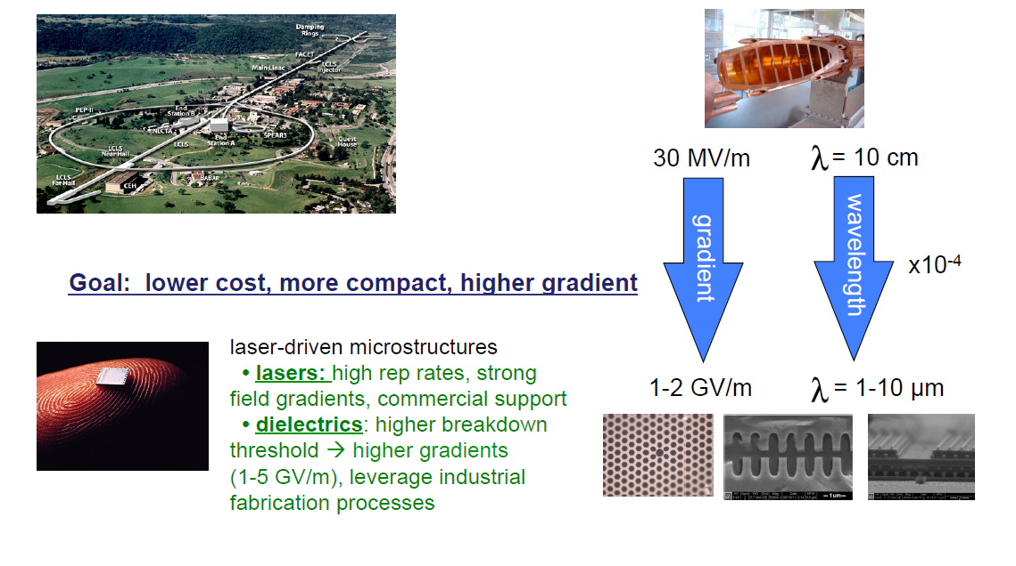
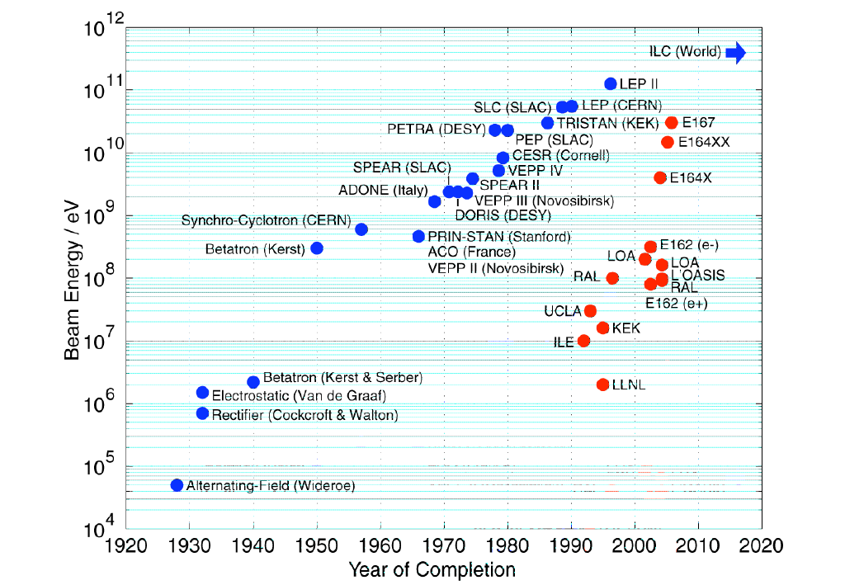
Is the future coming?

Slide 19
The dream

Slide 20
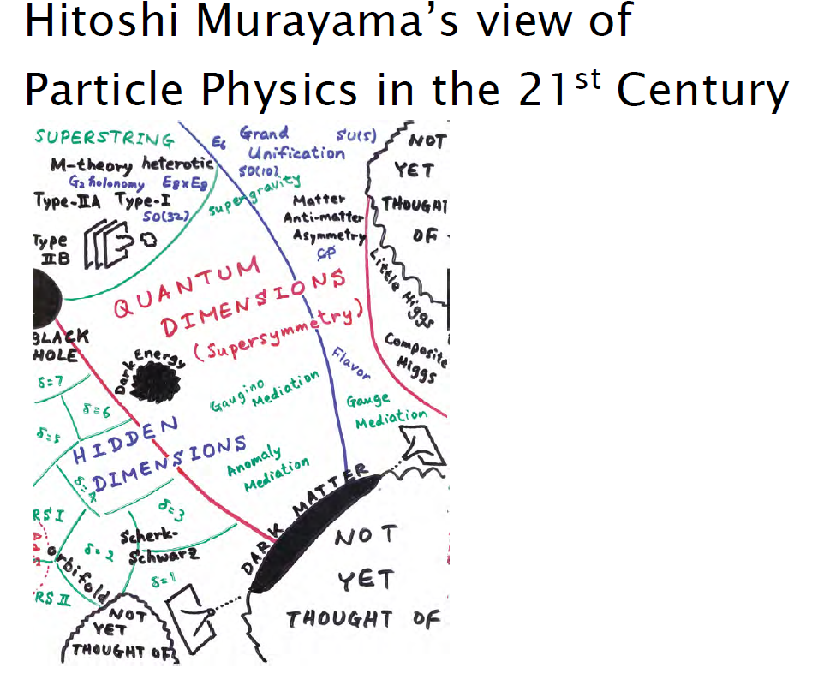
LIGHT AND PARTICLES in the 21-st century

Slide 21
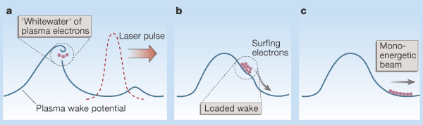
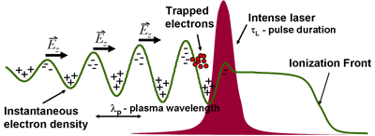
Spare Transparencies

Slide 22

Frascati
How many «free electron devices»?
For any kind of emission mechanism (Cerenkov, Smith Purcell…) a FEL device can be conceived

Slide 23
Interest For Plasma Fusion Applications
Resonance condition
Parallel component of the refractive index
Resonance frequency 250 GHz
Power 3 MW
Efficiency >30%
electron cyclotron frequency in plasma

Slide 24
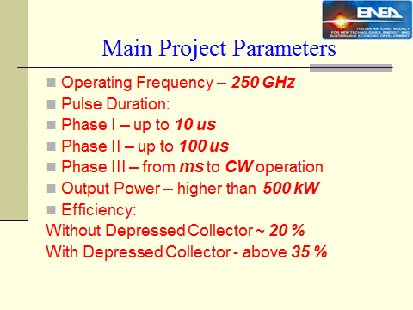
Required Parameters

Slide 25
An Exercise to fix Numbers
Operating Frequency 250 GHz
Beam current 5 A
Beam voltage 700 kV
Longitudinal velocity spread 0.3 – 0.5 %
Energy spread 1 – 2 %
Cavity magnetic field 5 T

