Slide 1
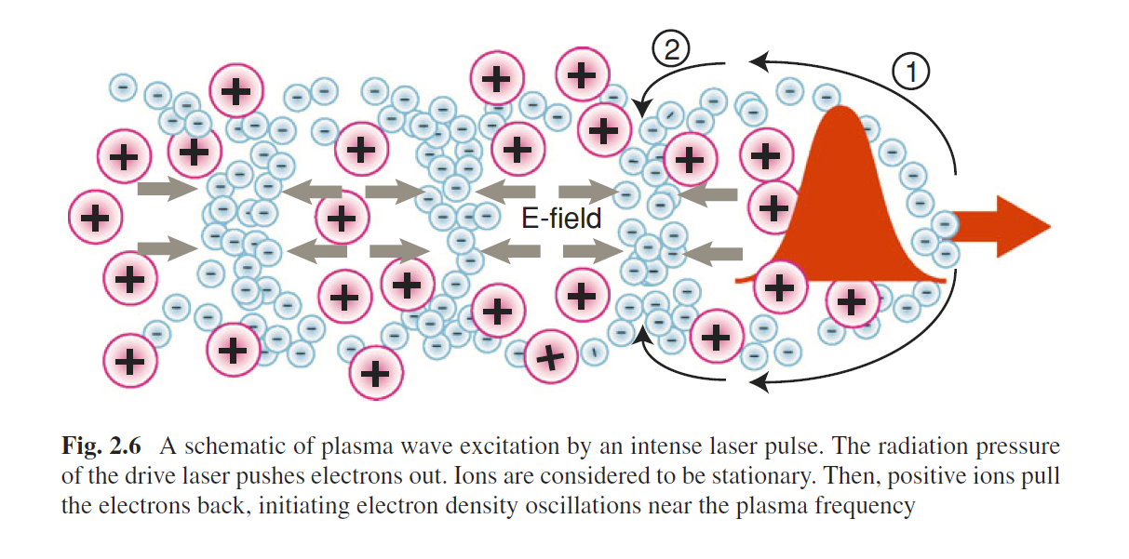
Plasma acc.

Slide 2
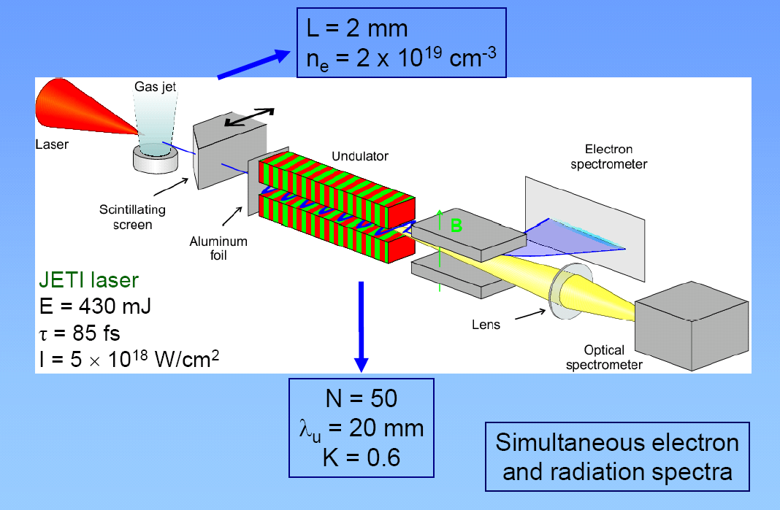
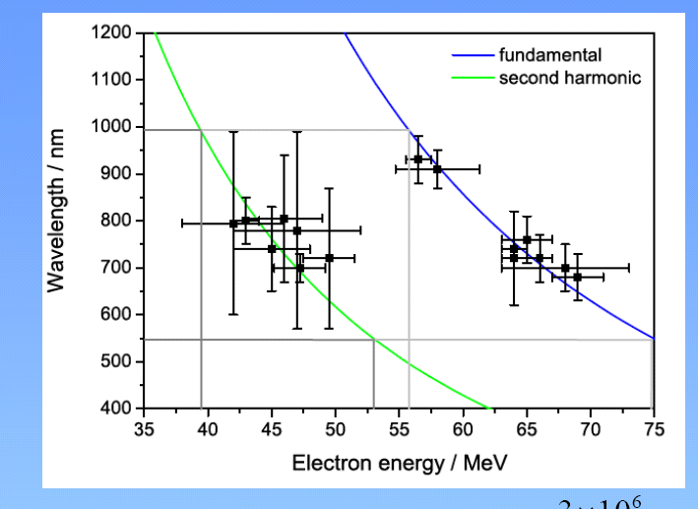
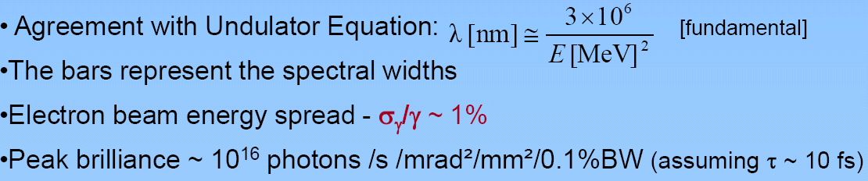
LASER-PLASMA SYNCHROTRON
H.-P. Schlenvoigt et al, Nature Physics 4, 130 - 133 (2008)

Slide 3
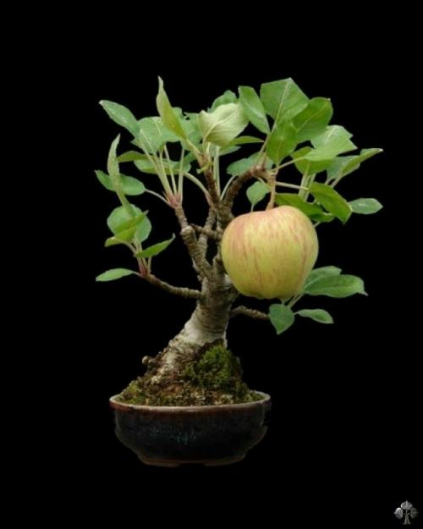
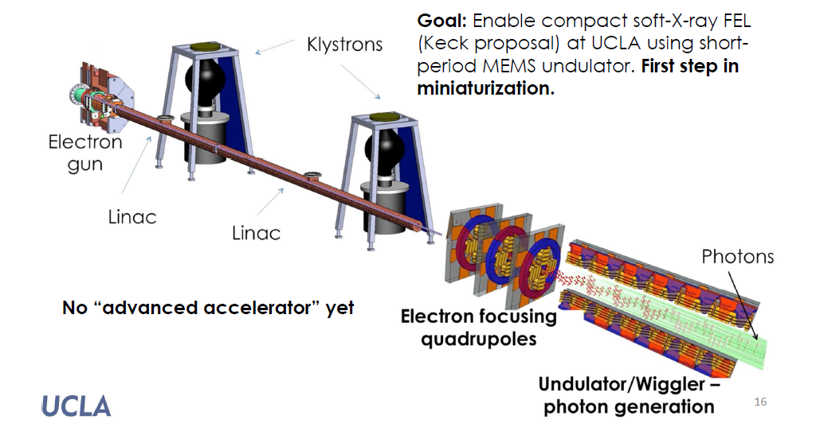
We are trying to go
Towards «Bonsai» FEL

Slide 4


But….

