Slide 1
Free Electron Laser and Fundamental Physics
FEL + CARM
ENEA Team

Slide 2
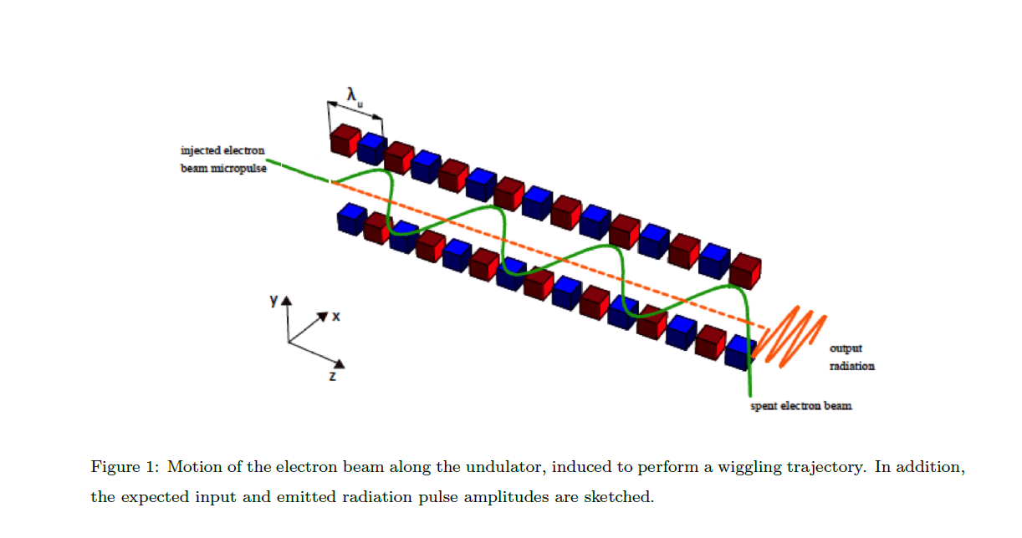
Why FEL Might be interesting ?

Slide 3
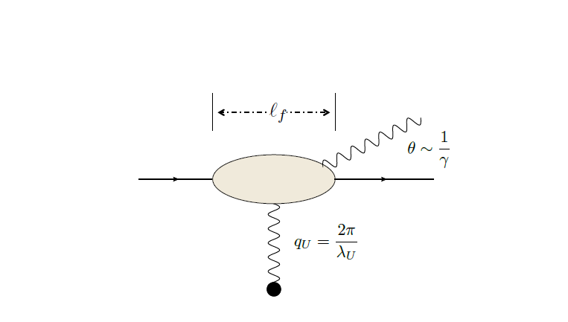
Fundamental interaction W-W

Slide 4
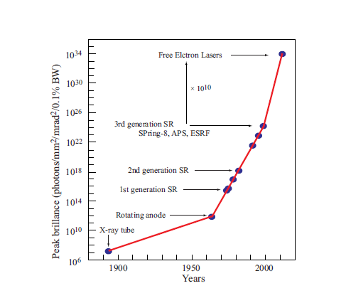
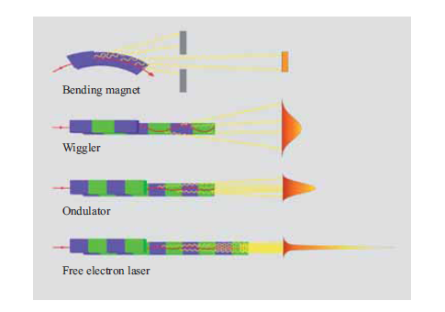
A New Perspective: Brightness
From a synchrotron radiation perspective

Slide 5
Brightness is associated with power density and power density is associted with Electric and magnetic fields

Slide 6
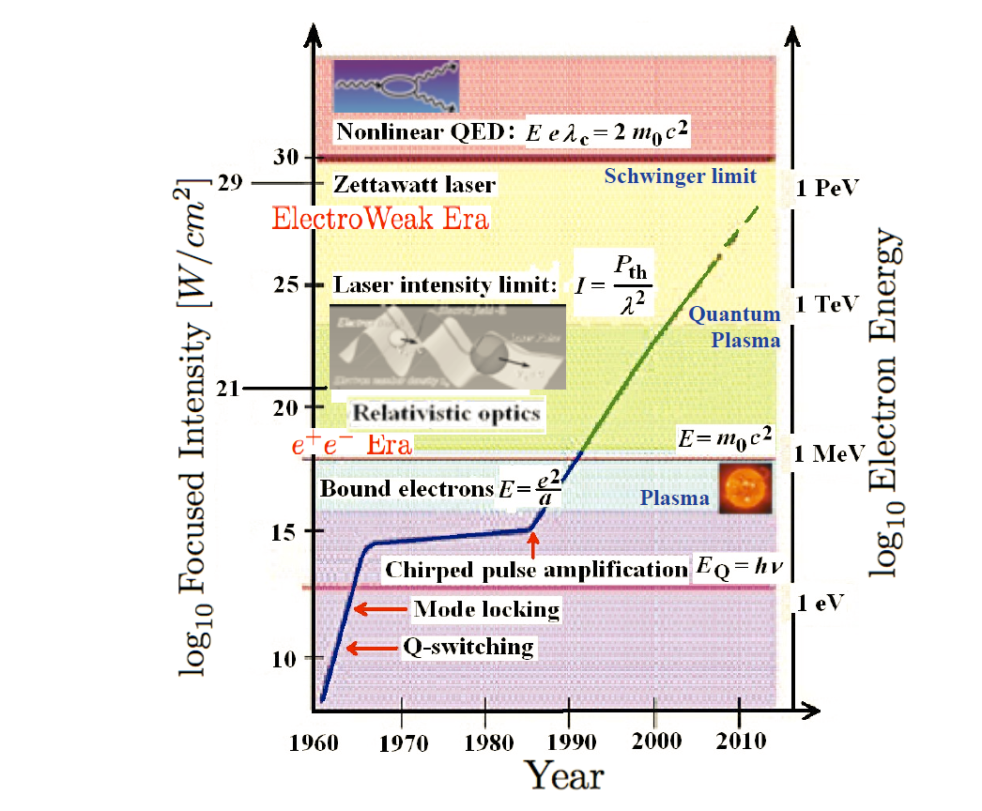
Laser Intensity evolution

Slide 7
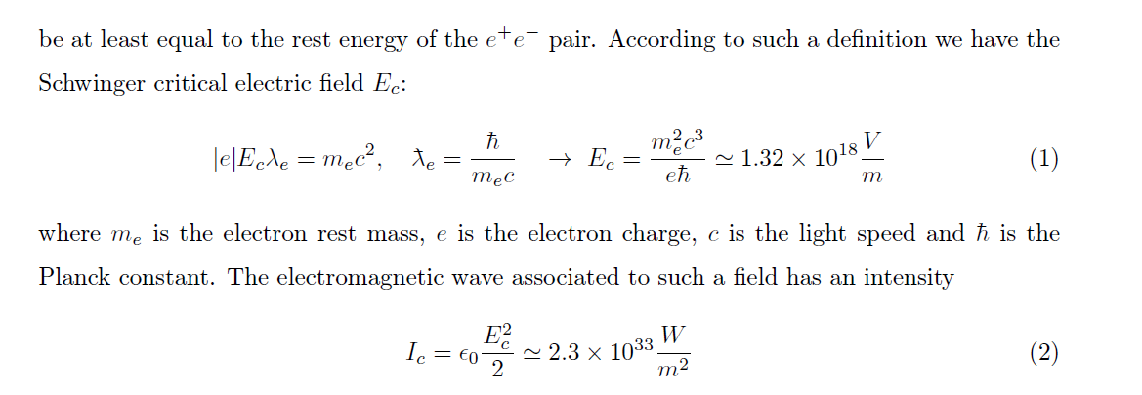
ultra-intense laser development
Vacuum physics
Vacuum breakdown
E = mc²
e–
e⁺
E

Slide 8
Non Linear QED Pair Creation From vacuum

Slide 9
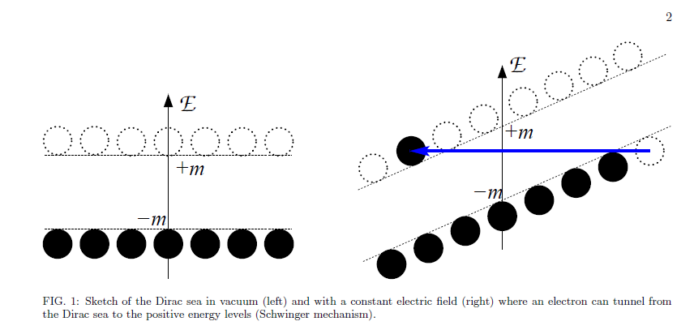
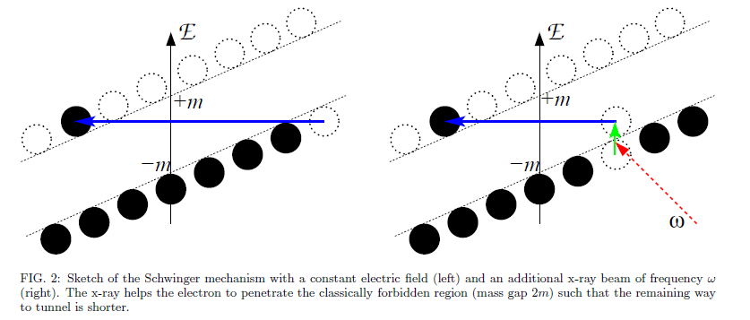
Schwinger mechanism

Slide 10
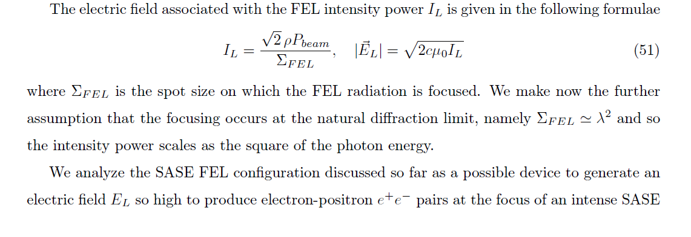
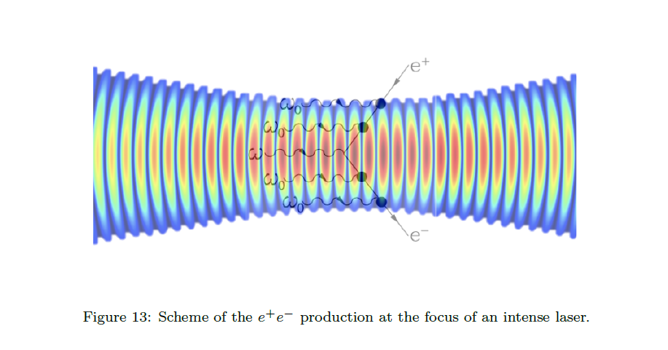

Slide 11
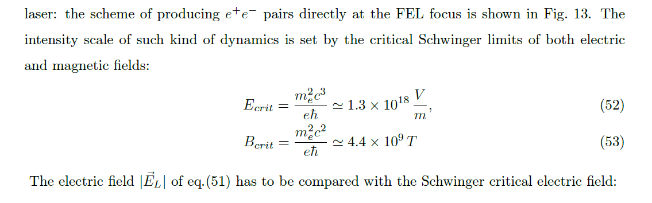
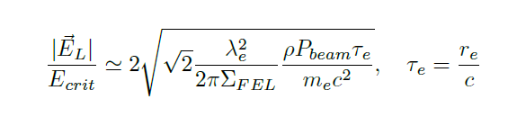

Slide 12
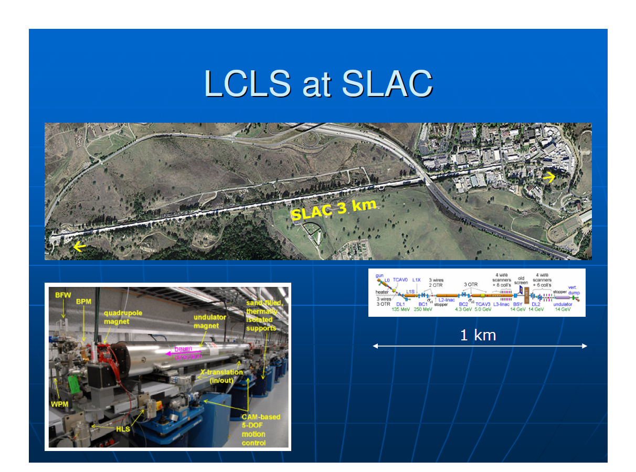
4-th Generation SR Sources the right choice: size, scientific case…

Slide 13
The Oscillator FEL Physics and Technology are well understood

Slide 14
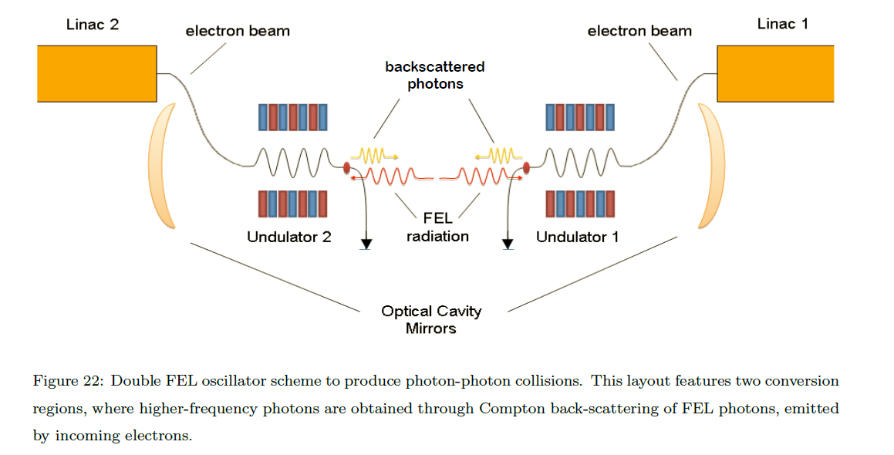
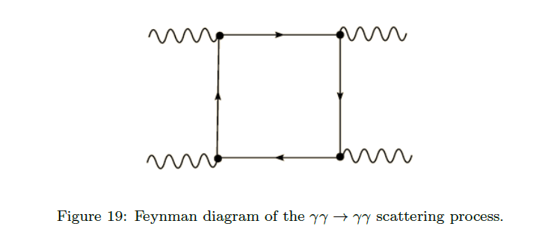
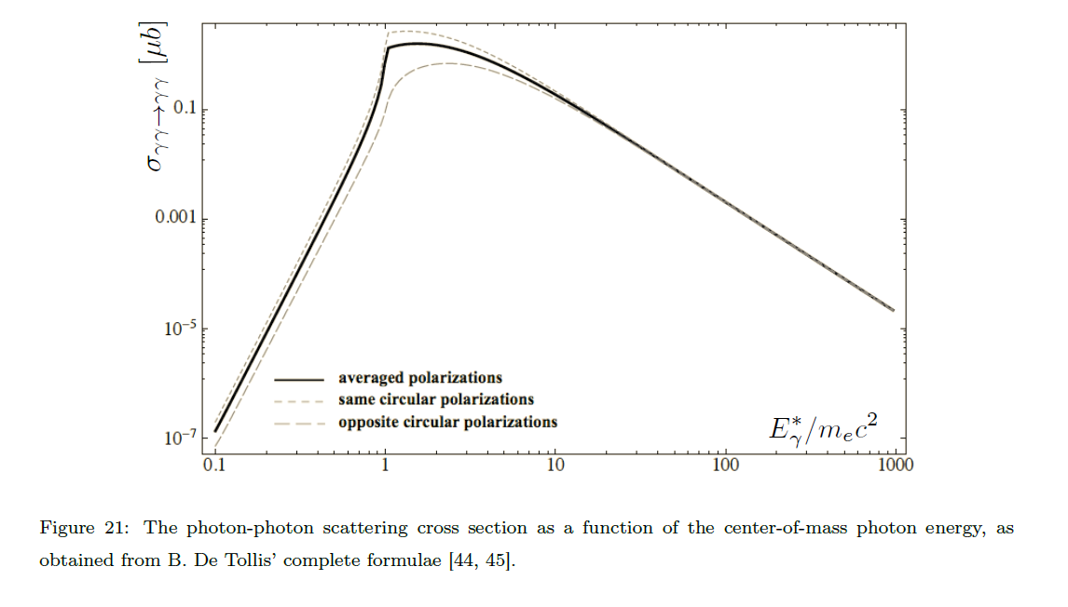
Double FEL experiments

Slide 15

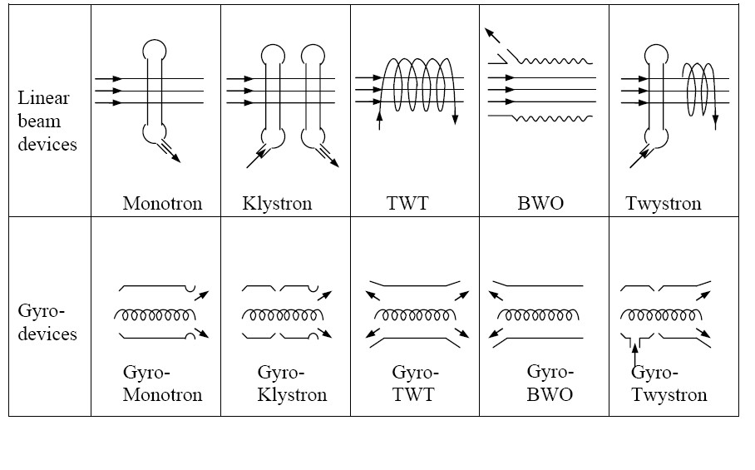
Different RF Sources
So Called HPM (High Power Microwaves)

Slide 16
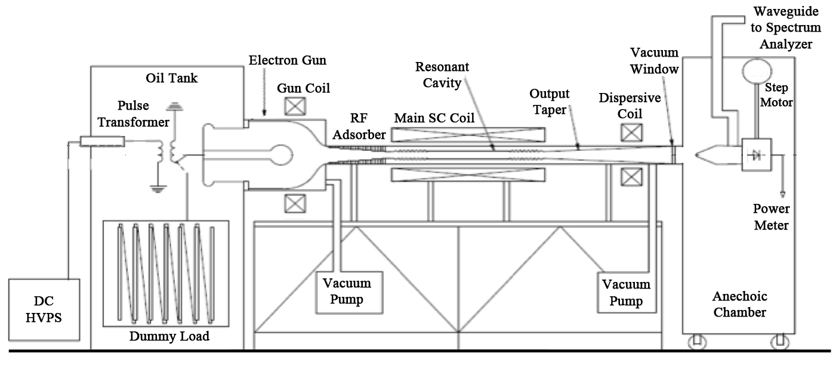
LAYOUT OF THE DEVICE

Slide 17
Derivation of the operating parameter for CARM operation at 250 GHz
A) Desired Frequency (250 GHz)
B) Power (CARM) 1-MW

Slide 18
Applications
Fusion (Core Business)
Dark Matter (Axion)
Microwave undulators

Slide 19
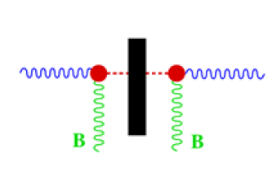
Shining through wall experiment
Photon-Magnetic field-axion
Axion-Magnetic field-Photon

Slide 20
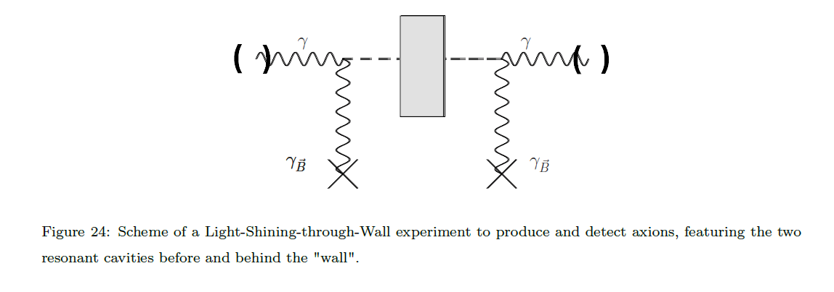


Dark Matter search

Slide 21
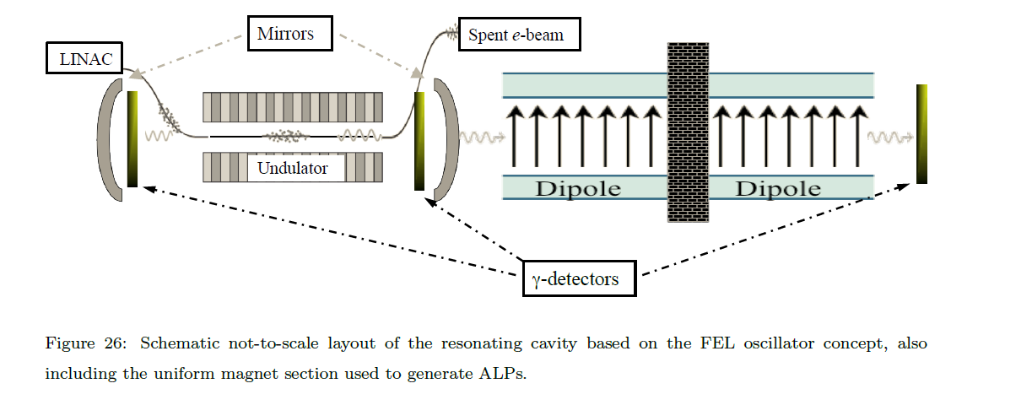
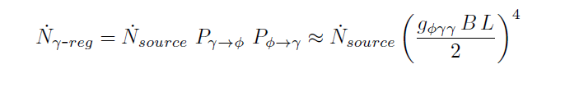
DARK-MATTER STUDIES

